Slide 1
Discrete Choice Modeling
William Greene
Stern School of Business
New York University

Slide 2
Bayesian Econometrics

Slide 3
Bayesian Estimation
Philosophical underpinnings: The meaning of statistical information
How to combine information contained in the sample with prior information

Slide 4
Classical Inference
Population
Measurement
Econometrics
Characteristics
Behavior Patterns
Choices
Imprecise inference about the entire population – sampling theory and asymptotics

Slide 5
Bayesian Inference
Population
Measurement
Econometrics
Characteristics
Behavior Patterns
Choices
Sharp, ‘exact’ inference about only the sample – the ‘posterior’ density.

Slide 6
Paradigms
Classical
  Formulate the theory
  Gather evidence
    Evidence consistent with theory? Theory stands and waits for more evidence to be gathered
    Evidence conflicts with theory? Theory falls
Bayesian
  Formulate the theory
  Assemble existing evidence on the theory
  Form beliefs based on existing evidence
  (*) Gather new evidence
  Combine beliefs with new evidence
  Revise beliefs regarding the theory
  Return to (*)

Slide 7
On Objectivity and Subjectivity
Objectivity and “Frequentist” methods in Econometrics – The data speak
Subjectivity and Beliefs
  Priors
  Evidence
  Posteriors
Science and the Scientific Method

Slide 8
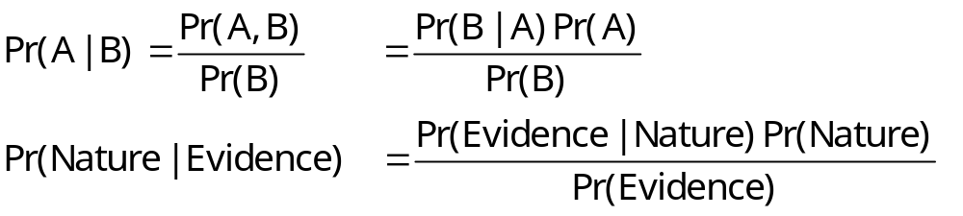
Foundational Result
A method of using new information to update existing beliefs about probabilities of events
Bayes Theorem for events. (Conceived for updating beliefs about games of chance)

Slide 9
Likelihoods
(Frequentist) The likelihood is the density of the observed data conditioned on the parameters
  Inference based on the likelihood is usually “maximum likelihood”
(Bayesian) A function of the parameters and the data that forms the basis for inference – not a probability distribution
  The likelihood embodies the current information about the parameters and the data

Slide 10
The Likelihood Principle
The likelihood embodies ALL the current information about the parameters and the data
Proportional likelihoods should lead to the same inferences, even given different interpretations.

Slide 11
“Estimation”
Assembling information
Prior information = out of sample. Literally prior or outside information
Sample information is embodied in the likelihood
Result of the analysis: “Posterior belief” = blend of prior and likelihood

Slide 12
Bayesian Investigation
No fixed “parameters.” θ is a random variable.
Data are realizations of random variables.
There is a marginal distribution p(data)
Parameters are part of the random state of nature, p(θ) = distribution of θ independently (prior to) the data, as understood by the analyst. (Two analysts could legitimately bring different priors to the study.)
Investigation combines sample information with prior information.
Outcome is a revision of the prior based on the observed information (data)

Slide 13
The Bayesian Estimator
The posterior distribution embodies all that is “believed” about the model.
  Posterior = f(model|data)
  = Likelihood(θ,data) * prior(θ) / P(data)
“Estimation” amounts to examining the characteristics of the posterior distribution(s).
  Mean, variance
  Distribution
  Intervals containing specified probabilities

Slide 14
Priors and Posteriors
The Achilles heel of Bayesian Econometrics
Noninformative and Informative priors for estimation of parameters
  Noninformative (diffuse) priors: How to incorporate the total lack of prior belief in the Bayesian estimator. The estimator becomes solely a function of the likelihood
  Informative prior: Some prior information enters the estimator. The estimator mixes the information in the likelihood with the prior information.
Improper and Proper priors
  P(θ) is uniform over the allowable range of θ
  Cannot integrate to 1.0 if the range is infinite.
  Salvation – improper, but noninformative priors will fall out of the posterior.

Slide 15
Symmetrical Treatment of Data and Parameters
Likelihood is p(data|θ)
Prior summarizes nonsample information about θ in p(θ)
Joint distribution is p(data, θ)
P(data,θ) = p(data|θ)p(θ)
Use Bayes theorem to get
p(θ|data) = posterior distribution

Slide 16
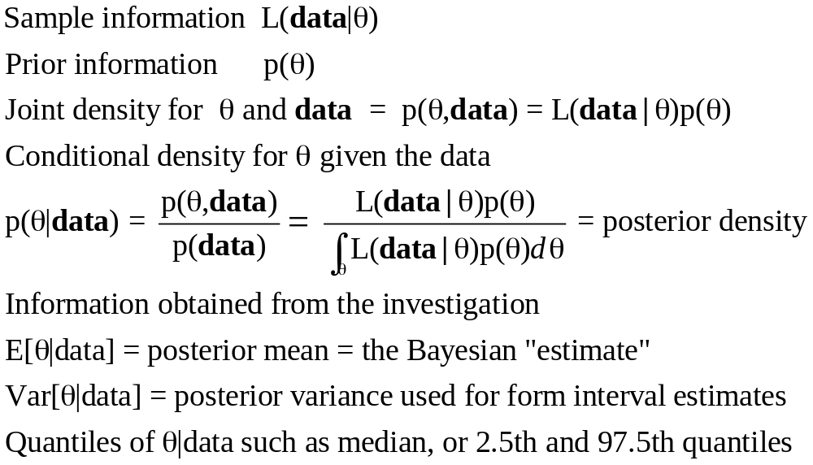
The Posterior Distribution

Slide 17
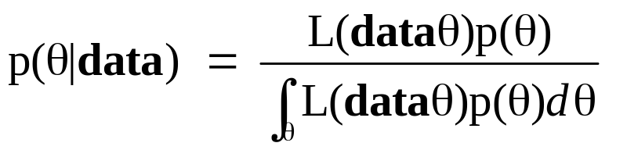
Priors – Where do they come from?
What does the prior contain?
  Informative priors – real prior information
  Noninformative priors
Mathematical complications
  Diffuse
    Uniform
    Normal with huge variance
  Improper priors
Conjugate priors

Slide 18
Application
Estimate θ, the probability that a production process will produce a defective product.
Sampling design: Choose N = 25 items from the production line.
D = the number of defectives.
Result of our experiment D = 8
Likelihood for the sample of data is L( θ | data) = θ ^{D}(1 − θ) ^{25−D}, 0 < θ < 1.
Maximum likelihood estimator of θ is q = D/25 = 0.32,
Asymptotic variance of the MLE is estimated by q(1 − q)/25 = 0.008704.

Slide 19
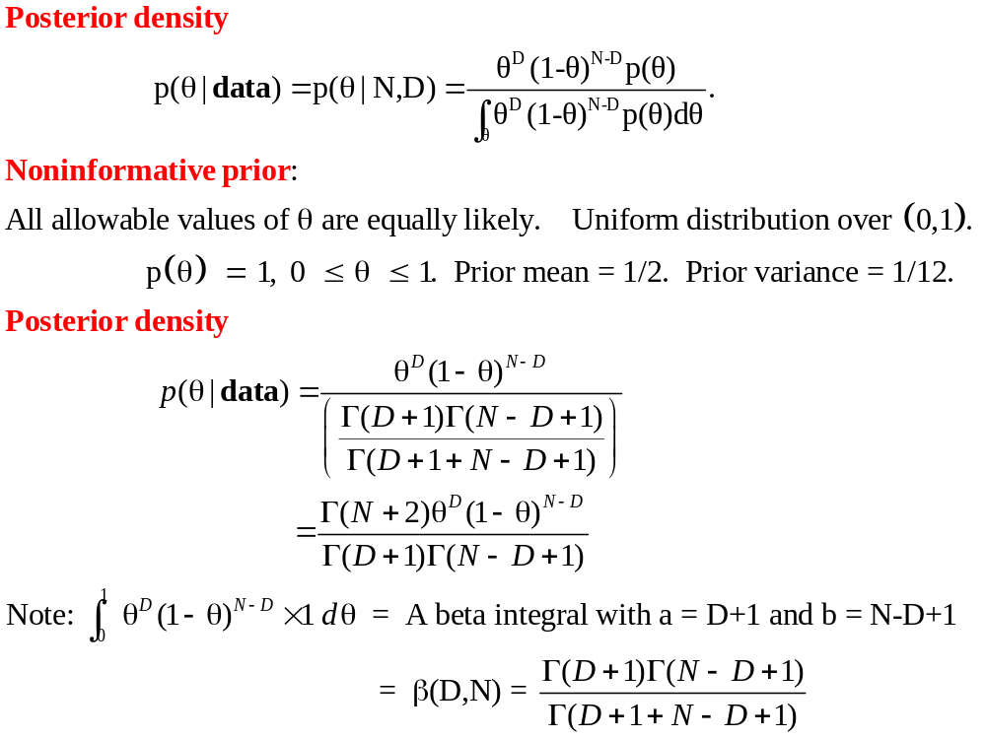
Application: Posterior Density

Slide 20
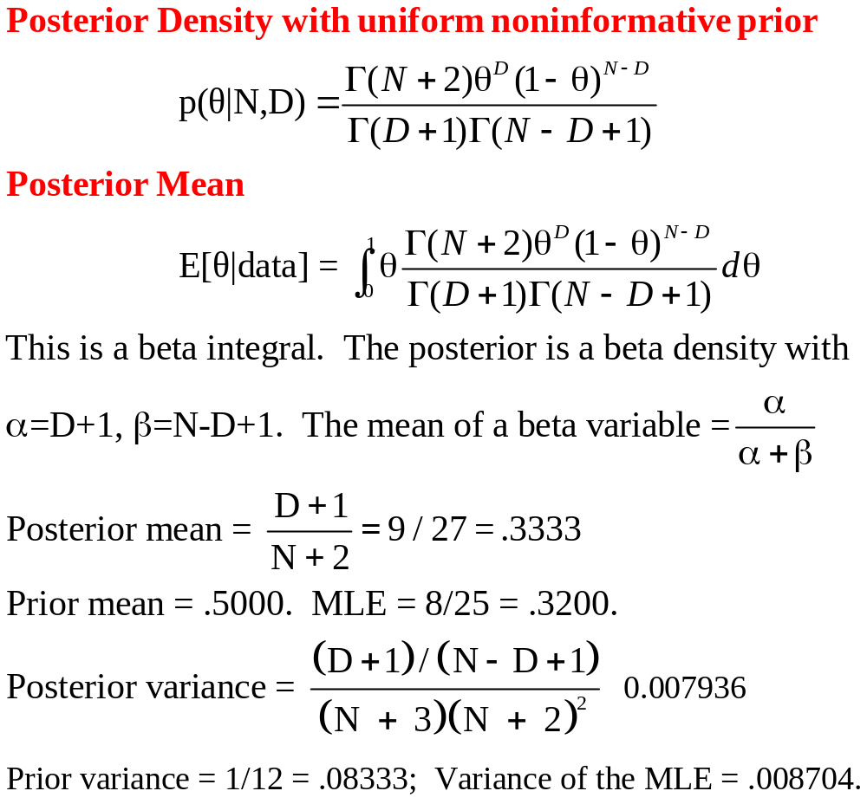
Posterior Moments

Slide 21
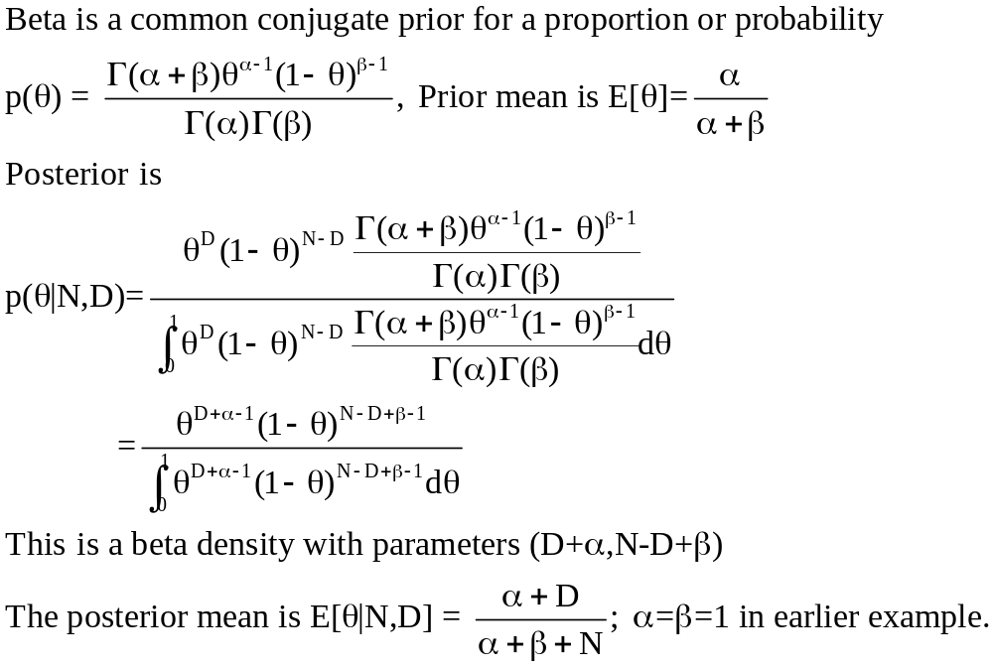
Informative prior

Slide 22
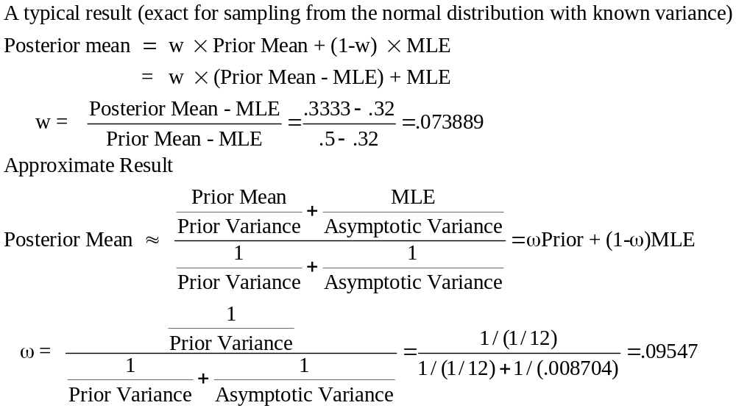
Mixing Prior and Sample Information

Slide 23
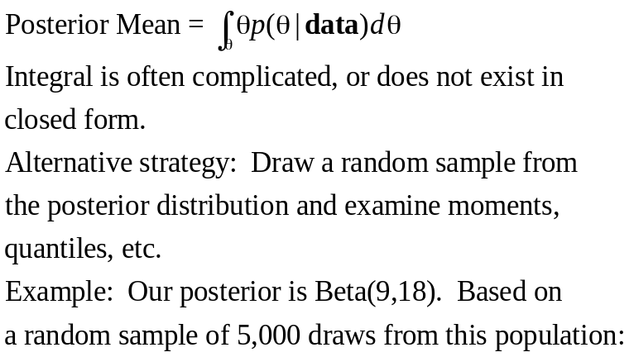
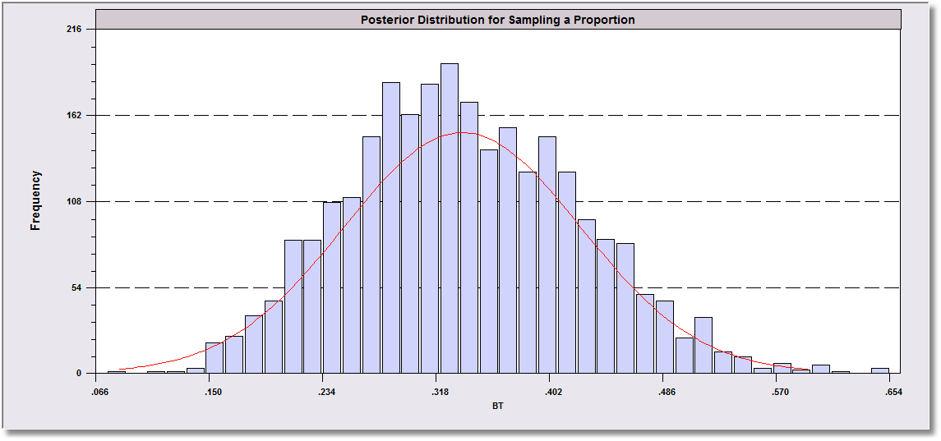
Modern Bayesian Analysis
Bayesian Estimate of Distribution of θ (Posterior mean was .333333)
Observations = 5000 (Posterior variance was .007936)
Sample Mean = .334017
Sample variance = .007454 Standard Deviation = .086336
Skewness = .248077 Kurtosis-3 (excess)= -.161478 Minimum = .066214 Maximum = .653625
.025 Percentile = .177090 .975 Percentile - .510028

Slide 24
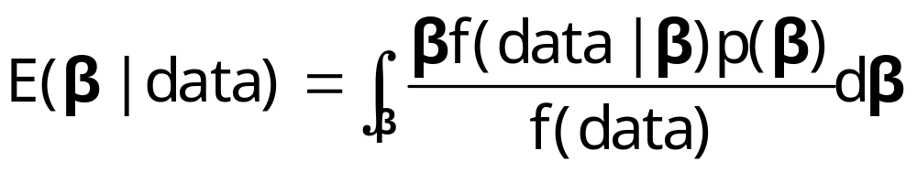
Bayesian Estimator
First generation: Do the integration (math)

Slide 25
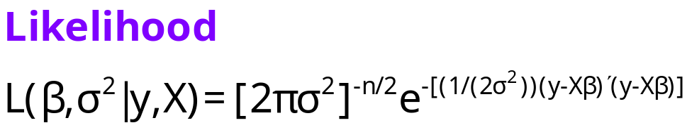
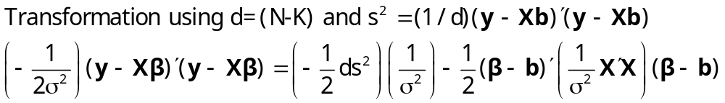
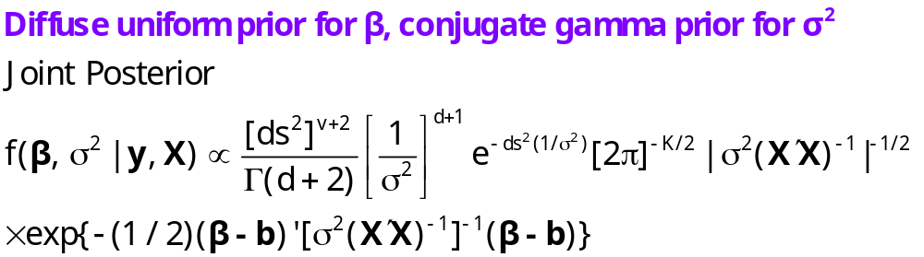
The Linear Regression Model

Slide 26
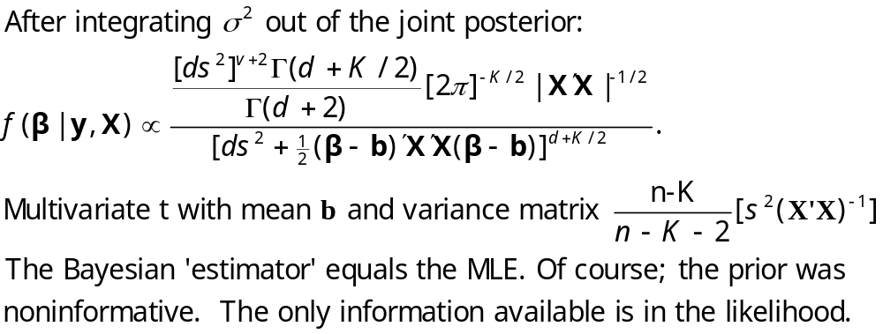
Marginal Posterior for β

Slide 27
Modern Bayesian Analysis
Multiple parameter settings
Derivation of exact form of expectations and variances for p(θ₁,θ₂ ,…,θ_{K} |data) is hopelessly complicated even if the density is tractable.
Strategy: Sample joint observations
(θ₁,θ₂ ,…,θ_{K}) from the posterior population and use marginal means, variances, quantiles, etc.
How to sample the joint observations???
(Still hopelessly complicated.)

Slide 28
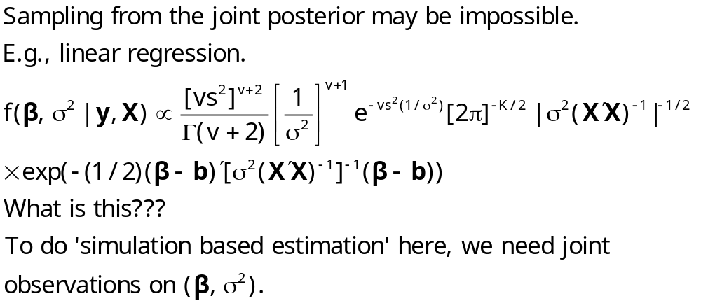
A Practical Problem

Slide 29
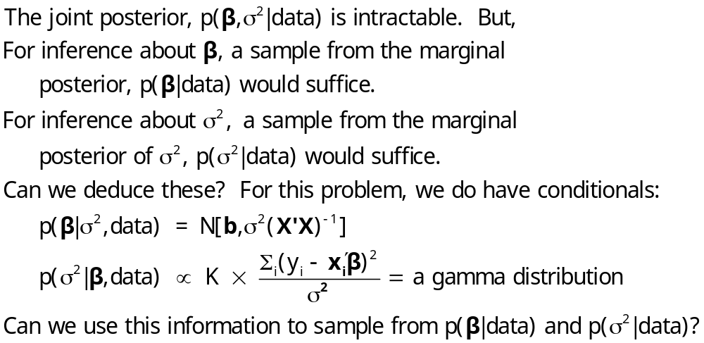
A Solution to the Sampling Problem

Slide 30
Magic Tool: The Gibbs Sampler
Problem: How to sample observations from the a population,
p(θ₁,θ₂ ,…,θ_{K} |data).
Solution: The Gibbs Sampler.
Target: Sample from f(x₁, x₂) = joint distribution
Joint distribution is unknown or it is not possible to sample from the joint distribution.
Assumed: Conditional distributions f(x₁|x₂) and f(x₂|x₁) are both known and marginal samples can be drawn from both.
Gibbs sampling: Obtain one draw from x₁,x₂ by many cycles between x₁|x₂ and x₂|x₁.
  Start x_{1,0} anywhere in the right range.
  Draw x_{2,0} from x₂|x_{1,0}.
  Return to x_{1,1} from x₁|x_{2,0} and so on.
  Several thousand cycles produces a draw
  Repeat several thousand times to produce a sample
Average the draws to estimate the marginal means.

Slide 31
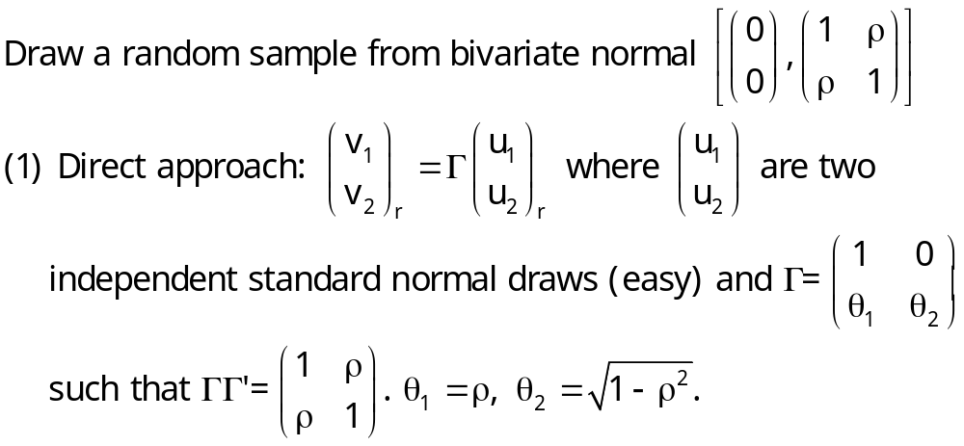
Bivariate Normal Sampling

Slide 32
Application: Bivariate Normal
Obtain a bivariate normal sample (x,y) from
Normal[(0,0),(1,1,ρ)]. N = 5000.
Conditionals: x|y is N[ρy,(1- ρ²)]
y|x is N[ρx,(1- ρ²)].
Gibbs sampler: y0=0.
  x1 = ρy0 + sqr(1- ρ²)v where v is a N(0,1) draw
  y1 = ρx1 + sqr(1- ρ²)w where w is a N(0,1) draw
Repeat cycle 60,000 times. Drop first 10,000. Retain every 10th observation of the remainder.

Slide 33
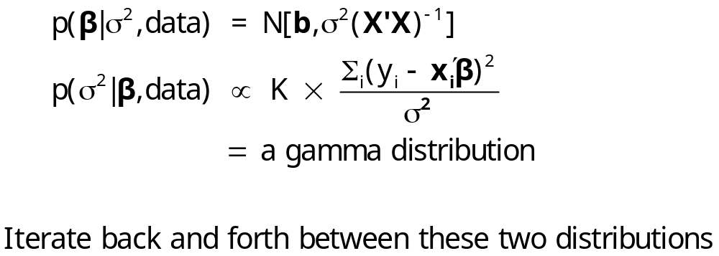
Gibbs Sampling for the Linear Regression Model

Slide 34
More General Gibbs Sampler
Objective: Sample joint observations on θ₁,θ₂ ,…,θ_{K}. from
p(θ₁,θ₂ ,…,θ_{K}|data) (Let K = 3)
Derive p(θ₁|θ₂,θ₃,data) p(θ₂|θ₁,θ₃,data) p(θ₃|θ₁,θ₂,data)
Gibbs Cycles produce joint observations
0. Start θ₁,θ₂,θ₃ at some reasonable values
1. Sample a draw from p(θ₁|θ₂,θ₃,data) using the draws of θ₁,θ₂ in hand
2. Sample a draw from p(θ₂|θ₁,θ₃,data) using the draw at step 1 for θ1
3. Sample a draw from p(θ₃|θ₁,θ₂,data) using the draws at steps 1 and 2
4. Return to step 1. After a burn in period (a few thousand), start collecting
the draws. The set of draws ultimately gives a sample from the joint
distribution.
Order within the chain does not matter.

Slide 35
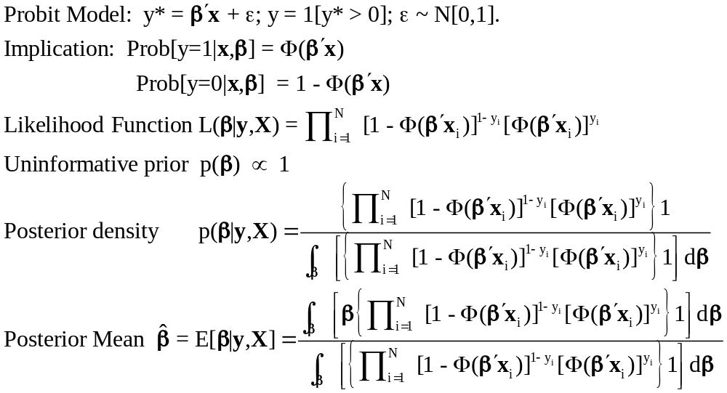
Using the Gibbs Sampler to Estimate a Probit Model

Slide 36
Strategy: Data Augmentation
Treat y_{i}* as unknown ‘parameters’ with β
‘Estimate’ θ = (β,y₁*,…,y_{N}*) = (β,y*)
Draw a sample of R observations from the joint population (β,y*).
Use the marginal observations on β to estimate the characteristics (e.g., mean) of the distribution of β|y,X

Slide 37
Gibbs Sampler Strategy
p(β|y*,(y,X)). If y* is known, y is known.
p(β|y*,(y,X)) = p(β|y*,X).
p(β|y*,X) defines a linear regression with
N(0,1) normal disturbances.
Known result for β|y*:
p(β|y*,(y,X), ε=N[0,I]) = N[b*,(X’X)⁻¹]
b* = (X’X)⁻¹X’y*
Deduce a result for y*|β

Slide 38
Gibbs Sampler, Continued
y_{i}*|β,x_{i} is Normal[x_{i}’β,1]
y_{i} is informative about y_{i}*:
  If y_{i} = 1 , then y_{i}* > 0; p(y_{i}*|β,x_{i} y_{i} = 1) is truncated normal: p(y_{i}*|β,x_{i} y_{i} = 1) = φ(x_{i}’β)/[1-Φ(x_{i}’β)]
  Denoted N⁺[x_{i}’β,1]
  If y_{i} = 0, then y_{i}* < 0; p(y_{i}*|β,x_{i} y_{i} = 0) is truncated normal: p(y_{i}*|β,x_{i} y_{i} = 0) = φ(x_{i}’β)/Φ(x_{i}’β)
  Denoted N⁻[x_{i}’β,1]

Slide 39
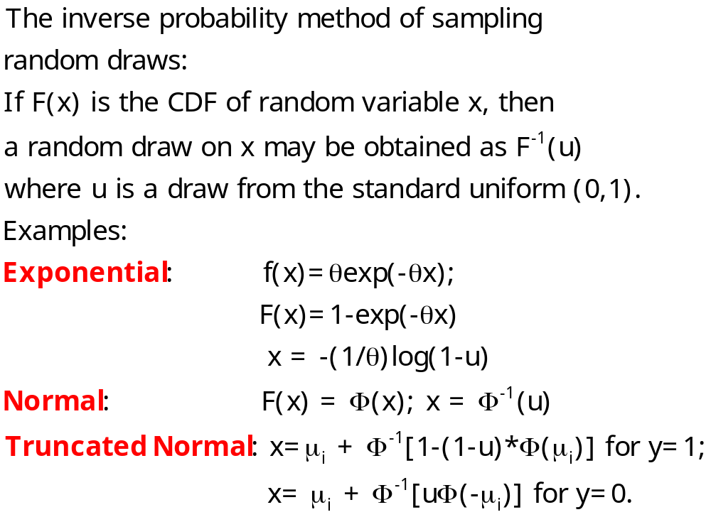
Generating Random Draws from f(x)

Slide 40

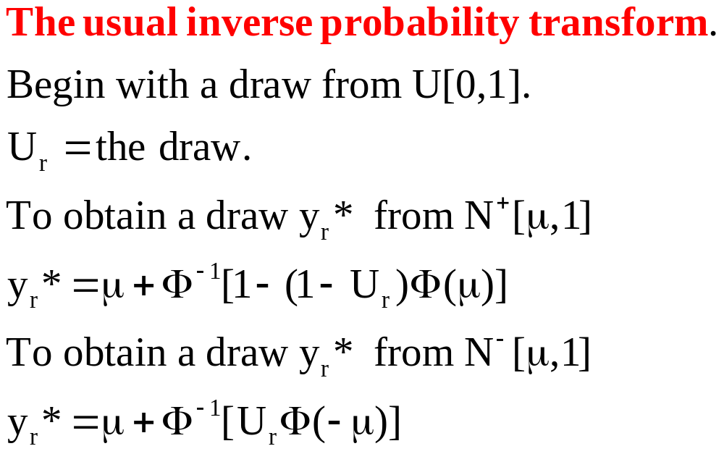
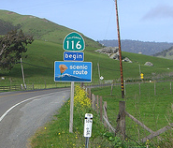
Sampling from the Truncated Normal

Slide 41
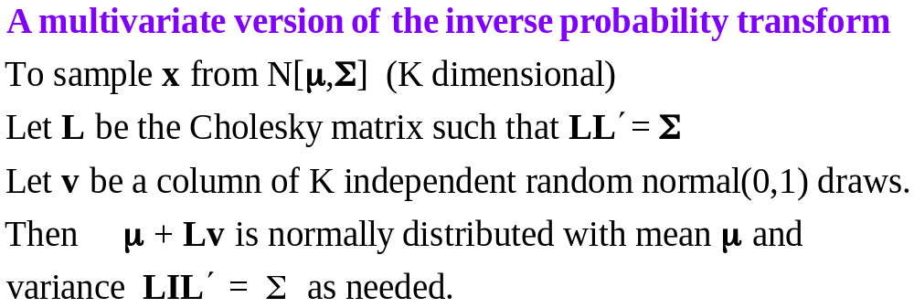

Sampling from the Multivariate Normal

Slide 42
Gibbs Sampler
Preliminary:
Obtain X’X then L such that LL’ = (X’X)⁻¹.
Preliminary: Choose initial value for β such as
β₀ = 0. Start with r = 1.
(y* step) Sample N observations on y*(r) using
β_{r-1} , x_{i} and y_{i} and the transformations for the truncated normal distribution.
(β step) Compute b*(r) = (X’X)⁻¹X’y*(r). Draw the observation on β(r) from the normal population with mean b*(r) and variance (X’X)⁻¹.
Cycle between the two steps 50,000 times. Discard the first 10,000 and retain every 10th observation from the retained 40,000.

Slide 43
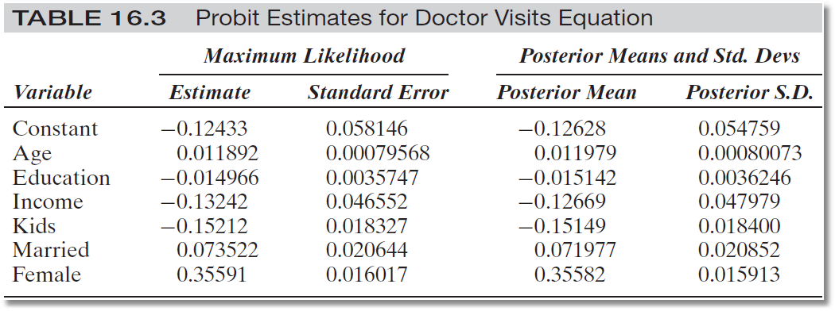
Frequentist and Bayesian Results
0.37 Seconds 2 Minutes

Slide 44
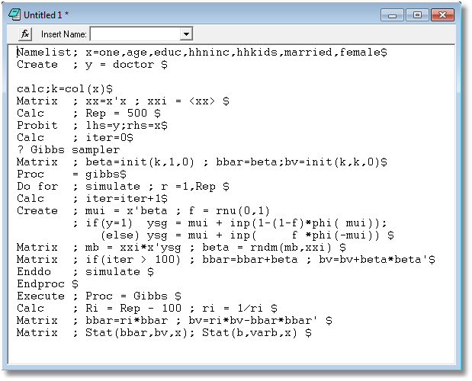
Appendix

Slide 45
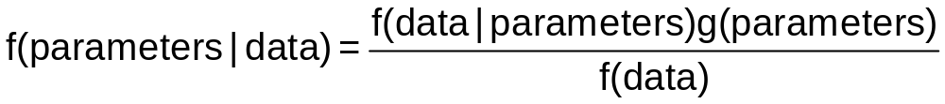
Bayesian Model Estimation
Specification of conditional likelihood:
f(data | parameters) = L(parameters|data)
Specification of priors: g(parameters)
Posterior density of parameters:
Posterior mean = E[parameters|data]

Slide 46
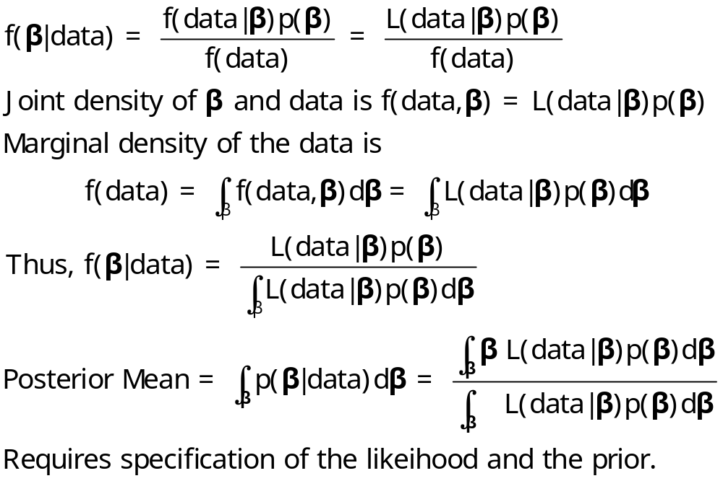
The Marginal Density for the Data is Irrelevant

Slide 47
Bayesian Estimators
Bayesian “Random Parameters” vs. Classical Randomly Distributed Parameters
Models of Individual Heterogeneity
  Sample Proportion
  Linear Regression
  Binary Choice
  Random Effects: Consumer Brand Choice
  Fixed Effects: Hospital Costs

Slide 48
A Random Effects Approach
Allenby and Rossi, “Marketing Models of Consumer Heterogeneity”
  Discrete Choice Model – Brand Choice
  Hierarchical Bayes
  Multinomial Probit
Panel Data: Purchases of 4 brands of ketchup

Slide 49
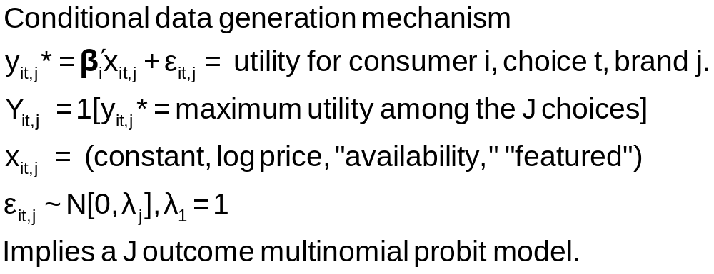
Structure

Slide 50
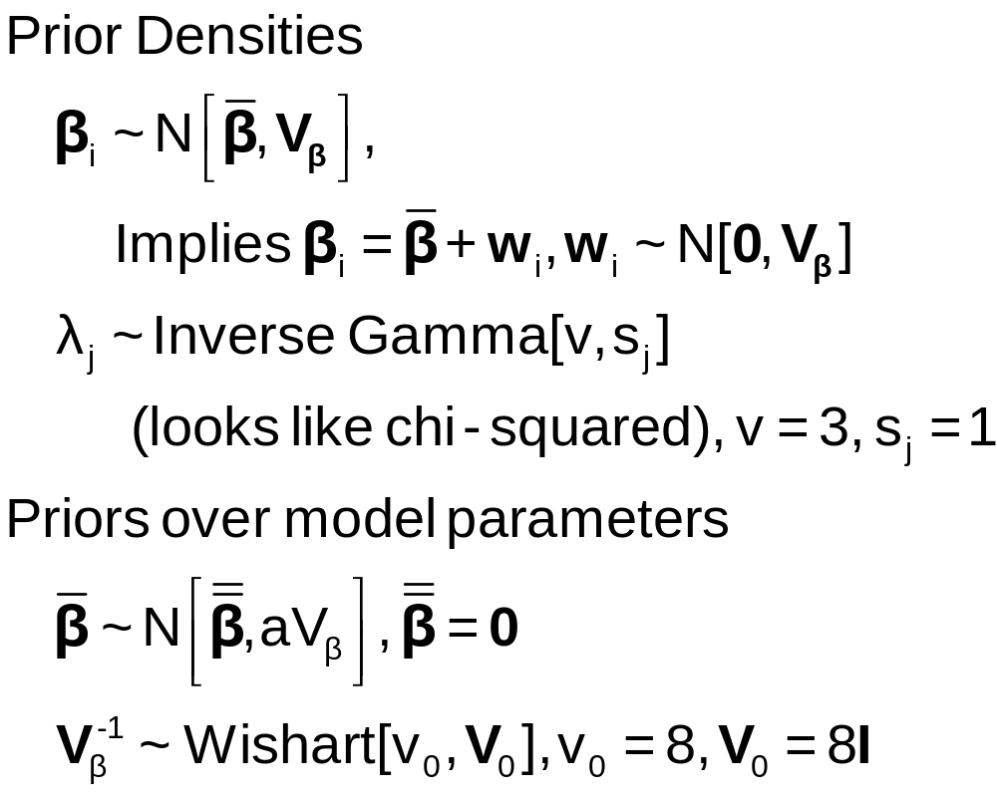
Priors

Slide 51
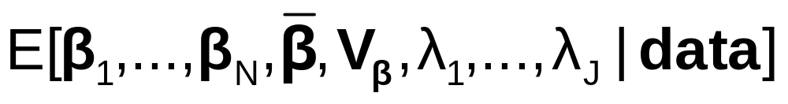
Bayesian Estimator
Joint Posterior =
Integral does not exist in closed form.
Estimate by random samples from the joint posterior.
Full joint posterior is not known, so not possible to sample from the joint posterior.
Gibbs sampler is used to sample from posterior

Slide 52
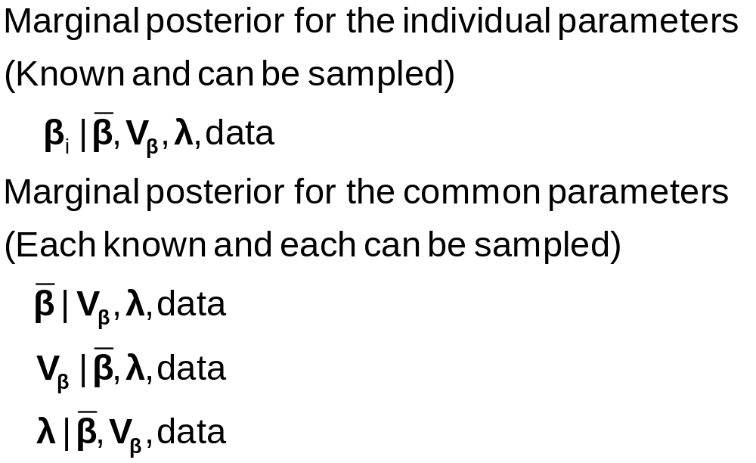
Gibbs Cycles for the MNP Model

Slide 53
Results
Individual parameter vectors and disturbance variances
Individual estimates of choice probabilities
The same as the “random parameters probit model” with slightly different weights.
Allenby and Rossi call the classical method an “approximate Bayesian” approach.
  (Greene calls the Bayesian estimator an “approximate random parameters model”)
  Who’s right?
    Bayesian layers on implausible uninformative priors and calls the maximum likelihood results “exact” Bayesian estimators.
    Classical is strongly parametric and a slave to the distributional assumptions.
    Bayesian is even more strongly parametric than classical.
    Neither is right – Both are right.

Slide 54
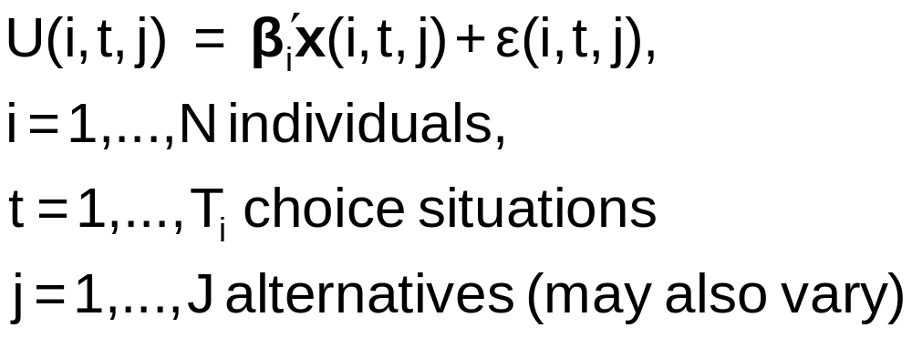
A Comparison of Maximum Simulated
Likelihood and Hierarchical Bayes
Ken Train: “A Comparison of Hierarchical Bayes and Maximum Simulated Likelihood for Mixed Logit”
Mixed Logit

Slide 55
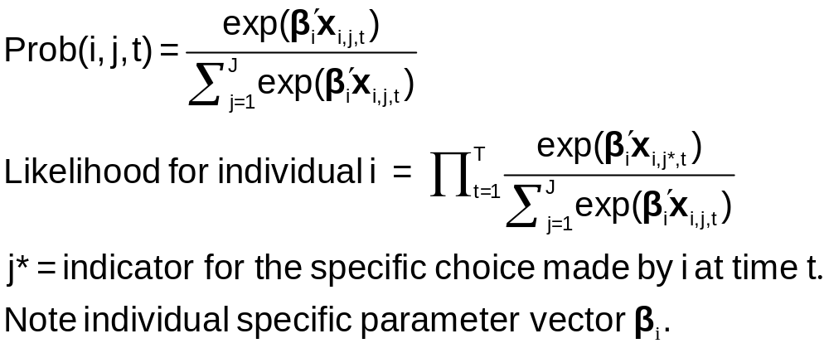
Stochastic Structure – Conditional Likelihood

Slide 56
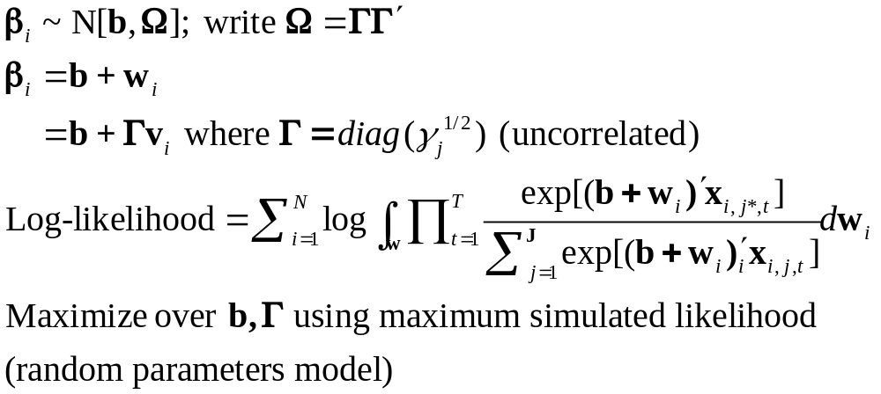
Classical Approach

Slide 57
Mixed Model Estimation
MLWin: Multilevel modeling for Windows
  http://multilevel.ioe.ac.uk/index.html
  Uses mostly Bayesian, MCMC methods
  “Markov Chain Monte Carlo (MCMC) methods allow Bayesian models to be fitted, where prior distributions for the model parameters are specified. By default MLwin sets diffuse priors which can be used to approximate maximum likelihood estimation.” (From their website.)

Slide 58
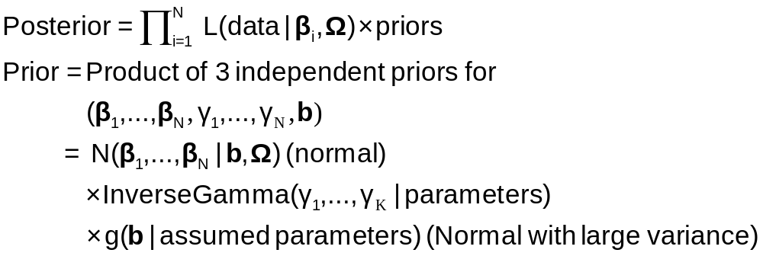
Bayesian Approach – Gibbs Sampling and Metropolis-Hastings

Slide 59
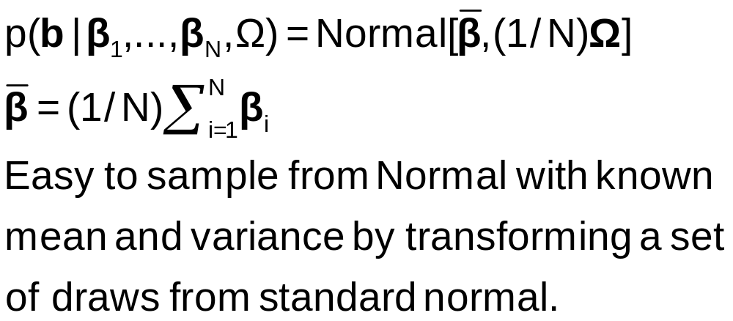
Gibbs Sampling from Posteriors: b

Slide 60
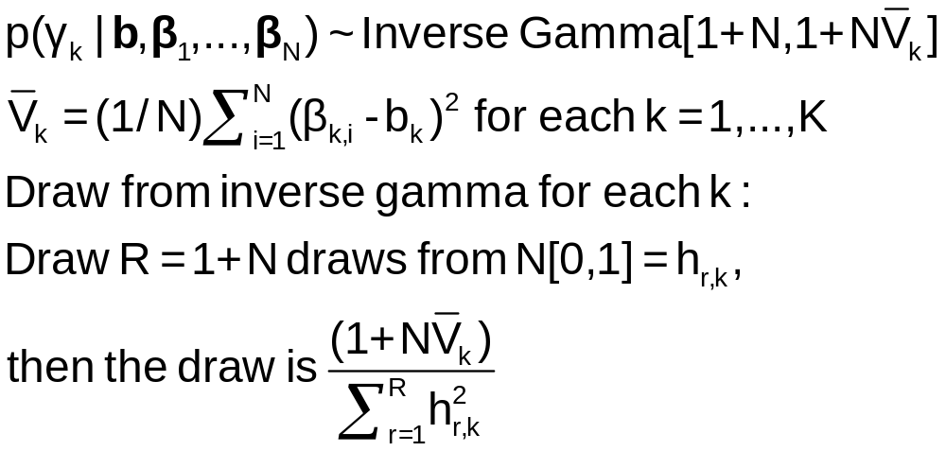
Gibbs Sampling from Posteriors: Ω

Slide 61
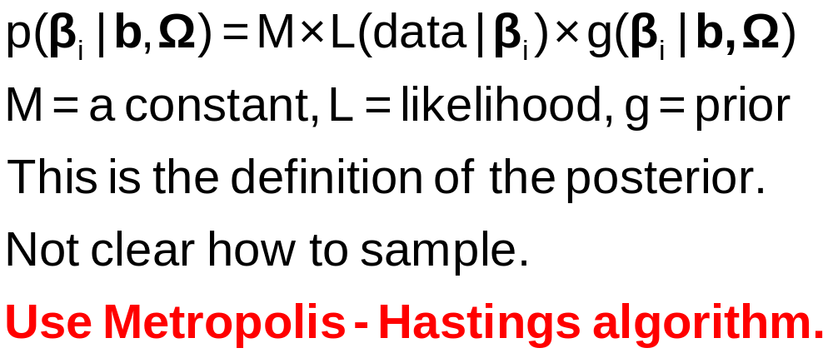
Gibbs Sampling from Posteriors: β_{i}

Slide 62
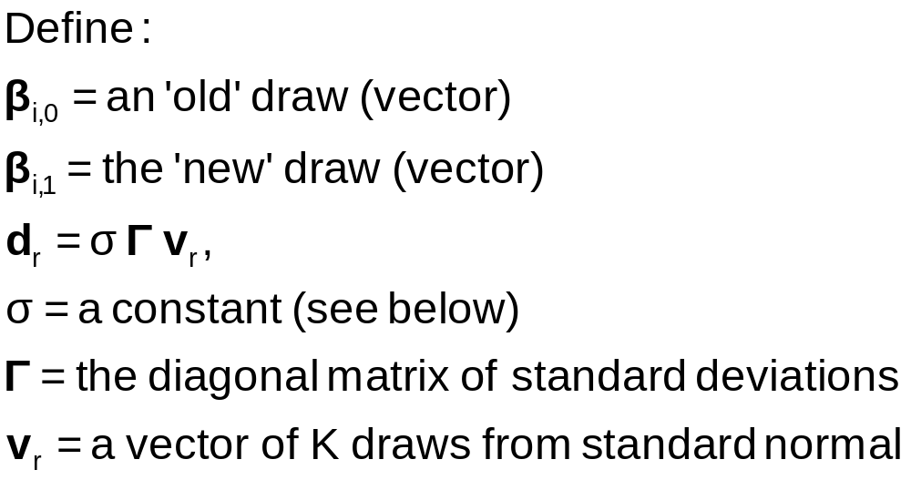
Metropolis – Hastings Method

Slide 63
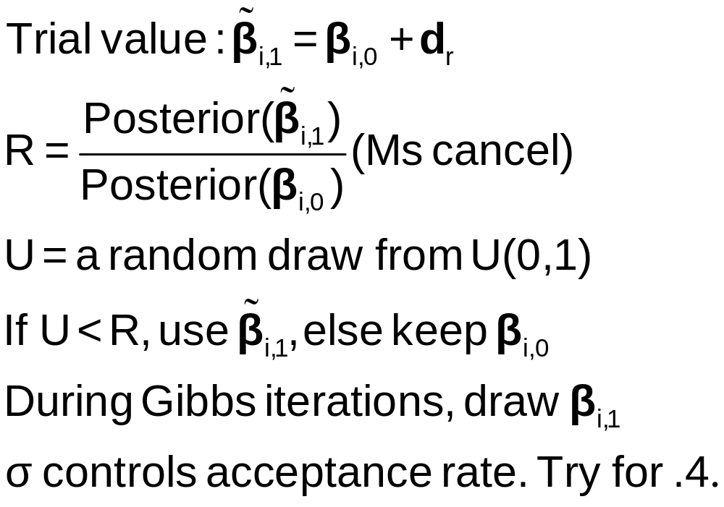
Metropolis Hastings: A Draw of β_{i}

Slide 64
Application: Energy Suppliers
N=361 individuals, 2 to 12 hypothetical suppliers
X=
  (1) fixed rates,
  (2) contract length,
  (3) local (0,1),
  (4) well known company (0,1),
  (5) offer TOD rates (0,1),
  (6) offer seasonal rates]

Slide 65
Estimates: Mean of Individual β_{i}
 | MSL Estimate (Asymptotic S.E.) | Bayes Posterior Mean (Posterior Std.Dev.)
Price | -1.04 (0.396) | -1.04 (0.0374)
Contract | -0.208 (0.0240) | -0.194 (0.0224)
Local | 2.40 (0.127) | 2.41 (0.140)
Well Known | 1.74 (0.0927) | 1.71 (0.100)
TOD | -9.94 (0.337) | -10.0 (0.315)
Seasonal | -10.2 (0.333) | -10.2 (0.310)

Slide 66
Nonlinear Models and Simulation
Bayesian inference over parameters in a nonlinear model:
  1. Parameterize the model
  2. Form the likelihood conditioned on the parameters
  3. Develop the priors – joint prior for all model parameters
  4. Posterior is proportional to likelihood times prior. (Usually requires conjugate priors to be tractable.)
  5. Draw observations from the posterior to study its characteristics.

Slide 67
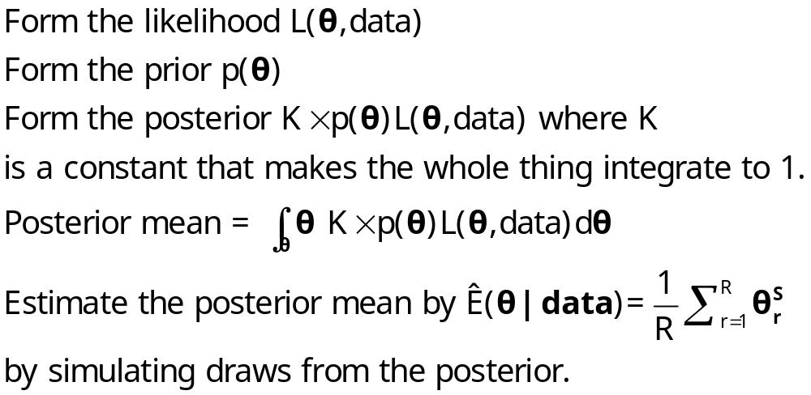
Simulation Based Inference

Slide 68
Large Sample Properties of Posteriors
Under a uniform prior, the posterior is proportional to the likelihood function
  Bayesian ‘estimator’ is the mean of the posterior
  MLE equals the mode of the likelihood
  In large samples, the likelihood becomes approximately normal – the mean equals the mode
  Thus, in large samples, the posterior mean will be approximately equal to the MLE.

Slide 69
Conclusions
Bayesian vs. Classical Estimation
  In principle, some differences in interpretation
  As practiced, just two different algorithms
  The religious debate is a red herring
Gibbs Sampler. A major technological advance
  Useful tool for both classical and Bayesian
  New Bayesian applications appear daily

Slide 70
Applications of the Paradigm
Classical econometricians doggedly cling to their theories even when the evidence conflicts with them – that is what specification searches are all about.
Bayesian econometricians NEVER incorporate prior evidence in their estimators – priors are always studiously noninformative. (Informative priors taint the analysis.) As practiced, Bayesian analysis is not Bayesian.

Slide 71
Methodological Issues
Priors: Schizophrenia
  Uninformative are disingenuous (and not Bayesian)
  Informative are not objective
Using existing information? Received studies generally do not do this.
Bernstein von Mises theorem and likelihood estimation.
  In large samples, the likelihood dominates
  The posterior mean will be the same as the MLE

Slide 72
Standard Criticisms
Of the Classical Approach
  Computationally difficult (ML vs. MCMC)
  No attention is paid to household level parameters.
  There is no natural estimator of individual or household level parameters
  Responses: None are true. See, e.g., Train (2003, ch. 10)
Of Classical Inference in this Setting
  Asymptotics are “only approximate” and rely on “imaginary samples.” Bayesian procedures are “exact.”
  Response: The inexactness results from acknowledging that we try to extend these results outside the sample. The Bayesian results are “exact” but have no generality and are useless except for this sample, these data and this prior. (Or are they? Trying to extend them outside the sample is a distinctly classical exercise.)

Slide 73
Modeling Issues
As N →∞, the likelihood dominates and the prior disappears ➔ Bayesian and Classical MLE converge. (Needs the mode of the posterior to converge to the mean.)
Priors
  Diffuse → large variances imply little prior information. (NONINFORMATIVE)
  INFORMATIVE priors – finite variances that appear in the posterior. “Taints” any final results.

Slide 74
Reconciliation: Bernstein-Von Mises Theorem
The posterior distribution converges to normal with covariance matrix equal to 1/N times the information matrix (same as classical MLE). (The distribution that is converging is the posterior, not the sampling distribution of the estimator of the posterior mean.)
The posterior mean (empirical) converges to the mode of the likelihood function. Same as the MLE. A proper prior disappears asymptotically.
Asymptotic sampling distribution of the posterior mean is the same as that of the MLE.

Slide 75
Sources
Lancaster, T.: An Introduction to Modern Bayesian Econometrics, Blackwell, 2004
Koop, G.: Bayesian Econometrics, Wiley, 2003
… “Bayesian Methods,” “Bayesian Data Analysis,” … (many books in statistics)
Papers in Marketing: Allenby, Ginter, Lenk, Kamakura,…
Papers in Statistics: Sid Chib,…
Books and Papers in Econometrics: Arnold Zellner, Gary Koop, Mark Steel, Dale Poirier,…

Slide 76
Software
Stata, Limdep, SAS, etc.
R, Matlab, Gauss
WinBUGS
  Bayesian inference Using Gibbs Sampling

Slide 77

http://www.mrc-bsu.cam.ac.uk/bugs/welcome.shtml

