Slide 1
Discrete Choice Modeling
William Greene
Stern School of Business
New York University
April 26-27, 2012
Georgetown University, Washington, DC

Slide 2


Discrete Choice Modeling
Theoretical Foundations
Econometric Methodology
  Discrete Choice Models
  Binary Choice Models
  Multinomial Choice Models
  Ordered and Bi-/Multivariate Choice
Model Building, Econometric Methods
  Statistical Bases, Specification Issues
  Estimation
  Analysis and
  Hypothesis Testing
Applications

Slide 3
Our Agenda
Day 1
  Basic econometric modeling ideas
  Regression foundations
  Theoretical foundations – random utility
  Binary choice
  Multinomial unordered choice
Day 2
  Binary choice
  Ordered choice
  Multiple equation models
  Multinomial choice

Slide 4
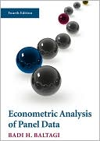
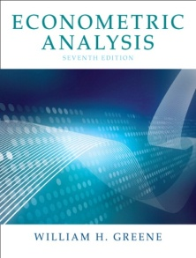
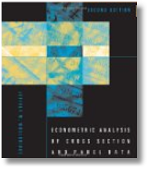

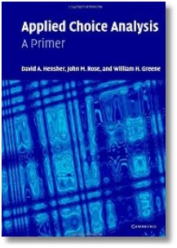

Course Format
9 – 3: Theory and Methods
  9:00 – 10:30 Session 1
  10:30 – 11:00 Break
  11:00 – 12:30 Session 2
  12:30 – 1:30 Lunch
  1:30 – 3:00 Session 3
  3:00 – 3:30 Break
3:30 – 5:00 Applications

