Slide 1
Econometric Methodology

Slide 2
The Sample and Measurement
Population
Measurement
Theory
Characteristics
Behavior Patterns
Choices

Slide 3
Inference
Population
Measurement
Econometric
Methods
Characteristics
Behavior Patterns
Choices

Slide 4
Classical Inference
Population
Measurement
Econometric
Methods
Characteristics
Behavior Patterns
Choices
Imprecise inference about the entire population – sampling theory and asymptotics

Slide 5
Bayesian Inference
Population
Measurement
Econometric
Methods
Characteristics
Behavior Patterns
Choices
Sharp, ‘exact’ inference about only the sample – the ‘posterior’ (to the data) density.

Slide 6
Econometric Frameworks
Nonparametric
Semiparametric
Parametric
  Classical (Sampling Theory)
  Bayesian
We will focus mainly on classical, parametric ethods

Slide 7
Objectives in Model Building
Specification: guided by underlying theory
  Modeling framework
  Functional forms
Estimation: coefficients, partial effects, model implications
Statistical inference: hypothesis testing
Prediction: individual and aggregate
Model assessment (fit, adequacy) and evaluation
Model extensions
  Interdependencies, multiple part models
  Heterogeneity
  Endogeneity
Exploration: Estimation and inference methods

Slide 8
Regression Basics
The “MODEL”
  Modeling the conditional mean – Regression
Other features of interest
  Modeling quantiles
  Conditional variances or covariances
  Modeling probabilities for discrete choice
  Modeling other features of the population

Slide 9
Application: Health Care Usage
German Health Care Usage Data, 7,293 Individuals, Varying Numbers of Periods
Data downloaded from Journal of Applied Econometrics Archive. This is an unbalanced panel with 7,293 individuals. They can be used for regression, count models, binary choice, ordered choice, and bivariate binary choice. This is a large data set. There are altogether 27,326 observations. The number of observations ranges from 1 to 7. (Frequencies are: 1=1525, 2=2158, 3=825, 4=926, 5=1051, 6=1000, 7=987). (Downloaded from the JAE Archive)
Variables in the file are
DOCTOR = 1(Number of doctor visits > 0)
HOSPITAL = 1(Number of hospital visits > 0)
HSAT = health satisfaction, coded 0 (low) - 10 (high)
DOCVIS = number of doctor visits in last three months
HOSPVIS = number of hospital visits in last calendar year
PUBLIC = insured in public health insurance = 1; otherwise = 0
ADDON = insured by add-on insurance = 1; otherswise = 0
HHNINC = household nominal monthly net income in German marks / 10000.
(4 observations with income=0 were dropped)
HHKIDS = children under age 16 in the household = 1; otherwise = 0
EDUC = years of schooling
AGE = age in years
MARRIED = marital status
Notes:
9

Slide 10

Household Income
Kernel Density Estimator Histogram

Slide 11
Regression – Income on Education
----------------------------------------------------------------------
Ordinary least squares regression ............
LHS=LOGINC Mean = -.92882
Standard deviation = .47948
Number of observs. = 887
Model size Parameters = 2
Degrees of freedom = 885
Residuals Sum of squares = 183.19359
Standard error of e = .45497
Fit R-squared = .10064
Adjusted R-squared = .09962
Model test F[ 1, 885] (prob) = 99.0(.0000)
Diagnostic Log likelihood = -559.06527
Restricted(b=0) = -606.10609
Chi-sq [ 1] (prob) = 94.1(.0000)
Info criter. LogAmemiya Prd. Crt. = -1.57279
--------+-------------------------------------------------------------
Variable| Coefficient Standard Error b/St.Er. P[|Z|>z] Mean of X
--------+-------------------------------------------------------------
Constant| -1.71604*** .08057 -21.299 .0000
EDUC| .07176*** .00721 9.951 .0000 10.9707
--------+-------------------------------------------------------------
Note: ***, **, * = Significance at 1%, 5%, 10% level.
----------------------------------------------------------------------

Slide 12
Specification and Functional Form
----------------------------------------------------------------------
Ordinary least squares regression ............
LHS=LOGINC Mean = -.92882
Standard deviation = .47948
Number of observs. = 887
Model size Parameters = 3
Degrees of freedom = 884
Residuals Sum of squares = 183.00347
Standard error of e = .45499
Fit R-squared = .10157
Adjusted R-squared = .09954
Model test F[ 2, 884] (prob) = 50.0(.0000)
Diagnostic Log likelihood = -558.60477
Restricted(b=0) = -606.10609
Chi-sq [ 2] (prob) = 95.0(.0000)
Info criter. LogAmemiya Prd. Crt. = -1.57158
--------+-------------------------------------------------------------
Variable| Coefficient Standard Error b/St.Er. P[|Z|>z] Mean of X
--------+-------------------------------------------------------------
Constant| -1.68303*** .08763 -19.207 .0000
EDUC| .06993*** .00746 9.375 .0000 10.9707
FEMALE| -.03065 .03199 -.958 .3379 .42277
--------+-------------------------------------------------------------

Slide 13
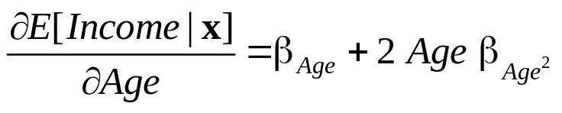
Interesting Partial Effects
----------------------------------------------------------------------
Ordinary least squares regression ............
LHS=LOGINC Mean = -.92882
Standard deviation = .47948
Number of observs. = 887
Model size Parameters = 5
Degrees of freedom = 882
Residuals Sum of squares = 171.87964
Standard error of e = .44145
Fit R-squared = .15618
Adjusted R-squared = .15235
Model test F[ 4, 882] (prob) = 40.8(.0000)
Diagnostic Log likelihood = -530.79258
Restricted(b=0) = -606.10609
Chi-sq [ 4] (prob) = 150.6(.0000)
Info criter. LogAmemiya Prd. Crt. = -1.62978
--------+-------------------------------------------------------------
Variable| Coefficient Standard Error b/St.Er. P[|Z|>z] Mean of X
--------+-------------------------------------------------------------
Constant| -5.26676*** .56499 -9.322 .0000
EDUC| .06469*** .00730 8.860 .0000 10.9707
FEMALE| -.03683 .03134 -1.175 .2399 .42277
AGE| .15567*** .02297 6.777 .0000 50.4780
AGE2| -.00161*** .00023 -7.014 .0000 2620.79
--------+-------------------------------------------------------------

Slide 14
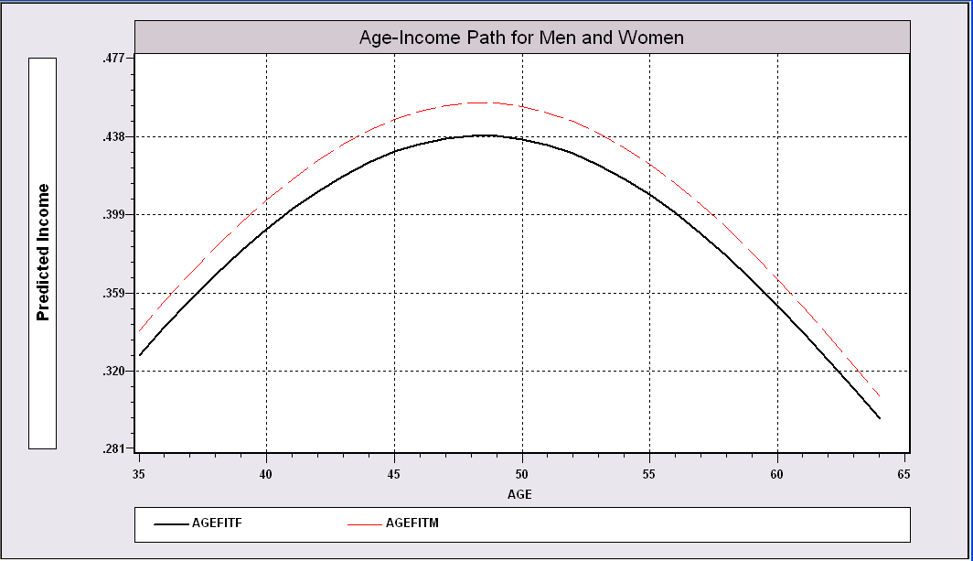
Impact of Age on Income

Slide 15
Inference: Does the same model apply to men and women?
*Subsample analyzed for this command is FEMALE = 0
Residuals Sum of squares = 90.80587
Number of observs. = 512
Fit R-squared = .16538
--------+-------------------------------------------------------------
Variable| Coefficient Standard Error b/St.Er. P[|Z|>z] Mean of X
--------+-------------------------------------------------------------
Constant| -5.45890*** .67675 -8.066 .0000
EDUC| .06626*** .00836 7.924 .0000 11.4342
AGE| .15894*** .02789 5.699 .0000 49.3750
AGE2| -.00160*** .00028 -5.695 .0000 2514.12
--------+-------------------------------------------------------------
*Subsample analyzed for this command is FEMALE = 1
Residuals Sum of squares = 79.45629
Number of observs. = 375
Fit R-squared = .14008
--------+-------------------------------------------------------------
Constant| -4.10991*** 1.03733 -3.962 .0001
EDUC| .05850*** .01399 4.180 .0000 10.3378
AGE| .11707*** .04103 2.853 .0046 51.9840
AGE2| -.00129*** .00040 -3.210 .0014 2766.43
--------+-------------------------------------------------------------
Residuals Sum of squares = 172.14877
Number of observs. = 887
Fit R-squared = .15486
--------+-------------------------------------------------------------
Constant| -5.24401*** .56478 -9.285 .0000
EDUC| .06676*** .00709 9.418 .0000 10.9707
AGE| .15342*** .02290 6.701 .0000 50.4780
AGE2| -.00159*** .00023 -6.944 .0000 2620.79
--------+-------------------------------------------------------------
F={[172.14877-(90.80587+79.45629)]/4} /{(90.80587+79.45629)/(512+375-2(4)} = 2.43, F* = 2.38

