Slide 1
Discrete Choice Modeling
William Greene
Stern School of Business
New York University

Slide 2
Part 5
Multinomial Logit Extensions

Slide 3
What’s Wrong with the MNL Model?
I.I.D. ➔ IIA
Independence from irrelevant alternatives
  Peculiar behavioral assumption
  Leads to skewed, implausible empirical results
  Functional forms, e.g., nested logit, avoid IIA
  IIA will be a nonissue in what follows.
Insufficiently heterogeneous:
“… economists are often more interested in aggregate effects and regard heterogeneity as a statistical nuisance parameter problem which must be addressed but not emphasized. Econometricians frequently employ methods which do not allow for the estimation of individual level parameters.” (Allenby and Rossi, Journal of Econometrics, 1999)

Slide 4
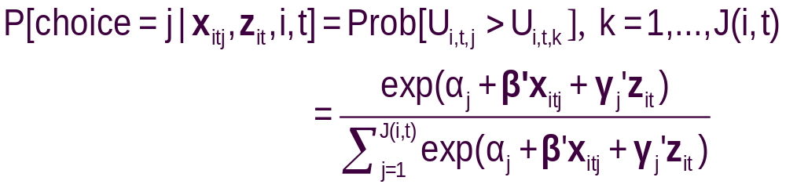
Relaxing IIA in the MNL Model
Independent extreme value (Gumbel):
  F(εitj) = Exp(-Exp(-εitj)) (random part of each utility)
  Identical variances (means absorbed in constants)
  Independence across utility functions
  Same parameters for all individuals (temporary)
Implied probabilities for observed outcomes

Slide 5
Part 5.1
Heteroscedasticity

Slide 6
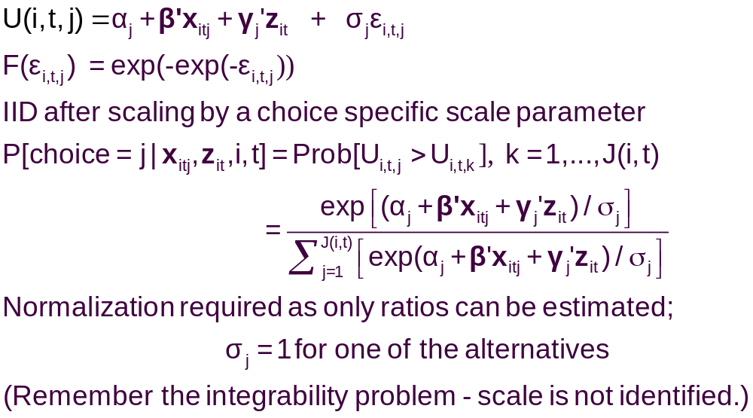
A Model with Choice Heteroscedasticity

Slide 7
Heteroscedastic Extreme Value Model (1)
+---------------------------------------------+
| Start values obtained using MNL model |
| Maximum Likelihood Estimates |
| Log likelihood function -184.5067 |
| Dependent variable Choice |
| Response data are given as ind. choice. |
| Number of obs.= 210, skipped 0 bad obs. |
+---------------------------------------------+
+--------+--------------+----------------+--------+--------+
|Variable| Coefficient | Standard Error |b/St.Er.|P[|Z|>z]|
+--------+--------------+----------------+--------+--------+
GC | .06929537 .01743306 3.975 .0001
TTME | -.10364955 .01093815 -9.476 .0000
INVC | -.08493182 .01938251 -4.382 .0000
INVT | -.01333220 .00251698 -5.297 .0000
AASC | 5.20474275 .90521312 5.750 .0000
TASC | 4.36060457 .51066543 8.539 .0000
BASC | 3.76323447 .50625946 7.433 .0000

Slide 8
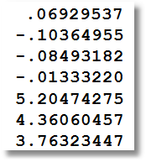
Heteroscedastic Extreme Value Model (2)
+---------------------------------------------+
| Heteroskedastic Extreme Value Model |
| Log likelihood function -182.4440 | (MNL logL was -184.5067)
| Number of parameters 10 |
| Restricted log likelihood -291.1218 |
+---------------------------------------------+
+--------+--------------+----------------+--------+--------+
|Variable| Coefficient | Standard Error |b/St.Er.|P[|Z|>z]|
+--------+--------------+----------------+--------+--------+
---------+Attributes in the Utility Functions (beta)
GC | .11903513 .06402510 1.859 .0630
TTME | -.11525581 .05721397 -2.014 .0440
INVC | -.15515877 .07928045 -1.957 .0503
INVT | -.02276939 .01122762 -2.028 .0426
AASC | 4.69411460 2.48091789 1.892 .0585
TASC | 5.15629868 2.05743764 2.506 .0122
BASC | 5.03046595 1.98259353 2.537 .0112
---------+Scale Parameters of Extreme Value Distns Minus 1.0
s_AIR | -.57864278 .21991837 -2.631 .0085
s_TRAIN | -.45878559 .34971034 -1.312 .1896
s_BUS | .26094835 .94582863 .276 .7826
s_CAR | .000000 ......(Fixed Parameter).......
---------+Std.Dev=pi/(theta*sqr(6)) for H.E.V. distribution.
s_AIR | 3.04385384 1.58867426 1.916 .0554
s_TRAIN | 2.36976283 1.53124258 1.548 .1217
s_BUS | 1.01713111 .76294300 1.333 .1825
s_CAR | 1.28254980 ......(Fixed Parameter).......
Normalized for estimation
Structural parameters

Slide 9
HEV Model - Elasticities
+---------------------------------------------------+
| Elasticity averaged over observations.|
| Attribute is INVC in choice AIR |
| Effects on probabilities of all choices in model: |
| * = Direct Elasticity effect of the attribute. |
| Mean St.Dev |
| * Choice=AIR -4.2604 1.6745 |
| Choice=TRAIN 1.5828 1.9918 |
| Choice=BUS 3.2158 4.4589 |
| Choice=CAR 2.6644 4.0479 |
| Attribute is INVC in choice TRAIN |
| Choice=AIR .7306 .5171 |
| * Choice=TRAIN -3.6725 4.2167 |
| Choice=BUS 2.4322 2.9464 |
| Choice=CAR 1.6659 1.3707 |
| Attribute is INVC in choice BUS |
| Choice=AIR .3698 .5522 |
| Choice=TRAIN .5949 1.5410 |
| * Choice=BUS -6.5309 5.0374 |
| Choice=CAR 2.1039 8.8085 |
| Attribute is INVC in choice CAR |
| Choice=AIR .3401 .3078 |
| Choice=TRAIN .4681 .4794 |
| Choice=BUS 1.4723 1.6322 |
| * Choice=CAR -3.5584 9.3057 |
+---------------------------------------------------+
Multinomial Logit
+---------------------------+
| INVC in AIR |
| Mean St.Dev |
| * -5.0216 2.3881 |
| 2.2191 2.6025 |
| 2.2191 2.6025 |
| 2.2191 2.6025 |
| INVC in TRAIN |
| 1.0066 .8801 |
| * -3.3536 2.4168 |
| 1.0066 .8801 |
| 1.0066 .8801 |
| INVC in BUS |
| .4057 .6339 |
| .4057 .6339 |
| * -2.4359 1.1237 |
| .4057 .6339 |
| INVC in CAR |
| .3944 .3589 |
| .3944 .3589 |
| .3944 .3589 |
| * -1.3888 1.2161 |
+---------------------------+

Slide 10
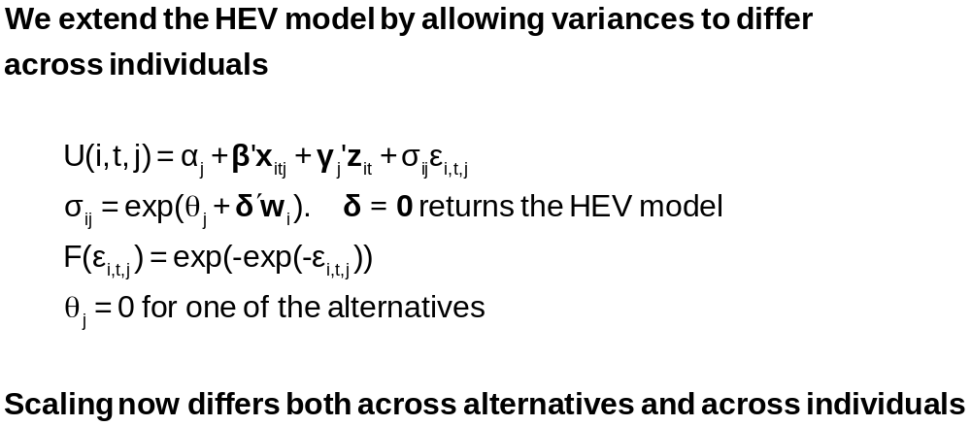
Variance Heterogeneity in MNL

Slide 11
Application: Shoe Brand Choice
Simulated Data: Stated Choice, 400 respondents, 8 choice situations, 3,200 observations
3 choice/attributes + NONE
  Fashion = High / Low
  Quality = High / Low
  Price = 25/50/75,100 coded 1,2,3,4
Heterogeneity: Sex, Age (<25, 25-39, 40+)
Underlying data generated by a 3 class latent class process (100, 200, 100 in classes)
Thanks to www.statisticalinnovations.com (Latent Gold)

Slide 12
Multinomial Logit Baseline Values
+---------------------------------------------+
| Discrete choice (multinomial logit) model |
| Number of observations 3200 |
| Log likelihood function -4158.503 |
| Number of obs.= 3200, skipped 0 bad obs. |
+---------------------------------------------+
+--------+--------------+----------------+--------+--------+
|Variable| Coefficient | Standard Error |b/St.Er.|P[|Z|>z]|
+--------+--------------+----------------+--------+--------+
FASH | 1.47890473 .06776814 21.823 .0000
QUAL | 1.01372755 .06444532 15.730 .0000
PRICE | -11.8023376 .80406103 -14.678 .0000
ASC4 | .03679254 .07176387 .513 .6082

Slide 13
Multinomial Logit Elasticities
+---------------------------------------------------+
| Elasticity averaged over observations.|
| Attribute is PRICE in choice BRAND1 |
| Effects on probabilities of all choices in model: |
| * = Direct Elasticity effect of the attribute. |
| Mean St.Dev |
| * Choice=BRAND1 -.8895 .3647 |
| Choice=BRAND2 .2907 .2631 |
| Choice=BRAND3 .2907 .2631 |
| Choice=NONE .2907 .2631 |
| Attribute is PRICE in choice BRAND2 |
| Choice=BRAND1 .3127 .1371 |
| * Choice=BRAND2 -1.2216 .3135 |
| Choice=BRAND3 .3127 .1371 |
| Choice=NONE .3127 .1371 |
| Attribute is PRICE in choice BRAND3 |
| Choice=BRAND1 .3664 .2233 |
| Choice=BRAND2 .3664 .2233 |
| * Choice=BRAND3 -.7548 .3363 |
| Choice=NONE .3664 .2233 |
+---------------------------------------------------+

Slide 14

Unlabeled Choice Experiments
This an unlabelled choice experiment: Compare
Choice = (Air, Train, Bus, Car)
To
Choice = (Brand 1, Brand 2, Brand 3, None)
Brand 1 is only Brand 1 because it is first in
the list.
What does it mean to substitute Brand 1 for
Brand 2?
What does the own elasticity for Brand 1 mean?

Slide 15
HEV Model without Heterogeneity
+---------------------------------------------+
| Heteroskedastic Extreme Value Model |
| Dependent variable CHOICE |
| Number of observations 3200 |
| Log likelihood function -4151.611 |
| Response data are given as ind. choice. |
+---------------------------------------------+
+--------+--------------+----------------+--------+--------+
|Variable| Coefficient | Standard Error |b/St.Er.|P[|Z|>z]|
+--------+--------------+----------------+--------+--------+
---------+Attributes in the Utility Functions (beta)
FASH | 1.57473345 .31427031 5.011 .0000
QUAL | 1.09208463 .22895113 4.770 .0000
PRICE | -13.3740754 2.61275111 -5.119 .0000
ASC4 | -.01128916 .22484607 -.050 .9600
---------+Scale Parameters of Extreme Value Distns Minus 1.0
s_BRAND1| .03779175 .22077461 .171 .8641
s_BRAND2| -.12843300 .17939207 -.716 .4740
s_BRAND3| .01149458 .22724947 .051 .9597
s_NONE | .000000 ......(Fixed Parameter).......
---------+Std.Dev=pi/(theta*sqr(6)) for H.E.V. distribution.
s_BRAND1| 1.23584505 .26290748 4.701 .0000
s_BRAND2| 1.47154471 .30288372 4.858 .0000
s_BRAND3| 1.26797496 .28487215 4.451 .0000
s_NONE | 1.28254980 ......(Fixed Parameter).......
Essentially no differences in variances across choices

Slide 16
Homogeneous HEV Elasticities
Multinomial Logit
+---------------------------------------------------+
| Attribute is PRICE in choice BRAND1 |
| Mean St.Dev |
| * Choice=BRAND1 -1.0585 .4526 |
| Choice=BRAND2 .2801 .2573 |
| Choice=BRAND3 .3270 .3004 |
| Choice=NONE .3232 .2969 |
| Attribute is PRICE in choice BRAND2 |
| Choice=BRAND1 .3576 .1481 |
| * Choice=BRAND2 -1.2122 .3142 |
| Choice=BRAND3 .3466 .1426 |
| Choice=NONE .3429 .1411 |
| Attribute is PRICE in choice BRAND3 |
| Choice=BRAND1 .4332 .2532 |
| Choice=BRAND2 .3610 .2116 |
| * Choice=BRAND3 -.8648 .4015 |
| Choice=NONE .4156 .2436 |
+---------------------------------------------------+
| Elasticity averaged over observations.|
| Effects on probabilities of all choices in model: |
| * = Direct Elasticity effect of the attribute. |
+---------------------------------------------------+
+--------------------------+
| PRICE in choice BRAND1|
| Mean St.Dev |
| * -.8895 .3647 |
| .2907 .2631 |
| .2907 .2631 |
| .2907 .2631 |
| PRICE in choice BRAND2|
| .3127 .1371 |
| * -1.2216 .3135 |
| .3127 .1371 |
| .3127 .1371 |
| PRICE in choice BRAND3|
| .3664 .2233 |
| .3664 .2233 |
| * -.7548 .3363 |
| .3664 .2233 |
+--------------------------+

Slide 17
Heteroscedasticity Across Individuals
+---------------------------------------------+
| Heteroskedastic Extreme Value Model | Homog-HEV MNL
| Log likelihood function -4129.518[10] | -4151.611[7] -4158.503[4]
+---------------------------------------------+
+--------+--------------+----------------+--------+--------+
|Variable| Coefficient | Standard Error |b/St.Er.|P[|Z|>z]|
+--------+--------------+----------------+--------+--------+
---------+Attributes in the Utility Functions (beta)
FASH | 1.01640726 .20261573 5.016 .0000
QUAL | .55668491 .11604080 4.797 .0000
PRICE | -7.44758292 1.52664112 -4.878 .0000
ASC4 | .18300524 .09678571 1.891 .0586
---------+Scale Parameters of Extreme Value Distributions
s_BRAND1| .81114924 .10099174 8.032 .0000
s_BRAND2| .72713522 .08931110 8.142 .0000
s_BRAND3| .80084114 .10316939 7.762 .0000
s_NONE | 1.00000000 ......(Fixed Parameter).......
---------+Heterogeneity in Scales of Ext.Value Distns.
MALE | .21512161 .09359521 2.298 .0215
AGE25 | .79346679 .13687581 5.797 .0000
AGE39 | .38284617 .16129109 2.374 .0176

Slide 18
Variance Heterogeneity Elasticities
Multinomial Logit
+---------------------------------------------------+
| Attribute is PRICE in choice BRAND1 |
| Mean St.Dev |
| * Choice=BRAND1 -.8978 .5162 |
| Choice=BRAND2 .2269 .2595 |
| Choice=BRAND3 .2507 .2884 |
| Choice=NONE .3116 .3587 |
| Attribute is PRICE in choice BRAND2 |
| Choice=BRAND1 .2853 .1776 |
| * Choice=BRAND2 -1.0757 .5030 |
| Choice=BRAND3 .2779 .1669 |
| Choice=NONE .3404 .2045 |
| Attribute is PRICE in choice BRAND3 |
| Choice=BRAND1 .3328 .2477 |
| Choice=BRAND2 .2974 .2227 |
| * Choice=BRAND3 -.7458 .4468 |
| Choice=NONE .4056 .3025 |
+---------------------------------------------------+
+--------------------------+
| PRICE in choice BRAND1|
| Mean St.Dev |
| * -.8895 .3647 |
| .2907 .2631 |
| .2907 .2631 |
| .2907 .2631 |
| PRICE in choice BRAND2|
| .3127 .1371 |
| * -1.2216 .3135 |
| .3127 .1371 |
| .3127 .1371 |
| PRICE in choice BRAND3|
| .3664 .2233 |
| .3664 .2233 |
| * -.7548 .3363 |
| .3664 .2233 |
+--------------------------+

Slide 19
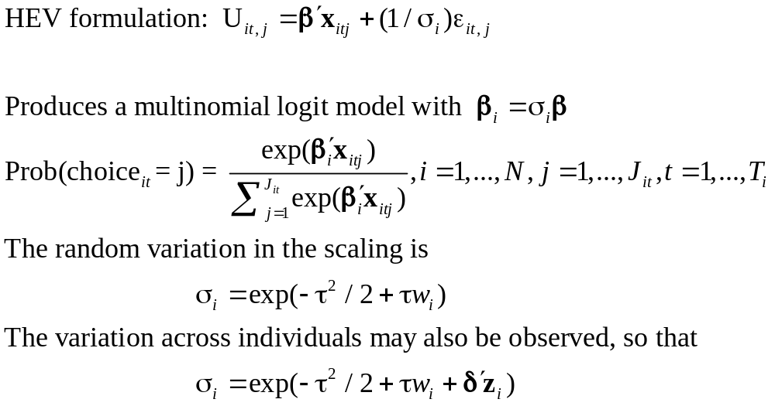
Unobserved Heterogeneity in Scaling

Slide 20
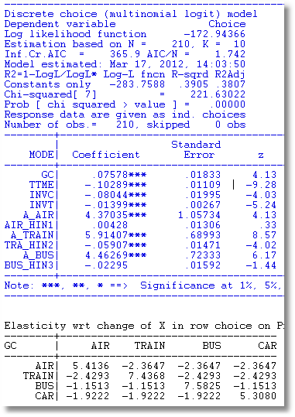
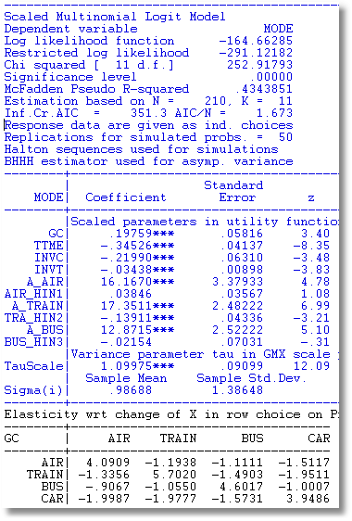
Scaled MNL

Slide 21
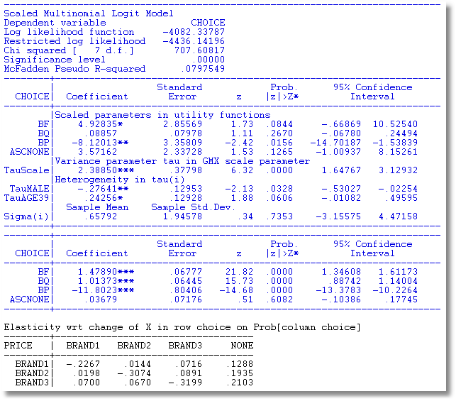
Observed and Unobserved Heterogeneity

Slide 22
Appendix

Slide 23
NLOGIT Commands for HEV Model
Nlogit
; lhs=choice
; choices=Brand1,Brand2,Brand3,None
;Rhs = Fash,Qual,Price,ASC4
;heteroscedasticity
;hfn=male,agel25,age2539
; Effects: Price(Brand1,Brand2,Brand3)$

Slide 24
Estimates of a Nested Logit Model
NLOGIT ; Lhs=mode
; Rhs=gc,ttme,invt,invc
; Rh2=one,hinc
; Choices=air,train,bus,car
; Tree=Travel[Private(Air,Car),
Public(Train,Bus)]
; Show tree
; Effects: invc(*)
; Describe
; RU1 $ Selects branch normalization

Slide 25
Estimates of a Nested Logit Model
NLOGIT ; lhs=mode
; rhs=gc,ttme,invt,invc
; rh2=one,hinc
; choices=air,train,bus,car
; tree=Travel[Fly(Air),
Ground(Train,Car,Bus)]
; show tree
; effects:gc(*)
; Describe
; ru2 $
(This is RANDOM UTILITY FORM 2. The different normalization shows the effect of the degenerate branch.)

