Slide 1
Discrete Choice Modeling
William Greene
Stern School of Business
New York University

Slide 2
Part 5.2
The Nested Logit Model

Slide 3
Extended Formulation of the MNL
Clusters of similar alternatives
Compound Utility: U(Alt)=U(Alt|Branch)+U(branch)
Behavioral implications – Correlations within branches
LIMB
Travel
BRANCH
Private
Public
TWIG
Air
Car
Train
Bus

Slide 4
Correlation Structure for a Two Level Model
Within a branch
  Identical variances (IIA applies)
  Covariance (all same) = variance at higher level
Branches have different variances (scale factors)
Nested logit probabilities: Generalized Extreme Value
Prob[Alt,Branch] = Prob(branch) * Prob(Alt|Branch)

Slide 5
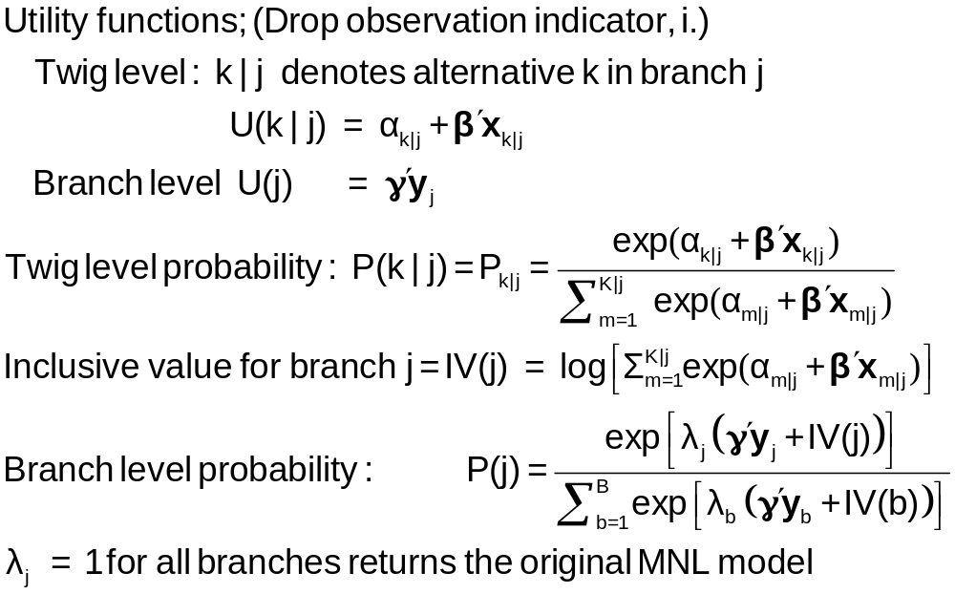
Probabilities for a Nested Logit Model

Slide 6
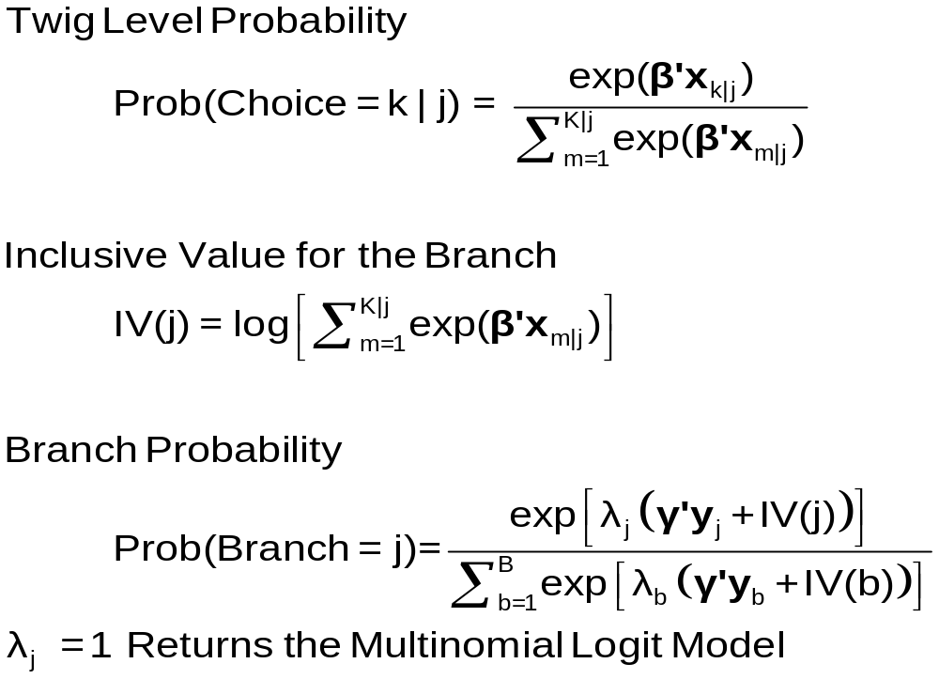
Model Form RU1

Slide 7
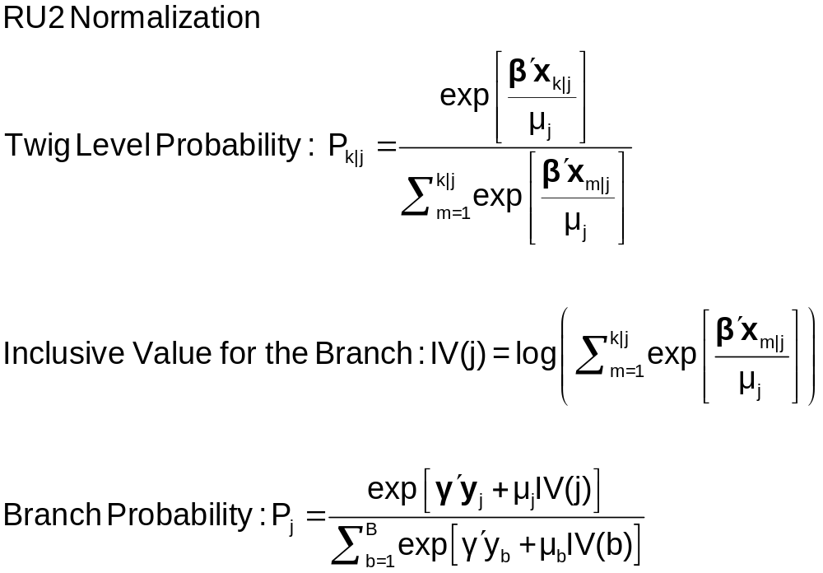
Moving Scaling Down to the Twig Level

Slide 8
RU2 Form Models Consistent with Utility Maximization
μ_{j} – 1 ≈ within branch equal correlation
If 0 < μ_{j} ≤ 1, probabilities are consistent with utility maximization for all x_{ij}
If μ_{j} > 1, probabilities are consistent with utility maximization for some x_{ij}.
If μ_{j} ≤ 0, probabilities not consistent with utility maximization for any x_{ij}.
[NLOGIT allows μ_{ij} =exp(δ´z_{i}) – “covariance heterogeneity.”]

Slide 9
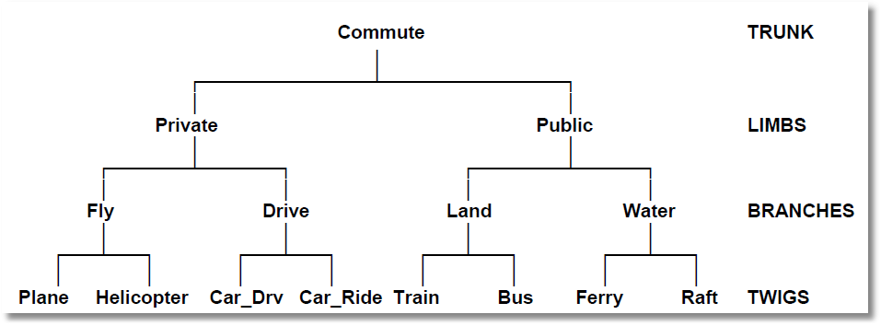
Higher Level Trees
E.g., Location (Neighborhood)
Housing Type (Rent, Buy, House, Apt)
Housing (# Bedrooms)

Slide 10
Estimation Strategy for Nested Logit Models
Two step estimation (ca. 1980s)
  For each branch, just fit MNL
    Loses efficiency – replicates coefficients
    Does not insure consistency with utility maximization
  For branch level, fit separate model, just including y and the inclusive values
    Again loses efficiency
    Not consistent with utility maximization – note the form of the
    branch probability
Full information ML (current)
Fit the entire model at once, imposing all restrictions

Slide 11
Model Structure
Tree Structure Specified for the Nested Logit Model
Sample proportions are marginal, not conditional.
Choices marked with * are excluded for the IIA test.
----------------+----------------+----------------+----------------+------+---
Trunk (prop.)|Limb (prop.)|Branch (prop.)|Choice (prop.)|Weight|IIA
----------------+----------------+----------------+----------------+------+---
Trunk{1} 1.00000|TRAVEL 1.00000|PRIVATE .55714|AIR .27619| 1.000|
| | |CAR .28095| 1.000|
| |PUBLIC .44286|TRAIN .30000| 1.000|
| | |BUS .14286| 1.000|
----------------+----------------+----------------+----------------+------+---
+---------------------------------------------------------------+
| Model Specification: Table entry is the attribute that |
| multiplies the indicated parameter. |
+--------+------+-----------------------------------------------+
| Choice |******| Parameter |
| |Row 1| GC TTME INVT INVC A_AIR |
| |Row 2| AIR_HIN1 A_TRAIN TRA_HIN3 A_BUS BUS_HIN4 |
+--------+------+-----------------------------------------------+
|AIR | 1| GC TTME INVT INVC Constant |
| | 2| HINC none none none none |
|CAR | 1| GC TTME INVT INVC none |
| | 2| none none none none none |
|TRAIN | 1| GC TTME INVT INVC none |
| | 2| none Constant HINC none none |
|BUS | 1| GC TTME INVT INVC none |
| | 2| none none none Constant HINC |
+---------------------------------------------------------------+

Slide 12
MNL Baseline
-----------------------------------------------------------
Discrete choice (multinomial logit) model
Dependent variable Choice
Log likelihood function -172.94366
Estimation based on N = 210, K = 10
R2=1-LogL/LogL* Log-L fncn R-sqrd R2Adj
Constants only -283.7588 .3905 .3787
Chi-squared[ 7] = 221.63022
Prob [ chi squared > value ] = .00000
Response data are given as ind. choices
Number of obs.= 210, skipped 0 obs
--------+--------------------------------------------------
Variable| Coefficient Standard Error b/St.Er. P[|Z|>z]
--------+--------------------------------------------------
GC| .07578*** .01833 4.134 .0000
TTME| -.10289*** .01109 -9.280 .0000
INVT| -.01399*** .00267 -5.240 .0000
INVC| -.08044*** .01995 -4.032 .0001
A_AIR| 4.37035*** 1.05734 4.133 .0000
AIR_HIN1| .00428 .01306 .327 .7434
A_TRAIN| 5.91407*** .68993 8.572 .0000
TRA_HIN3| -.05907*** .01471 -4.016 .0001
A_BUS| 4.46269*** .72333 6.170 .0000
BUS_HIN4| -.02295 .01592 -1.442 .1493
--------+--------------------------------------------------

Slide 13
FIML Parameter Estimates
-----------------------------------------------------------
FIML Nested Multinomial Logit Model
Dependent variable MODE
Log likelihood function -166.64835
The model has 2 levels.
Random Utility Form 1:IVparms = LMDAb|l
Number of obs.= 210, skipped 0 obs
--------+--------------------------------------------------
Variable| Coefficient Standard Error b/St.Er. P[|Z|>z]
--------+--------------------------------------------------
|Attributes in the Utility Functions (beta)
GC| .06579*** .01878 3.504 .0005
TTME| -.07738*** .01217 -6.358 .0000
INVT| -.01335*** .00270 -4.948 .0000
INVC| -.07046*** .02052 -3.433 .0006
A_AIR| 2.49364** 1.01084 2.467 .0136
AIR_HIN1| .00357 .01057 .337 .7358
A_TRAIN| 3.49867*** .80634 4.339 .0000
TRA_HIN3| -.03581*** .01379 -2.597 .0094
A_BUS| 2.30142*** .81284 2.831 .0046
BUS_HIN4| -.01128 .01459 -.773 .4395
|IV parameters, lambda(b|l),gamma(l)
PRIVATE| 2.16095*** .47193 4.579 .0000
PUBLIC| 1.56295*** .34500 4.530 .0000
|Underlying standard deviation = pi/(IVparm*sqr(6)
PRIVATE| .59351*** .12962 4.579 .0000
PUBLIC| .82060*** .18114 4.530 .0000
--------+--------------------------------------------------

Slide 14
RU2 Form of Nested Logit Model
-----------------------------------------------------------
FIML Nested Multinomial Logit Model
Dependent variable MODE
Log likelihood function -168.81283 (-148.63860 with RU1)
--------+--------------------------------------------------
Variable| Coefficient Standard Error b/St.Er. P[|Z|>z]
--------+--------------------------------------------------
|Attributes in the Utility Functions (beta)
GC| .06527*** .01787 3.652 .0003
TTME| -.06114*** .01119 -5.466 .0000
INVT| -.01231*** .00283 -4.354 .0000
INVC| -.07018*** .01951 -3.597 .0003
A_AIR| 1.22545 .87245 1.405 .1601
AIR_HIN1| .01501 .01226 1.225 .2206
A_TRAIN| 3.44408*** .68388 5.036 .0000
TRA_HIN2| -.02823*** .00852 -3.311 .0009
A_BUS| 2.58400*** .63247 4.086 .0000
BUS_HIN3| -.00726 .01075 -.676 .4993
|IV parameters, RU2 form = mu(b|l),gamma(l)
FLY| 1.00000 ......(Fixed Parameter)......
GROUND| .47778*** .10508 4.547 .0000
|Underlying standard deviation = pi/(IVparm*sqr(6)
FLY| 1.28255 ......(Fixed Parameter)......
GROUND| 2.68438*** .59041 4.547 .0000
--------+--------------------------------------------------

Slide 15
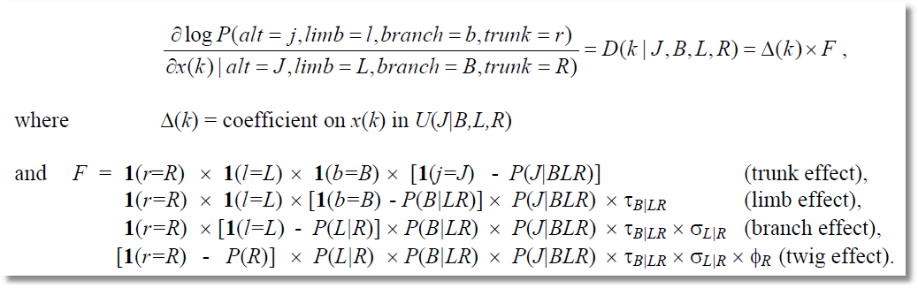
Elasticities Decompose Additively

Slide 16
Estimated Elasticities with Decomposition
+-----------------------------------------------------------------------+
| Elasticity averaged over observations. |
| Attribute is INVC in choice AIR |
| Decomposition of Effect if Nest Total Effect|
| Trunk Limb Branch Choice Mean St.Dev|
| Branch=PRIVATE |
| * Choice=AIR .000 .000 -2.456 -3.091 -5.547 3.525 |
| Choice=CAR .000 .000 -2.456 2.916 .460 3.178 |
| Branch=PUBLIC |
| Choice=TRAIN .000 .000 3.846 .000 3.846 4.865 |
| Choice=BUS .000 .000 3.846 .000 3.846 4.865 |
+-----------------------------------------------------------------------+
| Attribute is INVC in choice CAR |
| Branch=PRIVATE |
| Choice=AIR .000 .000 -.757 .650 -.107 .589 |
| * Choice=CAR .000 .000 -.757 -.830 -1.587 1.292 |
| Branch=PUBLIC |
| Choice=TRAIN .000 .000 .647 .000 .647 .605 |
| Choice=BUS .000 .000 .647 .000 .647 .605 |
+-----------------------------------------------------------------------+
| Attribute is INVC in choice TRAIN |
| Branch=PRIVATE |
| Choice=AIR .000 .000 1.340 .000 1.340 1.475 |
| Choice=CAR .000 .000 1.340 .000 1.340 1.475 |
| Branch=PUBLIC |
| * Choice=TRAIN .000 .000 -1.986 -1.490 -3.475 2.539 |
| Choice=BUS .000 .000 -1.986 2.128 .142 1.321 |
+-----------------------------------------------------------------------+
| Effects on probabilities of all choices in the model: |
| * indicates direct Elasticity effect of the attribute. |
+-----------------------------------------------------------------------+

Slide 17
Testing vs. the MNL
Log likelihood for the NL model
Constrain IV parameters to equal 1 with
; IVSET(list of branches)=[1]
Use likelihood ratio test
For the example:
  LogL = -166.68435
  LogL (MNL) = -172.94366
  Chi-squared with 2 d.f. = 2(-166.68435-(-172.94366))
  = 12.51862
  The critical value is 5.99 (95%)
  The MNL (and a fortiori, IIA) is rejected

Slide 18
Degenerate Branches
LIMB
Travel
BRANCH
Fly
Ground
TWIG
Air
Train
Car
Bus

Slide 19
NL Model with a Degenerate Branch
-----------------------------------------------------------
FIML Nested Multinomial Logit Model
Dependent variable MODE
Log likelihood function -148.63860
--------+--------------------------------------------------
Variable| Coefficient Standard Error b/St.Er. P[|Z|>z]
--------+--------------------------------------------------
|Attributes in the Utility Functions (beta)
GC| .44230*** .11318 3.908 .0001
TTME| -.10199*** .01598 -6.382 .0000
INVT| -.07469*** .01666 -4.483 .0000
INVC| -.44283*** .11437 -3.872 .0001
A_AIR| 3.97654*** 1.13637 3.499 .0005
AIR_HIN1| .02163 .01326 1.631 .1028
A_TRAIN| 6.50129*** 1.01147 6.428 .0000
TRA_HIN2| -.06427*** .01768 -3.635 .0003
A_BUS| 4.52963*** .99877 4.535 .0000
BUS_HIN3| -.01596 .02000 -.798 .4248
|IV parameters, lambda(b|l),gamma(l)
FLY| .86489*** .18345 4.715 .0000
GROUND| .24364*** .05338 4.564 .0000
|Underlying standard deviation = pi/(IVparm*sqr(6))
FLY| 1.48291*** .31454 4.715 .0000
GROUND| 5.26413*** 1.15331 4.564 .0000
--------+--------------------------------------------------

Slide 20
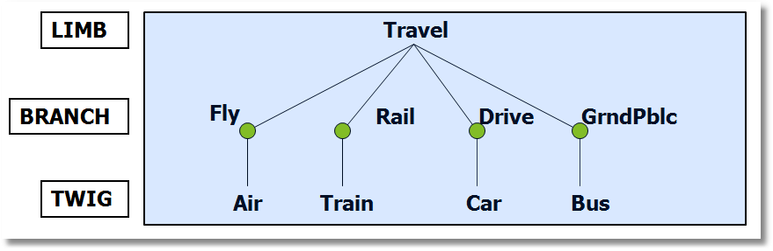
Using Degenerate Branches to Reveal Scaling

Slide 21
Scaling in Transport Modes
-----------------------------------------------------------
FIML Nested Multinomial Logit Model
Dependent variable MODE
Log likelihood function -182.42834
The model has 2 levels.
Nested Logit form:IVparms=Taub|l,r,Sl|r
& Fr.No normalizations imposed a priori
Number of obs.= 210, skipped 0 obs
--------+--------------------------------------------------
Variable| Coefficient Standard Error b/St.Er. P[|Z|>z]
--------+--------------------------------------------------
|Attributes in the Utility Functions (beta)
GC| .09622** .03875 2.483 .0130
TTME| -.08331*** .02697 -3.089 .0020
INVT| -.01888*** .00684 -2.760 .0058
INVC| -.10904*** .03677 -2.966 .0030
A_AIR| 4.50827*** 1.33062 3.388 .0007
A_TRAIN| 3.35580*** .90490 3.708 .0002
A_BUS| 3.11885** 1.33138 2.343 .0192
|IV parameters, tau(b|l,r),sigma(l|r),phi(r)
FLY| 1.65512** .79212 2.089 .0367
RAIL| .92758*** .11822 7.846 .0000
LOCLMASS| 1.00787*** .15131 6.661 .0000
DRIVE| 1.00000 ......(Fixed Parameter)......
--------+--------------------------------------------------
NLOGIT ; Lhs=mode
; Rhs=gc,ttme,invt,invc,one
; Choices=air,train,bus,car
; Tree=Fly(Air),
Rail(train),
LoclMass(bus),
Drive(Car)
; ivset:(drive)=[1]$

Slide 22
Simulating the Nested Logit Model
NLOGIT ; lhs=mode;rhs=gc,ttme,invt,invc ; rh2=one,hinc
; choices=air,train,bus,car
; tree=Travel[Private(Air,Car),Public(Train,Bus)] ; ru1
; simulation = * ; scenario:gc(car)=[*]1.5
+------------------------------------------------------+
|Simulations of Probability Model |
|Model: FIML: Nested Multinomial Logit Model |
|Number of individuals is the probability times the |
|number of observations in the simulated sample. |
|Column totals may be affected by rounding error. |
|The model used was simulated with 210 observations.|
+------------------------------------------------------+
-------------------------------------------------------------------------
Specification of scenario 1 is:
Attribute Alternatives affected Change type Value
--------- ------------------------------- ------------------- ---------
GC CAR Scale base by value 1.500
Simulated Probabilities (shares) for this scenario:
+----------+--------------+--------------+------------------+
|Choice | Base | Scenario | Scenario - Base |
| |%Share Number |%Share Number |ChgShare ChgNumber|
+----------+--------------+--------------+------------------+
|AIR | 26.515 56 | 8.854 19 |-17.661% -37 |
|TRAIN | 29.782 63 | 12.487 26 |-17.296% -37 |
|BUS | 14.504 30 | 71.824 151 | 57.320% 121 |
|CAR | 29.200 61 | 6.836 14 |-22.364% -47 |
|Total |100.000 210 |100.000 210 | .000% 0 |
+----------+--------------+--------------+------------------+

Slide 23
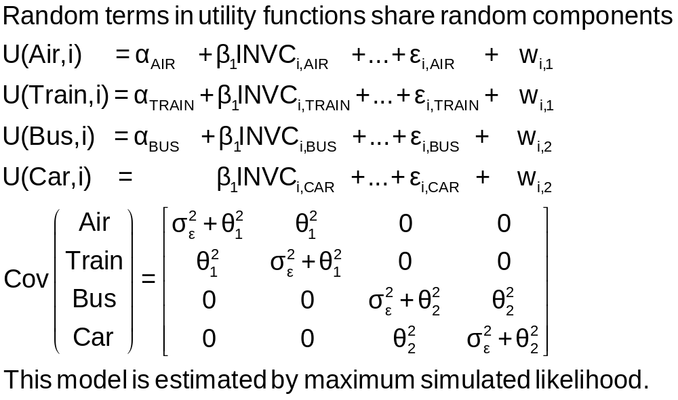
An Error Components Model

Slide 24
Error Components Logit Model
-----------------------------------------------------------
Error Components (Random Effects) model
Dependent variable MODE
Log likelihood function -182.27368
Response data are given as ind. choices
Replications for simulated probs. = 25
Halton sequences used for simulations
ECM model with panel has 70 groups
Fixed number of obsrvs./group= 3
Hessian is not PD. Using BHHH estimator
Number of obs.= 210, skipped 0 obs
--------+--------------------------------------------------
Variable| Coefficient Standard Error b/St.Er. P[|Z|>z]
--------+--------------------------------------------------
|Nonrandom parameters in utility functions
GC| .07293*** .01978 3.687 .0002
TTME| -.10597*** .01116 -9.499 .0000
INVT| -.01402*** .00293 -4.787 .0000
INVC| -.08825*** .02206 -4.000 .0001
A_AIR| 5.31987*** .90145 5.901 .0000
A_TRAIN| 4.46048*** .59820 7.457 .0000
A_BUS| 3.86918*** .67674 5.717 .0000
|Standard deviations of latent random effects
SigmaE01| .27336 3.25167 .084 .9330
SigmaE02| 1.21988 .94292 1.294 .1958
--------+--------------------------------------------------

Slide 25
Part 5.3
The Multinomial Probit Model

Slide 26
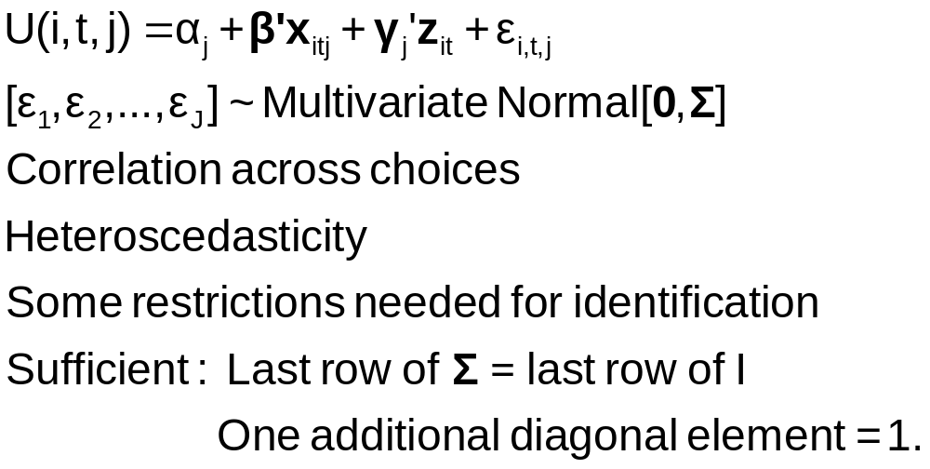
The Multinomial Probit Model

Slide 27
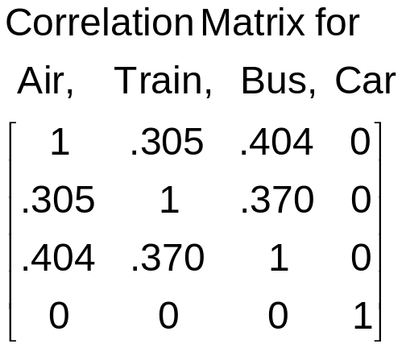
Multinomial Probit Model
+---------------------------------------------+
| Multinomial Probit Model |
| Dependent variable MODE |
| Number of observations 210 |
| Iterations completed 30 |
| Log likelihood function -184.7619 | Not comparable to MNL
| Response data are given as ind. choice. |
+---------------------------------------------+
+--------+--------------+----------------+--------+--------+
|Variable| Coefficient | Standard Error |b/St.Er.|P[|Z|>z]|
+--------+--------------+----------------+--------+--------+
---------+Attributes in the Utility Functions (beta)
GC | .10822534 .04339733 2.494 .0126
TTME | -.08973122 .03381432 -2.654 .0080
INVC | -.13787970 .05010551 -2.752 .0059
INVT | -.02113622 .00727190 -2.907 .0037
AASC | 3.24244623 1.57715164 2.056 .0398
TASC | 4.55063845 1.46158257 3.114 .0018
BASC | 4.02415398 1.28282031 3.137 .0017
---------+Std. Devs. of the Normal Distribution.
s[AIR] | 3.60695794 1.42963795 2.523 .0116
s[TRAIN]| 1.59318892 .81711159 1.950 .0512
s[BUS] | 1.00000000 ......(Fixed Parameter).......
s[CAR] | 1.00000000 ......(Fixed Parameter).......
---------+Correlations in the Normal Distribution
rAIR,TRA| .30491746 .49357120 .618 .5367
rAIR,BUS| .40383018 .63548534 .635 .5251
rTRA,BUS| .36973127 .42310789 .874 .3822
rAIR,CAR| .000000 ......(Fixed Parameter).......
rTRA,CAR| .000000 ......(Fixed Parameter).......
rBUS,CAR| .000000 ......(Fixed Parameter).......

Slide 28
Multinomial Probit Elasticities
+---------------------------------------------------+
| Elasticity averaged over observations.|
| Attribute is INVC in choice AIR |
| Effects on probabilities of all choices in model: |
| * = Direct Elasticity effect of the attribute. |
| Mean St.Dev |
| * Choice=AIR -4.2785 1.7182 |
| Choice=TRAIN 1.9910 1.6765 |
| Choice=BUS 2.6722 1.8376 |
| Choice=CAR 1.4169 1.3250 |
| Attribute is INVC in choice TRAIN |
| Choice=AIR .8827 .8711 |
| * Choice=TRAIN -6.3979 5.8973 |
| Choice=BUS 3.6442 2.6279 |
| Choice=CAR 1.9185 1.5209 |
| Attribute is INVC in choice BUS |
| Choice=AIR .3879 .6303 |
| Choice=TRAIN 1.2804 2.1632 |
| * Choice=BUS -7.4014 4.5056 |
| Choice=CAR 1.5053 2.5220 |
| Attribute is INVC in choice CAR |
| Choice=AIR .2593 .2529 |
| Choice=TRAIN .8457 .8093 |
| Choice=BUS 1.7532 1.3878 |
| * Choice=CAR -2.6657 3.0418 |
+---------------------------------------------------+
Multinomial Logit
+---------------------------+
| INVC in AIR |
| Mean St.Dev |
| * -5.0216 2.3881 |
| 2.2191 2.6025 |
| 2.2191 2.6025 |
| 2.2191 2.6025 |
| INVC in TRAIN |
| 1.0066 .8801 |
| * -3.3536 2.4168 |
| 1.0066 .8801 |
| 1.0066 .8801 |
| INVC in BUS |
| .4057 .6339 |
| .4057 .6339 |
| * -2.4359 1.1237 |
| .4057 .6339 |
| INVC in CAR |
| .3944 .3589 |
| .3944 .3589 |
| .3944 .3589 |
| * -1.3888 1.2161 |
+---------------------------+

