Slide 1
Discrete Choice Modeling
William Greene
Stern School of Business
New York University

Slide 2
Part 6
Modeling Heterogeneity

Slide 3
Several Types of Heterogeneity
Differences across choice makers
  Observable: Usually demographics such as age, sex
  Unobservable: Usually modeled as ‘random effects’
Choice strategy: How consumers make
decisions. (E.g., omitted attributes)
Preference Structure: Model frameworks such as latent class structures
Preferences: Model ‘parameters’
  Discrete variation – latent class
  Continuous variation – mixed models
  Discrete-Continuous variation

Slide 4
What’s Wrong with the MNL Model?
Insufficiently heterogeneous:
“… economists are often more interested in aggregate effects and regard heterogeneity as a statistical nuisance parameter problem which must be addressed but not emphasized. Econometricians frequently employ methods which do not allow for the estimation of individual level parameters.” (Allenby and Rossi, Journal of Econometrics, 1999)

Slide 5
Attention to Heterogeneity
Modeling heterogeneity is important
Attention to heterogeneity –
an informal survey of four literatures
 | Levels | Scaling
Economics | ● | None
Education | ● | None
Marketing | ● | Much
Transport | ● | Extensive

Slide 6
Heterogeneity in Choice Strategy
Consumers avoid ‘complexity’
  Lexicographic preferences eliminate certain choices ➔ choice set may be endogenously determined
  Simplification strategies may eliminate
  certain attributes
Information processing strategy is a
source of heterogeneity in the model.

Slide 7
Accommodating Heterogeneity
Observed? Enter in the model in
familiar (and unfamiliar) ways.
Unobserved? Takes the form of
randomness in the model.

Slide 8
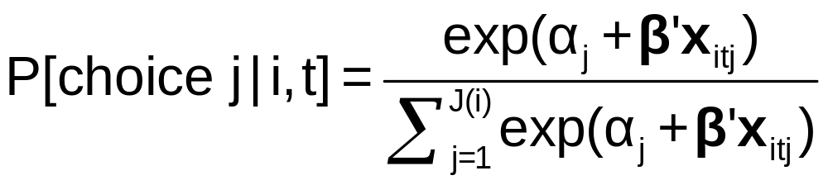
Heterogeneity and the MNL Model
Limitations of the MNL Model:
  IID ➔ IIA
  Fundamental tastes are the same across all individuals
How to adjust the model to allow variation across individuals?
  Full random variation
  Latent clustering – allow some variation

Slide 9
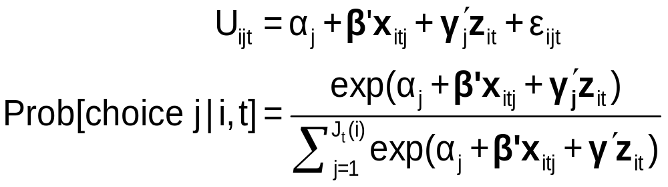
Observable Heterogeneity in Utility Levels
Choice, e.g., among brands of cars
x_{itj} = attributes: price, features
z_{it} = observable characteristics: age, sex, income

Slide 10
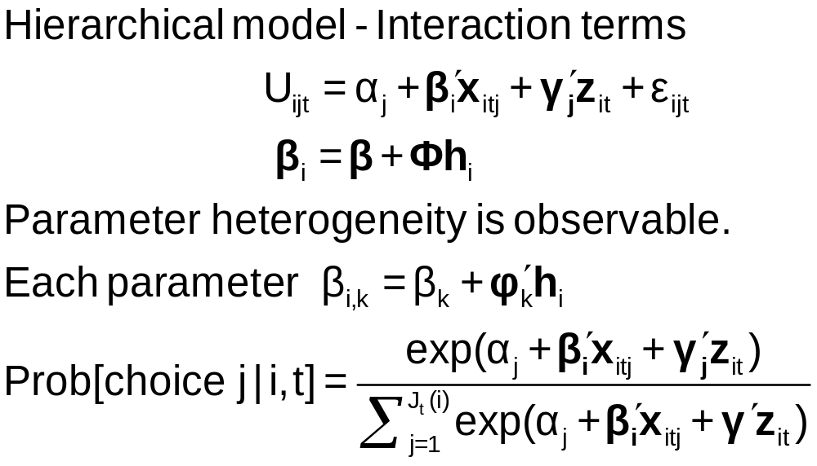
Observable Heterogeneity in
Preference Weights

Slide 11
Heteroscedasticity in the MNL Model
• Motivation: Scaling in utility functions
• If ignored, distorts coefficients
• Random utility basis
Uij = α_{j} + β’x_{ij} + γ’z_{i} + σ_{j}ε_{ij}
i = 1,…,N; j = 1,…,J(i)
F(ε_{ij}) = Exp(-Exp(-ε_{ij})) now scaled
• Extensions: Relaxes IIA
        Allows heteroscedasticity across
        choices and across individuals

Slide 12
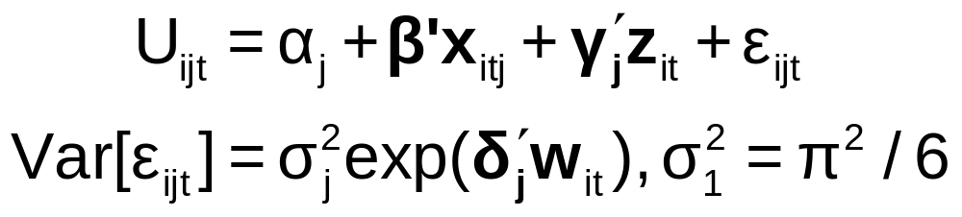
‘Quantifiable’ Heterogeneity in Scaling
w_{it} = observable characteristics:
age, sex, income, etc.

Slide 13
Modeling Unobserved Heterogeneity
Modeling individual heterogeneity
  Latent class – Discrete approximation
  Mixed logit – Continuous
  The mixed logit model
  Many extensions and blends of LC and RP
Data structure – RP and SP data
  Induces heterogeneity
  Induces heteroscedasticity – the scaling problem

