Slide 1
Discrete Choice Modeling
William Greene
Stern School of Business
New York University

Slide 2
Part 8
Stated Preference and Revealed Preference Data

Slide 3
Revealed and Stated Preference Data
Pure RP Data
  Market (ex-post, e.g., supermarket scanner data)
  Individual observations
Pure SP Data
  Contingent valuation
  (?) Validity
Combined (Enriched) RP/SP
  Mixed data
  Expanded choice sets

Slide 4
Panel Data
Repeated Choice Situations
Typically RP/SP constructions (experimental)
Accommodating “panel data”
  Multinomial Probit [Marginal, impractical]
  Latent Class
  Mixed Logit

Slide 5
Application
Survey sample of 2,688 trips, 2 or 4 choices per situation
Sample consists of 672 individuals
Choice based sample
Revealed/Stated choice experiment:
Revealed: Drive,ShortRail,Bus,Train
Hypothetical: Drive,ShortRail,Bus,Train,LightRail,ExpressBus
Attributes:
Cost –Fuel or fare
Transit time
Parking cost
Access and Egress time

Slide 6
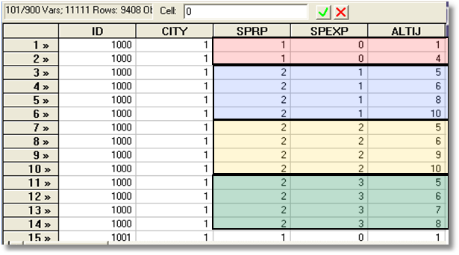
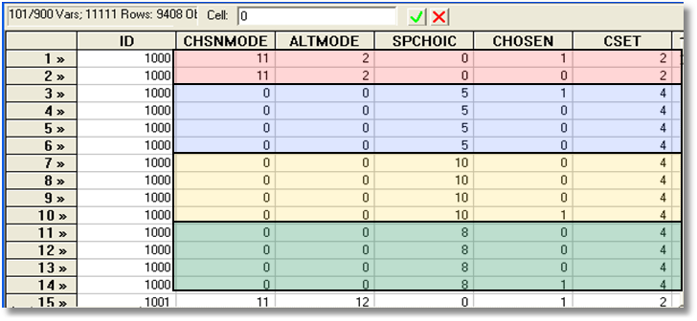
Each person makes four choices from a choice set that includes either two or four alternatives.
The first choice is the RP between two of the RP alternatives
The second-fourth are the SP among four of the six SP alternatives.
There are ten alternatives in total.

Slide 7
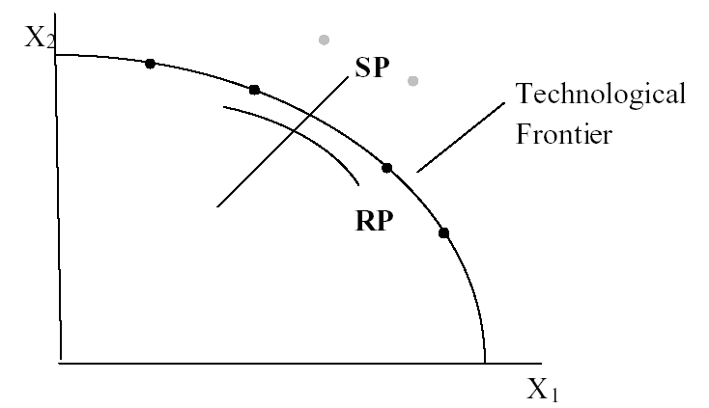
Revealed Preference Data
Advantage: Actual observations on actual behavior
Disadvantage: Limited range of choice sets and attributes – does not allow analysis of switching behavior.

Slide 8
Stated Preference Data
Pure hypothetical – does the subject take it seriously?
No necessary anchor to real market situations
Vast heterogeneity across individuals

Slide 9
Pooling RP and SP Data Sets - 1
Enrich the attribute set by replicating choices
E.g.:
  RP: Bus,Car,Train (actual)
  SP: Bus(1),Car(1),Train(1)
  Bus(2),Car(2),Train(2),…
How to combine?

Slide 10
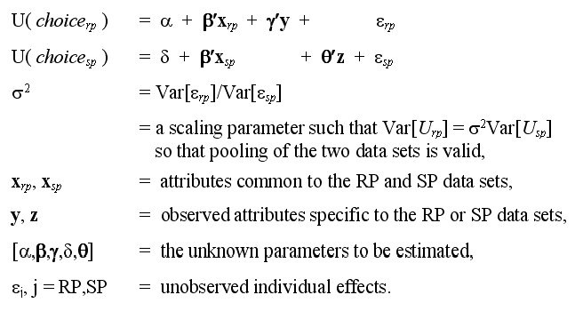
An Underlying Random Utility Model

Slide 11
Nested Logit Approach
Mode
RP
Car Train Bus SPCar SPTrain SPBus
Use a two level nested model, and constrain three SP IV parameters to be equal.

Slide 12
Enriched Data Set – Vehicle Choice
Choosing between Conventional, Electric and LPG/CNG Vehicles in Single-Vehicle Households
David A. Hensher William H. Greene
Institute of Transport Studies Department of Economics
School of Business Stern School of Business
The University of Sydney New York University
NSW 2006 Australia New York USA
September 2000

Slide 13
Fuel Types Study
Conventional, Electric, Alternative
1,400 Sydney Households
Automobile choice survey
RP + 3 SP fuel classes
Nested logit – 2 level approach – to handle the scaling issue

Slide 14
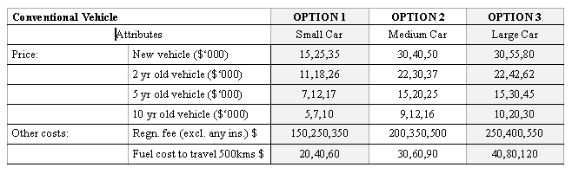
Attribute Space: Conventional

Slide 15
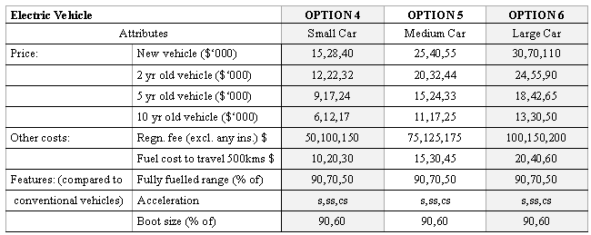
Attribute Space: Electric

Slide 16
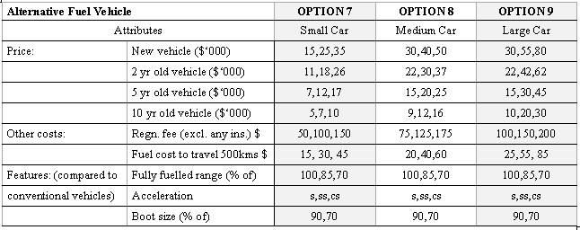
Attribute Space: Alternative

Slide 17
Mixed Logit Approaches
Pivot SP choices around an RP outcome.
Scaling is handled directly in the model
Continuity across choice situations is handled by random elements of the choice structure that are constant through time
  Preference weights – coefficients
  Scaling parameters
    Variances of random parameters
    Overall scaling of utility functions

Slide 18
Generalized Mixed Logit Model
U_{ijt} = α_{j} + β_{i}′x_{itj} + δ′z_{it} + ε_{ijt}.
β_{i} = σ_{i}β + [γ + σ_{i}(1 - γ)]Γv_{i}
σ_{i} = exp(-τ²/2 + τw_{i})

Slide 19
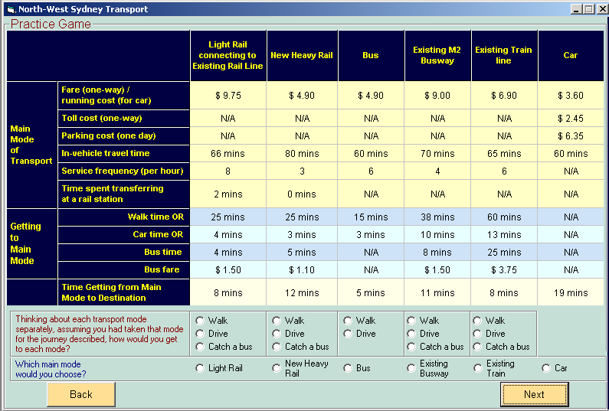
Survey Instrument

Slide 20
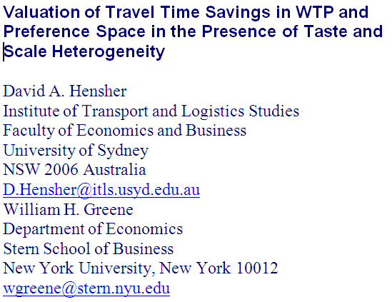

Slide 21
Generalized Mixed Logit Model
One choice setting
U_{ij} = α _{j} + β_{i}′x_{ij} + δ′z_{i} + ε_{ij}.
Stated choice setting, multiple choices
U_{ijt} = α_{j} + β_{i}′x_{itj} + δ′z_{it} + ε_{ijt}.
Random parameters
β_{i} = β + Γv_{i}
Generalized mixed logit
σ_{i} = exp(-τ²/2 + τw_{i})
β_{i} = σ_{i}β + [γ + σ_{i}(1 - γ)]Γv_{i}

Slide 22
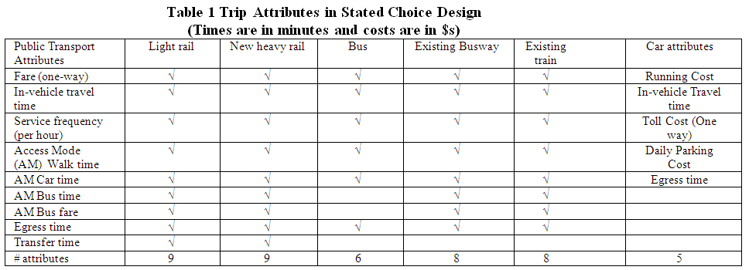
Experimental Design

Slide 23
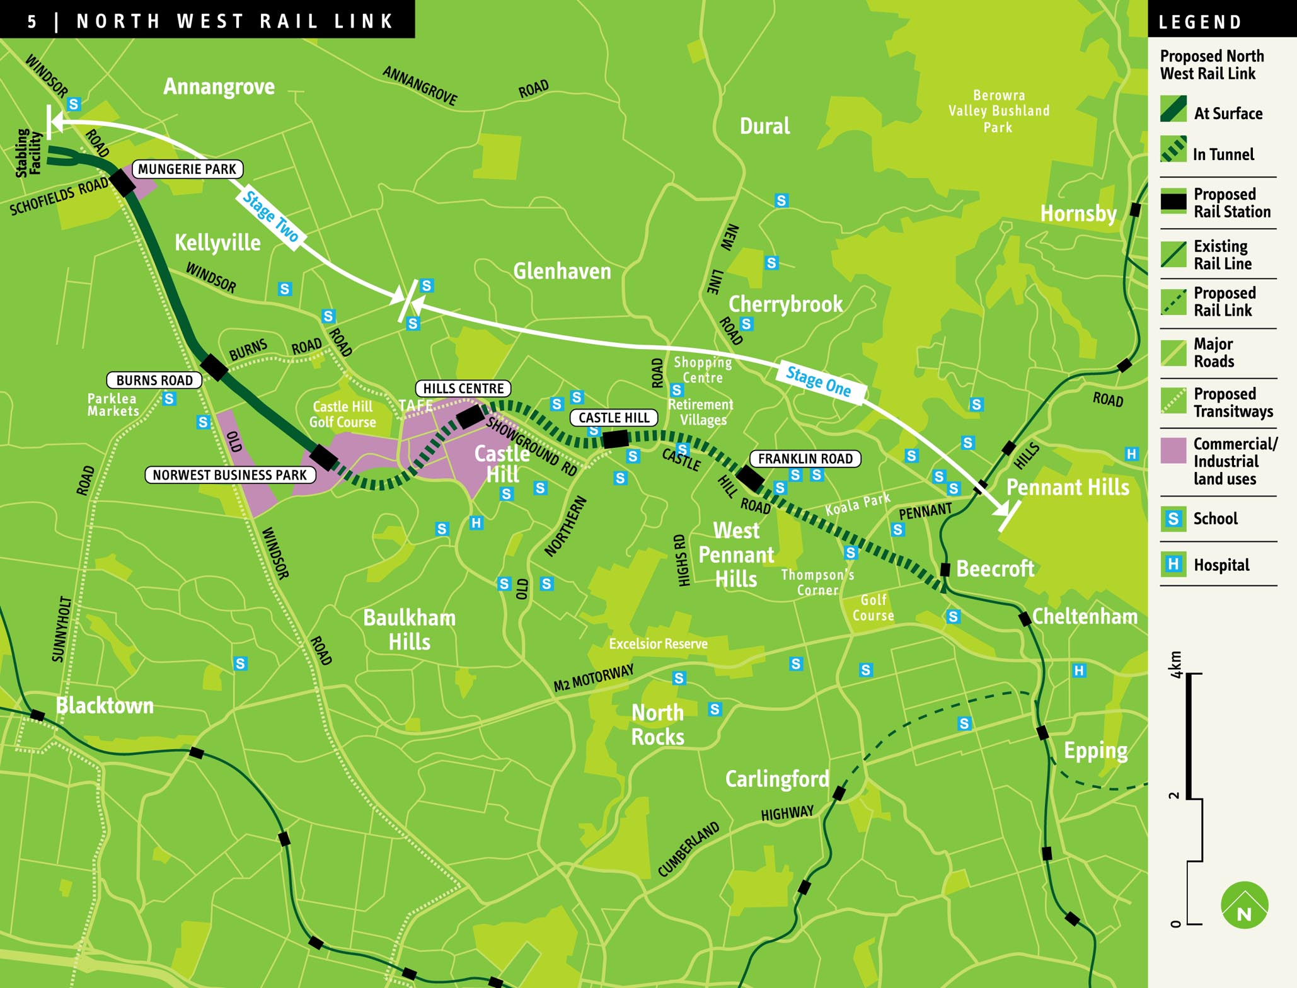
SP Study Using WTP Space

