Slide 1
Discrete Choice Modeling
William Greene
Stern School of Business
New York University

Slide 2
Modeling Categorical Variables
Theoretical foundations
Econometric methodology
  Models
  Statistical bases
  Econometric methods
Applications

Slide 3

Binary Outcome

Slide 4

Multinomial Unordered Choice

Slide 5

Ordered Outcome
Self Reported Health Satisfaction

Slide 6
Categorical Variables
Observed outcomes
  Inherently discrete: number of occurrences, e.g., family size
  Multinomial: The observed outcome indexes a set of unordered labeled choices.
  Implicitly continuous: The observed data are discrete by construction, e.g., revealed preferences; our main subject
Implications
  For model building
  For analysis and prediction of behavior

Slide 7
Binary Choice Models

Slide 8
Agenda
A Basic Model for Binary Choice
Specification
Maximum Likelihood Estimation
Estimating Partial Effects

Slide 9
A Random Utility Approach
Underlying Preference Scale, U*(choices)
Revelation of Preferences:
  U*(choices) < 0 Choice “0”
  U*(choices) > 0 Choice “1”

Slide 10
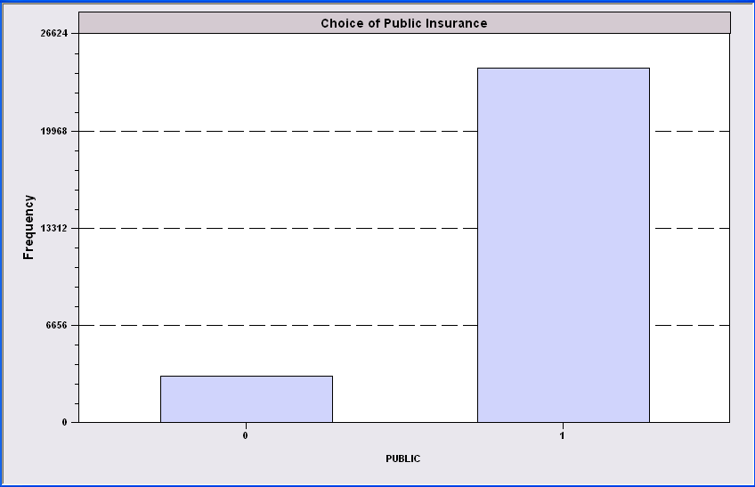
Simple Binary Choice: Insurance

Slide 11
Censored Health Satisfaction Scale
0 = Not Healthy
1 = Healthy

Slide 12
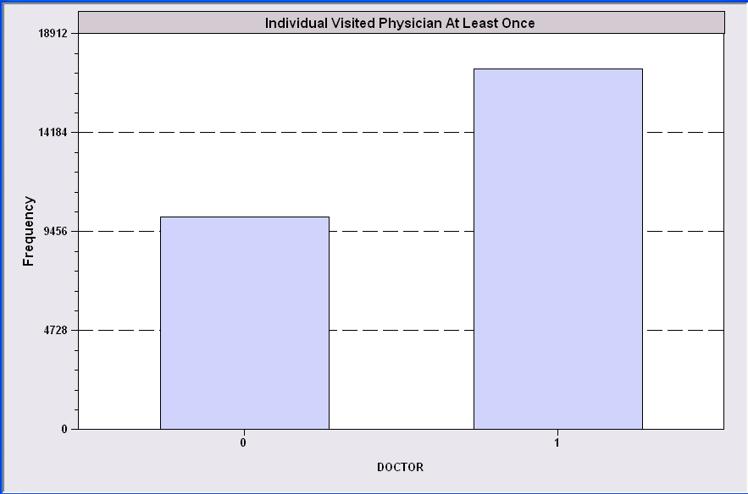
Count Transformed to Indicator

Slide 13
Redefined Multinomial Choice
Fly
Ground

Slide 14
A Model for Binary Choice
Yes or No decision (Buy/NotBuy, Do/NotDo)
Example, choose to visit physician or not
Model: Net utility of visit at least once
U_{visit} = α+β₁Age + β₂Income + γSex + ε
Choose to visit if net utility is positive
Net utility = U_{visit} – U_{not visit}
Data: X = [1,age,income,sex]
y = 1 if choose visit, ⬄ U_{visit} > 0, 0 if not.
Random Utility

Slide 15
Choosing Between the Two Alternatives
Modeling the Binary Choice
  U_{visit} = α + β₁ Age + β₂ Income + β₃ Sex + ε
Chooses to visit: U_{visit} > 0
α + β₁ Age + β₂ Income + β₃ Sex + ε > 0
ε > -[α + β₁ Age + β₂ Income + β₃ Sex ]

Slide 16
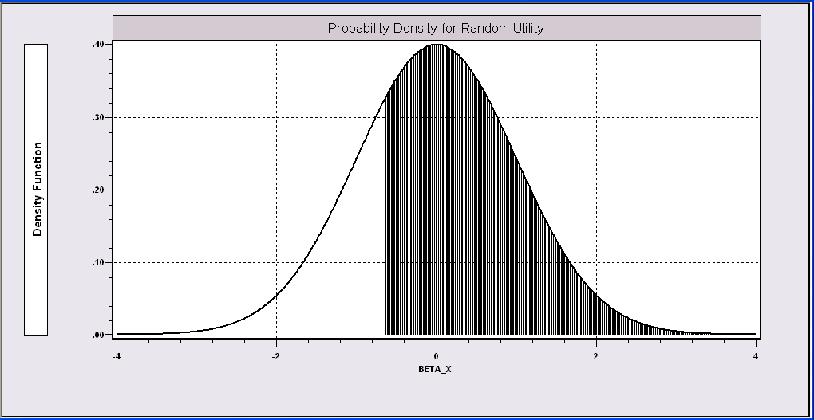
Probability Model for Choice Between Two Alternatives
Probability is governed by ε, the random part of the utility function.
ε > -[α + β₁Age + β₂Income + β₃Sex ]

Slide 17
What Can Be Learned from the Data?
(A Sample of Consumers, i = 1,…,N)
Are the characteristics “relevant?”
Predicting behavior
  Individual – E.g., will a person visit the physician?
  Will a person purchase the insurance?
  Aggregate – E.g., what proportion of the population will
  visit the physician? Buy the insurance?
Analyze changes in behavior when attributes change –
E.g., how will changes in education change the proportion
who buy the insurance?

Slide 18
Application: Health Care Usage
German Health Care Usage Data (GSOEP), 7,293 Individuals, Varying Numbers of Periods
Data downloaded from Journal of Applied Econometrics Archive. This is an unbalanced panel with 7,293 individuals. They can be used for regression, count models, binary choice, ordered choice, and bivariate binary choice. This is a large data set. There are altogether 27,326 observations. The number of observations ranges from 1 to 7. (Frequencies are: 1=1525, 2=2158, 3=825, 4=926, 5=1051, 6=1000, 7=987).
Variables in the file are
DOCTOR = 1(Number of doctor visits > 0)
HOSPITAL = 1(Number of hospital visits > 0)
HSAT = health satisfaction, coded 0 (low) - 10 (high)
DOCVIS = number of doctor visits in last three months
HOSPVIS = number of hospital visits in last calendar year
PUBLIC = insured in public health insurance = 1; otherwise = 0
ADDON = insured by add-on insurance = 1; otherwise = 0
HHNINC = household nominal monthly net income in German marks / 10000.
(4 observations with income=0 were dropped)
HHKIDS = children under age 16 in the household = 1; otherwise = 0
EDUC = years of schooling
AGE = age in years
FEMALE = 1 for female headed household, 0 for male
Notes:
18

Slide 19
Application
27,326 Observations
  1 to 7 years, panel
  7,293 households observed
  We use the 1994 year, 3,337 household observations
Descriptive Statistics
=========================================================
Variable Mean Std.Dev. Minimum Maximum
--------+------------------------------------------------
DOCTOR| .657980 .474456 .000000 1.00000
AGE| 42.6266 11.5860 25.0000 64.0000
HHNINC| .444764 .216586 .340000E-01 3.00000
FEMALE| .463429 .498735 .000000 1.00000

Slide 20
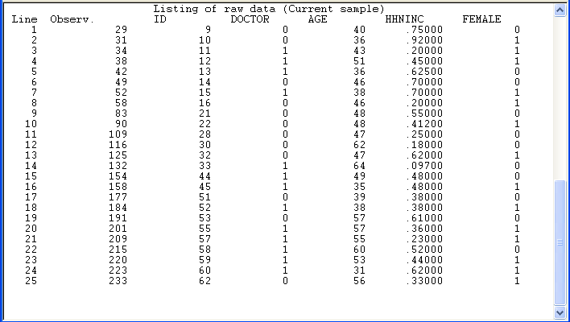
Binary Choice Data

Slide 21
An Econometric Model
Choose to visit iff Uvisit > 0
  Uvisit = α + β₁ Age + β₂ Income + β₃ Sex + ε
  Uvisit > 0 ⇔ ε > -(α + β₁ Age + β₂ Income + β₃ Sex)
  ε < α + β₁ Age + β₂ Income + β₃ Sex
Probability model: For any person observed by the analyst,
Prob(visit) = Prob[ε < α + β₁ Age + β₂ Income + β₃ Sex]
Note the relationship between the unobserved ε and the outcome

Slide 22
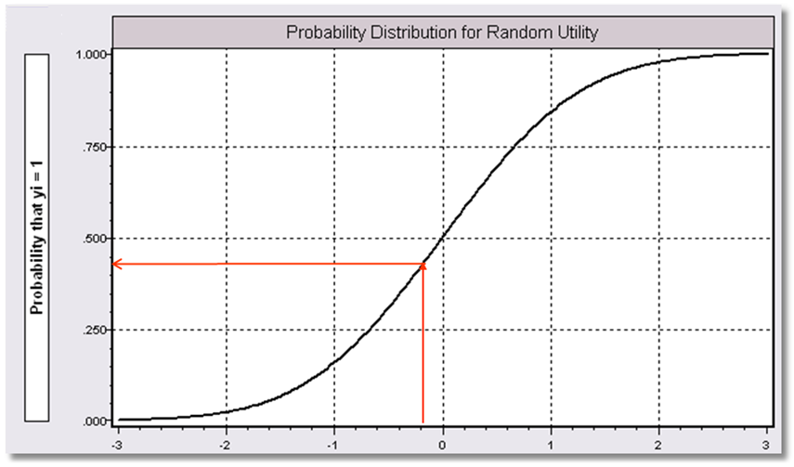
α+β₁Age + β₂ Income + β3 Sex

Slide 23
Modeling Approaches
Nonparametric – “relationship”
  Minimal Assumptions
  Minimal Conclusions
Semiparametric – “index function”
  Stronger assumptions
  Robust to model misspecification (heteroscedasticity)
  Still weak conclusions
Parametric – “Probability function and index”
  Strongest assumptions – complete specification
  Strongest conclusions
  Possibly less robust. (Not necessarily)

Slide 24
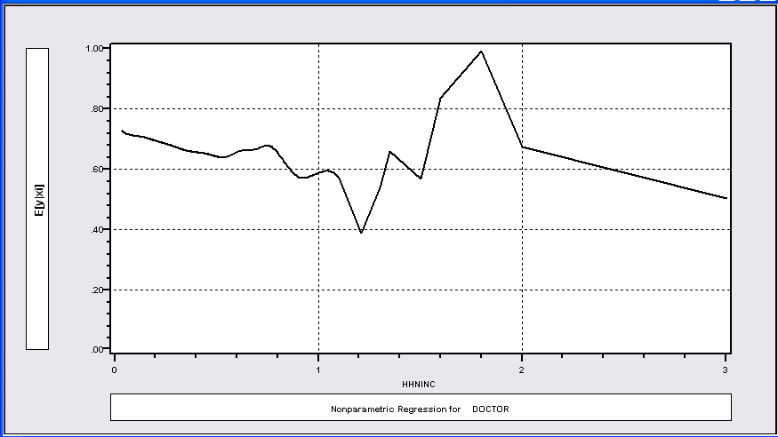
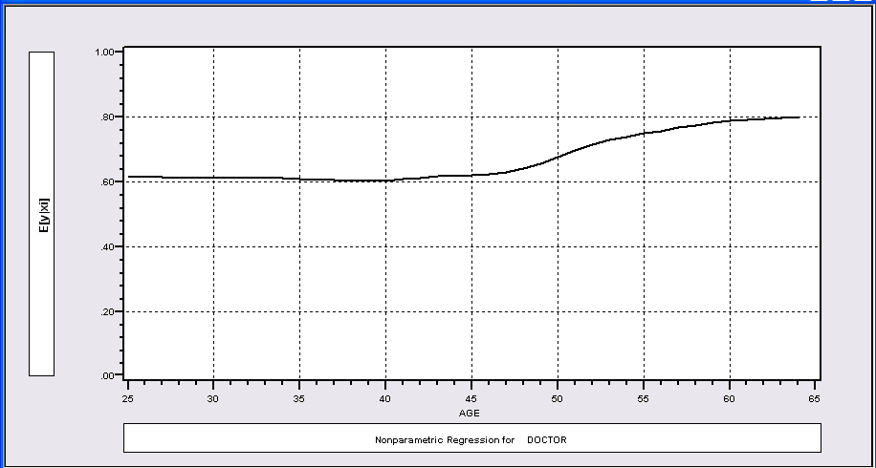
Nonparametric Regressions
P(Visit)=f(Age)
P(Visit)=f(Income)

Slide 25
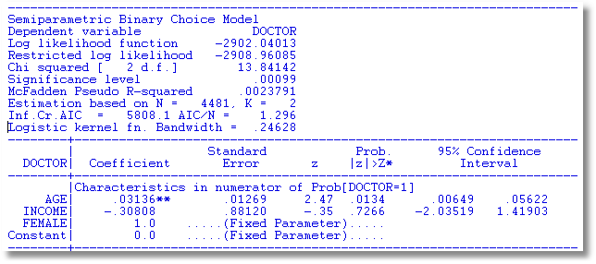
Klein and Spady Semiparametric
No specific distribution assumed
Note necessary normalizations. Coefficients are relative to FEMALE.
Prob(y_{i} = 1 | x_{i} ) =G(β’x) G is estimated by kernel methods

Slide 26
Fully Parametric
Index Function: U* = β’x + ε
Observation Mechanism: y = 1[U* > 0]
Distribution: ε ~ f(ε); Normal, Logistic, …
Maximum Likelihood Estimation:
Max(β) logL = Σ_{i} log Prob(Y_{i} = y_{i}|x_{i})

Slide 27
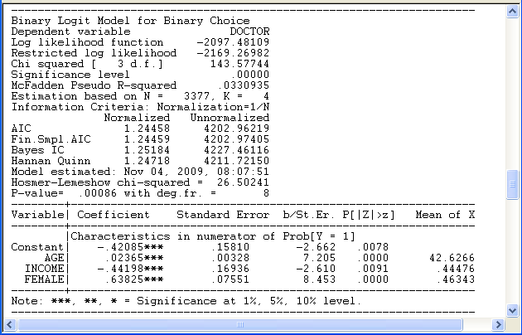
Parametric: Logit Model
What do these mean?

Slide 28


Parametric vs. Semiparametric
.02365/.63825 = .04133
-.44198/.63825 = -.69249

Slide 29
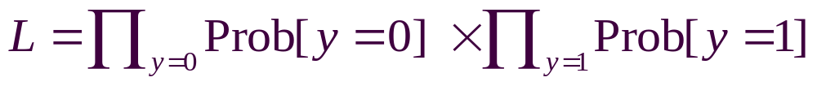
Parametric Model Estimation
How to estimate α, β₁, β₂, β₃?
  It’s not regression
  The technique of maximum likelihood
  Prob[y=1] =
  Prob[ε > -(α + β₁ Age + β₂ Income + β₃ Sex)]
  Prob[y=0] = 1 - Prob[y=1]
Requires a model for the probability

Slide 30
Completing the Model: F(ε)
The distribution
  Normal: PROBIT, natural for behavior
  Logistic: LOGIT, allows “thicker tails”
  Gompertz: EXTREME VALUE, asymmetric,
Does it matter?
  Yes, large difference in estimates
  Not much, quantities of interest are more stable.

Slide 31
Estimated Binary Choice Models
LOGIT PROBIT EXTREME VALUE
Variable Estimate t-ratio Estimate t-ratio Estimate t-ratio
Constant -0.42085 -2.662 -0.25179 -2.600 0.00960 0.078
Age 0.02365 7.205 0.01445 7.257 0.01878 7.129
Income -0.44198 -2.610 -0.27128 -2.635 -0.32343 -2.536
Sex 0.63825 8.453 0.38685 8.472 0.52280 8.407
Log-L -2097.48 -2097.35 -2098.17
Log-L(0) -2169.27 -2169.27 -2169.27
Ignore the t ratios for now.

Slide 32
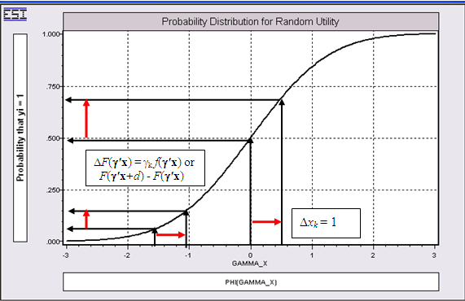
Effect on Predicted Probability of an Increase in Age
α + β₁ (Age+1) + β₂ (Income) + β₃ Sex
(β₁ is positive)

Slide 33
Partial Effects in Probability Models
Prob[Outcome] = some F(α+β₁Income…)
“Partial effect” = ∂F(α+β₁Income…) / ∂”x” (derivative)
  Partial effects are derivatives
  Result varies with model
    Logit: ∂F(α+β₁Income…) /∂x = Prob * (1-Prob) × β
    Probit: ∂ F(α+β₁Income…)/∂x = Normal density × β
    Extreme Value: ∂ F(α+β₁Income…)/∂x = Prob * (-log Prob) × β
  Scaling usually erases model differences

Slide 34
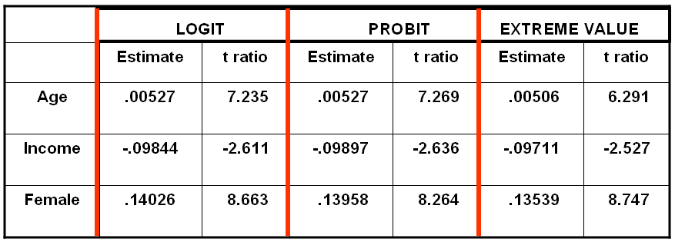
Estimated Partial Effects

Slide 35
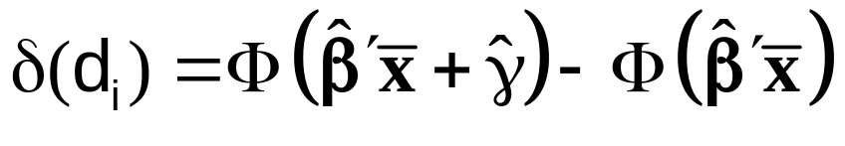
Partial Effect for a Dummy Variable
Prob[y_{i} = 1|x_{i},d_{i}] = F(β’x_{i}+γd_{i})
= conditional mean
Partial effect of d
Prob[y_{i} = 1|x_{i},d_{i}=1]- Prob[y_{i} = 1|x_{i},d_{i}=0]
Probit:

Slide 36
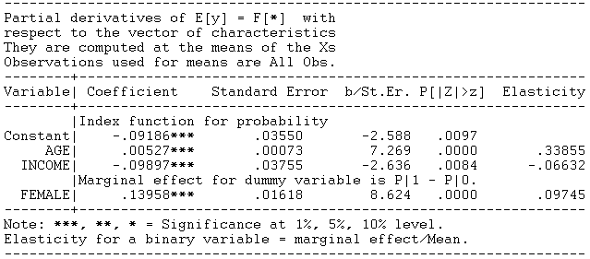
Partial Effect – Dummy Variable

Slide 37
Computing Partial Effects
Compute at the data means?
  Simple
  Inference is well defined.
Average the individual effects
  More appropriate?
  Asymptotic standard errors are problematic.

Slide 38
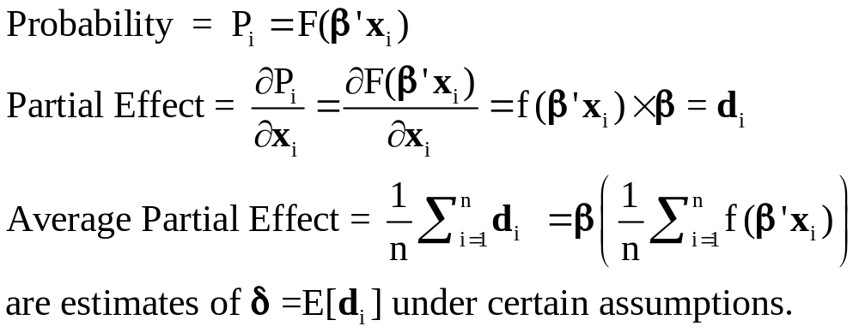
Average Partial Effects

Slide 39
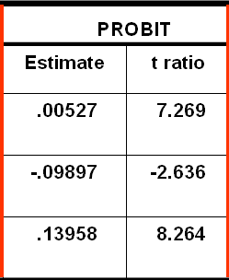
Average Partial Effects vs. Partial Effects at Data Means
=============================================
Variable Mean Std.Dev. S.E.Mean
=============================================
--------+------------------------------------
ME_AGE| .00511838 .000611470 .0000106
ME_INCOM| -.0960923 .0114797 .0001987
ME_FEMAL| .137915 .0109264 .000189

Slide 40
A Nonlinear Effect
P = F(age, age², income, female)
----------------------------------------------------------------------
Binomial Probit Model
Dependent variable DOCTOR
Log likelihood function -2086.94545
Restricted log likelihood -2169.26982
Chi squared [ 4 d.f.] 164.64874
Significance level .00000
--------+-------------------------------------------------------------
Variable| Coefficient Standard Error b/St.Er. P[|Z|>z] Mean of X
--------+-------------------------------------------------------------
|Index function for probability
Constant| 1.30811*** .35673 3.667 .0002
AGE| -.06487*** .01757 -3.693 .0002 42.6266
AGESQ| .00091*** .00020 4.540 .0000 1951.22
INCOME| -.17362* .10537 -1.648 .0994 .44476
FEMALE| .39666*** .04583 8.655 .0000 .46343
--------+-------------------------------------------------------------
Note: ***, **, * = Significance at 1%, 5%, 10% level.
----------------------------------------------------------------------

Slide 41
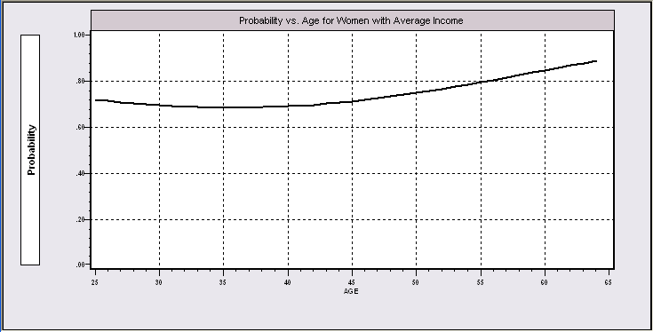
Nonlinear Effects
This is the probability implied by the model.

Slide 42
Partial Effects?
----------------------------------------------------------------------
Partial derivatives of E[y] = F[*] with
respect to the vector of characteristics
They are computed at the means of the Xs
Observations used for means are All Obs.
--------+-------------------------------------------------------------
Variable| Coefficient Standard Error b/St.Er. P[|Z|>z] Elasticity
--------+-------------------------------------------------------------
|Index function for probability
AGE| -.02363*** .00639 -3.696 .0002 -1.51422
AGESQ| .00033*** .729872D-04 4.545 .0000 .97316
INCOME| -.06324* .03837 -1.648 .0993 -.04228
|Marginal effect for dummy variable is P|1 - P|0.
FEMALE| .14282*** .01620 8.819 .0000 .09950
--------+-------------------------------------------------------------
Separate “partial effects” for Age and Age² make no sense.
They are not varying “partially.”

Slide 43
Practicalities of Nonlinearities
PROBIT ; Lhs=doctor
; Rhs=one,age,agesq,income,female
; Partial effects $
PROBIT ; Lhs=doctor
; Rhs=one,age,age*age,income,female $
PARTIALS ; Effects : age $

Slide 44
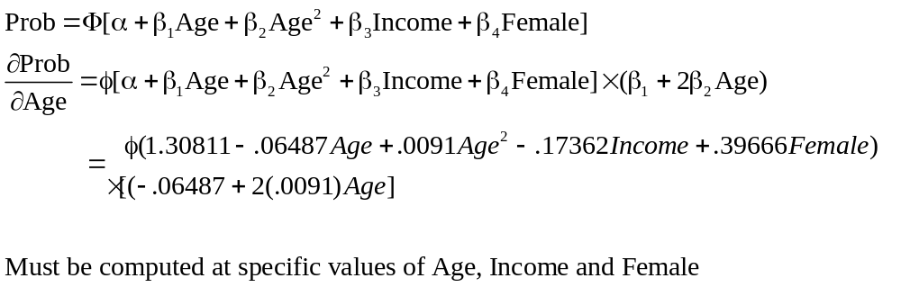
Partial Effect for Nonlinear Terms

Slide 45
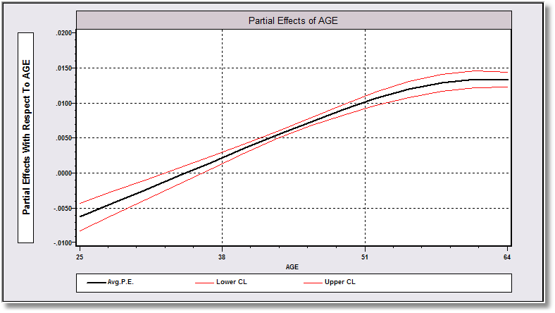
Average Partial Effect: Averaged over Sample Incomes and Genders for Specific Values of Age

Slide 46
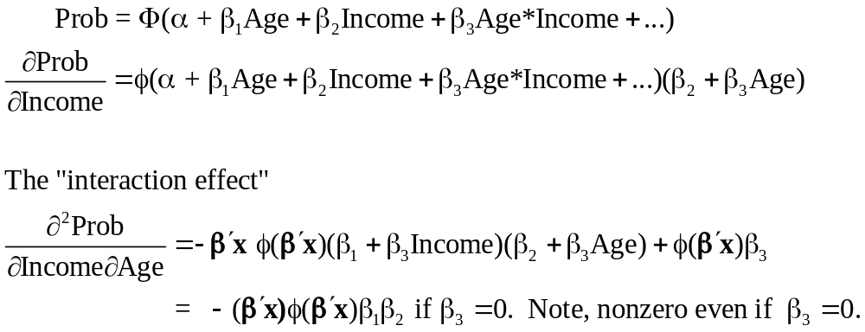
Interaction Effects

Slide 47
Partial Effects?
The software does not know that Age_Inc = Age*Income.
----------------------------------------------------------------------
Partial derivatives of E[y] = F[*] with
respect to the vector of characteristics
They are computed at the means of the Xs
Observations used for means are All Obs.
--------+-------------------------------------------------------------
Variable| Coefficient Standard Error b/St.Er. P[|Z|>z] Elasticity
--------+-------------------------------------------------------------
|Index function for probability
Constant| -.18002** .07421 -2.426 .0153
AGE| .00732*** .00168 4.365 .0000 .46983
INCOME| .11681 .16362 .714 .4753 .07825
AGE_INC| -.00497 .00367 -1.355 .1753 -.14250
|Marginal effect for dummy variable is P|1 - P|0.
FEMALE| .13902*** .01619 8.586 .0000 .09703
--------+-------------------------------------------------------------

Slide 48
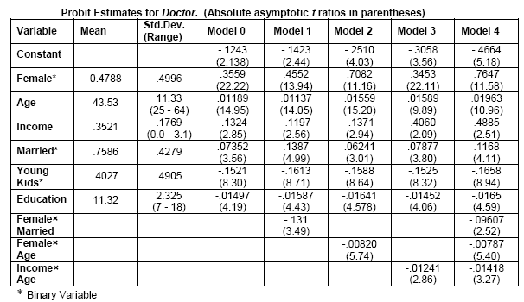
Models for Visit Doctor

Slide 49
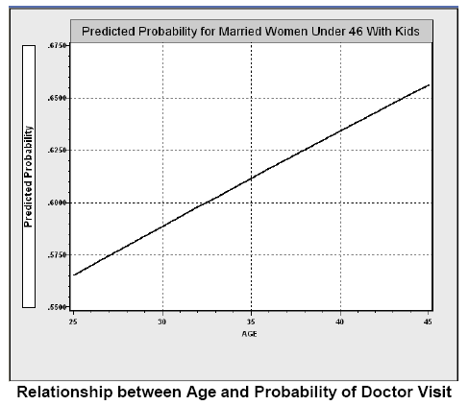
Direct Effect of Age

Slide 50
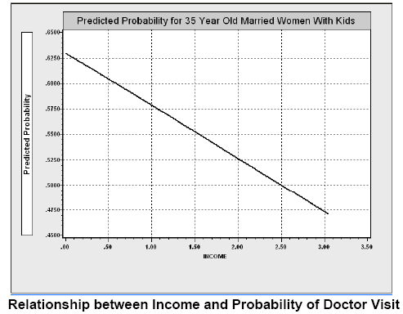
Income Effect

Slide 51
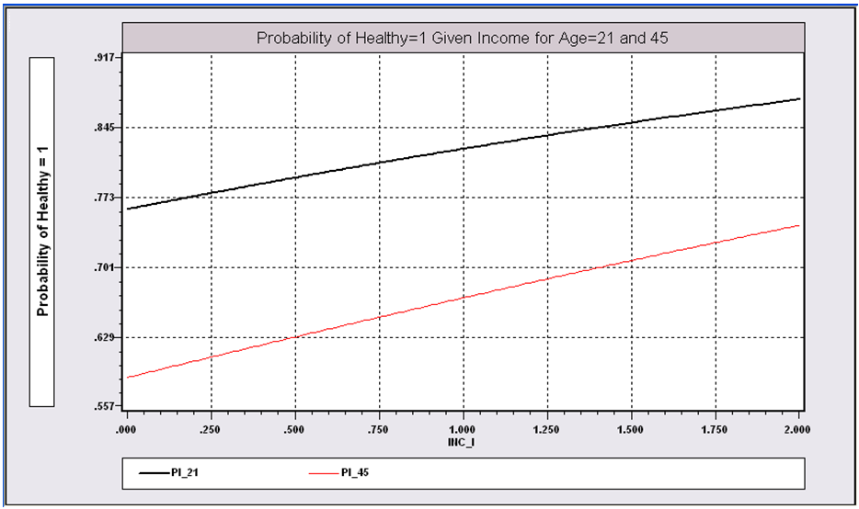
Income Effect on Health for Different Ages

Slide 52
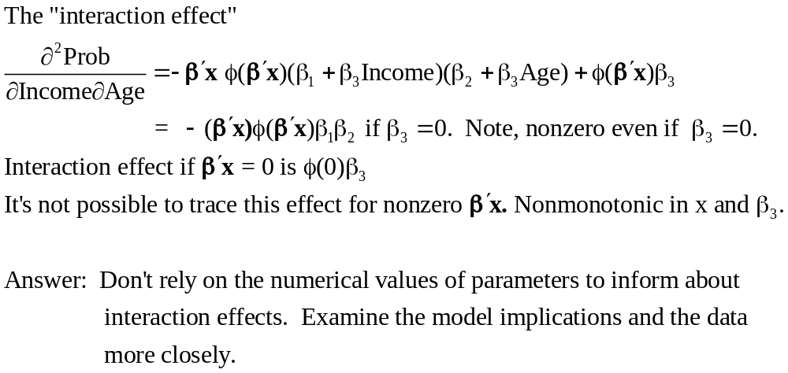
Interaction Effect

Slide 53
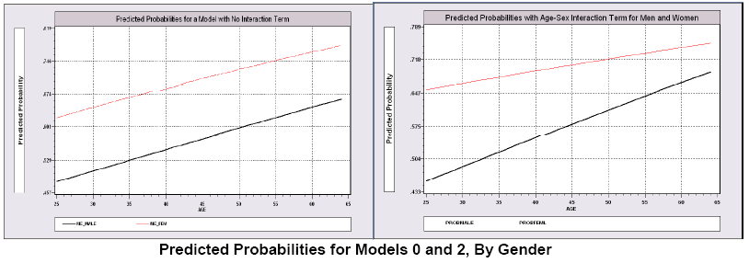
Gender – Age Interaction Effects

Slide 54
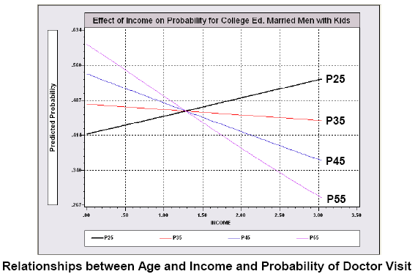
Interaction Effects

Slide 55
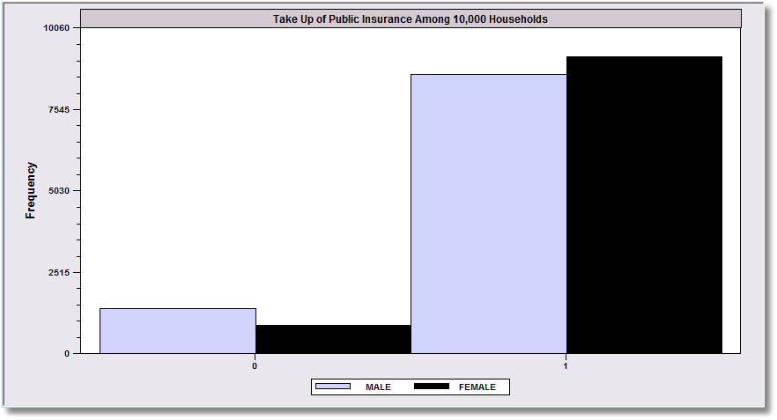
Margins and Odds Ratios
.8617
.9144
Overall take up rate of public insurance is greater for females than
males. What does the binary choice model say about the difference?

Slide 56
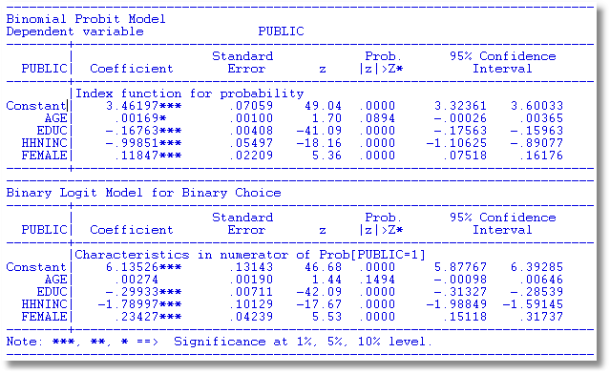
Binary Choice Models

Slide 57
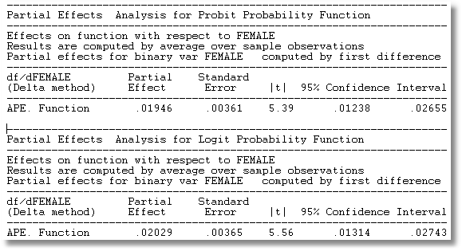
Average Partial Effects
Other things equal, the take up rate is about .02 higher in female headed households. The gross rates do not account for the facts that female headed households are a little older and a bit less educated, and both effects would push the take up rate up.

Slide 58
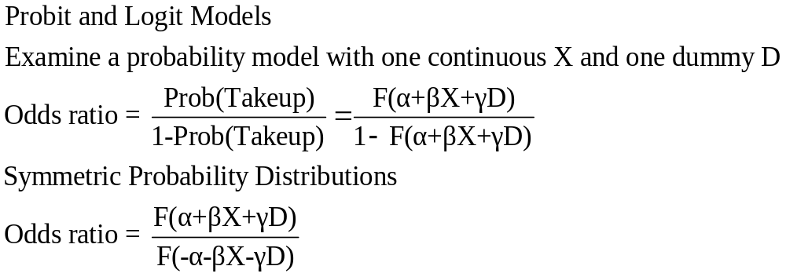
Odds Ratio

Slide 59
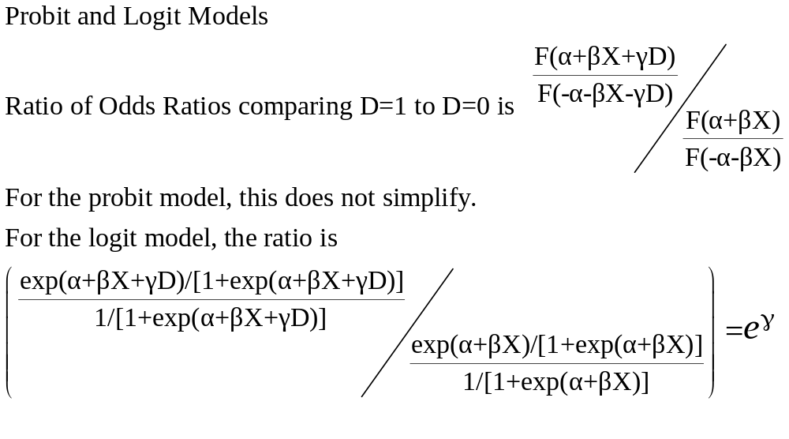
Ratio of Odds Ratios

Slide 60
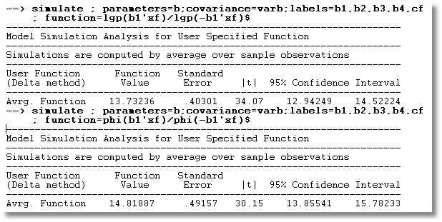
Odds Ratios for Insurance Takeup Model
Logit vs. Probit

Slide 61
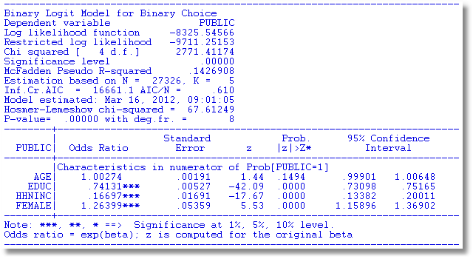
Reporting Odds Ratios

Slide 62
Margins are about units of measurement
Partial Effect
Odds Ratio
Takeup rate for female headed households is about 91.7%
Other things equal, female headed households are about .02 (about 2.1%) more likely to take up the public insurance
The odds that a female headed household takes up the insurance is about 14.
The odds go up by about 26% for a female headed household compared to a male headed household.

