Slide 1
Discrete Choice Modeling
William Greene
Stern School of Business
New York University

Slide 2
Inference in Binary Choice Models

Slide 3
Agenda
Measuring the Fit of the Model to the Data
Predicting the Dependent Variable
Covariance matrices for inference
Hypothesis Tests
  About estimated coefficients and partial effects
  Linear Restrictions
  Structural Change
  Heteroscedasticity
  Model Specification (Logit vs. Probit)
Aggregate Prediction and Model Simulation
Scaling and Heteroscedasticity
Choice Based Sampling

Slide 4
Measures of Fit in Binary Choice Models

Slide 5
How Well Does the Model Fit?
There is no R squared.
  Least squares for linear models is computed to maximize R²
  There are no residuals or sums of squares in a binary choice model
  The model is not computed to optimize the fit of the model to the data
How can we measure the “fit” of the model to the data?
  “Fit measures” computed from the log likelihood
    “Pseudo R squared” = 1 – logL/logL0
    Also called the “likelihood ratio index”
    Others… - these do not measure fit.
  Direct assessment of the effectiveness of the model at predicting the outcome

Slide 6
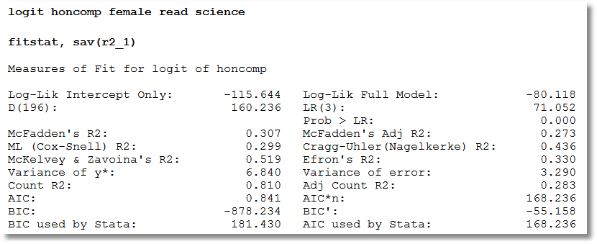
Fitstat

Slide 7
Log Likelihoods
logL = ∑_{i} log density (y_{i}|x_{i},β)
For probabilities
  Density is a probability
  Log density is < 0
  LogL is < 0
For other models, log density can be positive or negative.
  For linear regression,
  logL=-N/2(1+log2π+log(e’e/N)]
  Positive if s² < .058497

Slide 8
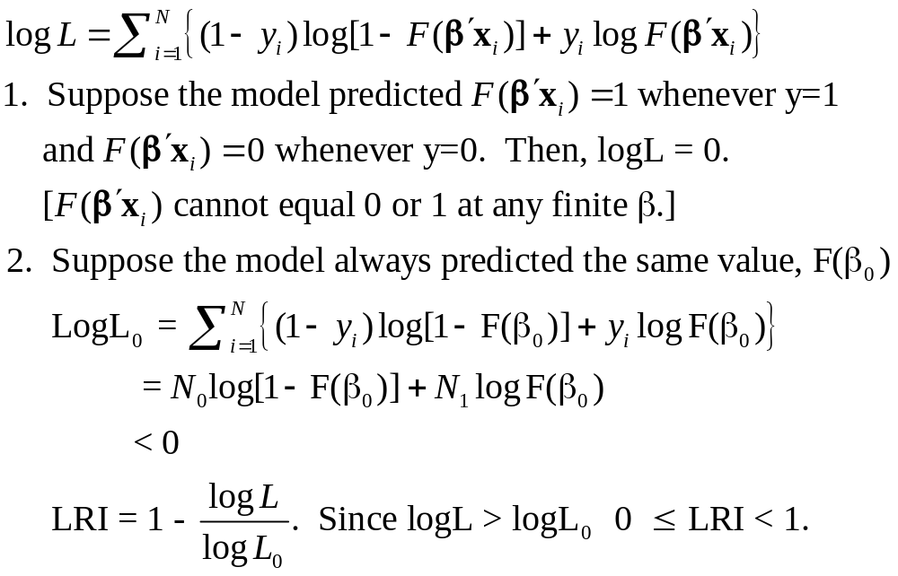
Likelihood Ratio Index

Slide 9
The Likelihood Ratio Index
Bounded by 0 and 1-ε
Rises when the model is expanded
Values between 0 and 1 have no meaning
Can be strikingly low.
Should not be used to compare models
  Use logL
  Use information criteria to compare nonnested models
Notes:
9

Slide 10
Fit Measures Based on LogL
----------------------------------------------------------------------
Binary Logit Model for Binary Choice
Dependent variable DOCTOR
Log likelihood function -2085.92452 Full model LogL
Restricted log likelihood -2169.26982 Constant term only LogL0
Chi squared [ 5 d.f.] 166.69058
Significance level .00000
McFadden Pseudo R-squared .0384209 1 – LogL/logL0
Estimation based on N = 3377, K = 6
Information Criteria: Normalization=1/N
Normalized Unnormalized
AIC 1.23892 4183.84905 -2LogL + 2K
Fin.Smpl.AIC 1.23893 4183.87398 -2LogL + 2K + 2K(K+1)/(N-K-1)
Bayes IC 1.24981 4220.59751 -2LogL + KlnN
Hannan Quinn 1.24282 4196.98802 -2LogL + 2Kln(lnN)
--------+-------------------------------------------------------------
Variable| Coefficient Standard Error b/St.Er. P[|Z|>z] Mean of X
--------+-------------------------------------------------------------
|Characteristics in numerator of Prob[Y = 1]
Constant| 1.86428*** .67793 2.750 .0060
AGE| -.10209*** .03056 -3.341 .0008 42.6266
AGESQ| .00154*** .00034 4.556 .0000 1951.22
INCOME| .51206 .74600 .686 .4925 .44476
AGE_INC| -.01843 .01691 -1.090 .2756 19.0288
FEMALE| .65366*** .07588 8.615 .0000 .46343
--------+-------------------------------------------------------------

Slide 11
Modifications of LRI Do Not Fix It
+----------------------------------------+
| Fit Measures for Binomial Choice Model |
| Logit model for variable DOCTOR |
+----------------------------------------+
| Y=0 Y=1 Total|
| Proportions .34202 .65798 1.00000|
| Sample Size 1155 2222 3377|
+----------------------------------------+
| Log Likelihood Functions for BC Model |
| P=0.50 P=N1/N P=Model| P=.5 => No Model. P=N1/N => Constant only
| LogL = -2340.76 -2169.27 -2085.92| Log likelihood values used in LRI
+----------------------------------------+
| Fit Measures based on Log Likelihood |
| McFadden = 1-(L/L0) = .03842|
| Estrella = 1-(L/L0)^(-2L0/n) = .04909| 1 – (1-LRI)^(-2L0/N)
| R-squared (ML) = .04816| 1 - exp[-(1/N)model chi-squard]
| Akaike Information Crit. = 1.23892| Multiplied by 1/N
| Schwartz Information Crit. = 1.24981| Multiplied by 1/N
+----------------------------------------+
| Fit Measures Based on Model Predictions|
| Efron = .04825| Note huge variation. This severely limits
| Ben Akiva and Lerman = .57139| the usefulness of these measures.
| Veall and Zimmerman = .08365|
| Cramer = .04771|
+----------------------------------------+

Slide 12
Fit Measures Based on Predictions
Computation
  Use the model to compute predicted probabilities
  Use the model and a rule to compute predicted y = 0 or 1
Fit measure compares predictions to actuals

Slide 13
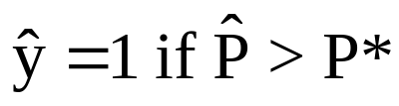
Predicting the Outcome
Predicted probabilities
P = F(a + b₁Age + b₂Income + b₃Female+…)
Predicting outcomes
  Predict y=1 if P is “large”
  Use 0.5 for “large” (more likely than not)
  Generally, use
Count successes and failures

Slide 14
Individual Predictions from a Logit Model
Predicted Values (* => observation was not in estimating sample.)
Observation Observed Y Predicted Y Residual x(i)b Pr[Y=1]
29 .000000 1.0000000 -1.0000000 .0756747 .5189097
31 .000000 1.0000000 -1.0000000 .6990731 .6679822
34 1.0000000 1.0000000 .000000 .9193573 .7149111
38 1.0000000 1.0000000 .000000 1.1242221 .7547710
42 1.0000000 1.0000000 .000000 .0901157 .5225137
49 .000000 .0000000 .000000 -.1916202 .4522410
52 1.0000000 1.0000000 .000000 .7303428 .6748805
58 .000000 1.0000000 -1.0000000 1.0132084 .7336476
83 .000000 1.0000000 -1.0000000 .3070637 .5761684
90 .000000 1.0000000 -1.0000000 1.0121583 .7334423
109 .000000 1.0000000 -1.0000000 .3792791 .5936992
116 1.0000000 .0000000 1.0000000 -.3408756 .2926339
125 .000000 1.0000000 -1.0000000 .9018494 .7113294
132 1.0000000 1.0000000 .000000 1.5735582 .8282903
154 1.0000000 1.0000000 .000000 .3715972 .5918449
158 1.0000000 1.0000000 .000000 .7673442 .6829461
177 .000000 1.0000000 -1.0000000 .1464560 .5365487
184 1.0000000 1.0000000 .000000 .7906293 .6879664
191 .000000 1.0000000 -1.0000000 .7200008 .6726072
Note two types of errors and two types of successes.

Slide 15
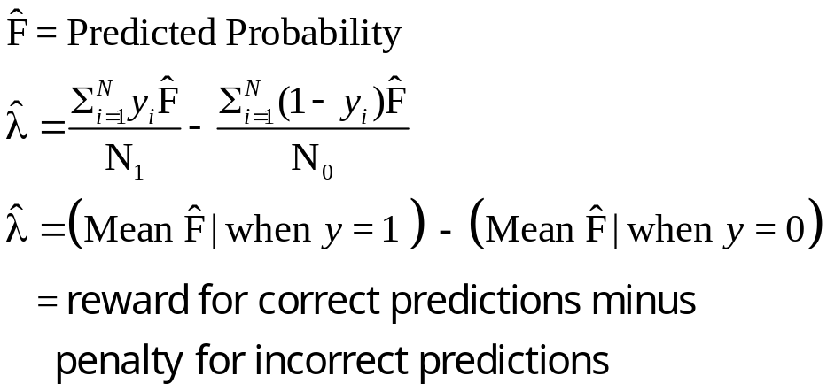
Cramer Fit Measure
+----------------------------------------+
| Fit Measures Based on Model Predictions|
| Efron = .04825|
| Ben Akiva and Lerman = .57139|
| Veall and Zimmerman = .08365|
| Cramer = .04771|
+----------------------------------------+

Slide 16
Aggregate Predictions
Prediction table is based on predicting individual observations.
+---------------------------------------------------------+
|Predictions for Binary Choice Model. Predicted value is |
|1 when probability is greater than .500000, 0 otherwise.|
|Note, column or row total percentages may not sum to |
|100% because of rounding. Percentages are of full sample.|
+------+---------------------------------+----------------+
|Actual| Predicted Value | |
|Value | 0 1 | Total Actual |
+------+----------------+----------------+----------------+
| 0 | 3 ( .1%)| 1152 ( 34.1%)| 1155 ( 34.2%)|
| 1 | 3 ( .1%)| 2219 ( 65.7%)| 2222 ( 65.8%)|
+------+----------------+----------------+----------------+
|Total | 6 ( .2%)| 3371 ( 99.8%)| 3377 (100.0%)|
+------+----------------+----------------+----------------+
The model predicts 2222/3337 = 66.6% correct, but LRI is only .03842 and Cramer’s measure is only .04771. A “model” that always predicts DOCTOR=1 does even better.

Slide 17
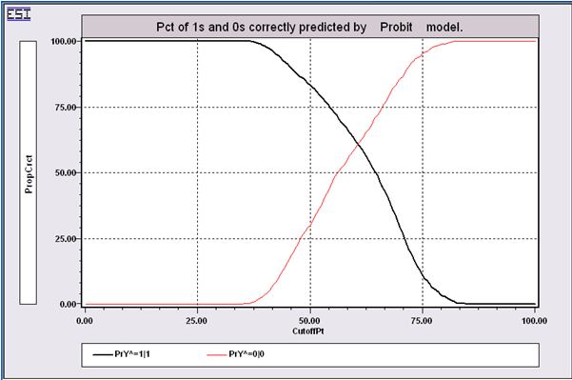
Predictions in Binary Choice
Predict y = 1 if P > P*
Success depends on the assumed P*
By setting P* lower, more observations will be predicted as 1. If P*=0, every observation will be predicted to equal 1, so all 1s will be correctly predicted. But, many 0s will be predicted to equal 1. As P* increases, the proportion of 0s correctly predicted will rise, but the proportion of 1s correctly predicted will fall.

Slide 18
Aggregate Predictions
Prediction table is based on predicting aggregate shares.
+---------------------------------------------------------+
|Crosstab for Binary Choice Model. Predicted probability |
|vs. actual outcome. Entry = Sum[Y(i,j)*Prob(i,m)] 0,1. |
|Note, column or row total percentages may not sum to |
|100% because of rounding. Percentages are of full sample.|
+------+---------------------------------+----------------+
|Actual| Predicted Probability | |
|Value | Prob(y=0) Prob(y=1) | Total Actual |
+------+----------------+----------------+----------------+
| y=0 | 431 ( 12.8%)| 723 ( 21.4%)| 1155 ( 34.2%)|
| y=1 | 723 ( 21.4%)| 1498 ( 44.4%)| 2222 ( 65.8%)|
+------+----------------+----------------+----------------+
|Total | 1155 ( 34.2%)| 2221 ( 65.8%)| 3377 ( 99.9%)|
+------+----------------+----------------+----------------+
Notes:
18

Slide 19
Simulating the Model to Examine
Changes in Market Shares
Suppose income increased by 25% for everyone.
+-------------------------------------------------------------+
|Scenario 1. Effect on aggregate proportions. Logit Model |
|Threshold T* for computing Fit = 1[Prob > T*] is .50000 |
|Variable changing = INCOME , Operation = *, value = 1.250 |
+-------------------------------------------------------------+
|Outcome Base case Under Scenario Change |
| 0 18 = .53% 61 = 1.81% 43 |
| 1 3359 = 99.47% 3316 = 98.19% -43 |
| Total 3377 = 100.00% 3377 = 100.00% 0 |
+-------------------------------------------------------------+
• The model predicts 43 fewer people would visit the doctor
NOTE: The same model used for both sets of predictions.

Slide 20
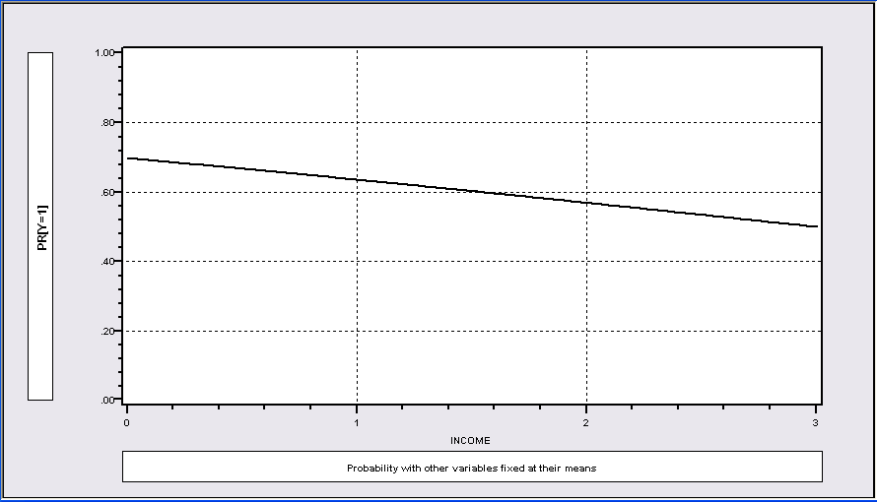
Graphical View of the Scenario

Slide 21
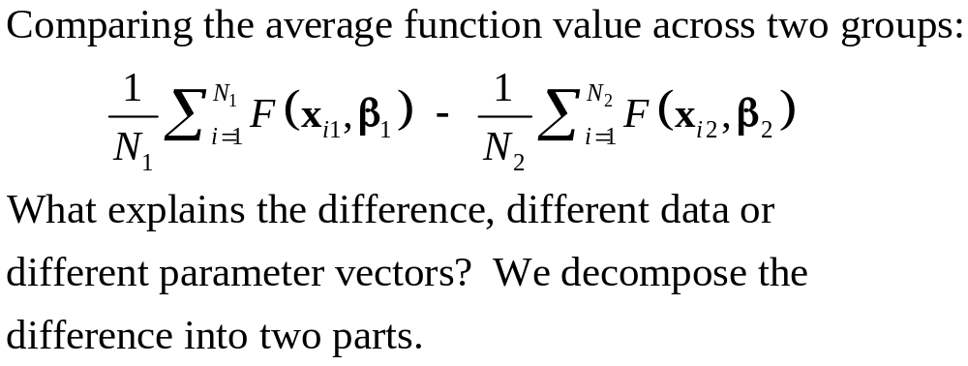
Comparing Groups: Oaxaca Decomposition

Slide 22
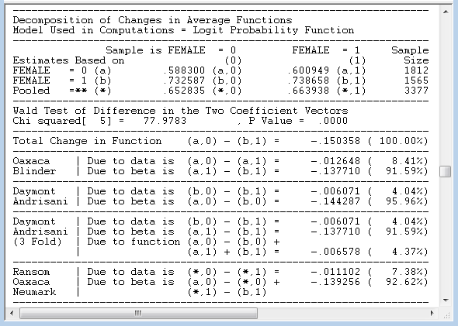
Oaxaca (and other) Decompositions

Slide 23
Hypothesis Testing in Binary Choice Models

Slide 24
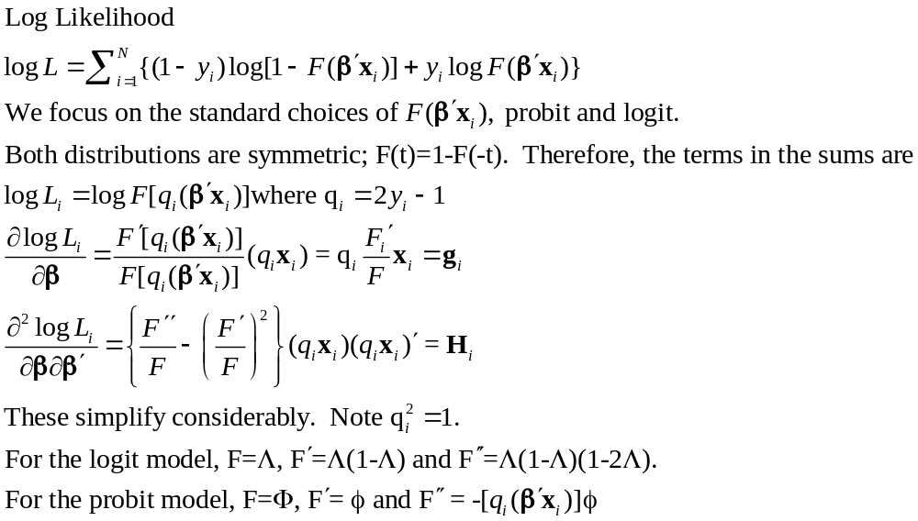
Covariance Matrix

Slide 25
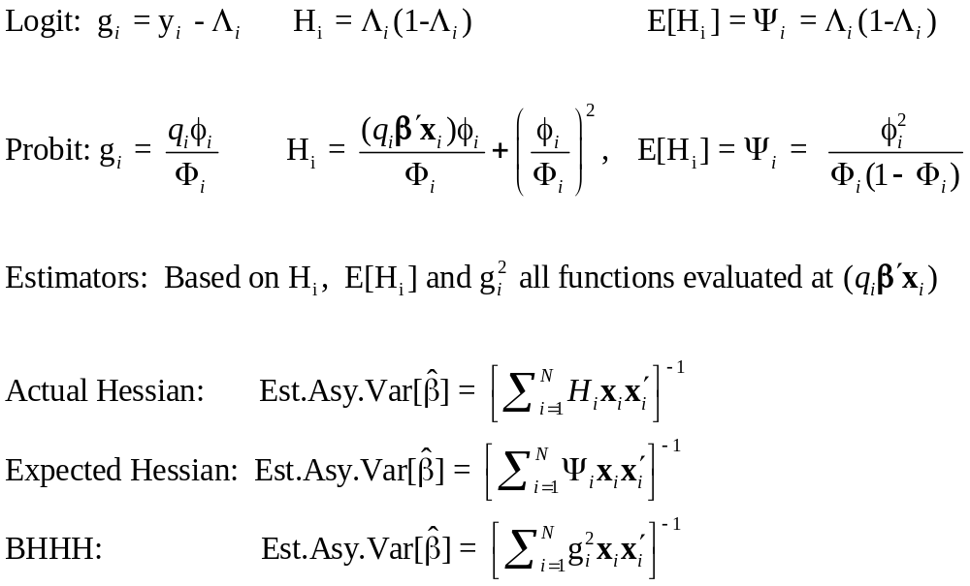
Simplifications

Slide 26
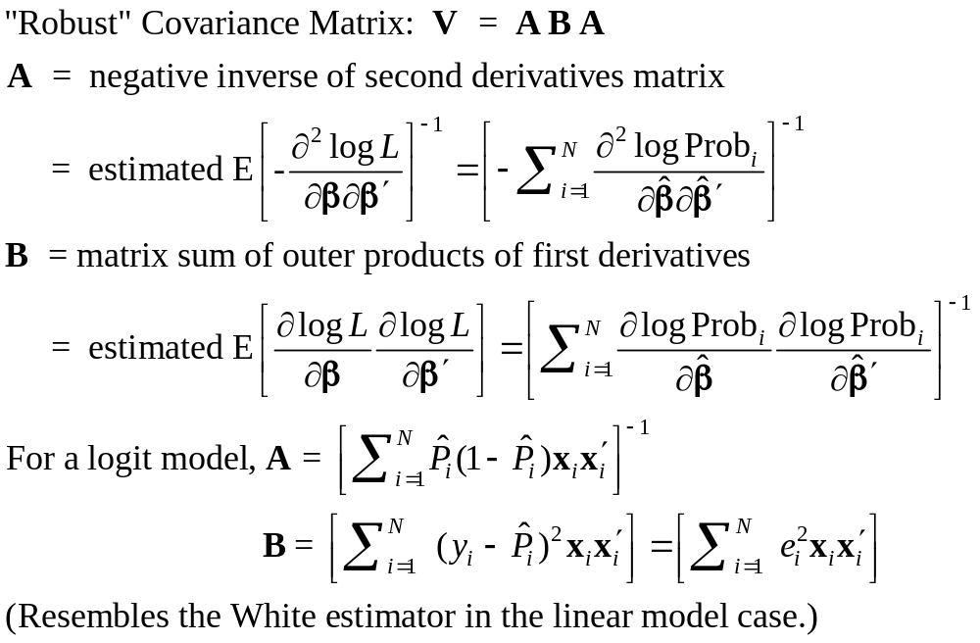
Robust Covariance Matrix(?)

Slide 27
The Robust Matrix is not Robust
To:
  Heteroscedasticity
  Correlation across observations
  Omitted heterogeneity
  Omitted variables (even if orthogonal)
  Wrong distribution assumed
  Wrong functional form for index function
In all cases, the estimator is inconsistent so a “robust” covariance matrix is pointless.
(In general, it is merely harmless.)

Slide 28
Estimated Robust Covariance Matrix for Logit Model
--------+-------------------------------------------------------------
Variable| Coefficient Standard Error b/St.Er. P[|Z|>z] Mean of X
--------+-------------------------------------------------------------
|Robust Standard Errors
Constant| 1.86428*** .68442 2.724 .0065
AGE| -.10209*** .03115 -3.278 .0010 42.6266
AGESQ| .00154*** .00035 4.446 .0000 1951.22
INCOME| .51206 .75103 .682 .4954 .44476
AGE_INC| -.01843 .01703 -1.082 .2792 19.0288
FEMALE| .65366*** .07585 8.618 .0000 .46343
--------+-------------------------------------------------------------
|Conventional Standard Errors Based on Second Derivatives
Constant| 1.86428*** .67793 2.750 .0060
AGE| -.10209*** .03056 -3.341 .0008 42.6266
AGESQ| .00154*** .00034 4.556 .0000 1951.22
INCOME| .51206 .74600 .686 .4925 .44476
AGE_INC| -.01843 .01691 -1.090 .2756 19.0288
FEMALE| .65366*** .07588 8.615 .0000 .46343

Slide 29
Hypothesis Tests
Restrictions: Linear or nonlinear functions of the model parameters
Structural ‘change’: Constancy of parameters
Specification Tests:
  Model specification: distribution
  Heteroscedasticity

Slide 30
Hypothesis Testing
There is no F statistic
Comparisons of Likelihood Functions: Likelihood Ratio Tests
Distance Measures: Wald Statistics
Lagrange Multiplier Tests

Slide 31
Base Model
----------------------------------------------------------------------
Binary Logit Model for Binary Choice
Dependent variable DOCTOR
Log likelihood function -2085.92452
Restricted log likelihood -2169.26982
Chi squared [ 5 d.f.] 166.69058
Significance level .00000
McFadden Pseudo R-squared .0384209
Estimation based on N = 3377, K = 6
Information Criteria: Normalization=1/N
Normalized Unnormalized
AIC 1.23892 4183.84905
Fin.Smpl.AIC 1.23893 4183.87398
Bayes IC 1.24981 4220.59751
Hannan Quinn 1.24282 4196.98802
Hosmer-Lemeshow chi-squared = 13.68724
P-value= .09029 with deg.fr. = 8
--------+-------------------------------------------------------------
Variable| Coefficient Standard Error b/St.Er. P[|Z|>z] Mean of X
--------+-------------------------------------------------------------
|Characteristics in numerator of Prob[Y = 1]
Constant| 1.86428*** .67793 2.750 .0060
AGE| -.10209*** .03056 -3.341 .0008 42.6266
AGESQ| .00154*** .00034 4.556 .0000 1951.22
INCOME| .51206 .74600 .686 .4925 .44476
AGE_INC| -.01843 .01691 -1.090 .2756 19.0288
FEMALE| .65366*** .07588 8.615 .0000 .46343
--------+-------------------------------------------------------------
H₀: Age is not a significant
determinant of
Prob(Doctor = 1)
H₀: β₂ = β₃ = β₅ = 0

Slide 32
Likelihood Ratio Tests
Null hypothesis restricts the parameter vector
Alternative releases the restriction
Test statistic: Chi-squared =
2 (LogL|Unrestricted model –
LogL|Restrictions) > 0
Degrees of freedom = number of restrictions

Slide 33
LR Test of H₀
UNRESTRICTED MODEL
Binary Logit Model for Binary Choice
Dependent variable DOCTOR
Log likelihood function -2085.92452
Restricted log likelihood -2169.26982
Chi squared [ 5 d.f.] 166.69058
Significance level .00000
McFadden Pseudo R-squared .0384209
Estimation based on N = 3377, K = 6
Information Criteria: Normalization=1/N
Normalized Unnormalized
AIC 1.23892 4183.84905
Fin.Smpl.AIC 1.23893 4183.87398
Bayes IC 1.24981 4220.59751
Hannan Quinn 1.24282 4196.98802
Hosmer-Lemeshow chi-squared = 13.68724
P-value= .09029 with deg.fr. = 8
RESTRICTED MODEL
Binary Logit Model for Binary Choice
Dependent variable DOCTOR
Log likelihood function -2124.06568
Restricted log likelihood -2169.26982
Chi squared [ 2 d.f.] 90.40827
Significance level .00000
McFadden Pseudo R-squared .0208384
Estimation based on N = 3377, K = 3
Information Criteria: Normalization=1/N
Normalized Unnormalized
AIC 1.25974 4254.13136
Fin.Smpl.AIC 1.25974 4254.13848
Bayes IC 1.26518 4272.50559
Hannan Quinn 1.26168 4260.70085
Hosmer-Lemeshow chi-squared = 7.88023
P-value= .44526 with deg.fr. = 8
Chi squared[3] = 2[-2085.92452 - (-2124.06568)] = 77.46456

Slide 34
Wald Test
Unrestricted parameter vector is estimated
Discrepancy: q= Rb – m (or r(b,m) if nonlinear) is computed
Variance of discrepancy is estimated:
Var[q] = R V R’
Wald Statistic is q’[Var(q)]⁻¹q = q’[RVR’]⁻¹q

Slide 35
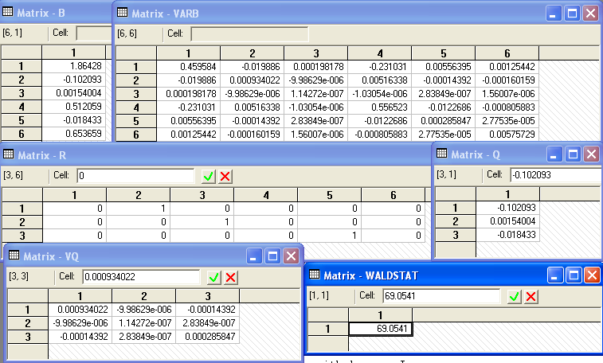
Carrying Out a Wald Test
Chi squared[3] = 69.0541

Slide 36
Lagrange Multiplier Test
Restricted model is estimated
Derivatives of unrestricted model and variances of derivatives are computed at restricted estimates
Wald test of whether derivatives are zero tests the restrictions
Usually hard to compute – difficult to program the derivatives and their variances.

Slide 37
LM Test for a Logit Model
Compute b₀ (subject to restictions)
(e.g., with zeros in appropriate positions.
Compute P_{i}(b₀) for each observation.
Compute e_{i}(b₀) = [y_{i} – P_{i}(b₀)]
Compute g_{i}(b₀) = x_{i}e_{i} using full x_{i} vector
LM = [Σ_{i}g_{i}(b₀)]’[Σ_{i}g_{i}(b₀)g_{i}(b₀)]⁻¹[Σ_{i}g_{i}(b₀)]

Slide 38
Test Results
Matrix DERIV has 6 rows and 1 columns.
+-------------+
1| .2393443D-05 zero from FOC
2| 2268.60186
3| .2122049D+06
4| .9683957D-06 zero from FOC
5| 849.70485
6| .2380413D-05 zero from FOC
+-------------+
Matrix LM has 1 rows and 1 columns.
1
+-------------+
1| 81.45829 |
+-------------+
Wald Chi squared[3] = 69.0541
LR Chi squared[3] = 2[-2085.92452 - (-2124.06568)] = 77.46456

Slide 39
A Test of Structural Stability
In the original application, separate models were fit for men and women.
We seek a counterpart to the Chow test for linear models.
Use a likelihood ratio test.

Slide 40
Testing Structural Stability
Fit the same model in each subsample
Unrestricted log likelihood is the sum of the subsample log likelihoods: LogL1
Pool the subsamples, fit the model to the pooled sample
Restricted log likelihood is that from the pooled sample: LogL0
Chi-squared = 2*(LogL1 – LogL0)
degrees of freedom = (K-1)*model size.

Slide 41
Structural Change (Over Groups) Test
----------------------------------------------------------------------
Dependent variable DOCTOR
Pooled Log likelihood function -2123.84754
--------+-------------------------------------------------------------
Variable| Coefficient Standard Error b/St.Er. P[|Z|>z] Mean of X
--------+-------------------------------------------------------------
Constant| 1.76536*** .67060 2.633 .0085
AGE| -.08577*** .03018 -2.842 .0045 42.6266
AGESQ| .00139*** .00033 4.168 .0000 1951.22
INCOME| .61090 .74073 .825 .4095 .44476
AGE_INC| -.02192 .01678 -1.306 .1915 19.0288
--------+-------------------------------------------------------------
Male Log likelihood function -1198.55615
--------+-------------------------------------------------------------
Constant| 1.65856* .86595 1.915 .0555
AGE| -.10350*** .03928 -2.635 .0084 41.6529
AGESQ| .00165*** .00044 3.760 .0002 1869.06
INCOME| .99214 .93005 1.067 .2861 .45174
AGE_INC| -.02632 .02130 -1.235 .2167 19.0016
--------+-------------------------------------------------------------
Female Log likelihood function -885.19118
--------+-------------------------------------------------------------
Constant| 2.91277*** 1.10880 2.627 .0086
AGE| -.10433** .04909 -2.125 .0336 43.7540
AGESQ| .00143*** .00054 2.673 .0075 2046.35
INCOME| -.17913 1.27741 -.140 .8885 .43669
AGE_INC| -.00729 .02850 -.256 .7981 19.0604
--------+-------------------------------------------------------------
Chi squared[5] = 2[-885.19118+(-1198.55615) – (-2123.84754] = 80.2004

Slide 42
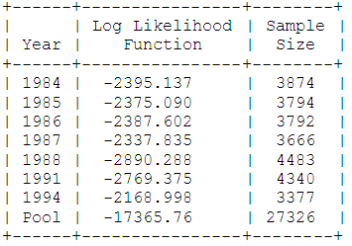
Structural Change Over Time
Health Satisfaction: Panel Data – 1984,1985,…,1988,1991,1994
Healthy(0/1) = f(1, Age, Educ, Income, Married(0/1), Kids(0.1)
The log likelihood for the pooled sample is -17365.76. The sum of the log likelihoods for the seven individual years is -17324.33. Twice the difference is 82.87. The degrees of freedom is 6×6 = 36. The 95% critical value from the chi squared table is 50.998, so the pooling hypothesis is rejected.

Slide 43
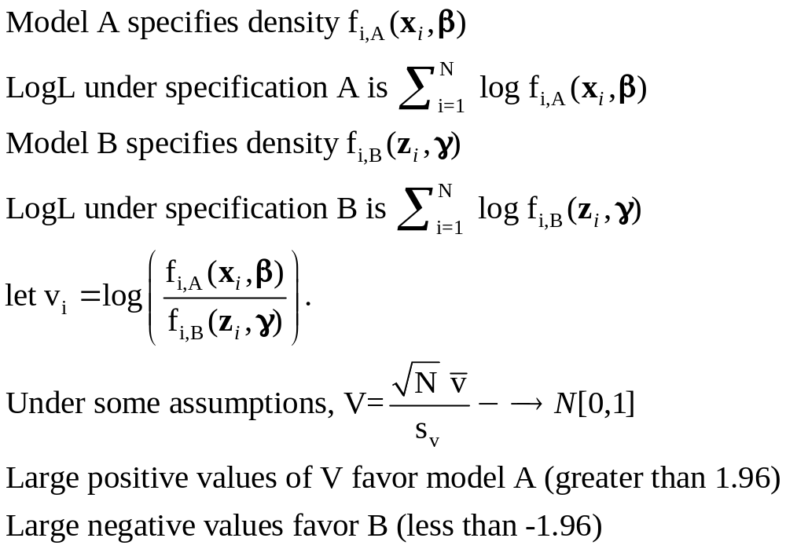
Vuong Test for Nonnested Models
Test of Logit (Model A) vs. Probit (Model B)?
+------------------------------------+
| Listed Calculator Results |
+------------------------------------+
VUONGTST= 1.570052

Slide 44
Inference About Partial Effects

Slide 45
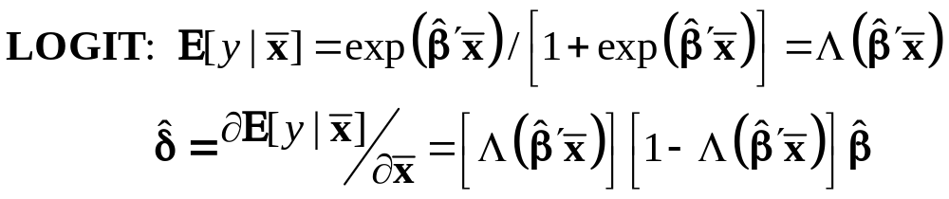
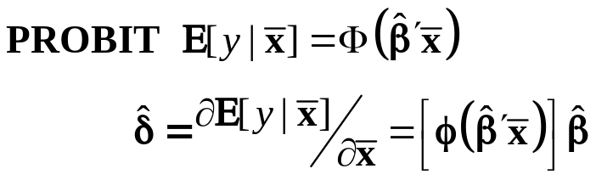
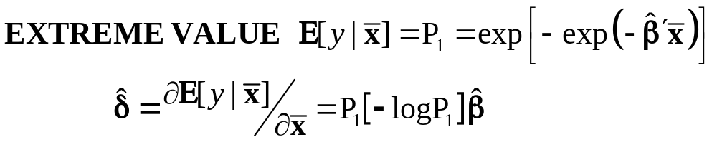
Marginal Effects for Binary Choice

Slide 46
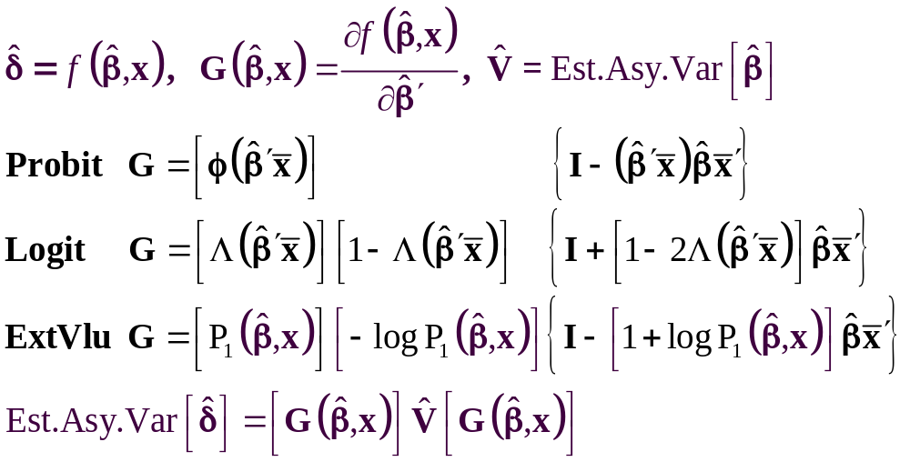
The Delta Method

Slide 47
Computing Effects
Compute at the data means?
  Simple
  Inference is well defined
Average the individual effects
  More appropriate?
  Asymptotic standard errors.
Is testing about marginal effects meaningful?
  f(b’x) must be > 0; b is highly significant
  How could f(b’x)*b equal zero?

Slide 48
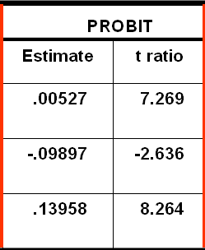
Average Partial Effects vs. Partial Effects at Data Means
=============================================
Variable Mean Std.Dev. S.E.Mean
=============================================
--------+------------------------------------
ME_AGE| .00511838 .000611470 .0000106
ME_INCOM| -.0960923 .0114797 .0001987
ME_FEMAL| .137915 .0109264 .000189
Neither the empirical standard deviations nor the standard errors of the means for the APEs are close to the estimates from the delta method. The standard errors for the APEs are computed incorrectly by not accounting for the correlation across observations
Std. Error
(.0007250)
(.03754)
(.01689)

Slide 49
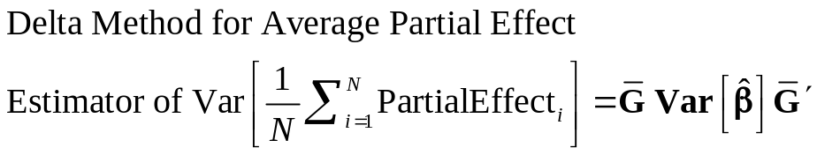
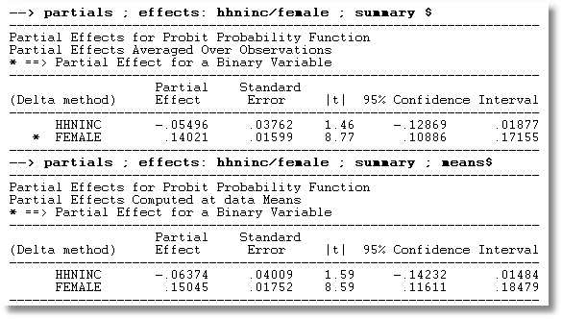
APE vs. Partial Effects at the Mean

Slide 50
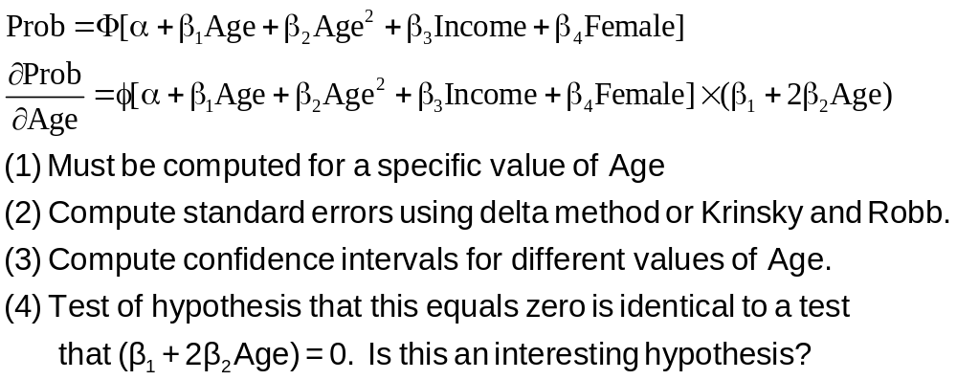
Partial Effect for Nonlinear Terms

Slide 51
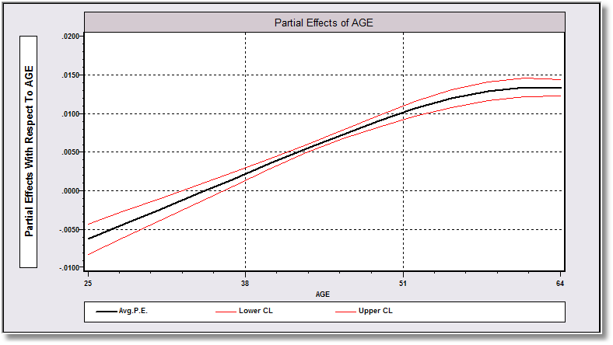
Average Partial Effect: Averaged over Sample Incomes and Genders for Specific Values of Age

Slide 52
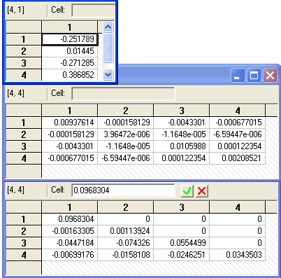
Krinsky and Robb
Estimate β by Maximum Likelihood with b
Estimate asymptotic covariance matrix with V
Draw R observations b(r) from the normal
population N[b,V]
b(r) = b + C*v(r), v(r) drawn from N[0,I]
C = Cholesky matrix, V = CC’
Compute partial effects d(r) using b(r)
Compute the sample variance of d(r),r=1,…,R
Use the sample standard deviations of the R observations to estimate the sampling standard errors for the partial effects.

Slide 53
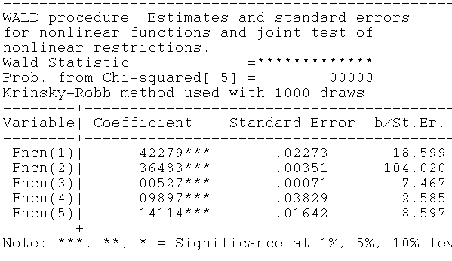
Krinsky and Robb
Delta Method

Slide 54
Heteroscedasticity

Slide 55
Scaling in Choice Models
Utility of choice U_{i} = α + β’x_{i} + ε_{i}
ε_{i} = Unobserved random component of utility
Mean: E[ε_{i}] = 0, Var[ε_{i}] = 1
Utility based model specification
Why assume variance = 1?
  Identification issue: Data do not provide information on σ
  Assumption of homoscedasticity across individuals
What if there are subgroups with different variances?
  Cost of ignoring the between group variation?
  Specifically modeling
More general heterogeneity across people
  Cost of the homogeneity assumption
  Modeling issues

Slide 56
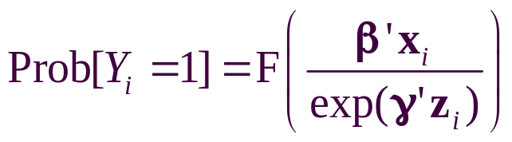
Heteroscedasticity in Binary Choice Models
Random utility: Y_{i} = 1 iff β’x_{i} + ε_{i} > 0
Resemblance to regression: How to accommodate heterogeneity in the random unobserved effects across individuals?
Heteroscedasticity – different scaling
  Parameterize: Var[ε_{i}] = exp(γ’z_{i})
  Reformulate probabilities
Probit or Logit:
Partial effects are now very complicated

Slide 57
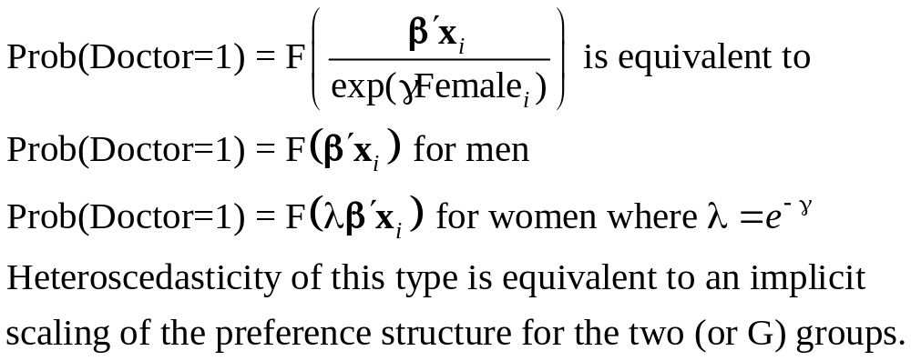
Scaling with a Dummy Variable

Slide 58
Application: Demographics
----------------------------------------------------------------------
Binary Logit Model for Binary Choice
Dependent variable DOCTOR
Log likelihood function -2096.42765
Restricted log likelihood -2169.26982
Chi squared [ 4 d.f.] 145.68433
Significance level .00000
McFadden Pseudo R-squared .0335791
Estimation based on N = 3377, K = 6
Heteroscedastic Logit Model for Binary Data
--------+-------------------------------------------------------------
Variable| Coefficient Standard Error b/St.Er. P[|Z|>z] Mean of X
--------+-------------------------------------------------------------
|Characteristics in numerator of Prob[Y = 1]
Constant| 1.31369*** .43268 3.036 .0024
AGE| -.05602*** .01905 -2.941 .0033 42.6266
AGESQ| .00082*** .00021 3.838 .0001 1951.22
INCOME| .11564 .47799 .242 .8088 .44476
AGE_INC| -.00704 .01086 -.648 .5172 19.0288
|Disturbance Variance Terms
FEMALE| -.81675*** .12143 -6.726 .0000 .46343
--------+-------------------------------------------------------------

Slide 59
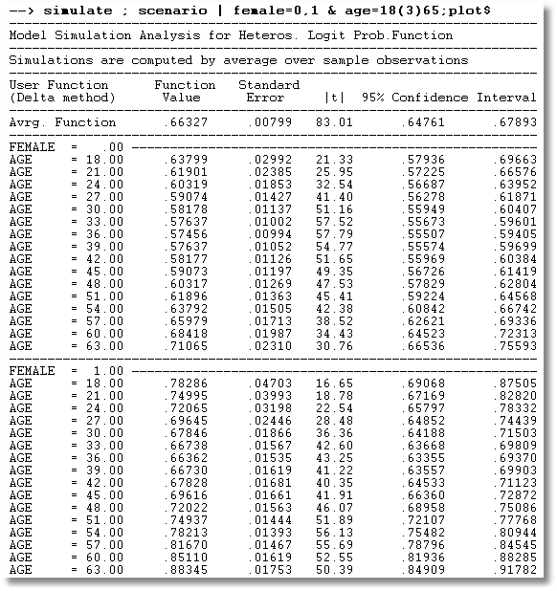
Heteroscedastic Probit Model: Probabilities by Age

Slide 60
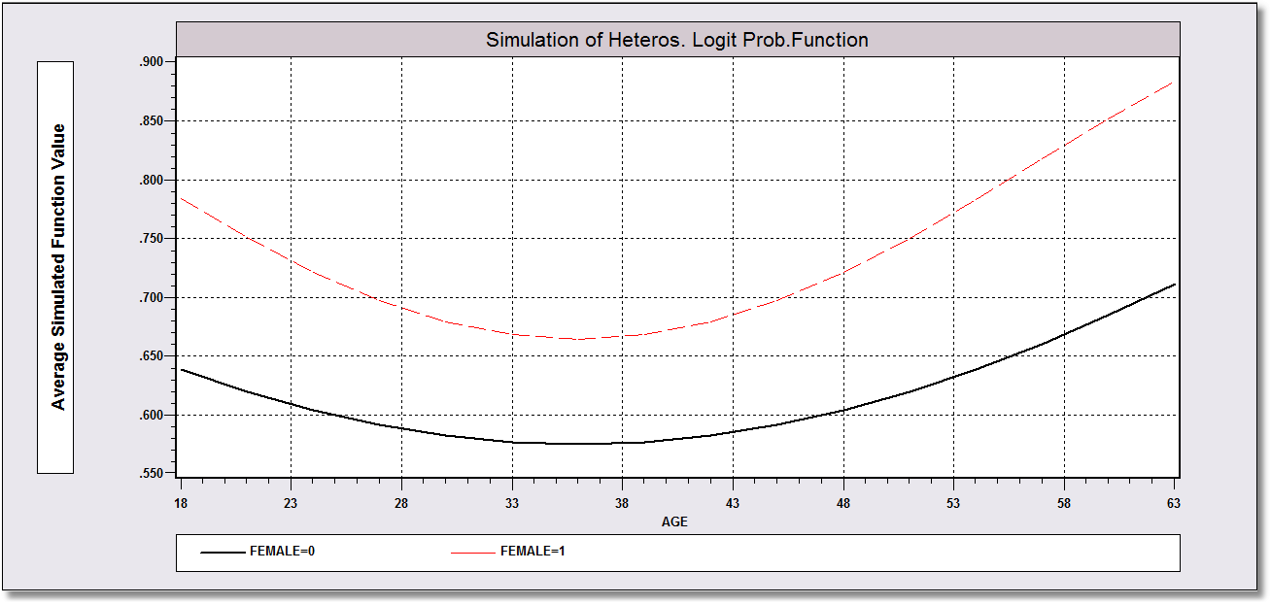
Heteroscedastic Probit Model: Probabilities by Age

Slide 61
Heteroscedasticity in Marginal Effects
For the univariate case:
E[y_{i}|x_{i},z_{i}] = Φ[β’x_{i} / exp(γ’z_{i})]
∂ E[y_{i}|x_{i},z_{i}] /∂x_{i} = Φ[β’x_{i} / exp(γ’z_{i})] times
[ 1/ exp(γ’z_{i})] β
∂ E[y_{i}|x_{i},z_{i}] /∂z_{i} = Φ[β’x_{i} / exp(γ’z_{i})] times
[- β’x_{i}/exp(γ’z_{i})] γ
If the variables are the same in x and z, these are added. Sign and magnitude are ambiguous

Slide 62
Partial Effects in the Scaling Model
------------------------------------------------------------------------------------
Partial derivatives of probabilities with respect to the vector of characteristics.
They are computed at the means of the Xs. Effects are the sum of the mean and var-
iance term for variables which appear in both parts of the function.
--------+---------------------------------------------------------------------------
Variable| Coefficient Standard Error b/St.Er. P[|Z|>z] Elasticity
--------+---------------------------------------------------------------------------
AGE| -.02121*** .00637 -3.331 .0009 -1.32701
AGESQ| .00032*** .717036D-04 4.527 .0000 .92966
INCOME| .13342 .15190 .878 .3797 .08709
AGE_INC| -.00439 .00344 -1.276 .2020 -.12264
FEMALE| .19362*** .04043 4.790 .0000 .13169
|Disturbance Variance Terms
FEMALE| -.05339 .05604 -.953 .3407 -.03632
|Sum of terms for variables in both parts
FEMALE| .14023*** .02509 5.588 .0000 .09538
--------+---------------------------------------------------------------------------
|Marginal effect for variable in probability – Homoscedastic Model
AGE| -.02266*** .00677 -3.347 .0008 -1.44664
AGESQ| .00034*** .747582D-04 4.572 .0000 .99890
INCOME| .11363 .16552 .687 .4924 .07571
AGE_INC| -.00409 .00375 -1.091 .2754 -.11660
|Marginal effect for dummy variable is P|1 - P|0.
FEMALE| .14306*** .01619 8.837 .0000 .09931
--------+---------------------------------------------------------------------------

Slide 63
Testing for Heteroscedasticity
Likelihood Ratio, Wald and Lagrange Multiplier Tests are all straightforward
All tests require a specification of the model of heteroscedasticity
There is no generic ‘test for heteroscedasticity’

Slide 64
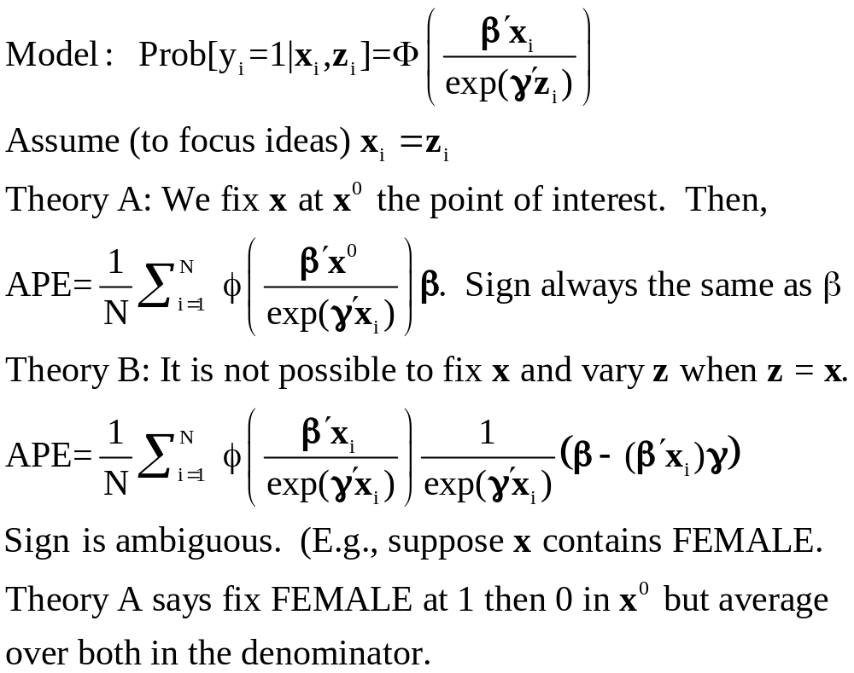
Some Disagreement About APE in the Heteroscedasticity Model

Slide 65
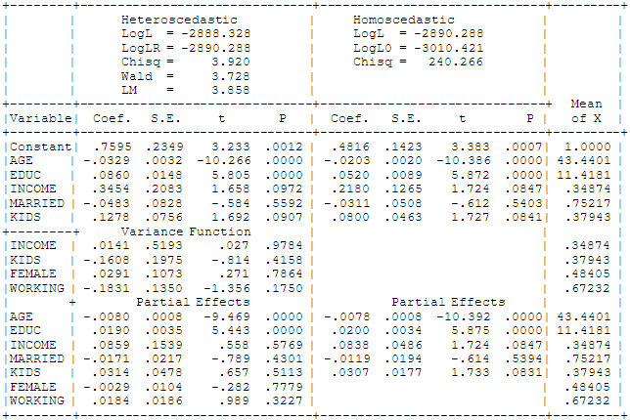
Heteroscedastic Probit Model: Tests

Slide 66
Endogeneity

Slide 67
Endogenous RHS Variable
U* = β’x + θh + ε
y = 1[U* > 0]
E[ε|h] ≠ 0 (h is endogenous)
  Case 1: h is continuous
  Case 2: h is binary = a treatment effect
Approaches
  Parametric: Maximum Likelihood
  Semiparametric (not developed here):
    GMM
    Various approaches for case 2

Slide 68
Endogenous Continuous Variable
U* = β’x + θh + ε
y = 1[U* > 0] ⇐
h = α’z + u
E[ε|h] ≠ 0 ⬄ Cov[u, ε] ≠ 0
Additional Assumptions:
(u,ε) ~ N[(0,0),(σ_{u}², ρσ_{u}, 1)]
z = a valid set of exogenous
variables, uncorrelated with (u,ε)
Correlation = ρ.
This is the source of the endogeneity
This is not IV estimation. Z may be uncorrelated with X without problems.

Slide 69


Endogenous Income
Income responds to
Age, Age², Educ, Married, Kids, Gender
0 = Not Healthy
1 = Healthy
Healthy = 0 or 1
Age, Married, Kids, Gender, Income
Determinants of Income (observed and unobserved) also determine health satisfaction.
Notes:
69

Slide 70
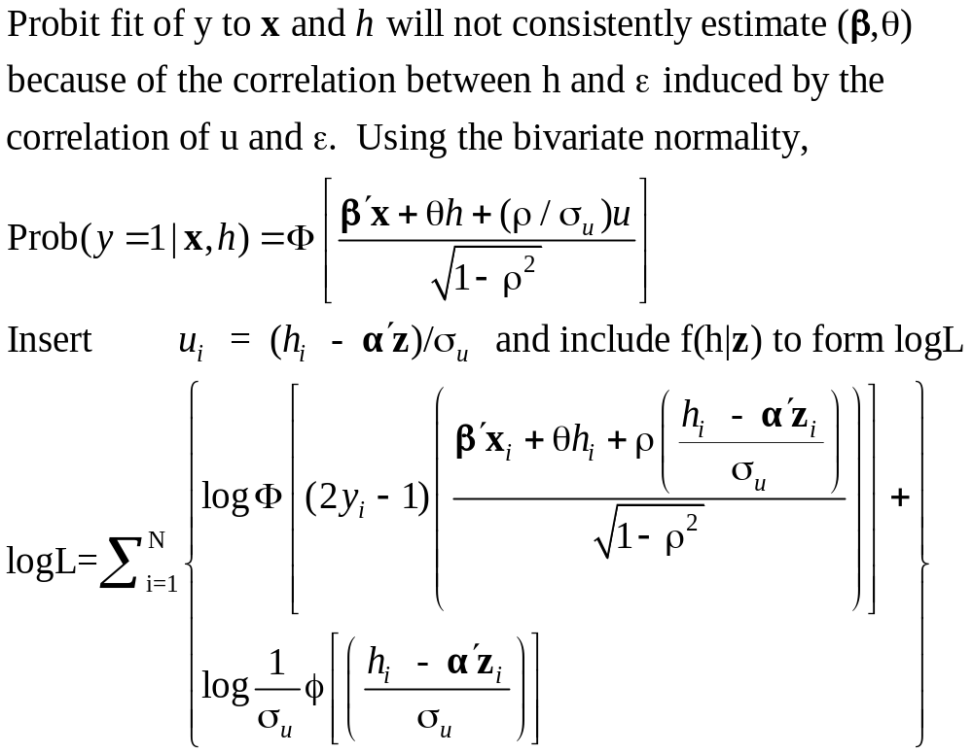
Estimation by ML (Control Function)

Slide 71
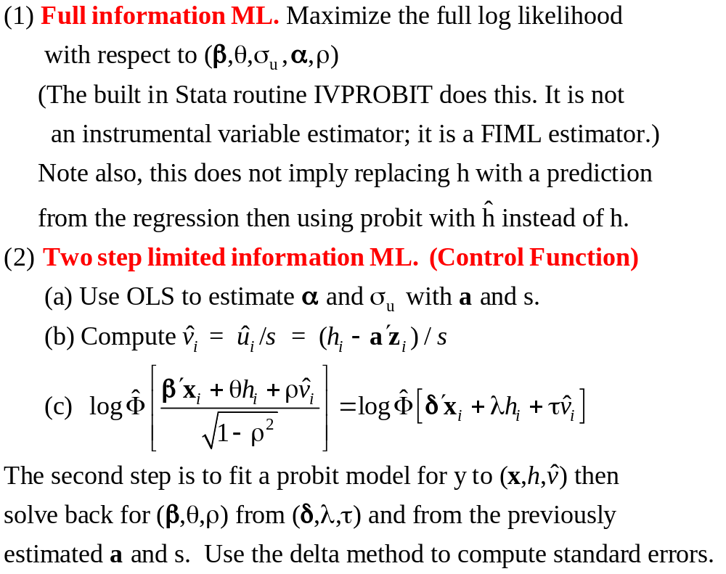
Two Approaches to ML

Slide 72
FIML Estimates
----------------------------------------------------------------------
Probit with Endogenous RHS Variable
Dependent variable HEALTHY
Log likelihood function -6464.60772
--------+-------------------------------------------------------------
Variable| Coefficient Standard Error b/St.Er. P[|Z|>z] Mean of X
--------+-------------------------------------------------------------
|Coefficients in Probit Equation for HEALTHY
Constant| 1.21760*** .06359 19.149 .0000
AGE| -.02426*** .00081 -29.864 .0000 43.5257
MARRIED| -.02599 .02329 -1.116 .2644 .75862
HHKIDS| .06932*** .01890 3.668 .0002 .40273
FEMALE| -.14180*** .01583 -8.959 .0000 .47877
INCOME| .53778*** .14473 3.716 .0002 .35208
|Coefficients in Linear Regression for INCOME
Constant| -.36099*** .01704 -21.180 .0000
AGE| .02159*** .00083 26.062 .0000 43.5257
AGESQ| -.00025*** .944134D-05 -26.569 .0000 2022.86
EDUC| .02064*** .00039 52.729 .0000 11.3206
MARRIED| .07783*** .00259 30.080 .0000 .75862
HHKIDS| -.03564*** .00232 -15.332 .0000 .40273
FEMALE| .00413** .00203 2.033 .0420 .47877
|Standard Deviation of Regression Disturbances
Sigma(w)| .16445*** .00026 644.874 .0000
|Correlation Between Probit and Regression Disturbances
Rho(e,w)| -.02630 .02499 -1.052 .2926
--------+-------------------------------------------------------------

Slide 73
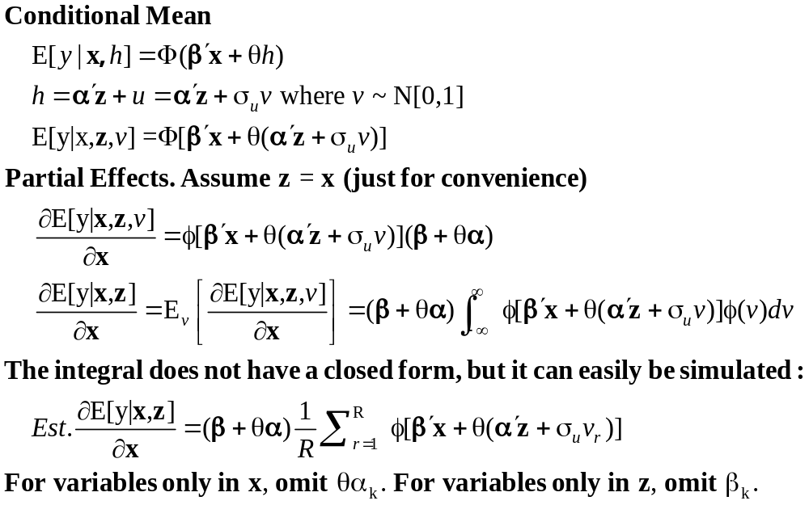
Partial Effects: Scaled Coefficients

Slide 74
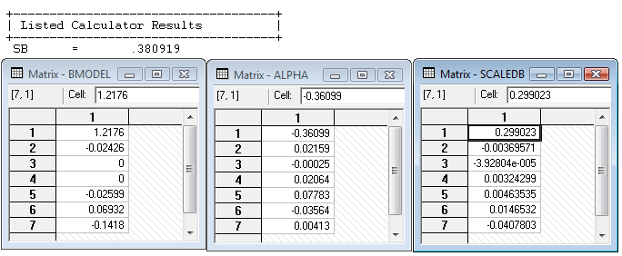
Partial Effects
θ = 0.53778
The scale factor is computed using the model coefficients, means of the variables and 35,000 draws from the standard normal population.

Slide 75
Endogenous Binary Variable
U* = β’x + θh + ε
y = 1[U* > 0]
h* = α’z + u
h = 1[h* > 0]
E[ε|h*] ≠ 0 ⬄ Cov[u, ε] ≠ 0
Additional Assumptions:
(u,ε) ~ N[(0,0),(σ_{u}², ρσ_{u}, 1)]
z = a valid set of exogenous
variables, uncorrelated with (u,ε)
⇐
Correlation = ρ.
This is the source of the endogeneity
This is not IV estimation. Z may be uncorrelated with X without problems.

Slide 76
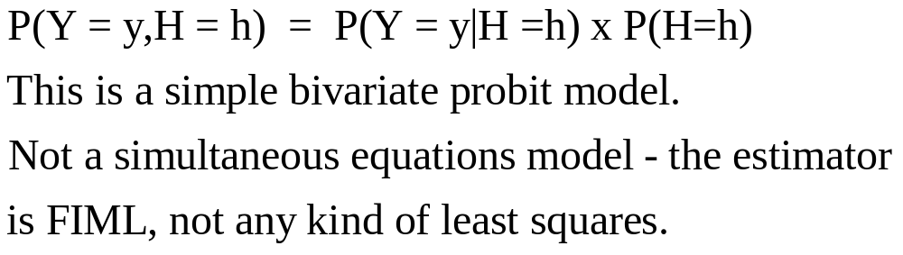

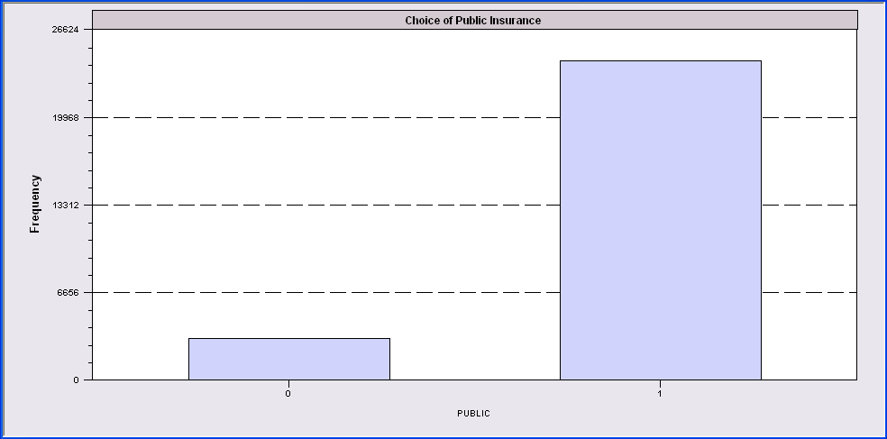
Endogenous Binary Variable
Doctor = F(age,age²,income,female,Public)
Public = F(age,educ,income,married,kids,female)

Slide 77
FIML Estimates
----------------------------------------------------------------------
FIML Estimates of Bivariate Probit Model
Dependent variable DOCPUB
Log likelihood function -25671.43905
Estimation based on N = 27326, K = 14
--------+-------------------------------------------------------------
Variable| Coefficient Standard Error b/St.Er. P[|Z|>z] Mean of X
--------+-------------------------------------------------------------
|Index equation for DOCTOR
Constant| .59049*** .14473 4.080 .0000
AGE| -.05740*** .00601 -9.559 .0000 43.5257
AGESQ| .00082*** .681660D-04 12.100 .0000 2022.86
INCOME| .08883* .05094 1.744 .0812 .35208
FEMALE| .34583*** .01629 21.225 .0000 .47877
PUBLIC| .43533*** .07357 5.917 .0000 .88571
|Index equation for PUBLIC
Constant| 3.55054*** .07446 47.681 .0000
AGE| .00067 .00115 .581 .5612 43.5257
EDUC| -.16839*** .00416 -40.499 .0000 11.3206
INCOME| -.98656*** .05171 -19.077 .0000 .35208
MARRIED| -.00985 .02922 -.337 .7361 .75862
HHKIDS| -.08095*** .02510 -3.225 .0013 .40273
FEMALE| .12139*** .02231 5.442 .0000 .47877
|Disturbance correlation
RHO(1,2)| -.17280*** .04074 -4.241 .0000
--------+-------------------------------------------------------------

Slide 78
Model Predictions
+--------------------------------------------------------+
| Bivariate Probit Predictions for DOCTOR and PUBLIC |
| Predicted cell (i,j) is cell with largest probability |
| Neither DOCTOR nor PUBLIC predicted correctly |
| 1599 of 27326 observations |
| Only DOCTOR correctly predicted |
| DOCTOR = 0: 1062 of 10135 observations |
| DOCTOR = 1: 632 of 17191 observations |
| Only PUBLIC correctly predicted |
| PUBLIC = 0: 140 of 3123 observations |
| PUBLIC = 1: 632 of 24203 observations |
| Both DOCTOR and PUBLIC correctly predicted |
| DOCTOR = 0 PUBLIC = 0: 69 of 1403 |
| DOCTOR = 1 PUBLIC = 0: 92 of 1720 |
| DOCTOR = 0 PUBLIC = 1: 252 of 8732 |
| DOCTOR = 1 PUBLIC = 1: 15008 of 15471 |
+--------------------------------------------------------+

Slide 79
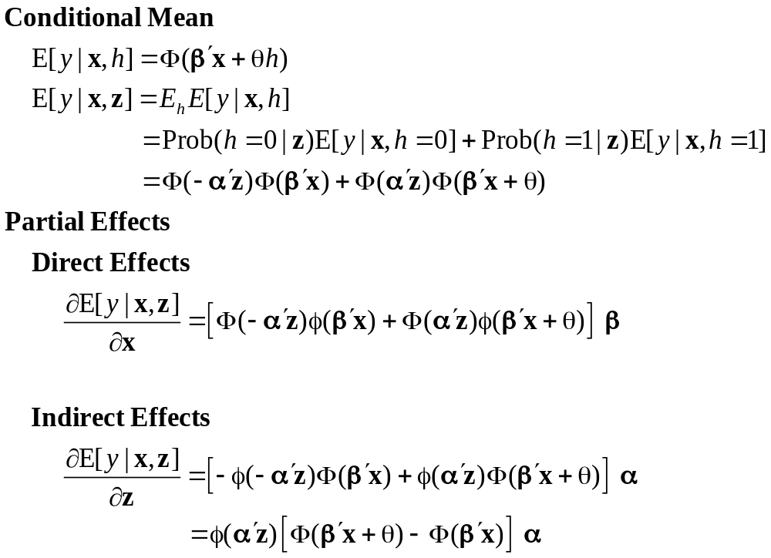
Partial Effects

Slide 80
Identification Issues
Exclusions are not needed for estimation
Identification is, in principle, by “functional form”
Researchers usually have a variable in the treatment equation that is not in the main probit equation “to improve identification”
A fully simultaneous model
  y1 = f(x1,y2), y2 = f(x2,y1)
  Not identified even with exclusion restrictions
  (Model is “incoherent”)

Slide 81
Selection

Slide 82
A Sample Selection Model
U* = β’x + ε
y = 1[U* > 0]
h* = α’z + u
h = 1[h* > 0]
E[ε|h] ≠ 0 ⬄ Cov[u, ε] ≠ 0
(y,x) are observed only when h = 1
Additional Assumptions:
(u,ε) ~ N[(0,0),(σ_{u}², ρσ_{u}, 1)]
z = a valid set of exogenous
variables, uncorrelated with (u,ε)
Correlation = ρ.
This is the source of the “selectivity:

Slide 83
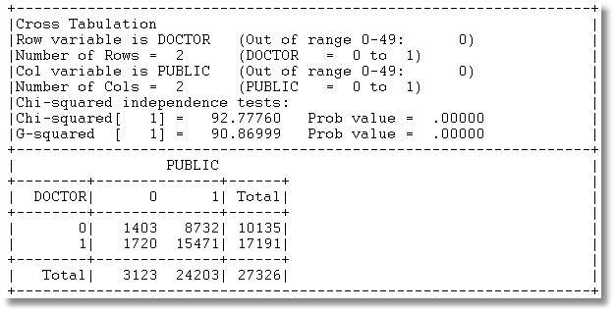
Application: Doctor,Public
3 Groups of observations: (Public=0), (Doctor=0|Public=1), (Doctor=1|Public=1)

Slide 84
Sample Selection
Doctor = F(age,age²,income,female,Public=1)
Public = F(age,educ,income,married,kids,female)

Slide 85
Selected Sample
+-----------------------------------------------------+
| Joint Frequency Table for Bivariate Probit Model |
| Predicted cell is the one with highest probability |
+-----------------------------------------------------+
| PUBLIC |
+-------------+---------------------------------------+
| DOCTOR | 0 1 Total |
|-------------+-------------+------------+------------+
| 0 | 0 | 8732 | 8732 |
| Fitted | ( 0) | ( 511) | ( 511) |
|-------------+-------------+------------+------------+
| 1 | 0 | 15471 | 15471 |
| Fitted | ( 477) | ( 23215) | ( 23692) |
|-------------+-------------+------------+------------+
| Total | 0 | 24203 | 24203 |
| Fitted | ( 477) | ( 23726) | ( 24203) |
|-------------+-------------+------------+------------+
| Counts based on 24203 selected of 27326 in sample |
+-----------------------------------------------------+

Slide 86
ML Estimates
----------------------------------------------------------------------
FIML Estimates of Bivariate Probit Model
Dependent variable DOCPUB
Log likelihood function -23581.80697
Estimation based on N = 27326, K = 13
Selection model based on PUBLIC
Means for vars. 1- 5 are after selection.
--------+-------------------------------------------------------------
Variable| Coefficient Standard Error b/St.Er. P[|Z|>z] Mean of X
--------+-------------------------------------------------------------
|Index equation for DOCTOR
Constant| 1.09027*** .13112 8.315 .0000
AGE| -.06030*** .00633 -9.532 .0000 43.6996
AGESQ| .00086*** .718153D-04 11.967 .0000 2041.87
INCOME| .07820 .05779 1.353 .1760 .33976
FEMALE| .34357*** .01756 19.561 .0000 .49329
|Index equation for PUBLIC
Constant| 3.54736*** .07456 47.580 .0000
AGE| .00080 .00116 .690 .4899 43.5257
EDUC| -.16832*** .00416 -40.490 .0000 11.3206
INCOME| -.98747*** .05162 -19.128 .0000 .35208
MARRIED| -.01508 .02934 -.514 .6072 .75862
HHKIDS| -.07777*** .02514 -3.093 .0020 .40273
FEMALE| .12154*** .02231 5.447 .0000 .47877
|Disturbance correlation
RHO(1,2)| -.19303*** .06763 -2.854 .0043
--------+-------------------------------------------------------------

Slide 87
Estimation Issues
This is a sample selection model applied to a nonlinear model
  There is no lambda
  Estimated by FIML, not two step least squares
  Estimator is a type of BIVARIATE PROBIT MODEL
The model is identified without exclusions (again)

Slide 88
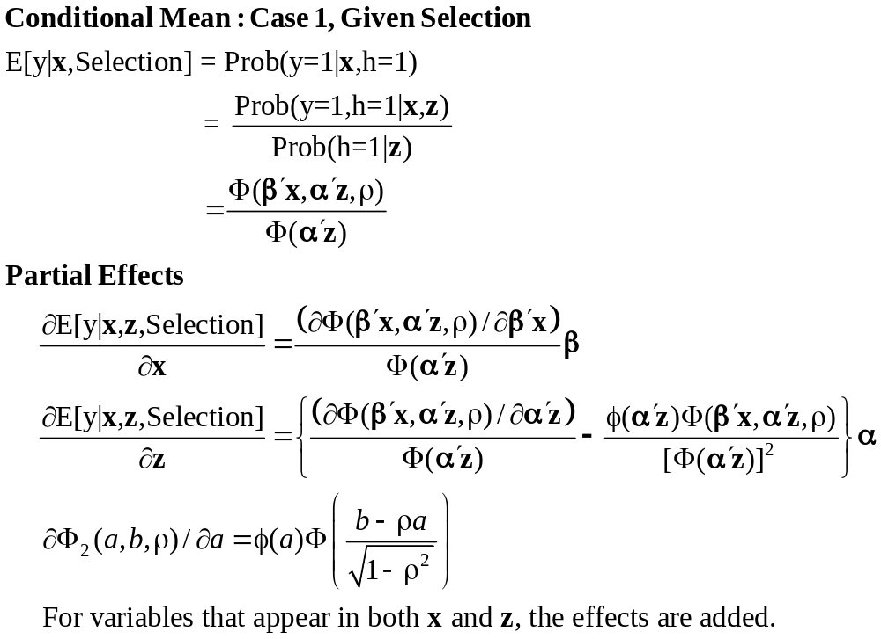
Partial Effects in the Selection Model

