Slide 1
Discrete Choice Modeling
William Greene
Stern School of Business
New York University

Slide 2
Part 5
Panel Data Models

Slide 3
Application: Health Care Panel Data
German Health Care Usage Data, 7,293 Individuals, Varying Numbers of Periods
Data downloaded from Journal of Applied Econometrics Archive. This is an unbalanced panel with 7,293 individuals. They can be used for regression, count models, binary choice, ordered choice, and bivariate binary choice. There are altogether 27,326 observations. The number of observations ranges from 1 to 7. (Frequencies are: 1=1525, 2=2158, 3=825, 4=926, 5=1051, 6=1000, 7=987).
Variables in the file are
DOCTOR = 1(Number of doctor visits > 0)
HOSPITAL = 1(Number of hospital visits > 0)
HSAT = health satisfaction, coded 0 (low) - 10 (high)
DOCVIS = number of doctor visits in last three months
HOSPVIS = number of hospital visits in last calendar year
PUBLIC = insured in public health insurance = 1; otherwise = 0
ADDON = insured by add-on insurance = 1; otherswise = 0
HHNINC = household nominal monthly net income in German marks / 10000.
(4 observations with income=0 were dropped)
HHKIDS = children under age 16 in the household = 1; otherwise = 0
EDUC = years of schooling
AGE = age in years
MARRIED = marital status
Notes:
3

Slide 4

Unbalanced Panels
Most theoretical results are for balanced panels.
Most real world panels are unbalanced.
Often the gaps are caused by attrition.
The major question is whether the gaps are ‘missing completely at random.’ If not, the observation mechanism is endogenous, and at least some methods will produce questionable results.
Researchers rarely have any reason to treat the data as nonrandomly sampled. (This is good news.)
Group Sizes

Slide 5
Unbalanced Panels and Attrition ‘Bias’
Test for ‘attrition bias.’ (Verbeek and Nijman, Testing for Selectivity Bias in Panel Data Models, International Economic Review, 1992, 33, 681-703.
  Variable addition test using covariates of presence in the panel
  Nonconstructive – what to do next?
Do something about attrition bias. (Wooldridge, Inverse Probability Weighted M-Estimators for Sample Stratification and Attrition, Portuguese Economic Journal, 2002, 1: 117-139)
  Stringent assumptions about the process
  Model based on probability of being present in each wave of the panel
We return to these in discussion of applications of ordered choice models

Slide 6
Panel Data Models
Benefits
  Modeling heterogeneity
  Rich specifications
  Modeling dynamic effects in individual behavior
Costs
  More complex models and estimation procedures
  Statistical issues for identification and estimation

Slide 7
Fixed and Random Effects
Model: Feature of interest y_{it}
Probability distribution or conditional mean
  Observable covariates x_{it}, z_{i}
  Individual specific heterogeneity, u_{i}
  Probability or mean, f(x_{it},z_{i},u_{i})
Random effects: E[u_{i}|x_{i1},…,x_{iT},z_{i}] = 0
Fixed effects: E[u_{i}|x_{i1},…,x_{iT},z_{i}] = g(X_{i},z_{i}).
The difference relates to how u_{i} relates to the observable covariates.

Slide 8

Household Income
We begin by analyzing Income using linear regression.

Slide 9
Fixed and Random Effects in Regression
y_{it} = a_{i} + b’x_{it} + e_{it}
  Random effects: Two step FGLS. First step is OLS
  Fixed effects: OLS based on group mean differences
How do we proceed for a binary choice model?
  y_{it}* = a_{i} + b’x_{it} + e_{it}
  y_{it} = 1 if y_{it}* > 0, 0 otherwise.
Neither ols nor two step FGLS works (even approximately) if the model is nonlinear.
  Models are fit by maximum likelihood, not OLS or GLS
  New complications arise that are absent in the linear case.

Slide 10
Pooled Linear Regression - Income
----------------------------------------------------------------------
Ordinary least squares regression ............
LHS=HHNINC Mean = .35208
Standard deviation = .17691
Number of observs. = 27326
Model size Parameters = 2
Degrees of freedom = 27324
Residuals Sum of squares = 796.31864
Standard error of e = .17071
Fit R-squared = .06883
Adjusted R-squared = .06879
Model test F[ 1, 27324] (prob) = 2019.6(.0000)
--------+-------------------------------------------------------------
Variable| Coefficient Standard Error b/St.Er. P[|Z|>z] Mean of X
--------+-------------------------------------------------------------
Constant| .12609*** .00513 24.561 .0000
EDUC| .01996*** .00044 44.940 .0000 11.3206
--------+-------------------------------------------------------------

Slide 11
Fixed Effects
----------------------------------------------------------------------
Least Squares with Group Dummy Variables..........
Ordinary least squares regression ............
LHS=HHNINC Mean = .35208
Standard deviation = .17691
Number of observs. = 27326
Model size Parameters = 7294
Degrees of freedom = 20032
Residuals Sum of squares = 277.15841
Standard error of e = .11763
Fit R-squared = .67591
Adjusted R-squared = .55791
Model test F[***, 20032] (prob) = 5.7(.0000)
--------+-------------------------------------------------------------
Variable| Coefficient Standard Error b/St.Er. P[|Z|>z] Mean of X
--------+-------------------------------------------------------------
EDUC| .03664*** .00289 12.688 .0000 11.3206
--------+-------------------------------------------------------------
For the pooled model, R squared was .06883 and
the estimated coefficient on EDUC was .01996.

Slide 12
Random Effects
----------------------------------------------------------------------
Random Effects Model: v(i,t) = e(i,t) + u(i)
Estimates: Var[e] = .013836
Var[u] = .015308
Corr[v(i,t),v(i,s)] = .525254
Lagrange Multiplier Test vs. Model (3) =*******
( 1 degrees of freedom, prob. value = .000000)
(High values of LM favor FEM/REM over CR model)
Baltagi-Li form of LM Statistic = 4534.78
Sum of Squares 796.363710
R-squared .068775
--------+-------------------------------------------------------------
Variable| Coefficient Standard Error b/St.Er. P[|Z|>z] Mean of X
--------+-------------------------------------------------------------
EDUC| .02051*** .00069 29.576 .0000 11.3206
Constant| .11973*** .00808 14.820 .0000
--------+-------------------------------------------------------------
Note: ***, **, * = Significance at 1%, 5%, 10% level.
----------------------------------------------------------------------
For the pooled model, the estimated coefficient on EDUC was .01996.

Slide 13
Fixed vs. Random Effects
Linear Models
Fixed Effects
  Robust to both cases
  Use OLS
  Convenient
Random Effects
  Inconsistent in FE case: effects correlated with X
  Use FGLS: No necessary distributional assumption
  Smaller number of parameters
  Inconvenient to compute
Nonlinear Models
Fixed Effects
  Usually inconsistent because of ‘IP’ problem
  Fit by full ML
  Extremely inconvenient
Random Effects
  Inconsistent in FE case : effects correlated with X
  Use full ML: Distributional assumption
  Smaller number of parameters
  Always inconvenient to compute

Slide 14
Binary Choice Model
Model is Prob(y_{it} = 1|x_{it}) (z_{i} is embedded in x_{it})
In the presence of heterogeneity,
Prob(y_{it} = 1|x_{it},u_{i}) = F(x_{it},u_{i})

Slide 15
Panel Data Binary Choice Models
Random Utility Model for Binary Choice
U_{it} = α + β’x_{it} + ε_{it} + Person i specific effect
Fixed effects using “dummy” variables
U_{it} = α_{i} + β’x_{it} + ε_{it}
Random effects using omitted heterogeneity
U_{it} = α + β’x_{it} + ε_{it} + u_{i}
Same outcome mechanism: Y_{it} = 1[U_{it} > 0]

Slide 16
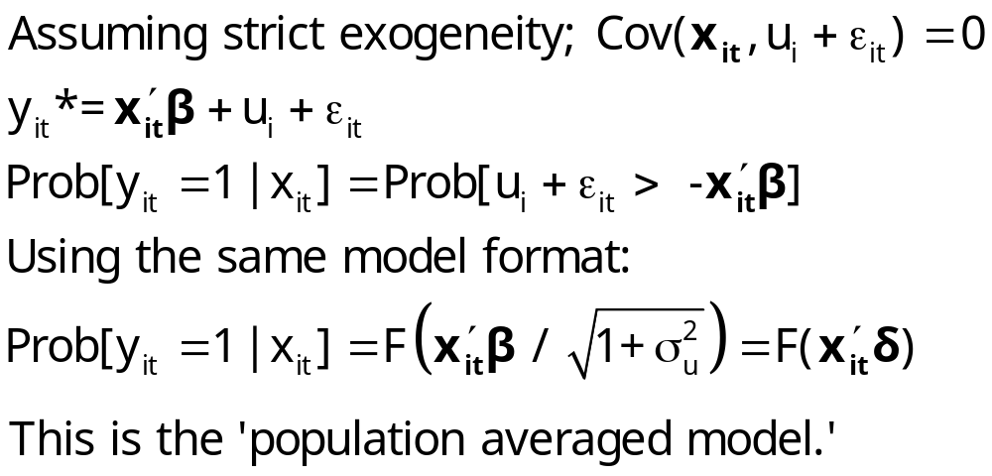
Ignoring Unobserved Heterogeneity

Slide 17
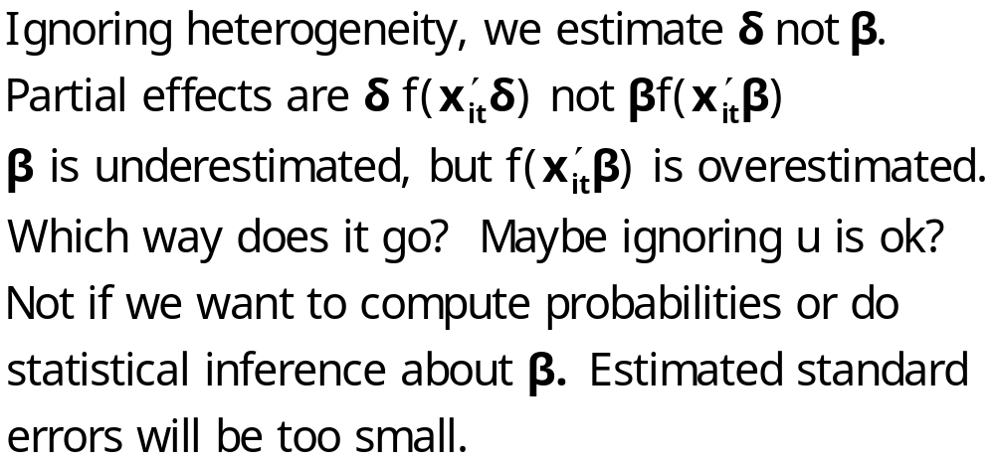
Ignoring Heterogeneity in the RE Model

Slide 18
Ignoring Heterogeneity (Broadly)
Presence will generally make parameter estimates look smaller than they would otherwise.
Ignoring heterogeneity will definitely distort standard errors.
Partial effects based on the parametric model may not be affected very much.
Is the pooled estimator ‘robust?’ Less so than in the linear model case.

Slide 19
Pooled vs. A Panel Estimator
----------------------------------------------------------------------
Binomial Probit Model
Dependent variable DOCTOR
--------+-------------------------------------------------------------
Variable| Coefficient Standard Error b/St.Er. P[|Z|>z] Mean of X
--------+-------------------------------------------------------------
Constant| .02159 .05307 .407 .6842
AGE| .01532*** .00071 21.695 .0000 43.5257
EDUC| -.02793*** .00348 -8.023 .0000 11.3206
HHNINC| -.10204** .04544 -2.246 .0247 .35208
--------+-------------------------------------------------------------
Unbalanced panel has 7293 individuals
--------+-------------------------------------------------------------
Constant| -.11819 .09280 -1.273 .2028
AGE| .02232*** .00123 18.145 .0000 43.5257
EDUC| -.03307*** .00627 -5.276 .0000 11.3206
HHNINC| .00660 .06587 .100 .9202 .35208
Rho| .44990*** .01020 44.101 .0000
--------+-------------------------------------------------------------

Slide 20
Partial Effects
----------------------------------------------------------------------
Partial derivatives of E[y] = F[*] with
respect to the vector of characteristics
They are computed at the means of the Xs
Observations used for means are All Obs.
--------+-------------------------------------------------------------
Variable| Coefficient Standard Error b/St.Er. P[|Z|>z] Elasticity
--------+-------------------------------------------------------------
|Pooled
AGE| .00578*** .00027 21.720 .0000 .39801
EDUC| -.01053*** .00131 -8.024 .0000 -.18870
HHNINC| -.03847** .01713 -2.246 .0247 -.02144
--------+-------------------------------------------------------------
|Based on the panel data estimator
AGE| .00620*** .00034 18.375 .0000 .42181
EDUC| -.00918*** .00174 -5.282 .0000 -.16256
HHNINC| .00183 .01829 .100 .9202 .00101
--------+-------------------------------------------------------------

Slide 21
Effect of Clustering
Y_{it} must be correlated with Y_{is} across periods
Pooled estimator ignores correlation
Broadly, y_{it} = E[y_{it}|x_{it}] + w_{it},
  E[y_{it}|x_{it}] = Prob(y_{it} = 1|x_{it})
  w_{it} is correlated across periods
Assuming the marginal probability is the same, the pooled estimator is consistent. (We just saw that it might not be.)
Ignoring the correlation across periods generally leads to underestimating standard errors.

Slide 22
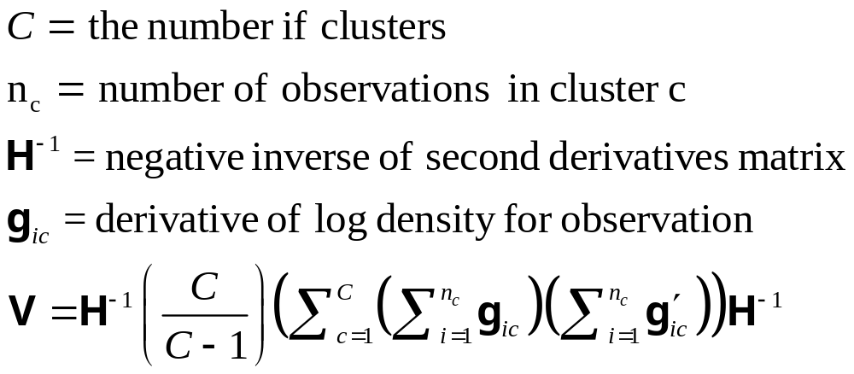
‘Cluster’ Corrected Covariance Matrix

Slide 23
Cluster Correction: Doctor
----------------------------------------------------------------------
Binomial Probit Model
Dependent variable DOCTOR
Log likelihood function -17457.21899
--------+-------------------------------------------------------------
Variable| Coefficient Standard Error b/St.Er. P[|Z|>z] Mean of X
--------+-------------------------------------------------------------
| Conventional Standard Errors
Constant| -.25597*** .05481 -4.670 .0000
AGE| .01469*** .00071 20.686 .0000 43.5257
EDUC| -.01523*** .00355 -4.289 .0000 11.3206
HHNINC| -.10914** .04569 -2.389 .0169 .35208
FEMALE| .35209*** .01598 22.027 .0000 .47877
--------+-------------------------------------------------------------
| Corrected Standard Errors
Constant| -.25597*** .07744 -3.305 .0009
AGE| .01469*** .00098 15.065 .0000 43.5257
EDUC| -.01523*** .00504 -3.023 .0025 11.3206
HHNINC| -.10914* .05645 -1.933 .0532 .35208
FEMALE| .35209*** .02290 15.372 .0000 .47877
--------+-------------------------------------------------------------

Slide 24
Modeling a Binary Outcome
Did firm i produce a product or process innovation in year t ? y_{it} : 1=Yes/0=No
Observed N=1270 firms for T=5 years, 1984-1988
Observed covariates: x_{it} = Industry, competitive pressures, size, productivity, etc.
How to model?
  Binary outcome
  Correlation across time
  Heterogeneity across firms
Notes:
24

Slide 25
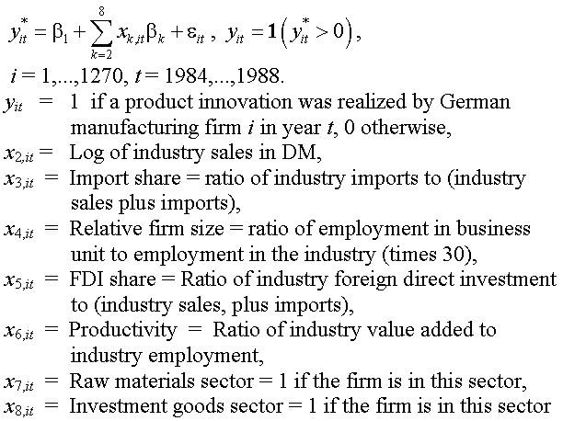
Application: Innovation

Slide 26
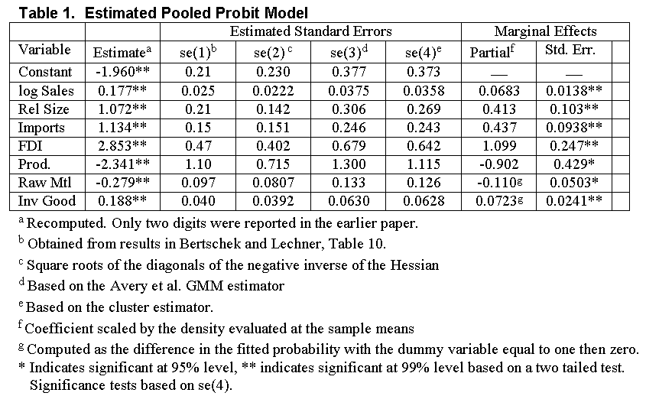

Slide 27
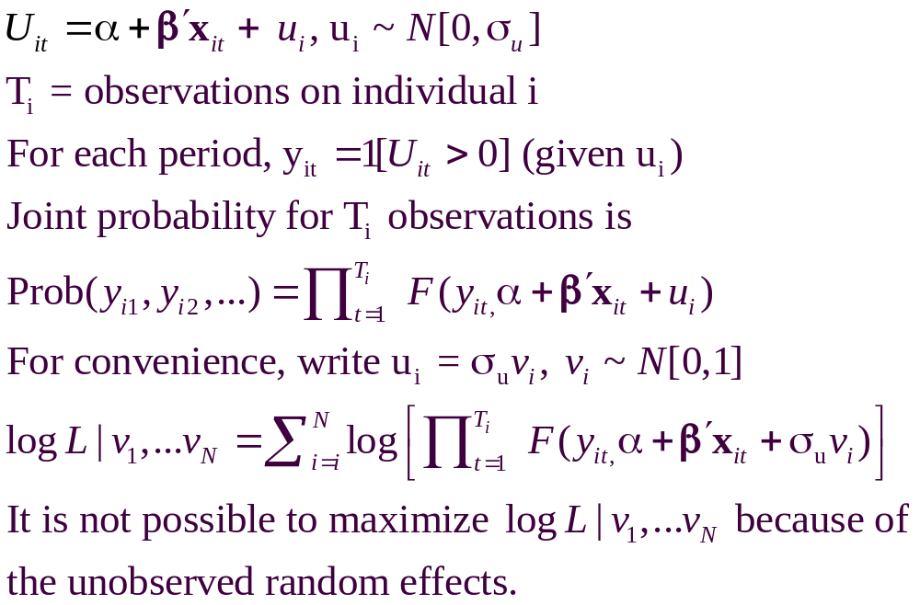
A Random Effects Model

Slide 28
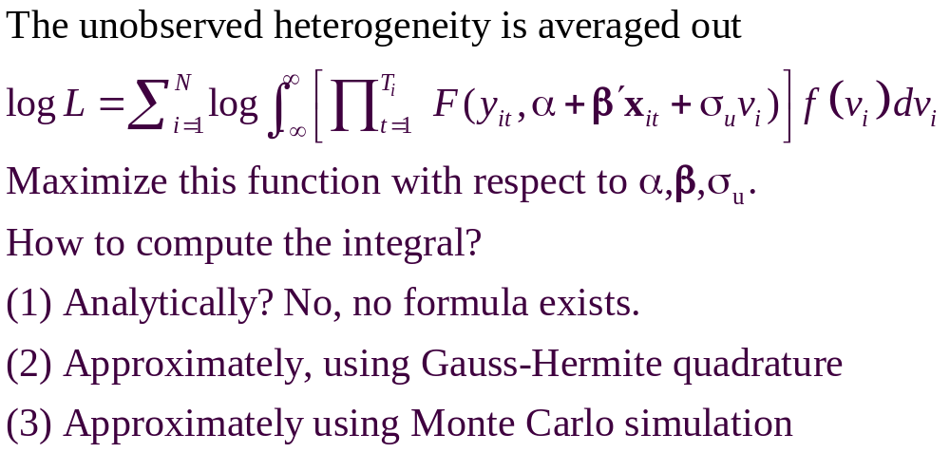
A Computable Log Likelihood

Slide 29
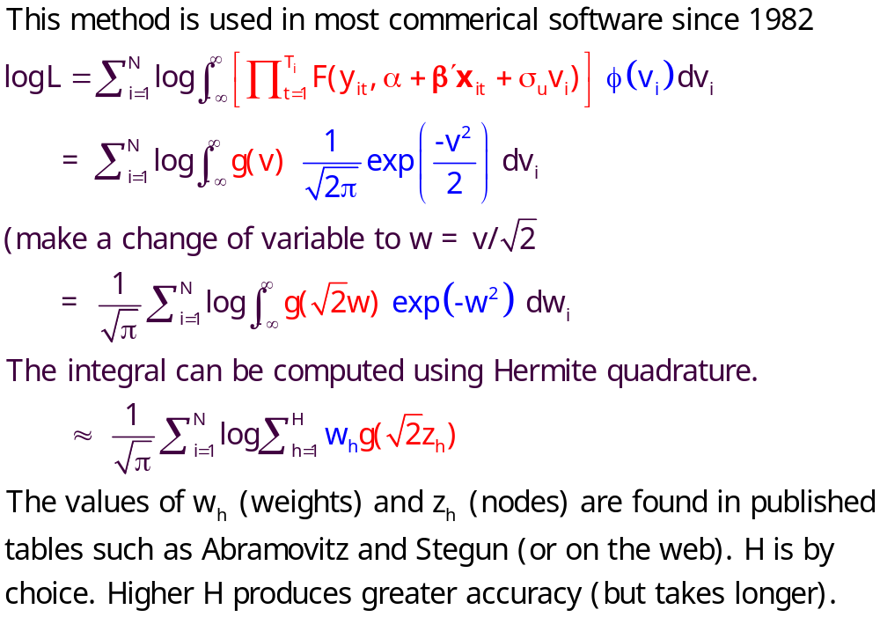
Quadrature – Butler and Moffitt

Slide 30
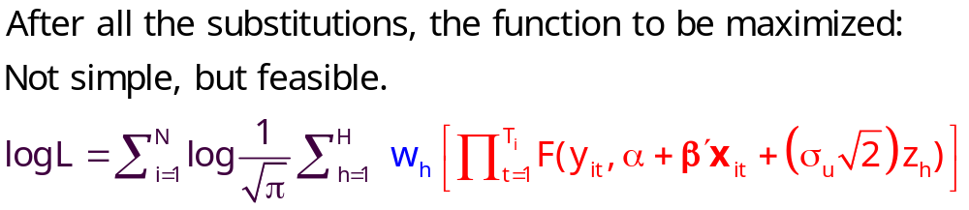
Quadrature Log Likelihood

Slide 31
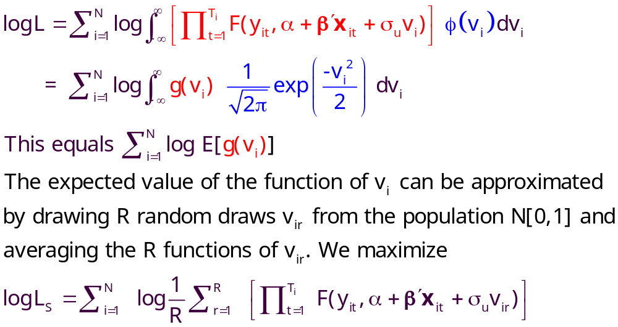
Simulation

Slide 32
Random Effects Model
----------------------------------------------------------------------
Random Effects Binary Probit Model
Dependent variable DOCTOR
Log likelihood function -16290.72192 ⬅ Random Effects
Restricted log likelihood -17701.08500 ⬅ Pooled
Chi squared [ 1 d.f.] 2820.72616
Significance level .00000
McFadden Pseudo R-squared .0796766
Estimation based on N = 27326, K = 5
Unbalanced panel has 7293 individuals
--------+-------------------------------------------------------------
Variable| Coefficient Standard Error b/St.Er. P[|Z|>z] Mean of X
--------+-------------------------------------------------------------
Constant| -.11819 .09280 -1.273 .2028
AGE| .02232*** .00123 18.145 .0000 43.5257
EDUC| -.03307*** .00627 -5.276 .0000 11.3206
HHNINC| .00660 .06587 .100 .9202 .35208
Rho| .44990*** .01020 44.101 .0000
--------+-------------------------------------------------------------
|Pooled Estimates using the Butler and Moffitt method
Constant| .02159 .05307 .407 .6842
AGE| .01532*** .00071 21.695 .0000 43.5257
EDUC| -.02793*** .00348 -8.023 .0000 11.3206
HHNINC| -.10204** .04544 -2.246 .0247 .35208
--------+-------------------------------------------------------------

Slide 33
Random Parameter Model
----------------------------------------------------------------------
Random Coefficients Probit Model
Dependent variable DOCTOR (Quadrature Based)
Log likelihood function -16296.68110 (-16290.72192)
Restricted log likelihood -17701.08500
Chi squared [ 1 d.f.] 2808.80780
Simulation based on 50 Halton draws
--------+-------------------------------------------------
Variable| Coefficient Standard Error b/St.Er. P[|Z|>z]
--------+-------------------------------------------------
|Nonrandom parameters
AGE| .02226*** .00081 27.365 .0000 ( .02232)
EDUC| -.03285*** .00391 -8.407 .0000 (-.03307)
HHNINC| .00673 .05105 .132 .8952 ( .00660)
|Means for random parameters
Constant| -.11873** .05950 -1.995 .0460 (-.11819)
|Scale parameters for dists. of random parameters
Constant| .90453*** .01128 80.180 .0000
--------+-------------------------------------------------------------
Using quadrature, a = -.11819. Implied ρ from these estimates is
.90454²/(1+.90453²) = .449998 compared to .44990 using quadrature.

Slide 34
Fixed Effects Models
Uit = α_{i} + β’xit + ε_{it}
For the linear model, α_{i} and β (easily) estimated separately using least squares
For most nonlinear models, it is not possible to condition out the fixed effects. (Mean deviations does not work.)
Even when it is possible to estimate β without α_{i}, in order to compute partial effects, predictions, or anything else interesting, some kind of estimate of α_{i} is still needed.

Slide 35
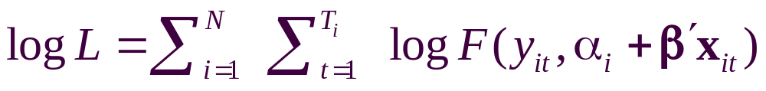
Fixed Effects Models
Estimate with dummy variable coefficients
Uit = α_{i} + β’xit + ε_{it}
Can be done by “brute force” even for 10,000s of individuals
F(.) = appropriate probability for the observed outcome
Compute β and α_{i} for i=1,…,N (may be large)

Slide 36
Unconditional Estimation
Maximize the whole log likelihood
Difficult! Many (thousands) of parameters.
Feasible – NLOGIT (2001) (‘Brute force’)
(One approach is just to create the thousands of dummy variables – SAS.)

Slide 37
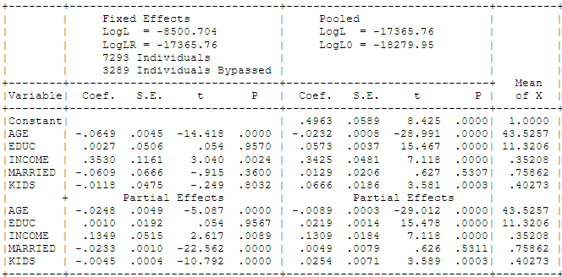
Fixed Effects Health Model
Groups in which y_{it} is always = 0 or always = 1. Cannot compute α_{i}.

Slide 38
Conditional Estimation
Principle: f(y_{i1},y_{i2},… | some statistic) is free of the fixed effects for some models.
Maximize the conditional log likelihood, given the statistic.
Can estimate β without having to estimate α_{i}.
Only feasible for the logit model. (Poisson and a few other continuous variable models. No other discrete choice models.)

Slide 39
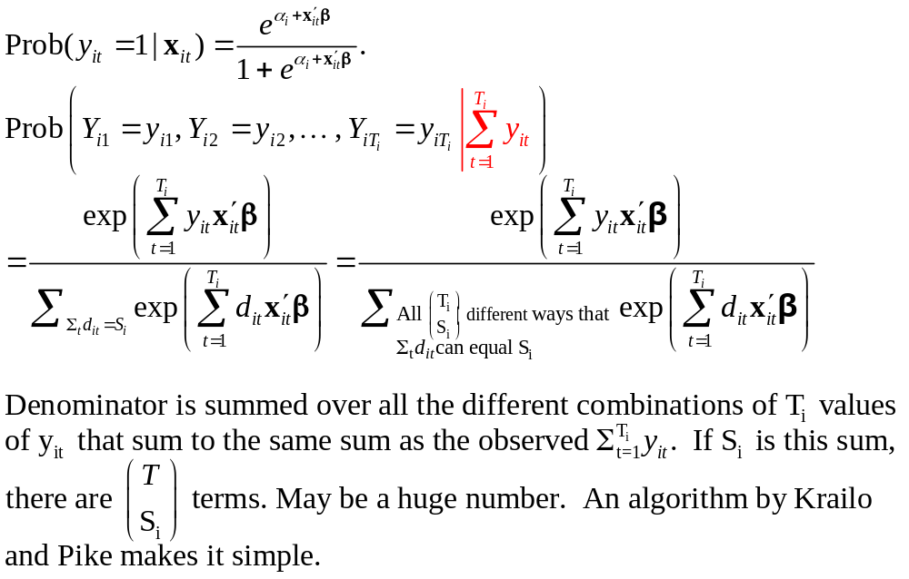
Binary Logit Conditional Probabiities

Slide 40
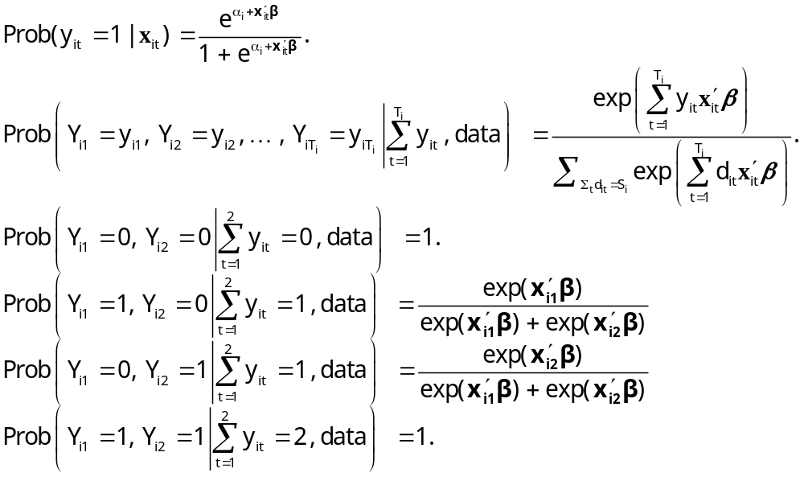
Example: Two Period Binary Logit

Slide 41
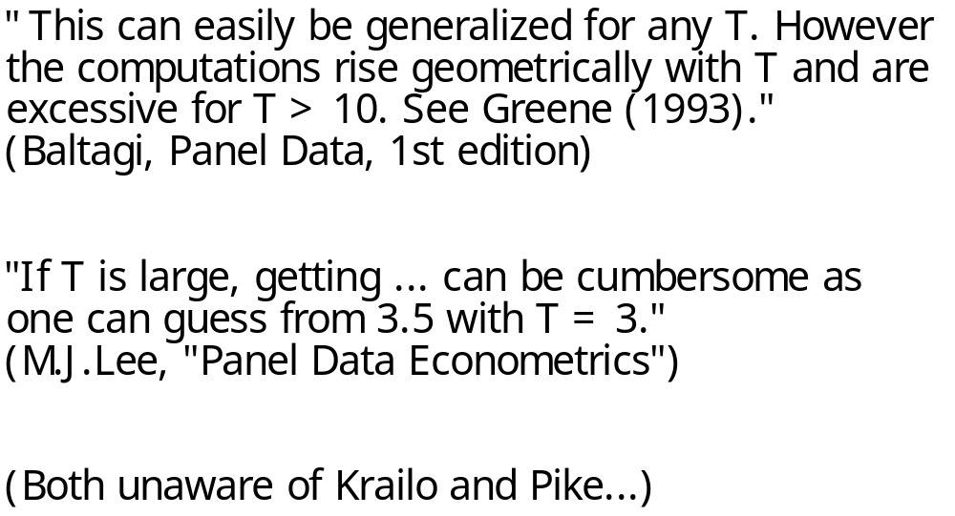
Comments on Enumeration in the Logit Model

Slide 42
Estimating Partial Effects
“The fixed effects logit estimator of β immediately gives us the effect of each element of x_{i} on the log-odds ratio… Unfortunately, we cannot estimate the partial effects… unless we plug in a value for α_{i}. Because the distribution of α_{i} is unrestricted – in particular, E[α_{i}] is not necessarily zero – it is hard to know what to plug in for α_{i}. In addition, we cannot estimate average partial effects, as doing so would require finding E[Λ(x_{it} β+ α_{i})], a task that apparently requires specifying a distribution for α_{i}.”
(Wooldridge, 2002)
Notes:
42

Slide 43
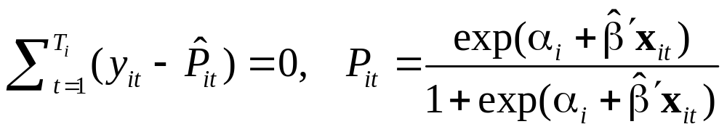
Binary Logit Estimation
Estimate β by maximizing conditional logL
Estimate α_{i} by using the ‘known’ β in the FOC for the unconditional logL
Solve for the N constants, one at a time treating β as known.
No solution when y_{it} sums to 0 or T_{i}
“Works” if E[α_{i}|Σ_{i}y_{it}] = E[α_{i}].
Use the average of the estimates of α_{i} for E[α_{i}]. Works if the cases of Σ_{i}y_{it} = 0 or Σ_{i}y_{it} = T occur completely at random.
Use this average to compute predictions and partial effects.

Slide 44
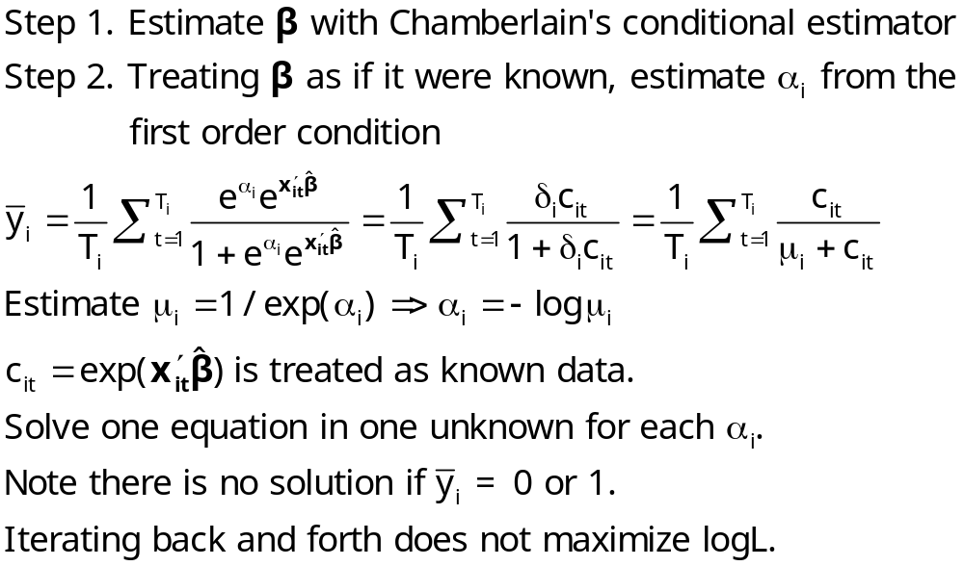
Logit Constant Terms

Slide 45
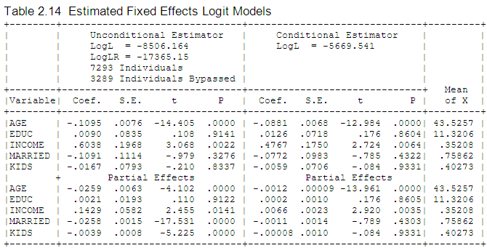
Fixed Effects Logit Health Model: Conditional vs. Unconditional

Slide 46
Advantages and Disadvantages of the FE Model
Advantages
  Allows correlation of effect and regressors
  Fairly straightforward to estimate
  Simple to interpret
Disadvantages
  Model may not contain time invariant variables
  Not necessarily simple to estimate if very large samples (Stata just creates the thousands of dummy variables)
  The incidental parameters problem: Small T bias

Slide 47
Incidental Parameters Problems: Conventional Wisdom
General: The unconditional MLE is biased in samples with fixed T except in special cases such as linear or Poisson regression (even when the FEM is the right model).
  The conditional estimator (that bypasses
  estimation of α_{i}) is consistent.
Specific: Upward bias (experience with probit and logit) in estimators of β. Exactly 100% when T = 2. Declines as T increases.

Slide 48
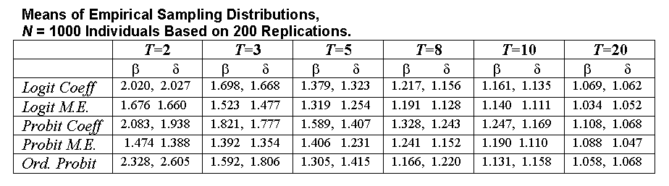
Some Familiar Territory – A Monte Carlo Study of the FE Estimator: Probit vs. Logit
Estimates of Coefficients and Marginal Effects at the Implied Data Means
Results are scaled so the desired quantity being estimated
(β, δ, marginal effects) all equal 1.0 in the population.

Slide 49
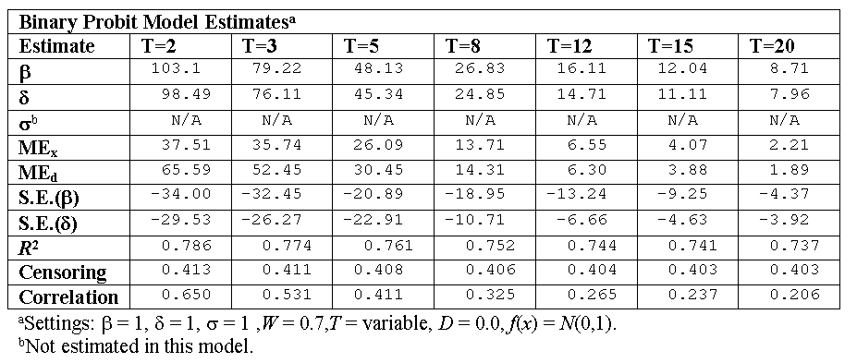
A Monte Carlo Study of the FE Probit Estimator
Percentage Biases in Estimates of Coefficients, Standard
Errors and Marginal Effects at the Implied Data Means

Slide 50
Bias Correction Estimators
Motivation: Undo the incidental parameters bias in the fixed effects probit model:
  (1) Maximize a penalized log likelihood function, or
  (2) Directly correct the estimator of β
Advantages
  For (1) estimates α_{i} so enables partial effects
  Estimator is consistent under some circumstances
  (Possibly) corrects in dynamic models
Disadvantage
  No time invariant variables in the model
  Practical implementation
  Extension to other models? (Ordered probit model (maybe) – see JBES 2009)

Slide 51
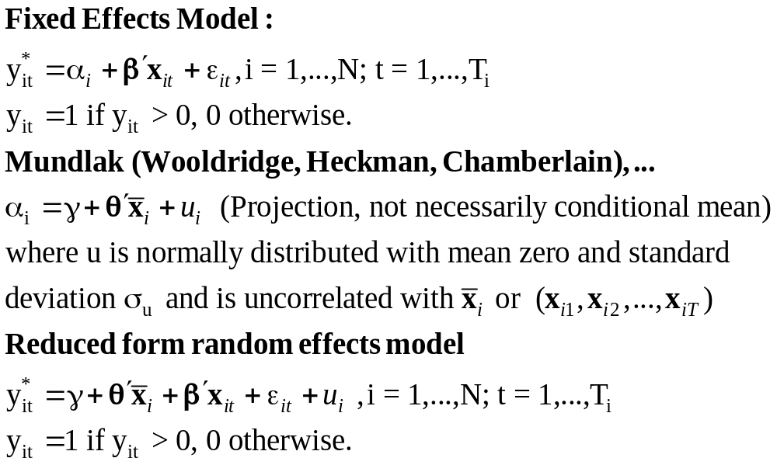
A Mundlak Correction for the FE Model
“Correlated Random Effects”

Slide 52
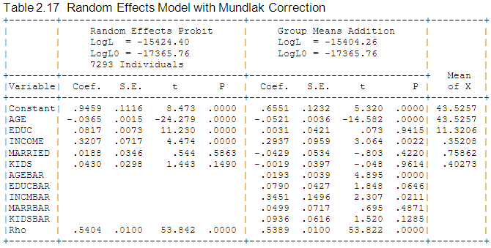
Mundlak Correction

Slide 53
A Variable Addition Test for FE vs. RE
The Wald statistic of 45.27922 and the likelihood ratio statistic of 40.280 are both far larger than the critical chi squared with 5 degrees of freedom, 11.07. This suggests that for these data, the fixed effects model is the preferred framework.

Slide 54
Fixed Effects Models Summary
Incidental parameters problem if T < 10 (roughly)
Inconvenience of computation
Appealing specification
Alternative semiparametric estimators?
  Theory not well developed for T > 2
  Not informative for anything but slopes (e.g., predictions and marginal effects)
Ignoring the heterogeneity definitely produces an inconsistent estimator (even with cluster correction!)
A Hobson’s choice
Mundlak correction is a useful common approach.

Slide 55
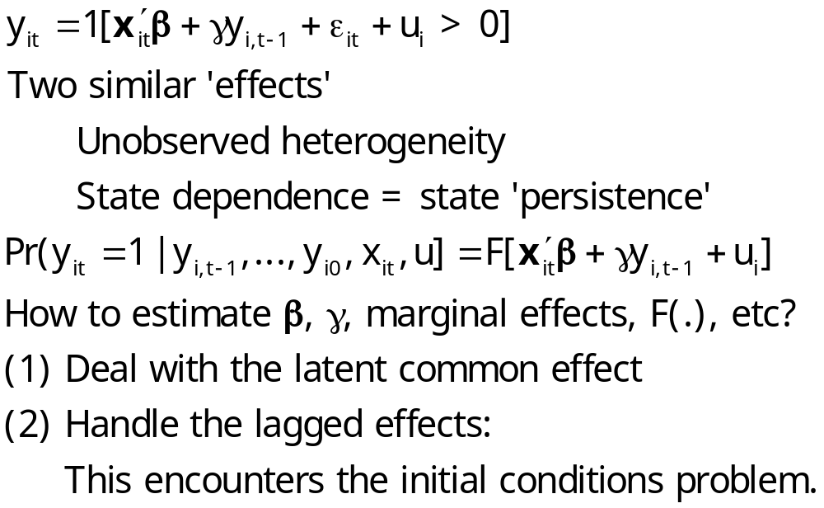
Dynamic Models

Slide 56
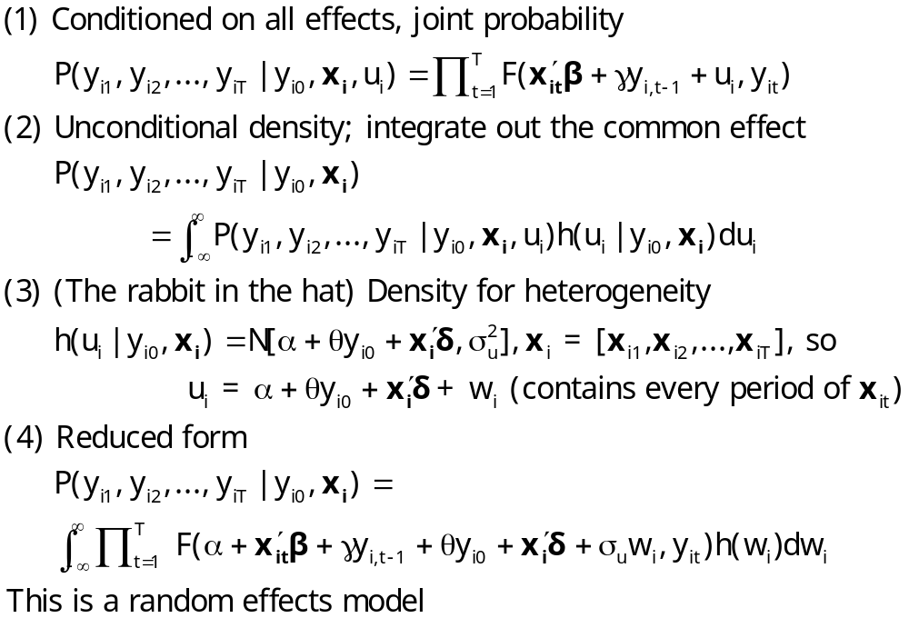
Dynamic Probit Model: A Standard Approach

Slide 57
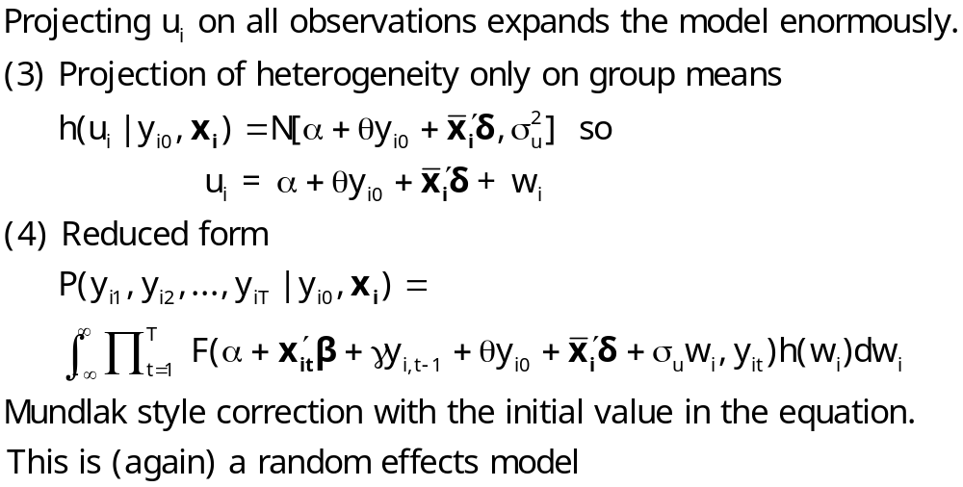
Simplified Dynamic Model

Slide 58
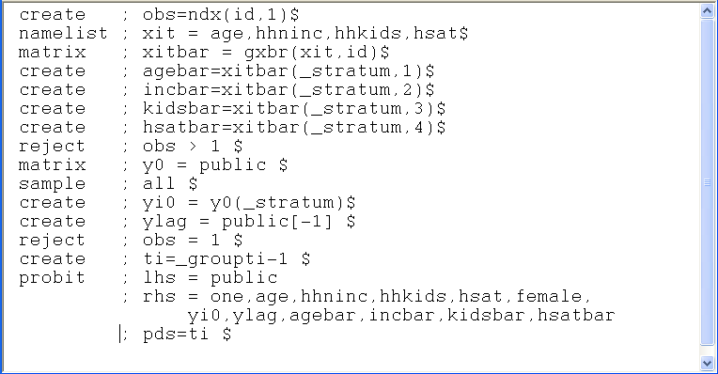
A Dynamic Model for Public Insurance
Age
Household Income
Kids in the household
Health Status
Basic Model
Add initial value, lagged value, group means

Slide 59
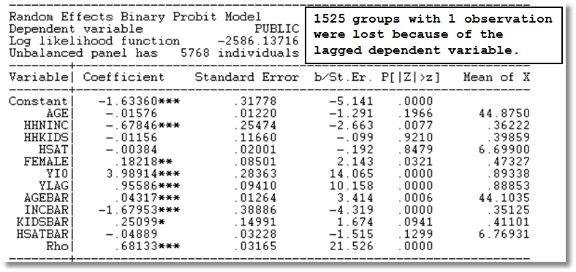
Dynamic Common Effects Model

