Slide 1
Discrete Choice Modeling
William Greene
Stern School of Business
New York University

Slide 2
Part 6
Modeling Latent Parameter Heterogeneity

Slide 3
Parameter Heterogeneity
Fixed and Random Effects Models
  Latent common time invariant “effects”
  Heterogeneity in level parameter – constant term – in the model
General Parameter Heterogeneity in Models
  Discrete: There is more than one time of individual in the population – parameters differ across types. Produces a Latent Class Model
  Continuous; Parameters vary randomly across individuals: Produces a Random Parameters Model or a Mixed Model. (Synonyms)

Slide 4
Latent Class Models
There are Q types of people, q = 1,…,Q
For each type,
Prob(Outcome|type=q) = f(y,x|β_{q})
Individual i is and remains a member of class q
An individual will be drawn at random from the population. Prob(in class q) = π_{q}
From the modeler’s point of view:
Prob(Outcome) = Σ_{q} π_{q} Prob(Outcome|type=q)
= Σ_{q} π_{q} f(y,x|β_{q})

Slide 5
Finite Mixture Model
Prob(Outcome|type=q) = f(y,x|β_{q}) depends on parameter vector
Parameters are randomly, discretely distributed among population members, with
Prob(β = β_{q}) = π_{q}, q = 1,…,Q
Integrating out the variation across parameters,
Prob(Outcome) = Σ_{q} π_{q} f(y,x|β_{q})
Same model, slightly different interpretation

Slide 6
Estimation Problems
Estimation of population features
  Latent parameter vectors, β_{q}, q = 1,…,Q
  Mixing probabilities, π_{q}, q = 1,…,Q
  Probabilities, partial effects, predictions, etc.
  Model structure: The number of classes, Q
Classification: Prediction of class membership for individuals

Slide 7
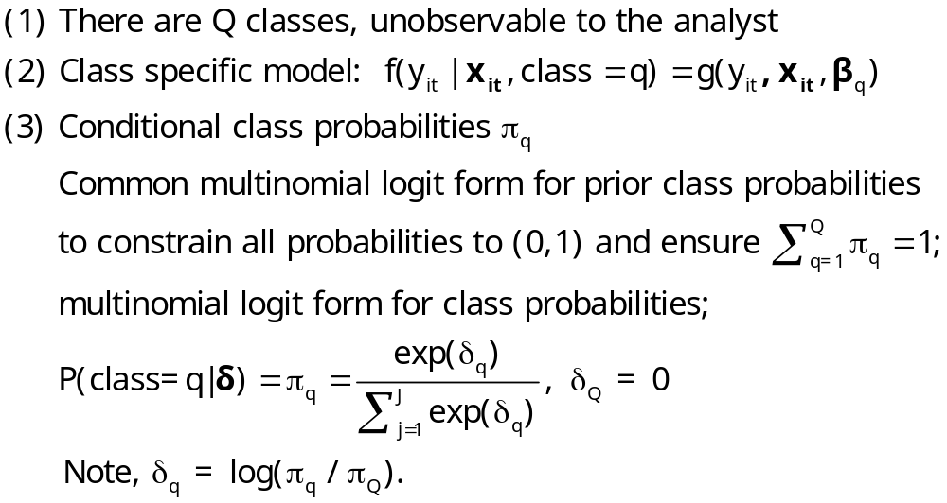
An Extended Latent Class Model

Slide 8
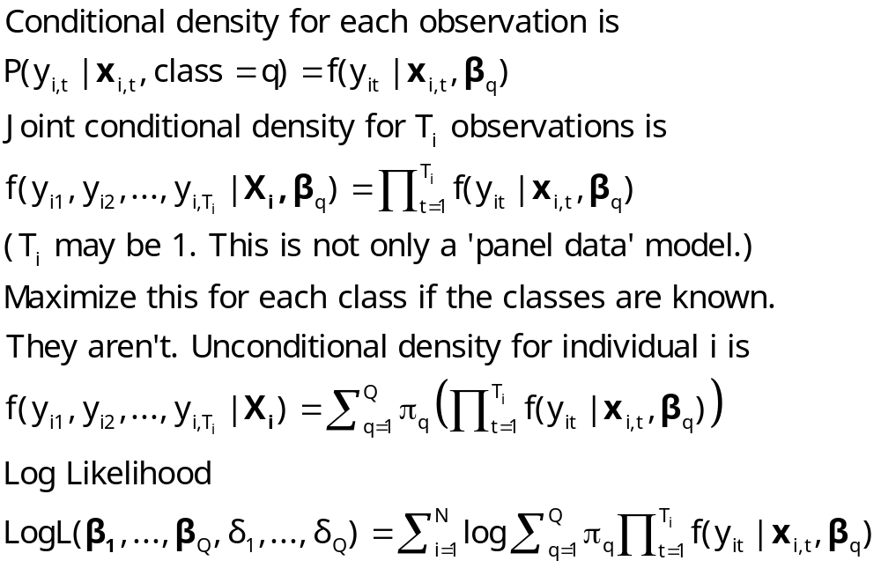
Log Likelihood for an LC Model

Slide 9
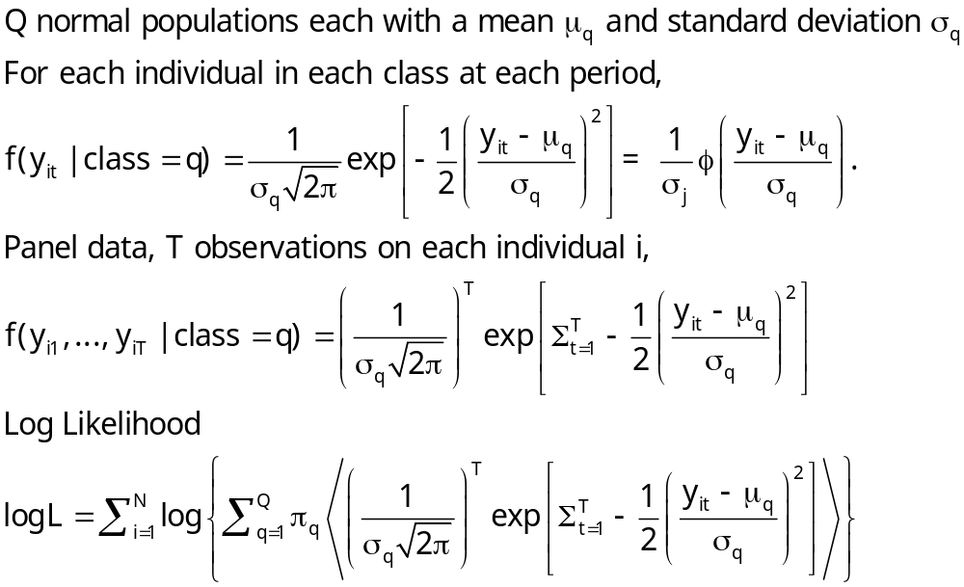
Example: Mixture of Normals

Slide 10
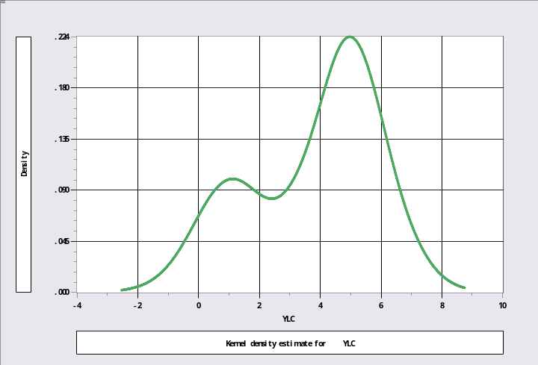
Unmixing a Mixed Sample
N[1,1] and N[5,1]
Sample ; 1 – 1000$
Calc ; Ran(123457)$
Create ; lc1=rnn(1,1) ; lc2=rnn(5,1)$
Create ; class=rnu(0,1)$
Create ; if(class<.3)ylc=lc1 ; (else)ylc=lc2$
Kernel ; rhs=ylc $
Regress ; lhs=ylc;rhs=one;lcm;pts=2;pds=1$

Slide 11
Mixture of Normals
+---------------------------------------------+
| Latent Class / Panel LinearRg Model |
| Dependent variable YLC |
| Number of observations 1000 |
| Log likelihood function -1960.443 |
| Info. Criterion: AIC = 3.93089 |
| LINEAR regression model |
| Model fit with 2 latent classes. |
+---------------------------------------------+
+--------+--------------+----------------+--------+--------+----------+
|Variable| Coefficient | Standard Error |b/St.Er.|P[|Z|>z]| Mean of X|
+--------+--------------+----------------+--------+--------+----------+
+--------+Model parameters for latent class 1 |
|Constant| 4.97029*** .04511814 110.162 .0000 |
|Sigma | 1.00214*** .03317650 30.206 .0000 |
+--------+Model parameters for latent class 2 |
|Constant| 1.05522*** .07347646 14.361 .0000 |
|Sigma | .95746*** .05456724 17.546 .0000 |
+--------+Estimated prior probabilities for class membership |
|Class1Pr| .70003*** .01659777 42.176 .0000 |
|Class2Pr| .29997*** .01659777 18.073 .0000 |
+--------+------------------------------------------------------------+
| Note: ***, **, * = Significance at 1%, 5%, 10% level. |
+---------------------------------------------------------------------+

Slide 12
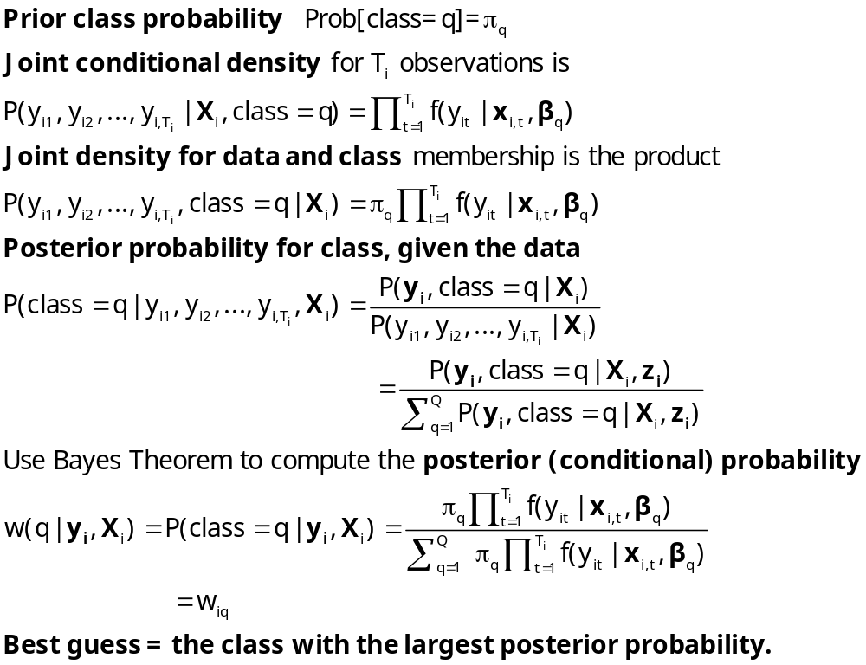
Estimating Which Class

Slide 13
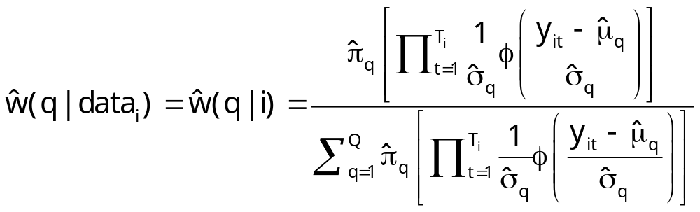
Posterior for Normal Mixture

Slide 14
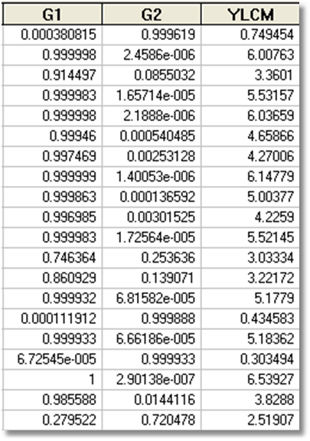
Estimated Posterior Probabilities

Slide 15
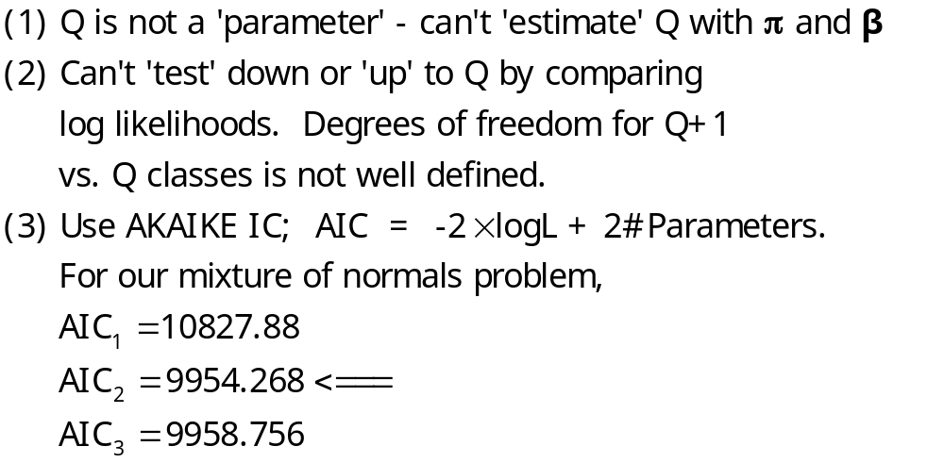
How Many Classes?

Slide 16
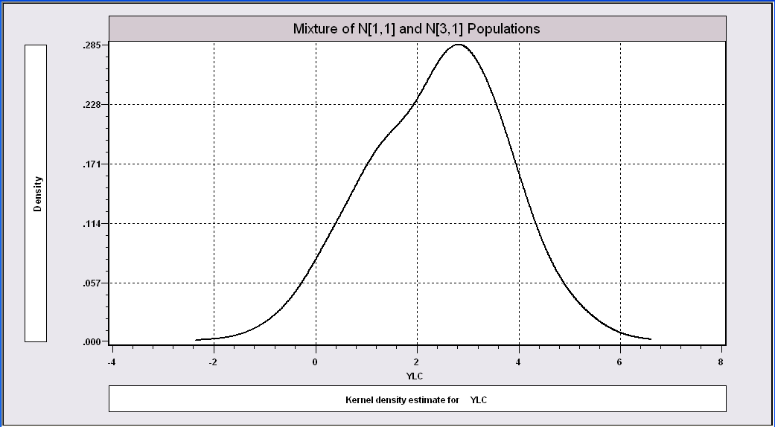
More Difficult When the
Populations are Close Together

Slide 17
The Technique Still Works
----------------------------------------------------------------------
Latent Class / Panel LinearRg Model
Dependent variable YLC
Sample is 1 pds and 1000 individuals
LINEAR regression model
Model fit with 2 latent classes.
--------+-------------------------------------------------------------
Variable| Coefficient Standard Error b/St.Er. P[|Z|>z] Mean of X
--------+-------------------------------------------------------------
|Model parameters for latent class 1
Constant| 2.93611*** .15813 18.568 .0000
Sigma| 1.00326*** .07370 13.613 .0000
|Model parameters for latent class 2
Constant| .90156*** .28767 3.134 .0017
Sigma| .86951*** .10808 8.045 .0000
|Estimated prior probabilities for class membership
Class1Pr| .73447*** .09076 8.092 .0000
Class2Pr| .26553*** .09076 2.926 .0034
--------+-------------------------------------------------------------

Slide 18
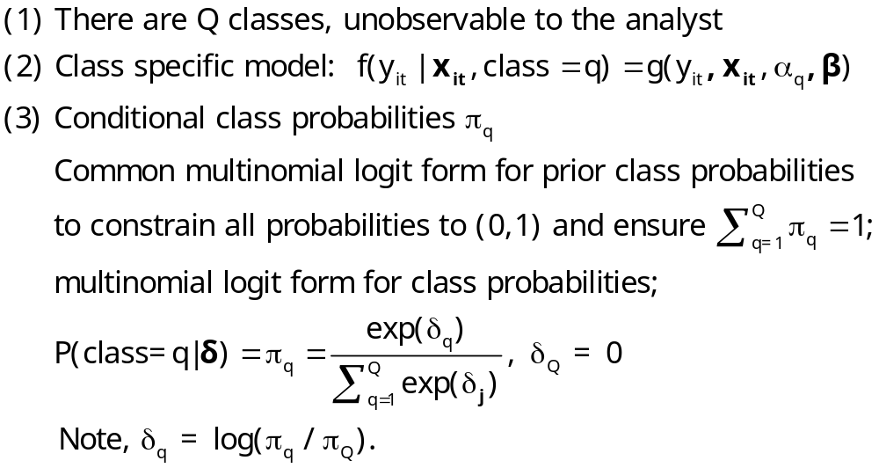
Heckman and Singer RE Model
Random Effects Model
Random Constants with Discrete Distribution

Slide 19
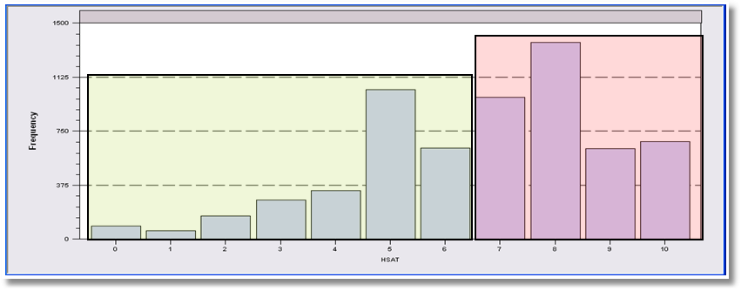
LCM for Health Status
Self Assessed Health Status = 0,1,…,10
Recoded: Healthy = HSAT > 6
Using only groups observed T=7 times; N=887
Prob = Φ(Age,Educ,Income,Married,Kids)
2, 3 classes

Slide 20
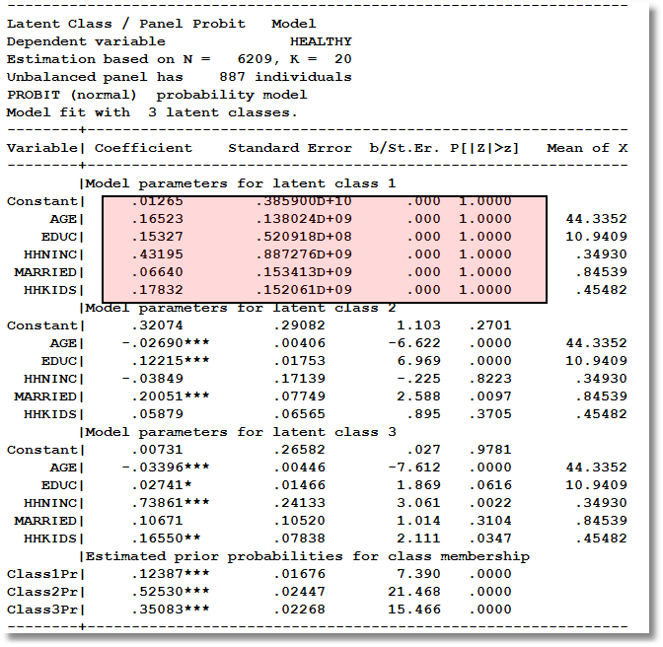
Too Many Classes

Slide 21
Two Class Model
----------------------------------------------------------------------
Latent Class / Panel Probit Model
Dependent variable HEALTHY
Unbalanced panel has 887 individuals
PROBIT (normal) probability model
Model fit with 2 latent classes.
--------+-------------------------------------------------------------
Variable| Coefficient Standard Error b/St.Er. P[|Z|>z] Mean of X
--------+-------------------------------------------------------------
|Model parameters for latent class 1
Constant| .61652** .28620 2.154 .0312
AGE| -.02466*** .00401 -6.143 .0000 44.3352
EDUC| .11759*** .01852 6.351 .0000 10.9409
HHNINC| .10713 .20447 .524 .6003 .34930
MARRIED| .11705 .09574 1.223 .2215 .84539
HHKIDS| .04421 .07017 .630 .5287 .45482
|Model parameters for latent class 2
Constant| .18988 .31890 .595 .5516
AGE| -.03120*** .00464 -6.719 .0000 44.3352
EDUC| .02122 .01934 1.097 .2726 10.9409
HHNINC| .61039*** .19688 3.100 .0019 .34930
MARRIED| .06201 .10035 .618 .5367 .84539
HHKIDS| .19465** .07936 2.453 .0142 .45482
|Estimated prior probabilities for class membership
Class1Pr| .56604*** .02487 22.763 .0000
Class2Pr| .43396*** .02487 17.452 .0000

Slide 22
Partial Effects in LC Model
----------------------------------------------------------------------
Partial derivatives of expected val. with
respect to the vector of characteristics.
They are computed at the means of the Xs.
Conditional Mean at Sample Point .6116
Scale Factor for Marginal Effects .3832
B for latent class model is a wghted avrg.
--------+-------------------------------------------------------------
Variable| Coefficient Standard Error b/St.Er. P[|Z|>z] Elasticity
--------+-------------------------------------------------------------
|Two class latent class model
AGE| -.01054*** .00134 -7.860 .0000 -.76377
EDUC| .02904*** .00589 4.932 .0000 .51939
HHNINC| .12475** .05598 2.228 .0259 .07124
MARRIED| .03570 .02991 1.194 .2326 .04934
HHKIDS| .04196** .02075 2.022 .0432 .03120
--------+-------------------------------------------------------------
|Pooled Probit Model
AGE| -.00846*** .00081 -10.429 .0000 -.63399
EDUC| .03219*** .00336 9.594 .0000 .59568
HHNINC| .16699*** .04253 3.927 .0001 .09865
|Marginal effect for dummy variable is P|1 - P|0.
MARRIED| .02414 .01877 1.286 .1986 .03451
|Marginal effect for dummy variable is P|1 - P|0.
HHKIDS| .06754*** .01483 4.555 .0000 .05195
--------+-------------------------------------------------------------

Slide 23
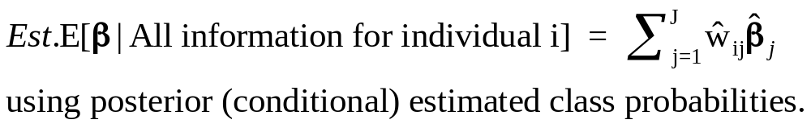
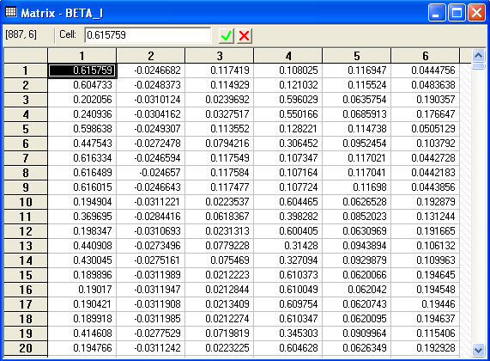
Conditional Means of Parameters

Slide 24
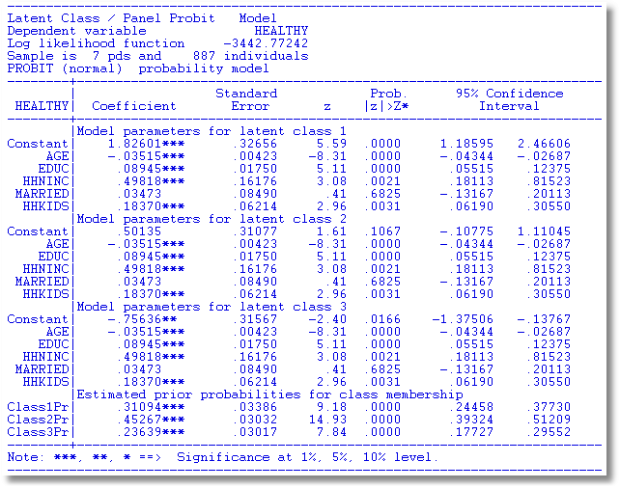
Heckman and Singer Model – 3 Points

Slide 25
Heckman/Singer vs. REM
-----------------------------------------------------------------------------
Random Effects Binary Probit Model
Sample is 7 pds and 887 individuals.
--------+--------------------------------------------------------------------
| Standard Prob. 95% Confidence
HEALTHY| Coefficient Error z |z|>Z* Interval
--------+--------------------------------------------------------------------
Constant| .33609 .29252 1.15 .2506 -.23723 .90941
(Other coefficients omitted)
Rho| .52565*** .02025 25.96 .0000 .48596 .56534
--------+--------------------------------------------------------------------
Rho = σ²/(1+s2) so σ² = rho/(1-rho) = 1.10814.
Mean = .33609, Variance = 1.10814
For Heckman and Singer model,
3 points a1,a2,a3 = 1.82601, .50135, -.75636
3 probabilities p1,p2,p3 = .31094, .45267, .23639
Mean = .61593 variance = .90642

Slide 26
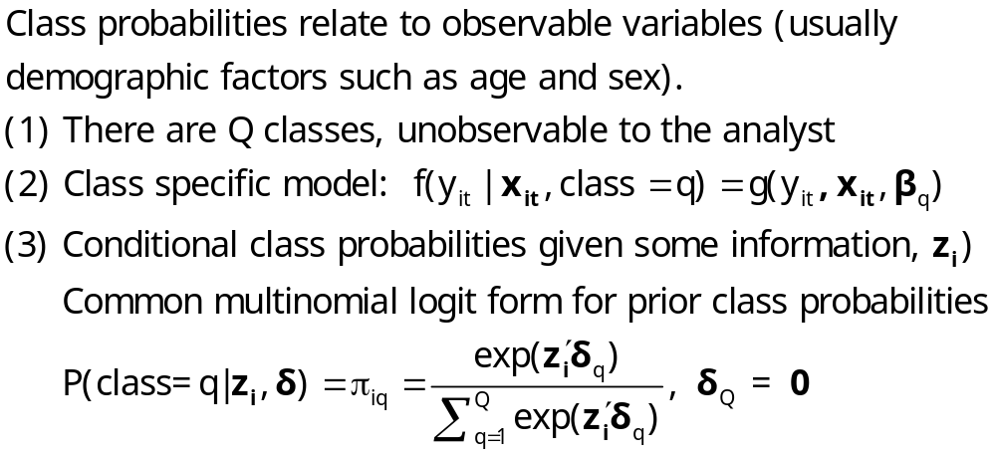
An Extended Latent Class Model
Notes:
26

Slide 27
Health Satisfaction Model
----------------------------------------------------------------------
Latent Class / Panel Probit Model Used mean AGE and FEMALE
Dependent variable HEALTHY in class probability model
Log likelihood function -3465.98697
--------+-------------------------------------------------------------
Variable| Coefficient Standard Error b/St.Er. P[|Z|>z] Mean of X
--------+-------------------------------------------------------------
|Model parameters for latent class 1
Constant| .60050** .29187 2.057 .0396
AGE| -.02002*** .00447 -4.477 .0000 44.3352
EDUC| .10597*** .01776 5.968 .0000 10.9409
HHNINC| .06355 .20751 .306 .7594 .34930
MARRIED| .07532 .10316 .730 .4653 .84539
HHKIDS| .02632 .07082 .372 .7102 .45482
|Model parameters for latent class 2
Constant| .10508 .32937 .319 .7497
AGE| -.02499*** .00514 -4.860 .0000 44.3352
EDUC| .00945 .01826 .518 .6046 10.9409
HHNINC| .59026*** .19137 3.084 .0020 .34930
MARRIED| -.00039 .09478 -.004 .9967 .84539
HHKIDS| .20652*** .07782 2.654 .0080 .45482
|Estimated prior probabilities for class membership
ONE_1| 1.43661*** .53679 2.676 .0074 (.56519)
AGEBAR_1| -.01897* .01140 -1.664 .0960
FEMALE_1| -.78809*** .15995 -4.927 .0000
ONE_2| .000 ......(Fixed Parameter)...... (.43481)
AGEBAR_2| .000 ......(Fixed Parameter)......
FEMALE_2| .000 ......(Fixed Parameter)......
--------+-------------------------------------------------------------

Slide 28
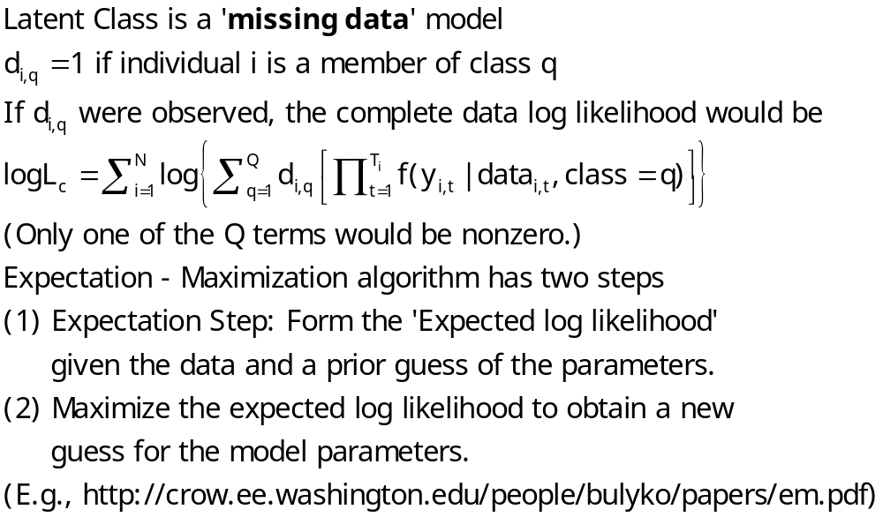
The EM Algorithm

Slide 29
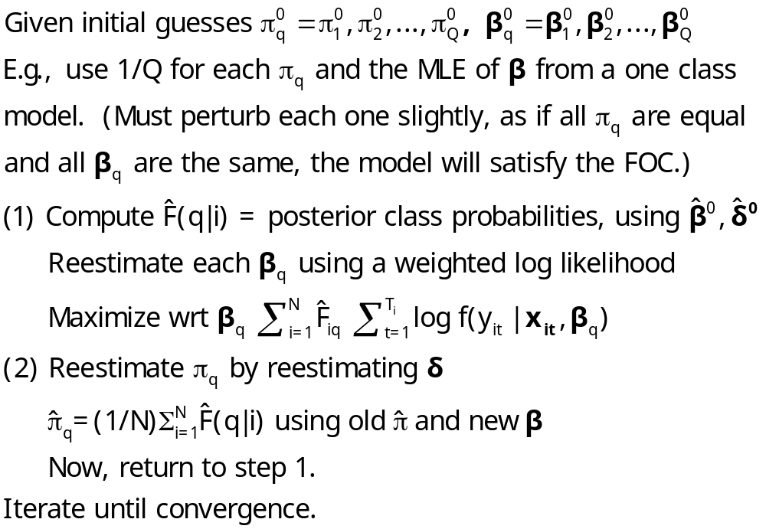
Implementing EM for LC Models

Slide 30
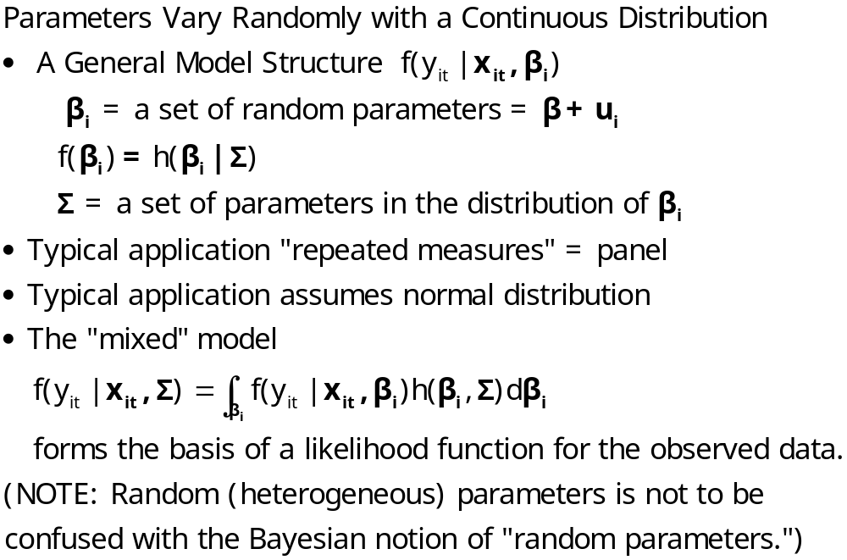
Random Parameters Models
Notes:
30

Slide 31
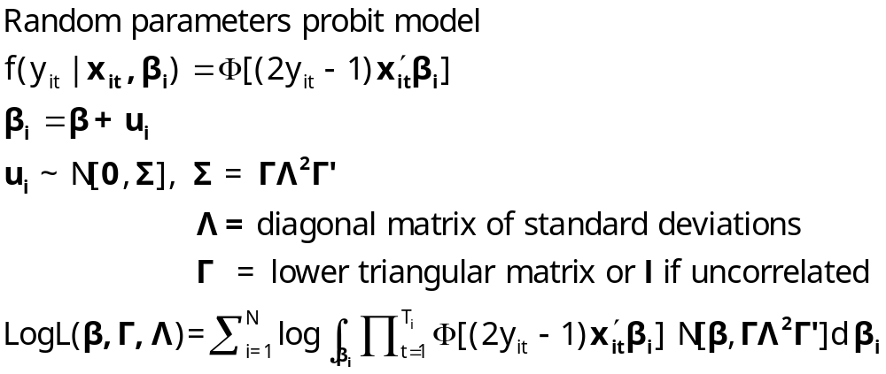
A Mixed Probit Model

Slide 32
Application – Healthy
German Health Care Usage Data, 7,293 Individuals, Varying Numbers of Periods
Variables in the file are
Data downloaded from Journal of Applied Econometrics Archive. This is an unbalanced panel with 7,293 individuals. They can be used for regression, count models, binary choice, ordered choice, and bivariate binary choice. There are altogether 27,326 observations. The number of observations ranges from 1 to 7. (Frequencies are: 1=1525, 2=2158, 3=825, 4=926, 5=1051, 6=1000, 7=987).
DOCTOR = 1(Number of doctor visits > 0)
HSAT = health satisfaction, coded 0 (low) - 10 (high)
DOCVIS = number of doctor visits in last three months
HOSPVIS = number of hospital visits in last calendar year
PUBLIC = insured in public health insurance = 1; otherwise = 0
ADDON = insured by add-on insurance = 1; otherswise = 0
HHNINC = household nominal monthly net income in German marks / 10000.
(4 observations with income=0 were dropped)
HHKIDS = children under age 16 in the household = 1; otherwise = 0
EDUC = years of schooling
AGE = age in years
MARRIED = marital status

Slide 33
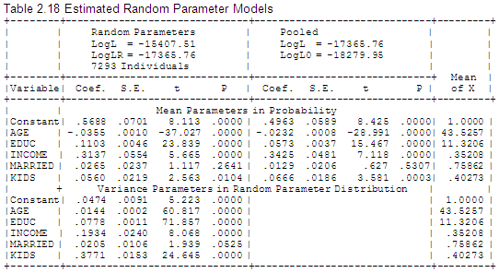
Estimates of a Mixed Probit Model

Slide 34
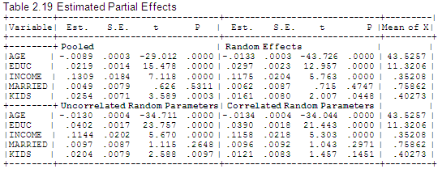
Partial Effects are Also Simulated

Slide 35
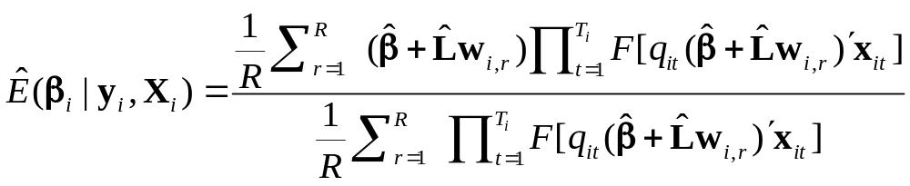
Simulating Conditional Means for Individual Parameters
Posterior estimates of E[parameters(i) | Data(i)]

Slide 36
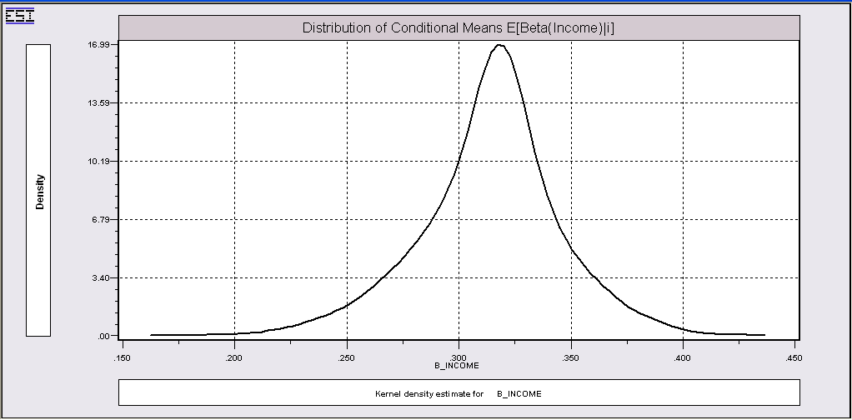
Summarizing Simulated Estimates

Slide 37
Correlated Parameters
----------------------------------------------------------------------
Random Coefficients Probit Model
Dependent variable HEALTHY
PROBIT (normal) probability model
Simulation based on 25 random draws
--------+-------------------------------------------------------------
Variable| Coefficient Standard Error b/St.Er. P[|Z|>z] Mean of X
--------+-------------------------------------------------------------
|Means for random parameters
Constant| .22395 .18073 1.239 .2153
AGE| -.03919*** .00257 -15.256 .0000 44.3352
EDUC| .15526*** .01173 13.236 .0000 10.9409
HHNINC| .28023** .12572 2.229 .0258 .34930
MARRIED| .03971 .05918 .671 .5023 .84539
HHKIDS| .06313 .04713 1.340 .1804 .45482
----------------------------------------------------------------------
Partial derivatives of expected val. with
respect to the vector of characteristics.
They are computed at the means of the Xs.
Conditional Mean at Sample Point .6351
Scale Factor for Marginal Effects .3758
AGE| -.01473*** .00102 -14.420 .0000 -1.02820
EDUC| .05835*** .00444 13.149 .0000 1.00526
HHNINC| .10532** .04722 2.231 .0257 .05793
MARRIED| .01492 .02228 .670 .5029 .01987
HHKIDS| .02373 .01754 1.353 .1761 .01699
--------+-------------------------------------------------------------

Slide 38
Cholesky Matrix
--------+-------------------------------------------------------------
Variable| Coefficient Standard Error b/St.Er. P[|Z|>z] Mean of X
--------+-------------------------------------------------------------
|Means for random parameters
Constant| .22395 .18073 1.239 .2153
AGE| -.03919*** .00257 -15.256 .0000 44.3352
EDUC| .15526*** .01173 13.236 .0000 10.9409
HHNINC| .28023** .12572 2.229 .0258 .34930
MARRIED| .03971 .05918 .671 .5023 .84539
HHKIDS| .06313 .04713 1.340 .1804 .45482
|Diagonal elements of Cholesky matrix
Constant| .66612*** .21850 3.049 .0023
AGE| .01041*** .00183 5.687 .0000
EDUC| .07307*** .00592 12.346 .0000
HHNINC| .18897* .10133 1.865 .0622
MARRIED| .47889*** .03140 15.252 .0000
HHKIDS| .44804*** .03126 14.334 .0000
|Below diagonal elements of Cholesky matrix
lAGE_ONE| -.00211 .00298 -.706 .4799
lEDU_ONE| .07359*** .01403 5.246 .0000
lEDU_AGE| -.01881** .00778 -2.417 .0156
lHHN_ONE| -.32031** .15453 -2.073 .0382
lHHN_AGE| .05302 .12989 .408 .6831
lHHN_EDU| .44021*** .13082 3.365 .0008
lMAR_ONE| -.19247** .07503 -2.565 .0103
lMAR_AGE| -.24710*** .06002 -4.117 .0000
lMAR_EDU| .01475 .05933 .249 .8037
lMAR_HHN| .07949* .04724 1.683 .0924
lHHK_ONE| -.07220 .05686 -1.270 .2041
lHHK_AGE| .21508*** .04456 4.827 .0000
lHHK_EDU| .31374*** .04369 7.181 .0000
lHHK_HHN| -.11592*** .04023 -2.881 .0040
lHHK_MAR| -.35853*** .04154 -8.631 .0000
--------+-------------------------------------------------------------

Slide 39
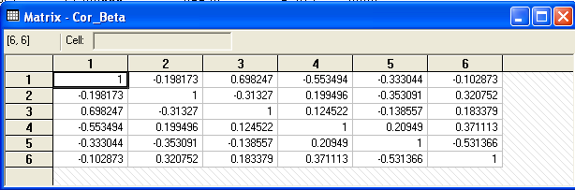
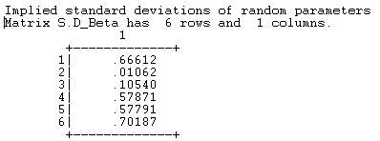
Estimated Parameter Correlation Matrix

Slide 40
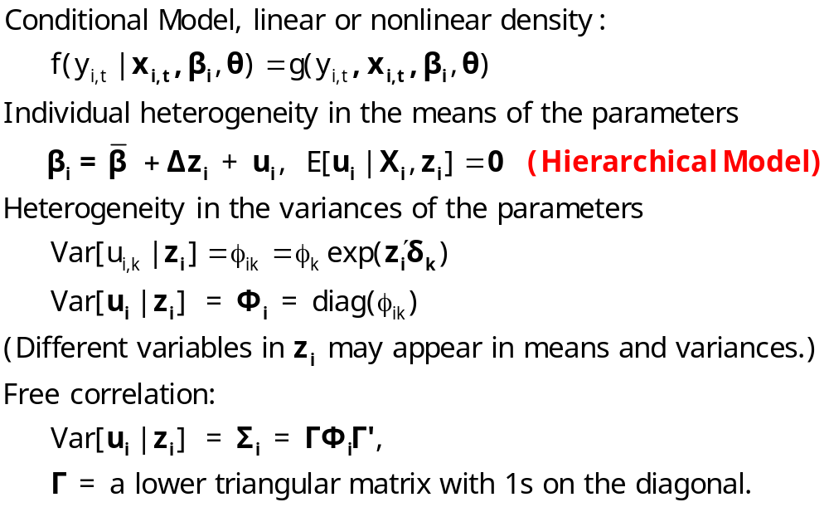
Modeling Parameter Heterogeneity

Slide 41
Hierarchical Probit Model
----------------------------------------------------------------------
Random Coefficients Probit Model
--------+-------------------------------------------------------------
Variable| Coefficient Standard Error b/St.Er. P[|Z|>z] Mean of X
--------+-------------------------------------------------------------
|Means for random parameters
Constant| 2.80514*** .84261 3.329 .0009
AGE| -.06321*** .01397 -4.523 .0000 44.3352
EDUC| -.15340*** .05506 -2.786 .0053 10.9409
HHNINC| 2.56154*** .67822 3.777 .0002 .34930
MARRIED| .61453** .26650 2.306 .0211 .84539
HHKIDS| -.19855 .24303 -.817 .4140 .45482
|Scale parameters for dists. of random parameters
Constant| .12981*** .02448 5.303 .0000
AGE| .01424*** .00050 28.712 .0000
EDUC| .00368** .00172 2.142 .0322
HHNINC| .52685*** .05165 10.201 .0000
MARRIED| .16399*** .02111 7.768 .0000
HHKIDS| .13928*** .02845 4.896 .0000
|Heterogeneity in the means of random parameters
cONE_AGE| -.02875 .02082 -1.381 .1673
cONE_FEM| -.98200*** .35328 -2.780 .0054
cAGE_AGE| .00022 .00029 .740 .4592
cAGE_FEM| .01552*** .00510 3.043 .0023
cEDU_AGE| .00575*** .00130 4.438 .0000
cEDU_FEM| -.00877 .02172 -.404 .6864
cHHN_AGE| -.04540*** .01485 -3.057 .0022
cHHN_FEM| -.03645 .25041 -.146 .8843
cMAR_AGE| -.01556** .00610 -2.550 .0108
cMAR_FEM| .20538* .11232 1.828 .0675
cHHK_AGE| .01053* .00552 1.906 .0566
cHHK_FEM| -.25666*** .08923 -2.876 .0040
--------+-------------------------------------------------------------

Slide 42
Mixed Model Estimation
Programs differ on the models fitted, the algorithms, the paradigm, and
the extensions provided to the simplest RPM, β_{i} = β+u_{i}.
MLWin: http://www.cmm.bristol.ac.uk/MLwiN/index.shtml
  Multilevel models
  Regression and some loglinear models
WinBUGS: Mainly for Bayesian Applications
  MCMC
  User specifies the model – constructs the Gibbs Sampler/Metropolis Hastings
SAS: Proc Mixed.
  Classical
  Uses primarily a kind of GLS/GMM (method of moments algorithm for loglinear models)
LIMDEP/NLOGIT
  Classical
  Mixing done by Monte Carlo integration – maximum simulated likelihood
  Numerous linear, nonlinear, loglinear models, multinomial choice models
Stata: Classical - GLAMM
  Mixing done by quadrature. (Very, very slow for 2 or more dimensions)
  Several loglinear models
  Arne Hole has developed a basic RP multinomial logit estimator
Ken Train’s Free Gauss Code
  Monte Carlo integration
  Used by many researchers
  Mixed Multinomial Logit model only (but free!)
Biogeme – Michel Bierlaire free multinomial logit package
R: nlme package – multilevel linear regression

Slide 43
Hierarchical Model
Notes:
43

Slide 44
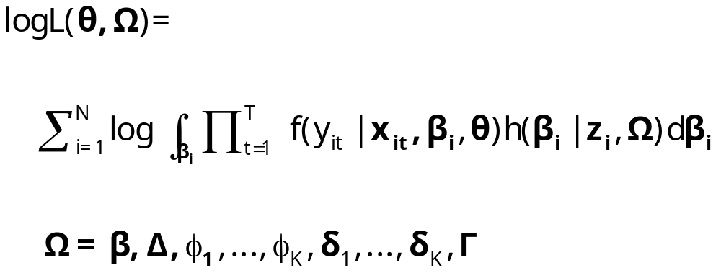
Maximum Simulated Likelihood

Slide 45
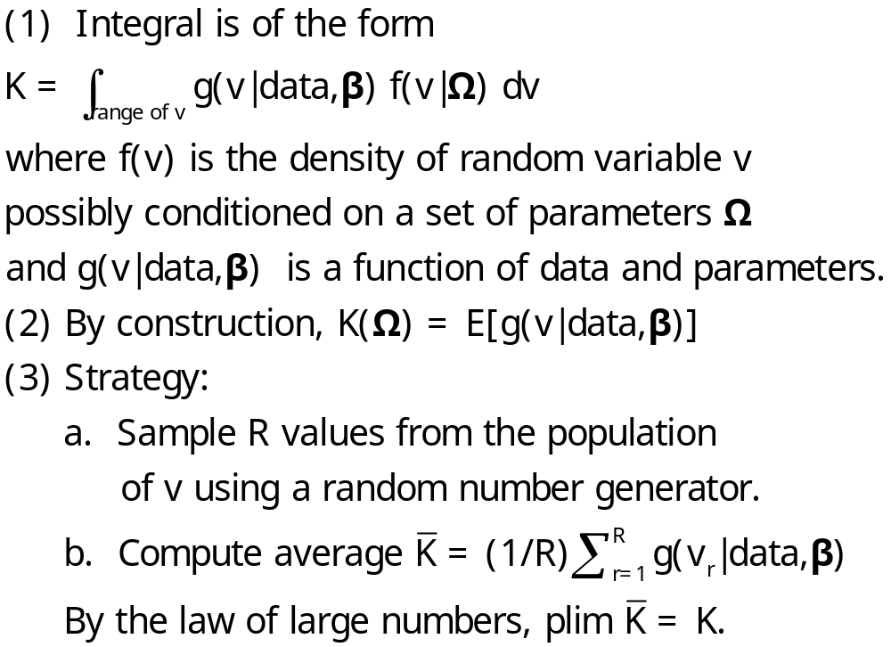
Monte Carlo Integration

Slide 46
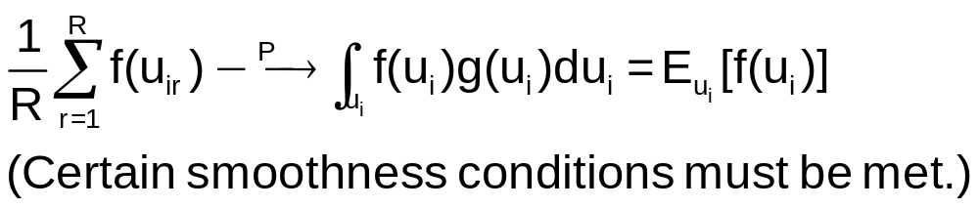
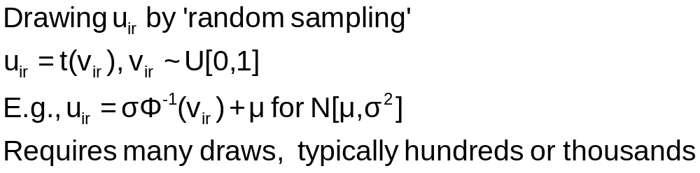
Monte Carlo Integration

Slide 47
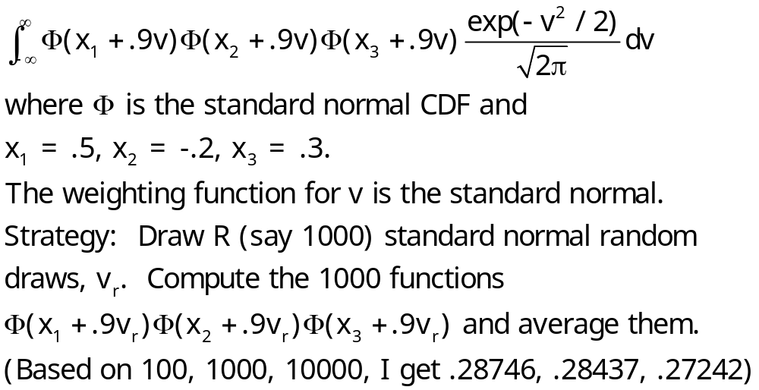
Example: Monte Carlo Integral

Slide 48
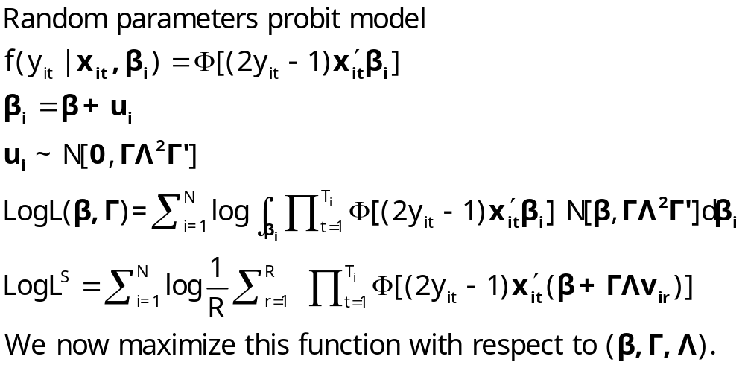
Simulated Log Likelihood for a Mixed Probit Model

Slide 49
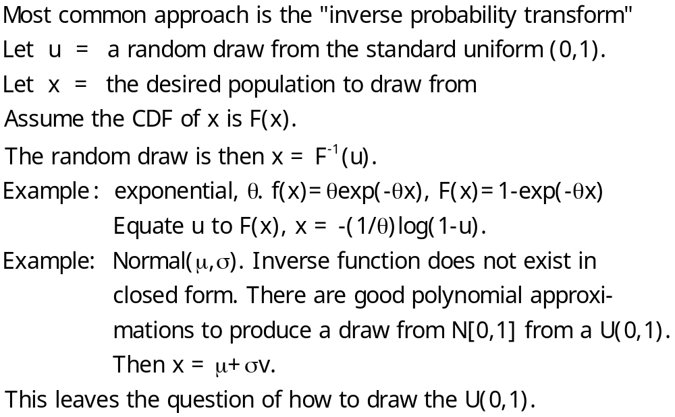
Generating a Random Draw

Slide 50
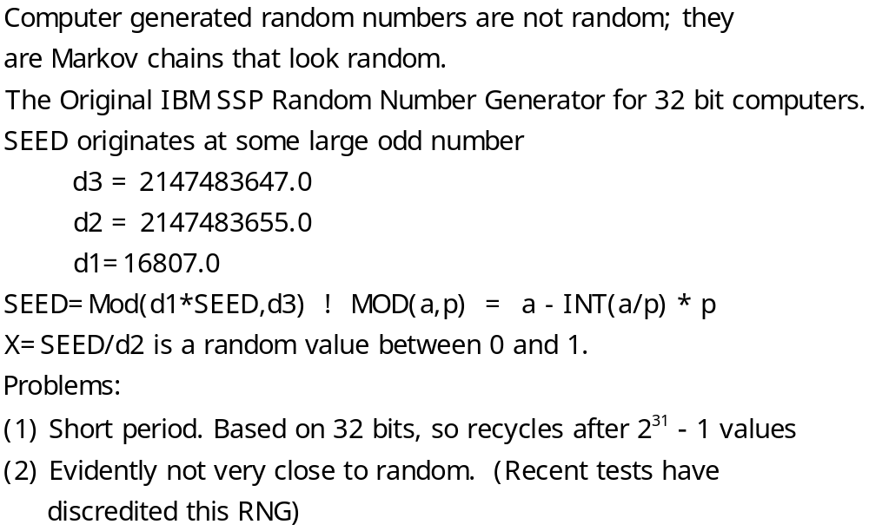
Drawing Uniform Random Numbers

Slide 51
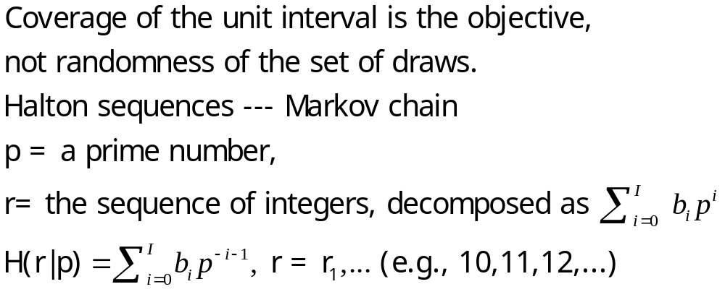
Quasi-Monte Carlo Integration Based on Halton Sequences
For example, using base p=5, the integer r=37 has b₀ = 2, b₁ = 2, and b₃ = 1; (37=1x5² + 2x5¹ + 2x5⁰). Then
H(37|5) = 2×5⁻¹ + 2×5⁻² + 1×5⁻³ = 0.448.

Slide 52
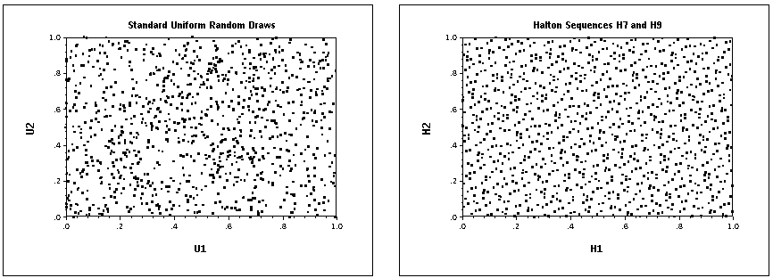
Halton Sequences vs. Random Draws
Requires far fewer draws – for one dimension, about 1/10. Accelerates estimation by a factor of 5 to 10.

