Slide 1
Discrete Choice Modeling
William Greene
Stern School of Business
New York University

Slide 2
Part 7
Ordered Choices

Slide 3


Slide 4
A Taxonomy of Discrete Outcomes
Types of outcomes
  Quantitative, ordered, labels
    Preference ordering: health satisfaction
    Rankings: Competitions, job preferences, contests (horse races)
  Quantitative, counts of outcomes: Doctor visits
  Qualitative, unordered labels: Brand choice
Ordered vs. unordered choices
Multinomial vs. multivariate
Single vs. repeated measurement

Slide 5
Ordered Discrete Outcomes
E.g.: Taste test, credit rating, course grade, preference scale
Underlying random preferences:
  Existence of an underlying continuous preference scale
  Mapping to observed choices
Strength of preferences is reflected in the discrete outcome
Censoring and discrete measurement
The nature of ordered data

Slide 6
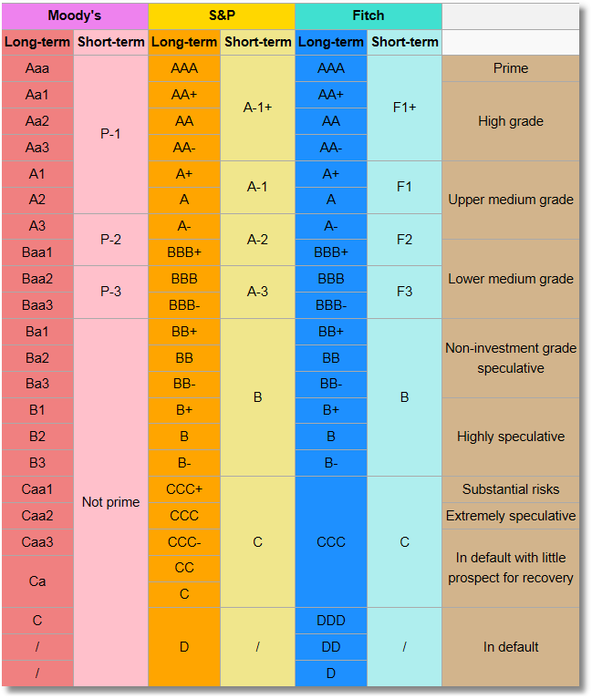
Bond Ratings

Slide 7
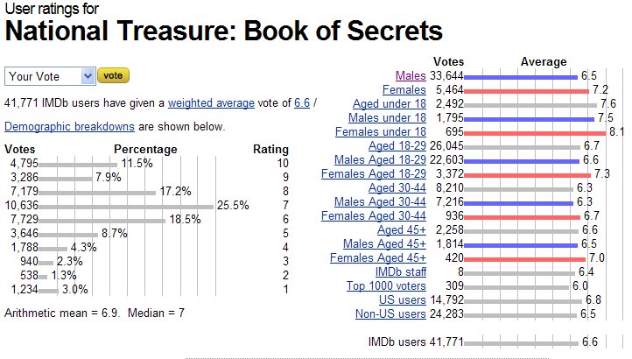
Ordered Preferences at IMDB.com

Slide 8
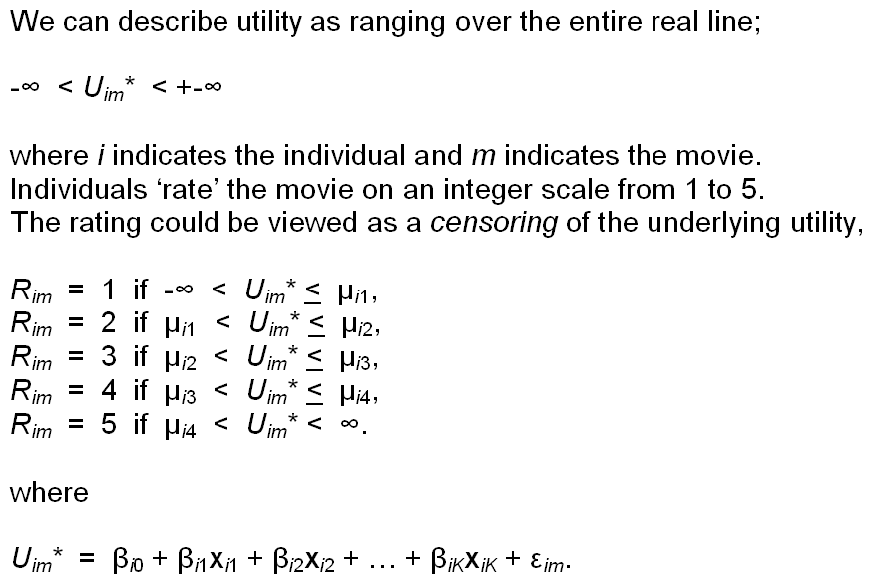
Translating Movie Preferences
Into a Discrete Outcomes

Slide 9

Health Satisfaction (HSAT)
Self administered survey: Health Care Satisfaction? (0 – 10)
Continuous Preference Scale

Slide 10
Modeling Ordered Choices
Random Utility (allowing a panel data setting)
Uit = α + β’x_{it} + ε_{it}
= a_{it} + ε_{it}
Observe outcome j if utility is in region j
Probability of outcome = probability of cell
Pr[Yit=j] = Prob[Yit < j] - Prob[Yit < j-1]
= F(μ_{j} – a_{it}) - F(μ_{j-1} – a_{it})

Slide 11
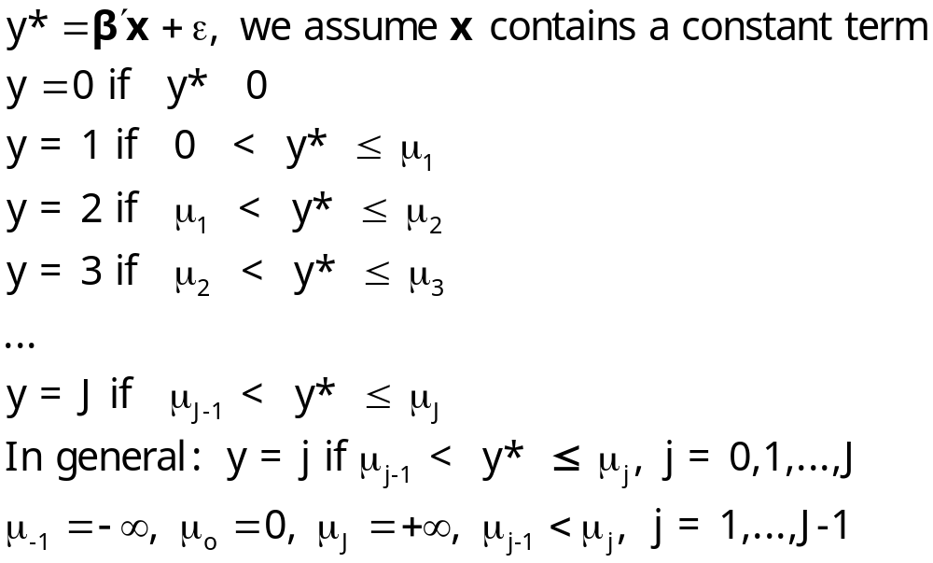
Ordered Probability Model

Slide 12

Combined Outcomes for Health Satisfaction

Slide 13
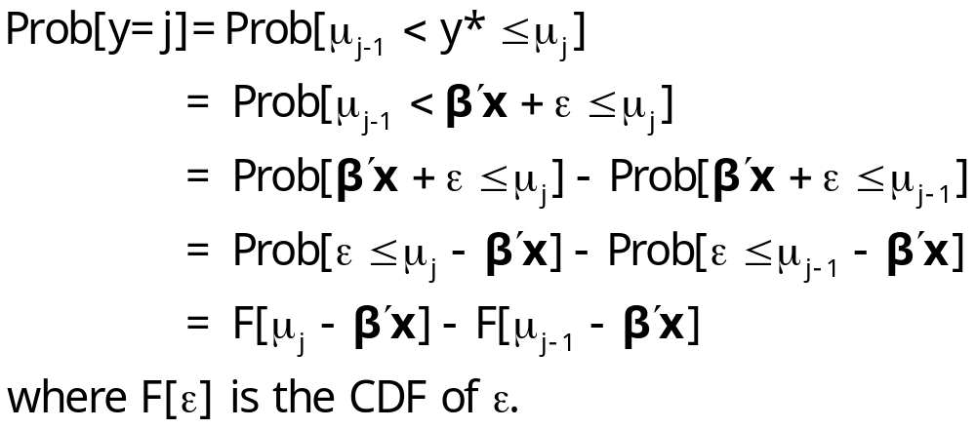
Probabilities for Ordered Choices

Slide 14
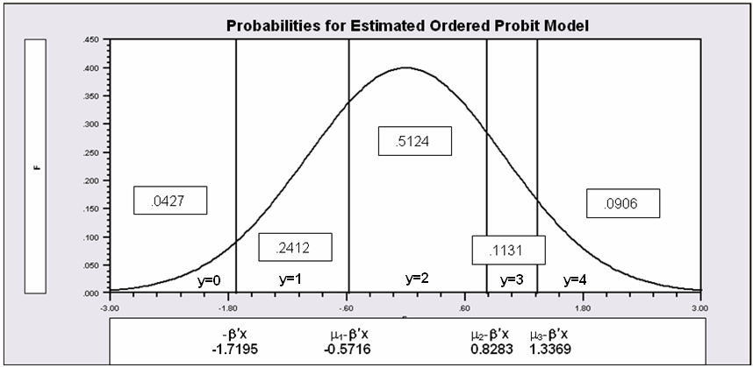
Probabilities for Ordered Choices
μ₁ =1.1479 μ₂ =2.5478 μ₃ =3.0564

Slide 15
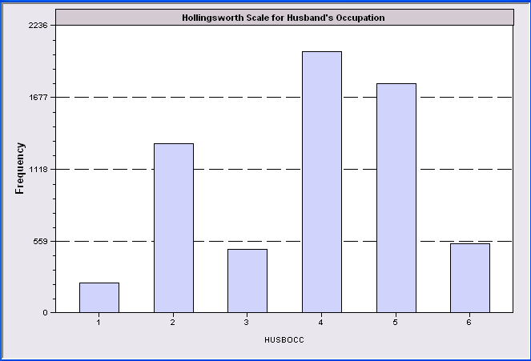
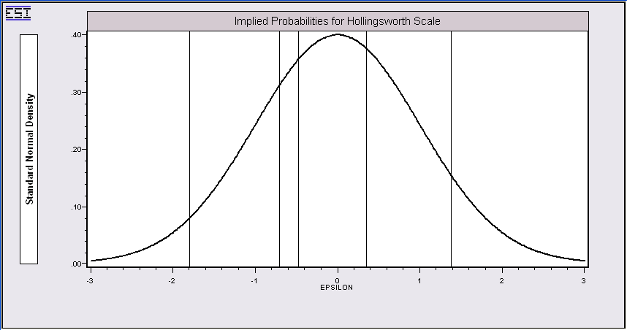
Thresholds and Probabilities
The threshold parameters adjust to make probabilities match sample
proportions. They do not adjust to discretize a normal or logistic distribution.

Slide 16
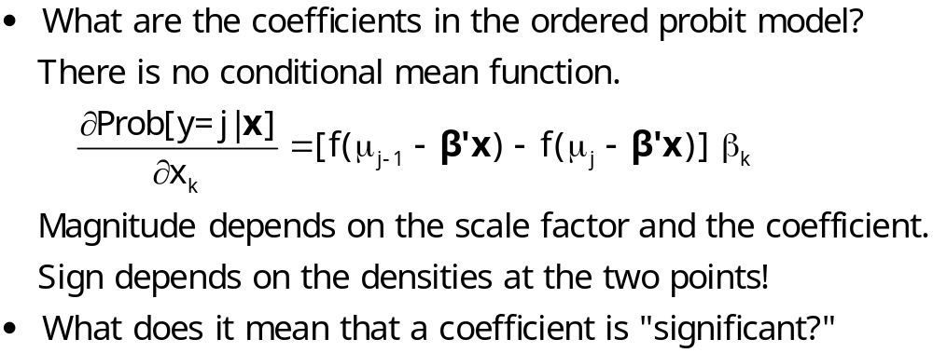
Coefficients

Slide 17
Partial Effects in the
Ordered Probability Model
Assume the β_{k} is positive.
Assume that x_{k} increases.
β’x increases. μ_{j}- β’x shifts to the left for all 5 cells.
Prob[y=0] decreases
Prob[y=1] decreases – the mass shifted out is larger than the mass shifted in.
Prob[y=3] increases – same reason in reverse.
Prob[y=4] must increase.
When β_{k} > 0, increase in x_{k} decreases Prob[y=0] and increases Prob[y=J]. Intermediate cells are ambiguous, but there is only one sign change in the marginal effects from 0 to 1 to … to J

Slide 18
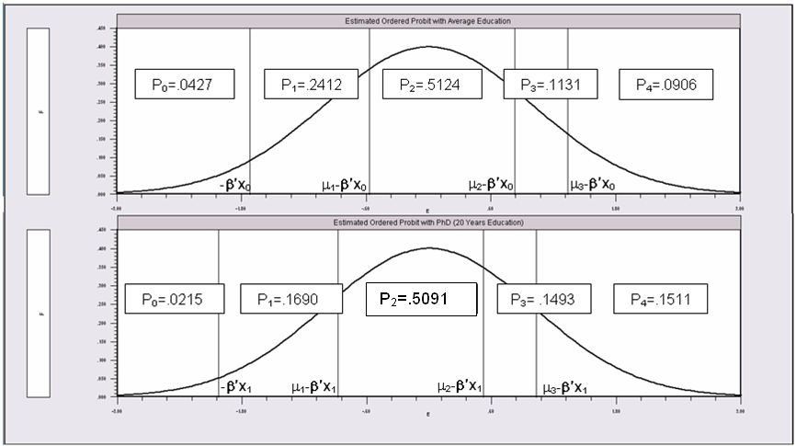
Effects of 8 More Years of Education

Slide 19
An Ordered Probability
Model for Health Satisfaction
+---------------------------------------------+
| Ordered Probability Model |
| Dependent variable HSAT |
| Number of observations 27326 |
| Underlying probabilities based on Normal |
| Cell frequencies for outcomes |
| Y Count Freq Y Count Freq Y Count Freq |
| 0 447 .016 1 255 .009 2 642 .023 |
| 3 1173 .042 4 1390 .050 5 4233 .154 |
| 6 2530 .092 7 4231 .154 8 6172 .225 |
| 9 3061 .112 10 3192 .116 |
+---------------------------------------------+
+---------+--------------+----------------+--------+---------+----------+
|Variable | Coefficient | Standard Error |b/St.Er.|P[|Z|>z] | Mean of X|
+---------+--------------+----------------+--------+---------+----------+
Index function for probability
Constant 2.61335825 .04658496 56.099 .0000
FEMALE -.05840486 .01259442 -4.637 .0000 .47877479
EDUC .03390552 .00284332 11.925 .0000 11.3206310
AGE -.01997327 .00059487 -33.576 .0000 43.5256898
HHNINC .25914964 .03631951 7.135 .0000 .35208362
HHKIDS .06314906 .01350176 4.677 .0000 .40273000
Threshold parameters for index
Mu(1) .19352076 .01002714 19.300 .0000
Mu(2) .49955053 .01087525 45.935 .0000
Mu(3) .83593441 .00990420 84.402 .0000
Mu(4) 1.10524187 .00908506 121.655 .0000
Mu(5) 1.66256620 .00801113 207.532 .0000
Mu(6) 1.92729096 .00774122 248.965 .0000
Mu(7) 2.33879408 .00777041 300.987 .0000
Mu(8) 2.99432165 .00851090 351.822 .0000
Mu(9) 3.45366015 .01017554 339.408 .0000

Slide 20
Ordered Probability Effects
+----------------------------------------------------+
| Marginal effects for ordered probability model |
| M.E.s for dummy variables are Pr[y|x=1]-Pr[y|x=0] |
| Names for dummy variables are marked by *. |
+----------------------------------------------------+
+---------+--------------+----------------+--------+---------+----------+
|Variable | Coefficient | Standard Error |b/St.Er.|P[|Z|>z] | Mean of X|
+---------+--------------+----------------+--------+---------+----------+
These are the effects on Prob[Y=00] at means.
*FEMALE .00200414 .00043473 4.610 .0000 .47877479
EDUC -.00115962 .986135D-04 -11.759 .0000 11.3206310
AGE .00068311 .224205D-04 30.468 .0000 43.5256898
HHNINC -.00886328 .00124869 -7.098 .0000 .35208362
*HHKIDS -.00213193 .00045119 -4.725 .0000 .40273000
These are the effects on Prob[Y=01] at means.
*FEMALE .00101533 .00021973 4.621 .0000 .47877479
EDUC -.00058810 .496973D-04 -11.834 .0000 11.3206310
AGE .00034644 .108937D-04 31.802 .0000 43.5256898
HHNINC -.00449505 .00063180 -7.115 .0000 .35208362
*HHKIDS -.00108460 .00022994 -4.717 .0000 .40273000
... repeated for all 11 outcomes
These are the effects on Prob[Y=10] at means.
*FEMALE -.01082419 .00233746 -4.631 .0000 .47877479
EDUC .00629289 .00053706 11.717 .0000 11.3206310
AGE -.00370705 .00012547 -29.545 .0000 43.5256898
HHNINC .04809836 .00678434 7.090 .0000 .35208362
*HHKIDS .01181070 .00255177 4.628 .0000 .40273000

Slide 21
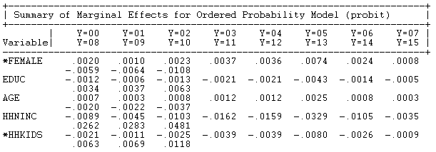
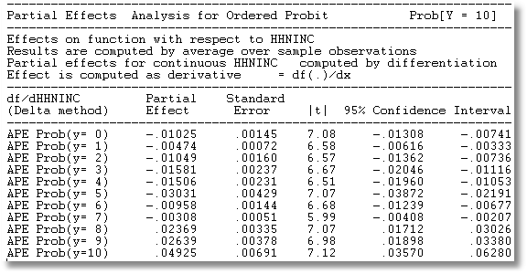
Ordered Probit Marginal Effects
Partial effects at means of the data
Average Partial Effect of HHNINC

Slide 22
The Single Crossing Effect
The marginal effect for EDUC is negative for Prob(0),…,Prob(7), then positive for Prob(8)…Prob(10). One “crossing.”

Slide 23
Analysis of Model Implications
Partial Effects
Fit Measures
Predicted Probabilities
  Averaged: They match sample proportions.
  By observation
  Segments of the sample
  Related to particular variables

Slide 24
Predictions of the Model:Kids
+----------------------------------------------+
|Variable Mean Std.Dev. Minimum Maximum |
+----------------------------------------------+
|Stratum is KIDS = 0.000. Nobs.= 2782.000 |
+--------+-------------------------------------+
|P0 | .059586 .028182 .009561 .125545 |
|P1 | .268398 .063415 .106526 .374712 |
|P2 | .489603 .024370 .419003 .515906 |
|P3 | .101163 .030157 .052589 .181065 |
|P4 | .081250 .041250 .028152 .237842 |
+----------------------------------------------+
|Stratum is KIDS = 1.000. Nobs.= 1701.000 |
+--------+-------------------------------------+
|P0 | .036392 .013926 .010954 .105794 |
|P1 | .217619 .039662 .115439 .354036 |
|P2 | .509830 .009048 .443130 .515906 |
|P3 | .125049 .019454 .061673 .176725 |
|P4 | .111111 .030413 .035368 .222307 |
+----------------------------------------------+
|All 4483 observations in current sample |
+--------+-------------------------------------+
|P0 | .050786 .026325 .009561 .125545 |
|P1 | .249130 .060821 .106526 .374712 |
|P2 | .497278 .022269 .419003 .515906 |
|P3 | .110226 .029021 .052589 .181065 |
|P4 | .092580 .040207 .028152 .237842 |
+----------------------------------------------+
This is a restricted model with outcomes collapsed into 5 cells.

Slide 25
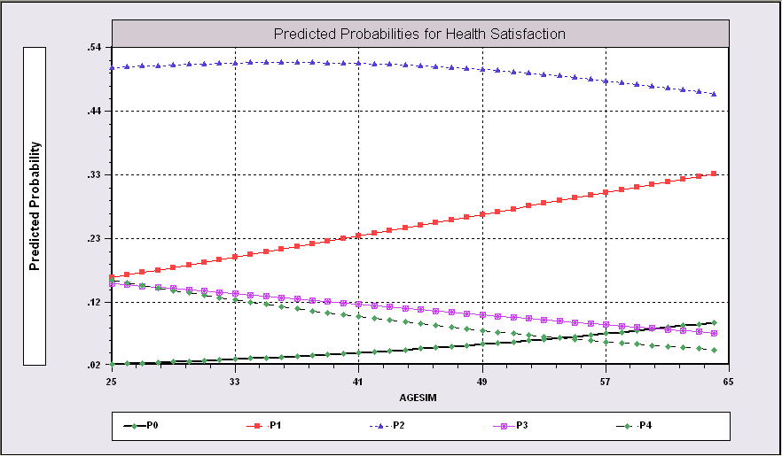
Predictions from the Model Related to Age

Slide 26
Fit Measures
There is no single “dependent variable” to explain.
There is no sum of squares or other measure of “variation” to explain.
Predictions of the model relate to a set of J+1 probabilities, not a single variable.
How to explain fit?
  Based on the underlying regression
  Based on the likelihood function
  Based on prediction of the outcome variable

Slide 27
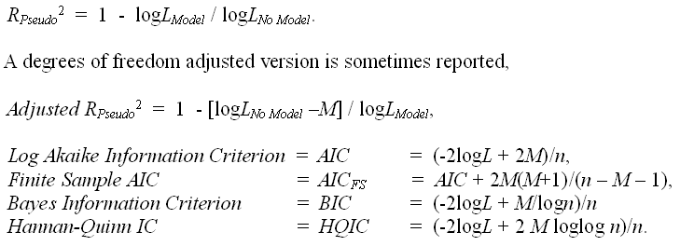
Log Likelihood Based Fit Measures

Slide 28
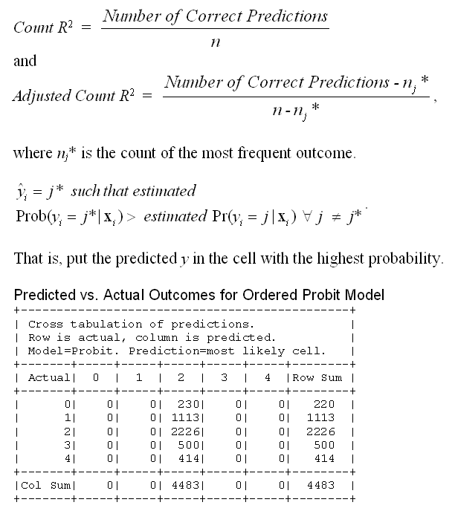
Fit Measure Based on Counting Predictions
This model always predicts the same cell.

Slide 29
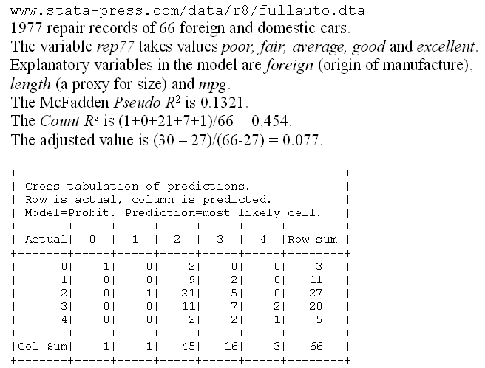
A Somewhat Better Fit

Slide 30
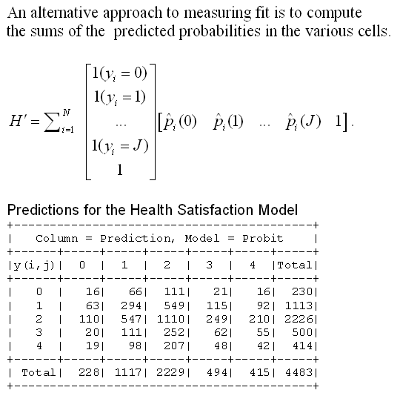
An Aggregate Prediction Measure

Slide 31
Different Normalizations
NLOGIT
  Y = 0,1,…,J, U* = α + β’x + ε
  One overall constant term, α
  J-1 “cutpoints;” μ₋₁ = -∞, μ₀ = 0, μ₁,… μ_{J-1}, μ_{J} = + ∞
Stata
  Y = 1,…,J+1, U* = β’x + ε
  No overall constant, α=0
  J “cutpoints;” μ₀ = -∞, μ₁,… μ_{J}, μ_{J+1} = + ∞

Slide 32
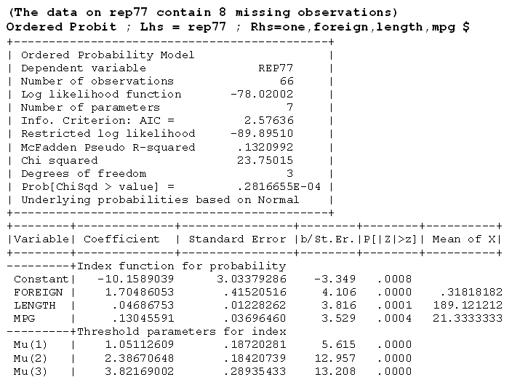



Slide 33
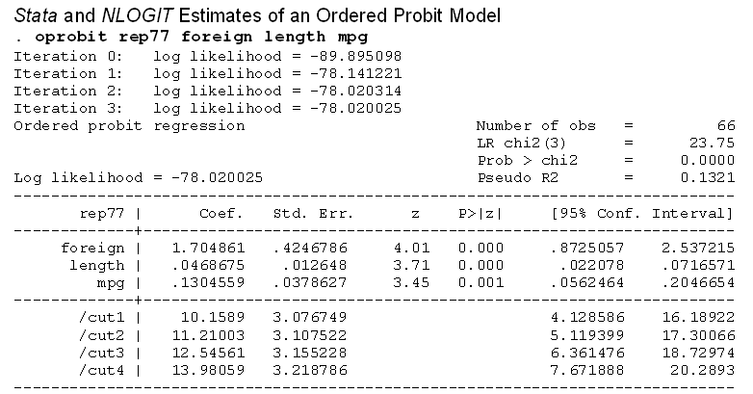



Slide 34
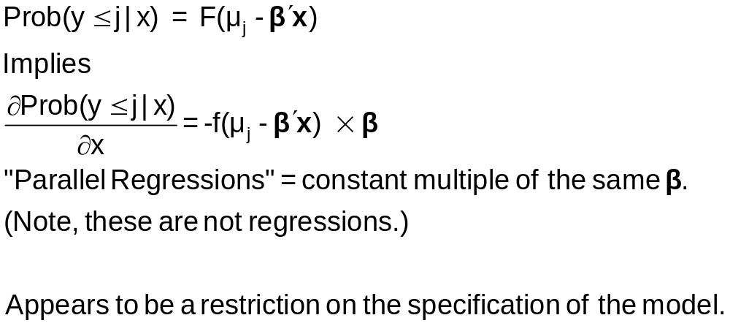
Parallel ‘Regressions’

Slide 35
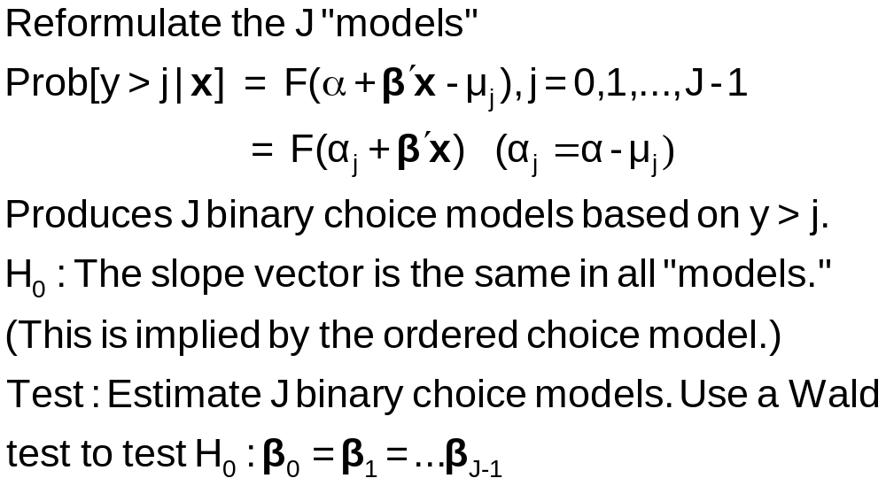
Brant Test for Parallel Regressions

Slide 36
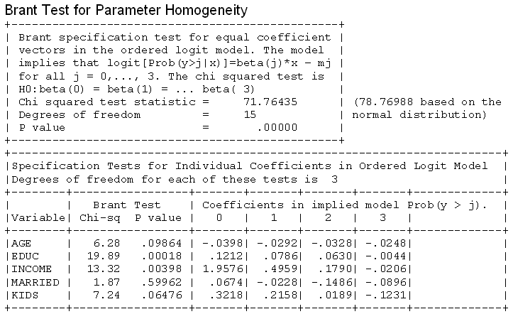
A Specification Test
What failure of the model specification is indicated by rejection?

Slide 37
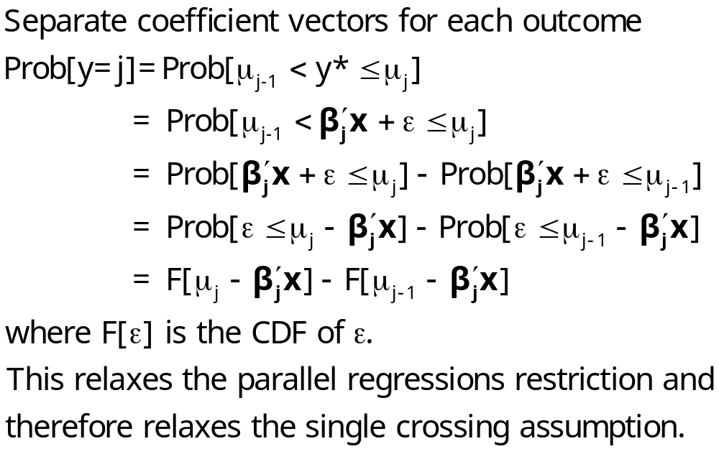
An Alternative Model Specification

Slide 38
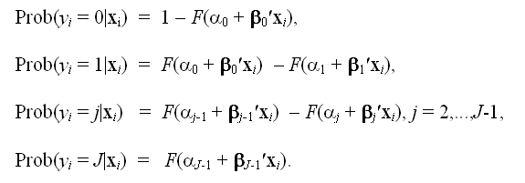
A “Generalized” Ordered Choice Model
Probabilities sum to 1.0
P(0) is positive, P(J) is positive
P(1),…,P(J-1) can be negative
It is not possible to draw (simulate) values on Y for this model. You would need to know the value of Y to know which coefficient vector to use to simulate Y!
The model is internally inconsistent. [“Incoherent” (Heckman)]

Slide 39
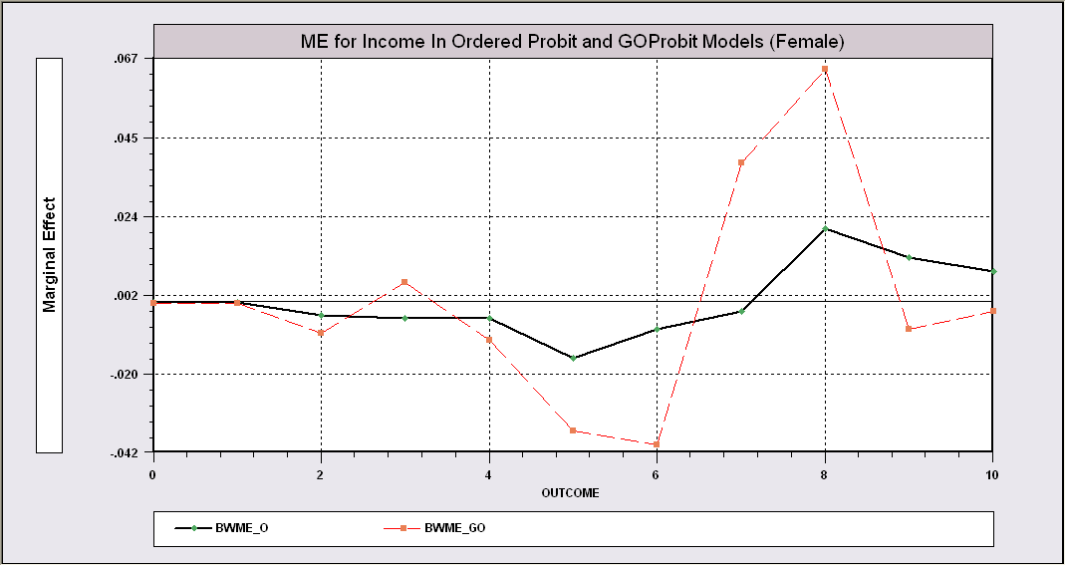
Partial Effects for Income – OP vs. GOP

Slide 40
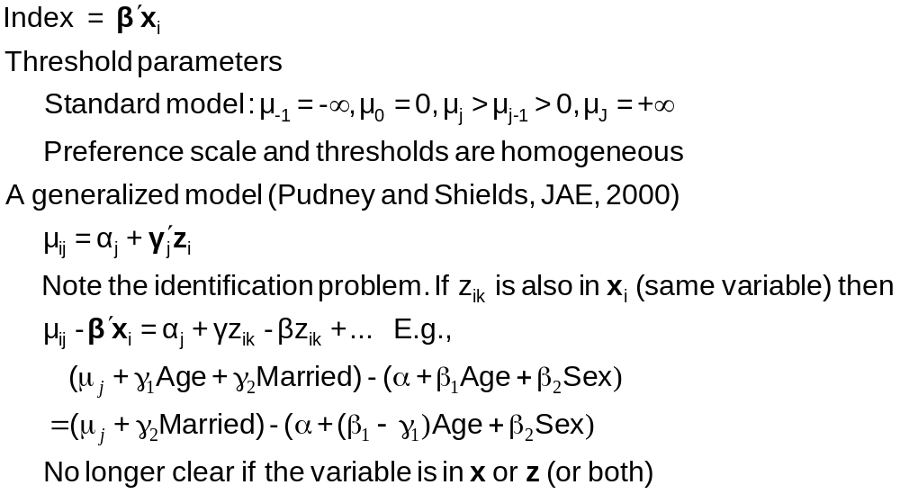
Generalizing the Ordered Probit with Heterogeneous Thresholds

Slide 41
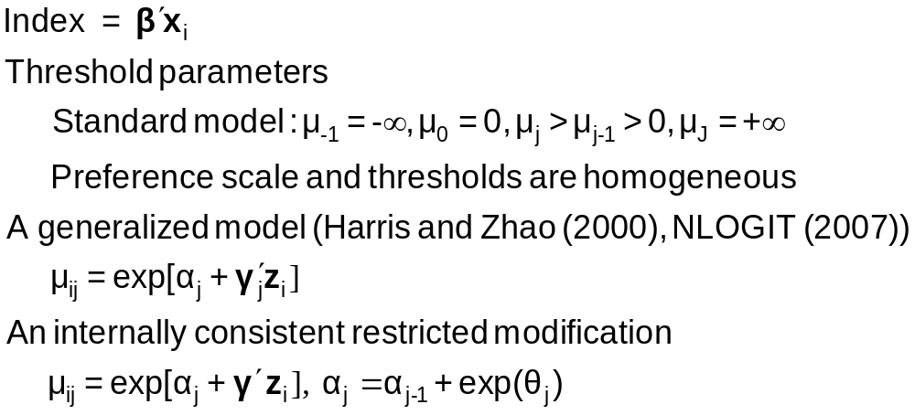
Hierarchical Ordered Probit

Slide 42
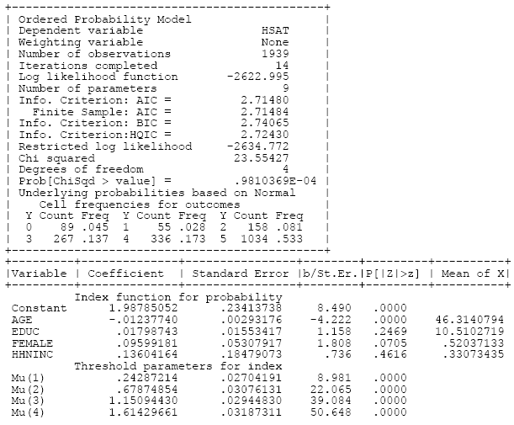
Ordered Choice Model

Slide 43
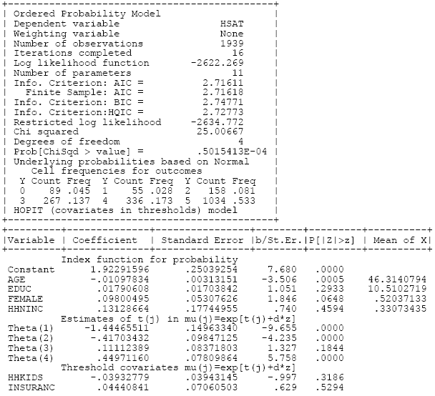
HOPit Model

Slide 44
Heterogeneity in OC Models
Scale Heterogeneity: Heteroscedasticity
Standard Models of Heterogeneity in Discrete Choice Models
  Fixed and Random Effects in Panels
  Latent Class Models
  Random Parameters

Slide 45
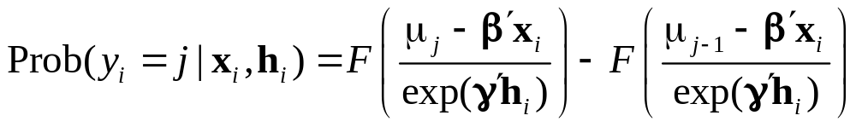
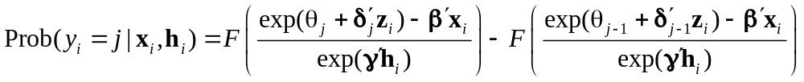
Heteroscedasticity in Two Models

Slide 46
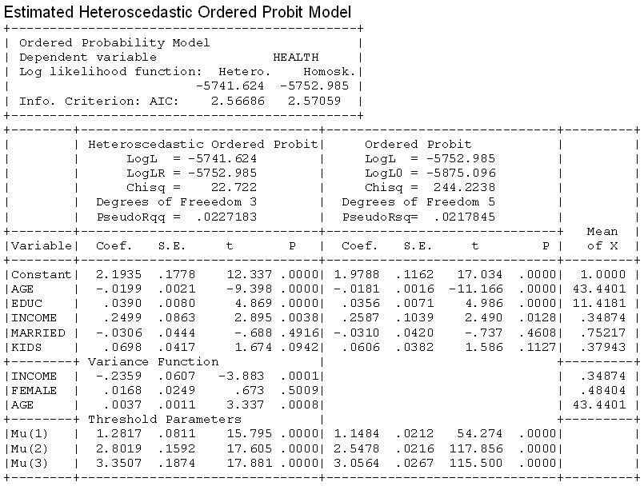

Slide 47
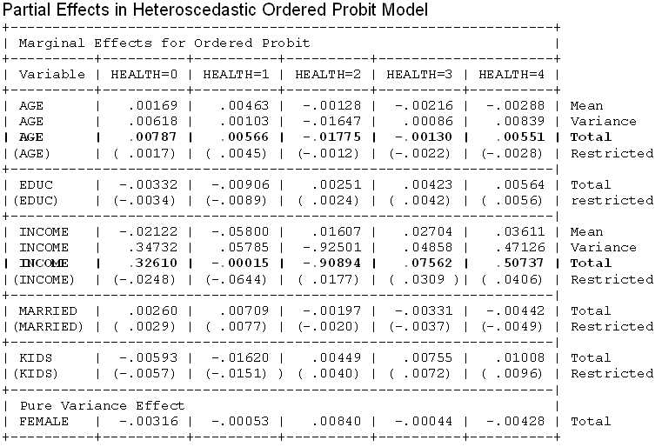

Slide 48
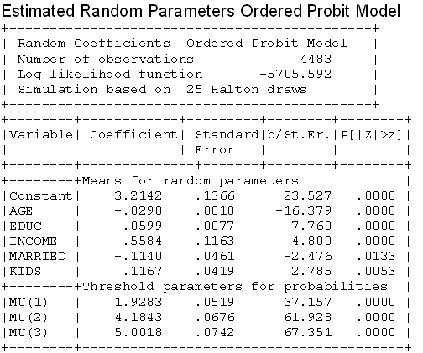
A Random Parameters Model

Slide 49
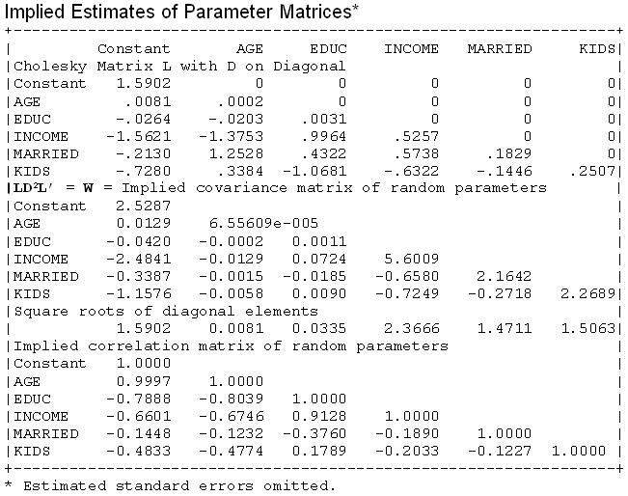

RP Model

Slide 50
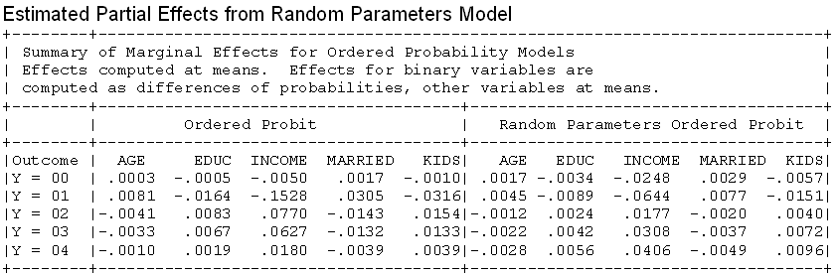
Partial Effects in RP Model

Slide 51
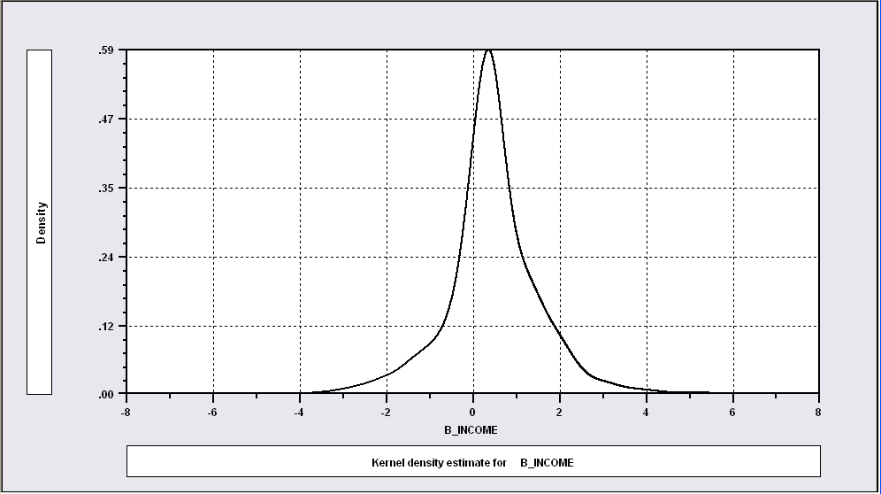
Distribution of Random Parameters
Kernel Density for Estimate of the Distribution of Means of Income Coefficient

Slide 52
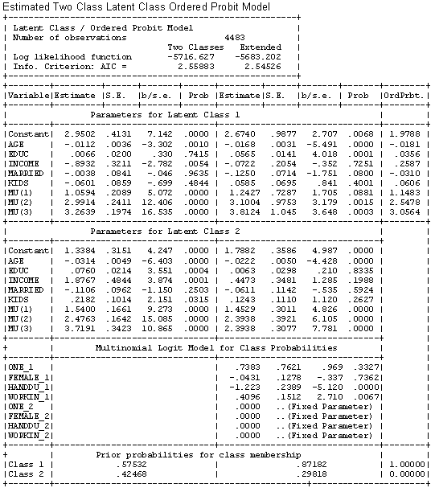
Latent Class Model

Slide 53
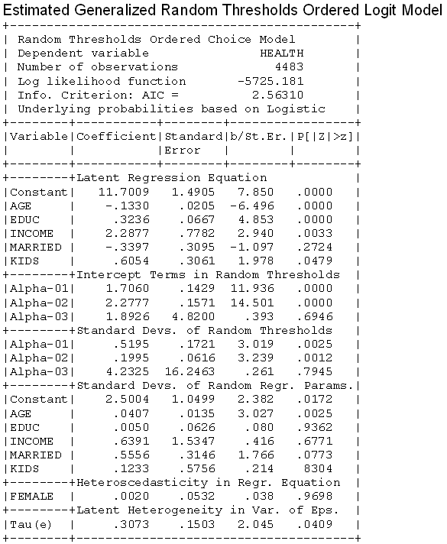
Random
Thresholds

Slide 54
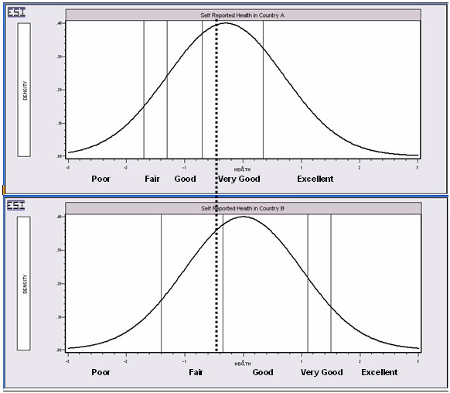
Differential Item Functioning
People in this country are optimistic – they report this value as ‘very good.’
People in this country are pessimistic – they report this same value as ‘fair’

Slide 55
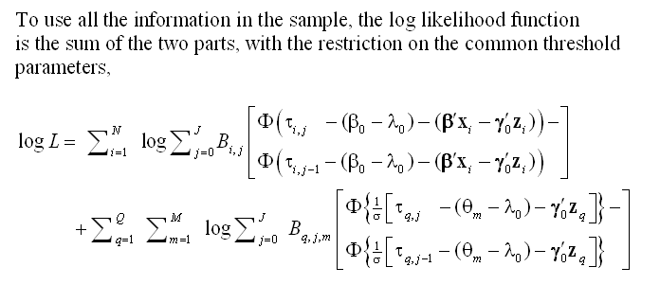
A Vignette Random Effects Model

Slide 56
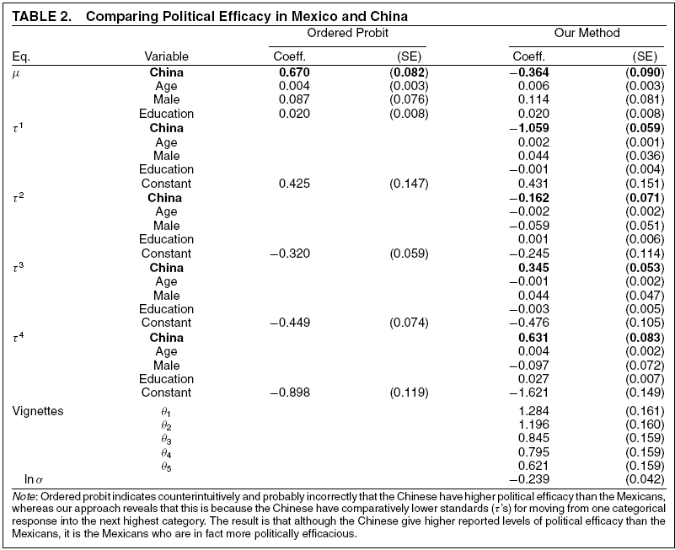
Vignettes

Slide 57
Panel Data
Fixed Effects
  The usual incidental parameters problem
  Practically feasible but methodologically ambiguous
  Partitioning Prob(y_{it} > j|x_{it}) produces estimable binomial logit models. (Find a way to combine multiple estimates of the same β.
Random Effects
  Standard application
  Extension to random parameters – see above

Slide 58
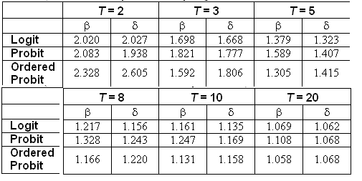
Incidental Parameters Problem
Table 9.1 Monte Carlo Analysis of the Bias of the MLE in Fixed Effects Discrete Choice Models (Means of empirical sampling distributions, N = 1,000 individuals, R = 200 replications)

Slide 59
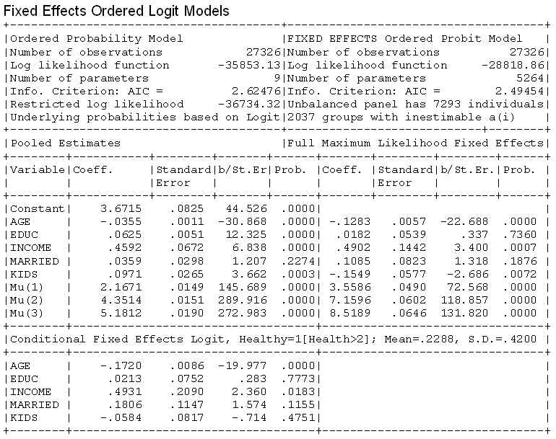

Slide 60
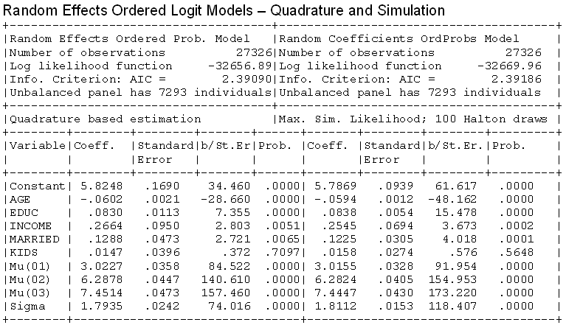
Random Effects

Slide 61
Model Extensions
Multivariate
  Bivariate
  Multivariate
Inflation and Two Part
  Zero inflation
  Sample Selection
  Endogenous Latent Class

Slide 62

Latent Class Application

Slide 63
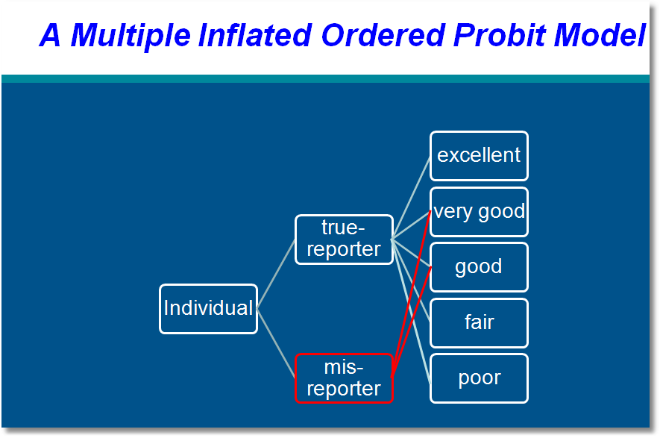

Slide 64
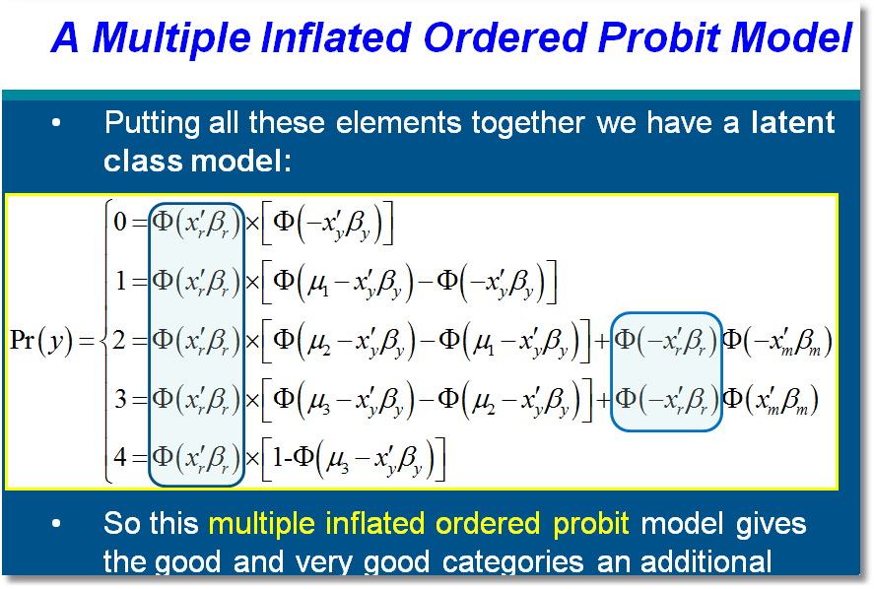

Slide 65
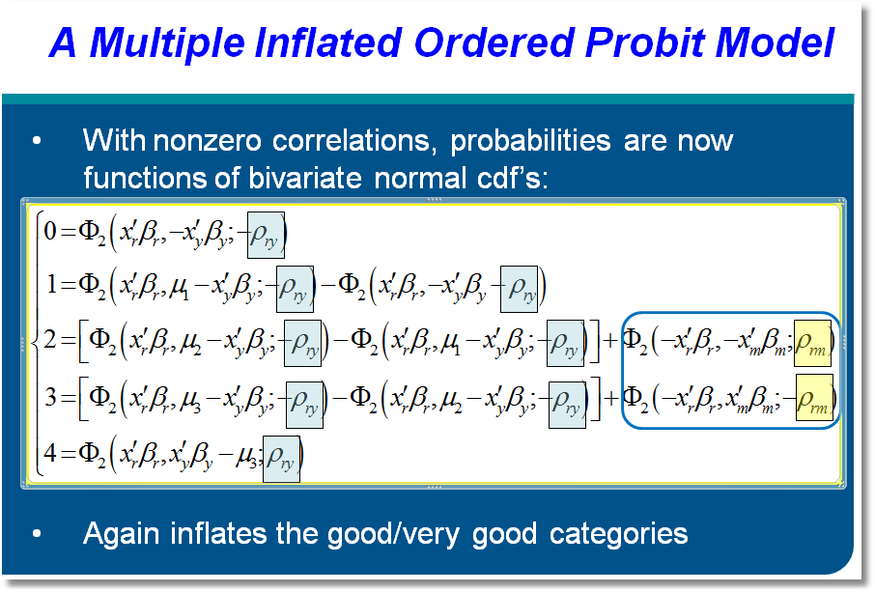

Slide 66
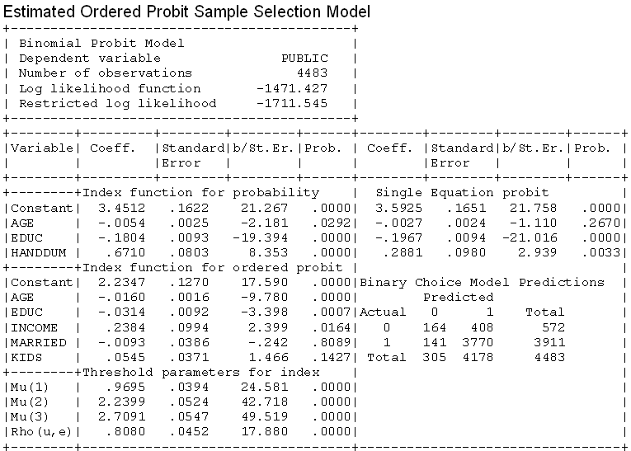
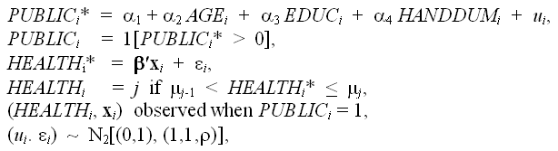
A Sample Selection Model

Slide 67

Dynamic Ordered Probit Model

Slide 68
Model for Self Assessed Health
British Household Panel Survey (BHPS)
  Waves 1-8, 1991-1998
  Self assessed health on 0,1,2,3,4 scale
  Sociological and demographic covariates
  Dynamics – inertia in reporting of top scale
Dynamic ordered probit model
  Balanced panel – analyze dynamics
  Unbalanced panel – examine attrition

Slide 69

Dynamic Ordered Probit Model
It would not be appropriate to include h_{i,t-1} itself in the model as this is a label, not a measure

Slide 70

Testing for Attrition Bias
Three dummy variables added to full model with unbalanced panel suggest presence of attrition effects.

Slide 71

Attrition Model with IP Weights
Assumes (1) Prob(attrition|all data) = Prob(attrition|selected variables) (ignorability)
(2) Attrition is an ‘absorbing state.’ No reentry.
Obviously not true for the GSOEP data above.
Can deal with point (2) by isolating a subsample of those present at wave 1 and the monotonically shrinking subsample as the waves progress.

Slide 72

Inverse Probability Weighting

Slide 73

Estimated Partial Effects by Model

Slide 74

Partial Effect for a Category
These are 4 dummy variables for state in the previous period. Using first differences, the 0.234 estimated for SAHEX means transition from EXCELLENT in the previous period to GOOD in the previous period, where GOOD is the omitted category. Likewise for the other 3 previous state variables. The margin from ‘POOR’ to ‘GOOD’ was not interesting in the paper. The better margin would have been from EXCELLENT to POOR, which would have (EX,POOR) change from (1,0) to (0,1).

