Slide 1
Topics in Microeconometrics
William Greene
Department of Economics
Stern School of Business

Slide 2

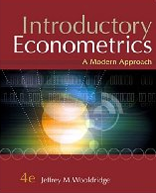
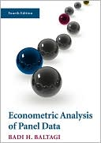
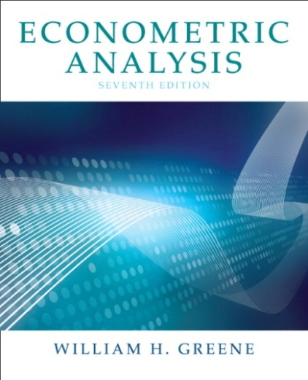

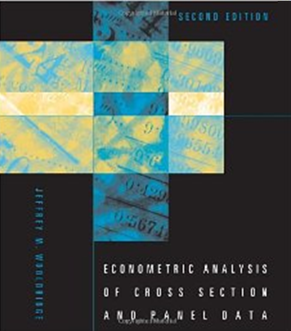

Descriptive Statistics and Linear Regression

Slide 3
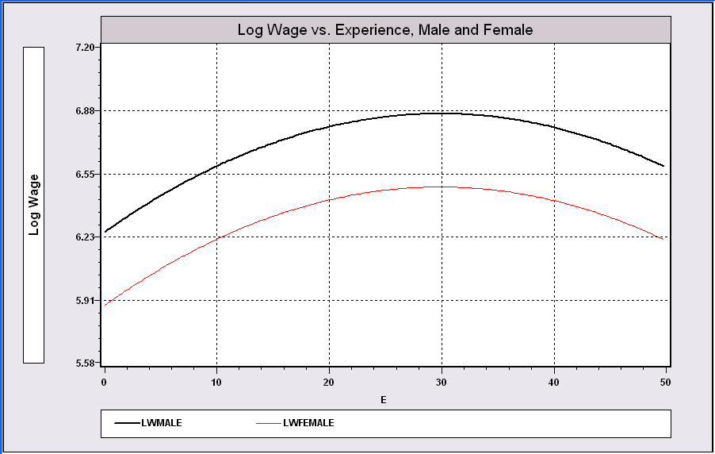
Model Building in Econometrics
Parameterizing the model
  Nonparametric analysis
  Semiparametric analysis
  Parametric analysis
Sharpness of inferences follows from the strength of the assumptions
A Model Relating (Log)Wage
to Gender and Experience

Slide 4
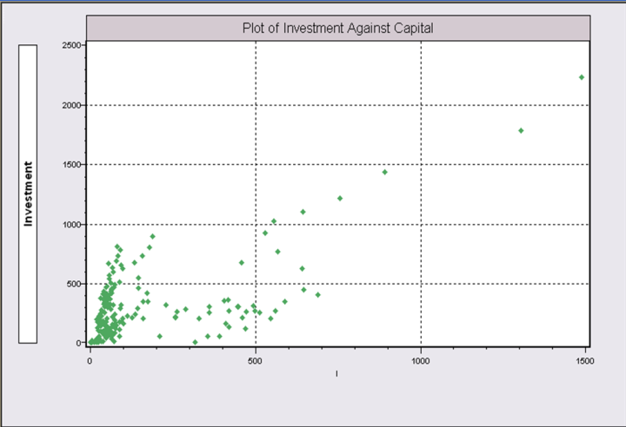
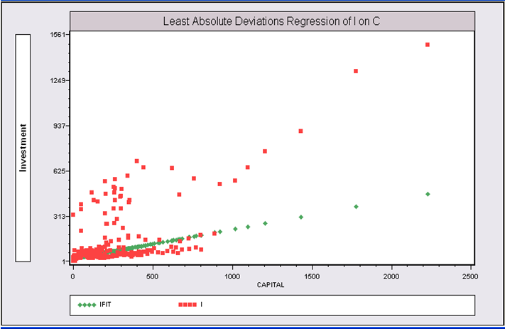
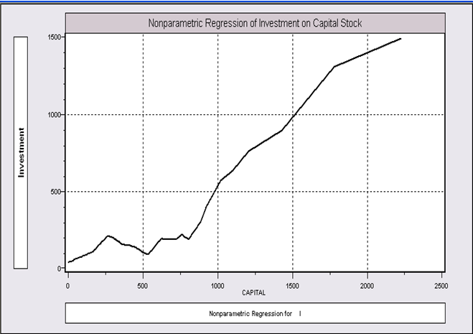
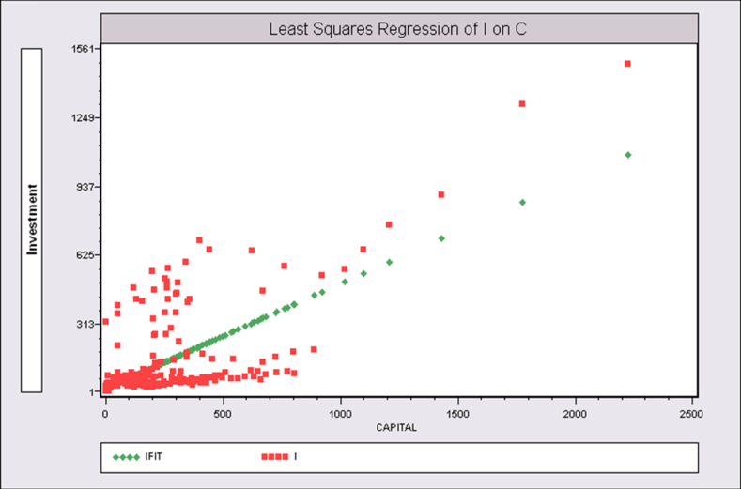
Application: Is there a relationship between investment and capital stock?
Semiparametric Regression: Least absolute deviations regression of y on x
Nonparametric Regression
Kernel regression of y on x
Parametric Regression: Least squares – maximum likelihood – regression of y on x

Slide 5
Cornwell and Rupert Panel Data
Cornwell and Rupert Returns to Schooling Data, 595 Individuals, 7 Years
Variables in the file are
EXP = work experience
WKS = weeks worked
OCC = occupation, 1 if blue collar,
IND = 1 if manufacturing industry
SOUTH = 1 if resides in south
SMSA = 1 if resides in a city (SMSA)
MS = 1 if married
FEM = 1 if female
UNION = 1 if wage set by union contract
ED = years of education
BLK = 1 if individual is black
LWAGE = log of wage = dependent variable in regressions
These data were analyzed in Cornwell, C. and Rupert, P., "Efficient Estimation with Panel Data: An Empirical Comparison of Instrumental Variable Estimators," Journal of Applied Econometrics, 3, 1988, pp. 149-155. See Baltagi, page 122 for further analysis. The data were downloaded from the website for Baltagi's text.
Notes:
5

Slide 6
A First Look at the Data
Descriptive Statistics
Basic Measures of Location and Dispersion
Graphical Devices
  Histogram
  Kernel Density Estimator

Slide 7
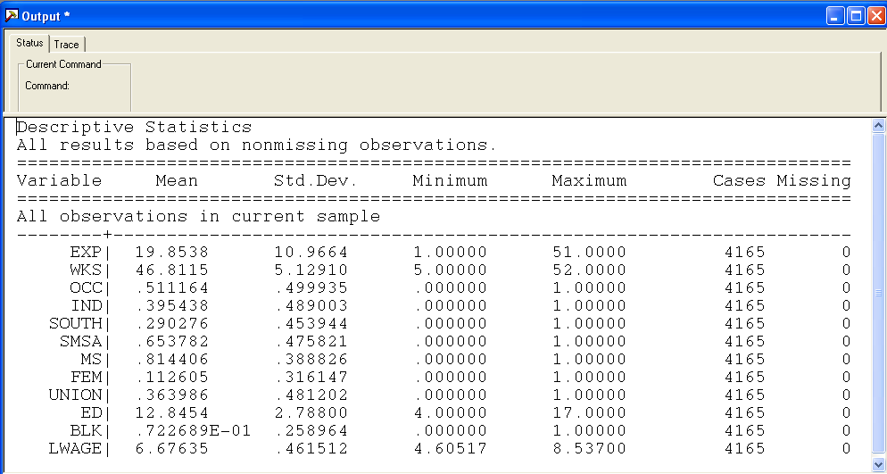

Slide 8
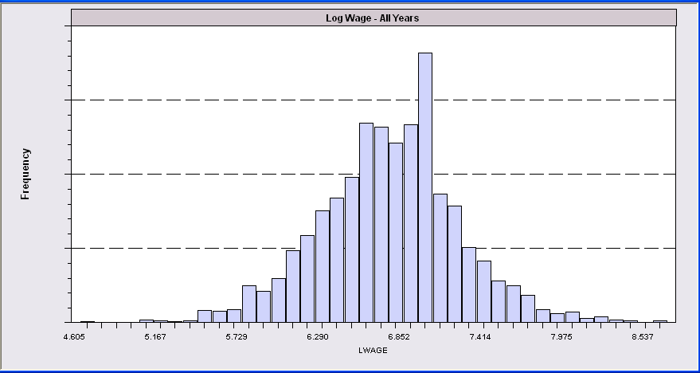
Histogram for LWAGE

Slide 9
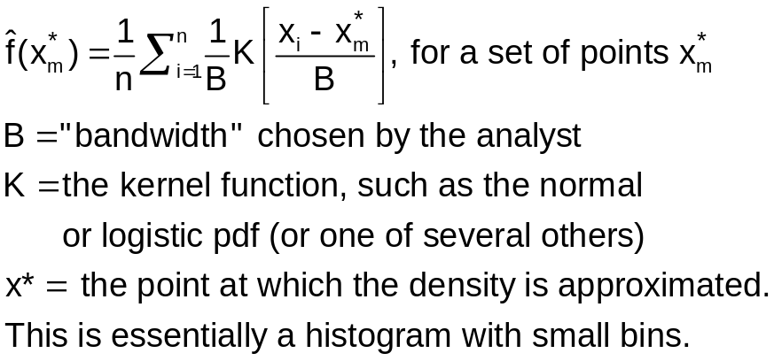
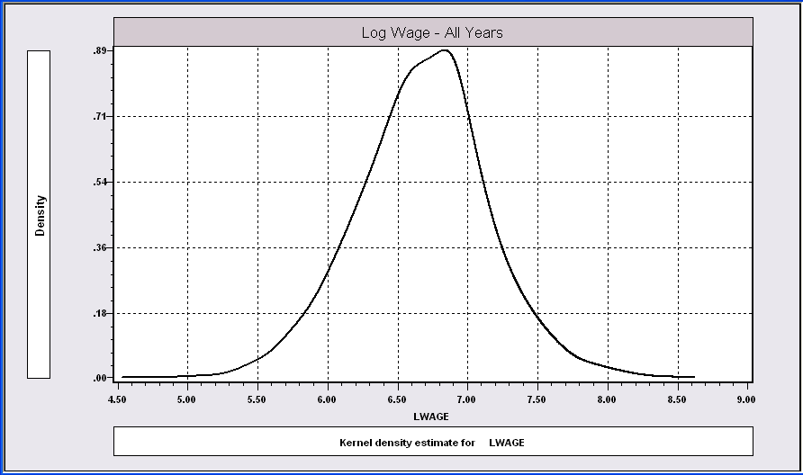
The kernel density estimator is a histogram (of sorts).

Slide 10
Kernel Estimator for LWAGE

Slide 11

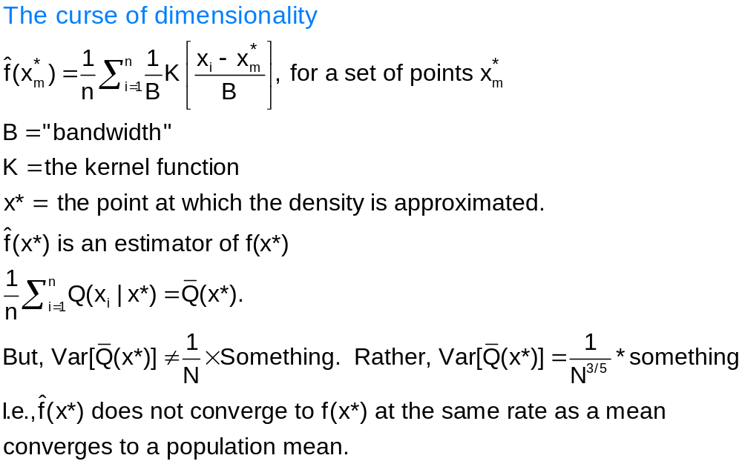

Kernel Density Estimator

Slide 12
Objective: Impact of Education on (log) wage
Specification: What is the right model to use to analyze this association?
Estimation
Inference
Analysis

Slide 13
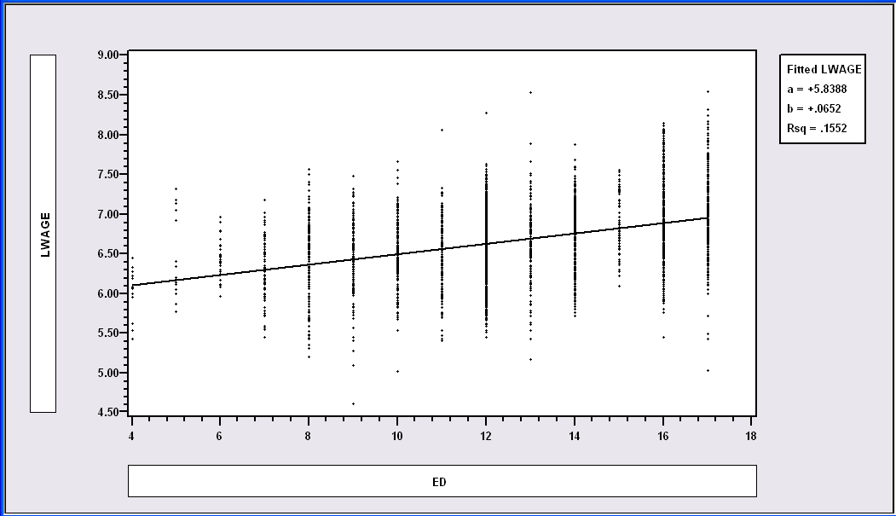
Simple Linear Regression
LWAGE = 5.8388 + 0.0652*ED

Slide 14
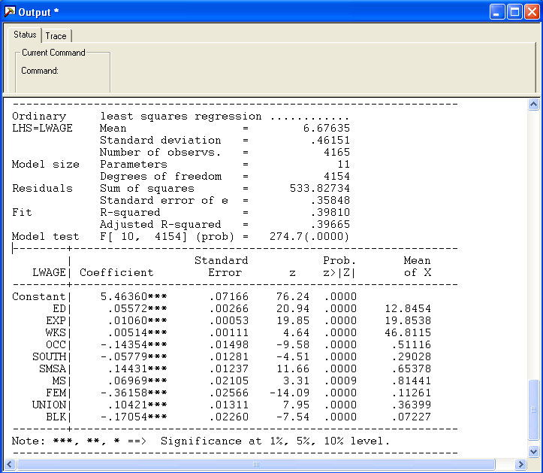
Multiple Regression

Slide 15
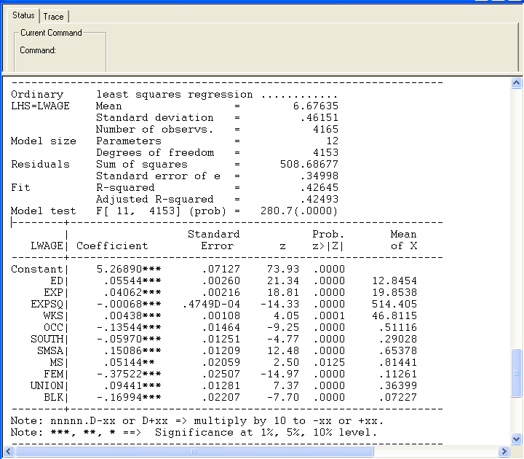
Specification: Quadratic Effect of Experience

Slide 16
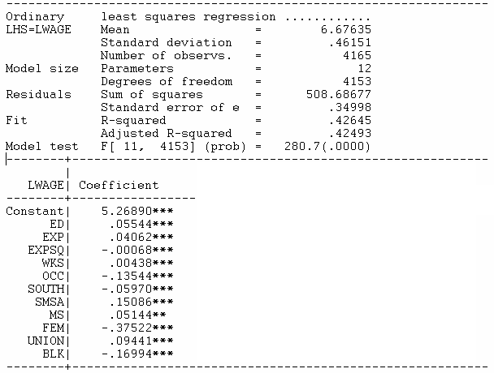
Partial Effects
Education: .05544
Experience: .04062 – 2*.00068*Exp
FEM – .37522

Slide 17
Model Implication: Effect of Experience and Male vs. Female

Slide 18
Hypothesis Test About Coefficients
Hypothesis
  Null: Restriction on β: Rβ – q = 0
  Alternative: Not the null
Approaches
  Fitting Criterion: R² decrease under the null?
  Wald: Rb – q close to 0 under the alternative?

Slide 19
Hypotheses
All Coefficients = 0?
R = [ 0 | I ] q = [0]
ED Coefficient = 0?
R = 0,1,0,0,0,0,0,0,0,0,0,0
q = 0
No Experience effect?
R = 0,0,1,0,0,0,0,0,0,0,0,0
0,0,0,1,0,0,0,0,0,0,0,0
q = 0
0

Slide 20
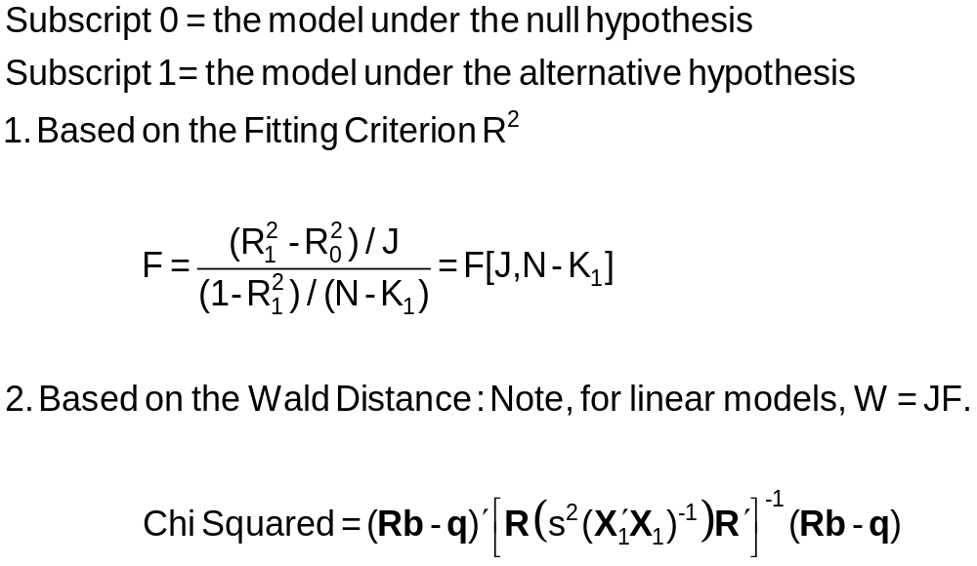
Hypothesis Test Statistics

Slide 21
Hypothesis: All Coefficients Equal Zero
All Coefficients = 0?
R = [0 | I] q = [0]
R₁² = .42645
R₀² = .00000
F = 280.7 with [11,4153]
Wald = b₂₋₁₂[V₂₋₁₂]⁻¹b₂₋₁₂
= 3087.83355
Note that Wald = JF
= 11(280.7)

Slide 22
Hypothesis: Education Effect = 0
ED Coefficient = 0?
R = 0,1,0,0,0,0,0,0,0,0,0,0
q = 0
R₁² = .42645
R₀² = .36355 (not shown)
F = 455.396
Wald = (.05544-0)²/(.0026)²
= 455.396
Note F = t² and Wald = F
For a single hypothesis about 1 coefficient.

Slide 23
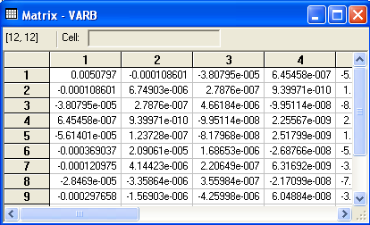
Hypothesis: Experience Effect = 0
No Experience effect?
R = 0,0,1,0,0,0,0,0,0,0,0,0
0,0,0,1,0,0,0,0,0,0,0,0
q = 0
0
R₀² = .34101, R₁² = .42645
F = 309.33
Wald = 618.601 (W* = 5.99)

Slide 24
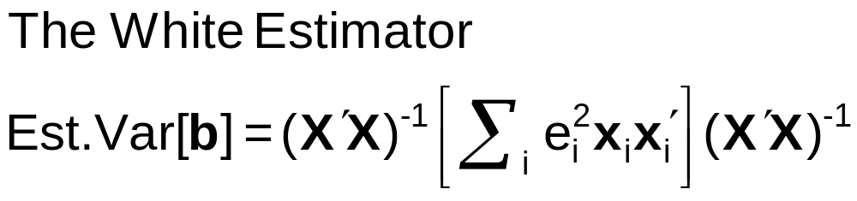
A Robust Covariance Matrix
What does robustness mean?
Robust to:
  Heteroscedasticty
Not robust to:
  Autocorrelation
  Individual heterogeneity
  The wrong model specification
‘Robust inference’

Slide 25
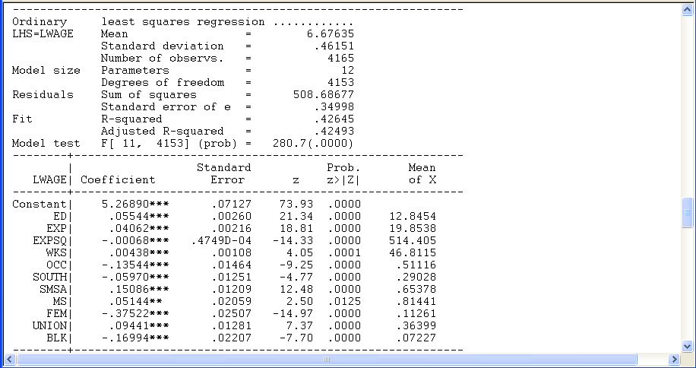
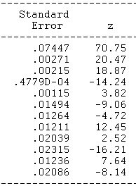
Robust Covariance Matrix
Heteroscedasticity Robust Covariance Matrix

