Slide 1
Topics in Microeconometrics
William Greene
Department of Economics
Stern School of Business

Slide 2

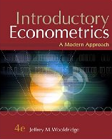





Part 2: Endogenous Variables in Linear Regression

Slide 3
Cornwell and Rupert Data
Cornwell and Rupert Returns to Schooling Data, 595 Individuals, 7 Years
Variables in the file are
EXP = work experience
WKS = weeks worked
OCC = occupation, 1 if blue collar,
IND = 1 if manufacturing industry
SOUTH = 1 if resides in south
SMSA = 1 if resides in a city (SMSA)
MS = 1 if married
FEM = 1 if female
UNION = 1 if wage set by union contract
ED = years of education
BLK = 1 if individual is black
LWAGE = log of wage = dependent variable in regressions
These data were analyzed in Cornwell, C. and Rupert, P., "Efficient Estimation with Panel Data: An Empirical Comparison of Instrumental Variable Estimators," Journal of Applied Econometrics, 3, 1988, pp. 149-155. See Baltagi, page 122 for further analysis. The data were downloaded from the website for Baltagi's text.
Notes:
3

Slide 4
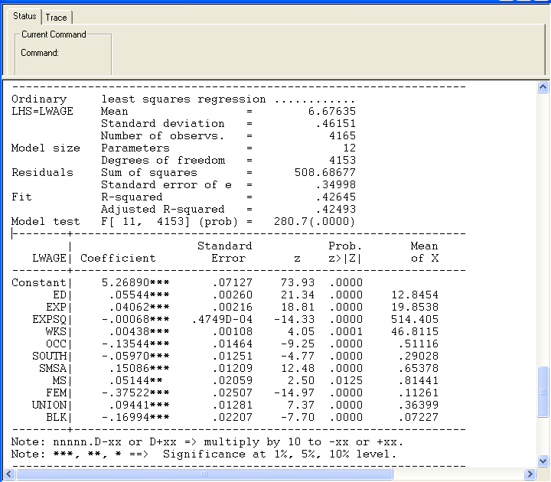
Specification: Quadratic Effect of Experience

Slide 5
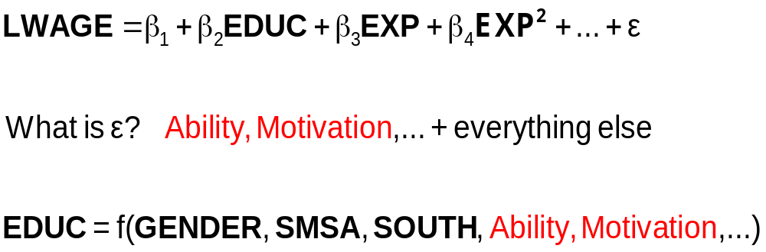
The Effect of Education on LWAGE

Slide 6
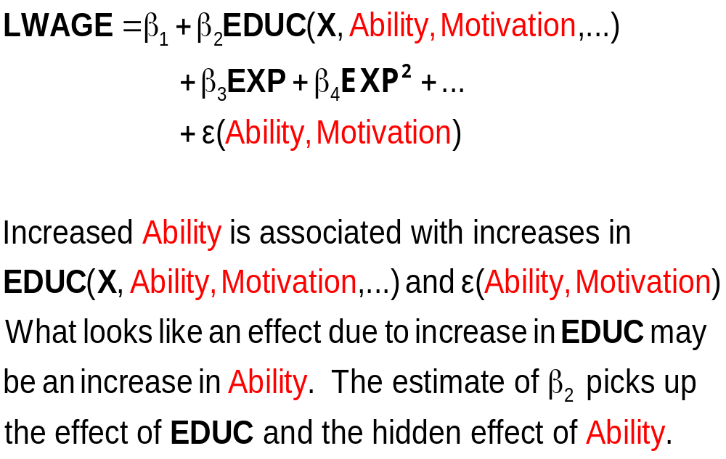
What Influences LWAGE?

Slide 7
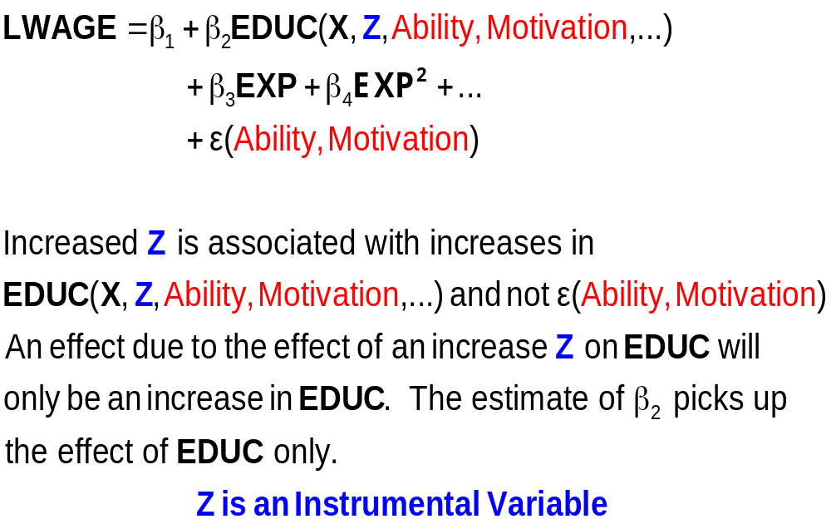
An Exogenous Influence

Slide 8
The First IV Study
(Snow, J., On the Mode of Communication of Cholera, 1855)
London Cholera epidemic, ca 1853-4
Cholera = f(Water Purity,u)+ε.
  Effect of water purity on cholera?
  Purity=f(cholera prone environment (poor, garbage in streets, rodents, etc.). Regression does not work.
  Two London water companies
Lambeth Southwark
======|||||======
^{Main sewage discharge}
Paul Grootendorst: A Review of Instrumental Variables Estimation of Treatment Effects…
http://individual.utoronto.ca/grootendorst/pdf/IV_Paper_Sept6_2007.pdf

Slide 9
Instrumental Variables
Structure
  LWAGE (ED,EXP,EXPSQ,WKS,OCC,
  SOUTH,SMSA,UNION)
  ED (MS, FEM, BLK)
  Reduced Form:
  LWAGE[ ED (MS, FEM, BLK),
  EXP,EXPSQ,WKS,OCC,
  SOUTH,SMSA,UNION ]

Slide 10
Two Stage Least Squares Strategy
  Reduced Form:
  LWAGE[ ED (MS, FEM, BLK,X),
  EXP,EXPSQ,WKS,OCC,
  SOUTH,SMSA,UNION ]
Strategy
  (1) Purge ED of the influence of everything but MS, FEM, BLK (and the other variables). Predict ED using all exogenous information in the sample (X and Z).
  (2) Regress LWAGE on this prediction of ED and everything else.
  Standard errors must be adjusted for the predicted ED

Slide 11
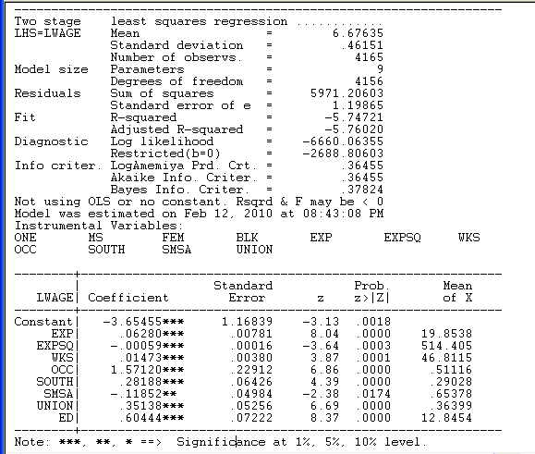
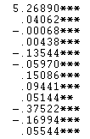
The weird results for the coefficient on ED happened because the instruments, MS,FEM,BLK are all dummy variables. There is not enough variation in these variables.

Slide 12
Source of Endogeneity
  LWAGE = f(ED,
  EXP,EXPSQ,WKS,OCC,
  SOUTH,SMSA,UNION) + ε
  ED = f(MS,FEM,BLK,
  EXP,EXPSQ,WKS,OCC,
  SOUTH,SMSA,UNION) + u

Slide 13
Remove the Endogeneity
  LWAGE = f(ED,
  EXP,EXPSQ,WKS,OCC,
  SOUTH,SMSA,UNION) + u + ε
  Strategy
    Estimate u
    Add u to the equation. ED is uncorrelated with ε when u is in the equation.

Slide 14
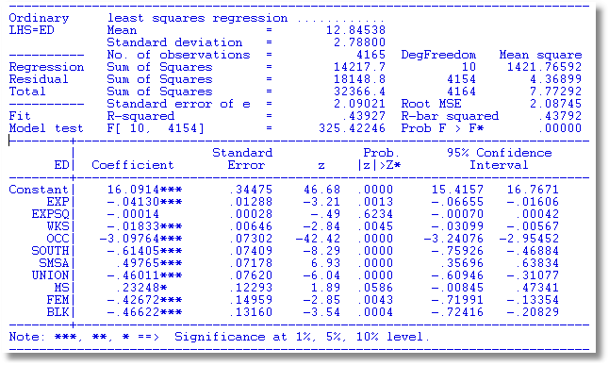
Auxiliary Regression for ED to Obtain Residuals

Slide 15
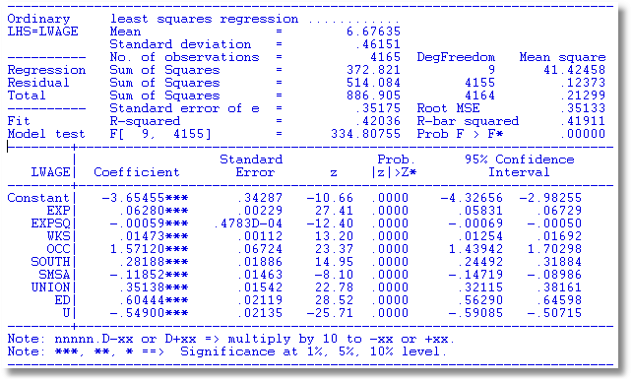
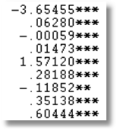
OLS with Residual (Control Function) Added
2SLS

Slide 16
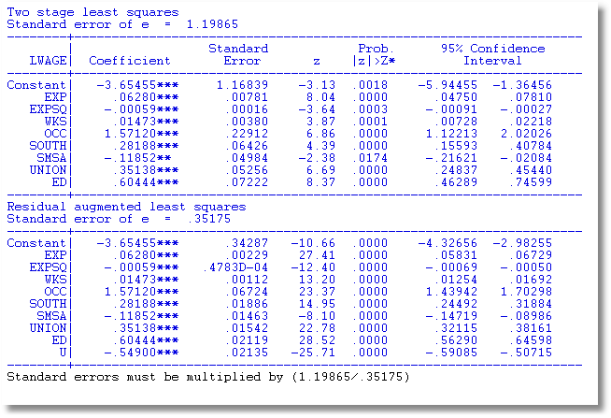
A Warning About Control Function

Slide 17
Endogenous Dummy Variable
Y = xβ + δT + ε (unobservable factors)
T = a dummy variable (treatment)
T = 0/1 depending on:
  x and z
  The same unobservable factors
T is endogenous – same as ED

Slide 18
Application: Health Care Panel Data
German Health Care Usage Data, 7,293 Individuals, Varying Numbers of Periods
Variables in the file are
Data downloaded from Journal of Applied Econometrics Archive. This is an unbalanced panel with 7,293 individuals. They can be used for regression, count models, binary choice, ordered choice, and bivariate binary choice. This is a large data set. There are altogether 27,326 observations. The number of observations ranges from 1 to 7. (Frequencies are: 1=1525, 2=2158, 3=825, 4=926, 5=1051, 6=1000, 7=987). Note, the variable NUMOBS below tells how many observations there are for each person. This variable is repeated in each row of the data for the person. (Downloaded from the JAE Archive)
DOCTOR = 1(Number of doctor visits > 0)
HOSPITAL = 1(Number of hospital visits > 0)
HSAT = health satisfaction, coded 0 (low) - 10 (high)
DOCVIS = number of doctor visits in last three months
HOSPVIS = number of hospital visits in last calendar year
PUBLIC = insured in public health insurance = 1; otherwise = 0
ADDON = insured by add-on insurance = 1; otherswise = 0
HHNINC = household nominal monthly net income in German marks / 10000.
(4 observations with income=0 were dropped)
HHKIDS = children under age 16 in the household = 1; otherwise = 0
EDUC = years of schooling
AGE = age in years
MARRIED = marital status
EDUC = years of education
Notes:
18

Slide 19
A study of moral hazard
Riphahn, Wambach, Million: “Incentive Effects in the Demand for Healthcare”
Journal of Applied Econometrics, 2003
Did the presence of the ADDON insurance influence the demand for health care – doctor visits and hospital visits?
For a simple example, we examine the PUBLIC insurance (89%) instead of ADDON insurance (2%).

Slide 20
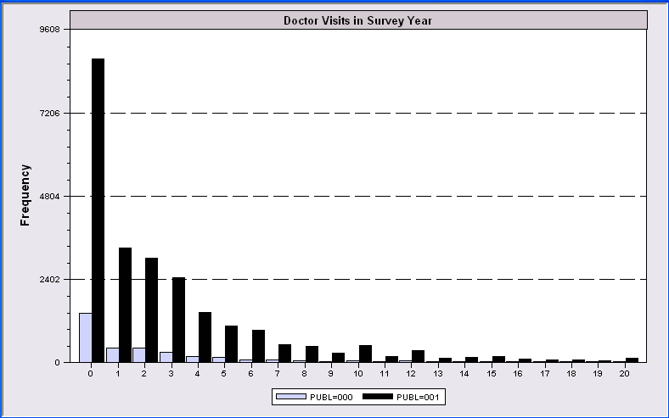
Evidence of Moral Hazard?

Slide 21
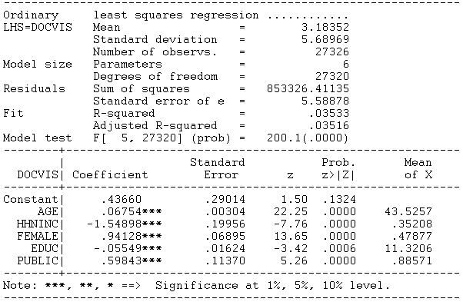
Regression Study

Slide 22
Endogenous Dummy Variable
Doctor Visits = f(Age, Educ, Health,
Presence of Insurance,
Other unobservables)
Insurance = f(Expected Doctor Visits,
Other unobservables)

Slide 23
Approaches
(Parametric) Control Function: Build a structural model for the two variables (Heckman)
(Semiparametric) Instrumental Variable: Create an instrumental variable for the dummy variable (Barnow/Cain/ Goldberger, Angrist, Current generation of researchers)
(?) Propensity Score Matching (Heckman et al., Becker/Ichino, Many recent researchers)

Slide 24
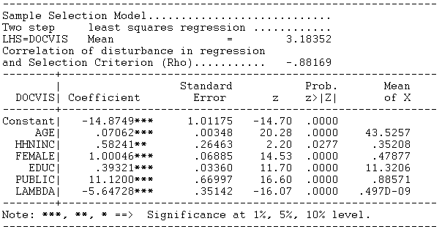
Heckman’s Control Function Approach
Y = xβ + δT + E[ε|T] + {ε - E[ε|T]}
λ = E[ε|T] , computed from a model for whether T = 0 or 1
Magnitude = 11.1200 is nonsensical in this context.

Slide 25
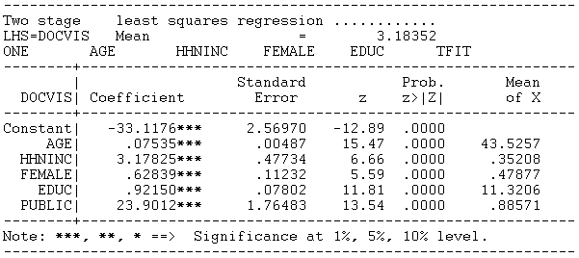
Instrumental Variable Approach
Construct a prediction for T using only the exogenous information
Use 2SLS using this instrumental variable.
Magnitude = 23.9012 is also nonsensical in this context.

Slide 26
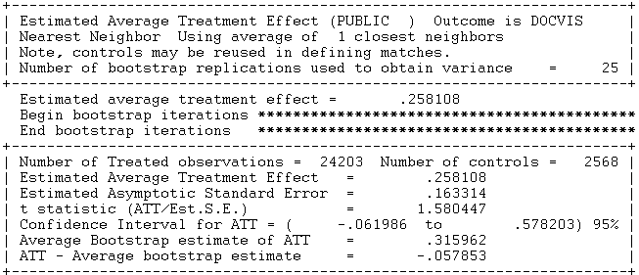
Propensity Score Matching
Create a model for T that produces probabilities for T=1: “Propensity Scores”
Find people with the same propensity score – some with T=1, some with T=0
Compare number of doctor visits of those with T=1 to those with T=0.

