Slide 1
Topics in Microeconometrics
William Greene
Department of Economics
Stern School of Business

Slide 2

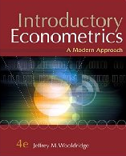





Part 3: Basic Linear Panel Data Models

Slide 3


Slide 4


Slide 5
Cornwell and Rupert Data
Cornwell and Rupert Returns to Schooling Data, 595 Individuals, 7 Years
Variables in the file are
EXP = work experience
WKS = weeks worked
OCC = occupation, 1 if blue collar,
IND = 1 if manufacturing industry
SOUTH = 1 if resides in south
SMSA = 1 if resides in a city (SMSA)
MS = 1 if married
FEM = 1 if female
UNION = 1 if wage set by union contract
ED = years of education
BLK = 1 if individual is black
LWAGE = log of wage = dependent variable in regressions
These data were analyzed in Cornwell, C. and Rupert, P., "Efficient Estimation with Panel Data: An Empirical Comparison of Instrumental Variable Estimators," Journal of Applied Econometrics, 3, 1988, pp. 149-155. See Baltagi, page 122 for further analysis. The data were downloaded from the website for Baltagi's text.
Notes:
5

Slide 6


Slide 7

Balanced and Unbalanced Panels
Distinction: Balanced vs. Unbalanced Panels
A notation to help with mechanics
  z_{i,t}, i = 1,…,N; t = 1,…,T_{i}
The role of the assumption
  Mathematical and notational convenience:
    Balanced, n=NT
    Unbalanced:
  Is the fixed T_{i} assumption ever necessary? Almost never.
Is unbalancedness due to nonrandom attrition from an otherwise balanced panel? This would require special considerations.

Slide 8
Application: Health Care Usage
German Health Care Usage Data, 7,293 Individuals, Varying Numbers of Periods
This is an unbalanced panel with 7,293 individuals. There are altogether 27,326 observations. The number of observations ranges from 1 to 7.
(Frequencies are: 1=1525, 2=2158, 3=825, 4=926, 5=1051, 6=1000, 7=987).
(Downloaded from the JAE Archive)
Variables in the file are
DOCTOR = 1(Number of doctor visits > 0)
HOSPITAL = 1(Number of hospital visits > 0)
HSAT = health satisfaction, coded 0 (low) - 10 (high)
DOCVIS = number of doctor visits in last three months
HOSPVIS = number of hospital visits in last calendar year
PUBLIC = insured in public health insurance = 1; otherwise = 0
ADDON = insured by add-on insurance = 1; otherswise = 0
HHNINC = household nominal monthly net income in German marks / 10000.
(4 observations with income=0 were dropped)
HHKIDS = children under age 16 in the household = 1; otherwise = 0
EDUC = years of schooling
AGE = age in years
MARRIED = marital status
Notes:
8

Slide 9
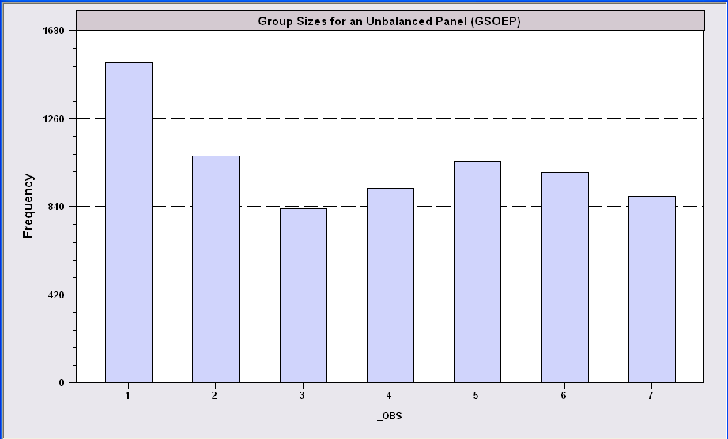
An Unbalanced Panel: RWM’s GSOEP Data on Health Care
N = 7,293 Households

Slide 10
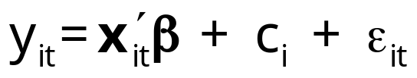
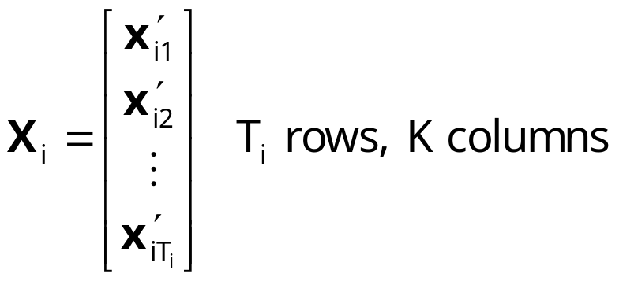
Fixed and Random Effects
Unobserved individual effects in regression: E[y_{it} | x_{it}, c_{i}]
  Notation:
Linear specification:
  Fixed Effects: E[c_{i} | X_{i} ] = g(X_{i}). Cov[x_{it},c_{i}] ≠0
  effects are correlated with included variables.
  Random Effects: E[c_{i} | X_{i} ] = 0. Cov[x_{it},c_{i}] = 0

Slide 11
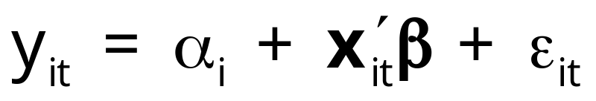
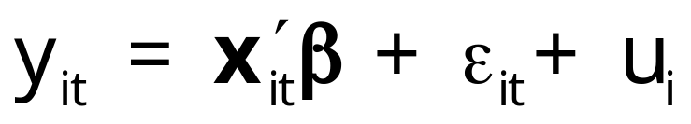
Convenient Notation
Fixed Effects – the ‘dummy variable model’
Random Effects – the ‘error components model’
Individual specific constant terms.
Compound (“composed”) disturbance

Slide 12
Estimating β
β is the partial effect of interest
Can it be estimated (consistently) in the presence of (unmeasured) c_{i}?
  Does pooled least squares “work?”
  Strategies for “controlling for c_{i}” using the sample data

Slide 13
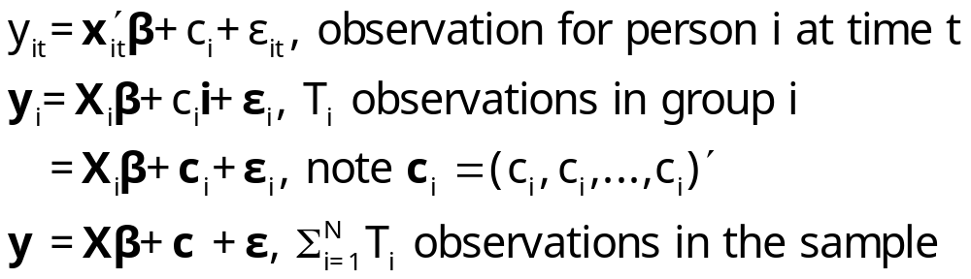
The Pooled Regression
Presence of omitted effects
Potential bias/inconsistency of OLS – depends on ‘fixed’ or ‘random’

Slide 14
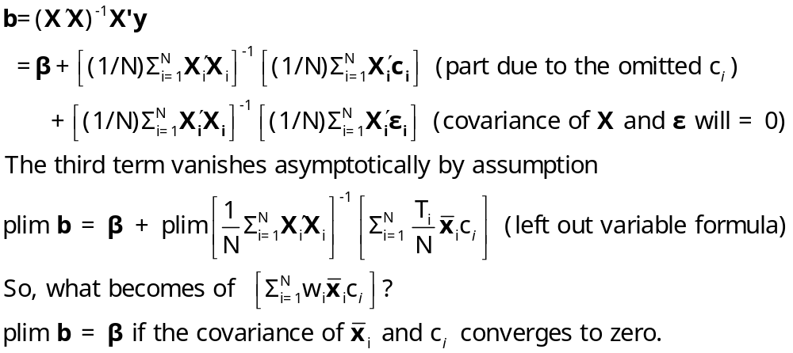
OLS with Individual Effects

Slide 15
Estimating the Sampling Variance of b
s²(X ́X)⁻¹? Inappropriate because
  Correlation across observations
  (Possibly) Heteroscedasticity
A ‘robust’ covariance matrix
  Robust estimation (in general)
  The White estimator
  A Robust estimator for OLS.

Slide 16
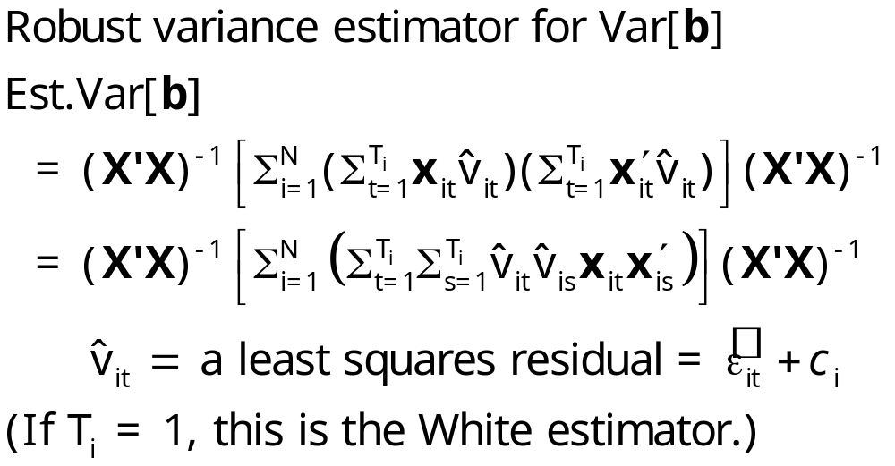
Cluster Estimator

Slide 17
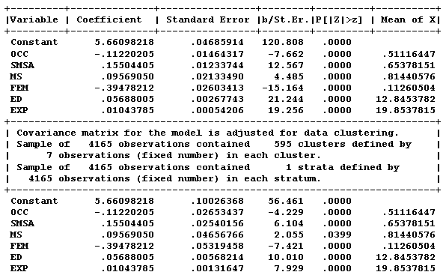
Application: Cornwell and Rupert

Slide 18
Bootstrap variance for a panel data estimator
Panel Bootstrap =
Block Bootstrap
Data set is N groups of size T_{i}
Bootstrap sample is N groups of size T_{i} drawn with replacement.

Slide 19
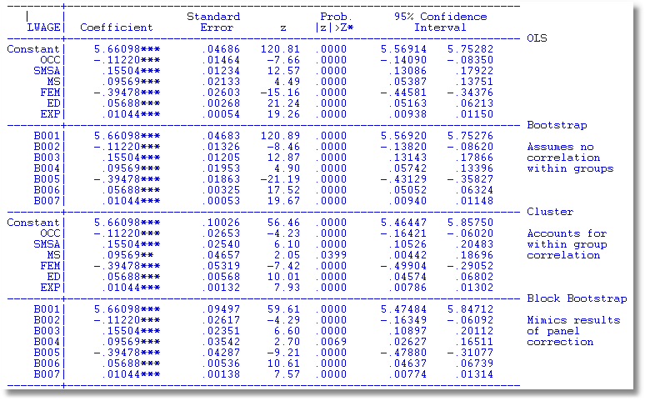

Slide 20
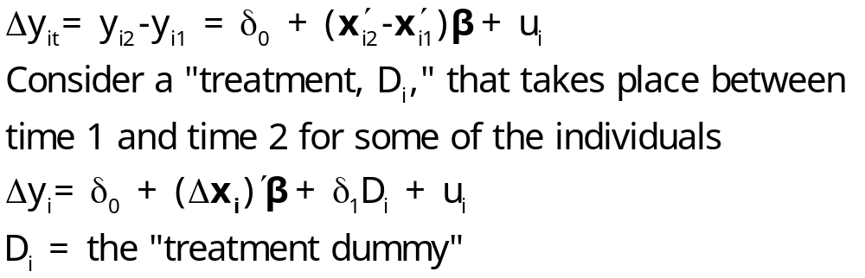
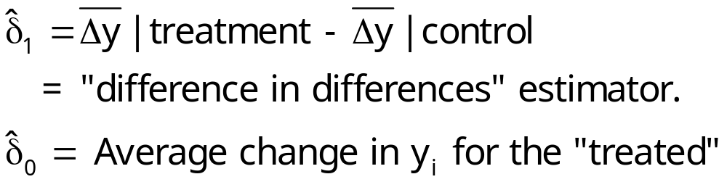
Difference in Differences
With two periods,
This is a linear regression model. If there are no regressors,

Slide 21
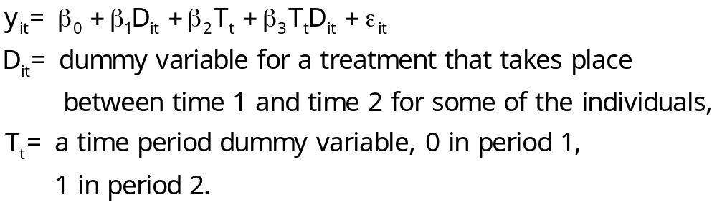
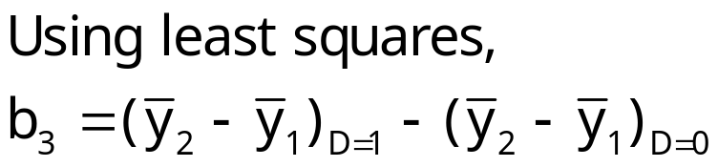
Difference-in-Differences Model
With two periods and strict exogeneity of D and T,
This is a linear regression model. If there are no regressors,

Slide 22
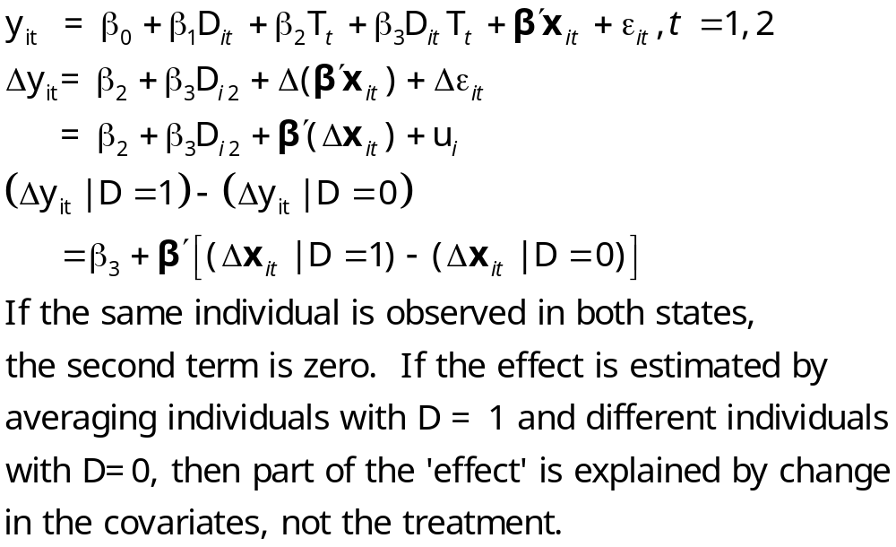
Difference in Differences

Slide 23
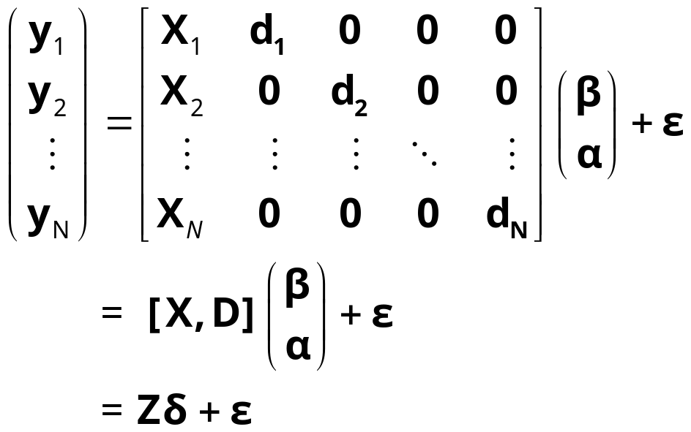
The Fixed Effects Model
y_{i} = X_{i}β + d_{i}α_{i} + ε_{i}, for each individual
  E[c_{i} | X_{i} ] = g(X_{i}); Effects are correlated with included variables.
  Cov[x_{it},c_{i}] ≠0

Slide 24
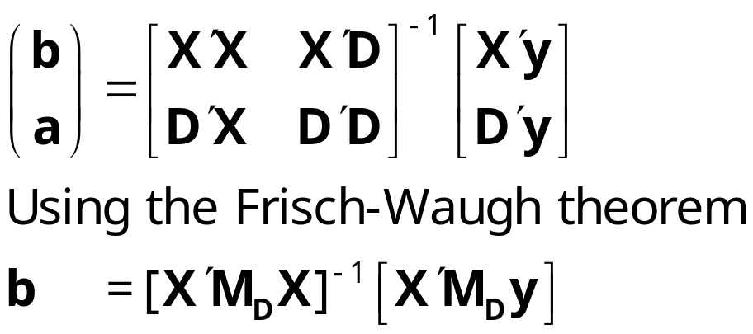
Estimating the Fixed Effects Model
The FEM is a plain vanilla regression model but with many independent variables
Least squares is unbiased, consistent, efficient, but inconvenient if N is large.

Slide 25
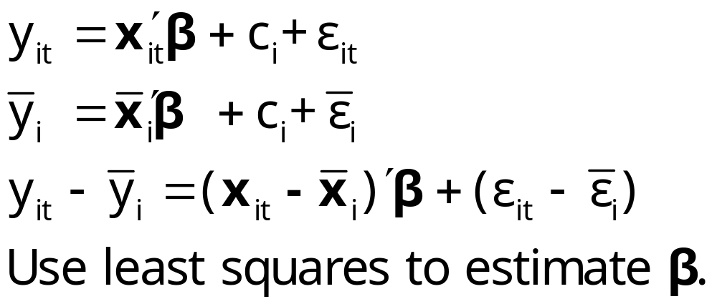
The Within Groups Transformation Removes the Effects

Slide 26
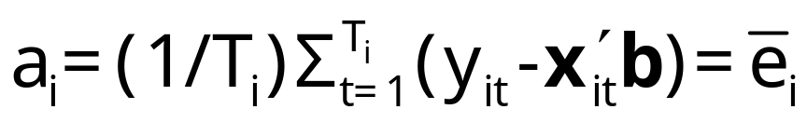
Least Squares Dummy Variable Estimator
b is obtained by ‘within’ groups least squares (group mean deviations)
a is estimated using the normal equations:
D’Xb+D’Da=D’y
a = (D’D)⁻¹D’(y – Xb)

Slide 27
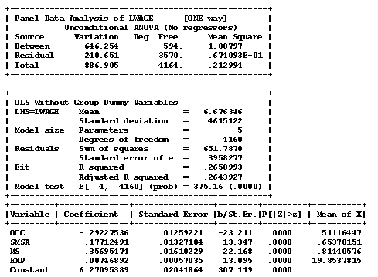
Application Cornwell and Rupert

Slide 28
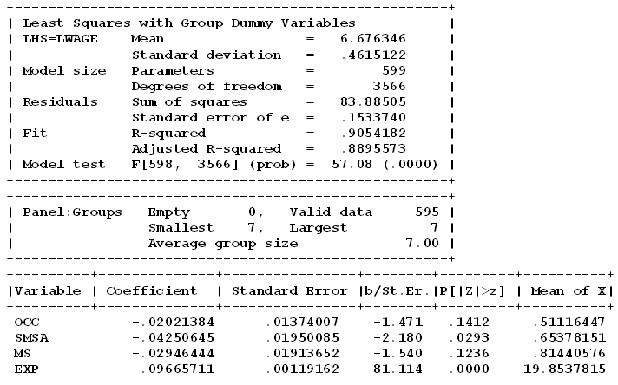

LSDV Results
Note huge changes in the coefficients. SMSA and MS change signs. Significance changes completely!
Pooled OLS

Slide 29
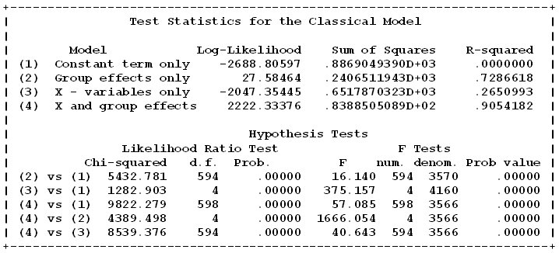
The Effect of the Effects

Slide 30
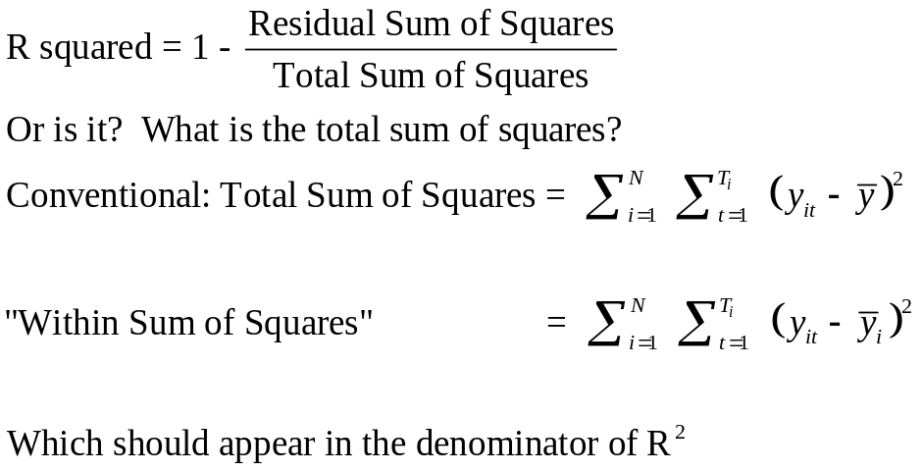
A Caution About Stata and R²
For the FE model above,
R² = 0.90542
R² = 0.65142
The coefficient estimates and standard errors are the same. The calculation of the R² is different. In the areg procedure, you are estimating coefficients for each of your covariates plus each dummy variable for your groups. In the xtreg, fe procedure the R² reported is obtained by only fitting a mean deviated model where the effects of the groups (all of the dummy variables) are assumed to be fixed quantities. So, all of the effects for the groups are simply subtracted out of the model and no attempt is made to quantify their overall effect on the fit of the model.
Since the SSE is the same, the R²=1−SSE/SST is very different. The difference is real in that we are making different assumptions with the two approaches. In the xtreg, fe approach, the effects of the groups are fixed and unestimated quantities are subtracted out of the model before the fit is performed. In the areg approach, the group effects are estimated and affect the total sum of squares of the model under consideration.

Slide 31
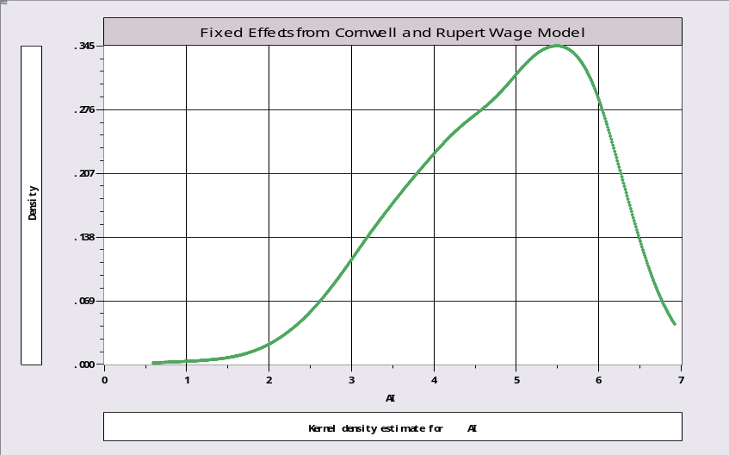
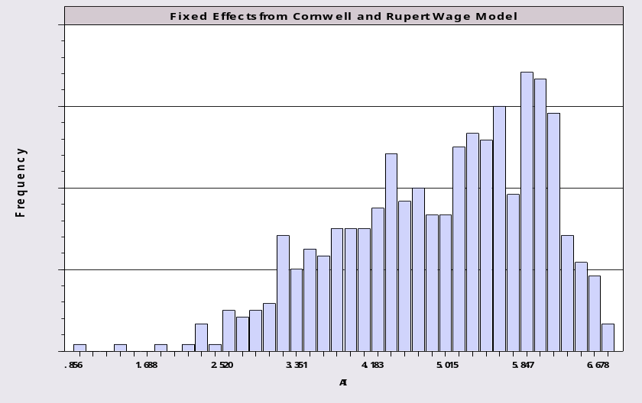
Examining the Effects with a KDE
Mean = 4.819,
Standard deviation = 1.054.

Slide 32
Robust Covariance Matrix for LSDV
Cluster Estimator for Within Estimator
+--------+--------------+----------------+--------+--------+----------+
|Variable| Coefficient | Standard Error |b/St.Er.|P[|Z|>z]| Mean of X|
+--------+--------------+----------------+--------+--------+----------+
|OCC | -.02021 .01374007 -1.471 .1412 .5111645|
|SMSA | -.04251** .01950085 -2.180 .0293 .6537815|
|MS | -.02946 .01913652 -1.540 .1236 .8144058|
|EXP | .09666*** .00119162 81.114 .0000 19.853782|
+--------+------------------------------------------------------------+
+---------------------------------------------------------------------+
| Covariance matrix for the model is adjusted for data clustering. |
| Sample of 4165 observations contained 595 clusters defined by |
| 7 observations (fixed number) in each cluster. |
+---------------------------------------------------------------------+
+--------+--------------+----------------+--------+--------+----------+
|Variable| Coefficient | Standard Error |b/St.Er.|P[|Z|>z]| Mean of X|
+--------+--------------+----------------+--------+--------+----------+
|DOCC | -.02021 .01982162 -1.020 .3078 .00000|
|DSMSA | -.04251 .03091685 -1.375 .1692 .00000|
|DMS | -.02946 .02635035 -1.118 .2635 .00000|
|DEXP | .09666*** .00176599 54.732 .0000 .00000|
+--------+------------------------------------------------------------+

Slide 33
Time Invariant Regressors
Time invariant x_{it} is defined as invariant for all i. E.g., sex dummy variable, FEM and ED (education in the Cornwell/Rupert data).
If x_{it,k} is invariant for all t, then the group mean deviations are all 0.

Slide 34
FE With Time Invariant Variables
+----------------------------------------------------+
| There are 3 vars. with no within group variation. |
| FEM ED BLK |
+----------------------------------------------------+
+--------+--------------+----------------+--------+--------+----------+
|Variable| Coefficient | Standard Error |b/St.Er.|P[|Z|>z]| Mean of X|
+--------+--------------+----------------+--------+--------+----------+
EXP | .09671227 .00119137 81.177 .0000 19.8537815
WKS | .00118483 .00060357 1.963 .0496 46.8115246
OCC | -.02145609 .01375327 -1.560 .1187 .51116447
SMSA | -.04454343 .01946544 -2.288 .0221 .65378151
FEM | .000000 ......(Fixed Parameter).......
ED | .000000 ......(Fixed Parameter).......
BLK | .000000 ......(Fixed Parameter).......
+--------------------------------------------------------------------+
| Test Statistics for the Classical Model |
+--------------------------------------------------------------------+
| Model Log-Likelihood Sum of Squares R-squared |
|(1) Constant term only -2688.80597 886.90494 .00000 |
|(2) Group effects only 27.58464 240.65119 .72866 |
|(3) X - variables only -1688.12010 548.51596 .38154 |
|(4) X and group effects 2223.20087 83.85013 .90546 |
+--------------------------------------------------------------------+

Slide 35
Drop The Time Invariant Variables
Same Results
+--------+--------------+----------------+--------+--------+----------+
|Variable| Coefficient | Standard Error |b/St.Er.|P[|Z|>z]| Mean of X|
+--------+--------------+----------------+--------+--------+----------+
EXP | .09671227 .00119087 81.211 .0000 19.8537815
WKS | .00118483 .00060332 1.964 .0495 46.8115246
OCC | -.02145609 .01374749 -1.561 .1186 .51116447
SMSA | -.04454343 .01945725 -2.289 .0221 .65378151
+--------------------------------------------------------------------+
| Test Statistics for the Classical Model |
+--------------------------------------------------------------------+
| Model Log-Likelihood Sum of Squares R-squared |
|(1) Constant term only -2688.80597 886.90494 .00000 |
|(2) Group effects only 27.58464 240.65119 .72866 |
|(3) X - variables only -1688.12010 548.51596 .38154 |
|(4) X and group effects 2223.20087 83.85013 .90546 |
+--------------------------------------------------------------------+
No change in the sum of squared residuals

Slide 36
Fixed Effects Vector Decomposition
Efficient Estimation of Time Invariant and Rarely Changing Variables in Finite Sample Panel Analyses with Unit Fixed Effects
Thomas Plümper and Vera Troeger
Political Analysis, 2007

Slide 37
Introduction
[T]he FE model … does not allow the estimation of time invariant variables. A second drawback of the FE model … results from its inefficiency in estimating the effect of variables that have very little within variance.
This article discusses a remedy to the related problems of estimating time invariant and rarely changing variables in FE models with unit effects

Slide 38
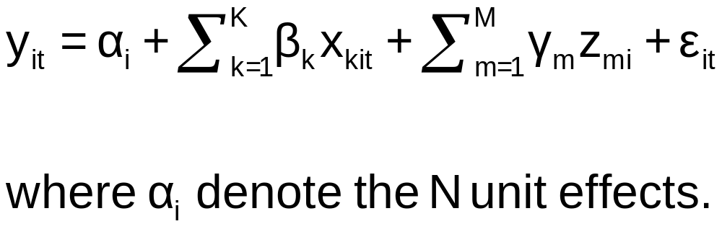
The Model

Slide 39
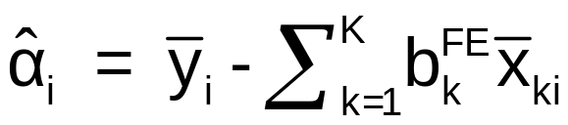
Fixed Effects Vector Decomposition
Step 1: Compute the fixed effects regression to get the “estimated unit effects.” “We run this FE model with the sole intention to obtain estimates of the unit effects, α_{i}.”

Slide 40
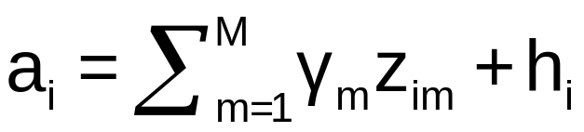
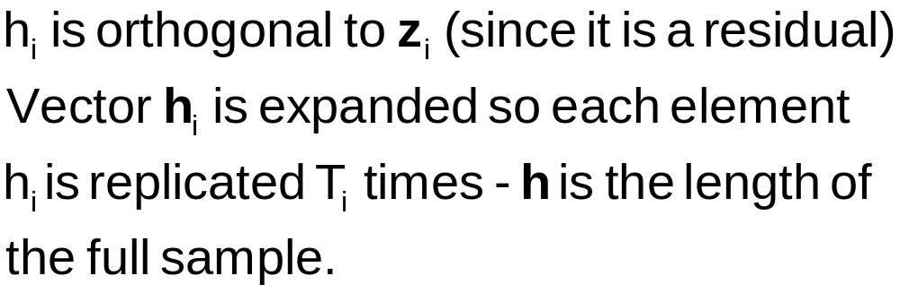
Step 2
Regress a_{i} on z_{i} and compute residuals

Slide 41
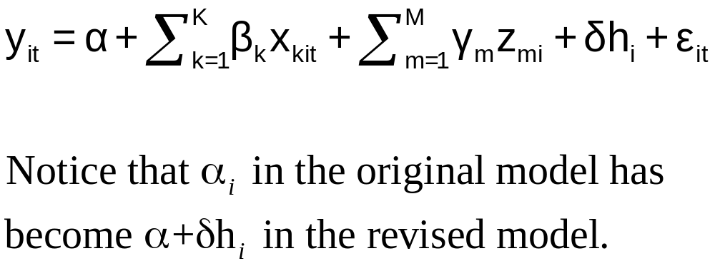
Step 3
Regress y_{it} on a constant, X, Z and h using ordinary least squares to estimate α, β, γ, δ.

Slide 42
Step 1 (Based on full sample)
These 3 variables have no within group variation.
FEM ED BLK
F.E. estimates are based on a generalized inverse.
--------+---------------------------------------------------------
| Standard Prob. Mean
LWAGE| Coefficient Error z z>|Z| of X
--------+---------------------------------------------------------
EXP| .09663*** .00119 81.13 .0000 19.8538
WKS| .00114* .00060 1.88 .0600 46.8115
OCC| -.02496* .01390 -1.80 .0724 .51116
IND| .02042 .01558 1.31 .1899 .39544
SOUTH| -.00091 .03457 -.03 .9791 .29028
SMSA| -.04581** .01955 -2.34 .0191 .65378
UNION| .03411** .01505 2.27 .0234 .36399
FEM| .000 .....(Fixed Parameter)..... .11261
ED| .000 .....(Fixed Parameter)..... 12.8454
BLK| .000 .....(Fixed Parameter)..... .07227
--------+---------------------------------------------------------

Slide 43
Step 2 (Based on 595 observations)
--------+---------------------------------------------------------
| Standard Prob. Mean
UHI| Coefficient Error z z>|Z| of X
--------+---------------------------------------------------------
Constant| 2.88090*** .07172 40.17 .0000
FEM| -.09963** .04842 -2.06 .0396 .11261
ED| .14616*** .00541 27.02 .0000 12.8454
BLK| -.27615*** .05954 -4.64 .0000 .07227
--------+---------------------------------------------------------

Slide 44
Step 3!
--------+---------------------------------------------------------
| Standard Prob. Mean
LWAGE| Coefficient Error z z>|Z| of X
--------+---------------------------------------------------------
Constant| 2.88090*** .03282 87.78 .0000
EXP| .09663*** .00061 157.53 .0000 19.8538
WKS| .00114*** .00044 2.58 .0098 46.8115
OCC| -.02496*** .00601 -4.16 .0000 .51116
IND| .02042*** .00479 4.26 .0000 .39544
SOUTH| -.00091 .00510 -.18 .8590 .29028
SMSA| -.04581*** .00506 -9.06 .0000 .65378
UNION| .03411*** .00521 6.55 .0000 .36399
FEM| -.09963*** .00767 -13.00 .0000 .11261
ED| .14616*** .00122 120.19 .0000 12.8454
BLK| -.27615*** .00894 -30.90 .0000 .07227
HI| 1.00000*** .00670 149.26 .0000 -.103D-13
--------+---------------------------------------------------------

Slide 45
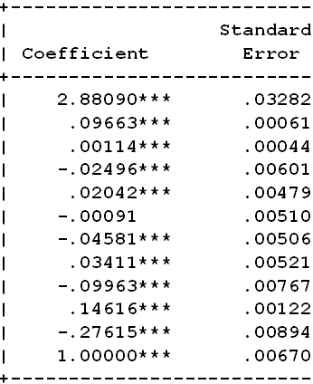
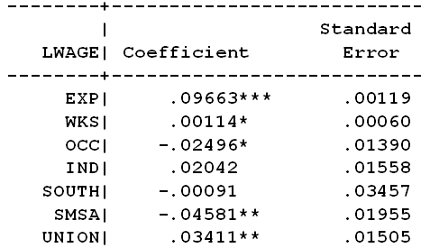
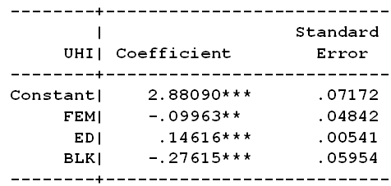
The Magic
Step 3
Step 1
Step 2

Slide 46
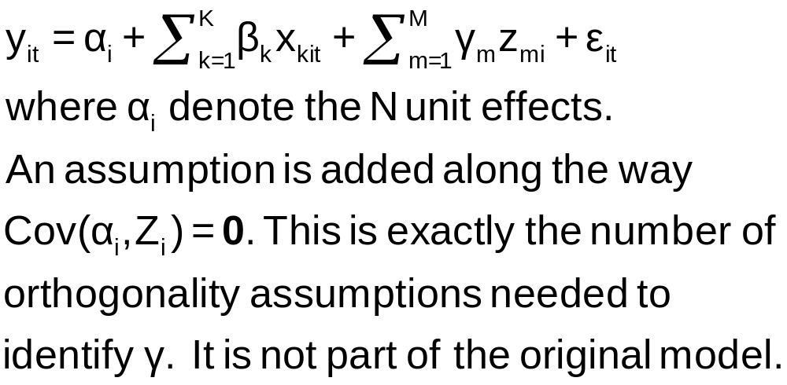
What happened here?

Slide 47
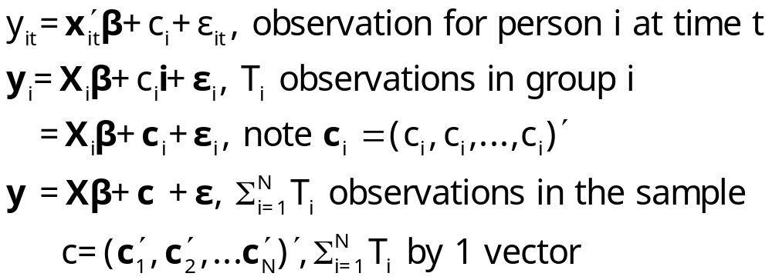
The Random Effects Model
The random effects model
c_{i} is uncorrelated with x_{it} for all t;
  E[c_{i} |X_{i}] = 0
  E[ε_{it}|X_{i},c_{i}]=0

Slide 48
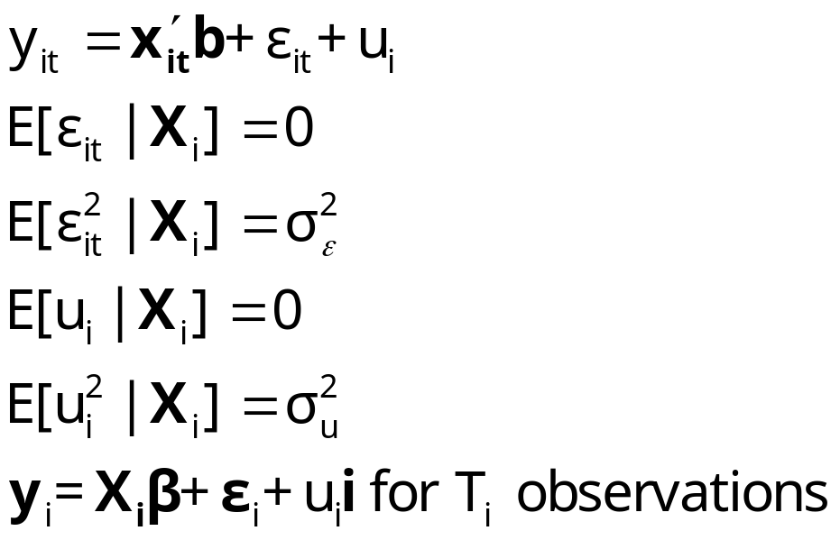
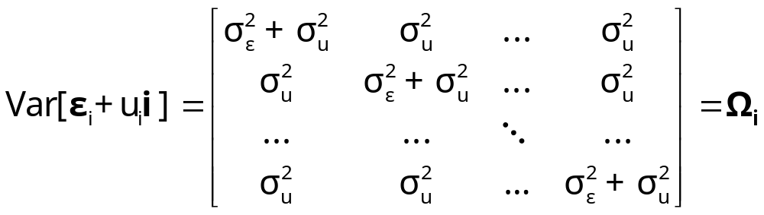
Error Components Model
A Generalized Regression Model

Slide 49
Random vs. Fixed Effects
Random Effects
  Small number of parameters
  Efficient estimation
  Objectionable orthogonality assumption (c_{i} ⊥ X_{i})
Fixed Effects
  Robust – generally consistent
  Large number of parameters

Slide 50
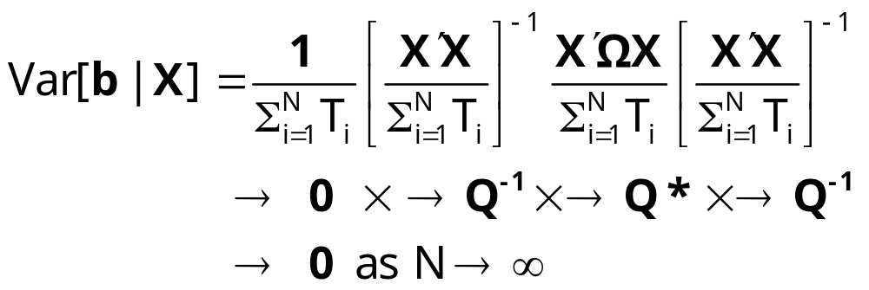
Ordinary Least Squares
Standard results for OLS in a GR model
  Consistent
  Unbiased
  Inefficient
True variance of the least squares estimator

Slide 51
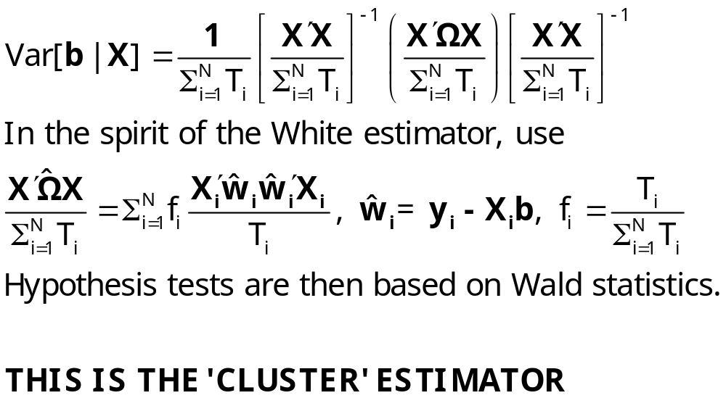
Estimating the Variance for OLS

Slide 52
OLS Results for Cornwell and Rupert
+----------------------------------------------------+
| Residuals Sum of squares = 522.2008 |
| Standard error of e = .3544712 |
| Fit R-squared = .4112099 |
| Adjusted R-squared = .4100766 |
+----------------------------------------------------+
+---------+--------------+----------------+--------+---------+----------+
|Variable | Coefficient | Standard Error |b/St.Er.|P[|Z|>z] | Mean of X|
+---------+--------------+----------------+--------+---------+----------+
Constant 5.40159723 .04838934 111.628 .0000
EXP .04084968 .00218534 18.693 .0000 19.8537815
EXPSQ -.00068788 .480428D-04 -14.318 .0000 514.405042
OCC -.13830480 .01480107 -9.344 .0000 .51116447
SMSA .14856267 .01206772 12.311 .0000 .65378151
MS .06798358 .02074599 3.277 .0010 .81440576
FEM -.40020215 .02526118 -15.843 .0000 .11260504
UNION .09409925 .01253203 7.509 .0000 .36398559
ED .05812166 .00260039 22.351 .0000 12.8453782

Slide 53
Alternative Variance Estimators
+---------+--------------+----------------+--------+---------+
|Variable | Coefficient | Standard Error |b/St.Er.|P[|Z|>z] |
+---------+--------------+----------------+--------+---------+
Constant 5.40159723 .04838934 111.628 .0000
EXP .04084968 .00218534 18.693 .0000
EXPSQ -.00068788 .480428D-04 -14.318 .0000
OCC -.13830480 .01480107 -9.344 .0000
SMSA .14856267 .01206772 12.311 .0000
MS .06798358 .02074599 3.277 .0010
FEM -.40020215 .02526118 -15.843 .0000
UNION .09409925 .01253203 7.509 .0000
ED .05812166 .00260039 22.351 .0000
Robust – Cluster___________________________________________
Constant 5.40159723 .10156038 53.186 .0000
EXP .04084968 .00432272 9.450 .0000
EXPSQ -.00068788 .983981D-04 -6.991 .0000
OCC -.13830480 .02772631 -4.988 .0000
SMSA .14856267 .02423668 6.130 .0000
MS .06798358 .04382220 1.551 .1208
FEM -.40020215 .04961926 -8.065 .0000
UNION .09409925 .02422669 3.884 .0001
ED .05812166 .00555697 10.459 .0000

Slide 54
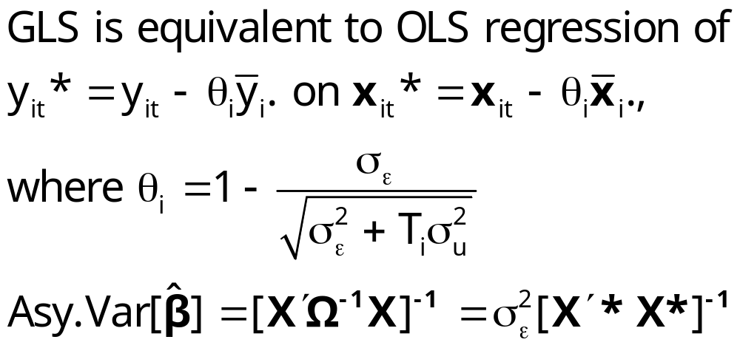
Generalized Least Squares

Slide 55
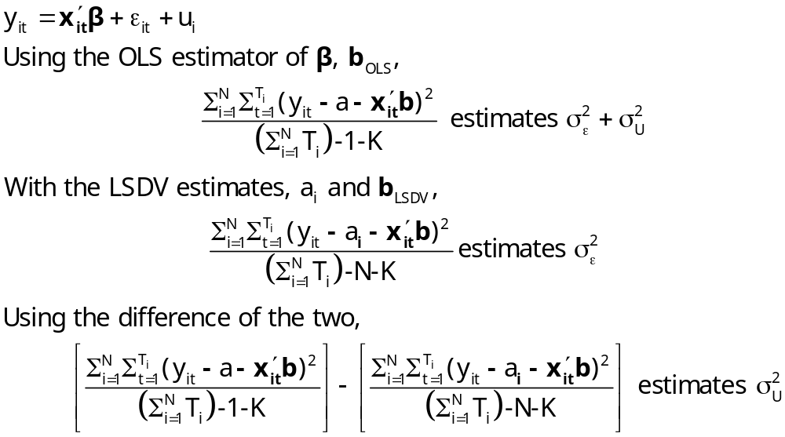
Estimators for the Variances

Slide 56
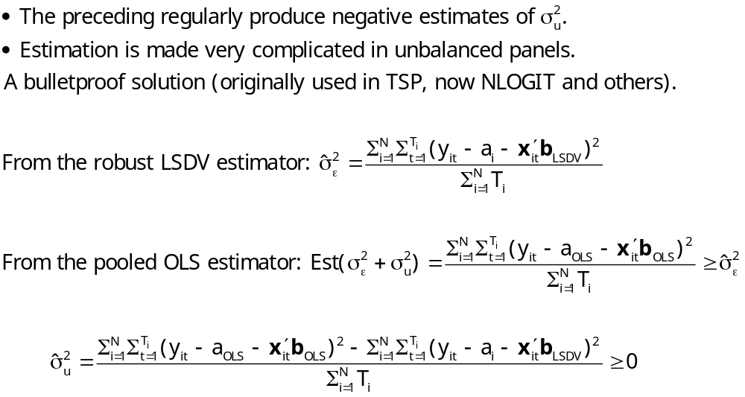
Practical Problems with FGLS

Slide 57
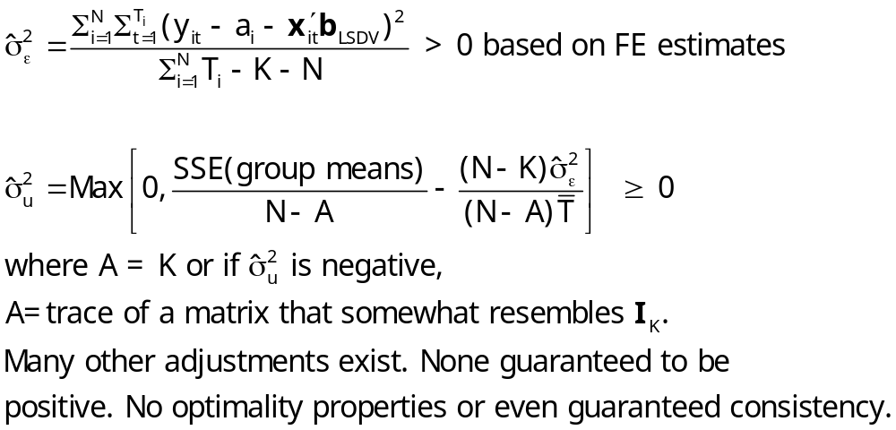
Stata Variance Estimators

Slide 58
Application
+--------------------------------------------------+
| Random Effects Model: v(i,t) = e(i,t) + u(i) |
| Estimates: Var[e] = .231188D-01 |
| Var[u] = .102531D+00 |
| Corr[v(i,t),v(i,s)] = .816006 |
| Variance estimators are based on OLS residuals. |
+--------------------------------------------------+
+---------+--------------+----------------+--------+---------+----------+
|Variable | Coefficient | Standard Error |b/St.Er.|P[|Z|>z] | Mean of X|
+---------+--------------+----------------+--------+---------+----------+
EXP .08819204 .00224823 39.227 .0000 19.8537815
EXPSQ -.00076604 .496074D-04 -15.442 .0000 514.405042
OCC -.04243576 .01298466 -3.268 .0011 .51116447
SMSA -.03404260 .01620508 -2.101 .0357 .65378151
MS -.06708159 .01794516 -3.738 .0002 .81440576
FEM -.34346104 .04536453 -7.571 .0000 .11260504
UNION .05752770 .01350031 4.261 .0000 .36398559
ED .11028379 .00510008 21.624 .0000 12.8453782
Constant 4.01913257 .07724830 52.029 .0000
No problems arise in this sample.

Slide 59
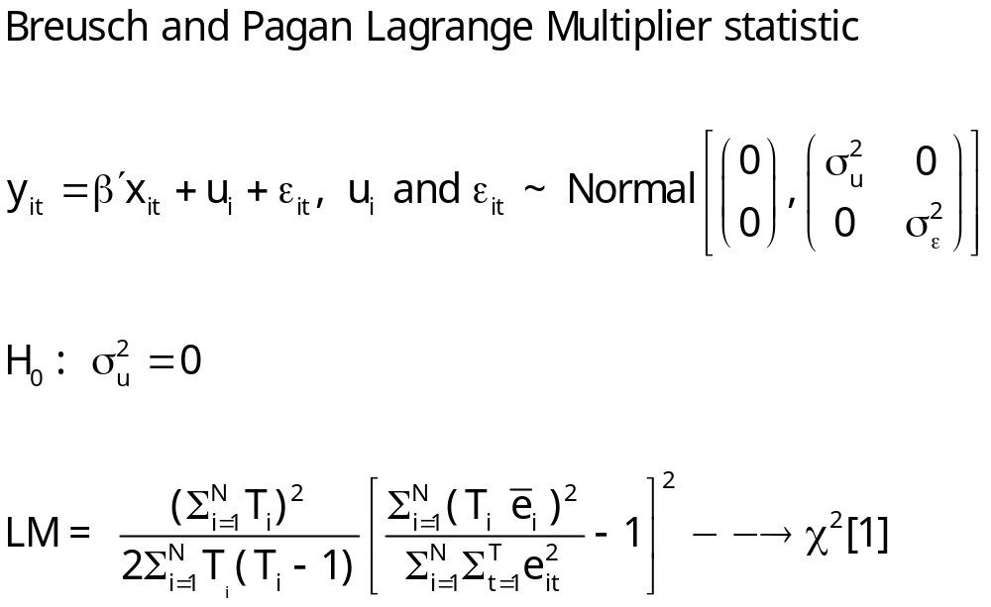
Testing for Effects: An LM Test

Slide 60
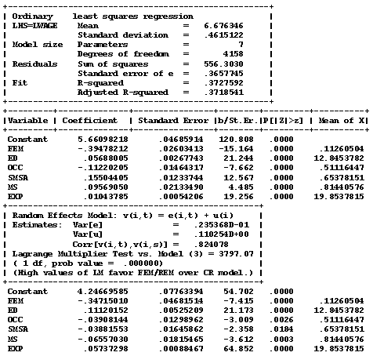
Application: Cornwell-Rupert

Slide 61
Hausman Test for FE vs. RE
Estimator | Random Effects E[c_{i}|X_{i}] = 0 | Fixed Effects E[c_{i}|X_{i}] ≠ 0
FGLS (Random Effects) | Consistent and Efficient | Inconsistent
LSDV (Fixed Effects) | Consistent Inefficient | Consistent Possibly Efficient

Slide 62
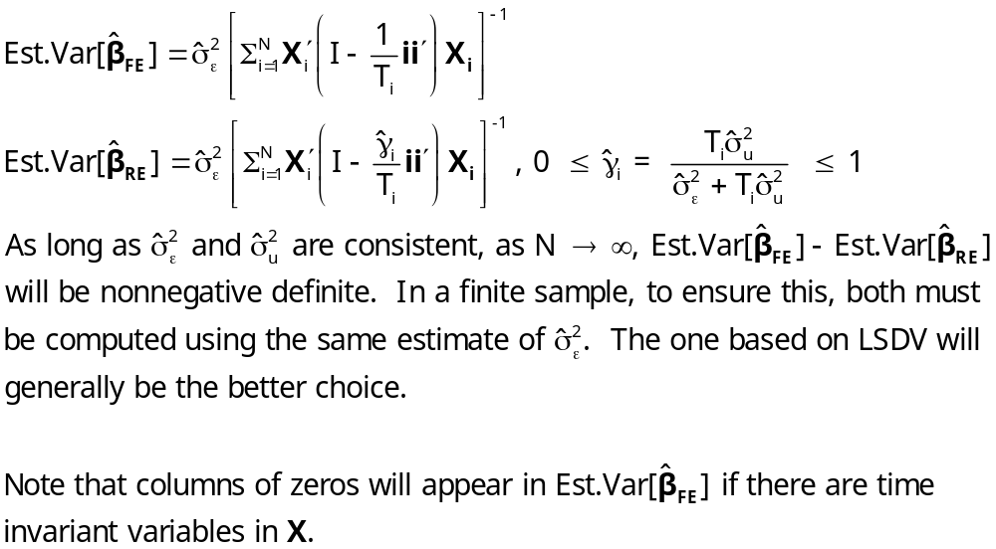
Computing the Hausman Statistic
β does not contain the constant term in the preceding.

Slide 63
Hausman Test
+--------------------------------------------------+
| Random Effects Model: v(i,t) = e(i,t) + u(i) |
| Estimates: Var[e] = .235368D-01 |
| Var[u] = .110254D+00 |
| Corr[v(i,t),v(i,s)] = .824078 |
| Lagrange Multiplier Test vs. Model (3) = 3797.07 |
| ( 1 df, prob value = .000000) |
| (High values of LM favor FEM/REM over CR model.) |
| Fixed vs. Random Effects (Hausman) = 2632.34 |
| ( 4 df, prob value = .000000) |
| (High (low) values of H favor FEM (REM).) |
+--------------------------------------------------+

Slide 64
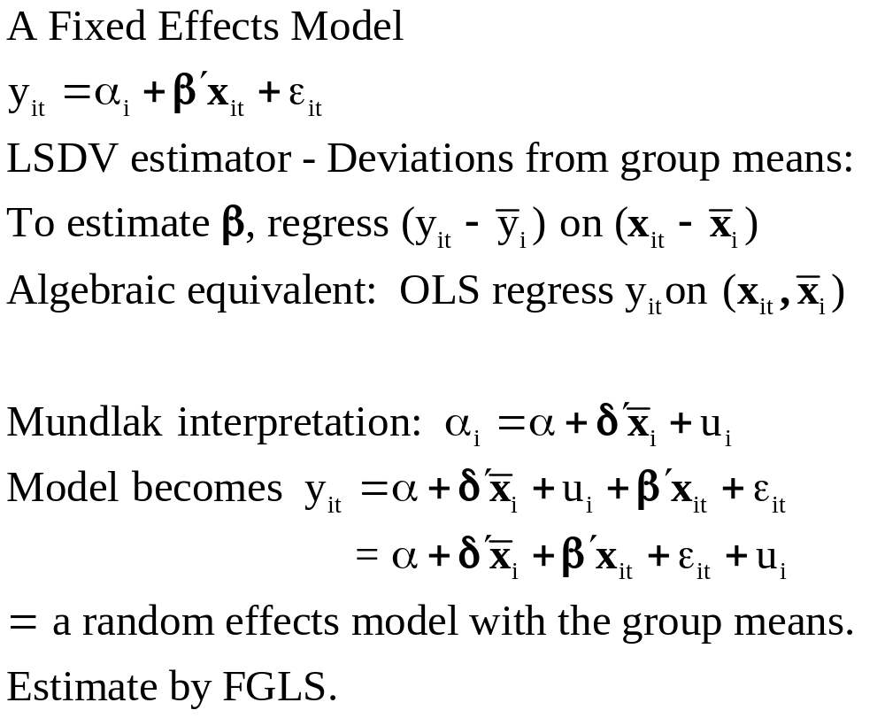
Variable Addition

Slide 65
A Variable Addition Test
Asymptotic equivalent to Hausman
Also equivalent to Mundlak formulation
In the random effects model, using FGLS
  Only applies to time varying variables
  Add expanded group means to the regression (i.e., observation i,t gets same group means for all t.
  Use Wald test to test for coefficients on means equal to 0. Large chi-squared weighs against random effects specification.

Slide 66
Fixed Effects
+----------------------------------------------------+
| Panel:Groups Empty 0, Valid data 595 |
| Smallest 7, Largest 7 |
| Average group size 7.00 |
| There are 3 vars. with no within group variation. |
| ED BLK FEM |
| Look for huge standard errors and fixed parameters.|
| F.E. results are based on a generalized inverse. |
| They will be highly erratic. (Problematic model.) |
| Unable to compute std.errors for dummy var. coeffs.|
+----------------------------------------------------+
+--------+--------------+----------------+--------+--------+----------+
|Variable| Coefficient | Standard Error |b/St.Er.|P[|Z|>z]| Mean of X|
+--------+--------------+----------------+--------+--------+----------+
|WKS | .00083 .00060003 1.381 .1672 46.811525|
|OCC | -.02157 .01379216 -1.564 .1178 .5111645|
|IND | .01888 .01545450 1.221 .2219 .3954382|
|SOUTH | .00039 .03429053 .011 .9909 .2902761|
|SMSA | -.04451** .01939659 -2.295 .0217 .6537815|
|UNION | .03274** .01493217 2.192 .0283 .3639856|
|EXP | .11327*** .00247221 45.819 .0000 19.853782|
|EXPSQ | -.00042*** .546283D-04 -7.664 .0000 514.40504|
|ED | .000 ......(Fixed Parameter)....... |
|BLK | .000 ......(Fixed Parameter)....... |
|FEM | .000 ......(Fixed Parameter)....... |
+--------+------------------------------------------------------------+

Slide 67
Random Effects
+--------------------------------------------------+
| Random Effects Model: v(i,t) = e(i,t) + u(i) |
| Estimates: Var[e] = .235368D-01 |
| Var[u] = .110254D+00 |
| Corr[v(i,t),v(i,s)] = .824078 |
| Lagrange Multiplier Test vs. Model (3) = 3797.07 |
| ( 1 df, prob value = .000000) |
| (High values of LM favor FEM/REM over CR model.) |
+--------------------------------------------------+
+--------+--------------+----------------+--------+--------+----------+
|Variable| Coefficient | Standard Error |b/St.Er.|P[|Z|>z]| Mean of X|
+--------+--------------+----------------+--------+--------+----------+
|WKS | .00094 .00059308 1.586 .1128 46.811525|
|OCC | -.04367*** .01299206 -3.361 .0008 .5111645|
|IND | .00271 .01373256 .197 .8434 .3954382|
|SOUTH | -.00664 .02246416 -.295 .7677 .2902761|
|SMSA | -.03117* .01615455 -1.930 .0536 .6537815|
|UNION | .05802*** .01349982 4.298 .0000 .3639856|
|EXP | .08744*** .00224705 38.913 .0000 19.853782|
|EXPSQ | -.00076*** .495876D-04 -15.411 .0000 514.40504|
|ED | .10724*** .00511463 20.967 .0000 12.845378|
|BLK | -.21178*** .05252013 -4.032 .0001 .0722689|
|FEM | -.24786*** .04283536 -5.786 .0000 .1126050|
|Constant| 3.97756*** .08178139 48.637 .0000 |
+--------+------------------------------------------------------------+

Slide 68
The Hausman Test, by Hand
--> matrix; br=b(1:8) ; vr=varb(1:8,1:8)$
--> matrix ; db = bf - br ; dv = vf - vr $
--> matrix ; list ; h =db'<dv>db$
Matrix H has 1 rows and 1 columns.
1
+--------------
1| 2523.64910
--> calc;list;ctb(.95,8)$
+------------------------------------+
| Listed Calculator Results |
+------------------------------------+
Result = 15.507313

Slide 69
Means Added to REM - Mundlak
+--------+--------------+----------------+--------+--------+----------+
|Variable| Coefficient | Standard Error |b/St.Er.|P[|Z|>z]| Mean of X|
+--------+--------------+----------------+--------+--------+----------+
|WKS | .00083 .00060070 1.380 .1677 46.811525|
|OCC | -.02157 .01380769 -1.562 .1182 .5111645|
|IND | .01888 .01547189 1.220 .2224 .3954382|
|SOUTH | .00039 .03432914 .011 .9909 .2902761|
|SMSA | -.04451** .01941842 -2.292 .0219 .6537815|
|UNION | .03274** .01494898 2.190 .0285 .3639856|
|EXP | .11327*** .00247500 45.768 .0000 19.853782|
|EXPSQ | -.00042*** .546898D-04 -7.655 .0000 514.40504|
|ED | .05199*** .00552893 9.404 .0000 12.845378|
|BLK | -.16983*** .04456572 -3.811 .0001 .0722689|
|FEM | -.41306*** .03732204 -11.067 .0000 .1126050|
|WKSB | .00863** .00363907 2.371 .0177 46.811525|
|OCCB | -.14656*** .03640885 -4.025 .0001 .5111645|
|INDB | .04142 .02976363 1.392 .1640 .3954382|
|SOUTHB | -.05551 .04297816 -1.292 .1965 .2902761|
|SMSAB | .21607*** .03213205 6.724 .0000 .6537815|
|UNIONB | .08152** .03266438 2.496 .0126 .3639856|
|EXPB | -.08005*** .00533603 -15.002 .0000 19.853782|
|EXPSQB | -.00017 .00011763 -1.416 .1567 514.40504|
|Constant| 5.19036*** .20147201 25.762 .0000 |
+--------+------------------------------------------------------------+

Slide 70
Wu (Variable Addition) Test
--> matrix ; bm=b(12:19);vm=varb(12:19,12:19)$
--> matrix ; list ; wu = bm'<vm>bm $
Matrix WU has 1 rows and 1 columns.
1
+--------------
1| 3004.38076

Slide 71
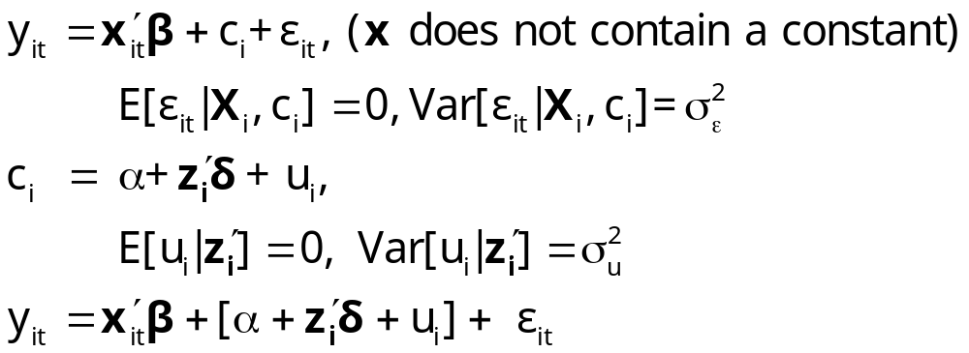
A Hierarchical Linear Model
Interpretation of the FE Model

Slide 72
Hierarchical Linear Model as REM
+--------------------------------------------------+
| Random Effects Model: v(i,t) = e(i,t) + u(i) |
| Estimates: Var[e] = .235368D-01 |
| Var[u] = .110254D+00 |
| Corr[v(i,t),v(i,s)] = .824078 |
| Sigma(u) = 0.3303 |
+--------------------------------------------------+
+--------+--------------+----------------+--------+--------+----------+
|Variable| Coefficient | Standard Error |b/St.Er.|P[|Z|>z]| Mean of X|
+--------+--------------+----------------+--------+--------+----------+
OCC | -.03908144 .01298962 -3.009 .0026 .51116447
SMSA | -.03881553 .01645862 -2.358 .0184 .65378151
MS | -.06557030 .01815465 -3.612 .0003 .81440576
EXP | .05737298 .00088467 64.852 .0000 19.8537815
FEM | -.34715010 .04681514 -7.415 .0000 .11260504
ED | .11120152 .00525209 21.173 .0000 12.8453782
Constant| 4.24669585 .07763394 54.702 .0000

Slide 73
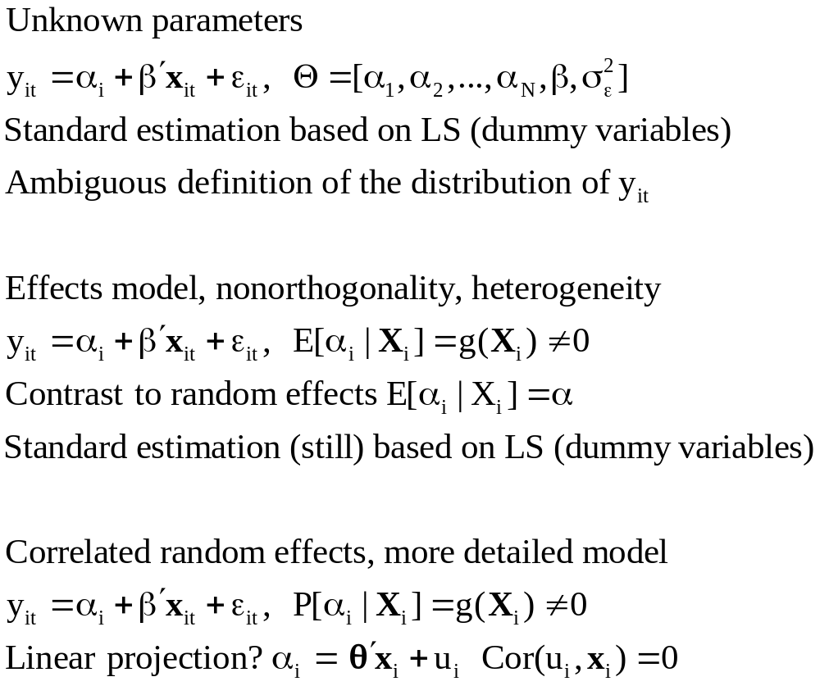
Evolution: Correlated Random Effects

Slide 74

Mundlak’s Estimator
Mundlak, Y., “On the Pooling of Time Series and Cross Section Data, Econometrica, 46, 1978, pp. 69-85.

Slide 75



Correlated Random Effects

Slide 76

Mundlak’s Approach for an FE Model with Time Invariant Variables

Slide 77
Mundlak Form of FE Model
+--------+--------------+----------------+--------+--------+----------+
|Variable| Coefficient | Standard Error |b/St.Er.|P[|Z|>z]| Mean of X|
+--------+--------------+----------------+--------+--------+----------+
x(i,t)=================================================================
OCC | -.02021384 .01375165 -1.470 .1416 .51116447
SMSA | -.04250645 .01951727 -2.178 .0294 .65378151
MS | -.02946444 .01915264 -1.538 .1240 .81440576
EXP | .09665711 .00119262 81.046 .0000 19.8537815
z(i)===================================================================
FEM | -.34322129 .05725632 -5.994 .0000 .11260504
ED | .05099781 .00575551 8.861 .0000 12.8453782
Means of x(i,t) and constant===========================================
Constant| 5.72655261 .10300460 55.595 .0000
OCCB | -.10850252 .03635921 -2.984 .0028 .51116447
SMSAB | .22934020 .03282197 6.987 .0000 .65378151
MSB | .20453332 .05329948 3.837 .0001 .81440576
EXPB | -.08988632 .00165025 -54.468 .0000 19.8537815
Variance Estimates=====================================================
Var[e]| .0235632
Var[u]| .0773825

Slide 78
Panel Data Extensions
Dynamic models: lagged effects of the dependent variable
Endogenous RHS variables
Cross country comparisons– large T
More general parameter heterogeneity – not only the constant term
Nonlinear models such as binary choice

Slide 79

The Hausman and Taylor Model

Slide 80

H&T’s 4 Step FGLS Estimator

Slide 81

H&T’s 4 STEP IV Estimator

Slide 82


Slide 83

Arellano/Bond/Bover’s Formulation Builds on Hausman and Taylor

Slide 84

Arellano/Bond/Bover’s Formulation Adds a Lagged DV to H&T
This formulation is the same as H&T with y_{i,t-1} contained in x2_{it} .

Slide 85
Dynamic (Linear) Panel
Data (DPD) Models
Application
Bias in Conventional Estimation
Development of Consistent Estimators
Efficient GMM Estimators

Slide 86

Dynamic Linear Model

Slide 87

A General DPD model

Slide 88

Arellano and Bond Estimator

Slide 89

Arellano and Bond Estimator

Slide 90

Arellano and Bond Estimator

Slide 91

Application: Maquiladora
http://www.dallasfed.org/news/research/2005/05us-mexico_felix.pdf

Slide 92

Maquiladora

Slide 93

Estimates

