Slide 1
Microeconometric Modeling
William Greene
Stern School of Business
New York University

Slide 2
Bootstrapping and Quantile Regresion

Slide 3
Estimating the Asymptotic
Variance of an Estimator
Known form of asymptotic variance: Compute from known results
Unknown form, known generalities about properties: Use bootstrapping
  Root N consistency
  Sampling conditions amenable to central limit theorems
  Compute by resampling mechanism within the sample.

Slide 4
Bootstrapping
Method:
1. Estimate parameters using full sample: → b
2. Repeat R times:
Draw n observations from the n, with replacement
Estimate β with b(r).
3. Estimate variance with
V = (1/R)Σ_{r} [b(r) - b][b(r) - b]’
(Some use mean of replications instead of b. Advocated (without motivation) by original designers of the method.)

Slide 5
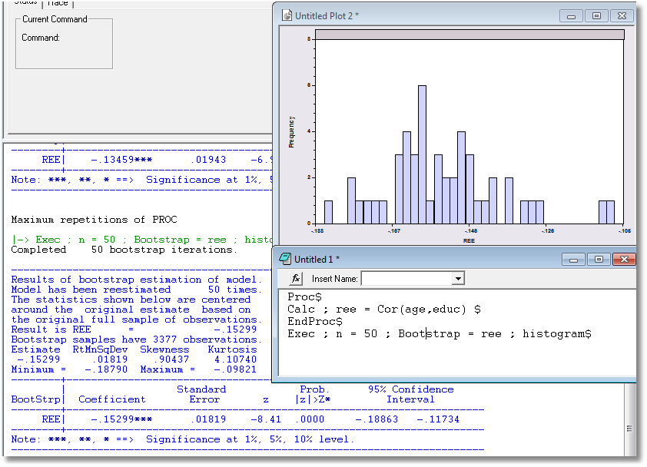
Application: Correlation between Age and Education

Slide 6
Bootstrap Regression - Replications
matrix;bboot=init(3,21,0.)$ Store results here
namelist;x=one,y,pg$ Define X
regress;lhs=g;rhs=x$ Compute and display b
calc;r=0$ Counter
proc Define procedure
regress;quietly;lhs=g;rhs=x$ … Regression (silent)
matrix;{r=r+1};bboot(*,r)=b$ ... Store b(r)
endproc Ends procedure
execute;n=20;bootstrap=b$ 20 bootstrap reps
matrix;list;bboot' $ Display replications

Slide 7
Results of Bootstrap Procedure
--------+-------------------------------------------------------------
Variable| Coefficient Standard Error t-ratio P[|T|>t] Mean of X
--------+-------------------------------------------------------------
Constant| -79.7535*** 8.67255 -9.196 .0000
Y| .03692*** .00132 28.022 .0000 9232.86
PG| -15.1224*** 1.88034 -8.042 .0000 2.31661
--------+-------------------------------------------------------------
Completed 20 bootstrap iterations.
----------------------------------------------------------------------
Results of bootstrap estimation of model.
Model has been reestimated 20 times.
Means shown below are the means of the
bootstrap estimates. Coefficients shown
below are the original estimates based
on the full sample.
bootstrap samples have 36 observations.
--------+-------------------------------------------------------------
Variable| Coefficient Standard Error b/St.Er. P[|Z|>z] Mean of X
--------+-------------------------------------------------------------
B001| -79.7535*** 8.35512 -9.545 .0000 -79.5329
B002| .03692*** .00133 27.773 .0000 .03682
B003| -15.1224*** 2.03503 -7.431 .0000 -14.7654
--------+-------------------------------------------------------------

Slide 8
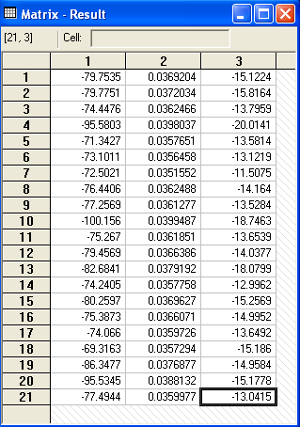
Bootstrap Replications
Full sample result
Bootstrapped sample results

Slide 9
Quantile Regression
Q(y|x,α) = β′x, α = quantile
Estimated by linear programming
Q(y|x,.50) = β′x, .50 ➔ median regression
Median regression estimated by LAD (estimates same parameters as mean regression if symmetric conditional distribution)
Why use quantile (median) regression?
  Semiparametric
  Robust to some extensions (heteroscedasticity?)
  Complete characterization of conditional distribution

Slide 10
Estimated Variance for
Quantile Regression
Asymptotic Theory
Bootstrap – an ideal application

Slide 11
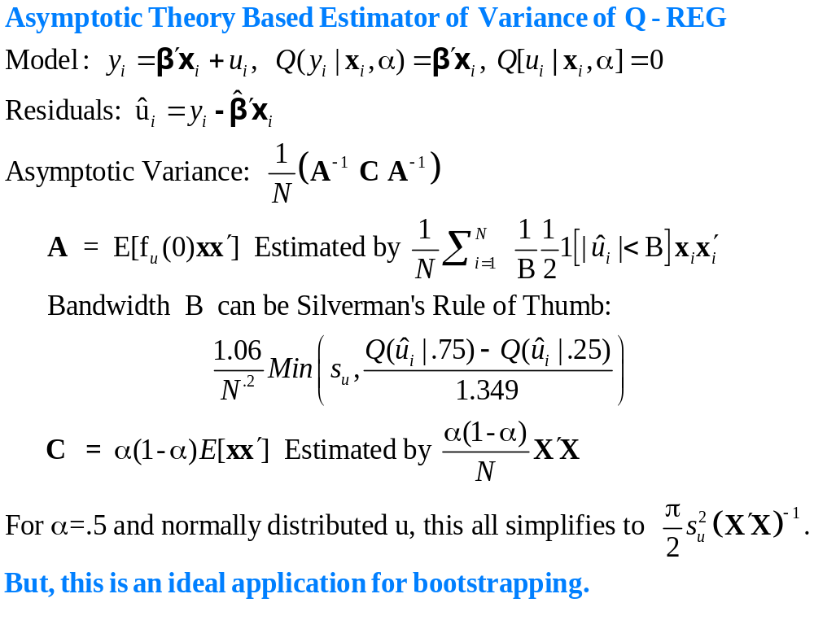

Slide 12
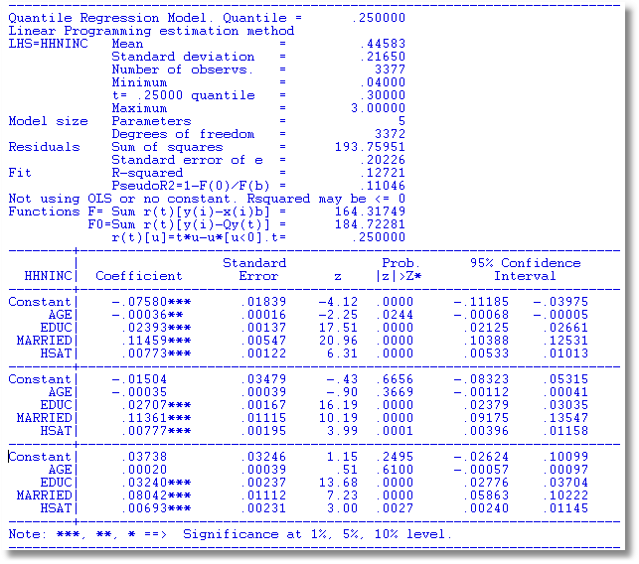
α = .25
α = .50
α = .75

Slide 13
OLS vs. Least Absolute Deviations
----------------------------------------------------------------------
Least absolute deviations estimator...............
Residuals Sum of squares = 1537.58603
Standard error of e = 6.82594
Fit R-squared = .98284
Adjusted R-squared = .98180
Sum of absolute deviations = 189.3973484
--------+-------------------------------------------------------------
Variable| Coefficient Standard Error b/St.Er. P[|Z|>z] Mean of X
--------+-------------------------------------------------------------
|Covariance matrix based on 50 replications.
Constant| -84.0258*** 16.08614 -5.223 .0000
Y| .03784*** .00271 13.952 .0000 9232.86
PG| -17.0990*** 4.37160 -3.911 .0001 2.31661
--------+-------------------------------------------------------------
Ordinary least squares regression ............
Residuals Sum of squares = 1472.79834
Standard error of e = 6.68059 Standard errors are based on
Fit R-squared = .98356 50 bootstrap replications
Adjusted R-squared = .98256
--------+-------------------------------------------------------------
Variable| Coefficient Standard Error t-ratio P[|T|>t] Mean of X
--------+-------------------------------------------------------------
Constant| -79.7535*** 8.67255 -9.196 .0000
Y| .03692*** .00132 28.022 .0000 9232.86
PG| -15.1224*** 1.88034 -8.042 .0000 2.31661
--------+-------------------------------------------------------------

