Slide 1
Topics in Microeconometrics
William Greene
Department of Economics
Stern School of Business

Slide 2

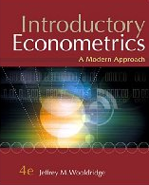





Random Parameters and Hierarchical Linear Models

Slide 3


Slide 4
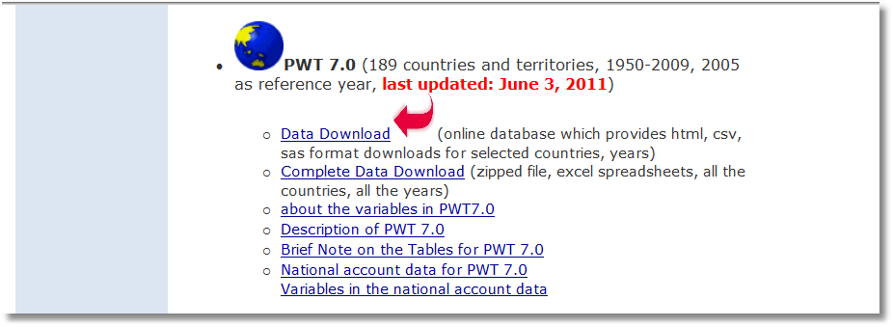

Slide 5
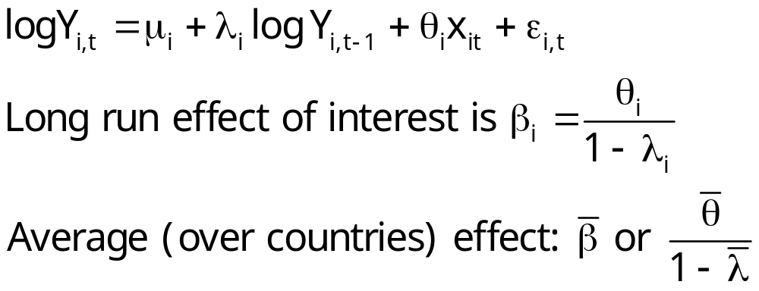
Heterogeneous Dynamic Model

Slide 6
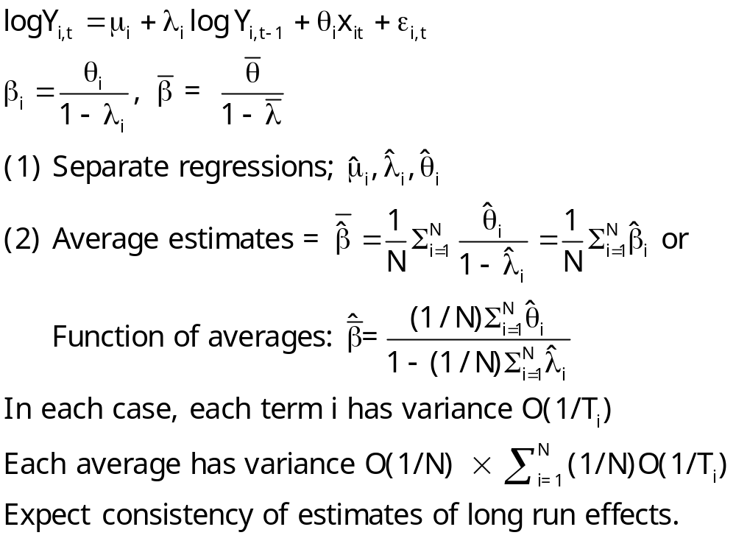
“Fixed Effects” Approach

Slide 7
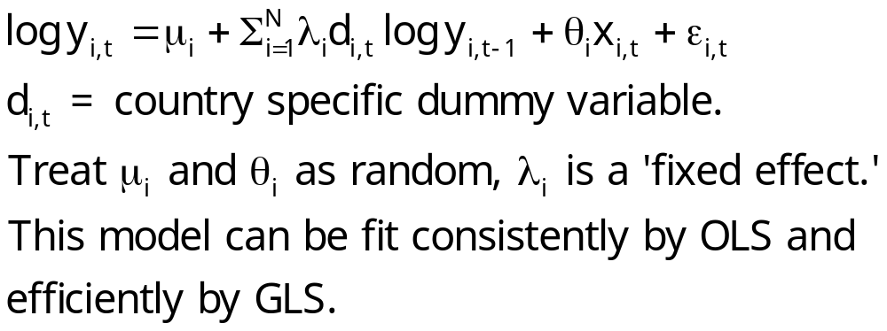
A Mixed/Fixed Approach

Slide 8
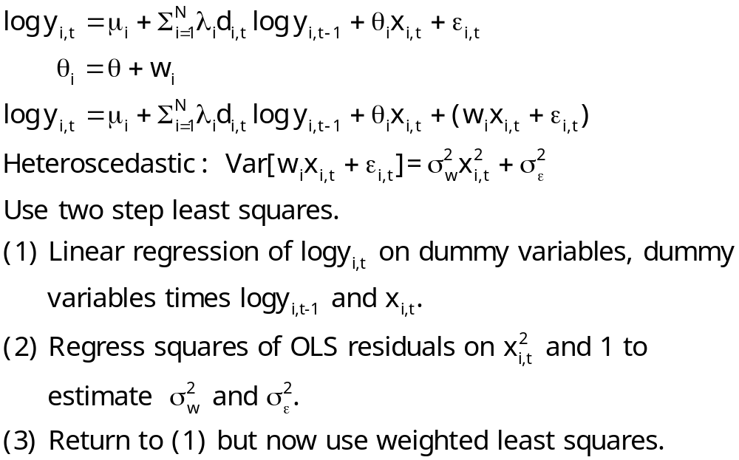
A Mixed Fixed Model Estimator

Slide 9
Baltagi and Griffin’s Gasoline Data
World Gasoline Demand Data, 18 OECD Countries, 19 years
Variables in the file are
COUNTRY = name of country
YEAR = year, 1960-1978
LGASPCAR = log of consumption per car
LINCOMEP = log of per capita income
LRPMG = log of real price of gasoline
LCARPCAP = log of per capita number of cars
See Baltagi (2001, p. 24) for analysis of these data. The article on which the analysis is based is Baltagi, B. and Griffin, J., "Gasoline Demand in the OECD: An Application of Pooling and Testing Procedures," European Economic Review, 22, 1983, pp. 117-137. The data were downloaded from the website for Baltagi's text.

Slide 10
Baltagi and Griffin’s Gasoline Market
COUNTRY = name of country
YEAR = year, 1960-1978
LGASPCAR = log of consumption per car y
LINCOMEP = log of per capita income z
LRPMG = log of real price of gasoline x1
LCARPCAP = log of per capita number of cars x2
y_{it} = β_{1i} + β_{2i} z_{it} + β_{3i} x1_{it} + β_{4i} x2_{it} + ε_{it}.

Slide 11
Fixed Effects

Slide 12
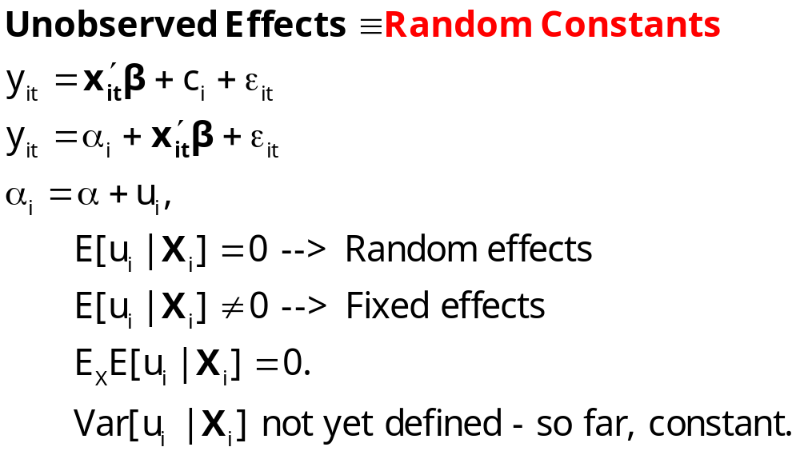
Parameter Heterogeneity

Slide 13
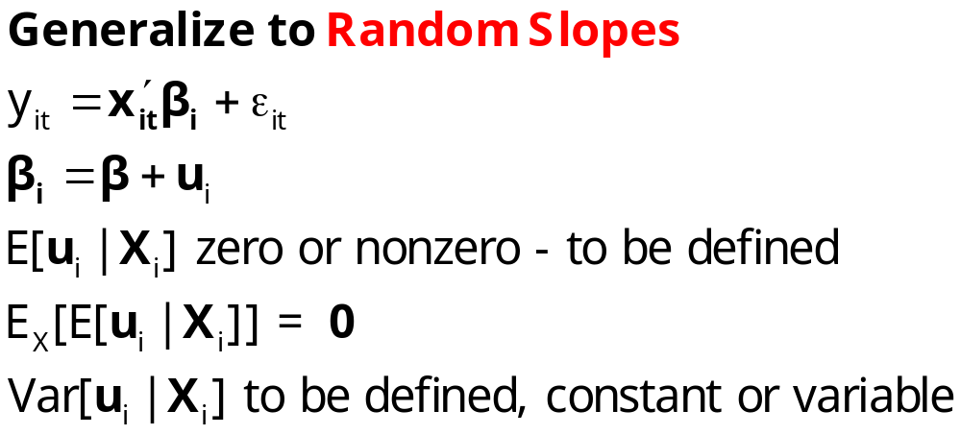
Parameter Heterogeneity

Slide 14
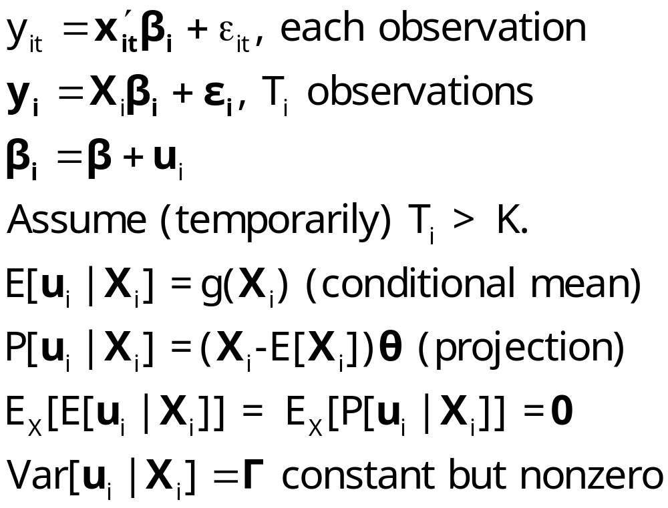
Fixed Effects
(Hildreth, Houck, Hsiao, Swamy)

Slide 15
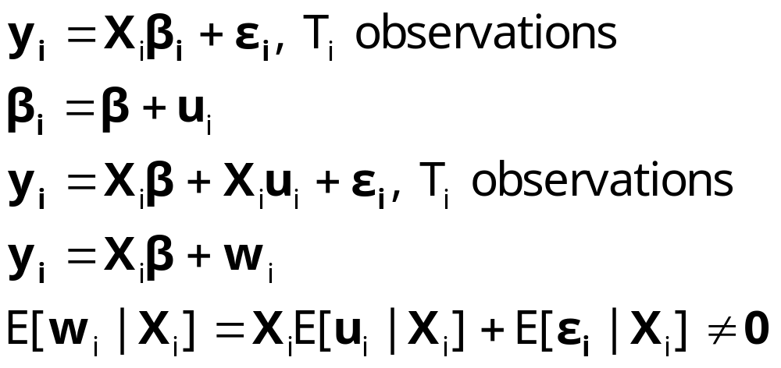
OLS and GLS Are Inconsistent

Slide 16
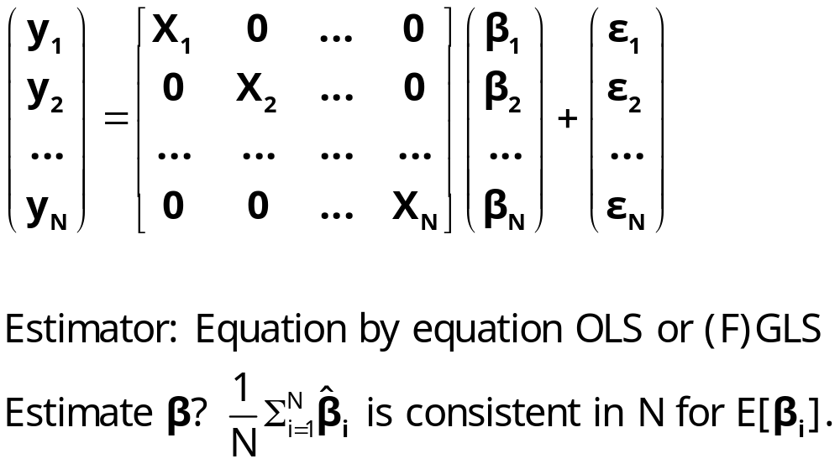
Estimating the Fixed Effects Model

Slide 17
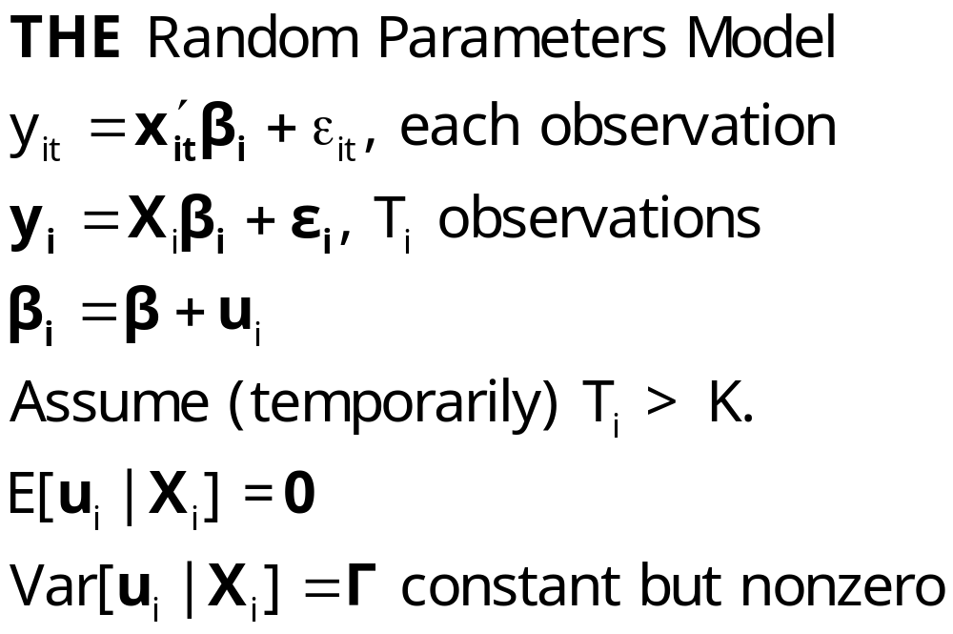
Random Effects and
Random Parameters

Slide 18
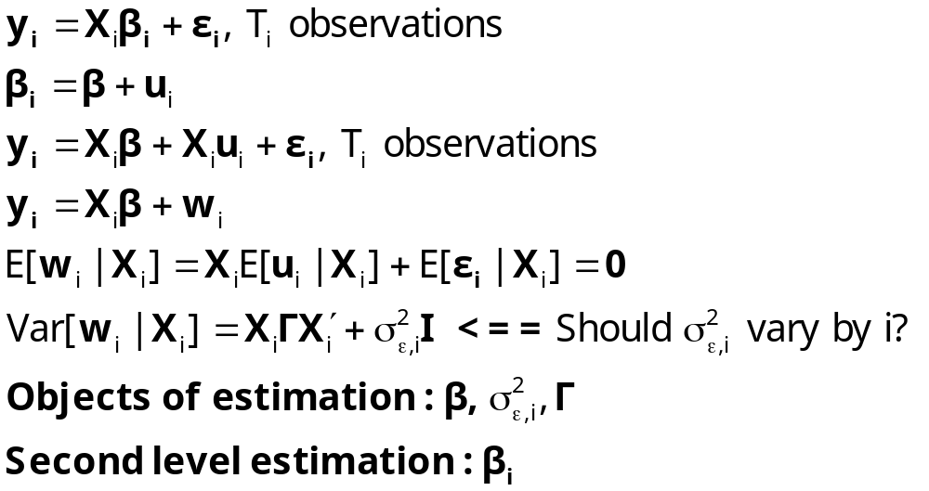
Estimating the Random
Parameters Model

Slide 19
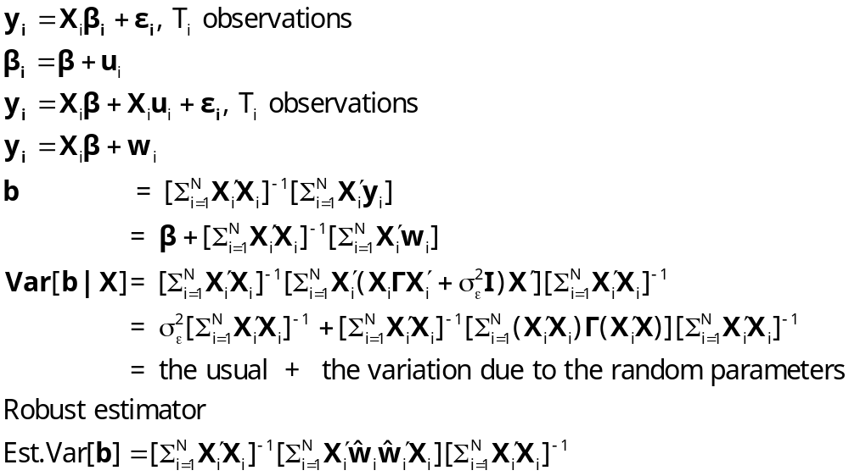
Estimating the Random
Parameters Model by OLS

Slide 20
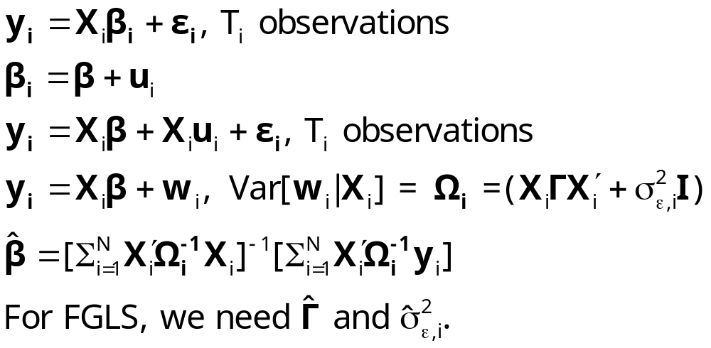
Estimating the Random
Parameters Model by GLS

Slide 21
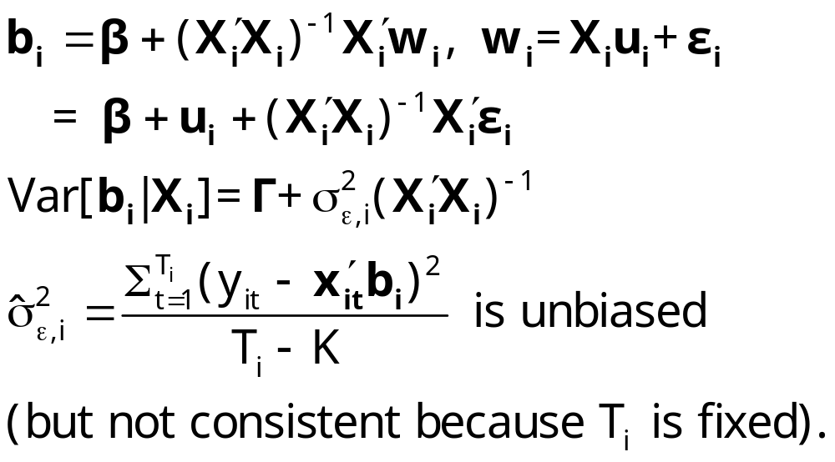
Estimating the RPM

Slide 22
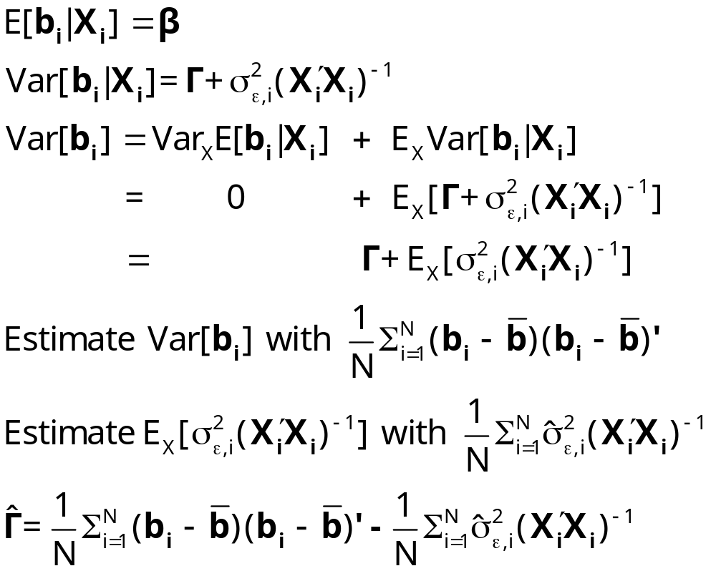
An Estimator for Γ

Slide 23
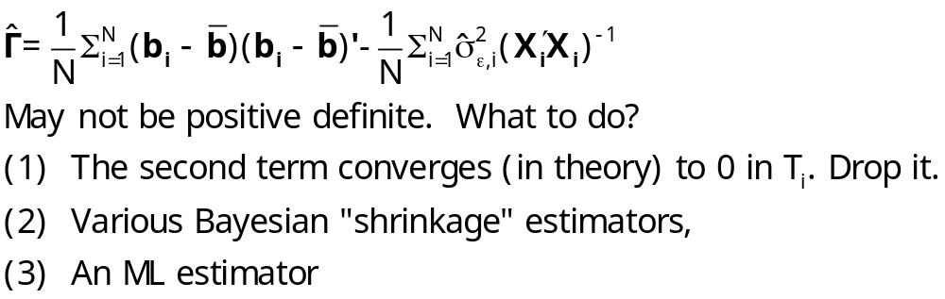
A Positive Definite Estimator for Γ

Slide 24
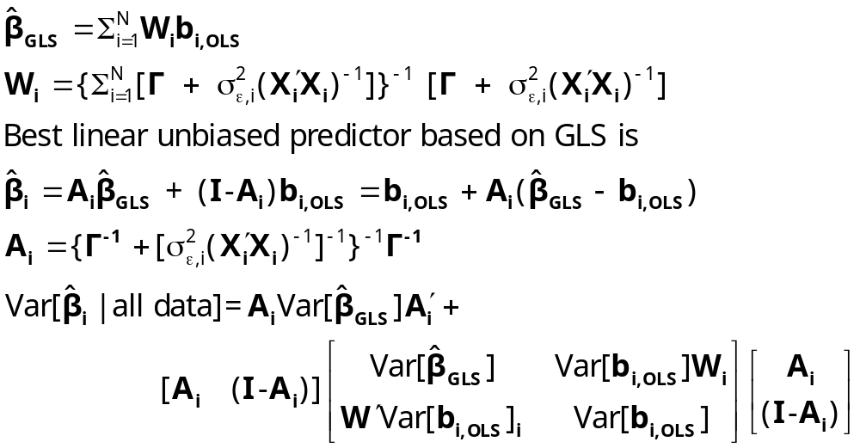
Estimating β_{i}

Slide 25
OLS and FGLS Estimates
+----------------------------------------------------+
| Overall OLS results for pooled sample. |
| Residuals Sum of squares = 14.90436 |
| Standard error of e = .2099898 |
| Fit R-squared = .8549355 |
+----------------------------------------------------+
+---------+--------------+----------------+--------+---------+
|Variable | Coefficient | Standard Error |b/St.Er.|P[|Z|>z] |
+---------+--------------+----------------+--------+---------+
Constant 2.39132562 .11693429 20.450 .0000
LINCOMEP .88996166 .03580581 24.855 .0000
LRPMG -.89179791 .03031474 -29.418 .0000
LCARPCAP -.76337275 .01860830 -41.023 .0000
+------------------------------------------------+
| Random Coefficients Model |
| Residual standard deviation = .3498 |
| R squared = .5976 |
| Chi-squared for homogeneity test = 22202.43 |
| Degrees of freedom = 68 |
| Probability value for chi-squared= .000000 |
+------------------------------------------------+
+---------+--------------+----------------+--------+---------+
|Variable | Coefficient | Standard Error |b/St.Er.|P[|Z|>z] |
+---------+--------------+----------------+--------+---------+
CONSTANT 2.40548802 .55014979 4.372 .0000
LINCOMEP .39314902 .11729448 3.352 .0008
LRPMG -.24988767 .04372201 -5.715 .0000
LCARPCAP -.44820927 .05416460 -8.275 .0000

Slide 26
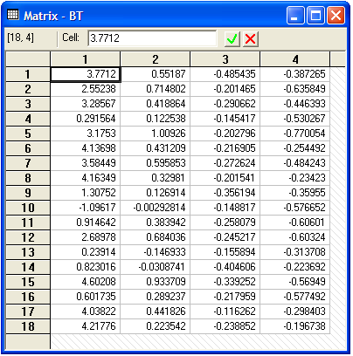
Best Linear Unbiased Country Specific Estimates

Slide 27
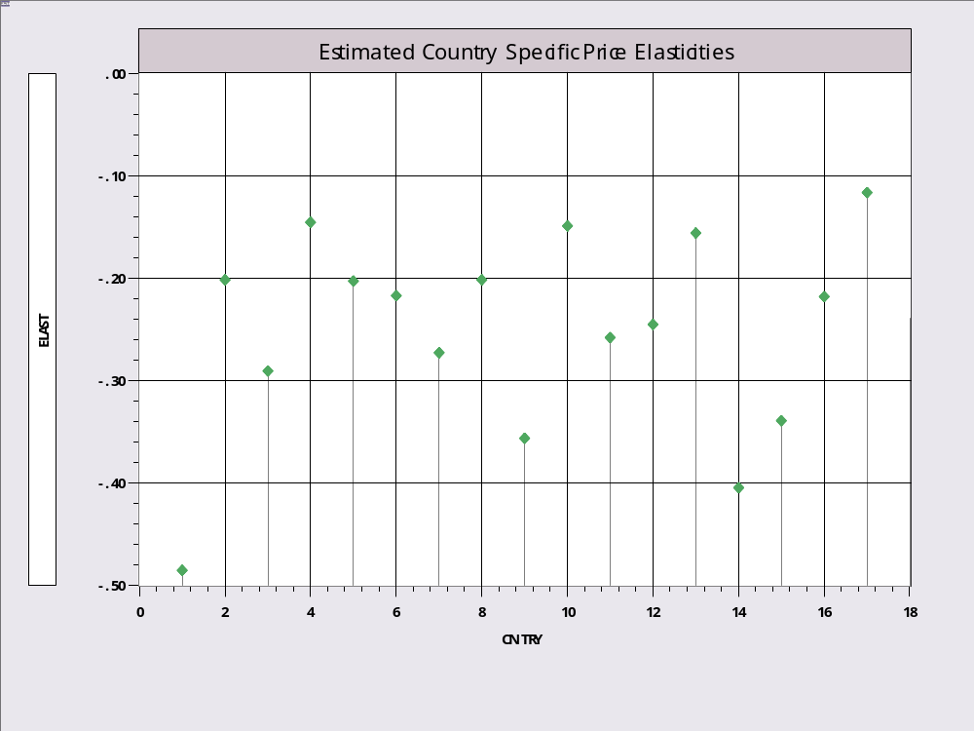
Estimated Price Elasticities

Slide 28
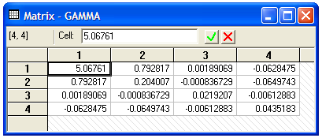
Estimated Γ

Slide 29
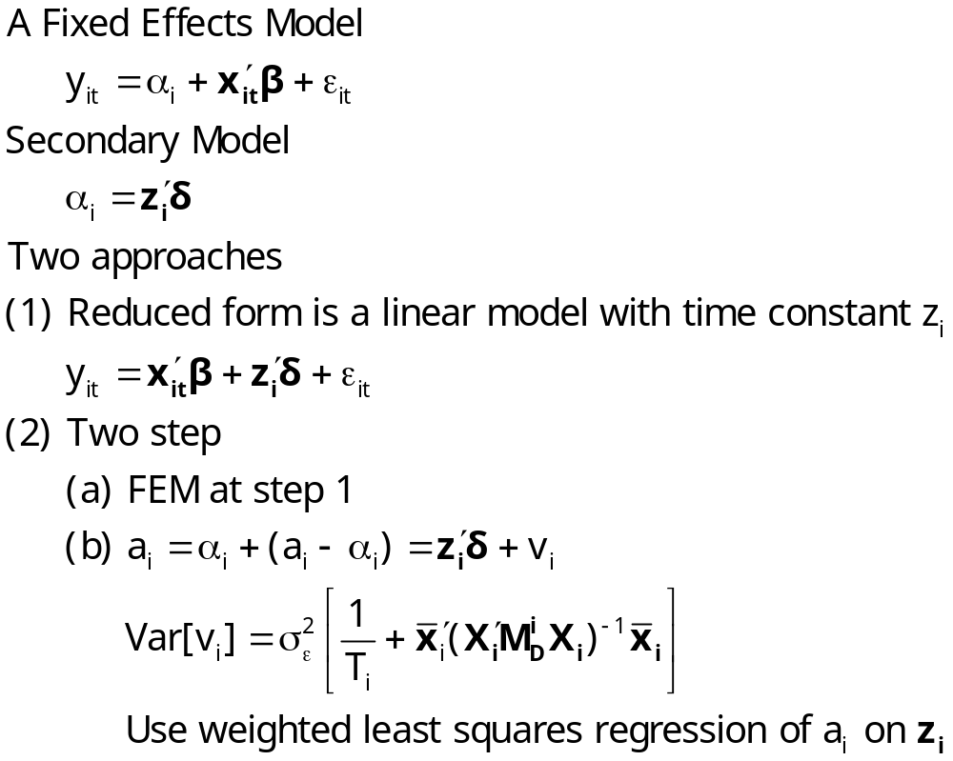
Two Step Estimation (Saxonhouse)

Slide 30
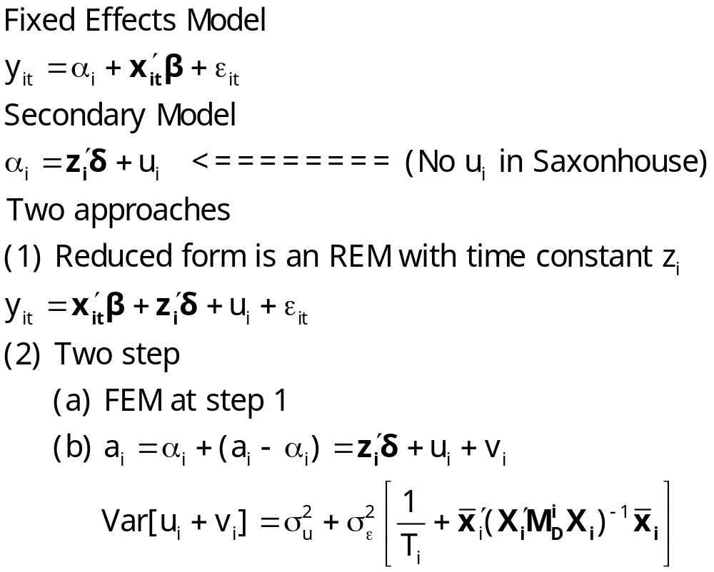
A Hierarchical Model

Slide 31
Analysis of Fannie Mae
Fannie Mae
The Funding Advantage
The Pass Through
Passmore, W., Sherlund, S., Burgess, G., “The Effect of Housing Government-Sponsored Enterprises on Mortgage Rates,” 2005, Real Estate Economics

Slide 32
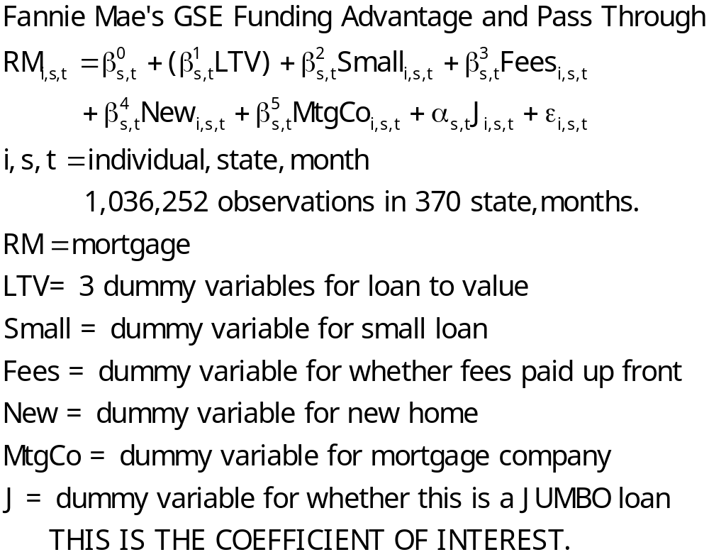
Two Step Analysis of Fannie-Mae

Slide 33
Average of 370 First Step Regressions
Symbol | Variable | Mean | S.D. | Coeff | S.E.
RM | Rate % | 7.23 | 0.79
J | Jumbo | 0.06 | 0.23 | 0.16 | 0.05
LTV1 | 75%-80% | 0.36 | 0.48 | 0.04 | 0.04
LTV2 | 81%-90% | 0.15 | 0.35 | 0.17 | 0.05
LTV3 | >90% | 0.22 | 0.41 | 0.15 | 0.04
New | New Home | 0.17 | 0.38 | 0.05 | 0.04
Small | < $100,000 | 0.27 | 0.44 | 0.14 | 0.04
Fees | Fees paid | 0.62 | 0.52 | 0.06 | 0.03
MtgCo | Mtg. Co. | 0.67 | 0.47 | 0.12 | 0.05
R² = 0.77

Slide 34
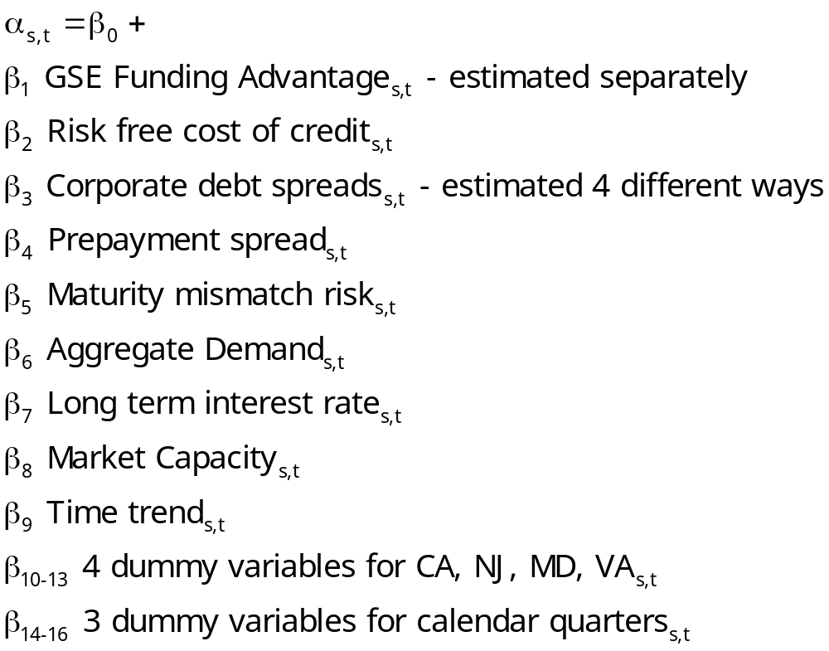
Second Step Uses 370 Estimates of α_{st}

Slide 35
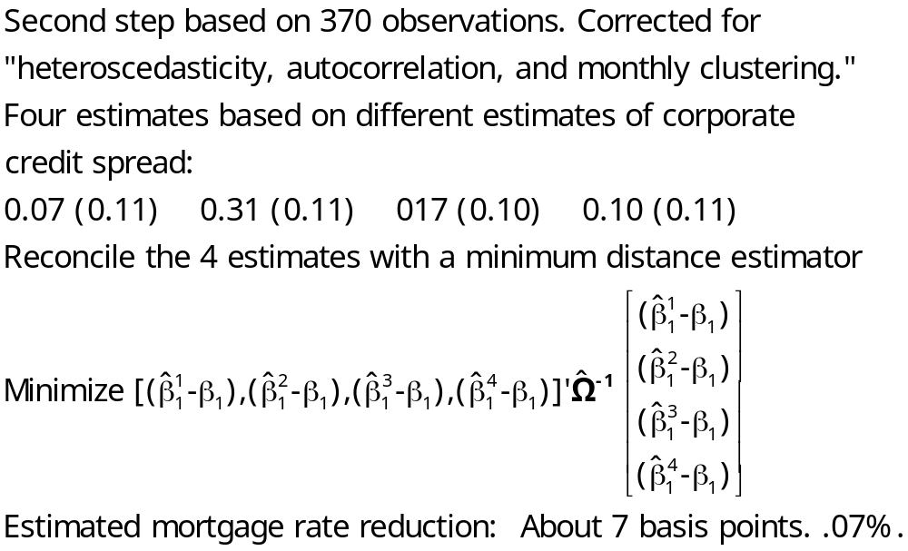
Estimates of β₁

Slide 36
RANDOM Effects
- continuous

Slide 37
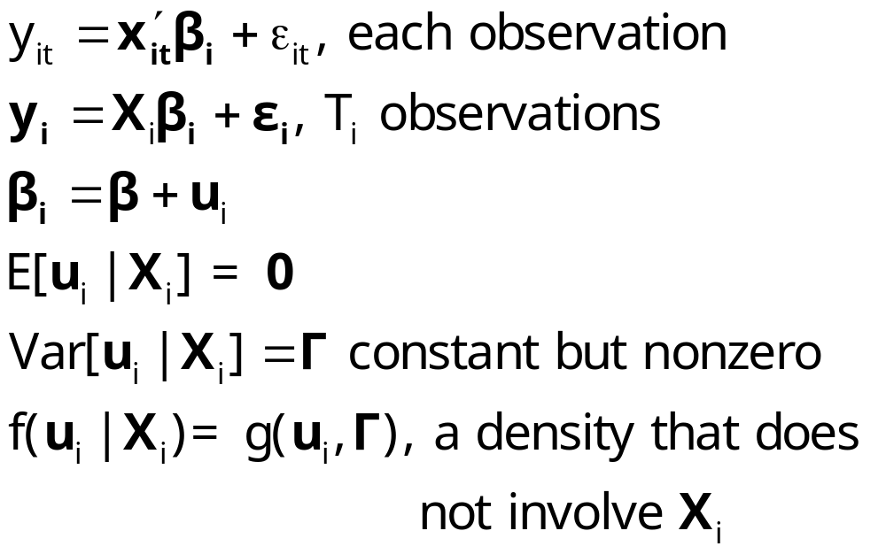
Continuous Parameter Variation
(The Random Parameters Model)

Slide 38
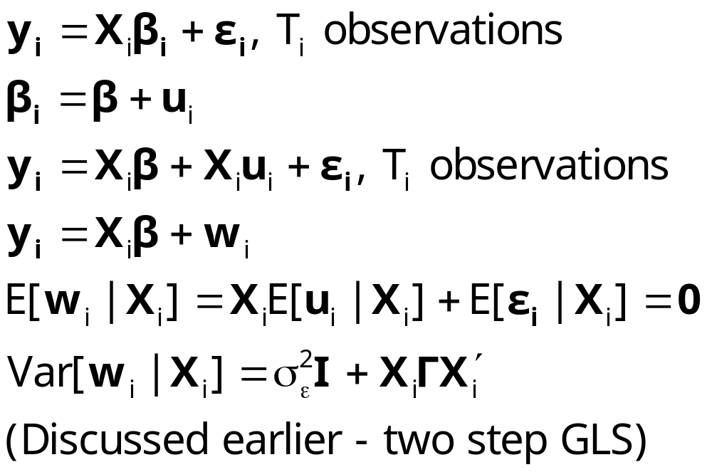
OLS and GLS Are Consistent

Slide 39
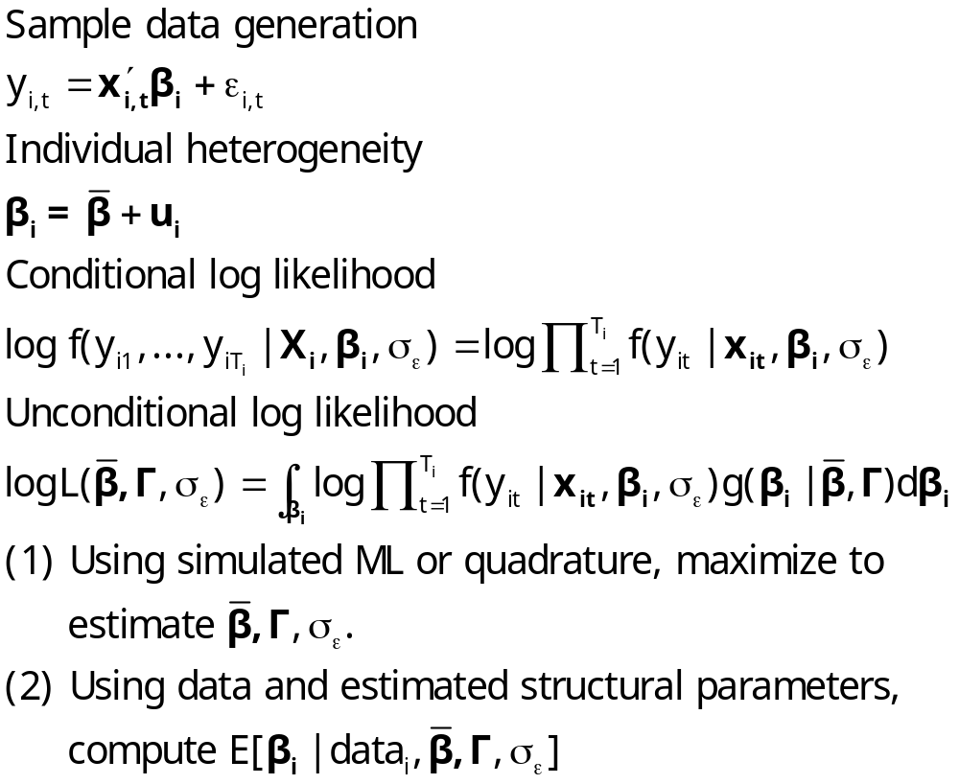
ML Estimation of the RPM

Slide 40
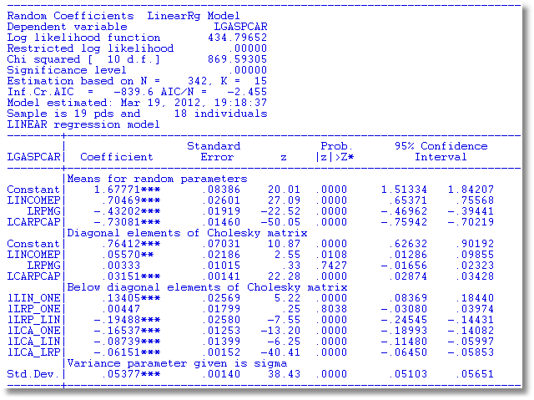
RP Gasoline Market

Slide 41
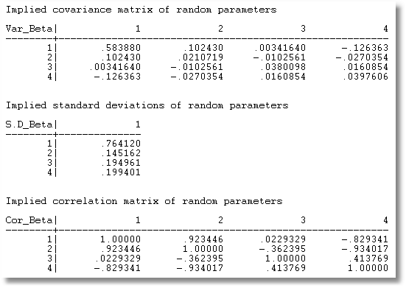
Parameter Covariance matrix

Slide 42
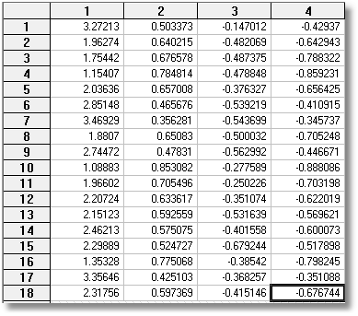
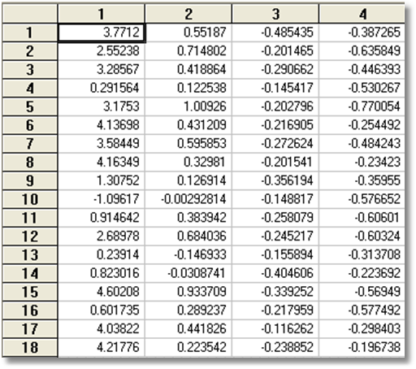
RP vs. Gen1

Slide 43
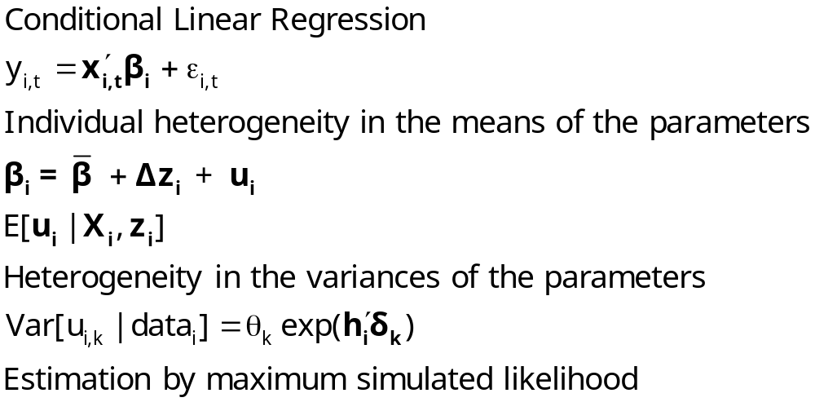
Modeling Parameter Heterogeneity

Slide 44
Hierarchical Linear Model
COUNTRY = name of country
YEAR = year, 1960-1978
LGASPCAR = log of consumption per car y
LINCOMEP = log of per capita income z
LRPMG = log of real price of gasoline x1
LCARPCAP = log of per capita number of cars x2
y_{it} = β_{1i} + β_{2i} x1_{it} + β_{3i} x2_{it} + ε_{it}.
β_{1i}=β₁+Δ₁ z_{i} + u_{1i}
β_{2i}=β₂+Δ₂ z_{i} + u_{2i}
β_{3i}=β₃+Δ₃ z_{i} + u_{3i}

Slide 45
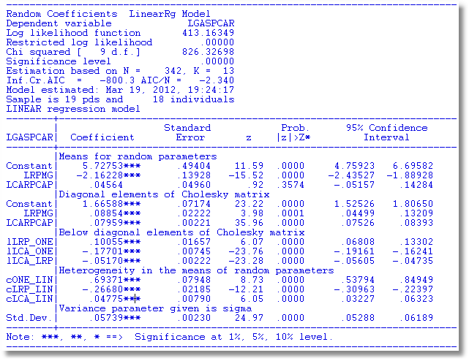
Estimated HLM

Slide 46
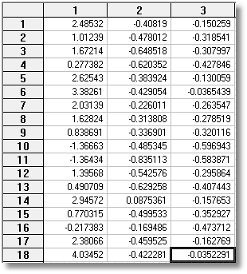
RP vs. HLM

Slide 47
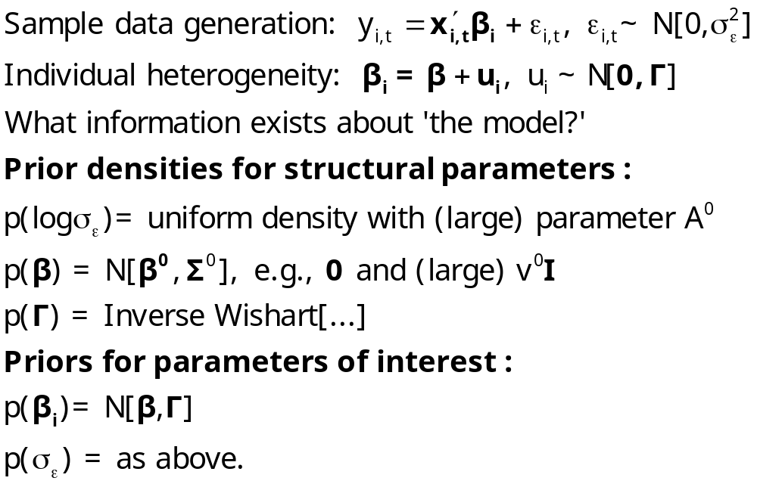
Hierarchical Bayesian Estimation

Slide 48
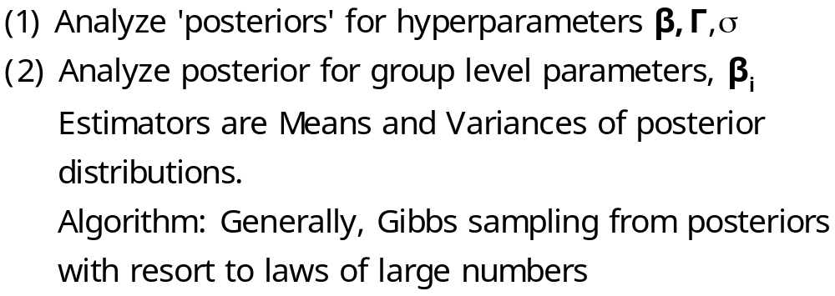
Estimation of Hierarchical
Bayes Models

Slide 49
A Hierarchical Linear Model
German Health Care Data
Hsat = β₁ + β₂AGE_{it} + γ_{i} EDUC_{it} + β₄ MARRIED_{it} + ε_{it}
γ_{i} = α₁ + α₂FEMALE_{i} + u_{i}
Sample ; all $
Setpanel ; Group = id ; Pds = ti $
Regress ; For [ti = 7] ; Lhs = newhsat ; Rhs = one,age,educ,married
; RPM = female ; Fcn = educ(n)
; pts = 25 ; halton ; panel ; Parameters$
Sample ; 1 – 887 $
Create ; betaeduc = beta_i $
Dstat ; rhs = betaeduc $
Histogram ; Rhs = betaeduc $

Slide 50
OLS Results
OLS Starting values for random parameters model...
Ordinary least squares regression ............
LHS=NEWHSAT Mean = 6.69641
Standard deviation = 2.26003
Number of observs. = 6209
Model size Parameters = 4
Degrees of freedom = 6205
Residuals Sum of squares = 29671.89461
Standard error of e = 2.18676
Fit R-squared = .06424
Adjusted R-squared = .06378
Model test F[ 3, 6205] (prob) = 142.0(.0000)
--------+---------------------------------------------------------
| Standard Prob. Mean
NEWHSAT| Coefficient Error z z>|Z| of X
--------+---------------------------------------------------------
Constant| 7.02769*** .22099 31.80 .0000
AGE| -.04882*** .00307 -15.90 .0000 44.3352
MARRIED| .29664*** .07701 3.85 .0001 .84539
EDUC| .14464*** .01331 10.87 .0000 10.9409
--------+---------------------------------------------------------

Slide 51
Maximum Simulated Likelihood
Normal exit: 27 iterations. Status=0. F= 12584.28
------------------------------------------------------------------
Random Coefficients LinearRg Model
Dependent variable NEWHSAT
Log likelihood function -12583.74717
Estimation based on N = 6209, K = 7
Unbalanced panel has 887 individuals
LINEAR regression model
Simulation based on 25 Halton draws
--------+---------------------------------------------------------
| Standard Prob. Mean
NEWHSAT| Coefficient Error z z>|Z| of X
--------+---------------------------------------------------------
|Nonrandom parameters
Constant| 7.34576*** .15415 47.65 .0000
AGE| -.05878*** .00206 -28.56 .0000 44.3352
MARRIED| .23427*** .05034 4.65 .0000 .84539
|Means for random parameters
EDUC| .16580*** .00951 17.43 .0000 10.9409
|Scale parameters for dists. of random parameters
EDUC| 1.86831*** .00179 1044.68 .0000
|Heterogeneity in the means of random parameters
cEDU_FEM| -.03493*** .00379 -9.21 .0000
|Variance parameter given is sigma
Std.Dev.| 1.58877*** .00954 166.45 .0000
--------+---------------------------------------------------------

Slide 52
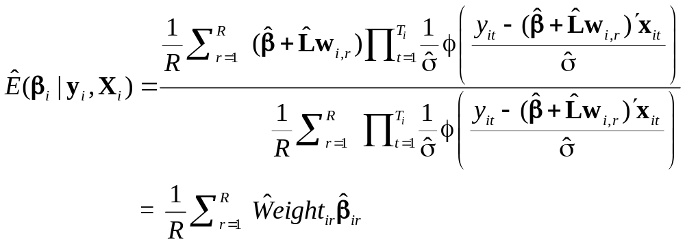
Simulating Conditional Means for Individual Parameters
Posterior estimates of E[parameters(i) | Data(i)]

Slide 53
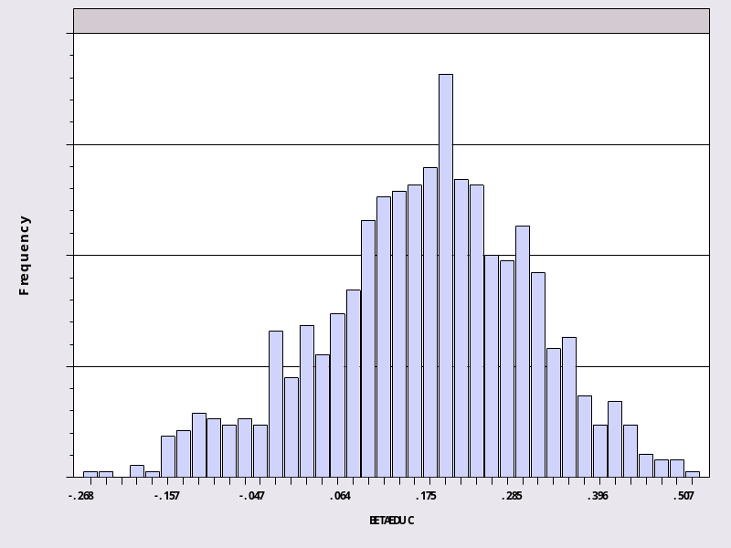
“Individual Coefficients”
--> Sample ; 1 - 887 $
--> create ; betaeduc = beta_i $
--> dstat ; rhs = betaeduc $
Descriptive Statistics
All results based on nonmissing observations.
==============================================================================
Variable Mean Std.Dev. Minimum Maximum Cases Missing
==============================================================================
All observations in current sample
--------+---------------------------------------------------------------------
BETAEDUC| .161184 .132334 -.268006 .506677 887 0

Slide 54
A Hierarchical Linear Model
A hedonic model of house values
Beron, K., Murdoch, J., Thayer, M., “Hierarchical Linear Models with Application to Air Pollution in the South Coast Air Basin,” American Journal of Agricultural Economics, 81, 5, 1999.

Slide 55
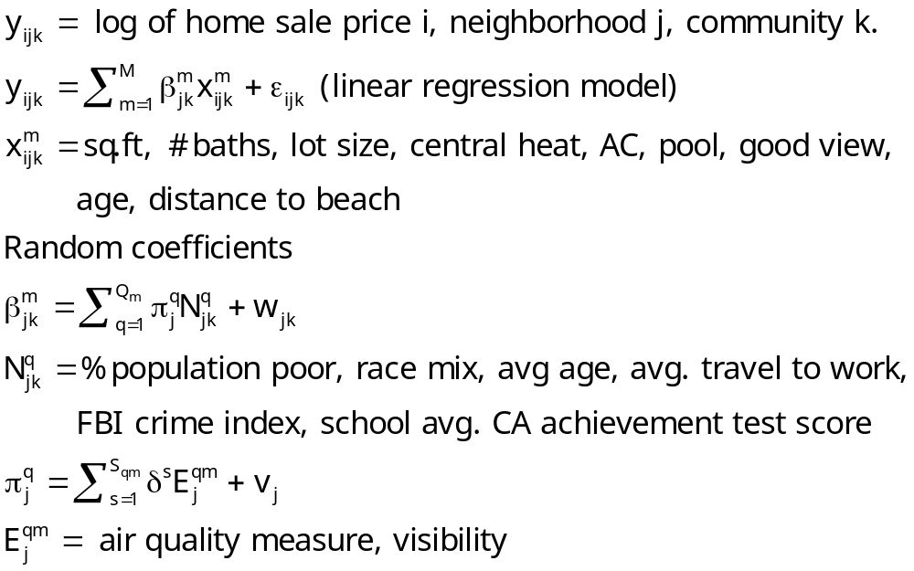
Three Level HLM

Slide 56
Mixed Model Estimation
Programs differ on the models fitted, the algorithms, the paradigm, and the extensions provided to the simplest RPM, β_{i} = β+w_{i}.
WinBUGS:
  MCMC
  User specifies the model – constructs the Gibbs Sampler/Metropolis Hastings
MLWin:
  Linear and some nonlinear – logit, Poisson, etc.
  Uses MCMC for MLE (noninformative priors)
SAS: Proc Mixed.
  Classical
  Uses primarily a kind of GLS/GMM (method of moments algorithm for loglinear models)
Stata: Classical
  Several loglinear models – GLAMM. Mixing done by quadrature.
  Maximum simulated likelihood for multinomial choice (Arne Hole, user provided)
LIMDEP/NLOGIT
  Classical
  Mixing done by Monte Carlo integration – maximum simulated likelihood
  Numerous linear, nonlinear, loglinear models
Ken Train’s Gauss Code
  Monte Carlo integration
  Mixed Logit (mixed multinomial logit) model only (but free!)
Biogeme
  Multinomial choice models
  Many experimental models (developer’s hobby)

Slide 57
Gen 2.1 – RANDOM Effects - DIscrete

Slide 58
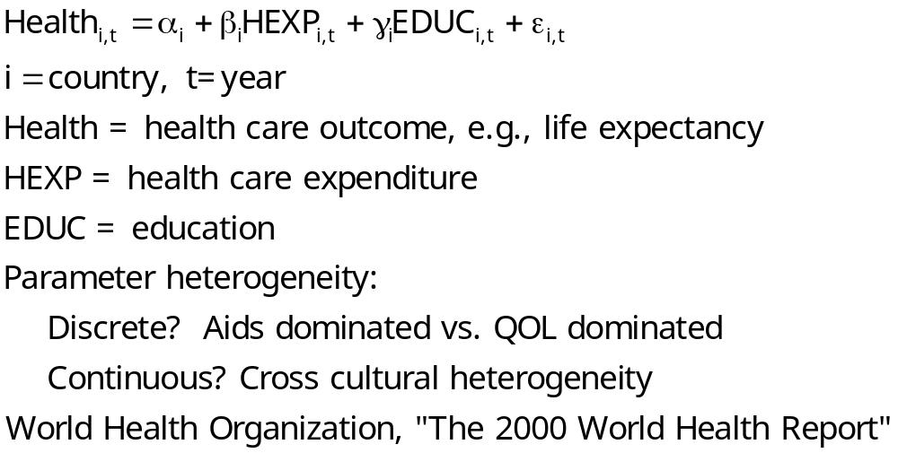
Heterogeneous Production Model

Slide 59
Parameter Heterogeneity
Fixed and Random Effects Models
  Latent common time invariant “effects”
  Heterogeneity in level parameter – constant term – in the model
General Parameter Heterogeneity in Models
  Discrete: There is more than one time of individual in the population – parameters differ across types. Produces a Latent Class Model
  Continuous; Parameters vary randomly across individuals: Produces a Random Parameters Model or a Mixed Model. (Synonyms)

Slide 60
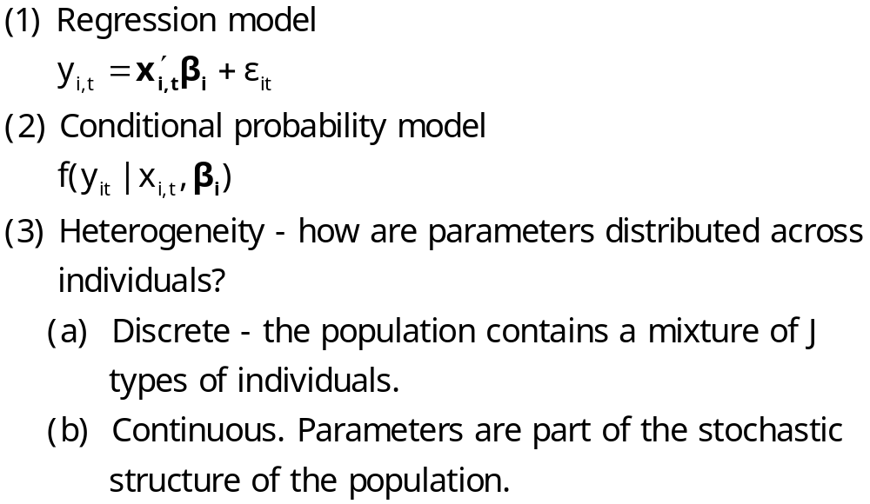
Parameter Heterogeneity

Slide 61
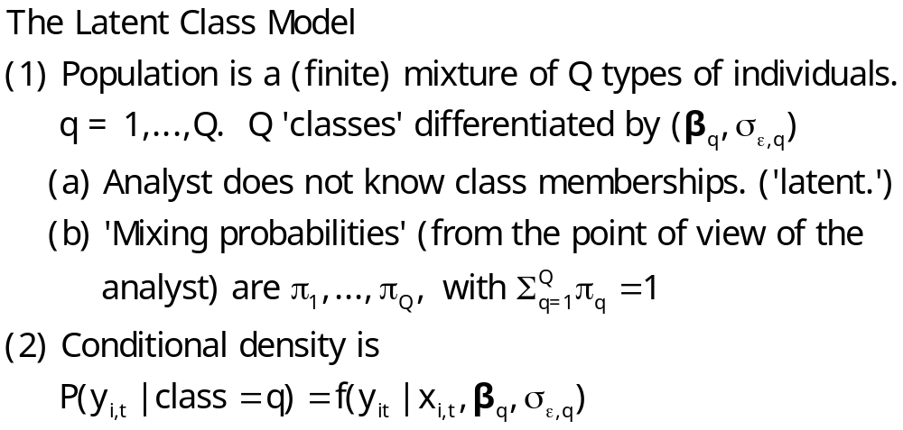
Discrete Parameter Variation

Slide 62
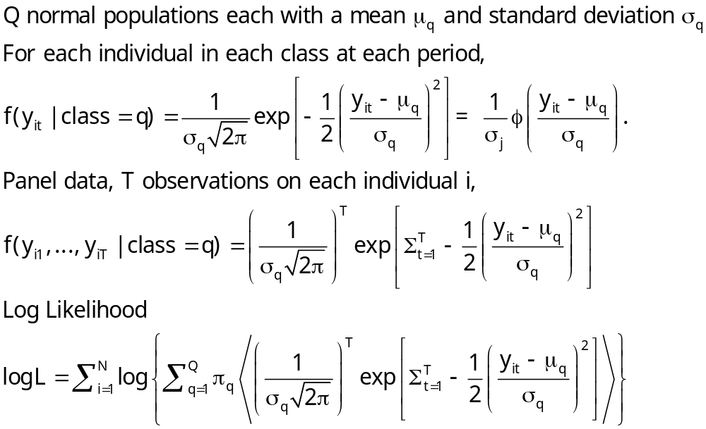
Example: Mixture of Normals

Slide 63
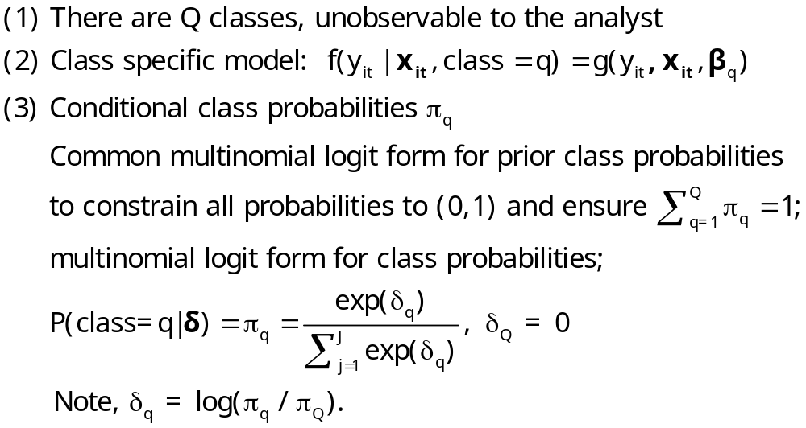
An Extended Latent Class Model

Slide 64
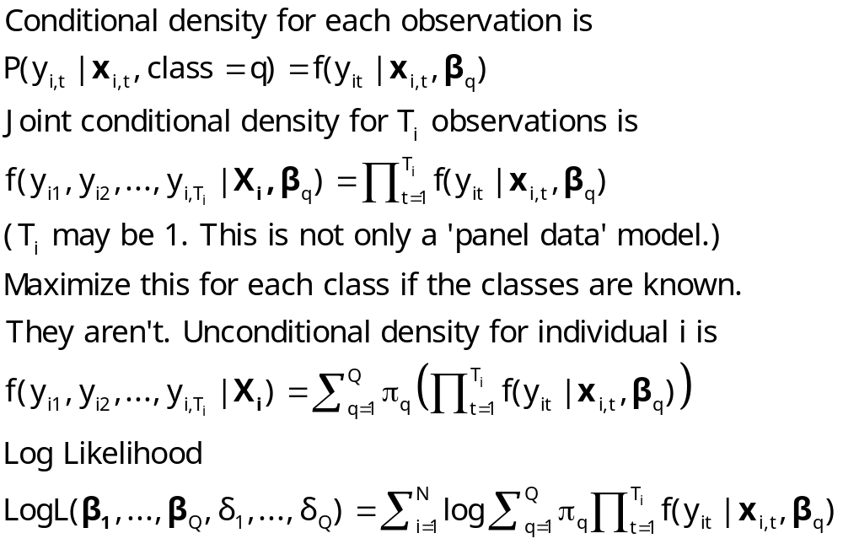
Log Likelihood for an LC Model

Slide 65
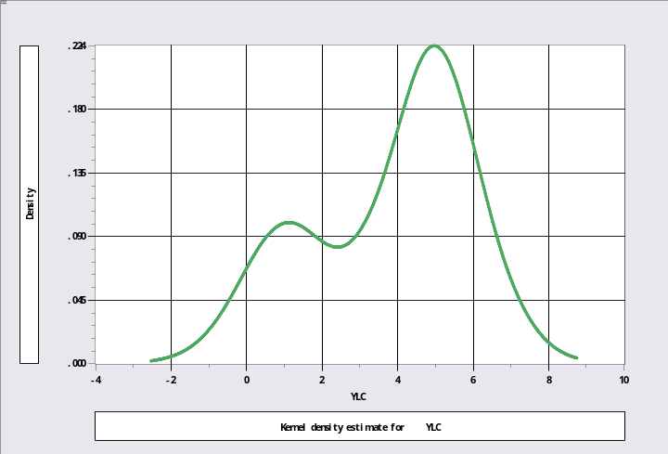
Unmixing a Mixed Sample
N[1,1] and N[5,1]
Sample ; 1 – 1000$
Calc ; Ran(123457)$
Create ; lc1=rnn(1,1) ; lc2=rnn(5,1)$
Create ; class=rnu(0,1)$
Create ; if(class<.3)ylc=lc1 ; (else)ylc=lc2$
Kernel ; rhs=ylc $
Regress ; lhs=ylc;rhs=one;lcm;pts=2;pds=1$

Slide 66
Mixture of Normals
+---------------------------------------------+
| Latent Class / Panel LinearRg Model |
| Dependent variable YLC |
| Number of observations 1000 |
| Log likelihood function -1960.443 |
| Info. Criterion: AIC = 3.93089 |
| LINEAR regression model |
| Model fit with 2 latent classes. |
+---------------------------------------------+
+--------+--------------+----------------+--------+--------+----------+
|Variable| Coefficient | Standard Error |b/St.Er.|P[|Z|>z]| Mean of X|
+--------+--------------+----------------+--------+--------+----------+
+--------+Model parameters for latent class 1 |
|Constant| 4.97029*** .04511814 110.162 .0000 |
|Sigma | 1.00214*** .03317650 30.206 .0000 |
+--------+Model parameters for latent class 2 |
|Constant| 1.05522*** .07347646 14.361 .0000 |
|Sigma | .95746*** .05456724 17.546 .0000 |
+--------+Estimated prior probabilities for class membership |
|Class1Pr| .70003*** .01659777 42.176 .0000 |
|Class2Pr| .29997*** .01659777 18.073 .0000 |
+--------+------------------------------------------------------------+
| Note: ***, **, * = Significance at 1%, 5%, 10% level. |
+---------------------------------------------------------------------+

Slide 67
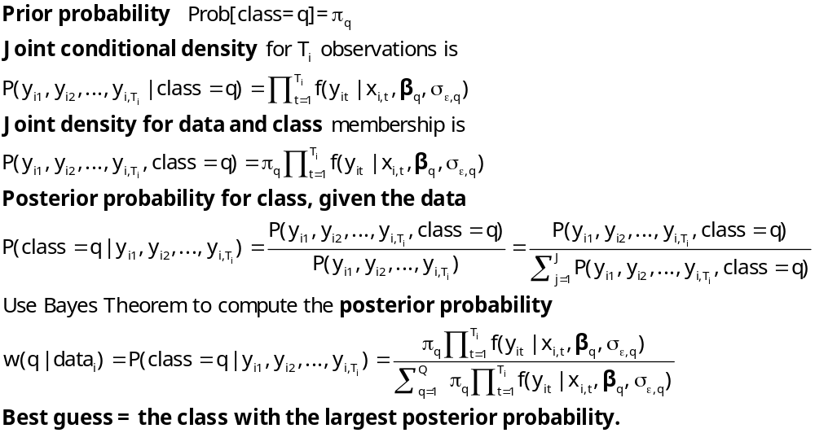
Estimating Which Class

Slide 68

Posterior for Normal Mixture

Slide 69

Estimated Posterior Probabilities

Slide 70

More Difficult When the
Populations are Close Together

Slide 71
The Technique Still Works
----------------------------------------------------------------------
Latent Class / Panel LinearRg Model
Dependent variable YLC
Sample is 1 pds and 1000 individuals
LINEAR regression model
Model fit with 2 latent classes.
--------+-------------------------------------------------------------
Variable| Coefficient Standard Error b/St.Er. P[|Z|>z] Mean of X
--------+-------------------------------------------------------------
|Model parameters for latent class 1
Constant| 2.93611*** .15813 18.568 .0000
Sigma| 1.00326*** .07370 13.613 .0000
|Model parameters for latent class 2
Constant| .90156*** .28767 3.134 .0017
Sigma| .86951*** .10808 8.045 .0000
|Estimated prior probabilities for class membership
Class1Pr| .73447*** .09076 8.092 .0000
Class2Pr| .26553*** .09076 2.926 .0034
--------+-------------------------------------------------------------

Slide 72

Estimating E[β_{i} |X_{i},y_{i}, β₁…, β_{Q}]

Slide 73

How Many Classes?

Slide 74

Latent Class Regression

Slide 75
Baltagi and Griffin’s Gasoline Data
World Gasoline Demand Data, 18 OECD Countries, 19 years
Variables in the file are
COUNTRY = name of country
YEAR = year, 1960-1978
LGASPCAR = log of consumption per car
LINCOMEP = log of per capita income
LRPMG = log of real price of gasoline
LCARPCAP = log of per capita number of cars
See Baltagi (2001, p. 24) for analysis of these data. The article on which the analysis is based is Baltagi, B. and Griffin, J., "Gasoline Demand in the OECD: An Application of Pooling and Testing Procedures," European Economic Review, 22, 1983, pp. 117-137. The data were downloaded from the website for Baltagi's text.

Slide 76

3 Class Linear Gasoline Model

Slide 77

Estimated Parameters
LCM vs. Gen1 RPM

Slide 78

An Extended Latent Class Model
Notes:
78

Slide 79

LC Poisson Regression for Doctor Visits

Slide 80

Heckman and Singer’s RE Model
Random Effects Model
Random Constants with Discrete Distribution

Slide 81

3 Class Heckman-Singer Form

Slide 82

The EM Algorithm

Slide 83

Implementing EM for LC Models

