Slide 1
Topics in Microeconometrics
William Greene
Department of Economics
Stern School of Business

Slide 2

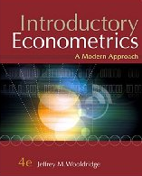





Part 5: Sample Selection in Nonlinear and Panel Models

Slide 3
Samples and Populations
Consistent estimation
  The sample is randomly drawn from the population
  Sample statistics converge to their population counterparts
A presumption: The ‘population’ is the population of interest.
Implication: If the sample is randomly drawn from a specific subpopulation, statistics converge to the characteristics of that subpopulation. These may not be the same as the full population
Can one generalize from the subpopulation to the full population?

Slide 4
Nonrandom Sampling
Simple nonrandom samples: Average incomes of airport travelers → mean income in the population as a whole?
Survivorship: Time series of returns on business performance. Mutual fund performance. (Past performance is no guarantee of future success. ☺)
Attrition: Drug trials. Effect of erythropoetin on quality of life survey.
Self-selection:
  Labor supply models
  Shere Hite’s (1976) “The Hite Report” ‘survey’ of sexual habits of Americans. “While her books are ground-breaking and important, they are based on flawed statistical methods and one must view their results with skepticism.”

Slide 5
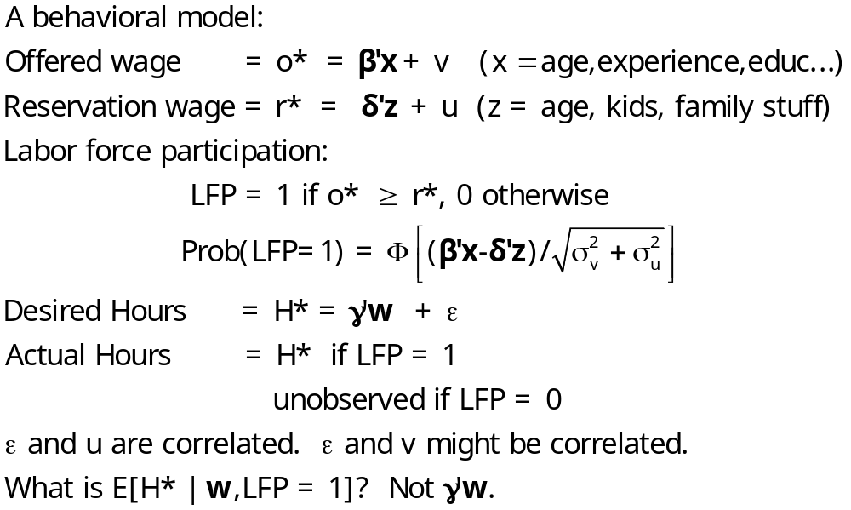
Heckman’s Canonical Model

Slide 6
Dueling Selection Biases – From two emails, same day.
“I am trying to find methods which can deal with data that is non-randomised and suffers from selection bias.”
“I explain the probability of answering questions using, among other independent variables, a variable which measures knowledge breadth. Knowledge breadth can be constructed only for those individuals that fill in a skill description in the company intranet. This is where the selection bias comes from.”

Slide 7
Sample Selection Observations
The selection ‘problem’ is caused by the correlation of the unobservables
  Selection on observables is often manageable within the conventional model.
  Selection on unobservables often requires a more detailed specification of the model – where does the effect come from?
The ‘bias’ relates to the inconsistency of familiar estimators such as least squares
The data are not biased; the (an) estimator is biased.

Slide 8
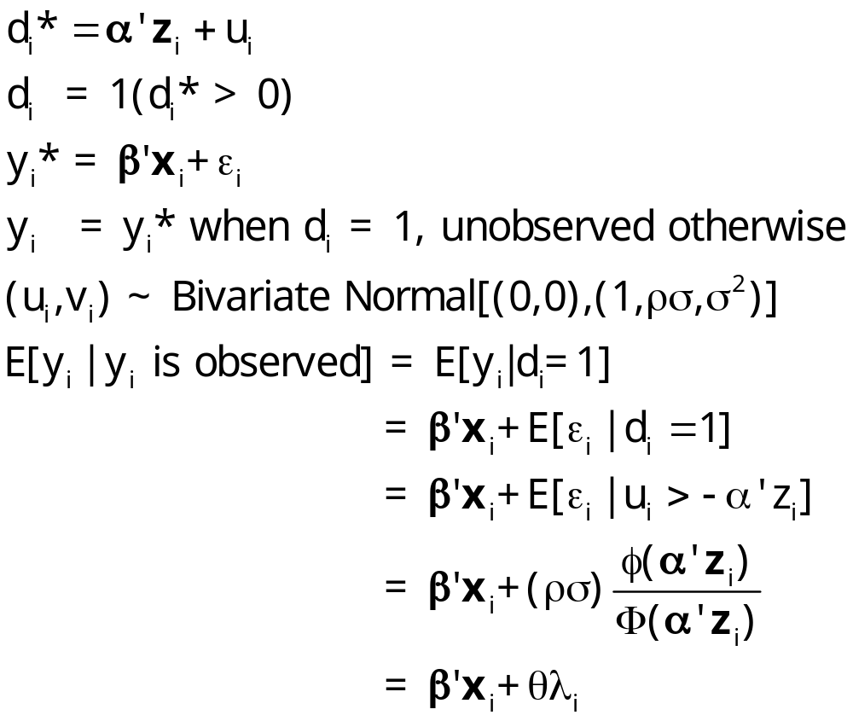
Standard Sample Selection Model

Slide 9
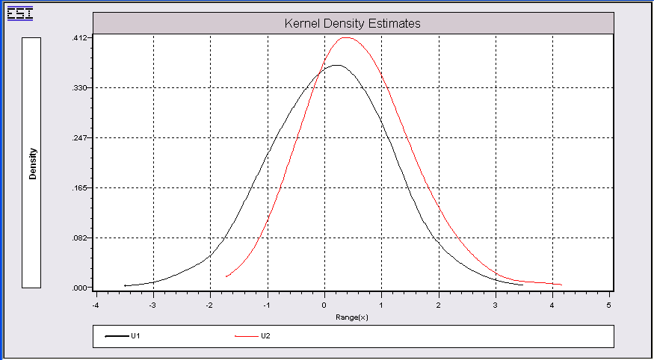
Incidental Truncation u1,u2~N[(0,0),(1,.71,1)
Conditional distribution of u2|u1 > 0. No longer ~ N[0,1]
Unconditional distribution of u2 ~ N[0,1]

Slide 10
Selection as a Specification Error
E[y_{i}|x_{i},y_{i} observed] = β’x_{i} + θ λ_{i}
Regression of y_{i} on x_{i} omits λ_{i}.
  λ_{i} will generally be correlated with x_{i} if z_{i} is.
  z_{i} and x_{i} often have variables in common.
  There is no specification error if θ = 0 ←→ ρ = 0
The “selection bias” is plim (b – β)

Slide 11
Estimation of the Selection Model
Two step least squares
  Inefficient
  Simple – exists in current software
  Simple to understand and widely used
Full information maximum likelihood
  Efficient. Not more or less robust
  Simple to do – exists in current software
  Not so simple to understand – widely misunderstood

Slide 12
Estimation
Heckman’s two step procedure
  (1) Estimate the probit model and compute λ_{i} for each observation using the estimated parameters.
  (2) a. Linearly regress y_{i} on x_{i} and λ_{i} using the observed data
  b. Correct the estimated asymptotic covariance
  matrix for the use of the estimated λ_{i}. (An
  application of Murphy and Topel (1984) – Heckman
  was 1979).

Slide 13
Mroz Application – Labor Supply
MROZ labor supply data. Cross section, 753 observations
Use LFP for binary choice, KIDS for count models.
LFP = labor force participation, 0 if no, 1 if yes.
WHRS = wife's hours worked. 0 if LFP=0
KL6 = number of kids less than 6
K618 = kids 6 to 18
WA = wife's age
WE = wife's education
WW = wife's wage, 0 if LFP=0.
RPWG = Wife's reported wage at the time of the interview
HHRS = husband's hours
HA = husband's age
HE = husband's education
HW = husband's wage
FAMINC = family income
MTR = marginal tax rate
WMED = wife's mother's education
WFED = wife's father's education
UN = unemployment rate in county of residence
CIT = dummy for urban residence
AX = actual years of wife's previous labor market experience
AGE = Age
AGESQ = Age squared
EARNINGS= WW * WHRS
LOGE = Log of EARNINGS
KIDS = 1 if kids < 18 in the home.

Slide 14
Labor Supply Model
NAMELIST ; Z = One,KL6,K618,WA,WE,HA,HE $
NAMELIST ; X = One,KL6,K618,Age,Agesq,WE,Faminc $
PROBIT ; Lhs = LFP ; Rhs = Z ; Hold(IMR=Lambda) $
SELECT ; Lhs = WHRS ; Rhs = X $
REGRESS ; Lhs = WHRS ; Rhs = X,Lambda $
REJECT ; LFP = 0 $
REGRESS ; Lhs = WHRS ; Rhs = X $

Slide 15
Participation Equation
+---------------------------------------------+
| Binomial Probit Model |
| Dependent variable LFP |
| Weighting variable None |
| Number of observations 753 |
+---------------------------------------------+
+---------+--------------+----------------+--------+---------+----------+
|Variable | Coefficient | Standard Error |b/St.Er.|P[|Z|>z] | Mean of X|
+---------+--------------+----------------+--------+---------+----------+
Index function for probability
Constant 1.00264501 .49994379 2.006 .0449
KL6 -.90399802 .11434394 -7.906 .0000 .23771580
K618 -.05452607 .04021041 -1.356 .1751 1.35325365
WA -.02602427 .01332588 -1.953 .0508 42.5378486
WE .16038929 .02773622 5.783 .0000 12.2868526
HA -.01642514 .01329110 -1.236 .2165 45.1208499
HE -.05191039 .02040378 -2.544 .0110 12.4913679

Slide 16
Hours Equation
+----------------------------------------------------+
| Sample Selection Model |
| Two stage least squares regression |
| LHS=WHRS Mean = 1302.930 |
| Standard deviation = 776.2744 |
| WTS=none Number of observs. = 428 |
| Model size Parameters = 8 |
| Degrees of freedom = 420 |
| Residuals Sum of squares = .2267214E+09 |
| Standard error of e = 734.7195 |
| Correlation of disturbance in regression |
| and Selection Criterion (Rho)........... -.84541 |
+----------------------------------------------------+
+---------+--------------+----------------+--------+---------+----------+
|Variable | Coefficient | Standard Error |b/St.Er.|P[|Z|>z] | Mean of X|
+---------+--------------+----------------+--------+---------+----------+
Constant 2442.26665 1202.11143 2.032 .0422
KL6 115.109657 282.008565 .408 .6831 .14018692
K618 -101.720762 38.2833942 -2.657 .0079 1.35046729
AGE 14.6359451 53.1916591 .275 .7832 41.9719626
AGESQ -.10078602 .61856252 -.163 .8706 1821.12150
WE -102.203059 39.4096323 -2.593 .0095 12.6588785
FAMINC .01379467 .00345041 3.998 .0001 24130.4229
LAMBDA -793.857053 494.541008 -1.605 .1084 .61466207

Slide 17
Selection “Bias” of OLS
+---------+--------------+----------------+--------+---------+----------+
|Variable | Coefficient | Standard Error |b/St.Er.|P[|Z|>z] | Mean of X|
+---------+--------------+----------------+--------+---------+----------+
Constant 2442.26665 1202.11143 2.032 .0422
KL6 115.109657 282.008565 .408 .6831 .14018692
K618 -101.720762 38.2833942 -2.657 .0079 1.35046729
AGE 14.6359451 53.1916591 .275 .7832 41.9719626
AGESQ -.10078602 .61856252 -.163 .8706 1821.12150
WE -102.203059 39.4096323 -2.593 .0095 12.6588785
FAMINC .01379467 .00345041 3.998 .0001 24130.4229
LAMBDA -793.857053 494.541008 -1.605 .1084 .61466207
+---------+--------------+----------------+--------+---------+----------+
|Variable | Coefficient | Standard Error |t-ratio |P[|T|>t] | Mean of X|
+---------+--------------+----------------+--------+---------+----------+
Constant 1812.12538 1144.33342 1.584 .1140
KL6 -299.128041 100.033124 -2.990 .0030 .14018692
K618 -126.399697 30.8728451 -4.094 .0001 1.35046729
AGE 11.2795338 53.8442084 .209 .8342 41.9719626
AGESQ -.26103541 .62632815 -.417 .6771 1821.12150
WE -47.3271780 17.2968137 -2.736 .0065 12.6588785
FAMINC .01261889 .00338906 3.723 .0002 24130.4229

Slide 18
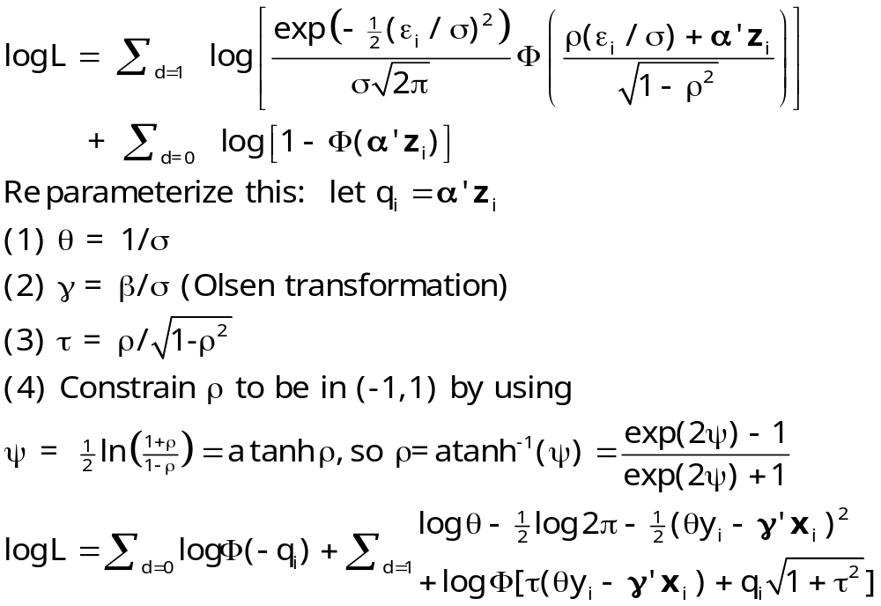
Maximum Likelihood Estimation

Slide 19
MLE
+---------------------------------------------+
| ML Estimates of Selection Model |
| Maximum Likelihood Estimates |
| Number of observations 753 |
| Iterations completed 47 |
| Log likelihood function -3894.471 |
| Number of parameters 16 |
| FIRST 7 estimates are probit equation. |
+---------------------------------------------+
+---------+--------------+----------------+--------+---------+
|Variable | Coefficient | Standard Error |b/St.Er.|P[|Z|>z] |
+---------+--------------+----------------+--------+---------+
Selection (probit) equation for LFP
Constant 1.01350651 .54823177 1.849 .0645
KL6 -.90129694 .11081111 -8.134 .0000
K618 -.05292375 .04137216 -1.279 .2008
WA -.02491779 .01428642 -1.744 .0811
WE .16396194 .02911763 5.631 .0000
HA -.01763340 .01431873 -1.231 .2181
HE -.05596671 .02133647 -2.623 .0087
Corrected regression, Regime 1
Constant 1946.84517 1167.56008 1.667 .0954
KL6 -209.024866 222.027462 -.941 .3465
K618 -120.969192 35.4425577 -3.413 .0006
AGE 12.0375636 51.9850307 .232 .8169
AGESQ -.22652298 .59912775 -.378 .7054
WE -59.2166488 33.3802882 -1.774 .0761
FAMINC .01289491 .00332219 3.881 .0001
SIGMA(1) 748.131644 59.7508375 12.521 .0000
RHO(1,2) -.22965163 .50082203 -.459 .6466

Slide 20
MLE vs. Two Step
Two Step
Constant 2442.26665 1202.11143 2.032 .0422
KL6 115.109657 282.008565 .408 .6831 .14018692
K618 -101.720762 38.2833942 -2.657 .0079 1.35046729
AGE 14.6359451 53.1916591 .275 .7832 41.9719626
AGESQ -.10078602 .61856252 -.163 .8706 1821.12150
WE -102.203059 39.4096323 -2.593 .0095 12.6588785
FAMINC .01379467 .00345041 3.998 .0001 24130.4229
LAMBDA -793.857053 494.541008 -1.605 .1084 .61466207
| Standard error of e = 734.7195 |
| Correlation of disturbance in regression |
| and Selection Criterion (Rho)........... -.84541 |
MLE
Constant 1946.84517 1167.56008 1.667 .0954
KL6 -209.024866 222.027462 -.941 .3465
K618 -120.969192 35.4425577 -3.413 .0006
AGE 12.0375636 51.9850307 .232 .8169
AGESQ -.22652298 .59912775 -.378 .7054
WE -59.2166488 33.3802882 -1.774 .0761
FAMINC .01289491 .00332219 3.881 .0001
SIGMA(1) 748.131644 59.7508375 12.521 .0000
RHO(1,2) -.22965163 .50082203 -.459 .6466

Slide 21
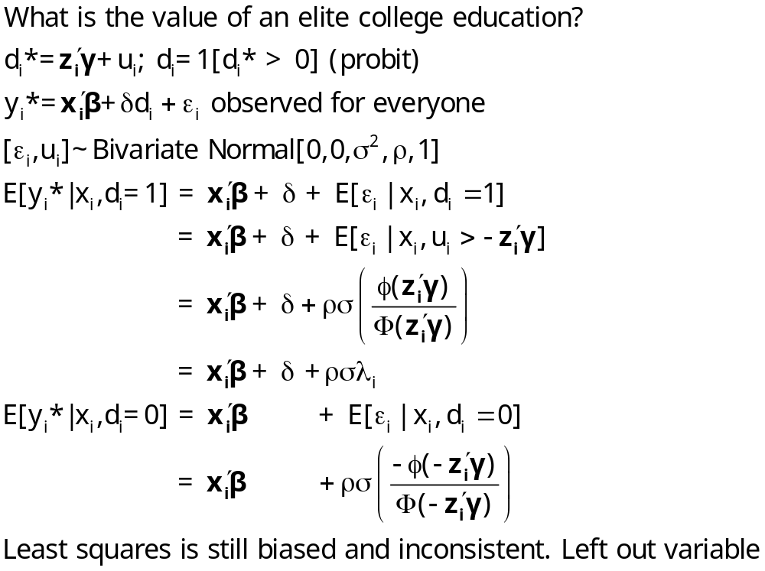
Extension – Treatment Effect

Slide 22
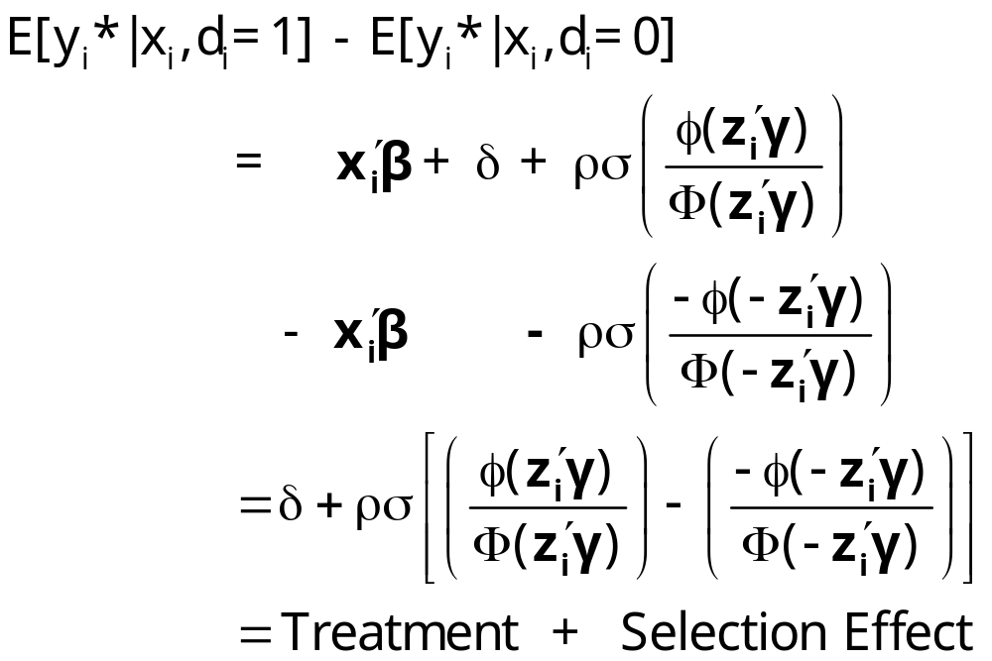
Treatment Effect

Slide 23
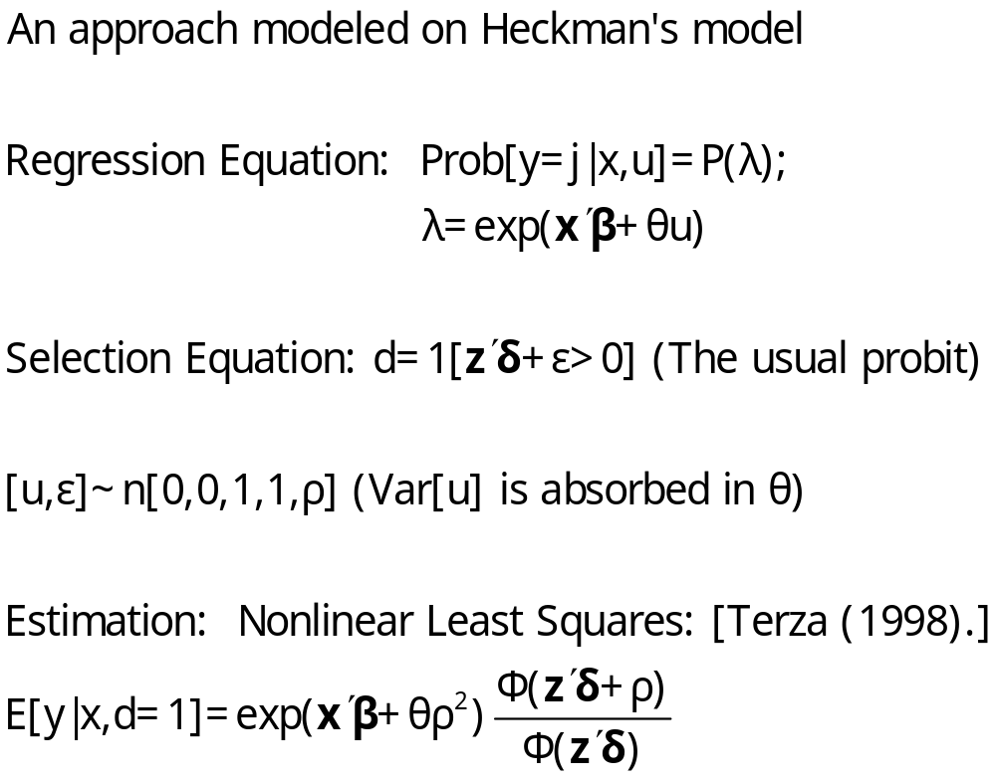
Sample Selection in Exponential Regression

Slide 24
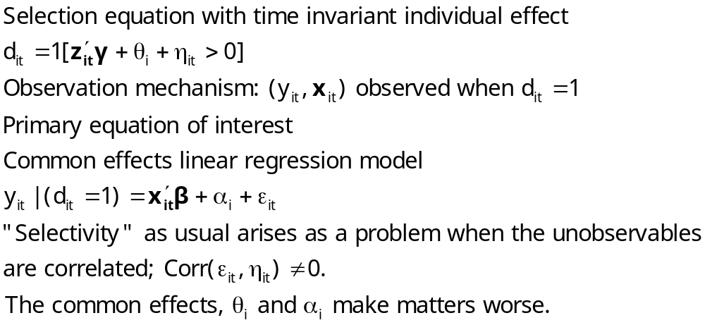
Panel Data and Selection

Slide 25
Panel Data and Sample Selection Models: A Nonlinear Time Series
I. 1990-1992: Fixed and Random Effects Extensions
II. 1995 and 2005: Model Identification through
Conditional Mean Assumptions
III. 1997-2005: Semiparametric Approaches based
on Differences and Kernel Weights
IV. 2007: Return to Conventional Estimators, with
Bias Corrections

Slide 26
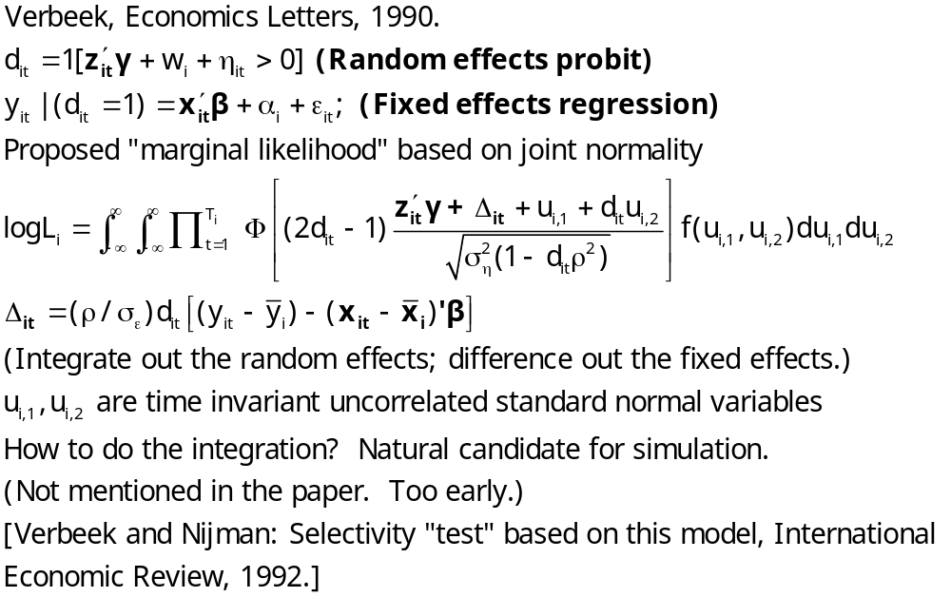
Panel Data Sample Selection Models

Slide 27
Zabel – Economics Letters
Inappropriate to have a mix of FE and RE models
Two part solution
  Treat both effects as “fixed”
  Project both effects onto the group means of the variables in the equations (Mundlak approach)
  Resulting model is two random effects equations
Use both random effects

Slide 28
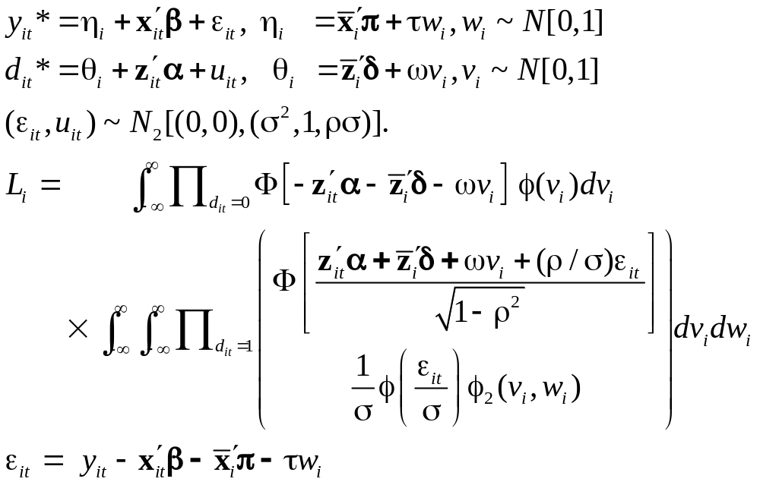
Selection with Fixed Effects

Slide 29
Practical Complications
The bivariate normal integration is actually the product of two univariate normals, because in the specification above, v_{i} and w_{i} are assumed to be uncorrelated. Vella notes, however, “… given the computational demands of estimating by maximum likelihood induced by the requirement to evaluate multiple integrals, we consider the applicability of available simple, or two step procedures.”

Slide 30
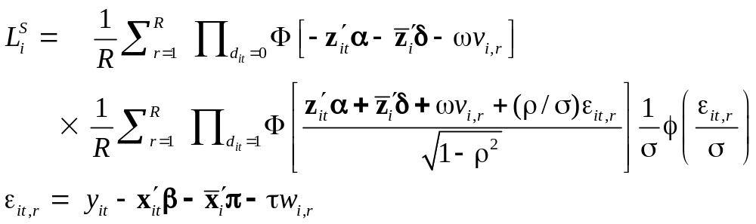
Simulation
The first line in the log likelihood is of the form E_{v}[Π_{d=0}Φ(…)] and the second line is of the form E_{w}[E_{v}[Φ(…)φ(…)/σ]]. Using simulation instead, the simulated likelihood is

Slide 31
Correlated Effects
Suppose that w_{i} and v_{i} are bivariate standard normal with correlation ρ_{vw}. We can project w_{i} on v_{i} and write
w_{i} = ρ_{vw}v_{i} + (1-ρ_{vw}²)^{1/2}h_{i}
where h_{i} has a standard normal distribution. To allow the correlation, we now simply substitute this expression for wi in the simulated (or original) log likelihood, and add ρ_{vw} to the list of parameters to be estimated. The simulation is then over still independent normal variates, v_{i} and h_{i}.

Slide 32
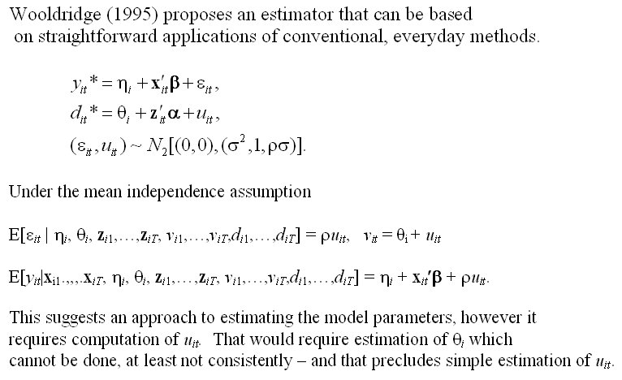
Conditional Means

Slide 33
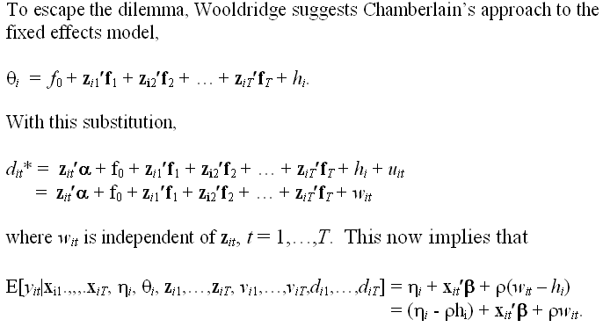
A Feasible Estimator

Slide 34
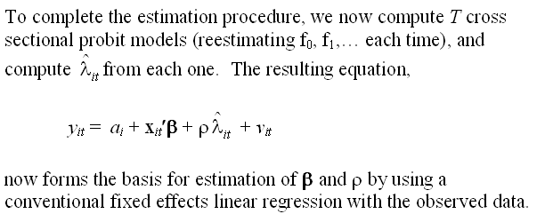
Estimation

Slide 35
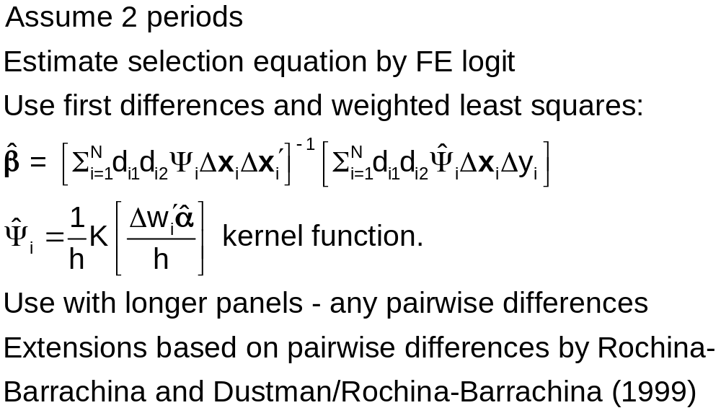
Kyriazidou - Semiparametrics

Slide 36
Bias Corrections
Val and Vella, 2007 (Working paper)
Assume fixed effects
  Bias corrected probit estimator at the first step
  Use fixed probit model to set up second step Heckman style regression treatment.

Slide 37
Postscript
What selection process is at work?
  All of the work examined here (and in the literature) assumes the selection operates anew in each period
  An alternative scenario: Selection into the panel, once, at baseline.
  Alternative: Sequential selection = endogenous attrition (Wooldridge 2002, inverse probability weighting)
Why aren’t the time invariant components correlated?
Other models
  All of the work on panel data selection assumes the main equation is a linear model.
  Any others? Discrete choice? Counts?

Slide 38
Attrition
In a panel, t=1,…,T individual I leaves the sample at time K_{i} and does not return.
If the determinants of attrition (especially the unobservables) are correlated with the variables in the equation of interest, then the now familiar problem of sample selection arises.

Slide 39
Dealing with Attrition in a QOL Study
The attrition issue: Appearance for the second interview was low for people with initial low QOL (death or depression) or with initial high QOL (don’t need the treatment). Thus, missing data at exit were clearly related to values of the dependent variable.
Solutions to the attrition problem
  Heckman selection model (used in the study)
    Prob[Present at exit|covariates] = Φ(z’θ) (Probit model)
    Additional variable added to difference model λ_{i} = Φ(z_{i}’θ)/Φ(z_{i}’θ)
  The FDA solution: fill with zeros. (!)

Slide 40
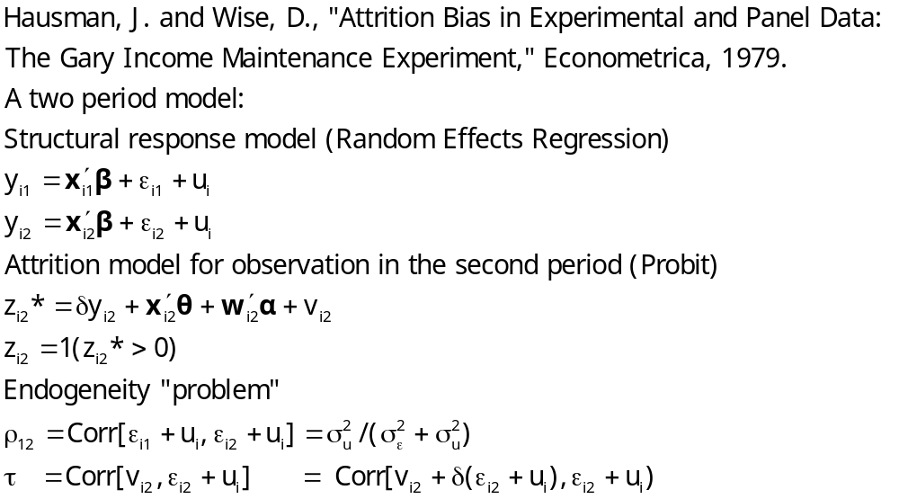
An Early Attrition Model

Slide 41
Methods of Estimating the Attrition Model
Heckman style “selection” model
Two step maximum likelihood
Full information maximum likelihood
Two step method of moments estimators
Weighting schemes that account for the “survivor bias”

Slide 42
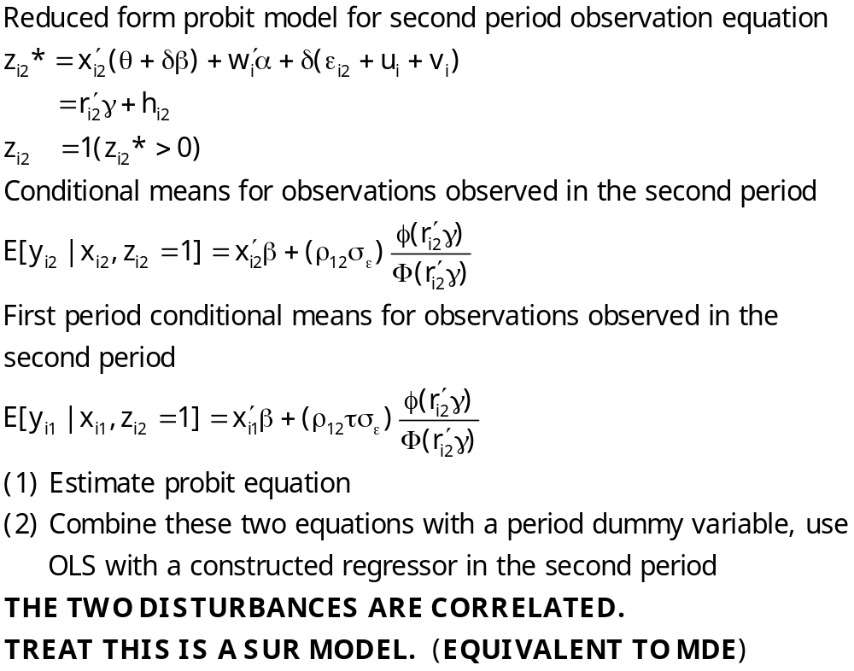
Selection Model

Slide 43
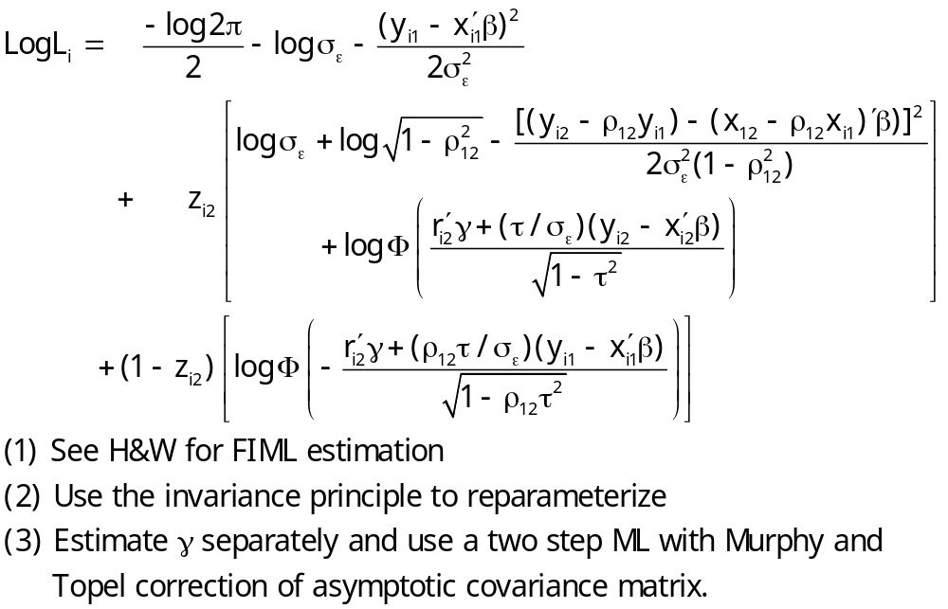
Maximum Likelihood

Slide 44
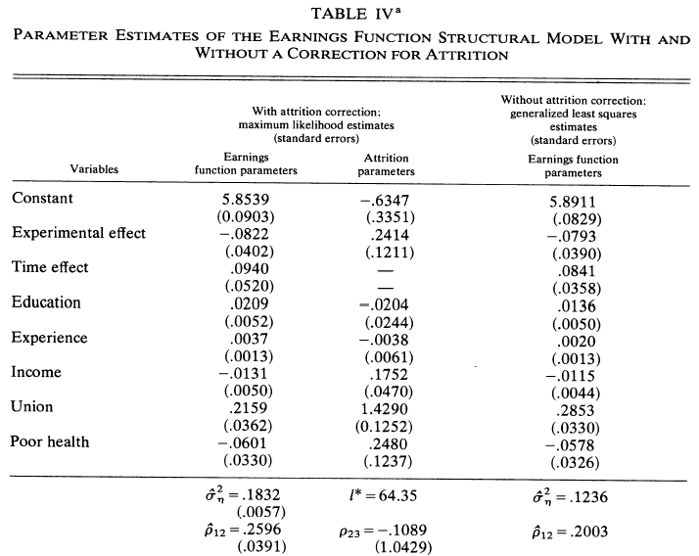

Slide 45
A Model of Attrition
Nijman and Verbeek, Journal of Applied Econometrics, 1992
Consumption survey (Holland, 1984 – 1986)
  Exogenous selection for participation (rotating panel)
  Voluntary participation (missing not at random – attrition)

Slide 46
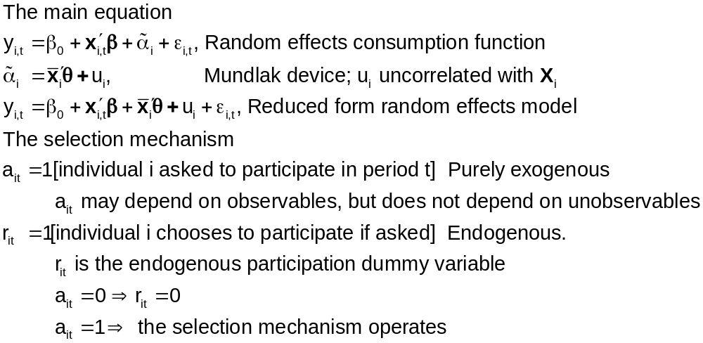
Attrition Model

Slide 47
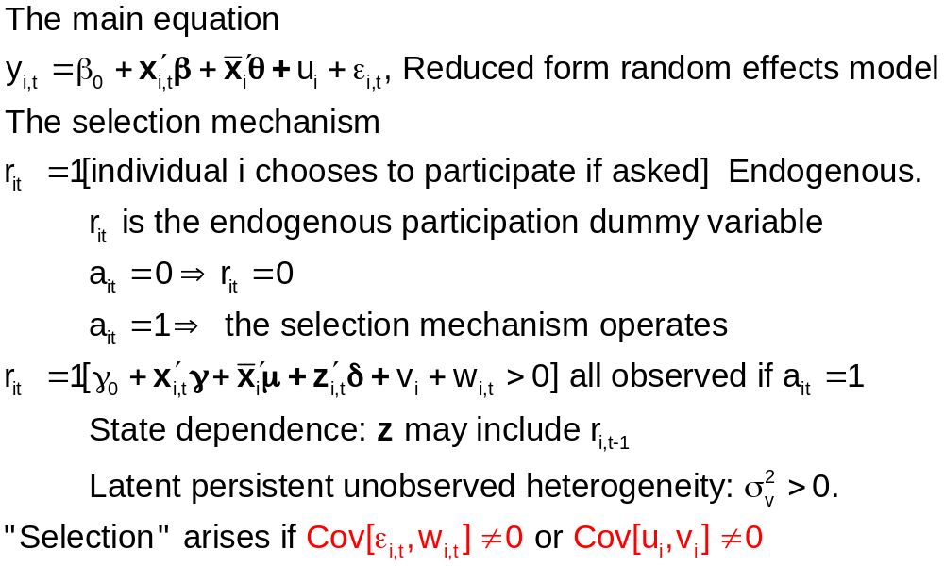
Selection Equation

Slide 48
Estimation Using One Wave
Use any single wave as a cross section with observed lagged values.
Advantage: Familiar sample selection model
Disadvantages
  Loss of efficiency
  “One can no longer distinguish between state dependence and unobserved heterogeneity.”

Slide 49
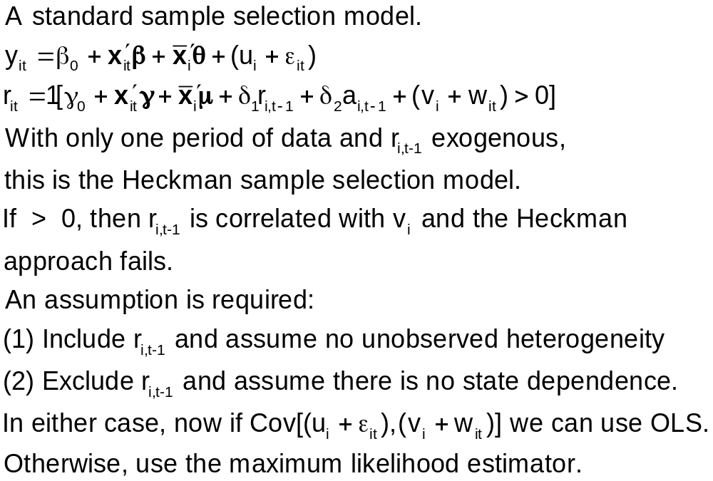
One Wave Model

Slide 50
Maximum Likelihood Estimation
Because numerical integration is required in one or two dimensions for every individual in the sample at each iteration of a high dimensional numerical optimization problem, this is, though feasible, not computationally attractive.
  The dimensionality of the optimization is irrelevant
  This is much easier in 2008 than it was in 1992 (especially with simulation) The authors did the computations with Hermite quadrature.

Slide 51
Testing for Selection?
Selectivity is parameterized in these models – coefficients are correlations or covariances.
Maximum Likelihood Results
    Covariances were highly insignificant.
    LR statistic=0.46.
Two step results produced the same conclusion based on a Hausman test
ML Estimation results looked like the two step results.

Slide 52
Selectivity in Nonlinear Models
The ‘Mills Ratio’ approach – just add a ‘lambda’ to whatever model is being estimated?
  The Heckman model applies to a probit model with a linear regression.
  The conditional mean in a nonlinear model is not something “+lambda”
The model can sometimes be built up from first principles

Slide 53
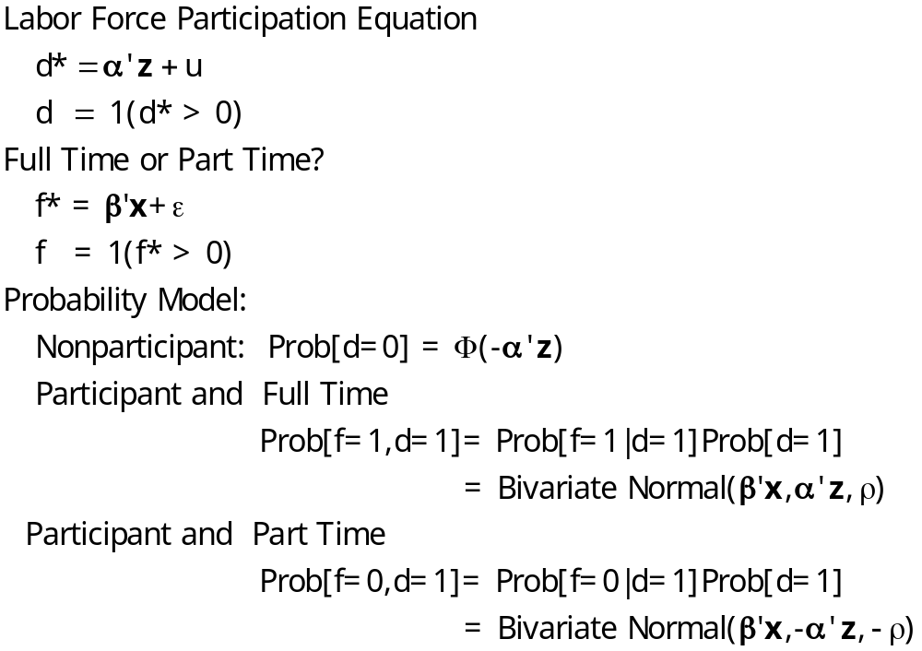
A Bivariate Probit Model

Slide 54
FT/PT Selection Model
+---------------------------------------------+
| FIML Estimates of Bivariate Probit Model |
| Dependent variable FULLFP |
| Weighting variable None |
| Number of observations 753 |
| Log likelihood function -723.9798 |
| Number of parameters 16 |
| Selection model based on LFP |
+---------------------------------------------+
+---------+--------------+----------------+--------+---------+----------+
|Variable | Coefficient | Standard Error |b/St.Er.|P[|Z|>z] | Mean of X|
+---------+--------------+----------------+--------+---------+----------+
Index equation for FULLTIME
Constant .94532822 1.61674948 .585 .5587
WW -.02764944 .01941006 -1.424 .1543 4.17768154
KL6 .04098432 .26250878 .156 .8759 .14018692
K618 -.13640024 .05930081 -2.300 .0214 1.35046729
AGE .03543435 .07530788 .471 .6380 41.9719626
AGESQ -.00043848 .00088406 -.496 .6199 1821.12150
WE -.08622974 .02808185 -3.071 .0021 12.6588785
FAMINC .210971D-04 .503746D-05 4.188 .0000 24130.4229
Index equation for LFP
Constant .98337341 .50679582 1.940 .0523
KL6 -.88485756 .11251971 -7.864 .0000 .23771580
K618 -.04101187 .04020437 -1.020 .3077 1.35325365
WA -.02462108 .01308154 -1.882 .0598 42.5378486
WE .16636047 .02738447 6.075 .0000 12.2868526
HA -.01652335 .01287662 -1.283 .1994 45.1208499
HE -.06276470 .01912877 -3.281 .0010 12.4913679
Disturbance correlation
RHO(1,2) -.84102682 .25122229 -3.348 .0008
Full Time = Hours > 1000

Slide 55
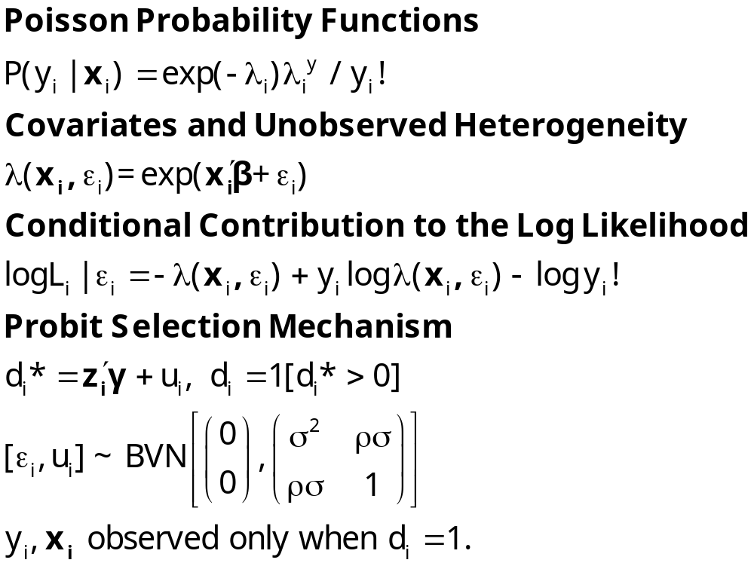
Building a Likelihood for a Poisson Regression Model with Selection

Slide 56
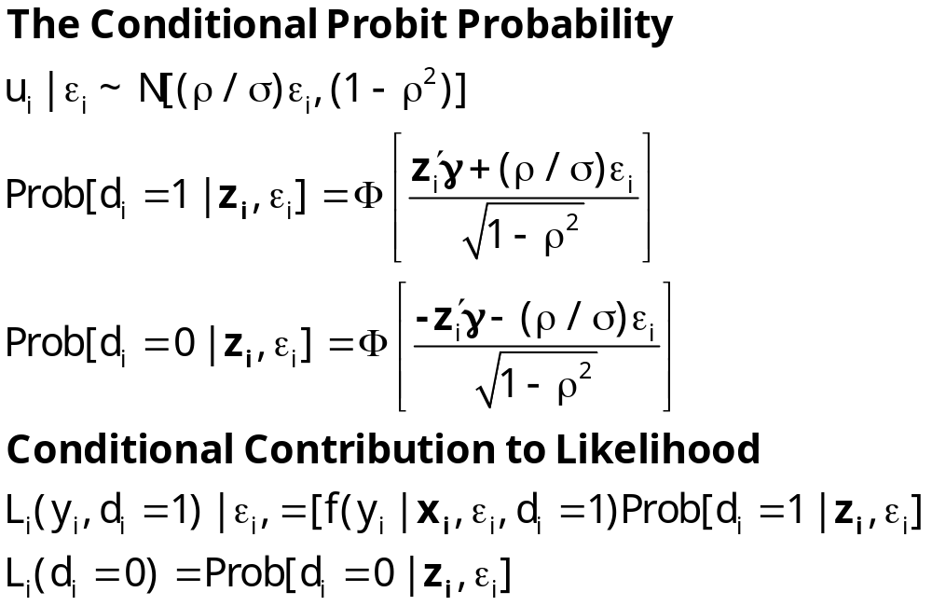
Building the Likelihood

Slide 57
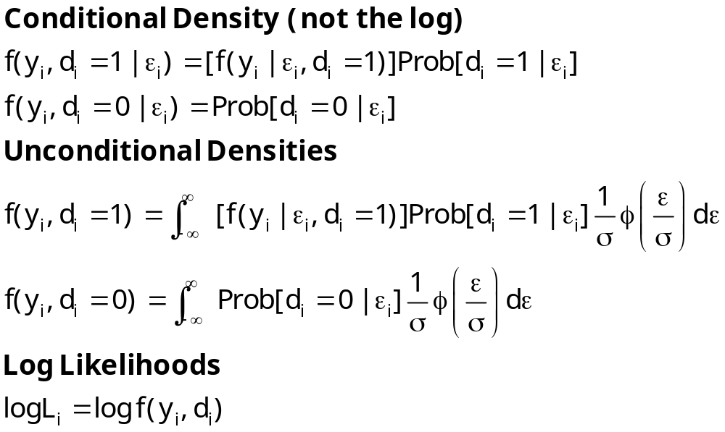
Conditional Likelihood

Slide 58
Poisson Model with Selection
Strategy:
  Hermite quadrature or maximum simulated likelihood.
  Not by throwing a ‘lambda’ into the unconditional likelihood
Could this be done without joint normality?
  How robust is the model?
  Is there any other approach available?
  Not easily. The subject of ongoing research

Slide 59
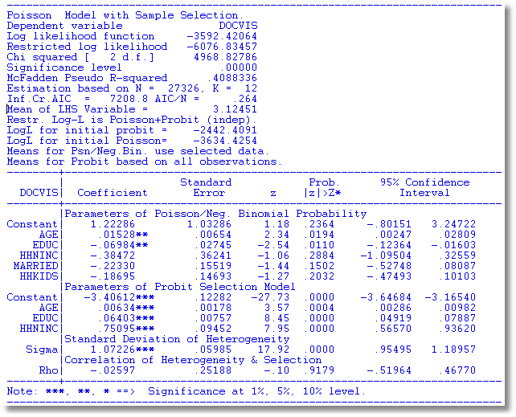

Slide 60
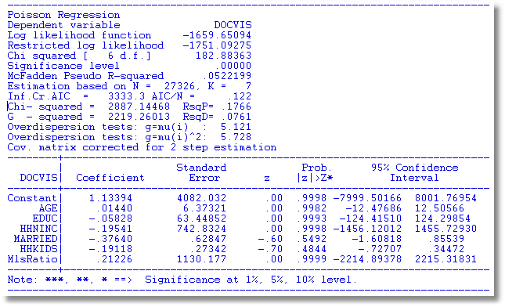

Slide 61

Stochastic Frontier Model: ML
y_{i} = β′x_{i} + v_{i} - u_{i}
where u_{i} = |σ_{u}U_{i}| = σ_{u} |U_{i}|, U_{i} ~ N[0,1²],
v_{i} = σ_{v}V_{i} , V_{i} ~ N[0,1²].
where ε_{i} = y_{i} - β′x_{i} = v_{i} – u_{i},
λ = σ_{u} /σ_{v},
σ =

Slide 62
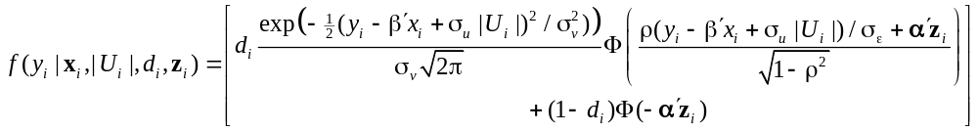
Sample Selected SF Model
d_{i} = 1[α′z_{i} + w_{i} > 0], w_{i} ~ N[0,1²]
y_{i} = β′x_{i} + ε_{i}, ε_{i} ~ N[0,σ_{ε}²]
(y_{i},x_{i}) observed only when d_{i} = 1.
ε_{i} = v_{i} - u_{i}
u_{i} = |σ_{u}U_{i}| = σ_{u} |U_{i}| where U_{i} ~ N[0,1²]
v_{i} = σ_{v}V_{i} where V_{i} ~ N[0,1²].
(w_{i},v_{i}) ~ N₂[(0,1), (1, ρσ_{v}, σ_{v}²)]

Slide 63
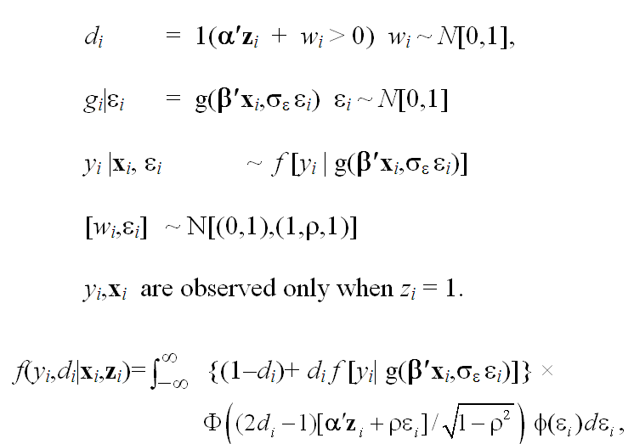
Sample Selection in a Nonlinear Model

Slide 64
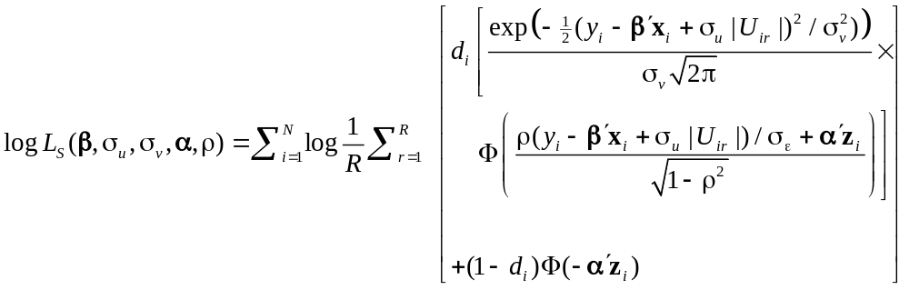
Simulated Log Likelihood for a Simpler Model

Slide 65
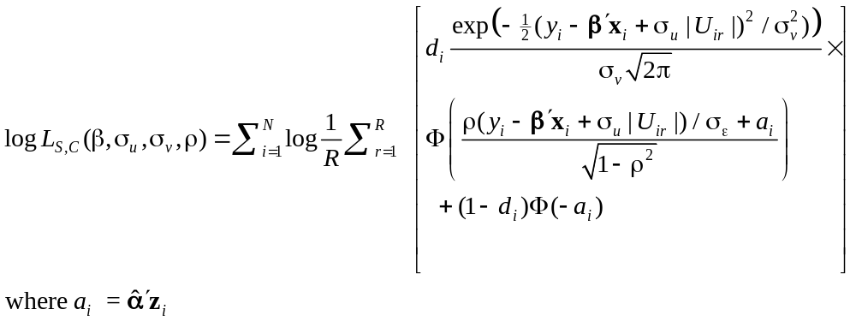
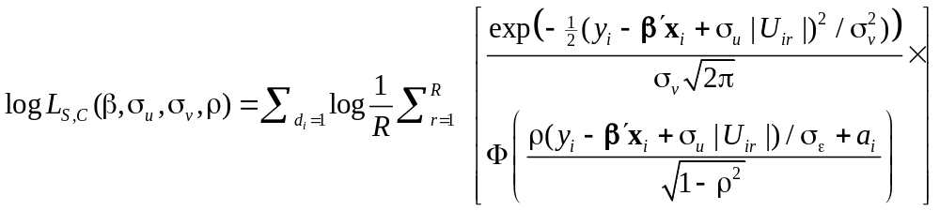
A 2 Step MSL Approach

Slide 66
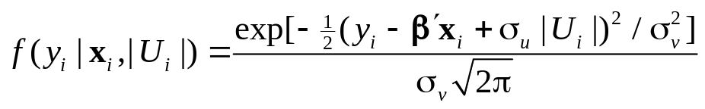
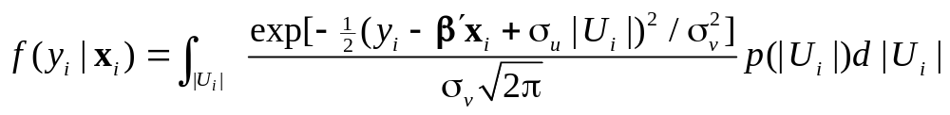
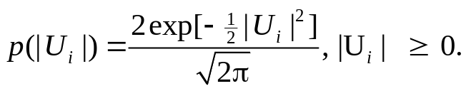
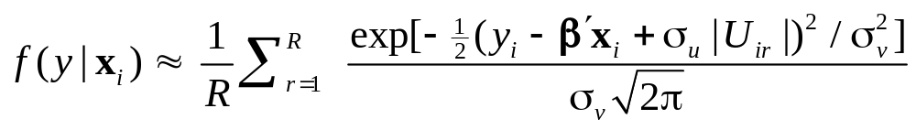
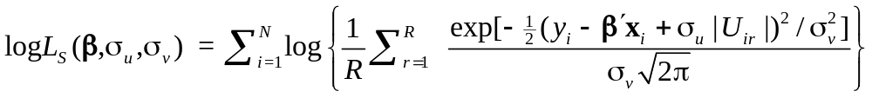
Simulated ML for the SF Model
This is simply a linear regression with a random constant term, α_{i} = α - σ_{u} |U_{i} |

Slide 67
Nonnormality Issue
How robust is the Heckman model to nonnormality of the unobserved effects?
Are there other techniques
  Parametric: Copula methods
  Semiparametric: Klein/Spady and Series methods
Other forms of the selection equation – e.g., multinomial logit
Other forms of the primary model: e.g., as above.

Slide 68

A Study of Health Status in the Presence of Attrition

Slide 69
Model for Self Assessed Health
British Household Panel Survey (BHPS)
  Waves 1-8, 1991-1998
  Self assessed health on 0,1,2,3,4 scale
  Sociological and demographic covariates
  Dynamics – inertia in reporting of top scale
Dynamic ordered probit model
  Balanced panel – analyze dynamics
  Unbalanced panel – examine attrition

Slide 70
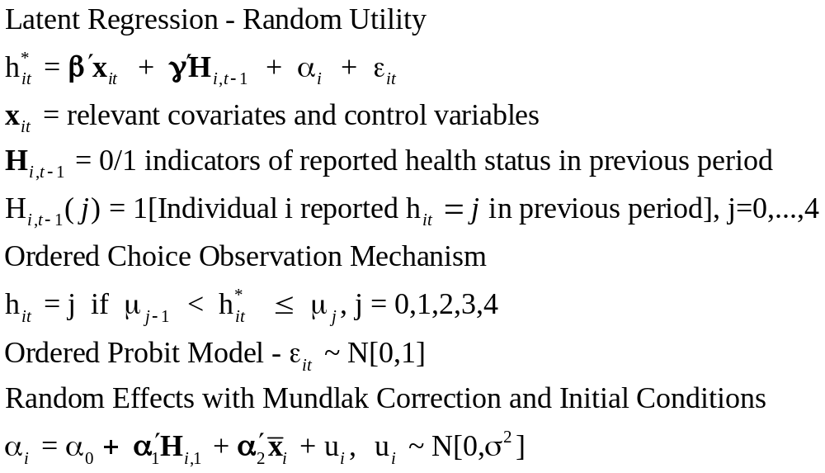
Dynamic Ordered Probit Model
It would not be appropriate to include h_{i,t-1} itself in the model as this is a label, not a measure

Slide 71
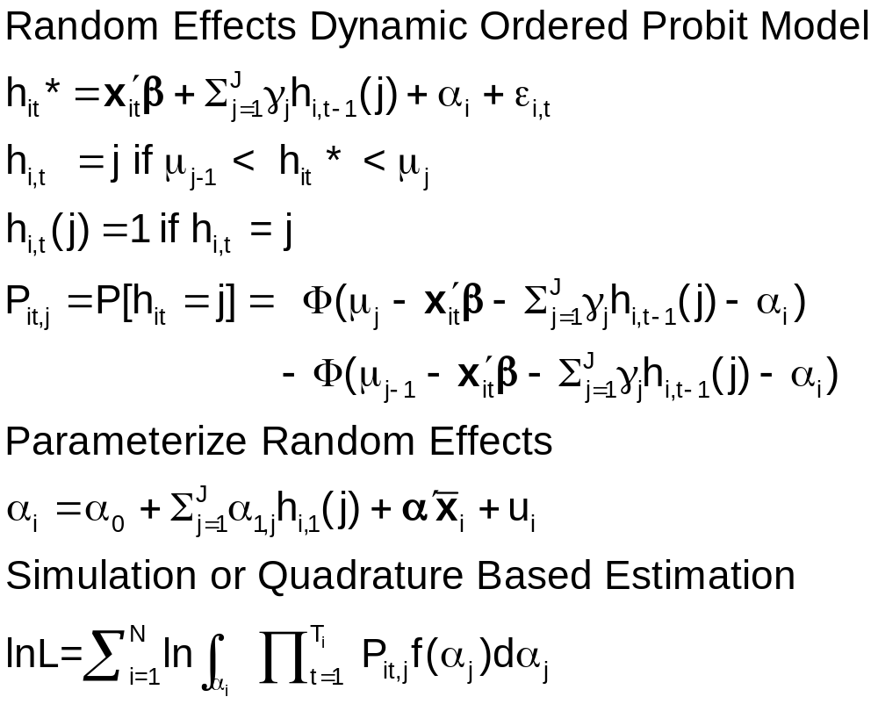
Random Effects Dynamic
Ordered Probit Model

Slide 72
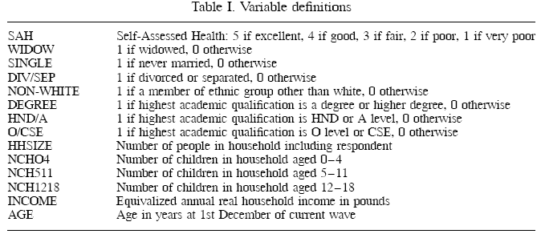
Data

Slide 73
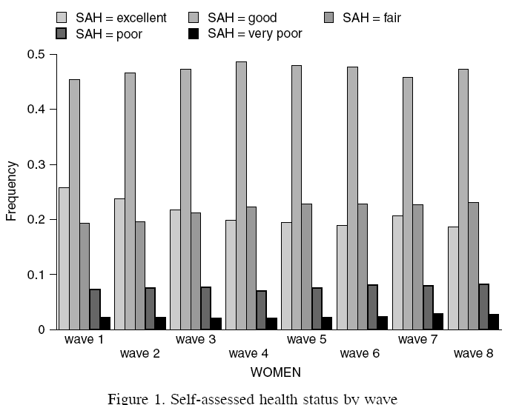
Variable of Interest

Slide 74
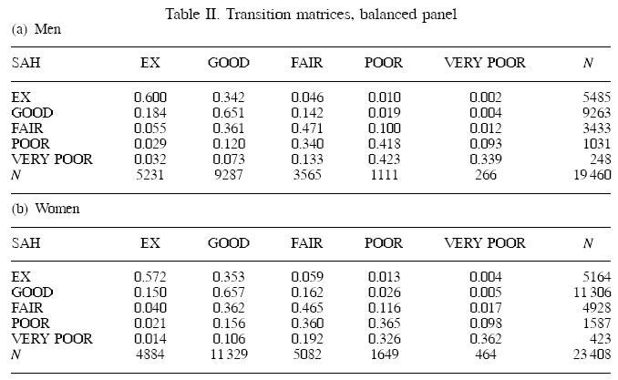
Dynamics

Slide 75
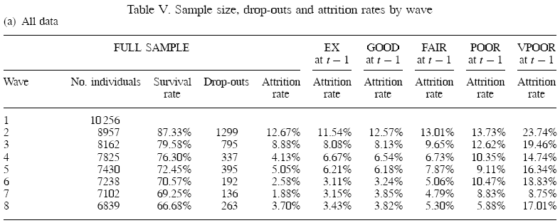
Attrition

Slide 76
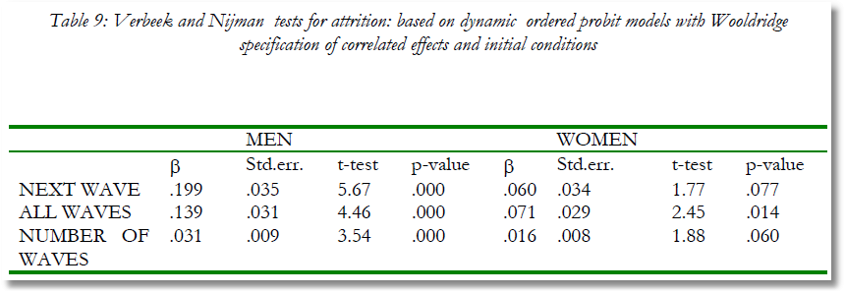
Testing for Attrition Bias
Three dummy variables added to full model with unbalanced panel suggest presence of attrition effects.

Slide 77
Probability Weighting Estimators
A Patch for Attrition
(1) Fit a participation probit equation for each wave.
(2) Compute p(i,t) = predictions of participation for each individual in each period.
  Special assumptions needed to make this work
Ignore common effects and fit a weighted pooled log likelihood: Σ_{i} Σ_{t} [d_{it}/p(i,t)]logLP_{it}.

Slide 78

Attrition Model with IP Weights
Assumes (1) Prob(attrition|all data) = Prob(attrition|selected variables) (ignorability)
(2) Attrition is an ‘absorbing state.’ No reentry.
Obviously not true for the GSOEP data above.
Can deal with point (2) by isolating a subsample of those present at wave 1 and the monotonically shrinking subsample as the waves progress.

Slide 79
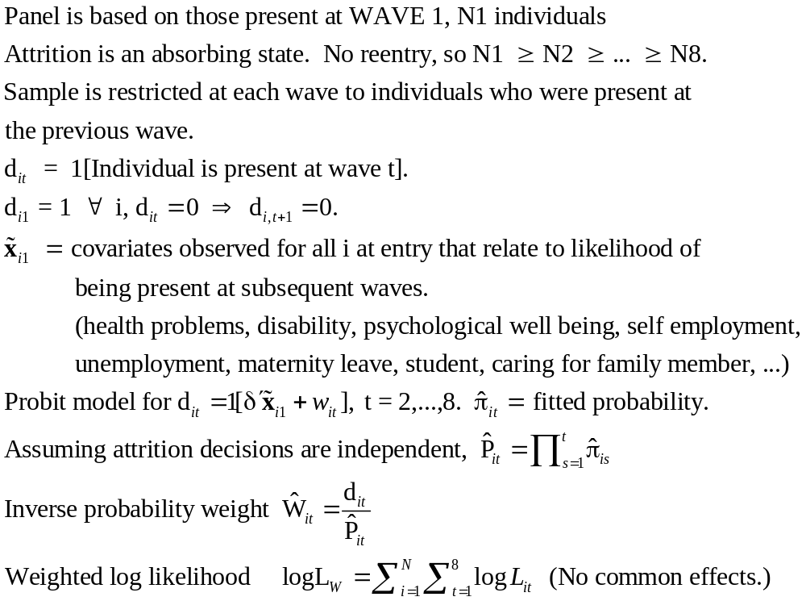
Inverse Probability Weighting

Slide 80

Estimated Partial Effects by Model

Slide 81
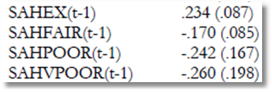
Partial Effect for a Category
These are 4 dummy variables for state in the previous period. Using first differences, the 0.234 estimated for SAHEX means transition from EXCELLENT in the previous period to GOOD in the previous period, where GOOD is the omitted category. Likewise for the other 3 previous state variables. The margin from ‘POOR’ to ‘GOOD’ was not interesting in the paper. The better margin would have been from EXCELLENT to POOR, which would have (EX,POOR) change from (1,0) to (0,1).

