Slide 1
Latent Class Modeling
William Greene
Department of Economics
Stern School of Business
New York University

Slide 2
Outline
Finite mixture and latent class models
Extensions of the latent class model
Applications of several variations
  Health economics
  Transport
  Production and efficiency
Aspects of estimation of LC models

Slide 3
The “Finite Mixture Model”
Latent Class Modeling 
Applications 
An unknown parametric model governs an outcome y
  F(y|x,θ)
  This is the model
We approximate F(y|x,θ) with a weighted sum of specified (e.g., normal) densities:
  F(y|x,θ) ≅ Σ_{j} π_{j} G(y|x,β)
  This is a search for functional form. With a sufficient number of (normal) components, we can approximate any density to any desired degree of accuracy. (McLachlan and Peel (2000))
  There is no “mixing” process at work

Slide 4
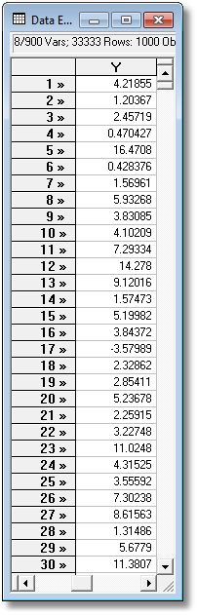
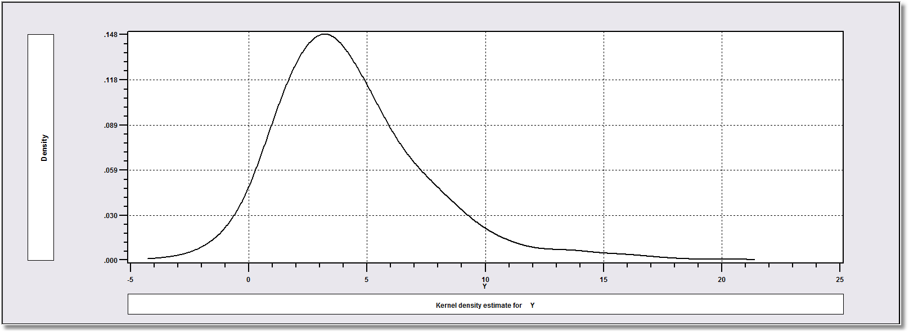
Latent Class Modeling 
Applications 
Density? Note significant mass below zero. Not a gamma or lognormal or any other familiar density.

Slide 5
Latent Class Modeling 
Applications 
Mixture of Two Normal Densities

Slide 6
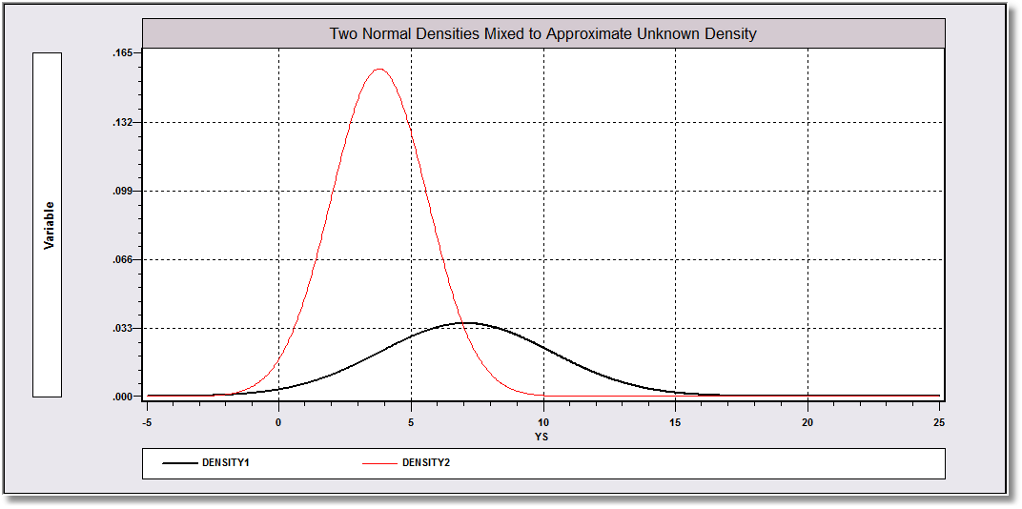
Latent Class Modeling 
Applications 
Mixing probabilities .715 and .285

Slide 7
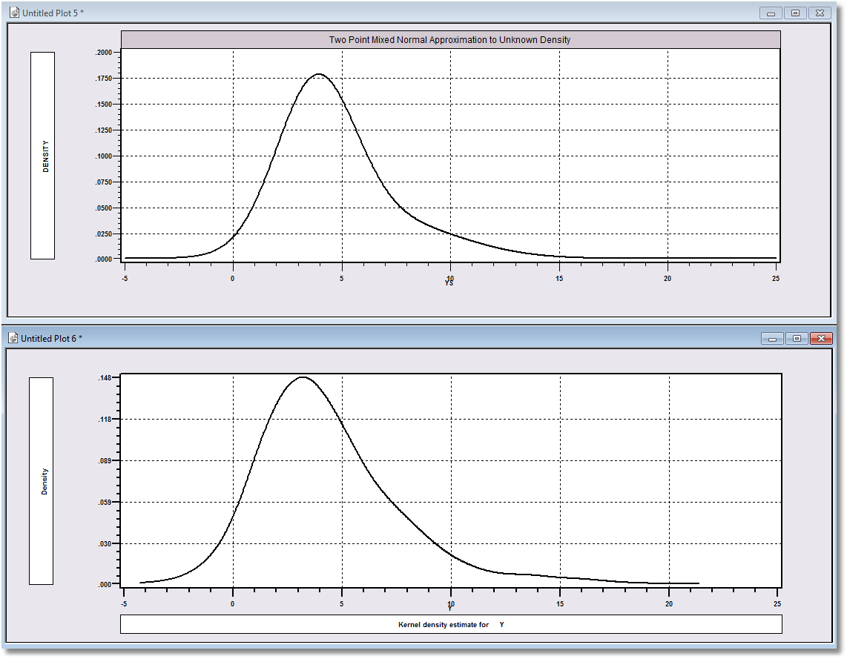
Latent Class Modeling 
Applications 
Approximation
Actual Distribution

Slide 8
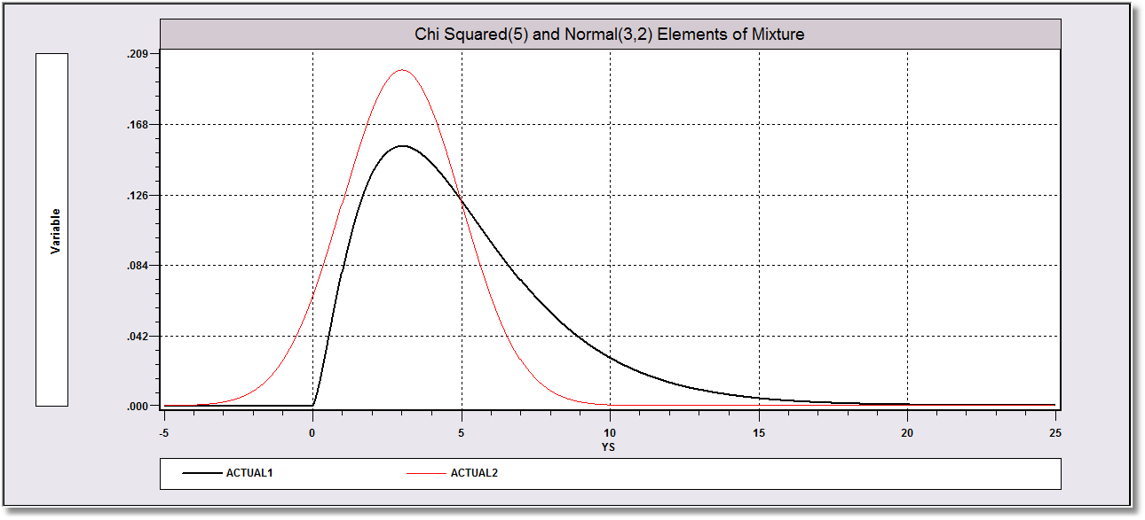
Latent Class Modeling 
Applications 
The actual process is a mix of chi squared(5) and normal(3,2) with mixing probabilities .7 and .3.

Slide 9
The Latent Class “Model”
Latent Class Modeling 
Applications 
Parametric Model:
  F(y|x,θ)
  E.g., y ~ N[x′β, σ²], y ~ Poisson[λ=exp(x′β)], etc.
  Density F(y|x,Θ) ≅ Σ_{j} π_{j} F(y|x,θ_{j} ),
  Θ=[θ₁, θ₂,…, θ_{J}, π₁, π₂,…, π_{J} )
  Generating mechanism for an individual drawn at random from the mixed population is F(y|x,Θ).
  Class probabilities relate to a stable process governing the mixture of types in the population

Slide 10
Latent Classes
Latent Class Modeling 
Applications 
Population contains a mixture of individuals of different types
Common form of the generating mechanism within the classes
Observed outcome y is governed by the common process F(y|x,θ_{j} )
Classes are distinguished by the parameters, θ_{j}.

Slide 11

Latent Class Modeling 
Applications 

Slide 12
An LC Hurdle NB2 Model
Latent Class Modeling 
Applications 
Analysis of ECHP panel data (1994-2001)
Two class Latent Class Model
  Typical in health economics applications
Hurdle model for physician visits
  Poisson hurdle for participation and intensity given participation
  Contrast to a negative binomial model

Slide 13
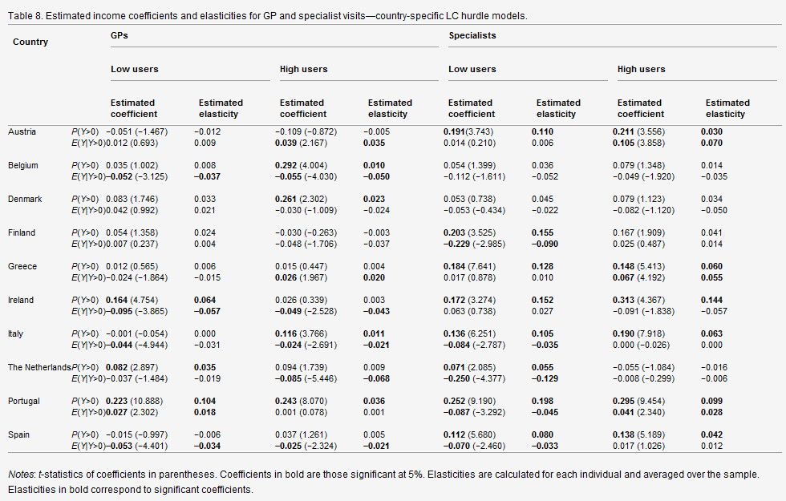
Latent Class Modeling 
Applications 

Slide 14
A Practical Distinction
Latent Class Modeling 
Applications 
Finite Mixture (Discrete Mixture):
  Functional form strategy
  Component densities have no meaning
  Mixing probabilities have no meaning
  There is no question of “class membership”
Latent Class:
  Mixture of subpopulations
  Component densities are believed to be definable “groups”
  (Low Users and High Users)
  The classification problem is interesting – who is in which class?
  Posterior probabilities, P(class|y,x) have meaning
  Question of the number of classes has content in the context of the analysis

Slide 15
Why Make the Distinction?
Latent Class Modeling 
Applications 
Same estimation strategy
Same estimation results
Extending the Latent Class Model
  Allows a rich, flexible model specification for behavior
  The classes may be governed by different processes

Slide 16
Antecedents
Latent Class Modeling 
Applications 
Long history of finite mixture and latent class modeling in statistics and econometrics.
  Early work starts with Pearson’s 1894 study of crabs in Naples – finite mixture of two normals – looking for evidence of two subspecies.
  See McLachlan and Peel (2000).
Some of the extensions I will note here have already been employed in earlier literature (and noticed in surveys)
  Different underlying processes
  Heterogeneous class probabilities
  Correlations of unobservables in class probabiities with unobservables in structural (within class) models
One has not and is not widespread (yet)
  Cross class restrictions implied by the theory of the model

Slide 17
Split Population Survival Models
Latent Class Modeling 
Applications 
Schmidt and Witte 1989 study of recidivism
F=1 for eventual failure, F=0 for never fail. Unobserved. P(F=1)=d, P(F=0)=1-d
C=1 for recidivist, observed. Prob(F=1|C=1)=1.
Density for time until failure actually occurs is d × g(t|F=1).
Density for observed duration (possibly censored)
  P(C=0)=(1-d)+d(G(T|F=1)) (Observation is censored)
  Density given C=1 = dg(t|F=1)
  G=survival function, t=time of observation.
Unobserved F implies a latent population split.
They added covariates to d: d_{i} =logit(z_{i}).
Different models apply to the two latent subpopulations.

Slide 18
Switching Regressions
Latent Class Modeling 
Applications 
Mixture of normals with heterogeneous mean
y ~ N(b₀’x, σ₀²) if d=0, y ~ N(b₀’x, σ₁²) if d=1
d is unobserved (Latent switching). P(d=1)=f(c’z).
Lack of identification (Kiefer)
Becomes a latent class model when regime 0 is a demand function and regime 1 is a supply function, d=0 if excess supply
The two regression equations may involve different variables – a true latent class model

Slide 19
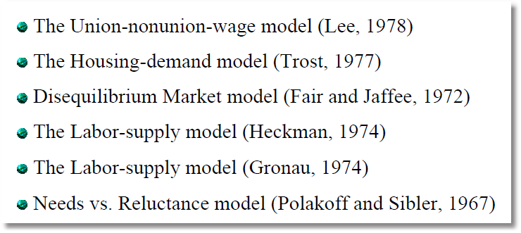
Latent Class Modeling 
Applications 
Applications
http://schwert.ssb.rochester.edu/f533/maddala_fei.pdf

Slide 20
Endogenous Switching
Latent Class Modeling 
Applications 
Not identified. Regimes do not coexist.

Slide 21
Zero Inflation Models
Latent Class Modeling 
Applications 
Lambert 1992, Technometrics. Quality control problem. Counting defects per unit of time on the assembly line. How to explain the zeros; is the process under control or not?
Two State Outcome: Prob(State=0)=R, Prob(State=1)=1-R
  State=0, Y=0 with certainty
  State=1, Y ~ some distribution support that includes 0, e.g., Poisson.
Prob(State 0|y>0) = 0
Prob(State 1|y=0) = (1-R)f(0)/[R + (1-R)f(0)]
R = Logistic probability (with the same covariates as f – the “zip-tau” model)
“Nonstandard” latent class model according to McLachlan and Peel
Recent users have extended this to “Outcome Inflated Models,” e.g., twos inflation in models of fertility.

Slide 22
Variations of Interest
Latent Class Modeling 
Applications 
Heterogeneous priors for the class probabilities
Correlation of unobservables in class probabilities with unobservables in regime specific models
Variations of model structure across classes
Behavioral basis for the mixed model with implied restrictions

Slide 23
Heterogeneous Class Probabilities
Latent Class Modeling 
Applications 
π_{j} = Prob(class=j) = governor of a detached
natural process.
π_{ij} = Prob(class=j|individual i)
  Usually modeled as a multinomial logit
  Now possibly a behavioral aspect of the process, no longer “detached” or “natural”
F(y_{i} |x_{i},Θ ) ≅ Σ_{j} π_{ij}(z_{i},δ)F(y_{i}|x_{i},θ_{j} )
Nagin and Land 1993, “Criminal Careers…

Slide 24
Interpreting the Discrete Variation
Latent Class Modeling 
Applications 
Most empirical applications of latent class models to health care utilisation take class membership probabilities as parameters π_{ij}=π_{j},j=1,…,C to be estimated along with θ₁,…,θ_{C} (e.g., P. Deb and P.K. Trivedi, Demand for medical care by the elderly: a finite mixture approach, Journal of Applied Econometrics 12 (1997), pp. 313–336 [Deb and Trivedi, 1997], [Deb, 2001], [Jiménez-Martín et al., 2002], [Atella et al., 2004] and [Bago d’Uva, 2006]). This is analogous to the hypothesis that individual heterogeneity is uncorrelated with the regressors in a random effects or random parameters specification. A more general approach is to parameterise the heterogeneity as a function of time invariant individual characteristics z_{i}, as in Mundlak (1978), thus accounting for the possible correlation between observed regressors and unobserved effects. This has been done in recent studies that consider continuous distributions for the individual effects, mostly by setting z_{i} = xbar_{i}. To implement this approach in the case of the latent class model, class membership can be modelled as a multinomial logit (as in, e.g., [Clark and Etilé, 2006], [Clark et al., 2005] and [Bago d’Uva, 2005]):

Slide 25
A Loose End in the Theory
Latent Class Modeling 
Applications 

Slide 26
A Mundlak Correction for LCM?
Latent Class Modeling 
Applications 

Slide 27
Applications
Latent Class Modeling 
Applications 
Obesity: Correlation of Unobservables
Self Assessed Health: Heterogeneous subpopulations
Choice Strategy in Travel Route Choice: Cross Class Restrictions
Cost Efficiency of Nursing Homes: Theoretical Restrictions on Underlying Models
Freight Forwarding: Finite Mixture of Random Parameters Models

Slide 28
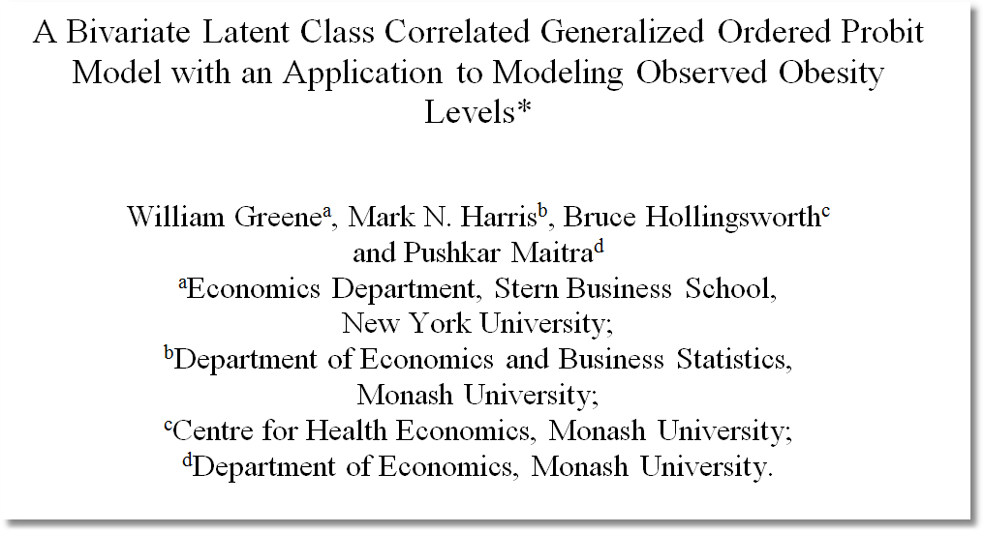
Latent Class Modeling 
Applications 

Slide 29
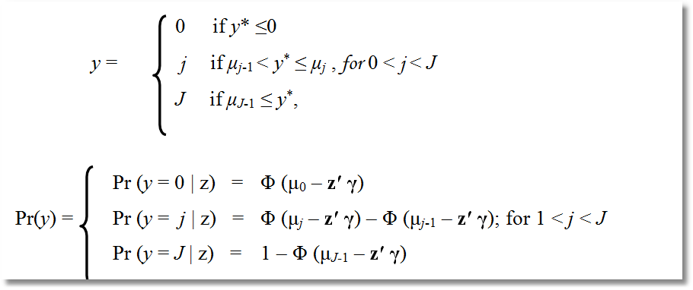
Modeling BMI
Latent Class Modeling 
Applications 
WHO BMI Classes: 1 – 4
Standard ordered probit model

Slide 30
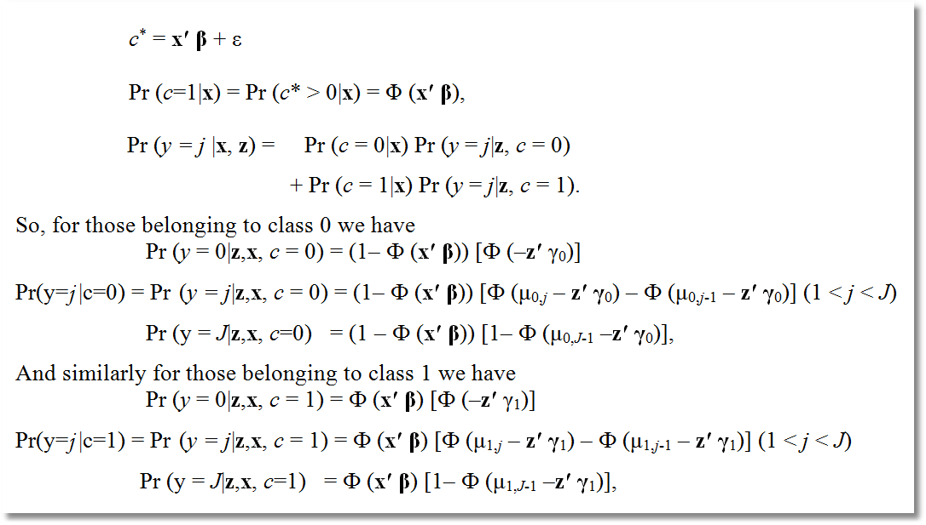
Standard Two Class LCM
Latent Class Modeling 
Applications 

Slide 31
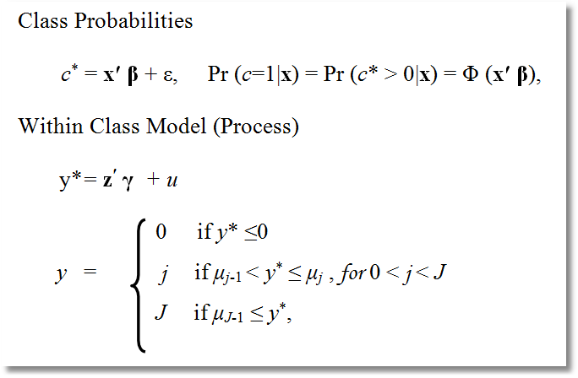
Correlation of Unobservables
Latent Class Modeling 
Applications 

Slide 32
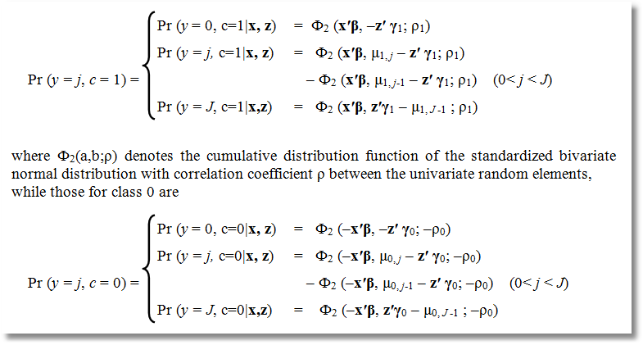
Latent Class Modeling 
Applications 
These assume c is observed. But, the right terms would be Pr(y=j|c=1)Pr(c=1) which is, trivially, [Pr(y=j,c=1)/Pr(c=1)] x Pr(c=1) which returns the preceding.

Slide 33
An Identification Issue in Generalized Ordered Choice Models
Latent Class Modeling 
Applications 
Prob(y=j|c=0)= Ф₂ (–x′β, μ_{0, j} – z′ γ₀; ­–ρ₀)
– Ф₂ (–x′β, μ_{0, j-1} – z′ γ₀; –ρ₀)
If μ_{0, j} = δ₀ + w_{i}′δ₀ then δ₀ and γ₀ are not separately identified.
We used μ_{cij} = exp (δ_{cj} + w_{i}′δ_{c}),
Isn’t this “identification by functional form?”

Slide 34

Latent Class Modeling 
Applications 

Slide 35
Introduction
Latent Class Modeling 
Applications 
The typical question would be: “In general, would you say your health is: Excellent, Very good, Good, Fair or Poor?"
So here respondents “tick a box”, typically from 1 – 5, for these responses
What we typically find is that approx. ¾ of the nation are of “good” or “very good” health
  in our data (HILDA) we get 72%
Get similar numbers for most developed countries
So, key question is, does this truly represent the health of the nation?

Slide 36
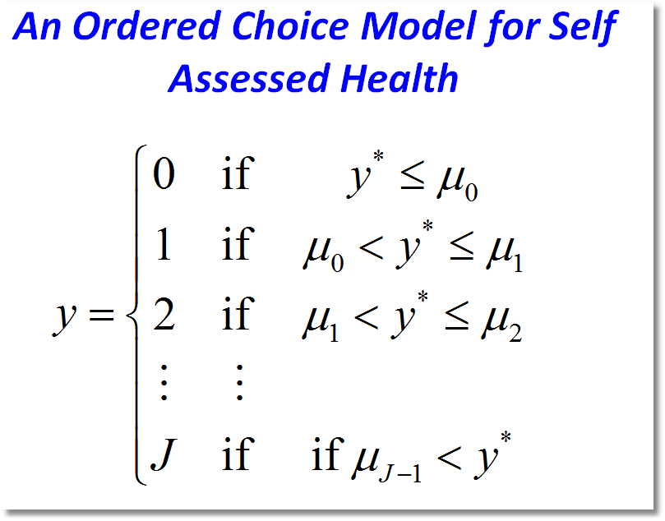
Latent Class Modeling 
Applications 

Slide 37
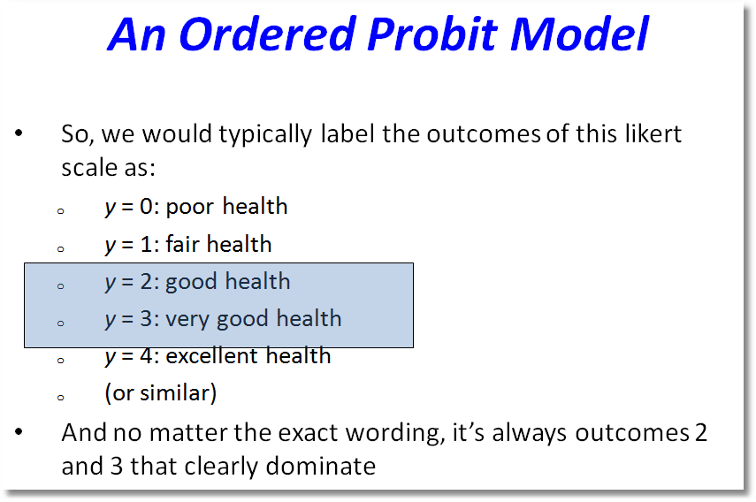
Latent Class Modeling 
Applications 

Slide 38
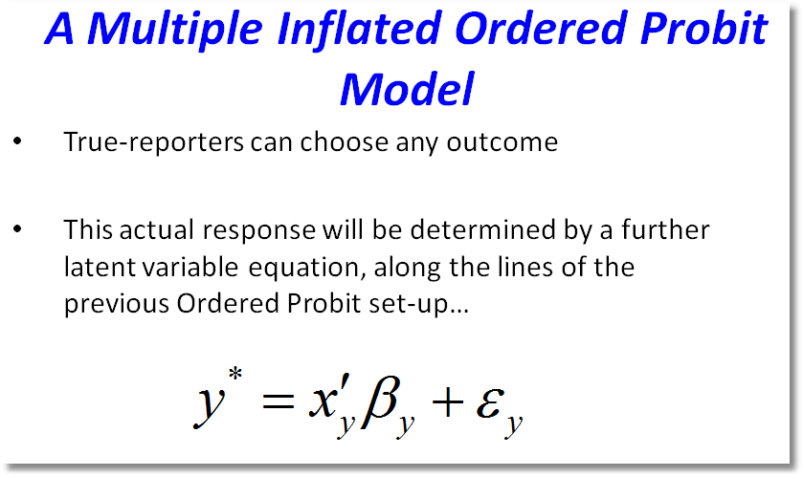
Latent Class Modeling 
Applications 

Slide 39
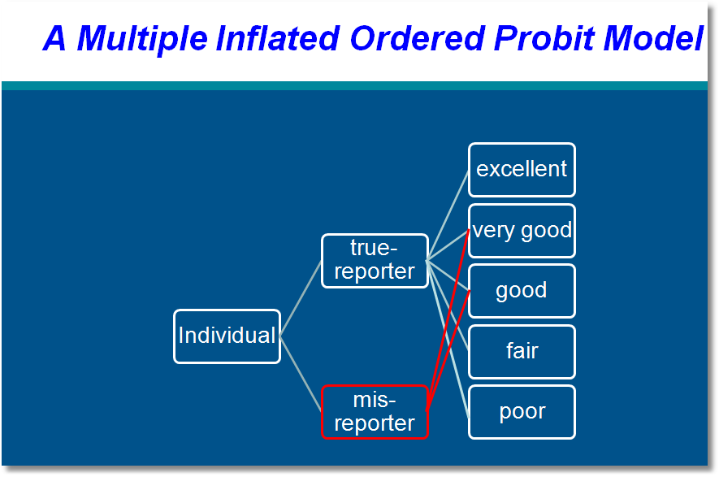
Latent Class Modeling 
Applications 

Slide 40
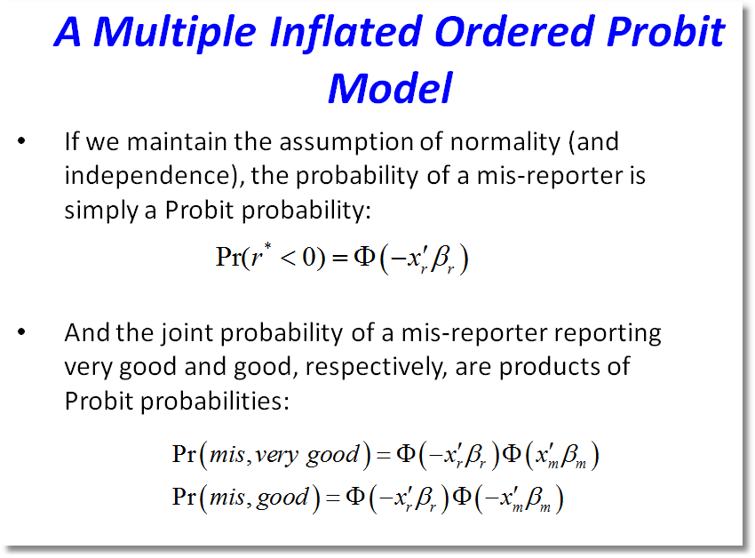
Latent Class Modeling 
Applications 

Slide 41
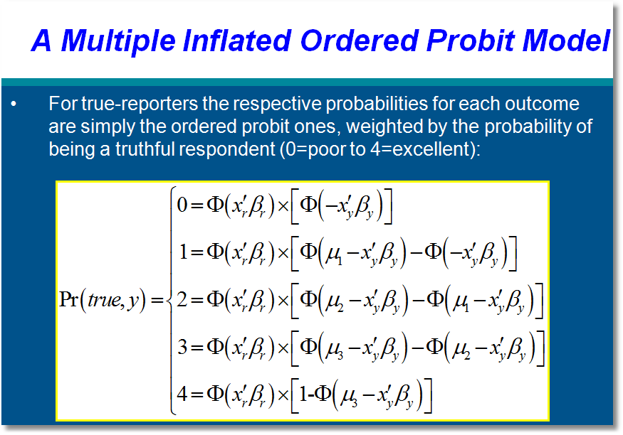
Latent Class Modeling 
Applications 

Slide 42
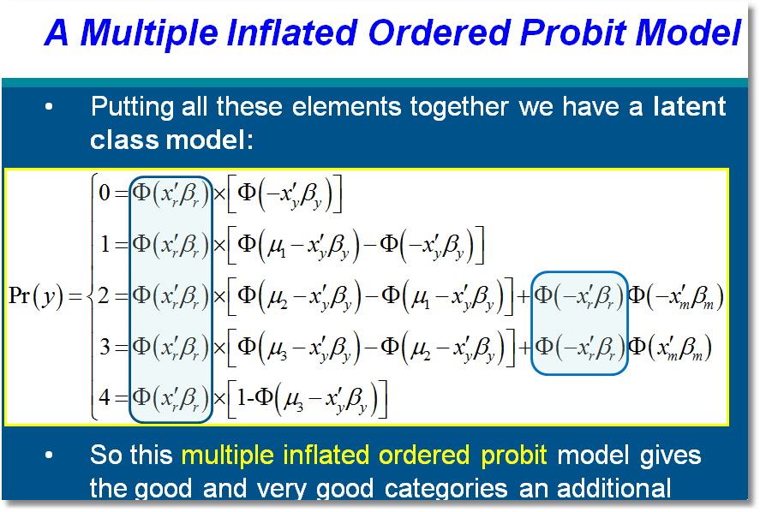
Latent Class Modeling 
Applications 

Slide 43
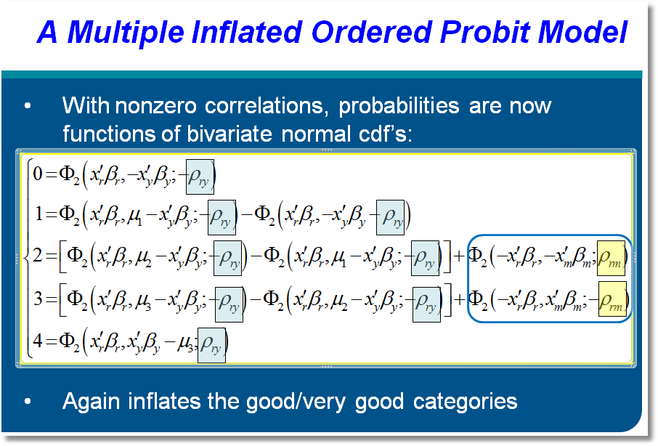
Latent Class Modeling 
Applications 

Slide 44
Choice Strategy
Latent Class Modeling 
Applications 
Hensher, D.A., Rose, J. and Greene, W. (2005) The Implications on Willingness to Pay of Respondents Ignoring Specific Attributes (DoD#6) Transportation, 32 (3), 203-222.
Hensher, D.A. and Rose, J.M. (2009) Simplifying Choice through Attribute Preservation or Non-Attendance: Implications for Willingness to Pay, Transportation Research Part E, 45, 583-590.
Rose, J., Hensher, D., Greene, W. and Washington, S. Attribute Exclusion Strategies in Airline Choice: Accounting for Exogenous Information on Decision Maker Processing Strategies in Models of Discrete Choice, Transportmetrica, 2011
Hensher, D.A. and Greene, W.H. (2010) Non-attendance and dual processing of common-metric attributes in choice analysis: a latent class specification, Empirical Economics 39 (2), 413-426
Campbell, D., Hensher, D.A. and Scarpa, R. Non-attendance to Attributes in Environmental Choice Analysis: A Latent Class Specification, Journal of Environmental Planning and Management, proofs 14 May 2011.
Hensher, D.A., Rose, J.M. and Greene, W.H. Inferring attribute non-attendance from stated choice data: implications for willingness to pay estimates and a warning for stated choice experiment design, 14 February 2011, Transportation, online 2 June 2001 DOI 10.1007/s11116-011-9347-8.

Slide 45
Decision Strategy in
Multinomial Choice
Latent Class Modeling 
Applications 

Slide 46
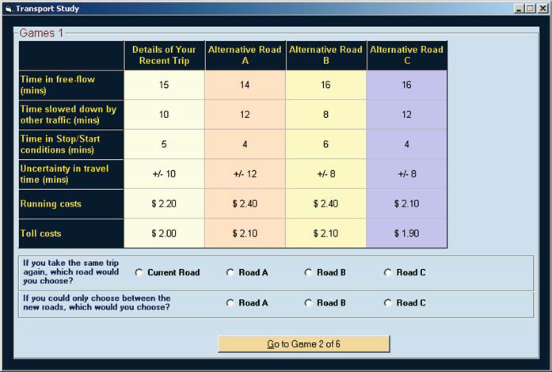
Stated Choice Experiment
Latent Class Modeling 
Applications 

Slide 47
Multinomial Logit Model
Latent Class Modeling 
Applications 

Slide 48
Individual Explicitly Ignores Attributes
Latent Class Modeling 
Applications 
Hensher, D.A., Rose, J. and Greene, W. (2005) The Implications on Willingness to Pay of Respondents Ignoring Specific Attributes (DoD#6) Transportation, 32 (3), 203-222.
Hensher, D.A. and Rose, J.M. (2009) Simplifying Choice through Attribute Preservation or Non-Attendance: Implications for Willingness to Pay, Transportation Research Part E, 45, 583-590.
Rose, J., Hensher, D., Greene, W. and Washington, S. Attribute Exclusion Strategies in Airline Choice: Accounting for Exogenous Information on Decision Maker Processing Strategies in Models of Discrete Choice, Transportmetrica, 2011
Choice situations in which the individual explicitly states that they ignored certain attributes in their decisions.

Slide 49
Stated Choice Experiment
Latent Class Modeling 
Applications 
Ancillary questions: Did you ignore any of these attributes?

Slide 50
Appropriate Modeling Strategy
Latent Class Modeling 
Applications 
Fix ignored attributes at zero? Definitely not!
  Zero is an unrealistic value of the attribute (price)
  The probability is a function of x_{ij} – x_{il}, so the substitution distorts the probabilities
Appropriate model: for that individual, the specific coefficient is zero – consistent with the utility assumption. A person specific, exogenously determined model
Surprisingly simple to implement

Slide 51
Individual Implicitly Ignores Attributes
Latent Class Modeling 
Applications 
Hensher, D.A. and Greene, W.H. (2010) Non-attendance and dual processing of common-metric attributes in choice analysis: a latent class specification, Empirical Economics 39 (2), 413-426
Campbell, D., Hensher, D.A. and Scarpa, R. Non-attendance to Attributes in Environmental Choice Analysis: A Latent Class Specification, Journal of Environmental Planning and Management, proofs 14 May 2011.
Hensher, D.A., Rose, J.M. and Greene, W.H. Inferring attribute non-attendance from stated choice data: implications for willingness to pay estimates and a warning for stated choice experiment design, 14 February 2011, Transportation, online 2 June 2001 DOI 10.1007/s11116-011-9347-8.

Slide 52
Stated Choice Experiment
Latent Class Modeling 
Applications 
Individuals seem to be ignoring attributes. Unknown to the analyst

Slide 53
The 2^{K} model
Latent Class Modeling 
Applications 
The analyst believes some attributes are ignored. There is no indicator.
Classes distinguished by which attributes are ignored
Same model applies now a latent class. For K attributes there are 2^{K} candidate coefficient vectors

Slide 54
A Latent Class Model
Latent Class Modeling 
Applications 

Slide 55
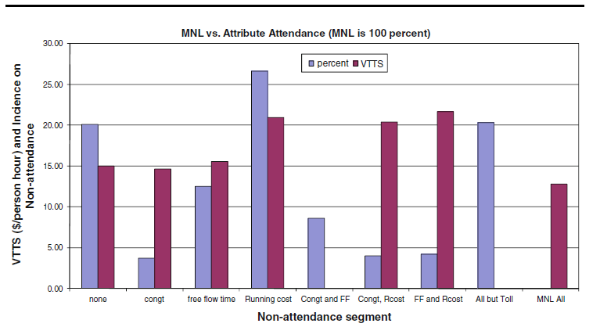
Results for the 2^{K} model
Latent Class Modeling 
Applications 

Slide 56
Latent Class Models with Cross Class Restrictions
Latent Class Modeling 
Applications 
8 Class Model: 6 structural utility parameters, 7 unrestricted prior probabilities.
Reduced form has 8(6)+8 = 56 parameters. (π_{j} = exp(α_{j})/∑_{j}exp(α_{j}), α_{J} = 0.)
EM Algorithm: Does not provide any means to impose cross class restrictions.
“Bayesian” MCMC Methods: May be possible to force the restrictions – it will not be simple.
Conventional Maximization: Simple

Slide 57
Practicalities
Latent Class Modeling 
Applications 

Slide 58
Latent Class Analysis of Nursing Home Cost Efficiency
Latent Class Modeling 
Applications 

Slide 59
Latent Class Efficiency Studies
Latent Class Modeling 
Applications 
Battese and Coelli – growing in weather “regimes” for Indonesian rice farmers
Kumbhakar and Orea – cost structures for U.S. Banks
Greene (Health Economics, 2005) – revisits WHO Year 2000 World Health Report

Slide 60
Studying Economic Efficiency in Health Care
Latent Class Modeling 
Applications 
Hospital and Nursing Home
  Cost efficiency
  Role of quality (not studied today)
AHRQ
EWEPA, NAPW

Slide 61
Stochastic Frontier Analysis
Latent Class Modeling 
Applications 
logC = f(output, input prices, environment) + v + u
ε = v + u
  v = noise – the usual “disturbance”
  u = inefficiency
Frontier efficiency analysis
  Estimate parameters of model
  Estimate u (to the extent we are able – we use E[u|ε])
  Evaluate and compare observed firms in the sample

Slide 62
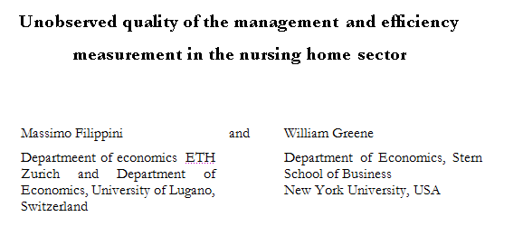
Latent Class Modeling 
Applications 

Slide 63
Nursing Home Costs
Latent Class Modeling 
Applications 
44 Swiss nursing homes, 13 years
Cost, Pk, Pl, output, two environmental variables
Estimate cost function
Estimate inefficiency

Slide 64
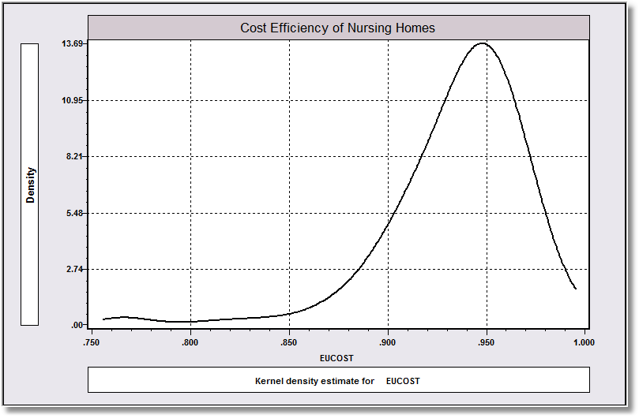
Estimated Cost Efficiency
Latent Class Modeling 
Applications 

Slide 65
Inefficiency?
Latent Class Modeling 
Applications 
Not all agree with the presence (or identifiability) of “inefficiency” in market outcomes data.
Variation around the common production structure may all be nonsystematic and not controlled by management
Implication, no inefficiency: u = 0.

Slide 66
A Two Class Model
Latent Class Modeling 
Applications 
Class 1: With Inefficiency
  logC = f(output, input prices, environment) + σ_{v}v + σ_{u}u
Class 2: Without Inefficiency
  logC = f(output, input prices, environment) + σ_{v}v
  σ_{u} = 0
Implement with a single zero restriction in a constrained (same cost function) two class model
Parameterization: λ = σ_{u} /σ_{v} = 0 in class 2.

Slide 67
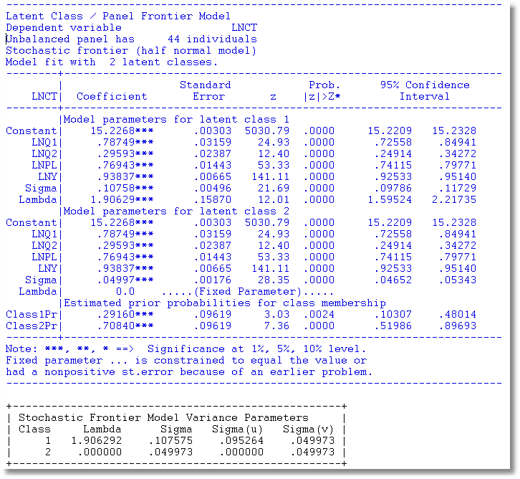
Latent Class Modeling 
Applications 
LogL= 464 with a common frontier model, 527 with two classes

Slide 68
Revealing Additional Dimensions of Preference Heterogeneity in a Latent Class Mixed Multinomial Logit Model
William H. Greene
Department of Economics
Stern School of Business
New York University, New York 10012 wgreene@stern.nyu.edu
David A. Hensher
Institute of Transport and Logistics Studies
Faculty of Economics and Business
The University of Sydney
NSW 2006 Australia
David.Hensher@sydney.edu.au
Latent Class Modeling 
Applications 

Slide 69
Freight Forwarding Experiment
Latent Class Modeling 
Applications 
A stated choice (SC) framework within which a freight transporter defined a recent reference trip in terms of its time and cost attributes (detailed below), treating fuel as a separate cost item to the variable user charge (VUC),
Whilst in-depth interviews and literature reviews revealed myriad attributes that influence freight decision making, we focussed on the subset of these attributes that were most likely to be directly affected by congestion charges.

Slide 70
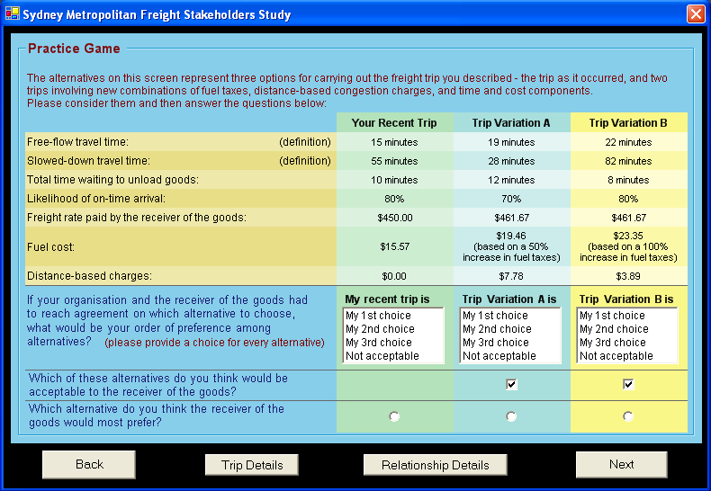
Latent Class Modeling 
Applications 

Slide 71
LC-RP Model
Latent Class Modeling 
Applications 
Latent Class Structure for Overall Model Format
Random Parameters Model within Classes
Prior class probabilities are heterogeneous

Slide 72
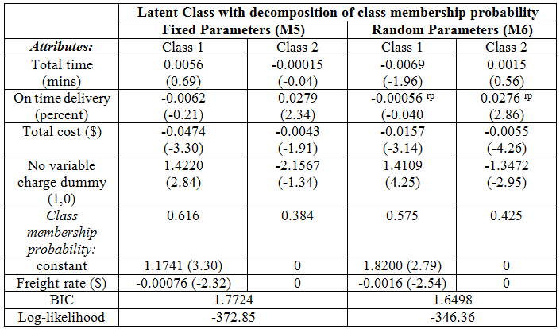
Latent Class Modeling 
Applications 

Slide 73
Conclusion
Latent class modeling provides a rich, flexible platform for behavioral model building.
Thank you.

