Slide 1
Current Issues in Financial Accounting
By
Baruch Lev
Stern School of Business
New York University
June 2015

Slide 2
At A Glance
Nothing new under the (accounting) sun (Ecclesiastes)
But regulators worldwide are active: update
All this activity for naught: accounting’s relevance fades
How can this be? Blame intangibles and estimates
What should managers and directors do?
  Provide better information, of course
  Proforma (non-GAAP) earnings
  Earnings guidance
  Improved conference calls
  The Value-Creation Report

Slide 3
U.S. Steel Reports Then and Now:
Dormant for 110 Years
United States Steel Corporation
Consolidated Income Statement
(in $ Millions)
 | Year | Year
 | 1902 | 2012
Sales | $560 | $19,328
Cost of sales | (411) | (18,291)
Gross profit | 149 | 1,037
Minus Expenses:
Selling & general expenses | (13) | (654)
Other gains/(losses) | 5 | (136)
Interest income | 3 | 7
Interest expense | (9) | (247)
Income tax | (2) | (131)
Net income (loss) | 133 | (124)

Slide 4
United States Steel Corporation
Consolidated Balance Sheet
(in $ Millions)
 | Year | Year
 | 1902 | 2012
Assets:
Current Assets
Cash & equivalents | 56 | 570
Net receivables | 49 | 2,090
Inventories | 104 | 2,503
Other current assets | 5 | 211
Total current assets | 214 | 5,374
Investments | 4 | 609
Property, Plant & Equipment | 1,325 | 6,408
Intangibles | — | 253
Goodwill | — | 1,822
Other non-current assets | 4 | 751
Total assets | 1,547 | 15,217

Slide 5
United States Steel Corporation
Consolidated Balance Sheet
Continued…
Liabilities
Current Liabilities
Accounts payable | 19 | 1,800
Payroll payable | 4 | 977
Accrued taxes | 1 | 146
Other current liabilities | 26 | 67
Total current liabilities | 50 | 2,990
Long-term debt | 371 | 3,936
Employee benefits | — | 4,416
Other non-current liabilities | 30 | 397
Total liabilities | 451 | 11,739
Stockholders’ Equity
Common stock | 1,018 | 3,282
Retained earnings | 78 | 196
Total shareholders’ equity | 1,096 | 3,478
Total Liabilities and Equity | 1,547 | 15,217

Slide 6
But Wait,
Recent Regulatory Actions
Revenue recognition (may 28, 2014: ASC 606 and IFRS 15).
  A comprehensive revenue (top line) recognition model for all contracts with customers. Specifies measurements as well as timing of recognition
  An entity will recognize revenue to depict the transfer of control over goods or services to customers at an amount the entity expects to collect. Arrangements where parties share risks and benefits (e.g., a biotech and pharma companies share in the development of a drug) are excluded.
  Specific rules for cases of financing agreements and noncash considerations, such as receiving equity (fair value), and allocation of transaction price to separate performance obligations (software).
  Revenue should be recognized when performance obligation is satisfied.

Slide 7
Continued…
Specific guidelines for licensing rights (IP, software, entertainment rights).
Warranties should be recognized on an accrual basis.
Overall observation: Little change from current practices. Mainly consolidation of existing rules. After 15 years of deliberation, implementation delayed by a year, and the rule already modified.

Slide 8
Continued…
B. Proposed Lease Accounting: General Objective: report most leases on the balance sheet (avoid off-balance sheet financing).
The main rule for financing leases (US GAAP): discounted value of lease payments exceed 75% of asset value, remains. IASB (international) requires essentially all leases to be recognized as financing.
Overall observation: marginal changes for US companies; significant changes for non-US companies.

Slide 9
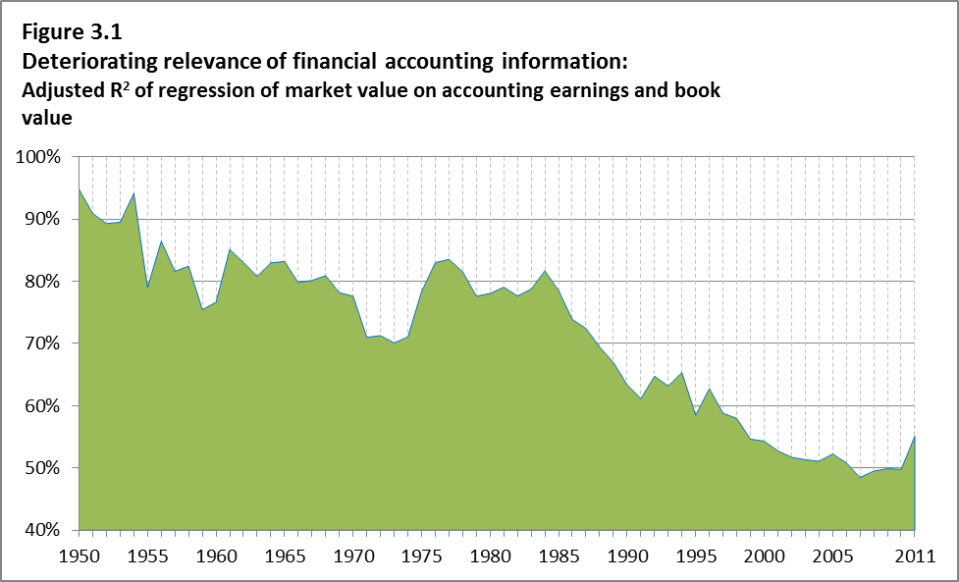
All This Regulatory Activity for Naught: Accounting Relevance Fades Away
Source: Lev and Gu, The End of Accounting ©.

Slide 10
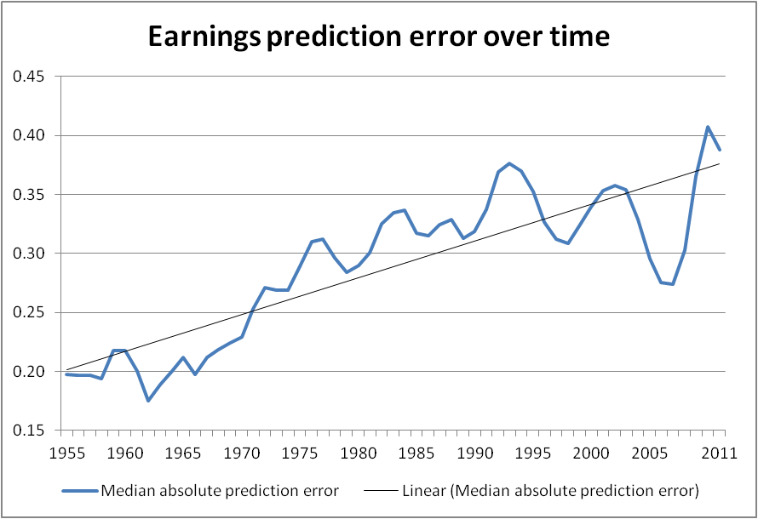
Source: Lev and Gu, The End of Accounting ©.

Slide 11
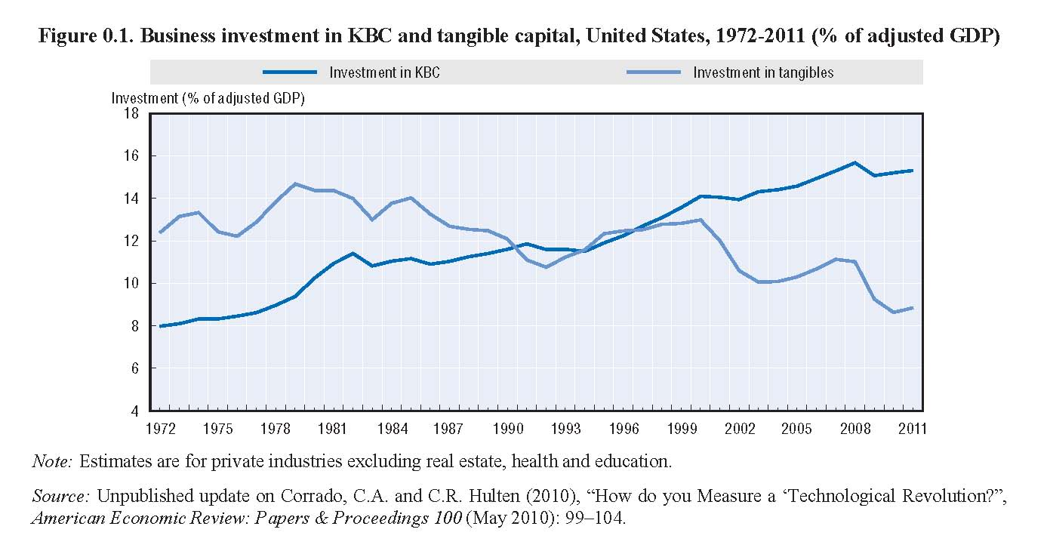
How Can This Be? The Culprits – Intangibles and Managerial Estimates
A. Intangibles (knowledge-based assets)

Slide 12
Accounting For Intangibles: Outdated and Opaque
US: Internally-generated intangibles are expensed, whereas acquired intangibles are capitalized.
International: Capitalize R&D beyond technological feasibility.
Except for R&D, no information disclosure on intangibles (brands, IT, human resource).
Not only high-tech: Coco Cola, Exxon, Progressive

Slide 13
Not Just High Tech
Coca Cola’s net assets (book value per share) at end of January 2014 were $7.28B and its share price around $40B, yielding a market-to-book ratio of 5.50.
Where have all Coke’s assets gone?
Same with Walmart with market-to-book ratio of 3.38

Slide 14
Not Only the Balance Sheet
Profitability Distorted:
Google’s Real Profitability
 | R&D Expense ($M) | 2013 R&D Amortization | 2012 R&D Amortization
2013 | (17.1%) $7,952 | — | —
2012 | (31.6%) $6,793 | 1,359 | —
2011 | (37.2%) $5,162 | 1,032 | 1,032
2010 | $3,762 | 752 | 752
2009 | $2,843 | 569 | 569
2008 | $2,793 | 559 | 559
2007 | $2,120 | — | 424
TOTAL |  | $4,271 | $3,336
R&D Capital |  | $18,557 | $14,876

Slide 15
A Large Growth Difference
Income | 2013 | 2012 | Growth
Reported income | $12,920 | $10,737 | 20.3% (14.5%)*
+ R&D expense | 7,952 | 6,793
– R&D amortization | 4,271 | 3,336
Adjusted income | 16,601 | 14,194 | 17.0% (19.3%)*
* Growth for 2010/11
ROE
Reported ROE | 12,920/87,309 = 14.8%
Adjusted ROE | 16,601/90,272 = 18.4%
Accounting distortions are very tricky

Slide 16
II. And You Thought Accounting is
About Facts…
B. Managerial estimates and forecasts
Most balance sheet and income statement items are based on managers’ subjective estimates and projections. Examples:
  Fixed assets—depreciation, impairment
  Accounts receivable—bad debt reserve
  Inventory—lower of cost or market
  Nontraded financial assets—mark to model
  Pension liability—based on multiple assumptions
  Stock options expense—same
  Warranty expense—same
“To know the past, one must know the future.”

Slide 17
But Sales are Surely Facts…
“ We recognize revenue on agreements for sales of goods and services under power generation units; nuclear fuel assemblies; larger oil drilling equipment projects; military development products…using long-term construction and production contract accounting. We estimate total long-term contract revenue…We measure long-term contract revenues by applying our contract-specific estimated margin rates…We measure sales of our commercial aircraft engines by applying our contract-specific estimated margin rates…(GE, 2012 financial report).
The “only” thing GE doesn’t tell you: how much of its $100B revenue is based on estimates.

Slide 18
Two Problems with Managerial Estimates/Projections
In a world of increased uncertainty and fast technological innovations, making projections is increasingly challenging and subject to larger and larger errors.
  The pension expense requires estimating 5-7 years’ investment returns.
  Asset and goodwill impairments require projecting long-term asset cash flows.
Estimates can be manipulated with impunity. Hard to prove intentional misestimates.
Indeed, most reporting manipulations are done by “massaging” estimates.
You should provide investors with factual, credible information.

Slide 19
III. Both Transactions and Events Create Value
But accounting reflects only transactions.
Value-changing events:
  Merck announced 12/20/12 that its highly touted cholesterol drug Tredaptive failed tests to reduce heart disease risk. Stock fell 3.4%.
Summarizing, serious accounting deficiencies—mistreatment of intangibles, heavy reliance on shaky estimates/projections, and bypassing important business events—diminish the relevance of financial information. A new approach is needed!

Slide 20
So What If Financial Report Information Deteriorates? Aren’t There Alternative Information Sources?
Apparently insufficient to supplement the information loss of financial reports.
  The informativeness of most shares deteriorates
  Analysts’ earnings prediction errors increase, as well as their disagreement.
And the consequences for companies are harsh

Slide 21
The Serious Consequences of Deficient Information
Investors’ uncertainty decreases share prices and raises the company’s cost of capital (“In capital markets, no news is bad news.”)
Deficient information increases share price volatility (surprises and disappoints), and enhances exposure to shareholders’ lawsuits.
Lagging share prices invite hedge fund interventions and takeover attempts.
Lagging share prices detracts from managers compensation and deters talent.
All bad consequences. So what’s to be done?

Slide 22
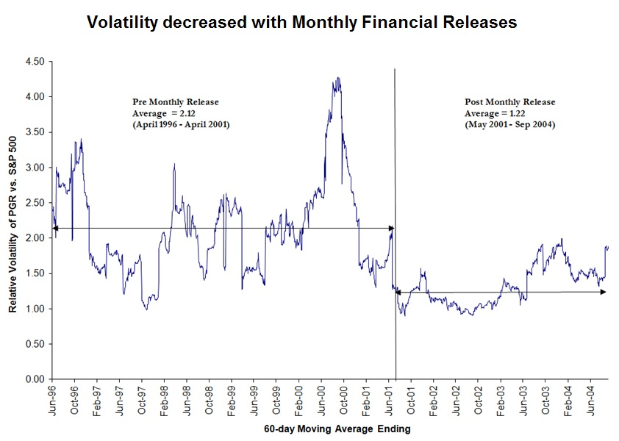
Progressive’s “Progressive Disclosure”

Slide 23
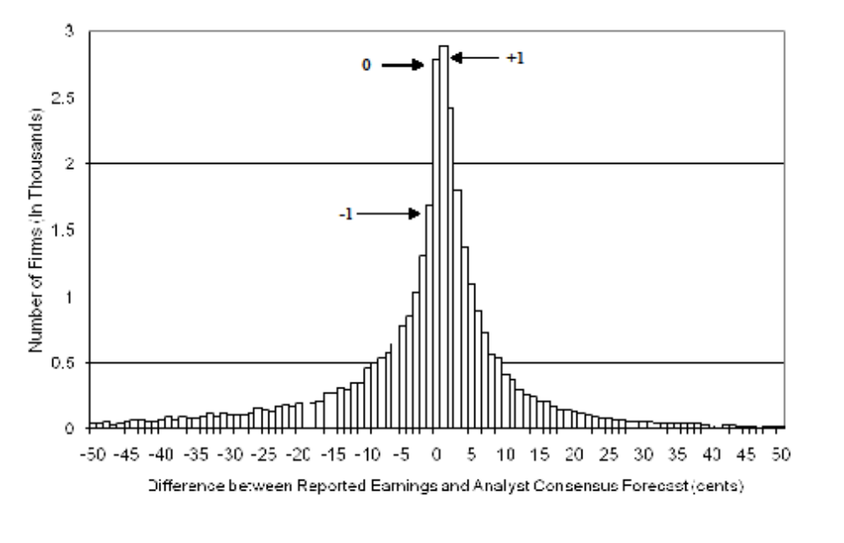
First and Foremost: Forget the Futile “Earnings Game” The “Harsh Consequences” of Missing the Consensus Are A Myth
The Distribution of Earnings Surprises

Slide 24
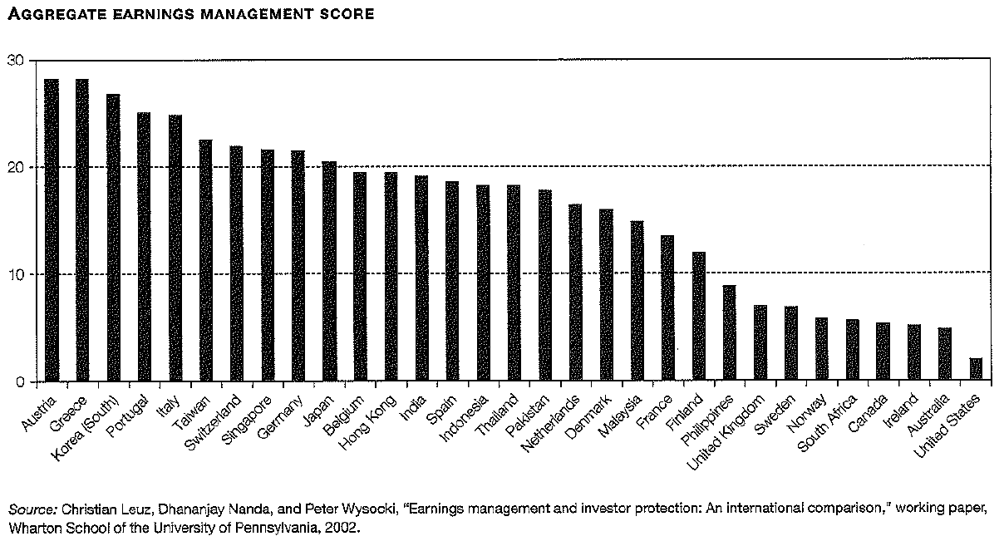
Before You Get Too Depressed:
Others are Worse Offenders

Slide 25
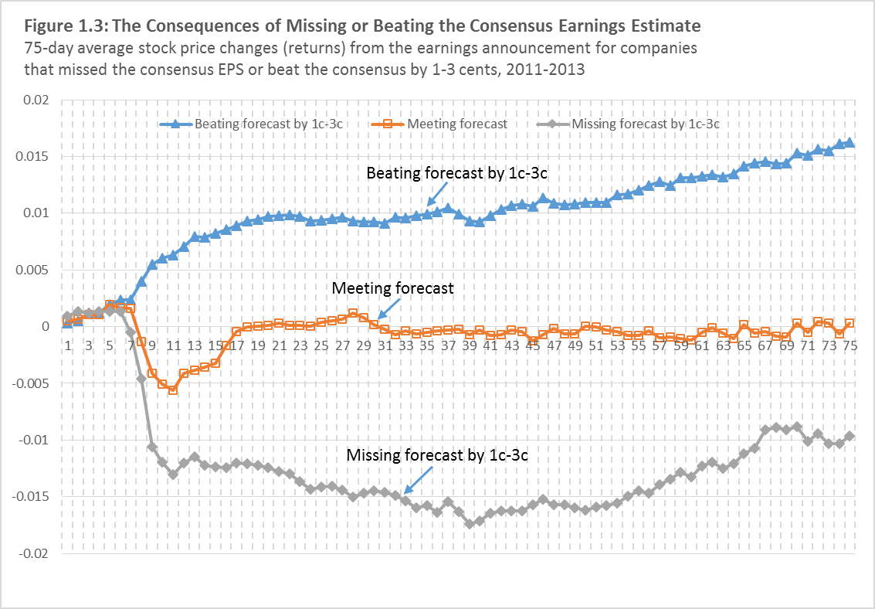
Consensus Misses and Beats Are
Non-Events

Slide 26
So, What’s To Be Done?
A. A Small Turn of the Dial: Proforma (Non-GAAP) Earnings
Management excludes from GAAP earnings one-time items (e.g., goodwill writeoff) and items which aren’t expenses, like customer acquisition costs (AOL):
  LinkedIn and Groupon exclude stock compensation ($30M and $94M, respectively) from earnings.
  Cisco excludes from earnings the stock option expense, and the amortization of intangibles.
SEC requires reconciliation of proforma with GAAP earnings, and prohibits a more prominent display of proforma.

Slide 27
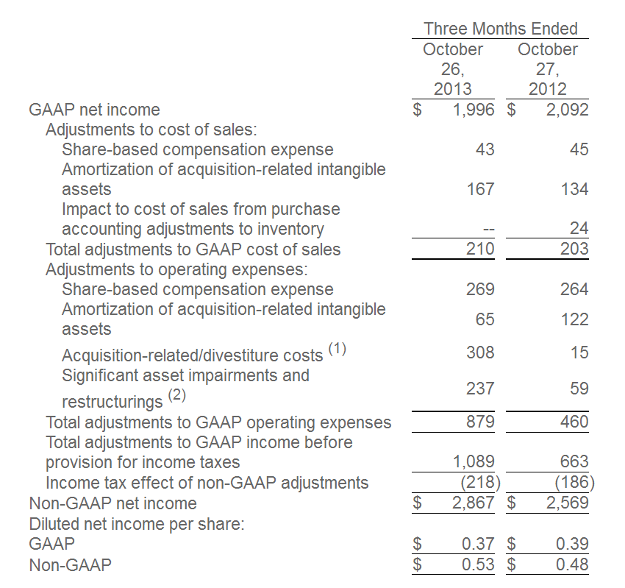
Cisco’s Reconciliation
Used with the permission of http://thenetwork.cisco.com/

Slide 28
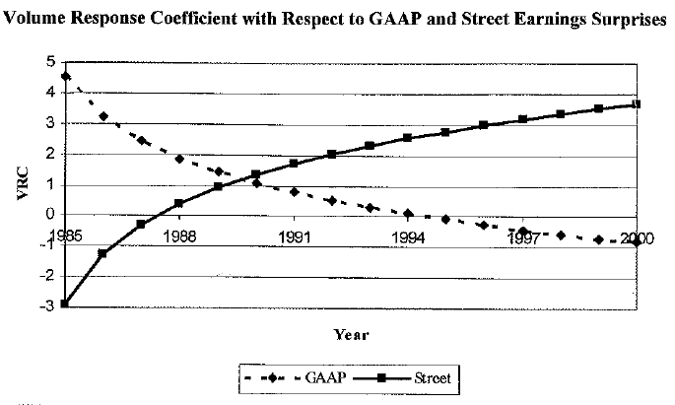
Surprise, Despite the Derision (EBE), Proforma Earnings are More Relevant to Investors Than GAAP Earnings
Source: Collins et al., 2005, “What Drives the Increased Performance of Earnings?”

Slide 29
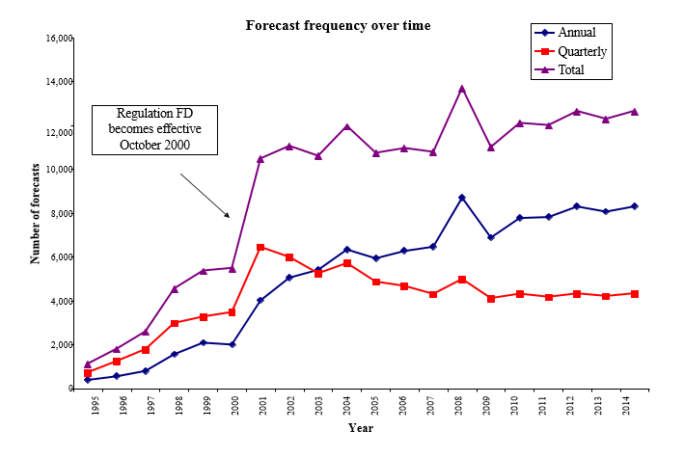
B. Earnings Guidance: A Means to Enhance Information Relevance

Slide 30
Guidance Examples
Abercrombie & Fitch had a terrible fourth quarter: earnings tumbled 79%. The guidance, however, was cheerful: next year’s EPS at $3.50 to $3.75, against a consensus of $3.47. Stock up 8.3% (WSJ, 2/16/12).
Apple (October 20, 2014) guides: 1st quarter 2015 revenue: $63.5 – 66.5 billion. (1st quarter 2014 revenue was: $57.6 billion.

Slide 31
The Raging Controversy About Guidance
The Conference Board, the Chamber of Commerce, McKinsey, Warren Buffett and even Al Gore, among others, urge managers to stop guiding investors.
They claim:
  Guidance encourages investors’ myopia and increases managers’ short-termness
  A waste of managers’ time and attention
  Managers aren’t better prognosticators than sophisticated investors
  Guidance doesn’t provide any benefits (e.g. doesn’t permanently increase stock prices)
  Managers should focus on the business and avoid getting involved in share valuation

Slide 32
Large Sample Research Begs to Differ
Research on firms that stopped quarterly guidance records:
  A substantial stock prices decrease (>5%) on announcement
  Increase in investors’ uncertainty (analysts’ forecast dispersion)
  Loss of analyst following
  Increased earnings surprises
  Increased share price volatility
  Guidance stoppers are mainly firms with operating difficulties and lagging share prices.
All bad things

Slide 33
What Does Guidance Achieve?
Decreases stock volatility (next page)
Increases managers’ credibility as straight shooters
Decreases litigation exposure and settlement figures
Constrains analysts’ earnings and sales expectations to a feasible range
Most importantly: Improves investors’ decisions by enhancing transparency

Slide 34
Who Should Guide?
Managers whose internal earnings/sales forecasts are superior to analysts’, and are willing to “commit” to a guidance strategy
When investors’ uncertainty about your firm’s operations is high (how would you measure investors’ uncertainty about your company?)
When most of your peers are guiding
When you wish to attract analysts
But, don’t game the guidance (“walk down” the consensus)
Most importantly: When forthcoming results will disappoint

Slide 35
C. Conference Calls: The Best Venue for Relevant Information
Enhancing Calls’ Effectiveness:
  Increase the ratio of numbers-to-words (blah-blah).
  Increase the ratio of standardized and verifiable numbers (margins, earnings guidance) to other numbers (employee/customer satisfaction, strategic vision).
  Decrease the ratio of management’s presentation-to- Q&A (Intel’s and Netflix’s ratio=0).
  Increase the number of investors and executives actively participating in the call. (How to do it?)

Slide 36
Take a clear stand (difficult for many managers):
  Wavering, hedging, uncertain expressions (maybe, perhaps, it depends) reduce call effectiveness.
  Counter-intuitively, negative words (loss, underperformance, write-off) enhance effectiveness of calls following a disappointing quarter.
  Empty expressions (“we look forward to a great quarter”) and sugarcoating (“despite the consensus miss, we had a great quarter”) are counter-productive.
  Provide verifiable forward-looking information (most important).
“Thank god it’s over”—wrong attitude

Slide 37

Be an early bird: Hard to believe—call effectiveness deteriorates as the day wears on.
(based on 33,000 calls)

Slide 38
D. Back to Fundamentals: Firm’s
Ultimate Objective
Firm’s ultimate objective: sustained competitive advantage. Firm’s ability to create and appropriate more value than its competitors.
Sustained competitive advantage is achieved by strategic resources, namely assets which are:
  Valuable: generate revenues higher than costs
  Rare: competitors don’t have access to these assets
  Non-imitable: competitors can’t easily imitate the assets
Apple’s and Pfizer’s patents, Coca Cola’s and Starbuck’s brands, Goldman Sachs’ reputation, Walmart’s supply chain technology, and Microsoft’s operating system are strategic resources.
What information in financial reports informs on strategic resources? (Attention IR!)

Slide 39
Information Investors (and Managers too) Need
Decisions about resources (inputs, assets):
  How much to invest in R&D, oil exploration, opening new stores, customer acquisition, M&A, etc.
How best to use these resources:
  Develop or license patents and trademarks, employee incentive/compensation, cost cutting, supply chains
How to protect resources from disruption (Pandora and Spotify to Sirius)
How to market products/services:
  Pricing, promotion, customer relations
All this, to establish and maintain sustained competitive advantage and create long-term growth

Slide 40

The Value-Creation Report: A Focus On the Company’s Strategy And Its Execution (Example: Netflix)
Period | Customer acquisition cost | Gross subs addition | Net subs addition | Churn rate | No. of Subs | Revenue per user | Cost per user | Gross margin
3Q2011 | $15.25 | 4.7M | (0.3M) | 6.3% | 23.8M | $34.7 | 22.65 | 285M
2Q2011 | 15.09 | 5.3 | 1.4 | 4.2 | 24.1 | 34.5 | 21.41 | 299M
3Q2010 | 19.81 | 4.1 | 1.3 | 3.8 | 15.9 | 36.4 | 22.65 | 209M
3Q2009 | 26.86 | 2.2 | 0.5 | 4.4 | 10.8 | 39.9 | 25.97 | 148M

Slide 41
Takeaway
The usefulness/relevance of financial (accounting) information to investors is fast deteriorating
This is not just a serious issue for investors, but a major challenge for managers.
Corrective actions have to be taken by managers and directors to:
  improve the information disclosed to investors
  augment historical information with forward-looking disclosures
  enhance the effectiveness of the company’s communications.
Don’t wait for other to exploit information deficiencies

