Slide 1

The wonderful world of intangibles
Baruch Lev
blev@stern.nyu.edu
June 2015

Slide 2
Things to Come
The “intangibles revolution”
Unique issues confronting managers and investors
Why are intangibles different?
Solutions: four case studies
A framework for managing intangibles

Slide 3
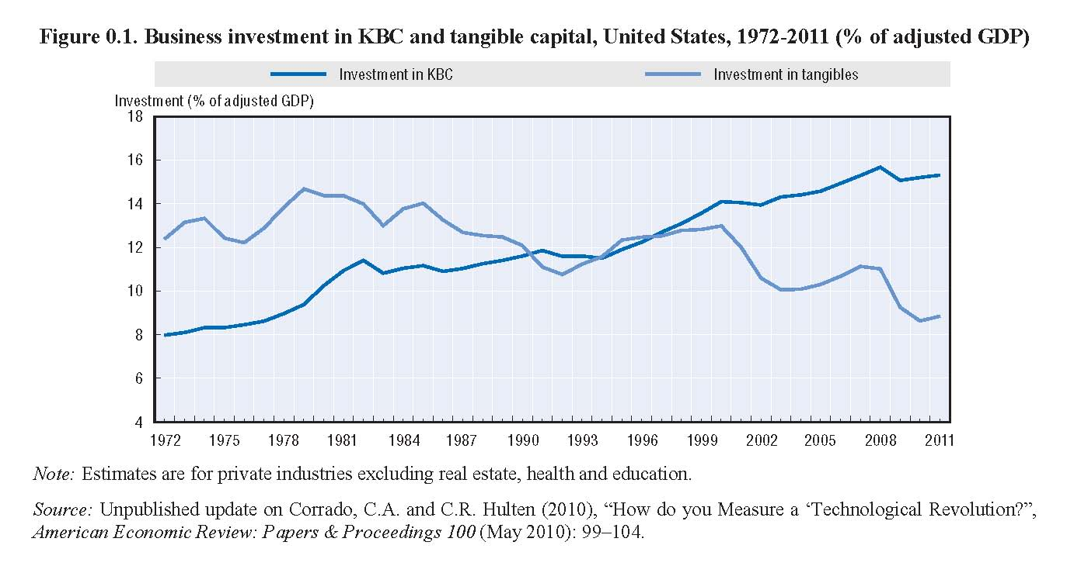
A Revolution in Corporate Productive Resources

Slide 4


What are Intangibles?
DEFINITION:
Intangible assets are sources of future benefits which do not have a physical embodiment.

Slide 5
The Major Categories of Intangibles
Discovery/Learning: | Patents on new products and services, communities of practice, adaptive capacity
Customers: | Brands, trademarks, on-line distribution channels, marketing alliances
Human Resources: | Unique work and compensation practices, employee training, incentives/compensation arrangements
Organizational Structure: | Business structures and processes, incentive systems, information and control systems.

Slide 6
The Unique Intangibles Challenge:
Sample Issues Managers and Investors Confront
Should we increase, decrease, or keep constant our investments in R&D, brands, technology, human resources?
Our IT expenses go up every year. What do we get for all this money?
What is the value of our patent portfolio? Should we sell/license patents we don’t develop?
Some international trading partners demand that we share our technology with them. Should we do that?

Slide 7
Intangibles Challenges…continued
Should we subcontract R&D and technology development to foreign outfits? Will we lose control over IP?
We have a large number of alliances and joint-ventures with other companies. What is the ROI of these activities? And how can we protect our intellectual capital from being poached by our partners?
Corporate financial reports (balance sheets, income statements) don’t provide any meaningful information about intangibles. What, if any, information should we provide to investors voluntarily?

Slide 8
Intangibles Challenges…continued
We hear a lot about corporate reputation. Is this just another fad, or an important, stand-alone intangible?
And for investors: since most intangibles are missing from the balance sheet, how do you value a company’s intangibles portfolio?
And government policy: What can governments, or super governments (EU) do to enhance intellectual capital in the private sector?

Slide 9
Why Are There So Many Questions About Intangibles?
Because They are Different
Hazy property rights (ownership) on intangibles
Intangibles are unique to the company—no comparables
Flawed internal and external information about intangibles and their contribution
  AA vs. IBM
Home Depot vs. Pfizer
  Airplanes fuel consumption and capacity utilization vs. brand investment and its contribution.

Slide 10

But Challenges to Some…
…are Opportunities to Others
Here are several proven methodologies to address the opening questions

Slide 11
DuPont: ROI of R&D and Brands
Three types of R&D: product, process-fixed, process-variable, and brands
ROI required for resource allocation decisions
Methodology:
  For each R&D vintage (year) identify emerging new and substantially improved products.
  Identify life-time net cash flows from these products and R&D investment
  Compute product ROI, and vintage R&D ROI
  Brand ROI determined from excess price over competitors, and outlays supporting brands
Very different estimated ROIs lead to significant changes in resource allocation.

Slide 12
Insurance Co.: What’s the Contribution of IT?
Heavy expenditures on IT led the board to ask: “What do we get for all this money?”
IT enables and supports the company’s value drivers (capital, human resources, systems) in creating value.

Slide 13
Insurance Co.: What’s the Contribution of IT?
So, how do these value-drivers at the company stack against competitors?
Methodology:
Estimate:
  (1) Average industry productivity (α, β, Ɣ)
  (2) Company Abnormal Growth = Actual Growth minus Predicted Growth based on Industry Average
Company ranked very high among peers.
Revenue Growth
Capital
Human Resources
Managerial Systems
α
β
Ɣ

Slide 14
DOW Chemicals: Protecting IP from Alliance Partners
Company has hundreds of R&D, production, and marketing alliances and joint venture.
Company suspects that some alliance partners poach knowhow through close ties with its executives
Methodology:
  Map the 10-year patent development of alliance partners.
  Identify partners that since the alliance with DOW “invaded” the Company’s technological territory (scientific classifications).
Dissolve suspect alliances

Slide 15
Hedge Fund:
Exploiting Investors’ Misvaluation of R&D
Researchers documented that investors systematically underestimate the potential of corporate R&D.
Methodology
  Capitalize and amortize corporate R&D (Example, for 5-year R&D life:
    R&D Capital (2013) =
    R&D (2013) + 0.80 R&D (2012) + 0.60 R&D (2011)…)
  Invest in firms with high R&D Capital/Total Assets; sell short companies with low R&D Capital.
This investment methodology yielded significant returns.

Slide 16
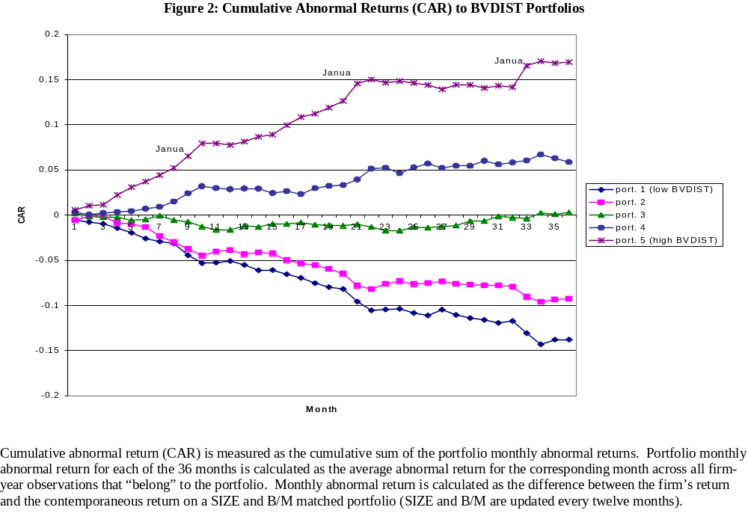

Slide 17
FRAMEWORK FOR MANAGING INTANGIBLES
Know Your Strategic Assets
Assess Threats to Str. Assets
Determine Optimal Utilization
Track and Report Net Benefits
Non-monetary
Monetary
Patents and their Attributes
(forward citation, time to expiration)
Disruption by competitors (iPhone—Blackberry)
Develop products, services (iPad, Lipitor, Esurance)
New customers and churn
ROI on Intangibles
Brands, Copyrights, Trademarks
(active, dormant)
Develop/produce/market via alliances (risk sharing)
Content viewers
Brand price-premium
Patents, brands, copyrights infringement
Movies, Content
(in-view, out of view)
License/sell IP (Gerstner at IBM)
Employee turnover
Alliances’ sales/cost contributions
Customer Franchise (repeat, loyal customers)
Premature decay (vanishing brand’s price premium)
Alliances/Joint Ventures
(active, dormant)
Donate IP
(social capital)
Patent citations and scope
IP Licensing revenues
Organizational amnesia
(retirees’ embedded knowledge)
Unique Business Processes (knowledge management)
Build IP defenses (Google-Motorola patents)
Knowledge management participation
Intangible capital

Slide 18

Enough already!

