Slide 1
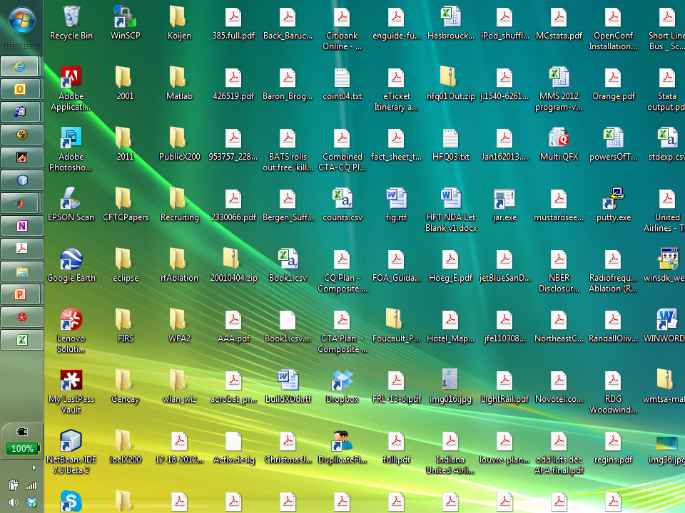

Slide 2
Disclaimers
I teach in an entry-level training program at a large financial firm that is generally thought to engage in high frequency trading.
I serve on a CFTC advisory committee that discusses issues related to high frequency trading.

Slide 3
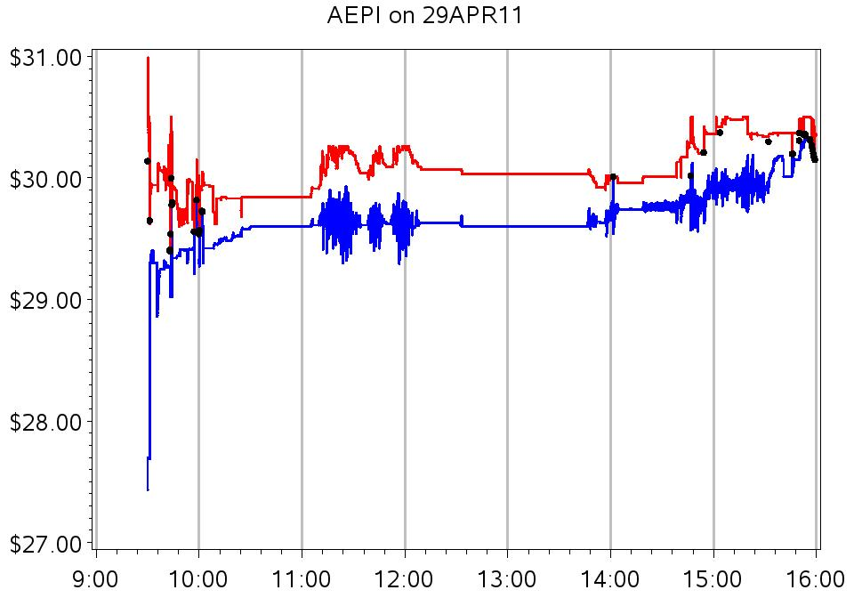
National Best Bid and Offer for AEPI during regular trading hours, April 29, 2011

Slide 4
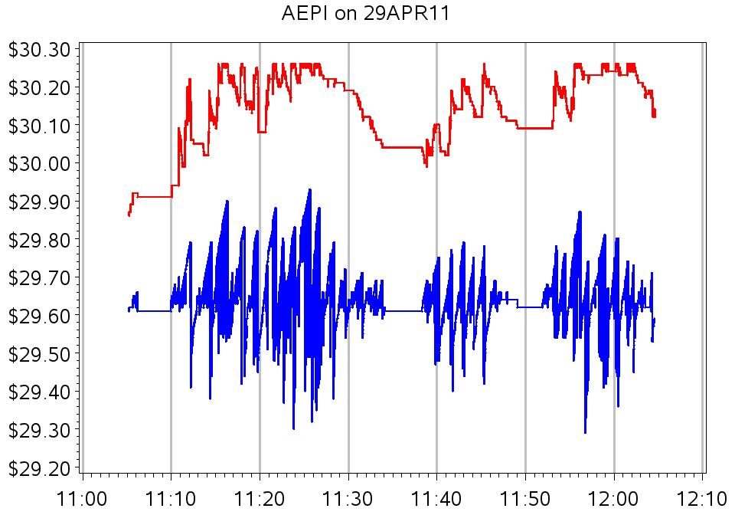
National Best Bid and Offer for AEPI from 11:00 to 12:10

Slide 5
Questions
Is this volatility typical?
Is the volatility informational?
  No net price change over the period of volatility.
  Volatility is mostly on one side of the market.

Slide 6
Who cares?
Noise degrades the informational value of any price.
Quote volatility → trade price uncertainty.
  … when a market sell order hits a volatile bid.
  … when the bid is being used as a reference to price some other trade (“dark trades”)
Quote volatility can be systematically exploited by intermediaries’ look-back options.

Slide 7
Analyzing price volatility
Usual approach
  First-difference the price series.
  Specify a parametric model for variance dynamics.
This study
  Non-parametric analysis of variances of price levels
Illustration for simulated random walks

Slide 8
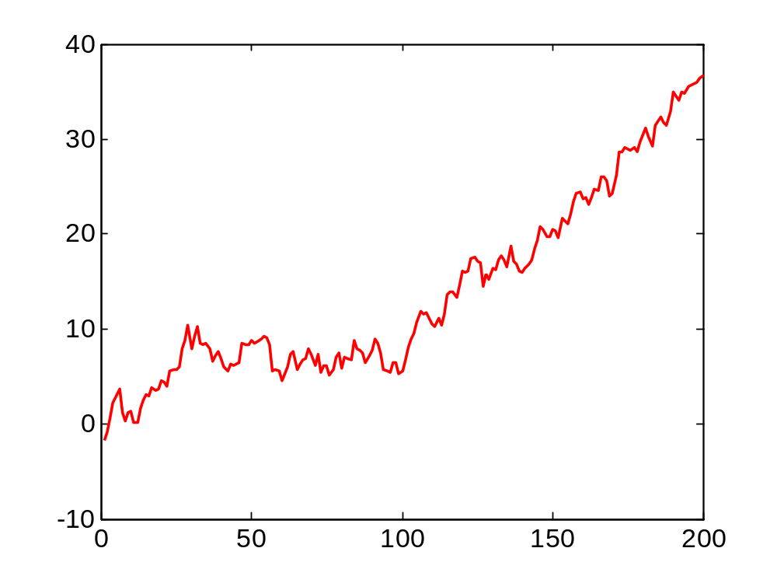

Slide 9
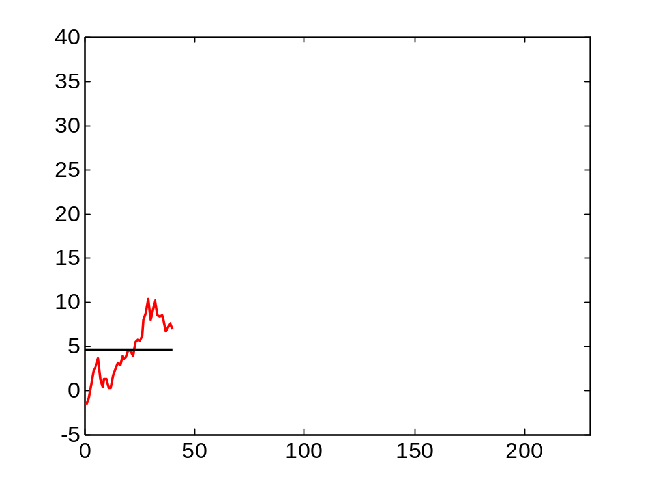

Slide 10
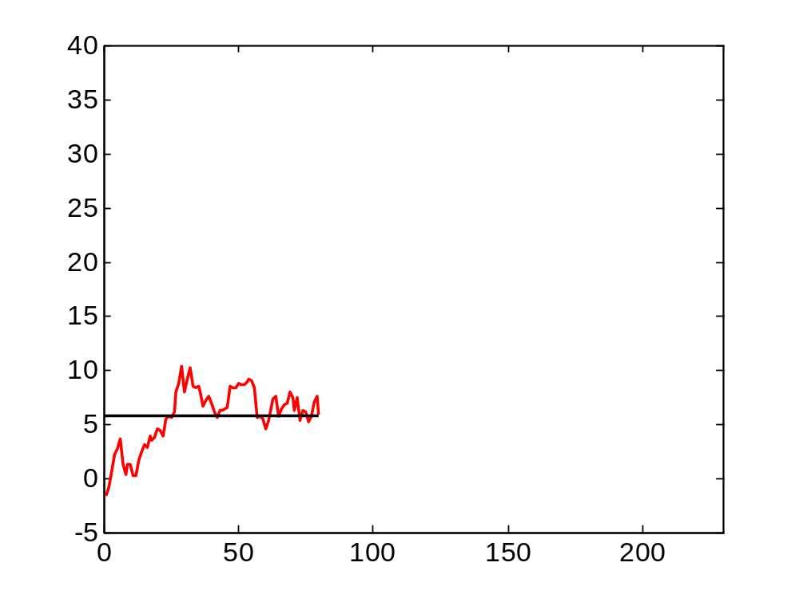

Slide 11
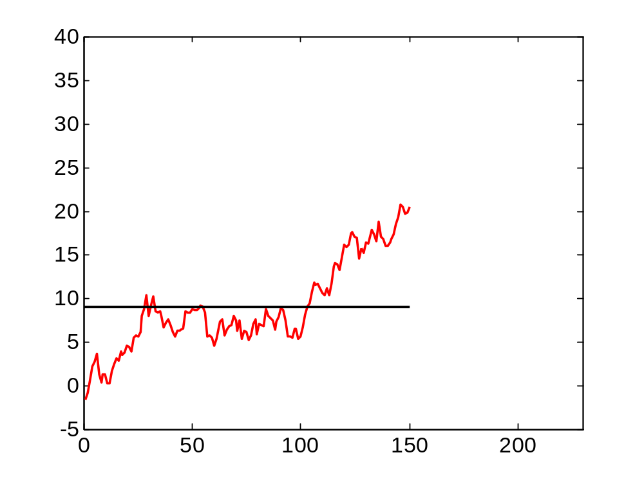

Slide 12
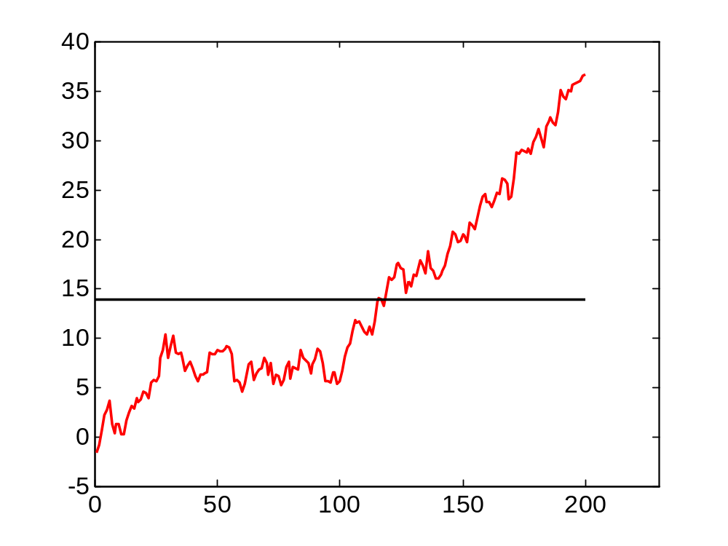

Slide 13
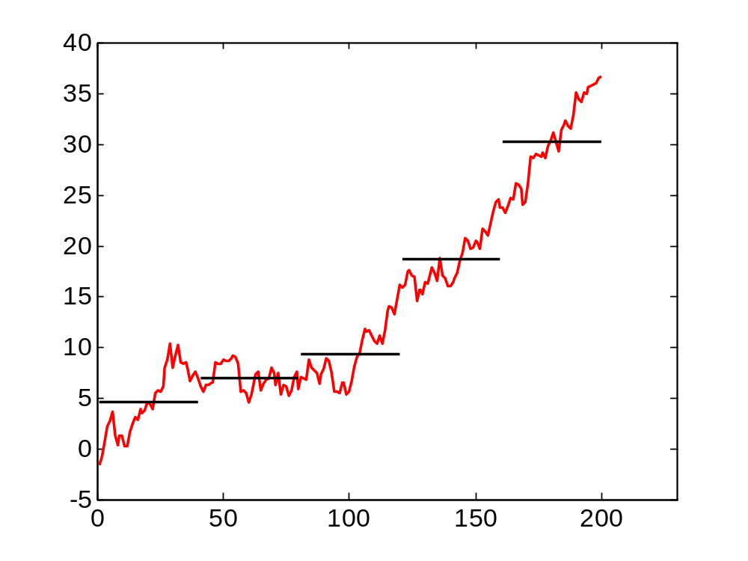

Slide 17
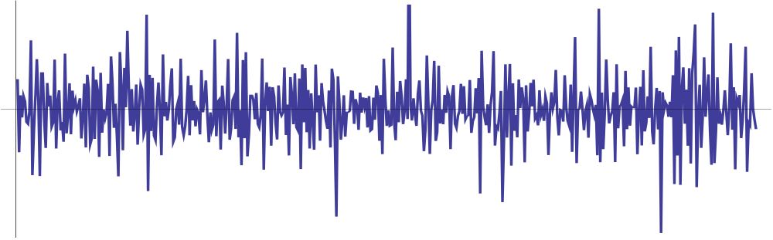
What’s lost by first-differencing?
First difference plot of a simulated series.

Slide 18
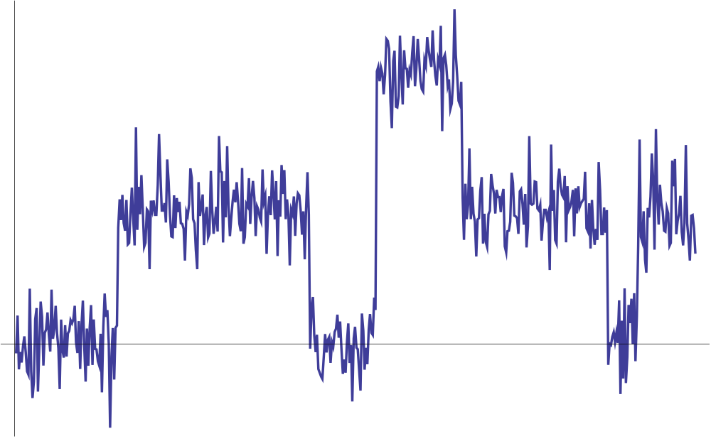
… and the integrated series

Slide 19
How should we implement these calculations?
The intervals …
  How wide?
  How aligned?

Slide 20
Time-scale decompositions
A time series = sum of components
  Each component is associated with a particular time scale (“horizon”)
    1 ms, 2 ms, 4 ms, 8 ms, …
    4,194,302 ms (≈ 70 minutes)
  Each component is associated with a variance.
Horizons and components are constructed systematically using wavelet transforms
  These transforms average over all alignments.

Slide 21
Sources
Percival, Donald B., and Andrew T. Walden, 2000. Wavelet methods for time series analysis (Cambridge University Press, Cambridge).
Gençay, Ramazan, Frank Selçuk, and Brandon Whitcher, 2002. An introduction to wavelets and other filtering methods in finance and economics (Academic Press (Elsevier), San Diego).

Slide 22
Wavelet methods
Strengths
  Isolate features associated with particular time-horizons.
  Localized
  Computationally efficient
Weaknesses
  Not part of the usual academic financial econometricians’ toolkit.
  No easy connection to forecasting or innovations representations.

Slide 23
The questions
What is the current level of high-frequency quote volatility?
Since 2000, trading technology has changed markedly.
  Has HF quote volatility increased?

Slide 24
The plan of the analysis
CRSP Universe 2001-2011. (Shrcd 10 or 11; average price in March between $2 and $1,000)
In each year, firms randomly chosen in sample stratified by dollar trading volume
2001-2011
April TAQ data with one-second time stamps
2011 April TAQ with one-millisecond time stamps
Lower-resolution wavelet analysis
High-resolution wavelet analysis

Slide 25
Gauging the magnitude of the volatility
Normalized by share price (basis points)
$ per share
  Access fees are about $0.003 (“3 mils”) per share
Relative to long-term (“fundamental”) volatility.
  Volatility in excess of what we’d expect from a random-walk.

Slide 26
NBBO volatility, mils per share
(Table 2 Panel A excerpt)
Time scale | Volatility ($0.001/share)
64 ms | 0.4
128 ms | 0.6
256 ms | 0.8
512 ms | 1.1
1,024 ms | 1.6
4.1 sec | 3.0
32.8 sec | 8.0

Slide 27
NBBO volatility, basis points (0.01%)
Table 2 Panel B excerpt
Time scale | Volatility, bp (0.01%)
64 ms | 0.3
128 ms | 0.4
256 ms | 0.6
512 ms | 0.8
1,024 ms | 1.2
4.1 sec | 2.2
32.8 sec | 5.6

Slide 28
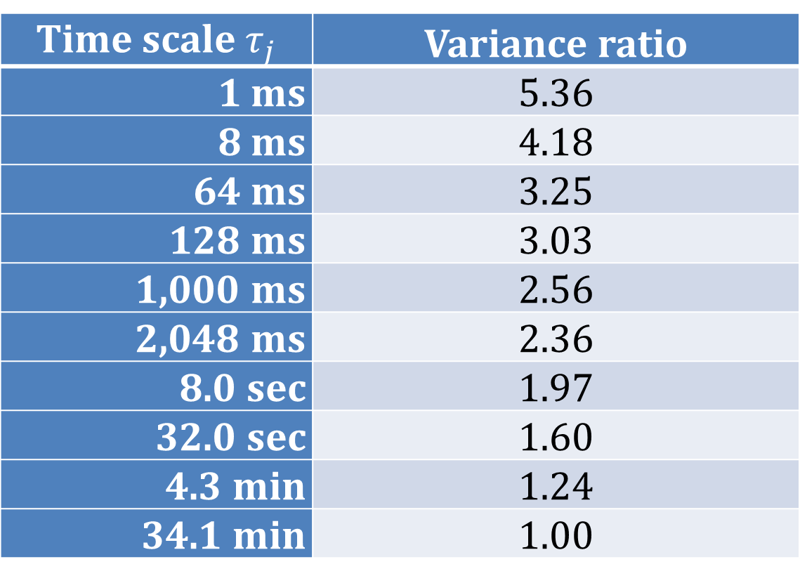
NBBO variance ratios, “short/long”
(Table 3, excerpt)
Time scale $τ_{j}$ | Variance ratio
1 ms | 5.36
8 ms | 4.18
64 ms | 3.25
128 ms | 3.03
1,000 ms | 2.56
2,048 ms | 2.36
8.0 sec | 1.97
32.0 sec | 1.60
4.3 min | 1.24
34.1 min | 1.00

Slide 29
The 2011 results: a summary
In mils per share or basis points, short term volatility is on average small.
Variance ratios: short term volatility is much higher than we’d expect when calibrated to a random-walk.

Slide 30
High-resolution analysis …
… with low resolution data
TAQ with millisecond time stamps only available from 2006 onwards
TAQ with second time stamps available back to 1993.
Can we draw inferences about subsecond variation from second-stamped data?

Slide 31
Simulating the time stamps
Quote A | 10:01:35
Quote B | 10:01:35
Quote C | 10:01:35
Where, within the second did these quotes actually occur?
Assume
  Quotes are correctly sequenced.
  Arrival intensities are time-homogeneous Poisson
Then the joint distribution of the fractional (sub-second) arrival times =
the joint distribution of the order statistics from a draw of three uniform random variables.

Slide 32
Simulating the time stamps
Quote A | 10:01:35.243
Quote B | 10:01:35.347
Quote C | 10:01:35.912
Where, within the second did these quotes actually occur?
Assume
  Quotes are correctly sequenced.
  Arrival intensities are time-homogeneous Poisson
Then the joint distribution of the fractional (sub-second) arrival times =
the joint distribution of the order statistics from a draw of three uniform random variables.

Slide 33
Does this really work?
2011 ms-stamped TAQ data
Strip the millisecond portions of the time-stamps
Simulate new millisecond stamps
Wavelet variance estimates using actual ms. time-stamps
Wavelet variance estimates using simulated ms. time-stamps.
Correlation?

Slide 34
Correlations between wavelet variances based on actual and simulated time-stamps
Time Scale | All
1 ms | 0.991
…
16 ms | 0.967
…
256 ms | 0.975
…
4.1 sec | 1.000
…
32.8 sec | 1.000

Slide 35
Summary statistics, historical sample
(Table 6, excerpt)
 | Year
 | 2001 | 2003 | 2005 | 2007 | 2009 | 2011
No. of firms | 30 | 30 | 30 | 30 | 30 | 30
Avg. daily trades | 97 | 65 | 276 | 889 | 869 | 1,341
Avg. daily quotes | 807 | 814 | 4,846 | 12,383 | 18,305 | 17,989

Slide 36
NBBO Volatility mils ($0.001) / share; (Table 7, excerpt)
 | Year
Time scale | 2001 | 2003 | 2005 | 2007 | 2009 | 2011
64 ms | 0.5 | 0.4 | 0.7 | 0.4 | 0.5 | 0.3
128 ms | 0.7 | 0.5 | 1.0 | 0.5 | 0.7 | 0.5
256 ms | 0.9 | 0.7 | 1.3 | 0.7 | 0.9 | 0.6
512 ms | 1.3 | 1.0 | 1.9 | 0.9 | 1.2 | 0.9
1,024 ms | 1.9 | 1.4 | 2.5 | 1.3 | 1.6 | 1.2
4.1 sec | 3.6 | 2.8 | 4.6 | 2.3 | 3.0 | 2.2
32.8 sec | 10.1 | 7.2 | 11.3 | 6.3 | 7.7 | 5.8

Slide 37
Given the increased quote traffic, why didn’t short-term quote volatility explode?
The good old days weren’t really that good.
  With no automatic execution, no penalty for erroneous quotes.
Maybe the present state of affairs isn’t so awful.

Slide 38
The elements of the story
There is a presumption that HF activity has increased over the 2000’s
  Strong trend in quote traffic
Short-term volatility (mils per share) does not show a clear increase.
Variance ratios show increase relative to 2001 (but not uniformly)

Slide 39
Connection to high frequency trading
Brogaard (2012), Hendershott and Riordan (2012) use Nasdaq HFT dataset: trades used to define a set of high frequency traders.
Hendershott, Jones and Menkveld (2011): NYSE message traffic
Hasbrouck and Saar (2012): strategic runs / order chains
General consensus: HF activity enhances market quality and lowers volatility.
Quote volatility results are less uniform.

Slide 40
Connection to realized volatility literature
Realized volatility = summed (absolute/squared) price changes.
  Andersen, Bollerslev, Diebold and Ebens (2001), and others
Hansen and Lunde (2006) advocate pre-averaging to eliminate microstructure noise.
Present study: “Don’t throw out the noise!”

Slide 41
Open questions
Analysis in this study focuses on average HFQ volatility.
  But there are extreme and interesting outliers.
What are the strategies?
  Are the HFQ episodes unstable algos?
  Are they sensible strategies to detect and access liquidity?
Wavelet methods show great promise in isolating strategic microstructure effects from long-term informational noise.

Slide 42
More pictures from the
National (High Frequency)
Portrait Gallery

Slide 43
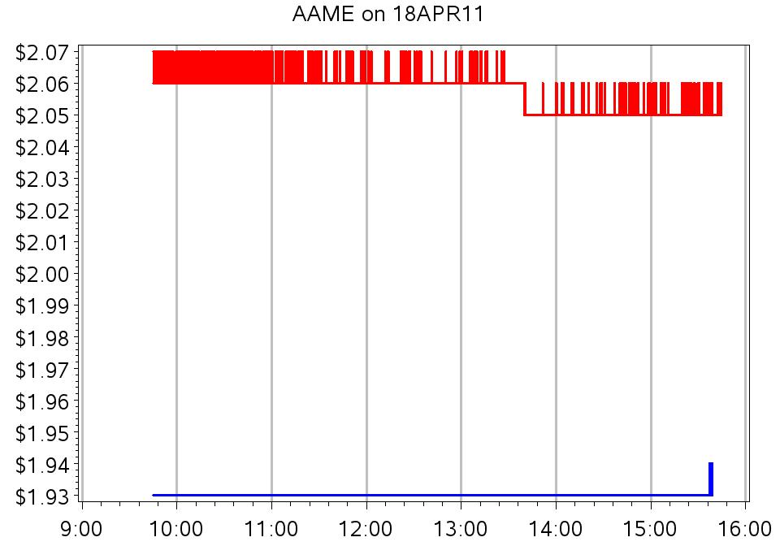

Slide 44
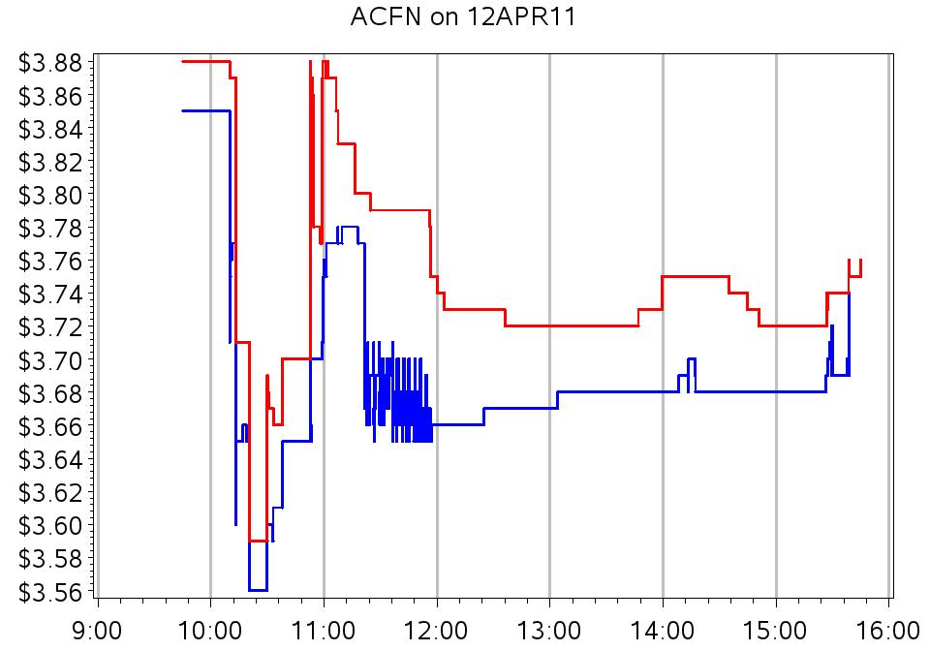

Slide 45
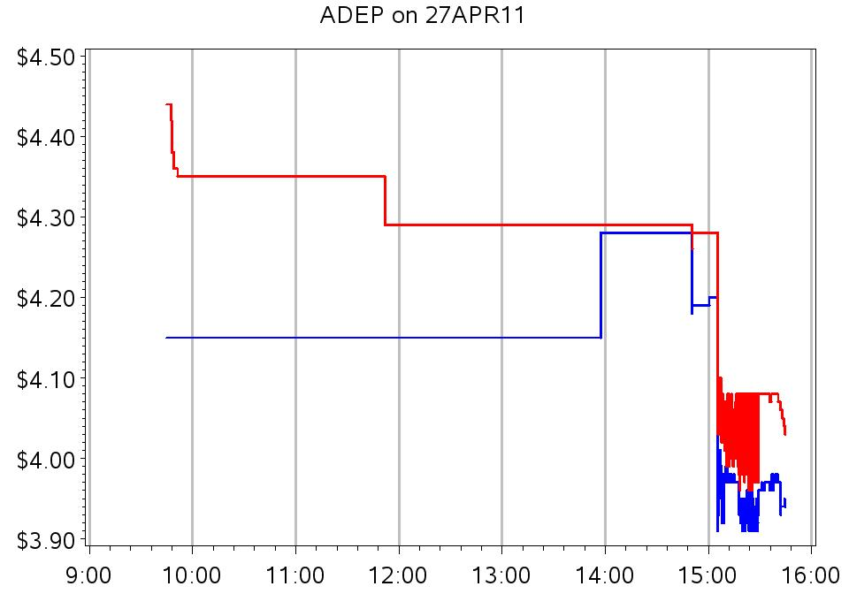

Slide 46
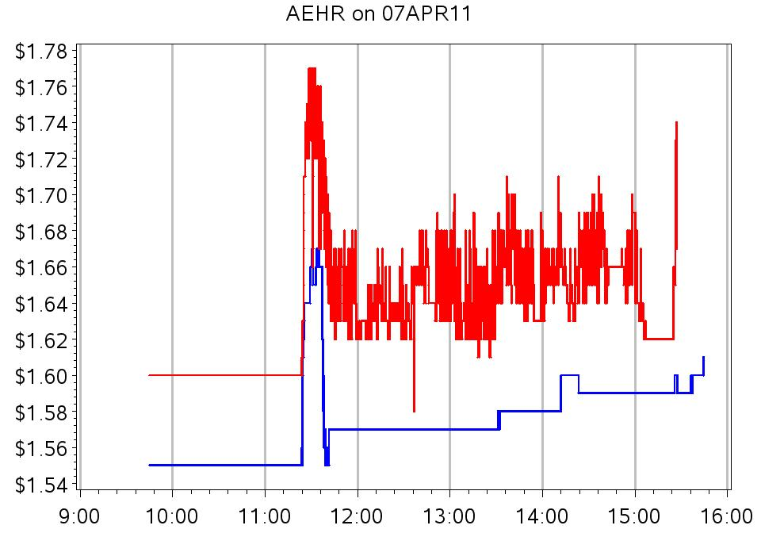

Slide 47
