Slide 1








Econometric Analysis of Panel Data
http://people.stern.nyu.edu/wgreene/Econometrics/PanelDataEconometrics.htm
William Greene
Department of Economics
University of South Florida

Slide 2
Panel Data Econometrics
This is a Ph.D. level, course in the area of Applied Econometrics dealing with Panel Data. We are particularly interested in those techniques as they are adapted to the analysis of 'longitudinal' data sets. Topics to be studied include specification, estimation, and inference in the context of models that include individual (firm, person, etc.) effects.

Slide 3


Slide 4
Panel Data Modeling
Outcome(s) y_{i}
  Model specification: Behavioral description
  Observation mechanism: Horizontal and time variation
  Common effects built explicitly into the model:
  • Observed and unobserved heterogeneity
  • Dynamic effects and behavior
Research Community:
  Microeconomics, political science, sociology: longitudinal
  Macroeconomics: Cross country growth and development
  Transport, marketing: stated choice experiments
  Health and Health Economics: repeated measures, mixed models
  Urban & regional economics: hierarchical models
  Medicine and Social Science/Medicine
  Psychology, Education
  Finance
  … and many more

Slide 5
Benefits of Panel Data
Time and individual variation in behavior unobservable in cross sections or aggregate time series
Observable and unobservable individual heterogeneity
Rich hierarchical structures
Dynamics in economic behavior

Slide 6




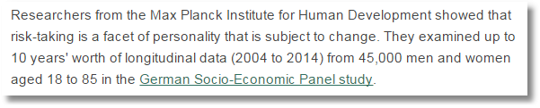
German Socio-Economic Panel Study (SOEP)

Slide 7
Econometric Models
Linear; static and dynamic
Discrete choice
Censoring, truncation, nonrandom selection
Structural models and demand systems
Time series models

Slide 8
Course Applications
Problem sets
Data sets: See the course website
Software:
  ‘Packages:’ Stata, NLOGIT, SAS, Eviews
  Programming environments: R, Matlab, Gauss, Mathematica
  We will not use class time for software instruction
‘Lab’ work
  Problem sets
  Replication project

Slide 9
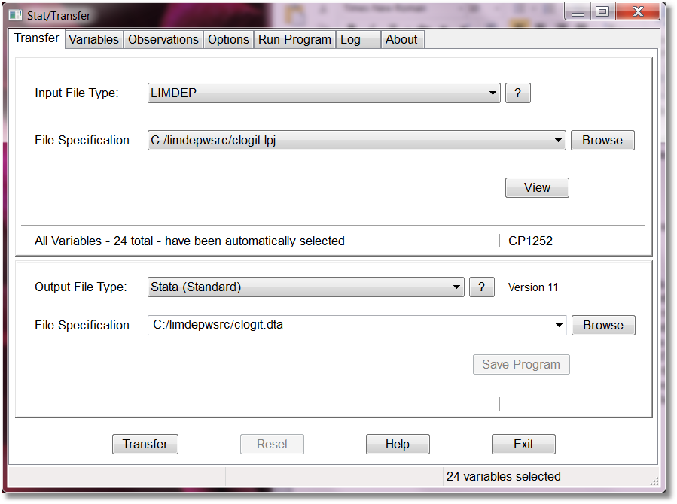
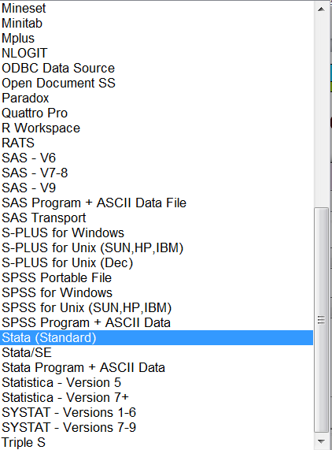
Rosetta Stone for Data Sets:
Stat Transfer

Slide 10
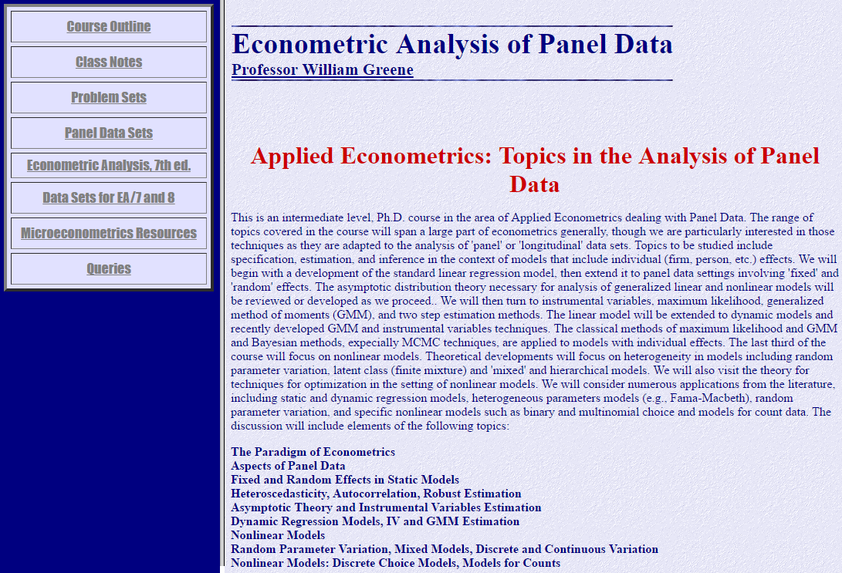
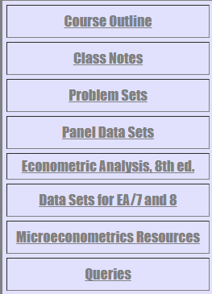
http://people.stern.nyu.edu/wgreene/Econometrics/PanelDataEconometrics.htm

Slide 11

Course Outline
http://people.stern.nyu.edu/wgreene/Econometrics/PanelDataOutline.htm

Slide 12

http://people.stern.nyu.edu/wgreene/Econometrics/PanelDataNotes.htm

Slide 13
Text Resources Beyond Class Notes
Baltagi (2014); Main text: read chapters 1,2
Greene (2018); Recommended:
read chapters 1,2,8,11,13
Wooldridge (2010); Suggested:
read chapters 1,2,4,10,11
Cameron and Trivedi (2005); Very interesting: Microeconometrics
Baltagi (2014 Handbook); Surveys and
special topics
Matyas and Sevestre (2008); Recent survey. Contributed papers. $$$$$
Hsiao(2014); Alternative to Baltagi
Frees (2004); Applications from many areas.

Slide 14
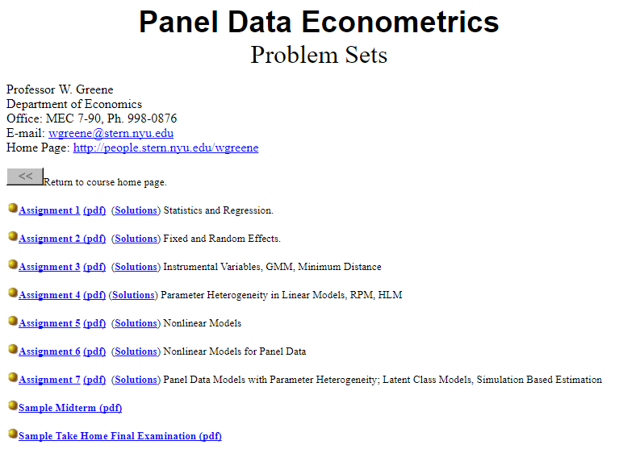
http://people.stern.nyu.edu/wgreene/Econometrics/PanelDataProblems.htm

Slide 15
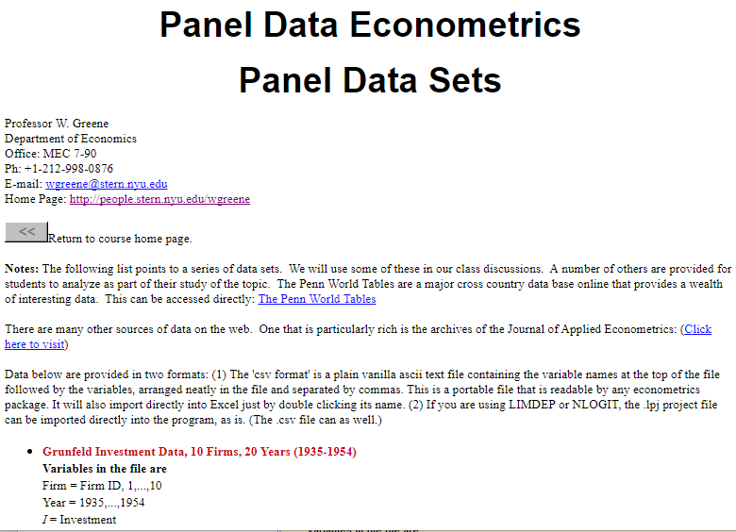
http://people.stern.nyu.edu/wgreene/Econometrics/PanelDataSets.htm

Slide 16
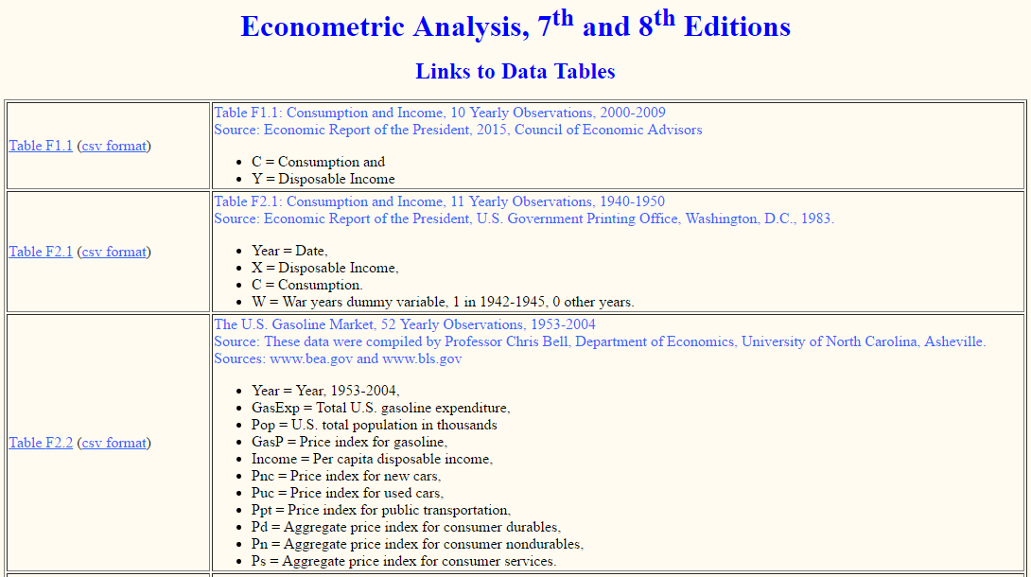
More Data Sets
Data sets for Econometric Analysis, 7 and 8 ed.
http://people.stern.nyu.edu/wgreene/Text/econometricanalysis.htm

Slide 17

Microeconometrics Course
http://people.stern.nyu.edu/wgreene/Microeconometrics.htm

Slide 18

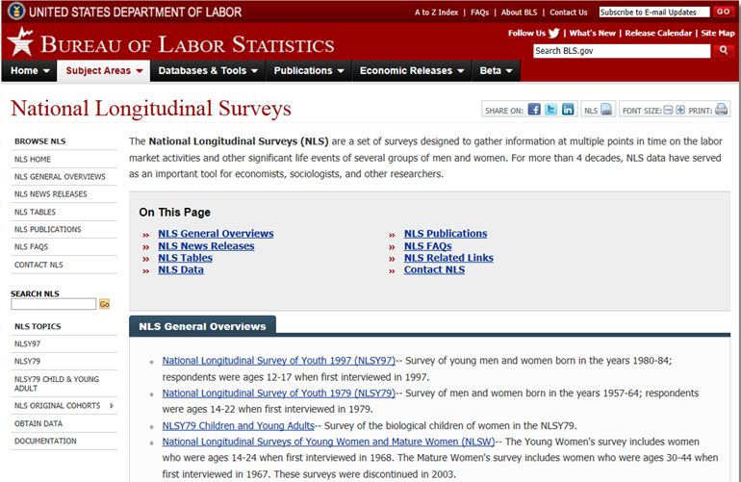
Panel Data Sets
Longitudinal data – ‘short panels’
  Panel Study of Income Dynamics (PSID), US
  National Longitudinal Surveys (NLS, US)
  British household panel survey (BHPS, UK) Understanding Society
  German Socioeconomic Panel (GSOEP, Germany)
  Medical Expenditure Panel Survey (MEPS, US)
  Household income and labor dynamics (HILDA, Australia)
  Many others…

Slide 19




Slide 20


Slide 21

Cross section time series – ‘long panels’

Slide 22

Financial data by firm, year – ‘huge panels’
  r_{it} – r_{ft} = β_{i}(r_{mt} - r_{ft}) + ε_{it}, i = 1,…,many; t=1,…many
  Exchange rate data, essentially infinite T, large N
  Effects: β_{i}= β + v_{i}

Slide 23
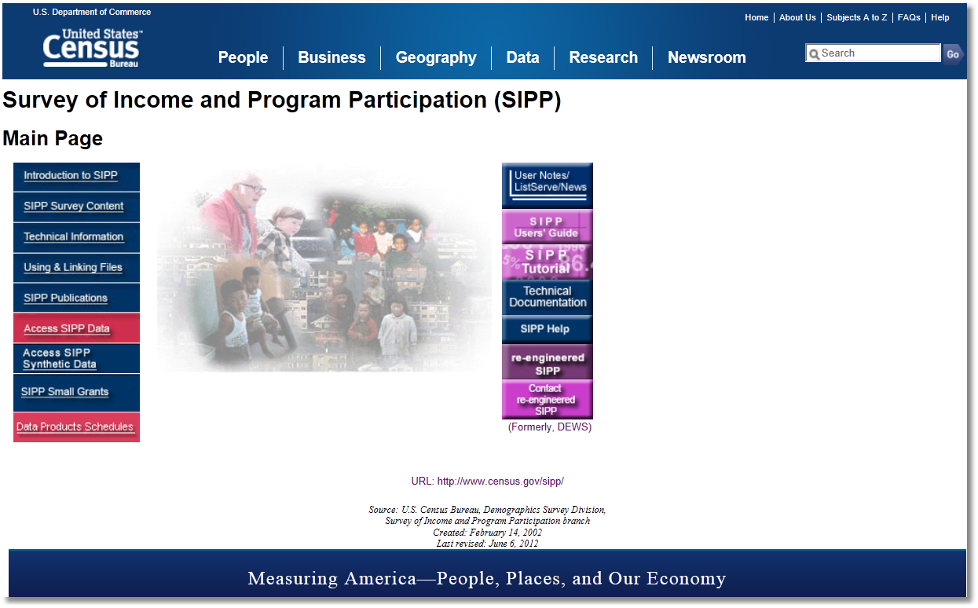
Rotating Panel Data

Slide 24
SIPP Rotating Panel
The lessons learned from ISDP were incorporated into the initial design of SIPP, which was used for the first 10 years of the survey. The original design of SIPP called for a nationally representative sample of individuals 15 years of age and older to be selected in households in the civilian noninstitutionalized population. Those individuals, along with others who subsequently lived with them, were to be interviewed once every 4 months over a 32-month period. To ease field procedures and spread the work evenly over the 4-month reference period for the interviewers, the Census Bureau randomly divided each panel into four rotation groups. Each rotation group was interviewed in a separate month. Four rotation groups thus constituted one cycle, called a wave, of interviewing for the entire panel. At each interview, respondents were asked to provide information covering the 4 months since the previous interview. The 4-month span was the reference period for the interview. The first sample, the 1984 Panel, began interviews in October 1983 with sample members in 19,878 households. The second sample, the 1985 Panel, began in February 1985. Subsequent panels began in February of each calendar year, resulting in concurrent administration of the survey in multiple panels.
The original goal was to have each panel cover eight waves. However, a number of panels were terminated early because of insufficient funding. For example, the 1988 Panel had six waves; the 1989 Panel, part of which was folded into the 1990 Panel, was halted after three waves. In addition, the intent was for each SIPP panel to have an initial sample size of 20,000 households. That target was rarely achieved; again, budget issues were usually the reason. The 1996 redesign (discussed below) entailed a number of important changes. First, the 1996 Panel spans 4 years and encompasses 12 waves. The redesign has abandoned the overlapping panel structure of the earlier SIPP, but sample size has been substantially increased: the 1996 Panel had an initial sample size of 40,188 households.

Slide 25

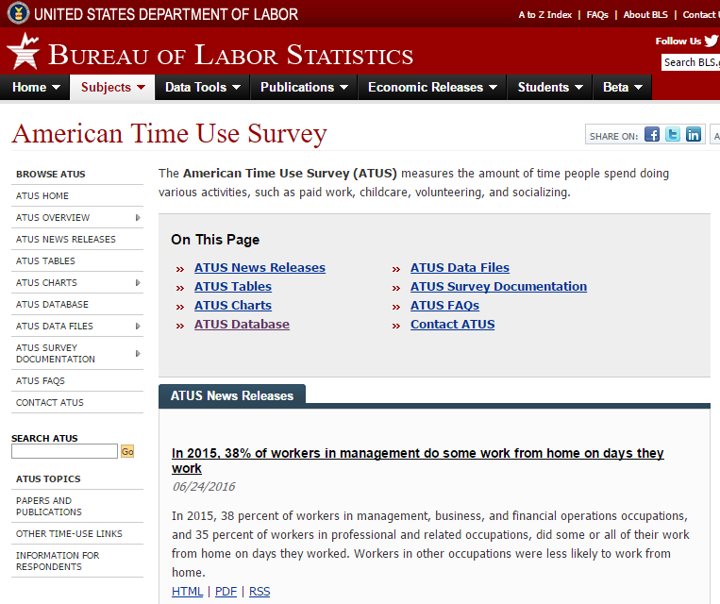
Pseudo panel: Time series of (different) cross sections. E.g., Yearly UK Family Expenditure Survey; 7,000+ different households. What can we learn from these?

Slide 26
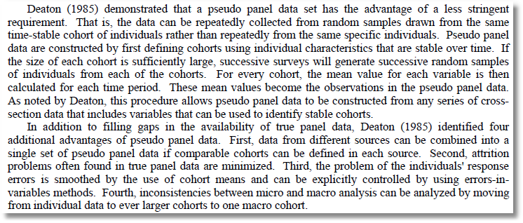
Pseudo Panel

Slide 27

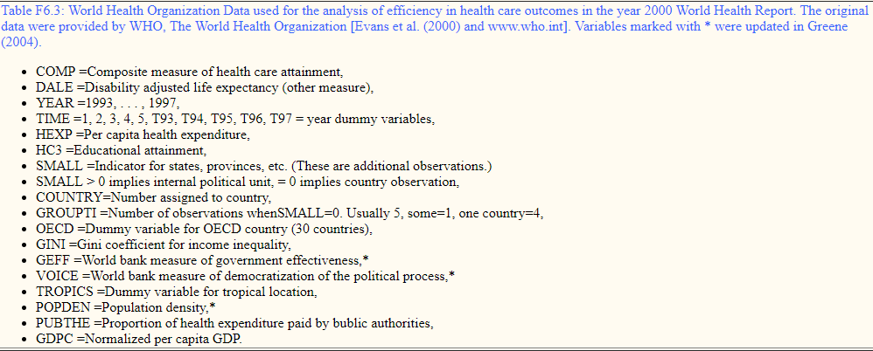
http://www.who.int/healthinfo/paper30.pdf
also paper29.pdf

Slide 28
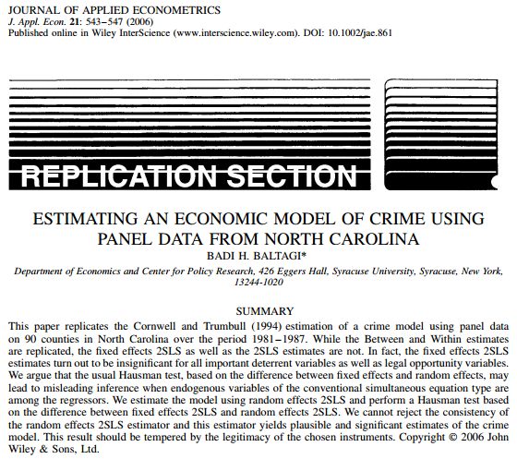
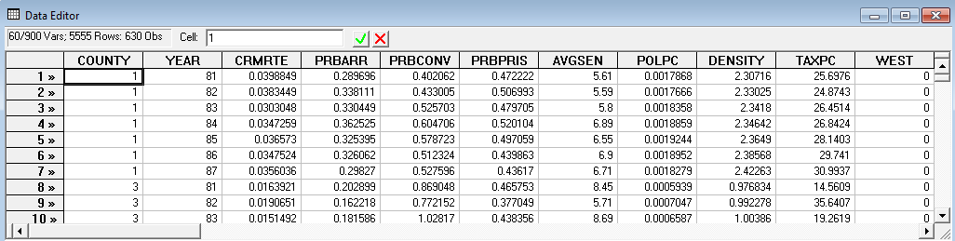

Slide 29
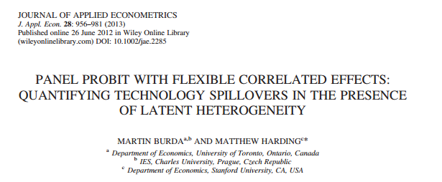
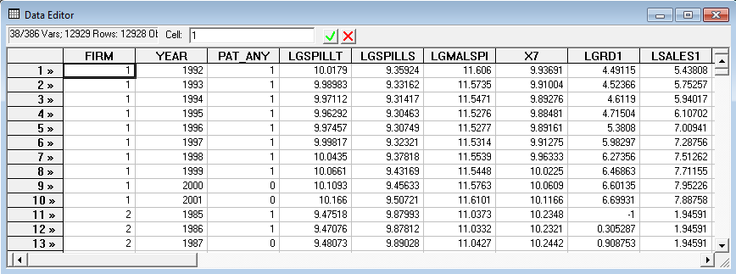

Slide 30
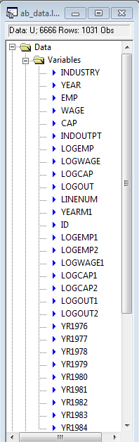

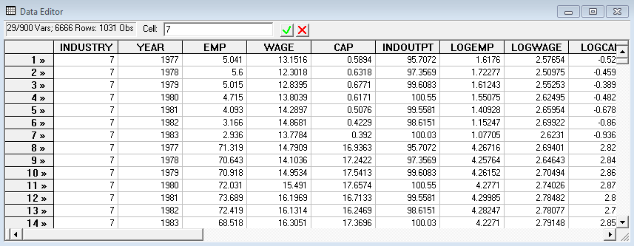

Slide 31
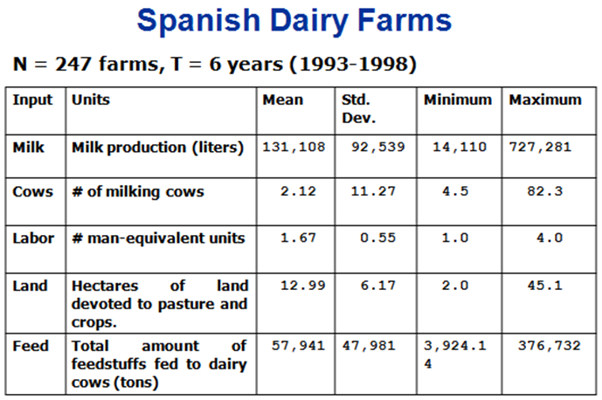

Slide 32
Cornwell and Rupert Data
Cornwell and Rupert Returns to Schooling Data, 595 Individuals, 7 Years
(1976-1982; Extracted from NLSY.) Variables in the file are
EXP = work experience
WKS = weeks worked
OCC = occupation, 1 if blue collar,
IND = 1 if manufacturing industry
SOUTH = 1 if resides in south
SMSA = 1 if resides in a city (SMSA)
MS = 1 if married
FEM = 1 if female
UNION = 1 if wage set by union contract
ED = years of education
LWAGE = log of wage = dependent variable in regressions
These data were analyzed in Cornwell, C. and Rupert, P., "Efficient Estimation with Panel Data: An Empirical Comparison of Instrumental Variable Estimators," Journal of Applied Econometrics, 3, 1988, pp. 149-155. See Baltagi, page 122 for further analysis. The data were downloaded from the website for Baltagi's text.
Notes:
32

Slide 33
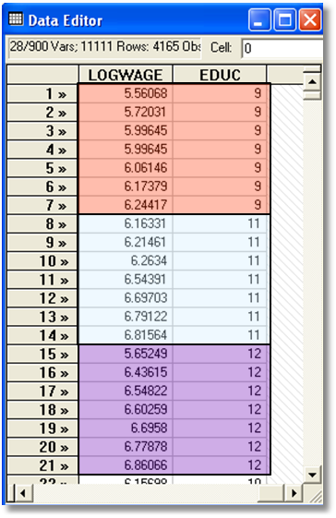

Slide 34

A Stated Choice Experiment: Unlabeled Alternatives, One Observation
t=1
t=2
t=3
t=4
t=5
t=6
t=7
t=8

Slide 35
Application: Health Care Panel Data
German Health Care Usage Data, 7,293 Individuals, Varying Numbers of Periods
Data downloaded from Journal of Applied Econometrics Archive. This is an unbalanced panel. They can be used for regression, count models, binary choice, ordered choice, and bivariate binary choice. This is a large data set. There are altogether 27,326 observations. The number of observations ranges from 1 to 7. (Frequencies are: 1=1525, 2=1079, 3=825, 4=926, 5=1051, 6=1000, 7=887).
DOCTOR = 1(Number of doctor visits > 0)
HOSPITAL = 1(Number of hospital visits > 0)
HSAT = health satisfaction, coded 0 (low) - 10 (high)
DOCVIS = number of doctor visits in last three months
HOSPVIS = number of hospital visits in last calendar year
PUBLIC = insured in public health insurance = 1; otherwise = 0
ADDON = insured by add-on insurance = 1; otherswise = 0
HHNINC = household nominal monthly net income in German marks / 10000.
HHKIDS = children under age 16 in the household = 1; otherwise = 0
EDUC = years of schooling
AGE = age in years
MARRIED = marital status
Notes:
35

Slide 36


Slide 37
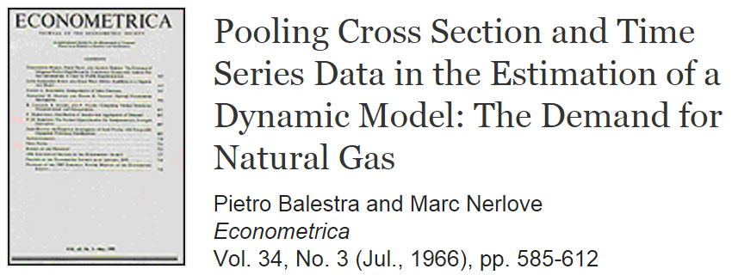
A 50th Anniversary
Mundlak, Y., 1961. Empirical production function free of management bias. Journal of Farm Economics 43, 44-56. (Wrote about (omitted) fixed effects.)
Rasch, G., “Probabilistic Models for Some Intelligence and Attainment Tests,” Denmark Paedogiska, 1960. (Points to a fixed effects logit model.)

Slide 38
Starting Point for Panel Data Modeling
A Dynamic Linear Model

Slide 39
Where Do We Go From Here?
Review of familiar classical procedures
Fundamental, familiar regression extensions; common effects models
Endogeneity, instrumental variables, GMM estimation
Dynamic models
Models of heterogeneity
Nonlinear models that carry forward the features of the linear, static and dynamic common effects models
Recent developments in non- and semiparametric approaches
Applications: Home grown and from the literature

