Slide 1
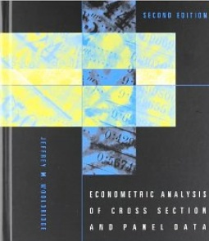
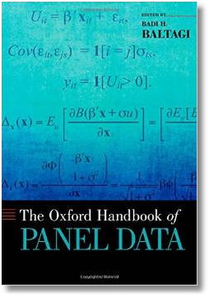

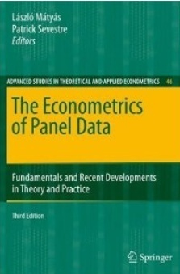




Econometric Analysis of Panel Data
William Greene
Department of Economics
University of South Florida

Slide 2
Time Series Applications
Panel Data Time Series Models
Univariate Time Series
Autocorrelation in Regression
Vector Autoregression
ARCH and GARCH Models
Macroeconomic Data
  Nonstationarity and Integrated Series
  Unit Roots
  Cointegration

Slide 3
Cross Country Growth Convergence

Slide 4
A Heterogeneous Dynamic Model

Slide 5
“Fixed Effects” Approach

Slide 6
Country Means
(Average the T observations for each i)

Slide 7
Country Means (cont.)

Slide 8
Time Series of Means
(Average across countries)

Slide 9
Pooling
Essentially the same as the time series case.
OLS and GLS are inconsistent
There could be no instrument that would work (by construction)

Slide 10
A Mixed/Fixed Approach

Slide 11
A Mixed Fixed Model Estimator

Slide 12


Slide 13
Nair-Reichert and Weinhold on Growth
Weinhold (1996) and Nair–Reichert and Weinhold (2001) analyzed growth and development in a panel of 24 developing countries observed for 25 years, 1971–1995. The model they employed was a variant of the mixed-fixed model proposed by Hsiao (1986, 2003). In their specification,
GGDP_{i,t} = α_{i} + γ_{i} d_{it} GGDP_{i,t-1} + β_{1i} GGDI_{i,t-1} + β_{2i} GFDI_{i,t-1}
+ β_{3i} GEXP_{i,t-1} + β₄ INFL_{i,t-1} + ε_{i,t}
GGDP = Growth rate of gross domestic product,
GGDI = Growth rate of gross domestic investment,
GFDI = Growth rate of foreign direct investment (inflows),
GEXP = Growth rate of exports of goods and services,
INFL = Inflation rate.
The constant terms and coefficients on the lagged dependent variable are country specific.
The remaining coefficients are treated as random, normally distributed, with means β_{k} and
unrestricted variances. They are modeled as uncorrelated. The model was estimated using a modification of the Hildreth–Houck–Swamy method

Slide 14
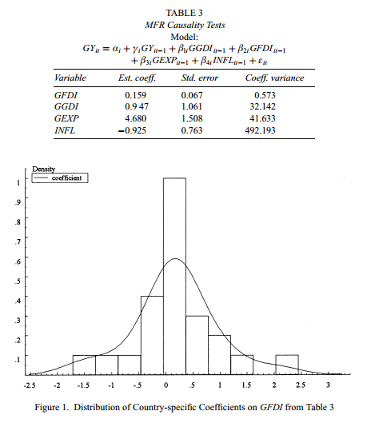

Slide 15
Heterogeneous Dynamic Models

Slide 16
time series data

Slide 17
Modeling an Economic
Time Series
Observed y₀, y₁, …, y_{t},…
What is the “sample”
Random sampling?
The “observation window”

Slide 18
Estimators
Functions of sums of observations
Law of large numbers?
  Nonindependent observations
  What does “increasing sample size” mean?
Asymptotic properties? (There are no finite sample properties.)

Slide 19
Interpreting a Time Series
Time domain: A “process”
  y(t) = ax(t) + by(t-1) + …
  Regression like approach/interpretation
Frequency domain: A sum of terms
  y(t) =
  Contribution of different frequencies to the observed series.
(“High frequency data and financial econometrics – “frequency” is used slightly differently here.)

Slide 20
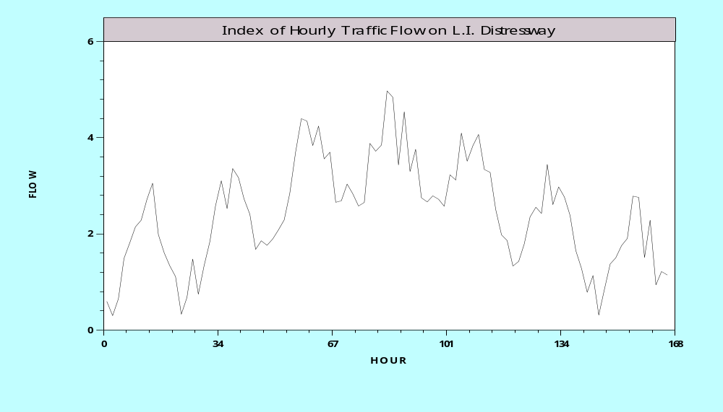
For example,…

Slide 21
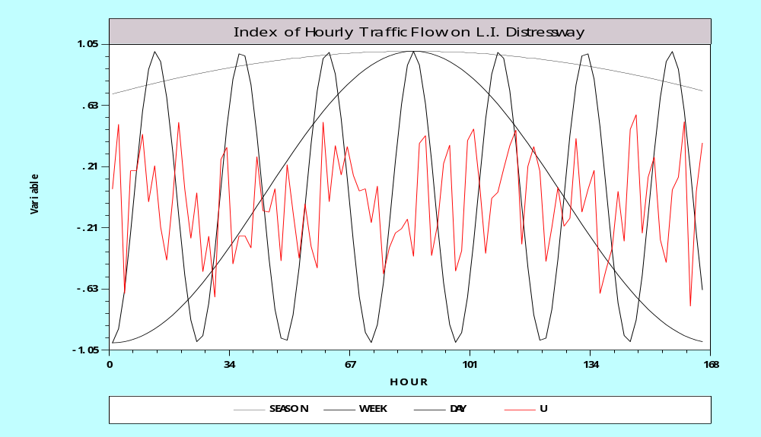
Decomposed

Slide 22
Studying the Frequency Domain
Cannot identify the number of terms
Cannot identify frequencies from the time series
Deconstructing the variance, autocovariances and autocorrelations
  Contributions at different frequencies
  Apparent large weights at different frequencies
  Using Fourier transforms of the data
  Does this provide “new” information about the series?

Slide 23
Stationary Time Series
z_{t} = b₁y_{t-1} + b₂y_{t-2} + … + b_{P}y_{t-P} + e_{t}
Autocovariance: γ_{k} = Cov[y_{t},y_{t-k}]
Autocorrelation: ρ_{k} = γ_{k} / γ₀
Stationary series: γ_{k} depends only on k, not on t
  Weak stationarity: E[y_{t}] is not a function of t, E[y_{t} * y_{t-s}] is not a function of t or s, only of |t-s|
  Strong stationarity: The joint distribution of [y_{t},y_{t-1},…,y_{t-s}] for any window of length s periods, is not a function of t or s.
A condition for weak stationarity: The smallest root of the characteristic polynomial: 1 - b₁z¹ - b₂z² - … - b_{P}z^{P} = 0, is greater than one.
  The unit circle
  Complex roots
  Example: y_{t} = ρy_{t-1} + e_{e}, 1 - ρz = 0 has root z = 1/ ρ,
  | z | > 1 => | ρ | < 1.

Slide 24
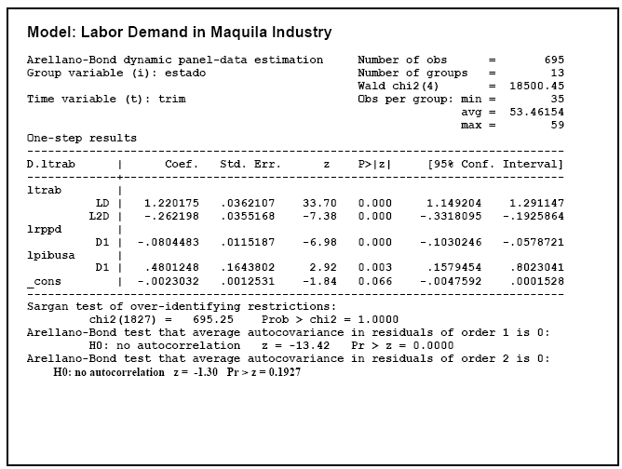
The characteristic polynomial is 1 - 1.220175z - (-0.262198)z² = 0

Slide 25
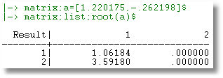

Slide 26
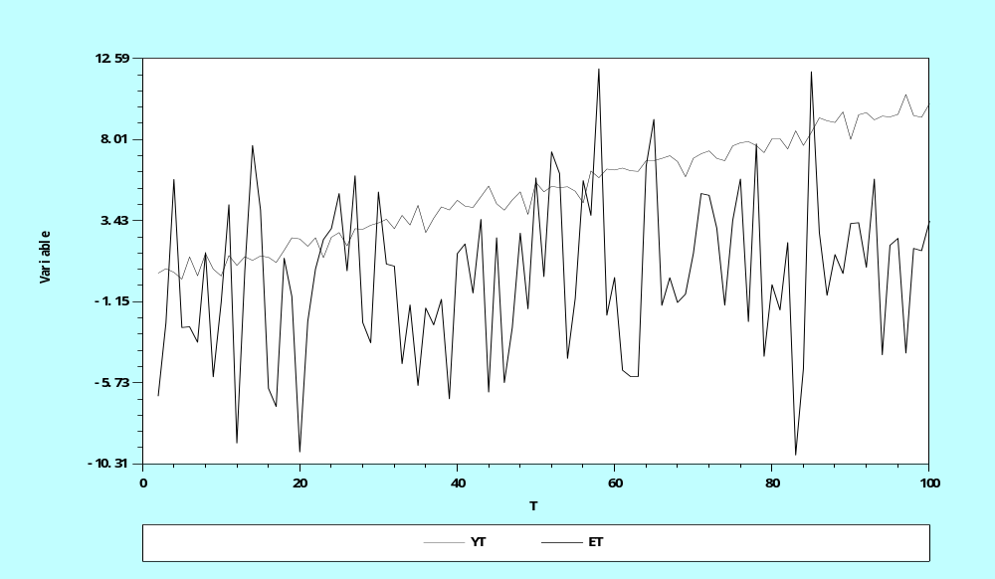
Stationary (et) vs.
Nonstationary (yt) Series

Slide 27
The Lag Operator
Lc = c when c is a constant
Lx_{t} = x_{t-1}
L² x_{t} = x_{t-2}
L^{P}x_{t} + L^{Q}x_{t} = x_{t-P} + x_{t-Q}
Polynomials in L: y_{t} = B(L)y_{t} + e_{t}
e.g., B(L) = (1.22L – 0.262L²)
A(L) y_{t} = e_{t}
Invertibility: y_{t} = [A(L)]⁻¹ e_{t}

Slide 28
Inverting a Stationary Series
y_{t}= ρy_{t-1} + e_{t} ➔ (1- ρL)y_{t} = e_{t}
y_{t} = [1- ρL]⁻¹ e_{t} = e_{t} + ρe_{t-1} + ρ²e_{t-2} + …
  Stationary series can be inverted
  Autoregressive vs. moving average form of series

Slide 29
Vector Autoregression

Slide 30
Vector Autoregression
The vector autoregression (VAR) model is one of the most successful, flexible,
and easy to use models for the analysis of multivariate time series. It is
a natural extension of the univariate autoregressive model to dynamic multivariate
time series. The VAR model has proven to be especially useful for
describing the dynamic behavior of economic and financial time series and
for forecasting. It often provides superior forecasts to those from univariate
time series models and elaborate theory-based simultaneous equations
models. Forecasts from VAR models are quite flexible because they can be
made conditional on the potential future paths of specified variables in the
model.
In addition to data description and forecasting, the VAR model is also
used for structural inference and policy analysis. In structural analysis, certain
assumptions about the causal structure of the data under investigation
are imposed, and the resulting causal impacts of unexpected shocks or
innovations to specified variables on the variables in the model are summarized.
These causal impacts are usually summarized with impulse response
functions and forecast error variance decompositions.
Eric Zivot: http://faculty.washington.edu/ezivot/econ584/notes/varModels.pdf

Slide 31
VAR

Slide 34
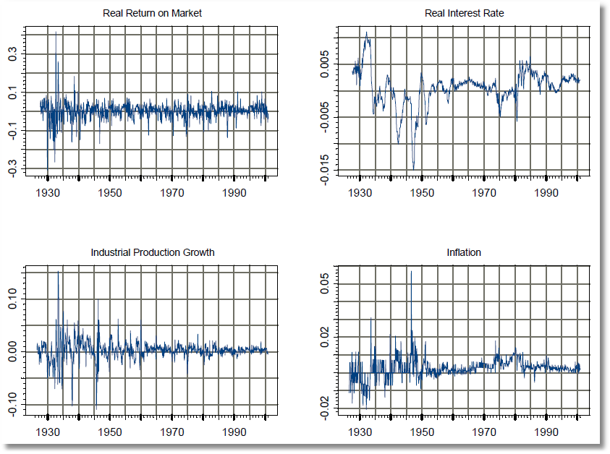
Zivot’s Data

Slide 35
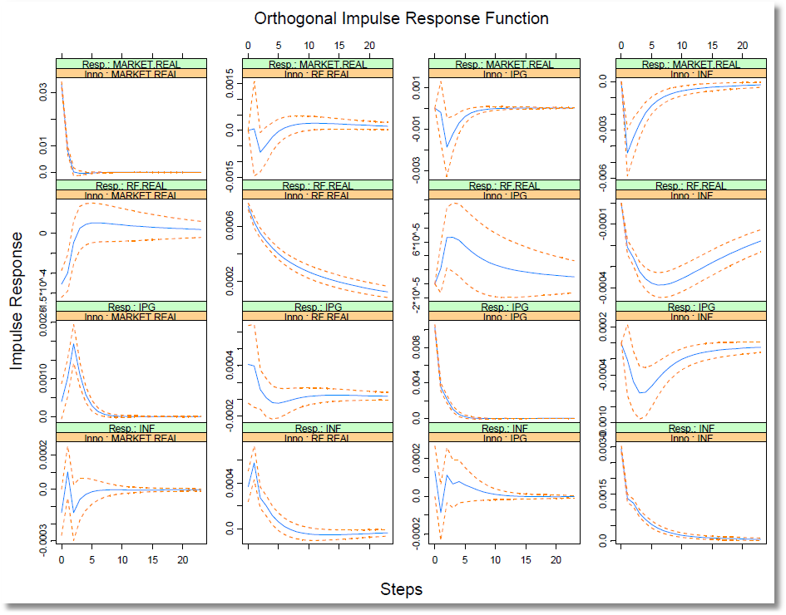
Impulse Responses

Slide 36
Arch and garch models

Slide 37
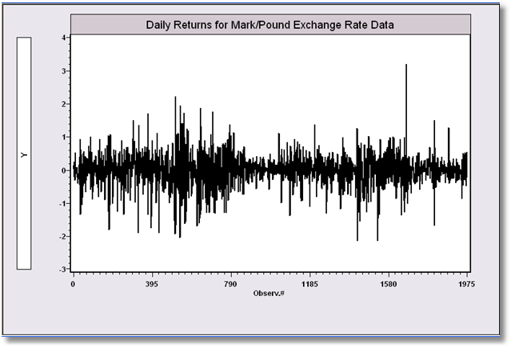
GARCH Models: A Model for Time Series with Latent Heteroscedasticity
Bollerslev/Ghysel, 1974

Slide 38
ARCH Model

Slide 39
GARCH Model

Slide 40
Estimated GARCH Model
----------------------------------------------------------------------
GARCH MODEL
Dependent variable Y
Log likelihood function -1106.60788
Restricted log likelihood -1311.09637
Chi squared [ 2 d.f.] 408.97699
Significance level .00000
McFadden Pseudo R-squared .1559676
Estimation based on N = 1974, K = 4
GARCH Model, P = 1, Q = 1
Wald statistic for GARCH = 3727.503
--------+-------------------------------------------------------------
Variable| Coefficient Standard Error b/St.Er. P[|Z|>z] Mean of X
--------+-------------------------------------------------------------
|Regression parameters
Constant| -.00619 .00873 -.709 .4783
|Unconditional Variance
Alpha(0)| .01076*** .00312 3.445 .0006
|Lagged Variance Terms
Delta(1)| .80597*** .03015 26.731 .0000
|Lagged Squared Disturbance Terms
Alpha(1)| .15313*** .02732 5.605 .0000
|Equilibrium variance, a0/[1-D(1)-A(1)]
EquilVar| .26316 .59402 .443 .6577
--------+-------------------------------------------------------------

Slide 41
Macroeconomic data

Slide 42
Analysis of Macroeconomic Data
Integrated series
The problem with regressions involving nonstationary series
  Spurious regressions
  Unit roots and misleading relationships
Solutions to the “problem”
  Random walks and first differencing
  Removing common trends
Cointegration: Formal solutions to regression models involving nonstationary data
Extending these results to panels
  Large T and small T cases.
  Parameter heterogeneity across countries

Slide 43
Nonstationary Data

Slide 44
Integrated Series

Slide 45
Stationary Data

Slide 46
Integrated Processes
Integration of order (P) when the P’th differenced series is stationary
Stationary series are I(0)
Trending series are often I(1). Then y_{t} – y_{t-1} = Δy_{t} is I(0). [Most macroeconomic data series.]
Accelerating series might be I(2). Then
(y_{t} – y_{t-1})- (y_{t} – y_{t-1}) = Δ²y_{t} is I(0)
Historic Hyperinflations
Interwar Germany, Hungary 1946, Zimbabwe 2007-2008
Money stock in hyperinflationary economies.
Price level in Venezuela in 2016 - 2017

Slide 47
A Unit Root?
How to test for ρ = 1?
By construction: ε_{t} – ε_{t-1} = (ρ - 1)ε_{t-1} + u_{t}
  Test for γ = (ρ - 1) = 0 using regression?
  Variance goes to 0 faster than 1/T. Need a new table; can’t use standard t tables.
  Dickey – Fuller tests
This invokes the possibility of unit roots in economic data. (Are there?)
  Nonstationary series
  Implications for conventional analysis

Slide 48
Unit Root Tests

Slide 49
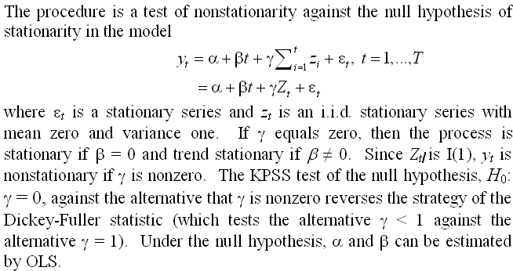
KPSS Test-1

Slide 50
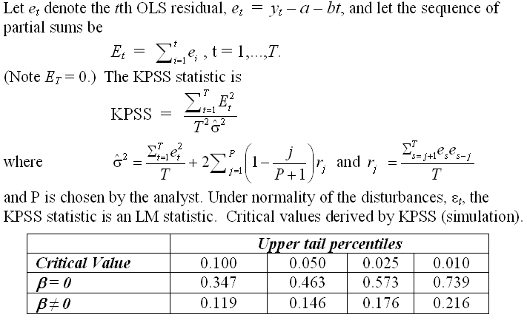
KPSS Test-2

Slide 51
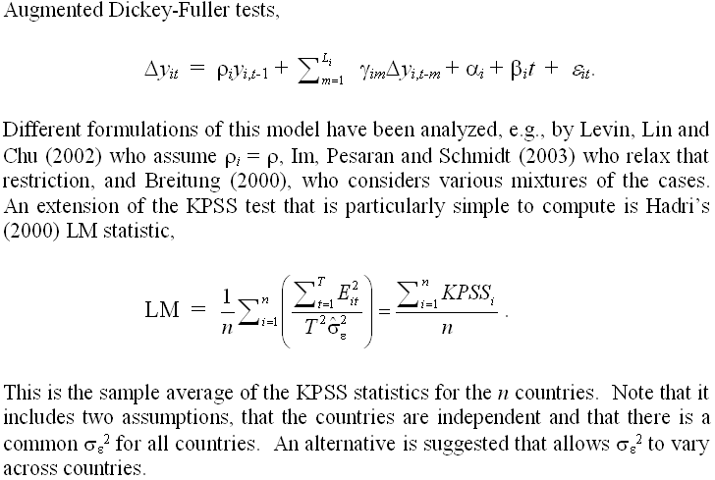
Panel Unit Root Tests

Slide 52
Purchasing Power Parity

Slide 53
Application
“Some international evidence on price determination: a non-stationary panel Approach,” Paul Ashworth, Joseph P. Byrne, Economic Modelling, 20, 2003, p. 809-838.
80 quarters, 13 OECD countries
log p_{i,t} = β₀ + β₁log(unit labor cost_{i,t})
+ β₂ log(world price_{,t})
+ β₃ log(intermediate goods price_{i,t})
+ β₄ (log-output gap_{i,t}) + ε_{i,t}
Various tests for unit roots and cointegration

Slide 54
Implications
Separate analyses by country
How to combine data and test statistics
Cointegrating relationships across countries

Slide 55
cointegration

Slide 56
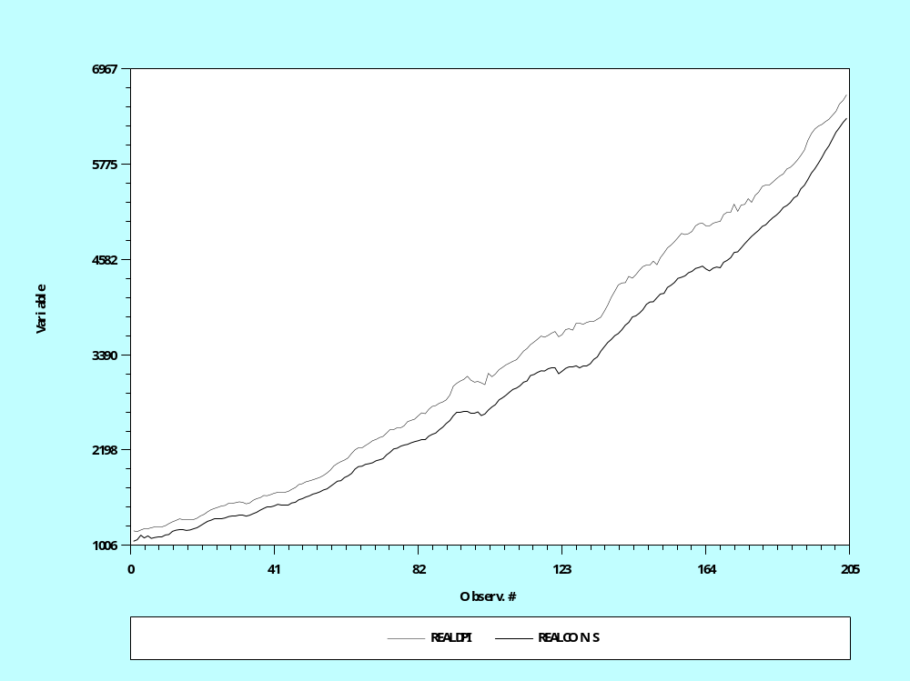
Cointegrated Processes:
Real DPI and Real Consumption

Slide 57
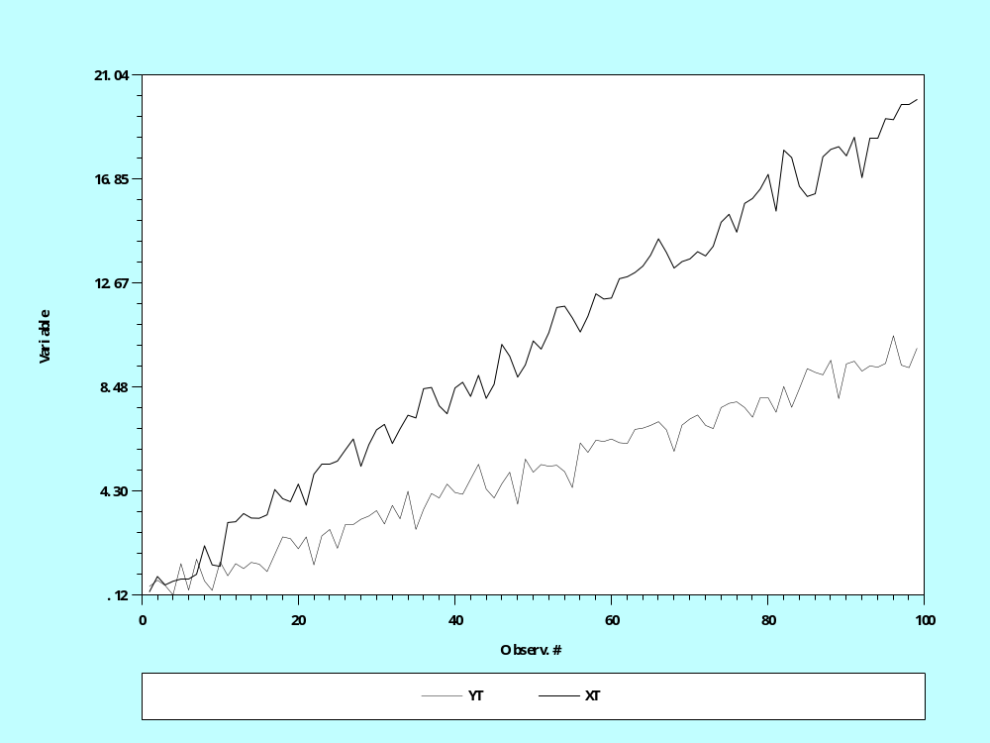
Lack of Cointegration
Divergent Series?

Slide 58
Cointegration
X(t) and y(t) are obviously I(1)
Looks like any linear combination of x(t) and y(t) will also be I(1)
Does a model y(t) = βx(t) + u(t) where u(t) is I(0) make any sense? How can u(t) be I(0)?
In fact, there is a linear combination, [1,-β] that is I(0).
  y(t) = .1*t + noise, x(t) = .2*t + noise
  y(t) and x(t) have a common trend
  y(t) and x(t) are cointegrated.

Slide 59
Cointegrated Variables?

Slide 60
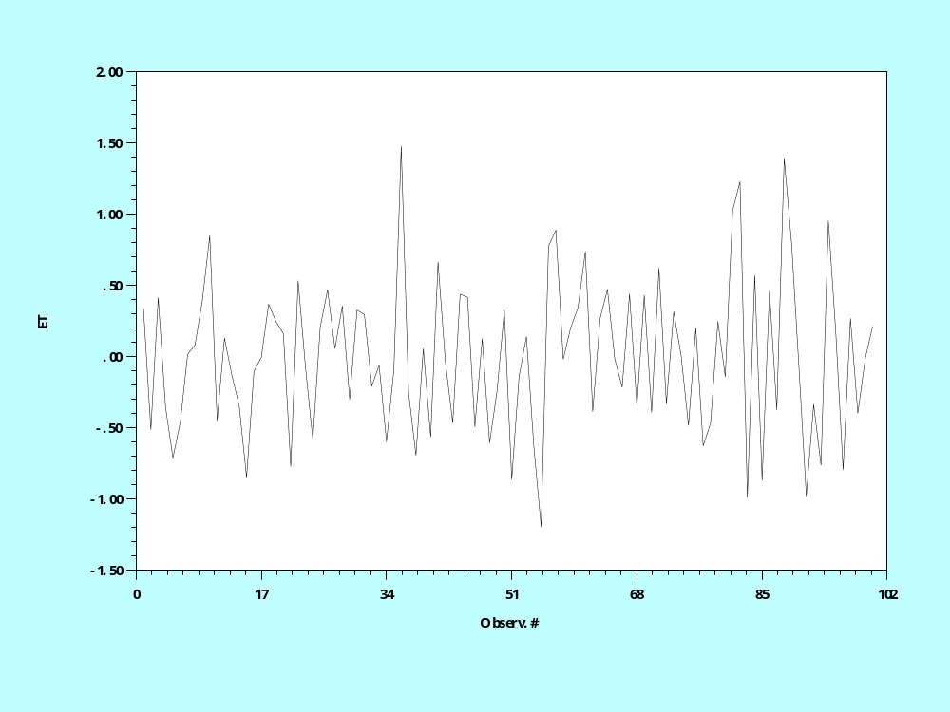
Cointegration and I(0) Residuals

Slide 61
Cointegrating Relationships
Implications:
  Long run vs. short run relationships
  Problems of spurious regressions (as usual)
Problem for existing empirical studies: Regressions involving variables of different integration. E.g., regressions of flows on stocks

Slide 62
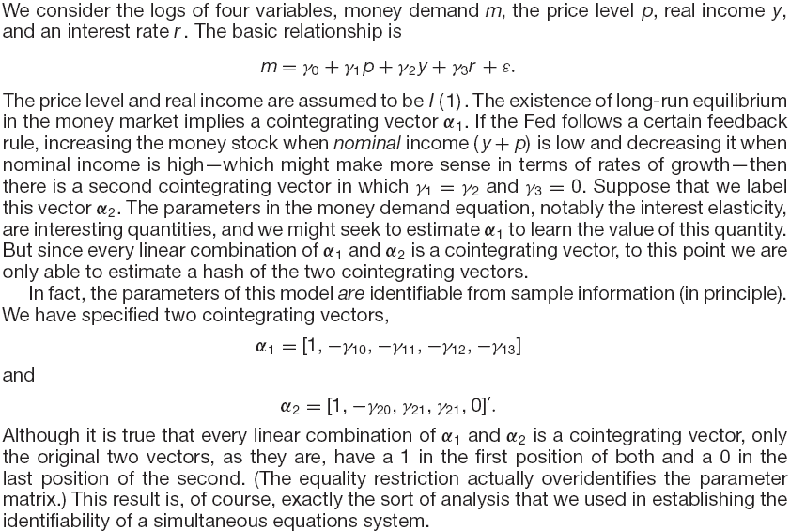
Money demand example

Slide 63
Appendix

Slide 64
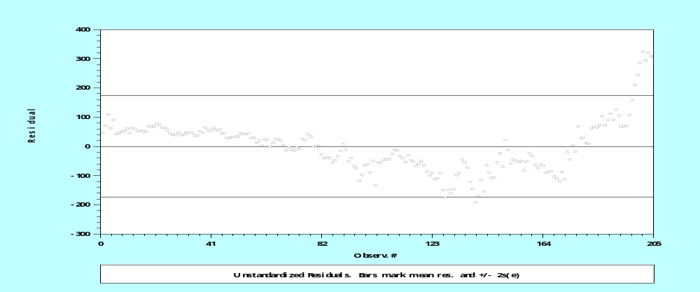
Autocorrelation in Regression
Y_{t} = b’x_{t} + ε_{t}
Cov(ε_{t}, ε_{t-1}) ≠ 0
Ex. RealCons_{t} = a + bRealIncome + ε_{t} U.S. Data, quarterly, 1950-2000

Slide 65
Autocorrelation
How does it arise?
What does it mean?
Modeling approaches
  Classical – direct: corrective
    Estimation that accounts for autocorrelation
    Inference in the presence of autocorrelation
  Contemporary – structural
    Model the source
    Incorporate the time series aspect in the model

Slide 66
Regression with Autocorrelation
y_{t} = x_{t}’b + e_{t}, e_{t} = ρe_{t-1} + u_{t}
(1- ρL)e_{t} = u_{t} ➔ e_{t} = (1- ρL)⁻¹u_{t}
  E[e_{t}] = E[ (1- ρL)⁻¹u_{t}] = (1- ρL)⁻¹E[u_{t}] = 0
  Var[e_{t}] = (1- ρL)⁻²Var[u_{t}] = 1+ ρ²σ_{u}² + …
  = σ_{u}²/(1- ρ²)
  Cov[e_{t},e_{t-1}] = Cov[ρe_{t-1} + u_{t}, e_{t-1}] =
  = ρCov[e_{t-1},e_{t-1}]+Cov[u_{t},e_{t-1}]
  = ρ σ_{u}²/(1- ρ²) + 0

Slide 67
OLS vs. GLS with Autocorrelation
OLS
  Unbiased?
  Consistent: (Except in the presence of a lagged dependent variable)
  Inefficient
GLS
  Consistent and efficient

Slide 68
+----------------------------------------------------+
| Ordinary least squares regression |
| LHS=REALCONS Mean = 2999.436 |
| Autocorrel Durbin-Watson Stat. = .0920480 |
| Rho = cor[e,e(-1)] = .9539760 |
+----------------------------------------------------+
+---------+--------------+----------------+--------+---------+----------+
|Variable | Coefficient | Standard Error |t-ratio |P[|T|>t] | Mean of X|
+---------+--------------+----------------+--------+---------+----------+
Constant -80.3547488 14.3058515 -5.617 .0000
REALDPI .92168567 .00387175 238.054 .0000 3341.47598
| Robust VC Newey-West, Periods = 10 |
Constant -80.3547488 41.7239214 -1.926 .0555
REALDPI .92168567 .01503516 61.302 .0000 3341.47598
+---------------------------------------------+
| AR(1) Model: e(t) = rho * e(t-1) + u(t) |
| Final value of Rho = .998782 |
| Iter= 6, SS= 118367.007, Log-L=-941.371914 |
| Durbin-Watson: e(t) = .002436 |
| Std. Deviation: e(t) = 490.567910 |
| Std. Deviation: u(t) = 24.206926 |
| Durbin-Watson: u(t) = 1.994957 |
| Autocorrelation: u(t) = .002521 |
| N[0,1] used for significance levels |
+---------------------------------------------+
+---------+--------------+----------------+--------+---------+----------+
|Variable | Coefficient | Standard Error |b/St.Er.|P[|Z|>z] | Mean of X|
+---------+--------------+----------------+--------+---------+----------+
Constant 1019.32680 411.177156 2.479 .0132
REALDPI .67342731 .03972593 16.952 .0000 3341.47598
RHO .99878181 .00346332 288.389 .0000

Slide 69
Detecting Autocorrelation
Use residuals directly (Durbin and Watson)
  d=
  Assumes normally distributed disturbances, strictly exogenous regressors
Variable addition (LM test) (Godfrey)
  Based on y_{t} = β’x_{t} + (ρε_{t-1} + u_{t})
  Use regression residuals e_{t} and test ρ = 0 in regression of e_{t} on x_{t} and e_{t-1}
  Assumes consistency of b.

Slide 70
Reinterpreting Autocorrelation

