Slide 1








Econometric Analysis of Panel Data
William Greene
Department of Economics
University of South Florida

Slide 2
Agenda
Random Parameter Models
  Fixed effects
  Random effects
Heterogeneity in Dynamic Panels
Random Coefficient Vectors-Classical vs. Bayesian
General RPM Swamy/Hsiao/Hildreth/Houck
Hierarchical and “Two Step” Models
‘True’ Random Parameter Variation
  Discrete – Latent Class
  Continuous
    Classical
    Bayesian

Slide 3
Random Effects and
Random Parameters

Slide 4
A Capital Asset Pricing Model

Slide 5
Heterogeneous Health Production Model

Slide 6
Parameter Heterogeneity

Slide 7
Parameter Heterogeneity

Slide 8
Fixed Effects
(Hildreth, Houck, Hsiao, Swamy)

Slide 9
OLS and GLS Are Inconsistent

Slide 10
Estimating the “Fixed Effects” Model

Slide 11
Estimating the Random
Parameters Model

Slide 12
Estimating the Random
Parameters Model by OLS

Slide 13
Estimating the Random
Parameters Model by GLS

Slide 14
Estimating the RPM

Slide 15
An Estimator for Γ

Slide 16
A Positive Definite Estimator for Γ

Slide 17
Estimating β_{i}

Slide 18
Baltagi and Griffin’s Gasoline Data
World Gasoline Demand Data, 18 OECD Countries, 19 years
Variables in the file are
COUNTRY = name of country
YEAR = year, 1960-1978
LGASPCAR = log of consumption per car
LINCOMEP = log of per capita income
LRPMG = log of real price of gasoline
LCARPCAP = log of per capita number of cars
See Baltagi (2001, p. 24) for analysis of these data. The article on which the analysis is based is Baltagi, B. and Griffin, J., "Gasoline Demand in the OECD: An Application of Pooling and Testing Procedures," European Economic Review, 22, 1983, pp. 117-137. The data were downloaded from the website for Baltagi's text.

Slide 19
OLS and FGLS Estimates
+----------------------------------------------------+
| Overall OLS results for pooled sample. |
| Residuals Sum of squares = 14.90436 |
| Standard error of e = .2099898 |
| Fit R-squared = .8549355 |
+----------------------------------------------------+
+---------+--------------+----------------+--------+---------+
|Variable | Coefficient | Standard Error |b/St.Er.|P[|Z|>z] |
+---------+--------------+----------------+--------+---------+
Constant 2.39132562 .11693429 20.450 .0000
LINCOMEP .88996166 .03580581 24.855 .0000
LRPMG -.89179791 .03031474 -29.418 .0000
LCARPCAP -.76337275 .01860830 -41.023 .0000
+------------------------------------------------+
| Random Coefficients Model |
| Residual standard deviation = .3498 |
| R squared = .5976 |
| Chi-squared for homogeneity test = 22202.43 |
| Degrees of freedom = 68 |
| Probability value for chi-squared= .000000 |
+------------------------------------------------+
+---------+--------------+----------------+--------+---------+
|Variable | Coefficient | Standard Error |b/St.Er.|P[|Z|>z] |
+---------+--------------+----------------+--------+---------+
CONSTANT 2.40548802 .55014979 4.372 .0000
LINCOMEP .39314902 .11729448 3.352 .0008
LRPMG -.24988767 .04372201 -5.715 .0000
LCARPCAP -.44820927 .05416460 -8.275 .0000

Slide 20
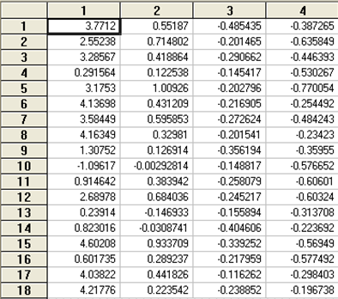
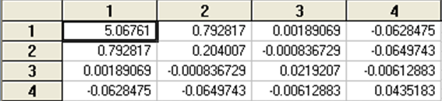
Country Specific Estimates
Estimated Γ

Slide 21
Two Step Estimation (Saxonhouse)

Slide 22
A Hierarchical Model

Slide 23
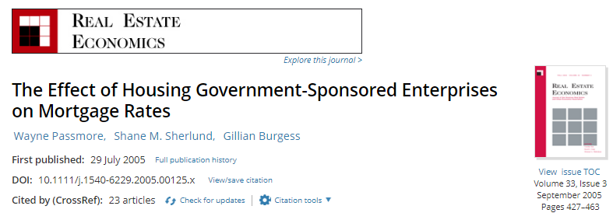
Analysis of Fannie Mae
Fannie Mae
The Funding Advantage
The Pass Through

Slide 24
Two Step Analysis of Fannie-Mae

Slide 25
Average of 370 First Step Regressions
Symbol | Variable | Mean | S.D. | Coeff | S.E.
RM | Rate % | 7.23 | 0.79
J | Jumbo | 0.06 | 0.23 | 0.16 | 0.05
LTV1 | 75%-80% | 0.36 | 0.48 | 0.04 | 0.04
LTV2 | 81%-90% | 0.15 | 0.35 | 0.17 | 0.05
LTV3 | >90% | 0.22 | 0.41 | 0.15 | 0.04
New | New Home | 0.17 | 0.38 | 0.05 | 0.04
Small | < $100,000 | 0.27 | 0.44 | 0.14 | 0.04
Fees | Fees paid | 0.62 | 0.52 | 0.06 | 0.03
MtgCo | Mtg. Co. | 0.67 | 0.47 | 0.12 | 0.05
R² = 0.77

Slide 26
Second Step

Slide 27
Estimates of β₁

Slide 28
The Minimum Distance Estimator

