Slide 1








Econometric Analysis of Panel Data
William Greene
Department of Economics
University of South Florida

Slide 2
12 Random parameters in linear models

Slide 3
A Random Parameters Linear Model
German Health Care Data
HSAT = β₁ + β₂AGE_{it} + β₃ MARRIED_{it} + γ_{i} EDUC_{it} + ε_{it}
γ_{i} = β₄ + α FEMALE_{i} + u_{i}
Setpanel ; Group = id
Regress ; Lhs = hsat ; Rhs = one,age, married,educ
; RPM = female ; Fcn = educ(normal)
; pts = 25 ; Halton ; Panel ; Parameters$
Kernel ; Rhs=beta_i ; Grid
; Title=Normal Distribution of Education Coefficient $

Slide 4
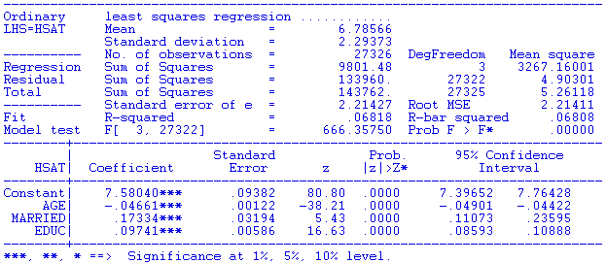
OLS Results

Slide 5
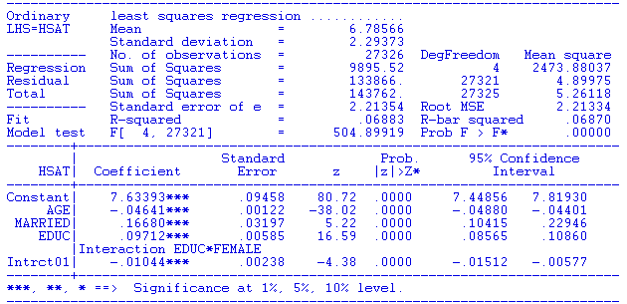
Simple Nonrandom Interaction

Slide 6
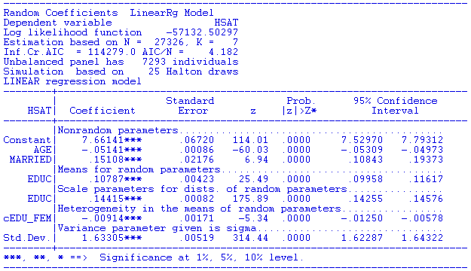
Maximum Simulated Likelihood

Slide 7
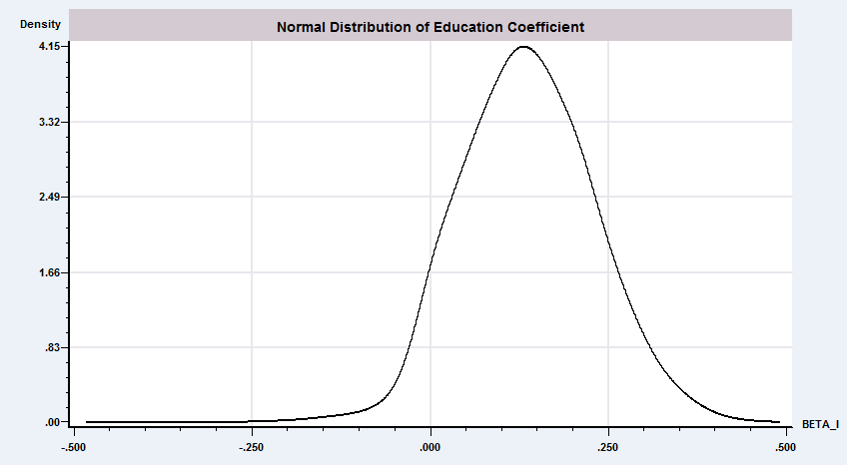
RP Model for Individual
Coefficients on Education
Fixed Coefficient Estimate

Slide 8
A Hierarchical Linear Model
A hedonic model of house values
Beron, K., Murdoch, J., Thayer, M., “Hierarchical Linear Models with Application to Air Pollution in the South Coast Air Basin,” American Journal of Agricultural Economics, 81, 5, 1999.

Slide 9
HLM

Slide 10
Parameter Heterogeneity

Slide 11
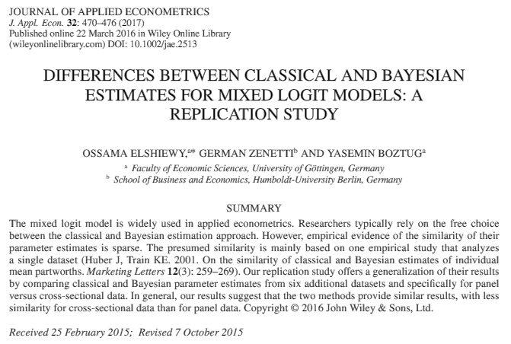
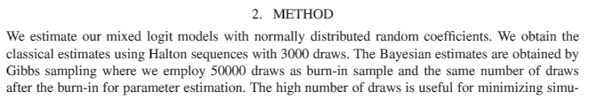

Slide 12
Discrete Parameter Variation

Slide 13


Slide 14


Slide 15
Endogenous Switching (ca.1980)
Not identified. Regimes do not coexist.

Slide 16

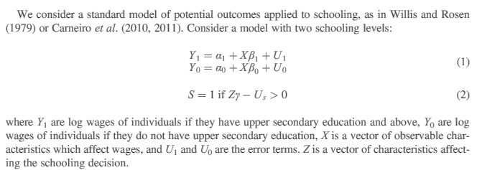
Endogenous Switching 2017

Slide 17
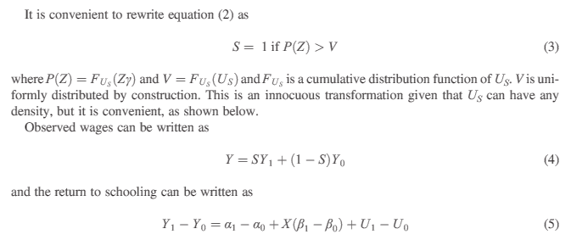
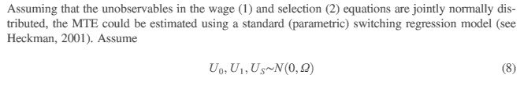
Observed Switching

Slide 18
Log Likelihood for an LC Model

Slide 19
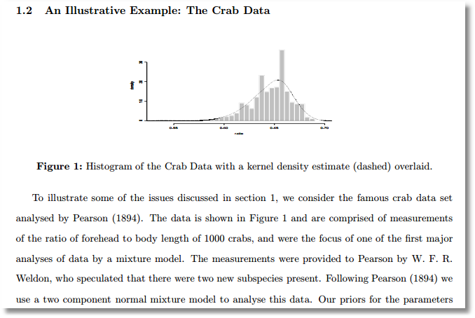

Slide 20
Example: Mixture of Normals

Slide 21
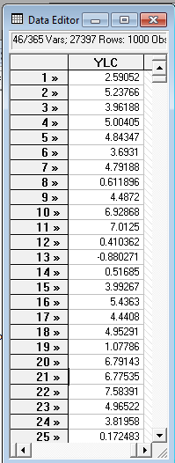
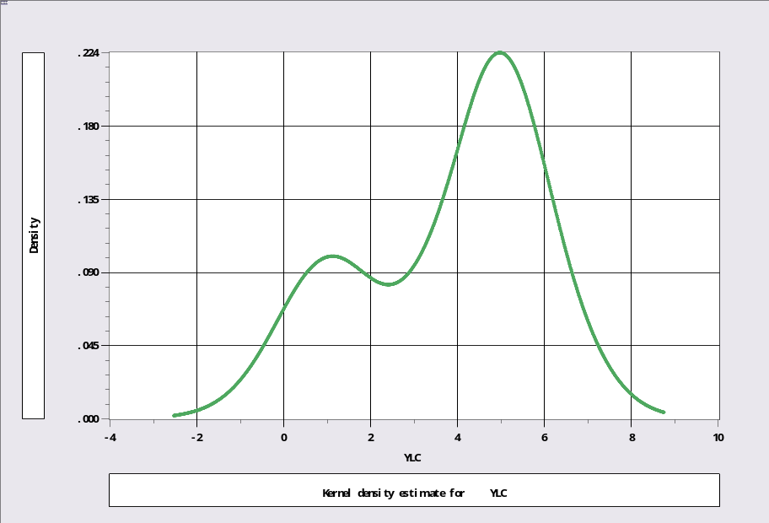
Unmixing a Mixed Sample (T=1,Q=2)
Sample ; 1 – 1000$
Calc ; Ran(123457)$
Create ; lc1=rnn(1,1) ;lc2=rnn(5,1)$
Create ; class=rnu(0,1)$
Create ; if(class<.3)ylc=lc1 ; (else)ylc=lc2$
Kernel ; rhs=ylc $
Regress ; lhs=ylc;rhs=one;lcm;pts=2;pds=1$

Slide 22
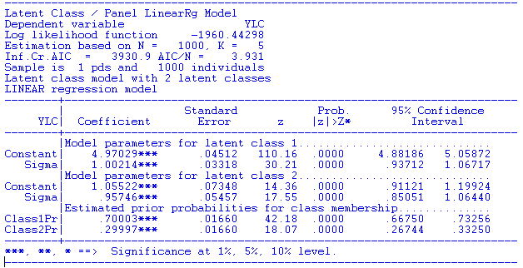
Mixture of Normals

Slide 23
Estimating Which Class

Slide 24
Posterior for Normal Mixture

Slide 25
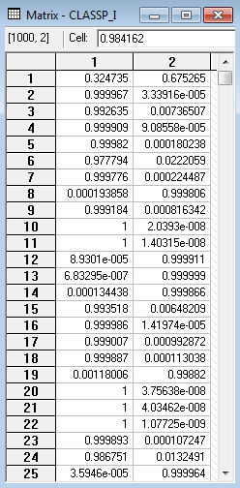
Estimated Posterior Probabilities
Estimated Mean in Class 1 is 5
Estimated mean in Class 2 is 1
Priors are
0.7 for class 1
0.3 for class 2.

Slide 26
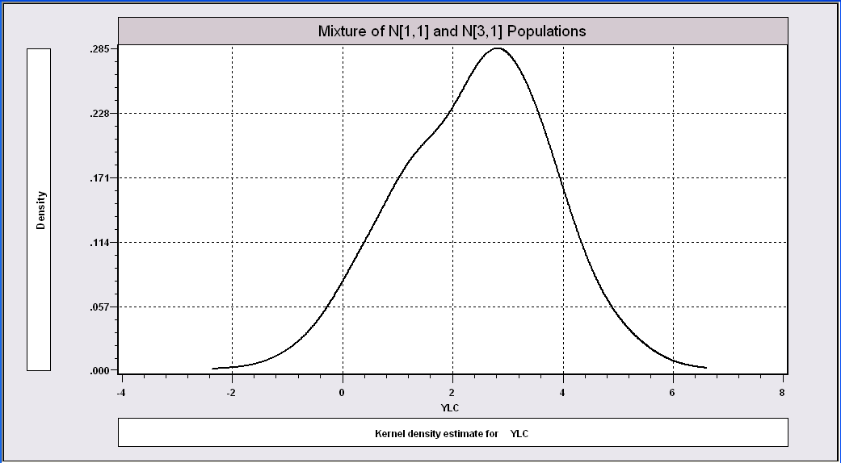
More Difficult When the
Populations are Close Together

Slide 27
The Technique Still Works
----------------------------------------------------------------------
Latent Class / Panel LinearRg Model
Dependent variable YLC
Sample is 1 pds and 1000 individuals
LINEAR regression model
Model fit with 2 latent classes.
--------+-------------------------------------------------------------
Variable| Coefficient Standard Error b/St.Er. P[|Z|>z] Mean of X
--------+-------------------------------------------------------------
|Model parameters for latent class 1
Constant| 2.93611*** .15813 18.568 .0000
Sigma| 1.00326*** .07370 13.613 .0000
|Model parameters for latent class 2
Constant| .90156*** .28767 3.134 .0017
Sigma| .86951*** .10808 8.045 .0000
|Estimated prior probabilities for class membership
Class1Pr| .73447*** .09076 8.092 .0000
Class2Pr| .26553*** .09076 2.926 .0034
--------+-------------------------------------------------------------

Slide 28
Predicting Class Membership
Means = 1 and 5 Means = 1 and 3
+----------------------------------++----------------------------------+
|Cross Tabulation ||Cross Tabulation |
+--------+--------+-----------------+--------+--------+-----------------
| | | CLASS || | | CLASS |
| CLASS1| Total | 0 1 || CLASS1| Total | 0 1 |
+--------+--------+----------------++--------+--------+----------------+
| 0| 787 | 759 28 || 0| 787 | 523 97 |
| 1| 1713 | 18 1695 || 1| 1713 | 250 1622 |
+--------+--------+----------------++--------+--------+----------------+
| Total| 2500 | 777 1723 || Total| 2500 | 777 1723 |
+--------+--------+----------------++--------+--------+----------------+
Note: This is generally not possible as the true underlying class membership is not known.

Slide 29
How Many Classes?

Slide 30
A Latent Class Regression

Slide 31
An Extended Latent Class Model

Slide 32
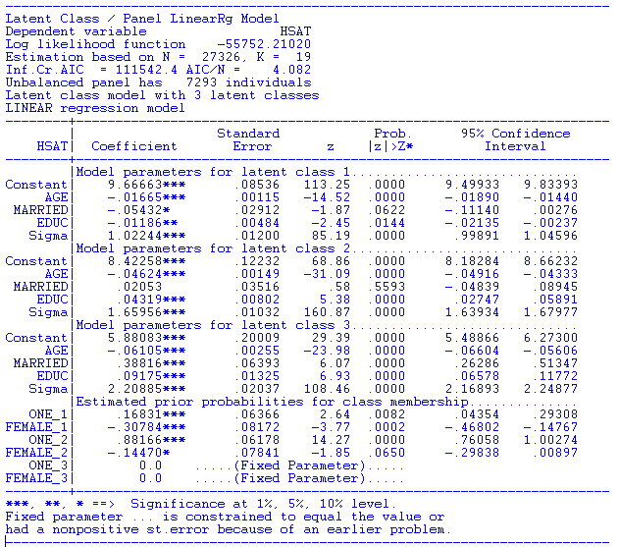
Health Satisfaction Model

Slide 33
Estimating E[β_{i} |X_{i},y_{i}, β₁…, β_{Q}]

Slide 34
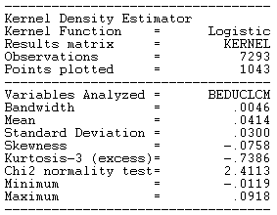
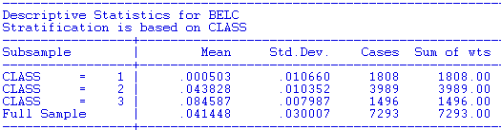
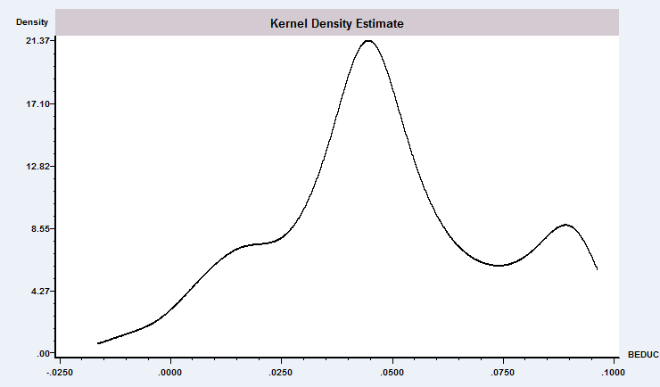
Mean = 0.04 Mean = 0.11

Slide 35
Baltagi and Griffin’s Gasoline Data
World Gasoline Demand Data, 18 OECD Countries, 19 years
Variables in the file are
COUNTRY = name of country
YEAR = year, 1960-1978
LGASPCAR = log of consumption per car
LINCOMEP = log of per capita income
LRPMG = log of real price of gasoline
LCARPCAP = log of per capita number of cars
See Baltagi (2001, p. 24) for analysis of these data. The article on which the analysis is based is Baltagi, B. and Griffin, J., "Gasoline Demand in the OECD: An Application of Pooling and Testing Procedures," European Economic Review, 22, 1983, pp. 117-137. The data were downloaded from the website for Baltagi's text.

Slide 36
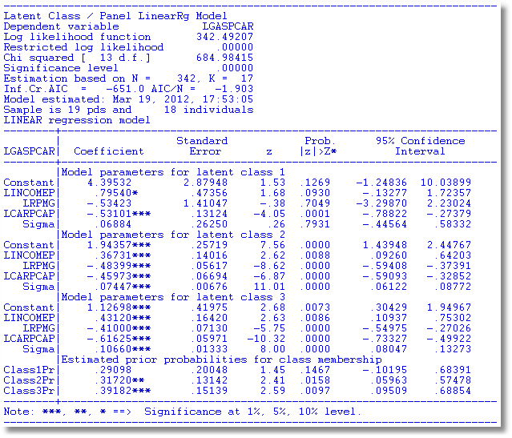
3 Class Linear Gasoline Model

Slide 37
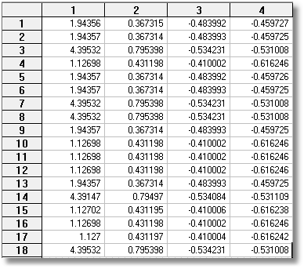
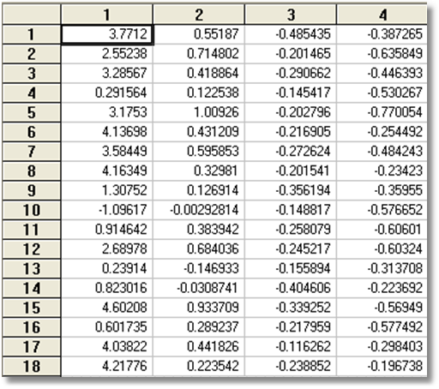
Estimated Parameters
LCM vs. Gen1 RPM

Slide 38
Heckman and Singer’s RE Model
Random Effects Model
Random Constants with Discrete Distribution

Slide 39
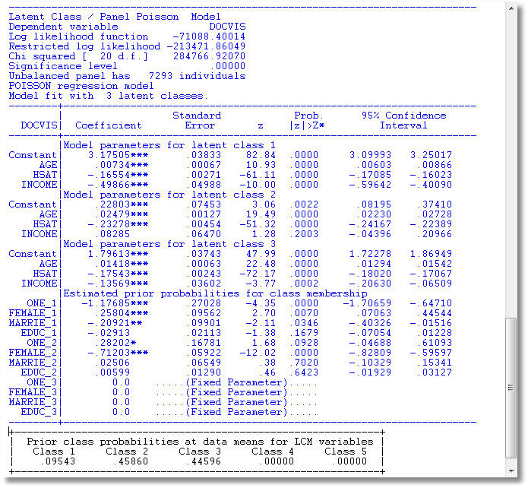
LC3 Regression for Doctor Visits

Slide 40
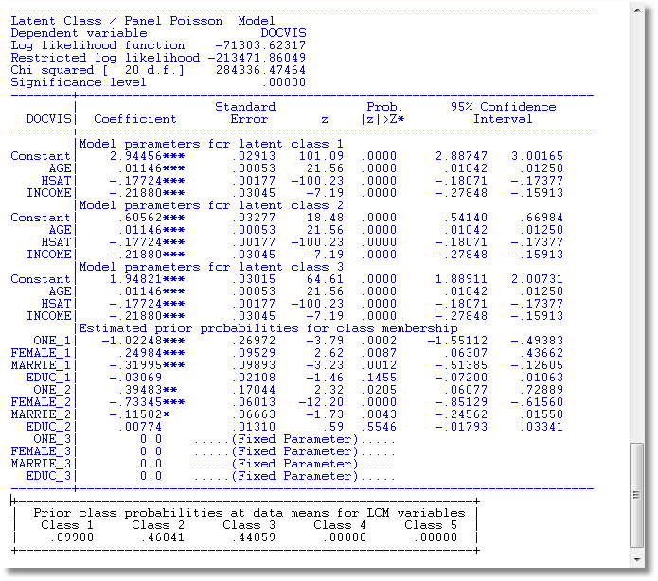
3 Class Heckman-Singer Form

Slide 41
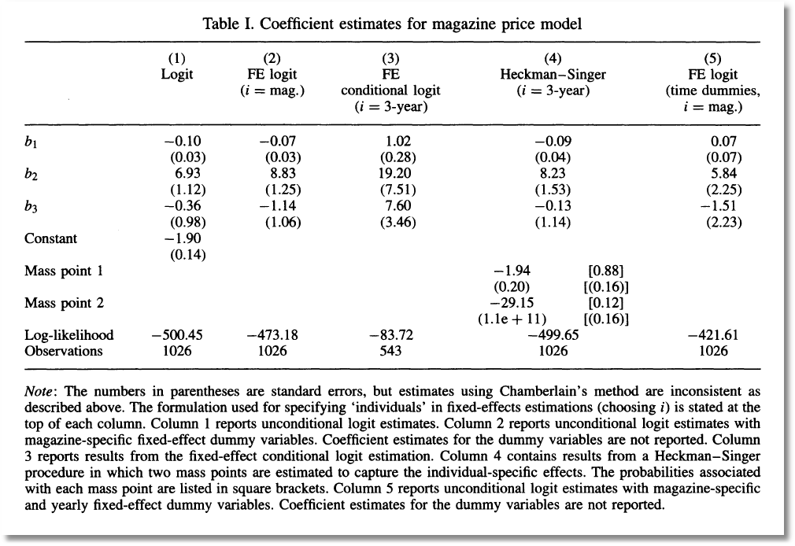

Slide 42
The EM Algorithm

Slide 43
Implementing EM for LC Models

Slide 44
Continuous Parameter Variation
(The Random Parameters Model)

Slide 45
OLS and GLS Are Consistent for β

Slide 46
ML Estimation of the RPM

Slide 47
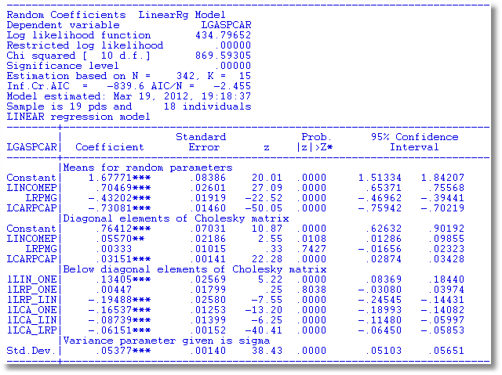
RP Gasoline Market

Slide 48
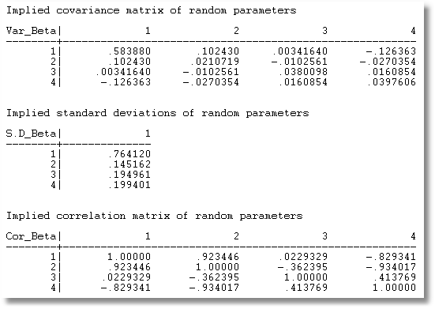
Parameter Covariance matrix

Slide 49
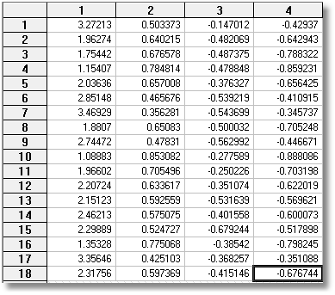
RP vs. Gen1

Slide 50
Modeling Parameter Heterogeneity

Slide 51
Hierarchical Linear Model
COUNTRY = name of country
YEAR = year, 1960-1978
LGASPCAR = log of consumption per car y
LINCOMEP = log of per capita income z
LRPMG = log of real price of gasoline x₁
LCARPCAP = log of per capita number of cars x₂
y_{it} = β_{1i} + β_{2i} x_{1it} + β_{3i} x_{2it} + ε_{it}.
β_{1i}=β₁+Δ₁ z_{i} + u_{1i}
β_{2i}=β₂+Δ₂ z_{i} + u_{2i}
β_{3i}=β₃+Δ₃ z_{i} + u_{3i}

Slide 52
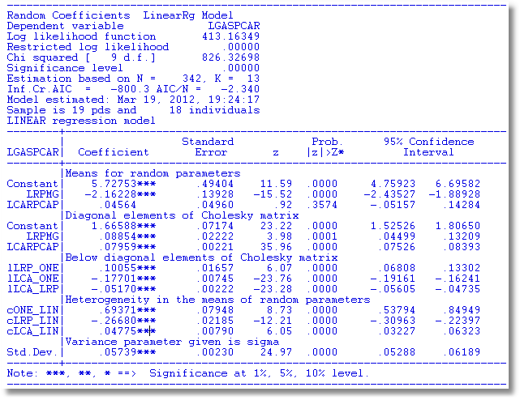
Estimated HLM

Slide 53
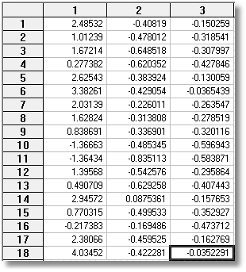
RP vs. HLM

Slide 54
Random Effects Linear Model

Slide 55
MLE: REM - Panel Data

Slide 56
Maximum Simulated Likelihood

Slide 57
Likelihood Function for Individual i

Slide 58
Log Likelihood Function

Slide 59
Computing the Expected LogL
Example: Hermite Quadrature Nodes and Weights, H=5
Nodes: -2.02018,-0.95857, 0.00000, 0.95857, 2.02018
Weights: 1.99532,0.39362, 0.94531, 0.39362, 1.99532
Applications usually use many more points, up to 96 and
Much more accurate (more digits) representations.

Slide 60
Quadrature

Slide 61
32 Point Hermite Quadrature
Nodes are a_{h} and use negative and positive values
0.194840741569399326708741289532, 0.584978765435932448466957544011,
0.976500463589682838484704871982, 1.37037641095287183816170564864,
1.76765410946320160462767325853, 2.16949918360611217330570559502,
2.57724953773231745403092930114, 2.99249082500237420628549407606,
3.41716749281857073587392729564, 3.85375548547144464388787292109,
4.30554795335119844526348653193, 4.77716450350259639303579405689,
5.27555098651588012781906048140, 5.81222594951591383276596615366,
6.40949814926966041217376374153, 7.12581390983072757279520760342/
Weights are w_{h} and use same weight for a_{h} and -a_{h}
3.75238352592802392866818389D-1, 2.77458142302529898137698919D-1,
1.51269734076642482575147115D-1, 6.04581309559126141865857608D-2,
1.75534288315734303034378446D-2, 3.65489032665442807912565712D-3,
5.36268365527972045970238102D-4, 5.41658406181998255800193939D-5,
3.65058512956237605737032419D-6, 1.57416779254559402926869258D-7,
4.09883216477089661823504101D-9, 5.93329146339663861451156822D-11,
4.21501021132644757296944521D-13,1.19734401709284866582868190D-15,
9.23173653651829223349442007D-19,7.31067642738416239327427846D-23/

Slide 62
Compute the Integral by Simulation

Slide 63
Convergence Results

Slide 64
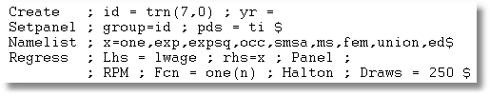
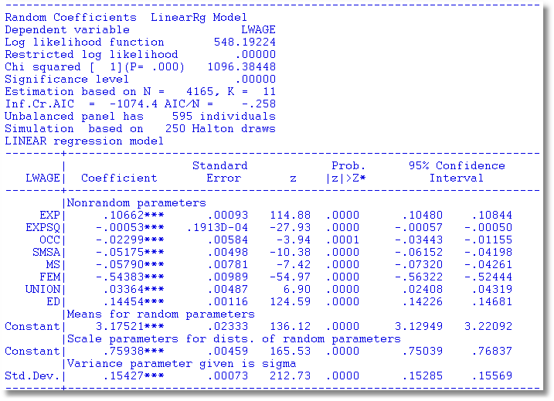
MSL vs. ML
FGLS MLE MSL
σ_{ε}² .023119 .023534 .023779
σ_{u}² .102531 .708869 .576658

Slide 65
Simulating Conditional Means for Individual Parameters
Posterior estimates of E[parameters(i) | Data(i)]

Slide 66
RP Model for Individual
Coefficients on Education
Fixed Coefficient Estimate

