Slide 1
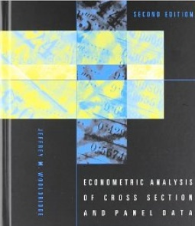
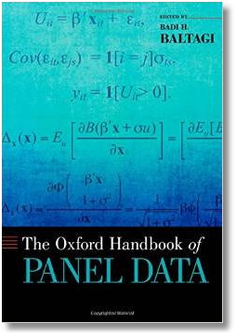

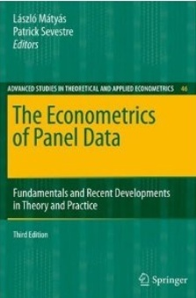



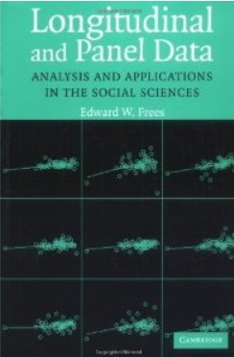
Econometric Analysis of Panel Data
William Greene
Department of Economics
University of South Florida

Slide 2
Nonlinear Models
Nonlinear Models
Estimation Theory for Nonlinear Models
  Estimators
  Properties
  M Estimation
    Nonlinear Least Squares
    Maximum Likelihood Estimation
  GMM Estimation
    Minimum Distance Estimation
    Minimum Chi-square Estimation
Computation – Nonlinear Optimization
  Nonlinear Least Squares
  Newton-like Algorithms; Gradient Methods
(Background: JW, Chapters 12-14, Greene, Chapters 12-14, App. E)

Slide 3
What is a ‘Model?’
Purely verbal description of a phenomenon
Unconditional ‘characteristics’ of a population
Conditional moments: E[g(y)|x]: median, mean, variance, quantile, correlations, probabilities…
Conditional probabilities and densities
Conditional means and regressions
Fully parametric and semiparametric specifications
  Parametric specification: Known up to parameter θ
  Parameter spaces
  Conditional means: E[y|x] = m(x, θ)

Slide 4
What is a Nonlinear Model?
Model: E[g(y)|x] = m(x,θ)
Objective:
  Learn about θ from y, X
  Usually “estimate” θ
Linear Model: Closed form; = h(y, X)
Nonlinear Model: “Any model that is not linear”
  Not wrt m(x,θ). E.g., y=exp(θ’x + ε)
  Wrt estimator: Implicitly defined. h(y, X, )=0, E.g., E[y|x]= exp(θ’x)

Slide 5
What is an Estimator?
Point and Interval
Set estimation: θ ⊂ some subset of R^{K}
Classical and Bayesian

Slide 6
Parameters
Model parameters – features of the population
The “true” parameter(s)

Slide 7
M Estimation
Classical estimation method

Slide 8
An Analogy Principle for M Estimation

Slide 9
Estimation

Slide 10
(1) The Parameters Are Identified

Slide 11
(2) Continuity of the Criterion

Slide 12
Consistency

Slide 13
Asymptotic Normality of M Estimators

Slide 14
Estimating the Asymptotic Variance

Slide 15
Nonlinear Least Squares

Slide 16
Application - Income
German Health Care Usage Data, 7,293 Individuals, Varying Numbers of Periods
Variables in the file are
Data downloaded from Journal of Applied Econometrics Archive. This is an unbalanced panel with 7,293 individuals. They can be used for regression, count models, binary choice, ordered choice, and bivariate binary choice. This is a large data set. There are altogether 27,326 observations. The number of observations ranges from 1 to 7. (Frequencies are: 1=1525, 2=2158, 3=825, 4=926, 5=1051, 6=1000, 7=987).
HHNINC = household nominal monthly net income in German marks / 10000.
(4 observations with income=0 were dropped)
HHKIDS = children under age 16 in the household = 1; otherwise = 0
EDUC = years of schooling
AGE = age in years

Slide 17
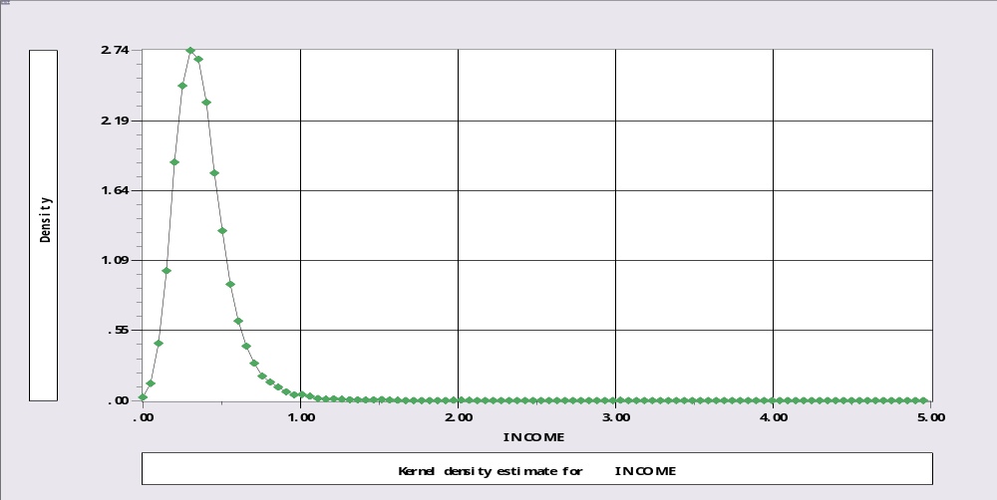
Income Data

Slide 18
Exponential Model

Slide 19
Conventional Variance Estimator

Slide 20
Variance Estimator for the M Estimator

Slide 21
Computing NLS
Reject; hhninc=0$
Calc ; b0=log(xbr(hhninc))$
Nlsq ; lhs = hhninc
; fcn = exp(a0+a1*educ+a2*married+a3*age)
; start = b0, 0, 0, 0
; labels = a0,a1,a2,a3$
Name ; x = one,educ,married,age$
Create; thetai = exp(x'b); ei = hhninc-thetai
; gi=ei*thetai ; hi = thetai*thetai$
Matrix; varM = <x'[hi] x> * x'[gi^2]x * <x'[hi] x> $
Matrix; stat(b,varm,x)$

Slide 22
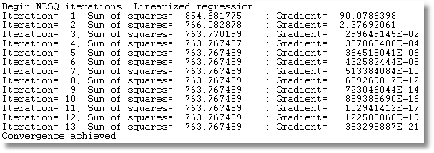
Iterations

Slide 23
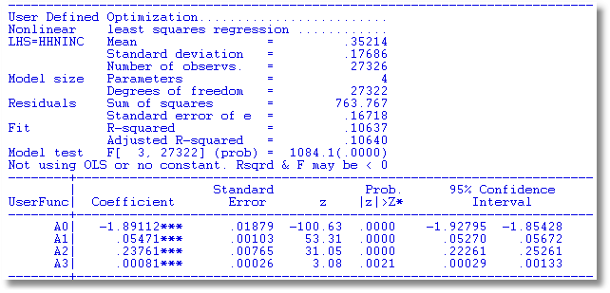

NLS Estimates with Different Variance Estimators

Slide 24
Hypothesis Tests for M Estimation

Slide 25
Wald Test

Slide 26
Change in the Criterion Function

Slide 27
Score Test

Slide 28
Exponential Model

Slide 29
Wald Test
Calc ; b0=log(xbr(hhninc))$
Nlsq ; lhs = hhninc
; fcn = exp(a0+a1*educ+a2*married+a3*age)
; start = b0, 0, 0, 0
; labels = a0,a1,a2,a3$
Matrix ; List ; R = [0,1,0,0 /
0,0,1,0 /
0,0,0,1]
; c = R*b ; Vc = R*Varb*R’ ; Wald = c’ <VC> c $
Matrix R has 3 rows and 4 columns.
0.00000 1.00000 0.00000 0.000000
0.00000 0.000000 1.00000 0.000000
0.00000 0.000000 0.00000 1.00000
Matrix C has 3 rows and 1 columns.
0.05471
0.23761
0.00081
Matrix VC has 3 rows and 3 columns.
.1053686D-05 .4530603D-06 .3649631D-07
.4530603D-06 .5859546D-04 -.3565863D-06
.3649631D-07 -.3565863D-06 .6940296D-07
Matrix WALD = 3627.17514

Slide 30
Change in Function
Calc ; b0 = log(xbr(hhninc)) $
Nlsq ; lhs = hhninc ; labels = a0,a1,a2,a3
; start = b0,0,0,0
; fcn = exp(a0+a1*educ+a2*married+a3*age)$
Calc ; qbar = sumsqdev/n $
Nlsq ; lhs = hhninc ; labels = a0,a1,a2,a3
; start = b0,0,0,0 ; fix = a1,a2,a3
; fcn = exp(a0+a1*educ+a2*married+a3*age)$
Calc ; qbar0 = sumsqdev/n $
Calc ; cm = 2*n*(qbar0 – qbar) $
(Sumsqdev = 763.767; Sumsqdev_0 = 854.682)
2(854.682 – 763.767) = 181.83

Slide 31
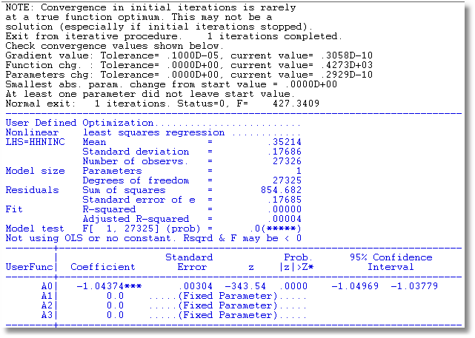
Constrained Estimation
Was 763.767

Slide 32
LM Test

Slide 33
LM Test
Namelist; x = one,educ,married,age$
Nlsq ; lhs = hhninc ; labels = a0,a1,a2,a3
; start = b0,0,0,0 ; fix = a1,a2,a3
; fcn = exp(a0+a1*educ+a2*married+a3*age)$
Create ; thetai = exp(x'b)
Create ; ei = hhninc - thetai$
Create ; gi = ei*thetai ; gi2 = gi*gi $
Matrix ; list
; LM = gi’x * <x'[gi2]x> * x’gi $
Matrix LM
1
+--------------
1| 1915.03286

Slide 34
Maximum Likelihood Estimation
Fully parametric estimation.
Density of y_{i} is fully specified
The likelihood function = the joint density of the observed random variables.
Example: density for the exponential model

Slide 35
The Likelihood Function

Slide 36
Consistency and Asymptotic Normality of the MLE
Conditions are identical to those for M estimation
Terms in proofs are log density and its derivatives
Nothing new is needed.
  Law of large numbers
  Lindberg-Feller central limit theorem applies to derivatives of the log likelihood.

Slide 37
Asymptotic Variance of the MLE

Slide 38
The Information Matrix Equality

Slide 39
Three Variance Estimators
Negative inverse of expected second derivatives matrix. (Usually not known)
Negative inverse of actual second derivatives matrix.
Inverse of variance of first derivatives

Slide 40
Asymptotic Efficiency
M estimator based on the conditional mean is semiparametric. Not necessarily efficient.
MLE is fully parametric. It is efficient among all consistent and asymptotically normal estimators when the density is as specified.
This is the Cramer-Rao bound.
Note the implied comparison to nonlinear least squares for the exponential regression model.

Slide 41
Invariance

Slide 42
Log Likelihood Function

Slide 43
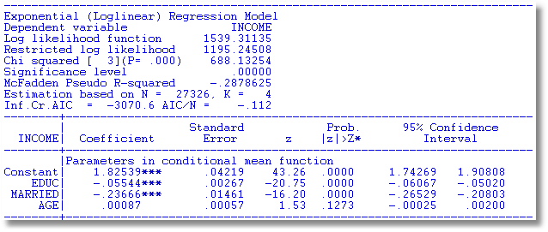
Application: Exponential Regression – MLE and NLS
MLE assumes E[y|x] = exp(-β′x) – Note sign reversal.

Slide 44
Variance Estimators

Slide 45
Three Variance Estimators

Slide 46
Robust (?) Estimator

Slide 47
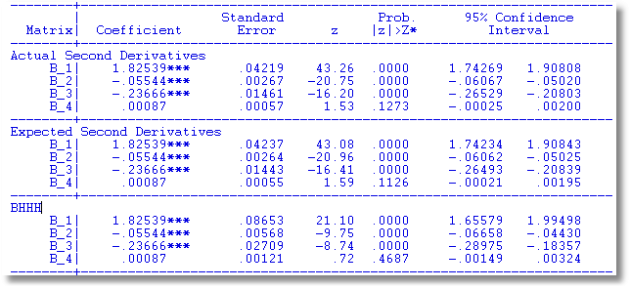
Variance Estimators
Loglinear ; Lhs=hhninc;Rhs=x ; Model = Exponential
create;thetai=exp(x'b);hi=hhninc*thetai;gi2=(hi-1)^2$
matr;he=<x'x>;ha=<x'[hi]x>;bhhh=<x'[gi2]x>$
matr;stat(b,ha);stat(b,he);stat(b,bhhh)$

Slide 48
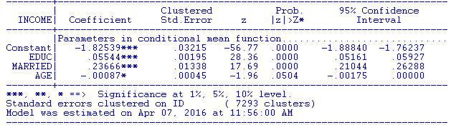
Robust Standard Errors
Exponential (Loglinear) Regression Model
--------+--------------------------------------------------------------------
| Clustered Prob. 95% Confidence
INCOME| Coefficient Std.Error z |z|>Z* Interval
--------+--------------------------------------------------------------------
|Parameters in conditional mean function.............................
Constant| -1.82539*** .02113 -86.37 .0000 -1.86681 -1.78397
EDUC| .05544*** .00126 43.90 .0000 .05296 .05791
MARRIED| .23666*** .00833 28.40 .0000 .22033 .25299
AGE| -.00087*** .00027 -3.20 .0014 -.00141 -.00034
--------+--------------------------------------------------------------------
NOTICE: The standard errors go down...
Standard errors clustered on Fixed (27326 clusters)

Slide 49
Hypothesis Tests
Trinity of tests for nested hypotheses
  Wald
  Likelihood ratio
  Lagrange multiplier
All as defined for the M estimators

Slide 50
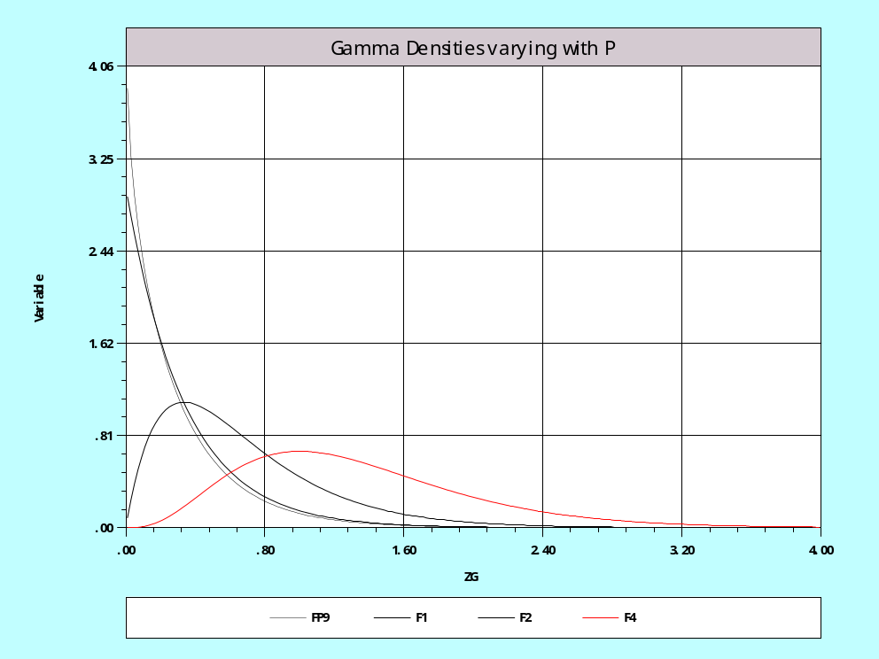
Example Exponential vs. Gamma
Exponential: P = 1
P > 1

Slide 51
Log Likelihood

Slide 52
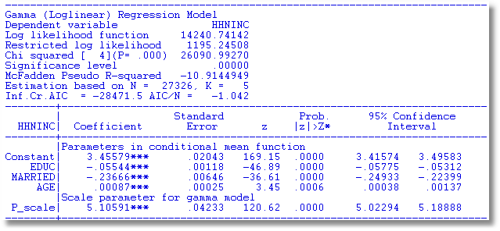
Estimated Gamma Model

Slide 53
Testing P = 1
Wald: W = (5.10591-1)²/.04233² = 9408.5
Likelihood Ratio:
  lnL|(P=1)= 1539.31
  lnL|P = 14240.74
  LR = 2(14240.74 - 1539.31)=25402.86
Lagrange Multiplier…

Slide 54
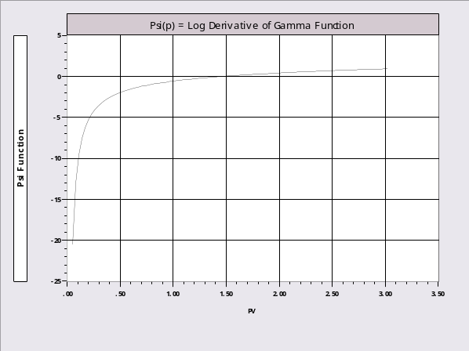
Derivatives for the LM Test

Slide 55
Score Test

Slide 56
Calculated LM Statistic
Loglinear ; Lhs = hhninc ; Rhs = x ; Model = Exponential $
Create;thetai=exp(x’b) ; gi=(hhninc*thetai – 1) $
Create;gpi=log(hhninc*thetai)-psi(1)$
Create;g1i=gi;g2i=gi*educ;g3i=gi*married;g4i=gi*age;g5i=gpi$
Namelist;ggi=g1i,g2i,g3i,g4i,g5i$
Matrix;list ; lm = 1'ggi * <ggi'ggi> * ggi'1 $
Matrix LM has 1 rows and 1 columns.
1
+--------------
1| 23468.7
? Use built-in procedure.
? LM is computed with actual Hessian instead of BHHH
Loglinear ; Lhs = hhninc ; Rhs = x ; Model = Exponential $
logl;lhs=hhninc;rhs=x;model=gamma;start=b,1;maxit=0 $
| LM Stat. at start values 9604.33 |

Slide 57
Clustered Data

Slide 58
Inference with ‘Clustering’

Slide 59
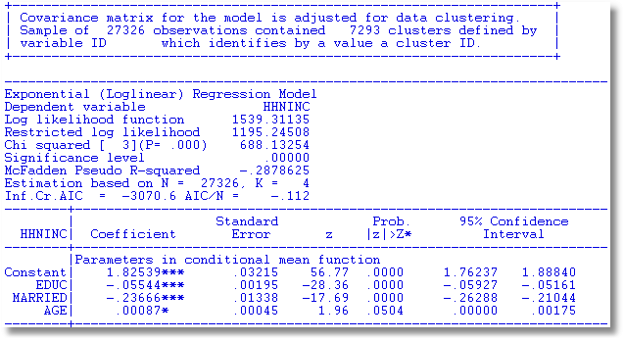
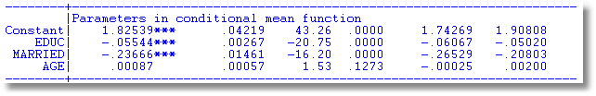
Cluster Estimation

Slide 60
On Clustering
The theory is rather loose.
That the marginals would be correctly specified while there is ‘correlation’ across observations is ambiguous
It seems to work pretty well in practice (anyway)
BUT… It does not imply that one can safely just pool the observations in a panel and ignore unobserved common effects.

Slide 61
‘Robust’ Estimation
If the model is misspecified in some way, then the information matrix equality does not hold.
Assuming the estimator remains consistent, the appropriate asymptotic covariance matrix would be the ‘robust’ matrix, actually, the original one,

Slide 62
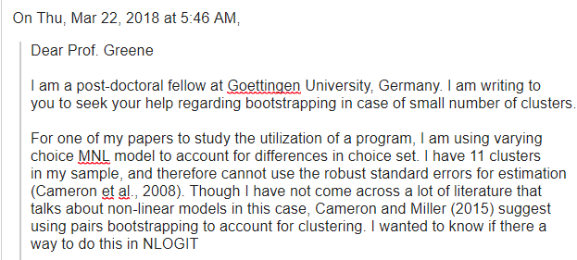

Slide 63
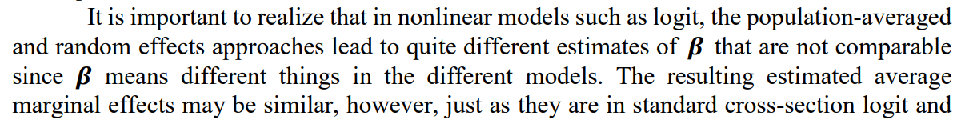
From Cameron and Miller: Practitioner’s Guide… Clustering

Slide 64
A Concentrated Log Likelihood

Slide 65
Normal Linear Regression

Slide 66
Two Step Estimation and Murphy/Topel

Slide 67
Two Step Estimation

Slide 68
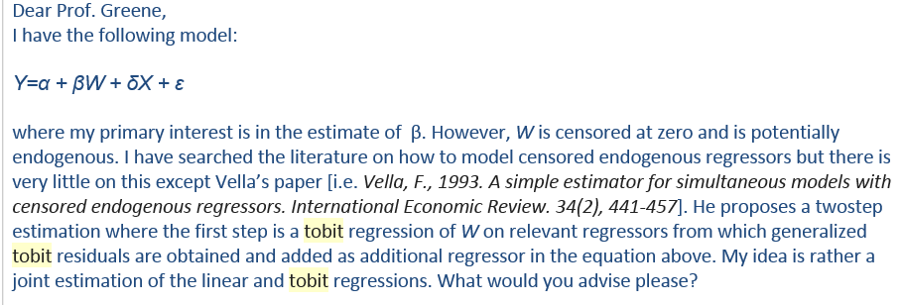

Slide 69
Murphy-Topel - 1

Slide 70
Murphy-Topel - 2

Slide 71
Optimization - Algorithms

Slide 72
Optimization

Slide 73
Algorithms

Slide 74
Line Search Methods

Slide 75
Quasi-Newton Methods

Slide 76
Stopping Rule

Slide 77
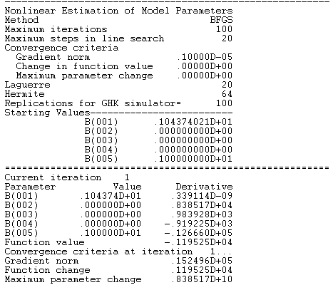
Start value for constant is log (mean HHNINC)
Start value for P is 1 => exponential model.

Slide 78
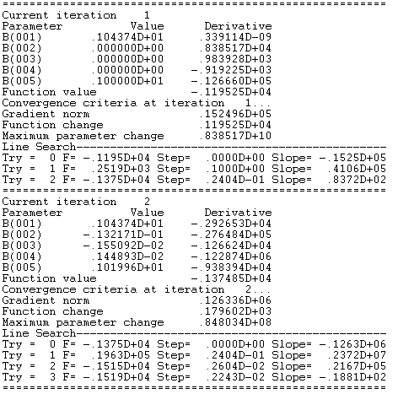

Slide 79
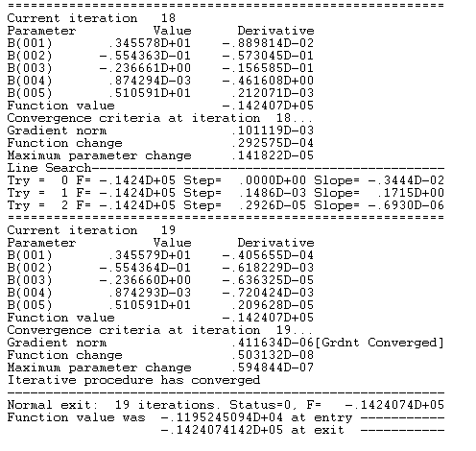

Slide 80
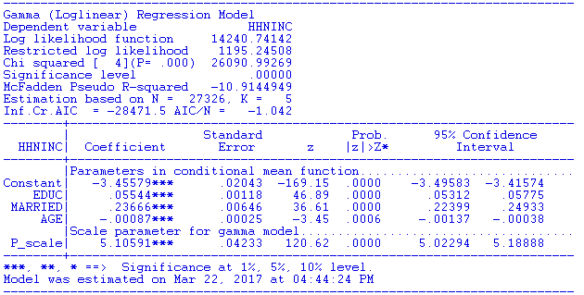

Slide 81
Appendix

Slide 82
The Conditional Mean Function

Slide 83
Asymptotic Normality of M Estimators

Slide 84
Asymptotic Normality

Slide 85
Asymptotic Normality

Slide 86
Asymptotic Variance

Slide 87
Conditional and Unconditional Likelihood

Slide 88
Concentrated Log Likelihood

Slide 89
‘Regularity’ Conditions for MLE
Conditions for the MLE to be consistent, etc.
Augment the continuity and identification conditions for M estimation
Regularity:
  Three times continuous differentiability of the log density
  Finite third moments of log density
  Conditions needed to obtain expected values of derivatives of log density are met.
(See Greene (Chapter 14))

Slide 90
GMM Estimation

Slide 91
GMM Estimation-1
GMM is broader than M estimation and ML estimation
Both M and ML are GMM estimators.

Slide 92
GMM Estimation - 2

Slide 93
ML and M Estimation

