Slide 1








Econometric Analysis of Panel Data
William Greene
Department of Economics
University of South Florida
Notes:
Basic Results for Binary Choice. Cross section – independent observations.

Slide 2
Econometric Analysis of Panel Data
15. Models for Binary Choice
Notes:
Basic Results for Binary Choice. Cross section – independent observations.
We will examine slides up to #104.

Slide 3
Agenda and References
Binary choice modeling – the leading example of formal nonlinear modeling
Binary choice modeling with panel data
  Models for heterogeneity
  Estimation strategies
    Unconditional and conditional
    Fixed and random effects
The incidental parameters problem
JW chapter 15, Baltagi, ch. 11, Hsiao ch. 7, Greene ch. 17.
Notes:
Most of the methodology for nonlinear models can be developed in the context of binary choice models.
Issues for panel data in Notes 16. The main issue is how to model (account for) unobserved heterogeneity. Most of the results for linear regression with
Fixed and random effects must be changed for the nonlinear case. Main issues to be studied are (1) FE and RE models, (2) Dynamic models, (3) handling
Fixed effects – dealing with the incidental parameters problem.

Slide 4

Model for a Binary Dependent Variable
Binary outcome.
  Event occurs or doesn’t (e.g., the person adopts green technology, the person enters the labor force, etc.)
  Model the probability of the event. P(x)=Prob(y=1|x)
  Probability responds to independent variables
Requirements for a probability
  0 < Probability < 1
  P(x) should be monotonic in x – it’s a CDF
Notes:
Modeling discrete choices requires a different style of econometric analysis. Modeling probabilities of events is not based on linear (style) regression analysis. On the other hand, the logic of modeling probabilities does bear some similarity to regression. E.g., the conditional probability of an event can increase or decrease with variation in the conditioning factor. We start by establishing what a model of a probability would look like.

Slide 5
Behavioral Utility Based Approach
Observed outcomes partially reveal underlying preferences
There exists an underlying preference scale defined over alternatives, U*(choices)
Revelation of preferences between two choices labeled 0 and 1 reveals the ranking of the underlying utility
  U*(choice 1) > U*(choice 0) Choose 1
  U*(choice 1) < U*(choice 0) Choose 0
Net utility = U = U*(choice 1) - U*(choice 0). U > 0 => choice 1
Notes:
Random utility is the most common (though not the only) paradigm on which probability models for behavior are based.

Slide 6
A Model for Binary Choice
Yes or No decision (Buy/NotBuy, Do/NotDo)
Example, choose to visit physician or not
Model: Net utility of visit at least once
U_{visit} = α+β₁Age + β₂Income + γSex + ε
Choose to visit if net utility is positive
Net utility = U_{visit} – U_{not visit}
Data: X = [1,age,income,sex]
y = 1 if choose visit, ⬄ U_{visit} > 0, 0 if not.
Random Utility
Notes:
Turning the RUM into an econometric model entails some thinking based on regression modeling. E.g., why do we need the random factor in random utility – because of unobserved heterogeneity in outcomes given stimuli.

Slide 7
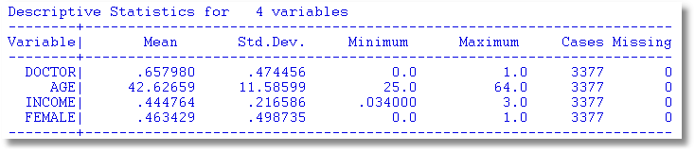
Application
27,326 Observations
  1 to 7 years, panel
  7,293 households observed
  We use the 1994 year, 3,337 household observations
Notes:
For example…

Slide 8

Binary Outcome: Visit Doctor
Notes:
Can we explain the variation in outcomes across heterogeneous individuals? What model will work?

Slide 9
Choosing Between the Two Alternatives
Modeling the Binary Choice
  U_{visit} = α + β₁ Age + β₂ Income + β₃ Sex + ε
Chooses to visit: U_{visit} > 0
α + β₁ Age + β₂ Income + β₃ Sex + ε > 0
ε > -[α + β₁ Age + β₂ Income + β₃ Sex ]
Notes:
We can only observe which of two alternatives is preferred. Given the observed factors (age, income, sex), the preference is random across individuals. In the example, “Visit” is preferred to “No Visit” if the random term epsilon exceeds the nonrandom index function. Provides a model framework in which otherwise similar people make different decisions.

Slide 10
An Econometric Model
Choose to visit iff Uvisit > 0
  Uvisit = α + β₁ Age + β₂ Income + β₃ Sex + ε
  Uvisit > 0 ⇔ ε > -(α + β₁ Age + β₂ Income + β₃ Sex)
  ε < α + β₁ Age + β₂ Income + β₃ Sex
Probability model: For any person observed by the analyst,
Prob(visit) = Prob[ε < α + β₁ Age + β₂ Income + β₃ Sex]
Note the relationship between the unobserved ε and the outcome
Notes:
Drawing the connection between the underlying theory and a statistical relationship. (The second subitem above uses the relationship F(z) = 1 – F(-z) for symmetric distributions such as normal and logistic.

Slide 11
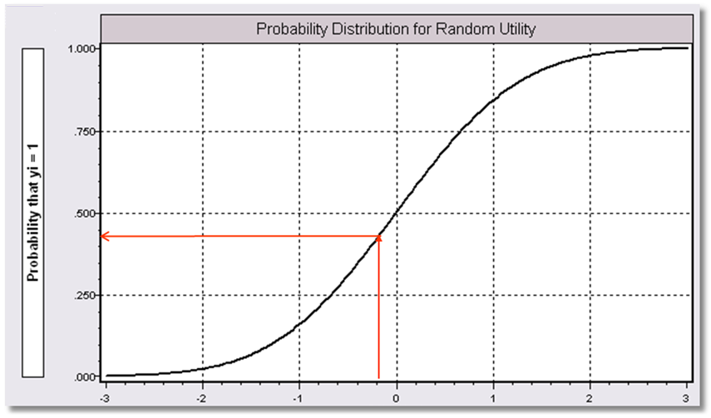
α+β₁Age + β₂ Income + β3 Sex
Notes:
Based on the previous slide.

Slide 12
Fully Parametric
Index Function: U* = β’x + ε
Observation Mechanism: y = 1[U* > 0]
Distribution: ε ~ f(ε); Normal, Logistic, …
Maximum Likelihood Estimation:
Max(β) logL = Σ_{i} log Prob(Y_{i} = y_{i}|x_{i})
Notes:
Once the specification (model) is completely specified, a likelihood function can be constructed. There are non- and semiparametric approaches in the literature, but they are marginal in the literature.

Slide 13
Completing the Model: F(ε)
The distribution
  Normal: PROBIT, natural for behavior
  Logistic: LOGIT, allows “thicker tails”
  Gompertz: EXTREME VALUE, asymmetric
  Others…
Does it matter?
  Yes, large difference in estimates
  Not much, quantities of interest are more stable.
Notes:
There are many candidates for the distribution. Easy to program. Probit (since the 1930s) is the natural choice and probably most popular. Logit is second among social scientists. One would hope that the choice, since it seems arbitrary, doesn’t matter much. That turns out to be true.

Slide 14
Parametric Model Estimation
How to estimate α, β₁, β₂, β₃?
  The technique of maximum likelihood
  Prob[y=1] = Prob[ε > -(α + β₁ Age + β₂ Income + β₃ Sex)]
  Prob[y=0] = 1 - Prob[y=1]
Requires a model for the probability
Notes:
Maximum likelihood estimation.

Slide 15
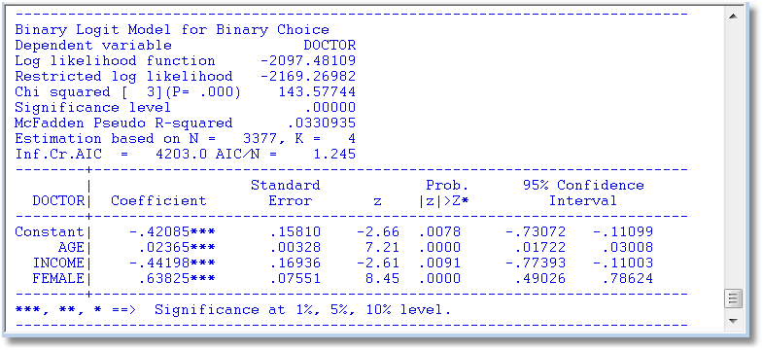
Parametric: Logit Model
What do these mean?
Notes:
A logit model based on the example/data specified earlier. Step 1. How do we interpret the coefficients. What does the value 0.63825 on the gender dummy variable mean? How should it be interpreted?

Slide 16
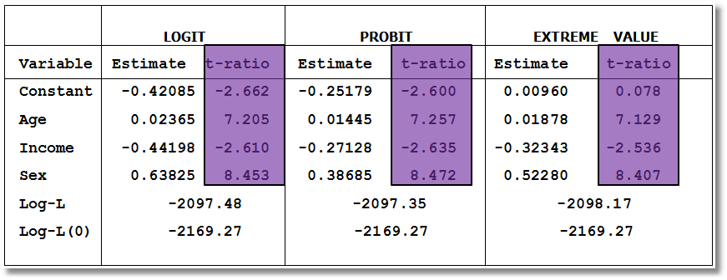
Estimated Binary Choice Models
Ignore the t ratios for now.
Notes:
Superficially, it looks like the three different models produce quite different results. This is not good.

Slide 17
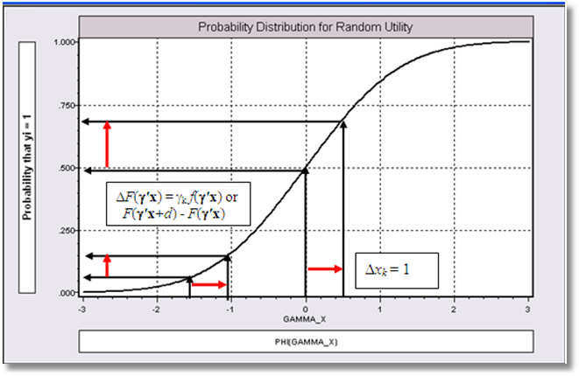
Effect on Predicted Probability of an Increase in Age
α + β₁ (Age+1) + β₂ (Income) + β₃ Sex
(β₁ is positive)
Notes:
The model, ultimately, describes how the probability varies with values of the determinants, e.g., age. The probability function is nonlinear, so it is necessary to take the derivative at a particular. Clearly, the starting point matters. (Same change in the index function, beta1, different change in the function.

Slide 18
Partial Effects in
Probability Models
Prob[Outcome] = some F(α+β₁Income…)
“Partial effect” = ∂F(α+β₁Income…) / ∂”x” (derivative)
  Partial effects are derivatives
  Result varies with model
    Logit: ∂F(α+β₁Income…) /∂x = Prob * (1-Prob) × β
    Probit: ∂ F(α+β₁Income…)/∂x = Normal density × β
    Extreme Value: ∂ F(α+β₁Income…)/∂x = Prob * (-log Prob) × β
  Scaling usually erases model differences
Notes:
Resolving the different results across the different specifications. Each has its own coefficients and its own scale factor. Scal times coefficients tends to erase the differences across models.

Slide 19
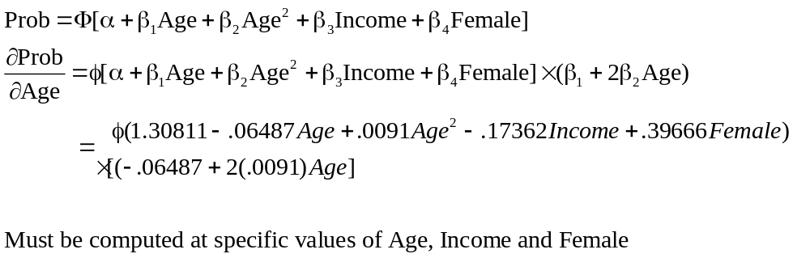
Partial Effect for Nonlinear Terms
Notes:
Matters are even more complicated if there are nonlinearities, such as interaction terms in the index. See Ai and Norton (2003) and Greene (2010).

Slide 20
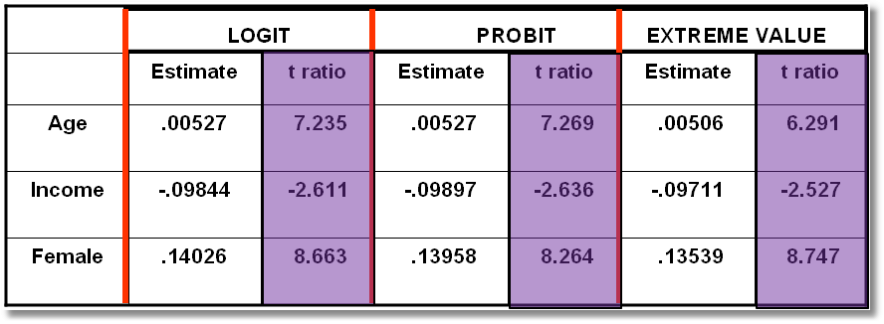
Estimated Partial Effects
Notes:
As expected. Partial effects across models do not differ substantively. Choice of model is based on rather marginal considerations, such as the appeal of odds ratios, or preference for the normal distribution.

Slide 21
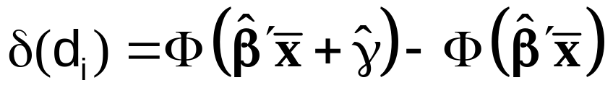
Partial Effect for a Dummy Variable
Prob[y_{i} = 1|x_{i},d_{i}] = F(β’x_{i}+γd_{i})
= conditional mean
Partial effect of d
Prob[y_{i} = 1|x_{i}, d_{i}=1] - Prob[y_{i} = 1|x_{i}, d_{i}=0]
Probit:
Notes:
Change in a dummy variable is not “marginal.” Use partial difference. (Tends to give similar reslts.)

Slide 22
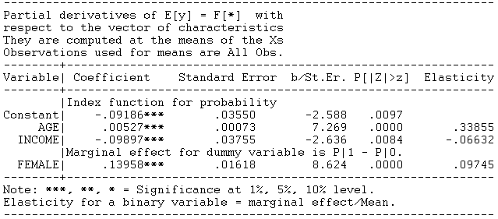
Partial Effect – Dummy Variable

Slide 23
Computing Effects
Compute at the data means?
  Simple
  Inference is well defined
Average the individual effects
  More appropriate?
  Asymptotic standard errors more complicated.
Is testing about marginal effects meaningful?
  f(b’x) must be > 0; b is highly significant
  How could f(b’x)*b equal zero?
Notes:
Average partial effects are usually preferred. (The third item is discussed in Greene (2010). Has not attracted much attention.)

Slide 24
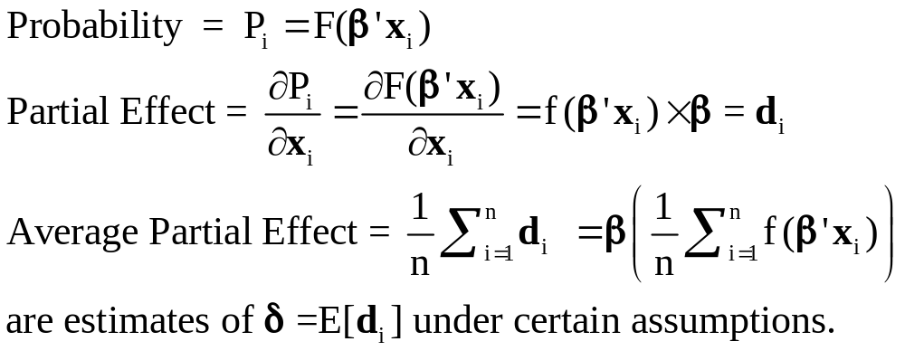
Average Partial Effects
Notes:
The APE.

Slide 25
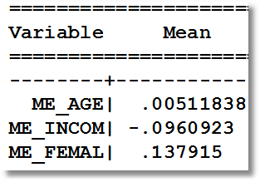
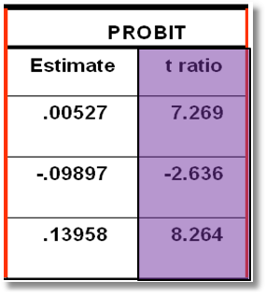
Average Partial Effects vs. Partial Effects at Data Means
Notes:
Small differences. APE is usually preferred.

Slide 26
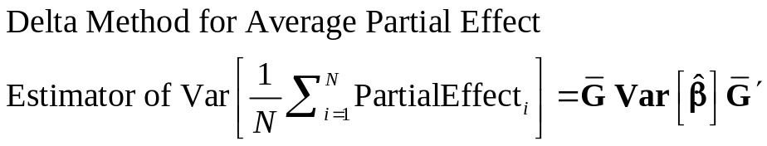
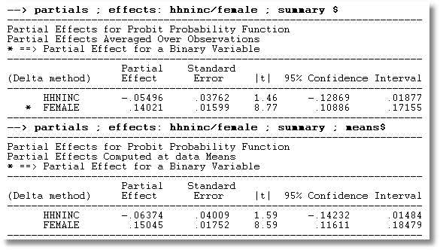
APE vs. Partial Effects at the Mean

Slide 27
Practicalities of Nonlinearities
The software does not know that agesq = age².
PROBIT ; Lhs=doctor
; Rhs=one,age,agesq,income,female
; Partial effects $
PROBIT ; Lhs=doctor
; Rhs=one,age,age*age,income,female $
PARTIALS ; Effects : age $
The software now knows that age * age is age².
Notes:
Technological advance in modern software.

Slide 28
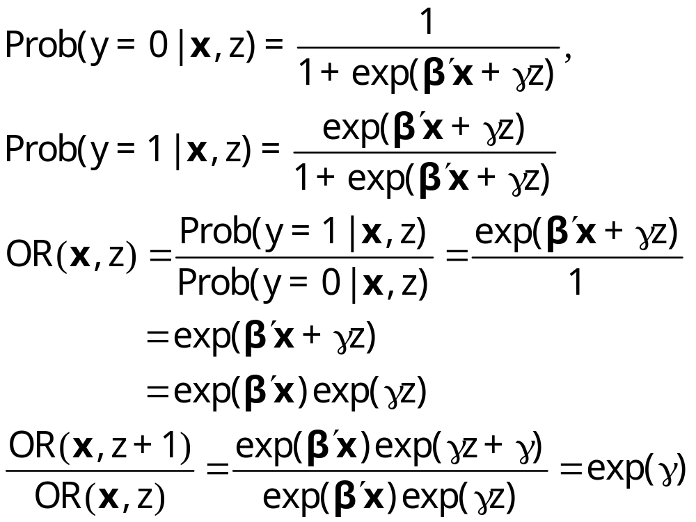
Odds Ratios
This calculation is not meaningful if the model is not a binary logit model
Notes:
Odds ratios. Reasonable people differ on how useful these are. Many researchers like the logit model because “odds ratios” are produced and are easy to compute.

Slide 29
Odds Ratio
Exp(γ) = multiplicative change in the odds ratio when z changes by 1 unit.
dOR(x,z)/dx = OR(x,z)*β, not exp(β)
The “odds ratio” is not a partial effect – it is not a derivative.
It is only meaningful when the odds ratio is itself of interest and the change of the variable by a whole unit is meaningful.
“Odds ratios” might be interesting for dummy variables

Slide 30
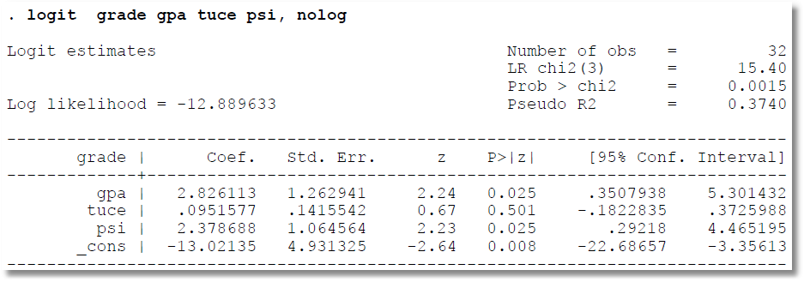
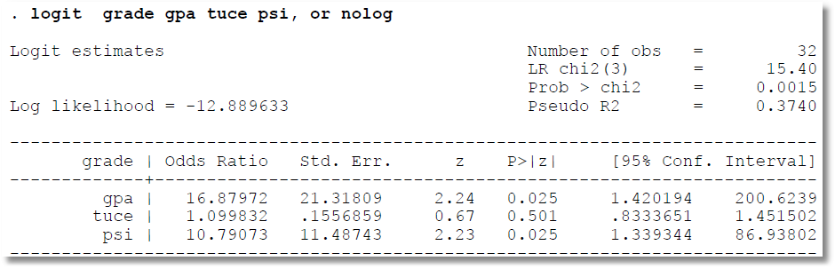
Cautions About reported Odds Ratios
Notes:
Don’t be misled. CI is computed properly [exp(limit)] but not labeled well.

Slide 31
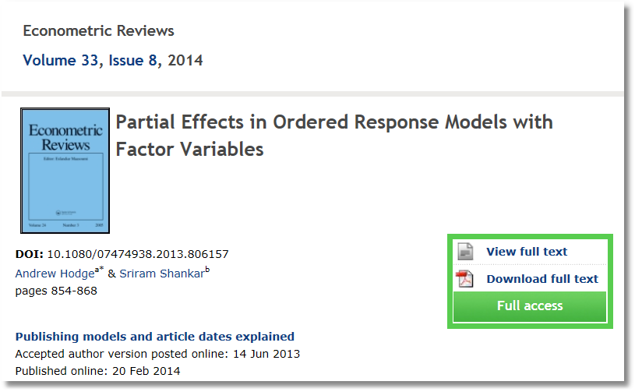
Notes:
The “effect” in a model might be a change from one category to another.

Slide 32
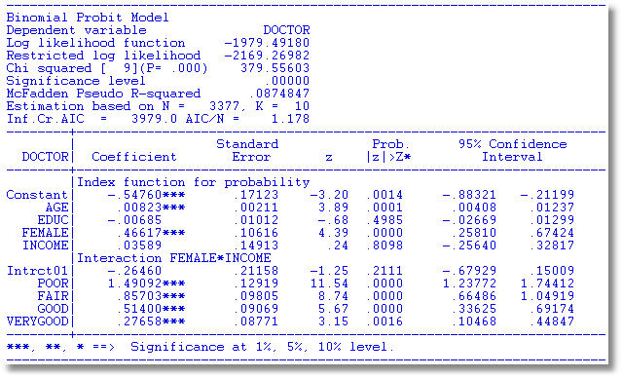
Notes:
5 levels of health, poor, fair, good, very good, excellent.

Slide 33
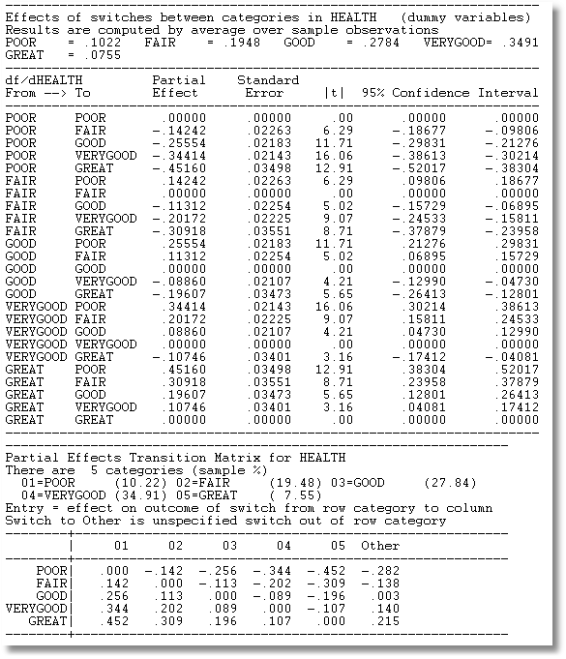
Effect on Prob(Visit Doctor)
Notes:
Effect on probability of visiting doctor resulting from switch from one category to another. A transition matrix.

Slide 34

A Dynamic Ordered Probit Model

Slide 35
Model for Self Assessed Health
British Household Panel Survey (BHPS)
  Waves 1-8, 1991-1998
  Self assessed health on 0,1,2,3,4 scale
  Sociological and demographic covariates
  Dynamics – inertia in reporting of top scale
Dynamic ordered probit model
  Balanced panel – analyze dynamics
  Unbalanced panel – examine attrition

Slide 36

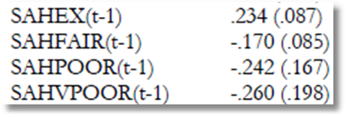
Partial Effect for a Category
These are 4 dummy variables for state in the previous period. Using first differences, the 0.234 estimated for SAHEX means transition from EXCELLENT in the previous period to GOOD in the current period, where GOOD is the omitted category. Likewise for the other 3 previous state variables. The margin from ‘POOR’ to ‘GOOD’ was not interesting in the paper. The better margin would have been from EXCELLENT to POOR, which would have (EX,POOR) change from (1,0) to (0,1).

Slide 37
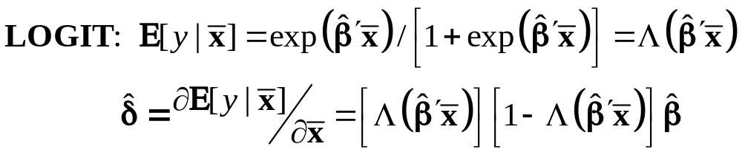
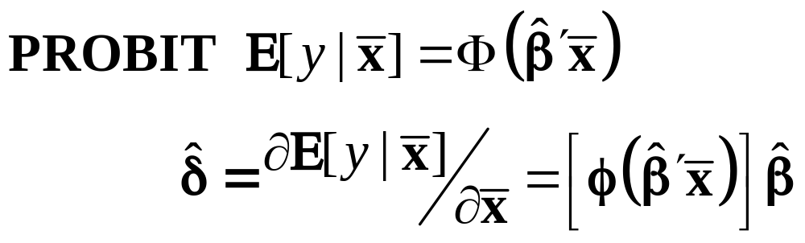
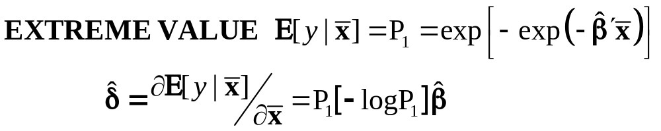
Marginal Effects for Binary Choice
Notes:
Messy function of data and estimated parameters. How to compute standard errors?

Slide 38
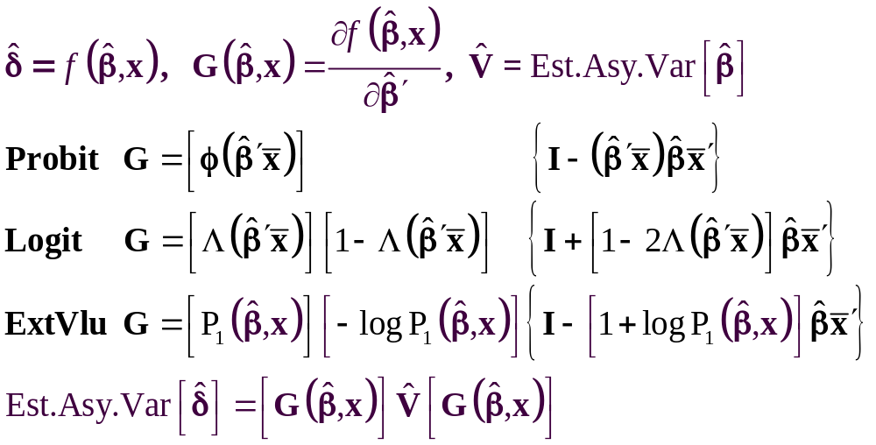
The Delta Method
Notes:
Delta method is the usual choice. V is the estimated asymptotic covariance matrix for the parameter estimator. G is the “Jacobian,” the derivatives of the vector of partial effects with respect to the parameters. Gis a Kx(K+1) matrix (the row for the partial effect wrt the constant term is omitted.)

Slide 39
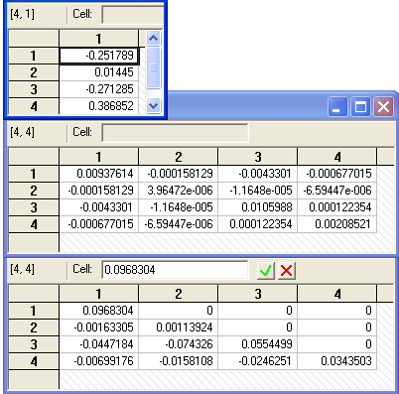
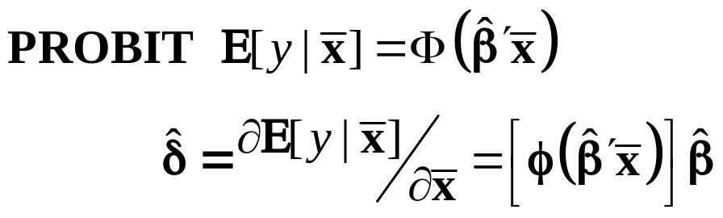
Method of Krinsky and Robb
Estimate β by Maximum Likelihood with b
Estimate asymptotic covariance matrix with V
Draw R observations b(r) from the normal
population N[b,V]
b(r) = b + C*v(r), v(r) drawn from N[0,I]
C = Cholesky matrix, V = CC’
Compute partial effects d(r) using b(r)
Compute the sample variance of d(r),r=1,…,R
Use the sample standard deviations of the R observations to estimate the sampling standard errors for the partial effects.
Notes:
Krinsky and Robb is less common. Works as well as delta method as long as R is large enough.

Slide 40
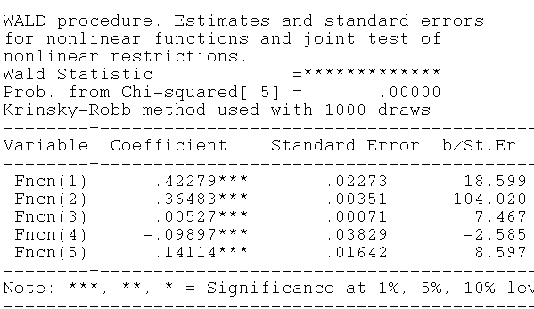
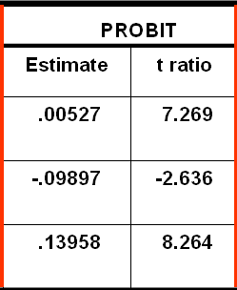
Krinsky and Robb
Delta Method

Slide 41
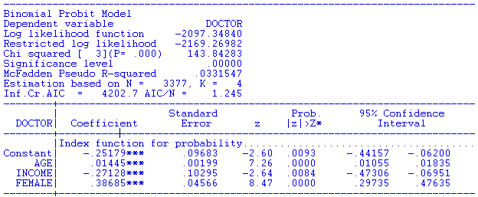
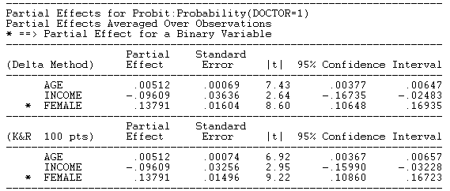

Slide 42
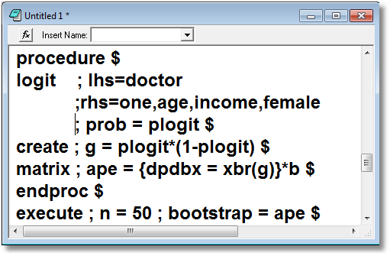
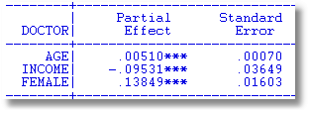
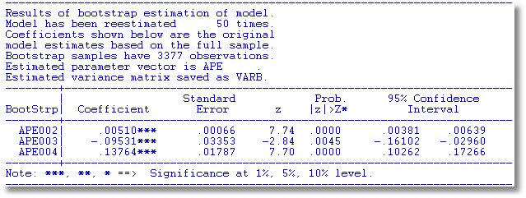
Delta Method

Slide 43

Notes:
A nice application of binary choice models. The puzzle is that despite overwhelming economic advantage, consumers are reluctant to adopt efficient light bulb (CFL, LED) technologies. The interesting effect in this paper is the influence of environmental consciousness on this decision.

Slide 44
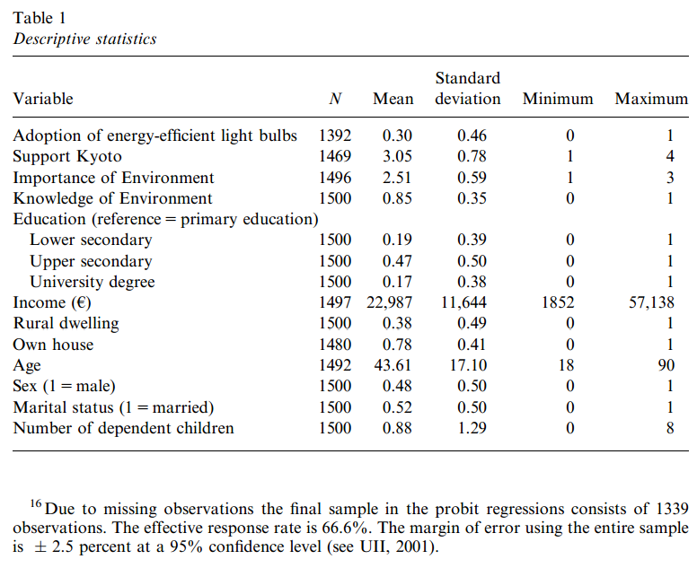
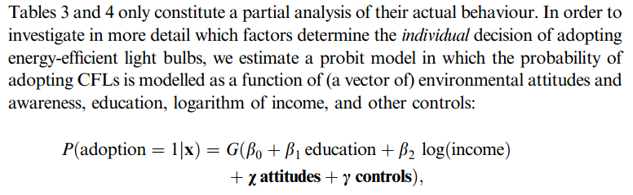
Notes:
Probit model.

Slide 45
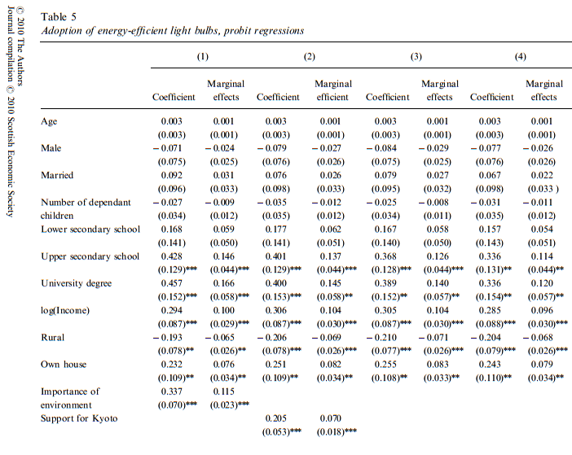
Notes:
Authors report both coefficients and partial effects. Some very recent applications skip the coefficients and just report partial effects.

Slide 46
Measuring Fit

Slide 47
How Well Does the Model Fit?
There is no R squared.
  Least squares for linear models is computed to maximize R²
  There are no residuals or sums of squares in a binary choice model
  The model is not computed to optimize the fit of the model to the data
How can we measure the “fit” of the model to the data?
  “Fit measures” computed from the log likelihood
    “Pseudo R squared” = 1 – logL/logL0
    Also called the “likelihood ratio index”
    Others… - these do not measure fit.
  Direct assessment of the effectiveness of the model at predicting the outcome

Slide 48
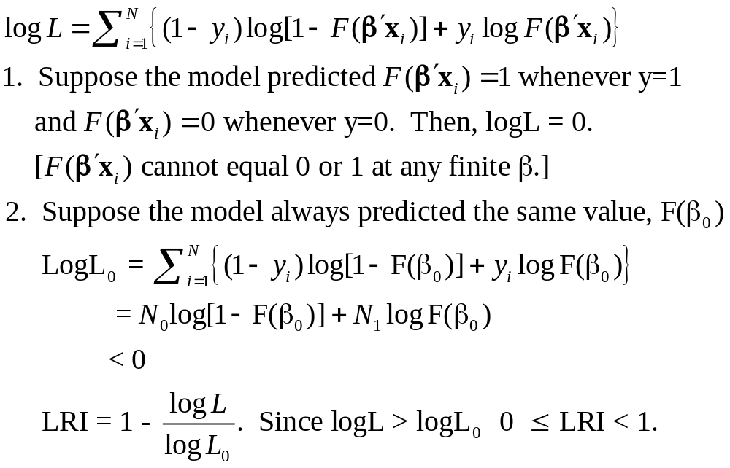
Likelihood Ratio Index
Notes:
Pseudo R-squared. Be careful about calling it R-squared. It’s not actually a squared correlation or based on sums of squares.

Slide 49
Fit Measures Based on LogL
----------------------------------------------------------------------
Binary Logit Model for Binary Choice
Dependent variable DOCTOR
Log likelihood function -2085.92452 Full model LogL
Restricted log likelihood -2169.26982 Constant term only LogL0
Chi squared [ 5 d.f.] 166.69058
Significance level .00000
McFadden Pseudo R-squared .0384209 1 – LogL/logL0
Estimation based on N = 3377, K = 6
Information Criteria: Normalization=1/N
Normalized Unnormalized
AIC 1.23892 4183.84905 -2LogL + 2K
Fin.Smpl.AIC 1.23893 4183.87398 -2LogL + 2K + 2K(K+1)/(N-K-1)
Bayes IC 1.24981 4220.59751 -2LogL + KlnN
Hannan Quinn 1.24282 4196.98802 -2LogL + 2Kln(lnN)
--------+-------------------------------------------------------------
Variable| Coefficient Standard Error b/St.Er. P[|Z|>z] Mean of X
--------+-------------------------------------------------------------
|Characteristics in numerator of Prob[Y = 1]
Constant| 1.86428*** .67793 2.750 .0060
AGE| -.10209*** .03056 -3.341 .0008 42.6266
AGESQ| .00154*** .00034 4.556 .0000 1951.22
INCOME| .51206 .74600 .686 .4925 .44476
AGE_INC| -.01843 .01691 -1.090 .2756 19.0288
FEMALE| .65366*** .07588 8.615 .0000 .46343
--------+-------------------------------------------------------------

Slide 50
Fit Measures Based on Predictions
Computation
  Use the model to compute predicted probabilities
  Use the model and a rule to compute predicted y = 0 or 1
Fit measure compares predictions to actuals

Slide 51
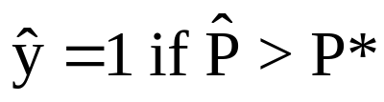
Predicting the Outcome
Predicted probabilities
P = F(a + b₁Age + b₂Income + b₃Female+…)
Predicting outcomes
  Predict y=1 if P is “large”
  Use 0.5 for “large” (more likely than not)
  Generally, use
Count successes and failures

Slide 52
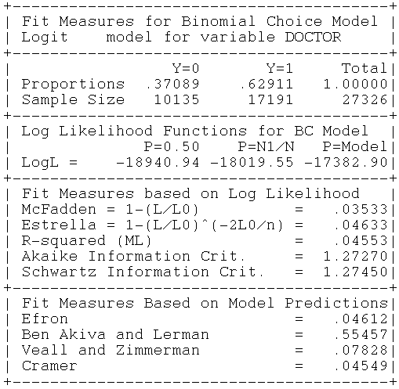

Slide 53
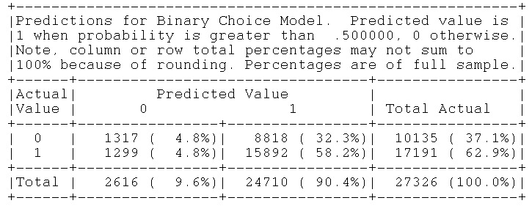
Notes:
This is a “confusion matrix.” The parameters are not actually computed to optimize the sum of the diagonals.

Slide 54
Hypothesis Testing in Binary Choice Models

Slide 55
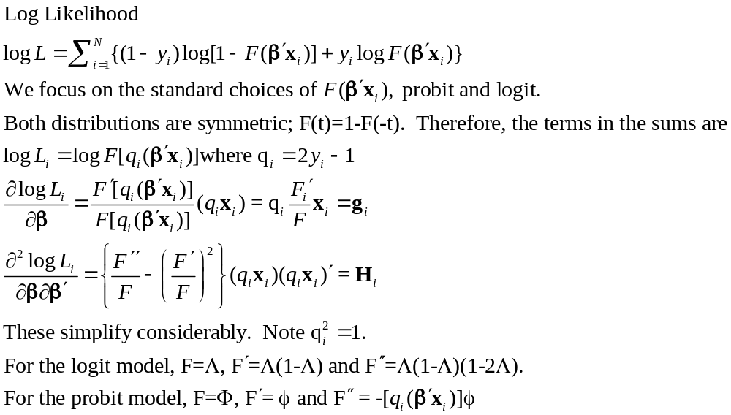
Covariance Matrix for the MLE
Notes:
Inference begins with the criterion function, logL, the estimates and the estimated covariance matrix.

Slide 56
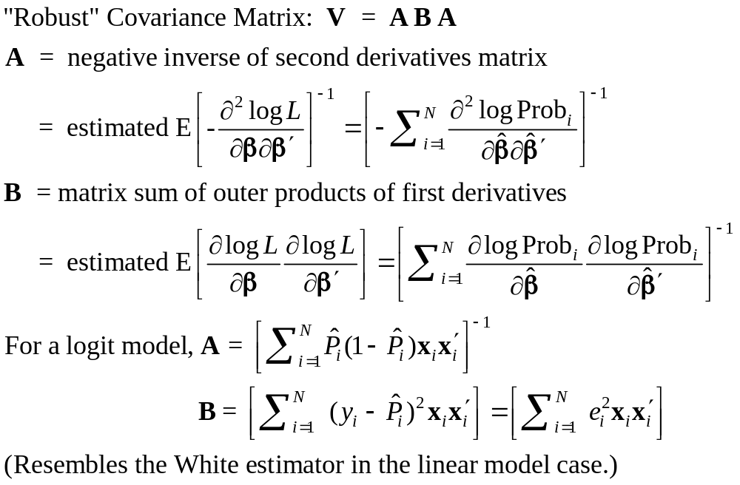
Robust Covariance Matrix
Notes:
The estimator is not “wrong.” But, it is not clear what it is robust to. Most of the familiar model failures (measurement error, omitted variables, latent heterogeneity) make the MLE inconsistent. This calculation is usually harmless, but not actually beneficial.

Slide 57
Robust Covariance Matrix for Logit Model
--------+-------------------------------------------------------------
Variable| Coefficient Standard Error b/St.Er. P[|Z|>z] Mean of X
--------+-------------------------------------------------------------
|Robust Standard Errors
Constant| 1.86428*** .68442 2.724 .0065
AGE| -.10209*** .03115 -3.278 .0010 42.6266
AGESQ| .00154*** .00035 4.446 .0000 1951.22
INCOME| .51206 .75103 .682 .4954 .44476
AGE_INC| -.01843 .01703 -1.082 .2792 19.0288
FEMALE| .65366*** .07585 8.618 .0000 .46343
--------+-------------------------------------------------------------
|Conventional Standard Errors Based on Second Derivatives
Constant| 1.86428*** .67793 2.750 .0060
AGE| -.10209*** .03056 -3.341 .0008 42.6266
AGESQ| .00154*** .00034 4.556 .0000 1951.22
INCOME| .51206 .74600 .686 .4925 .44476
AGE_INC| -.01843 .01691 -1.090 .2756 19.0288
FEMALE| .65366*** .07588 8.615 .0000 .46343

Slide 58
Base Model for Hypothesis Tests
----------------------------------------------------------------------
Binary Logit Model for Binary Choice
Dependent variable DOCTOR
Log likelihood function -2085.92452
Restricted log likelihood -2169.26982
Chi squared [ 5 d.f.] 166.69058
Significance level .00000
McFadden Pseudo R-squared .0384209
Estimation based on N = 3377, K = 6
Information Criteria: Normalization=1/N
Normalized Unnormalized
AIC 1.23892 4183.84905
--------+-------------------------------------------------------------
Variable| Coefficient Standard Error b/St.Er. P[|Z|>z] Mean of X
--------+-------------------------------------------------------------
|Characteristics in numerator of Prob[Y = 1]
Constant| 1.86428*** .67793 2.750 .0060
AGE| -.10209*** .03056 -3.341 .0008 42.6266
AGESQ| .00154*** .00034 4.556 .0000 1951.22
INCOME| .51206 .74600 .686 .4925 .44476
AGE_INC| -.01843 .01691 -1.090 .2756 19.0288
FEMALE| .65366*** .07588 8.615 .0000 .46343
--------+-------------------------------------------------------------
H₀: Age is not a significant
determinant of
Prob(Doctor = 1)
H₀: β₂ = β₃ = β₅ = 0
Notes:
We consider ways to test a hypothesis.

Slide 59
Likelihood Ratio Tests
Null hypothesis restricts the parameter vector
Alternative relaxes the restriction
Test statistic: Chi-squared =
2 (LogL|Unrestricted model –
LogL|Restrictions) > 0
Degrees of freedom = number of restrictions
Notes:
LR is the most familiar.

Slide 60
LR Test of H₀
UNRESTRICTED MODEL
Binary Logit Model for Binary Choice
Dependent variable DOCTOR
Log likelihood function -2085.92452
Restricted log likelihood -2169.26982
Chi squared [ 5 d.f.] 166.69058
Significance level .00000
McFadden Pseudo R-squared .0384209
Estimation based on N = 3377, K = 6
Information Criteria: Normalization=1/N
Normalized Unnormalized
AIC 1.23892 4183.84905
RESTRICTED MODEL
Binary Logit Model for Binary Choice
Dependent variable DOCTOR
Log likelihood function -2124.06568
Restricted log likelihood -2169.26982
Chi squared [ 2 d.f.] 90.40827
Significance level .00000
McFadden Pseudo R-squared .0208384
Estimation based on N = 3377, K = 3
Information Criteria: Normalization=1/N
Normalized Unnormalized
AIC 1.25974 4254.13136
Chi squared[3] = 2[-2085.92452 - (-2124.06568)] = 77.46456

Slide 61
Wald Test
Unrestricted parameter vector is estimated
Discrepancy: q= Rb – m (or r(b,m) if nonlinear) is computed
Variance of discrepancy is estimated:
Var[q] = R V R’
Wald Statistic is q’[Var(q)]⁻¹q = q’[RVR’]⁻¹q
Notes:
The standard t test is a Wald test for the restriction β(k) = 0.

Slide 62
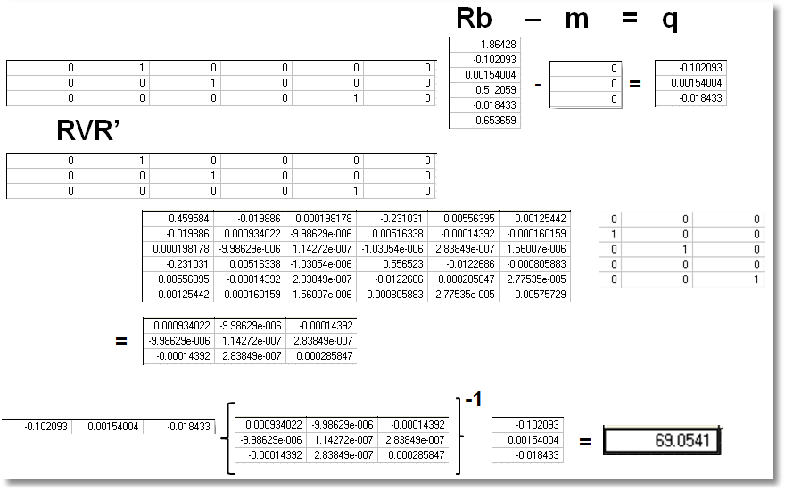
Wald Test
Chi squared[3] = 69.0541
Notes:
Mechanics of a Wald test.

Slide 63
Lagrange Multiplier Test
Restricted model is estimated
Derivatives of unrestricted model and variances of derivatives (Hessian) are computed at restricted estimates
Wald test of whether derivatives are zero tests the restrictions
Usually hard to compute – difficult to program the derivatives and their variances.
Notes:
The LM test is not common. It is simple because it based only on the possibly simpler restricted model.

Slide 64
LM Test for a Logit Model
Compute b₀ (subject to restictions)
(e.g., with zeros in appropriate positions.
Compute P_{i}(b₀) for each observation.
Compute e_{i}(b₀) = [y_{i} – P_{i}(b₀)]
Compute g_{i}(b₀) = x_{i}e_{i} using full x_{i} vector
LM = [Σ_{i}g_{i}(b₀)]’[Σ_{i}g_{i}(b₀)g_{i}(b₀)]⁻¹[Σ_{i}g_{i}(b₀)]

Slide 65
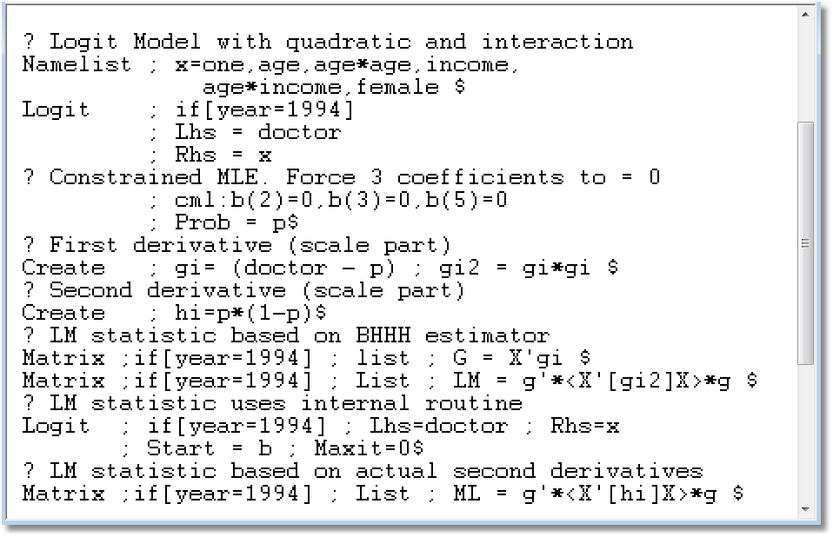

Slide 66
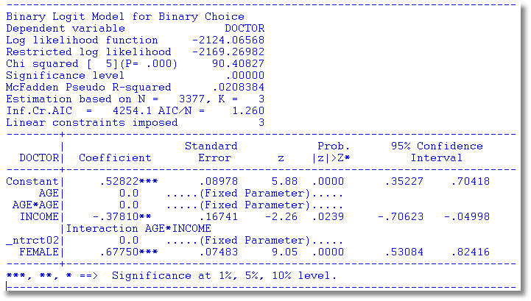

Slide 67
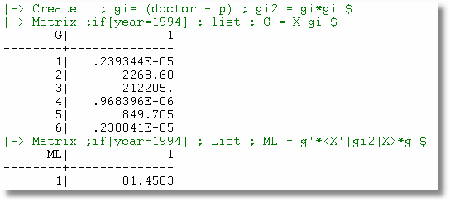
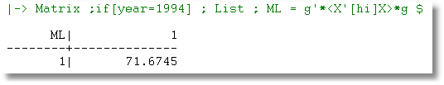
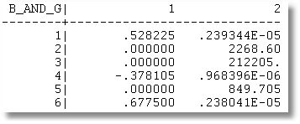
Notes:
Mechanics of the LM test.

Slide 68
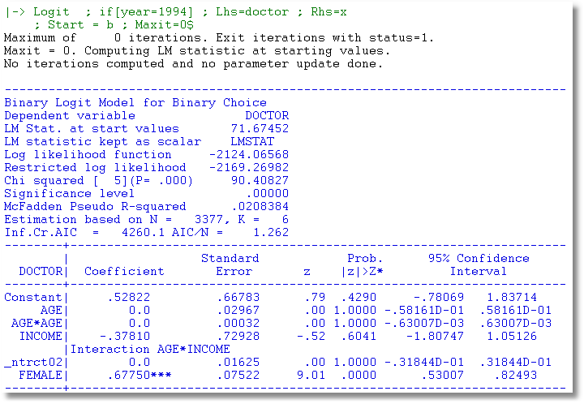
Notes:
Actually built-in to NLOGIT. ;MAXIT=0 triggers LM test using starting values.

Slide 69

Notes:
This interesting application uses several of the techniques and results we have discussed here.

Slide 70


Notes:
This is a recursive discrete choice model. The S equation is a probit model as we have discussed to this point. The H equation is an “ordered choice” (scale variable, coded 1,2,3,4,5). Notice that S is endogenous in the H equation if epsilon and v are correlated. This is the typical form of “endogeneity” in a treatment effects sort of model. Note that both models are nonlinear. Can’t use 2SLS here, though there are some who would (Angrist and Pischke). How to estimate the model? With bivariate normality, full information ML.

Slide 71


Wald Test
Notes:
Carrying out a test of the validity of the three instruments. Since the model is not linear, this test is actually inappropriate. Still, notice they use a Wald test. They also use the delta method to compute a standard error for the estimate of rho when the compute an estimate of tau = (1/2)ln[(1-rho)/(1+rho)]. Tau is the hyperbolic arctangent (atanh(.)) of rho, not the tanh(rho). The “test of instruments’ strength is carried out as if the equations were linear.. The rule of thumb threshold of 10 is actually not proper here. The three instruments are shown on the next page.

Slide 72


Slide 73
Bivariate Probit Models

Slide 74


Slide 75

Notes:
Another application related to health. Now a panel data application. The Debt equation is a probit. Health is also a probit model, but Debt is endogenous in the Health equation if epsilon and v are correlated. (Same arrangement as the SNAP model.) Again, it’s tempting to use 2SLS here, but improper as the models are nonlinear.

Slide 76

Journal of Consumer Affairs
Notes:
Yet another bivariate probit application. This one dynamic.

Slide 77

Probit Model for Being “Banked”
Notes:
Random effects probit for “banked” in period t.

Slide 78

Two Period Random Effects Probit
Notes:
Bivariate aspect is set up by a two period model where status in period 1 is conditioned on status in period 0. Note common random effect that makes this a “bivariate” model.

Slide 79

Recursive Bivariate Probit
Notes:
Becomes a bivariate probit model with dynamic pecification. Note yi0 is endogenous because of the common ui in the two periods.

Slide 80


Partial Effects
Notes:
Partial effects on unbanked status in period 1 given banked status in period 0. This is a switching outcomes model, not a treatment effects model.

Slide 81
Endogenous RHS Variable
U* = β’x + θh + ε
y = 1[U* > 0]
E[ε|h] ≠ 0 (h is endogenous)
  Case 1: h is continuous
  Case 2: h is binary = a treatment effect
Approaches
  Parametric: Maximum Likelihood
  Semiparametric (not developed here):
    GMM
    Various approaches for case 2
Notes:
Now some generalities. Note that the treatment effects model is one case of the more general bivariate probit model, as shown in the preceding examples.

Slide 82
Endogenous Binary Variable
U* = β’x + θh + ε
y = 1[U* > 0]
h* = α’z + u
h = 1[h* > 0]
E[ε|h*] ≠ 0 ⬄ Cov[u, ε] ≠ 0
Additional Assumptions:
(u,ε) ~ N[(0,0),(σ_{u}², ρσ_{u}, 1)]
z = a valid set of exogenous
variables, uncorrelated with (u,ε)
⇐
Correlation = ρ.
This is the source of the endogeneity
This is not IV estimation. Z may be uncorrelated with X without problems.
Notes:
This is the template case in the treatment effects literature. Estimable by FIML by many people. (Stata “IVProbit” model. Not really IV. The Stata routine is FIML. Currently, many, many people
Use 2SLS even with the two nonlinear equations.

Slide 83


Endogenous Binary Variable
Doctor = F(age,age²,income,female,Public)
Public = F(age,educ,income,married,kids,female)
Notes:
A stylized application. Public is endogenous treatment in the Doctor equation.

Slide 84

Log Likelihood for the RBP Model
What about instruments and identification?
Notes:
Z and X can be the same. The model can be estimated by FIML anyway. Not by 2SLS if so, however, because h^ will be a linear combination of the variables in X. This is an
Example of identification by functional form. We’ll see this again later.

Slide 85
FIML Estimates
----------------------------------------------------------------------
FIML Estimates of Bivariate Probit Model
Dependent variable DOCPUB
Log likelihood function -25671.43905
Estimation based on N = 27326, K = 14
--------+-------------------------------------------------------------
Variable| Coefficient Standard Error b/St.Er. P[|Z|>z] Mean of X
--------+-------------------------------------------------------------
|Index equation for DOCTOR
Constant| .59049*** .14473 4.080 .0000
AGE| -.05740*** .00601 -9.559 .0000 43.5257
AGESQ| .00082*** .681660D-04 12.100 .0000 2022.86
INCOME| .08883* .05094 1.744 .0812 .35208
FEMALE| .34583*** .01629 21.225 .0000 .47877
PUBLIC| .43533*** .07357 5.917 .0000 .88571
|Index equation for PUBLIC
Constant| 3.55054*** .07446 47.681 .0000
AGE| .00067 .00115 .581 .5612 43.5257
EDUC| -.16839*** .00416 -40.499 .0000 11.3206
INCOME| -.98656*** .05171 -19.077 .0000 .35208
MARRIED| -.00985 .02922 -.337 .7361 .75862
HHKIDS| -.08095*** .02510 -3.225 .0013 .40273
FEMALE| .12139*** .02231 5.442 .0000 .47877
|Disturbance correlation
RHO(1,2)| -.17280*** .04074 -4.241 .0000
--------+-------------------------------------------------------------
Notes:
Notice the correlation. If it is zero, then PUBLIC is exogenous. So we test endogeneity by testing whether RHO is nonzero. There is no such constructive test for endogeneity in the
Linear case.

Slide 86

Partial Effects
Notes:
Partial effects are rather complicated. Modern researchers don’t like complicated results.

Slide 87

2 Stage Residual Inclusion
Notes:
This is a newer method of dealing with endogeneity. We saw this approach when we discussed 2SLS. In the equation above, to fit the y1 equation using 2SLS, what we can do
Is regress y2 on x2 and z, compute the residuals, and add those residuals to the y1 equation, then just use OLS. Terza, Basu, and Rathouz advocate something like this for the
RBP model. There is disagreement about how to compute the “residual.” TBR argue for y2 minus fitted probability. Greene and others argue for Chesher and Irish generalized
Residual, which equals the “lambda” in Heckman’s selection model. Note the last line. The 2SRI method uses a constructed variable that is a function of the parameters estimated
For the y2 equation. So, the standard errors should be adjusted (upwards). Murphy and Topel (we discussed in class) is a common method. (This has nothing to do with clustering.)

Slide 88

Notes:
This is the ingredients of the Murphy and Topel correction. It is actually a bit less complicated than it looks. Seee the next two pages.

Slide 89


Slide 90


Slide 91

Notes:
Top set of results is the 2SRI estimates. Consistent, but the standard errors should be too small. Bottom results are what would be reported. Correction produces slight pward adjustment
Of the standard errors.

Slide 92
Identification Issues
Exclusions are not needed for estimation
Identification is, in principle, by “functional form”
Researchers usually have a variable in the treatment equation that is not in the main probit equation “to improve identification”
A fully simultaneous model
  y1 = f(x1,y2), y2 = f(x2,y1)
  Not identified even with exclusion restrictions
  (Model is “incoherent”)
Notes:
The fully simultaneous model might be tempting, but it is not possible to estimate it.

Slide 93


FIML Partial
Effects
Two Stage Least Squares Effects
Notes:
What happens if you skip all this complicated stuff and just use 2SLS. You would think 2SLS would approximate something. What? Apparently, the direct partial effects.
There is no theory to rely on to claim (hope) that this will be a reliable approximation. Which one is “right?” If you are skeptical (worried) about normality, then neither is right.
Your professor believes that when in doubt, the FIML estimator is the better choice. (Normality should not be very “wrong.”)

Slide 94

A Simultaneous Equations Model
Notes:
Note, to determine y1, you need y2. But, to determine y2, you need y1. That is the problem of incoherency.
If the computer program is able to estimate anything with this model, it’s due to rounding error, not the model itself.

Slide 95
Fully Simultaneous “Model”
----------------------------------------------------------------------
FIML Estimates of Bivariate Probit Model
Dependent variable DOCHOS
Log likelihood function -20318.69455
--------+-------------------------------------------------------------
Variable| Coefficient Standard Error b/St.Er. P[|Z|>z] Mean of X
--------+-------------------------------------------------------------
|Index equation for DOCTOR
Constant| -.46741*** .06726 -6.949 .0000
AGE| .01124*** .00084 13.353 .0000 43.5257
FEMALE| .27070*** .01961 13.807 .0000 .47877
EDUC| -.00025 .00376 -.067 .9463 11.3206
MARRIED| -.00212 .02114 -.100 .9201 .75862
WORKING| -.00362 .02212 -.164 .8701 .67705
HOSPITAL| 2.04295*** .30031 6.803 .0000 .08765
|Index equation for HOSPITAL
Constant| -1.58437*** .08367 -18.936 .0000
AGE| -.01115*** .00165 -6.755 .0000 43.5257
FEMALE| -.26881*** .03966 -6.778 .0000 .47877
HHNINC| .00421 .08006 .053 .9581 .35208
HHKIDS| -.00050 .03559 -.014 .9888 .40273
DOCTOR| 2.04479*** .09133 22.389 .0000 .62911
|Disturbance correlation
RHO(1,2)| -.99996*** .00048 ******** .0000
--------+-------------------------------------------------------------
Notes:
These results should not be tested.

Slide 96

A Recursive Bivariate Probit Model:
Treatment Effects
Notes:
This basic template is the “Recursive Bivariate Probit,” RBP model.

Slide 97
-----------------------------------------------------------------------------
FIML - Recursive Bivariate Probit Model
Dependent variable PUBDOC
Log likelihood function -25671.32339
Estimation based on N = 27326, K = 14
Inf.Cr.AIC = 51370.6 AIC/N = 1.880
--------+--------------------------------------------------------------------
PUBLIC| Standard Prob. 95% Confidence
DOCTOR| Coefficient Error z |z|>Z* Interval
--------+--------------------------------------------------------------------
|Index equation for PUBLIC....................................
Constant| 3.55056*** .07446 47.68 .0000 3.40462 3.69650
AGE| .00067 .00115 .58 .5626 -.00159 .00293
EDUC| -.16835*** .00416 -40.48 .0000 -.17650 -.16020
INCOME| -.98735*** .05172 -19.09 .0000 -1.08872 -.88598
MARRIED| -.00997 .02922 -.34 .7329 -.06724 .04729
HHKIDS| -.08094*** .02510 -3.22 .0013 -.13014 -.03174
FEMALE| .12140*** .02231 5.44 .0000 .07768 .16512
|Index equation for DOCTOR....................................
Constant| .58983*** .14474 4.08 .0000 .30615 .87351
AGE| -.05740*** .00601 -9.56 .0000 -.06917 -.04563
AGESQ| .00082*** .6817D-04 12.10 .0000 .00069 .00096
INCOME| .08900* .05097 1.75 .0808 -.01091 .18890
FEMALE| .34580*** .01629 21.22 .0000 .31386 .37773
PUBLIC| .43595*** .07358 5.92 .0000 .29174 .58016
|Disturbance correlation.........................................
RHO(1,2)| -.17317*** .04075 -4.25 .0000 -.25303 -.09330
--------+--------------------------------------------------------------------

Slide 98
Treatment Effects
y₁ is a “treatment”
Treatment effect of y₁ on y₂.
Prob(y₂=1)_{y1=1} – Prob(y₂=1)_{y1=0}
= Φ(β’x + θ) - Φ(β’x)
Treatment effect on the treated involves an unobserved counterfactual. Compare being treated to being untreated for someone who was actually treated.
Prob(y₂=1|y₁=1)_{y1=1} - Prob(y₂=1|y₁=1)_{y1=0}
Notes:
Using the RBP in a treatment effects setting. These calculations can be done with the estimated model.

Slide 99

Treatment Effect on the Treated
Notes:
Treatment effects on the treated. This expression appears in Angrist and Pischke’s Mostly Harmless Econometrics, however they advocate using 2SLS instead of FIML.

Slide 100
Treatment Effects
---------------------------------------------------------------------
Partial Effects Analysis for RcrsvBvProb: ATE of PUBLIC on DOCTOR
---------------------------------------------------------------------
Effects on function with respect to PUBLIC
Results are computed by average over sample observations
Partial effects for binary var PUBLIC computed by first difference
---------------------------------------------------------------------
df/dPUBLIC Partial Standard
(Delta Method) Effect Error |t| 95% Confidence Interval
---------------------------------------------------------------------
APE. Function .16446 .02820 5.83 .10920 .21973
---------------------------------------------------------------------
Partial Effects Analysis for RcrsvBvProb: ATET of PUBLIC on DOCTOR
---------------------------------------------------------------------
Effects on function with respect to PUBLIC
Results are computed by average over sample observations
Partial effects for binary var PUBLIC computed by first difference
---------------------------------------------------------------------
df/dPUBLIC Partial Standard
(Delta Method) Effect Error |t| 95% Confidence Interval
---------------------------------------------------------------------
APE. Function .15417 .02482 6.21 .10553 .20282

Slide 101

Notes:
This is an application of the RBP model.

Slide 102


recursive
Notes:
The authors used FIML. Section 4.2 is a comment about identification by functional form. The 1978 quote of Heckman is not correct. Heckman’s statement of the identification condition
Was implied by full rank, but it was much simpler than that. In any event, recent authors do as these authors did, and include “instrumental variables” in the second equation to “improve” (aid)
Identification.

Slide 103



Causal Inference
Notes:
Computation of treatment effects. Note that PIP is a dummy variable. They used a derivative anyway.

Slide 104


Slide 105
APPENDIX

Slide 106


The Linear Probability “Model”

Slide 107


The Dependent Variable equals zero for 98.9% of the observations. In the sample of 163,474 observations, the LHS variable equals 1 about 1,500 times.

Slide 108

2SLS for a binary dependent variable.

Slide 109
Linear Probability Model
Prob(y=1|x)=β′x
Upside
  Easy to compute using LS. (Not really)
  Can use 2SLS (Are able to use 2SLS)
Downside
  Probabilities not between 0 and 1
  “Disturbance” is binary – makes no statistical sense
  Heteroscedastic
  Statistical underpinning is inconsistent with the data

Slide 110



Slide 111


Slide 112

1.7% of the observations are > 20
DV = 1(DocVis > 20)

Slide 113

What does OLS Estimate?
MLE
Average Partial Effects
OLS Coefficients

Slide 114


Slide 115

Negative Predicted Probabilities

Slide 116


Slide 117


Slide 118
1.7% of the observations are > 20
DV = 1(DocVis > 20)

Slide 119
What does OLS Estimate?
MLE
Average Partial Effects
OLS Coefficients

Slide 121
Negative Predicted Probabilities

Slide 122

Probability Model for Choice Between Two Alternatives
Probability is governed by ε, the random part of the utility function.
ε > -[α + β₁Age + β₂Income + β₃Sex ]

Slide 123
Effect on Predicted Probability of an Increase in Age
α + β₁ (Age+1) + β₂ (Income) + β₃ Sex
(β₁ is positive)

Slide 124

Partial Effect for Nonlinear Terms

Slide 125

Average Partial Effect: Averaged over Sample Incomes and Genders for Specific Values of Age

Slide 126

Simplifications

Slide 127
My model includes two equations: s and f, representing smoking participation and smoking frequency. I want to use ziop to separate nonsmokers and potential smokers. So I need to compute P(s=0) and P(s=1, f=0). [P(F=0)=p(S=0)+p(S=1,F=0)]. The problem when I compute ME(P(s=0)) and ME(p(S=1,F=0)). All MEs of P(s=0) are not significant. The estimated coefficients, mus, and rho are all reasonable, and ME(p(S=1,F=0)) look reasonable as well. I don't know why MEs of s=0 are not significant at all with reasonable coefficients. (I use GAUSS to compute MEs). Is it possible that this happens?
Response
Since the MEs are very nonlinear functions, it can certainly happen that none are
significant even if the underlying coefficients are. I can't judge this based on your
description, however. Also, of course, since
you computed these with Gauss, I can't comment on the computations. I would have to
assume you programmed them correctly, but I cannot verify that.
Dear Professor Greene
I have finally convinced myself after plenty tests that my GAUSS codes are correct. This leaves me only one conclusion that ZIOPC is not suitable for the data. My co-author and I have to rethink the whole paper, which we have been working on for a couple of months.

Slide 128
March 28, 2017
Dear Bill,
… I am working on a paper, where the dependent variable is citation-weighted patents, which has a lot of zeros. The major independent variables are political variables, and they might be endogenous (that some omitted variables drive both the patents and political variables). I tried both Poisson and the zero-inflated Poisson (ZIP) regressions, and the Vuong (1989) statistic shows that ZIP is a better model for the data. I want to further use some instrumental variable approach (IV) for the endogenous variables in the ZIP model, but I couldn't find any regression packages to use. Do you have any advice? And given my data is an unbalanced panel, I wonder whether there is any panel estimator for ZIP with endogenous variables?
Best regards,

Slide 129


Nonparametric Regressions
P(Visit)=f(Age)
P(Visit)=f(Income)

Slide 130

Klein and Spady Semiparametric
No specific distribution assumed
Note necessary normalizations. Coefficients are relative to FEMALE.
Prob(y_{i} = 1 | x_{i} ) =G(β’x) G is estimated by kernel methods

Slide 131
Bootstrapping
For R repetitions:
Draw N observations with replacement
Refit the model
Recompute the vector of partial effects
Compute the empirical standard deviation of the R observations on the partial effects.

Slide 132

Partial Effect for Nonlinear Terms

Slide 133
Average Partial Effect: Averaged over Sample Incomes and Genders for Specific Values of Age

Slide 134


Slide 136


Slide 137

Endogenous Binary Variable

Slide 138
APPLICATION: GENDER ECONOMICS COURSES IN LIBERAL ARTS COLLEGES
Burnett (1997) proposed the following bivariate probit model for the presence of a gender economics course in the curriculum of a liberal arts college:
The dependent variables in the model are
y1 = presence of a gender economics course,
y2 = presence of a women’s studies program on the campus.
The independent variables in the model are
z1= constant term;
z2= academic reputation of the college, coded 1 (best), 2, . . . to 141;
z3= size of the full time economics faculty, a count;
z4= percentage of the economics faculty that are women, proportion (0 to 1);
z5= religious affiliation of the college, 0 = no, 1 = yes;
z6= percentage of the college faculty that are women, proportion (0 to 1);
z7–z10 = regional dummy variables, south, midwest, northeast, west.
The regressor vectors are

Slide 139

Bivariate Probit

Slide 140

Likelihood Function

Slide 141

Labor Supply Model

Slide 142
Endogenous RHS Variable
U* = β’x + θh + ε
y = 1[U* > 0]
E[ε|h] ≠ 0 (h is endogenous)
  Case 1: h is binary = a treatment effect
  Case 2: h is continuous
Approaches
  Parametric: Maximum Likelihood
  Semiparametric (not developed here):
    GMM
    Various approaches for case 2
  2 Stage least squares – a good approximation?

Slide 143
Endogenous Continuous Variable
U* = β’x + θh + ε
y = 1[U* > 0] ⇐
h = α’z + u
E[ε|h] ≠ 0 ⬄ Cov[u, ε] ≠ 0
Additional Assumptions:
(u,ε) ~ N[(0,0),(σ_{u}², ρσ_{u}, 1)]
z = a valid set of exogenous
variables, uncorrelated with (u,ε)
Correlation = ρ.
This is the source of the endogeneity
This is not IV estimation. Z may be uncorrelated with X without problems.

Slide 144


Endogenous Income
Income responds to
Age, Age², Educ, Married, Kids, Gender
0 = Not Healthy
1 = Healthy
Healthy = 0 or 1
Age, Married, Kids, Gender, Income
Determinants of Income (observed and unobserved) also determine health satisfaction.
Notes:
144

Slide 145

Two Approaches to ML

Slide 146

Control Function Approach
This is Stata’s “IVProbit Model.” A misnomer, since it is not an instrumental variable approach at all – they and we use full information maximum likelihood. (Instrumental variables do not appear in the specification.)

Slide 147
Likelihood Function

Slide 148

Estimation by ML (Control Function)

Slide 149
FIML Estimates
----------------------------------------------------------------------
Probit with Endogenous RHS Variable
Dependent variable HEALTHY
Log likelihood function -6464.60772
--------+-------------------------------------------------------------
Variable| Coefficient Standard Error b/St.Er. P[|Z|>z] Mean of X
--------+-------------------------------------------------------------
|Coefficients in Probit Equation for HEALTHY
Constant| 1.21760*** .06359 19.149 .0000
AGE| -.02426*** .00081 -29.864 .0000 43.5257
MARRIED| -.02599 .02329 -1.116 .2644 .75862
HHKIDS| .06932*** .01890 3.668 .0002 .40273
FEMALE| -.14180*** .01583 -8.959 .0000 .47877
INCOME| .53778*** .14473 3.716 .0002 .35208
|Coefficients in Linear Regression for INCOME
Constant| -.36099*** .01704 -21.180 .0000
AGE| .02159*** .00083 26.062 .0000 43.5257
AGESQ| -.00025*** .944134D-05 -26.569 .0000 2022.86
EDUC| .02064*** .00039 52.729 .0000 11.3206
MARRIED| .07783*** .00259 30.080 .0000 .75862
HHKIDS| -.03564*** .00232 -15.332 .0000 .40273
FEMALE| .00413** .00203 2.033 .0420 .47877
|Standard Deviation of Regression Disturbances
Sigma(w)| .16445*** .00026 644.874 .0000
|Correlation Between Probit and Regression Disturbances
Rho(e,w)| -.02630 .02499 -1.052 .2926
--------+-------------------------------------------------------------

Slide 150

Partial Effects: Scaled Coefficients

Slide 151

Partial Effects
θ = 0.53778
The scale factor is computed using the model coefficients, means of the variables and 35,000 draws from the standard normal population.

Slide 152
Labor Supply Model

Slide 153
Log Likelihoods
logL = ∑_{i} log density (y_{i}|x_{i},β)
For probabilities
  Density is a probability
  Log density is < 0
  LogL is < 0
For other models, log density can be positive or negative.
  For linear regression,
  logL=-N/2(1+log2π+log(e’e/N)]
  Positive if s² < .058497

Slide 154
The Likelihood Ratio Index
Bounded by 0 and 1-ε
Rises when the model is expanded
Values between 0 and 1 have no meaning
Can be strikingly low.
Should not be used to compare models
  Use logL
  Use information criteria to compare nonnested models
Notes:
154

Slide 155

Cramer Fit Measure
+----------------------------------------+
| Fit Measures Based on Model Predictions|
| Efron = .04825|
| Ben Akiva and Lerman = .57139|
| Veall and Zimmerman = .08365|
| Cramer = .04771|
+----------------------------------------+

