Slide 1








Econometric Analysis of Panel Data
William Greene
Department of Economics
University of South Florida

Slide 2
Econometric Analysis of Panel Data
16. Panel Data Models for Binary Choice

Slide 3


Slide 5
Estimation Strategies for Health
1. Pooled probit
2. Random effects probit
3. 2 Step residual inclusion
  Step 1: RE Probit for XSDebt
  Step 2: RE Probit for Health including residual
    Control function. Needs Murphy and Topel
    How are the “residuals” computed
4. Recursive bivariate probit with random
effects: Random parameters (constants).

Slide 6


Slide 7
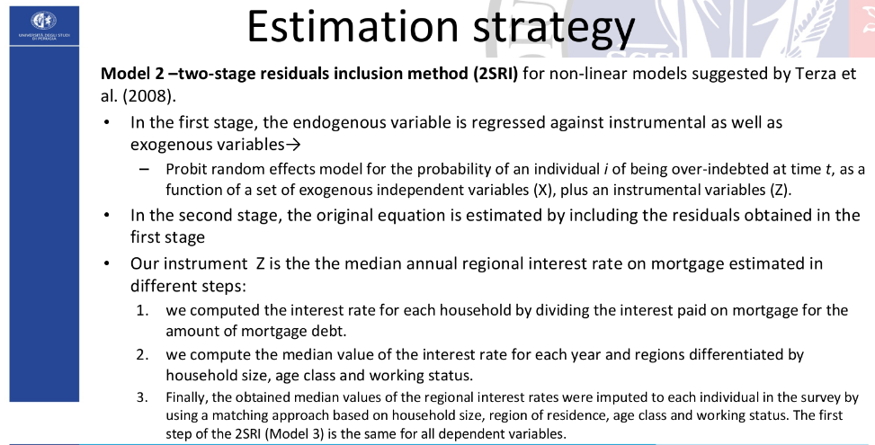

Slide 8


Slide 9
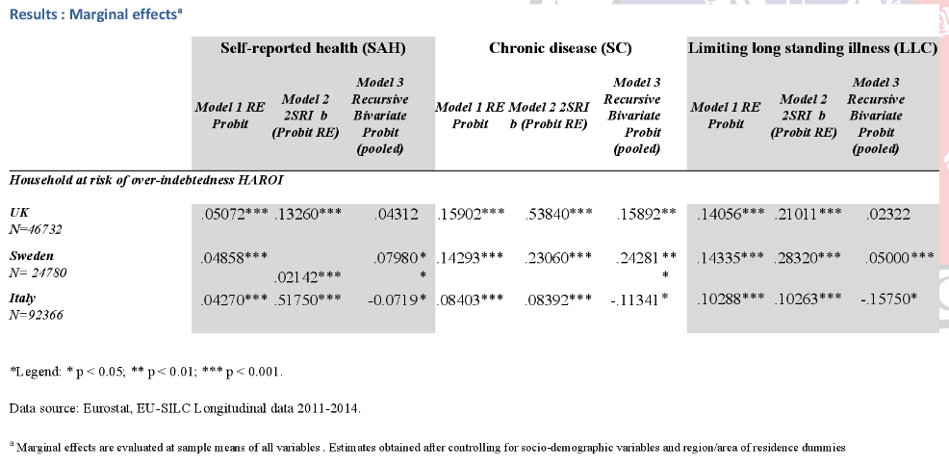

Slide 10
Modeling a Binary Outcome
Did firm i produce a product or process innovation in year t ? y_{it} : 1=Yes/0=No
Observed N=1270 firms for T=5 years, 1984-1988
Observed covariates: x_{it} = Industry, competitive pressures, size, productivity, etc.
How to model?
  Binary outcome
  Correlation across time
  Heterogeneity across firms

Slide 11
Application

Slide 12
The “Panel Probit Model”

Slide 13
FIML
See Greene, W., “Convenient Estimators for the Panel Probit Model: Further Results,” Empirical Economics, 29, 1, Jan. 2004, pp. 21-48.

Slide 14
GMM

Slide 15
GMM Estimation-1

Slide 16
GMM Estimation-2

Slide 17

Many interesting qualitative variables such as health satisfaction, labor outcomes, insurance, etc.

Slide 18


Slide 19
Application: Health Care Panel Data
German Health Care Usage Data, 7,293 Individuals, Varying Numbers of Periods
Data downloaded from Journal of Applied Econometrics Archive. This is an unbalanced panel with 7,293 individuals. They can be used for regression, count models, binary choice, ordered choice, and bivariate binary choice. There are altogether 27,326 observations. The number of observations ranges from 1 to 7. (Frequencies are: 1=1525, 2=2158, 3=825, 4=926, 5=1051, 6=1000, 7=987).
Variables in the file are
DOCTOR = 1(Number of doctor visits > 0)
HOSPITAL = 1(Number of hospital visits > 0)
HSAT = health satisfaction, coded 0 (low) - 10 (high)
DOCVIS = number of doctor visits in last three months
HOSPVIS = number of hospital visits in last calendar year
PUBLIC = insured in public health insurance = 1; otherwise = 0
ADDON = insured by add-on insurance = 1; otherswise = 0
INCOME = household nominal monthly net income in German marks / 10000.
(4 observations with income=0 were dropped)
HHKIDS = children under age 16 in the household = 1; otherwise = 0
EDUC = years of schooling
AGE = age in years
MARRIED = marital status
Notes:
19

Slide 20

Unbalanced Panels
Most theoretical results are for balanced panels.
Most real world panels are unbalanced.
Often the gaps are caused by attrition.
The major question is whether the gaps are ‘missing completely at random.’ If not, the observation mechanism is endogenous, and at least some methods will produce questionable results.
Researchers rarely have any reason to treat the data as nonrandomly sampled. (This is good news.)
Group Sizes

Slide 21
Unbalanced Panels and Attrition ‘Bias’
Test for ‘attrition bias.’ (Verbeek and Nijman, Testing for Selectivity Bias in Panel Data Models, International Economic Review, 1992, 33, 681-703.
  Variable addition test using covariates of presence in the panel
  Nonconstructive – what to do next?
Do something about attrition bias. (Wooldridge, Inverse Probability Weighted M-Estimators for Sample Stratification and Attrition, Portuguese Economic Journal, 2002, 1: 117-139)
  Stringent assumptions about the process
  Model based on probability of being present in each wave of the panel

Slide 22
Panel Data Binary Choice Models
Random Utility Model for Binary Choice
U_{it} = α + β’x_{it} + ε_{it} + Person i specific effect
Fixed effects using “dummy” variables
U_{it} = α_{i} + β’x_{it} + ε_{it}
Random effects using omitted heterogeneity
U_{it} = α + β’x_{it} + ε_{it} + u_{i}
Same outcome mechanism: Y_{it} = 1[U_{it} > 0]

Slide 23
Ignoring Unobserved Heterogeneity

Slide 24
Ignoring Heterogeneity in the RE Model

Slide 25
Ignoring Heterogeneity (Broadly)
Presence will generally make parameter estimates look smaller than they would otherwise.
Ignoring heterogeneity will definitely distort standard errors.
Partial effects based on the parametric model may not be affected very much.
Is the pooled estimator ‘robust?’ Less so than in the linear model case.

Slide 26
Pooled vs. RE Panel Estimator
----------------------------------------------------------------------
Binomial Probit Model
Dependent variable DOCTOR
--------+-------------------------------------------------------------
Variable| Coefficient Standard Error b/St.Er. P[|Z|>z] Mean of X
--------+-------------------------------------------------------------
Constant| .02159 .05307 .407 .6842
AGE| .01532*** .00071 21.695 .0000 43.5257
EDUC| -.02793*** .00348 -8.023 .0000 11.3206
INCOME| -.10204** .04544 -2.246 .0247 .35208
--------+-------------------------------------------------------------
Unbalanced panel has 7293 individuals
--------+-------------------------------------------------------------
Constant| -.11819 .09280 -1.273 .2028
AGE| .02232*** .00123 18.145 .0000 43.5257
EDUC| -.03307*** .00627 -5.276 .0000 11.3206
INCOME| .00660 .06587 .100 .9202 .35208
Rho| .44990*** .01020 44.101 .0000
--------+-------------------------------------------------------------

Slide 27
Partial Effects
----------------------------------------------------------------------
Partial derivatives of E[y] = F[*] with
respect to the vector of characteristics
They are computed at the means of the Xs
Observations used for means are All Obs.
--------+-------------------------------------------------------------
Variable| Coefficient Standard Error b/St.Er. P[|Z|>z] Elasticity
--------+-------------------------------------------------------------
|Pooled
AGE| .00578*** .00027 21.720 .0000 .39801
EDUC| -.01053*** .00131 -8.024 .0000 -.18870
INCOME| -.03847** .01713 -2.246 .0247 -.02144
--------+-------------------------------------------------------------
|Based on the panel data estimator
AGE| .00620*** .00034 18.375 .0000 .42181
EDUC| -.00918*** .00174 -5.282 .0000 -.16256
INCOME| .00183 .01829 .100 .9202 .00101
--------+-------------------------------------------------------------

Slide 28
Effect of Clustering
Y_{it} must be correlated with Y_{is} across periods
Pooled estimator ignores correlation
Broadly, y_{it} = E[y_{it}|x_{it}] + w_{it},
  E[y_{it}|x_{it}] = Prob(y_{it} = 1|x_{it})
  w_{it} is correlated across periods
Assuming the marginal probability is the same, the pooled estimator is consistent. (We just saw that it might not be.)
Ignoring the correlation across periods generally leads to underestimating standard errors.

Slide 29
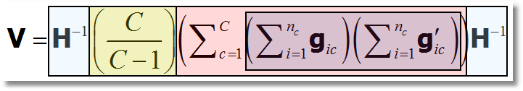
‘Cluster’ Corrected Covariance Matrix

Slide 32
Cluster Correction: Doctor
----------------------------------------------------------------------
Binomial Logit Model
Dependent variable DOCTOR
Log likelihood function -17457.21899
--------+-------------------------------------------------------------
Variable| Coefficient Standard Error b/St.Er. P[|Z|>z] Mean of X
--------+-------------------------------------------------------------
| Conventional Standard Errors
Constant| -.25597*** .05481 -4.670 .0000
AGE| .01469*** .00071 20.686 .0000 43.5257
EDUC| -.01523*** .00355 -4.289 .0000 11.3206
INCOME| -.10914** .04569 -2.389 .0169 .35208
FEMALE| .35209*** .01598 22.027 .0000 .47877
------------+---------------------------------------------------------
| Corrected Standard Errors
Constant| -.25597*** .07744 -3.305 .0009
AGE| .01469*** .00098 15.065 .0000 43.5257
EDUC| -.01523*** .00504 -3.023 .0025 11.3206
INCOME| -.10914* .05645 -1.933 .0532 .35208
FEMALE| .35209*** .02290 15.372 .0000 .47877
--------+-------------------------------------------------------------

Slide 33
Random Effects

Slide 34
Quadrature – Butler and Moffitt (1982)

Slide 35
Quadrature Log Likelihood

Slide 36
Simulation Based Estimator

Slide 37
Random Effects Model: Quadrature
----------------------------------------------------------------------
Random Effects Binary Probit Model
Dependent variable DOCTOR
Log likelihood function -16290.72192 ⬅ Random Effects
Restricted log likelihood -17701.08500 ⬅ Pooled
Chi squared [ 1 d.f.] 2820.72616
Estimation based on N = 27326, K = 5
Unbalanced panel has 7293 individuals
--------+-------------------------------------------------------------
Variable| Coefficient Standard Error b/St.Er. P[|Z|>z] Mean of X
--------+-------------------------------------------------------------
Constant| -.11819 .09280 -1.273 .2028
AGE| .02232*** .00123 18.145 .0000 43.5257
EDUC| -.03307*** .00627 -5.276 .0000 11.3206
INCOME| .00660 .06587 .100 .9202 .35208
Rho| .44990*** .01020 44.101 .0000
--------+-------------------------------------------------------------
|Pooled Estimates
Constant| .02159 .05307 .407 .6842
AGE| .01532*** .00071 21.695 .0000 43.5257
EDUC| -.02793*** .00348 -8.023 .0000 11.3206
INCOME| -.10204** .04544 -2.246 .0247 .35208
--------+-------------------------------------------------------------

Slide 38
Random Constant Term Model
----------------------------------------------------------------------
Random Coefficients Probit Model
Dependent variable DOCTOR (Quadrature Based)
Log likelihood function -16296.68110 (-16290.72192)
Restricted log likelihood -17701.08500
Chi squared [ 1 d.f.] 2808.80780
Simulation based on 50 Halton draws
--------+-------------------------------------------------
Variable| Coefficient Standard Error b/St.Er. P[|Z|>z]
--------+-------------------------------------------------
|Nonrandom parameters
AGE| .02226*** .00081 27.365 .0000 ( .02232)
EDUC| -.03285*** .00391 -8.407 .0000 (-.03307)
INCOME| .00673 .05105 .132 .8952 ( .00660)
|Means for random parameters
Constant| -.11873** .05950 -1.995 .0460 (-.11819)
|Scale parameters for dists. of random parameters
Constant| .90453*** .01128 80.180 .0000
--------+-------------------------------------------------------------
Using quadrature, a = -.11819. Implied ρ from these estimates is
.90454²/(1+.90453²) = .449998 compared to .449900 using quadrature.

Slide 39
Dynamic Models

Slide 40
Dynamic Probit Model: A Simple Approach

Slide 41
Simplified Dynamic Model (Wooldridge 2005)

Slide 42
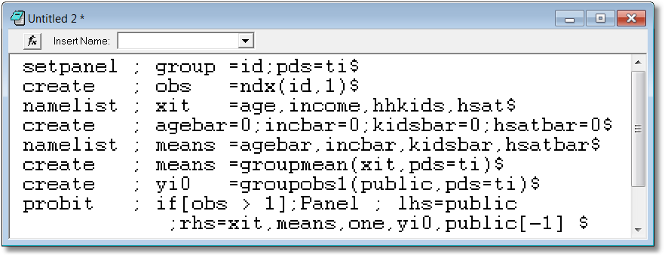
A Dynamic Model for Public Insurance
Age
Household Income
Kids in the household
Health Status
Add initial value, lagged value, group means

Slide 43
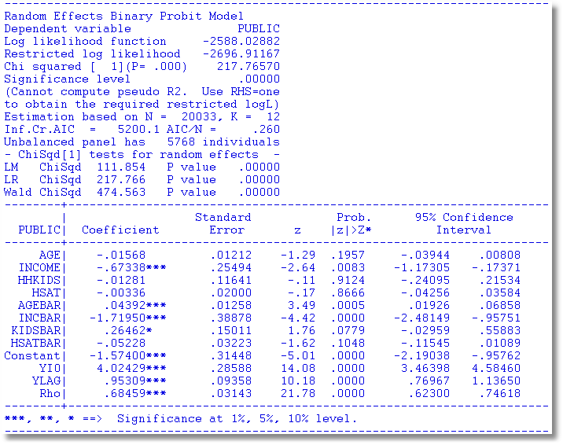
Dynamic Common Effects Model

Slide 44
Distributional Issue
Normal distributions assumed throughout
  Normal distribution for the unique component, ε_{i,t}
  Normal distribution assumed for the heterogeneity, u_{i}
  Sensitive to the distribution?
Alternative: Discrete distribution for u_{i}.
  Heckman and Singer style, latent class model.
  Conventional estimation methods.
Why is the model not sensitive to normality for ε_{i,t} but it is sensitive to normality for u_{i}?

Slide 45
Heckman and Singer’s RE Model
Random Effects Model
Random Constants with Discrete Distribution

Slide 46
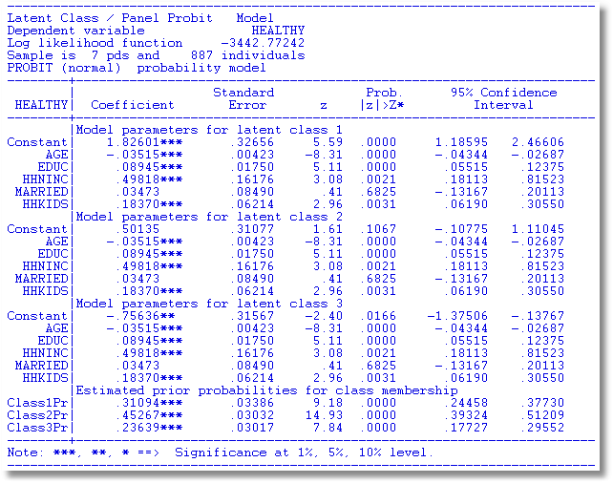
Heckman and Singer Binary
ChoiceModel – 3 Points

Slide 47
Heckman/Singer vs. REM
-----------------------------------------------------------------------------
Random Effects Binary Probit Model
Sample is 7 pds and 887 individuals.
--------+--------------------------------------------------------------------
| Standard Prob. 95% Confidence
HEALTHY| Coefficient Error z |z|>Z* Interval
--------+--------------------------------------------------------------------
Constant| .33609 .29252 1.15 .2506 -.23723 .90941
(Other coefficients omitted)
Rho| .52565*** .02025 25.96 .0000 .48596 .56534
--------+--------------------------------------------------------------------
Rho = σ²/(1+ σ²) so σ² = rho/(1-rho) = 1.10814.
Mean = .33609, Variance = 1.10814
For Heckman and Singer model,
3 points a1,a2,a3 = 1.82601, .50135, -.75636
3 probabilities p1,p2,p3 = .31094, .45267, .23639
Mean = .61593 variance = .90642

Slide 48
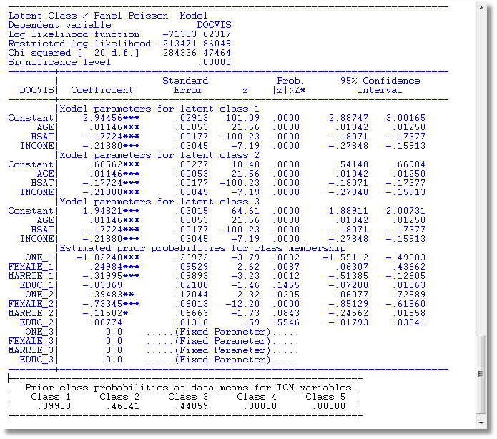
3 Class Heckman-Singer Form

Slide 49
Fixed Effects

Slide 50
Fixed Effects Models
Estimate with dummy variable coefficients
Uit = α_{i} + β’xit + ε_{it}
Can be done by “brute force” for 10,000s of individuals
F(.) = appropriate probability for the observed outcome
Compute β and α_{i} for i=1,…,N (may be large)
See fixedeffectsbias.pdf in course materials.

Slide 51
Unconditional Estimation
Maximize the whole log likelihood
Difficult! Many (thousands) of parameters.
Feasible – NLOGIT (2004) (“Brute force”)

Slide 52
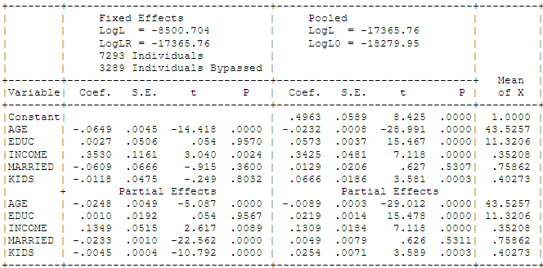
Fixed Effects Health Model
Groups in which y_{it} is always = 0 or always = 1. Cannot compute α_{i}.

Slide 53
Conditional Estimation
Principle: f(y_{i1},y_{i2},… | some statistic) is free of the fixed effects for some models.
Maximize the conditional log likelihood, given the statistic.
Can estimate β without having to estimate α_{i}.
Only feasible for the logit model. (Poisson and a few other continuous variable models. No other discrete choice models.)

Slide 54
Binary Logit Conditional Probabiities

Slide 55
Example: Two Period Binary Logit

Slide 56
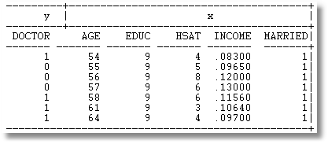
Example: Seven Period Binary Logit

Slide 57
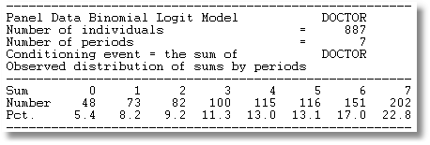
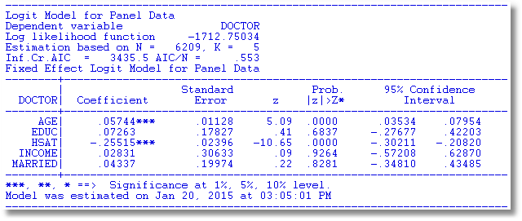

Slide 58
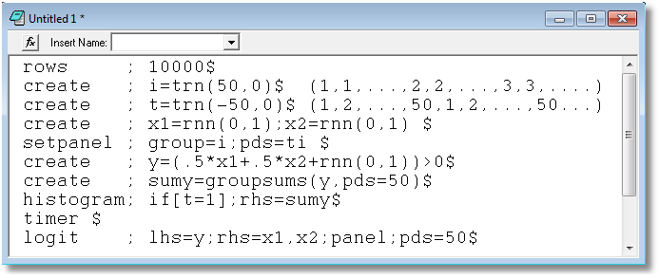

Slide 59
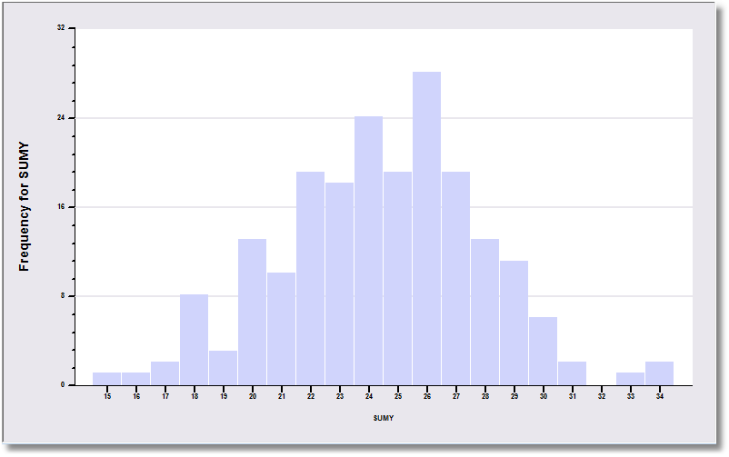
The sample is 200 individuals each observed 50 times.

Slide 60
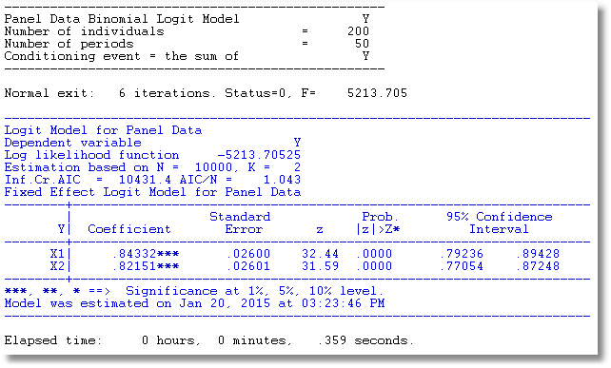
The data are generated from a probit process with b1 = b2 = .5. But, it is fit as a logit model. The coefficients obey the familiar relationship, 1.6*probit.

Slide 61
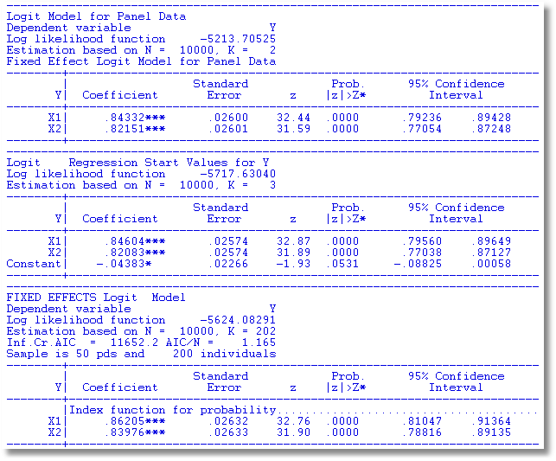
Large T Results. T = 50
Chamberlain estimator is always consistent.
Pooled estimator is consistent because the true model actually has no effects.
Brute force estimator is consistent because the IP problem goes away with large T.

Slide 62
Estimating Partial Effects
“The fixed effects logit estimator of β immediately gives us the effect of each element of x_{i} on the log-odds ratio… Unfortunately, we cannot estimate the partial effects… unless we plug in a value for α_{i}. Because the distribution of α_{i} is unrestricted – in particular, E[α_{i}] is not necessarily zero – it is hard to know what to plug in for α_{i}. In addition, we cannot estimate average partial effects, as doing so would require finding E[Λ(x_{it} β+ α_{i})], a task that apparently requires specifying a distribution for α_{i}.”
(Wooldridge, 2010)
Notes:
62

Slide 63
Logit Constant Terms

Slide 64
Advantages and Disadvantages of the FE Model
Advantages
  Allows correlation of effect and regressors
  Fairly straightforward to estimate
  Simple to interpret
Disadvantages
  Model may not contain time invariant variables
  Not necessarily simple to estimate if very large samples (Stata just creates the thousands of dummy variables)
  The incidental parameters problem: Small T bias

Slide 65
Incidental Parameters Problems: Conventional Wisdom
General: The unconditional MLE is biased in samples with fixed T except in special cases such as linear or Poisson regression (even when the FEM is the right model).
  The conditional estimator (that bypasses
  estimation of α_{i}) is consistent.
Specific: Upward bias (experience with probit and logit) in estimators of β

Slide 66
The Incidental Parameters Problem
The model is correctly specified
The log likelihood is correctly specified and maximized
The estimator is inconsistent
  The number of parameters grows with N
  The “bias” in the MLE gets smaller as T grows
  At infinite T, the estimator is consistent in N
In the linear FEM, the MLE of σ² is affected by this problem.

Slide 67
Maximum Likelihood Estimation

Slide 68
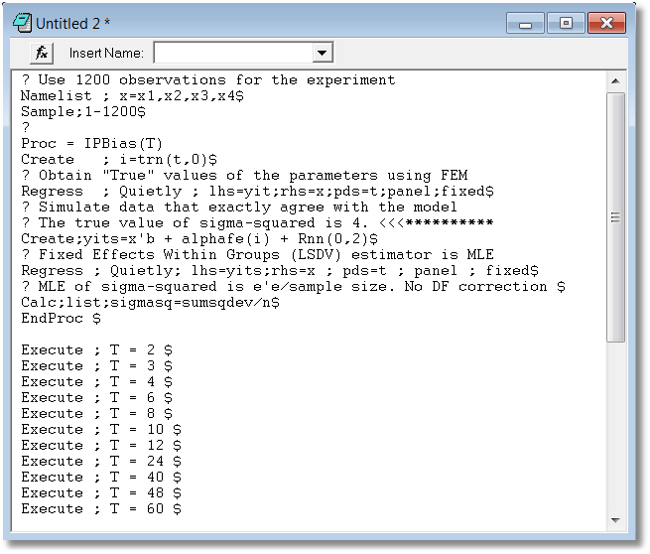

Slide 69
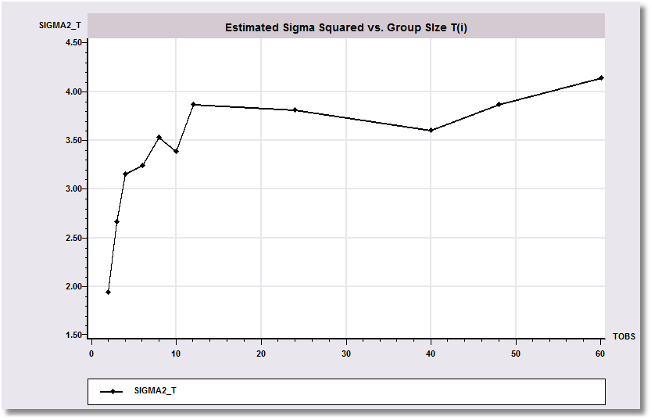
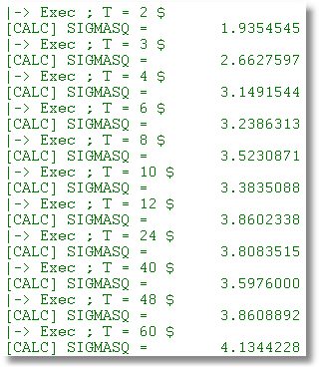
The Incidental Parameters Problem

Slide 70
What We KNOW - Analytic
Newey and Hahn: MLE converges in probability to a vector of constants. (Variance diminishes with increase in N).
Abrevaya and Hsiao: Logit estimator converges to 2β when T = 2.
Han, Schmidt, Greene: Probit estimator converges to 2β when T = 2.

Slide 71
What We THINK We Know – Monte Carlo
Heckman:
  Bias in probit estimator is small if T → 8
  Bias in probit estimator is toward 0 in some cases
Katz (et al – numerous others), Greene
  Bias in probit and logit estimators is large
  Upward bias persists even as T → 20
  Bias does vanish, mostly by T = 20

Slide 72

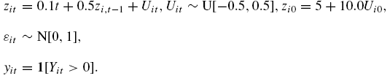
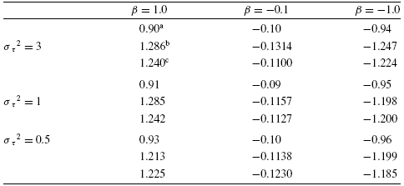
Heckman’s Monte Carlo Study

Slide 73
Some Familiar Territory – A Monte Carlo Study of the FE Estimator: Probit vs. Logit
(Greene, The Econometrics Journal, 7, 2004, pp. 98-119)
Estimates of Coefficients and Marginal Effects at the Implied Data Means
Results are scaled so the desired quantity being estimated (β, δ, marginal effects) all equal 1.0 in the population.

Slide 74
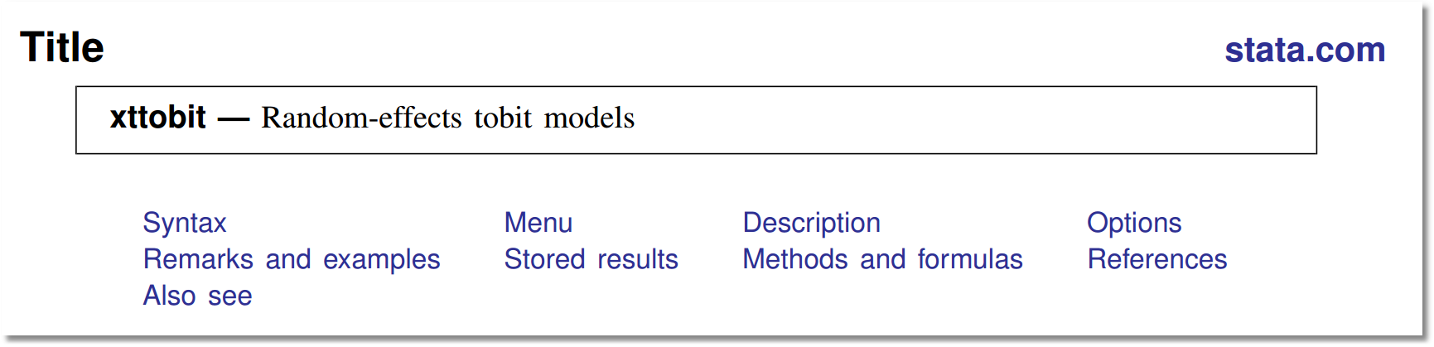
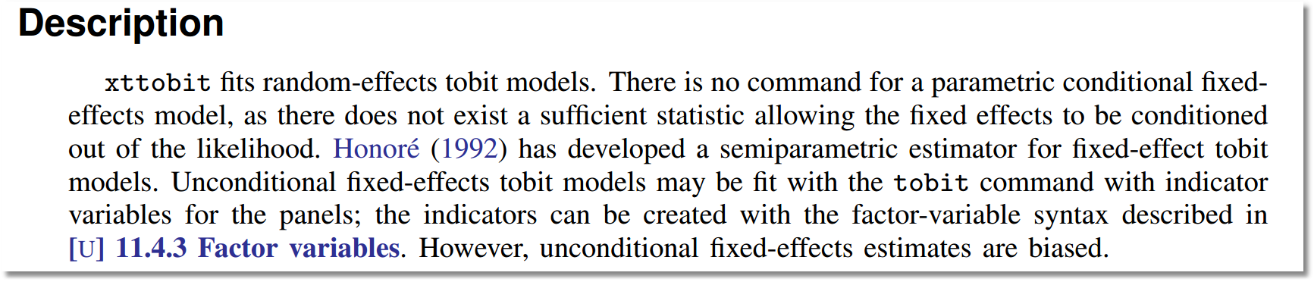
Stata on the True Fixed Effects (Tobit) MLE
Application True Fixed Effects SFM Incidental Parameters Problem Consistent Estimation Conclusions

Slide 75
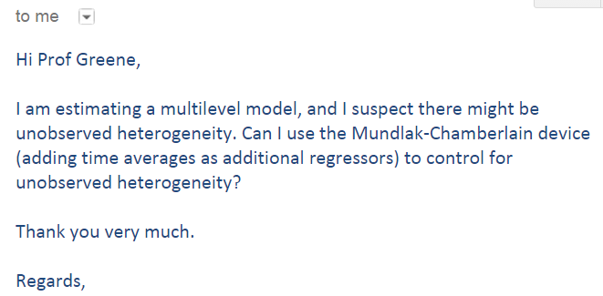
Arrived 6 PM April 13, 2015

Slide 76
Fixed Effects
Attention mostly focused on index function models; f(y_{it}|x_{it}) = some function of x_{it}’β+α_{i}.
Incidental parameters problems
  Bias of estimator of β is O(1/T)
  How do we estimate α_{i}?
  How can we compute interesting partial effects?
Models
  Linear model: No problem
  Poisson (nonlinear model): No problem
  1 or 2 other models: No problem
  Other nonlinear models: The literature speaks in generalities
    The probit and logit models have been analyzed at length
    Almost nothing is known about any other model save for Greene’s (2002-2004) limited Monte Carlo studies (frontier, tobit, truncation, ordered probit, probit, logit)

Slide 77
A Mundlak Correction for the FE Model

Slide 78
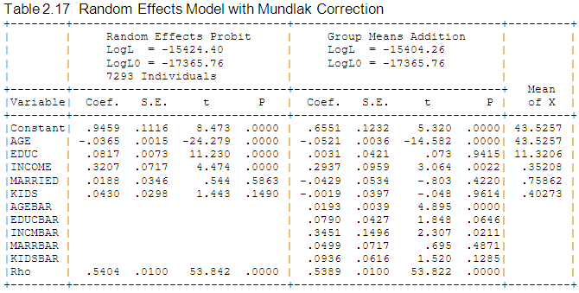
Mundlak Correction

Slide 79
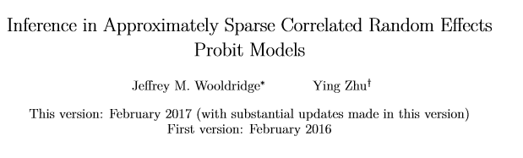
“Simulation results in Li and Zheng (2008) suggest that, for obtaining partial effects, the estimates are not overly sensitive to the normality assumption.
However, the findings of Arellano and Bonhomme (2009) and Rebe-Hesketh and Skrondal (2013) suggest that misspecification of the conditional mean can cause substantial bias even in the partial effects.”
OK for invariance to the underlying distribution specified. BUT, the estimators compute the appropriate partial effects for the conditional mean specified, not some alternatively underlying “truth.” If the underlying CEF is linear, a nonlinear specification will find the partials for the underlying nonlinear model specified, not for a hypothetical linear model. The nonlinear model can bend toward linearity. The reverse is not true. (E.g., Levitt.)

Slide 80
A Variable Addition Test for FE vs. RE
The Wald statistic of 45.27922 and the likelihood ratio statistic of 40.280 are both far larger than the critical chi squared with 5 degrees of freedom, 11.07. This suggests that for these data, the fixed effects model is the preferred framework.

Slide 81
Application

Slide 82
Estimates of a Fixed Effects Probit Model
-----------------------------------------------------------------------------
FIXED EFFECTS Probit Model
Dependent variable IP
Log likelihood function -2087.22475
Estimation based on N = 6350, K = 953
Inf.Cr.AIC = 6080.4 AIC/N = .958
Model estimated: Apr 16, 2013, 10:00:53
Unbalanced panel has 1270 individuals
Skipped 552 groups with inestimable ai
PROBIT (normal) probability model
--------+--------------------------------------------------------------------
| Standard Prob. 95% Confidence
IP| Coefficient Error z |z|>Z* Interval
--------+--------------------------------------------------------------------
|Index function for probability
EMPLP| .12108D-05 .00015 .01 .9934 -.28688D-03 .28930D-03
LOGSALES| -.53108 .34472 -1.54 .1234 -1.20672 .14457
IMUM| 4.26647 2.87407 1.48 .1377 -1.36660 9.89953
FDIUM| -7.34800** 3.31144 -2.22 .0265 -13.83830 -.85770
--------+--------------------------------------------------------------------
Note: nnnnn.D-xx or D+xx => multiply by 10 to -xx or +xx.
Note: ***, **, * ==> Significance at 1%, 5%, 10% level.
-----------------------------------------------------------------------------

Slide 83
Pooled, Fixed Effects and Random Effects Probit
+---------------------------------------------+
| Probit Regression Start Values for IP |
+---------+--------------+----------------+--------+---------+----------+
|Variable | Coefficient | Standard Error |b/St.Er.|P[|Z|>z] | Mean of X|
+---------+--------------+----------------+--------+---------+----------+
EMPLP .00013619 .154784D-04 8.798 .0000 580.944724
LOGSALES .13668535 .01792267 7.626 .0000 10.5400961
IMUM .89572747 .14180988 6.316 .0000 .25275054
FDIUM 3.24193536 .38236984 8.479 .0000 .04580618
Constant -1.63354524 .20737277 -7.877 .0000
+---------------------------------------------+
| Random Effects Binary Probit Model |
+---------+--------------+----------------+--------+---------+----------+
EMPLP .00017616 .117150D-04 15.037 .0000 580.944724
LOGSALES .21174534 .04309101 4.914 .0000 10.5400961
IMUM 1.41657383 .34121909 4.152 .0000 .25275054
FDIUM 4.41817066 .83712165 5.278 .0000 .04580618
Constant -2.51015928 .49459030 -5.075 .0000
Rho .58588783 .01864491 31.423 .0000
+---------------------------------------------+
| FIXED EFFECTS Probit Model |
+---------+--------------+----------------+--------+---------+----------+
EMPLP .121081D-05 .00014700 .008 .9934 419.786630
LOGSALES -.53108315 .34473601 -1.541 .1234 10.5368540
IMUM 4.26652343 2.87418573 1.484 .1377 .25359436
FDIUM -7.34808205 3.31155361 -2.219 .0265 .04444097

Slide 84
Fixed Effects
Advantages
  Allows correlation of effect and regressors
  Fairly straightforward to estimate
  Simple to interpret
Disadvantages
  Not necessarily simple to estimate if very large samples (Stata just creates the thousands of dummy variables)
  The incidental parameters problem: Small T bias.
  No time invariant variables

Slide 85
Fixed Effects Models Summary
Incidental parameters problem if T < 10 (roughly)
Inconvenience of computation
Appealing specification
Alternative semiparametric estimators?
  Theory not well developed for T > 2
  Not informative for anything but slopes (e.g., predictions and marginal effects)
Ignoring the heterogeneity definitely produces an inconsistent estimator (even with cluster correction!)
A Hobson’s choice
Mundlak correction is a useful common approach.

Slide 86
Bias Correction Estimators
Motivation: Undo the incidental parameters bias in the fixed effects probit model:
  (1) Maximize a penalized log likelihood function, or
  (2) Directly correct the estimator of β
Advantages
  For (1) estimates α_{i} so enables partial effects
  Estimator is consistent under some circumstances
  (Possibly) corrects in dynamic models
Disadvantage
  No time invariant variables in the model
  Practical implementation
  Extension to other models? (Ordered probit model (maybe) – see JBES 2009)

Slide 87
Bias Reduction
Parametric (probit and logit) models with fixed effects
(We examine non- and semiparametric methods at the end of the course.)
Recent references: All about probit and logit models.
  [1] Carro, J., “Estimating dynamic panel data discrete choice models with fixed effects,” JE, 140, 2007, pp. 503-528
  [2] Val, F., “Fixed Effects estimation of structural parameters and marginal effects in panel probit models,” JE, 2010
  [3] Hahn, J. and G. Kuersteiner, “Bias reduction for dynamic nonlinear panel models with fixed effects,” UCLA, 2003
  [4] Hahn, J. and W. Newey, “Jackknife and Analytical Bias reduction for nonlinear panel models,” Econometrica, 2004.
  See, also, bibliographies and work of T. Woutersen, B. Honoré and E. Kyriazidou.

Slide 88
Bias Reduction – 1: Hahn
All rely on a large T approximation to the bias when T is (very small)
All analyze the equivalent of the brute force, unconditional estimator.
Hahn/Kuersteiner and Hahn/Newey
  plim b_{MLE} = β + B(T) where B(T) is O(1/T)
  Derive an expression for B(T)
  The bias corrected estimator is obtained by subtraction
  No further analysis is obtained to estimate fixed effects or partial effects.

Slide 89
Bias Reduction – 2: Val
Plim b_{MLE} = β + B(T)
Find, D(T) a large sample approximation such that Plim b_{MLE} +D(T) = β + F(T) where F(T) is O(1/T²)
Finds a counterpart approximation to the marginal effects.

Slide 90
Bias Reduction – 3: Carro
Change the log likelihood. Maximum Modified Likelihood Estimator = MMLE
Maximize MMLE such that the solution to MMLE is b_{MMLE} plim b_{MMLE} = β +G(T) where G(T) is O(1/T²).
Also obtains a solution for α_{i} (unlike the others).
a_{i,MMLE} = f(b_{MMLE})
(A problem? When y_{it} is always the same, there is no solution for a_{i}.)

Slide 91
Appendix

Slide 92
Different Normalizations
Separate constants: using D
Overall constant and N-1 constrasts
Overall constant, N constants, Σ_{i} γ_{i} = 0

Slide 93
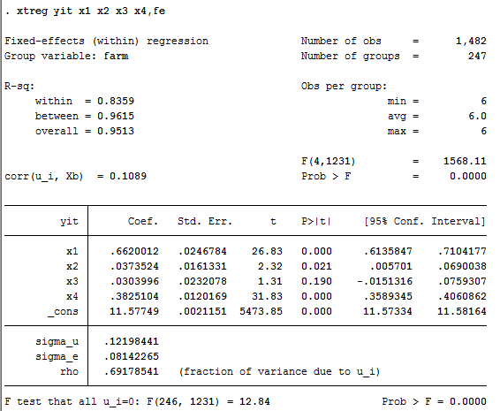
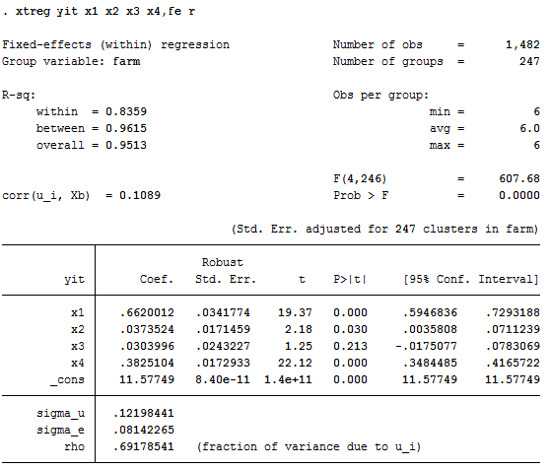
A Caution About Stata and Fixed Effects
?

Slide 94
Between Groups Estimator
Inconsistency of the group means estimator

Slide 95
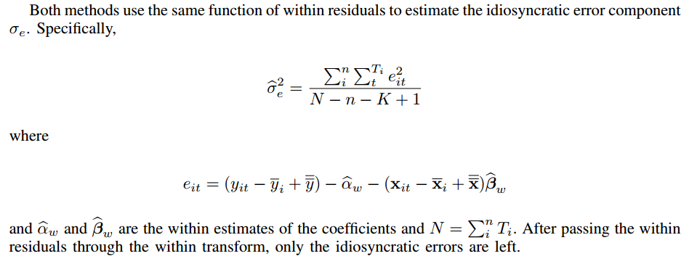

Slide 96
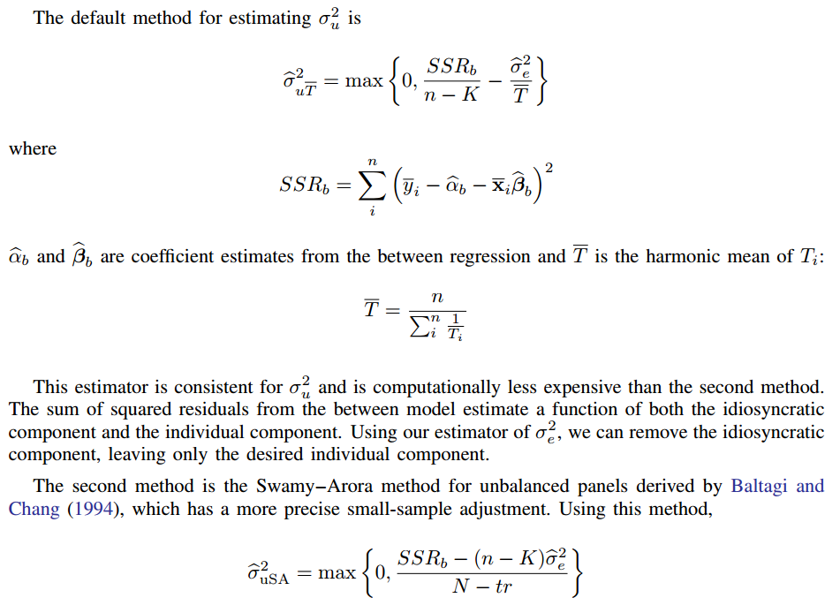

Slide 97
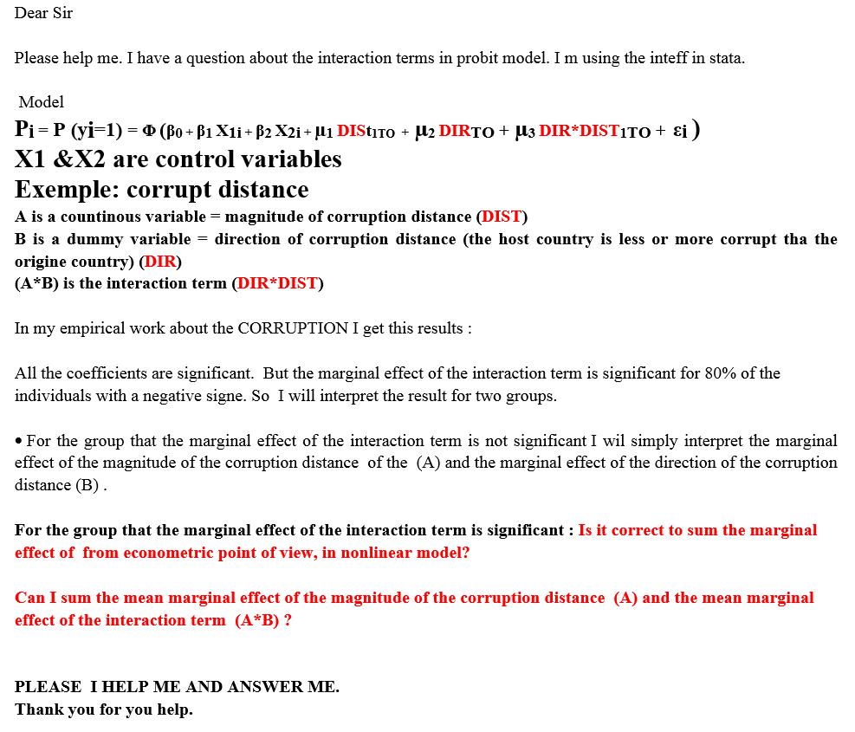

Slide 98
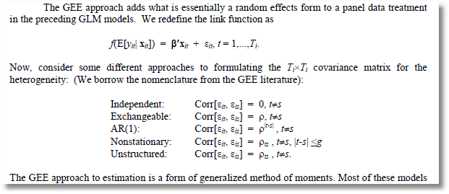
GEE Estimation

Slide 99
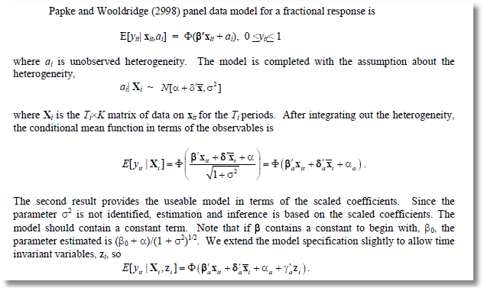
Fractional Response

Slide 100
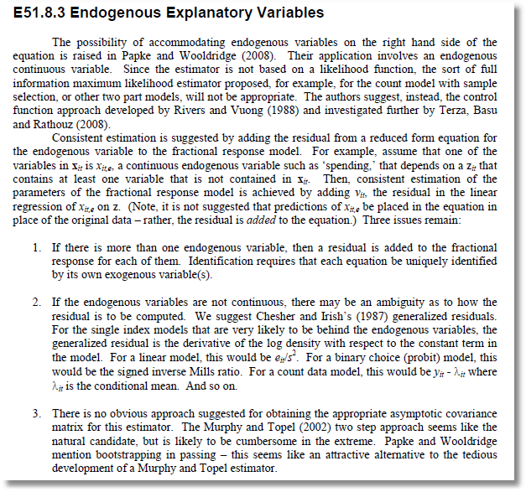
Fractional Response Model

Slide 101
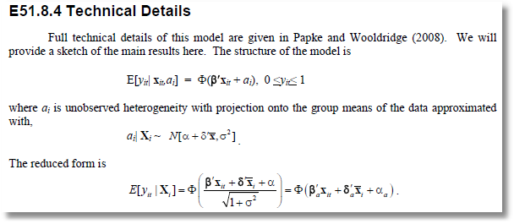
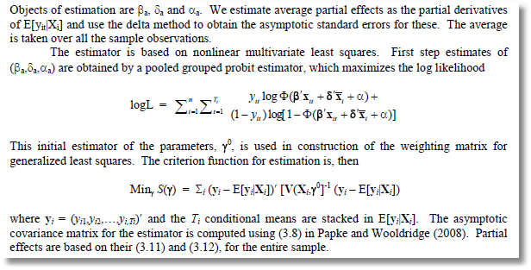
Fractional Response Model

Slide 102
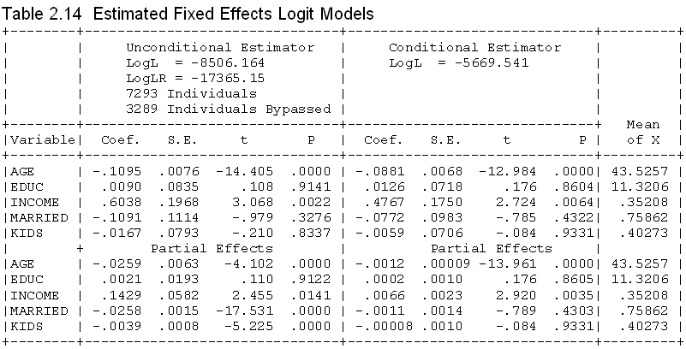
Conditional vs. Unconditional
Dep. Var. = Healthy
Note, this estimator is not consistent – Incidental Parameters Problem

Slide 103
Escaping the FE Assumptions

Slide 104
Modeling a Binary Outcome
Did firm i produce a product or process innovation in year t ? y_{it} : 1=Yes/0=No
Observed N=1270 firms for T=5 years, 1984-1988
Observed covariates: x_{it} = Industry, competitive pressures, size, productivity, etc.
How to model?
  Binary outcome
  Correlation across time
  Heterogeneity across firms

Slide 105
Application – Doctor Visits
Riphahn, Million Wambach, JAE, 2003
German Health Care Usage Data, 7,293 Individuals, Varying Numbers of Periods
Variables in the file are
Data downloaded from Journal of Applied Econometrics Archive. This is an unbalanced panel with 7,293 individuals. They can be used for regression, count models, binary choice, ordered choice, and bivariate binary choice. This is a large data set. There are altogether 27,326 observations. The number of observations ranges from 1 to 7. (Frequencies are: 1=1525, 2=2158, 3=825, 4=926, 5=1051, 6=1000, 7=987). Note, the variable NUMOBS below tells how many observations there are for each person. This variable is repeated in each row of the data for the person.
DOCTOR = 1(Number of doctor visits > 0)
HSAT = health satisfaction, coded 0 (low) - 10 (high)
DOCVIS = number of doctor visits in last three months
HOSPVIS = number of hospital visits in last calendar year
PUBLIC = insured in public health insurance = 1; otherwise = 0
ADDON = insured by add-on insurance = 1; otherswise = 0
HHNINC = household nominal monthly net income in German marks / 10000.
(4 observations with income=0 were dropped)
HHKIDS = children under age 16 in the household = 1; otherwise = 0
EDUC = years of schooling
AGE = age in years
MARRIED = marital status
EDUC = years of education

Slide 106
Application: Innovations
Bertschek and Lechner, J of Econometrics, 1998

Slide 107
Application
Stewart, JAE, 2007
British Household Panel Survey (1991-1996)
3060 households retained (balanced) out of 4739 total.
Unemployment indicator (0.1)
Data features
  Panel data – unobservable heterogeneity
  State persistence: “Someone unemployed at t-1 is more than 20 times as likely to be unemployed at t as someone employed at t-1.”

Slide 108
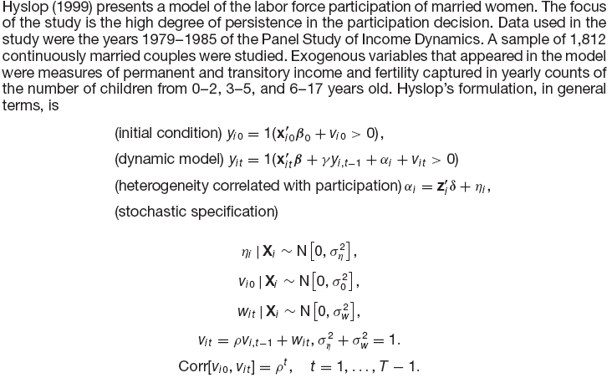
Application: Direct Approach

Slide 109
GHK Simulation/Estimation
The presence of the autocorrelation and state dependence in the model invalidate the simple maximum likelihood procedures we examined earlier. The appropriate likelihood function is constructed by formulating the probabilities as
Prob( y_{i,0}, y_{i,1}, . . .) = Prob(y_{i,0}) × Prob(y_{i,1} | y_{i,0}) ×・ ・ ・×Prob(y_{i,T} | y_{i,T-1}) .
This still involves a T = 7 order normal integration, which is approximated in the study using a simulator similar to the GHK simulator.

Slide 110
A Dynamic RE Probit

Slide 111
Problems with Dynamic RE Probit
Assumes y_{i,0} and the effects are uncorrelated
Assumes the initial conditions are exogenous – OK if the process and the observation begin at the same time, not if different.
Doesn’t allow time invariant variables in the model.
The normality assumption in the projection.

Slide 112
Heckman’s Solution

Slide 114
Bias Reduction?
Approximations rely on large T
Work “moderately well” when T is as low as 8 or 10.
Completely miss the mark when T=2, 3,4
Nothing is known about any other models.

Slide 115
Bias Correction Estimators
Motivation: Undo the incidental parameters bias in the fixed effects probit model:
  (1) Maximize a penalized log likelihood function, or
  (2) Directly correct the estimator of β
Advantages
  For (1) estimates α_{i} so enables partial effects
  Estimator is consistent under some circumstances
  (Possibly) corrects in dynamic models
Disadvantage
  No time invariant variables in the model
  Practical implementation
  Extension to other models? (Ordered probit model (maybe) – see JBES 2009)

Slide 116
Bias Reduction
Parametric (probit and logit) models with fixed effects
(We examine non- and semiparametric methods at the end of the course.)
Recent references: All about probit and logit models.
  [1] Carro, J., “Estimating dynamic panel data discrete choice models with fixed effects,” JE, 140, 2007, pp. 503-528
  [2] Val, F., “Fixed Effects estimation of structural parameters and marginal effects in panel probit models,” JE, 2010
  [3] Hahn, J. and G. Kuersteiner, “Bias reduction for dynamic nonlinear panel models with fixed effects,” UCLA, 2003
  [4] Hahn, J. and W. Newey, “Jackknife and Analytical Bias reduction for nonlinear panel models,” Econometrica, 2004.
  See, also, bibliographies and work of T. Woutersen, B. Honoré and E. Kyriazidou.

Slide 117
Bias Reduction – 1: Hahn
All rely on a large T approximation to the bias when T is (very small)
All analyze the equivalent of the brute force, unconditional estimator.
Hahn/Kuersteiner and Hahn/Newey
  plim b_{MLE} = β + B(T) where B(T) is O(1/T)
  Derive an expression for B(T)
  The bias corrected estimator is obtained by subtraction
  No further analysis is obtained to estimate fixed effects or partial effects.

Slide 118
Bias Reduction – 2: Val
Plim b_{MLE} = β + B(T)
Find, D(T) a large sample approximation such that Plim b_{MLE} +D(T) = β + F(T) where F(T) is O(1/T²)
Finds a counterpart approximation to the marginal effects.

Slide 119
Bias Reduction – 3: Carro
Change the log likelihood. Maximum Modified Likelihood Estimator = MMLE
Maximize MMLE such that the solution to MMLE is b_{MMLE} plim b_{MMLE} = β +G(T) where G(T) is O(1/T²).
Also obtains a solution for α_{i} (unlike the others).
a_{i,MMLE} = f(b_{MMLE})
(A problem? When y_{it} is always the same, there is no solution for a_{i}.)

