Slide 1
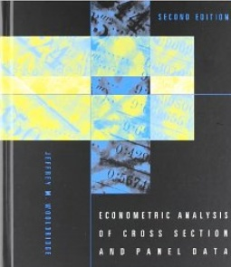


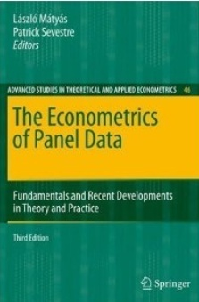




Econometric Analysis of Panel Data
William Greene
Department of Economics
University of South Florida

Slide 2
Econometric Analysis of Panel Data
17. Spatial Autoregression
and Spatial Autocorelation

Slide 3
Nonlinear Models with Spatial Data
William Greene
Stern School of Business, New York University
Washington D.C.
July 12, 2013

Slide 4
Applications
❶ School District Open Enrollment: A Spatial Multinomial Logit Approach; David Brasington, University of Cincinnati, USA, Alfonso Flores-Lagunes, State University of New York at Binghamton, USA, Ledia Guci, U.S. Bureau of Economic Analysis, USA
❷ Smoothed Spatial Maximum Score Estimation of Spatial Autoregressive Binary Choice Panel Models; Jinghua Lei, Tilburg University, The Netherlands
❸ Application of Eigenvector-based Spatial Filtering Approach to a Multinomial Logit Model for Land Use Data; Takahiro Yoshida & Morito Tsutsumi, University of Tsukuba, Japan
❹ Estimation of Urban Accessibility Indifference Curves by Generalized Ordered Models and Kriging; Abel Brasil, Office of Statistical and Criminal Analysis, Brazil, & Jose Raimundo Carvalho, Universidade Federal do Cear´a, Brazil
❺ Choice Set Formation: A Comparative Analysis, Mehran Fasihozaman Langerudi,
Mahmoud Javanmardi, Kouros Mohammadian, P.S Sriraj, University of Illinois at
Chicago, USA, & Behnam Amini, Imam Khomeini International University, Iran
Not including semiparametric and quantile based linear specifications

Slide 5
Hypothesis of Spatial Autocorrelation
Thanks to Luc Anselin, Ag. U. of Ill.

Slide 6
Testing for Spatial Autocorrelation
W = Spatial Weight Matrix. Think “Spatial Distance Matrix.” W_{ii} = 0.

Slide 7
Modeling Spatial Autocorrelation

Slide 8
Spatial Autoregression

Slide 9
Generalized Regression
Potentially very large N – GPS data on agriculture plots
Estimation of . There is no natural residual based estimator
Complicated covariance structure – no simple transformations

Slide 10
Spatial Autocorrelation in Regression

Slide 11
Panel Data Application:
Spatial Autocorrelation

Slide 12
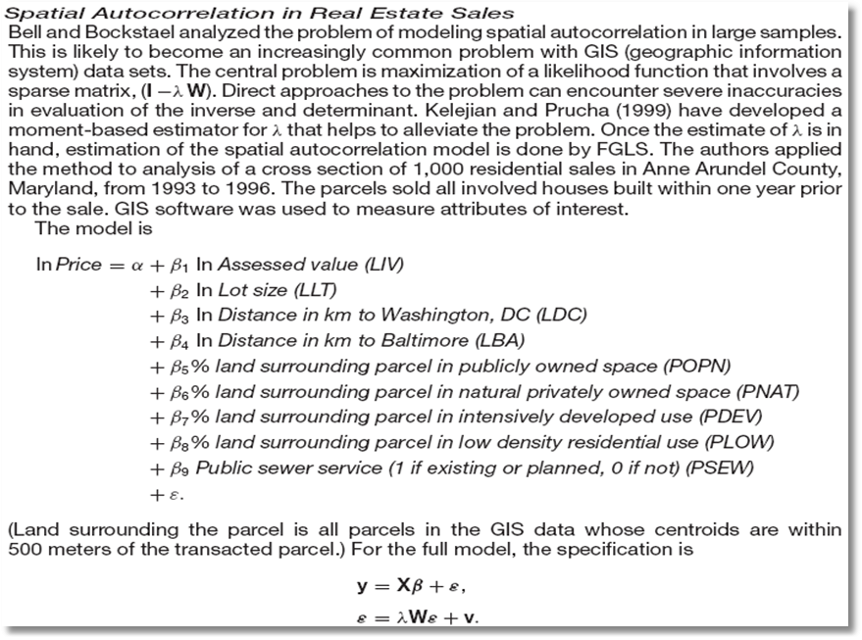

Slide 13
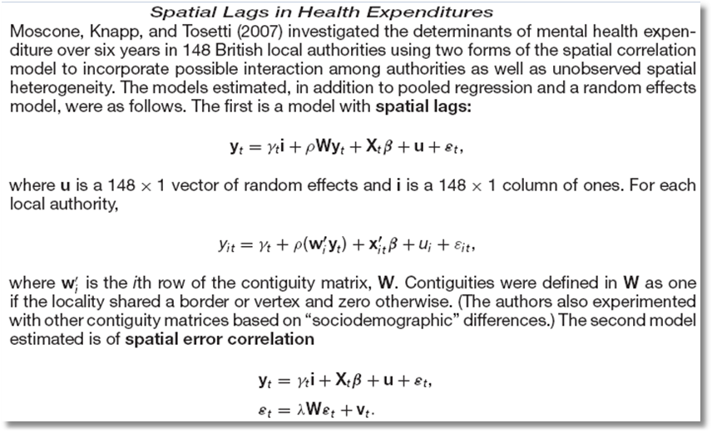
Spatial Autocorrelation in a Panel

Slide 14
❶ Spatial Autoregression in a Linear Model

Slide 15
❷ Spatial Autocorrelation in Regression

Slide 16
Panel Data Applications

Slide 17
Analytical Environment
❶ Generalized linear regression
❷ Complicated disturbance covariance matrix
❸ Estimation platform: Generalized least
squares, GMM or maximum likelihood.
❹ Central problem, estimation of 

Slide 18
Practical Obstacles
❶ Numerical problem: Maximize logL involving sparse (I-W)
❷ Inaccuracies in determinant and inverse
❸ Appropriate asymptotic covariance matrices for
estimators
❹ Estimation of . There is no natural residual based
estimator
❺ Potentially very large N – GIS data on agriculture plots
❻ Complicated covariance structures – no simple
transformations to Gauss-Markov form

Slide 19
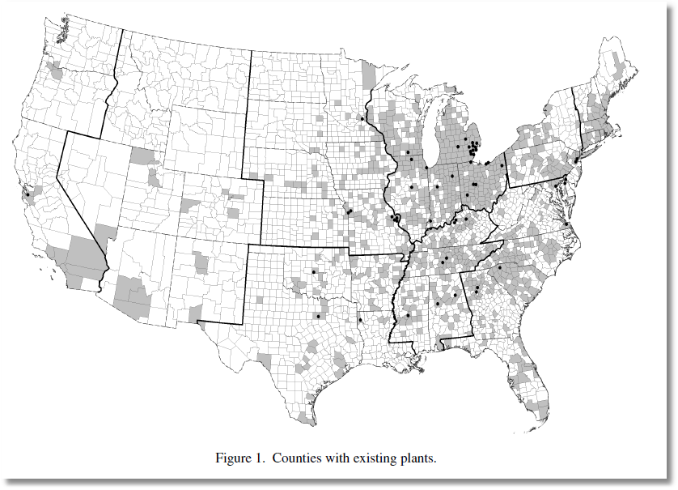
Binary Outcome: Y=1[New Plant Located in County]
Klier and McMillen: Clustering of Auto Supplier Plants in the United States. JBES, 2008

Slide 20
Outcomes in Nonlinear Settings
❶ Land use intensity in Austin, Texas – Discrete Ordered
Intensity = ‘1’ < ‘2’ < ‘3’ < ‘4’
❷ Land Usage Types, 1,2,3 … – Discrete Unordered
❸ Oak Tree Regeneration in Pennsylvania – Count
Number = 0,1,2,… (Excess (vs. Poisson) zeros)
❹ Teenagers in the Bay area:
physically active = 1 or physically inactive = 0 – Binary
❺ Pedestrian Injury Counts in Manhattan – Count
❻ Efficiency of Farms in West-Central Brazil – Stochastic
Frontier
❼ Catch by Alaska trawlers - Nonrandom Sample

Slide 21
Modeling Discrete Outcomes
❶ “Dependent Variable” typically labels an outcome
  No quantitative meaning
  Conditional relationship to covariates
❷ No “regression” relationship in most cases.
• Models are often not conditional means.
• The “model” is usually a probability
❸ Nonlinear models – usually not estimated by any type
of linear least squares
❹ Objective of estimation is usually partial effects, not
coefficients.

Slide 22
Nonlinear Spatial Modeling
❶ Discrete outcome y_{it} = 0, 1, …, J for
some finite or infinite (count case) J.
  i = 1,…,n
  t = 1,…,T
❷ Covariates x_{it}
❸ Conditional Probability (y_{it} = j)
= a function of x_{it}.

Slide 23
Two Platforms
❶ Random Utility for Preference Models
Outcome reveals underlying utility
  Binary: u* = θ’x y = 1 if u* > 0
  Ordered: u* = θ’x y = j if μ_{j-1} < u* < μ_{j}
  Unordered: u*(j) = θ’x_{j} , y = j if u*(j) > u*(k)
❷ Nonlinear Regression for Count Models
Outcome is governed by a nonlinear
regression
  E[y|x] = g(θ,x)

Slide 24
Maximum Likelihood Estimation
Cross Section Case: Binary Outcome

Slide 25
Cross Section Case: n Observations

Slide 26
Spatially Correlated Observations
Correlation Based on Unobservables

Slide 27
Spatially Correlated Observations
Based on Correlated Utilities

Slide 28
LogL for an Unrestricted BC Model

Slide 29
Spatial Autoregression Based on Observed Outcomes

Slide 30
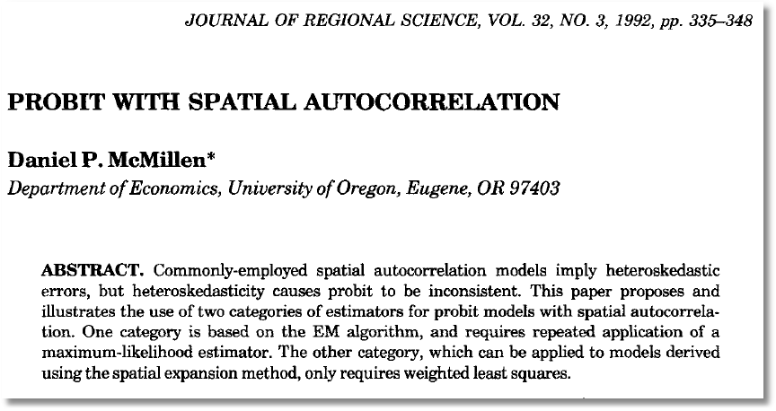

Slide 32
GMM in the Base Case with ρ = 0
Pinske, J. and Slade, M., (1998) “Contracting in Space: An Application of Spatial Statistics to Discrete Choice Models,” Journal of Econometrics, 85, 1, 125-154.
Pinkse, J. , Slade, M. and Shen, L (2006) “Dynamic Spatial Discrete Choice Using One Step GMM: An Application to Mine Operating Decisions”, Spatial Economic Analysis, 1: 1, 53 — 99.
See, also, Bertschuk, I., and M. Lechner, 1998. “Convenient Estimators for the Panel Probit Model.” Journal of Econometrics, 87, 2, pp. 329–372

Slide 33
GMM in the Spatial Autocorrelation Model

Slide 34

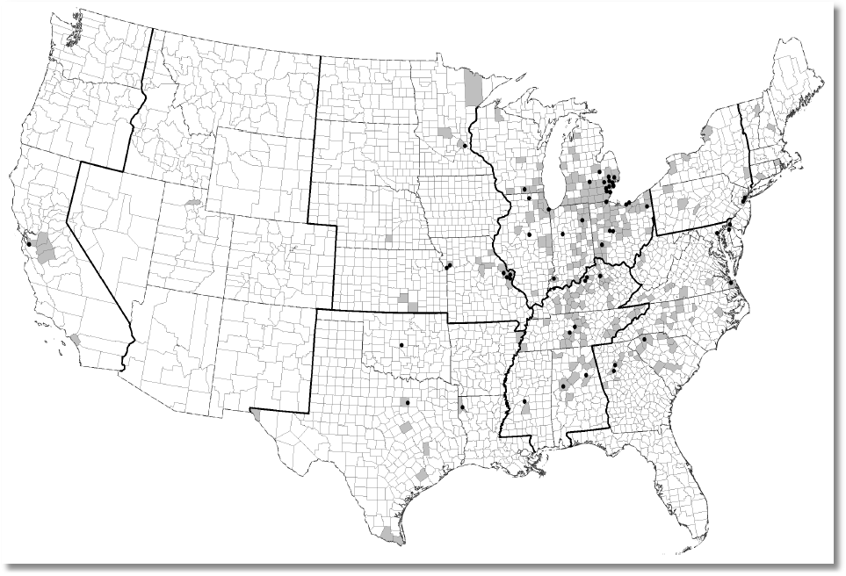

Slide 35
Pseudo Maximum Likelihood
❶ Maximize a likelihood function that
approximates the true one
❷ Produces consistent estimators of
parameters
❸ How to obtain standard errors?
❹ Asymptotic normality? Conditions for
CLT are more difficult to establish.

Slide 36
Pseudo MLE

Slide 38
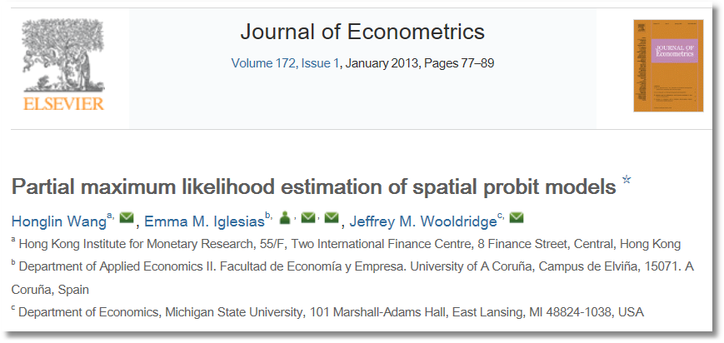
See also Arbia, G., “Pairwise Likelihood Inference for Spatial Regressions Estimated on Very Large Data Sets” Manuscript, Catholic University del Sacro Cuore, Rome, 2012.

Slide 39
Partial MLE
(Looks Like Case, 1992)

Slide 40
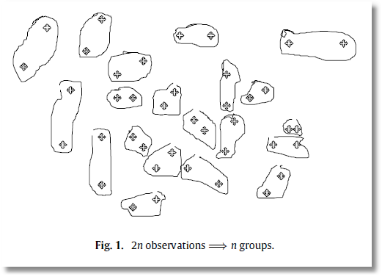
Bivariate Probit
❶ Pseudo MLE
❷ Consistent
❸ Asymptotically normal?
  Resembles time series case
  Correlation need not fade with ‘distance’
❹ Better than Pinske/Slade Univariate Probit?
❺ How to choose the pairings?

Slide 41

An Ordered Choice Model (OCM)

Slide 42
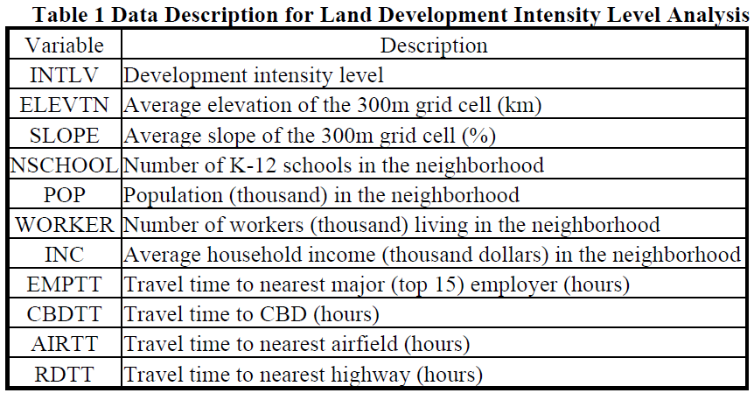
OCM for Land Use Intensity

Slide 43

Unordered Multinomial Choice

Slide 44
Spatial Multinomial Probit
Chakir, R. and Parent, O. (2009) “Determinants of land use changes: A spatial multinomial probit approach, Papers in Regional Science, 88, 2, 328-346.

Slide 45
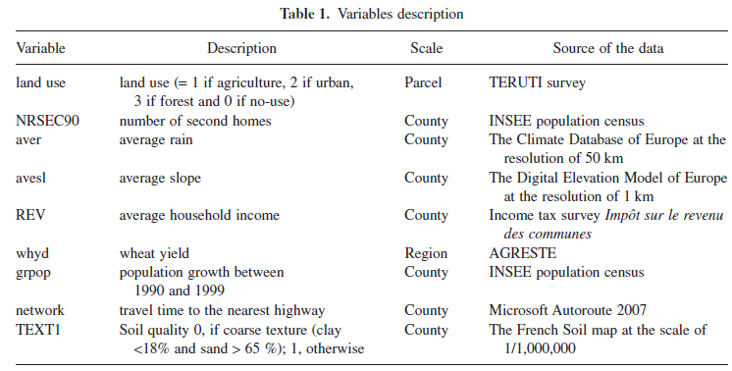

Slide 46
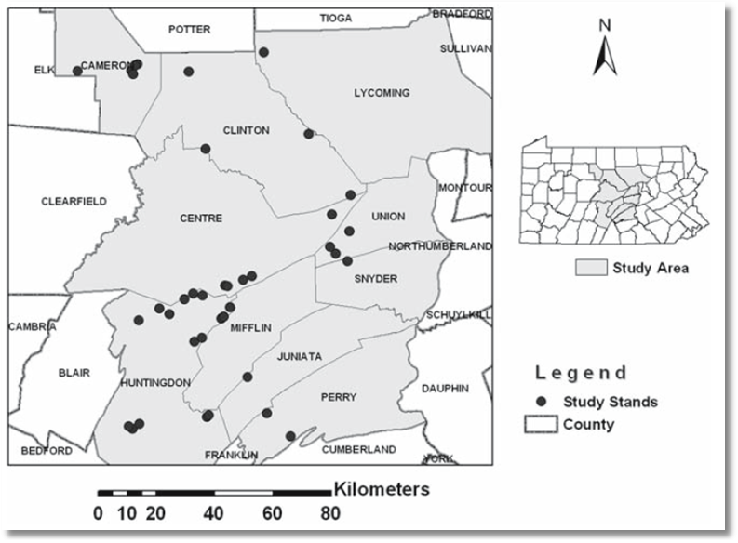
Canonical Model for Counts
Rathbun, S and Fei, L (2006) “A Spatial Zero-Inflated Poisson Regression Model for Oak Regeneration,” Environmental Ecology Statistics, 13, 2006, 409-426

Slide 47
Spatial Autocorrelation in a Sample Selection Model
Flores-Lagunes, A. and Schnier, K., “Sample Selection and Spatial Dependence,” Journal of Applied Econometrics, 27, 2, 2012, pp. 173-204.
❶ Alaska Department of Fish and Game.
❷ Pacific cod fishing eastern Bering Sea – grid of locations
❸ Observation = ‘catch per unit effort’ in grid square
❹ Data reported only if 4+ similar vessels fish in the region
❺ 1997 sample = 320 observations with 207 reported full data

Slide 48
Spatial Autocorrelation in a Sample Selection Model
❶ LHS is catch per unit effort = CPUE
❷ Site characteristics: MaxDepth, MinDepth, Biomass
❸ Fleet characteristics:
  Catcher vessel (CV = 0/1)
  Hook and line (HAL = 0/1)
  Nonpelagic trawl gear (NPT = 0/1)
  Large (at least 125 feet) (Large = 0/1)

Slide 49
Spatial Autocorrelation in a Sample Selection Model

Slide 50
Spatial Autocorrelation in a Sample Selection Model

Slide 51
Spatial Weights

Slide 52
Two Step Estimation
❶
❷

