Slide 1

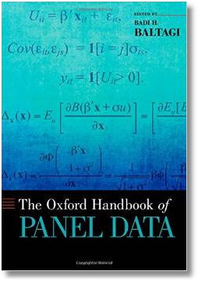






Econometric Analysis of Panel Data
William Greene
Department of Economics
University of South Florida

Slide 2
Econometric Analysis of Panel Data
18. Ordered Outcomes
and Interval Censoring

Slide 3
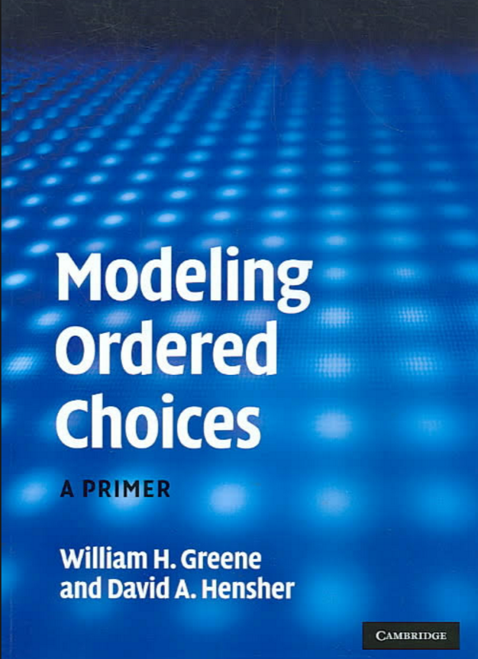

Slide 4
Ordered Discrete Outcomes
E.g.: Taste test, credit rating, course grade, preference scale
Underlying random preferences:
  Existence of an underlying continuous preference scale
  Mapping to observed choices
Strength of preferences is reflected in the discrete outcome
Censoring and discrete measurement
The nature of ordered data

Slide 5
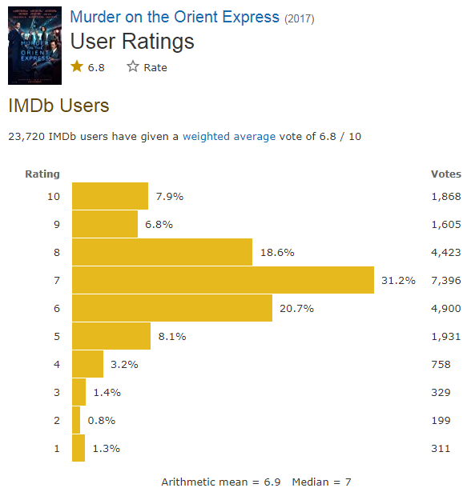
Ordered Choices at IMDb

Slide 6
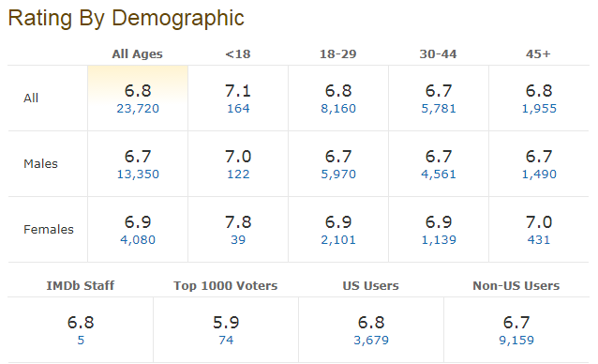

Slide 7
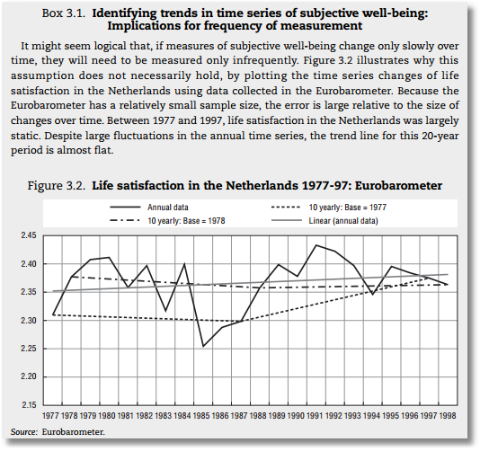


Slide 8
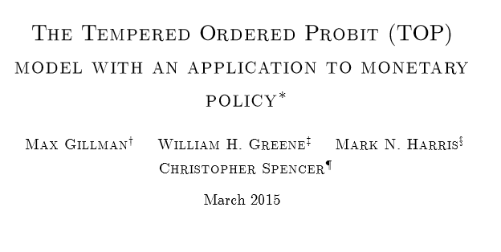

Slide 9
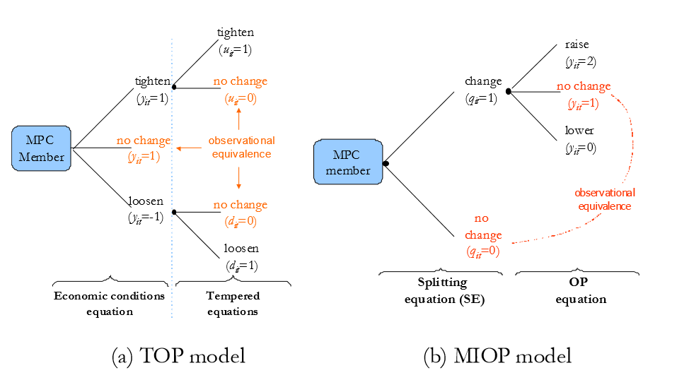

Slide 10
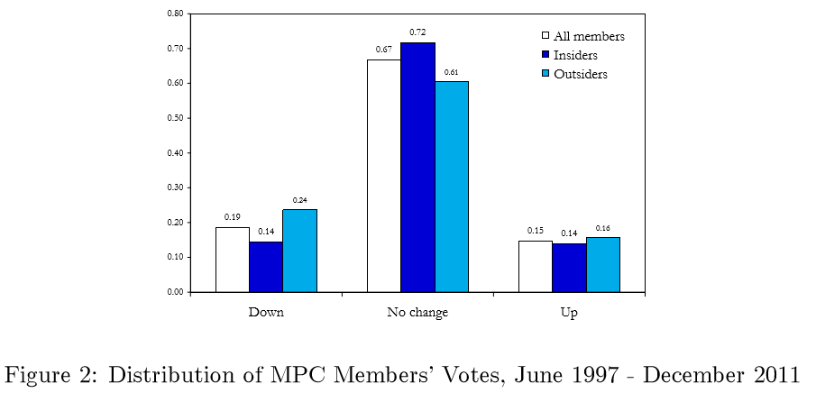

Slide 11
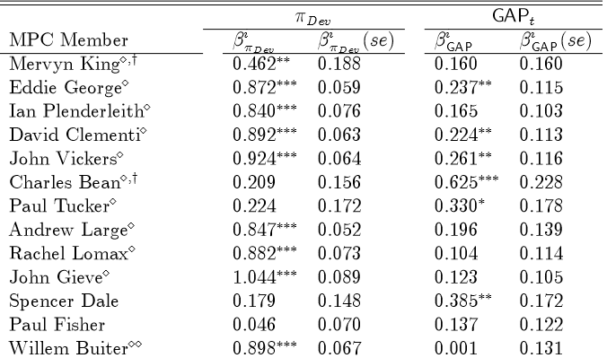
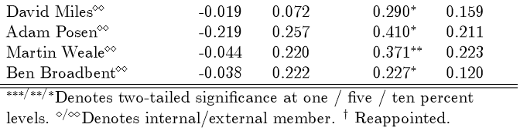

Slide 12

Health Satisfaction (HSAT)
Self administered survey: Health Care Satisfaction? (0 – 10)
Continuous Preference Scale

Slide 13
Modeling Ordered Choices
Random Utility (allowing a panel data setting)
Uit = α + β’xit + ε_{it}
= a_{it} + ε_{it}
Observe outcome j if utility is in region j
Probability of outcome = probability of cell
Pr[Yit=j] = F(μ_{j} – a_{it}) - F(μ_{j-1} – a_{it})

Slide 14
Ordered Probability Model

Slide 15

Combined Outcomes for Health Satisfaction

Slide 16
Ordered Probabilities

Slide 17
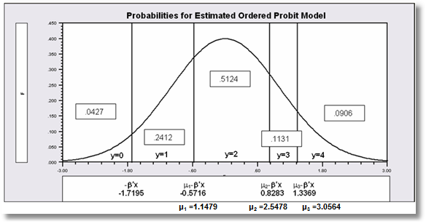

Slide 18
Coefficients

Slide 19
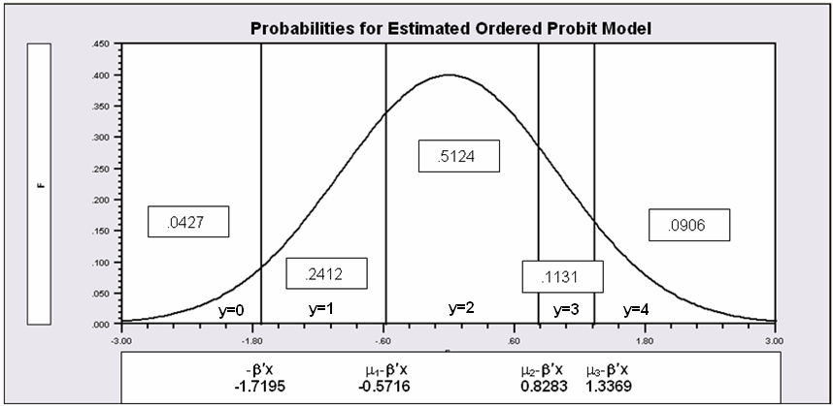
Partial Effects in the Ordered Choice Model
Assume the β_{k} is positive.
Assume that x_{k} increases.
β’x increases. μ_{j}- β’x shifts to the left for all 5 cells.
Prob[y=0] decreases
Prob[y=1] decreases – the mass shifted out is larger than the mass shifted in.
Prob[y=3] increases – same reason in reverse.
Prob[y=4] must increase.
When β_{k} > 0, increase in x_{k} decreases Prob[y=0] and increases Prob[y=J]. Intermediate cells are ambiguous, but there is only one sign change in the marginal effects from 0 to 1 to … to J

Slide 20
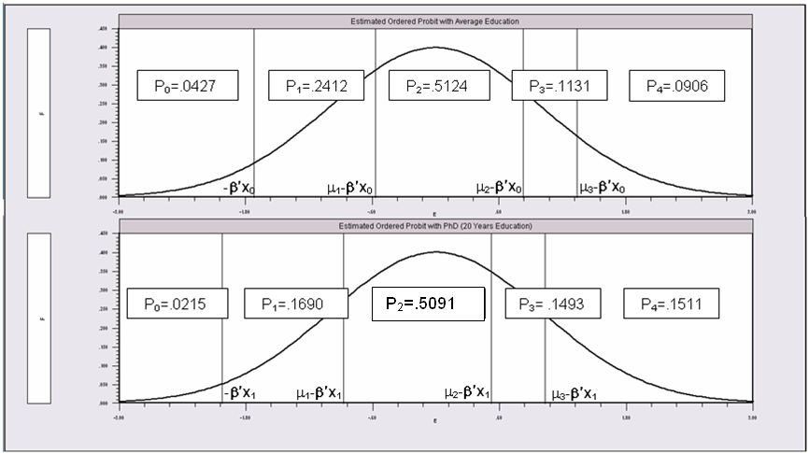
Partial Effects of 8 Years of Education

Slide 21
An Ordered Probability
Model for Health Satisfaction
+---------------------------------------------+
| Ordered Probability Model |
| Dependent variable HSAT |
| Number of observations 27326 |
| Underlying probabilities based on Normal |
| Cell frequencies for outcomes |
| Y Count Freq Y Count Freq Y Count Freq |
| 0 447 .016 1 255 .009 2 642 .023 |
| 3 1173 .042 4 1390 .050 5 4233 .154 |
| 6 2530 .092 7 4231 .154 8 6172 .225 |
| 9 3061 .112 10 3192 .116 |
+---------------------------------------------+
+---------+--------------+----------------+--------+---------+----------+
|Variable | Coefficient | Standard Error |b/St.Er.|P[|Z|>z] | Mean of X|
+---------+--------------+----------------+--------+---------+----------+
Index function for probability
Constant 2.61335825 .04658496 56.099 .0000
FEMALE -.05840486 .01259442 -4.637 .0000 .47877479
EDUC .03390552 .00284332 11.925 .0000 11.3206310
AGE -.01997327 .00059487 -33.576 .0000 43.5256898
HHNINC .25914964 .03631951 7.135 .0000 .35208362
HHKIDS .06314906 .01350176 4.677 .0000 .40273000
Threshold parameters for index
Mu(1) .19352076 .01002714 19.300 .0000
Mu(2) .49955053 .01087525 45.935 .0000
Mu(3) .83593441 .00990420 84.402 .0000
Mu(4) 1.10524187 .00908506 121.655 .0000
Mu(5) 1.66256620 .00801113 207.532 .0000
Mu(6) 1.92729096 .00774122 248.965 .0000
Mu(7) 2.33879408 .00777041 300.987 .0000
Mu(8) 2.99432165 .00851090 351.822 .0000
Mu(9) 3.45366015 .01017554 339.408 .0000

Slide 22
Ordered Probability Partial Effects
+----------------------------------------------------+
| Marginal effects for ordered probability model |
| M.E.s for dummy variables are Pr[y|x=1]-Pr[y|x=0] |
| Names for dummy variables are marked by *. |
+----------------------------------------------------+
+---------+--------------+----------------+--------+---------+----------+
|Variable | Coefficient | Standard Error |b/St.Er.|P[|Z|>z] | Mean of X|
+---------+--------------+----------------+--------+---------+----------+
These are the effects on Prob[Y=00] at means.
*FEMALE .00200414 .00043473 4.610 .0000 .47877479
EDUC -.00115962 .986135D-04 -11.759 .0000 11.3206310
AGE .00068311 .224205D-04 30.468 .0000 43.5256898
HHNINC -.00886328 .00124869 -7.098 .0000 .35208362
*HHKIDS -.00213193 .00045119 -4.725 .0000 .40273000
These are the effects on Prob[Y=01] at means.
*FEMALE .00101533 .00021973 4.621 .0000 .47877479
EDUC -.00058810 .496973D-04 -11.834 .0000 11.3206310
AGE .00034644 .108937D-04 31.802 .0000 43.5256898
HHNINC -.00449505 .00063180 -7.115 .0000 .35208362
*HHKIDS -.00108460 .00022994 -4.717 .0000 .40273000
... repeated for all 11 outcomes
These are the effects on Prob[Y=10] at means.
*FEMALE -.01082419 .00233746 -4.631 .0000 .47877479
EDUC .00629289 .00053706 11.717 .0000 11.3206310
AGE -.00370705 .00012547 -29.545 .0000 43.5256898
HHNINC .04809836 .00678434 7.090 .0000 .35208362
*HHKIDS .01181070 .00255177 4.628 .0000 .40273000

Slide 23
Ordered Probit Marginal Effects

Slide 24
Analysis of Model Implications
Partial Effects
Fit Measures
Predicted Probabilities
  Averaged: They match sample proportions.
  By observation
  Segments of the sample
  Related to particular variables

Slide 25
Fit Measures
There is no single “dependent variable” to explain.
There is no sum of squares or other measure of “variation” to explain.
Predictions of the model relate to a set of J+1 probabilities, not a single variable.
How to explain fit?
  Based on the underlying regression
  Based on the likelihood function
  Based on prediction of the outcome variable

Slide 26
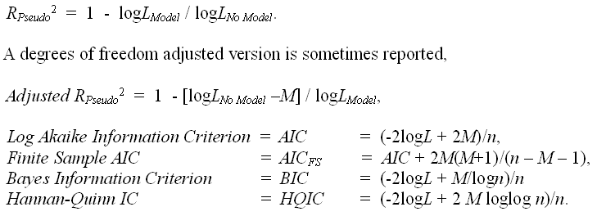
Log Likelihood Based Fit Measures

Slide 27
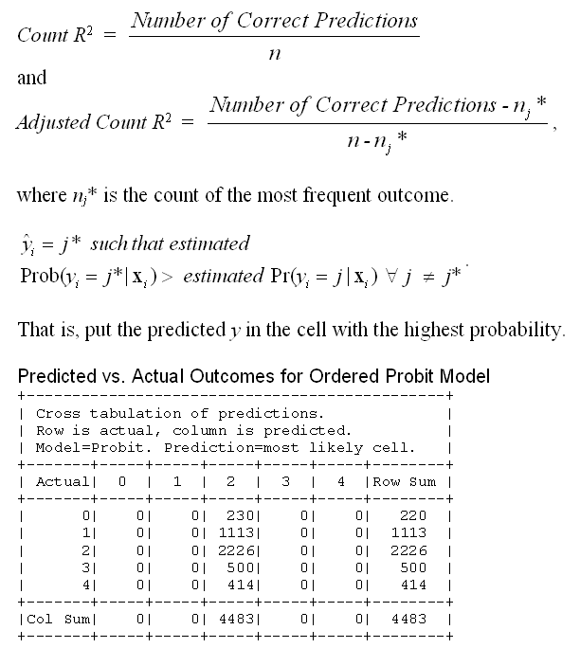

Slide 28
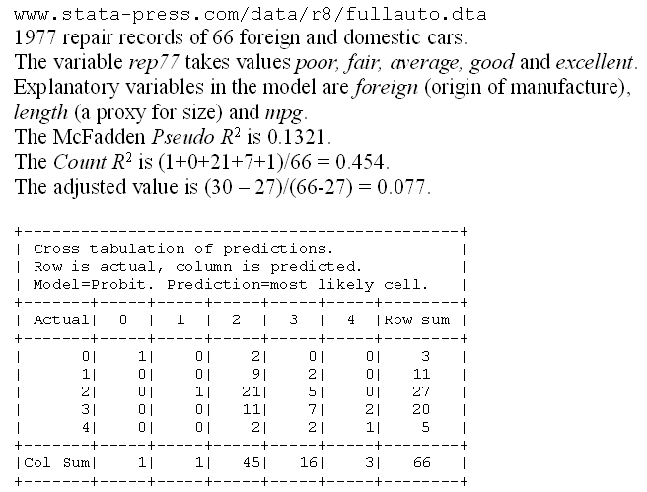
A Somewhat Better Fit

Slide 29
Zero Inflated Ordered Probit

Slide 30
Teenage Smoking

Slide 31
Interval Censored Data

Slide 32
Interval Censored Data

Slide 33
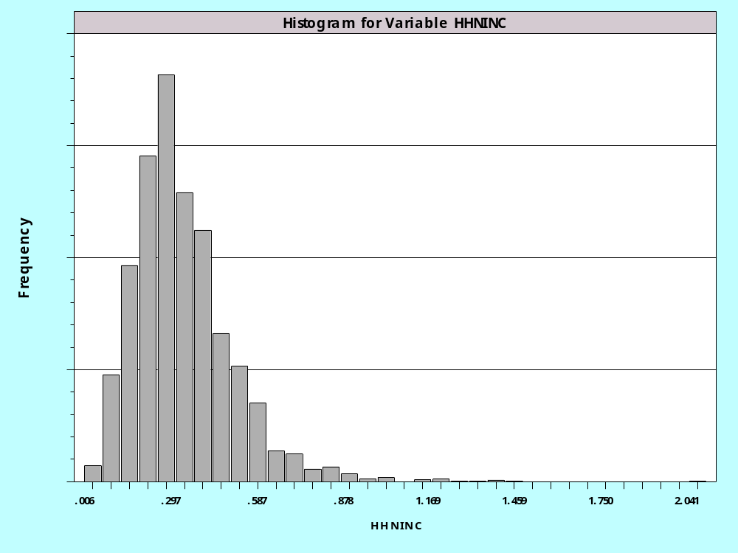
Income Data

Slide 34
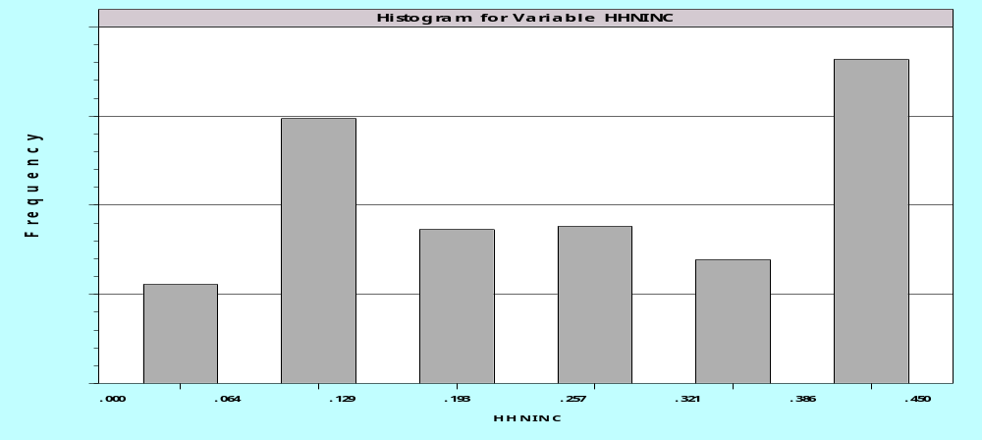
Interval Censored Income Data
0 - .15 .15-.25 .25-.30 .30-.35 .35-.40 .40+
0 1 2 3 4 5
How do these differ from the health satisfaction data?

Slide 35
Interval Censored Data

Slide 36
Interval Censored Data Model
+---------------------------------------------+
| Limited Dependent Variable Model - CENSORED |
| Dependent variable INCNTRVL |
| Iterations completed 10 |
| Akaike IC=15285.458 Bayes IC=15317.663 |
| Finite sample corrected AIC =15285.471 |
| Censoring Thresholds for the 6 cells: |
| Lower Upper Lower Upper |
| 1 ******* .15 2 .15 .25 |
| 3 .25 .30 4 .30 .35 |
| 5 .35 .40 6 .40 ******* |
+---------------------------------------------+
+---------+--------------+----------------+--------+---------+----------+
|Variable | Coefficient | Standard Error |b/St.Er.|P[|Z|>z] | Mean of X|
+---------+--------------+----------------+--------+---------+----------+
Primary Index Equation for Model
Constant .09855610 .01405518 7.012 .0000
AGE -.00117933 .00016720 -7.053 .0000 46.7491906
EDUC .01728507 .00092143 18.759 .0000 10.9669624
MARRIED .09317316 .00441004 21.128 .0000 .75458666
Sigma .11819820 .00169166 69.871 .0000
OLS Standard error of e = .1558463
Constant .07968461 .01698076 4.693 .0000
AGE -.00105530 .00020911 -5.047 .0000 46.7491906
EDUC .02096821 .00108429 19.338 .0000 10.9669624
MARRIED .09198074 .00540896 17.005 .0000 .75458666

Slide 37
The Interval Censored Data Model
What are the marginal effects?
How do you predict the dependent variable?
Does the model fit the “data?”

Slide 38
Panel Data Models

Slide 39
Fixed Effects in Ordered Probit
FEM is feasible, but still has the IP problem:
The model does not allow time invariant variables. (True for all FE models.)
+---------------------------------------------+
| FIXED EFFECTS OrdPrb Model for HSAT |
| Probability model based on Normal |
| Unbalanced panel has 7293 individuals. |
| Bypassed 1626 groups with inestimable a(i). |
| Ordered probit (normal) model |
| LHS variable = values 0,1,...,10 |
+---------------------------------------------+
+--------+--------------+----------------+--------+--------+----------+
|Variable| Coefficient | Standard Error |b/St.Er.|P[|Z|>z]| Mean of X|
+--------+--------------+----------------+--------+--------+----------+
---------+Index function for probability
AGE | -.07112929 .00272163 -26.135 .0000 43.9209856
HHNINC | .30440707 .06911872 4.404 .0000 .35112607
HHKIDS | -.05314566 .02759325 -1.926 .0541 .40921377
MU(1) | .32488357 .02036536 15.953 .0000
MU(2) | .84482743 .02736195 30.876 .0000
MU(3) | 1.39401405 .03002759 46.424 .0000
MU(4) | 1.82295281 .03102039 58.766 .0000
MU(5) | 2.69905015 .03228035 83.613 .0000
MU(6) | 3.12710938 .03273985 95.514 .0000
MU(7) | 3.79215121 .03344945 113.370 .0000
MU(8) | 4.84337386 .03489854 138.784 .0000
MU(9) | 5.57234230 .03629839 153.515 .0000

Slide 40
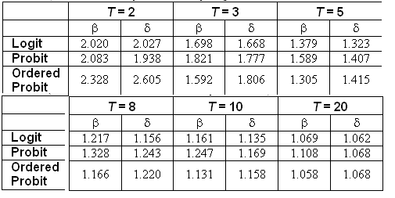
Incidental Parameters Problem
Table 9.1 Monte Carlo Analysis of the Bias of the MLE in Fixed Effects Discrete Choice Models (Means of empirical sampling distributions, N = 1,000 individuals, R = 200 replications)

Slide 41
Solution to IP in Ordered Choice Model

Slide 42
Two Studies
Ferrer-i-Carbonell, A. and Frijters, P., “How Important is Methodogy for the Estimates of the Determinants of Happiness?” Working paper, University of Amsterdam, 2004.
Das, M. and van Soest, A., “A Panel Data Model for Subjective Information in Household Income Growth,” Journal of Economic Behavior and Organization, 40, 1999, 409-426.

Slide 43
Omitted Heterogeneity in the Ordered Probability Model

Slide 44
Random Effects Ordered Probit
+---------------------------------------------+
| Random Effects Ordered Probability Model |
| Log likelihood function -7350.039 |
| Number of parameters 10 |
| Akaike IC=14720.078 Bayes IC=14784.488 |
| Log likelihood function -7570.099 |
| Number of parameters 9 |
| Akaike IC=15158.197 Bayes IC=15216.166 |
| Chi squared 440.1194 |
| Degrees of freedom 1 |
| Prob[ChiSqd > value] = .0000000 |
| Underlying probabilities based on Normal |
| Unbalanced panel has 2721 individuals. |
+---------------------------------------------+
Log Likelihood function rises by 220.
AIC falls by a lot.

Slide 45
Random Effects Ordered Probit
+---------+--------------+----------------+--------+---------+
|Variable | Coefficient | Standard Error |b/St.Er.|P[|Z|>z] |
+---------+--------------+----------------+--------+---------+
Index function for probability
Constant 2.30977026 .19358195 11.932 .0000
AGE -.01871746 .00209003 -8.956 .0000
LOGINC .18063717 .04447407 4.062 .0000
EDUC .05189883 .01138694 4.558 .0000
MARRIED .16934087 .05625235 3.010 .0026
Threshold parameters for index model
Mu(01) .37231012 .02099440 17.734 .0000
Mu(02) 1.02152648 .02996734 34.088 .0000
Mu(03) 1.90942649 .03834274 49.799 .0000
Mu(04) 3.13364227 .05394482 58.090 .0000
Std. Deviation of random effect
Sigma .86357820 .03459713 24.961 .0000
+---------+--------------+----------------+--------+--------+
Index function for probability
Constant 1.73092403 .13201381 13.112 .0000
AGE -.01459464 .00141680 -10.301 .0000
LOGINC .17731072 .03283610 5.400 .0000
EDUC .03956549 .00760040 5.206 .0000
MARRIED .09513703 .03850569 2.471 .0135
Threshold parameters for index
Mu(1) .27875355 .01454454 19.166 .0000
Mu(2) .76803748 .01708019 44.967 .0000
Mu(3) 1.44624995 .01794090 80.612 .0000
Mu(4) 2.37085047 .02336295 101.479 .0000

Slide 46
RE Ordered Probit Fits Worse
+---------------------------------------------------------------------------+
| Cross tabulation of predictions. Row is actual, column is predicted. |
| Model = Probit . Prediction is number of the most probable cell. |
+-------+-------+-----+-----+-----+-----+-----+-----+-----+-----+-----+-----+
| Actual|Row Sum| 0 | 1 | 2 | 3 | 4 | 5 | 6 | 7 | 8 | 9 |
+-------+-------+-----+-----+-----+-----+-----+-----+-----+-----+-----+-----+
| 0| 447| 0| 0| 0| 163| 284| 0|
| 1| 255| 0| 0| 0| 77| 178| 0|
| 2| 642| 0| 0| 0| 177| 465| 0|
| 3| 1173| 0| 0| 0| 255| 918| 0|
| 4| 1390| 0| 0| 0| 285| 1105| 0|
| 5| 726| 0| 0| 0| 88| 638| 0| Random Effects Model
+-------+-------+-----+-----+-----+-----+-----+-----+-----+-----+-----+-----+
|Col Sum| 4633| 0| 0| 0| 1045| 3588| 0| 0| 0| 0| 0|
+-------+-------+-----+-----+-----+-----+-----+-----+-----+-----+-----+-----+
| 0| 447| 1| 0| 0| 135| 311| 0|
| 1| 255| 0| 0| 0| 66| 189| 0|
| 2| 642| 2| 0| 0| 141| 499| 0|
| 3| 1173| 1| 0| 0| 212| 960| 0|
| 4| 1390| 1| 0| 0| 217| 1172| 0|
| 5| 726| 1| 0| 0| 68| 657| 0| Pooled Model
+-------+-------+-----+-----+-----+-----+-----+-----+-----+-----+-----+-----+
|Col Sum| 4633| 6| 0| 0| 839| 3788| 0| 0| 0| 0| 0|
+-------+-------+-----+-----+-----+-----+-----+-----+-----+-----+-----+-----+

Slide 47
+---------------------------------------------+
| Random Coefficients OrdProbs Model |
| Log likelihood function -7399.789 |
| Number of parameters 14 |
| Akaike IC=14827.577 Bayes IC=14917.751 |
| LHS variable = values 0,1,..., 5 |
| Simulation based on 10 Halton draws |
+---------------------------------------------+
+---------+--------------+----------------+--------+---------+----------+
|Variable | Coefficient | Standard Error |b/St.Er.|P[|Z|>z] | Mean of X|
+---------+--------------+----------------+--------+---------+----------+
Means for random parameters
Constant 2.20558990 .09383245 23.506 .0000
AGE -.01777008 .00100651 -17.655 .0000 46.7491906
LOGINC .22137632 .02324751 9.523 .0000 -1.23143358
EDUC .04993003 .00533564 9.358 .0000 10.9669624
MARRIED .15204526 .02732037 5.565 .0000 .75458666
Scale parameters for dists. of random parameters
Constant .73499851 .01269198 57.910 .0000
AGE .00450991 .00023099 19.524 .0000
LOGINC .18122682 .00982249 18.450 .0000
EDUC .00242171 .00098524 2.458 .0140
MARRIED .17686840 .01274872 13.873 .0000
Threshold parameters for probabilities
MU(1) .35236133 .01417318 24.861 .0000
MU(2) .96740071 .01930160 50.120 .0000
MU(3) 1.81667039 .02269549 80.045 .0000
MU(4) 2.99534033 .02813426 106.466 .0000

Slide 48
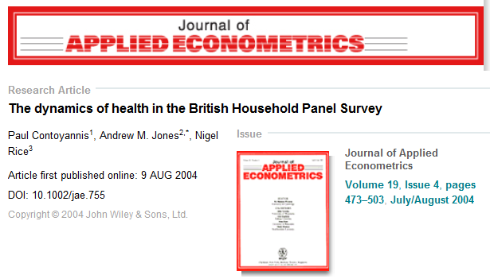
A Dynamic Ordered Probit Model

Slide 49
Model for Self Assessed Health
British Household Panel Survey (BHPS)
  Waves 1-8, 1991-1998
  Self assessed health on 0,1,2,3,4 scale
  Sociological and demographic covariates
  Dynamics – inertia in reporting of top scale
Dynamic ordered probit model
  Balanced panel – analyze dynamics
  Unbalanced panel – examine attrition

Slide 50
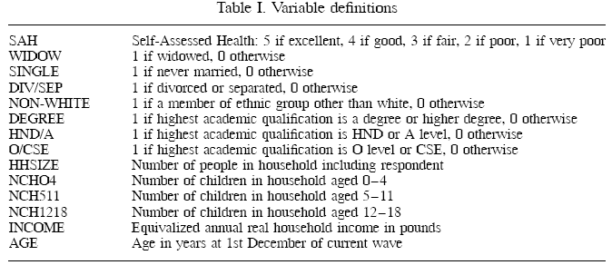
Data

Slide 51
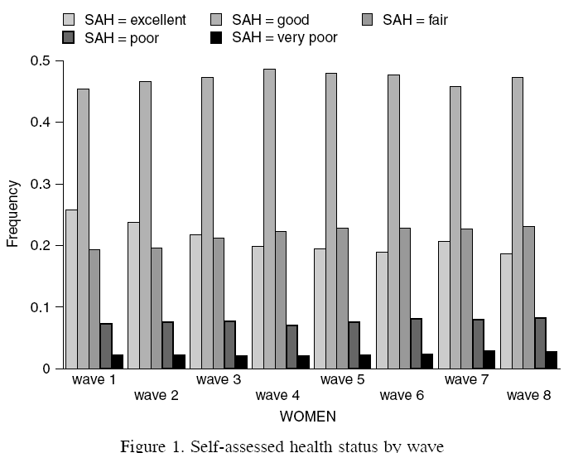
Variable of Interest

Slide 52
Dynamic Ordered Probit Model
It would not be appropriate to include h_{i,t-1} itself in the model as this is a label, not a measure

Slide 53
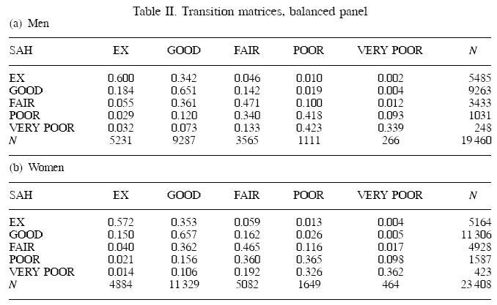
Dynamics

Slide 54

Estimated Partial Effects by Model

Slide 55
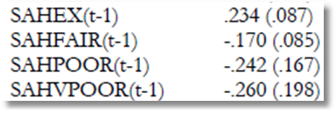
Partial Effect for a Category
These are 4 dummy variables for state in the previous period. Using first differences, the 0.234 estimated for SAHEX means transition from EXCELLENT in the previous period to GOOD in the previous period, where GOOD is the omitted category. Likewise for the other 3 previous state variables. The margin from ‘POOR’ to ‘GOOD’ was not interesting in the paper. The better margin would have been from EXCELLENT to POOR, which would have (EX,POOR) change from (1,0) to (0,1).

Slide 56
Ordered Choice Model Extensions

Slide 57
Nested Random Effects
Winkelmann, R., “Subjective Well Being and the Family: Results from an Ordered Probit Model with Multiple Random Effects,” IZA Discussion Paper 1016, Bonn, 2004.
GSOEP, T=14 years
  21,168 person-years
  7,485 family-years
  1,309 families
  Y=subjective well being (0 to 10)
  Age, Sex, Employment status, health, log income, family size, time trend

Slide 58
Nested RE Ordered Probit
y*(i,t)=x_{i,t}’β + a_{j} (family)
+ u_{i,j} (individual in family)
+ v_{i,j,t} (unique factor)
Ordered probit formulation.
Model is estimated by nested simulation over u_{ij} in a_{j}.

Slide 59
Log Likelihood for Nested Effects-1

Slide 60
Log Likelihood for Nested Effects-2

Slide 61
Log Likelihood for Nested Effects-3

Slide 62
Log Likelihood for Nested Effects-4

Slide 63
Log Likelihood for Nested Effects-5

Slide 64
Generalizing the Ordered Probit with Heterogeneous Thresholds

Slide 65
Generalized Ordered Probit-1
Y=Grade (rank)
Z=Sex, Race
X=Experience, Education, Training, History, Marital Status, Age

Slide 66
Generalized Ordered Probit-2

Slide 67
A G.O.P Model
+---------+--------------+----------------+--------+---------+----------+
|Variable | Coefficient | Standard Error |b/St.Er.|P[|Z|>z] | Mean of X|
+---------+--------------+----------------+--------+---------+----------+
Index function for probability
Constant 1.73737318 .13231824 13.130 .0000
AGE -.01458121 .00141601 -10.297 .0000 46.7491906
LOGINC .17724352 .03275857 5.411 .0000 -1.23143358
EDUC .03897560 .00780436 4.994 .0000 10.9669624
MARRIED .09391821 .03761091 2.497 .0125 .75458666
Estimates of t(j) in mu(j)=exp[t(j)+d*z]
Theta(1) -1.28275309 .06080268 -21.097 .0000
Theta(2) -.26918032 .03193086 -8.430 .0000
Theta(3) .36377472 .02109406 17.245 .0000
Theta(4) .85818206 .01656304 51.813 .0000
Threshold covariates mu(j)=exp[t(j)+d*z]
FEMALE .00987976 .01802816 .548 .5837
How do we interpret the result for FEMALE?

Slide 68
Hierarchical Ordered Probit

Slide 69
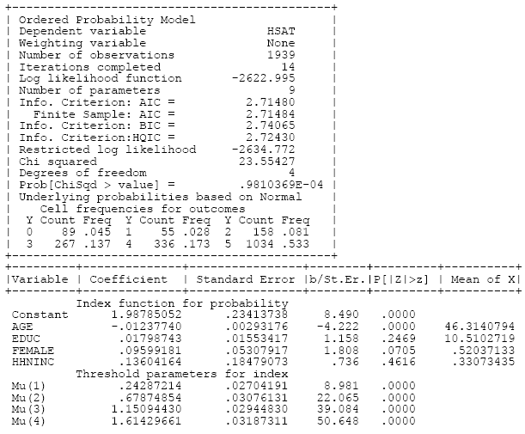
Ordered Choice Model

Slide 70
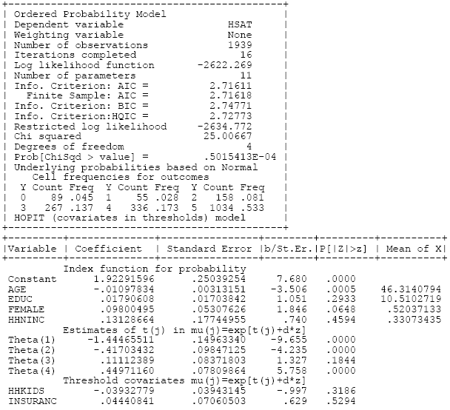
HOPit Model

Slide 71
Appendix:
Applications

Slide 72
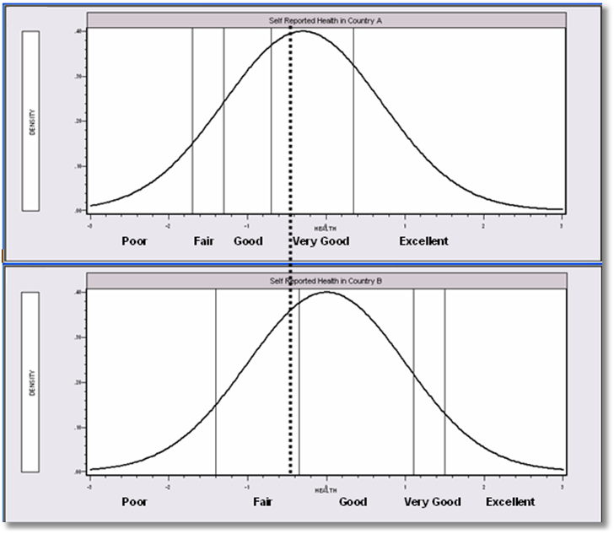
Differential Item Functioning

Slide 73
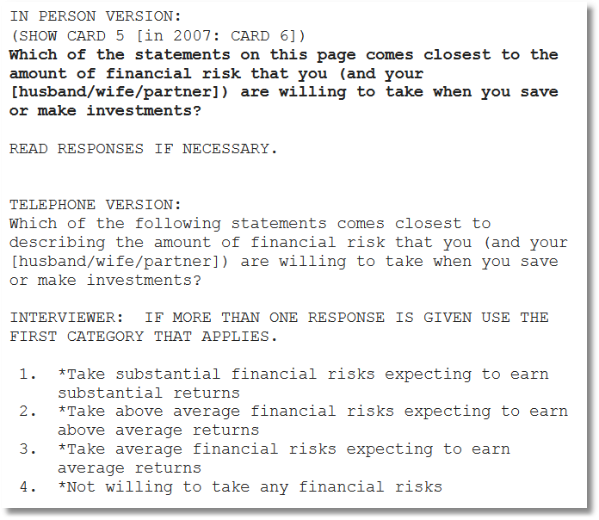

Slide 74
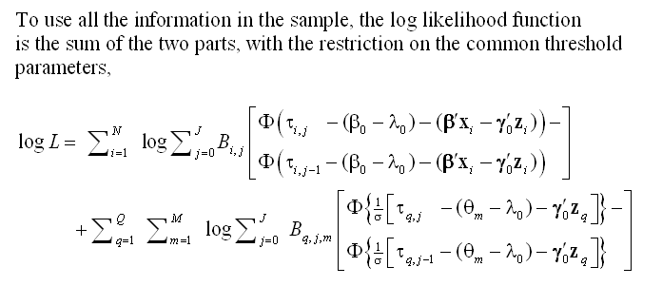
A Vignette Random Effects Model

Slide 75
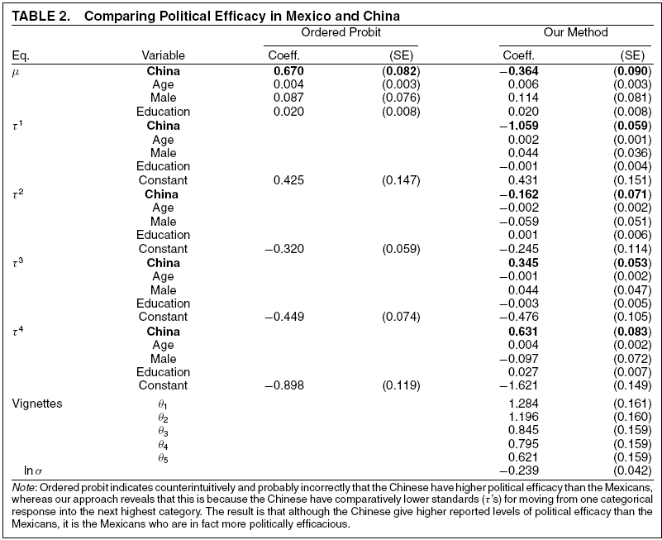
Vignettes

Slide 76


Slide 77
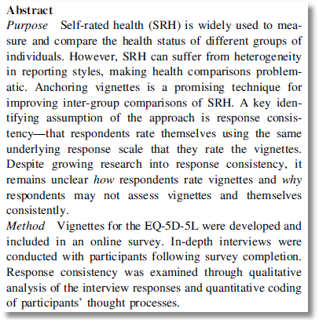

Slide 78
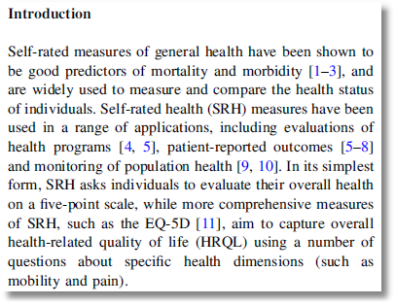

Slide 79
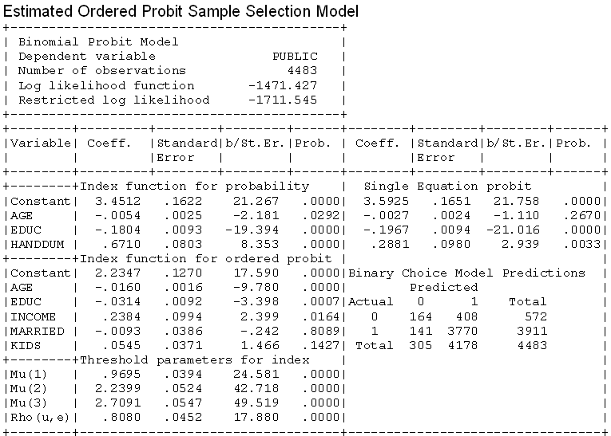
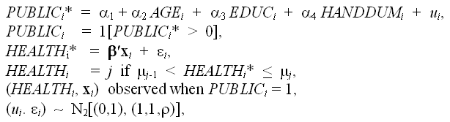
A Sample Selection Model

Slide 80
A Bivariate Latent Class Correlated Generalised Ordered
Probit Model with an Application to Modelling Observed Obesity Levels
William Greene
Stern School of Business, New York University
With Mark Harris, Bruce Hollingsworth, Pushkar Maitra
Monash University
Stern Economics Working Paper 08-18.
http://w4.stern.nyu.edu/emplibrary/ObesityLCGOPpaperReSTAT.pdf
Economics Letters, 2014
Notes:
80

Slide 81
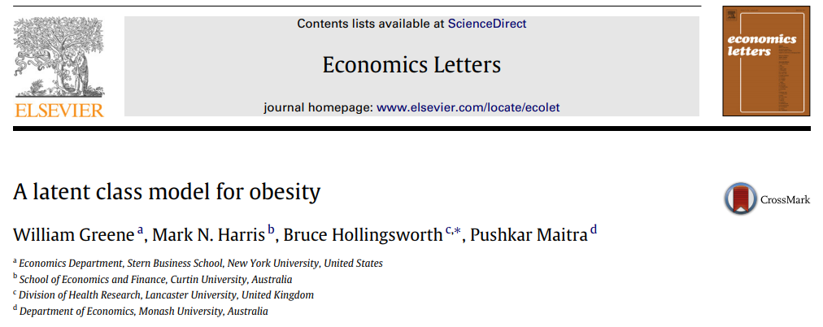

Slide 82

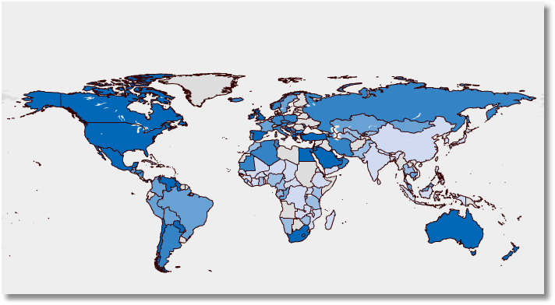

300 Million People Worldwide. International Obesity Task Force: www.iotf.org

Slide 83
Costs of Obesity
In the US more people are obese than smoke or use illegal drugs
Obesity is a major risk factor for non-communicable diseases like heart problems and cancer
Obesity is also associated with:
  lower wages and productivity, and absenteeism
  low self-esteem
An economic problem. It is costly to society:
  USA costs are around 4-8% of all annual health care expenditure - US $100 billion
  Canada, 5%; France, 1.5-2.5%; and New Zealand 2.5%

Slide 84
Measuring Obesity
An individual’s weight given their height should lie within a certain range
  Body Mass Index (BMI)
  Weight (Kg)/height(Meters)²
World Health Organization guidelines:
  Underweight BMI < 18.5
  Normal 18.5 < BMI < 25
  Overweight 25 < BMI < 30
  Obese BMI > 30
  Morbidly Obese BMI > 40
Kg = 2.2 Pounds Meter = 39.36 Inches

Slide 85
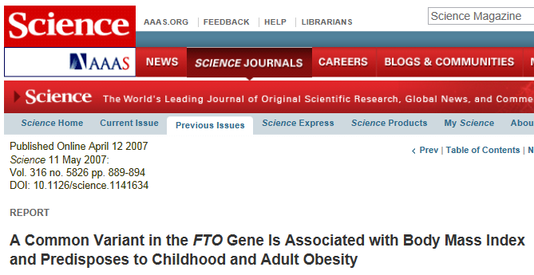
Two Latent Classes: Approximately Half of European Individuals

Slide 86
Modeling BMI Outcomes
Grossman-type health production function
Health Outcomes = f(inputs)
Existing literature assumes BMI is an ordinal, not cardinal, representation of individuals.
  Weight-related health status
  Do not assume a one-to-one relationship between BMI levels and (weight-related) health status levels
Translate BMI values into an ordinal scale using WHO guidelines
Preserves underlying ordinal nature of the BMI index but recognizes that individuals within a so-defined weight range are of an (approximately) equivalent (weight-related) health status level

Slide 87
Conversion to a Discrete Measure
Measurement issues: Tendency to under-report BMI
  women tend to under-estimate/report weight;
  men over-report height.
Using bands should alleviate this
Allows focus on discrete ‘at risk’ groups

Slide 88
A Censored Regression Model for BMI
Simple Regression Approach Based on Actual BMI:
BMI* = β′x + ε, ε ~ N[0,σ²] , σ² = 1
True BMI = weight proxy is unobserved
Interval Censored Regression Approach
WT = 0 if BMI* < 25 Normal
1 if 25 < BMI* < 30 Overweight 2 if BMI* > 30 Obese
• Inadequate accommodation of heterogeneity
• Inflexible reliance on WHO classification
• Rigid measurement by the guidelines

Slide 89
Heterogeneity in the BMI Ranges
Boundaries are set by the WHO narrowly defined for all individuals
Strictly defined WHO definitions may consequently push individuals into inappropriate categories
We allow flexibility at the margins of these intervals
Following Pudney and Shields (2000) therefore we consider Generalised Ordered Choice models - boundary parameters are now functions of observed personal characteristics

Slide 90
Generalized Ordered Probit Approach
A Latent Regression Model for True BMI
BMI_{i}* = β′x_{i} + ε_{i} , ε_{i} ~ N[0,σ²], σ² = 1
Observation Mechanism for Weight Type
WT_{i} = 0 if BMI_{i}* < 0 Normal
1 if 0 < BMI_{i}* < μ(w_{i}) Overweight
2 if μ(w_{i}) < BMI_{i}* Obese

Slide 91
Latent Class Modeling
Several ‘types’ or ‘classes. Obesity be due to genetic reasons (the FTO gene) or lifestyle factors
Distinct sets of individuals may have differing reactions to various policy tools and/or characteristics
The observer does not know from the data which class an individual is in.
Suggests a latent class approach for health outcomes
(Deb and Trivedi, 2002, and Bago d’Uva, 2005)

Slide 92
Latent Class Application
Two class model (considering FTO gene):
  More classes make class interpretations much more difficult
  Parametric models proliferate parameters
Endogenous class membership: Two classes allow us to correlate the equations driving class membership and observed weight outcomes via unobservables.

Slide 93
Heterogeneous Class Probabilities
π_{j} = Prob(class=j) = governor of a detached
natural process. Homogeneous.
π_{ij} = Prob(class=j|z_{i},individual i)
Now possibly a behavioral aspect of the process, no longer “detached” or “natural”
Nagin and Land 1993, “Criminal Careers…

Slide 94
Endogeneity of Class Membership

Slide 95
Model Components
x: determines observed weight levels within classes
For observed weight levels we use lifestyle factors such as marital status and exercise levels
z: determines latent classes
For latent class determination we use genetic proxies such as age, gender and ethnicity: the things we can’t change
w: determines position of boundary parameters within classes
For the boundary parameters we have: weight-training intensity and age (BMI inappropriate for the aged?) pregnancy (small numbers and length of term unknown)

Slide 96
Data
US National Health Interview Survey (2005); conducted by the National Center for Health Statistics
Information on self-reported height and weight levels, BMI levels
Demographic information
Split sample (30,000+) by gender

Slide 97
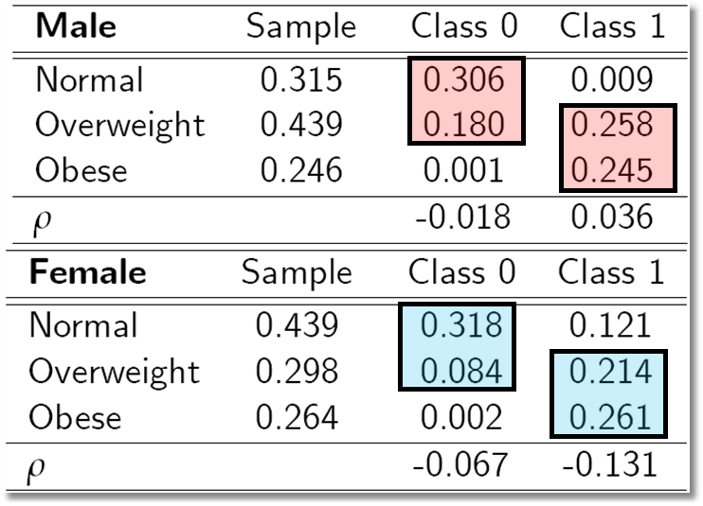
Outcome Probabilities
Class 0 dominated by normal and overweight probabilities ‘normal weight’ class
Class 1 dominated by probabilities at top end of the scale ‘non-normal weight’
Unobservables for weight class membership, negatively correlated with those determining weight levels:

Slide 98
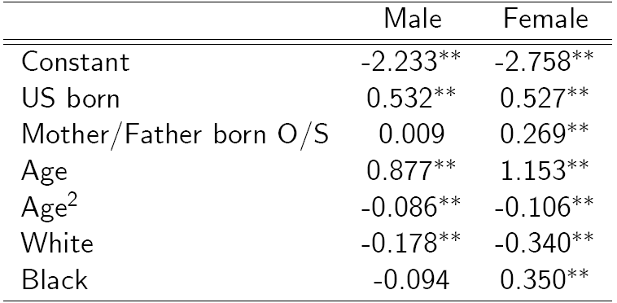
Classification (Latent Probit) Model

Slide 99
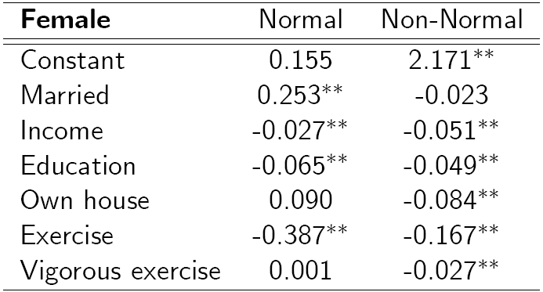
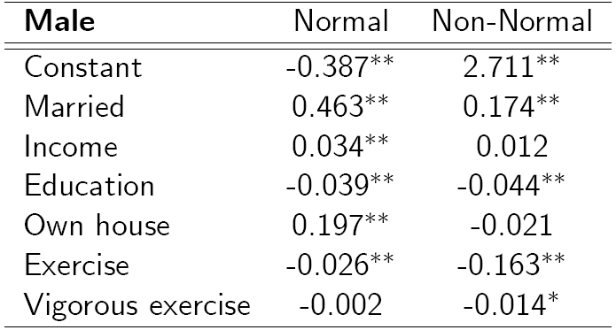
BMI Ordered Choice Model
Conditional on class membership, lifestyle factors
Marriage comfort factor only for normal class women
Both classes associated with income, education
Exercise effects similar in magnitude
Exercise intensity only important for ‘non-normal’ class:
Home ownership only important for .non-normal.class, and negative: result of differing socieconomic status distributions across classes?

Slide 100
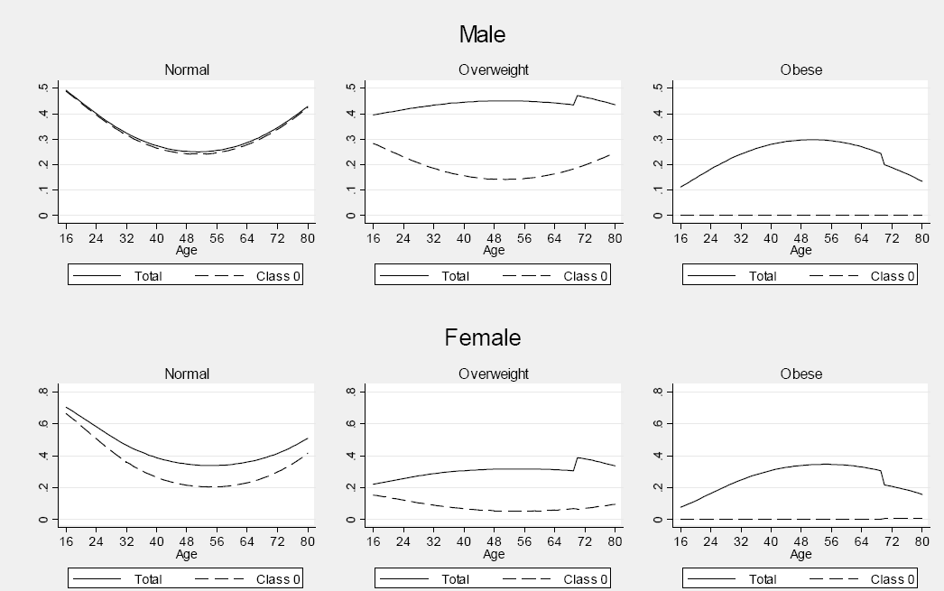
Effects of Aging on Weight Class

Slide 101
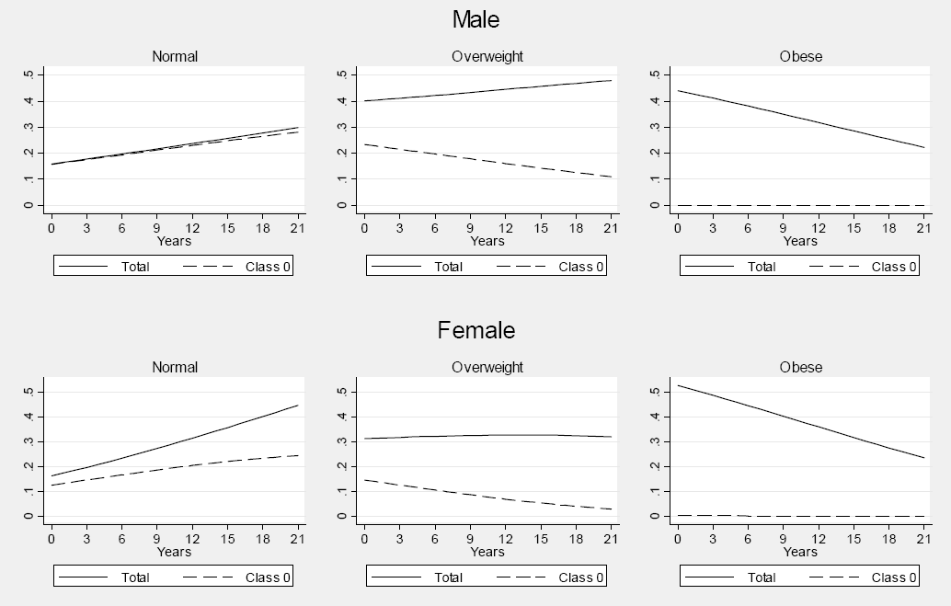
Effect of Education on Probabilities

Slide 102
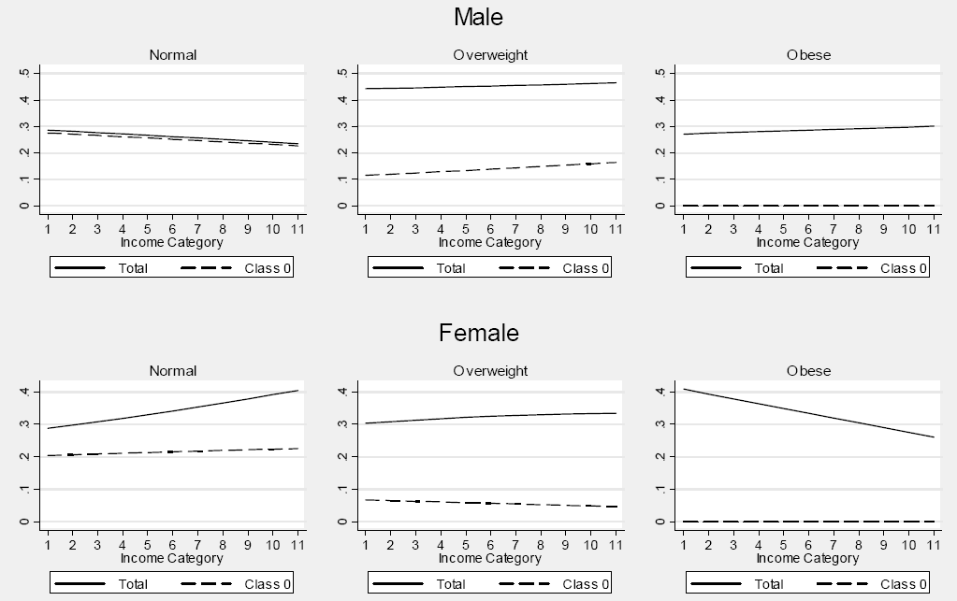
Effect of Income on Probabilities

Slide 103
Obesity
The International Obesity Taskforce (http://www.iotf.org) calls obesity one of the most important medical and public health problems of our time.
Defined as a condition of excess body fat; associated with a large number of debilitating and life-threatening disorders
Health experts argue that given an individual’s height, their weight should lie within a certain range
  Most common measure = Body Mass Index (BMI):
  Weight (Kg)/height(Meters)²
WHO guidelines:
  BMI < 18.5 are underweight
  18.5 < BMI < 25 are normal
  25 < BMI < 30 are overweight
  BMI > 30 are obese
Around 300 million people worldwide are obese, a figure likely to rise
Notes:
103

Slide 104
Models for BMI
Simple Regression Approach Based on Actual BMI:
BMI* = β′x + ε, ε ~ N[0,σ²]
No accommodation of heterogeneity
Rigid measurement by the guidelines
Interval Censored Regression Approach
WT = 0 if BMI* < 25 Normal
1 if 25 < BMI* < 30 Overweight
2 if BMI* > 30 Obese
Inadequate accommodation of heterogeneity
Inflexible reliance on WHO classification
Notes:
104

Slide 105
An Ordered Probit Approach
A Latent Regression Model for “True BMI”
BMI* = β′x + ε, ε ~ N[0,σ²], σ² = 1
“True BMI” = a proxy for weight is
unobserved
Observation Mechanism for Weight Type
WT = 0 if BMI* < 0 Normal
1 if 0 < BMI* < μ Overweight
2 if BMI* > μ Obese
Notes:
105

Slide 106
A Basic Ordered Probit Model
Notes:
106

Slide 107
Latent Class Modeling
Irrespective of observed weight category, individuals can be thought of being in one of several ‘types’ or ‘classes. e.g. an obese individual may be so due to genetic reasons or due to lifestyle factors
These distinct sets of individuals likely to have differing reactions to various policy tools and/or characteristics
The observer does not know from the data which class an individual is in.
Suggests use of a latent class approach
  Growing use in explaining health outcomes (Deb and Trivedi, 2002, and Bago d’Uva, 2005)
Notes:
107

Slide 108
A Latent Class Model
For modeling purposes, class membership is distributed with a discrete distribution,
Prob(individual i is a member of class = c)
= π_{ic} = π_{c}
Prob(WT_{i} = j | x_{i})
= Σ_{c} Prob(WT_{i} = j | x_{i},class = c)Prob(class = c).
Notes:
108

Slide 109
Probabilities in the Latent Class Model
Notes:
109

Slide 110
Class Assignment
Class membership may relate to demographics such as age and sex.
Notes:
110

Slide 111
Generalized Ordered Probit – Latent Classes and Variable Thresholds
Notes:
111

Slide 112
Data
US National Health Interview Survey (2005); conducted by the National Centre for Health Statistics
Information on self-reported height and weight levels, BMI levels
Demographic information
Remove those underweight
Split sample (30,000+) by gender
Notes:
112

Slide 113
Model Components
x: determines observed weight levels within classes
For observed weight levels we use lifestyle factors such as marital status and exercise levels
z: determines latent classes
For latent class determination we use genetic proxies such as age, gender and ethnicity: the things we can’t change
w: determines position of boundary parameters within classes
For the boundary parameters we have: weight-training intensity and age (BMI inappropriate for the aged?) pregnancy (small numbers and length of term unknown)

Slide 114
Different Normalizations
NLOGIT
  Y = 0,1,…,J, U* = α + β’x + ε
  One overall constant term, α
  J-1 “cutpoints;” μ₋₁ = -∞, μ₀ = 0, μ₁,… μ_{J-1}, μ_{J} = + ∞
Stata
  Y = 1,…,J+1, U* = β’x + ε
  No overall constant, α=0
  J “cutpoints;” μ₀ = -∞, μ₁,… μ_{J}, μ_{J+1} = + ∞

Slide 115
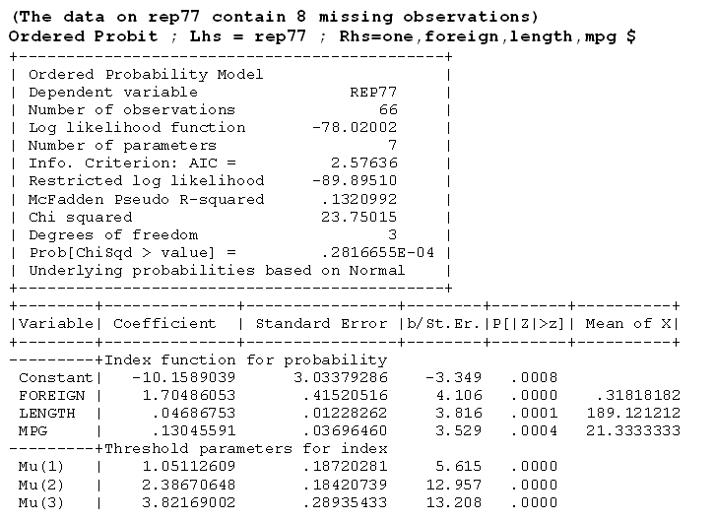

Slide 116
