Slide 1








Econometric Analysis of Panel Data
William Greene
Department of Economics
University of South Florida

Slide 2
Econometric Analysis of Panel Data
19. Limited Dependent Variables
And Models for Count Data

Slide 3
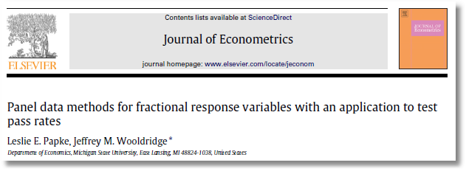

Slide 4
A Fractional Response Model

Slide 5
Estimators

Slide 6
Estimators

Slide 7
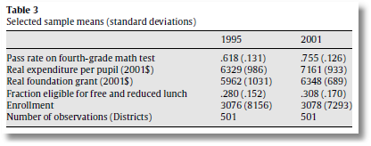
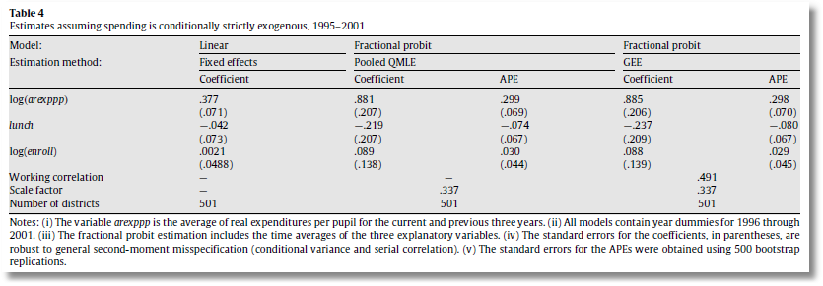

Slide 8
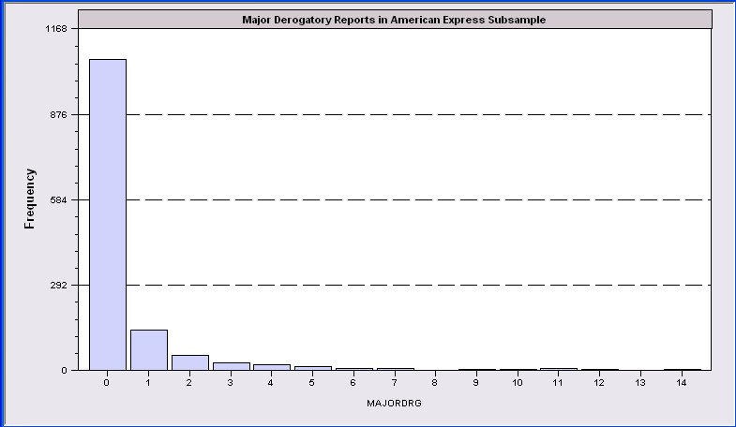
Application: Major Derogatory Reports
AmEx Credit Card Holders
N = 1310 (of 13,777)
Number of major derogatory reports in 1 year
Issues:
Nonrandom selection
Excess zeros

Slide 9
Histogram for Credit Data
Histogram for MAJORDRG NOBS= 1310, Too low: 0, Too high: 0
Bin Lower limit Upper limit Frequency Cumulative Frequency
========================================================================
0 .000 1.000 1053 ( .8038) 1053( .8038)
1 1.000 2.000 136 ( .1038) 1189( .9076)
2 2.000 3.000 50 ( .0382) 1239( .9458)
3 3.000 4.000 24 ( .0183) 1263( .9641)
4 4.000 5.000 17 ( .0130) 1280( .9771)
5 5.000 6.000 10 ( .0076) 1290( .9847)
6 6.000 7.000 5 ( .0038) 1295( .9885)
7 7.000 8.000 6 ( .0046) 1301( .9931)
8 8.000 9.000 0 ( .0000) 1301( .9931)
9 9.000 10.000 2 ( .0015) 1303( .9947)
10 10.000 11.000 1 ( .0008) 1304( .9954)
11 11.000 12.000 4 ( .0031) 1308( .9985)
12 12.000 13.000 1 ( .0008) 1309( .9992)
13 13.000 14.000 0 ( .0000) 1309( .9992)
14 14.000 15.000 1 ( .0008) 1310(1.0000)

Slide 10
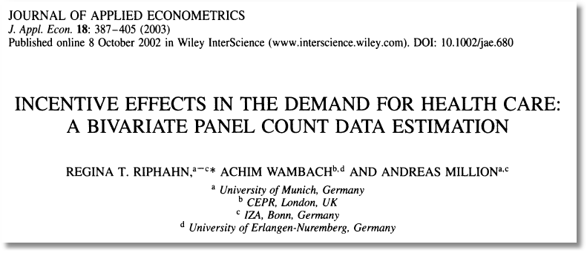

Slide 11

Doctor Visits

Slide 12
Basic Modeling for Counts of Events
E.g., Visits to site, number of purchases, number of doctor visits
Regression approach
  Quantitative outcome measured
  Discrete variable, model probabilities
Poisson probabilities – “loglinear model”

Slide 13
Poisson Model for Doctor Visits
----------------------------------------------------------------------
Poisson Regression
Dependent variable DOCVIS
Log likelihood function -103727.29625
Restricted log likelihood -108662.13583
Chi squared [ 6 d.f.] 9869.67916
Significance level .00000
McFadden Pseudo R-squared .0454145
Estimation based on N = 27326, K = 7
Information Criteria: Normalization=1/N
Normalized Unnormalized
AIC 7.59235 207468.59251
Chi- squared =255127.59573 RsqP= .0818
G - squared =154416.01169 RsqD= .0601
Overdispersion tests: g=mu(i) : 20.974
Overdispersion tests: g=mu(i)^2: 20.943
--------+-------------------------------------------------------------
Variable| Coefficient Standard Error b/St.Er. P[|Z|>z] Mean of X
--------+-------------------------------------------------------------
Constant| .77267*** .02814 27.463 .0000
AGE| .01763*** .00035 50.894 .0000 43.5257
EDUC| -.02981*** .00175 -17.075 .0000 11.3206
FEMALE| .29287*** .00702 41.731 .0000 .47877
MARRIED| .00964 .00874 1.103 .2702 .75862
HHNINC| -.52229*** .02259 -23.121 .0000 .35208
HHKIDS| -.16032*** .00840 -19.081 .0000 .40273
--------+-------------------------------------------------------------

Slide 14
Partial Effects
----------------------------------------------------------------------
Partial derivatives of expected val. with
respect to the vector of characteristics.
Effects are averaged over individuals.
Observations used for means are All Obs.
Conditional Mean at Sample Point 3.1835
Scale Factor for Marginal Effects 3.1835
--------+-------------------------------------------------------------
Variable| Coefficient Standard Error b/St.Er. P[|Z|>z] Mean of X
--------+-------------------------------------------------------------
AGE| .05613*** .00131 42.991 .0000 43.5257
EDUC| -.09490*** .00596 -15.923 .0000 11.3206
FEMALE| .93237*** .02555 36.491 .0000 .47877
MARRIED| .03069 .02945 1.042 .2973 .75862
HHNINC| -1.66271*** .07803 -21.308 .0000 .35208
HHKIDS| -.51037*** .02879 -17.730 .0000 .40273
--------+-------------------------------------------------------------

Slide 15
Poisson Model Specification Issues
Equi-Dispersion: Var[y_{i}|x_{i}] = E[y_{i}|x_{i}].
Overdispersion: If λ_{i} = exp[β’x_{i} + ε_{i}],
  E[y_{i}|x_{i}] = γexp[β’x_{i}]
  Var[y_{i}] > E[y_{i}] (overdispersed)
  ε_{i} ~ log-Gamma ➔ Negative binomial model
  ε_{i} ~ Normal[0,σ²] ➔ Normal-mixture model
  ε_{i} is viewed as unobserved heterogeneity (“frailty”).
    Normal model may be more natural.
    Estimation is a bit more complicated.

Slide 17
Time: 4:49PM April 15, 2015
I estimated a negative binomial random parameters model, and I found the following result regarding the dispersion parameter.
Dispersion parameter for NegBin distribution
ScalParm| .18597D+08 .5109D+13 .00 1.0000 -.10014D+14 .10014D+14
This seems surprising, in that z = 0.00; p-value= 1.000. Then, I estimated a simple negative binomial model, and the z value was 2.19 and p-value 0.0284. What could explain this difference between the random model and the non-random model? Is it normal that z has a value of 0.000?

Slide 18
Since you are using a cross section, the NB model is overspecified.The difference between Poisson and NB is a linear random term added to the index
in the Poisson model. (With log-gamma distribution.) When you also make the
parameters random, you just add a second random term to the constant, this time
with a normal distribution. That model is not estimable, as you found.
If you want the equivalent of a random parameters NB model, fit a Poisson model
with random constant term - that produces the NB model equivalent - and with
random slopes on the x variables.
If you were using panel data, the NB model would be identified.

Slide 19
Poisson Model for Doctor Visits
----------------------------------------------------------------------
Poisson Regression
Dependent variable DOCVIS
Log likelihood function -103727.29625
Restricted log likelihood -108662.13583
Chi squared [ 6 d.f.] 9869.67916
Significance level .00000
McFadden Pseudo R-squared .0454145
Estimation based on N = 27326, K = 7
Information Criteria: Normalization=1/N
Normalized Unnormalized
AIC 7.59235 207468.59251
Chi- squared =255127.59573 RsqP= .0818
G - squared =154416.01169 RsqD= .0601
Overdispersion tests: g=mu(i) : 20.974
Overdispersion tests: g=mu(i)^2: 20.943
--------+-------------------------------------------------------------
Variable| Coefficient Standard Error b/St.Er. P[|Z|>z] Mean of X
--------+-------------------------------------------------------------
Constant| .77267*** .02814 27.463 .0000
AGE| .01763*** .00035 50.894 .0000 43.5257
EDUC| -.02981*** .00175 -17.075 .0000 11.3206
FEMALE| .29287*** .00702 41.731 .0000 .47877
MARRIED| .00964 .00874 1.103 .2702 .75862
HHNINC| -.52229*** .02259 -23.121 .0000 .35208
HHKIDS| -.16032*** .00840 -19.081 .0000 .40273
--------+-------------------------------------------------------------

Slide 20
--------+-------------------------------------------------------------
Variable| Coefficient Standard Error b/St.Er. P[|Z|>z] Mean of X
--------+-------------------------------------------------------------
| Standard – Negative Inverse of Second Derivatives
Constant| .77267*** .02814 27.463 .0000
AGE| .01763*** .00035 50.894 .0000 43.5257
EDUC| -.02981*** .00175 -17.075 .0000 11.3206
FEMALE| .29287*** .00702 41.731 .0000 .47877
MARRIED| .00964 .00874 1.103 .2702 .75862
HHNINC| -.52229*** .02259 -23.121 .0000 .35208
HHKIDS| -.16032*** .00840 -19.081 .0000 .40273
--------+-------------------------------------------------------------
| Robust – Sandwich
Constant| .77267*** .08529 9.059 .0000
AGE| .01763*** .00105 16.773 .0000 43.5257
EDUC| -.02981*** .00487 -6.123 .0000 11.3206
FEMALE| .29287*** .02250 13.015 .0000 .47877
MARRIED| .00964 .02906 .332 .7401 .75862
HHNINC| -.52229*** .06674 -7.825 .0000 .35208
HHKIDS| -.16032*** .02657 -6.034 .0000 .40273
--------+-------------------------------------------------------------
| Cluster Correction
Constant| .77267*** .11628 6.645 .0000
AGE| .01763*** .00142 12.440 .0000 43.5257
EDUC| -.02981*** .00685 -4.355 .0000 11.3206
FEMALE| .29287*** .03213 9.116 .0000 .47877
MARRIED| .00964 .03851 .250 .8023 .75862
HHNINC| -.52229*** .08295 -6.297 .0000 .35208
HHKIDS| -.16032*** .03455 -4.640 .0000 .40273

Slide 21
Negative Binomial Specification
Prob(Y_{i}=j|x_{i}) has greater mass to the right and left
of the mean
Conditional mean function is the same as the
Poisson: E[y_{i}|x_{i}] = λ_{i}=Exp(β’x_{i}), so marginal
effects have the same form.
Variance is Var[y_{i}|x_{i}] = λ_{i}(1 + α λ_{i}), α is the
overdispersion parameter; α = 0 reverts
to the Poisson.
Poisson is consistent when NegBin is appropriate.
Therefore, this is a case for the ROBUST
covariance matrix estimator. (Neglected
heterogeneity that is uncorrelated with x_{i}.)

Slide 22
NegBin Model for Doctor Visits
----------------------------------------------------------------------
Negative Binomial Regression
Dependent variable DOCVIS
Log likelihood function -60134.50735 NegBin LogL
Restricted log likelihood -103727.29625 Poisson LogL
Chi squared [ 1 d.f.] 87185.57782 Reject Poisson model
Significance level .00000
McFadden Pseudo R-squared .4202634
Estimation based on N = 27326, K = 8
Information Criteria: Normalization=1/N
Normalized Unnormalized
AIC 4.40185 120285.01469
NegBin form 2; Psi(i) = theta
--------+-------------------------------------------------------------
Variable| Coefficient Standard Error b/St.Er. P[|Z|>z] Mean of X
--------+-------------------------------------------------------------
Constant| .80825*** .05955 13.572 .0000
AGE| .01806*** .00079 22.780 .0000 43.5257
EDUC| -.03717*** .00386 -9.622 .0000 11.3206
FEMALE| .32596*** .01586 20.556 .0000 .47877
MARRIED| -.00605 .01880 -.322 .7477 .75862
HHNINC| -.46768*** .04663 -10.029 .0000 .35208
HHKIDS| -.15274*** .01729 -8.832 .0000 .40273
|Dispersion parameter for count data model
Alpha| 1.89679*** .01981 95.747 .0000
--------+-------------------------------------------------------------

Slide 23
Marginal Effects
+---------------------------------------------------------------------
Scale Factor for Marginal Effects 3.1835 POISSON
--------+-------------------------------------------------------------
Variable| Coefficient Standard Error b/St.Er. P[|Z|>z] Mean of X
--------+-------------------------------------------------------------
AGE| .05613*** .00131 42.991 .0000 43.5257
EDUC| -.09490*** .00596 -15.923 .0000 11.3206
FEMALE| .93237*** .02555 36.491 .0000 .47877
MARRIED| .03069 .02945 1.042 .2973 .75862
HHNINC| -1.66271*** .07803 -21.308 .0000 .35208
HHKIDS| -.51037*** .02879 -17.730 .0000 .40273
--------+-------------------------------------------------------------
Scale Factor for Marginal Effects 3.1924 NEGATIVE BINOMIAL
--------+-------------------------------------------------------------
AGE| .05767*** .00317 18.202 .0000 43.5257
EDUC| -.11867*** .01348 -8.804 .0000 11.3206
FEMALE| 1.04058*** .06212 16.751 .0000 .47877
MARRIED| -.01931 .06382 -.302 .7623 .75862
HHNINC| -1.49301*** .16272 -9.176 .0000 .35208
HHKIDS| -.48759*** .06022 -8.097 .0000 .40273
--------+-------------------------------------------------------------

Slide 24

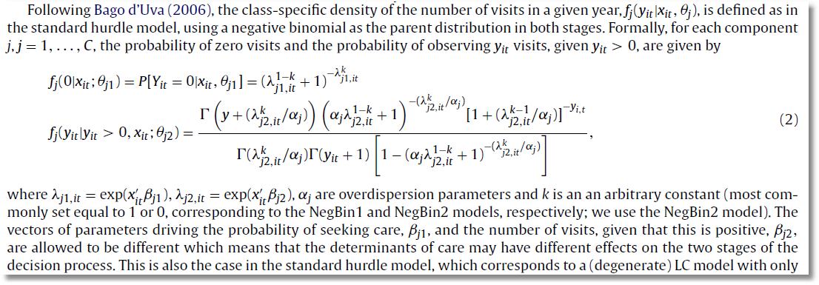

Slide 25
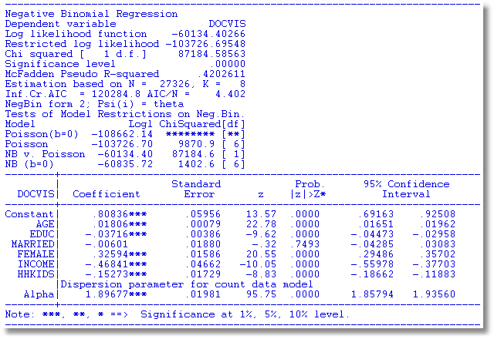

Slide 26
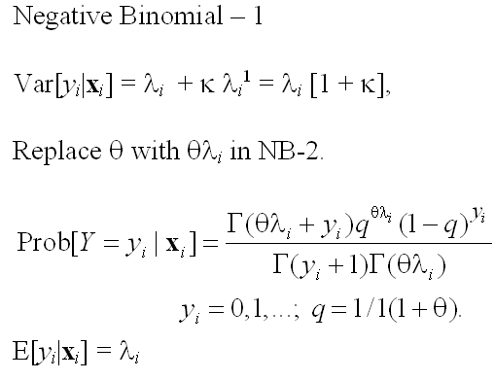
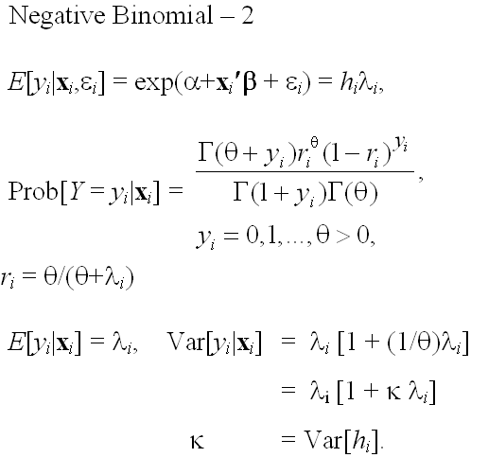
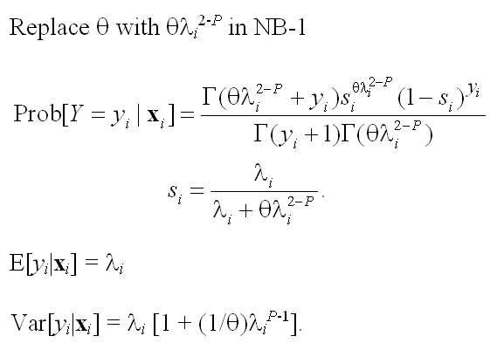
Model Formulations
E[y_{i} |x_{i} ]=λ_{i}

Slide 27
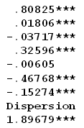
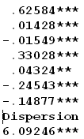
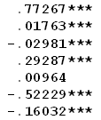
NegBin-P Model
----------------------------------------------------------------------
Negative Binomial (P) Model
Dependent variable DOCVIS
Log likelihood function -59992.32903
Restricted log likelihood -103727.29625
Chi squared [ 1 d.f.] 87469.93445
--------+-----------------------------------------
Variable| Coefficient Standard Error b/St.Er.
--------+-----------------------------------------
Constant| .60840*** .06452 9.429
AGE| .01710*** .00082 20.782
EDUC| -.02313*** .00414 -5.581
FEMALE| .36386*** .01640 22.187
MARRIED| .03670* .02030 1.808
HHNINC| -.35093*** .05146 -6.819
HHKIDS| -.16902*** .01911 -8.843
|Dispersion parameter for count data model
Alpha| 3.85713*** .14581 26.453
|Negative Binomial. General form, NegBin P
P| 1.38693*** .03142 44.140
--------+-------------------------------------------------------------
NB-2 NB-1 Poisson

Slide 28
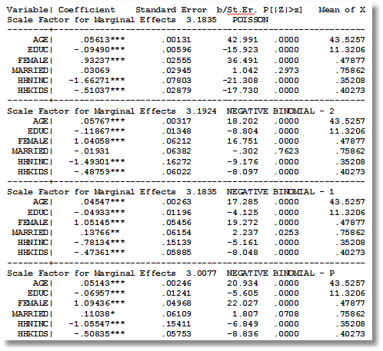

Slide 29
Zero Inflation – ZIP Models
Two regimes: (Recreation site visits)
  Zero (with probability 1). (Never visit site)
  Poisson with Pr(0) = exp[- β’x_{i}]. (Number of visits, including zero visits this season.)
Unconditional:
  Pr[0] = P(regime 0) + P(regime 1)*Pr[0|regime 1]
  Pr[j | j >0] = P(regime 1)*Pr[j|regime 1]
“Two inflation” – Number of children
These are “latent class models”

Slide 30
Zero Inflation Models

Slide 31
Notes on Zero Inflation Models
Poisson is not nested in ZIP. γ = 0 in ZIP does not produce Poisson; it produces ZIP with P(regime 0) = ½.
  Standard tests are not appropriate
  Use Vuong statistic. ZIP model almost always wins.
Zero Inflation models extend to NB models –ZINB is a standard model
  Creates two sources of overdispersion
  Generally difficult to estimate

Slide 32
ZIP Model
----------------------------------------------------------------------
Zero Altered Poisson Regression Model
Logistic distribution used for splitting model.
ZAP term in probability is F[tau x Z(i) ]
Comparison of estimated models
Pr[0|means] Number of zeros Log-likelihood
Poisson .04933 Act.= 10135 Prd.= 1347.9 -103727.29625
Z.I.Poisson .36565 Act.= 10135 Prd.= 9991.8 -83843.36088
Vuong statistic for testing ZIP vs. unaltered model is 44.6739
Distributed as standard normal. A value greater than
+1.96 favors the zero altered Z.I.Poisson model.
A value less than -1.96 rejects the ZIP model.
--------+-------------------------------------------------------------
Variable| Coefficient Standard Error b/St.Er. P[|Z|>z] Mean of X
--------+-------------------------------------------------------------
|Poisson/NB/Gamma regression model
Constant| 1.47301*** .01123 131.119 .0000
AGE| .01100*** .00013 83.038 .0000 43.5257
EDUC| -.02164*** .00075 -28.864 .0000 11.3206
FEMALE| .10943*** .00256 42.728 .0000 .47877
MARRIED| -.02774*** .00318 -8.723 .0000 .75862
HHNINC| -.42240*** .00902 -46.838 .0000 .35208
HHKIDS| -.08182*** .00323 -25.370 .0000 .40273
|Zero inflation model
Constant| -.75828*** .06803 -11.146 .0000
FEMALE| -.59011*** .02652 -22.250 .0000 .47877
EDUC| .04114*** .00561 7.336 .0000 11.3206
--------+-------------------------------------------------------------

Slide 33
Marginal Effects for Different Models
Scale Factor for Marginal Effects 3.1835 POISSON
Variable| Coefficient Standard Error b/St.Er. P[|Z|>z] Mean of X
--------+-------------------------------------------------------------
AGE| .05613*** .00131 42.991 .0000 43.5257
EDUC| -.09490*** .00596 -15.923 .0000 11.3206
FEMALE| .93237*** .02555 36.491 .0000 .47877
MARRIED| .03069 .02945 1.042 .2973 .75862
HHNINC| -1.66271*** .07803 -21.308 .0000 .35208
HHKIDS| -.51037*** .02879 -17.730 .0000 .40273
--------+-------------------------------------------------------------
Scale Factor for Marginal Effects 3.1924 NEGATIVE BINOMIAL - 2
AGE| .05767*** .00317 18.202 .0000 43.5257
EDUC| -.11867*** .01348 -8.804 .0000 11.3206
FEMALE| 1.04058*** .06212 16.751 .0000 .47877
MARRIED| -.01931 .06382 -.302 .7623 .75862
HHNINC| -1.49301*** .16272 -9.176 .0000 .35208
HHKIDS| -.48759*** .06022 -8.097 .0000 .40273
--------+-------------------------------------------------------------
Scale Factor for Marginal Effects 3.1149 ZERO INFLATED POISSON
AGE| .03427*** .00052 66.157 .0000 43.5257
EDUC| -.11192*** .00662 -16.901 .0000 11.3206
FEMALE| .97958*** .02917 33.577 .0000 .47877
MARRIED| -.08639*** .01031 -8.379 .0000 .75862
HHNINC| -1.31573*** .03112 -42.278 .0000 .35208
HHKIDS| -.25486*** .01064 -23.958 .0000 .40273
--------+-------------------------------------------------------------
Notes:
33

Slide 34
Zero Inflation Models

Slide 35
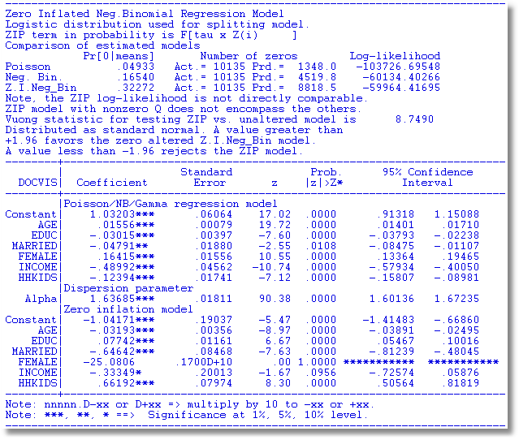
An Unidentified ZINB Model

Slide 36
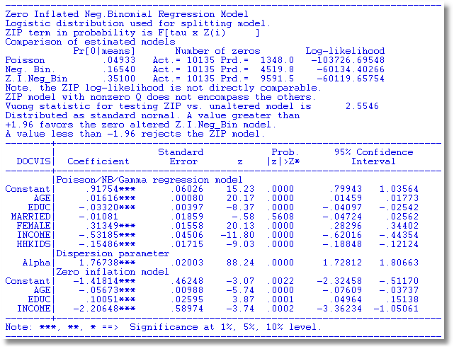

Slide 37
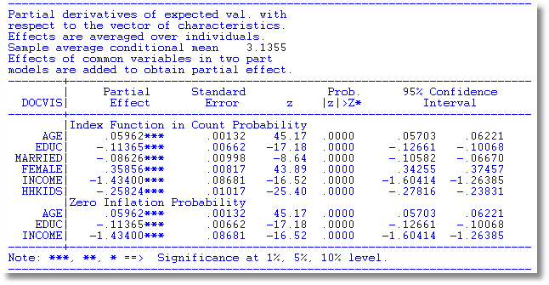
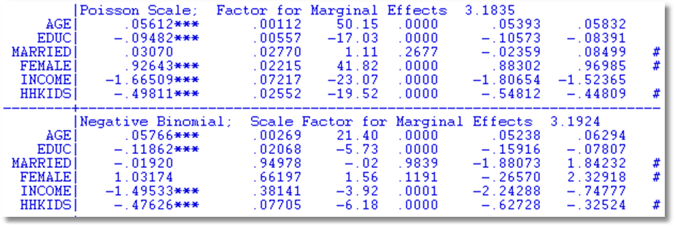
Partial Effects for Different Models
Notes:
37

Slide 38
The Vuong Statistic for Nonnested Models

Slide 39
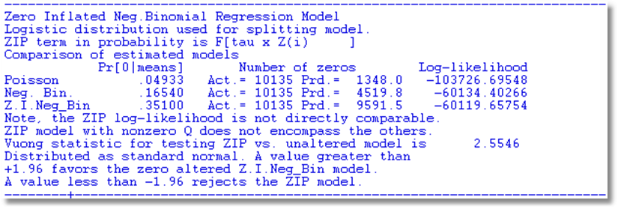

Slide 40
A Hurdle Model
Two part model:
  Model 1: Probability model for more than zero occurrences
  Model 2: Model for number of occurrences given that the number is greater than zero.
Applications common in health economics
  Usage of health care facilities
  Use of drugs, alcohol, etc.

Slide 42
Hurdle Model

Slide 43
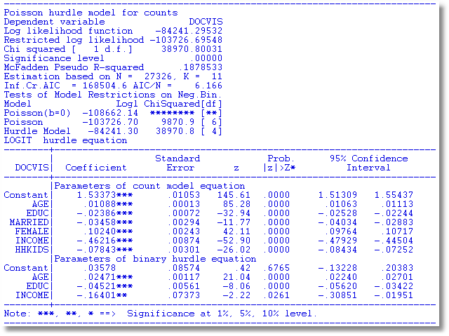
Hurdle Model for Doctor Visits

Slide 44
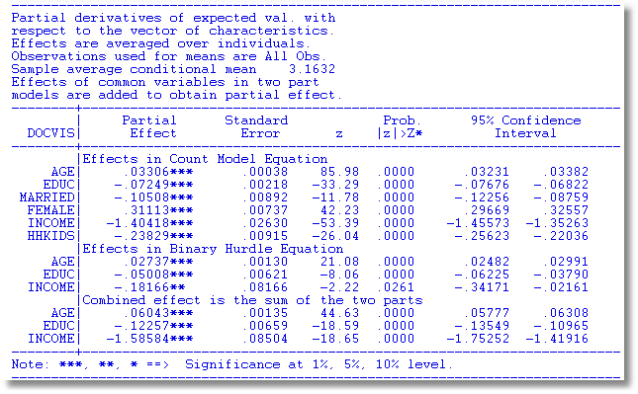
Partial Effects

Slide 47
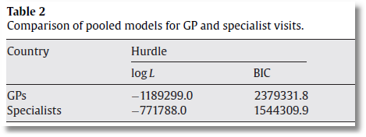
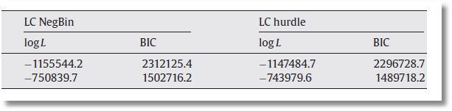

Slide 48

Application of Several of the Models
Discussed in this Section

Slide 49
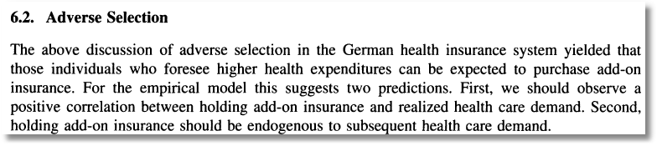
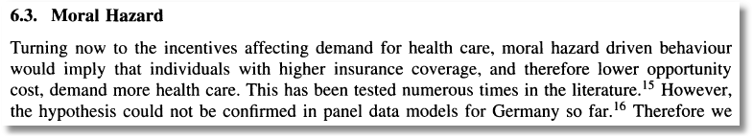

Slide 50

See also:
van Ophem H. 2000. Modeling selectivity in count data models. Journal of Business and Economic Statistics
18: 503–511.
Winkelmann finds that there is no correlation between the decisions… A significant correlation is expected … [T]he correlation comes from the way the relation between the decisions is modeled.

Slide 51
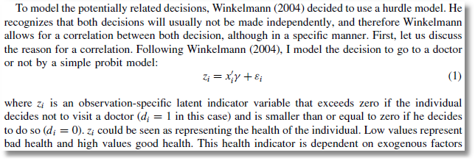
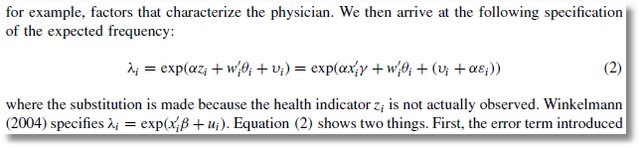
Probit Participation Equation
Poisson-Normal Intensity Equation

Slide 52
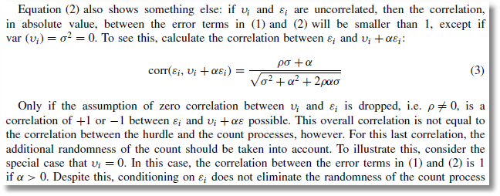
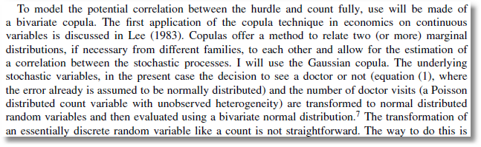
Bivariate-Normal Heterogeneity in Participation and Intensity Equations
Gaussian Copula for Participation and Intensity Equations

Slide 53
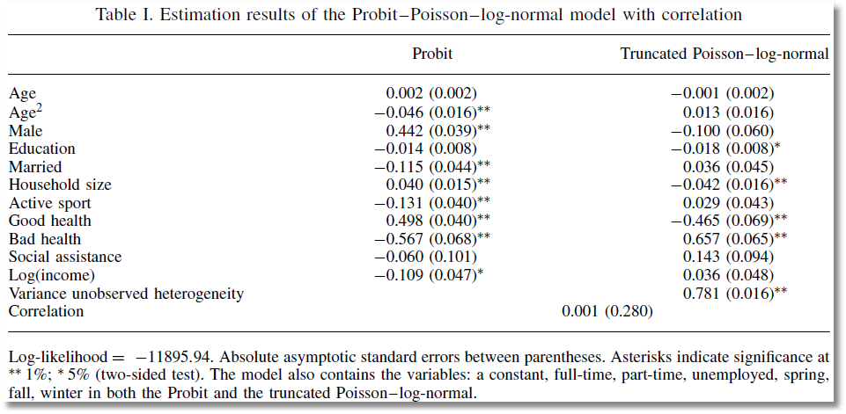
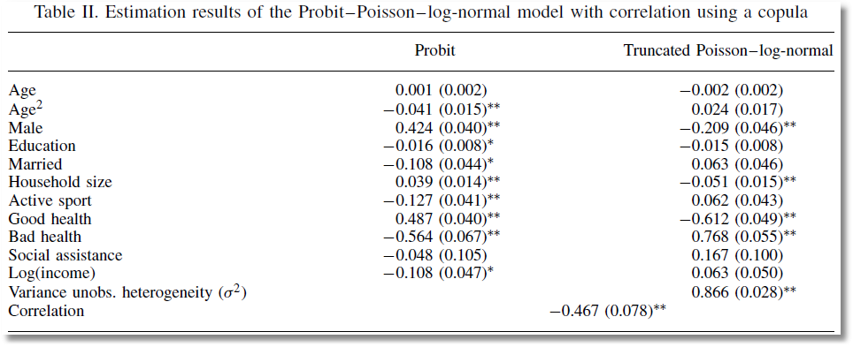
Correlation between Heterogeneity Terms
Correlation between Counts

Slide 54
Panel Data Models
Heterogeneity; λ_{it} = exp(β’x_{it} + c_{i})
  Fixed Effects
    Poisson: Standard, no incidental parameters issue
    Negative Binomial
      Hausman, Hall, Griliches (1984) put FE in variance, not the mean
      Use “brute force” to get a conventional FE model
  Random Effects
    Poisson
      Log-gamma heterogeneity becomes an NB model
      Contemporary treatments are using normal heterogeneity with simulation or quadrature based estimators
    NB with random effects is equivalent to two “effects” one time varying one time invariant. The model is probably overspecified
Random Parameters: Mixed models, latent class models, hiererchical – all extended to Poisson and NB

Slide 55

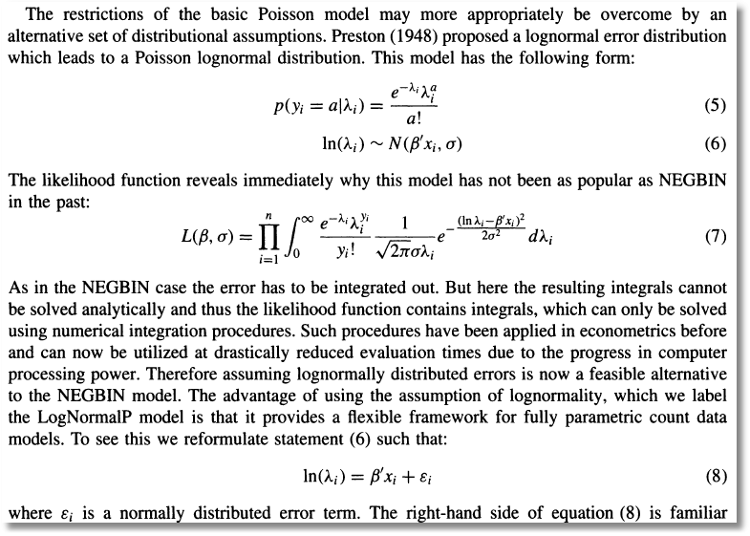
Poisson (log)Normal Mixture

Slide 56
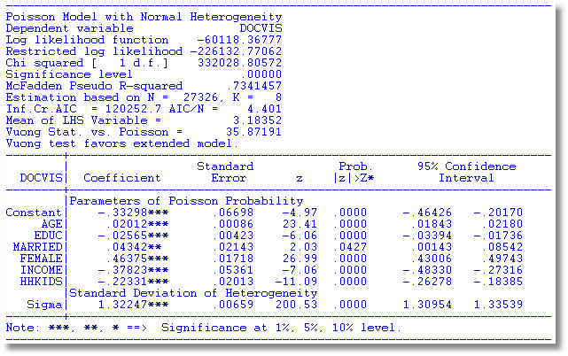
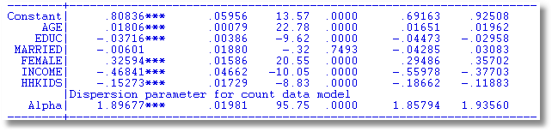

Slide 57
A Peculiarity of the FENB Model
‘True’ FE model has λ_{i}=exp(α_{i}+x_{it}’β). Cannot be fit if there are time invariant variables.
Hausman, Hall and Griliches (Econometrica, 1984) has α_{i} appearing in θ.
  Produces different results
  Implies that the FEM can contain time invariant variables.

Slide 58
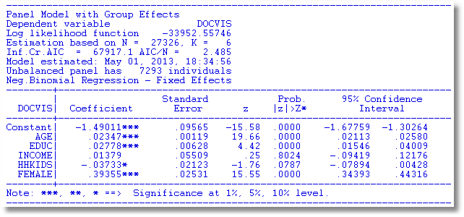
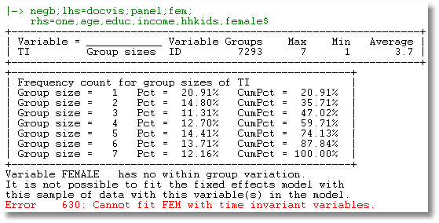

Slide 59

See: Allison and Waterman (2002),
Guimaraes (2007)
Greene, Econometric Analysis (2011)

Slide 60
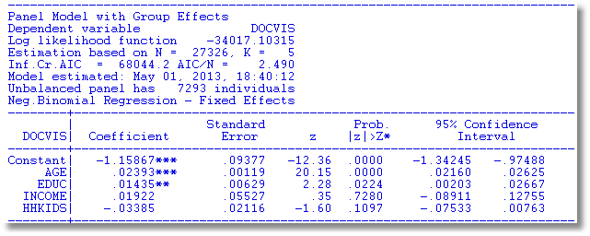
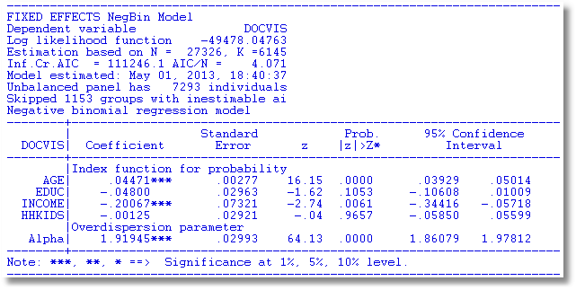

Slide 61
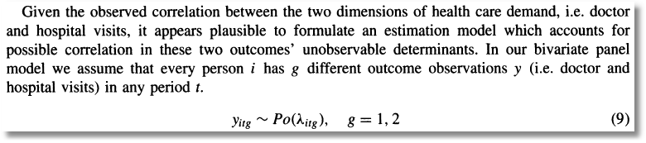
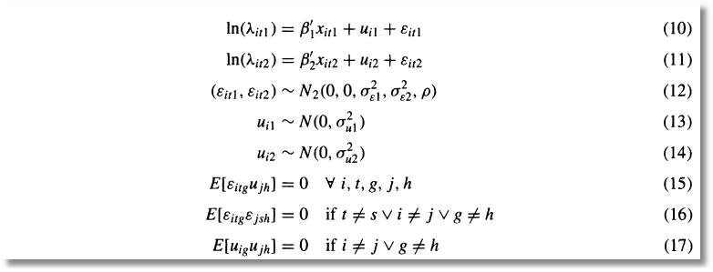
Bivariate Random Effects

Slide 62
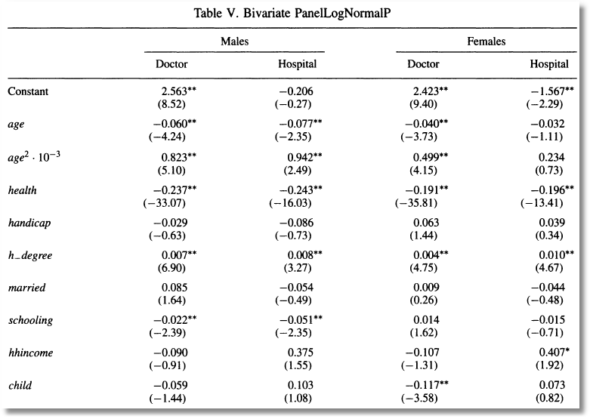
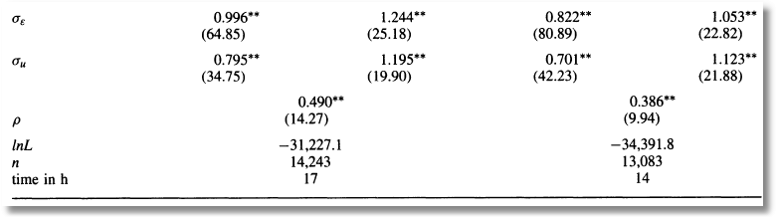

Slide 63
Censoring and Corner Solution Models
Censoring model: T(y*) = 0 if y* < 0 and y* otherwise.
Corner solution: y = 0 if some exogenous condition is met; y = g(x)+e if the condition is not met. We then model P(y=0) and E[y|x,y>0]. (See text, pp. 518-519)
Application: Fair, R., “A Theory of Extramarital
Affairs,” JPE, 1978.
Same structural form

Slide 64
The Tobit Model
Y* = x’β+ε, y = Max(0,y*), ε ~ N[0,σ²]
  Other censoring limits:
  y=Max(L,y*) => y-L=Max(0,y*-L). Change constant term and LHS variable
  Upper censoring:
  y=Min(U,y*) => U-y = Max(0,U-Y*). Change constant and LHS variable and swap signs of estimated coefficients.
  Censoring limit is person specific: Same as above: Constant term becomes the variable with a coefficient fixed at 1.
  Censoring at both extremes: y=Max(L,Min(y*,U)). A minor extension of the model. Easy to accommodate. (Already done in major software.)
  Interval censoring over the entire range. See yesterday’s notes.
(Tobin: “Estimation of Relationships for Limited Dependent Variables,” Econometrica, 1958. Tobin’s probit?)

Slide 65


Slide 66
Conditional Mean Functions

Slide 67
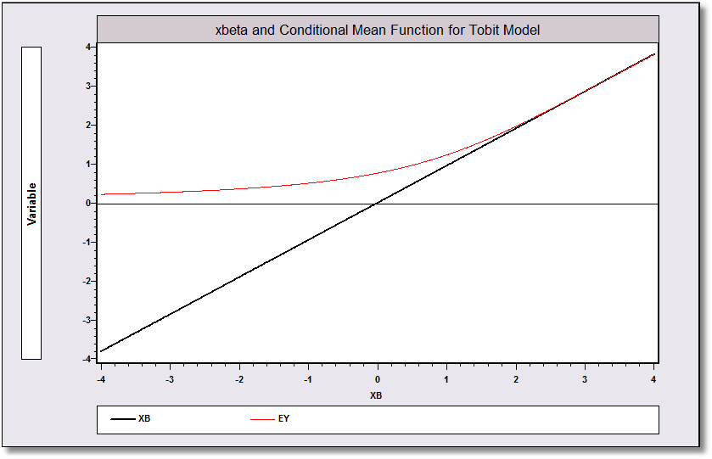
Conditional Means

Slide 68
Predictions and Residuals
What variable do we want to predict?
  y*? Probably not – not relevant
  y? Randomly drawn observation from the population
  y | y>0? Maybe. Depends on the desired function
What is the residual?
  y – prediction? Probably not. What do you do with the zeros?
  Anything - xβ? Probably not. xβ is not the mean.
  Generalized residuals – coming below.

Slide 69
OLS is Inconsistent - Attenuation

Slide 70
Estimating the Tobit Model

Slide 71
Hessian for Tobit Model

Slide 72
Simplified Hessian

Slide 73
Recovering Structural Parameters

Slide 74
Marginal Effects in Censored Regressions

Slide 75
A Decomposition

Slide 76
Application: Fair’s Data
F22.2 Fair’s (1977) Extramarital Affairs Data, 601 Cross Section observations.
Source: Fair (1977) and http://fairmodel.econ.yale.edu/rayfair/pdf/1978ADAT.ZIP.
Several variables not used are denoted X1, ..., X5.)
y = Number of affairs in the past year, (0,1,2,3,4-10=7, more=12, mean = 1.46
(Frequencies 451, 34, 17, 19, 42, 38)
z1 = Sex, 0=female; mean=.476
z2 = Age, mean=32.5
z3 = Number of years married, mean=8.18
z4 = Children, 0=no; mean=.715
z5 = Religiousness, 1=anti, …,5=very. Mean=3.12
z6 = Education, years, 9, 12, 16, 17, 18, 20; mean=16.2
z7 = Occupation, Hollingshead scale, 1,…,7; mean=4.19
z8 = Self rating of marriage. 1=very unhappy; 5=very happy

Slide 77
Fair’s Study
Corner solution model
Discovered the EM method in the Econometrica paper
Used the tobit instead of the Poisson (or some other) count model
Did not account for the censoring at the high end of the data

Slide 78
Estimated Tobit Model

Slide 79
Neglected Heterogeneity

Slide 80
Discarding the Limit Data

Slide 81
Regression with the Truncated Distribution

Slide 82
Estimated Tobit Model

Slide 83
Two Part Specifications

Slide 84
Panel Data Application
Pooling: Standard results, including “cluster” estimator(s) for asymptotic covariance matrices
Random effects
  Butler and Moffitt – same as for probit
  Mundlak/Wooldridge extension – group means
  Extension to random parameters and latent class models
Fixed effects: Some surprises (Greene, Econometric Reviews, 2005)

Slide 85
Fixed Effects MLE for Tobit
No bias in slopes. Large downward bias in estimator of σ

Slide 86
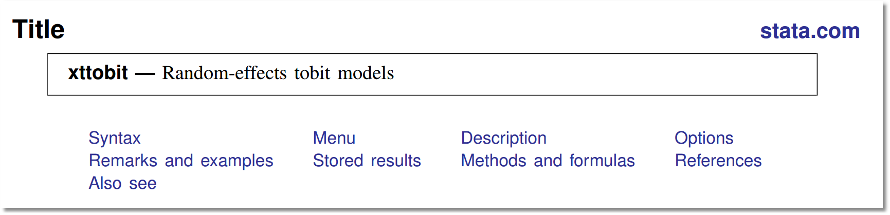
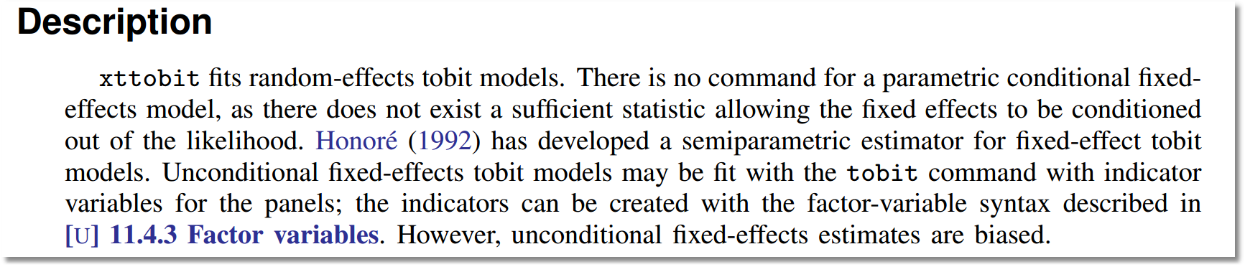
Stata on the True Fixed Effects (Tobit) MLE
Application True Fixed Effects SFM Incidental Parameters Problem Consistent Estimation Conclusions

Slide 87
FE Truncated Regression
Large bias in estimated slopes and standard deviation.
Not much in marginal effects.

