Slide 1








Econometric Analysis of Panel Data
William Greene
Department of Economics
University of South Florida

Slide 2
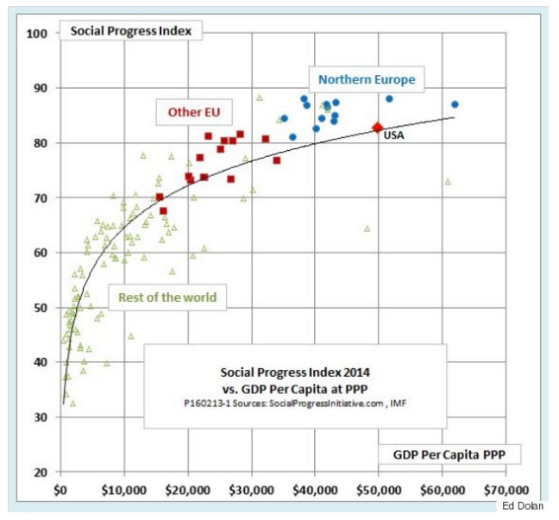
Reverse Causality in the Preston Curve?
lnSPI = α + β*lnGDPPC(PPP) + ε, 0 < β < 1.
(Huffington Post, 2/16/16)

Slide 3
In two of my projects, I was asked by reviewers to address the endogeneity concerns. In one project, I regress employee departure on project termination. Arguably project termination is not exogenous.
DEPARTURE = f(a + b*PROJECT TERMINATION + e)
(Time until departure???)
In the other, I regress firms’ charitable giving in specific countries on their business activities in the local community. Again, business presence in countries are not exogenous. The problem is, both papers used non-linear models (Hazard model in one, and hurdle model in the other), which are required by the data I have. Are you aware of any econometric methods to deal with endogeneity in non-linear models? My search online did not go anywhere.
Hazard Model: Not a linear model.
Prob[event happens in time interval t to t+Δ| event happens after time t] =
a function of (x’β)
http://people.stern.nyu.edu/wgreene/Econometrics/
NonlinearPanelDataModels.pdf

Slide 4
I have been asked this question (or ones like it) dozens of times. I think the issue is getting way overplayed. But, I'm not the majority voice, so you are going to have to deal with this.
Step 1: you or the referee need to figure out (make a case for) by what construction is "project termination" endogenous. What is correlated with what **in your hazard model** that makes the variable endogenous? There must be a second equation that implies that project termination is endogenous. What is it? What unobservable in that equation is correlated with what unobservable in the hazard model that makes it endogenous. Same questions for your hurdle model.
Step 2: Depends on the outcome of Step 1…

Slide 5

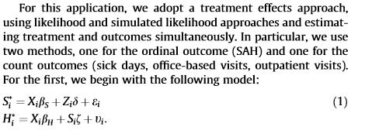

Slide 6
By what construction is SNAP endogenous in the HEALTH equation?
SNAP = Xβ_{SNAP} + Zδ + ε
HEALTH = Xβ_{HEALTH} + ηSNAP + v

Slide 7
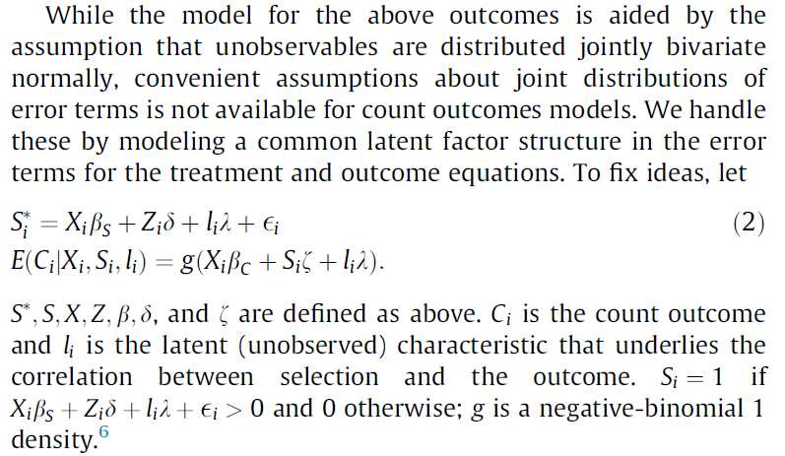


Slide 9
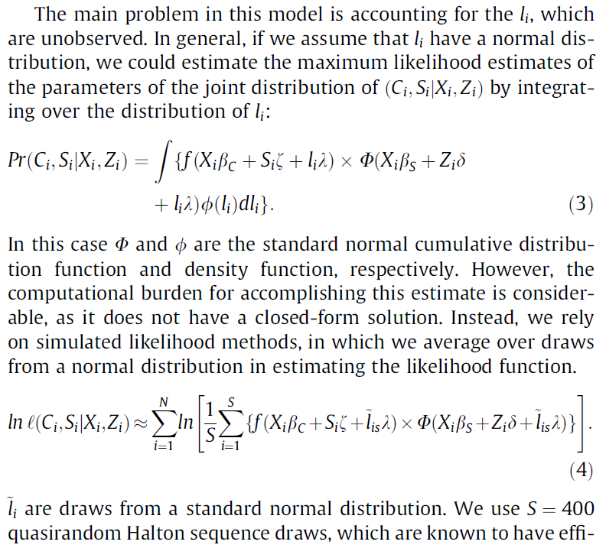

Slide 10
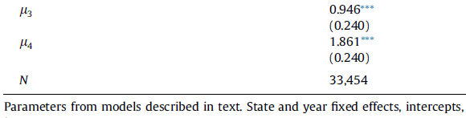

Slide 12
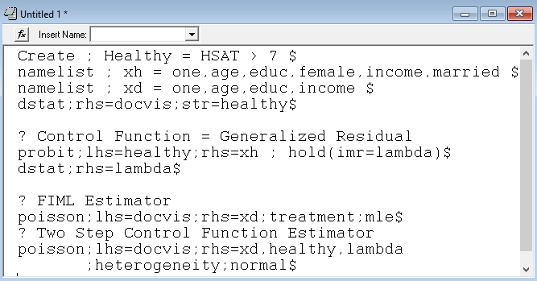

Slide 13
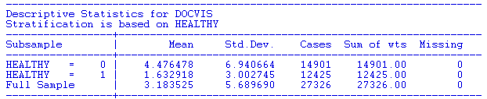
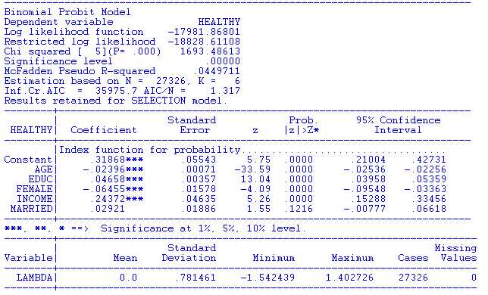

Slide 14
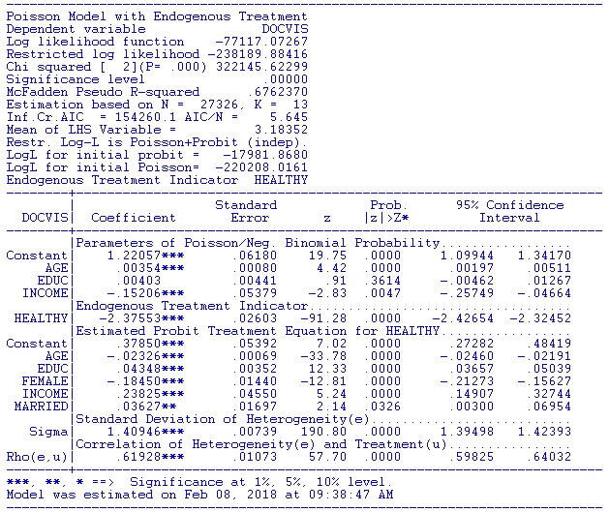

Slide 15
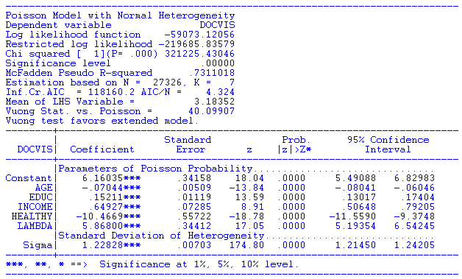

Slide 16
Endogeneity
y = Xβ+ε,
Definition: E[ε|x]≠0
Why not?
  Omitted variables
  Unobserved heterogeneity (equivalent to omitted variables)
  Measurement error on the RHS (equivalent to omitted variables)
  Endogenous sampling and attrition
  Simultaneity (?) (“reverse causality”)

Slide 17
Cornwell and Rupert Data
Cornwell and Rupert Returns to Schooling Data, 595 Individuals, 7 Years
Variables in the file are
EXP = work experience
WKS = weeks worked
OCC = occupation, 1 if blue collar,
IND = 1 if manufacturing industry
SOUTH = 1 if resides in south
SMSA = 1 if resides in a city (SMSA)
MS = 1 if married
FEM = 1 if female
UNION = 1 if wage set by union contract
ED = years of education
LWAGE = log of wage = dependent variable in regressions
These data were analyzed in Cornwell, C. and Rupert, P., "Efficient Estimation with Panel Data: An Empirical Comparison of Instrumental Variable Estimators," Journal of Applied Econometrics, 3, 1988, pp. 149-155. See Baltagi, page 122 for further analysis. The data were downloaded from the website for Baltagi's text.
Notes:
17

Slide 18

Specification: Quadratic Effect of Experience

Slide 19
The Effect of Education on LWAGE

Slide 20
What Influences LWAGE?

Slide 21
The General Problem

Slide 22
Instrumental Variables
Framework: y = Xβ + ε, K variables in X.
There exists a set of K variables, Z such that
plim(Z’X/n) ≠ 0 but plim(Z’ε/n) = 0
The variables in Z are called instrumental variables.
An alternative (to least squares) estimator of β is
b_{IV} = (Z’X)⁻¹Z’y ~ Cov(Z,y) / Cov(Z,X)
We consider the following:
  Why use this estimator?
  What are its properties compared to least squares?
We will also examine an important application

Slide 23
An Exogenous Influence

Slide 24
Instrumental Variables
My theory claims that MS and FEM are instruments
Structural equations
  LWAGE (ED,EXP,EXPSQ,WKS,OCC,
  SOUTH,SMSA,UNION)
  ED (…,MS, FEM) ← Equation explains the endogeneity
Reduced Form:
LWAGE[ ED (…,MS, FEM),
EXP,EXPSQ,WKS,OCC,
SOUTH,SMSA,UNION ]

Slide 25
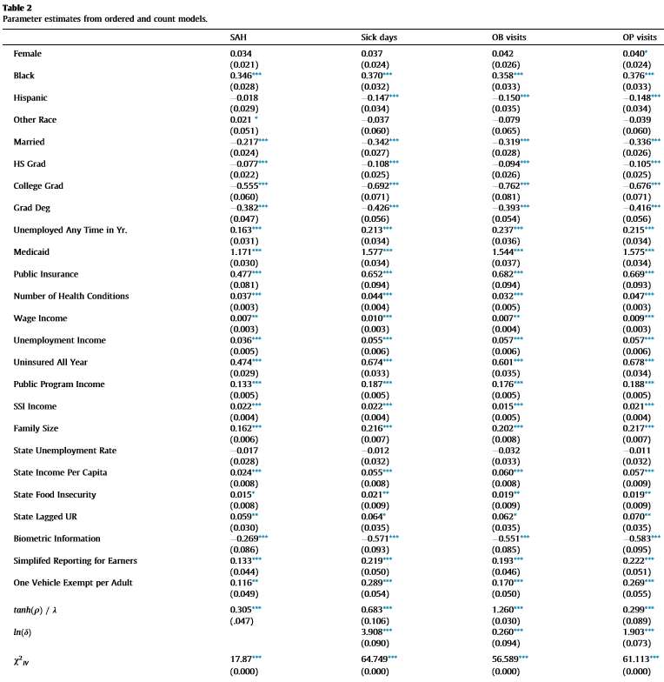
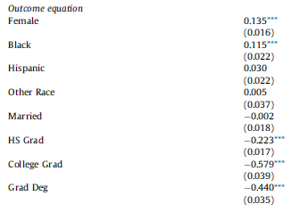
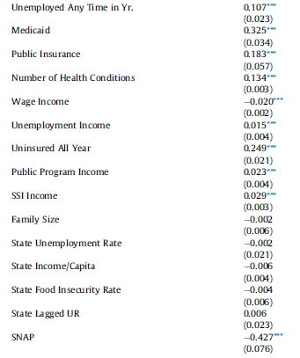
SNAP Model.
X is in both equations.
Z is in SNAP equation.
SNAP is in Health equation.
X
Z

Slide 26
Instrumental Variables in Regression
Typical Case: One “problem” variable – the “last” one
y_{it} = β₁x_{1it} + β₂x_{2it} + … + β_{K}x_{Kit} + ε_{it}
E[ε_{it}|x_{1it}…,x_{Kit}] ≠ 0. (0 for all others)
There exists a variable z_{it} such that
Relevance
  E[x_{Kit}| x_{1it}, x_{2it},…, x_{K-1,it},z_{it}] = g(x_{1it}, x_{2it},…, x_{K-1,it},z_{it})
  In the presence of the other variables, z_{it} “explains” x_{it}
  A projection interpretation: In the projection,
x_{Kt} =θ₁x_{1it},+ θ₂x_{2it} + … + θ_{k-1}x_{K-1,it} + θ_{K} z_{it}, θ_{K} ≠ 0.
  Exogeneity
  E[ε_{it}| x_{1it}, x_{2it},…, x_{K-1,it},z_{it}] = 0
  In the presence of the other variables, z_{it} and ε_{it} are uncorrelated.

Slide 27
Two Stage Least Squares Strategy
  Reduced Form:
  LWAGE[ ED (MS, FEM,X),
  EXP,EXPSQ,WKS,OCC,
  SOUTH,SMSA,UNION ]
Strategy
  (1) Purge ED of the influence of everything but MS, FEM and the other X variables. Predict ED using all exogenous information in the sample (X,MS,FEM).
  (2) Regress LWAGE on this prediction of ED and everything else.
  Standard errors must be adjusted for the predicted ED

Slide 28
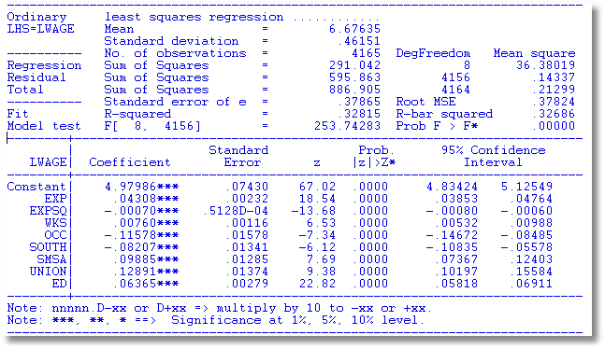
OLS Regression (Inconsistent)

Slide 29
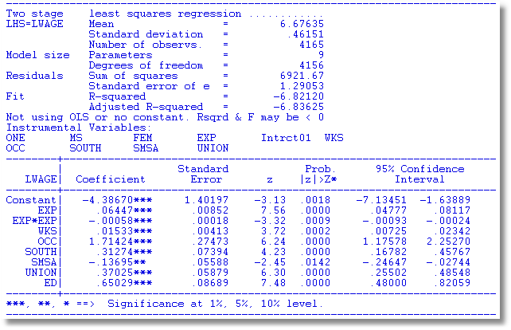
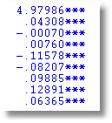
2SLS Regression (Maybe not a very good theory))
The weird results for the coefficient on ED may be due to the instruments, MS and FEM being dummy variables. There is not much variation in these variables and not much covariation with the other variables.
2SLS coefficient estimate is implausible. Now what?

Slide 30
An Interpretation
The Source of the Endogeneity
  LWAGE = f(ED,
  EXP,EXPSQ,WKS,OCC,
  SOUTH,SMSA,UNION) + ε
  ED = f(MS,FEM,
  EXP,EXPSQ,WKS,OCC,
  SOUTH,SMSA,UNION) + u

Slide 31
Can We Remove the Endogeneity?
  LWAGE = f(ED,
  EXP,EXPSQ,WKS,OCC,
  SOUTH,SMSA,UNION) + u + ε
  LWAGE = f(ED,
  EXP,EXPSQ,WKS,OCC,
  SOUTH,SMSA,UNION) + u + ε
  Strategy
    Estimate u
    Add u to the equation.
    ED is correlated with u+ε because it is correlated with u.
    ED is uncorrelated with u+ε if u is in the equation.

Slide 32
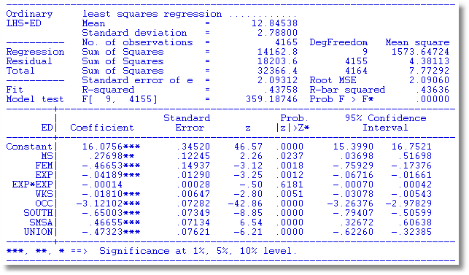
Auxiliary Regression for
ED to Obtain Residuals
IVs
Exog. Vars

Slide 33
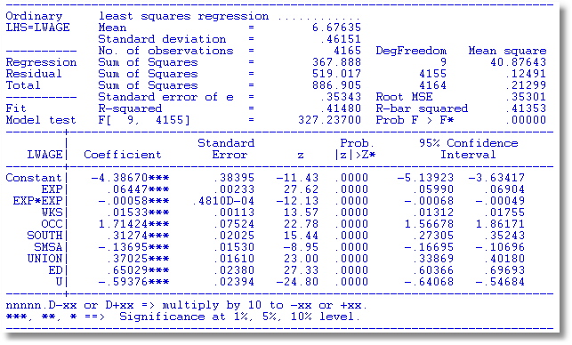
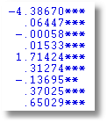
OLS with Residual Added (Control Function)
2SLS

Slide 34
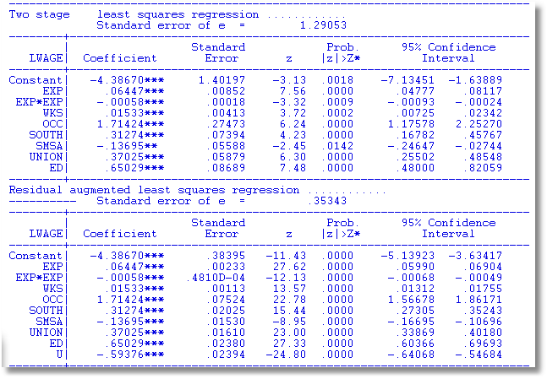
A Warning About Control Functions
Sum of squares is not computed correctly because U is in the regression.
A general result. Control function estimators usually require a fix to the estimated covariance matrix for the estimator.

Slide 35
Estimating σ²

Slide 36
Robust estimation of VC
“Predicted” X
“Actual” X

Slide 37
2SLS vs. Robust Standard Errors
+--------------------------------------------------+
| Robust Standard Errors |
+---------+--------------+----------------+--------+
|Variable | Coefficient | Standard Error |b/St.Er.|
+---------+--------------+----------------+--------+
B_1 45.4842872 4.02597121 11.298
B_2 .05354484 .01264923 4.233
B_3 -.00169664 .00029006 -5.849
B_4 .01294854 .05757179 .225
B_5 .38537223 .07065602 5.454
B_6 .36777247 .06472185 5.682
B_7 .95530115 .08681261 11.000
+--------------------------------------------------+
| 2SLS Standard Errors |
+---------+--------------+----------------+--------+
|Variable | Coefficient | Standard Error |b/St.Er.|
+---------+--------------+----------------+--------+
B_1 45.4842872 .36908158 123.236
B_2 .05354484 .03139904 1.705
B_3 -.00169664 .00069138 -2.454
B_4 .01294854 .16266435 .080
B_5 .38537223 .17645815 2.184
B_6 .36777247 .17284574 2.128
B_7 .95530115 .20846241 4.583

Slide 38
Inference with IV Estimators

Slide 39
Endogeneity Test? (Hausman)
Exogenous Endogenous
OLS Consistent, Efficient Inconsistent
2SLS Consistent, Inefficient Consistent
Base a test on d = b_{2SLS} - b_{OLS}
Use a Wald statistic, d’[Var(d)]⁻¹d
What to use for the variance matrix?
Hausman: V_{2SLS} - V_{OLS}

Slide 40
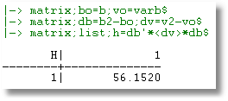
Hausman Test

Slide 41
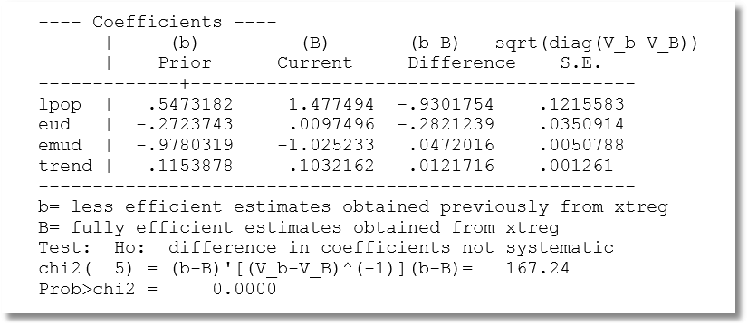
Hausman Test: One at a Time?

Slide 42
Endogeneity Test: Wu
Considerable complication in Hausman test (text, pp. 276-277)
Simplification: Wu test.
Regress y on X and estimated for the endogenous part of X. Then use an ordinary Wald test.

Slide 43
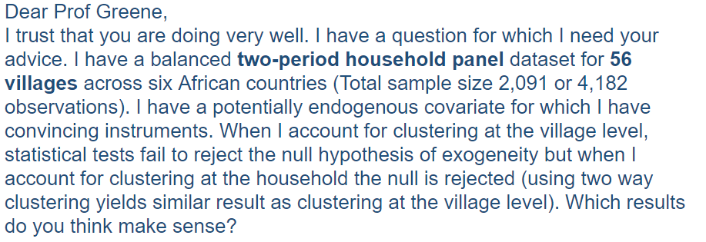
Monday, 2/6/17

Slide 44
Regression Based Endogeneity Test

Slide 45
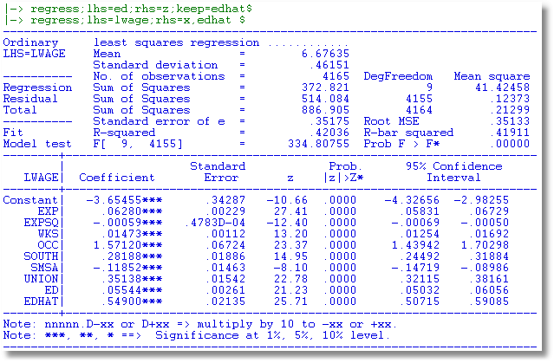
Wu Test
Since this is 2SLS using a control function, the standard errors should have been adjusted to carry out this test. (The sum of squares is too small.)

Slide 46
Testing Endogeneity of WKS
(1) Regress WKS on 1,EXP,EXPSQ,OCC,SOUTH,SMSA,MS.
U=residual, WKSHAT=prediction
(2) Regress LWAGE on 1,EXP,EXPSQ,OCC,SOUTH,SMSA,WKS, U or WKSHAT
+---------+--------------+----------------+--------+---------+----------+
|Variable | Coefficient | Standard Error |b/St.Er.|P[|Z|>z] | Mean of X|
+---------+--------------+----------------+--------+---------+----------+
Constant -9.97734299 .75652186 -13.188 .0000
EXP .01833440 .00259373 7.069 .0000 19.8537815
EXPSQ -.799491D-04 .603484D-04 -1.325 .1852 514.405042
OCC -.28885529 .01222533 -23.628 .0000 .51116447
SOUTH -.26279891 .01439561 -18.255 .0000 .29027611
SMSA .03616514 .01369743 2.640 .0083 .65378151
WKS .35314170 .01638709 21.550 .0000 46.8115246
U -.34960141 .01642842 -21.280 .0000 -.341879D-14
+---------+--------------+----------------+--------+---------+----------+
|Variable | Coefficient | Standard Error |b/St.Er.|P[|Z|>z] | Mean of X|
+---------+--------------+----------------+--------+---------+----------+
Constant -9.97734299 .75652186 -13.188 .0000
EXP .01833440 .00259373 7.069 .0000 19.8537815
EXPSQ -.799491D-04 .603484D-04 -1.325 .1852 514.405042
OCC -.28885529 .01222533 -23.628 .0000 .51116447
SOUTH -.26279891 .01439561 -18.255 .0000 .29027611
SMSA .03616514 .01369743 2.640 .0083 .65378151
WKS .00354028 .00116459 3.040 .0024 46.8115246
WKSHAT .34960141 .01642842 21.280 .0000 46.8115246

Slide 47
Weak Instruments
One endogenous variable: y = Xβ +x_{k}δ+ ε; Instruments (X,Z) Z is exogenous
Symptom: The relevance condition, plim Z’X/n not zero, is close to being violated. Relevance: Z must “explain” x_{k} after controlling for X.
Detection:
  Standard F test in the regression of x_{k} on (X,Z). Wald test
  of coefficients on Z equal 0, F < 10 suggests a problem. (Staiger and Stock)
  Other versions by Stock and Yogo (2005), Cragg and Donald (1993), Kleibergen and Paap (2006) for when x_{k} is more than one variable and for when x_{k} = (X,Z)Π + u and is heteroscedastic, clustered, nonnormal, etc.
Remedy:
  Not much – most of the discussion is about the condition, not what to do about it.
  Use LIML instead of 2SLS? Requires a normality assumption. Probably not too restrictive. Not common.

Slide 48
Weak Instruments (cont.)

Slide 49
Weak Instruments

Slide 50
Endogenous Union Effect
Name ; Xunion = one,occ,smsa,ed,exp,union $
Name ; Zinst = fem,ind,south $
Name ; Zunion = one,occ,smsa,ed,exp,Zinst $
? Inconsistent OLS
Regr ; Lhs = lwage ; Rhs = Xunion ; Cluster = 7 $
? Two Stage Least Squares gives a nonsense result
2sls ; Lhs=lwage;rhs=Xunion;Inst=Zunion ; Cluster=7 $
? Test for weak instruments
Regr ; Lhs=union ; Rhs=Zunion ; res = u
; Cluster = 7 ; test:zinst $
? Control function estimator
? 2SLS coefficients with the wrong standard errors
Regr ; Lhs=lwage;rhs=xunion,u;cluster=7$

Slide 51
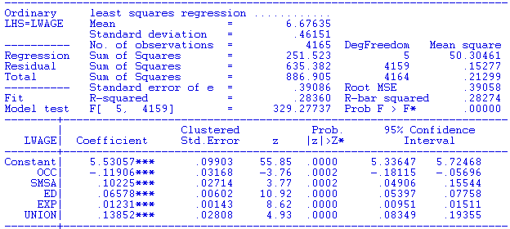
OLS Should Be Inconsistent

Slide 52
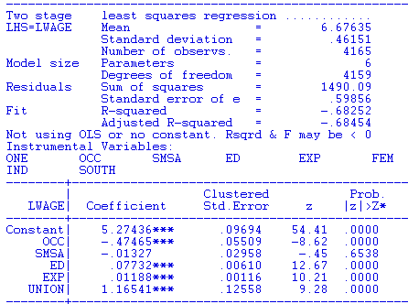
Nonsense 2SLS Result

Slide 53
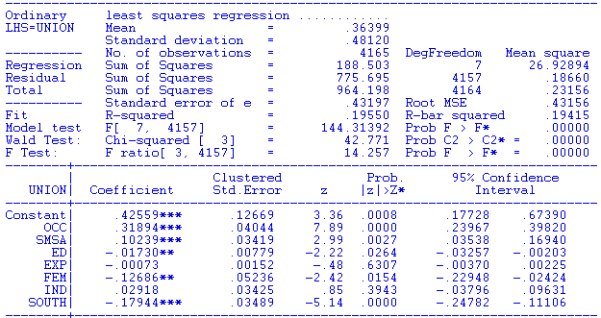
Weak Instruments? No
What is going on here? When the endogenous variable and/or the excluded instruments are binary, the actual results are sometimes a bit unstable. The theoretical results are generally about covariation of continuous variables.

Slide 54
Appendix
Miscellaneous

Slide 55
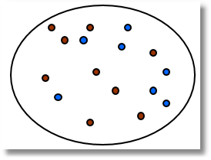
The First IV Study Was a Natural Experiment
(Snow, J., On the Mode of Communication of Cholera, 1855) http://www.ph.ucla.edu/epi/snow/snowbook3.html
London Cholera epidemic, ca 1853-4
Cholera = f(Water Purity,u) + ε.
  ‘Causal’ effect of water purity on cholera?
  Purity=f(cholera prone environment (poor, garbage in streets, rodents, etc.). Regression does not work.
  Two London water companies
Lambeth Southwark & Vauxhall
^{Main sewage discharge}
River Thames
Paul Grootendorst: A Review of Instrumental Variables Estimation of Treatment Effects…
http://individual.utoronto.ca/grootendorst/pdf/IV_Paper_Sept6_2007.pdf
A review of instrumental variables estimation in the applied health sciences. Health Services and Outcomes Research Methodology 2007; 7(3-4):159-179.

Slide 59
On Sat, May 3, 2014 at 4:48 PM, … wrote:
Dear Professor Greene,
I am giving an Econometrics course in Brazil and we are using your textbook. I got a question which I think only you can help me. In our last class, I did a formal proof that var(beta_hat_OLS) is lower or equal than var(beta_hat_2SLS), under homoscedasticity.
We know this assertive is also valid under heteroscedasticity, but a graduate student asked me the proof (which is my problem).
Do you know where can I find it?

Slide 60
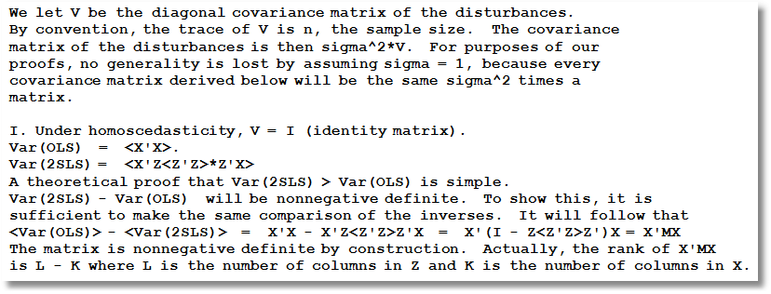

Slide 61
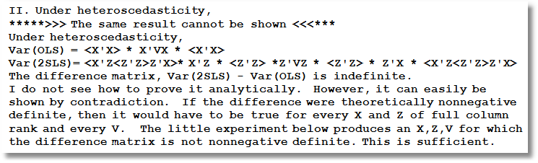

Slide 62
