Slide 1








Econometric Analysis of Panel Data
William Greene
Department of Economics
University of South Florida

Slide 2
Objectives in Model Building
What is THE MODEL?
Specification: guided by underlying theory
  Modeling framework
  Functional forms
Estimation: coefficients, partial effects, model implications – policy analysis (effectiveness)
Statistical inference: hypothesis testing
Prediction: individual and aggregate
Model assessment (fit, adequacy) and evaluation
Model extensions
  Interdependencies, multiple part models
  Heterogeneity
  Endogeneity
Exploration: Estimation and inference methods

Slide 3
Application: Health Care
German Health Care Usage Data, 7,293 Individuals, Varying Numbers of Periods
Data downloaded from Journal of Applied Econometrics Archive. They can be used for regression, count models, binary choice, ordered choice, and bivariate binary choice. There are altogether 27,326 observations. The number of observations ranges from 1 to 7. (Frequencies are: 1=1525, 2=2158, 3=825, 4=926, 5=1051, 6=1000, 7=987).
Variables in the file are
DOCTOR = 1(Number of doctor visits > 0)
HOSPITAL = 1(Number of hospital visits > 0)
HSAT = health satisfaction, coded 0 (low) - 10 (high)
DOCVIS = number of doctor visits in last three months
HOSPVIS = number of hospital visits in last calendar year
PUBLIC = insured in public health insurance = 1; otherwise = 0
ADDON = insured by add-on insurance = 1; otherswise = 0
HHNINC = household nominal monthly net income in German marks / 10000.
(4 observations with income=0 were dropped)
HHKIDS = children under age 16 in the household = 1; otherwise = 0
EDUC = years of schooling
AGE = age in years
MARRIED = marital status
Notes:
3

Slide 4


Slide 5
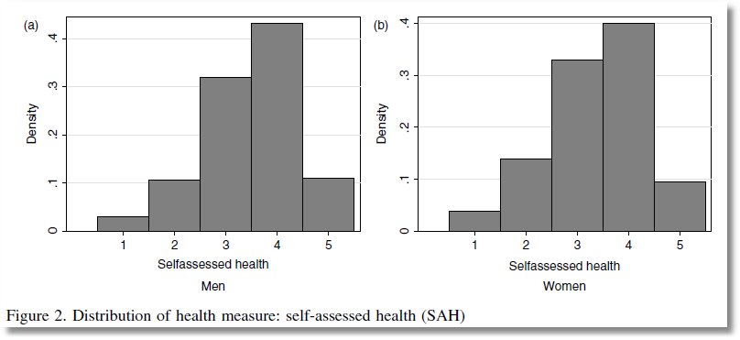
This study analyzes ‘self assessed health’ coded
1,2,3,4,5 = very low, low, med, high very high

Slide 6
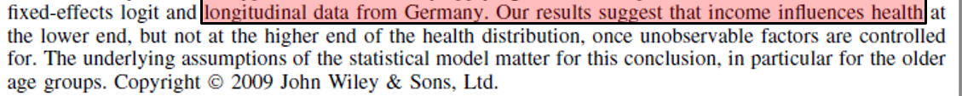
The objective is analysis of partial effects

Slide 7
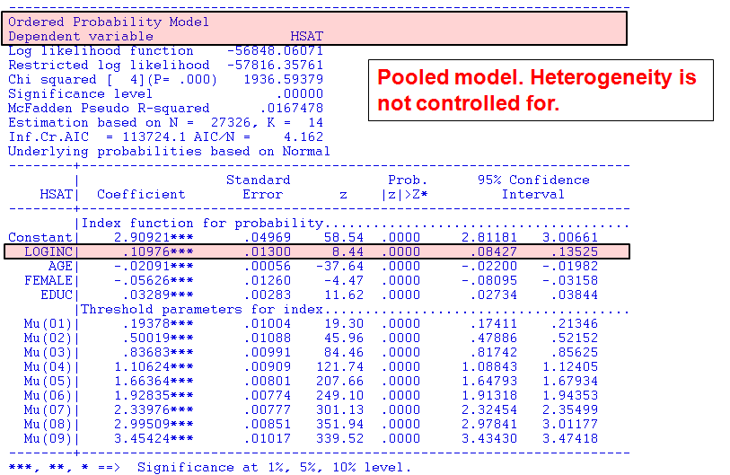

Slide 8
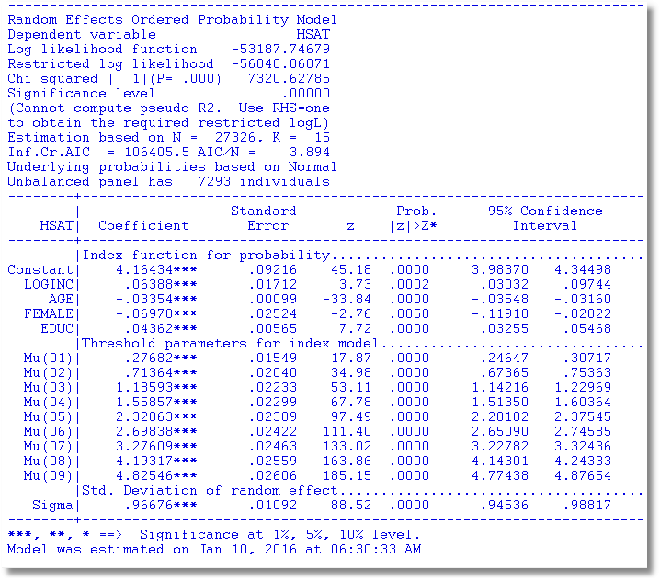
Individual heterogeneity is “controlled for.”

Slide 9
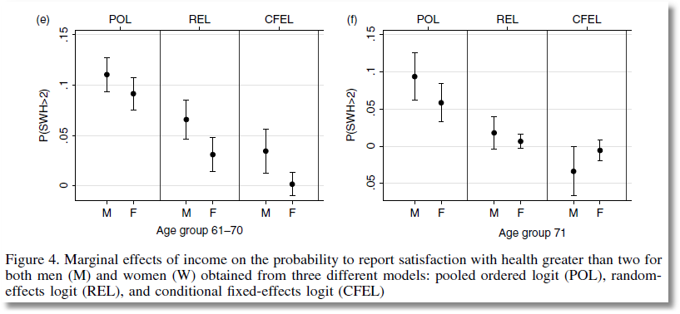
From Jones and Schurer (2011)
Confidence Intervals for Socioeconomic Gradient

Slide 10
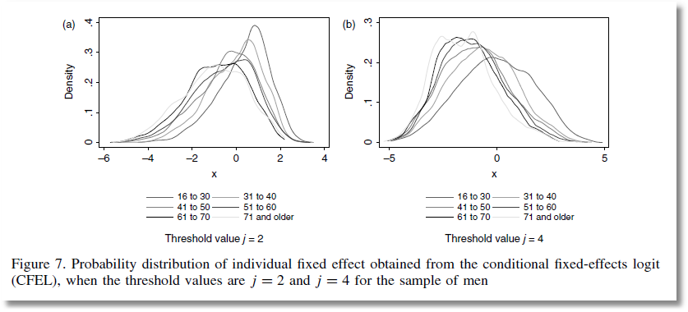
From Jones and Schurer (2011)

Slide 11
A First Look at the Data
Descriptive Statistics
Basic Measures of Location and Dispersion
Graphical Devices
  Box Plots
  Histogram
  Kernel Density Estimator

Slide 12
Cornwell and Rupert Panel Data
Cornwell and Rupert Returns to Schooling Data, 595 Individuals, 7 Years
Variables in the file are
EXP = work experience
WKS = weeks worked
OCC = occupation, 1 if blue collar,
IND = 1 if manufacturing industry
SOUTH = 1 if resides in south
SMSA = 1 if resides in a city (SMSA)
MS = 1 if married
FEM = 1 if female
UNION = 1 if wage set by union contract
ED = years of education
LWAGE = log of wage = dependent variable in regressions
These data were analyzed in Cornwell, C. and Rupert, P., "Efficient Estimation with Panel Data: An Empirical Comparison of Instrumental Variable Estimators," Journal of Applied Econometrics, 3, 1988, pp. 149-155.
Notes:
12

Slide 13

Notice the time variation of LogWage with no time variation of Educ. How do we interpret this?

Slide 14
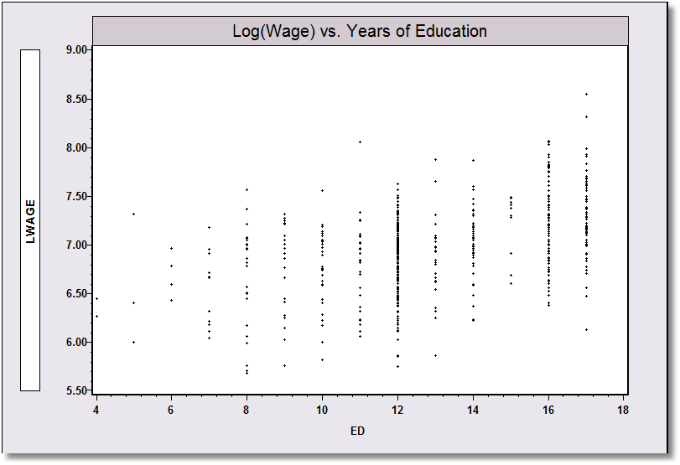
Application: Is there a “relationship” between (log) Wage and Education?

Slide 15
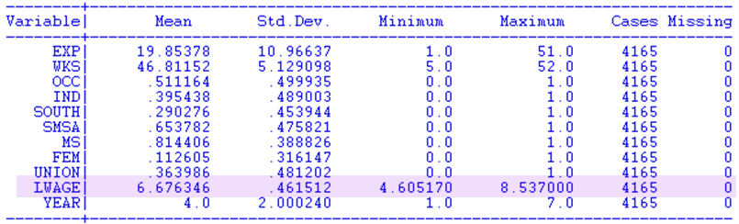
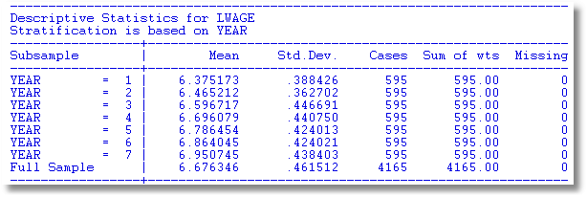

Slide 16
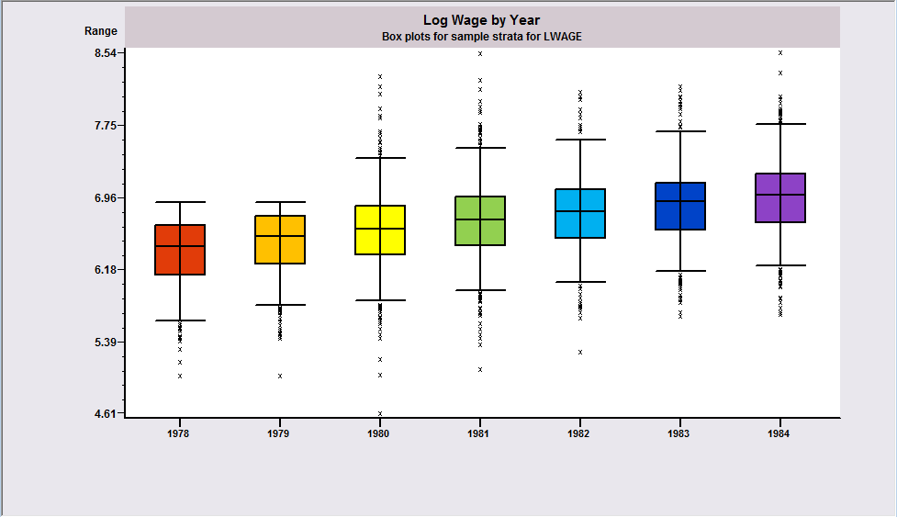
Box Plots
Shows trend in median log wage

Slide 17
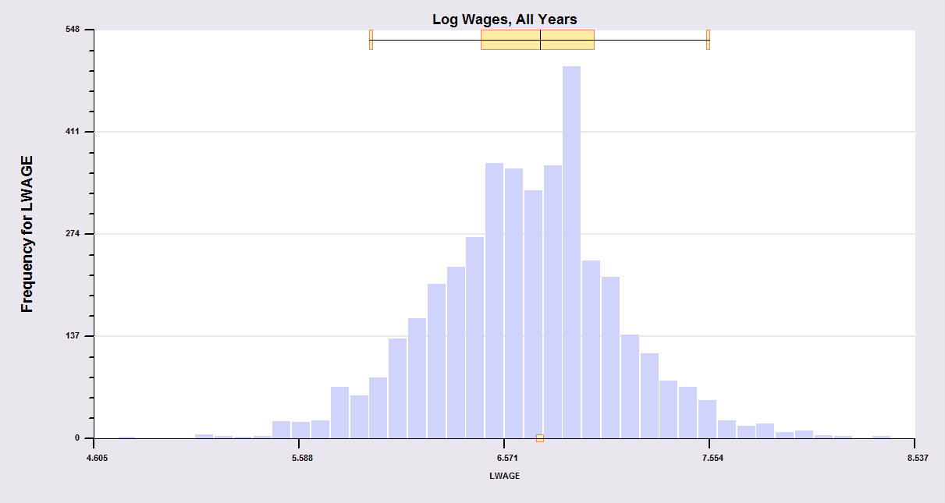
Histogram: Pooled data obscure within person variation
What is the source of the variance, variation across people or variation over time?

Slide 18
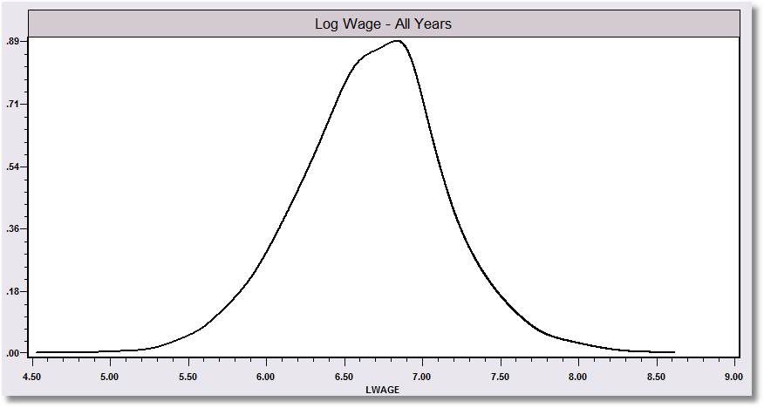
Kernel density estimator suggests the underlying distribution for a continuous variable

Slide 19
Kernel Estimator for LWAGE

Slide 20
Objective: Impact of Education on (log) Wage
Specification: What is the right model to use to analyze this association?
Estimation
Inference
Analysis

Slide 21
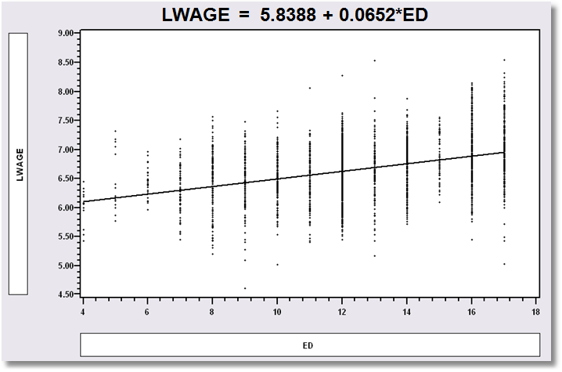
Simple Linear Regression
LWAGE = 5.8388 + 0.0652*ED

Slide 22
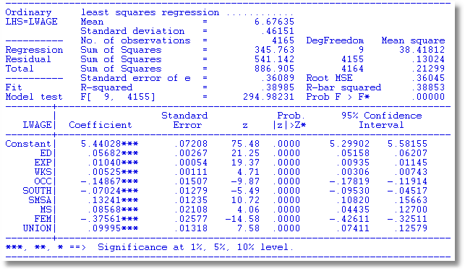
Multiple Regression

Slide 23

Nonlinear Specification:
Quadratic Effect of Experience

Slide 24
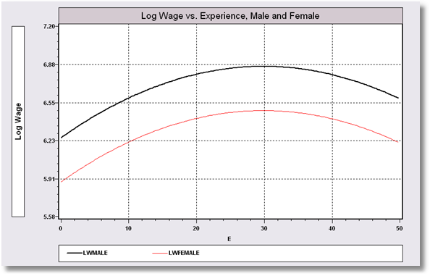
Model Implication: Effect of Experience and Male vs. Female

Slide 25
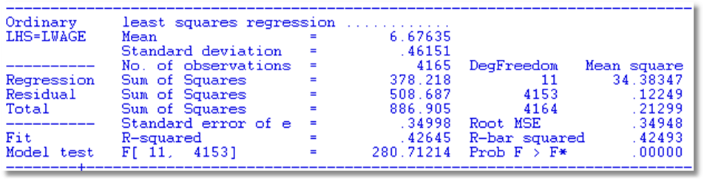
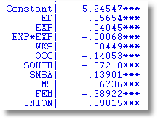
Partial Effect of Experience:
Coefficients do not tell the story
Education: .05654
Experience: .04045 - 2*.00068*Exp
FEM: -.38922

Slide 26
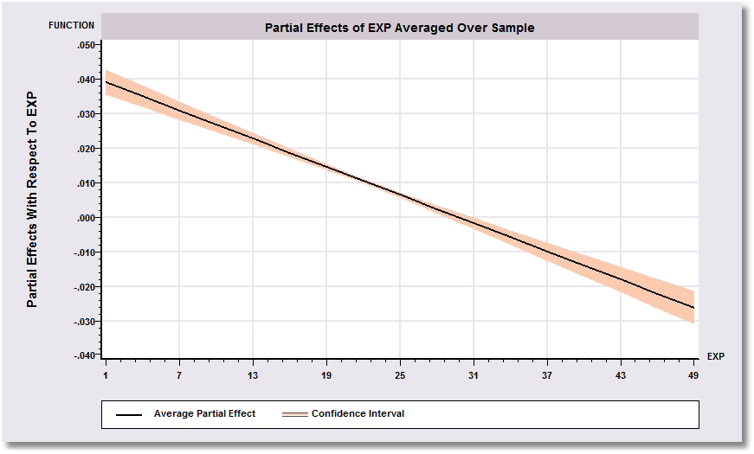
Effect of Experience = .04045 - 2*.00068*Exp
Positive from 1 to 30, negative above 30.

Slide 27
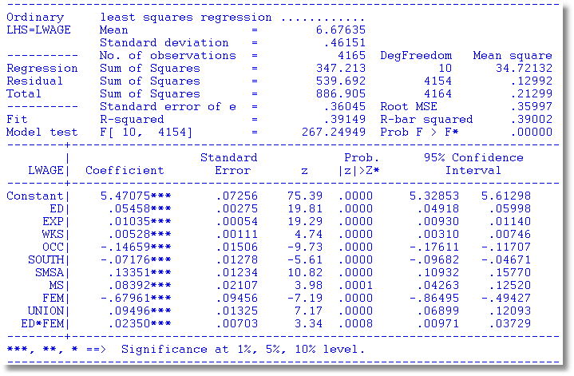
Interaction Effect
Gender Difference in Partial Effects

Slide 28
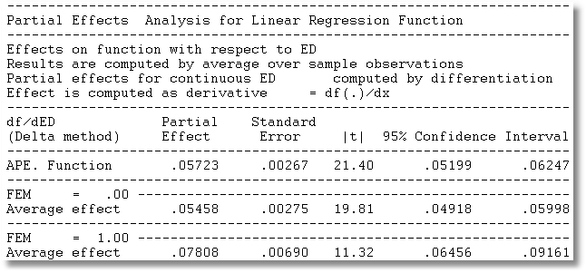
Partial Effect of a Year of Education
∂E[logWage]/∂ED=β_{ED} + β_{ED*FEM} *FEM
Note, the effect is positive.
Effect is larger for women.

Slide 29
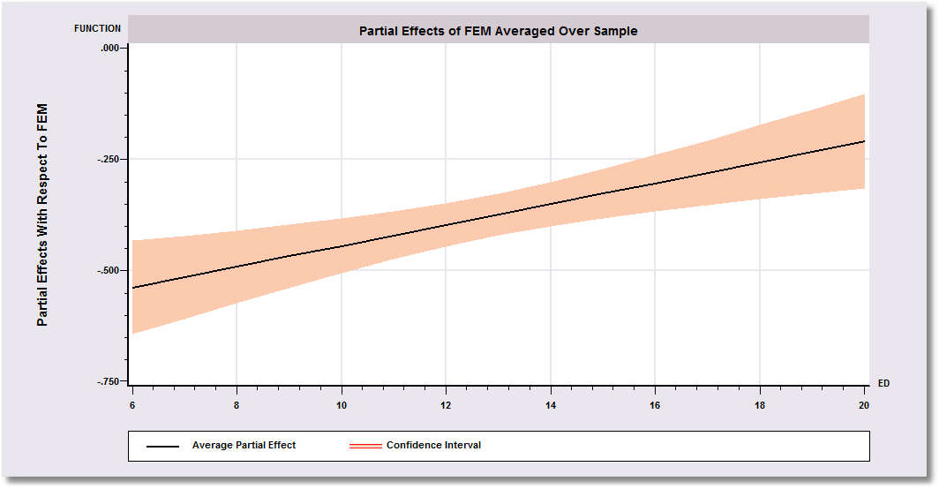
Gender Effect Varies by Years of Education
-0.67961 is misleading

Slide 30
The Linear Regression Model
y = Xβ+ε, N observations, K columns in X, including a column of ones.
  Standard assumptions about X
  Standard assumptions about ε|X
  E[ε|X]=0, E[ε]=0 and Cov[ε,x]=0
Regression?
  If E[y|X] = Xβ then Xβ is the regression of y on X

Slide 31
Estimation of the Parameters
Least squares, LAD, other estimators – we will focus on least squares
Properties
Statistical inference: Hypothesis tests, post estimation analysis (e.g., partial effects)
Prediction (not this course)

Slide 32
Properties of Least Squares
Finite sample properties: Unbiased, etc.
Asymptotic properties
  Consistent? Under what assumptions?
  Efficient?
    Contemporary work: Often not important
    Efficiency within a class: GMM
  Asymptotically normal: How is this established?
Robust estimation: To be considered later

Slide 33
Least Squares Summary

Slide 34
Regression – Income on Education
----------------------------------------------------------------------
Ordinary least squares regression ............
LHS=LOGINC Mean = -.92882
Standard deviation = .47948
Number of observs. = 887
Model size Parameters = 2
Degrees of freedom = 885
Residuals Sum of squares = 183.19359
Standard error of e = .45497
Fit R-squared = .10064
Adjusted R-squared = .09962
Model test F[ 1, 885] (prob) = 99.0(.0000)
Diagnostic Log likelihood = -559.06527
Restricted(b=0) = -606.10609
Chi-sq [ 1] (prob) = 94.1(.0000)
Info criter. LogAmemiya Prd. Crt. = -1.57279
--------+-------------------------------------------------------------
Variable| Coefficient Standard Error b/St.Er. P[|Z|>z] Mean of X
--------+-------------------------------------------------------------
Constant| -1.71604*** .08057 -21.299 .0000
EDUC| .07176*** .00721 9.951 .0000 10.9707
--------+-------------------------------------------------------------
Note: ***, **, * = Significance at 1%, 5%, 10% level.
----------------------------------------------------------------------

Slide 35
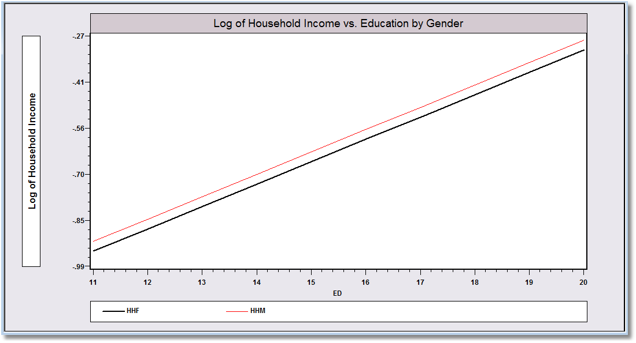
Specification and Functional Form
----------------------------------------------------------------------
Ordinary least squares regression ............
LHS=LOGINC Mean = -.92882
Standard deviation = .47948
Number of observs. = 887
Model size Parameters = 3
Degrees of freedom = 884
Residuals Sum of squares = 183.00347
Standard error of e = .45499
Fit R-squared = .10157
Adjusted R-squared = .09954
Model test F[ 2, 884] (prob) = 50.0(.0000)
Diagnostic Log likelihood = -558.60477
Restricted(b=0) = -606.10609
Chi-sq [ 2] (prob) = 95.0(.0000)
Info criter. LogAmemiya Prd. Crt. = -1.57158
--------+-------------------------------------------------------------
Variable| Coefficient Standard Error b/St.Er. P[|Z|>z] Mean of X
--------+-------------------------------------------------------------
Constant| -1.68303*** .08763 -19.207 .0000
EDUC| .06993*** .00746 9.375 .0000 10.9707
FEMALE| -.03065 .03199 -.958 .3379 .42277
--------+-------------------------------------------------------------

Slide 36
Interesting Partial Effects
----------------------------------------------------------------------
Ordinary least squares regression ............
LHS=LOGINC Mean = -.92882
Standard deviation = .47948
Number of observs. = 887
Model size Parameters = 5
Degrees of freedom = 882
Residuals Sum of squares = 171.87964
Standard error of e = .44145
Fit R-squared = .15618
Adjusted R-squared = .15235
Model test F[ 4, 882] (prob) = 40.8(.0000)
Diagnostic Log likelihood = -530.79258
Restricted(b=0) = -606.10609
Chi-sq [ 4] (prob) = 150.6(.0000)
Info criter. LogAmemiya Prd. Crt. = -1.62978
--------+-------------------------------------------------------------
Variable| Coefficient Standard Error b/St.Er. P[|Z|>z] Mean of X
--------+-------------------------------------------------------------
Constant| -5.26676*** .56499 -9.322 .0000
EDUC| .06469*** .00730 8.860 .0000 10.9707
FEMALE| -.03683 .03134 -1.175 .2399 .42277
AGE| .15567*** .02297 6.777 .0000 50.4780
AGESQ| -.00161*** .00023 -7.014 .0000 2620.79
--------+-------------------------------------------------------------

Slide 37
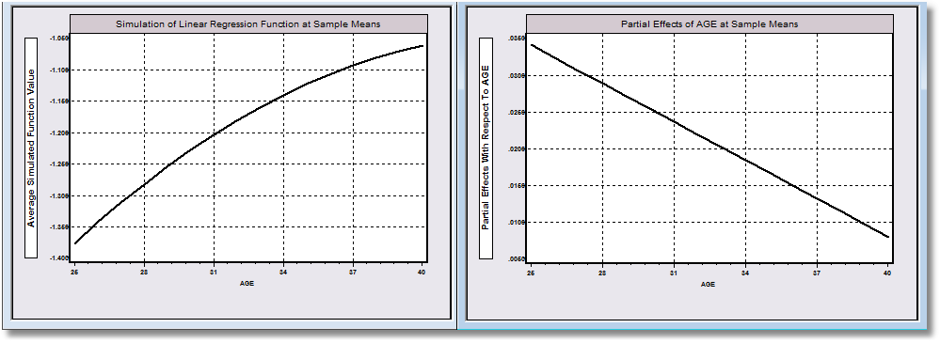
Function: Log Income | Age Partial Effect wrt Age

Slide 38
Partial Effects
What did the model tell us?
Covariation and partial effects: How does the y “vary” with the x?
Partial Effects: Effect of what on what?????
  For continuous variables
  For dummy variables
Elasticities: ε(x)=δ(x) * x / E[y|x]

Slide 39
Bootstrap Estimation of the Asymptotic
Variance of an Estimator
Known form of asymptotic variance:
Compute from known results
Unknown form, known generalities about properties: Use bootstrapping
  Root N consistency
  Sampling conditions amenable to central limit theorems
  Compute by resampling mechanism within the sample.

Slide 40
Bootstrapping Algorithm
1. Estimate parameters using full sample: → b
2. Repeat R times:
Draw n observations from the n, with replacement
Estimate β with b(r).
3. Estimate variance with sample variance of replicates:

Slide 41
Application to Spanish Dairy Farms lny=a+b₁lnx₁+b₂lnx₂+b₃lnx₃+b₄lnx₄+ε
Input | Units | Mean | Std. Dev. | Minimum | Maximum
Y Milk | Milk production (liters) | 131,108 | 92,539 | 14,110 | 727,281
X1 Cows | # of milking cows | 2.12 | 11.27 | 4.5 | 82.3
X2 Labor | # man-equivalent units | 1.67 | 0.55 | 1.0 | 4.0
X3 Land | Hectares of land devoted to pasture and crops. | 12.99 | 6.17 | 2.0 | 45.1
X4 Feed | Total amount of feedstuffs fed to dairy cows (tons) | 57,941 | 47,981 | 3,924.14 | 376,732
N = 247 farms, T = 6 years (1993-1998)

Slide 42
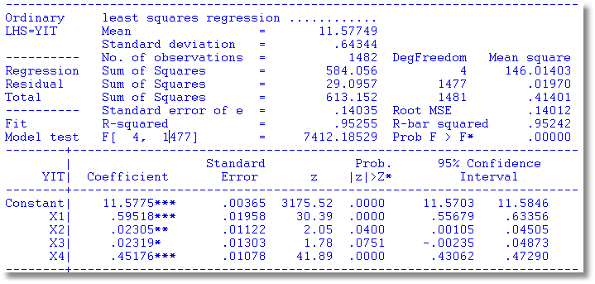
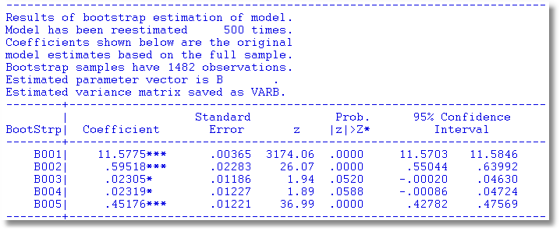
Bootstrapped Standard Errors

Slide 43
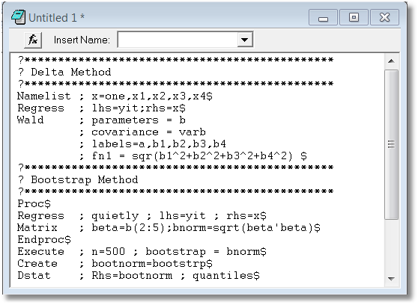
Bootstrapped Confidence Intervals
Estimate Norm(β)=(β₁² + β₂² + β₃² + β₄²)^{1/2}

Slide 44
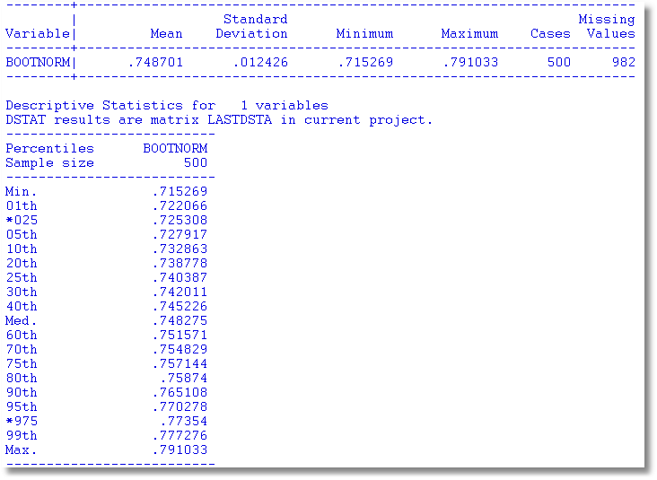
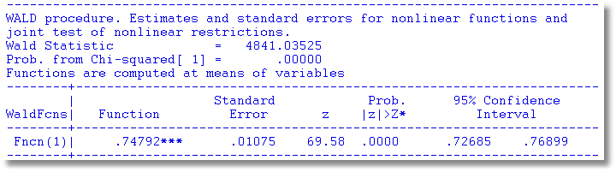
Bootstrap CI is a bit wider.

Slide 45
Quantile Regression
Q(y|x,α) = β′x, α = quantile
Estimated by linear programming
Q(y|x,.50) = β′x, .50 ➔ median regression
Median regression estimated by LAD (estimates same parameters as mean regression if symmetric conditional distribution)
Why use quantile (median) regression?
  Semiparametric
  Robust to some extensions (heteroscedasticity?)
  Complete characterization of conditional distribution

Slide 46
Estimated Variance for Quantile Regression

Slide 47
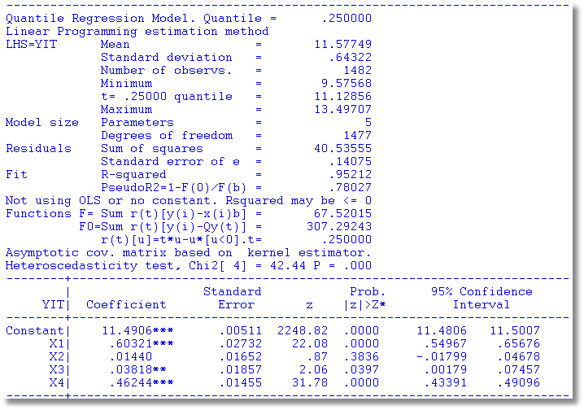
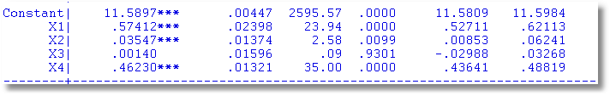
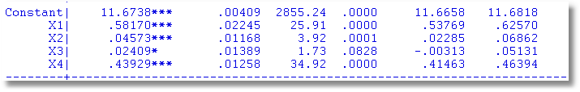
Quantile Regressions
α = .25
α = .50
α = .75

Slide 48
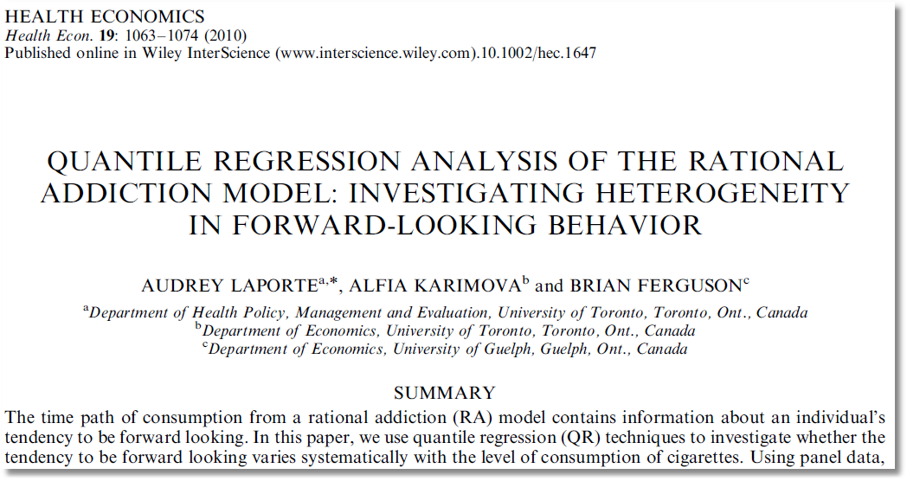

Slide 49
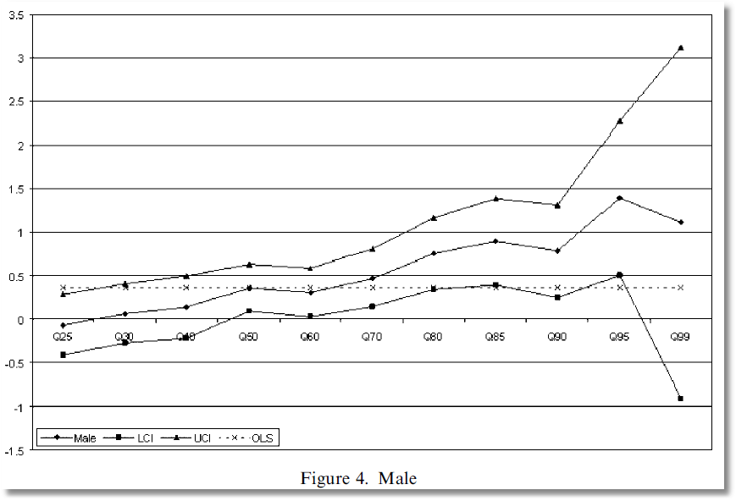
Coefficient on MALE dummy variable in quantile regressions

Slide 50
Econometric Relationship
A relationship of interest:
  Number of hospital visits: H = 0,1,2,…
  Covariates: x₁=Age, x₂=Sex, x₃=Income, x₄=Health
Causality and covariation
  Theoretical implications of ‘causation’
  Comovement and association
  Intervention of omitted or ‘latent’ variables
  Temporal relationship – movement of the “causal variable” precedes the effect.

Slide 51
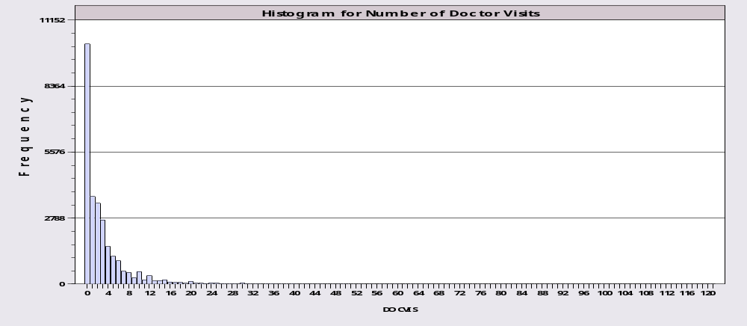
Application: Doctor Visits
German individual health care data: N=27,236
Model for number of visits to the doctor:
  Poisson regression (fit by maximum likelihood)
  Conditional Mean: E[V|Income] = exp(1.412 - .0745 × income)
  OLS Linear Projection: g*(Income)= 3.917 - .2083 × income

Slide 52
Models
Conditional mean function: E[y | x]
Projection: Proj[y | x] (resembles regression)
Other conditional characteristics – what is ‘the model?’
  Conditional variance function: Var[y | x]
  Conditional quantiles, e.g., median [y | x]
  Other conditional moments
Conditional probabilities: P(y|x)
What is the sense in which “y varies with x?”

Slide 53
Endogeneity
A relationship of interest:
  Number of hospital visits: H = 0,1,2,…
  Covariates: x₁=Age, x₂=Sex, x₃=Income, x₄=Health
Should Health be ‘Endogenous’ in this model?
  What do we mean by ‘Endogenous’
  What is an appropriate econometric method of accommodating endogeneity?

Slide 54
Average Partial Effects
When δ(x) ≠β, APE = E_{x}[δ(x)]=
Approximation: Is δ(E[x]) = E_{x}[δ(x)]? (no)
Empirically: Estimated APE =
Empirical approximation: Estimated APE =
For the doctor visits model
  δ(x)= β exp(α+βx)=-.0745exp(1.412-.0745income)
  Sample APE = -.2373
  Approximation = -.2354
  Slope of the linear projection = -.2083 (!)

Slide 55
APE and PE at the Mean
Implication: Computing the APE by averaging over observations (and counting on the LLN and the Slutsky theorem) vs. computing partial effects at the means of the data.
In the earlier example: Sample APE = -.2373
  Approximation = -.2354

Slide 56
The Canonical Panel Data Problem

Slide 58

Estimated Partial Effects by Model

Slide 59
Hypothesis Testing
Nested vs. nonnested tests
  y=b₁x+e vs. y=b₁x+b₂z+e: Nested
  y=bx+e vs. y=cz+u: Not nested
  y=bx+e vs. logy=clogx: Not nested
  y=bx+e; e ~ Normal vs. e ~ t[.]: Not nested
  Fixed vs. random effects: Not nested
  Logit vs. probit: Not nested
  x is (not) endogenous: Maybe nested. We’ll see …
Parametric restrictions
  Linear: Rβ-q = 0, R is JxK, J < K, full row rank
  General: r(β,q) = 0, r = a vector of J functions,
  R(β,q) = ∂r(β,q)/∂β’.
  Use r(β,q)=0 for linear and nonlinear cases

Slide 60
Example: Panel Data on Spanish Dairy Farms
N = 247 farms, T = 6 years (1993-1998)
 | Units | Mean | Std. Dev. | Minimum | Maximum
OutputMilk | Milk production (liters) | 131,107 | 92,584 | 14,410 | 727,281
Input Cows | # of milking cows | 22.12 | 11.27 | 4.5 | 82.3
Input Labor | # man-equivalent units | 1.67 | 0.55 | 1.0 | 4.0
Input Land | Hectares of land devoted to pasture and crops. | 12.99 | 6.17 | 2.0 | 45.1
Input Feed | Total amount of feedstuffs fed to dairy cows (Kg) | 57,941 | 47,981 | 3,924.14 | 376,732

Slide 61
Application
y = log output
x = Cobb douglas production: x = 1,x₁,x₂,x₃,x₄
= constant and logs of 4 inputs (5 terms)
z = Translog terms, x₁², x₂², etc. and all cross products,
x₁x₂, x₁x₃, x₁x₄, x₂x₃, etc. (10 terms)
w = (x,z) (all 15 terms)
Null hypothesis is Cobb Douglas, alternative is
translog = Cobb-Douglas plus second order terms.

Slide 62
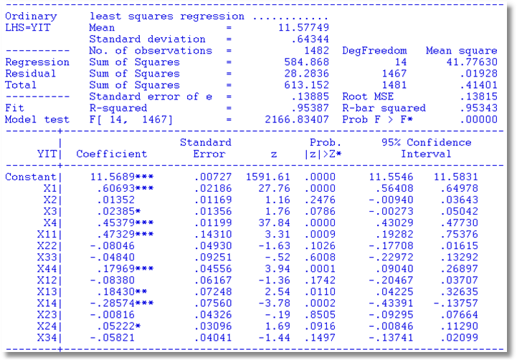
Translog Regression Model
β_{x}
H₀:β_{z}=0

Slide 63
Wald Tests
r(b,q)= close to zero?
Wald distance function:
r(b,q)’{Var[r(b,q)]}⁻¹ r(b,q) →χ²[J]
Use the delta method to estimate Var[r(b,q)]
  Est.Asy.Var[b]=s²(X’X)⁻¹
  Est.Asy.Var[r(b,q)]= R(b,q){s²(X’X)⁻¹}R’(b,q)
The standard F test is a Wald test; JF = χ²[J].

Slide 64
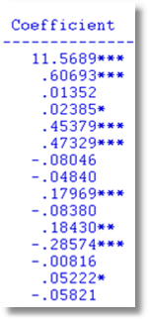
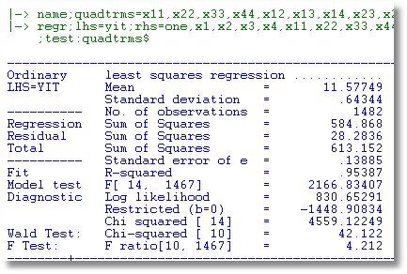
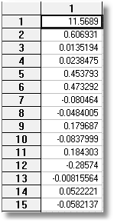
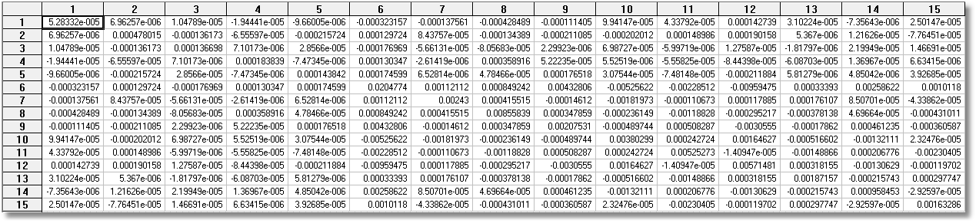
Close
to
0?
W=J*F

Slide 65
Likelihood Ratio Test
The normality assumption
Does it work ‘approximately?’
For any regression model y_{i} = h(x_{i},β)+ε_{i} where
ε_{i} ~N[0,σ²], (linear or nonlinear), at the linear (or nonlinear) least squares estimator, however computed, with or without restrictions,
This forms the basis for likelihood ratio tests.

Slide 66
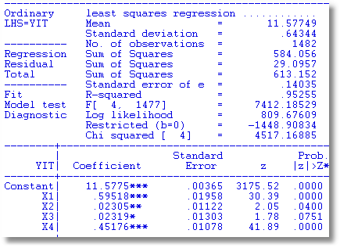
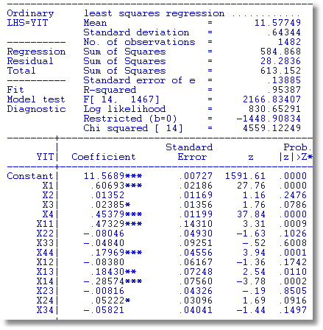
Likelihood Ratio Test
LR = 2(830.653 – 809.676) = 41.954
10 Degrees of Freedom
Critical Value (95%) = 18.31

Slide 67
Score or LM Test: General
Maximum Likelihood (ML) Estimation
A hypothesis test
  H₀: Restrictions on parameters are true
  H₁: Restrictions on parameters are not true
Basis for the test: b₀ = parameter estimate under H₀ (i.e., restricted), b₁ = unrestricted
Derivative results: For the likelihood function under H₁,
  (∂logL₁/∂β | β=b₁) = 0 (derivatives = 0 exactly, by definition)
  (∂logL₁/∂β | β=b₀) ≠ 0. Is it close? If so, the restrictions look
  reasonable

Slide 68
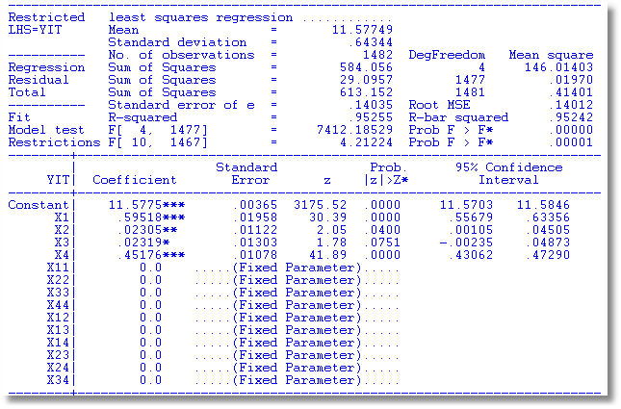
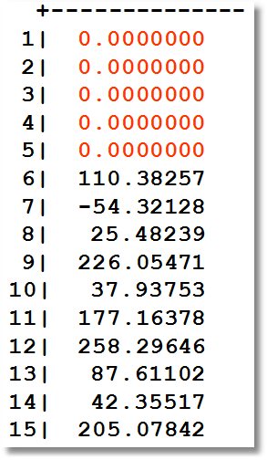
Restricted regression and derivatives for the LM Test
Derivatives are
Are the residuals from regression of y on X alone uncorrelated with Z (after X)?

Slide 69
Computing the LM Statistic
Testing β_{z} = 0 in y=Xβ_{x}+Zβ_{z}+ε
Statistic computed from regression of y on X alone
1. Compute Restricted Regression (y on X alone) and compute
residuals, e₀
2. Regress e₀ on (X,Z). LM = NR² in this regression. (Regress
e₀ on the RHS of the unrestricted regression.

Slide 70
Application of the Score Test
Linear Model: Y = Xβ+Zδ+ε = Wθ + ε
  Test H₀: δ=0
  Restricted estimator is [b’,0’]’
NAMELIST ; X = a list… ; Z = a list … ; W = X,Z $
REGRESS ; Lhs = y ; Rhs = X ; Res = e $
CALC ; List ; LM = N * Rsq(W,e) $

Slide 71
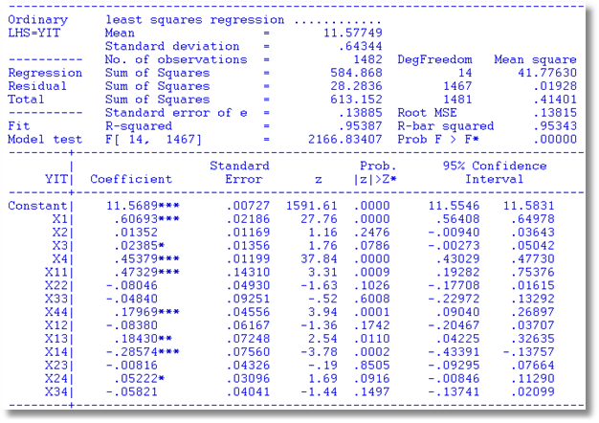
Regression Specification Tests
LR = 41.954
LM = 41.365
Wald Test: Chi-squared [ 10] = 42.122
F Test: F ratio[10, 1467] = 4.212

Slide 72
Why is it the Lagrange Multiplier Test?

Slide 73
Robustness
Assumptions are narrower than necessary
  (1) Disturbances might be heteroscedastic
  (2) Disturbances might be correlated across observations – these are panel data
  (3) Normal distribution assumption is unnecessary
F, LM and LR tests rely on normality, no longer valid
Wald test relies on appropriate covariance matrix. (1) and (2) invalidate s²(X’X)⁻¹.

Slide 74
Robust Inference Strategy
(1) Use a robust estimator of the asymptotic covariance matrix. (Next class)
(2) The Wald statistic based on an appropriate covariance matrix is robust to distributional assumptions – it relies on the CLT.

Slide 75
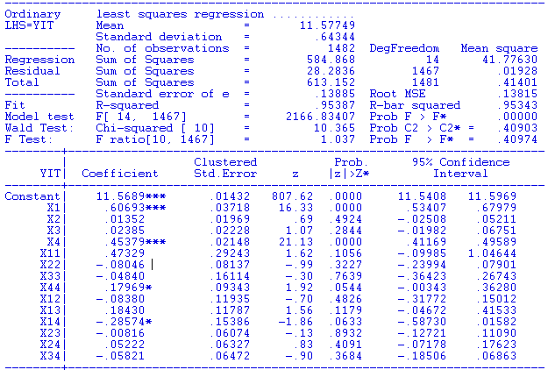
Wald test based on conventional standard errors:
Wald Test: Chi-squared [ 10] = 42.122
P = 0.00001
Wald statistic based on robust covariance matrix = 10.365.
P = 0.409!!
I am skeptical of this result.

