Slide 1


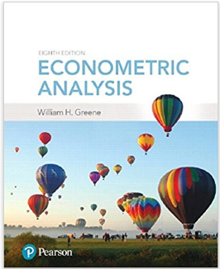



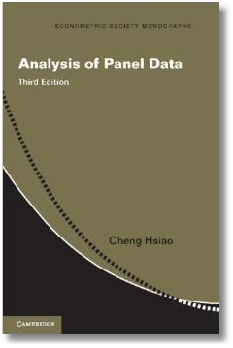
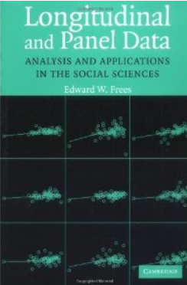
Econometric Analysis of Panel Data
William Greene
Department of Economics
University of South Florida

Slide 2
Econometric Analysis of Panel Data
20. Sample Selection and Attrition

Slide 3
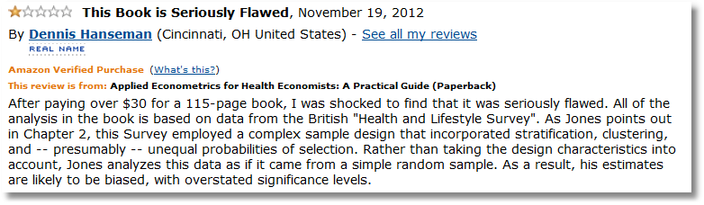

Slide 4
Dueling Selection Biases –
From two emails, same day.
“I am trying to find methods which can deal with data that is non-randomised and suffers from selection bias.”
“I explain the probability of answering questions using, among other independent variables, a variable which measures knowledge breadth. Knowledge breadth can be constructed only for those individuals that fill in a skill description in the company intranet. This is where the selection bias comes from.

Slide 5
Selection on Observables (JW 2010, p.791)
Savings=b₀+b₁Income+b₂Age+b₃Married+b₄Kids+u
Survey data are available for household heads age 45+
“This restricted sample raises a sample selection issue because we are interested in the savings for all families but we can obtain a random sample only for a subset of the population.”
What equation applies to the subset? The same one
Selection on observables: Does not raise a selection issue. (Proved on pp. 791-797.)

Slide 6
The Crucial Element
Selection on the unobservables
  Selection into the sample is based on both observables and unobservables
  All the observables are accounted for
  Unobservables in the selection rule also appear in the model of interest (or are correlated with unobservables in the model of interest)
“Selection Bias”=the bias due to not accounting for the unobservables that link the equations.

Slide 7
A Sample Selection Model
Linear model
2 step
ML – Murphy & Topel
Binary choice application
Other models

Slide 8
Canonical Sample Selection Model

Slide 9
Applications
Labor Supply model:
  y*=wage-reservation wage
  d=labor force participation
Attrition model: Clinical studies of medicines
Survival bias in financial data
Income studies – value of a college application
Treatment effects
Any survey data in which respondents self select to report
Etc…

Slide 10
Estimation of the Selection Model
Two step least squares
  Inefficient
  Simple – exists in current software
  Simple to understand and widely used
Full information maximum likelihood
  Efficient
  Simple – exists in current software
  Not so simple to understand – widely misunderstood

Slide 11
Heckman’s Model

Slide 12
Two Step Estimation
The “LAMBDA”

Slide 13
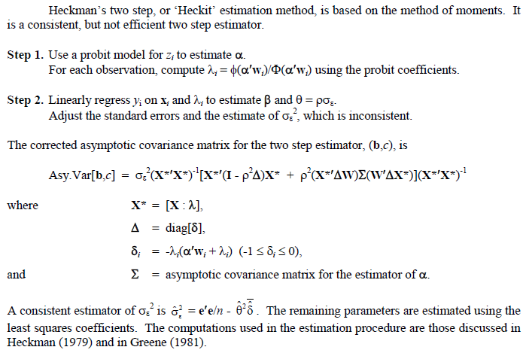

Slide 14
FIML Estimation

Slide 15
Occam’s (Semi)parametric Razor
Central model does not need bivariate normality
Essential nature of the model only requires
  d = 1( some function of z (and γ) > 0)
  E[ ε | x,d=1,z ] = x’b + h(z, γ)
Progress requires a more formal model for d, such as a probit.
  A formal connection between ε and u.
  E[ε | d=1] = ρσu How do you estimate u? This needs a control function.
  Don’t assume normality, but E[ε|d=1] still = λ. Not credible.

Slide 16
Classic Application
Mroz, T., Married women’s labor supply, Econometrica, 1987.
  N =753
  N₁ = 428
A (my) specification
  LFP=f(age,age²,family income, education, kids)
  Wage=g(experience, exp², education, city)
Two step and FIML estimation

Slide 17
Selection Equation
+---------------------------------------------+
| Binomial Probit Model |
| Dependent variable LFP |
| Number of observations 753 |
| Log likelihood function -490.8478 |
+---------------------------------------------+
+--------+--------------+----------------+--------+--------+----------+
|Variable| Coefficient | Standard Error |b/St.Er.|P[|Z|>z]| Mean of X|
+--------+--------------+----------------+--------+--------+----------+
---------+Index function for probability
Constant| -4.15680692 1.40208596 -2.965 .0030
AGE | .18539510 .06596666 2.810 .0049 42.5378486
AGESQ | -.00242590 .00077354 -3.136 .0017 1874.54847
FAMINC | .458045D-05 .420642D-05 1.089 .2762 23080.5950
WE | .09818228 .02298412 4.272 .0000 12.2868526
KIDS | -.44898674 .13091150 -3.430 .0006 .69588313

Slide 18
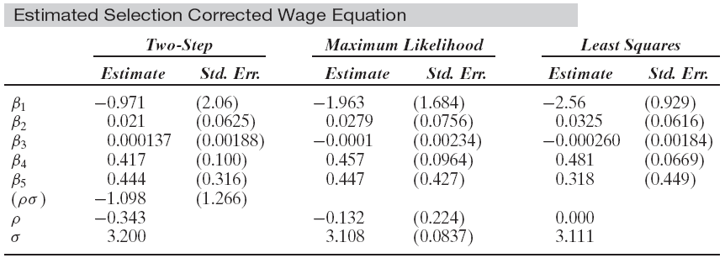
Heckman Estimator and MLE

Slide 19
Extension – Treatment Effect

Slide 20
Exponential Regression Sample Selection

Slide 21
Received Sunday, April 27, 2014
I have a paper regarding strategic alliances between firms, and their impact on firm risk. While observing how a firm’s strategic alliance formation impacts its risk, I need to correct for two types of selection biases. The reviews at Journal of Marketing asked us to correct for the propensity of firms to enter into alliances, and also the propensity to select a specific partner, before we examine how the partnership itself impacts risk.
Our approach involved conducting a probit of alliance formation propensity, take the inverse mills and include it in the second selection equation which is also a probit of partner selection. Then, we include inverse mills from the second selection into the main model. The review team states that this is not correct, and we need an MLE estimation in order to correctly model the set of three equations. The Associate Editor’s point is given below. Can you please provide any guidance on whether this is a valid criticism of our approach. Is there a procedure in LIMDEP that can handle this set of three equations with two selection probit models?
AE’s comment:
“Please note that the procedure of using an inverse mills ratio is only consistent when the main equation where the ratio is being used is linear. In non-linear cases (like the second probit used by the authors), this is not correct. Please see any standard econometric treatment like Greene or Wooldridge. A MLE estimator is needed which will be far from trivial to specify and estimate given error correlations between all three equations.”

Slide 22
Extensions – Binary Data

Slide 23
Panel Data and Selection

Slide 24
Panel Data and Sample Selection Models: A Nonlinear Time Series
I. 1990-1992: Fixed and Random Effects
Extensions
II. 1995 and 2005: Model Identification through
Conditional Mean Assumptions
III. 1997-2005: Semiparametric Approaches based
on Differences and Kernel Weights
IV. 2007: Return to Conventional Estimators, with
Bias Corrections

Slide 25
Panel Data Sample Selection Models

Slide 26
Zabel – Economics Letters (1992)
Inappropriate to have a mix of FE and RE models
Two part solution
  Treat both effects as “fixed”
  Project both effects onto the group means of the variables in the equations (Mundlak)
  Resulting model is two random effects equations
Use both random effects

Slide 27
Selection with Fixed Effects

Slide 28
Practical Complications
The bivariate normal integration is actually the product of two univariate normals, because in the specification above, v_{i} and w_{i} are assumed to be uncorrelated. Vella (2000) notes, however, “… given the computational demands of estimating by maximum likelihood induced by the requirement to evaluate multiple integrals, we consider the applicability of available simple, or two step procedures.”

Slide 29
Simulation
The first line in the log likelihood is of the form E_{v}[Π_{d=0}Φ(…)] and the second line is of the form E_{w}[E_{v}[Φ(…)φ(…)/σ]]. Using simulation instead, the simulated likelihood is

Slide 30
Correlated Effects
Suppose that w_{i} and v_{i} are bivariate standard normal with correlation ρ_{vw}. We can project w_{i} on v_{i} and write
w_{i} = ρ_{vw}v_{i} + (1-ρ_{vw}²)^{1/2}h_{i}
where h_{i} has a standard normal distribution. To allow the correlation, we now simply substitute this expression for w_{i} in the simulated (or original) log likelihood, and add ρ_{vw} to the list of parameters to be estimated. The simulation is then over still independent normal variates, v_{i} and h_{i}.

Slide 31
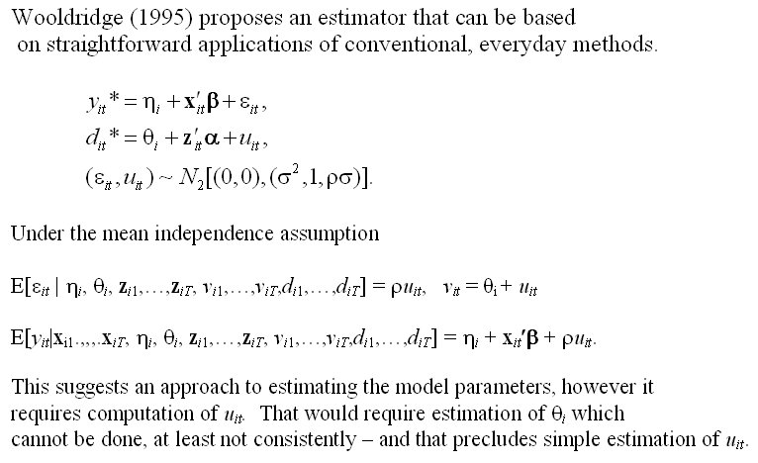
Conditional Means

Slide 32
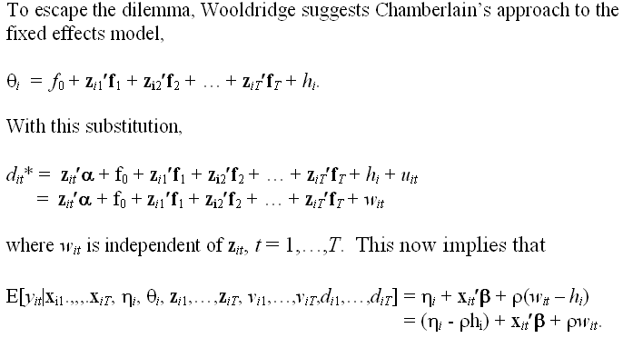
A Feasible Estimator

Slide 33
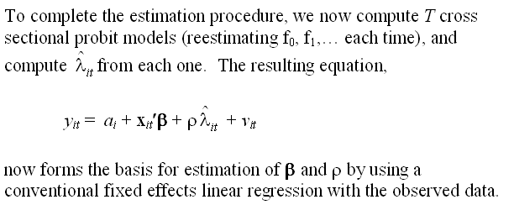
Estimation

Slide 34
Kyriazidou - Semiparametrics

Slide 35
Bias Corrections
Val and Vella, 2007 (Working paper)
Assume fixed effects
  Bias corrected probit estimator at the first step
  (because of the incidental parameters problem).
  IS THIS NECESSARY? What is biased?
  Use fixed probit model to set up second step Heckman style regression treatment.

Slide 36
Postscript
What selection process is at work?
  All of the work examined here (and in the literature) assumes the selection operates anew in each period
  An alternative scenario: Selection into the panel, once, at baseline.
Why aren’t the time invariant components correlated?
Other models
  All of the work on panel data selection assumes the main equation is a linear model.
  Any others? Discrete choice? Counts?

Slide 37
A Panel Data Model
● Selection takes place only at the baseline.
● There is no attrition.

Slide 38
Simulated Log Likelihood

Slide 39
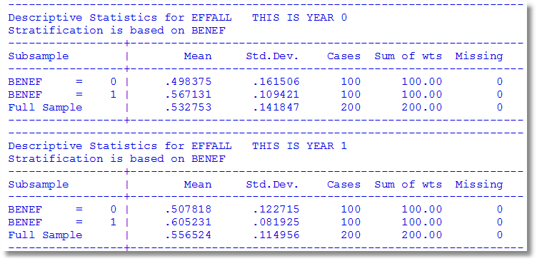
Main Empirical Conclusions from Waves 0 and 1
Benefit group is more efficient in both years
The gap is wider in the second year
Both means increase from year 0 to year 1
Both variances decline from year 0 to year 1

Slide 40
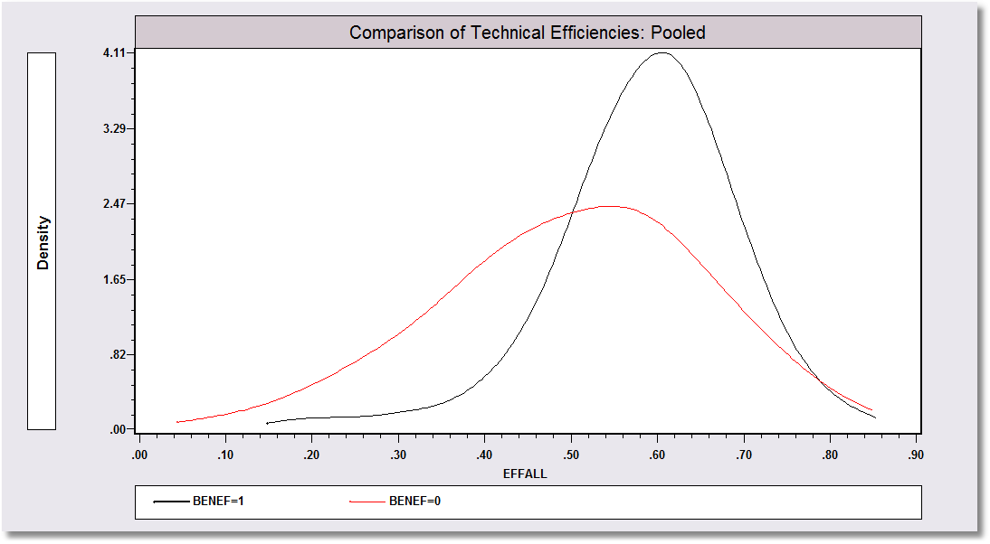

Slide 41
Attrition
In a panel, t=1,…,T individual I leaves the sample at time K_{i} and does not return.
If the determinants of attrition (especially the unobservables) are correlated with the variables in the equation of interest, then the now familiar problem of sample selection arises.

Slide 42
Application of a Two Period Model
“Hemoglobin and Quality of Life in Cancer Patients with Anemia,”
Finkelstein (MIT), Berndt (MIT), Greene (NYU), Cremieux (Univ. of Quebec)
1998
With Ortho Biotech – seeking to change labeling of already approved drug ‘erythropoetin.’ r-HuEPO

Slide 43
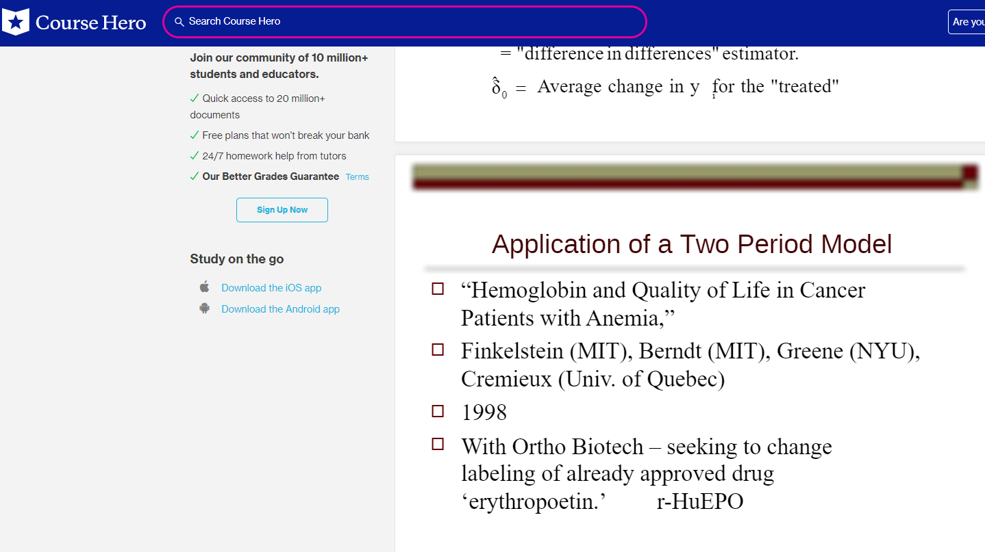

Slide 44
QOL Study
Quality of life study
  i = 1,… 1200+ clinically anemic cancer patients undergoing chemotherapy, treated with transfusions and/or r-HuEPO
  t = 0 at baseline, 1 at exit. (interperiod survey by some patients was not used)
y_{it} = self administered quality of life survey, scale = 0,…,100
x_{it} = hemoglobin level, other covariates
  Treatment effects model (hemoglobin level)
  Background – r-HuEPO treatment to affect Hg level
Important statistical issues
  Unobservable individual effects
  The placebo effect
  Attrition – sample selection
  FDA mistrust of “community based” – not clinical trial based statistical evidence
Objective – when to administer treatment for maximum marginal benefit

Slide 45
Dealing with Attrition
The attrition issue: Appearance for the second interview was low for people with initial low QOL (death or depression) or with initial high QOL (don’t need the treatment). Thus, missing data at exit were clearly related to values of the dependent variable.
Solutions to the attrition problem
  Heckman selection model (used in the study)
    Prob[Present at exit|covariates] = Φ(z’θ) (Probit model)
    Additional variable added to difference model λ_{i} = Φ(z_{i}’θ)/Φ(z_{i}’θ)
  The FDA solution: fill with zeros. (!)

Slide 46
An Early Attrition Model

Slide 47
Methods of Estimating the Attrition Model
Heckman style “selection” model
Two step maximum likelihood
Full information maximum likelihood
Two step method of moments estimators
Weighting schemes that account for the “survivor bias”

Slide 48
Selection Model

Slide 49
Maximum Likelihood

Slide 51
A Model of Attrition
Nijman and Verbeek, Journal of Applied Econometrics, 1992
Consumption survey (Holland, 1984 – 1986)
  Exogenous selection for participation (rotating panel)
  Voluntary participation (missing not at random – attrition)

Slide 52
Attrition Model

Slide 53
Selection Equation

Slide 54
Estimation Using One Wave
Use any single wave as a cross section with observed lagged values.
Advantage: Familiar sample selection model
Disadvantages
  Loss of efficiency
  “One can no longer distinguish between state dependence and unobserved heterogeneity.”

Slide 55
One Wave Model

Slide 56
Maximum Likelihood Estimation
See Zabel’s model.
Because numerical integration is required in one or two dimensions for every individual in the sample at each iteration of a high dimensional numerical optimization problem, this is, though feasible, not computationally attractive.
  The dimensionality of the optimization is irrelevant
  This is much easier in 2019 than it was in 1992 (especially with simulation) The authors did the computations with Hermite quadrature.

Slide 57
Testing for Selection?
Maximum Likelihood Results
    Covariances were highly insignificant.
    LR statistic=0.46.
Two step results produced the same conclusion based on a Hausman test
ML Estimation results looked like the two step results.

Slide 58

A Dynamic Ordered Probit Model

Slide 59
Random Effects Dynamic
Ordered Probit Model

Slide 60
A Study of Health Status in the Presence of Attrition
“THE DYNAMICS OF HEALTH IN THE BRITISH HOUSEHOLD PANEL SURVEY,”
Contoyannis, P., Jones, A., N. Rice
Journal of Applied Econometrics, 19, 2004,
pp. 473-503.
Self assessed health
British Household Panel Survey (BHPS)
  1991 – 1998 = 8 waves
  About 5,000 households

Slide 61
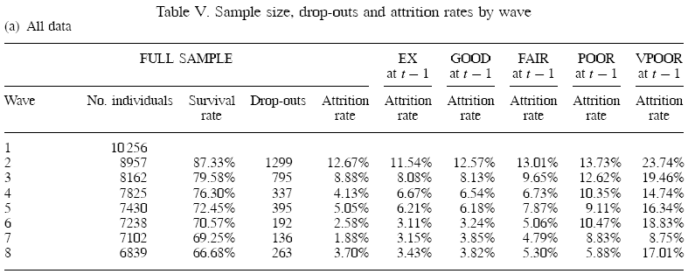
Attrition

Slide 62
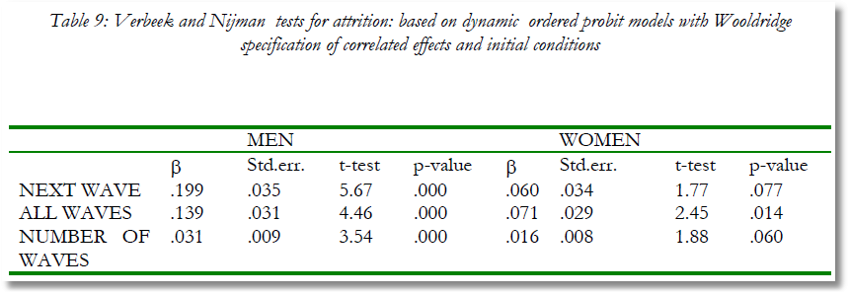
Testing for Attrition Bias
Three dummy variables added to full model with unbalanced panel suggest presence of attrition effects.

Slide 63
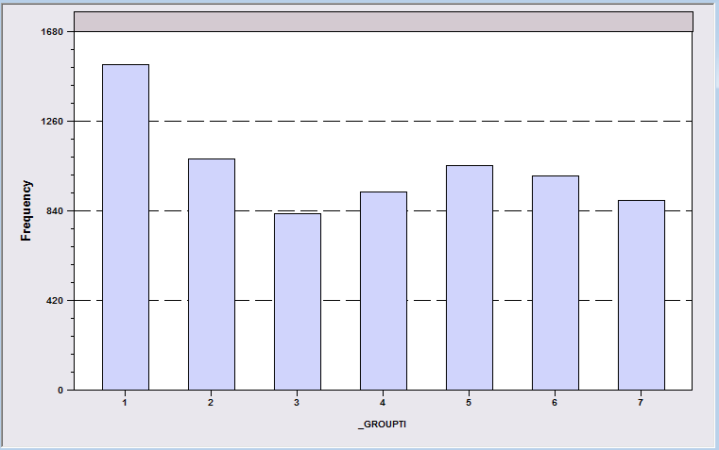
Attrition Model with IP Weights
Assumes (1) Prob(attrition|all data) = Prob(attrition|selected variables) (ignorability)
(2) Attrition is an ‘absorbing state.’ No reentry.
Obviously not true for the GSOEP data above.
Can deal with point (2) by isolating a subsample of those present at wave 1 and the monotonically shrinking subsample as the waves progress.

Slide 64
Probability Weighting Estimators
A Patch for Attrition
(1) Fit a participation probit equation for each wave.
(2) Compute p(i,t) = predictions of participation for each individual in each period.
  Special assumptions needed to make this work
Ignore common effects and fit a weighted pooled log likelihood: Σ_{i} Σ_{t} [d_{it}/p(i,t)]logLP_{it}.

Slide 65
Inverse Probability Weighting

Slide 66
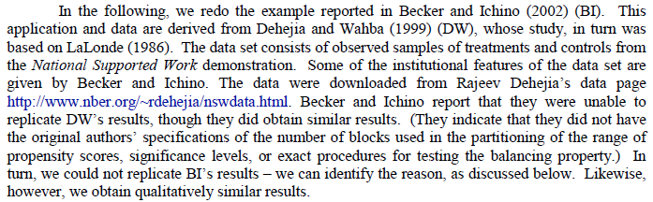
Selection on Observables
National Supported Work Demonstration

Slide 67
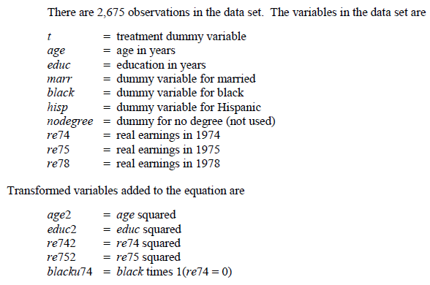
Propensity Score Matching
A Work Training Application

Slide 68
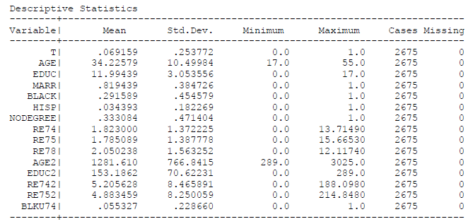
The Data

Slide 69
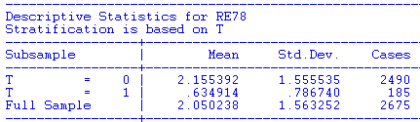
Naïve Comparison of Means

Slide 70
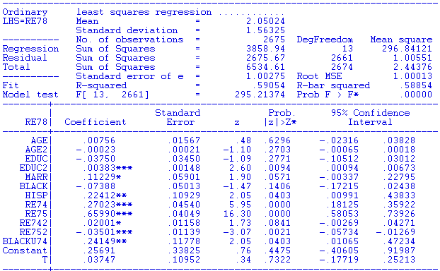
Treatment Effect Regression

Slide 71
Extension – Treatment Effect

Slide 72
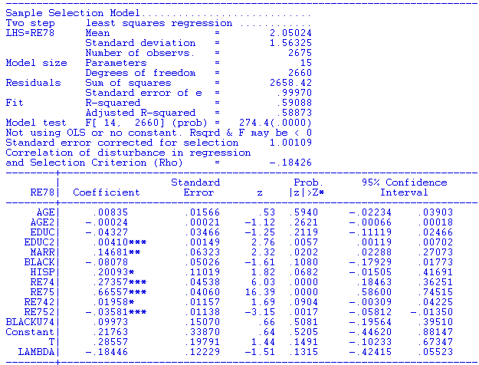
Heckman Model
Underlying Probit equation for T has the same exogenous variables as the regression. No “exclusions.”

Slide 74
FIML Estimation

Slide 75
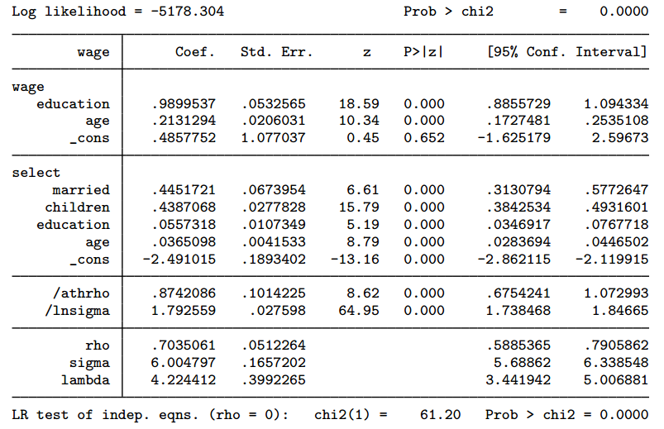

Slide 76
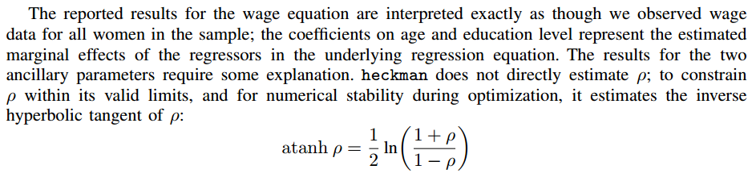
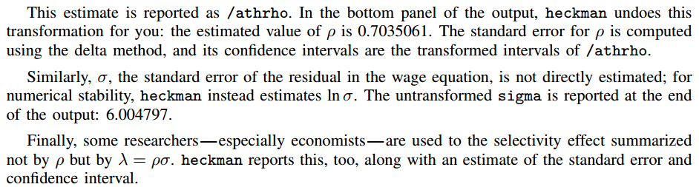

Slide 77
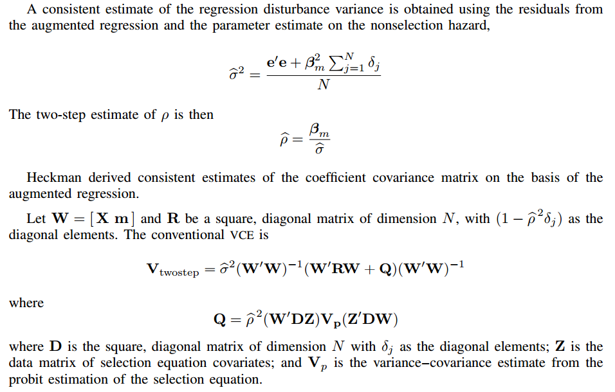

Slide 78
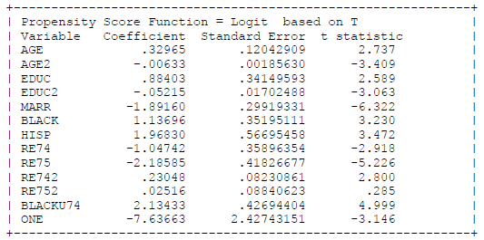
Logit Based Propensity Scores

Slide 79
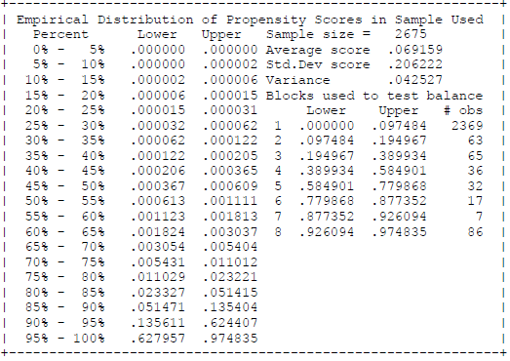
Matching Based On Propensities

Slide 80
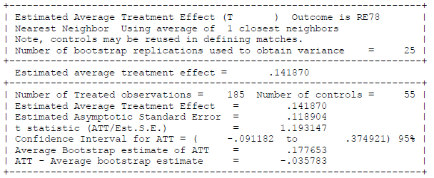
Estimated Treatment Effect
Simple Pairwise Matching

