Slide 1

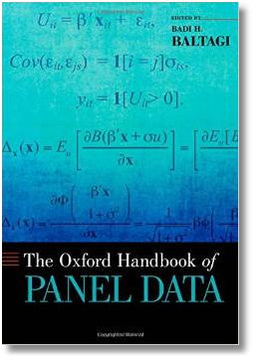






Econometric Analysis of Panel Data
William Greene
Department of Economics
University of South Florida

Slide 2
21. Hazard and Duration Models

Slide 3
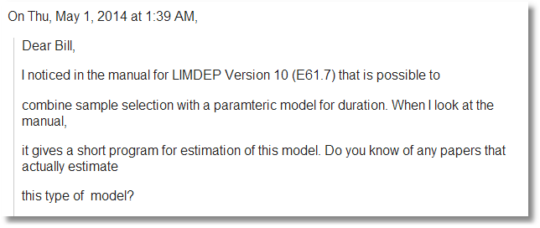
My recollection of my co-author's description of his problem was something like the following. We observe people in good health and in bad health, and we want to analyze something about some aspect of a duration problem where we expect the duration is related to health status. Ignoring health status selection would lead to considerable bias in the duration estimation.

Slide 4
Modeling Duration
Time until business failure
Time until exercise of a warranty
Length of an unemployment spell
Length of time between children
Time between business cycles
Time between wars or civil insurrections
Time between policy changes
Etc.

Slide 5
Hazard Models for Duration
Basic hazard rate model
Parametric models
Duration dependence
Censoring
Time varying covariates
Sample selection

Slide 6
The Hazard Function

Slide 7
Hazard Function

Slide 8
A Simple Hazard Function

Slide 9
Duration Dependence

Slide 10
Parametric Models of Duration

Slide 11
Censoring

Slide 12
Accelerated Failure Time Models

Slide 13
Proportional Hazards Models

Slide 14
Estimation

Slide 15
Time Varying Covariates

Slide 16
Unobserved Heterogeneity

Slide 17
Interpretation
What are the coefficients?
Are there ‘marginal effects?’
What is of interest in the study?

Slide 18
A Semiparametric Model

Slide 19
Nonparametric Approach
Based simply on counting observations
  K spells = ending times 1,…,K
  d_{j} = # spells ending at time t_{j}
  m_{j} = # spells censored in interval [t_{j} , t_{j+1})
  r_{j} = # spells in the risk set at time t_{j} = Σ (d_{j}+m_{j})
Estimated hazard, h(t_{j}) = d_{j}/r_{j}
Estimated survival = Π [1 – h(t_{j})] (Kaplan-Meier “product limit” estimator

Slide 20
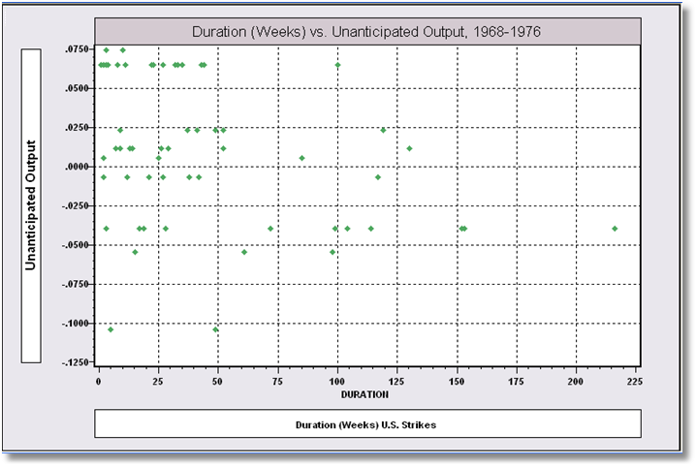
Kennan’s Strike Duration Data

Slide 21
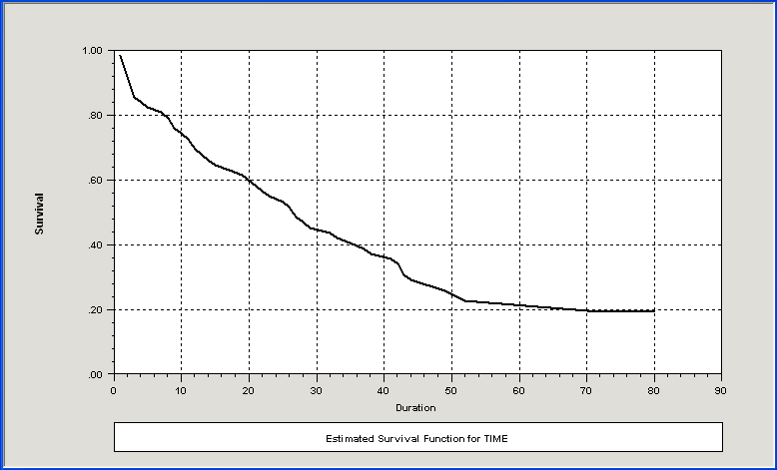
Kaplan Meier Survival Function

Slide 22
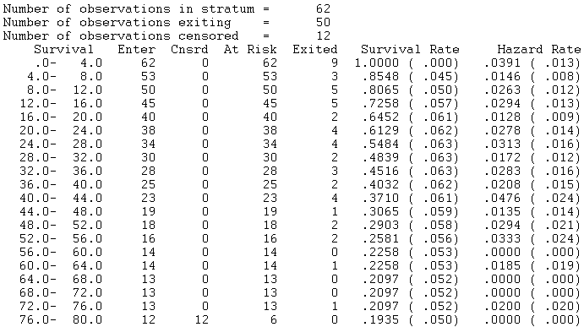
Hazard Rates

Slide 23
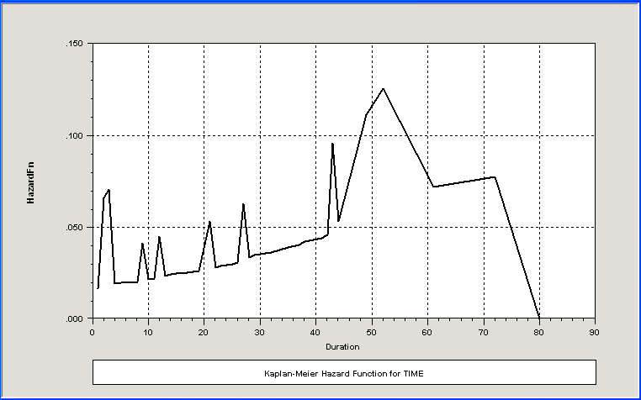
Hazard Function

Slide 24
Weibull Model
+---------------------------------------------+
| Loglinear survival model: WEIBULL |
| Log likelihood function -97.39018 |
| Number of parameters 3 |
| Akaike IC= 200.780 Bayes IC= 207.162 |
+---------------------------------------------+
+---------+--------------+----------------+--------+---------+----------+
|Variable | Coefficient | Standard Error |b/St.Er.|P[|Z|>z] | Mean of X|
+---------+--------------+----------------+--------+---------+----------+
RHS of hazard model
Constant 3.82757279 .15286595 25.039 .0000
PROD -10.4301961 3.26398911 -3.196 .0014 .01102306
Ancillary parameters for survival
Sigma 1.05191710 .14062354 7.480 .0000
σ = 1/p

Slide 25
Weibull Model
+----------------------------------------------------------------+
| Parameters of underlying density at data means: |
| Parameter Estimate Std. Error Confidence Interval |
| ------------------------------------------------------------ |
| Lambda .02441 .00358 .0174 to .0314 |
| P .95065 .12709 .7016 to 1.1997 |
| Median 27.85629 4.09007 19.8398 to 35.8728 |
| Percentiles of survival distribution: |
| Survival .25 .50 .75 .95 |
| Time 57.75 27.86 11.05 1.80 |
+----------------------------------------------------------------+

Slide 26
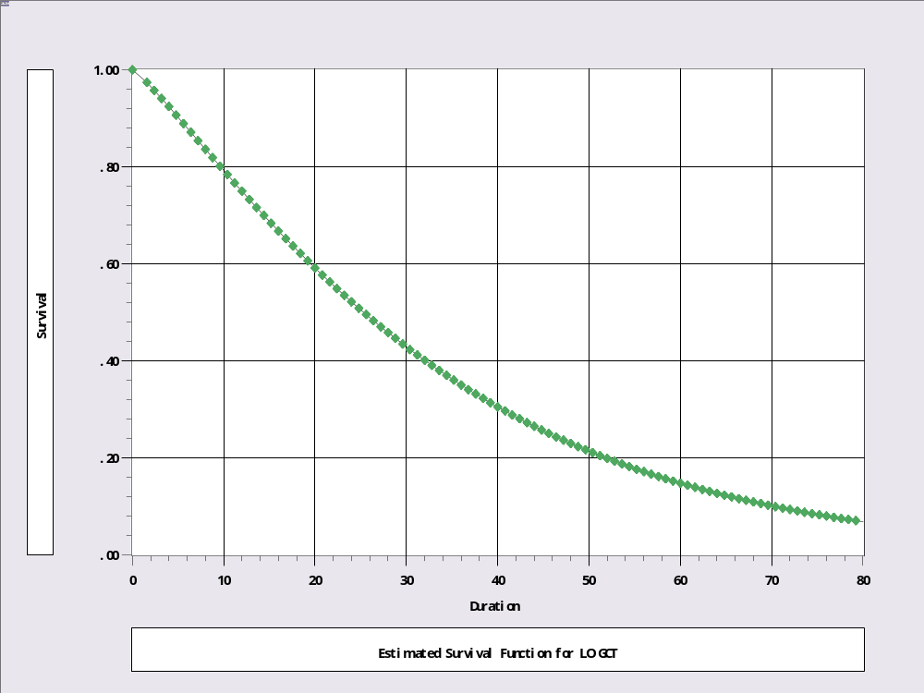
Survival Function

Slide 27
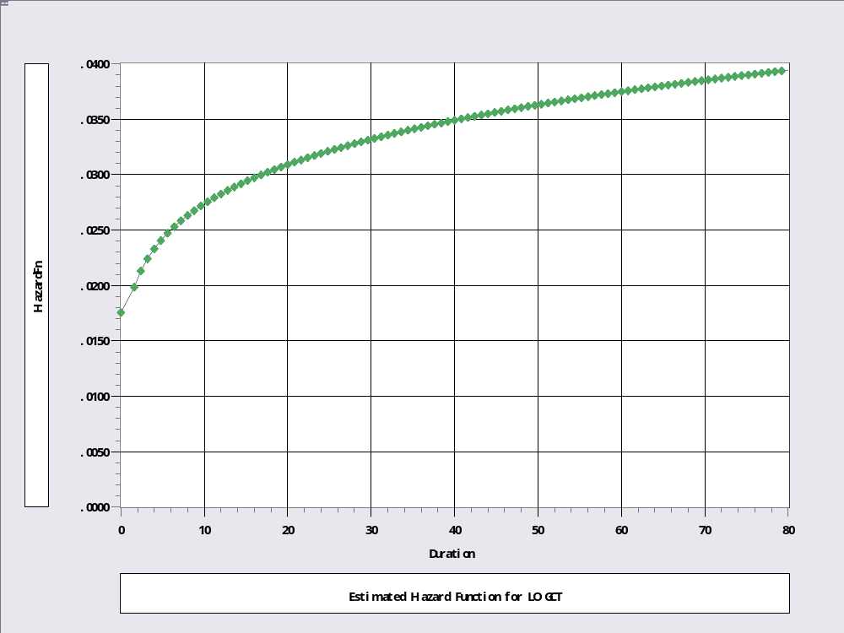
Hazard Function

Slide 28
Loglogistic Model
+---------------------------------------------+
| Loglinear survival model: LOGISTIC |
| Dependent variable LOGCT |
| Log likelihood function -97.53461 |
| Censoring status variable is C |
+---------------------------------------------+
+---------+--------------+----------------+--------+---------+----------+
|Variable | Coefficient | Standard Error |b/St.Er.|P[|Z|>z] | Mean of X|
+---------+--------------+----------------+--------+---------+----------+
RHS of hazard model
Constant 3.33044203 .17629909 18.891 .0000
PROD -10.2462322 3.46610670 -2.956 .0031 .01102306
Ancillary parameters for survival
Sigma .78385188 .10475829 7.482 .0000
+---------------------------------------------+
| Loglinear survival model: WEIBULL |
| Log likelihood function -97.39018 |
| Number of parameters 3 |
|Variable | Coefficient | Standard Error |b/St.Er.|P[|Z|>z] | Mean of X|
+---------+--------------+----------------+--------+---------+----------+
RHS of hazard model
Constant 3.82757279 .15286595 25.039 .0000
PROD -10.4301961 3.26398911 -3.196 .0014 .01102306
Ancillary parameters for survival
Sigma 1.05191710 .14062354 7.480 .0000

Slide 29
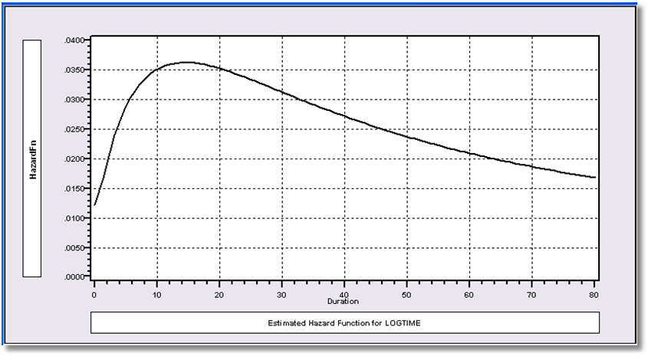
Loglogistic Hazard Model

Slide 32
What is the pseudo R squared?
Kaplan Meier based on counting observations
  K spells = ending times 1,…,K
  d_{j} = # spells ending at time t_{j} = 1 if no ties
  m_{j} = # spells censored in interval [t_{j} , t_{j+1})
  r_{j} = # spells in the risk set at time t_{j} = Σ (d_{j}+m_{j})
Estimated hazard, h(t_{j}) = d_{j}/r_{j}
(Kaplan-Meier “product limit” estimator

Slide 34
Appendix:
Application

Slide 35
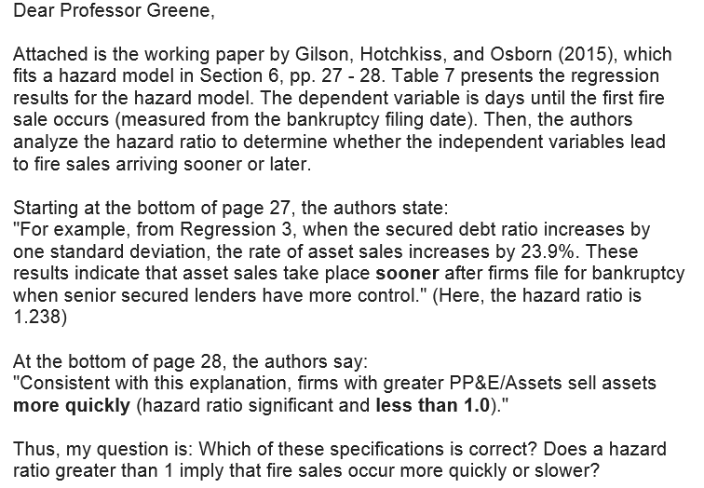

Slide 36
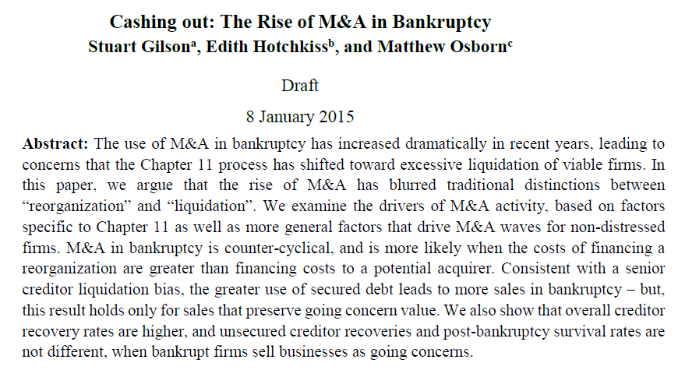

Slide 37
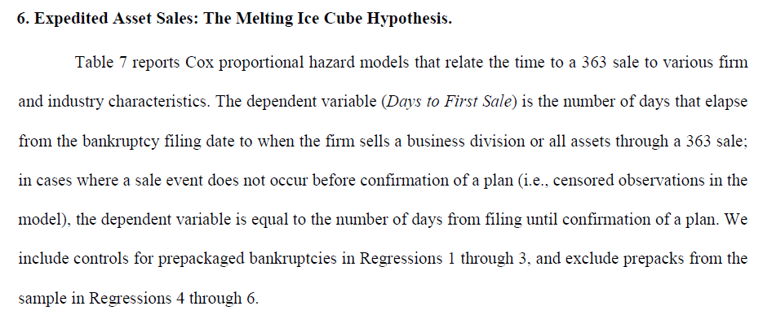

Slide 38
Starting at the bottom of page 27, the authors state:
"For example, from Regression 3, when the secured debt ratio increases by one standard deviation, the rate of asset sales increases by 23.9%. These results indicate that asset sales take place sooner after firms file for bankruptcy when senior secured lenders have more control." (Here, the hazard ratio is 1.238)
If β > 0, exp(b) > 1. So a positive beta means the hazard increases when the x increases. If the hazard increases, the probability of a transition at time t+D increases. This does not mean that asset sales take place sooner as such. It means that asset sales at a point in time become more likely. Loosely, this is more or less consistent.
“Consistent with this explanation, firms with greater PP&E/Assets sell assets more quickly (hazard ratio significant and less than 1.0).“
The “hazard ratio” is exp(b) = .603, so b = log(.603) = -.505. When PP&E increases, the hazard decreases. Sales in the next interval become less likely, not more. This statement does not seem correct.

Slide 39
There is no place in the model for heteroscedasticity to reside. The statement about heteroscedasticity robust standard errors doesn’t look right.
I do not know what correction was made. No actual correction makes sense. I cannot tell whether a correction of this sort would damage the standard errors or not.
The unit of observation in the Cox model is not the individual observation. It is the distinct exit time. Observations will appear in the risk set at potentially many points in time. The computation of “clustering” does not make any sense.
Given that the clustering relates to years, as does the definition of the risk set, this correction probably did damage the standard errors. My assessment based on what I know so far is that I do not trust the standard errors. Since only stars, and not standard errors are reported, I do not trust these results either.

Slide 40
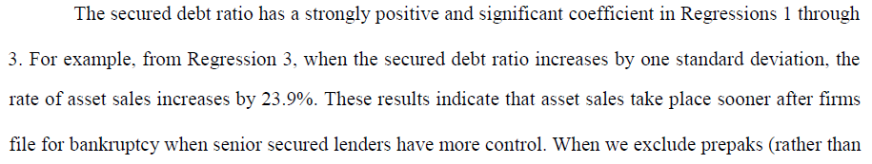
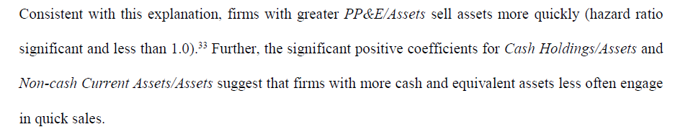

Slide 41
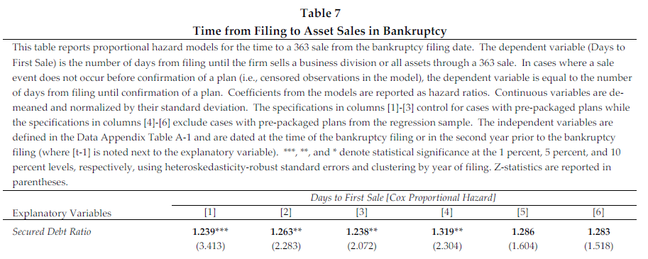
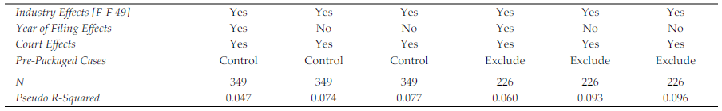
PP&E/Assets[t-1] 0.603***

