Slide 1


22. Stochastic Frontier Models
And Efficiency Measurement

Slide 2
The Production Function
“A single output technology is commonly described by means of a production function f(z) that gives the maximum amount q of output that can be produced using input amounts (z₁,…,z_{L-1}) > 0.
“Microeconomic Theory,” Mas-Colell, Whinston, Green: Oxford, 1995, p. 129. See also Samuelson (1938) and Shephard (1953).

Slide 3
Thoughts on Inefficiency
Failure to achieve the theoretical maximum
Hicks (ca. 1935) on the benefits of monopoly
Leibenstein (ca. 1966): X inefficiency
Debreu, Farrell (1950s) on management inefficiency
All related to firm behavior in the absence of
market restraint – the exercise of market
power.

Slide 4

Applications
Banking
Accounting Firms, Insurance Firms
Health Care: Hospitals, Nursing Homes
Higher Education
Fishing
Sports: Hockey, Baseball
World Health Organization – World Health
Industries: Railroads, Farming
Utilities: Electricity, Gas, Sewage, Water
Several hundred applications in print
since 2000

Slide 5
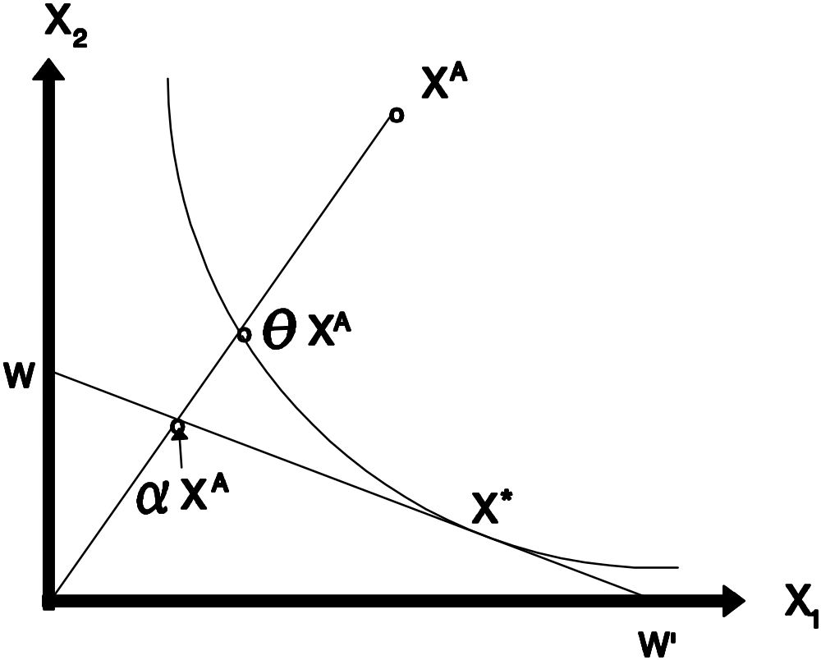
Technical Efficiency

Slide 6
Technical Inefficiency
= Production parameters, “i” = firm i.

Slide 7
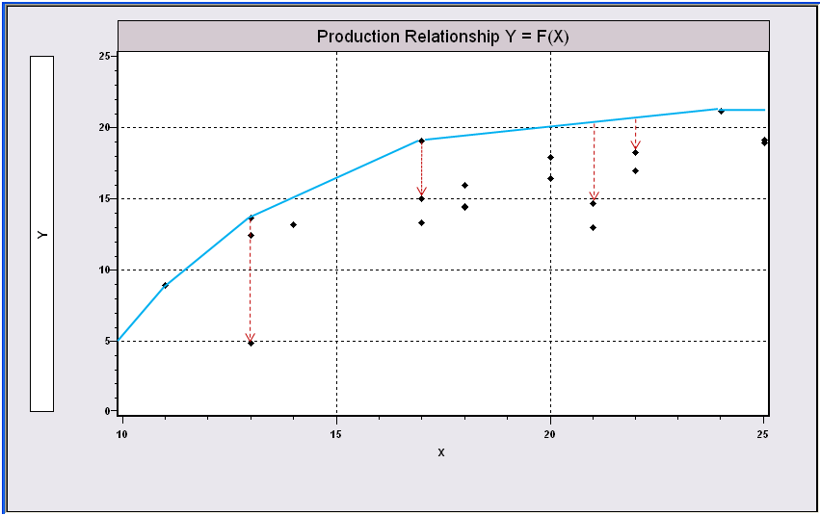
(Nonparametric) Data
Envelopment Analysis

Slide 8
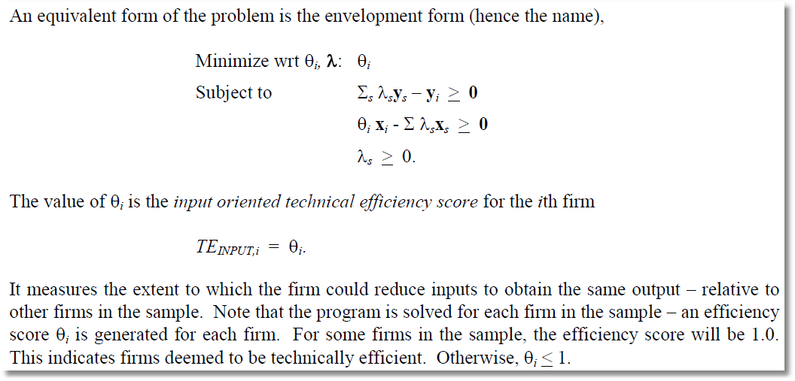
DEA is done using linear programming

Slide 9
Regression Basis

Slide 10
Maintaining the Theory
One Sided Residuals, u_{i} < 0
Deterministic Frontier
  Statistical Approach: Gamma Frontier. Not successful
  Nonstatistical Approach: Data Envelopment Analysis based on linear programming – wildly successful. Hundreds of applications; an industry with an army of management consultants

Slide 11
Gamma Frontier
Greene (1980, 1993, 2003)

Slide 12
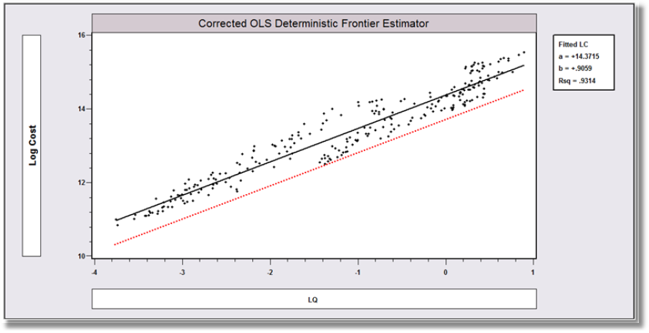
Cost Frontier

Slide 13
The Stochastic Frontier Model

Slide 14
Stochastic Frontier Disturbances

Slide 15
Half Normal Model (ALS)

Slide 16
Estimating the Stochastic Frontier
OLS
  Slope estimator is unbiased and consistent
  Constant term is biased downward
  e’e/N estimates Var[ε]=Var[v]+Var[u]=σ_{v}²+ σ_{u}²[(π-2)/ π]
  No estimates of the variance components
Maximum Likelihood
  The usual properties
  Likelihood function has two modes: OLS with λ=0 and ML with λ>0.

Slide 17
Other Possible Distributions

Slide 18
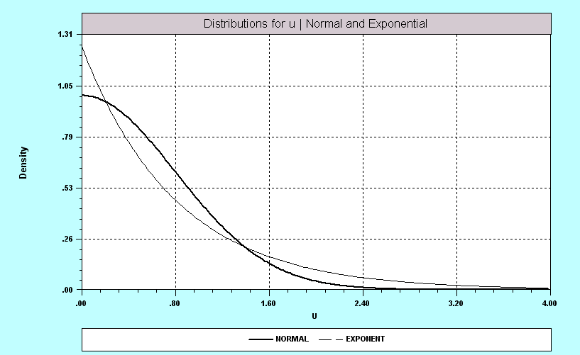
Normal vs. Exponential Models

Slide 19
Estimating Inefficiency

Slide 20
Dual Cost Function

Slide 21
Application: Electricity Data
Sample = 123 Electricity Generating Firms, Data from 1970
Variable Mean Std. Dev. Description
========================================================
FIRM 62.000 35.651 Firm number, 1,…,123
COST 48.467 64.064 Total cost
OUTPUT 9501.1 12512. Total generation in KWH
CAPITAL .14397 .19558 K = Capital share * Cost / PK
LABOR .00074 .00099 L = Labor share * Cost / PL
FUEL 1.0047 1.2867 F = Fuel share * Cost / PL
LPRICE 7988.6 1252.8 PL = Average labor price
LSHARE .14286 .056310 Labor share in total cost
CPRICE 72.895 9.5163 PK = Capital price
CSHARE .22776 .06010 Capital share in total cost
FPRICE 30.807 7.9282 PF = Fuel price in cents ber BTU
FSHARE .62938 .08619 Fuel share in total cost
LOGC_PF -.38339 1.5385 Log (Cost/PF)
LOGQ 8.1795 1.8299 Log output
LOGQSQ 35.113 13.095 ½ Log (Q)²

Slide 22
OLS – Cost Function
+----------------------------------------------------+
| Ordinary least squares regression |
| Residuals Sum of squares = 2.443509 |
| Standard error of e = .1439017 |
| Fit R-squared = .9915380 |
| Diagnostic Log likelihood = 66.47364 |
+----------------------------------------------------+
|Variable | Coefficient | Standard Error |t-ratio |P[|T|>t] | Mean of X|
+---------+--------------+----------------+--------+---------+----------+
Constant -7.29402077 .34427692 -21.186 .0000
LOGQ .39090935 .03698792 10.569 .0000 8.17947153
LOGPL_PF .26078497 .06810921 3.829 .0002 5.58088278
LOGPK_PF .07478746 .06164533 1.213 .2275 .88666047
LOGQSQ .06241301 .00515483 12.108 .0000 35.1125267

Slide 23
ML – Cost Function
+---------------------------------------------+
| Maximum Likelihood Estimates |
| Log likelihood function 66.86502 |
| Variances: Sigma-squared(v)= .01185 |
| Sigma-squared(u)= .02233 |
| Sigma(v) = .10884 |
| Sigma(u) = .14944 |
| Sigma = Sqr[(s^2(u)+s^2(v)]= .18488 |
+---------------------------------------------+
|Variable | Coefficient | Standard Error |b/St.Er.|P[|Z|>z] | Mean of X|
+---------+--------------+----------------+--------+---------+----------+
Primary Index Equation for Model
Constant -7.49421176 .32997411 -22.712 .0000
LOGQ .41097893 .03599288 11.418 .0000 8.17947153
LOGPL_PF .26058898 .06554430 3.976 .0001 5.58088278
LOGPK_PF .05531289 .06001748 .922 .3567 .88666047
LOGQSQ .06058236 .00493666 12.272 .0000 35.1125267
Variance parameters for compound error
Lambda 1.37311716 .29711056 4.622 .0000
Sigma .18487506 .00110120 167.884 .0000

Slide 24
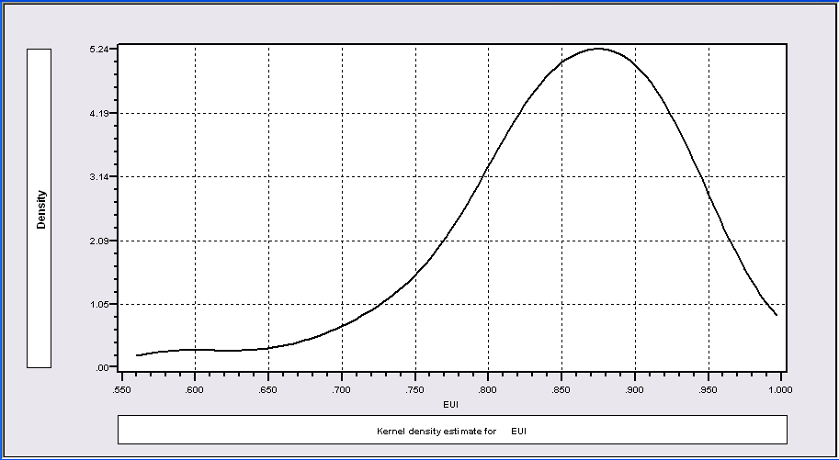
Estimated Efficiencies

Slide 25
Panel Data Applications
U_{i} is the ‘effect’
  Fixed (OLS) or random effect (ML)
  Is inefficiency fixed over time?
‘True’ fixed and random effects
  Is inefficiency time varying?
  Where does heterogeneity show up in the model?

Slide 26
Main Issues in Panel Data Modeling
Issues
  Capturing Time Invariant Effects
  Dealing with Time Variation in Inefficiency
  Separating Heterogeneity from Inefficiency
Contrasts – Panel Data vs. Cross Section

Slide 27
Familiar RE and FE Models
Wisdom from the linear model
FE: y(i,t) = f[x(i,t)] + a(i) + e(i,t)
  What does a(i) capture?
  Nonorthogonality of a(i) and x(i,t)
  The LSDV estimator
RE: y(i,t) = f[x(i,t)] + u(i) + e(i,t)
  How does u(i) differ from a(i)?
  Generalized least squares and maximum likelihood
What are the time invariant effects?

Slide 28
Frontier Model for Panel Data
y(i,t) = β’x(i,t) – u(i) +v(i,t)
Effects model with time invariant inefficiency
Same dichotomy between FE and RE – correlation with x(i,t).
  FE case is completely unlike the assumption in the cross section case

Slide 29
Pitt and Lee RE Model

Slide 30
Estimating Efficiency

Slide 31
Schmidt and Sickles FE Model
lny_{it} = α + β’x_{it} + a_{i} + v_{it}
estimated by least squares (‘within’)

Slide 32
A Problem of Heterogeneity
In the “effects” model, u(i) absorbs
two sources of variation
  Time invariant inefficiency
  Time invariant heterogeneity unrelated to inefficiency
(Decomposing u(i,t)=u*(i)+u**(i,t)
in the presence of v(i,t) is hopeless.)

Slide 33
Time Invariant Heterogeneity

Slide 34
A True RE Model (Greene, 2004)

Slide 35
Kumbhakar et al.(2011) – True True RE
y_{it} = b₀ + b’x_{it} + (e_{i0} + e_{it}) - (u_{i0} + u_{it})
e_{i0} and e_{it} full normally distributed
u_{i0} and u_{it} half normally distributed
(So far, only one application)
Colombi, Kumbhakar, Martini, Vittadini, “A Stochastic Frontier with Short Run and Long Run Inefficiency, 2011

Slide 36
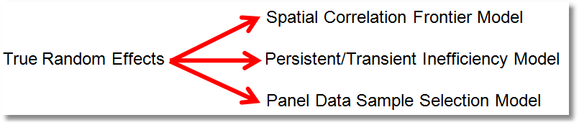
Generalized True Random Effects Model

Slide 37
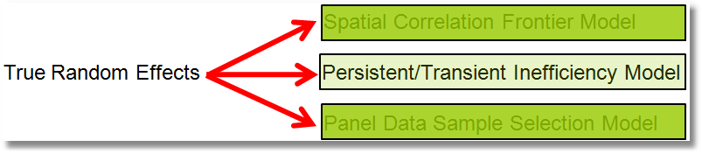

A Stochastic Frontier Model with Short-Run and Long-Run Inefficiency:
Colombi, R., Kumbhakar, S., Martini, G., Vittadini, G., University of Bergamo, WP, 2011, JPA 2014, forthcoming.
Tsionas, G. and Kumbhakar, S.
Firm Heterogeneity, Persistent and Transient Technical Inefficiency:
A Generalized True Random Effects Model
Journal of Applied Econometrics. Published online, November, 2012.
Extremely involved Bayesian MCMC procedure. Efficiency components estimated by data augmentation.

Slide 39
Estimating Efficiency in the CSN Model

Slide 40
Estimating the GTRE Model

Slide 41
“From the sampling theory perspective, the application of the model is computationally prohibitive when T is large. This is because the likelihood function depends on a (T+1)-dimensional integral of the normal distribution.” [Tsionas and Kumbhakar (2012, p. 6)]

Slide 42
Kumbhakar, Lien, Hardaker
Technical Efficiency in Competing Panel Data Models: A Study of Norwegian Grain Farming, JPA, Published online, September, 2012.
Three steps based on GLS:
(1) RE/FGLS to estimate (α,β)
(2) Decompose time varying residuals using MoM and SF.
(3) Decompose estimates of time invariant residuals.

Slide 44
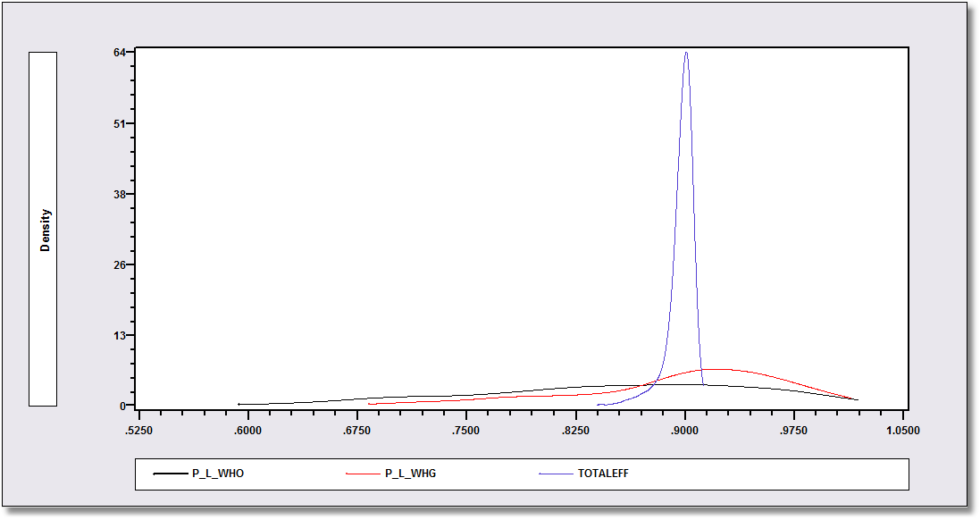
WHO Results: 2014

Slide 45
A True FE Model

Slide 46
Schmidt et al. (2011) – Results on TFE
Problem of TFE model – incidental parameters problem.
Where is the bias? Estimator of σ_{u}
Is there a solution?
  Not based on OLS
  Chen, Schmidt, Wang: MLE for data in group mean deviation form

Slide 48

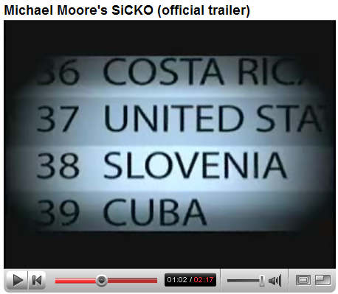
Health Care Systems

Slide 49


Slide 50


Slide 51

WHO Was Interested in Broad
Goals of a Health System

Slide 52
They Created a Measure – COMP = Composite Index
“In order to assess overall efficiency, the first step was to combine the individual
attainments on all five goals of the health system into a single number, which we call the composite index. The composite index is a weighted average of the five component goals specified above. First, country attainment on all five indicators (i.e., health, health inequality, responsiveness-level, responsiveness-distribution, and fair-financing) were rescaled restricting them to the [0,1] interval. Then the following weights were used to construct the overall composite measure: 25% for health (DALE), 25% for health inequality, 12.5% for the level of responsiveness, 12.5% for the distribution of responsiveness, and 25% for fairness in financing. These weights are based on a survey carried out by WHO to elicit stated preferences of individuals in their relative valuations of the goals of the health system.”
(From the World Health Organization Technical Report)

Slide 53
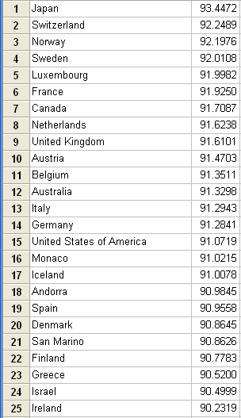
Did They Rank Countries by COMP? Yes, but that was not what produced the number 37 ranking!

Slide 54
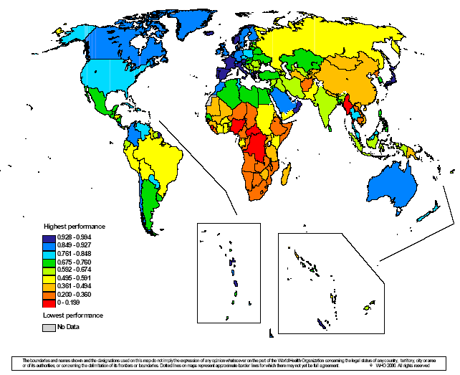
Comparative Health Care Efficiency of 191 Countries

Slide 55
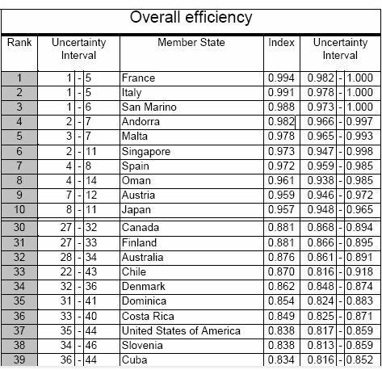
The US Ranked 37th in Efficiency!
Countries were ranked by overall efficiency

Slide 57
World Health Organization
Variable Mean Std. Dev. Description
==============================================================================
Time Varying: 1993-1997
COMP 75.0062726 12.2051123 Composite health attainment
DALE 58.3082712 12.1442590 Disability adjusted life expectancy
HEXP 548.214857 694.216237 Health expenditure per capita
EDUC 6.31753664 2.73370613 Education
Time Invariant
OECD .279761905 .449149577 OECD Member country, dummy variable
GDPC 8135.10785 7891.20036 Per capita GDP in PPP units
POPDEN 953.119353 2871.84294 Population density
GINI .379477914 .090206941 Gini coefficient for income distribution
TROPICS .463095238 .498933251 Dummy variable for tropical location
PUBTHE 58.1553571 20.2340835 Proportion of health spending paid by govt
GEFF .113293978 .915983955 World bank government effectiveness measure
VOICE .192624849 .952225978 World bank measure of democratization
Application: Distinguishing Between Heterogeneity and Inefficiency: Stochastic Frontier Analysis of the World Health Organization’s Panel Data on National Health Care Systems, Health Economics, 2005

Slide 58
WHO Results Based on FE Model

Slide 59
SF Model with Country Heterogeneity

Slide 60
Stochastic Frontier Results

Slide 61

TECHNICAL EFFICIENCY ANALYSIS CORRECTING FOR BIASES FROM OBSERVED AND UNOBSERVED
VARIABLES: AN APPLICATION TO A NATURAL RESOURCE MANAGEMENT PROJECT
Empirical Economics: Volume 43, Issue 1 (2012), Pages 55-72
Boris Bravo-Ureta
University of Connecticut
Daniel Solis
University of Miami
William Greene
Stern School of Business,
New York University

Slide 62
The MARENA Program in Honduras
❶ Several programs have been implemented to address
resource degradation while also seeking to improve
productivity, managerial performance and reduce
poverty (and in some cases make up for lack of public
support).
❷ One such effort is the Programa Multifase de Manejo de
Recursos Naturales en Cuencas Prioritarias or MARENA
in Honduras focusing on small scale hillside farmers.

Slide 63

OVERALL CONCEPTUAL FRAMEWORK
MARENA
Training &
Financing
More Production and Productivity
Natural, Human &
Social Capital
More Farm
Income
Off-Farm
Income
Sustainability
Working HYPOTHESIS: if farmers receive private benefits (higher income) from project activities (e.g., training, financing) then adoption is likely to be sustainable and to generate positive externalities.
Notes:
63

Slide 64
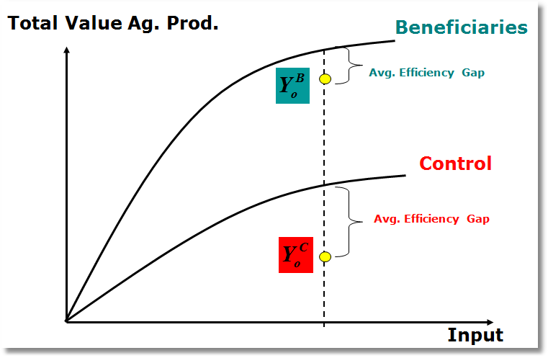
Expected Impact Evaluation

Slide 65
Methods
❶ A matched group of beneficiaries and control
farmers is determined using Propensity Score
Matching techniques to mitigate biases that
would stem from selection on observed
variables.
❷ In addition, we deal with possible self-selection
on unobservables arising from unobserved
variables using a selectivity correction model for
stochastic frontiers recently introduced by
Greene (2010).

Slide 66
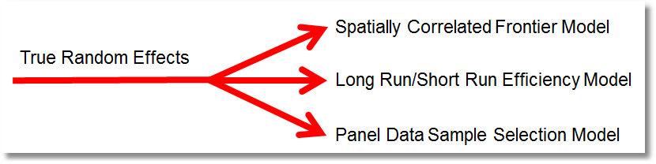
First Wave MARENA Study
This paper brings together the stochastic frontier analysis with impact evaluation methodology to analyze the impact of a development program in Central America. We compare technical efficiency (TE) across treatment and control groups using cross sectional data associated with the MARENA Program in Honduras.

Slide 67
“Standard” Sample Selection Linear Model: 2 Step
d_{i} = 1[δ′z_{i} + h_{i} > 0], h_{i} ~ N[0,1²]
y_{i} = α + β′x_{i} + ε_{i}, ε_{i} ~ N[0,σ_{ε}²]
(h_{i},ε_{i}) ~ N₂[(0,1), (1, ρσ_{ε}, σ_{ε}²)]
(y_{i},x_{i}) observed only when d_{i} = 1.
E[y_{i}|x_{i},d_{i}=1] = α + β′x_{i} + E[ε_{i}|d_{i}=1]
= α + β′x_{i} + ρσ_{ε} φ(δ′z_{i})/Φ(δ′z_{i})
= α + β′x_{i} + θ γ_{i}.

Slide 68
MLE for Sample Selection: FIML and “2 Step”
Two – Step MLE for Sample Selection: Estimate δ first then
treat δ’z_{i} as data. 2nd step estimation based on selected sample.

Slide 69
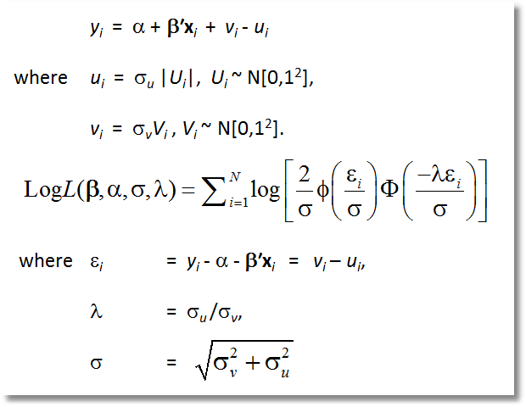
Stochastic Frontier Model: ML

Slide 70
Simulated logL for the Standard SF Model
This is simply a linear regression with a random constant term, α_{i} = α - σ_{u} |U_{i} |
Notes:
70

Slide 71
A Sample Selected SF Model
d_{i} = 1[δ′z_{i} + h_{i} > 0], h_{i} ~ N[0,1²]
y_{i} = α + β′x_{i} + ε_{i}, ε_{i} ~ N[0,σ_{ε}²]
(y_{i},x_{i}) observed only when d_{i} = 1.
ε_{i} = v_{i} - u_{i}
u_{i} = σ_{u}|U_{i}| where U_{i} ~ N[0,1²]
v_{i} = σ_{v}V_{i} where V_{i} ~ N[0,1²].
(h_{i},v_{i}) ~ N₂[(0,1), (1, ρσ_{v}, σ_{v}²)]

Slide 72
Likelihood For a Sample Selected SF Model
Notes:
72

Slide 73
Simulated Log Likelihood for a Selectivity Corrected Stochastic Frontier Model
The simulation is over the inefficiency term.

Slide 74
A 2 Step MSL Approach
❶ Estimate δ – Probit MLE for selection mechanism
❷ Estimate [α,β,σ_{v},σ_{u},ρ] by maximum simulated likelihood
using selected observations, conditioned on the estimate
of δ.
❸ 2nd step standard errors corrected by Murphy-Topel.
Notes:
74

Slide 75
2nd Step of the MSL Approach

Slide 76
JLMS Estimator of u_{i}

Slide 77

Variables Used in the Analysis
Production
Participation

Slide 78
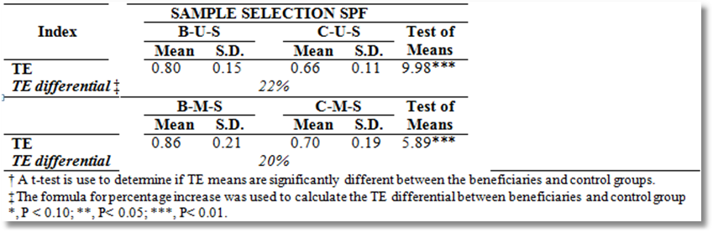
Findings from the First Wave
B = Benefits recipients
C = Controls
U = Unmatched Sample
M = Matched Subsamples (Propensity Score Matching)

Slide 79
Findings from the first Wave
❶ Avg. TE for Beneficiaries is 71% in all models except for BENEF-U-SS
where average TE is 80%.
❷ Average TE for control farmers ranges from 39% (CONTROL-U) to 66%
(CONTROL-U-SS).
❸ TE gap between beneficiaries and control decreases with matching.
This result is expected since PSM makes both studied samples comparable.
❹ Correcting for Sample Selection further decreases this gap.
❺ TE for Beneficiaries remains consistently higher than for control farmers.

Slide 80
A Panel Data Model
● Selection takes place only at the baseline.
● There is no attrition.

Slide 81
Simulated Log Likelihood
Using the Two Step Approach

Slide 82
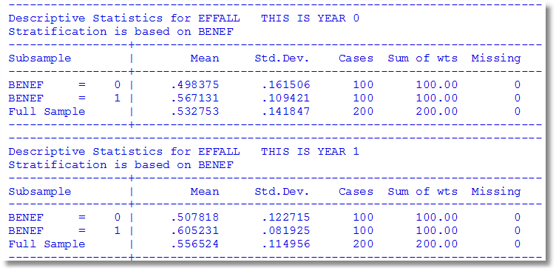
Main Empirical Conclusions from Waves 0 and 1
Benefit group is more efficient in both years
The gap is wider in the second year
Both means increase from year 0 to year 1
Both variances decline from year 0 to year 1

Slide 83
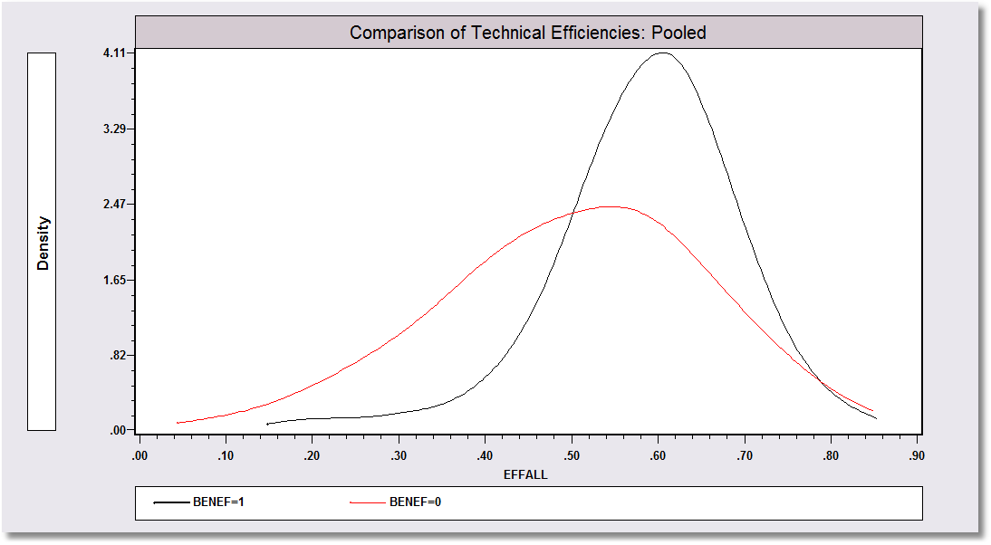

Slide 84
