Slide 1








Econometric Analysis of Panel Data
William Greene
Department of Economics
University of South Florida

Slide 2
Econometric Analysis of Panel Data
23. Individual Heterogeneity
and Random Parameter Variation

Slide 3
Heterogeneity
Observational: Observable differences across individuals (e.g., choice makers)
Choice strategy: How consumers make decisions – the underlying behavior
Structural: Differences in model frameworks
Preferences: Differences in model ‘parameters’

Slide 4
Parameter Heterogeneity

Slide 5
Distinguish Bayes and Classical
Both depart from the heterogeneous ‘model,’ f(y_{it}|x_{it})=g(y_{it},x_{it},β_{i})
What do we mean by ‘randomness’
  With respect to the information of the analyst (Bayesian)
  With respect to some stochastic process governing ‘nature’ (Classical)
Bayesian: No difference between ‘fixed’ and ‘random’
Classical: Full specification of joint distributions for observed random variables; piecemeal definitions of ‘random’ parameters. Usually a form of ‘random effects’

Slide 6
Fixed Management and Technical Efficiency in a Random Coefficients Model
Antonio Alvarez, University of Oviedo
Carlos Arias, University of Leon
William Greene, Stern School of Business, New York University

Slide 7
The Production Function Model
Definition: Maximal output, given the inputs
Inputs: Variable factors, Quasi-fixed (land)
Form: Log-quadratic - translog
Latent Management as an unobservable input

Slide 8
Application to Spanish Dairy Farms
N = 247 farms, T = 6 years (1993-1998)
Input | Units | Mean | Std. Dev. | Minimum | Maximum
Milk | Milk production (liters) | 131,108 | 92,539 | 14,110 | 727,281
Cows | # of milking cows | 2.12 | 11.27 | 4.5 | 82.3
Labor | # man-equivalent units | 1.67 | 0.55 | 1.0 | 4.0
Land | Hectares of land devoted to pasture and crops. | 12.99 | 6.17 | 2.0 | 45.1
Feed | Total amount of feedstuffs fed to dairy cows (tons) | 57,941 | 47,981 | 3,924.14 | 376,732

Slide 9
Translog Production Model

Slide 10
Random Coefficients Model
[Chamberlain/Mundlak:]
Same random effect appears in each random parameter
Only the first order terms are random

Slide 11
Discrete vs. Continuous Variation
Classical context: Description of how parameters are distributed across individuals
Variation
  Discrete: Finite number of different parameter vectors distributed across individuals
    Mixture is unknown as well as the parameters: Implies randomness from the point of the analyst. (Bayesian?)
    Might also be viewed as discrete approximation to a continuous distribution
  Continuous: There exists a stochastic process governing the distribution of parameters, drawn from a continuous pool of candidates.
Background common assumption: An over-reaching stochastic process that assigns parameters to individuals

Slide 12
Discrete Parameter Variation

Slide 13
Latent Classes
A population contains a mixture of individuals of different types (classes)
Common form of the data generating mechanism within the classes
Observed outcome y is governed by the common process F(y|x,θ_{j} )
Classes are distinguished by the parameters, θ_{j}.

Slide 14
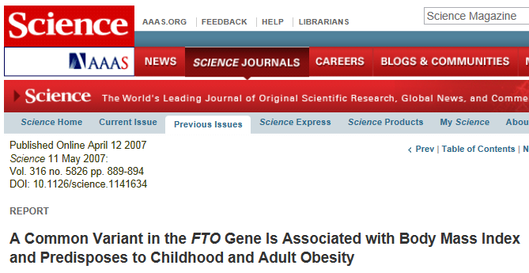

Slide 15


Slide 16
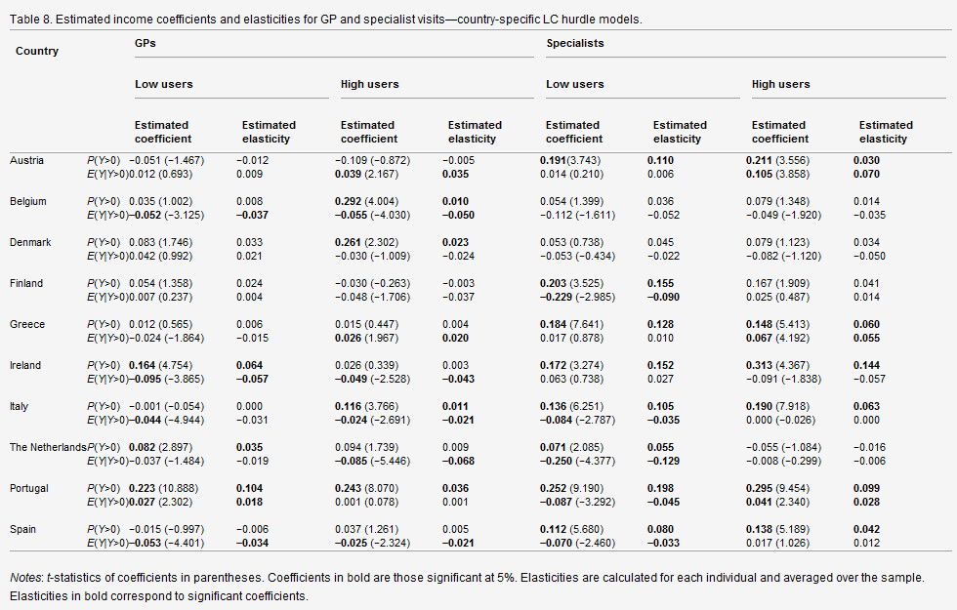

Slide 17

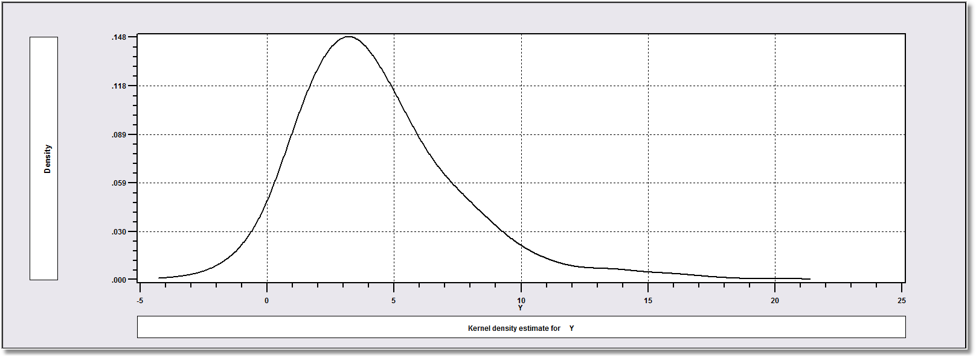
How Finite Mixture Models Work
Density? Note significant mass below zero. Not a gamma or lognormal or any other familiar density.

Slide 18
Find the ‘Best’ Fitting Mixture of Two Normal Densities

Slide 19
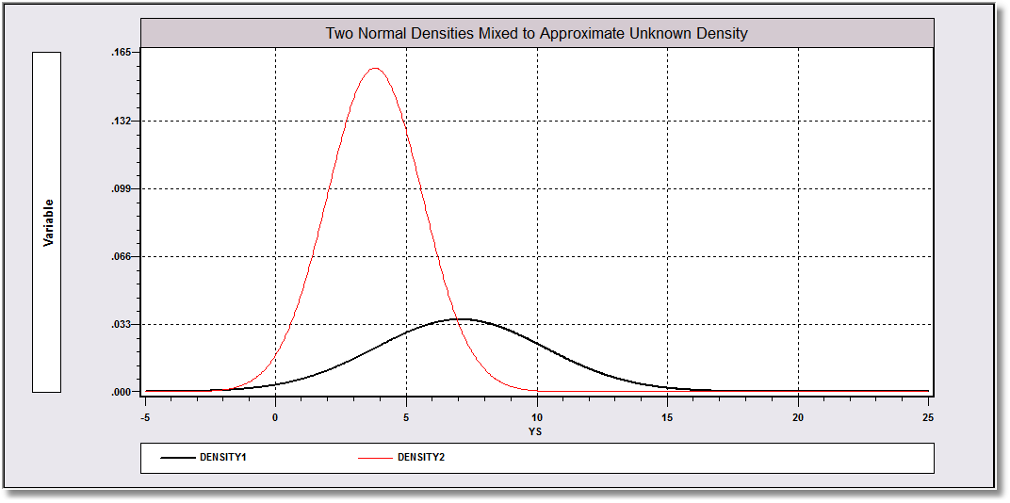
Mixing probabilities .715 and .285

Slide 20
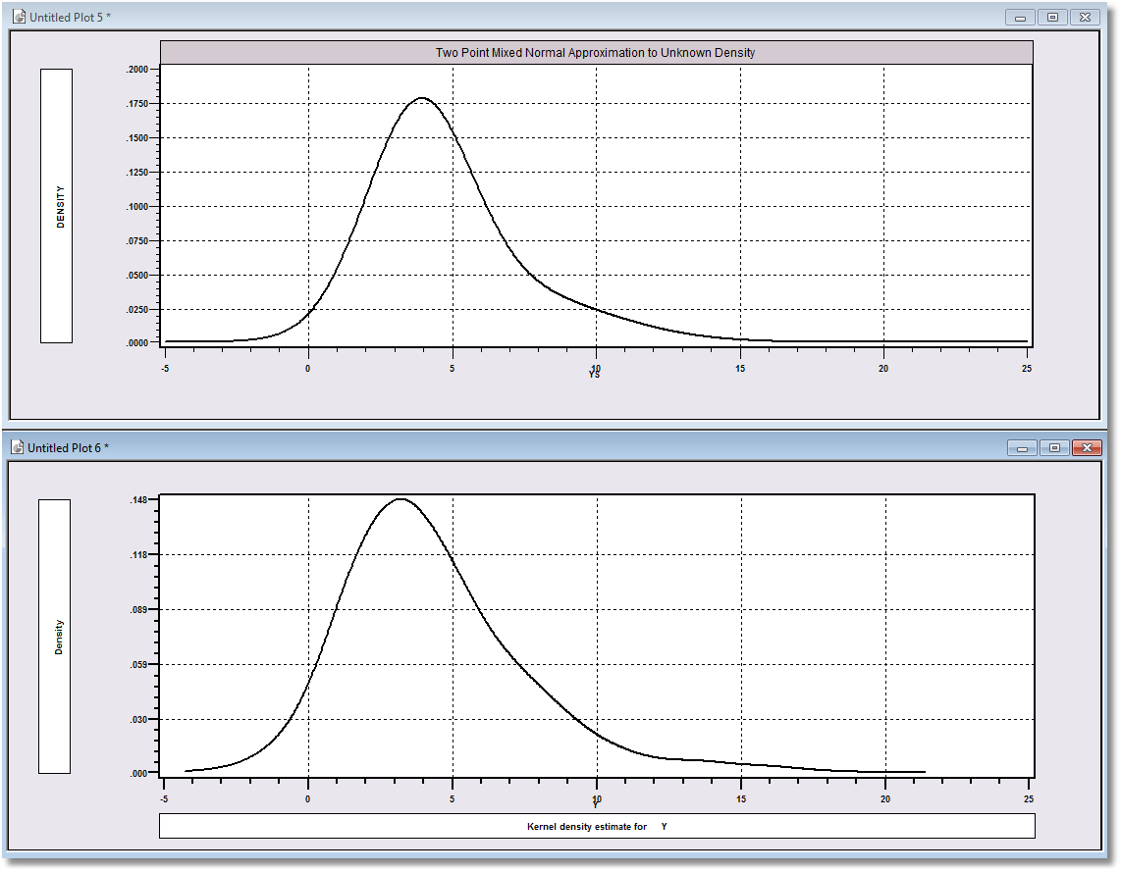
Approximation
Actual Distribution

Slide 21
Application Shoe Brand Choice
Simulated Data: Stated Choice, 400 respondents, 8 choice situations
3 choice/attributes + NONE
  Fashion = High=1 / Low=0
  Quality = High=1 / Low=0
  Price = 25/50/75,100,125 coded 1,2,3,4,5 then divided by 25.
Heterogeneity: Sex, Age (<25, 25-39, 40+) categorical
Underlying data generated by a 3 class latent class process (100, 200, 100 in classes)
Thanks to www.statisticalinnovations.com (Latent Gold)

Slide 22
A Random Utility Model
Random Utility Model for Discrete Choice
Among J alternatives at time t by person i.
Uitj = αj + β′xitj + εijt
αj = Choice specific constant
xitj = Attributes of choice presented to person
(Information processing strategy. Not all
attributes will be evaluated. E.g., lexicographic
utility functions over certain attributes.)
β = ‘Taste weights,’ ‘Part worths,’ marginal utilities
εijt = Unobserved random component of utility
Mean=E[εijt] = 0; Variance=Var[εijt] = σ²

Slide 23
The Multinomial Logit Model
Independent type 1 extreme value (Gumbel):
  F(εitj) = 1 – Exp(-Exp(εitj))
  Independence across utility functions
  Identical variances, σ² = π²/6
  Same taste parameters for all individuals

Slide 24
Estimated MNL
+---------------------------------------------+
| Discrete choice (multinomial logit) model |
| Log likelihood function -4158.503 |
| Akaike IC= 8325.006 Bayes IC= 8349.289 |
| R2=1-LogL/LogL* Log-L fncn R-sqrd RsqAdj |
| Constants only -4391.1804 .05299 .05259 |
+---------------------------------------------+
+---------+--------------+----------------+--------+---------+
|Variable | Coefficient | Standard Error |b/St.Er.|P[|Z|>z] |
+---------+--------------+----------------+--------+---------+
BF 1.47890473 .06776814 21.823 .0000
BQ 1.01372755 .06444532 15.730 .0000
BP -11.8023376 .80406103 -14.678 .0000
BN .03679254 .07176387 .513 .6082

Slide 25
Latent Classes and Random Parameters

Slide 26
Estimated Latent Class Model
+---------------------------------------------+
| Latent Class Logit Model |
| Log likelihood function -3649.132 |
+---------------------------------------------+
+---------+--------------+----------------+--------+---------+
|Variable | Coefficient | Standard Error |b/St.Er.|P[|Z|>z] |
+---------+--------------+----------------+--------+---------+
Utility parameters in latent class -->> 1
BF|1 3.02569837 .14335927 21.106 .0000
BQ|1 -.08781664 .12271563 -.716 .4742
BP|1 -9.69638056 1.40807055 -6.886 .0000
BN|1 1.28998874 .14533927 8.876 .0000
Utility parameters in latent class -->> 2
BF|2 1.19721944 .10652336 11.239 .0000
BQ|2 1.11574955 .09712630 11.488 .0000
BP|2 -13.9345351 1.22424326 -11.382 .0000
BN|2 -.43137842 .10789864 -3.998 .0001
Utility parameters in latent class -->> 3
BF|3 -.17167791 .10507720 -1.634 .1023
BQ|3 2.71880759 .11598720 23.441 .0000
BP|3 -8.96483046 1.31314897 -6.827 .0000
BN|3 .18639318 .12553591 1.485 .1376
This is THETA(1) in class probability model.
Constant -.90344530 .34993290 -2.582 .0098
_MALE|1 .64182630 .34107555 1.882 .0599
_AGE25|1 2.13320852 .31898707 6.687 .0000
_AGE39|1 .72630019 .42693187 1.701 .0889
This is THETA(2) in class probability model.
Constant .37636493 .33156623 1.135 .2563
_MALE|2 -2.76536019 .68144724 -4.058 .0000
_AGE25|2 -.11945858 .54363073 -.220 .8261
_AGE39|2 1.97656718 .70318717 2.811 .0049
This is THETA(3) in class probability model.
Constant .000000 ......(Fixed Parameter).......
_MALE|3 .000000 ......(Fixed Parameter).......
_AGE25|3 .000000 ......(Fixed Parameter).......
_AGE39|3 .000000 ......(Fixed Parameter).......

Slide 27
Latent Class Elasticities
+-----------------------------------------------------------------+
| Elasticity Averaged over observations. |
| Effects on probabilities of all choices in the model: |
| Attribute is PRICE in choice B1 MNL LCM |
| * Choice=B1 .000 .000 .000 -.889 -.801 |
| Choice=B2 .000 .000 .000 .291 .273 |
| Choice=B3 .000 .000 .000 .291 .248 |
| Choice=NONE .000 .000 .000 .291 .219 |
| Attribute is PRICE in choice B2 |
| Choice=B1 .000 .000 .000 .313 .311 |
| * Choice=B2 .000 .000 .000 -1.222 -1.248 |
| Choice=B3 .000 .000 .000 .313 .284 |
| Choice=NONE .000 .000 .000 .313 .268 |
| Attribute is PRICE in choice B3 |
| Choice=B1 .000 .000 .000 .366 .314 |
| Choice=B2 .000 .000 .000 .366 .344 |
| * Choice=B3 .000 .000 .000 -.755 -.674 |
| Choice=NONE .000 .000 .000 .366 .302 |
+-----------------------------------------------------------------+

Slide 28
Individual Specific Means

Slide 29
A Practical Distinction
Finite Mixture (Discrete Mixture):
  Functional form strategy
  Component densities have no meaning
  Mixing probabilities have no meaning
  There is no question of “class membership”
  The number of classes is uninteresting – enough to get a good fit
Latent Class:
  Mixture of subpopulations
  Component densities are believed to be definable “groups”
  (Low Users and High Users in Bago d’Uva and Jones application)
  The classification problem is interesting – who is in which class?
  Posterior probabilities, P(class|y,x) have meaning
  Question of the number of classes has content in the context of the analysis

Slide 30
The Latent Class Model

Slide 31
Estimating an LC Model

Slide 32
Estimating Which Class

Slide 33
‘Estimating’ β_{i}

Slide 34
How Many Classes?

Slide 35
Modeling Obesity with a
Latent Class Model
Mark Harris
Department of Economics, Curtin University
Bruce Hollingsworth
Department of Economics, Lancaster University
Pushkar Maitra
Department of Economics, Monash University
William Greene
Stern School of Business, New York University

Slide 36

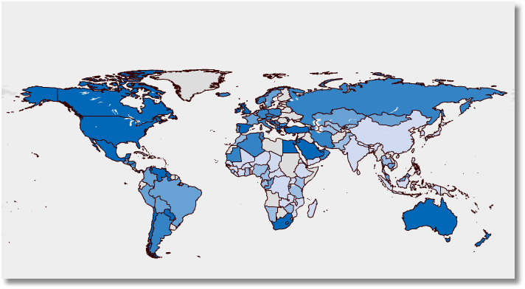

300 Million People Worldwide. International Obesity Task Force: www.iotf.org

Slide 37
Costs of Obesity
In the US more people are obese than smoke or use illegal drugs
Obesity is a major risk factor for non-communicable diseases like heart problems and cancer
Obesity is also associated with:
  lower wages and productivity, and absenteeism
  low self-esteem
An economic problem. It is costly to society:
  USA costs are around 4-8% of all annual health care expenditure - US $100 billion
  Canada, 5%; France, 1.5-2.5%; and New Zealand 2.5%

Slide 38
Measuring Obesity
An individual’s weight given their height should lie within a certain range
  Body Mass Index (BMI)
  Weight (Kg)/height(Meters)²
World Health Organization guidelines:
  Underweight BMI < 18.5
  Normal 18.5 < BMI < 25
  Overweight 25 < BMI < 30
  Obese BMI > 30
  Morbidly Obese BMI > 40

Slide 39
Two Latent Classes: Approximately Half of European Individuals

Slide 40
Modeling BMI Outcomes
Grossman-type health production function
Health Outcomes = f(inputs)
Existing literature assumes BMI is an ordinal, not cardinal, representation of individuals.
  Weight-related health status
  Do not assume a one-to-one relationship between BMI levels and (weight-related) health status levels
Translate BMI values into an ordinal scale using WHO guidelines
Preserves underlying ordinal nature of the BMI index but recognizes that individuals within a so-defined weight range are of an (approximately) equivalent (weight-related) health status level

Slide 41
Conversion to a Discrete Measure
Measurement issues: Tendency to under-report BMI
  women tend to under-estimate/report weight;
  men over-report height.
Using bands should alleviate this
Allows focus on discrete ‘at risk’ groups

Slide 42
A Censored Regression Model for BMI
Simple Regression Approach Based on Actual BMI:
BMI* = β′x + ε, ε ~ N[0,σ²] , σ² = 1
True BMI = weight proxy is unobserved
Interval Censored Regression Approach
WT = 0 if BMI* < 25 Normal
1 if 25 < BMI* < 30 Overweight 2 if BMI* > 30 Obese
• Inadequate accommodation of heterogeneity
• Inflexible reliance on WHO classification
• Rigid measurement by the guidelines

Slide 43
Heterogeneity in the BMI Ranges
Boundaries are set by the WHO narrowly defined for all individuals
Strictly defined WHO definitions may consequently push individuals into inappropriate categories
We allow flexibility at the margins of these intervals
Following Pudney and Shields (2000) therefore we consider Generalised Ordered Choice models - boundary parameters are now functions of observed personal characteristics

Slide 44
Generalized Ordered Probit Approach
A Latent Regression Model for True BMI
BMI_{i}* = β′x_{i} + ε_{i} , ε_{i} ~ N[0,σ²], σ² = 1
Observation Mechanism for Weight Type
WT_{i} = 0 if BMI_{i}* < 0 Normal
1 if 0 < BMI_{i}* < μ_{i}(w_{i}) Overweight
2 if μ(w_{i}) < BMI_{i}* Obese

Slide 45
Latent Class Modeling
Several ‘types’ or ‘classes. Obesity be due to genetic reasons (the FTO gene) or lifestyle factors
Distinct sets of individuals may have differing reactions to various policy tools and/or characteristics
The observer does not know from the data which class an individual is in.
Suggests a latent class approach for health outcomes
(Deb and Trivedi, 2002, and Bago d’Uva, 2005)

Slide 46
Latent Class Application
Two class model (considering FTO gene):
  More classes make class interpretations much more difficult
  Parametric models proliferate parameters
Endogenous class membership: Two classes allow us to correlate the equations driving class membership and observed weight outcomes via unobservables.

Slide 47
Heterogeneous Class Probabilities
π_{j} = Prob(class=j) = governor of a detached
natural process. Homogeneous.
π_{ij} = Prob(class=j|z_{i},individual i)
Now possibly a behavioral aspect of the process, no longer “detached” or “natural”
Nagin and Land 1993, “Criminal Careers…

Slide 48
Endogeneity of Class Membership

Slide 49
Model Components
x: determines observed weight levels within classes
For observed weight levels we use lifestyle factors such as marital status and exercise levels
z: determines latent classes
For latent class determination we use genetic proxies such as age, gender and ethnicity: the things we can’t change
w: determines position of boundary parameters within classes
For the boundary parameters we have: weight-training intensity and age (BMI inappropriate for the aged?) pregnancy (small numbers and length of term unknown)

Slide 50
Data
US National Health Interview Survey (2005); conducted by the National Center for Health Statistics
Information on self-reported height and weight levels, BMI levels
Demographic information
Split sample (30,000+) by gender

Slide 51
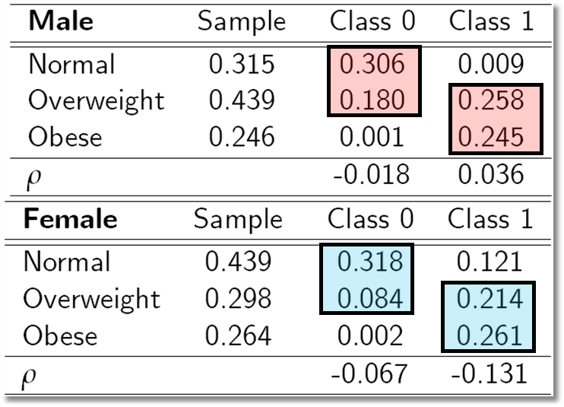
Outcome Probabilities
Class 0 dominated by normal and overweight probabilities ‘normal weight’ class
Class 1 dominated by probabilities at top end of the scale ‘non-normal weight’
Unobservables for weight class membership, negatively correlated with those determining weight levels:

Slide 52
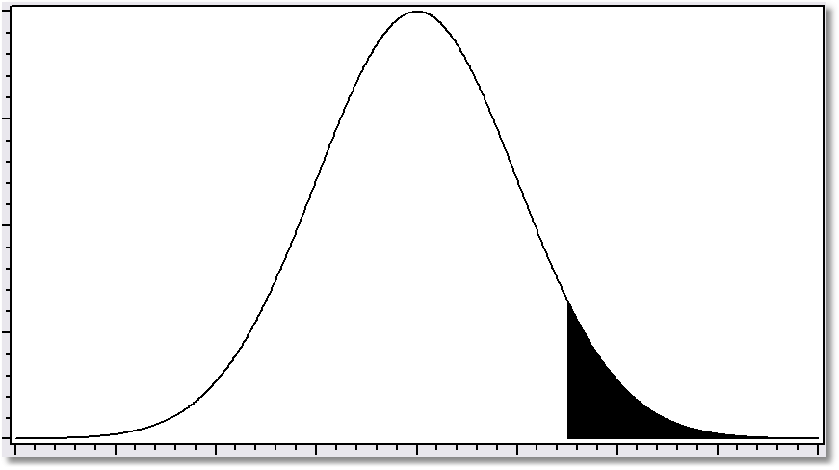
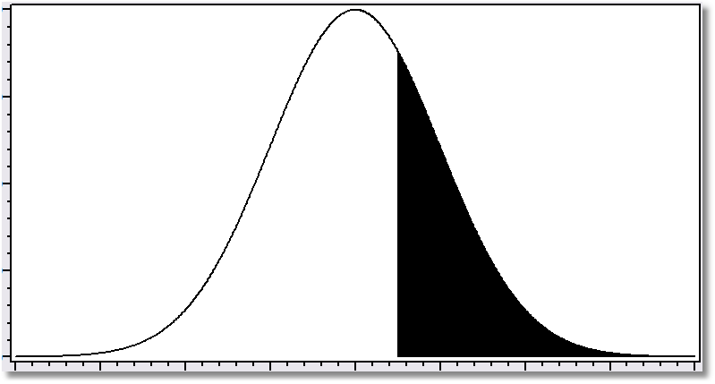
Class 1
Normal Overweight Obese
Class 0
Normal Overweight Obese

Slide 53
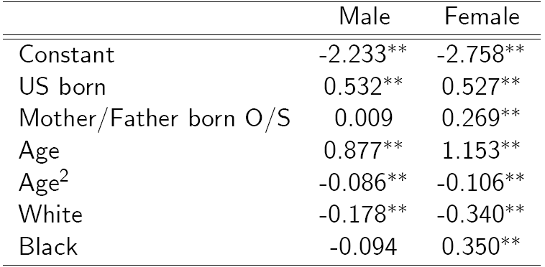
Classification (Latent Probit) Model

Slide 54
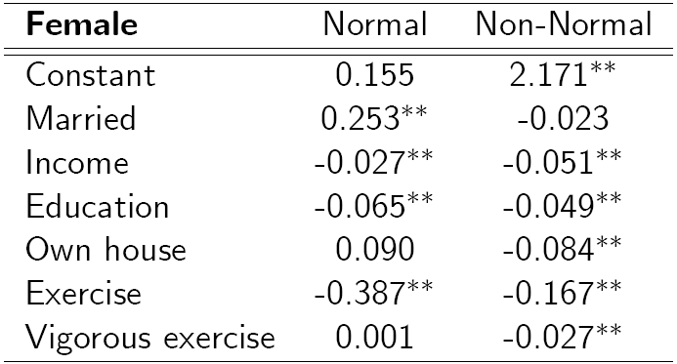
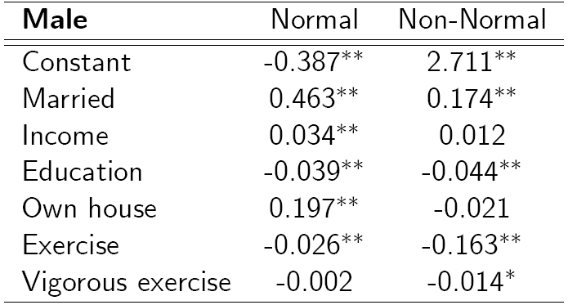
BMI Ordered Choice Model
Conditional on class membership, lifestyle factors
Marriage comfort factor only for normal class women
Both classes associated with income, education
Exercise effects similar in magnitude
Exercise intensity only important for ‘non-normal’ class:
Home ownership only important for .non-normal.class, and negative: result of differing socieconomic status distributions across classes?

Slide 55
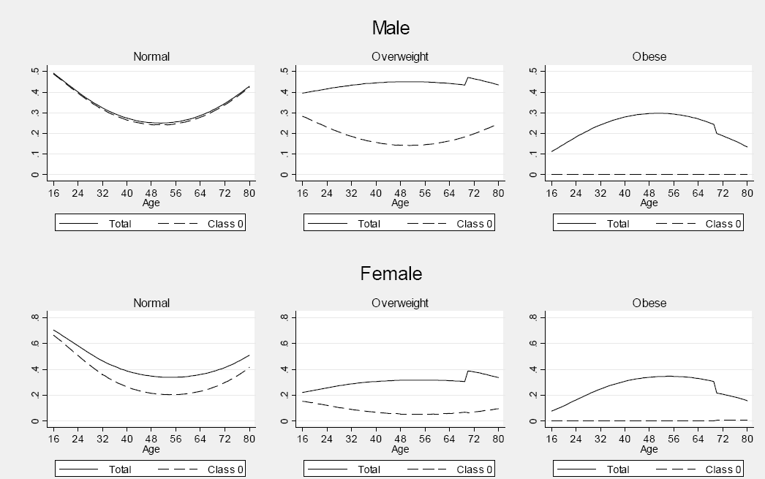
Effects of Aging on Weight Class

Slide 56
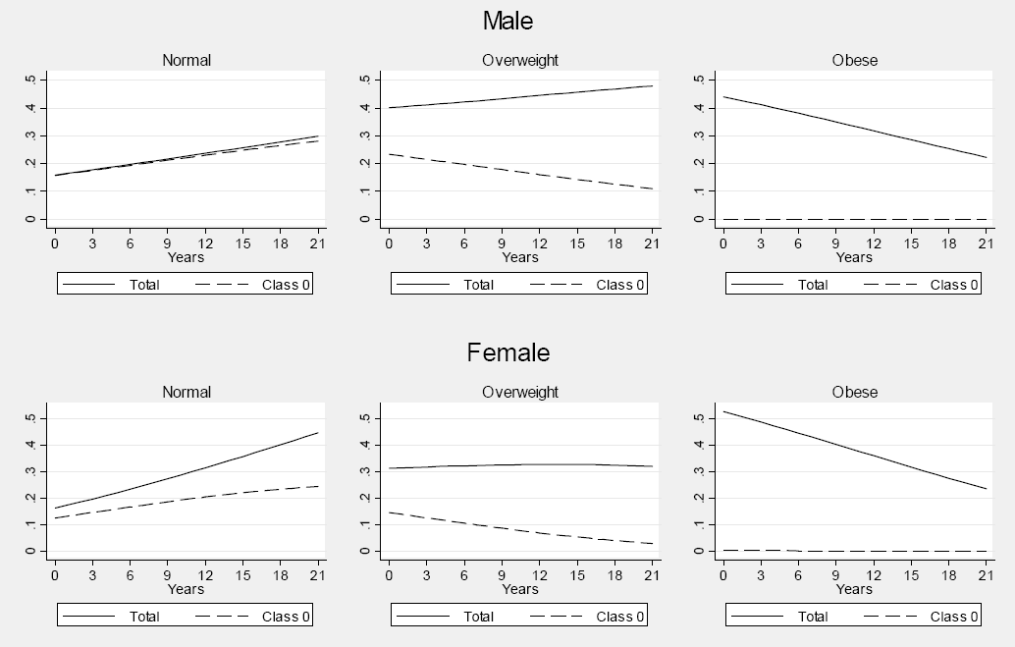
Effect of Education on Probabilities

Slide 57
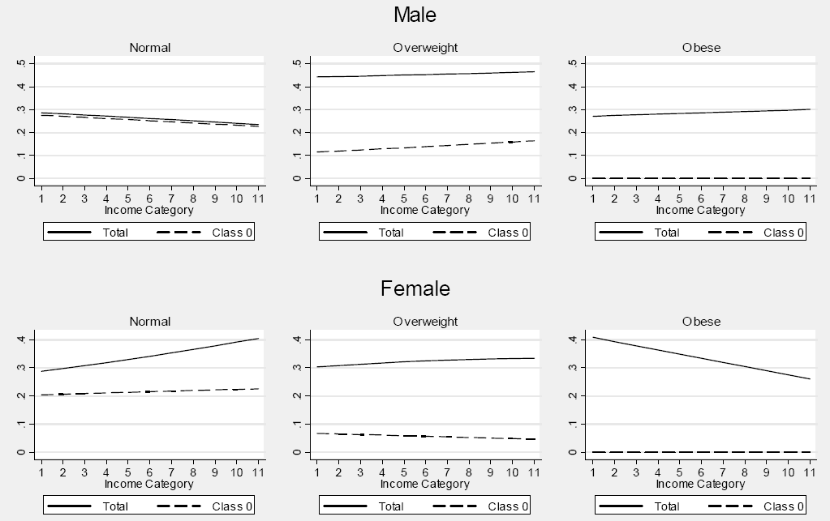
Effect of Income on Probabilities

Slide 58
Inflated Responses in Self-Assessed Health
Mark Harris
Department of Economics, Curtin University
Bruce Hollingsworth
Department of Economics, Lancaster University
William Greene
Stern School of Business, New York University

Slide 59
Introduction
Health sector an important part of developed countries’ economies: E.g., Australia 9% of GDP
To see if these resources are being effectively utilized, we need to fully understand the determinants of individuals’ health levels
To this end much policy, and even more academic research, is based on measures of self-assessed health (SAH) from survey data

Slide 60
SAH vs. Objective Health Measures
Favorable SAH categories seem artificially high.
• 60% of Australians are either overweight or obese (Dunstan et. al, 2001)
• 1 in 4 Australians has either diabetes or a condition of impaired glucose
metabolism
• Over 50% of the population has elevated cholesterol
• Over 50% has at least 1 of the “deadly quartet” of health conditions
(diabetes, obesity, high blood pressure, high cholestrol)
• Nearly 4 out of 5 Australians have 1 or more long term health conditions
(National Health Survey, Australian Bureau of Statistics 2006)
• Australia ranked #1 in terms of obesity rates
Similar results appear for other countries

Slide 61
SAH vs. Objective Health
1. Are these SAH outcomes are “over-inflated”
2. And if so, why, and what kinds of people are doing the over-inflating/mis-reporting?

Slide 62
HILDA Data
The Household, Income and Labour Dynamics in Australia (HILDA) dataset:
  1. a longitudinal survey of households in Australia
  2. well tried and tested dataset
  3. contains a host of information on SAH and other health
  measures, as well as numerous demographic variables

Slide 63
Self Assessed Health
“In general, would you say your health is: Excellent, Very good, Good, Fair or Poor?"
Responses 1,2,3,4,5 (we will be using 0,1,2,3,4)
Typically ¾ of responses are “good” or “very good” health; in our data (HILDA) we get 72%
Similar numbers for most developed countries
Does this truly represent the health of the nation?

Slide 64
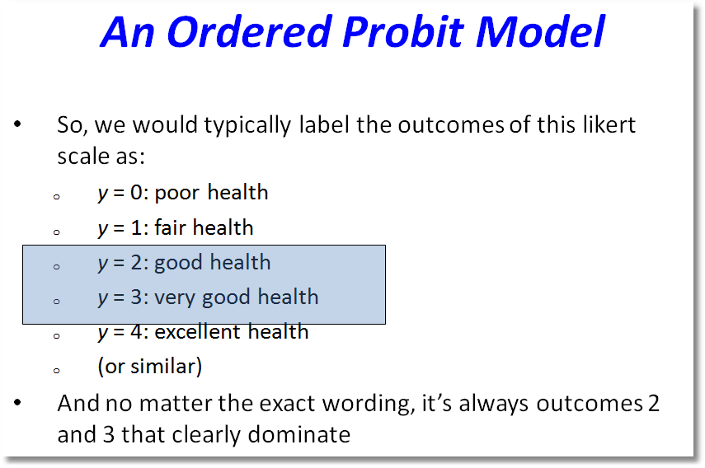

Slide 65
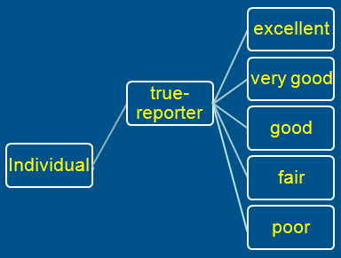
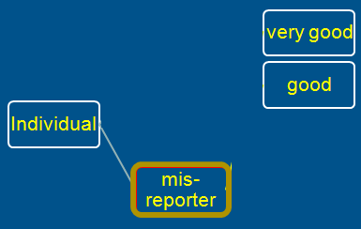
A Two Class Latent Class Model
True Reporter
Misreporter

Slide 66
Reporter Type Model

Slide 67
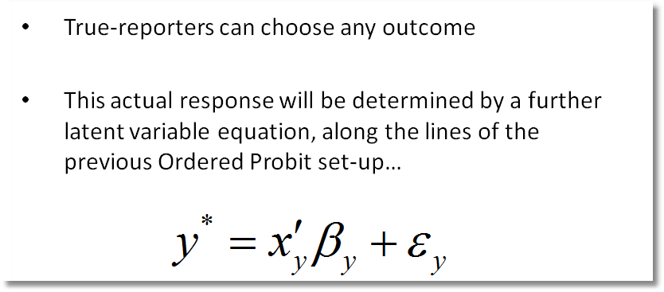
Y=4
Y=3
Y=2
Y=1
Y=0

Slide 68
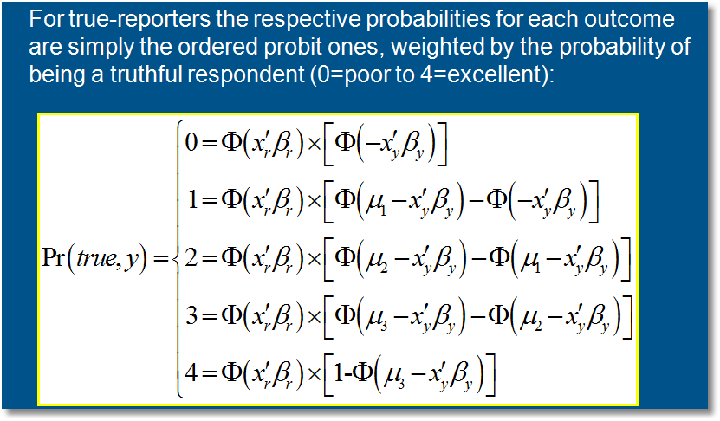
Pr(true,y) = Pr(true) * Pr(y | true)

Slide 69
Mis-reporters choose either good or very good
The response is determined by a probit model
Y=3
Y=2

Slide 70
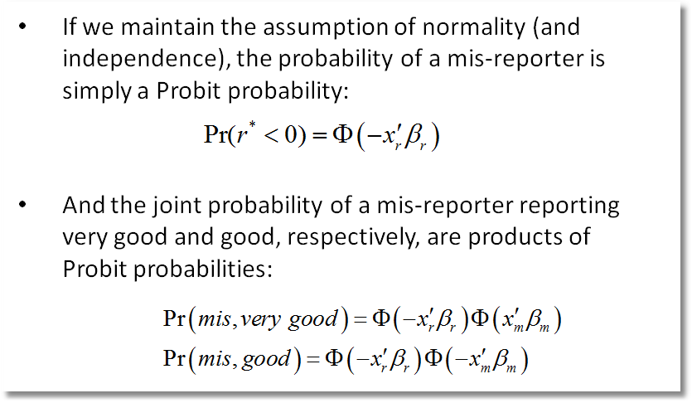

Slide 71
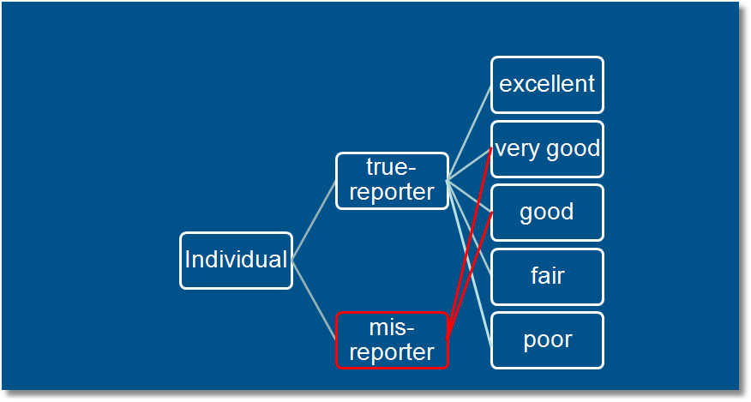
Observed Mixture of Two Classes

Slide 72
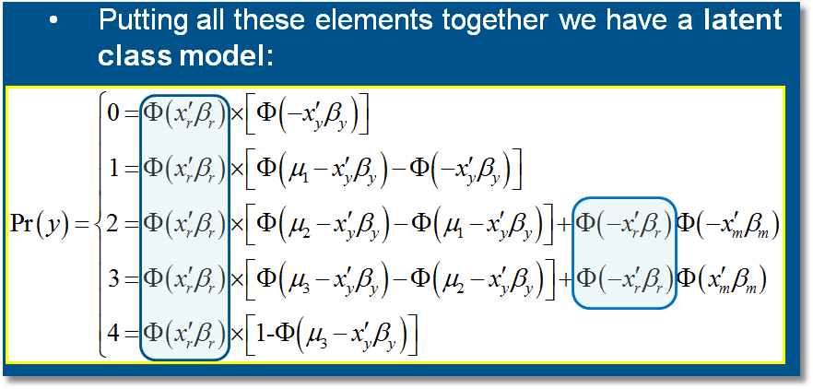

Slide 73
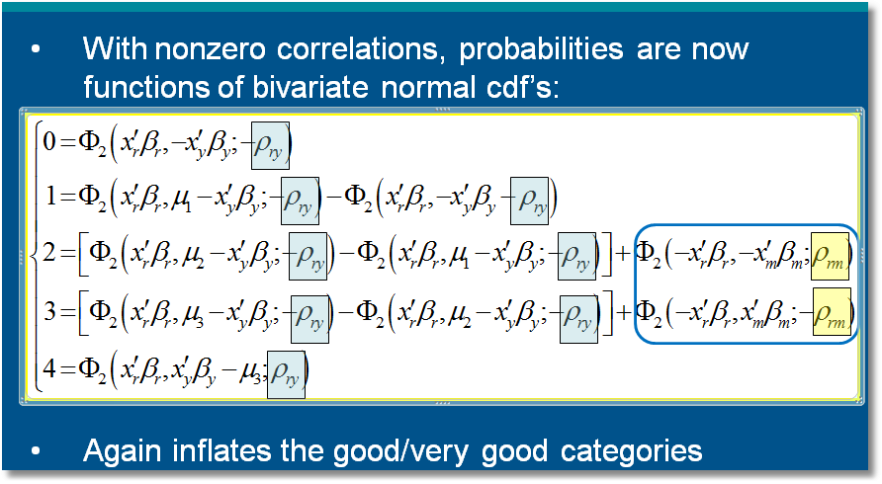

Slide 74
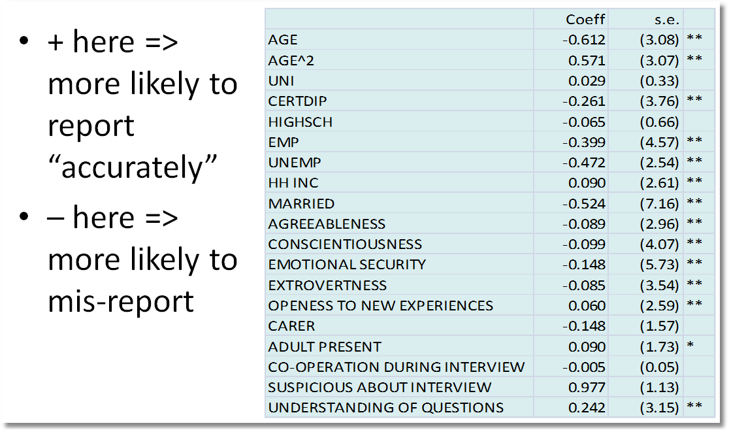
Who are the Misreporters?

Slide 75
Priors and Posteriors

Slide 76
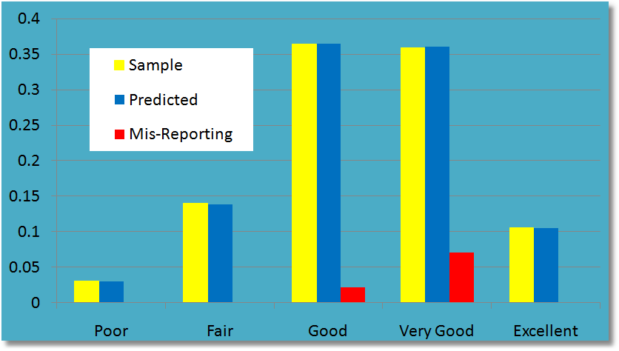
General Results

Slide 77
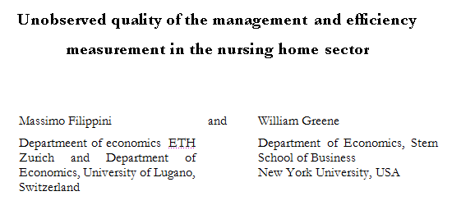

Slide 78
Latent Class Efficiency Studies
Battese and Coelli – growing in weather “regimes” for Indonesian rice farmers
Kumbhakar and Orea – cost structures for U.S. Banks
Greene (Health Economics, 2005) – revisits WHO Year 2000 World Health Report

Slide 79
Studying Economic Efficiency in Health Care
Hospital and Nursing Home
  Cost efficiency
  Role of quality (not studied today)
Agency for Health Reseach and Quality (AHRQ)

Slide 80
Stochastic Frontier Analysis
logC = f(output, input prices, environment) + v + u
ε = v + u
  v = noise – the usual “disturbance”
  u = inefficiency
Frontier efficiency analysis
  Estimate parameters of model
  Estimate u (to the extent we are able – we use E[u|ε])
  Evaluate and compare observed firms in the sample

Slide 81
Nursing Home Costs
44 Swiss nursing homes, 13 years
Cost, Pk, Pl, output, two environmental variables
Estimate cost function
Estimate inefficiency

Slide 82
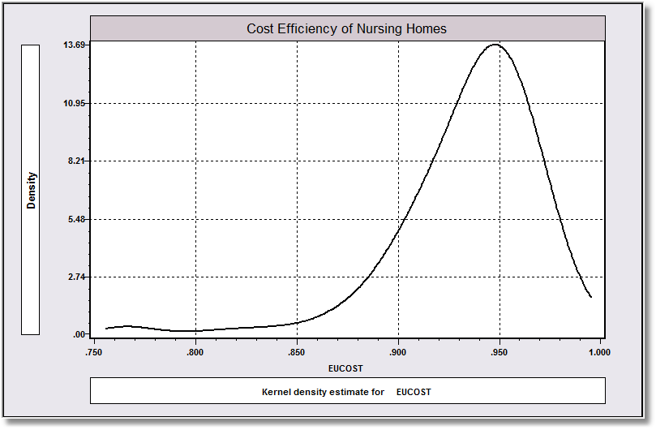
Estimated Cost Efficiency

Slide 83
Inefficiency?
Not all agree with the presence (or identifiability) of “inefficiency” in market outcomes data.
Variation around the common production structure may all be nonsystematic and not controlled by management
Implication, no inefficiency: u = 0.

Slide 84
A Two Class Model
Class 1: With Inefficiency
  logC = f(output, input prices, environment) + σ_{v}v + σ_{u}u
Class 2: Without Inefficiency
  logC = f(output, input prices, environment) + σ_{v}v
  σ_{u} = 0
Implement with a single zero restriction in a constrained (same cost function) two class model
Parameterization: λ = σ_{u} /σ_{v} = 0 in class 2.

Slide 85
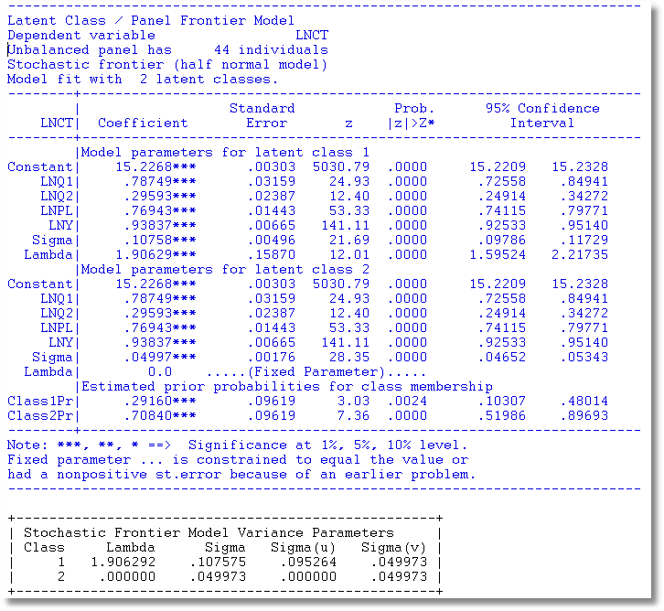
LogL= 464 with a common frontier model, 527 with two classes

Slide 86
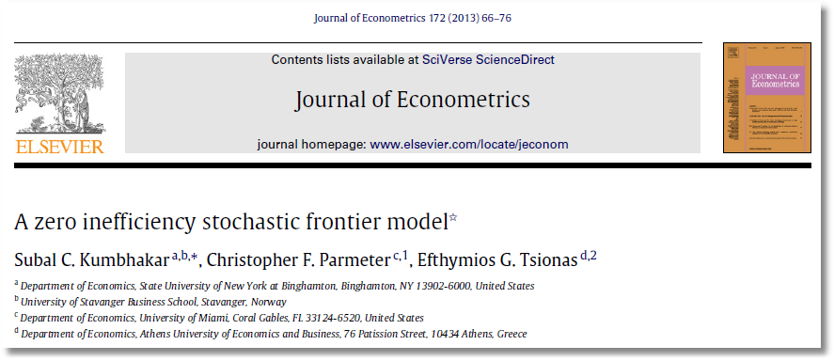

Slide 87
Random Parameters (Mixed) Models

Slide 88
Mixed Model Estimation
WinBUGS:
  MCMC
  User specifies the model – constructs the Gibbs Sampler/Metropolis Hastings
SAS: Proc Mixed.
  Classical
  Uses primarily a kind of GLS/GMM (method of moments algorithm for loglinear models)
MLWin
  Hierarchical models – mostly linear
Stata: Classical
  Mixing done by quadrature. (Very slow for 2 or more dimensions)
  Several loglinear models – GLAMM
  Several user written routines
LIMDEP/NLOGIT
  Classical
  Mixing done by Monte Carlo integration – maximum simulated likelihood
  Numerous linear, nonlinear, loglinear models
Ken Train’s Gauss Code; Arne Hole R Code
  Monte Carlo integration
  Used by many researchers
  Mixed Logit (mixed multinomial logit) model only (but free!)
Programs differ on the models fitted, the algorithms, the paradigm, and the extensions provided to the simplest RPM, β_{i} = β+w_{i}.

Slide 89
Modeling Parameter Heterogeneity

Slide 90
A Mixed Probit Model

Slide 91
Maximum Simulated Likelihood

Slide 92
Simulated Log Likelihood for a Mixed Probit Model

Slide 93
Application – Doctor Visits
German Health Care Usage Data, 7,293 Individuals, Varying Numbers of Periods
Variables in the file are
Data downloaded from Journal of Applied Econometrics Archive. This is an unbalanced panel with 7,293 individuals. They can be used for regression, count models, binary choice, ordered choice, and bivariate binary choice. This is a large data set. There are altogether 27,326 observations. The number of observations ranges from 1 to 7. (Frequencies are: 1=1525, 2=2158, 3=825, 4=926, 5=1051, 6=1000, 7=987). Note, the variable NUMOBS below tells how many observations there are for each person. This variable is repeated in each row of the data for the person.
DOCTOR = 1(Number of doctor visits > 0)
HSAT = health satisfaction, coded 0 (low) - 10 (high)
DOCVIS = number of doctor visits in last three months
HOSPVIS = number of hospital visits in last calendar year
PUBLIC = insured in public health insurance = 1; otherwise = 0
ADDON = insured by add-on insurance = 1; otherswise = 0
HHNINC = household nominal monthly net income in German marks / 10000.
(4 observations with income=0 were dropped)
HHKIDS = children under age 16 in the household = 1; otherwise = 0
EDUC = years of schooling
AGE = age in years
MARRIED = marital status
EDUC = years of education

Slide 94
Estimates of a Mixed Probit Model
+---------------------------------------------+
| Random Coefficients Probit Model |
| Dependent variable DOCTOR |
| Log likelihood function -16483.96 |
| Restricted log likelihood -17700.96 |
| Unbalanced panel has 7293 individuals. |
+---------------------------------------------+
+---------+--------------+----------------+--------+---------+----------+
|Variable | Coefficient | Standard Error |b/St.Er.|P[|Z|>z] | Mean of X|
+---------+--------------+----------------+--------+---------+----------+
Means for random parameters
Constant -.09594899 .04049528 -2.369 .0178
AGE .02102471 .00053836 39.053 .0000 43.5256898
HHNINC -.03119127 .03383027 -.922 .3565 .35208362
EDUC -.02996487 .00265133 -11.302 .0000 11.3206310
MARRIED -.03664476 .01399541 -2.618 .0088 .75861817
+---------+--------------+----------------+--------+---------+----------+
Constant .02642358 .05397131 .490 .6244
AGE .01538640 .00071823 21.423 .0000 43.5256898
HHNINC -.09775927 .04626475 -2.113 .0346 .35208362
EDUC -.02811308 .00350079 -8.031 .0000 11.3206310
MARRIED -.00930667 .01887548 -.493 .6220 .75861817

Slide 95
Random Parameters Probit
Diagonal elements of Cholesky matrix
Constant .55259608 .05381892 10.268 .0000
AGE .279052D-04 .00041019 .068 .9458
HHNINC .03545309 .04094725 .866 .3866
EDUC .00994387 .00093271 10.661 .0000
MARRIED .01013553 .00643526 1.575 .1153
Below diagonal elements of Cholesky matrix
lAGE_ONE .00668600 .00071466 9.355 .0000
lHHN_ONE -.23713634 .04341767 -5.462 .0000
lHHN_AGE .09364751 .03357731 2.789 .0053
lEDU_ONE .01461359 .00355382 4.112 .0000
lEDU_AGE -.00189900 .00167248 -1.135 .2562
lEDU_HHN .00991594 .00154877 6.402 .0000
lMAR_ONE -.04871097 .01854192 -2.627 .0086
lMAR_AGE -.02059540 .01362752 -1.511 .1307
lMAR_HHN -.12276339 .01546791 -7.937 .0000
lMAR_EDU .09557751 .01233448 7.749 .0000

Slide 96
Application Shoe Brand Choice
Simulated Data: Stated Choice, 400 respondents, 8 choice situations
3 choice/attributes + NONE
  Fashion = High=1 / Low=0
  Quality = High=1 / Low=0
  Price = 25/50/75,100,125 coded 1,2,3,4,5 then divided by 25.
Heterogeneity: Sex, Age (<25, 25-39, 40+) categorical
Underlying data generated by a 3 class latent class process (100, 200, 100 in classes)
Thanks to www.statisticalinnovations.com (Latent Gold and Jordan Louviere)

Slide 97

Stated Choice Experiment: Unlabeled Alternatives, One Observation
t=1
t=2
t=3
t=4
t=5
t=6
t=7
t=8

Slide 98
A Discrete (4 Brand) Choice Model with Heterogeneous and Heteroscedastic Random Parameters

Slide 99
Multinomial Logit Model Estimates

Slide 100
Mixed Logit Estimates
+---------------------------------------------+
| Random Parameters Logit Model |
| Log likelihood function -3911.945 |
| At start values -4158.5029 .05929 .05811 |
+---------------------------------------------+
+---------+--------------+----------------+--------+---------+
|Variable | Coefficient | Standard Error |b/St.Er.|P[|Z|>z] |
+---------+--------------+----------------+--------+---------+
Random parameters in utility functions
BF 1.46523951 .12626655 11.604 .0000
BQ 1.14369857 .16954024 6.746 .0000
Nonrandom parameters in utility functions
BP -12.1098155 .91584476 -13.223 .0000
BN .17706909 .07784730 2.275 .0229
Heterogeneity in mean, Parameter:Variable
BF:MAL .28052695 .14266576 1.966 .0493
BQ:MAL -.42310284 .20387789 -2.075 .0380
Derived standard deviations of parameter distributions
NsBF 1.16430284 .13731611 8.479 .0000
NsBQ 1.81872569 .18108194 10.044 .0000
Heteroscedasticity in random parameters
sBF|AG -.32466344 .16986949 -1.911 .0560
sBF0|AG -.51032609 .23975740 -2.129 .0333
sBQ|AG -.37953350 .13798031 -2.751 .0059
sBQ0|AG -.41636803 .17143046 -2.429 .0151

Slide 101
Estimated Elasticities
+--------------------------------------------------------------+
| Elasticity Averaged over observations. |
| Effects on probabilities of all choices in the model: |
| Attribute is PRICE in choice B1 RPL MNL LCM |
| * Choice=B1 .000 .000 -.818 -.889 -.801 |
| Choice=B2 .000 .000 .240 .291 .273 |
| Choice=B3 .000 .000 .244 .291 .248 |
| Choice=NONE .000 .000 .241 .291 .219 |
| Attribute is PRICE in choice B2 |
| Choice=B1 .000 .000 .291 .313 .311 |
| * Choice=B2 .000 .000 -1.100 -1.222 -1.248 |
| Choice=B3 .000 .000 .270 .313 .284 |
| Choice=NONE .000 .000 .276 .313 .268 |
| Attribute is PRICE in choice B3 |
| Choice=B1 .000 .000 .287 .366 .314 |
| Choice=B2 .000 .000 .326 .366 .344 |
| * Choice=B3 .000 .000 -.647 -.755 -.674 |
| Choice=NONE .000 .000 .311 .366 .302 |
+--------------------------------------------------------------+

Slide 102
Conditional Estimators

Slide 103
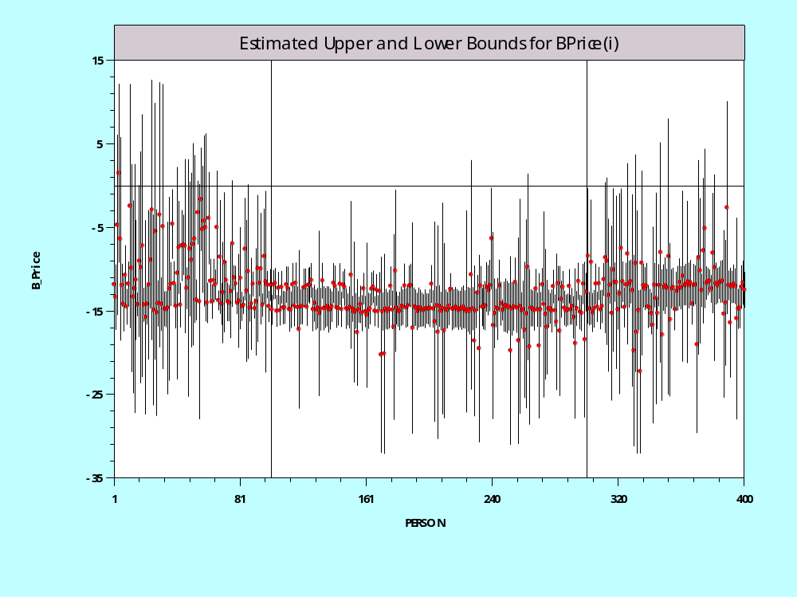
Individual E[β_{i}|data_{i}] Estimates

Slide 104
Disaggregated Parameters
The description of classical methods as only producing aggregate results is obviously untrue.
As regards “targeting specific groups…” both of these sets of methods produce estimates for the specific data in hand. Unless we want to trot out the specific individuals in this sample to do the analysis and marketing, any extension is problematic. This should be understood in both paradigms.
NEITHER METHOD PRODUCES ESTIMATES OF INDIVIDUAL PARAMETERS, CLAIMS TO THE CONTRARY NOTWITHSTANDING. BOTH PRODUCE ESTIMATES OF THE MEAN OF THE CONDITIONAL (POSTERIOR) DISTRIBUTION OF POSSIBLE PARAMETER DRAWS CONDITIONED ON THE PRECISE SPECIFIC DATA FOR INDIVIDUAL I.

Slide 105
Appendix: EM Algorithm

Slide 106
The EM Algorithm

Slide 107
Implementing EM

Slide 108
Appendix: Monte Carlo Integration

Slide 109
Monte Carlo Integration

Slide 110
Monte Carlo Integration

Slide 111
Example: Monte Carlo Integral

Slide 112
Generating a Random Draw

Slide 113
Drawing Uniform Random Numbers

Slide 114
L’Ecuyer’s RNG
Define: norm = 2.328306549295728e-10,
m1 = 4294967087.0, m1 = 4294944443.0,
a12 = 140358.0, a13n = 810728.0,
a21 = 527612.0, a23n = 1370589.0,
Initialize s10 = the seed, s11 = 4231773.0,
s12 = 1975.0, s20 = 137228743.0,
s21 = 98426597.0, s22 = 142859843.0.
Preliminaries for each draw (Resets at least some of 5 seeds)
p1 = a12*s11 - a13n*s10, k = int(p1/m1), p1 = p1 - k*m1
if p1 < 0, p1 = p1 + m1, s10 = s11, s11 = s12, s12 = p1;
p2 = a21*s22 - a23n*s20, k = int(p2/m2), p2 = p2 - k*m2
if p2 < 0, p2 = p2 + m2, s20 = s21, s21 = s22, s22 = p2;
Compute the random number
u = norm*(p1 - p2) if p1 > p2,
u = norm*(p1 - p2 + m1) otherwise.
Passes all known randomness tests. Period = 2¹⁹¹
Pierre L'Ecuyer. Canada Research Chair in Stochastic Simulation and Optimization. Département d'informatique et de recherche opérationnelle
University of Montreal.

Slide 115
Quasi-Monte Carlo Integration Based on Halton Sequences
For example, using base p=5, the integer r=37 has b₀ = 2, b₁ = 2, and b₃ = 1; (37=1x5² + 2x5¹ + 2x5⁰). Then
H(37|5) = 2×5⁻¹ + 2×5⁻² + 1×5⁻³ = 0.448.

Slide 116
Halton Sequences vs.
Random Draws
Requires far fewer draws – for one dimension, about 1/10. Accelerates estimation by a factor of 5 to 10.

