Slide 1







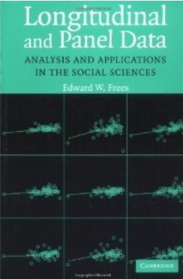
Econometric Analysis of Panel Data
William Greene
Department of Economics
University of South Florida

Slide 2

Econometric Analysis of Panel Data
24A. Multinomial Choice Extensions

Slide 3
Rank Data and Best/Worst

Slide 4
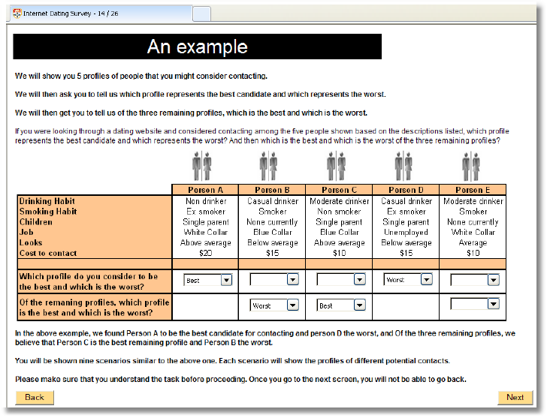

Slide 5
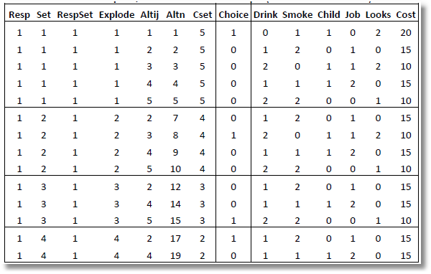
Rank Data and Exploded Logit
Alt 1 is the best overall
Alt 3 is the best among
remaining alts 2,3,4,5
Alt 5 is the best among
remaining alts 2,4,5
Alt 2 is the best among remaining alts 2,4
Alt 4 is the worst.

Slide 6
Exploded Logit

Slide 7
Exploded Logit

Slide 8
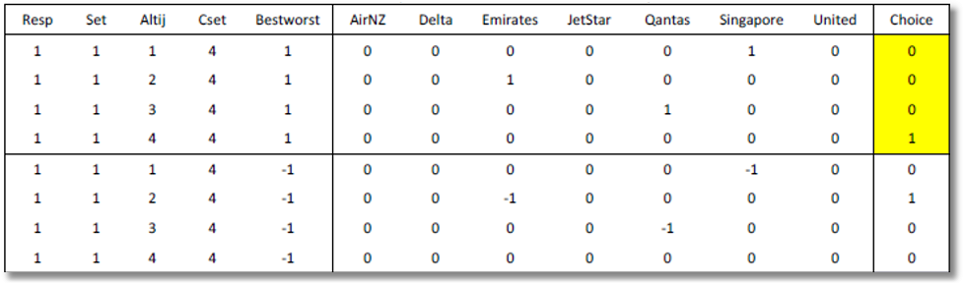
Best Worst
Individual simultaneously ranks best and worst alternatives.
Prob(alt j) = best = exp[U(j)] / Σ_{m}exp[U(m)]
Prob(alt k) = worst = exp[-U(k)] / Σ_{m}exp[-U(m)]

Slide 9
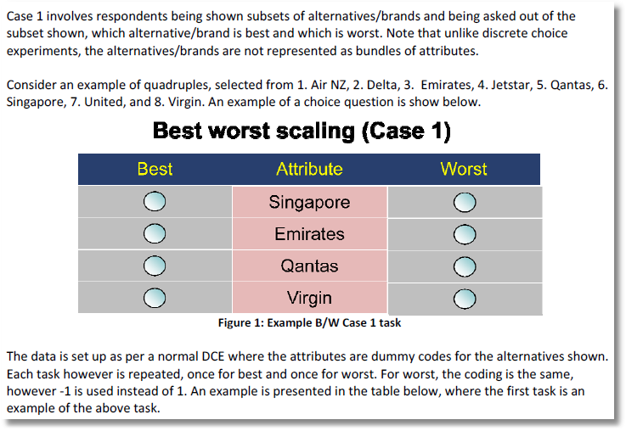

Slide 10
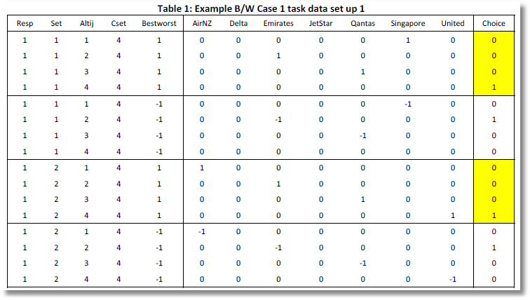
Choices

Slide 11
Best

Slide 12
Worst

Slide 13
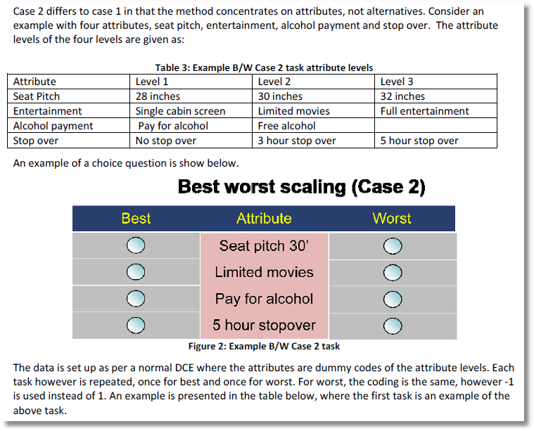

Slide 14
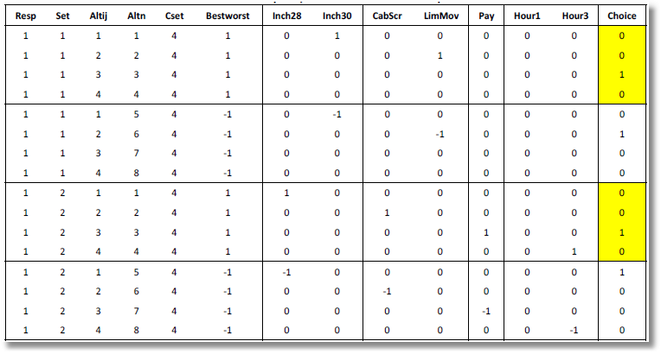
Uses the result that if U(i,j) is the lowest utility, -U(i,j) is the highest.

Slide 15
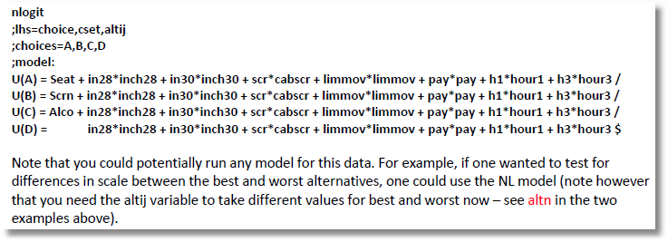
Uses the result that if U(i,j) is the lowest utility, -U(i,j) is the highest.

Slide 16
Nested Logit Approach.

Slide 17
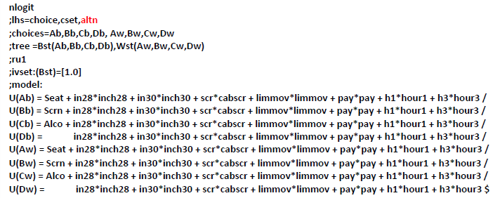
Nested Logit Approach – Different Scaling for Worst
8 choices are two blocks of 4.
Best in one brance, worst in the second branch

Slide 20
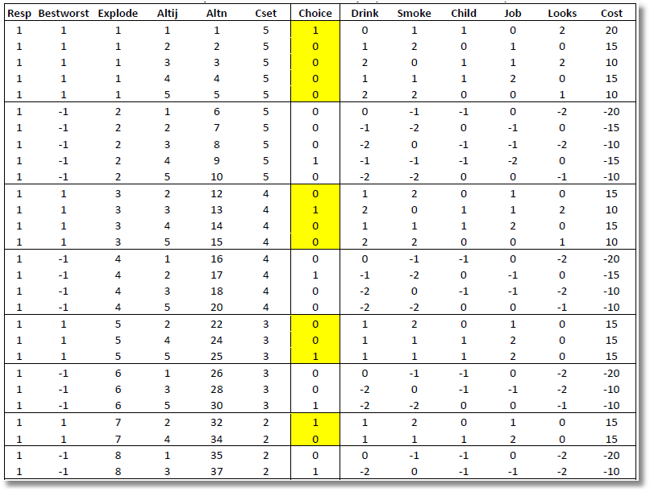

Slide 21
Model Extensions
AR(1): w_{i,k,t} = ρ_{k}w_{i,k,t-1} + v_{i,k,t}
Dynamic effects in the model
Restricting sign – lognormal distribution:
Restricting Range and Sign: Using triangular distribution and range = 0 to 2β.
Heteroscedasticity and heterogeneity

Slide 22
Error Components Logit Modeling
Alternative approach to building cross choice correlation
Common ‘effects.’ W_{i} is a ‘random individual effect.’

Slide 23
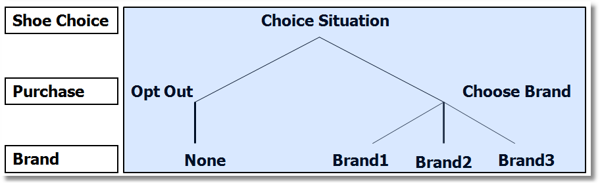
Implied Covariance Matrix
Nested Logit Formulation

Slide 24
Error Components Logit Model
-----------------------------------------------------------
Error Components (Random Effects) model
Dependent variable CHOICE
Log likelihood function -4158.45044
Estimation based on N = 3200, K = 5
Response data are given as ind. choices
Replications for simulated probs. = 50
Halton sequences used for simulations
ECM model with panel has 400 groups
Fixed number of obsrvs./group= 8
Number of obs.= 3200, skipped 0 obs
--------+--------------------------------------------------
Variable| Coefficient Standard Error b/St.Er. P[|Z|>z]
--------+--------------------------------------------------
|Nonrandom parameters in utility functions
FASH| 1.47913*** .06971 21.218 .0000
QUAL| 1.01385*** .06580 15.409 .0000
PRICE| -11.8052*** .86019 -13.724 .0000
ASC4| .03363 .07441 .452 .6513
SigmaE01| .09585*** .02529 3.791 .0002
--------+--------------------------------------------------
Random Effects Logit Model
Appearance of Latent Random
Effects in Utilities
Alternative E01
+-------------+---+
| BRAND1 | * |
+-------------+---+
| BRAND2 | * |
+-------------+---+
| BRAND3 | * |
+-------------+---+
| NONE | |
+-------------+---+
Correlation = {0.0959² / [1.6449 + 0.0959²]}^{1/2} = 0.0954

Slide 25
Aggregate Data and Multinomial Choice:
The Model of Berry, Levinsohn and Pakes

Slide 26
Resources
Automobile Prices in Market Equilibrium, S. Berry, J. Levinsohn, A. Pakes, Econometrica, 63, 4, 1995, 841-890. (BLP)
  http://people.stern.nyu.edu/wgreene/Econometrics/BLP.pdf
A Practitioner’s Guide to Estimation of Random-Coefficients Logit Models of Demand, A. Nevo, Journal of Economics and Management Strategy, 9, 4, 2000, 513-548
  http://people.stern.nyu.edu/wgreene/Econometrics/Nevo-BLP.pdf
A New Computational Algorithm for Random Coefficients Model with Aggregate-level Data, Jinyoung Lee, UCLA Economics, Dissertation, 2011
  http://people.stern.nyu.edu/wgreene/Econometrics/Lee-BLP.pdf
  Elasticities of Market Shares and Social Health Insurance Choice in Germany: A Dynamic Panel Data Approach, M. Tamm et al., Health Economics, 16, 2007, 243-256.
  http://people.stern.nyu.edu/wgreene/Econometrics/Tamm.pdf

Slide 27


Slide 28
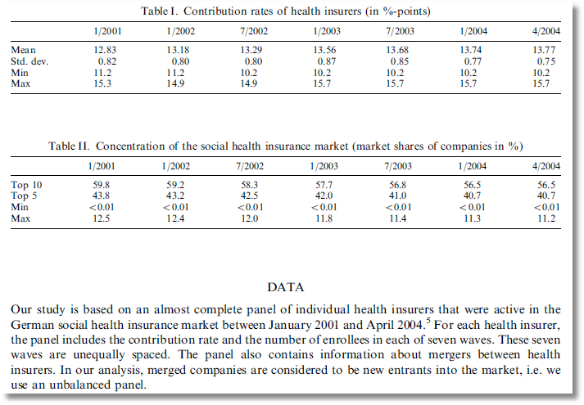

Slide 29
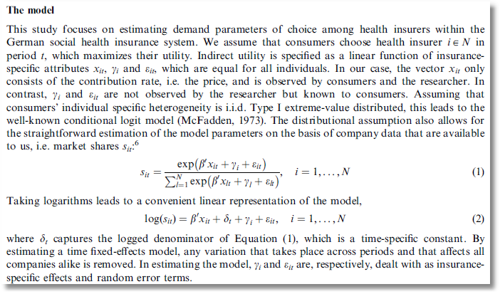

Slide 30
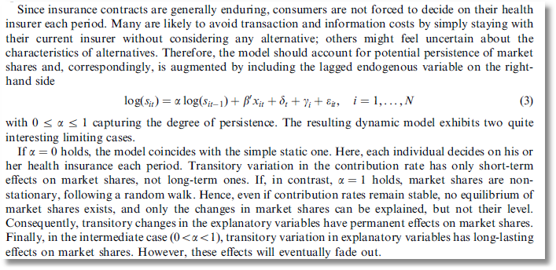

Slide 31
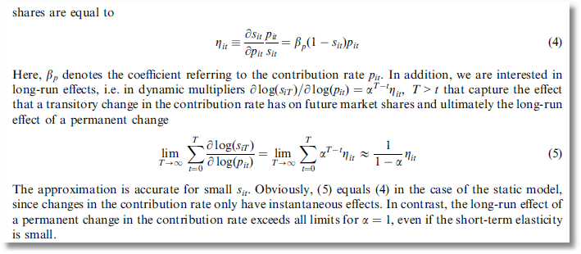

Slide 32
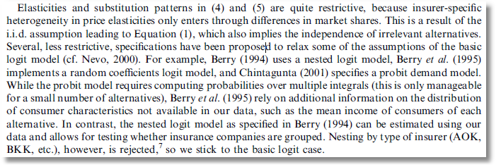

Slide 33
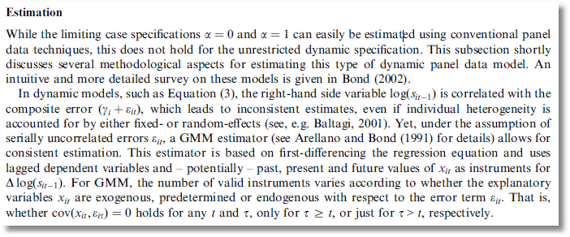
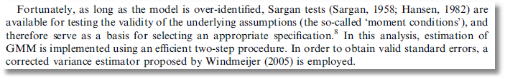

Slide 34
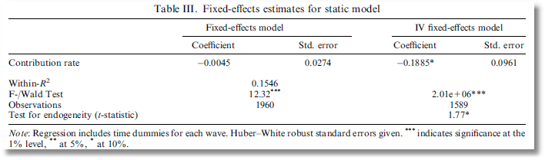
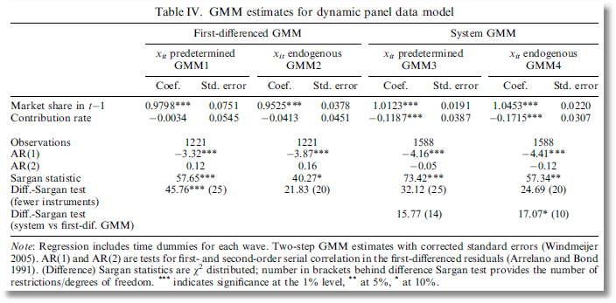

Slide 35
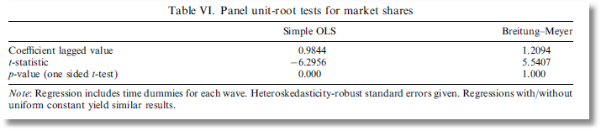
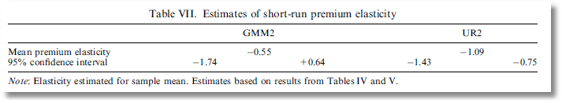
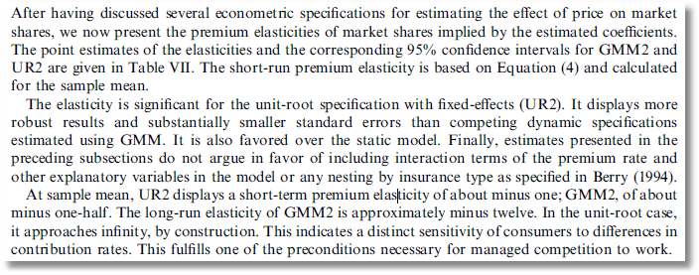

Slide 36
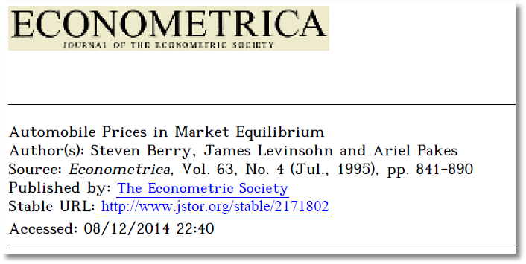
Aggregate Data and Multinomial Choice:
The Model of Berry, Levinsohn and Pakes

Slide 37
Theoretical Foundation
Consumer market for J differentiated brands of a good
  j =1,…, J_{t} brands or types
  i = 1,…, N consumers
  t = i,…,T “markets” (like panel data)
Consumer i’s utility for brand j (in market t) depends on
  p = price
  x = observable attributes
  f = unobserved attributes
  w = unobserved heterogeneity across consumers
  ε = idiosyncratic aspects of consumer preferences
Observed data consist of aggregate choices, prices and features of the brands.

Slide 38
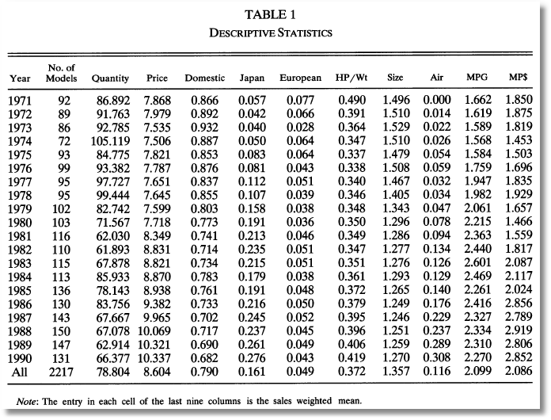
BLP Automobile Market
J_{t}
t

Slide 39
Random Utility Model
Utility: U_{ijt}=U(w_{i},p_{jt},x_{jt},f_{jt}|θ), i = 1,…,(large)N, j=1,…,J
  w_{i} = individual heterogeneity; time (market) invariant. w has a continuous distribution across the population.
  p_{jt}, x_{jt}, f_{jt}, = price, observed attributes, unobserved features of brand j; all may vary through time (across markets)
Revealed Preference: Choice j provides maximum utility
Across the population, given market t, set of prices p_{t} and features (X_{t},f_{t}), there is a set of values of w_{i} that induces choice j, for each j=1,…,J_{t}; then, s_{j}(p_{t},X_{t},f_{t}|θ) is the market share of brand j in market t.
There is an outside good that attracts a nonnegligible market share, j=0. Therefore,

Slide 40
Functional Form
(Assume one market for now so drop “’t.”)
U_{ij}=U(w_{i},p_{j},x_{j},f_{j}|θ)= x_{j}'β – αp_{j} + f_{j} + ε_{ij}
= δ_{j} + ε_{ij}
E_{consumers i}[ε_{ij}] = 0, δ_{j} is E[Utility].
Will assume logit form to make integration unnecessary. The expectation has a closed form.

Slide 41
Heterogeneity
Assumptions so far imply IIA. Cross price elasticities depend only on market shares.
Individual heterogeneity: Random parameters
U_{ij}=U(w_{i},p_{j},x_{j},f_{j}|θ_{i})= x_{j}'β_{i} – αp_{j} + f_{j} + ε_{ij}
β_{ik} = β_{k} + σ_{k}v_{ik}.
The mixed model only imposes IIA for a particular consumer, but not for the market as a whole.

Slide 42
Endogenous Prices: Demand side
U_{ij}=U(w_{i},p_{j},x_{j},f_{j}|θ)= x_{j}'β_{i} – αp_{j} + f_{j} + ε_{ij}
f_{j} is unobserved
Utility responds to the unobserved f_{j}
Price p_{j} is partly determined by features f_{j}.
In a choice model based on observables, price is correlated with the unobservables that determine the observed choices.

Slide 43
Endogenous Price: Supply Side
There are a small number of competitors in this market
Price is determined by firms that maximize profits given the features of its products and its competitors.
mc_{j} = g(observed cost characteristics c,
unobserved cost characteristics h)
At equilibrium, for a profit maximizing firm that produces one product,
s_{j} + (p_{j}-mc_{j})∂s_{j}/∂p_{j} = 0
Market share depends on unobserved cost characteristics as well as unobserved demand characteristics, and price is correlated with both.

Slide 44
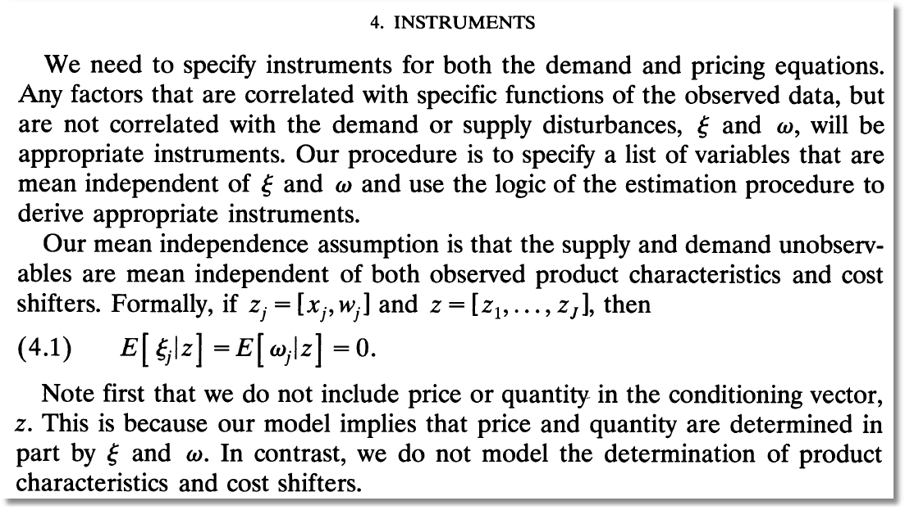
Instrumental Variables
(ξ and ω are our h and f.)

Slide 45
Econometrics: Essential Components

Slide 46
Econometrics

Slide 47
GMM Estimation Strategy - 1

Slide 48
GMM Estimation Strategy - 2

Slide 49
BLP Iteration

Slide 50

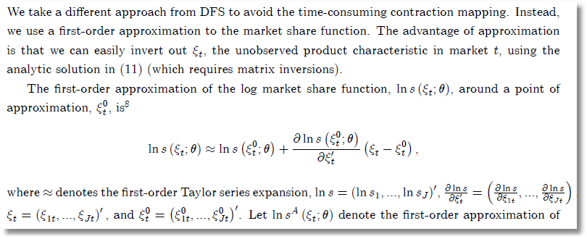
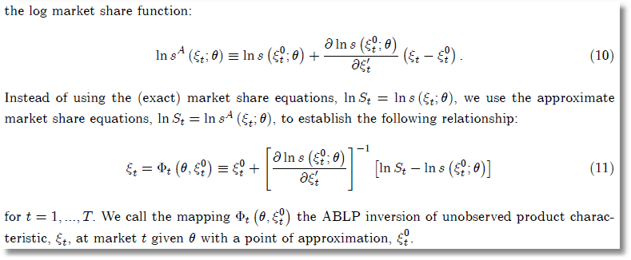
ABLP Iteration
ξ_{t} is
our f_{t}.
θ is our
(β,Σ)
No superscript is our (M); superscript 0 is our (M-1).

Slide 51
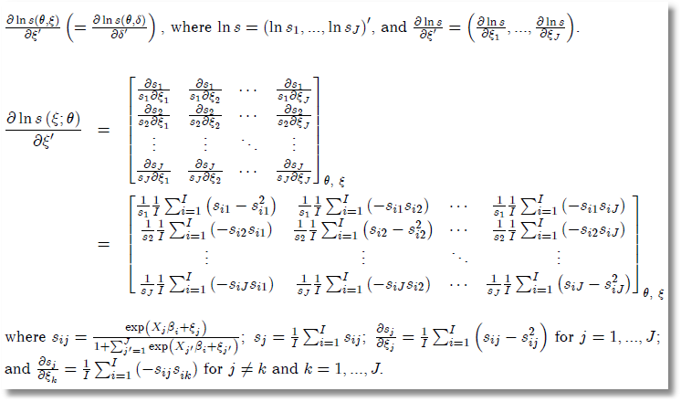
Side Results

Slide 52
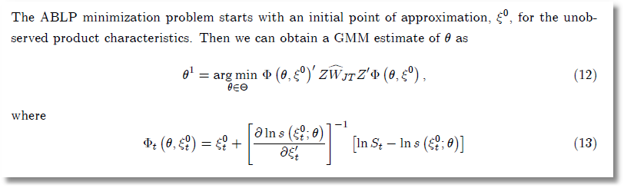
ABLP Iterative Estimator

Slide 53
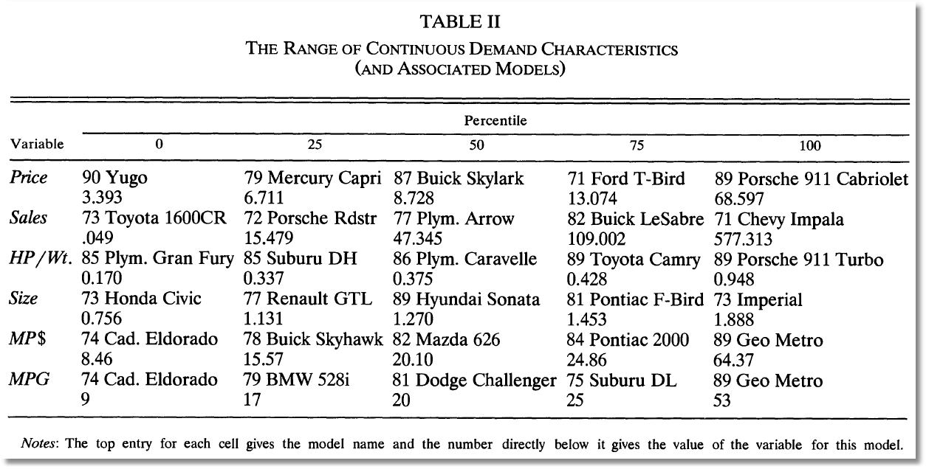
BLP Design Data

Slide 54
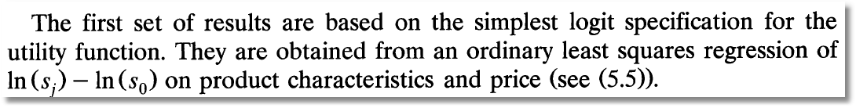
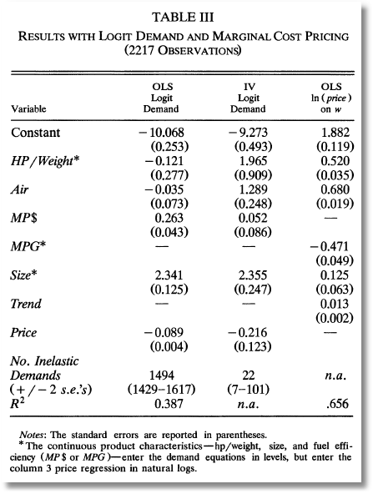
Exogenous price and nonrandom parameters

Slide 55
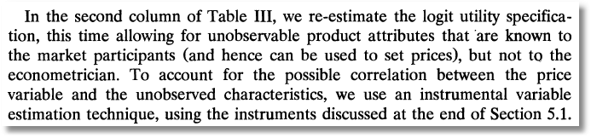
IV Estimation

Slide 56
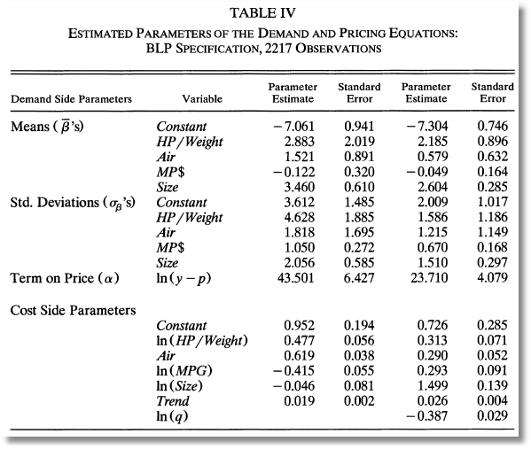
Full Model

Slide 57
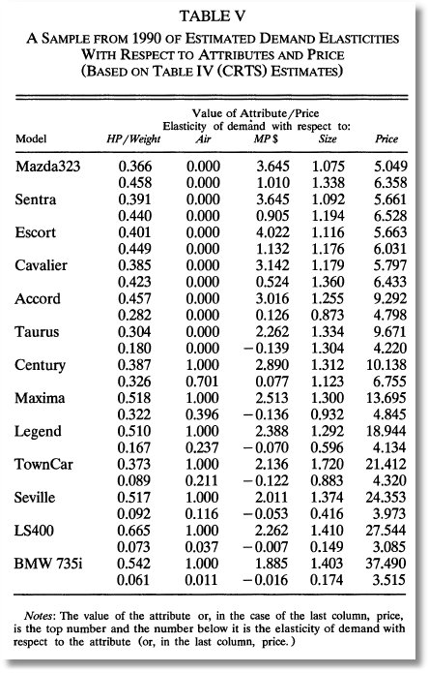
Some Elasticities

Slide 58
Hybrid Choice Models

Slide 59
What is a hybrid choice model?
Incorporates latent variables in choice model
Extends development of discrete choice model to incorporate other aspects of preference structure of the chooser
Develops endogeneity of the preference structure.

Slide 60
Endogeneity
"Recent Progress on Endogeneity in Choice Modeling" with Jordan Louviere & Kenneth Train & Moshe Ben-Akiva & Chandra Bhat & David Brownstone & Trudy Cameron & Richard Carson & J. Deshazo & Denzil Fiebig & William Greene & David Hensher & Donald Waldman, 2005. Marketing Letters Springer, vol. 16(3), pages 255-265, December.
Narrow view: U(i,j) = b’x(i,j) + ε(i,j), x(i,j) correlated with ε(i,j)
(Berry, Levinsohn, Pakes, brand choice for cars, endogenous price attribute.)
Implications for estimators that assume it is.
Broader view: Sounds like heterogeneity.
  Preference structure: RUM vs. RRM
  Heterogeneity in choice strategy – e.g., omitted attribute models
  Heterogeneity in taste parameters: location and scaling
  Heterogeneity in functional form: Possibly nonlinear utility functions

Slide 61
Heterogeneity
Narrow view: Random variation in marginal utilities and scale
  RPM, LCM
  Scaling model
  Generalized Mixed model
Broader view: Heterogeneity in preference weights
  RPM and LCM with exogenous variables
  Scaling models with exogenous variables in variances
  Looks like hierarchical models

Slide 62
Heterogeneity and the MNL Model

Slide 63
Observable Heterogeneity in
Preference Weights

Slide 64
‘Quantifiable’ Heterogeneity in Scaling
w_{i} = observable characteristics:
age, sex, income, etc.

Slide 65
Unobserved Heterogeneity in Scaling

Slide 66
A helpful way to view hybrid choice models
Adding attitude variables to the choice model
In some formulations, it makes them look like mixed parameter models
“Interactions” is a less useful way to interpret

Slide 67
Observable Heterogeneity in Utility Levels
Choice, e.g., among brands of cars
x_{itj} = attributes: price, features
z_{it} = observable characteristics: age, sex, income

Slide 68
Unbservable heterogeneity in utility levels and other preference indicators

Slide 69


Slide 70
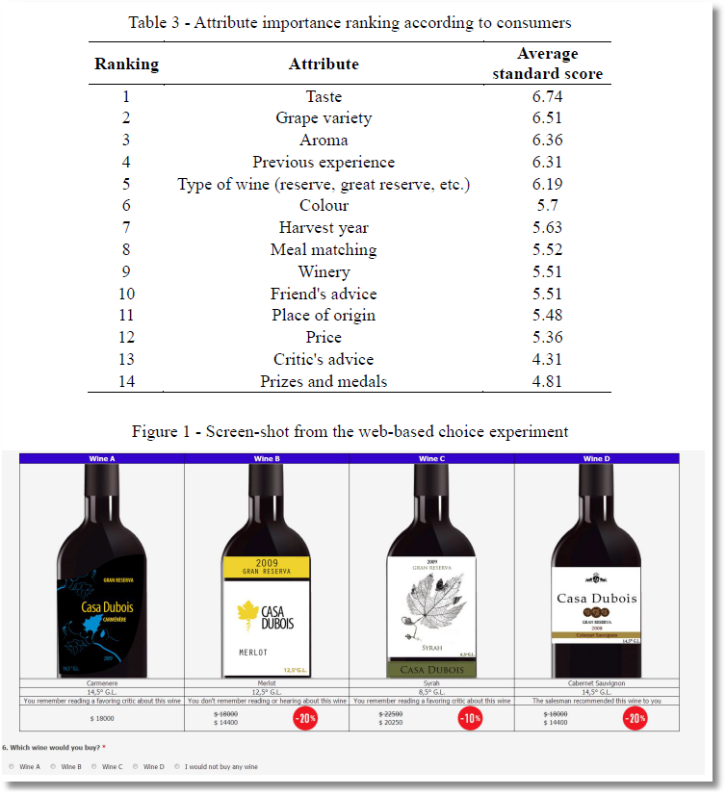

Slide 71
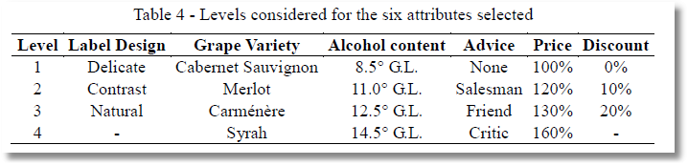

Slide 72
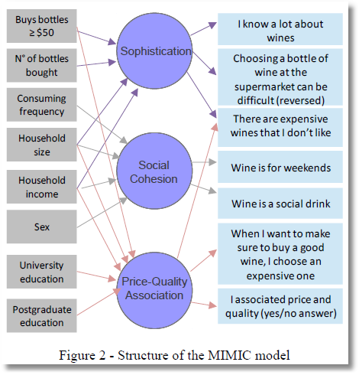
Observed Latent Observed
x → z* → y

Slide 73
MIMIC Model
Multiple Causes and Multiple Indicators
X z* Y

Slide 74
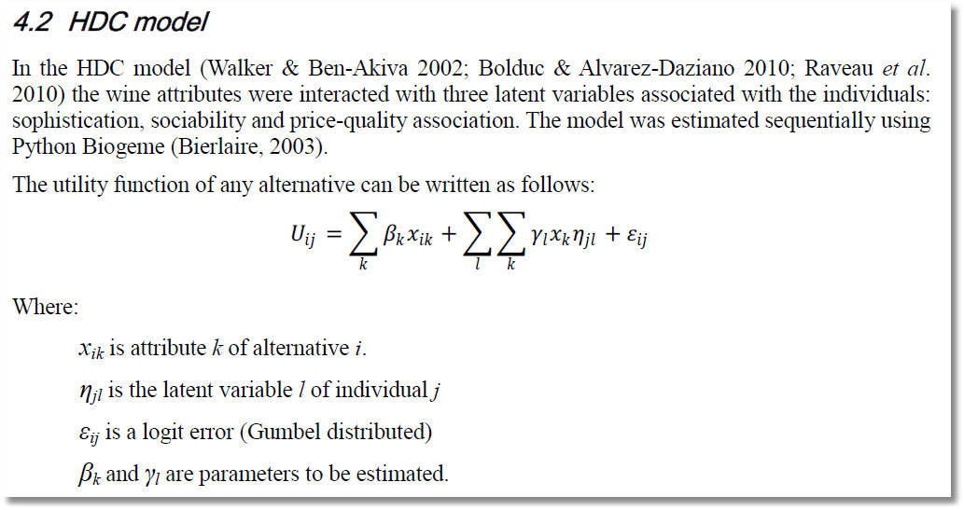
Note. Alternative i, Individual j.

Slide 75
This is a mixed logit model. The interesting extension is the source of the individual heterogeneity in the random parameters.

Slide 76
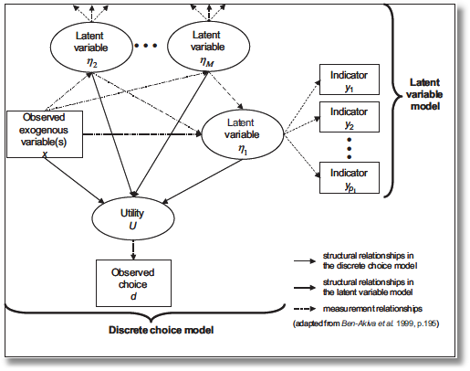
“Integrated Model”
Incorporate attitude measures in preference structure

Slide 77
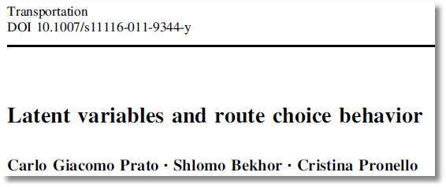
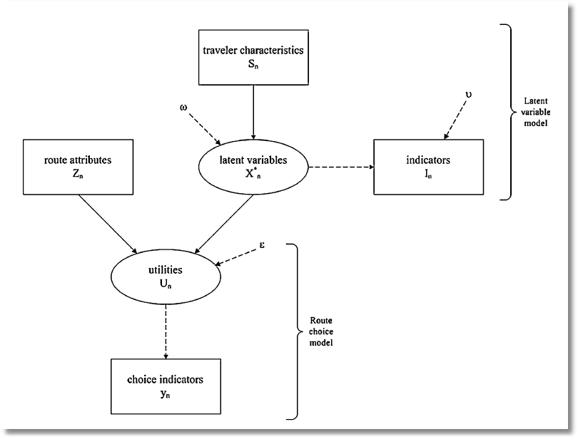

Slide 78
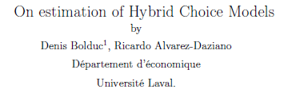
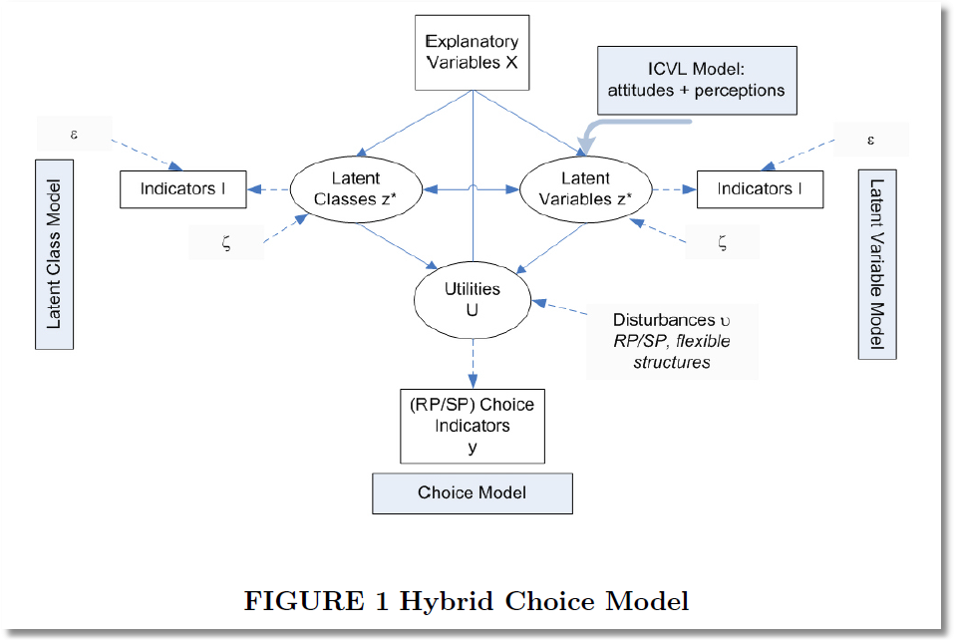

Slide 79
Hybrid choice
Equations of the MIMIC Model

Slide 80
Identification Problems
Identification of latent variable models with cross sections
How to distinguish between different latent variable models. How many latent variables are there? More than 0. Less than or equal to the number of indicators.
Parametric point identification

