Slide 1







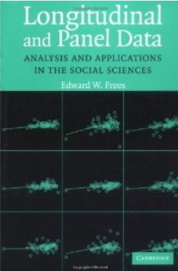
Econometric Analysis of Panel Data
William Greene
Department of Economics
University of South Florida

Slide 2

Econometric Analysis of Panel Data
24. Multinomial Choice and Stated Choice Experiments

Slide 3
A Microeconomics Platform
Consumers Maximize Utility (!!!)
Fundamental Choice Problem: Maximize U(x₁,x₂,…) subject to prices and budget constraints
A Crucial Result for the Classical Problem:
  Indirect Utility Function: V = V(p,I)
  Demand System of Continuous Choices
  Observed data usually consist of choices, prices, income
The Integrability Problem: Utility is not revealed by demands

Slide 4
Implications for Discrete Choice Models
Theory is silent about discrete choices
Translation of utilities to discrete choice requires:
  Well defined utility indexes: Completeness of rankings
  Rationality: Utility maximization
  Axioms of revealed preferences
Consumers often act to simplify choice situations
This allows us to build “models.”
  What common elements can be assumed?
  How can we account for heterogeneity?
However, revealed choices do not reveal utility, only rankings which are scale invariant.

Slide 5
Multinomial Choice Among J Alternatives
• Random Utility Basis
Uitj = α_{ij} + β_{i}’x_{itj} + γ_{ij}z_{it} + ε_{ijt}
i = 1,…,N; j = 1,…,J(i,t); t = 1,…,T(i)
N individuals studied, J(i,t) alternatives in the choice
set, T(i) [usually 1] choice situations examined.
• Maximum Utility Assumption
Individual i will Choose alternative j in choice setting t if and only if
Uitj > Uitk for all k ≠ j.
• Underlying assumptions
  Smoothness of utilities
  Axioms of utility maximization: Transitive, Complete, Monotonic

Slide 6
Features of Utility Functions
The linearity assumption U_{itj} = α_{ij} + β_{i}′x_{itj} + γ_{j}′z_{it} + ε_{ijt}
To be relaxed later: U_{itj} = V(x_{itj},z_{it},β_{i}) + ε_{ijt}
The choice set:
  Individual (i) and situation (t) specific
  Unordered alternatives j = 1,…,J(i,t)
Deterministic (x,z,γ_{j}) and random components (α_{ij},β_{i},ε_{ijt})
Attributes of choices, x_{itj} and characteristics of the chooser, z_{it}.
  Alternative specific constants α_{ij} may vary by individual
  Preference weights, β_{i} may vary by individual
  Individual components, γ_{j} typically vary by choice, not by person
  Scaling parameters, σ_{ij} = Var[ε_{ijt}], subject to much modeling

Slide 7

Unordered Choices of 210 Travelers

Slide 8
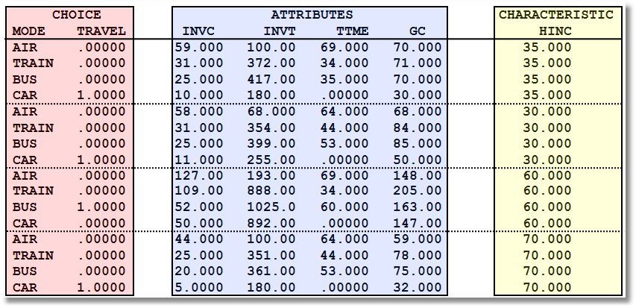
Data on Multinomial Discrete Choices

Slide 9
The Multinomial Logit (MNL) Model
Independent extreme value (Gumbel):
  F(εitj) = Exp(-Exp(-εitj)) (random part of each utility)
  Independence across utility functions
  Identical variances (means absorbed in constants)
  Same parameters for all individuals (temporary)
Implied probabilities for observed outcomes

Slide 10

Multinomial Choice Models

Slide 11
I want to estimate a multinomial logit model with three possible outcomes. I will get two sets of coefficients. If I make 1 the reference category, one set of coefficients will represent the independent variables impact on the probability of ending up in category 2 versus 1, and the other set will estimate the impact on the probability of ending up in 3 versus 1. However, some independent variables cannot be in both equations. I assume that I could do this by fixing (holding) certain coefficient estimates at 0 for the choice of 2 versus 1; while holding other coefficient values at 0 for the 3 versus 1 choice in the joint estimation of the model. I looked in the manual and saw a “Fix” command that looked like it would accomplish this. However, it was not clear to me how to hold different coefficients at 0 for the 2-1 choice versus the 3-1 choice.

Slide 12
Specifying the Probabilities
• Choice specific attributes (X) vary by choices, multiply by generic
coefficients. E.g., TTME=terminal time, GC=generalized cost of travel mode
Generic characteristics (Income, constants) must be interacted with
choice specific constants.
• Estimation by maximum likelihood; d_{ij} = 1 if person i chooses j

Slide 13
Willingness to Pay

Slide 14
An Estimated MNL Model
-----------------------------------------------------------
Discrete choice (multinomial logit) model
Dependent variable Choice
Log likelihood function -199.97662
Estimation based on N = 210, K = 5
Information Criteria: Normalization=1/N
Normalized Unnormalized
AIC 1.95216 409.95325
Fin.Smpl.AIC 1.95356 410.24736
Bayes IC 2.03185 426.68878
Hannan Quinn 1.98438 416.71880
R2=1-LogL/LogL* Log-L fncn R-sqrd R2Adj
Constants only -283.7588 .2953 .2896
Chi-squared[ 2] = 167.56429
Prob [ chi squared > value ] = .00000
Response data are given as ind. choices
Number of obs.= 210, skipped 0 obs
--------+--------------------------------------------------
Variable| Coefficient Standard Error b/St.Er. P[|Z|>z]
--------+--------------------------------------------------
GC| -.01578*** .00438 -3.601 .0003
TTME| -.09709*** .01044 -9.304 .0000
A_AIR| 5.77636*** .65592 8.807 .0000
A_TRAIN| 3.92300*** .44199 8.876 .0000
A_BUS| 3.21073*** .44965 7.140 .0000
--------+--------------------------------------------------

Slide 15
Estimated MNL Model
-----------------------------------------------------------
Discrete choice (multinomial logit) model
Dependent variable Choice
Log likelihood function -199.97662
Estimation based on N = 210, K = 5
Information Criteria: Normalization=1/N
Normalized Unnormalized
AIC 1.95216 409.95325
Fin.Smpl.AIC 1.95356 410.24736
Bayes IC 2.03185 426.68878
Hannan Quinn 1.98438 416.71880
R2=1-LogL/LogL* Log-L fncn R-sqrd R2Adj
Constants only -283.7588 .2953 .2896
Chi-squared[ 2] = 167.56429
Prob [ chi squared > value ] = .00000
Response data are given as ind. choices
Number of obs.= 210, skipped 0 obs
--------+--------------------------------------------------
Variable| Coefficient Standard Error b/St.Er. P[|Z|>z]
--------+--------------------------------------------------
GC| -.01578*** .00438 -3.601 .0003
TTME| -.09709*** .01044 -9.304 .0000
A_AIR| 5.77636*** .65592 8.807 .0000
A_TRAIN| 3.92300*** .44199 8.876 .0000
A_BUS| 3.21073*** .44965 7.140 .0000
--------+--------------------------------------------------

Slide 16
Estimated MNL Model
-----------------------------------------------------------
Discrete choice (multinomial logit) model
Dependent variable Choice
Log likelihood function -199.97662
Estimation based on N = 210, K = 5
Information Criteria: Normalization=1/N
Normalized Unnormalized
AIC 1.95216 409.95325
Fin.Smpl.AIC 1.95356 410.24736
Bayes IC 2.03185 426.68878
Hannan Quinn 1.98438 416.71880
R2=1-LogL/LogL* Log-L fncn R-sqrd R2Adj
Constants only -283.7588 .2953 .2896
Chi-squared[ 2] = 167.56429
Prob [ chi squared > value ] = .00000
Response data are given as ind. choices
Number of obs.= 210, skipped 0 obs
--------+--------------------------------------------------
Variable| Coefficient Standard Error b/St.Er. P[|Z|>z]
--------+--------------------------------------------------
GC| -.01578*** .00438 -3.601 .0003
TTME| -.09709*** .01044 -9.304 .0000
A_AIR| 5.77636*** .65592 8.807 .0000
A_TRAIN| 3.92300*** .44199 8.876 .0000
A_BUS| 3.21073*** .44965 7.140 .0000
--------+--------------------------------------------------

Slide 17
j = Train
m = Car
k = Price

Slide 18
k = Price
j = Train
j = Train
m = Car

Slide 20
+---------------------------------------------------+
| Elasticity averaged over observations.|
| Attribute is INVT in choice AIR |
| Mean St.Dev |
| * Choice=AIR -.2055 .0666 |
| Choice=TRAIN .0903 .0681 |
| Choice=BUS .0903 .0681 |
| Choice=CAR .0903 .0681 |
+---------------------------------------------------+
| Attribute is INVT in choice TRAIN |
| Choice=AIR .3568 .1231 |
| * Choice=TRAIN -.9892 .5217 |
| Choice=BUS .3568 .1231 |
| Choice=CAR .3568 .1231 |
+---------------------------------------------------+
| Attribute is INVT in choice BUS |
| Choice=AIR .1889 .0743 |
| Choice=TRAIN .1889 .0743 |
| * Choice=BUS -1.2040 .4803 |
| Choice=CAR .1889 .0743 |
+---------------------------------------------------+
| Attribute is INVT in choice CAR |
| Choice=AIR .3174 .1195 |
| Choice=TRAIN .3174 .1195 |
| Choice=BUS .3174 .1195 |
| * Choice=CAR -.9510 .5504 |
+---------------------------------------------------+
| Effects on probabilities of all choices in model: |
| * = Direct Elasticity effect of the attribute. |
+---------------------------------------------------+
Note the effect of IIA on the cross effects.
Own effect
Cross effects
Elasticities are computed for each observation; the mean and standard deviation are then computed across the sample observations.

Slide 21
A Multinomial Logit Common Effects Model
How to handle unobserved effects in other nonlinear models?
  Single index models such as probit, Poisson, tobit, etc. that are functions of an x_{it}'β can be modified to be functions of x_{it}'β + c_{i}.
  Other models – not at all obvious. Rarely found in the literature.
Dealing with fixed and random effects?
Dynamics makes things much worse.

Slide 22
A Multinomial Logit Model

Slide 23
A Heterogeneous Multinomial
Logit Model

Slide 24
Common Effects Multinomial Logit

Slide 25
Simulation Based Estimation

Slide 26
Application Shoe Brand Choice
Simulated Data: Stated Choice, N=400 respondents, T=8 choice situations, 3,200 observations
3 choice/attributes + NONE ➔ J=4
  Fashion = High / Low
  Quality = High / Low
  Price = 25/50/75,100 coded 1,2,3,4; and Price²
Heterogeneity: Sex, Age (<25, 25-39, 40+)
Underlying data generated by a 3 class latent class process (100, 200, 100 in classes)

Slide 27

Stated Choice Experiment: Unlabeled Alternatives, One Observation
t=1
t=2
t=3
t=4
t=5
t=6
t=7
t=8

Slide 28

Unlabeled Choice Experiments
This an unlabelled choice experiment: Compare
Choice = (Air, Train, Bus, Car)
To
Choice = (Brand 1, Brand 2, Brand 3, None)
Brand 1 is only Brand 1 because it is first in
the list.
What does it mean to substitute Brand 1 for
Brand 2?
What does the own elasticity for Brand 1 mean?

Slide 29
Application

Slide 30
No Common Effects
+---------------------------------------------+
| Start values obtained using MNL model |
| Log likelihood function -4119.500 |
+---------------------------------------------+
+--------+--------------+----------------+--------+--------+
|Variable| Coefficient | Standard Error |b/St.Er.|P[|Z|>z]|
+--------+--------------+----------------+--------+--------+
FASH | 1.45964424 .07748860 18.837 .0000
QUAL | 1.10637961 .07153725 15.466 .0000
PRICE | 2.31763951 3.98732636 .581 .5611
PRICESQ | -55.5527148 13.8684229 -4.006 .0001
ASC4 | .64637513 .24440240 2.645 .0082
B1_MAL1 | -.16751621 .10552035 -1.588 .1124
B1_YNG1 | -.58118337 .11969068 -4.856 .0000
B1_OLD1 | -.02600079 .14091863 -.185 .8536
B2_MAL2 | -.05966758 .10055110 -.593 .5529
B2_YNG2 | -.14991404 .11180414 -1.341 .1800
B2_OLD2 | -.15128297 .14133889 -1.070 .2845
B3_MAL3 | -.12076085 .09301010 -1.298 .1942
B3_YNG3 | -.12265952 .10419547 -1.177 .2391
B3_OLD3 | -.04753400 .12950649 -.367 .7136

Slide 31
Random Effects MNL Model
+---------------------------------------------+
| Error Components (Random Effects) model | Restricted logL = -4119.5
| Log likelihood function -4112.495 | Chi squared(3) = 14.01 (Crit.Val.=7.81)
+---------------------------------------------+
+--------+--------------+----------------+--------+--------+
|Variable| Coefficient | Standard Error |b/St.Er.|P[|Z|>z]|
+--------+--------------+----------------+--------+--------+
---------+Nonrandom parameters in utility functions
FASH | 1.50759565 .08204283 18.376 .0000
QUAL | 1.14155991 .07884212 14.479 .0000
PRICE | 2.61115484 4.23285024 .617 .5373
PRICESQ | -58.0172769 14.7409678 -3.936 .0001
ASC4 | .72127357 .25703909 2.806 .0050
B1_MAL1 | -.19918832 .11818500 -1.685 .0919
B1_YNG1 | -.61263642 .12580875 -4.870 .0000
B1_OLD1 | -.03213515 .15732926 -.204 .8382
B2_MAL2 | -.04059494 .10950154 -.371 .7108
B2_YNG2 | -.12504492 .11986238 -1.043 .2968
B2_OLD2 | -.12470329 .14151490 -.881 .3782
B3_MAL3 | -.10619757 .10471334 -1.014 .3105
B3_YNG3 | -.10372335 .11851081 -.875 .3815
B3_OLD3 | -.02538899 .13269408 -.191 .8483
---------+Standard deviations of latent random effects
SigmaE01| .53459541 .09531536 5.609 .0000
SigmaE02| .01799747 .62983694 .029 .9772
SigmaE03| .03109637 .35256770 .088 .9297

Slide 32
Revealed and Stated Preference Data
Pure RP Data
  Market (ex-post, e.g., supermarket scanner data)
  Individual observations
Pure SP Data
  Contingent valuation
  (?) Validity
Combined (Enriched) RP/SP
  Mixed data
  Expanded choice sets

Slide 33
Revealed Preference Data
Advantage: Actual observations on actual behavior
Disadvantage: Limited range of choice sets and attributes – does not allow analysis of switching behavior.

Slide 34
Stated Preference Data
Pure hypothetical – does the subject take it seriously?
No necessary anchor to real market situations
Vast heterogeneity across individuals

Slide 35
Pooling RP and SP Data Sets - 1
Enrich the attribute set by replicating choices
E.g.:
  RP: Bus,Car,Train (actual)
  SP: Bus(1),Car(1),Train(1)
  Bus(2),Car(2),Train(2),…
How to combine?

Slide 36
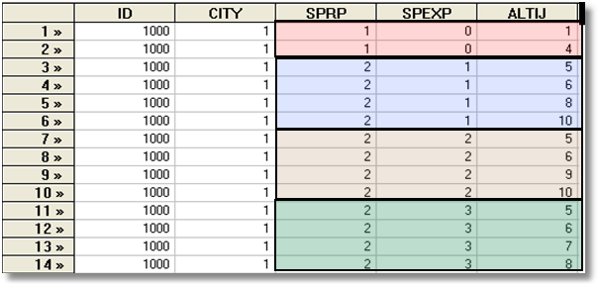
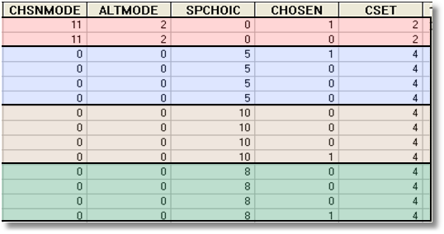
Each person makes four choices from a choice set that includes either 2 or 4 alternatives.
The first choice is the RP between two of the 4 RP alternatives
The second-fourth are the SP among four of the 6 SP alternatives.
There are 10 alternatives in total.
A Stated Choice Experiment with Variable Choice Sets

Slide 37
Enriched Data Set – Vehicle Choice
Choosing between Conventional, Electric and LPG/CNG Vehicles in Single-Vehicle Households
David A. Hensher William H. Greene
Institute of Transport Studies Department of Economics
School of Business Stern School of Business
The University of Sydney New York University
NSW 2006 Australia New York USA
September 2000

Slide 38
Fuel Types Study
Conventional, Electric, Alternative
1,400 Sydney Households
Automobile choice survey
RP + 3 SP fuel classes
Nested logit – 2 level approach – to handle the scaling issue

Slide 39
Attribute Space: Conventional

Slide 40
Attribute Space: Electric

Slide 41
Attribute Space: Alternative

Slide 42


Slide 43
The Random Parameters Logit Model
Multiple choice situations: Independent conditioned on the individual specific parameters

Slide 44
Continuous Random Variation in Preference Weights

Slide 45
Mixed Logit Approaches
Pivot SP choices around an RP outcome.
Scaling is handled directly in the model
Continuity across choice situations is handled by random elements of the choice structure that are constant through time
  Preference weights – coefficients
  Scaling parameters
    Variances of random parameters
    Overall scaling of utility functions

Slide 46
Application
Survey sample of 2,688 trips, 2 or 4 choices per situation
Sample consists of 672 individuals
Choice based sample
Revealed/Stated choice experiment:
Revealed: Drive,ShortRail,Bus,Train
Hypothetical: Drive,ShortRail,Bus,Train,LightRail,ExpressBus
Attributes:
Cost –Fuel or fare
Transit time
Parking cost
Access and Egress time

Slide 47
Nested Logit Approach
Mode
RP
Car Train Bus SPCar SPTrain SPBus
Use a two level nested model, and constrain three SP IV parameters to be equal.

Slide 48
Each person makes four choices from a choice set that includes either 2 or 4 alternatives.
The first choice is the RP between two of the 4 RP alternatives
The second-fourth are the SP among four of the 6 SP alternatives.
There are 10 alternatives in total.
A Stated Choice Experiment with Variable Choice Sets

Slide 49
Panel Data
Repeated Choice Situations
Typically RP/SP constructions (experimental)
Accommodating “panel data”
  Multinomial Probit [marginal, impractical]
  Latent Class
  Mixed Logit

Slide 50
Customers’ Choice of Energy Supplier
California, Stated Preference Survey
361 customers presented with 8-12 choice situations each
Supplier attributes:
  Fixed price: cents per kWh
  Length of contract
  Local utility
  Well-known company
  Time-of-day rates (11¢ in day, 5¢ at night)
  Seasonal rates (10¢ in summer, 8¢ in winter, 6¢ in spring/fall)
(TrainCalUtilitySurvey.lpj)

Slide 51
Population Distributions
Normal for:
  Contract length
  Local utility
  Well-known company
Log-normal for:
  Time-of-day rates
  Seasonal rates
Price coefficient held fixed

Slide 52
Estimated Model
Estimate Std error
Price -.883 0.050
Contract mean -.213 0.026
std dev .386 0.028
Local mean 2.23 0.127
std dev 1.75 0.137
Known mean 1.59 0.100
std dev .962 0.098
TOD mean* 2.13 0.054
std dev* .411 0.040
Seasonal mean* 2.16 0.051
std dev* .281 0.022
*Parameters of underlying normal.

Slide 53
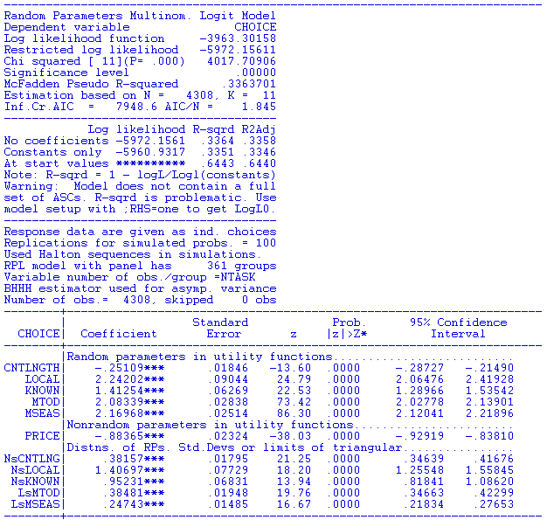

Slide 54
Distribution of Brand Value
Standard deviation
=2.0¢
10% dislike local utility
0
2.5¢
Brand value of local utility

Slide 55
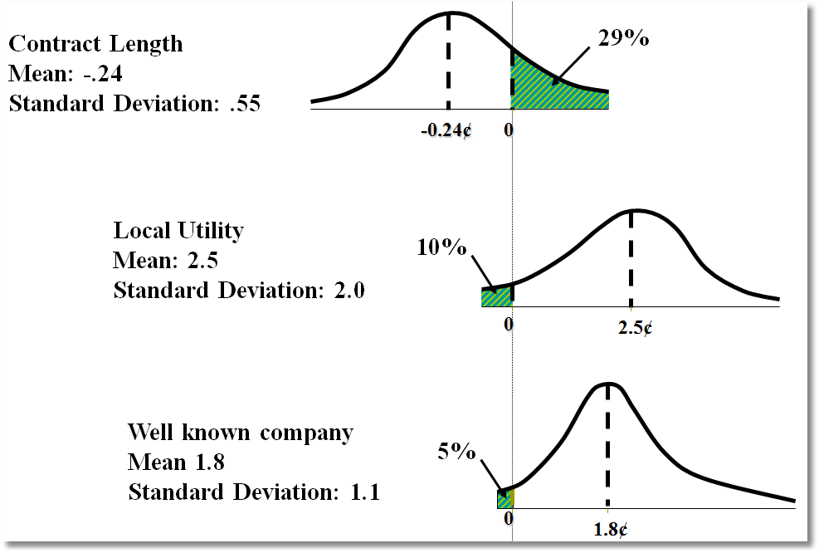
Random Parameter Distributions

Slide 56
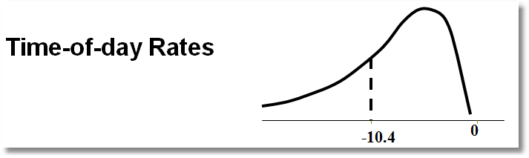
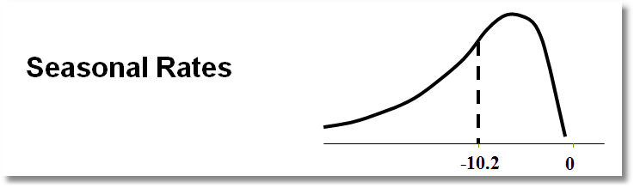
Time of Day Rates (Customers do not like – lognormal coefficient. Multiply variable by -1.)

Slide 57
Estimating Individual Parameters
Model estimates = structural parameters, α, β, ρ, Δ, Σ, Γ
Objective, a model of individual specific parameters, β_{i}
Can individual specific parameters be estimated?
  Not quite – β_{i} is a single realization of a random process; one random draw.
  We estimate E[β_{i} | all information about i]
  (This is also true of Bayesian treatments, despite claims to the contrary.)

Slide 58
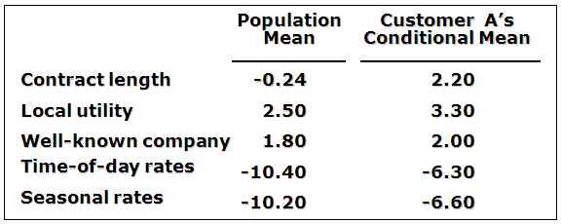
Expected Preferences of Each Customer
Customer likes long-term contract, local utility, and non-fixed rates.
Local utility can retain and make profit from this customer by offering a long-term contract with time-of-day or seasonal rates.

Slide 59
Posterior Estimation of β_{i}
Estimate by simulation

Slide 60
Application: Shoe Brand Choice
Simulated Data: Stated Choice,
  400 respondents,
  8 choice situations, 3,200 observations
3 choice/attributes + NONE
  Fashion = High / Low
  Quality = High / Low
  Price = 25/50/75,100 coded 1,2,3,4
Heterogeneity: Sex (Male=1), Age (<25, 25-39, 40+)
Underlying data generated by a 3 class latent class process (100, 200, 100 in classes)

Slide 61
Stated Choice Experiment: Unlabeled Alternatives, One Observation
t=1
t=2
t=3
t=4
t=5
t=6
t=7
t=8

Slide 62
Random Parameters Logit Model
Individual parameters

Slide 63
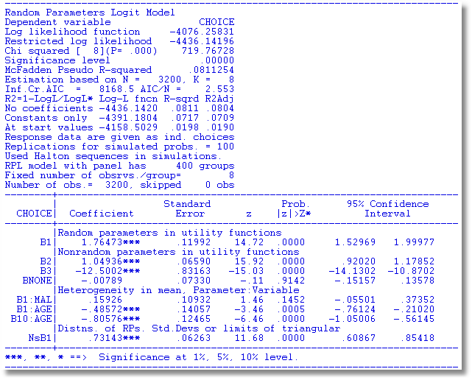
Individual parameters

Slide 64
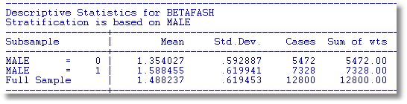
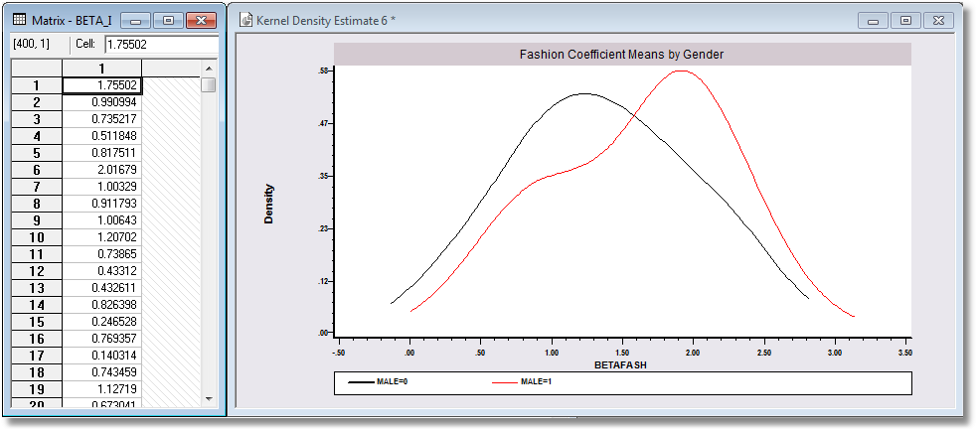
Individual parameters

Slide 65
Decision Strategy in Multinomial Choice

Slide 66
The 2^{K} model
The analyst believes some attributes are ignored. There is no indicator.
Classes distinguished by which attributes are ignored
Same model applies, now a latent class. For K attributes there are 2^{K} candidate coefficient vectors

Slide 67
Latent Class Models with
Cross Class Restrictions
8 Class Model: 6 structural utility parameters, 7 unrestricted prior probabilities.
Reduced form has 8(6)+8 = 56 parameters. (π_{j} = exp(α_{j})/∑_{j}exp(α_{j}), α_{J} = 0.)
EM Algorithm: Does not provide any means to impose cross class restrictions.
“Bayesian” MCMC Methods: May be possible to force the restrictions – it will not be simple.
Conventional Maximization: Simple

Slide 68


Slide 69
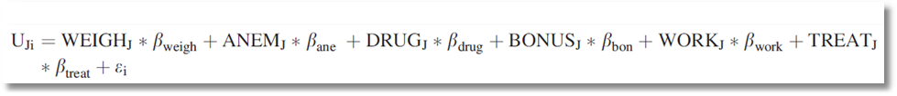
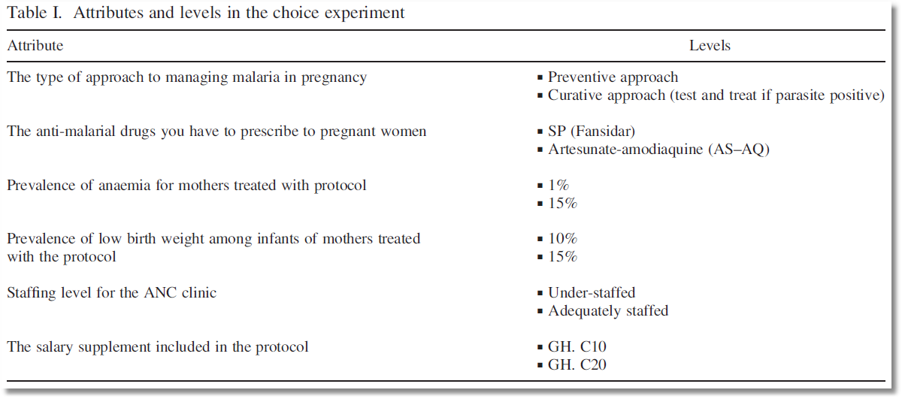
Choice Model with 6 Attributes

Slide 70
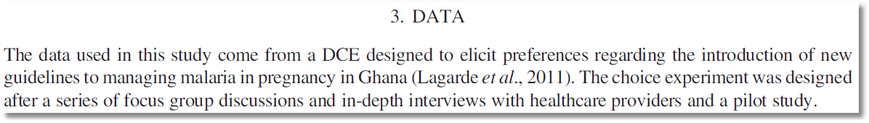
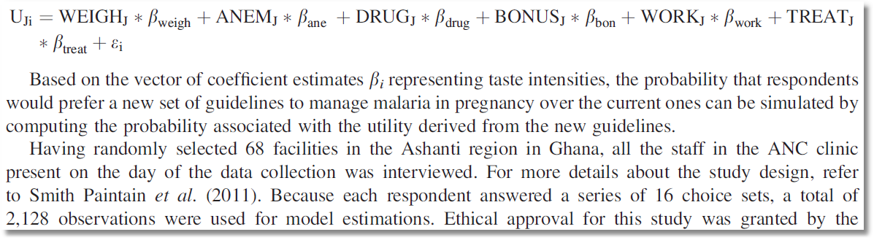
Stated Choice Experiment

Slide 71
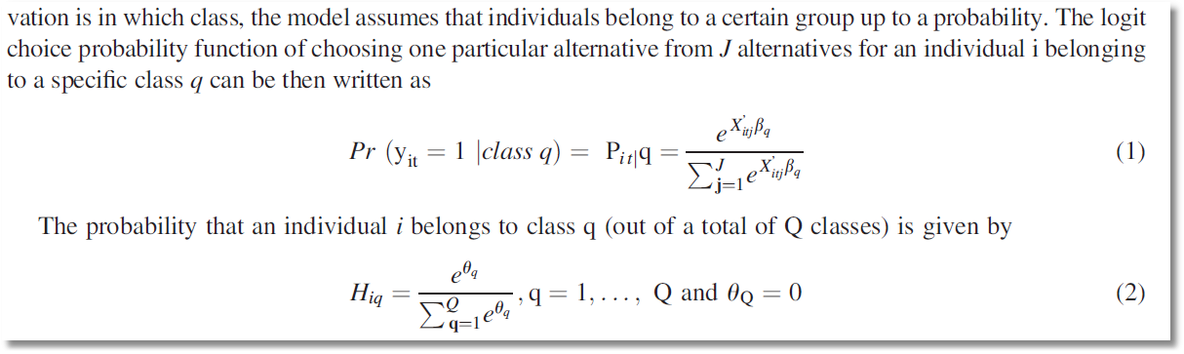
Latent Class Model – Prior Class Probabilities

Slide 72
Observable Heterogeneity in Utility Levels
Choice, e.g., among brands of cars
x_{itj} = attributes: price, features
z_{it} = observable characteristics: age, sex, income

Slide 73
Unbservable heterogeneity in utility levels and other preference indicators

Slide 74
A helpful way to view hybrid choice models
Adding attitude variables to the choice model
In some formulations, it makes them look like mixed parameter models
“Interactions” is a less useful way to interpret

Slide 75


Slide 76
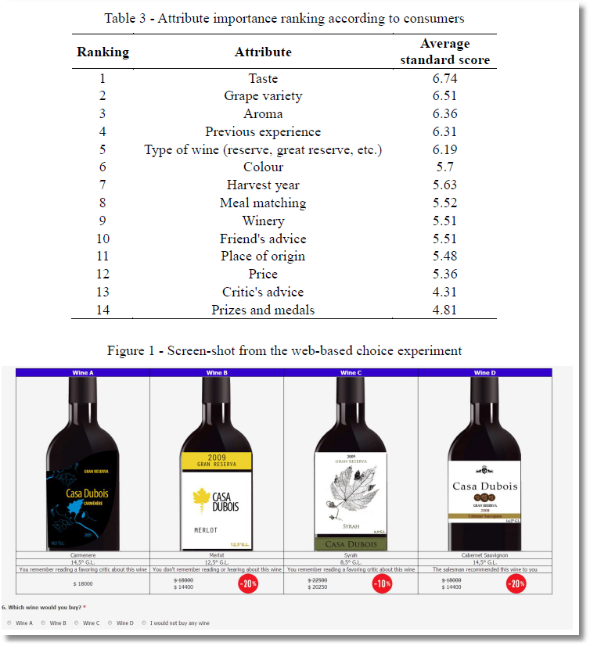

Slide 77
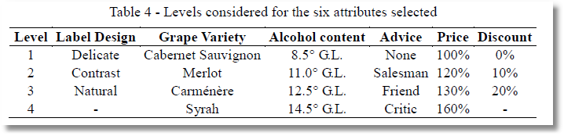

Slide 78
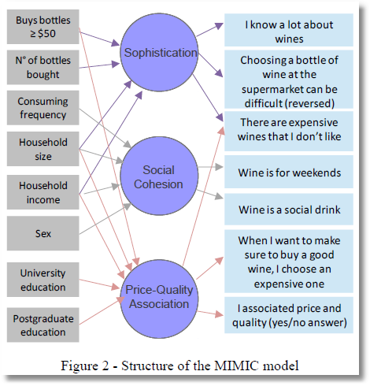
Observed Latent Observed
x → z* → y

Slide 79
MIMIC Model
Multiple Indicators and
Multiple Causes
X z* Y

Slide 80
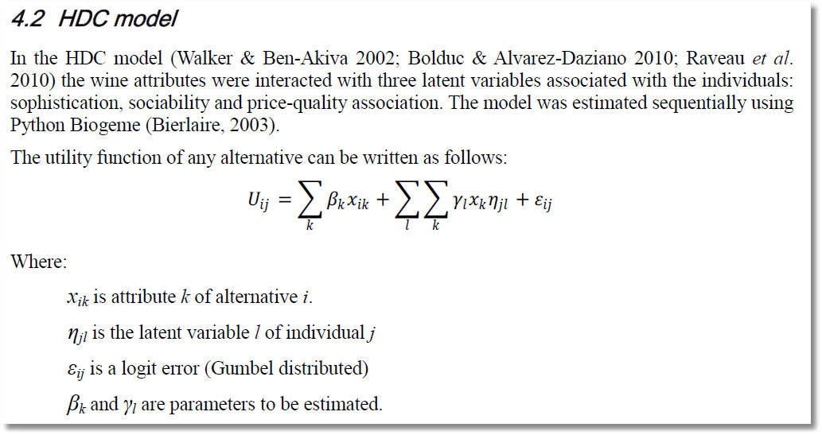
Note. Alternative i, Individual j.

Slide 81
This is a mixed logit model. The interesting extension is the source of the individual heterogeneity in the random parameters.

Slide 82
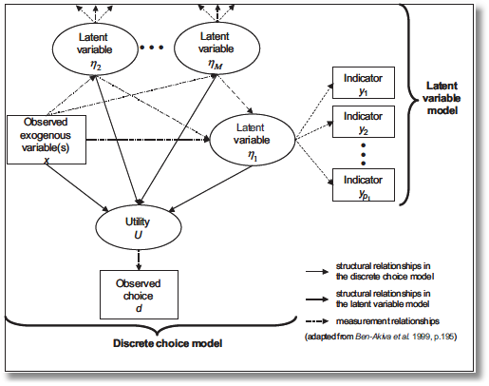
“Integrated Model”
Incorporate attitude measures in preference structure

Slide 83
Appendix:
Fixed Effects Multinomial Logit
Application of Minimum Distance Estimation

Slide 84
Binary Logit Conditional Probabiities

Slide 85
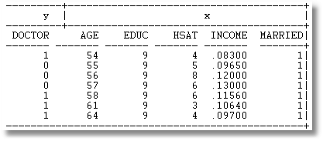
Example: SevenPeriod Binary Logit

Slide 86
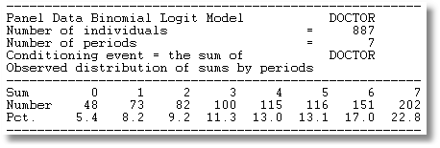
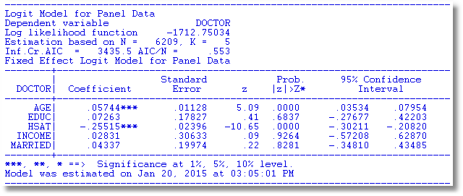

Slide 87
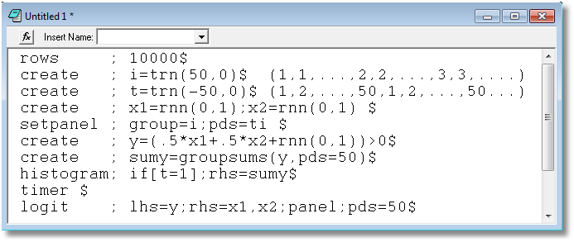

Slide 88
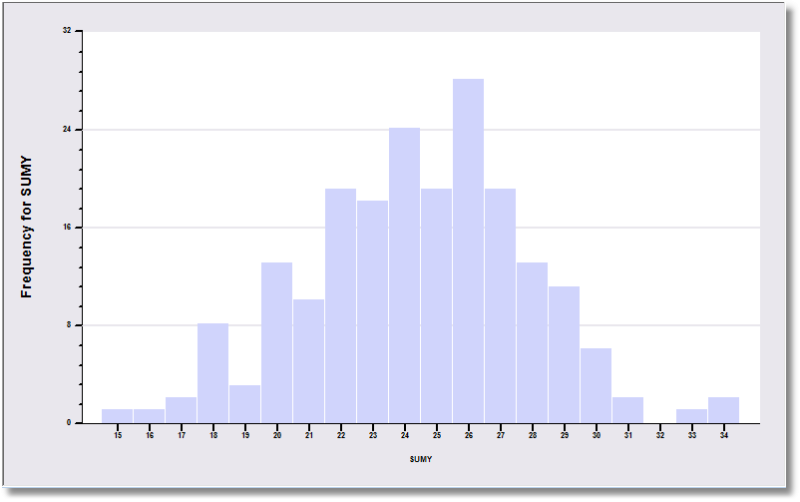
The sample is 200 individuals each observed 50 times.

Slide 89
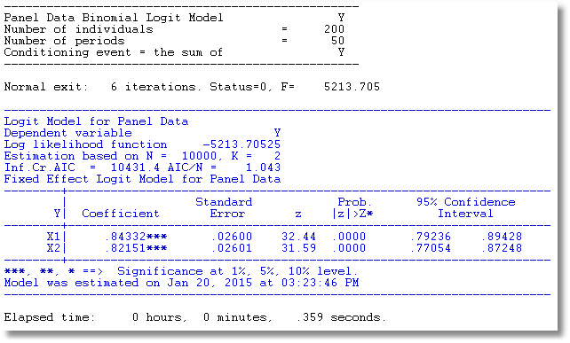
The data are generated from a probit process with b1 = b2 = .5. But, it is fit as a logit model. The coefficients obey the familiar relationship, 1.6*probit.

Slide 90
Multinomial Logit Model: J+1 choices including a base choice.

Slide 91
Estimation Strategy
Conditional ML of the full MNL model. Impressively complicated.
A Minimum Distance (MDE) Strategy
  Each alternative treated as a binary choice vs. the base provides an estimator of β
    Select subsample that chose either option j or the base
    Estimate β using this binary choice setting
    This provides J different estimators of the same β
  Optimally combine the different estimators of β

Slide 92
Minimum Distance Estimation

Slide 93
MDE Estimation

Slide 94
MDE Estimation

Slide 95


Slide 96
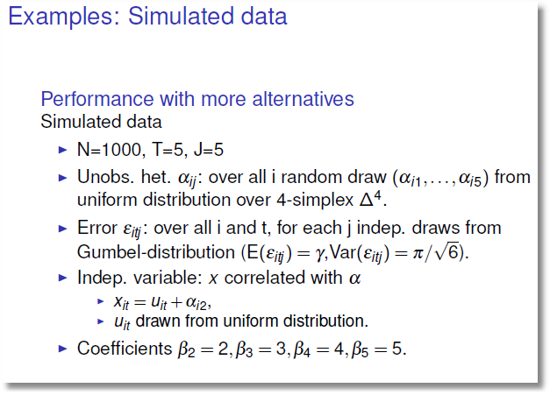

Slide 97
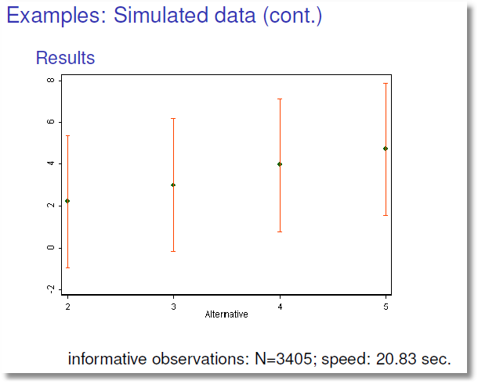

Slide 98
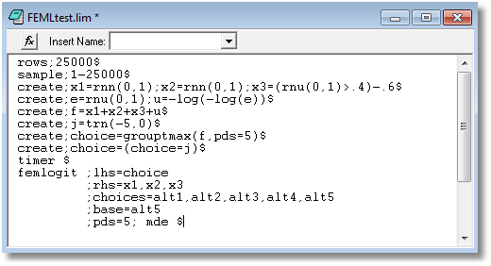

Slide 99
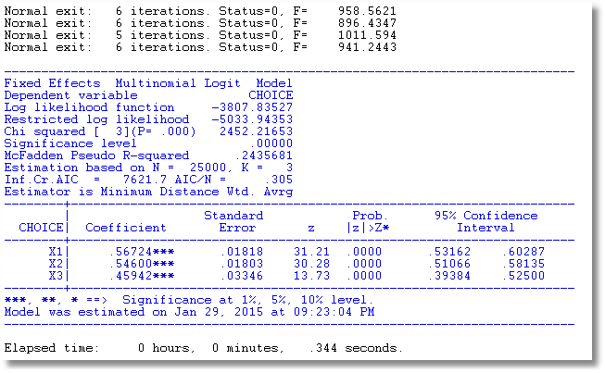

Slide 100
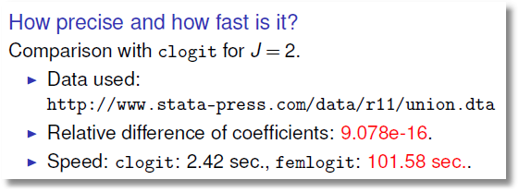
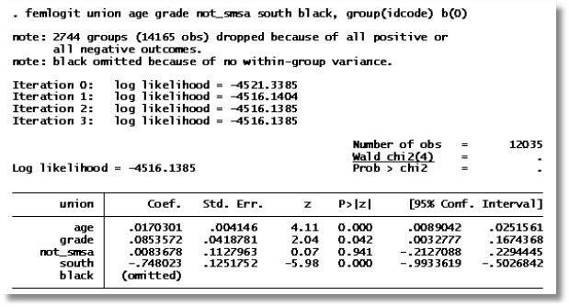

Slide 101
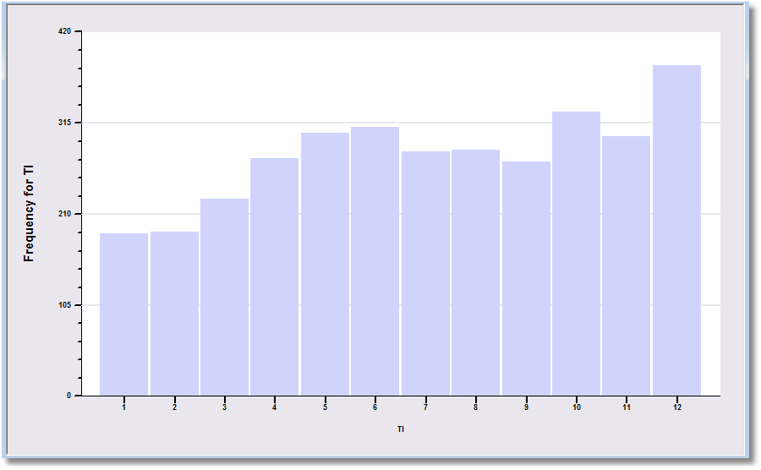

Slide 102
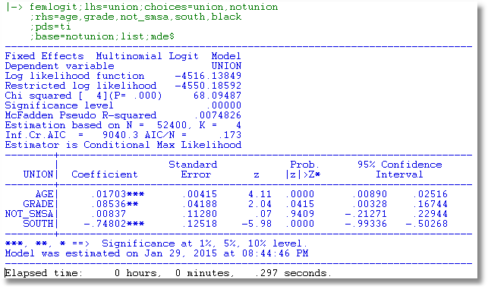

Slide 103
Why a 300 fold increase in speed?
MDE is much faster
Not using Krailo and Pike, or not using efficiently
Numerical derivatives for an extremely messy function (increase the number of function evaluations by at least 5 times)

