Slide 1
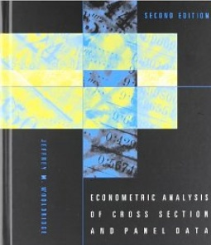
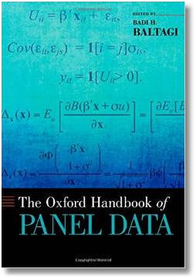

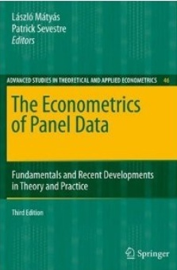
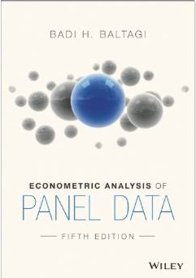



Econometric Analysis of Panel Data
William Greene
Department of Economics
University of South Florida

Slide 2
Econometric Analysis of Panel Data
25. Bayesian Econometric Models
for Panel Data

Slide 3
Sources
Lancaster, T.: An Introduction to Modern Bayesian Econometrics, Blackwell, 2004
Koop, G.: Bayesian Econometrics, Wiley, 2003
… “Bayesian Methods,” “Bayesian Data Analysis,” … (many books in statistics)
Papers in Marketing: Allenby, Ginter, Lenk, Kamakura,…
Papers in Statistics: Sid Chib,…
Books and Papers in Econometrics: Arnold Zellner, Gary Koop, Mark Steel, Dale Poirier, John Geweke …

Slide 4
Software
Stata, Limdep, SAS, etc.
R, Matlab, Gauss
WinBUGS
  Bayesian inference Using Gibbs Sampling

Slide 5
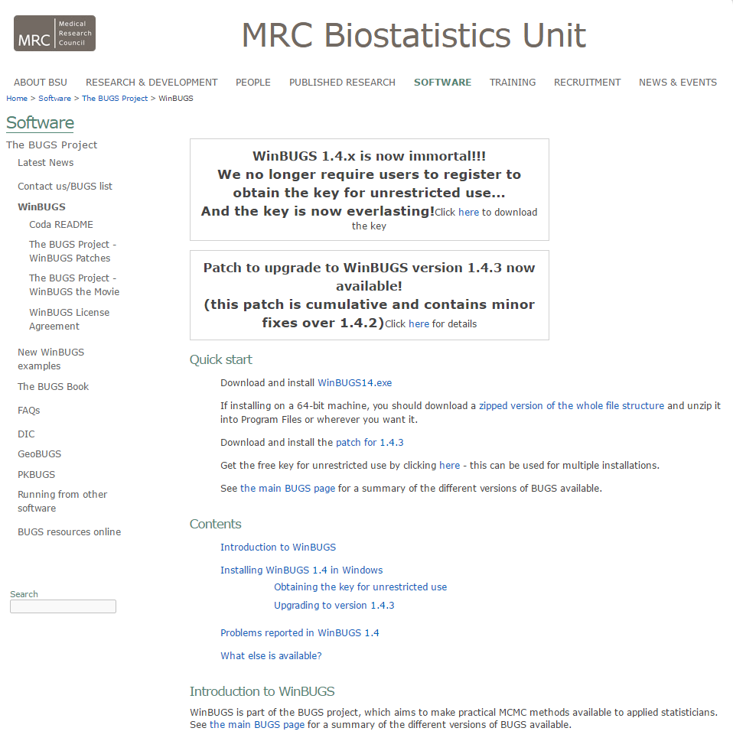
http://www.mrc-bsu.cam.ac.uk/software/bugs/the-bugs-project-winbugs/

Slide 6
A Philosophical Underpinning
A method of using new information to update existing beliefs about probabilities of events
Bayes Theorem for events. (Conceived for updating beliefs about games of chance)

Slide 7
On Objectivity and Subjectivity
Objectivity and “Frequentist” methods in Econometrics – The data speak
Subjectivity and Beliefs
  Priors
  Evidence
  Posteriors
Science and the Scientific Method

Slide 8
Paradigms
Classical
  Formulate the theory
  Gather evidence
    Evidence consistent with theory? Theory stands and waits for more evidence to be gathered
    Evidence conflicts with theory? Theory falls
Bayesian
  Formulate the theory
  Assemble existing evidence on the theory
  Form beliefs based on existing evidence
  Gather evidence
  Combine beliefs with new evidence
  Revise beliefs regarding the theory

Slide 9
Applications of the Paradigm
Classical econometricians doggedly cling to their theories even when the evidence conflicts with them – that is what specification searches are all about.
Bayesian econometricians NEVER incorporate prior evidence in their estimators – priors are always studiously noninformative. (Informative priors taint the analysis.) As practiced, Bayesian analysis is not Bayesian.

Slide 10
Likelihoods
(Frequentist) The likelihood is the density of the observed data conditioned on the parameters
  Inference based on the likelihood is usually “maximum likelihood”
(Bayesian) A function of the parameters and the data that forms the basis for inference – not a probability distribution
  The likelihood embodies the current information about the parameters and the data

Slide 11
The Likelihood Principle
The likelihood embodies ALL the current information about the parameters and the data
Proportional likelihoods should lead to the same inferences

Slide 12
Application:
(1) 20 Bernoulli trials, 7 successes (Binomial)
(2) N Bernoulli trials until the 7th success (Negative Binomial)

Slide 13
Inference

Slide 14
The Bayesian Estimator
The posterior distribution embodies all that is “believed” about the model.
  Posterior = f(model|data)
  = Likelihood(θ,data) * prior(θ) / P(data)
“Estimation” amounts to examining the characteristics of the posterior distribution(s).
  Mean, variance
  Distribution
  Intervals containing specified probabilities

Slide 15
Priors and Posteriors
The Achilles heel of Bayesian Econometrics
Noninformative and Informative priors for estimation of parameters
  Noninformative (diffuse) priors: How to incorporate the total lack of prior belief in the Bayesian estimator. The estimator becomes solely a function of the likelihood
  Informative prior: Some prior information enters the estimator. The estimator mixes the information in the likelihood with the prior information.
Improper and Proper priors
  P(θ) is uniform over the allowable range of θ
  Cannot integrate to 1.0 if the range is infinite.
  Salvation – improper, but noninformative priors will fall out of the posterior.

Slide 16
Diffuse (Flat) Priors

Slide 17
Conjugate Prior

Slide 18
THE Question
Where does the prior come from?

Slide 19
Large Sample Properties of Posteriors
Under a uniform prior, the posterior is proportional to the likelihood function
  Bayesian ‘estimator’ is the mean of the posterior
  MLE equals the mode of the likelihood
  In large samples, the likelihood becomes approximately normal – the mean equals the mode
  Thus, in large samples, the posterior mean will be approximately equal to the MLE.

Slide 20
Reconciliation
A Theorem (Bernstein-Von Mises)
The posterior distribution converges to normal with covariance matrix equal to 1/N times the information matrix (same as classical MLE). (The distribution that is converging is the posterior, not the sampling distribution of the estimator of the posterior mean.)
The posterior mean (empirical) converges to the mode of the likelihood function. Same as the MLE. A proper prior disappears asymptotically.
Asymptotic sampling distribution of the posterior mean is the same as that of the MLE.

Slide 21
Mixed Model Estimation
MLWin: Multilevel modeling for Windows
  http://www.bristol.ac.uk/cmm/software/mlwin/
  Uses mostly Bayesian, MCMC methods
  “Markov Chain Monte Carlo (MCMC) methods allow Bayesian models to be fitted, where prior distributions for the model parameters are specified. By default MLwin sets diffuse priors which can be used to approximate maximum likelihood estimation.” (From their website.)

Slide 22
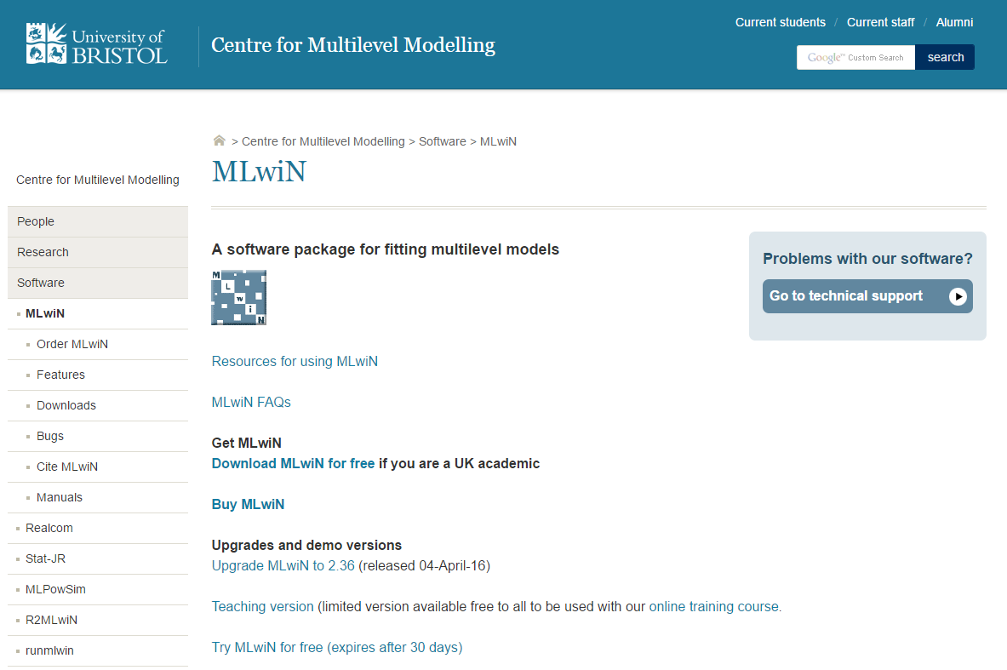

Slide 23
Bayesian Estimators
First generation: Do the integration (math)
Contemporary - Simulation:
  (1) Deduce the posterior
  (2) Draw random samples of draws from the posterior and compute the sample means and variances of the samples.
  (Relies on the law of large numbers.)

Slide 24
The Linear Regression Model

Slide 25
Marginal Posterior for β

Slide 26
Nonlinear Models and Simulation
Bayesian inference over parameters in a nonlinear model:
  1. Parameterize the model
  2. Form the likelihood conditioned on the parameters
  3. Develop the priors – joint prior for all model parameters
  4. Posterior is proportional to likelihood times prior. (Usually requires conjugate priors to be tractable.)
  5. Draw observations from the posterior to study its characteristics.

Slide 27
Simulation Based Inference

Slide 28
A Practical Problem

Slide 29
A Solution to the Sampling Problem

Slide 30
The Gibbs Sampler
Target: Sample from marginals of f(x₁, x₂) = joint distribution
Joint distribution is unknown or it is not possible to sample from the joint distribution.
Assumed: f(x₁|x₂) and f(x₂|x₁) both known and samples can be drawn from both.
Gibbs sampling: Obtain one draw from x₁,x₂ by many cycles between x₁|x₂ and x₂|x₁.
  Start x_{1,0} anywhere in the right range.
  Draw x_{2,0} from x₂|x_{1,0}.
  Return to x_{1,1} from x₁|x_{2,0} and so on.
  Several thousand cycles produces the draws
  Discard the first several thousand to avoid initial conditions. (Burn in)
Average the draws to estimate the marginal means.

Slide 31
Bivariate Normal Sampling

Slide 32
Gibbs Sampling for the Linear Regression Model

Slide 33
Application – the Probit Model

Slide 34
Gibbs Sampling for the Probit Model

Slide 35
Generating Random Draws from f(X)

Slide 36
Example: Simulated Probit
? Generate raw data
Sample ; 1 - 1000 $
Create ; x1=rnn(0,1) ; x2 = rnn(0,1) $
Create ; ys = .2 + .5*x1 - .5*x2 + rnn(0,1) ; y = ys > 0 $
Namelist; x=one,x1,x2$
Matrix ; xx=x'x ; xxi = <xx> $
Calc ; Rep = 200 ; Ri = 1/Rep$
Probit ; lhs=y;rhs=x$
? Gibbs sampler
Matrix ; beta=[0/0/0] ; bbar=init(3,1,0);bv=init(3,3,0)$$
Proc = gibbs$
Do for ; simulate ; r =1,Rep $
Create ; mui = x'beta ; f = rnu(0,1)
; if(y=1) ysg = mui + inp(1-(1-f)*phi( mui));
(else) ysg = mui + inp( f *phi(-mui)) $
Matrix ; mb = xxi*x'ysg ; beta = rndm(mb,xxi)
; bbar=bbar+beta ; bv=bv+beta*beta'$
Enddo ; simulate $
Endproc $
Execute ; Proc = Gibbs $ (Note, did not discard burn-in)
Matrix ; bbar=ri*bbar ; bv=ri*bv-bbar*bbar' $
Matrix ; Stat(bbar,bv); Stat(b,varb) $

Slide 37
Example: Probit MLE vs. Gibbs
--> Matrix ; Stat(bbar,bv); Stat(b,varb) $
+---------------------------------------------------+
|Number of observations in current sample = 1000 |
|Number of parameters computed here = 3 |
|Number of degrees of freedom = 997 |
+---------------------------------------------------+
+---------+--------------+----------------+--------+---------+
|Variable | Coefficient | Standard Error |b/St.Er.|P[|Z|>z] |
+---------+--------------+----------------+--------+---------+
BBAR_1 .21483281 .05076663 4.232 .0000
BBAR_2 .40815611 .04779292 8.540 .0000
BBAR_3 -.49692480 .04508507 -11.022 .0000
+---------+--------------+----------------+--------+---------+
|Variable | Coefficient | Standard Error |b/St.Er.|P[|Z|>z] |
+---------+--------------+----------------+--------+---------+
B_1 .22696546 .04276520 5.307 .0000
B_2 .40038880 .04671773 8.570 .0000
B_3 -.50012787 .04705345 -10.629 .0000

Slide 38
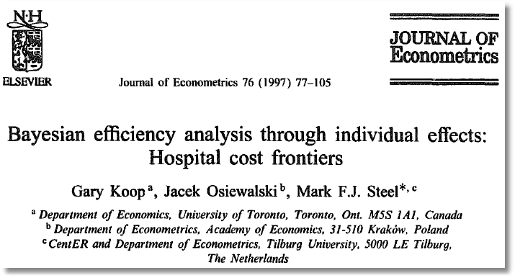
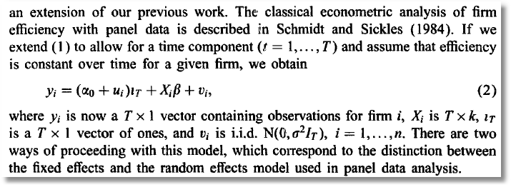

Slide 39
A Random Parameters Approach to Modeling Heterogeneity
Allenby and Rossi, “Marketing Models of Consumer Heterogeneity,” Journal of Econometrics, 89, 1999.
  Discrete Choice Model – Brand Choice
  “Hierarchical Bayes”
  Multinomial Probit
Panel Data: Purchases of 4 brands of Ketchup

Slide 40
Structure

Slide 41
Bayesian Priors

Slide 42
Bayesian Estimator
Joint posterior mean=
Integral does not exist in closed form.
Estimate by random samples from the joint posterior.
Full joint posterior is not known, so not possible to sample from the joint posterior.

Slide 43
Gibbs Cycles for the MNP Model
Samples from the marginal posteriors

Slide 44
Bayesian Fixed Effects
Application: Koop, et al., “Hospital Cost Efficiency,” Journal of Econometrics, 1997, 76, pp. 77-106
Treat individual constants as first level parameters
Model=f(α₁,…,α_{N},β,σ,data)
Formal Bayesian treatment of K+N+1 parameters in the model.
  Stochastic Frontier – as in latent variable application
  Bayesian counterparts to fixed effects and random effects models
??? Incidental parameters? (Almost surely, or something like it.) How do you deal with it
  Irrelevant – There are no asymptotic properties
  Must be relevant – estimates are numerically unstable

Slide 45
Comparison of Maximum Simulated Likelihood and Hierarchical Bayes
Ken Train: “A Comparison of Hierarchical Bayes and Maximum Simulated Likelihood for Mixed Logit”
Mixed Logit

Slide 46
Stochastic Structure – Conditional Likelihood
Note individual specific parameter vector, β_{i}

Slide 47
Classical Approach

Slide 48
Bayesian Approach – Gibbs Sampling and Metropolis-Hastings

Slide 49
Gibbs Sampling from Posteriors: b

Slide 50
Gibbs Sampling from Posteriors: Γ

Slide 51
Gibbs Sampling from Posteriors: β_{i}

Slide 52
Metropolis – Hastings Method

Slide 53
Metropolis Hastings: A Draw of β_{i}

Slide 54
Application: Energy Suppliers
N=361 individuals, 2 to 12 hypothetical suppliers. (A stated choice experiment)
X=
  (1) fixed rates,
  (2) contract length,
  (3) local (0,1),
  (4) well known company (0,1),
  (5) offer TOD rates (0,1),
  (6) offer seasonal rates]

Slide 55
Estimates: Mean of Individual β_{i}
 | MSL Estimate | Bayes Posterior Mean (Std. Dev.)
Price | -1.04 (0.396) | -1.04 (0.0374)
Contract | -0.208 (0.0240) | -0.194 (0.0224)
Local | 2.40 (0.127) | 2.41 (0.140)
Well Known | 1.74 (0.0927) | 1.71 (0.100)
TOD | -9.94 (0.337) | -10.0 (0.315)
Seasonal | -10.2 (0.333) | -10.2 (0.310)

Slide 56
Conclusions
Bayesian vs. Classical Estimation
  In principle, some differences in interpretation
  As practiced, just two different algorithms
  The religious debate is a red herring
Gibbs Sampler. A major technological advance
  Useful tool for both classical and Bayesian
  New Bayesian applications appear daily

Slide 57
Standard Criticisms
Of the Classical Approach
  Computationally difficult (ML vs. MCMC)
  No attention is paid to household level parameters.
  There is no natural estimator of individual or household level parameters
  Responses: None are true. See, e.g., Train (2009, ch. 10)
Of Classical Inference in this Setting
  Asymptotics are “only approximate” and rely on “imaginary samples.” Bayesian procedures are “exact.”
  Response: The inexactness results from acknowledging that we try to extend these results outside the sample. The Bayesian results are “exact” but have no generality and are useless except for this sample, these data and this prior. (Or are they? Trying to extend them outside the sample is a distinctly classical exercise.)

Slide 58
Standard Criticisms
Of the Bayesian Approach
  Computationally difficult.
  Response: Not really, with MCMC and Metropolis-Hastings
  The prior (conjugate or not) is a canard. It has nothing to do with “prior knowledge” or the uncertainty of the investigator.
  Response: In fact, the prior usually has little influence on the results. (Bernstein and von Mises Theorem)
Of Bayesian ‘Inference’
  It is not statistical inference
  How do we discern any uncertainty in the results? This is precisely the underpinning of the Bayesian method. There is no uncertainty. It is ‘exact.’

