Slide 1








Econometric Analysis of Panel Data
William Greene
Department of Economics
University of South Florida

Slide 2
Fixed and Random Effects
Unobserved individual effects in regression: E[y_{it} | x_{it}, c_{i}]
  Notation:
Linear specification:
  Fixed Effects: E[c_{i} | X_{i} ] = g(X_{i}). Cov[x_{it},c_{i}] ≠0
  effects are correlated with included variables.
  Random Effects: E[c_{i} | X_{i} ] = μ; effects are uncorrelated with included variables. If X_{i} contains a constant term, μ=0 WLOG. Common: Cov[x_{it},c_{i}] =0, but E[c_{i} | X_{i} ] = μ is needed for the full model

Slide 3
Convenient Notation
Fixed Effects – the ‘dummy variable model’
Random Effects – the ‘error components model’
Individual specific constant terms.
Compound (“composed”) disturbance

Slide 4
Balanced and Unbalanced Panels
Distinction: Balanced vs. Unbalanced Panels
A notation to help with mechanics
  z_{i,t}, i = 1,…,N; t = 1,…,T_{i}
The role of the assumption
  Mathematical and notational convenience:
    Balanced, n=NT
    Unbalanced:
  Is the fixed T_{i} assumption ever necessary? Almost never. (Baltagi chapter 9 is about algebra, not different models!)
Is unbalancedness due to nonrandom attrition from an otherwise balanced panel? This will require special considerations.

Slide 5
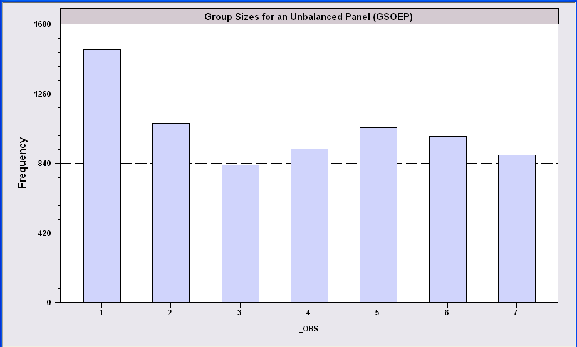
An Unbalanced Panel: RWM’s GSOEP Data on Health Care
N = 7,293 Households
Some households exited then returned

Slide 6
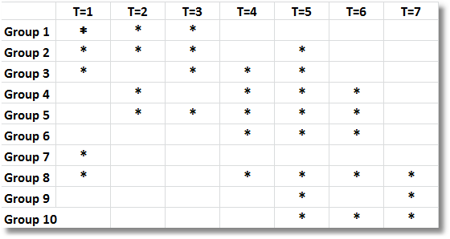
Unbalanced Panel Data – Not Attrition

Slide 7
Unbalanced Panels and Attrition ‘Bias’
Test for ‘attrition bias.’ (Verbeek and Nijman, Testing for Selectivity Bias in Panel Data Models, International Economic Review, 1992, 33, 681-703.
  Attrition bias seems to relate to sample selection (bias)
  Variable addition test using covariates of presence in the panel
  Nonconstructive – what to do next?
Do something about attrition bias. (Wooldridge, Inverse Probability Weighted M-Estimators for Sample Stratification and Attrition, Portuguese Economic Journal, 2002, 1: 117-139)
  Stringent assumptions about the process
  Model based on probability of being present in each wave of the panel

Slide 8
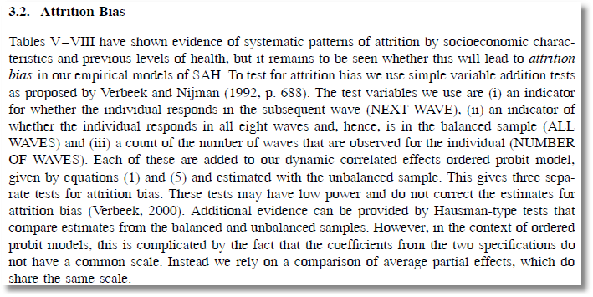
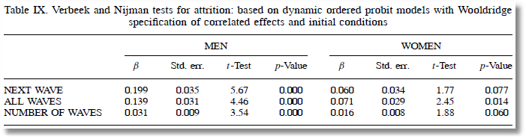

Slide 9
Inverse Probability Weighting

Slide 10
Exogeneity wrt Common Effects
Contemporaneous exogeneity
  E[ε_{it}|x_{it},c_{i}]=0 → Not sufficient for regression
  Doesn’t imply how to estimate β
  Not sufficient if x_{it} contains lagged values of y_{it}
Strict exogeneity – the most common assumption
  E[ε_{it}|x_{i1}, x_{i2},…,x_{iT},c_{i}]=0
  Can always use first difference or fixed effects
Sequential exogeneity (ε_{it} uncorrelated with history)
  E[ε_{it}|x_{i1}, x_{i2},…,x_{it},c_{i}] = 0
These assumptions are not testable. They are part of the model. They may need to be justified.

Slide 11
Assumptions for Asymptotics
Convergence of moments involving cross section X_{i}.
N increasing, T or T_{i} assumed fixed.
  “Fixed T asymptotics” (see text, p. 175)
  Time series characteristics are not relevant (may be nonstationary)
  If T is also growing, need to treat as multivariate time series.
Ranks of matrices. X must have full column rank. (X_{i} may not, if T_{i} < K.)
Strict exogeneity and dynamics. If x_{it} contains y_{i,t-1} then x_{it} cannot be strictly exogenous. X_{it} will be correlated with the unobservables in period t-1. (To be revisited later.)

Slide 12
Estimating β
β is the partial effect of interest
Can it be estimated (consistently) in the presence of (unmeasured) c_{i}?
  Does pooled least squares “work?”
  Strategies for “controlling for c_{i}” using the sample data
(We will worry about endogeneity of x later.)

Slide 13
The Pooled Regression
Presence of omitted effects
Potential bias/inconsistency of OLS – depends on ‘fixed’ or ‘random’

Slide 14
OLS with Omitted Individual Effects
Bias turns on the group means

Slide 15
Estimating the Sampling Variance of b_{OLS}
s²(X ́X)⁻¹?
  Correlation across observations => No
  Possible heteroscedasticity
Find a “robust” covariance matrix
  Robust estimation (in general)
  The White estimator
  A Robust estimator for OLS.

Slide 16
A ‘Cluster’ Estimator

Slide 17
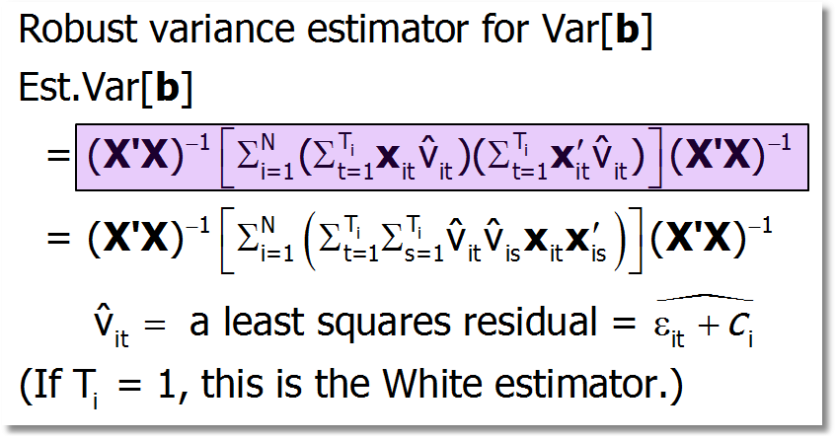
Cluster Estimator (cont.)

Slide 18
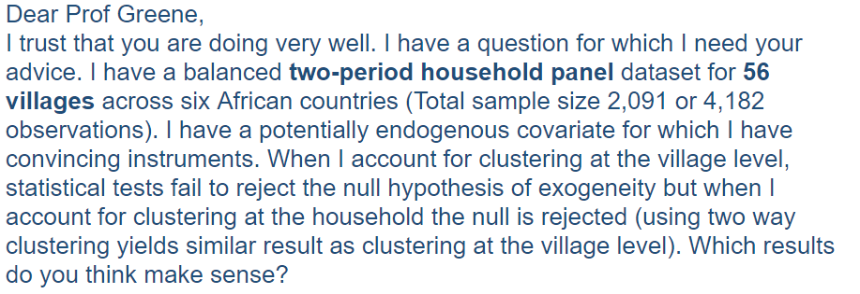
Monday, 2/6/17
By “clustering” at the village level, the effective sample of 2,091 observations becomes an effective sample of 56 observations!

Slide 19
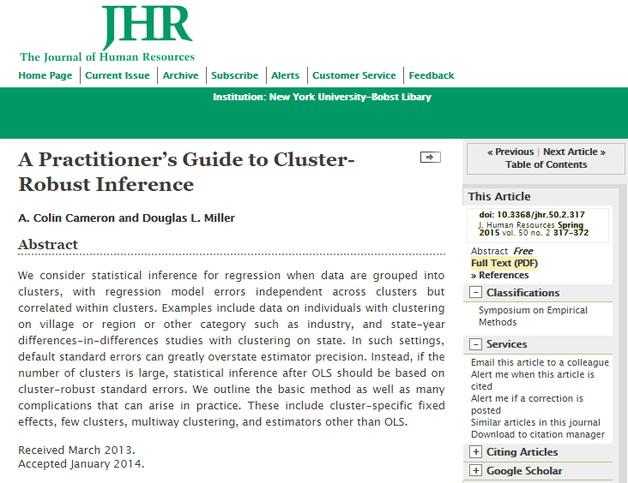

Slide 20
Cornwell and Rupert Data
Cornwell and Rupert Returns to Schooling Data, 595 Individuals, 7 Years
Variables in the file are
EXP = work experience
WKS = weeks worked
OCC = occupation, 1 if blue collar,
IND = 1 if manufacturing industry
SOUTH = 1 if resides in south
SMSA = 1 if resides in a city (SMSA)
MS = 1 if married
FEM = 1 if female
UNION = 1 if wage set by union contract
ED = years of education
LWAGE = log of wage = dependent variable in regressions
These data were analyzed in Cornwell, C. and Rupert, P., "Efficient Estimation with Panel Data: An Empirical Comparison of Instrumental Variable Estimators," Journal of Applied Econometrics, 3, 1988, pp. 149-155. See Baltagi, page 122 for further analysis. The data were downloaded from the website for Baltagi's text.

Slide 21
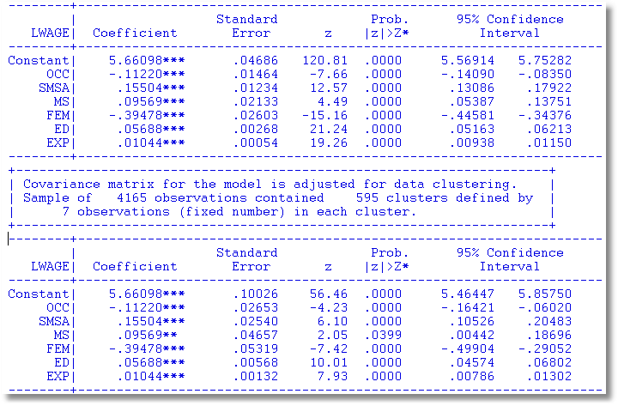
Application: Cornell and Rupert

Slide 22
Bootstrapping
Some assumptions that underlie it - the sampling mechanism
Method:
1. Estimate using full sample: --> b
2. Repeat R times:
Draw n observations from the n, with replacement
Estimate β with b(r).
3. Estimate variance with
W = (1/R)Σ_{r} [b(r) - ][b(r) - ]’

Slide 23
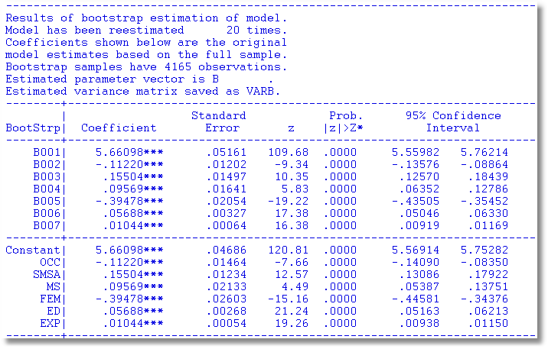
Results of Bootstrap Procedure

Slide 24

Bootstrap variance for a panel data estimator
Panel Bootstrap =
Block Bootstrap
Data set is N groups of size T_{i}
Bootstrap sample is N groups of size T_{i} drawn with replacement.

Slide 25
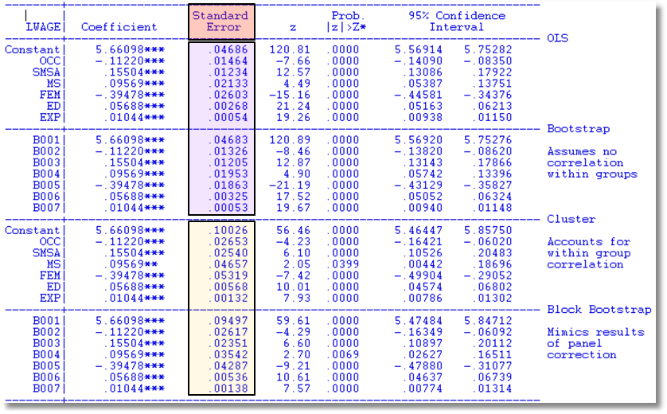
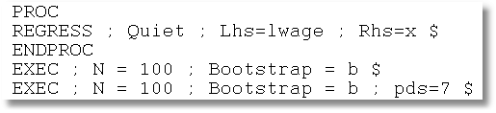

Slide 26
Bootstrapping
Naïve bootstrap: Why is it naïve?
Cases when it fails
  Time series
  “Clustered data” if not blocked
  Order statistics
  Parameters on the edge of the parameter space
Alternatives
  Block bootstrap
  “Wild” bootstrap (injects extra randomness)

Slide 27
Mundlak’s Estimator: A Control Fn.
Mundlak, Y., “On the Pooling of Time Series and Cross Section Data, Econometrica, 46, 1978, pp. 69-85.

Slide 28
Using First Differences
Eliminating the heterogeneity

Slide 29
OLS with First Differences
With strict exogeneity of (X_{i},c_{i}), OLS regression of Δy_{it} on Δx_{it} is unbiased and consistent but inefficient.
GLS is unpleasantly complicated. In order to compute a first step estimator of σ_{ε}² we would use fixed effects. We should just stop there. Or, use OLS in first differences and use Newey-West with one lag.

Slide 30
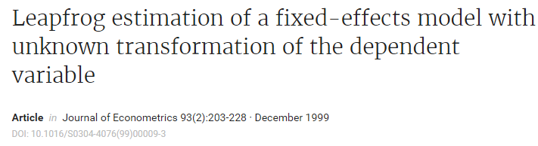
Leapfrog Estimator
Jason Abrevaya

Slide 31
Two Periods
With two periods and strict exogeneity,
This is a classical regression model. If there are no regressors,

Slide 32
Difference-in-Differences Model
With two periods and strict exogeneity of D and T,
This is a linear regression model. If there are no regressors,

Slide 33
Difference in Differences

Slide 34


Slide 35


Slide 36
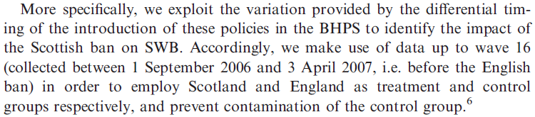

Slide 37
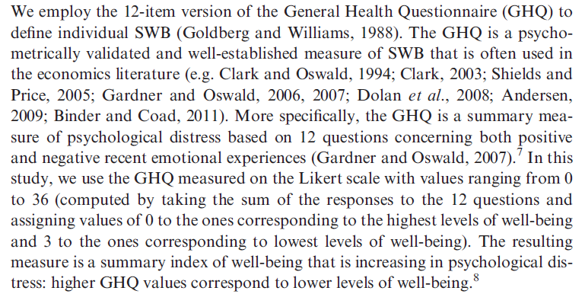

Slide 38
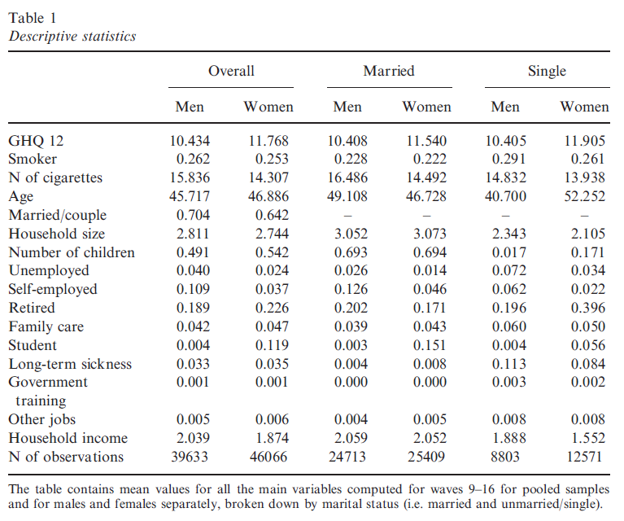

Slide 39
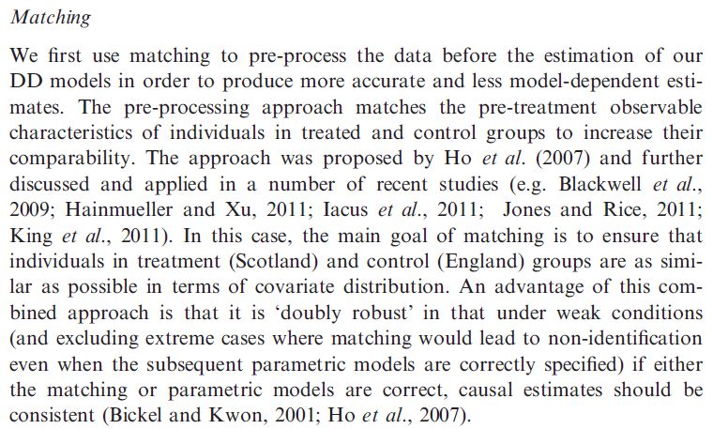

Slide 40
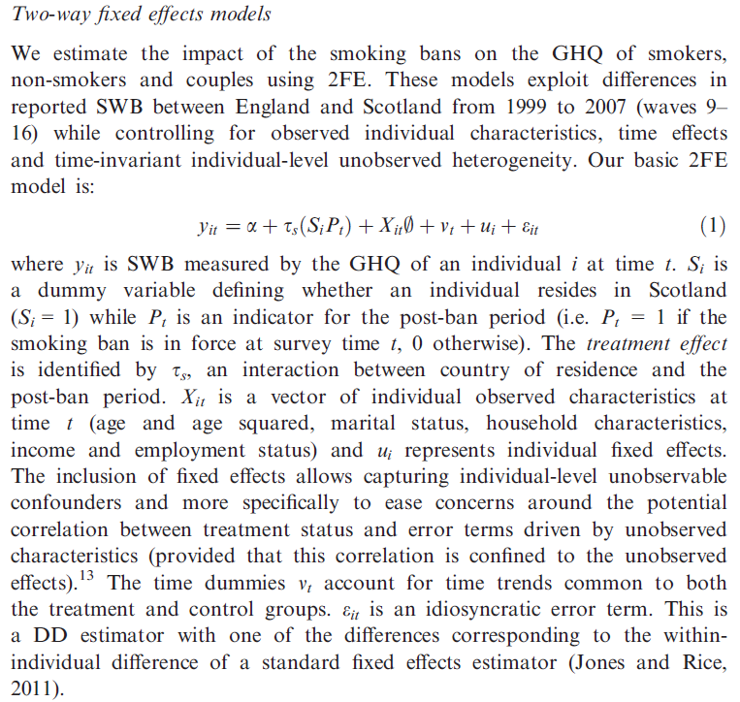

Slide 41
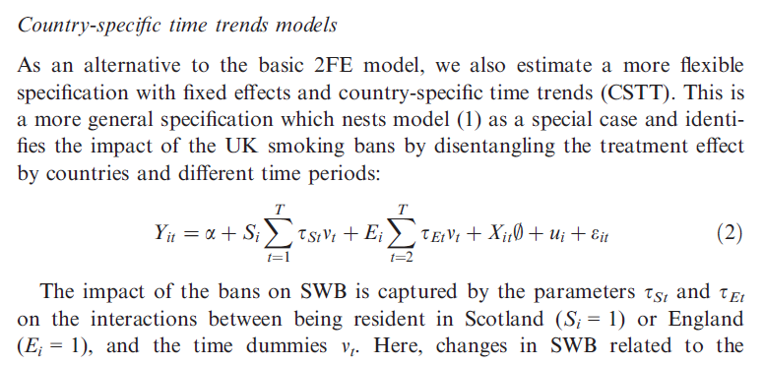

Slide 42

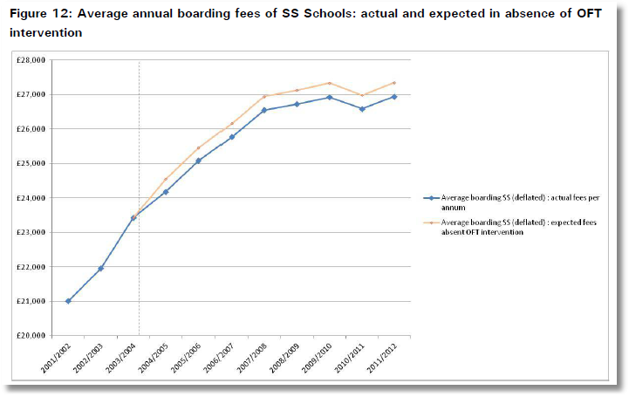
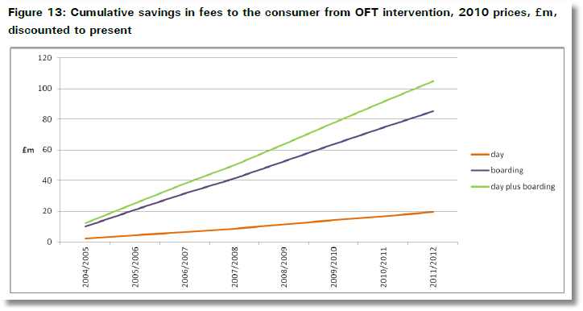

http://dera.ioe.ac.uk/14610/1/oft1416.pdf

Slide 43


Outcome is the fees charged.
Activity is collusion on fees.

Slide 44
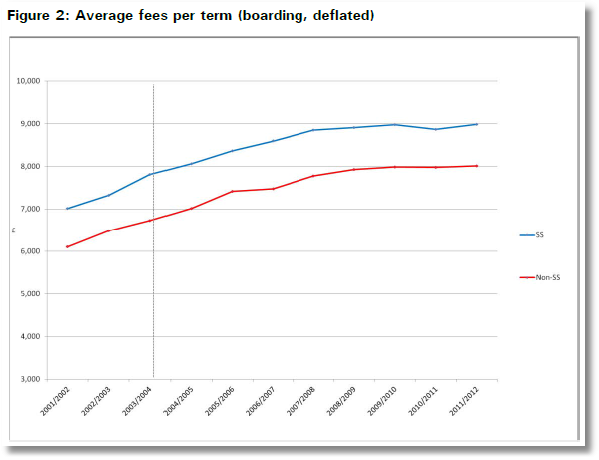
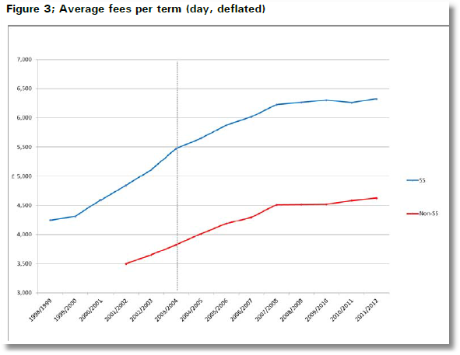
Treatment Schools: Treatment is an intervention by the Office of Fair Trading
Control Schools were not involved in the conspiracy
Treatment is not voluntary

Slide 45
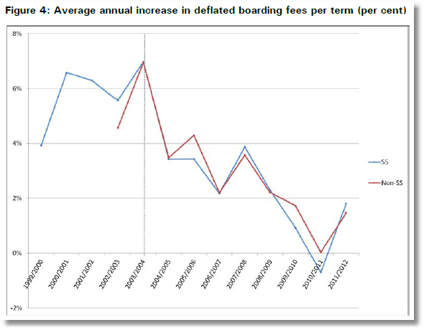

Slide 46
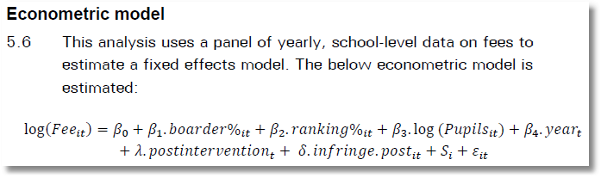

Slide 47

Treatment (Intervention) Effect = δ

Slide 48
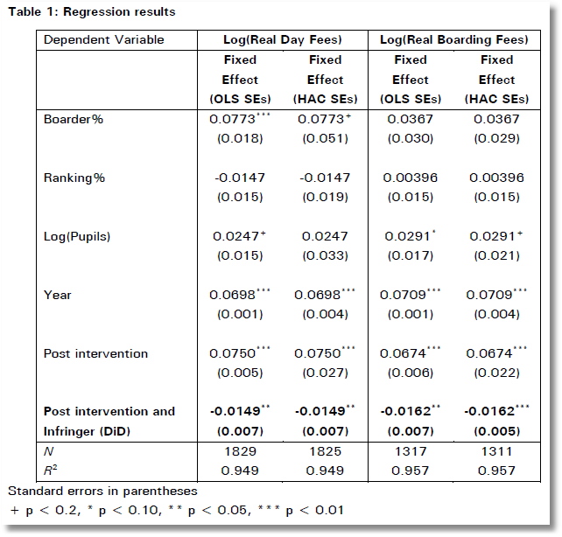
In order to test robustness two versions of the fixed effects model were run. The first is Ordinary Least Squares, and the second is heteroscedasticity and auto-correlation robust (HAC) standard errors in order to check for heteroscedasticity and autocorrelation.

Slide 49


