Slide 1

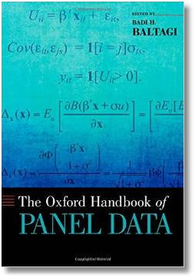






Econometric Analysis of Panel Data
William Greene
Department of Economics
University of South Florida

Slide 2
Chamberlain’s Approach and
Minimum Distance Estimation
Chamberlain (1984) “Panel Data,” Handbook of Econometrics
Innovation: treat the panel as a system of equations: SUR Models, See Wooldridge, Ch. 7 through p. 172.
Assumptions:
  Balanced panel
  Minimal restrictions on variances and covariances of disturbances (zero means, finite fourth moments)
Model the correlation between effects and regressors

Slide 3
Chamberlain

Slide 4
Chamberlain - Data

Slide 5
Chamberlain Model

Slide 6
Chamberlain SUR Model

Slide 7
Chamberlain – Implied Model

Slide 8
Chamberlain Estimation of Π
FGLS. Use the usual two step GLS estimator.
OLS. System has an unrestricted covariance matrix and the same regressors in every equation. GLS = FGLS = equation by equation OLS. Denote the T OLS coefficient vectors as
P = [p₁, p₂, p₃ …, p_{T}].
  Unconstrained OLS will be consistent. Plim p_{t} = π_{t}, t=1,…,T
  OLS is inefficient. There are T(T-1) different estimates of β in P and T-1 estimates of each δ_{t}.

Slide 9
Chamberlain Estimation of Σ

Slide 10
Chamberlain Estimator: Application
Cornwell and Rupert:
Lwage_{it} = α_{i} + β₁Exp_{it} + β₂Exp_{it}² + β₃Wks_{it} + ε_{it}
α_{i} projected onto all 7 periods of Exp, Exp² and Wks.
For each of the 7 years, we regress Lwage_{it} on a constant
and the three variables for all 7 years.
Each regression has 22 coefficients.

Slide 11
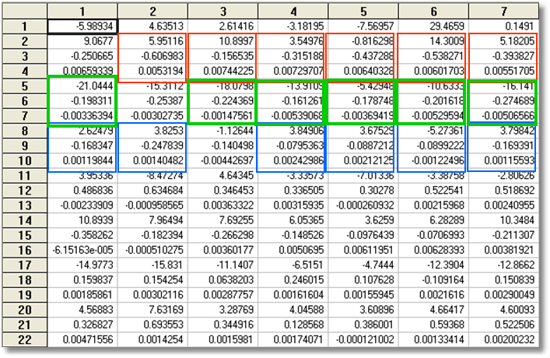
Chamberlain Approach
Least Squares Estimates
1976 1977 1978 1979 1980 1981 1982 What They Estimate
There are 7 estimates of α
There are potentially 42 estimates of β
There are potentially 6 estimates of each δ_{t}.
How do we “average” the different estimates to get a single estimate?

Slide 12
Efficient Estimation of Π
Minimum Distance Estimation: Chamberlain (1984). (See Wooldridge, pp. 545-547.)
  Asymptotically efficient
  Assumes only finite fourth moments of v_{it}
Maximum likelihood Estimation: Joreskog (1981), Greene (1981,2008)
  Add normality assumption
  Same asymptotic properties as MDE (!)

Slide 13
MDE-1
Cornwell and Rupert. Pooled, all 7 years
+--------+--------------+----------------+--------+--------+----------+
|Variable| Coefficient | Standard Error |b/St.Er.|P[|Z|>z]| Mean of X|
+--------+--------------+----------------+--------+--------+----------+
Constant| 5.25112359 .07128679 73.662 .0000
EXP | .04010465 .00215918 18.574 .0000 19.8537815
EXPSQ | -.00067338 .474431D-04 -14.193 .0000 514.405042
WKS | .00421609 .00108137 3.899 .0001 46.8115246
OCC | -.14000934 .01465670 -9.553 .0000 .51116447
IND | .04678864 .01179350 3.967 .0001 .39543818
SOUTH | -.05563737 .01252710 -4.441 .0000 .29027611
SMSA | .15166712 .01206870 12.567 .0000 .65378151
MS | .04844851 .02056867 2.355 .0185 .81440576
FEM | -.36778522 .02509705 -14.655 .0000 .11260504
UNION | .09262675 .01279951 7.237 .0000 .36398559
ED | .05670421 .00261283 21.702 .0000 12.8453782

Slide 14
MDE-2
Cornwell and Rupert. Year 1
+--------+--------------+----------------+--------+--------+----------+
|Variable| Coefficient | Standard Error |b/St.Er.|P[|Z|>z]| Mean of X|
+--------+--------------+----------------+--------+--------+----------+
Constant| 5.11054693 .13191639 38.741 .0000
EXP | .03199044 .00426736 7.497 .0000 16.8537815
EXPSQ | -.00057556 .00010715 -5.372 .0000 400.282353
WKS | .00516535 .00183814 2.810 .0050 46.2806723
OCC | -.11540477 .02987160 -3.863 .0001 .52436975
IND | .01473703 .02447046 .602 .5470 .39159664
SOUTH | -.05868033 .02588364 -2.267 .0234 .29243697
SMSA | .18340943 .02526029 7.261 .0000 .66050420
MS | .07416736 .04493028 1.651 .0988 .82352941
FEM | -.30678002 .05378268 -5.704 .0000 .11260504
UNION | .11046575 .02637235 4.189 .0000 .36134454
ED | .04757357 .00539679 8.815 .0000 12.8453782

Slide 15
MDE-3
Cornwell and Rupert. Year 7
+--------+--------------+----------------+--------+--------+----------+
|Variable| Coefficient | Standard Error |b/St.Er.|P[|Z|>z]| Mean of X|
+--------+--------------+----------------+--------+--------+----------+
Constant| 5.59009297 .19011263 29.404 .0000
EXP | .02938018 .00652410 4.503 .0000 22.8537815
EXPSQ | -.00048597 .00012680 -3.833 .0001 638.527731
WKS | .00341276 .00267762 1.275 .2025 46.4521008
OCC | -.16152170 .03690729 -4.376 .0000 .51260504
IND | .08466281 .02916370 2.903 .0037 .40504202
SOUTH | -.05876312 .03090689 -1.901 .0573 .29243697
SMSA | .16619142 .02955099 5.624 .0000 .64201681
MS | .09523724 .04892770 1.946 .0516 .80504202
FEM | -.32455710 .06072947 -5.344 .0000 .11260504
UNION | .10627809 .03167547 3.355 .0008 .36638655
ED | .05719350 .00659101 8.678 .0000 12.8453782

Slide 16
MDE-4

Slide 17
MDE-5

Slide 18
MDE-6

Slide 19
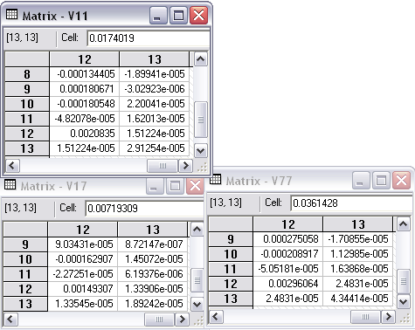
MDE-7
S₁₁ S₂₁
S₁₂ S₂₂

Slide 20
MDE-8

Slide 21
MDE-9

Slide 22
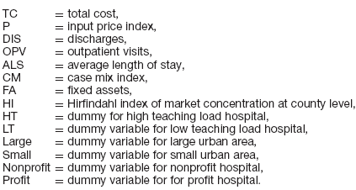
Carey Hospital Cost Model

Slide 23
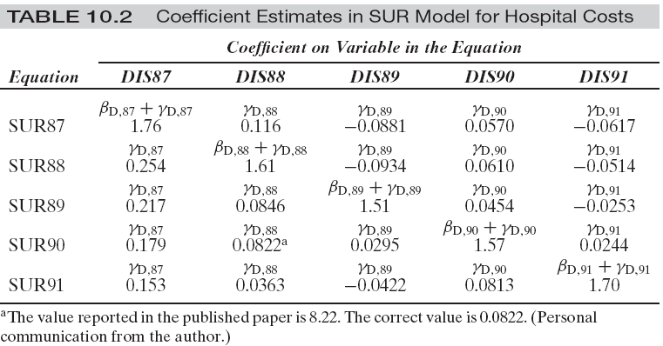
Multiple Estimates (25) of 10 Structural Parameters

Slide 24
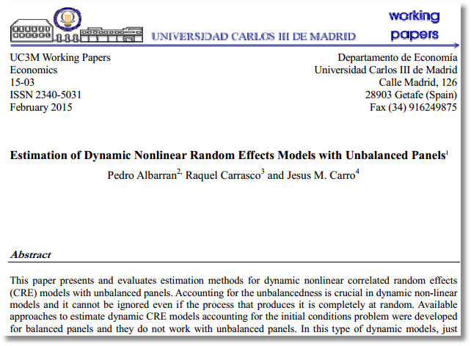

Slide 25

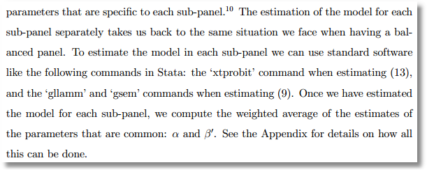

Slide 26
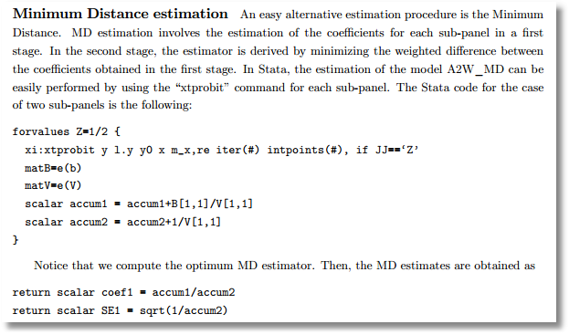

Slide 27
Appendix I. Chamberlain Model Algebra

Slide 28
Minimum Distance Estimation

Slide 29
MDE (2)

Slide 30
MDE (3)

Slide 31
Maximum Likelihood Estimation

Slide 32
MLE (2)

Slide 33
Rearrange the Panel Data

Slide 34
Generalized Regression Model

Slide 35
Least Squares

Slide 36
GLS and FGLS

