Slide 1








Econometric Analysis of Panel Data
William Greene
Department of Economics
University of South Florida

Slide 2

http://people.stern.nyu.edu/wgreene/Econometrics/Bell-Jones-Fixed-vs-Random-Sept-2013.pdf

Slide 3
Fixed Effects Models
The fixed effects model
c_{i} is arbitrarily correlated with x_{it} but E[ε_{it}|X_{i},c_{i}]=0
Dummy variable representation

Slide 4
Useful Analysis of Variance Notation
Total variation = Within groups variation
+ Between groups variation

Slide 5
Baltagi and Griffin’s Gasoline Data
World Gasoline Demand Data, 18 OECD Countries, 19 years
Variables in the file are
COUNTRY = name of country
YEAR = year, 1960-1978
LGASPCAR = log of consumption per car
LINCOMEP = log of per capita income
LRPMG = log of real price of gasoline
LCARPCAP = log of per capita number of cars
See Baltagi (2001, p. 24) for analysis of these data. The article on which the analysis is based is Baltagi, B. and Griffin, J., "Gasoline Demand in the OECD: An Application of Pooling and Testing Procedures," European Economic Review, 22, 1983, pp. 117-137. The data were downloaded from the website for Baltagi's text.

Slide 6
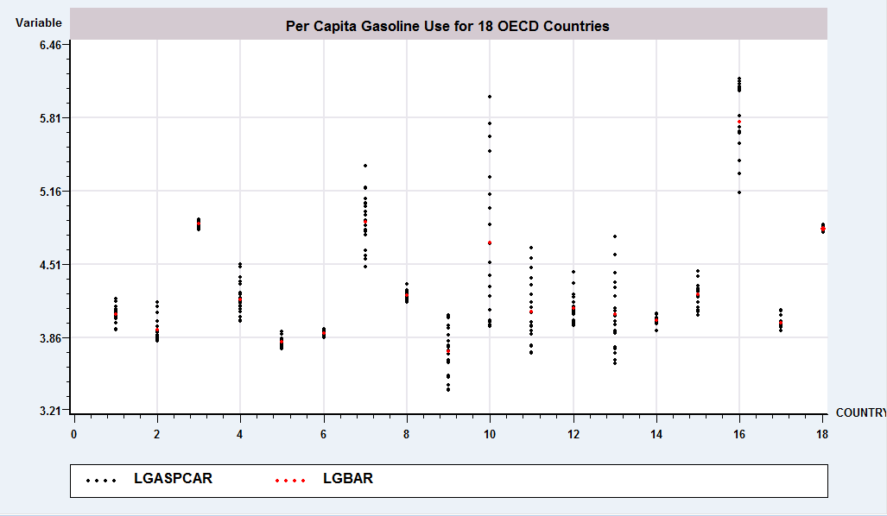
Analysis of Variance

Slide 7
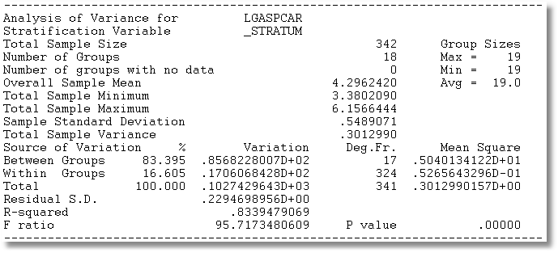
The Analysis of Variance

Slide 8
The Fixed Effects Model
y_{i} = X_{i}β + d_{i}α_{i} + ε_{i}, for each individual
  E[c_{i} | X_{i} ] = g(X_{i}); Effects are correlated with included variables.
  Cov[x_{it},c_{i}] ≠0

Slide 10
Estimating the Fixed Effects Model
The FEM is a simple linear regression model but with many independent variables
Least squares estimator of β is unbiased, consistent, efficient, but inconvenient if N is large.

Slide 11
Fixed Effects Estimator (cont.)

Slide 12
The Within Transformation Removes the Effects
Wooldridge notation for data in deviations from group means

Slide 13
Least Squares Dummy Variable Estimator
b is obtained by ‘within’ groups least squares (group mean deviations)
Normal equations for a are D’Xb+D’Da=D’y
a = (D’D)⁻¹D’(y – Xb)
Notes: This is simple algebra – the estimator is just OLS
Least squares is an estimator, not a model. (Repeat twice.)
Note what a_{i} is when T_{i} = 1. Follow this with y_{it}-a_{i}-x_{it}’b=0 if T_{i}=1.

Slide 14
A Fixed Effects Log Wage Equation
EXP = work experience
WKS = weeks worked
OCC = occupation, 1 if blue collar,
IND = 1 if manufacturing industry
SOUTH = 1 if resides in south
SMSA = 1 if resides in a city (SMSA)
MS = 1 if married
FEM = 1 if female
UNION = 1 if wage set by union contract
ED = years of education
LWAGE = log of wage = dependent variable in regressions
Are the other unobserved attributes likely to be correlated with the observed variables?
One possibility: Health_{i} probably correlated with Exp_{it} and Wks_{it}. A fixed effects treatment would be appropriate. (Motivation and Ability are the usual candidates here.)

Slide 15
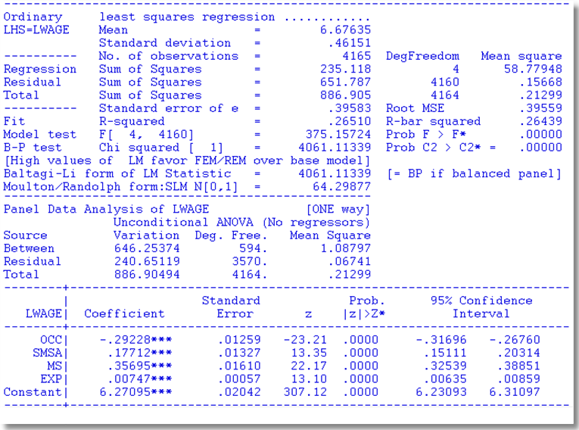
Application Cornwell and Rupert

Slide 16

LSDV Results
Note huge changes in the coefficients. SMSA and MS change signs. Significance changes completely!
Pooled OLS

Slide 17
Different Normalizations
Separate constants: using D
Overall constant and N-1 constrasts
Overall constant, N constants, Σ_{i} γ_{i} = 0

Slide 18
Renormalizing Fixed Effects
N Dummy Variables vs. a Constant and N-1 Dummy Variables
Implication: No change in other coefficients, no change in sum of squares or R²

Slide 19
xtreg lx2ppii lx5ppii lx7ppii lx14 lx15,fe
Fixed-effects (within) regression Number of obs = 210
Group variable: id Number of groups = 30
R-sq: Obs per group:
within = 0.6875 min = 7
between = 0.5190 <***** avg = 7.0
overall = 0.5446 max = 7
F(4,176) = 96.78
corr(u_i, Xb) = -0.0122 (How to compute this?) Prob > F = 0.0000
------------------------------------------------------------------------------
lx2ppii | Coef. Std. Err. t P>|t| [95% Conf. Interval]
-------------+----------------------------------------------------------------
lx5ppii | .6814873 .0372348 18.30 0.000 .6080031 .7549715
lx7ppii | .0176203 .0192227 0.92 0.361 -.0203163 .055557
lx14 | -.1034633 .1198958 -0.86 0.389 -.3400818 .1331553
lx15 | -.0486583 .1786855 -0.27 0.786 -.4013003 .3039837
_cons | 3.23385 2.156826 1.50 0.136 -1.022721 7.490421
(Which constant term is this? Which one is omitted? First? Last?
-------------+----------------------------------------------------------------
sigma_u | .68475697 (How is this computed?)
sigma_e | .250843
rho | .88168388 (fraction of variance due to u_i)
------------------------------------------------------------------------------
F test that all u_i=0: F(29, 176) = 20.77 Prob > F = 0.0000

Slide 20
The Effect of the Effects

Slide 21
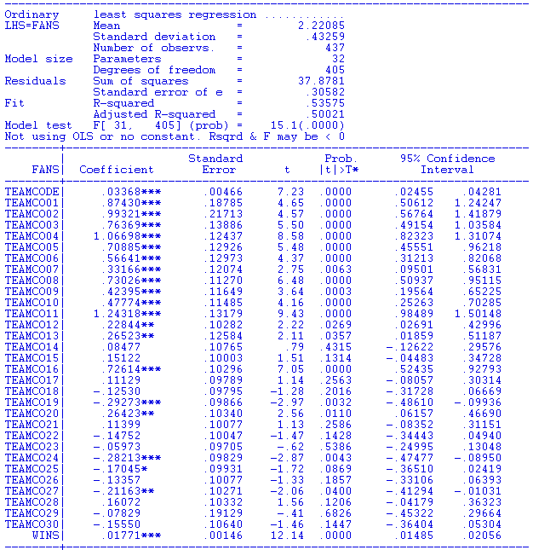
Inside Baseball: 31 Teams, 16 years. Fans = a(i) + bWins(i,t) + e(i,t)

Slide 22
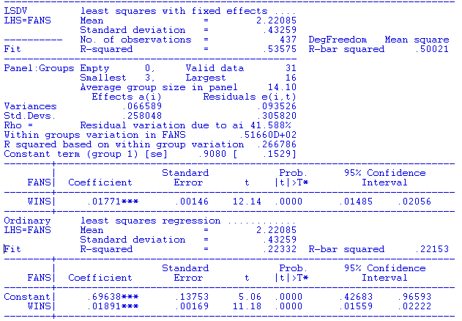
Inside Baseball: 31 Teams, 16 years. Fans = a(i) + bWins(i,t) + e(i,t)

Slide 23
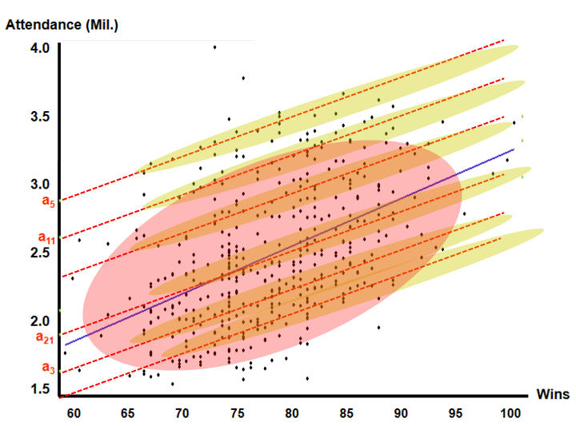

Slide 24
A Caution About Stata and R²
For the FE model above,
R² = 0.90542 areg
R² = 0.65142 xtreg fe
The coefficient estimates and standard errors are the same. The calculation of the R² is different. In the areg procedure, you are estimating coefficients for each of your covariates plus each dummy variable for your groups. In the xtreg, fe procedure the R² reported is obtained by only fitting a mean deviated model where the effects of the groups (all of the dummy variables) are assumed to be fixed quantities. So, all of the effects for the groups are simply subtracted out of the model and no attempt is made to quantify their overall effect on the fit of the model.
Since the SSE is the same, the R²=1−SSE/SST is very different. The difference is real in that we are making different assumptions with the two approaches. In the xtreg, fe approach, the effects of the groups are fixed and unestimated quantities are subtracted out of the model before the fit is performed. In the areg approach, the group effects are estimated and affect the total sum of squares of the model under consideration.

Slide 25
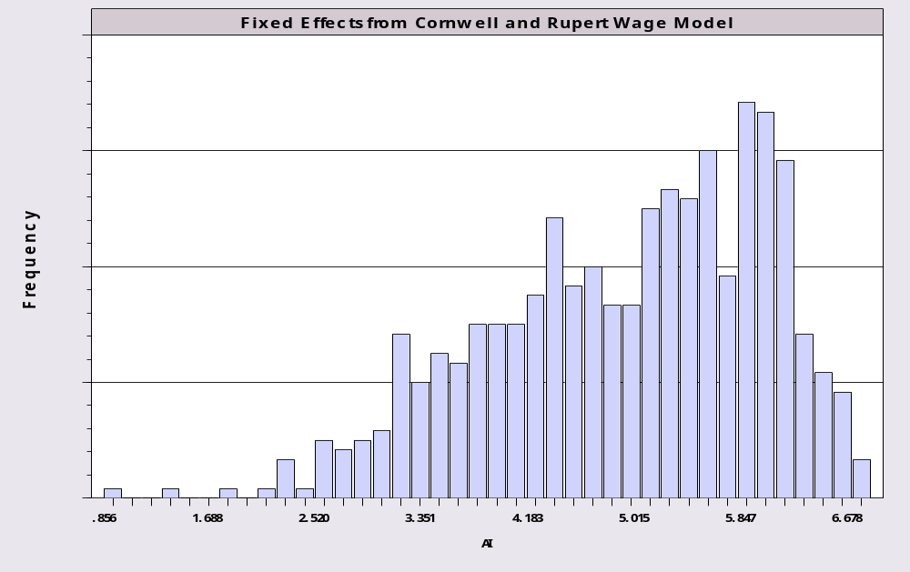
The Estimated Fixed Effects

Slide 26
A Kernel Density Estimator

Slide 27
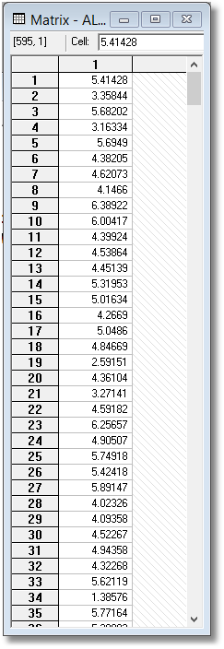
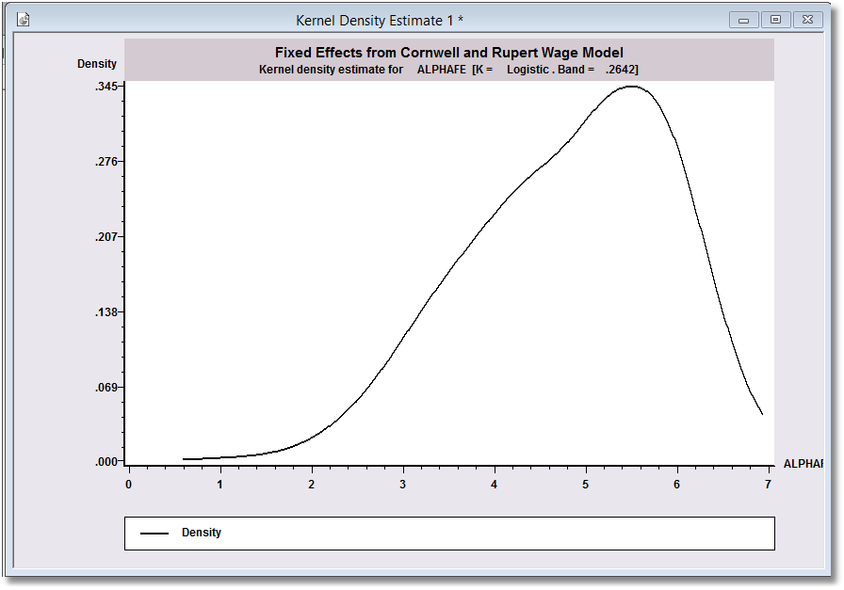
Examining the Effects
with a KDE
Mean = 4.819, standard deviation = 1.054.

Slide 28
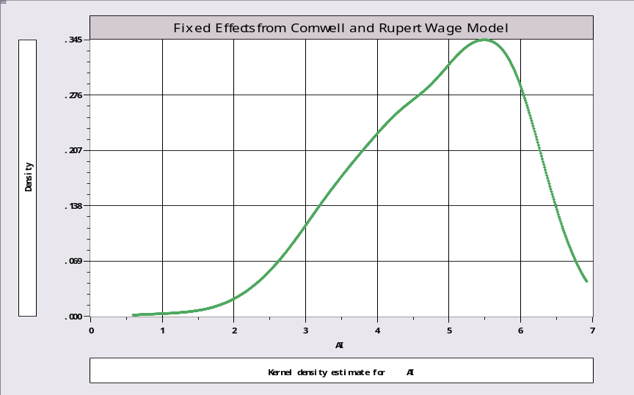
Histogram vs. KDE
CREATE ; ID=TRN(7,0)$
SETPANEL ; GROUP=ID $
REGRESS ;lhs=lwage;rhs=occ,smsa,ms,exp ; panel ; fixed $
? Creates 595 by 1 matrix named ALPHAFE
HISTOGRAM; rhs=alphafe ;title=Fixed Effects from Cornwell and Rupert Wage Model$
KERNEL;rhs=alphafe ; title=Fixed Effects from Cornwell and Rupert Wage Model$

Slide 29
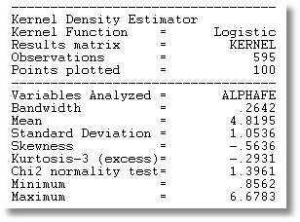

Slide 30
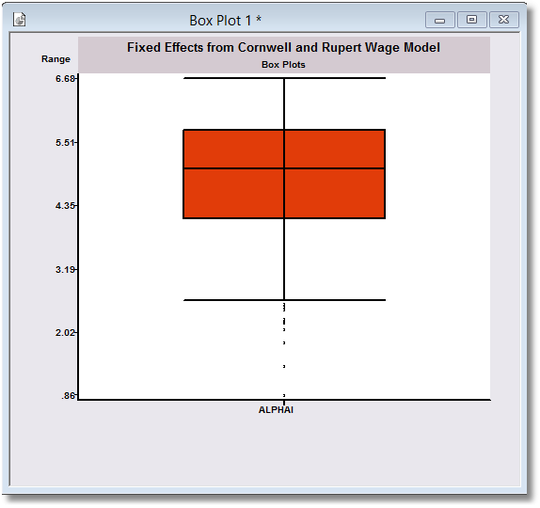

Slide 31
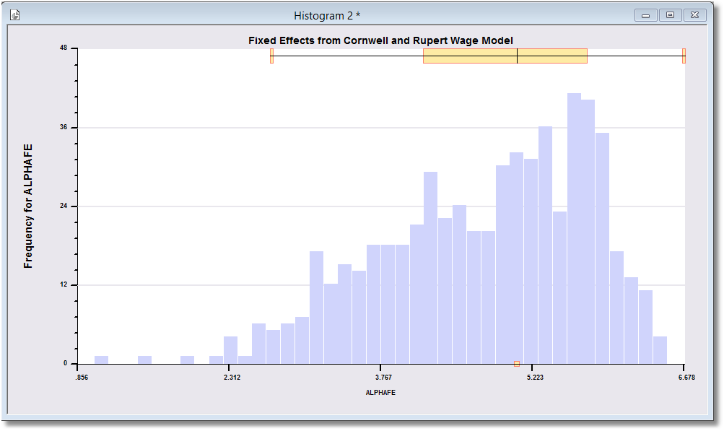

Slide 32
Robustness of the LSDV Estimator
Under the full Gauss-Markov assumptions, b is unbiased and consistent (and even efficient).
If Var[ε_{i}] = Ω_{i} ≠σ_{ε}²I_{Ti} then b is consistent but inefficient. (We’ll return to robust estimation below.)
Under all assumptions, Var[a_{i}] is O(1/T_{i}).
a_{i} is unbiased but inconsistent.
  Inconsistent not because it estimates the wrong parameter, but because it converges to a random variable, not a constant. T_{i} is not increasing.

Slide 33
Inference About OLS
Assume strict exogeneity: Cov[ε_{it},(x_{js},c_{j})]=0. Every disturbance in every period for each person is uncorrelated with variables and effects for every person and across periods.
Now, it’s just least squares in a classical linear regression model.
Asy.Var[b] =

Slide 34
Robust Counterpart to White Estimator?
Assumes Var[ε_{i}] = Ω_{i} ≠σ²I_{Ti}
e_{i} = y_{i} – a_{i}i_{Ti} - X_{i}b = M_{D}y_{i} – M_{D}X_{i}b
(T_{i} x 1 vector of group residuals)
Resembles (and is based on) White, but treats a full vector of disturbances at a time. Robust to heteroscedasticity and autocorrelation (within the groups).

Slide 35
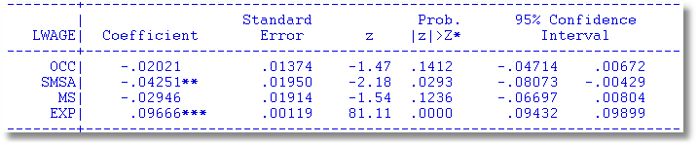
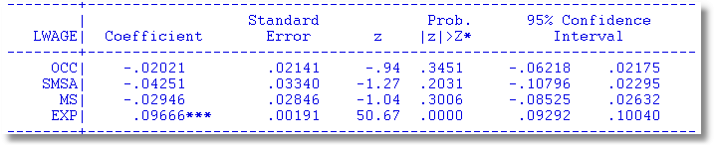

Robust Covariance Matrix for LSDV
Cluster Estimator for Within Estimator

Slide 36
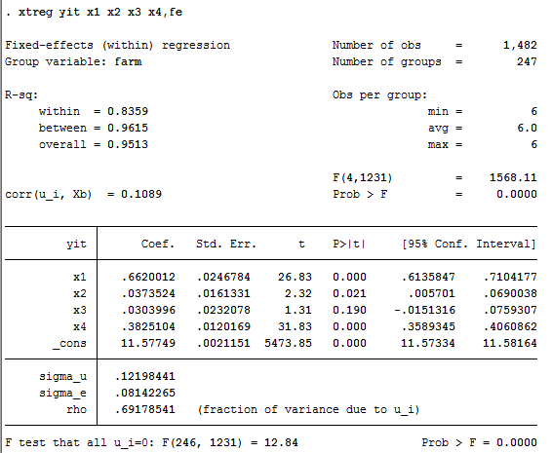
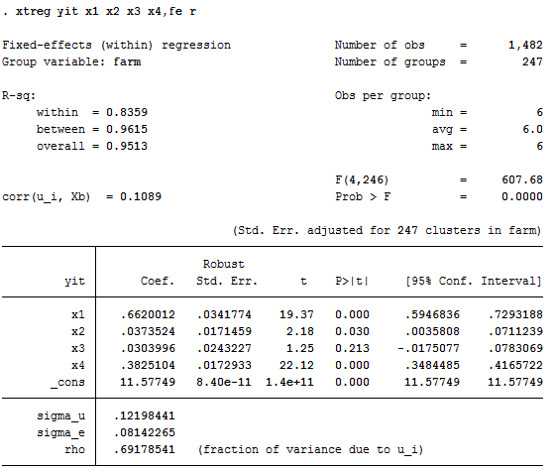
A Caution About Stata and Fixed Effects

Slide 37
Asymptotics for a_{i}

Slide 38
LSDV is an IV Estimator

Slide 42
LSDV is a Control Function Estimator

Slide 43
LSDV is a Control Function Estimator

Slide 44
LSDV is a Control Function Estimator

Slide 45
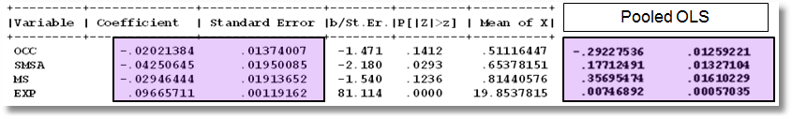
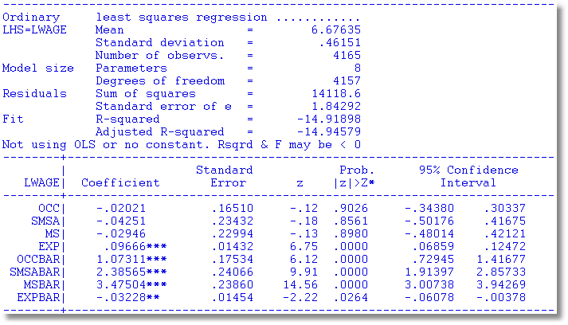
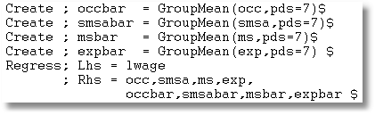

Slide 46
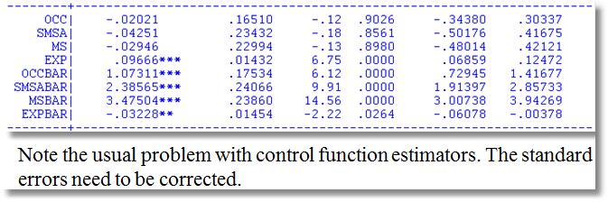
The problem here is the estimator of the disturbance variance. The matrix is OK.
Note, for example, .01374007/.01950085 (top panel)
= .16510 /.23432 (bottom panel).

Slide 47
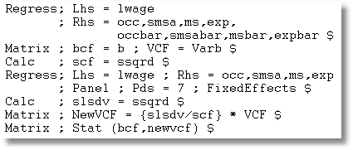
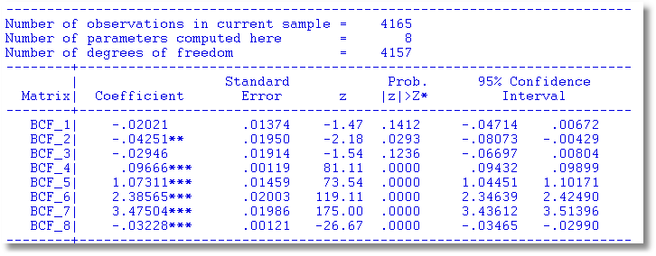

Slide 48
Generalized Least Squares?
If Var[ε_{i}] = Ω_{i} ≠σ_{ε}²I_{Ti} then b is consistent but inefficient.

Slide 49
Maximum Likelihood Estimation

Slide 50
ML Estimation (cont.)

Slide 51
The Incidental Parameters Problem
The model is correctly specified
The log likelihood is correctly specified and maximized
The estimator of σ² is inconsistent
  The number of parameters grows with N
  The “bias” in the MLE gets smaller as T grows
  At infinite T, the estimator is consistent in N
In the linear FEM, the MLE of σ² is affected by this problem.

Slide 52
FE Log Likelihood for Normal ε

Slide 53
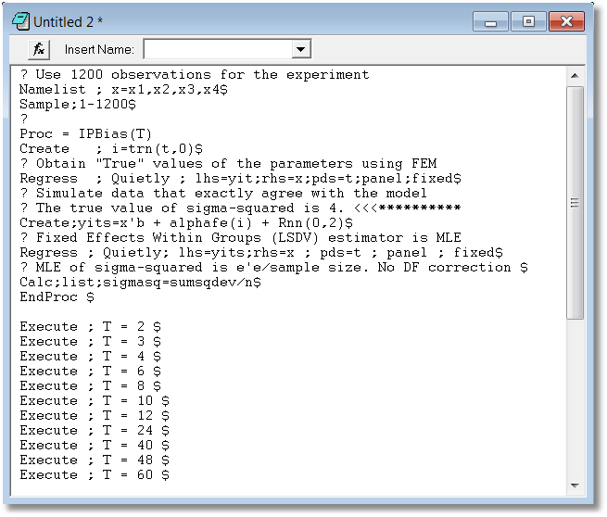

Slide 54
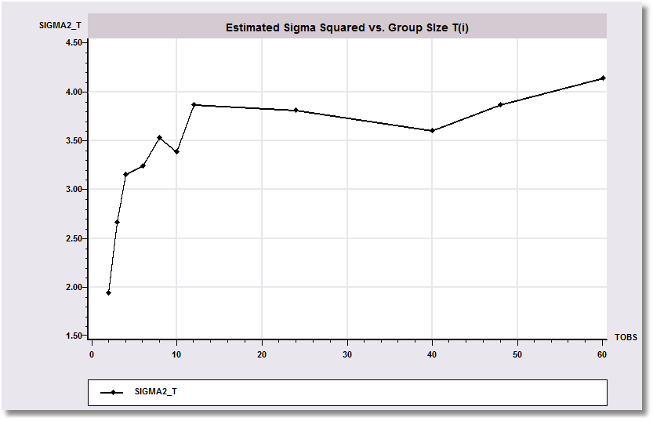
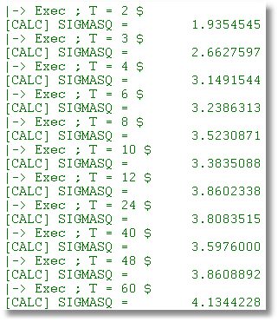
The Incidental Parameters Problem
The true value of σ² is 4.0. The estimator converges on 4 from below.

Slide 55
Between Groups Estimator
Inconsistency of the group means estimator

Slide 56
Time Invariant Regressors
Time invariant x_{it} is defined as invariant for all i. E.g., SEX dummy variable. ED (education in the Cornwell/Rupert data).
If x_{it,k} is invariant for all i, then x_{it,k} = Σ_{i}h_{i}d_{i} for the set of dummy variables and some set of h_{i}s.
If x_{it,k} is invariant for all i, then the group mean deviations are all 0.

Slide 57
FE With Time Invariant Variables
+----------------------------------------------------+
| There are 2 vars. with no within group variation. |
| FEM ED |
+----------------------------------------------------+
+--------+--------------+----------------+--------+--------+----------+
|Variable| Coefficient | Standard Error |b/St.Er.|P[|Z|>z]| Mean of X|
+--------+--------------+----------------+--------+--------+----------+
EXP | .09671227 .00119137 81.177 .0000 19.8537815
WKS | .00118483 .00060357 1.963 .0496 46.8115246
OCC | -.02145609 .01375327 -1.560 .1187 .51116447
SMSA | -.04454343 .01946544 -2.288 .0221 .65378151
FEM | .000000 ......(Fixed Parameter).......
ED | .000000 ......(Fixed Parameter).......
+--------------------------------------------------------------------+
| Test Statistics for the Classical Model |
+--------------------------------------------------------------------+
| Model Log-Likelihood Sum of Squares R-squared |
|(1) Constant term only -2688.80597 886.90494 .00000 |
|(2) Group effects only 27.58464 240.65119 .72866 |
|(3) X - variables only -1688.12010 548.51596 .38154 |
|(4) X and group effects 2223.20087 83.85013 .90546 |
+--------------------------------------------------------------------+

Slide 58
Drop The Time Invariant Variables
Same Results
+--------+--------------+----------------+--------+--------+----------+
|Variable| Coefficient | Standard Error |b/St.Er.|P[|Z|>z]| Mean of X|
+--------+--------------+----------------+--------+--------+----------+
EXP | .09671227 .00119087 81.211 .0000 19.8537815
WKS | .00118483 .00060332 1.964 .0495 46.8115246
OCC | -.02145609 .01374749 -1.561 .1186 .51116447
SMSA | -.04454343 .01945725 -2.289 .0221 .65378151
+--------------------------------------------------------------------+
| Test Statistics for the Classical Model |
+--------------------------------------------------------------------+
| Model Log-Likelihood Sum of Squares R-squared |
|(1) Constant term only -2688.80597 886.90494 .00000 |
|(2) Group effects only 27.58464 240.65119 .72866 |
|(3) X - variables only -1688.12010 548.51596 .38154 |
|(4) X and group effects 2223.20087 83.85013 .90546 |
+--------------------------------------------------------------------+
No change in the sum of squared residuals

Slide 59
Two Way Fixed Effects
A two way FE model. Individual dummy variables and time dummy variables.
  y_{it} = α_{i} + γ_{t} + x_{it}’β + ε_{it}
  Normalization needed as the individual and time dummies both sum to one. Reformulate model:
  y_{it} = μ + α_{i}* + γ_{t}* + x_{it}’β + ε_{it} with
  Σ_{i} α_{i}* =0, Σ_{t} γ_{t}* = 0
  Full estimation:
  Practical estimation. Add T-1 dummies
  Complication: Unbalanced panels are complicated
  Complication in recent applications: Vary large N and very large T

Slide 60


Slide 61
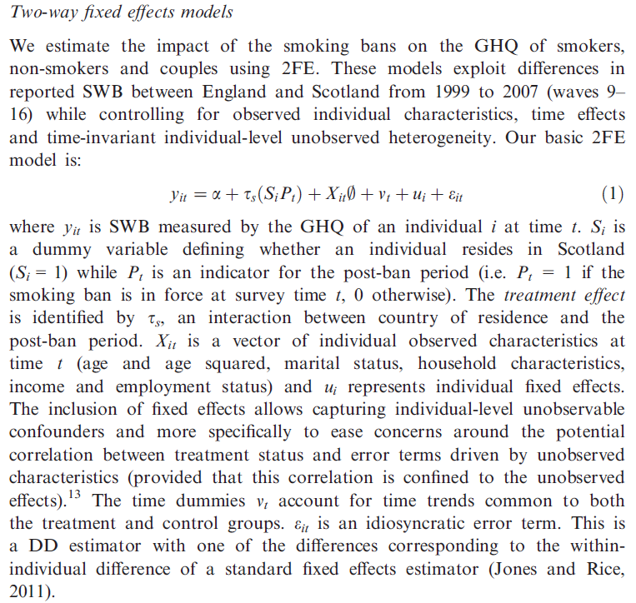

Slide 62
Fixed Effects Estimators
Slope estimators, as usual with transformed data

Slide 63
Two Way Fixed Effects Application
Spanish Dairy Farms; N=247, T=6
+--------+--------------+----------------+--------+--------+----------+
|Variable| Coefficient | Standard Error |b/St.Er.|P[|Z|>z]| Mean of X|
+--------+--------------+----------------+--------+--------+----------+
No Effects
Constant| 11.5774868 .00364586 3175.515 .0000
X1 | .59517558 .01958331 30.392 .0000 0
X2 | .02305014 .01122274 2.054 .0400 0
X3 | .02319244 .01303099 1.780 .0751 0
X4 | .45175783 .01078465 41.889 .0000 0
Firm Dummies
X1 | .66200103 .02467845 26.825 .0000 0
X2 | .03735244 .01613309 2.315 .0206 0
X3 | .03039947 .02320776 1.310 .1902 0
X4 | .38251038 .01201690 31.831 .0000 0
Firm and Time Dummies
X1 | .63796531 .02379854 26.807 .0000 0
X2 | .04127557 .01544463 2.672 .0075 0
X3 | .02819226 .02217322 1.271 .2036 0
X4 | .30816028 .01322571 23.300 .0000 0
REGRESS ; Lhs = yit ; Rhs = one,x1,x2,x3,x4 ; pds=6 ; period=t $
Marginal changes in the estimates. Why?

Slide 64
Analysis of Variance (FIT)
+--------------------------------------------------------------------+
| Test Statistics for the Classical Model |
+--------------------------------------------------------------------+
| Model Log-Likelihood Sum of Squares R-squared |
|(1) Constant term only -1448.90832 .6131518321D+03 .0000000 |
|(2) Group effects only 412.25944 .4974526192D+02 .9188696 |
|(3) X - variables only 809.67611 .2909570093D+02 .9525473 |
|(4) X and group effects 1751.64437 .8161093811D+01 .9866899 |
|(5) X ind.&time effects 1826.23878 .7379537558D+01 .9879646 |
+--------------------------------------------------------------------+
| Hypothesis Tests |
| Likelihood Ratio Test F Tests |
| Chi-squared d.f. Prob. F num. denom. P value |
|(2) vs (1) 3722.336 246 .00000 56.859 246 1235 .00000 |
|(3) vs (1) 4517.169 4 .00000 7412.185 4 1477 .00000 |
|(4) vs (1) 6401.105 250 .00000 365.021 250 1231 .00000 |
|(4) vs (2) 2678.770 4 .00000 1568.114 4 1231 .00000 |
|(4) vs (3) 1883.937 246 .00000 12.836 246 1231 .00000 |
|(5) vs (4) 149.189 5 .00000 25.969 5 1226 .00000 |
|(5) vs (3) 2033.125 252 .00000 14.317 252 1226 .00000 |
+--------------------------------------------------------------------+

Slide 65
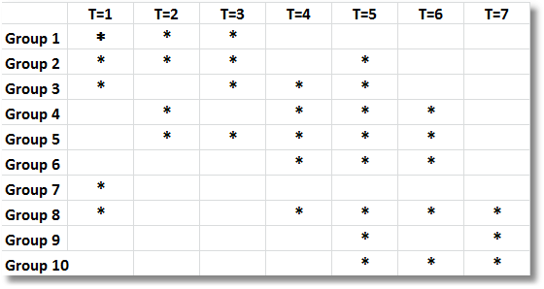
Unbalanced Panel Data
(First 10 households in healthcare data)

Slide 66
Two Way FE with Unbalanced Data

Slide 67
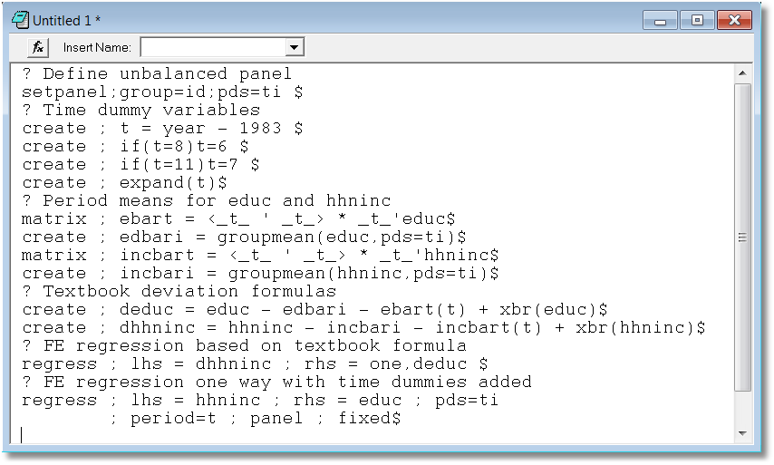

Slide 68
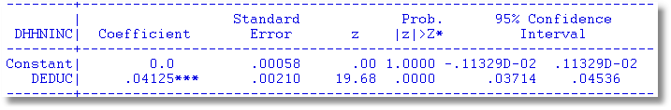
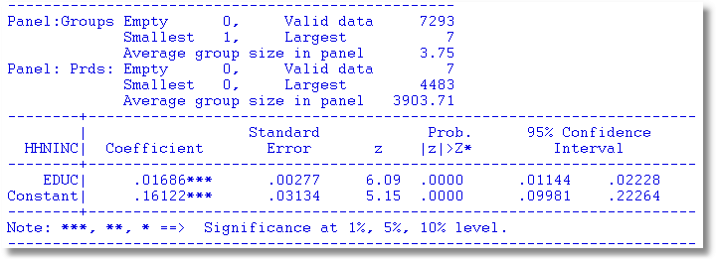
Textbook formula application. This is incorrect.
Two way fixed effects as one way with time dummies

Slide 69
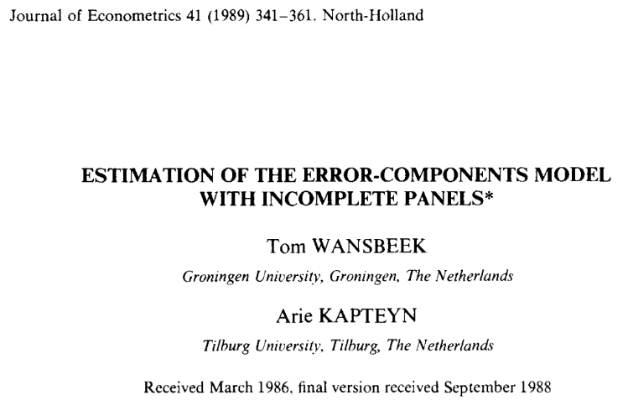
Extremely complicated. Usually unnecessary.

Slide 70
Mundlak’s Approach

Slide 71
Mundlak Form of FE Model
+--------+--------------+----------------+--------+--------+----------+
|Variable| Coefficient | Standard Error |b/St.Er.|P[|Z|>z]| Mean of X|
+--------+--------------+----------------+--------+--------+----------+
x(i,t)
OCC | -.02021384 .01375165 -1.470 .1416 .51116447
SMSA | -.04250645 .01951727 -2.178 .0294 .65378151
MS | -.02946444 .01915264 -1.538 .1240 .81440576
EXP | .09665711 .00119262 81.046 .0000 19.8537815
z(i)
FEM | -.34322129 .05725632 -5.994 .0000 .11260504
ED | .05099781 .00575551 8.861 .0000 12.8453782
Means of x(I,t) and constant
Constant| 5.72655261 .10300460 55.595 .0000
OCCB | -.10850252 .03635921 -2.984 .0028 .51116447
SMSAB | .22934020 .03282197 6.987 .0000 .65378151
MSB | .20453332 .05329948 3.837 .0001 .81440576
EXPB | -.08988632 .00165025 -54.468 .0000 19.8537815
Estimates: Var[e] = .0235632
Var[u] = .0773825

Slide 72
A “Hierarchical” Model

Slide 73
Estimating a Hierarchical Model
Classical assumptions at both levels
Two step estimation
Fixed effects, dummy variables at top level
  Regress a_{i} on z_{i} to estimate δ at the 2nd level. The regression is heteroscedastic. Use OLS/White or Weighted LS with

Slide 74
A Two Step Regression
Sample ; all$
Create ; person=trn(7,0) ; year=trn(-7,0)$
Namelist ; varyingX=occ,smsa,ms,exp$
Namelist ; fixedX=one,fem,ed$
? FE regression to compute dummy variable coefficients
Regress ; lhs=lwage ; rhs=varyingX ; panel ; fixed ; pds=7$
Create ; ai=alphafe(person)$
Create ; occb= GroupMean(occ,pds=7)$
Create ; msb = GroupMean(ms,pds=7)$
Create ; smsab=GroupMean(smsa,pds=7)$
Create ; expb= GroupMean(exp,pds=7)$
? Standard errors for dummy variable coefficient estimates
Namelist ; means=occb,smsab,msb,expb$
Create ; varai=ssqrd/_Groupti + qfr(means,varb) ; wt=1/varai$
? Weighted least squares regression of dummy variable coefficients
? on time invariant variables.
Regress ; if[year = 7] ; lhs=ai;rhs=FixedX;wts=wt$
Regress ; if[year = 7] ; lhs=ai;rhs=FixedX;Het $

Slide 75
First Stage Fixed Effects Model

Slide 76
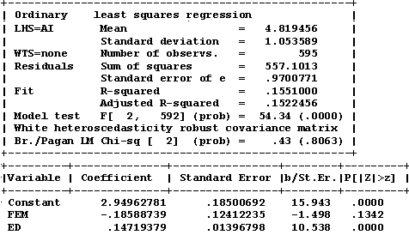
Second Stage Regressions
Weighted Least Squares OLS with White Estimator

Slide 77
Application
Federal Reserve Board, Division of Research & Statistics and Monetary Affairs, 2004, rev. 1/2005
Passmore, W., S. Sherlund, and G. Burgess. “The Effect of Housing Government Sponsored Enterprises on Mortgage Rates,” Real Estate Economics, 33, 3, 2005, pp. 427–463.

Slide 78
First Stage – Rate Difference

Slide 79
An Algebraic Aspect
J_{i} is not quite a group dummy variable. For the group, J_{i} is one for some members of the group – those with a “jumbo” mortgage.

Slide 80
Second Stage – Pass Through

Slide 81
Appendix I. Fixed Effects Vector
Decomposition

Slide 82
Efficient Estimation of Time Invariant and Rarely Changing Variables in Finite Sample Panel Analyses with Unit Fixed Effects
Thomas Plümper and Vera Troeger
Political Analysis, 2007

Slide 83


A magic act proceeds in three steps:
The Pledge
The Turn
The Prestige

Slide 84
Introduction: The Pledge
[T]he FE model … does not allow the estimation of time invariant variables. A second drawback of the FE model … results from its inefficiency in estimating the effect of variables that have very little within variance.
This article discusses a remedy to the related problems of estimating time invariant and rarely changing variables in FE models with unit effects

Slide 85
The Model

Slide 86
Fixed Effects Vector Decomposition
Step 1: Compute the fixed effects regression to get the “estimated unit effects.” “We run this FE model with the sole intention to obtain estimates of the unit effects, α_{i}.”

Slide 87
Step 2
Regress a_{i} on z_{i} and compute residuals

Slide 88
Step 3
Regress y_{it} on a constant, X, Z and h using ordinary least squares to estimate α, β, γ, δ.

Slide 89
The Turn:
Based on Cornwell and Rupert
namelist ; x = exp,wks,occ,ind,south,smsa,union
; z = fem,ed $
(1) Step 1.
regress ; lhs=lwage;rhs=x,z;panel;fixed;pds=7 $ create ; uhi = alphafe(_stratum) $
(2) Step 2
regress ; lhs = uhi ; rhs = one,z ; res = hi $
(3) Step 3.
regress ; lhs = lwage ; rhs = one,x,z,hi $

Slide 90
Step 1 (Based on full sample)
These 2 variables have no within group variation.
FEM ED
F.E. estimates are based on a generalized inverse.
--------+---------------------------------------------------------
| Standard Prob. Mean
LWAGE| Coefficient Error z z>|Z| of X
--------+---------------------------------------------------------
EXP| .09663*** .00119 81.13 .0000 19.8538
WKS| .00114* .00060 1.88 .0600 46.8115
OCC| -.02496* .01390 -1.80 .0724 .51116
IND| .02042 .01558 1.31 .1899 .39544
SOUTH| -.00091 .03457 -.03 .9791 .29028
SMSA| -.04581** .01955 -2.34 .0191 .65378
UNION| .03411** .01505 2.27 .0234 .36399
FEM| .000 .....(Fixed Parameter)..... .11261
ED| .000 .....(Fixed Parameter)..... 12.8454
--------+---------------------------------------------------------

Slide 91
Step 2 (Based on 595 observations)
--------+---------------------------------------------------------
| Standard Prob. Mean
UHI| Coefficient Error z z>|Z| of X
--------+---------------------------------------------------------
Constant| 2.88090*** .07172 40.17 .0000
FEM| -.09963** .04842 -2.06 .0396 .11261
ED| .14616*** .00541 27.02 .0000 12.8454
--------+---------------------------------------------------------

Slide 92
Step 3!
--------+---------------------------------------------------------
| Standard Prob. Mean
LWAGE| Coefficient Error z z>|Z| of X
--------+---------------------------------------------------------
Constant| 2.88090*** .03282 87.78 .0000
EXP| .09663*** .00061 157.53 .0000 19.8538
WKS| .00114*** .00044 2.58 .0098 46.8115
OCC| -.02496*** .00601 -4.16 .0000 .51116
IND| .02042*** .00479 4.26 .0000 .39544
SOUTH| -.00091 .00510 -.18 .8590 .29028
SMSA| -.04581*** .00506 -9.06 .0000 .65378
UNION| .03411*** .00521 6.55 .0000 .36399
FEM| -.09963*** .00767 -13.00 .0000 .11261
ED| .14616*** .00122 120.19 .0000 12.8454
HI| 1.00000*** .00670 149.26 .0000 -.103D-13
--------+---------------------------------------------------------

Slide 93
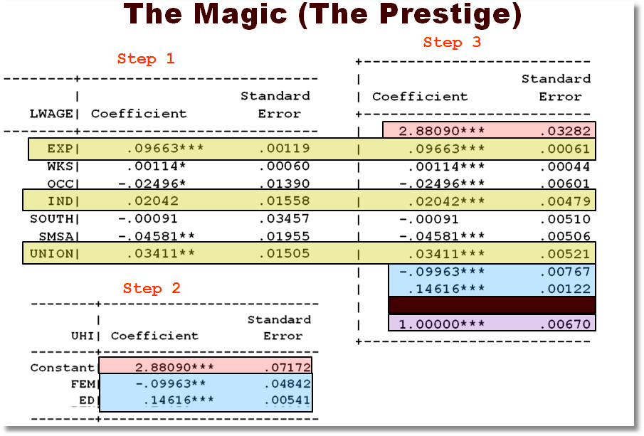

Slide 94
What happened here?

Slide 95
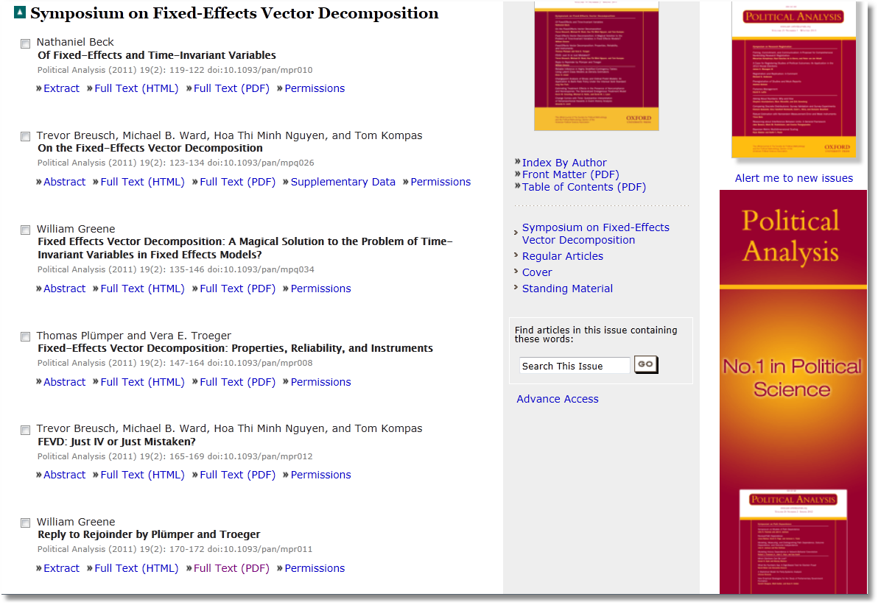

Slide 96
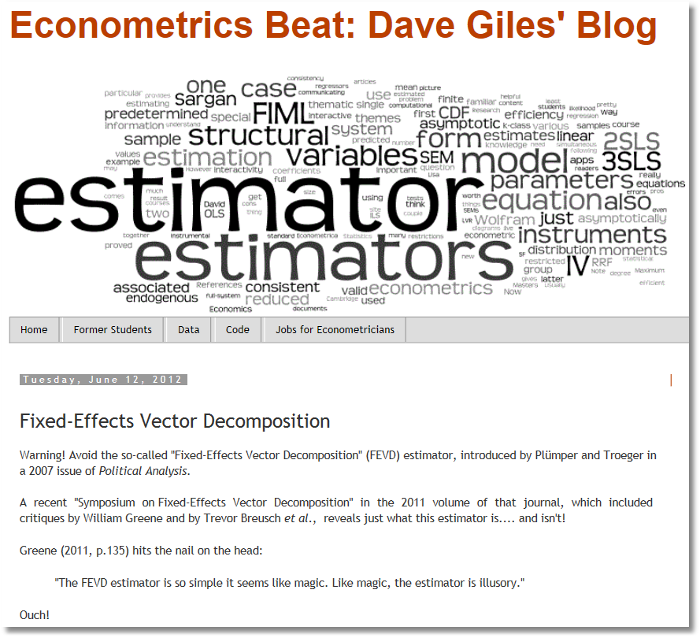
http://davegiles.blogspot.com/2012/06/fixed-effects-vector-decomposition.html

Slide 97

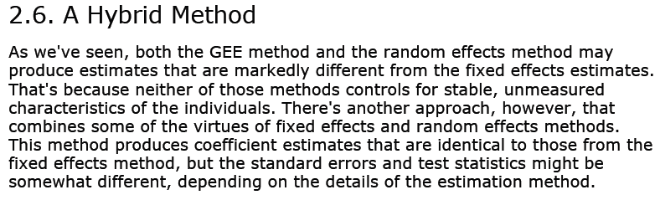
Paul Allison, 2005

Slide 98
Appendix II. Fixed Effects Algebra

Slide 99
Panel Data Algebra

Slide 100
Balanced Panel Data Algebra

Slide 101
Balanced Panel

Slide 102
Balanced Panel

Slide 103
Balanced Panel

Slide 104
Balanced Panel

Slide 105
Balanced Panel

