Slide 1
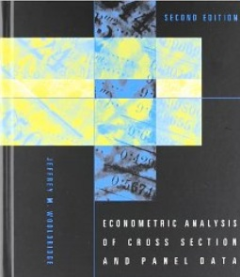
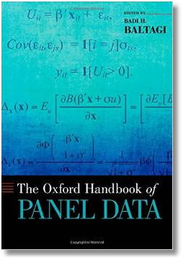

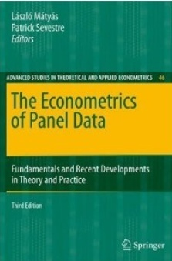




Econometric Analysis of Panel Data
William Greene
Department of Economics
University of South Florida

Slide 2
The Random Effects Model
The random effects model
c_{i} is uncorrelated with x_{it} for all t;
  E[c_{i} |X_{i}] = 0
  E[ε_{it}|X_{i},c_{i}]=0

Slide 3
A Random Effects Log Wage Equation
EXP = work experience
WKS = weeks worked
OCC = occupation, 1 if blue collar,
IND = 1 if manufacturing industry
SOUTH = 1 if resides in south
SMSA = 1 if resides in a city (SMSA)
MS = 1 if married
FEM = 1 if female
UNION = 1 if wage set by union contract
ED = years of education
LWAGE = log of wage = dependent variable in regressions
Are the other unobserved attributes likely to be correlated with the observed variables?
The usual candidates are already in the equation. There could be other factors that appear to be randomly distributed across individuals (as regards the included variables). A random effects treatment would be appropriate.

Slide 4
Random vs. Fixed Effects
Fixed Effects
  Robust – generally consistent
  Large number of parameters
  More reasonable assumption
  Precludes time invariant regressors ☹
Random Effects
  Small number of parameters
  Efficient estimation
  Questionable orthogonality assumption (c_{i} ⊥ X_{i})
Which is the more reasonable model?
Is there a model in between?

Slide 5
Error Components Model
Generalized Regression Model

Slide 6
Notation

Slide 7
Notation – Generalized Regression

Slide 8
What does the orthogonality assumption mean?

Slide 9
Convergence of Moments

Slide 10
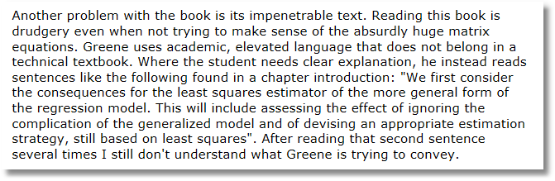
Let’s start by considering the OLS estimator that ignores the effects.
Amazon review of 7th edition.

Slide 11
Ordinary Least Squares
Standard results for OLS in a GR model
  Consistent
  Unbiased
  Inefficient
True Variance. Use n = Σ_{i} T_{i}

Slide 12
Estimating the Variance for OLS

Slide 13
Mechanics of the Cluster Estimator

Slide 14

Alternative OLS Variance Estimators
+---------+--------------+----------------+--------+---------+
|Variable | Coefficient | Standard Error |b/St.Er.|P[|Z|>z] |
+---------+--------------+----------------+--------+---------+
Constant 5.40159723 .04838934 111.628 .0000
EXP .04084968 .00218534 18.693 .0000
EXPSQ -.00068788 .480428D-04 -14.318 .0000
OCC -.13830480 .01480107 -9.344 .0000
SMSA .14856267 .01206772 12.311 .0000
MS .06798358 .02074599 3.277 .0010
FEM -.40020215 .02526118 -15.843 .0000
UNION .09409925 .01253203 7.509 .0000
ED .05812166 .00260039 22.351 .0000
Robust
Constant 5.40159723 .10156038 53.186 .0000
EXP .04084968 .00432272 9.450 .0000
EXPSQ -.00068788 .983981D-04 -6.991 .0000
OCC -.13830480 .02772631 -4.988 .0000
SMSA .14856267 .02423668 6.130 .0000
MS .06798358 .04382220 1.551 .1208
FEM -.40020215 .04961926 -8.065 .0000
UNION .09409925 .02422669 3.884 .0001
ED .05812166 .00555697 10.459 .0000

Slide 15
Generalized Least Squares

Slide 16
GLS

Slide 17
Estimators for the Variances

Slide 18
Feasible GLS Uses Estimates of σ_{ε}² and σ_{u}²
x´ does not contain a constant term in the preceding.

Slide 19
Practical Problems with FGLS

Slide 20
Stata Variance Estimators

Slide 21
Computing Variance Estimators for C&R

Slide 22
Application
+--------------------------------------------------+
| Random Effects Model: v(i,t) = e(i,t) + u(i) |
| Estimates: Var[e] = 0.023119 |
| Var[u] = 0.102531 |
| Corr[v(i,t),v(i,s)] = 0.816006 |
+--------------------------------------------------+
--------------------------------------------------------------
|Variable | Coefficient | Standard Error |b/St.Er.|P[|Z|>z] |
--------------------------------------------------------------
EXP .08819204 .00224823 39.227 .0000
EXPSQ -.00076604 .496074D-04 -15.442 .0000
OCC -.04243576 .01298466 -3.268 .0011
SMSA -.03404260 .01620508 -2.101 .0357
MS -.06708159 .01794516 -3.738 .0002
FEM -.34346104 .04536453 -7.571 .0000
UNION .05752770 .01350031 4.261 .0000
ED .11028379 .00510008 21.624 .0000
Constant 4.01913257 .07724830 52.029 .0000

Slide 23
Testing for Effects: An LM Test

Slide 24
LM Tests
Random Effects Model: v(i,t) = e(i,t) + u(i)
Estimates: Var[e] = .023119
SD.[e] = .152049
Var[u] = .102531
SD.[u] = .320205
Corr[v(i,t),v(i,s)] = .816006
Sum of Squares 1411.241136
Variances computed using OLS and LSDV with d.f.
Lagrange Multiplier Test vs. RE Model: 3713.07
[ 1 degrees of freedom, prob. value = .000000]
(High values of LM favor FEM/REM over CR model)
Namelist ; x = one,exp,expsq,occ,smsa,ms,fem,union,ed $
Regress ; Lhs = lwage ; rhs = x ; panel ; random ; pds = 7 $

Slide 25
Testing for Effects: Method of Moments

Slide 26
Testing:
Dissecting the Wooldridge Statistic

Slide 27
Testing for Effects
Namelist ; x = one,exp,expsq,occ,smsa,ms,fem,union,ed$
Regress ; Lhs = lwage ; rhs=x;res = e $
Create ; Person=trn(7,0)$
? Vector of group sums of residuals
Calc ; T = 7 ; Groups = 595 $
Matrix ; tebar=T*gxbr(e,person)$
? Direct computation of LM statistic
Calc ; list;lm=Groups*T/(2*(T-1))*(tebar'tebar/sumsqdev - 1)^2$
? Wooldridge chi squared (N(0,1) squared)
Create ; e2=e*e$
Matrix ; e2i=T*gxbr(e2,person)$
Matrix ; ri=dirp(tebar,tebar)-e2i ; rbar=1/groups*ri'1$
Calc ; list;z2=groups*rbar^2/(ri'ri/groups)$
[CALC] LM = 3713.066
[CALC] Z2 = 182.773
Critical chi squared = 3.84 (1 degree of freedom)

Slide 28
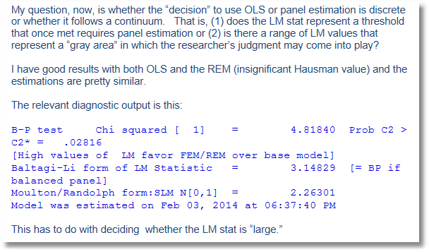

Slide 29
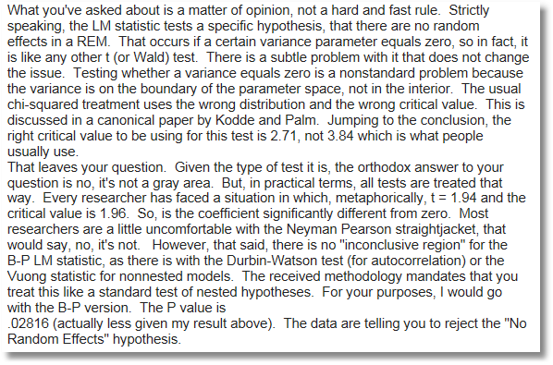

Slide 30
Two Way Random Effects Model

Slide 31
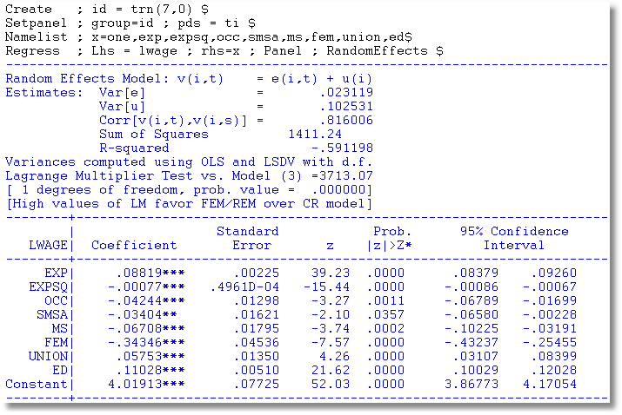
One Way REM

Slide 32
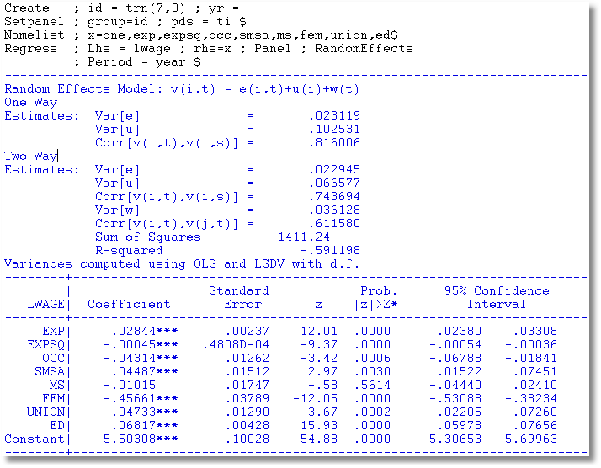
Two Way REM
Note sum = .102705

Slide 33
Hausman Test for FE vs. RE
Estimator | Random Effects E[c_{i}|X_{i}] = 0 | Fixed Effects E[c_{i}|X_{i}] ≠ 0
FGLS (Random Effects) | Consistent and Efficient | Inconsistent
LSDV (Fixed Effects) | Consistent Inefficient | Consistent Possibly Efficient

Slide 34
Hausman Test for Effects
β does not contain the constant term in the preceding.

Slide 35
Computing the Hausman Statistic
β does not contain the constant term in the preceding.

Slide 36
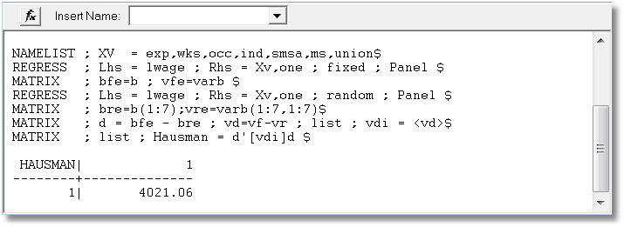

Slide 37
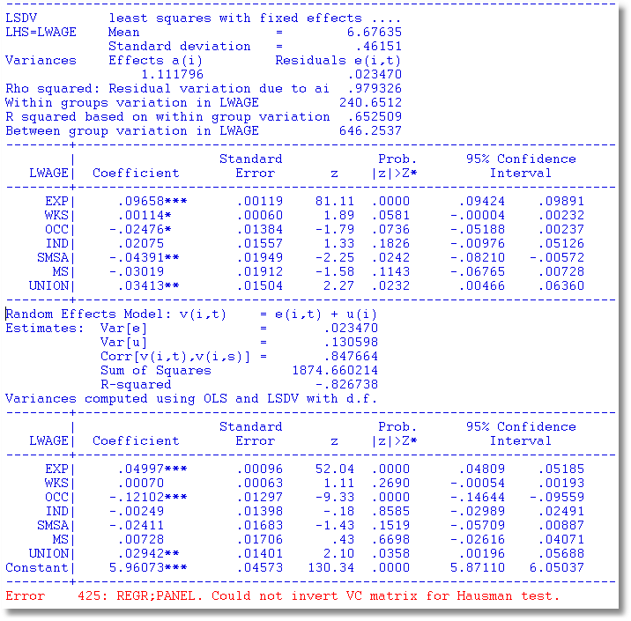

Slide 38
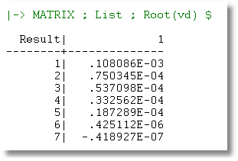
What’s Wrong with the
Hausman Test?
What went wrong?
The matrix is not positive definite.
It has a negative characteristic root.
The matrix is indefinite.
(Software such as Stata and NLOGIT find this problem and refuse to proceed.)
Properly, the statistic cannot be computed.
The naïve calculation came out positive by the luck of the draw.

Slide 39
A Variable Addition Test
Asymptotically equivalent to Hausman
Also equivalent to Mundlak formulation
In the random effects model, using FGLS
  Only applies to time varying variables
  Add expanded group means to the regression (i.e., observation i,t gets same group means for all t.
  Use standard F or Wald test to test for coefficients on means equal to 0. Large F or chi-squared weighs against random effects specification.

Slide 40
Variable Addition

Slide 41
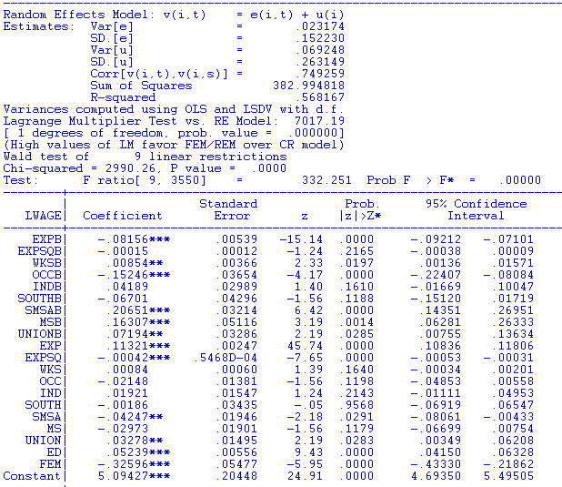
Means Added

Slide 42
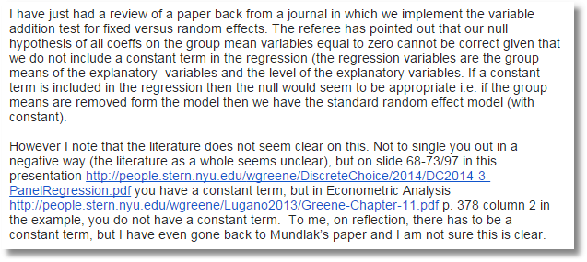
There should be a constant term.

Slide 43
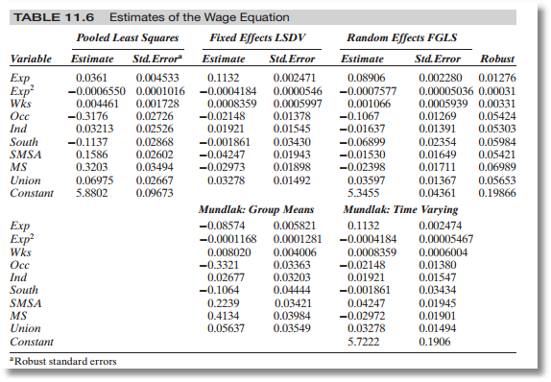

Slide 44
Mundlak’s Estimator
Mundlak, Y., “On the Pooling of Time Series and Cross Section Data, Econometrica, 46, 1978, pp. 69-85.

Slide 45
Evolution: Correlated Random Effects

Slide 46
Mundlak’s Approach for an FE Model with Time Invariant Variables

Slide 47
Mundlak Form of FE Model
+--------+--------------+----------------+--------+--------+----------+
|Variable| Coefficient | Standard Error |b/St.Er.|P[|Z|>z]| Mean of X|
+--------+--------------+----------------+--------+--------+----------+
x(i,t)=================================================================
OCC | -.02021384 .01375165 -1.470 .1416 .51116447
SMSA | -.04250645 .01951727 -2.178 .0294 .65378151
MS | -.02946444 .01915264 -1.538 .1240 .81440576
EXP | .09665711 .00119262 81.046 .0000 19.8537815
z(i)===================================================================
FEM | -.34322129 .05725632 -5.994 .0000 .11260504
ED | .05099781 .00575551 8.861 .0000 12.8453782
Means of x(i,t) and constant===========================================
Constant| 5.72655261 .10300460 55.595 .0000
OCCB | -.10850252 .03635921 -2.984 .0028 .51116447
SMSAB | .22934020 .03282197 6.987 .0000 .65378151
MSB | .20453332 .05329948 3.837 .0001 .81440576
EXPB | -.08988632 .00165025 -54.468 .0000 19.8537815
Variance Estimates=====================================================
Var[e]| .0235632
Var[u]| .0773825 (Reduces the time invariant variance.)

Slide 48
A Hierarchical Linear Model
Interpretation of the FE Model

Slide 49
Hierarchical Linear Model as REM
+--------------------------------------------------+
| Random Effects Model: v(i,t) = e(i,t) + u(i) |
| Estimates: Var[e] = .235368D-01 |
| Var[u] = .110254D+00 |
| Corr[v(i,t),v(i,s)] = .824078 |
| Sigma(u) = 0.3303 |
+--------------------------------------------------+
+--------+--------------+----------------+--------+--------+----------+
|Variable| Coefficient | Standard Error |b/St.Er.|P[|Z|>z]| Mean of X|
+--------+--------------+----------------+--------+--------+----------+
OCC | -.03908144 .01298962 -3.009 .0026 .51116447
SMSA | -.03881553 .01645862 -2.358 .0184 .65378151
MS | -.06557030 .01815465 -3.612 .0003 .81440576
EXP | .05737298 .00088467 64.852 .0000 19.8537815
FEM | -.34715010 .04681514 -7.415 .0000 .11260504
ED | .11120152 .00525209 21.173 .0000 12.8453782
Constant| 4.24669585 .07763394 54.702 .0000

Slide 50
HLM (Simulation Estimator) vs. REM
---------+ Nonrandom parameters
OCC | -.02461285 .00566374 -4.346 .0000 .51116447
SMSA | -.06076787 .00490494 -12.389 .0000 .65378151
MS | -.04446541 .00850068 -5.231 .0000 .81440576
EXP | .08508257 .00046901 181.409 .0000 19.8537815
---------+ Means for random parameters
Constant| 2.89358963 .02426391 119.255 .0000
---------+ Scale parameters for dists. of random parameters
Constant| .86092728 .00448368 192.014 .0000
---------+ Heterogeneity in the means of random parameters
cONE_FEM| -.54972521 .01030773 -53.331 .0000
cONE_ED | .16915125 .00122320 138.286 .0000
========================================================================
---------+Variance parameter given is sigma
Std.Dev.| .15681703 .00074231 211.256 .0000
(REM Estimated by two step FGLS) Sigma(u) = 0.3303
OCC | -.03908144 .01298962 -3.009 .0026 .51116447
SMSA | -.03881553 .01645862 -2.358 .0184 .65378151
MS | -.06557030 .01815465 -3.612 .0003 .81440576
EXP | .05737298 .00088467 64.852 .0000 19.8537815
FEM | -.34715010 .04681514 -7.415 .0000 .11260504
ED | .11120152 .00525209 21.173 .0000 12.8453782
Constant| 4.24669585 .07763394 54.702 .0000

Slide 51
Surprising Algebraic Results
Regression with X and FEM gives the same results as X with group means and a constant
REM with X and group means gives the same results as FEM by group means.
(Standard errors are different in all cases.)

Slide 52
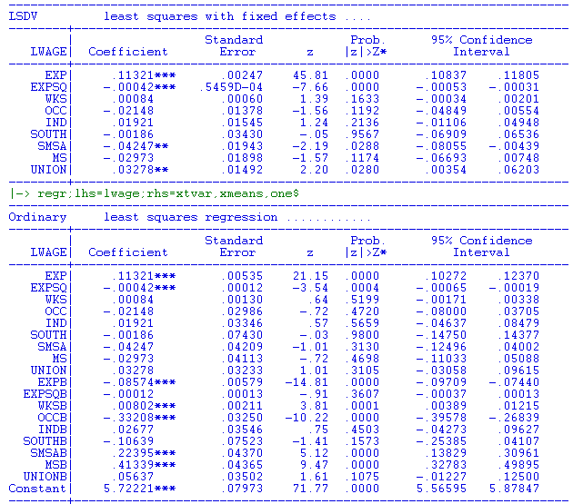

Slide 53
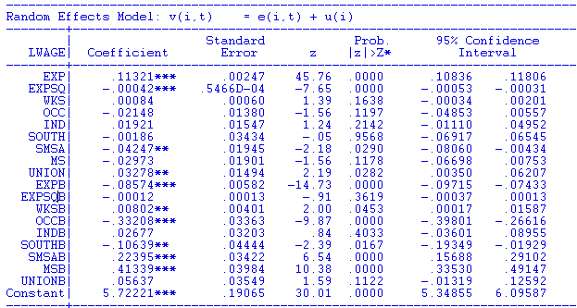

Slide 54

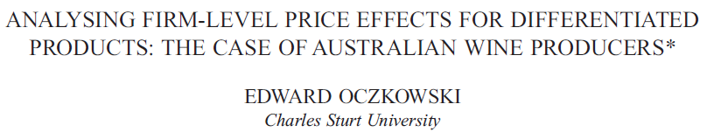
Wine Economics
A Case Study
doi: 10.1111/1467-8454.12060
Australian Economic Papers, 55, 1, March, 2016.
http://people.stern.nyu.edu/wgreene/Econometrics/Wine-FEM.pdf

Slide 55
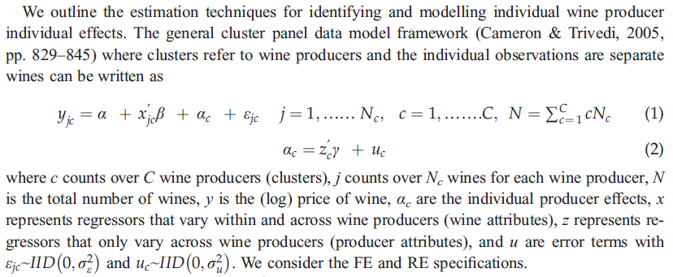
Model

Slide 56
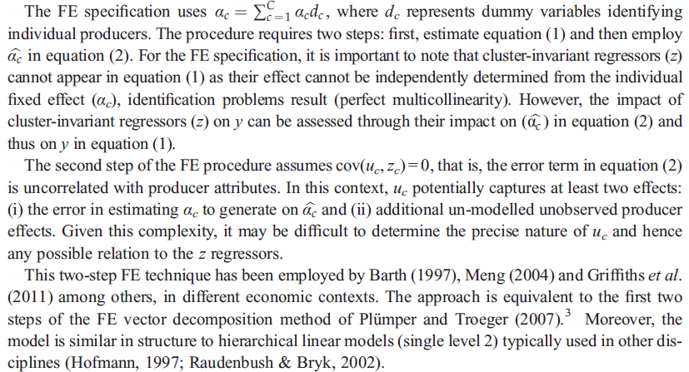

Fixed Effects

Slide 57
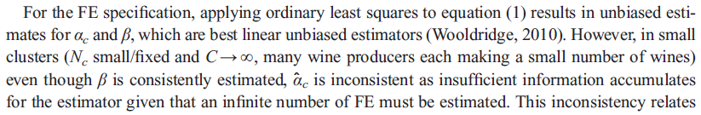
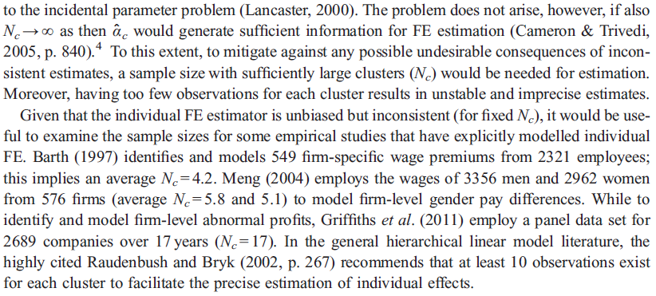
Incidental Parameters

Slide 58
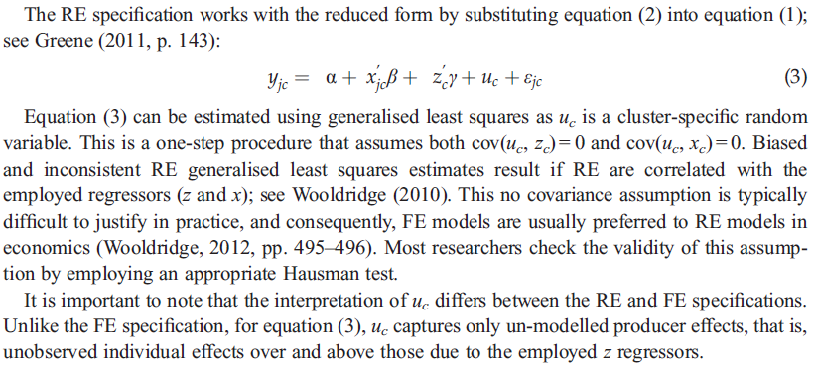
Random Effects

Slide 59
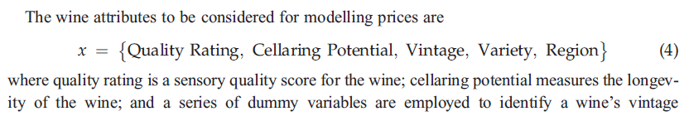
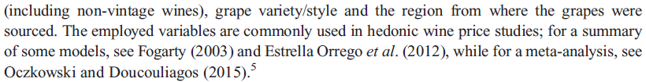
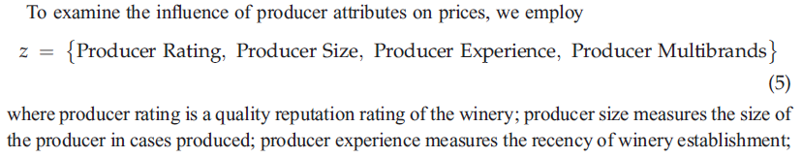
Attributes and Characteristics

Slide 60
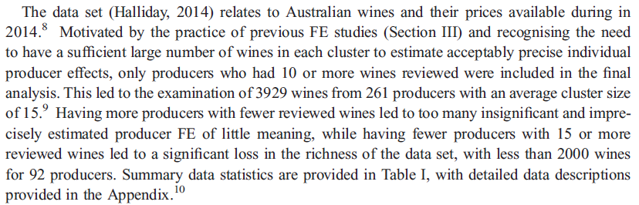
Data

Slide 61
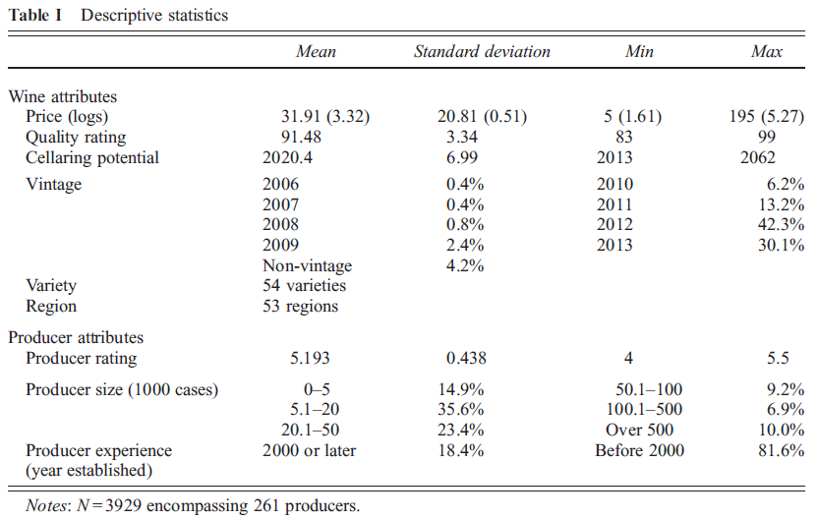

Slide 62
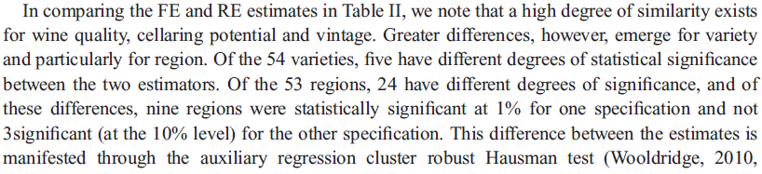
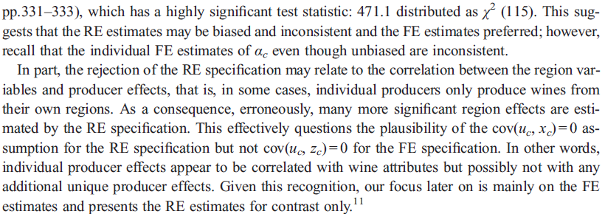
Hausman Test

Slide 63
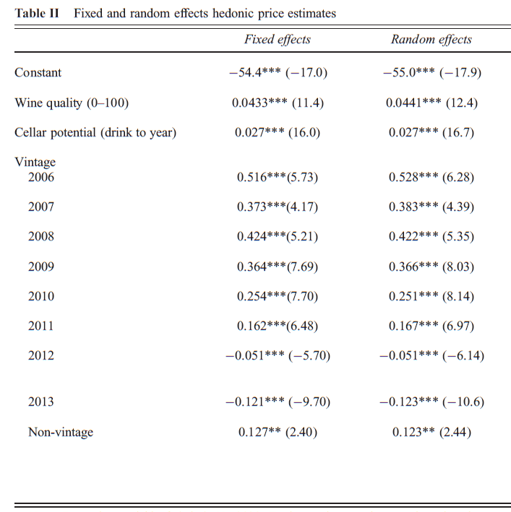

Slide 64
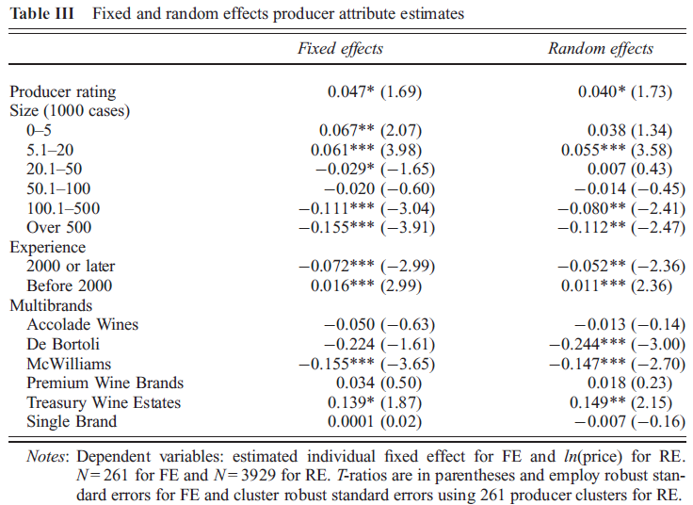

Slide 65
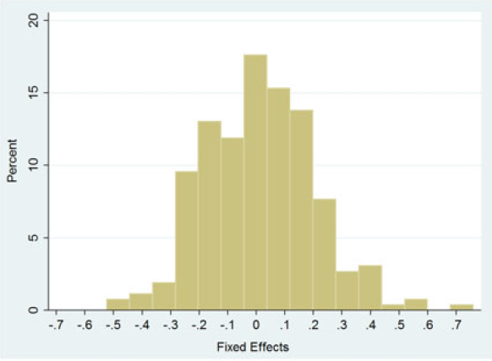
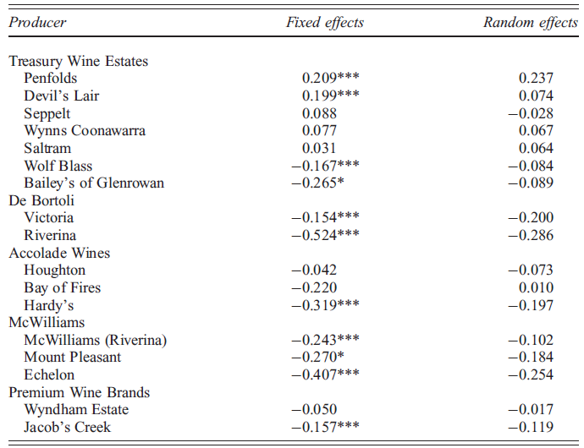
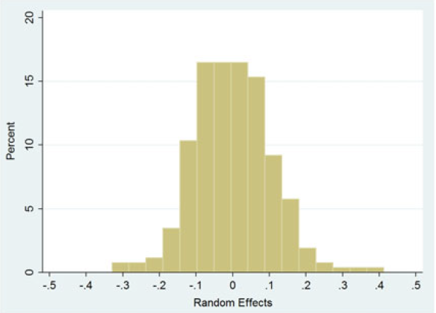

Slide 66
Appendix

Slide 67


Correlated Random Effects

Slide 68
Panel Data Algebra (1)

Slide 69
Panel Data Algebra (2)

Slide 70
Panel Data Algebra (3)

Slide 71
Fixed vs. Random Effects
β does not contain the constant term in the preceding.

