Slide 1








Econometric Analysis of Panel Data
William Greene
Department of Economics
University of South Florida

Slide 2
The Random Effects Model
The random effects model
c_{i} is uncorrelated with x_{it} for all t;
  E[c_{i} |X_{i}] = 0
  E[ε_{it}|X_{i},c_{i}]=0

Slide 3
Error Components Model
Generalized Regression Model

Slide 4
Notation for GR Model

Slide 5
Maximum Likelihood of the REM

Slide 6
MLE Panel Data Algebra
Second term in LnL_{i}

Slide 7
MLE Panel Data Algebra
Third term in LogL_{i}

Slide 8
MLE Panel Data Algebra
Combine Terms in lnL_{i}

Slide 9
Maximizing the Log Likelihood by Iterated FGLS
Difficult: “Brute force” + some elegant theoretical results: See Baltagi, pp. 22-23. (Back and forth from GLS to σ_{ε}² and σ_{u}².)
Somewhat less difficult and more practical: At any iteration, given estimates of σ_{ε}² and σ_{u}² the estimator of β is GLS (of course), so we iterate back and forth between these. See Hsiao, pp. 39-40.

Slide 10
Direct Maximization of LogL by Nonlinear Optimization

Slide 11

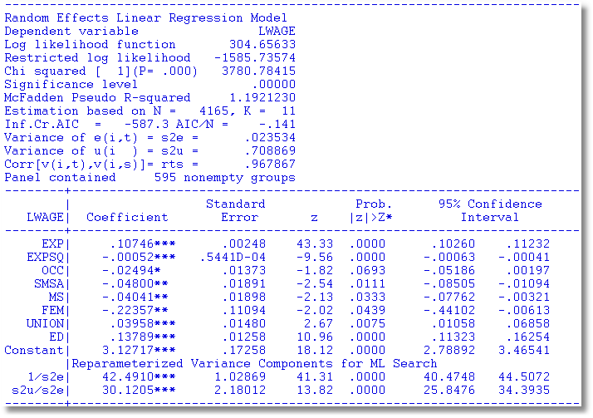
θ²
τ

Slide 12
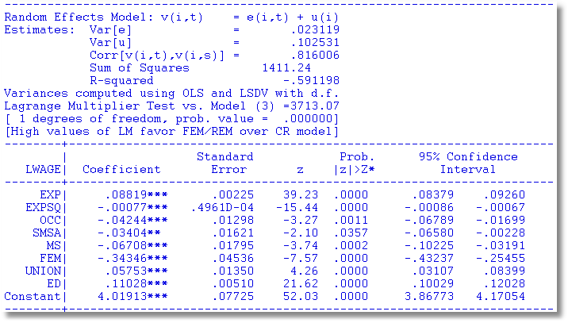


2 Step FGLS vs. MLE. The estimates of σ_{u}² are quite different.
The large difference in the estimate of σ_{u}² explains the difference between MLE and 2 step FGLS

Slide 13
Maximum Simulated Likelihood

Slide 14
Likelihood Function for Individual i

Slide 15
Log Likelihood Function

Slide 16
Computing the Expected LogL
Example: Hermite Quadrature Nodes and Weights, H=5
Nodes: -2.02018,-0.95857, 0.00000, 0.95857, 2.02018
Weights: 1.99532,0.39362, 0.94531, 0.39362, 1.99532
Applications usually use many more points, up to 96 and
Much more accurate (more digits) representations.

Slide 17
32 Point Hermite Quadrature
Nodes: use z_{h} and –z_{h}
0.194840741569399326708741289532, 0.584978765435932448466957544011,
0.976500463589682838484704871982, 1.37037641095287183816170564864,
1.76765410946320160462767325853, 2.16949918360611217330570559502,
2.57724953773231745403092930114, 2.99249082500237420628549407606,
3.41716749281857073587392729564, 3.85375548547144464388787292109,
4.30554795335119844526348653193, 4.77716450350259639303579405689,
5.27555098651588012781906048140, 5.81222594951591383276596615366,
6.40949814926966041217376374153, 7.12581390983072757279520760342/
Weights w_{h} with z_{h} and -z_{h}
3.75238352592802392866818389D-1, 2.77458142302529898137698919D-1,
1.51269734076642482575147115D-1, 6.04581309559126141865857608D-2,
1.75534288315734303034378446D-2, 3.65489032665442807912565712D-3,
5.36268365527972045970238102D-4, 5.41658406181998255800193939D-5,
3.65058512956237605737032419D-6, 1.57416779254559402926869258D-7,
4.09883216477089661823504101D-9, 5.93329146339663861451156822D-11,
4.21501021132644757296944521D-13,1.19734401709284866582868190D-15,
9.23173653651829223349442007D-19,7.31067642738416239327427846D-23/

Slide 18
Quadrature

Slide 19
Compute the Integral by Simulation

Slide 20
Convergence Results for MSL

Slide 21
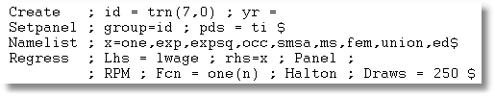
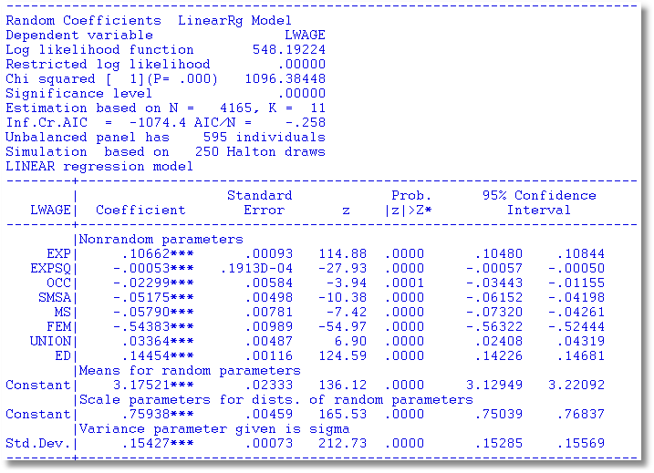
MSL vs. ML
FGLS MLE MSL
σ_{ε}² .023119 .023534 .023779
σ_{u}² .102531 .708869 .576658

Slide 22
Two Level Panel Data
Nested by construction
Unbalanced panels
  No real obstacle to estimation
  Some inconvenient algebra.
  In 2 step FGLS of the RE, need “1/T” to solve for an estimate of σ_{u}². What to use?

Slide 23
Balanced Nested Panel Data
Z_{i,j,k,t} = test score for student ijkt;
student t, teacher k, school j, district i
L = 2 school districts, i = 1,…,L
M_{i} = 3 schools in each district, j = 1,…,M_{i}
N_{ij} = 4 teachers in each school, k = 1,…,N_{ij}
T_{ijk} = 20 students in each class, t = 1,…,T_{ijk}
Antweiler, W., “Nested Random Effects Estimation in Unbalanced Panel Data,” Journal of Econometrics, 101, 2001, pp. 295-313.

Slide 24
Nested Effects Model

Slide 25
GLS with Nested Effects

Slide 26
Unbalanced Nested Data
With unbalanced panels, all the preceding results fall apart.
GLS, FGLS, even fixed effects become analytically intractable. (Unless you just compute all the dummy variables.)
The log likelihood is very tractable
Note a collision of practicality with nonrobustness. (Normality must be assumed.)

Slide 27
Log Likelihood (1)

Slide 28
Log Likelihood (2)

Slide 29
Maximizing Log L
Antweiler provides analytic first derivatives for gradient methods of optimization. Ugly to program.
Numerical derivatives:

Slide 30
Asymptotic Covariance Matrix

Slide 31
An Appropriate Asymptotic Covariance Matrix

Slide 32
Some Observations
Assuming the wrong (e.g., nonnested) error structure
  Still consistent – GLS with the wrong weights
  Standard errors (apparently) biased downward (Moulton bias)
Adding “time” effects or other nonnested effects is “very challenging.” Perhaps do with “fixed” effects (dummy variables).

Slide 33
An Application
Y_{1jkt} = ln of atmospheric sulfur dioxide concentration at observation station k at time t, in country i.
H = 2621, 293 stations, 44 countries, various numbers of observations, not equally spaced
Three levels, not 4 as in article.
X_{jkt} =1,ln(GDP/km²),ln(K/L),ln(Income), Suburban, Rural,Communist,ln(Oil price), average temperature, time trend.

Slide 34
Estimates

Slide 35
appendix

Slide 36
Gauss-Hermite Quadrature
Change of Variable

