Slide 1








Econometric Analysis of Panel Data
William Greene
Department of Economics
University of South Florida

Slide 2


Slide 3
Regression Extensions
Time Varying Fixed Effects
Measurement Error
Spatial Autoregression and Autocorrelation (Baltagi 10.5)

Slide 4
Time Varying Effects Models
Time Varying Fixed Effects: Additive
y_{it} = β’x_{it} + a_{i}(t) + ε_{it}
y_{it} = β’x_{it} + a_{i} + c_{t} + ε_{it}
a_{i}(t) = a_{i} + c_{t}, t=1,…,T
Two way fixed effects model
Now standard in fixed effects modeling.

Slide 5
-----------------------------------------------------------------------------
LSDV least squares with fixed effects ....
LHS=YIT Mean = 11.57749
Standard deviation = .64344
---------- No. of observations = 1482 DegFreedom Mean square
Regression Sum of Squares = 605.772 255 2.37558
Residual Sum of Squares = 7.37954 1226 .00602
Total Sum of Squares = 613.152 1481 .41401
---------- Standard error of e = .07758 Root MSE .07057
Fit R-squared = .98796 R-bar squared .98546
Estd. Autocorrelation of e(i,t) = .007815
--------------------------------------------------
Panel:Groups Empty 0, Valid data 247
Smallest 6, Largest 6
Average group size in panel 6.00
Variances Effects a(i) Residuals e(i,t)
.021204 .006019
Std.Devs. .145615 .077583
Rho squared: Residual variation due to ai .778892
Within groups variation in YIT .49745D+02
R squared based on within group variation .851653
Between group variation in YIT .56341D+03
--------+--------------------------------------------------------------------
| Standard Prob. 95% Confidence
YIT| Coefficient Error z |z|>Z* Interval
--------+--------------------------------------------------------------------
X1| .63797*** .02380 26.81 .0000 .59132 .68461
X2| .04128*** .01544 2.67 .0075 .01100 .07155
X3| .02819 .02217 1.27 .2036 -.01527 .07165
X4| .30816*** .01323 23.30 .0000 .28224 .33408
--------+--------------------------------------------------------------------
T| Base = 1993
1994 | .03292*** .00713 4.62 .0000 .01894 .04690
1995 | .06137*** .00749 8.20 .0000 .04669 .07604
1996 | .07195*** .00801 8.98 .0000 .05625 .08765
1997 | .07530*** .00843 8.93 .0000 .05878 .09183
1998 | .09401*** .00892 10.53 .0000 .07651 .11150
--------+--------------------------------------------------------------------
Evidence of technical change

Slide 6

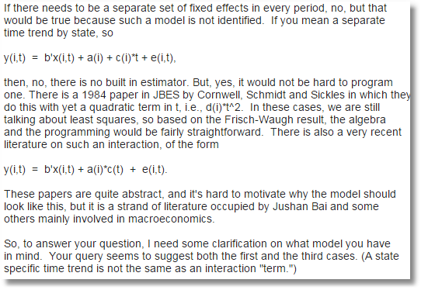
Time Varying Fixed Effects
911
Rescue

Slide 7
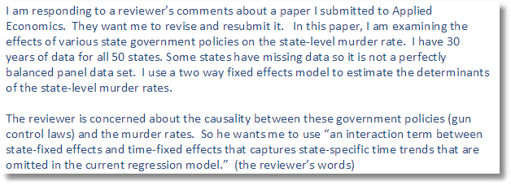
Need for Clarification

Slide 8
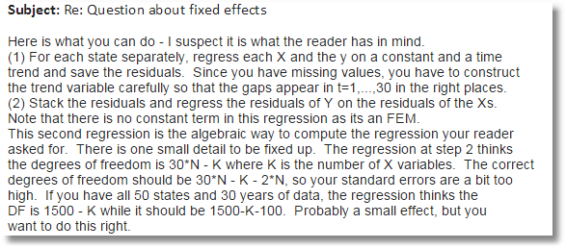
Time Varying Fixed Effects

Slide 9
A Partial Fixed Effects Model

Slide 10
Time Varying Effects Models
Time Varying Fixed Effects: Additive Polynomial
y_{it} = β’x_{it} + a_{i}(t) + ε_{it}
y_{it} = β’x_{it} + a_{i0} + a_{i1}t + a_{i2}t²+ ε_{it}
Let W_{i} = [1,t,t²]_{Tx3} A_{i} = stack of W_{i} with 0s inserted
Use OLS, Frisch and Waugh. Extend “within” estimator.
Note A_{i}’A_{j} = 0 for all i ≠ j.
See Cornwell, Schmidt, Sickles (1990) (Frontiers literature.)

Slide 11
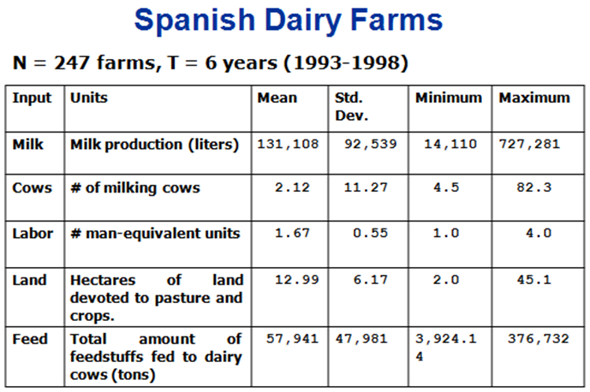

Slide 12
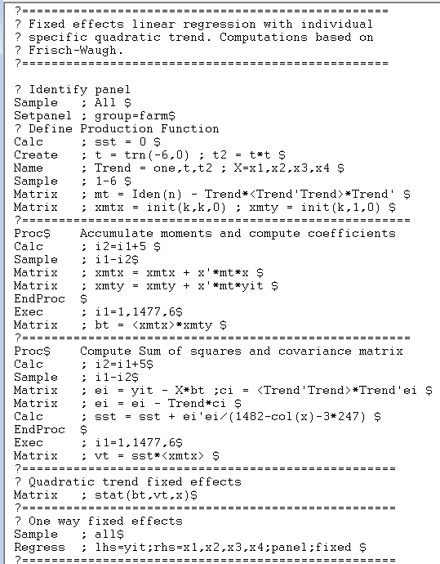

Slide 13
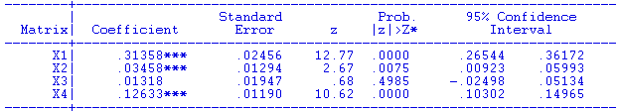
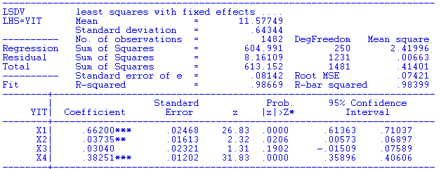
calc;list;r2=1-(1482-col(x)-3*247)*sst/((n-1)*var(yit))$
[CALC] R2 = .9975014
F[2*247, 1482-4-3*247]
= (.99750 - .98669)/(2*247) / ((1 - .99750)/(1482 – 4 – 3*247))
= 6.45
Wald = 6.45*494 = 3186. Critical chi squared for 494 DF = 546.81

Slide 14
Time Varying Effects Models
Random Effects
y_{it} = β’x_{it} + ε_{it} + a_{i}(t)
or
y_{it} = β’x_{it} + ε_{it} + u_{i}g(t,θ)
A heteroscedastic random effects model
Stochastic frontiers literature – Battese-Coelli (1992)

Slide 15
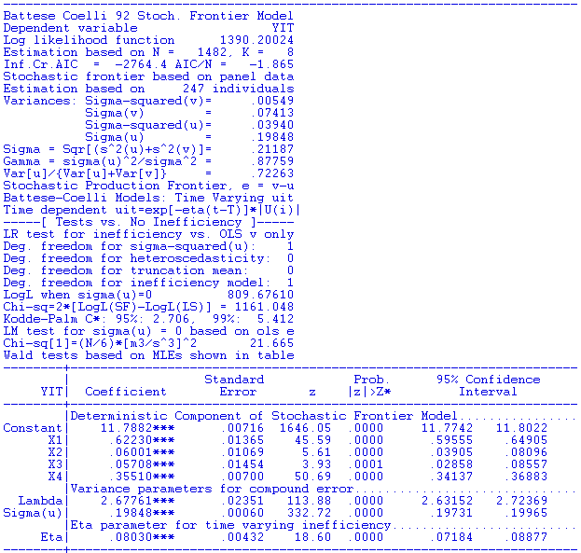

Slide 16
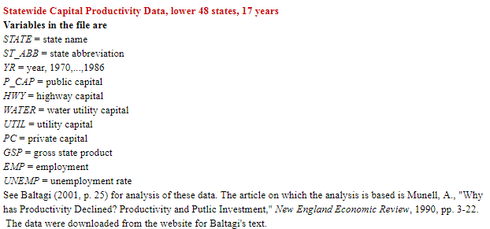
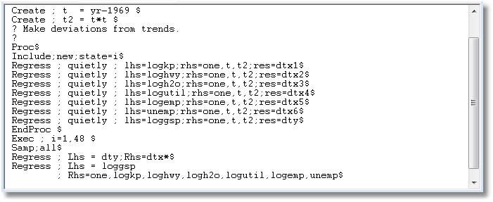
Munnell State Production Model

Slide 17
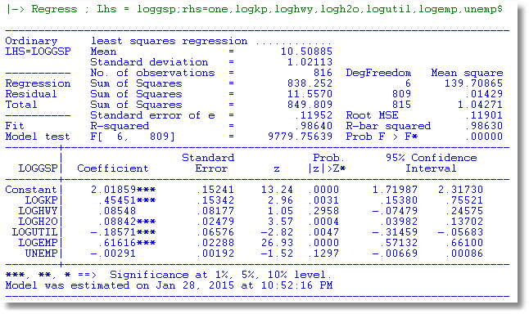
No Effects

Slide 18
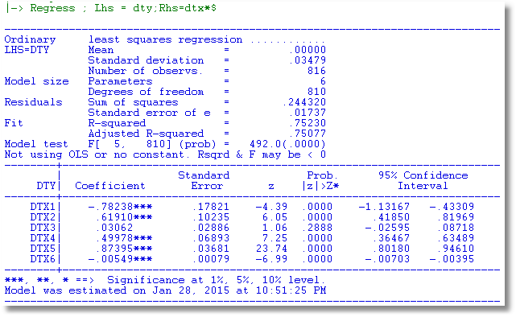
Quadratic Fixed Effects
Correct DF: 816-6-3(48)=666
Multiply standard errors by sqr(810/666) = 1.103

Slide 19
Time Varying Effects Models
Time Varying Fixed Effects: Multiplicative
y_{it} = β’x_{it} + a_{i}(t) + ε_{it}
y_{it} = β’x_{it} + α_{i}γ_{t} + ε_{it}
Not estimable. Needs a normalization. γ₁ = 1.
An EM iteration: (Chen (2015).)

Slide 20

EM Algorithm (Chen (2015))

Slide 21
Measurement Error

Slide 22
General Conclusions About Measurement Error
In the presence of individual effects, inconsistency is in unknown directions
With panel data, different transformations of the data (first differences, group mean deviations) estimate different functions of the parameters – possible method of moments estimators
Model may be estimable by minimum distance or GMM
With panel data, lagged values may provide suitable instruments for IV estimation.
Various applications listed in Baltagi (pp. 205-208).

Slide 23
Application: A Twins Study

Slide 24
Wage Equation

Slide 25
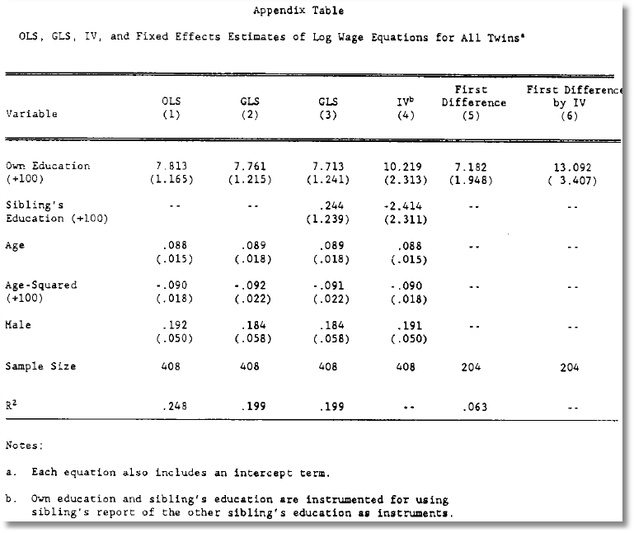

Slide 26
Spatial Autocorrelation
Thanks to Luc Anselin, Ag. U. of Ill.

Slide 27
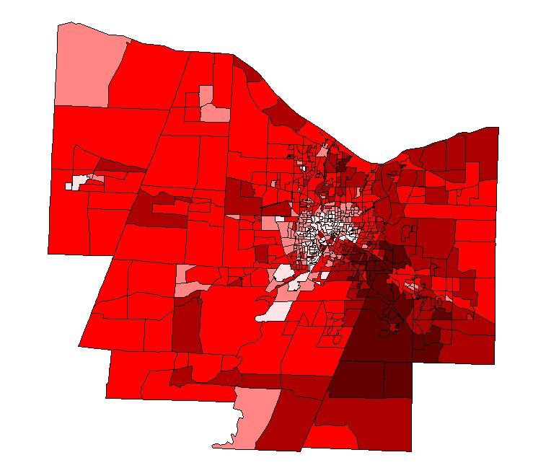
Spatially Autocorrelated Data
Per Capita Income in
Monroe County, NY
Thanks Arthur J. Lembo Jr., Geography, Cornell.

Slide 28
Hypothesis of Spatial Autocorrelation
Thanks to Luc Anselin, Ag. U. of Ill.

Slide 29
Testing for Spatial Autocorrelation
W = Spatial Weight Matrix. Think “Spatial Distance Matrix.” W_{ii} = 0.

Slide 30
Modeling Spatial Autocorrelation

Slide 31
Spatial Autoregression

Slide 32
Generalized Regression
Potentially very large N – GPS data on agriculture plots
Estimation of λ. There is no natural residual based estimator
Complicated covariance structure – no simple transformations

Slide 33
Spatial Autocorrelation in Regression

Slide 34
Panel Data Application:
Spatial Autocorrelation

Slide 35
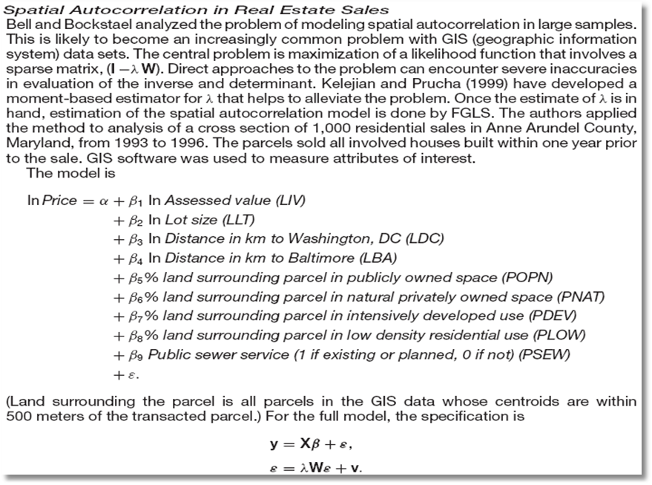

Slide 36
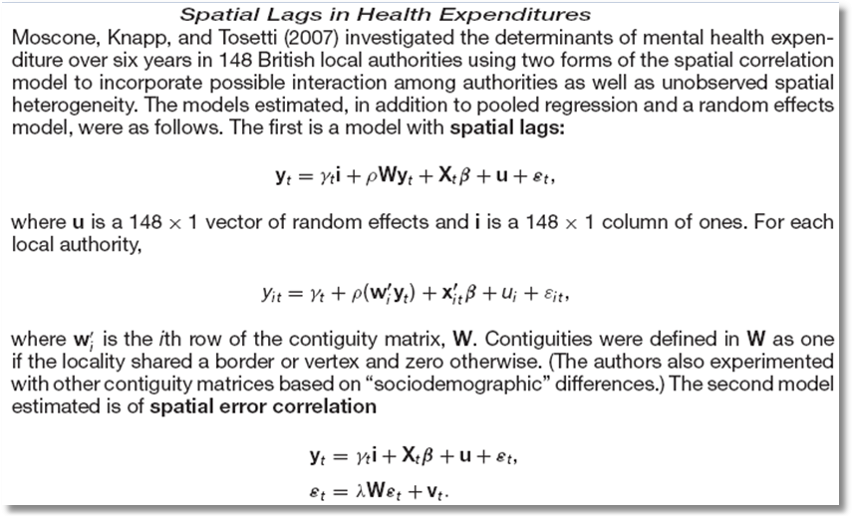
Spatial Autocorrelation in a Panel

Slide 37
Spatial Autocorrelation in a Sample Selection Model
Flores-Lagunes, A. and Schnier, K., “Sample Selection and Spatial Dependence,” Journal of Applied Econometrics, 27, 2, 2012, pp. 173-204.
❶ Alaska Department of Fish and Game.
❷ Pacific cod fishing eastern Bering Sea – grid of locations
❸ Observation = ‘catch per unit effort’ in grid square
❹ Data reported only if 4+ similar vessels fish in the region
❺ 1997 sample = 320 observations with 207 reported full data

Slide 38
Spatial Autocorrelation in a Sample Selection Model
❶ LHS is catch per unit effort = CPUE
❷ Site characteristics: MaxDepth, MinDepth, Biomass
❸ Fleet characteristics:
  Catcher vessel (CV = 0/1)
  Hook and line (HAL = 0/1)
  Nonpelagic trawl gear (NPT = 0/1)
  Large (at least 125 feet) (Large = 0/1)

Slide 39
Spatial Autocorrelation in a Sample Selection Model

Slide 40
Spatial Autocorrelation in a Sample Selection Model

Slide 41
Spatial Weights

Slide 42
Appendix: Miscellaneous

Slide 43
Ordinary Least Squares
Standard results for OLS in a GR model
  Consistent
  Unbiased
  Inefficient
Variance does (we expect) converge to zero;

Slide 44
Estimating the Variance for OLS

Slide 45
White Estimator for OLS

Slide 46
Generalized Least Squares

Slide 47
Maximum Likelihood

Slide 48
Conclusion Het. in Effects
Choose robust OLS or simple FGLS with moments based variances.
  Note the advantage of panel data – individual specific variances
  As usual, the payoff is a function of
    Variance of the variances
    The extent to which variances are correlated with regressors.
MLE and specific models for variances probably don’t pay off much unless the model(s) for the variances is (are) of specific interest.

Slide 49
Generalized Regression

Slide 50
OLS Estimation

Slide 51
Feasible GLS

Slide 52
GLS Estimation

Slide 53
Heteroscedasticity
Naturally expected in microeconomic data, less so in macroeconomic
Model Platforms
  Fixed Effects
  Random Effects
Estimation
  OLS with (or without) robust covariance matrices
  GLS and FGLS
  Maximum Likelihood

Slide 54
Dear Professor Greene,
I have to apply multiplicative heteroscedastic models, that I studied in your book, to the analysis of trade data.
Since I have not found any Matlab implementations, I am starting to write the method from scratch. I was wondering if you are aware of reliable implementations in Matlab or any other language, which I can use as a reference.

Slide 55
Baltagi and Griffin’s Gasoline Data
World Gasoline Demand Data, 18 OECD Countries, 19 years
Variables in the file are
COUNTRY = name of country
YEAR = year, 1960-1978
LGASPCAR = log of consumption per car
LINCOMEP = log of per capita income
LRPMG = log of real price of gasoline
LCARPCAP = log of per capita number of cars
See Baltagi (2001, p. 24) for analysis of these data. The article on which the analysis is based is Baltagi, B. and Griffin, J., "Gasoline Demand in the OECD: An Application of Pooling and Testing Procedures," European Economic Review, 22, 1983, pp. 117-137. The data were downloaded from the website for Baltagi's text.

Slide 56
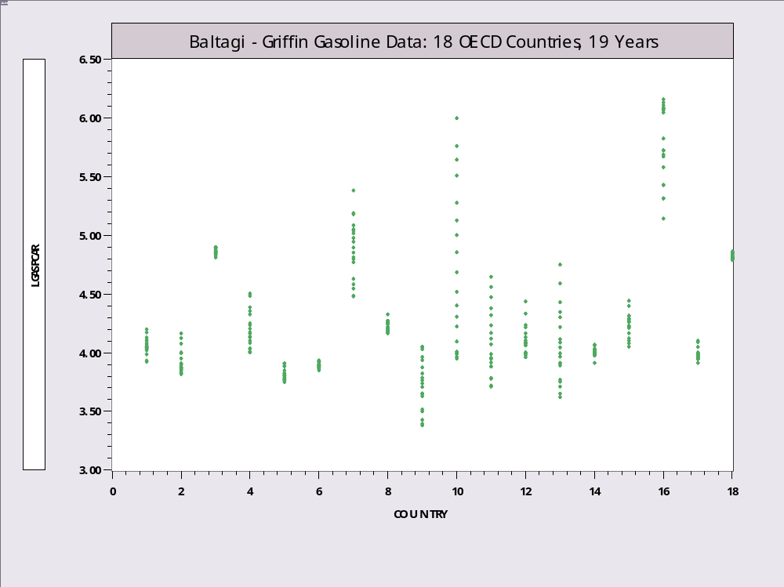
Heteroscedastic Gasoline Data

Slide 57
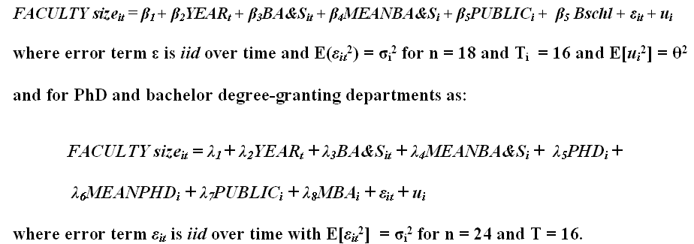
Does Teaching Load Affect Faculty Size?
Becker, W., Greene, W., Seigfried, J.
Do Undergraduate Majors or PhD Students Affect Faculty Size? American Economist 56(1): 69-77. Becker, Jr., W.E., W.H. Greene & J.J. Siegfried. 2011
Mundlak form of Random Effects

Slide 58
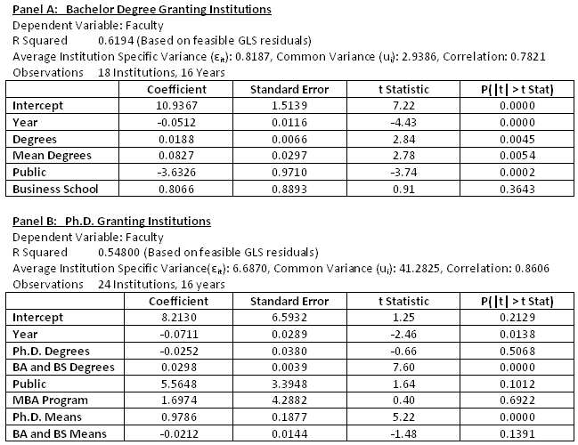
Random Effects Regressions

Slide 59
Modeling the Scedastic Function

Slide 60
Two Step Estimation

Slide 61
Heteroscedasticity in the RE Model

Slide 62
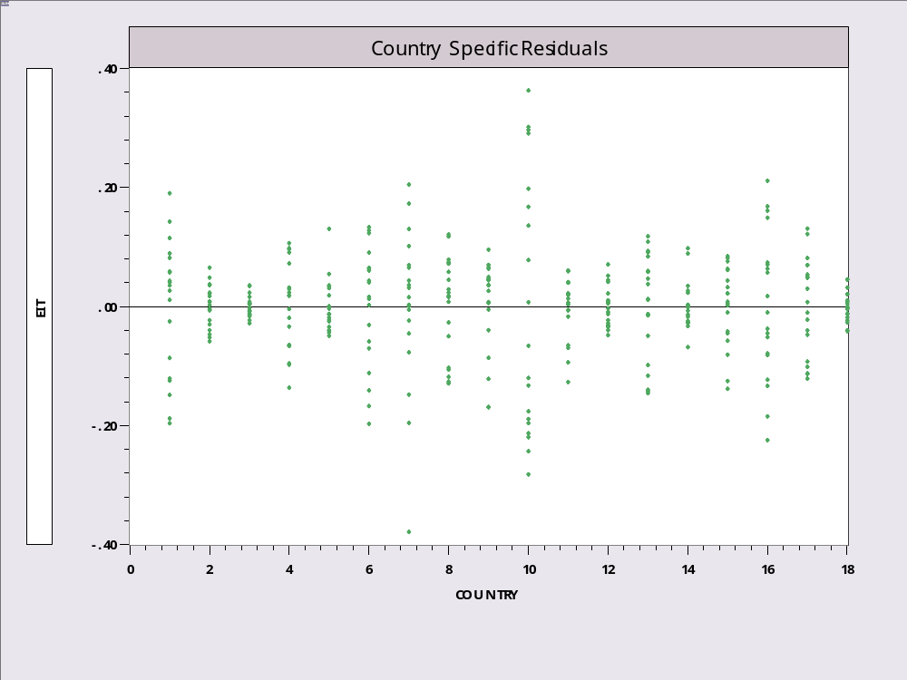
LSDV Residuals

Slide 63
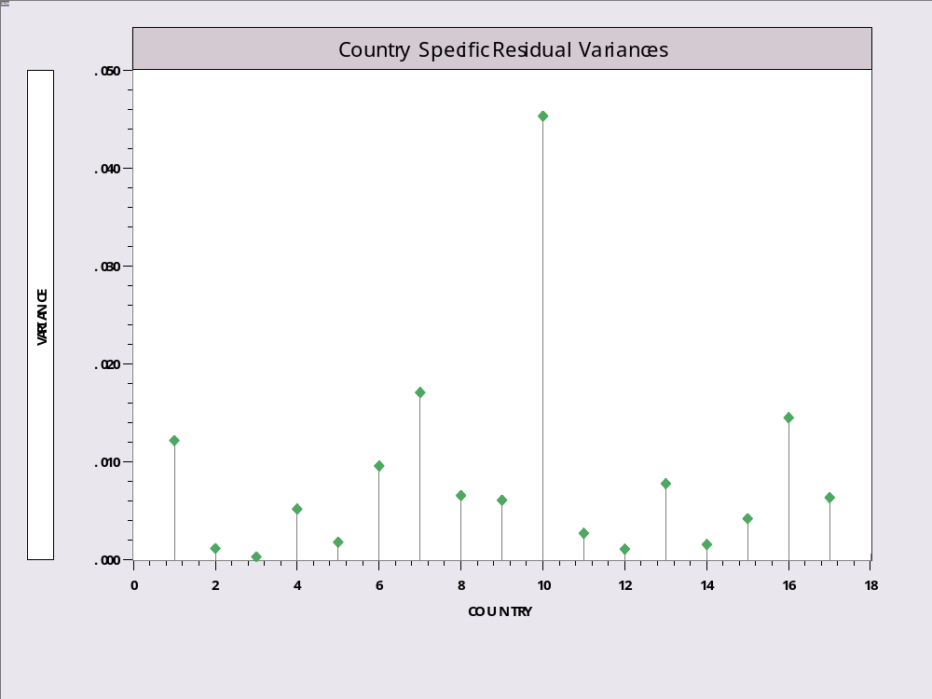
Evidence of Country Specific Heteroscedasticity

Slide 64
Heteroscedasticity in the FE Model
Ordinary Least Squares
  Within groups estimation as usual.
  Standard treatment – this is just a (large) linear regression model.
  White estimator

Slide 65
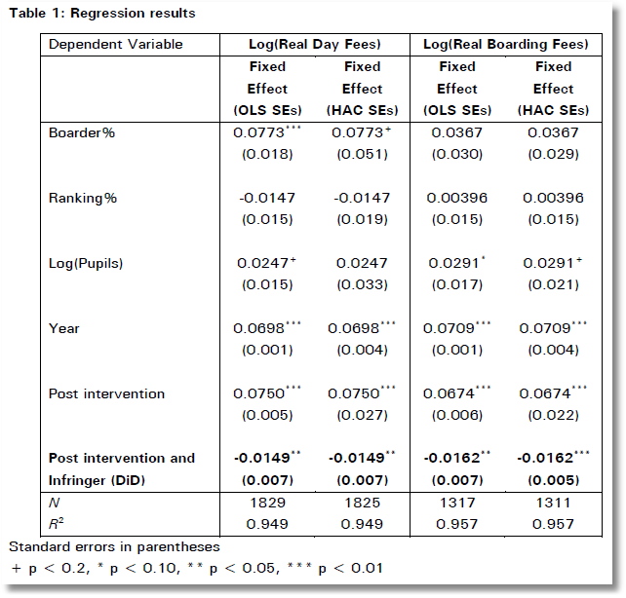
In order to test robustness two versions of the fixed effects model were run. The first is Ordinary Least Squares, and the second is heteroscedasticity and auto-correlation robust (HAC) standard errors in order to check for heteroscedasticity and autocorrelation.
[Only one version of the model was computed. There was no “check.”]

Slide 66
Narrower Assumptions

Slide 67
Heteroscedasticity in Gasoline Data
+----------------------------------------------------+
| Least Squares with Group Dummy Variables |
| LHS=LGASPCAR Mean = 4.296242 |
| Fit R-squared = .9733657 |
| Adjusted R-squared = .9717062 |
+----------------------------------------------------+
Least Squares - Within
+---------+--------------+----------------+--------+---------+----------+
|Variable | Coefficient | Standard Error |t-ratio |P[|T|>t] | Mean of X|
+---------+--------------+----------------+--------+---------+----------+
LINCOMEP .66224966 .07338604 9.024 .0000 -6.13942544
LRPMG -.32170246 .04409925 -7.295 .0000 -.52310321
LCARPCAP -.64048288 .02967885 -21.580 .0000 -9.04180473
+---------+--------------+----------------+--------+---------+----------+
White Estimator
+---------+--------------+----------------+--------+---------+----------+
LINCOMEP .66224966 .07277408 9.100 .0000 -6.13942544
LRPMG -.32170246 .05381258 -5.978 .0000 -.52310321
LCARPCAP -.64048288 .03876145 -16.524 .0000 -9.04180473
+---------+--------------+----------------+--------+---------+----------+
White Estimator using Grouping
+---------+--------------+----------------+--------+---------+----------+
LINCOMEP .66224966 .06238100 10.616 .0000 -6.13942544
LRPMG -.32170246 .05197389 -6.190 .0000 -.52310321
LCARPCAP -.64048288 .03035538 -21.099 .0000 -9.04180473

Slide 68
Estimating the Variance Components: Baltagi
Invoking Mazodier and Trognon (1978) and Baltagi and Griffin (1988).

Slide 69
Estimating the Variance Components: Hsiao
So, who’s right? Hsiao. This is no longer in Baltagi.
Invoking Mazodier and Trognon (1978) and Baltagi and Griffin (1988).

Slide 70
Maximum Likelihood

Slide 71
OLS and PCSE
+--------------------------------------------------+
| Groupwise Regression Models |
| Pooled OLS residual variance (SS/nT) .0436 |
| Test statistics for homoscedasticity: |
| Deg.Fr. = 17 C*(.95) = 27.59 C*(.99) = 33.41 |
| Lagrange multiplier statistic = 111.5485 |
| Wald statistic = 546.3827 |
| Likelihood ratio statistic = 109.5616 |
| Log-likelihood function = 50.492889 |
+--------------------------------------------------+
+---------+--------------+----------------+--------+---------+
|Variable | Coefficient | Standard Error |b/St.Er.|P[|Z|>z] |
+---------+--------------+----------------+--------+---------+
Constant 2.39132562 .11624845 20.571 .0000
LINCOMEP .88996166 .03559581 25.002 .0000
LRPMG -.89179791 .03013694 -29.592 .0000
LCARPCAP -.76337275 .01849916 -41.265 .0000
+----------------------------------------------------+
| OLS with Panel Corrected Covariance Matrix |
+----------------------------------------------------+
+---------+--------------+----------------+--------+---------+
|Variable | Coefficient | Standard Error |b/St.Er.|P[|Z|>z] |
+---------+--------------+----------------+--------+---------+
Constant 2.39132562 .06388479 37.432 .0000
LINCOMEP .88996166 .02729303 32.608 .0000
LRPMG -.89179791 .02641611 -33.760 .0000
LCARPCAP -.76337275 .01605183 -47.557 .0000

Slide 72
FGLS
+--------------------------------------------------+
| Groupwise Regression Models |
| Pooled OLS residual variance (SS/nT) .0436 |
| Log-likelihood function = 50.492889 |
+--------------------------------------------------+
+---------+--------------+----------------+--------+---------+
|Variable | Coefficient | Standard Error |b/St.Er.|P[|Z|>z] |
+---------+--------------+----------------+--------+---------+
Constant 2.39132562 .11624845 20.571 .0000
LINCOMEP .88996166 .03559581 25.002 .0000
LRPMG -.89179791 .03013694 -29.592 .0000
LCARPCAP -.76337275 .01849916 -41.265 .0000
+--------------------------------------------------+
| Groupwise Regression Models |
| Test statistics against the correlation |
| Deg.Fr. = 153 C*(.95) = 182.86 C*(.99) = 196.61 |
| Test statistics against the correlation |
| Likelihood ratio statistic = 1010.7643 |
+---------+--------------+----------------+--------+---------+
|Variable | Coefficient | Standard Error |b/St.Er.|P[|Z|>z] |
+---------+--------------+----------------+--------+---------+
Constant 2.11399182 .00962111 219.724 .0000
LINCOMEP .80854298 .00219271 368.741 .0000
LRPMG -.79726940 .00123434 -645.909 .0000
LCARPCAP -.73962381 .00074366 -994.570 .0000

Slide 73
Autocorrelation
Source?
Already present in RE model – equicorrelated.
Models:
  Autoregressive: ε_{i,t} = ρε_{i,t-1} + v_{it} – how to interpret
  Unrestricted: (Already considered)
Estimation requires an estimate of ρ

Slide 74
FGLS – Fixed Effects

Slide 75
FGLS – Random Effects

Slide 76
Microeconomic Data - Wages
+----------------------------------------------------+
| Least Squares with Group Dummy Variables |
| LHS=LWAGE Mean = 6.676346 |
| Model size Parameters = 600 |
| Degrees of freedom = 3565 |
| Estd. Autocorrelation of e(i,t) .148641 |
+----------------------------------------------------+
+---------+--------------+----------------+--------+---------+
|Variable | Coefficient | Standard Error |b/St.Er.|P[|Z|>z] |
+---------+--------------+----------------+--------+---------+
OCC -.01722052 .01363100 -1.263 .2065
SMSA -.04124493 .01933909 -2.133 .0329
MS -.02906128 .01897720 -1.531 .1257
EXP .11359630 .00246745 46.038 .0000
EXPSQ -.00042619 .544979D-04 -7.820 .0000

Slide 77
Macroeconomic Data –
Baltagi/Griffin Gasoline Market
+----------------------------------------------------+
| Least Squares with Group Dummy Variables |
| LHS=LGASPCAR Mean = 4.296242 |
| Estd. Autocorrelation of e(i,t) .775557 |
+----------------------------------------------------+
+---------+--------------+----------------+--------+---------+
|Variable | Coefficient | Standard Error |t-ratio |P[|T|>t] |
+---------+--------------+----------------+--------+---------+
LINCOMEP .66224966 .07338604 9.024 .0000
LRPMG -.32170246 .04409925 -7.295 .0000
LCARPCAP -.64048288 .02967885 -21.580 .0000

Slide 78
Aggregation Test

Slide 79
Baltagi and Griffin’s Gasoline Data
World Gasoline Demand Data, 18 OECD Countries, 19 years
Variables in the file are
COUNTRY = name of country
YEAR = year, 1960-1978
LGASPCAR = log of consumption per car
LINCOMEP = log of per capita income
LRPMG = log of real price of gasoline
LCARPCAP = log of per capita number of cars
See Baltagi (2001, p. 24) for analysis of these data. The article on which the analysis is based is Baltagi, B. and Griffin, J., "Gasoline Demand in the OECD: An Application of Pooling and Testing Procedures," European Economic Review, 22, 1983, pp. 117-137. The data were downloaded from the website for Baltagi's text.

Slide 80
A Test Against Aggregation
Log Likelihood from restricted model = 655.093. Free parameters in β and Σ are 4 + 18(19)/2 = 175.
Log Likelihood from model with separate country dummy variables = 876.126. Free parameters in β and Σ are 21 + 171 = 192
Chi-squared[17]=2(876.126-655.093)=442.07
Critical value=27.857. Homogeneity hypothesis is rejected a fortiori.

