Slide 1



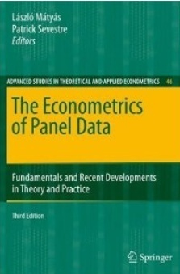




Econometric Analysis of Panel Data
William Greene
Department of Economics
University of South Florida

Slide 2
Agenda
Single equation instrumental variable estimation
  Exogeneity
  Instrumental Variable (IV) Estimation
  Two Stage Least Squares (2SLS)
  Generalized Method of Moments (GMM)
Panel data
  Fixed effects
  Hausman and Taylor’s formulation
  Application
  Arellano/Bond/Bover framework

Slide 3
Structure and Regression

Slide 4
Least Squares
Useful insight: LS converges to something, just not the parameter we are hoping to estimate.

Slide 5
Exogeneity and Endogeneity

Slide 6
The IV Estimator

Slide 7
A Moment Based Estimator

Slide 8
Cornwell and Rupert Data
Cornwell and Rupert Returns to Schooling Data, 595 Individuals, 7 Years
Variables in the file are
EXP = work experience, EXPSQ = EXP²
WKS = weeks worked
OCC = occupation, 1 if blue collar,
IND = 1 if manufacturing industry
SOUTH = 1 if resides in south
SMSA = 1 if resides in a city (SMSA)
MS = 1 if married
FEM = 1 if female
UNION = 1 if wage set by union contract
ED = years of education
LWAGE = log of wage = dependent variable in regressions
These data were analyzed in Cornwell, C. and Rupert, P., "Efficient Estimation with Panel Data: An Empirical Comparison of Instrumental Variable Estimators," Journal of Applied Econometrics, 3, 1988, pp. 149-155. See Baltagi, page 122 for further analysis. The data were downloaded from the website for Baltagi's text.

Slide 9
Wage Equation with
Endogenous Weeks Worked
lnWage=β₁+ β₂ Exp + β₃ ExpSq + β₄OCC + β₅ South + β₆ SMSA + β₇ WKS + ε
Weeks worked (WKS) is believed to be endogenous in this equation.
We use the Marital Status dummy variable MS as an exogenous variable.
Wooldridge Condition (Exogeneity) (5.3) Cov[MS, ε] = 0 is assumed.
Auxiliary regression: For MS to be a ‘valid,’ relevant instrumental variable,
In the regression of WKS on [1,EXP,EXPSQ,OCC,South,SMSA,MS]
MS significantly “explains” WKS.
A projection interpretation: In the projection
x_{itK} =θ₁ x_{it1} + θ₂ x_{it2} + … + θ_{K-1} x_{it,K-1} + θ_{K} z_{it} +u, θ_{K} ≠ 0.

Slide 10
Auxiliary Projection of WKS on (X,z)
Ordinary least squares regression
LHS=WKS Mean = 46.81152
--------------------------------------------------------------
Variable | Coefficient | Standard Error |b/St.Er.|P[|Z|>z]
--------------------------------------------------------------
Constant 45.4842872 .36908158 123.236 .0000
EXP .05354484 .03139904 1.705 .0881
EXPSQ -.00169664 .00069138 -2.454 .0141
OCC .01294854 .16266435 .080 .9366
SOUTH .38537223 .17645815 2.184 .0290
SMSA .36777247 .17284574 2.128 .0334
MS .95530115 .20846241 4.583 .0000
Stock and Staiger (and others) test for “weak instrument,” z² > 10.
4.583² = 21.004. We do not expect MS to be a weak instrument.

Slide 11
IV for WKS in Lwage Equation - OLS
Ordinary least squares regression. LWAGE |
Residuals Sum of squares = 678.5643 |
Fit R-squared = .2349075 |
Adjusted R-squared = .2338035 |
+---------+--------------+----------------+--------+---------+
|Variable | Coefficient | Standard Error |b/St.Er.|P[|Z|>z] |
+---------+--------------+----------------+--------+---------+
Constant 6.07199231 .06252087 97.119 .0000
EXP .04177020 .00247262 16.893 .0000
EXPSQ -.00073626 .546183D-04 -13.480 .0000
OCC -.27443035 .01285266 -21.352 .0000
SOUTH -.14260124 .01394215 -10.228 .0000
SMSA .13383636 .01358872 9.849 .0000
WKS .00529710 .00122315 4.331 .0000

Slide 12
IV (2SLS) for WKS
+----------------------------------------------------+
| LHS=LWAGE Mean = 6.676346 |
| Standard deviation = .4615122 |
| Residuals Sum of squares = 13853.55 |
| Standard error of e = 1.825317 |
+----------------------------------------------------+
--------------------------------------------------------------
|Variable | Coefficient | Standard Error |b/St.Er.|P[|Z|>z] |
--------------------------------------------------------------
Constant -9.97734299 3.59921463 -2.772 .0056
EXP .01833440 .01233989 1.486 .1373
EXPSQ -.799491D-04 .00028711 -.278 .7807
OCC -.28885529 .05816301 -4.966 .0000
SOUTH -.26279891 .06848831 -3.837 .0001
SMSA .03616514 .06516665 .555 .5789
WKS .35314170 .07796292 4.530 .0000
OLS------------------------------------------------------
WKS .00529710 .00122315 4.331 .0000

Slide 13
Generalizing the IV Estimator-1

Slide 14
Generalizing the IV Estimator - 2

Slide 15
The Best Set of Instruments

Slide 16

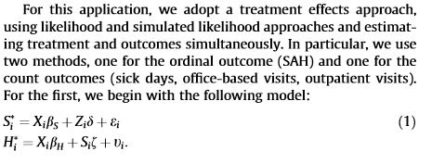

Slide 17
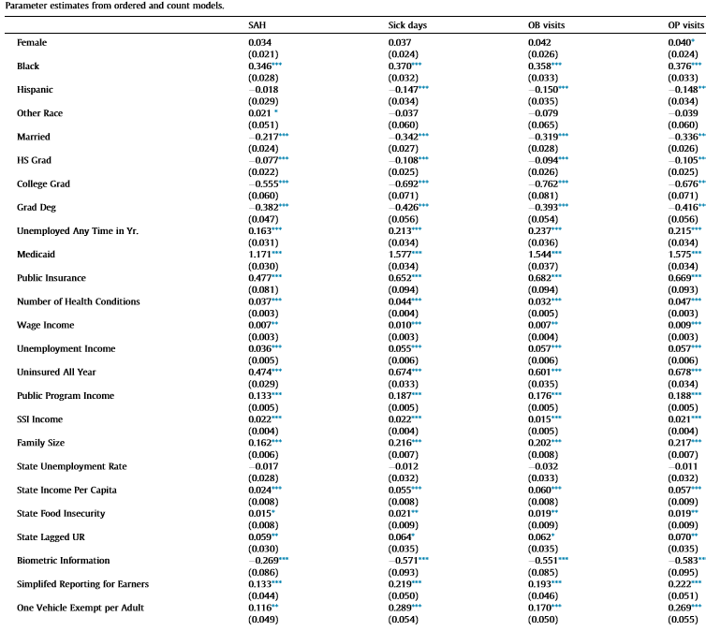

Slide 18
Two Stage Least Squares

Slide 19
2SLS Estimator

Slide 20
2SLS Algebra

Slide 21
2SLS for Panel Data

Slide 22
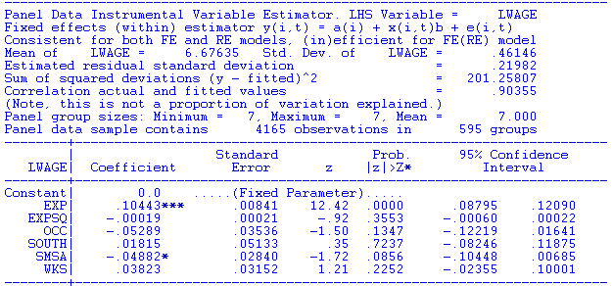
CREATE ; id = trn(7,0)$
SETPANEL ; Group = id $
NAMELIST ; x = one,exp,expsq,occ,south,smsa,wks$
NAMELIST ; z = one,exp,expsq,occ,south,smsa,ms,union,ed$
FE2SLS ; Lhs = lwage ; Rhs = X ; Inst = z ; Panel$
RE2SLS ; Lhs = lwage ; Rhs = X ; Inst = z ; Panel$

Slide 23
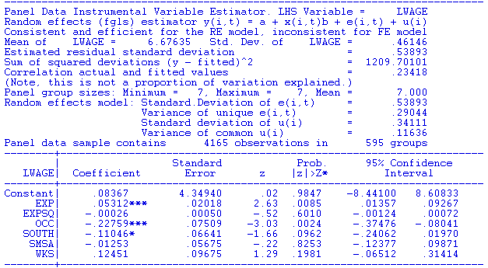
CREATE ; id = trn(7,0)$
SETPANEL ; Group = id $
NAMELIST ; x = one,exp,expsq,occ,south,smsa,wks$
NAMELIST ; z = one,exp,expsq,occ,south,smsa,ms,union,ed$
FE2SLS ; Lhs = lwage ; Rhs = X ; Inst = z ; Panel$
RE2SLS ; Lhs = lwage ; Rhs = X ; Inst = z ; Panel$

Slide 24
GMM Estimation
Orthogonality Conditions

Slide 25
GMM Estimation - 1

Slide 26
NAMELIST ; x = one,exp,expsq,occ,south,smsa,wks$
NAMELIST ; z = one,exp,expsq,occ,south,smsa,ms,union,ed$
2SLS ; lhs = lwage ; RHS = X ; INST = Z $
NLSQ ; fcn = lwage-b1'x ? (Linear function begins with b1)
; labels = b1,b2,b3,b4,b5,b6,b7
; start = b ? (Starting values are 2SLS)
; inst = Z
; pds = 0 $ ? (Use White Estimator)

Slide 27
GMM Estimation - 2

Slide 29
An Optimal Weighting Matrix

Slide 30
The GMM Estimator

Slide 33
Extended GMM Estimation

Slide 34
Application - GMM
NAMELIST ; x = one,exp,expsq,occ,south,smsa,wks$
NAMELIST ; z = one,exp,expsq,occ,south,smsa,ms,union,ed$
2SLS ; lhs = lwage ; RHS = X ; INST = Z $
NLSQ ; fcn = lwage-b1'x
; labels = b1,b2,b3,b4,b5,b6,b7
; start = b ? 2sls starting values
; inst = Z
; pds = 0 $ White. If > 0, uses Newey-West)

Slide 35
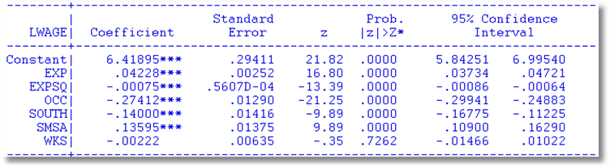
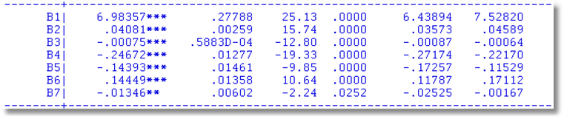
2SLS
GMM with Heteroscedasticity

Slide 37


Slide 38

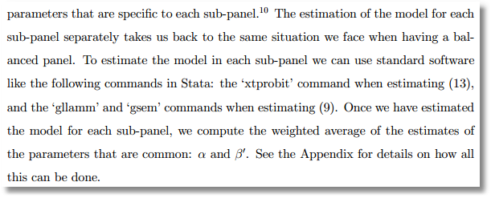

Slide 39
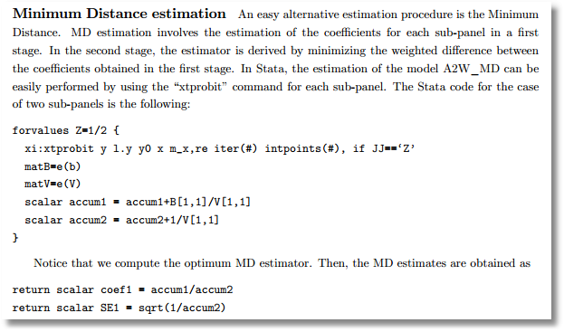
Not optimal, but better than a simple average.

Slide 40
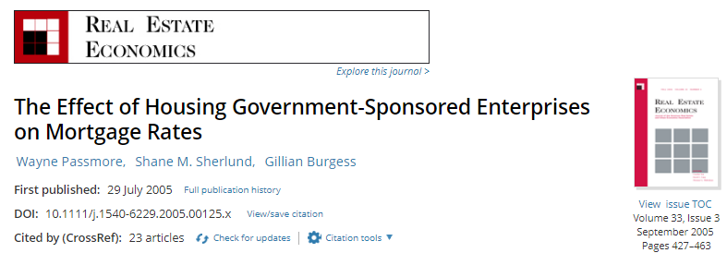
Analysis of Fannie Mae
Fannie Mae
The Funding Advantage
The Pass Through

Slide 41
First Stage – Rate Difference

Slide 42
Second Stage – Pass Through

Slide 43
A Minimum Distance Estimator
Estimates of β₁

Slide 44
The Minimum Distance Estimator

Slide 45
Testing the Overidentifying Restrictions

Slide 46
Inference About the Parameters

Slide 47
Extending the Form of the GMM Estimator to Nonlinear Models

Slide 48
A Nonlinear Conditional Mean

Slide 49
Nonlinear Regression/GMM
NAMELIST ; x = one,exp,expsq,occ,south,smsa,wks$
NAMELIST ; z = one,exp,expsq,occ,south,smsa,ms,union,ed$
? Get initial values to use for optimal weighting matrix
NLSQ ; lhs = lwage ; fcn=exp(b1'x) ; inst = z
; labels=b1,b2,b3,b4,b5,b6,b7 ; start=7_0$
? GMM using previous estimates to compute weighting matrix
NLSQ (GMM) ; fcn = lwage-exp(b1'x) ; inst = Z
; labels = b1,b2,b3,b4,b5,b6,b7 ; start = b
; pds = 0 $ (Means use White style estimator)

Slide 50
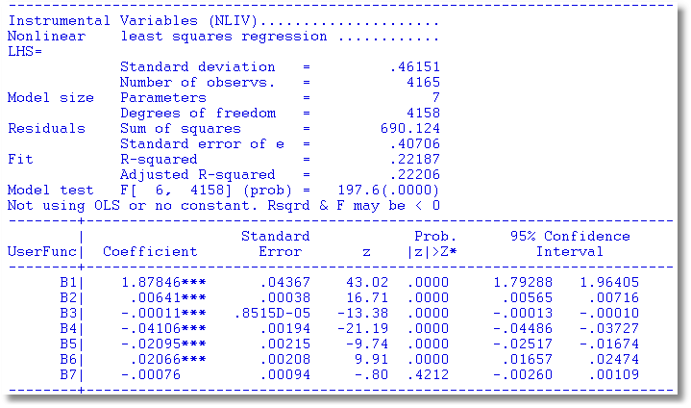
Nonlinear Wage Equation Estimates
NLSQ Initial Values

Slide 51
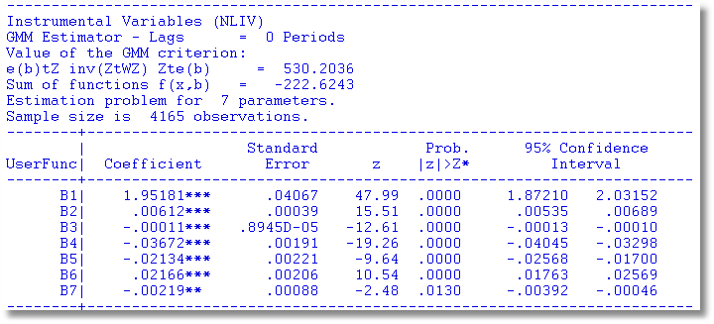
Nonlinear Wage Equation Estimates
2nd Step GMM

Slide 52
Appendix

Slide 53
IV Estimation

Slide 54
Specification Test Based on the Criterion

Slide 55
