Slide 1

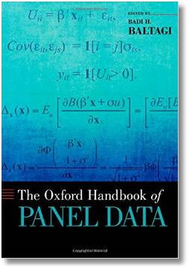






Econometric Analysis of Panel Data
William Greene
Department of Economics
University of South Florida

Slide 2
The Hausman and Taylor RE Model

Slide 3
A Useful Result: LSDV is an IV Estimator

Slide 4
Hausman and Taylor Use that Result

Slide 5
H&T’s FGLS Estimator

Slide 6
H&T’s FGLS Estimator (cont.)

Slide 7
H&T’s 4 STEP IV Estimator

Slide 8
The Hausman and Taylor Application: NLSY Wage Equation

Slide 9
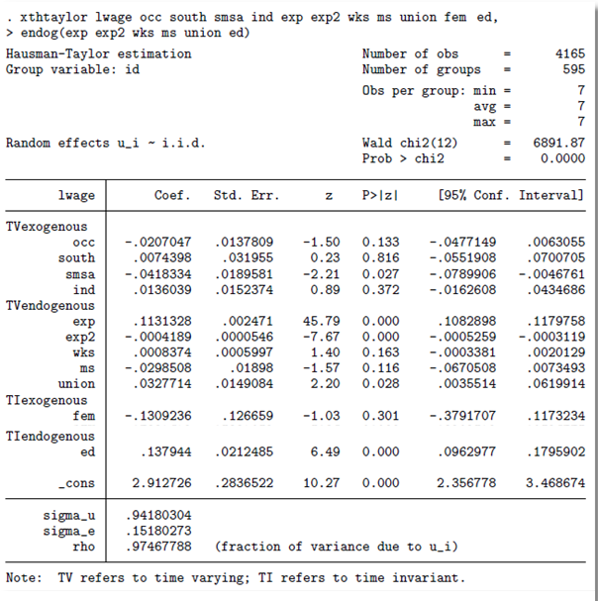
Stata implementation of Hausman and Taylor estimator based on Cornwell and Rupert.
Standard example.
Is marital status really endogenous?

Slide 10
Dynamic (Linear) Panel
Data (DPD) Models
Application
Bias in Conventional Estimation
Development of Consistent Estimators
Efficient GMM Estimators

Slide 11
THE Dynamic Linear Model

Slide 12
A General DPD model

Slide 13
OLS and GLS are inconsistent

Slide 14
LSDV is Also Inconsistent
[(Steven) Nickell Bias]

Slide 15
IV Estimation of the DPD Model
Anderson Hsiao IV Estimator

Slide 16
Arellano and Bond Estimator - 1

Slide 17
Arellano and Bond Estimator - 2

Slide 18
Ahn and Schmidt

Slide 19
Arellano/Bond/Bover’s Formulation
Start with H&T

Slide 20
Arellano/Bond/Bover’s Formulation
Dynamic Model

Slide 21
Arellano/Bond/Bover’s Formulation

Slide 22
Arellano/Bond/Bover Estimator
H is a TxT transformation matrix, such as M_{i}, + additional rows and/or columns.

Slide 23
GMM Criterion

Slide 24

Application: Maquiladora

Slide 25
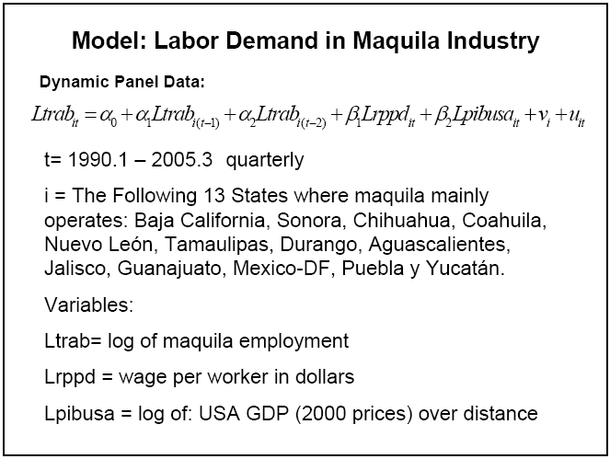
Maquiladora

Slide 26
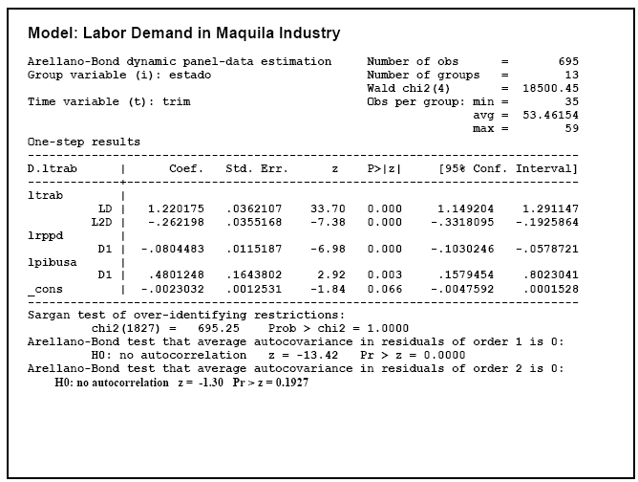

Slide 27
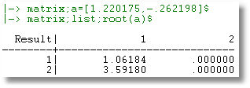

Slide 28
Postscript
There is no theoretical guidance on the instrument set
There is no theoretical guidance on the form of the covariance matrix
There is no theoretical guidance on the number of lags at any level of the model
There is no theoretical guidance on the form of the exogeneity – and it is not testable.
Results vary wildly with small variations in the assumptions.

Slide 29
Appendix

Slide 30
The Panel Data Case

Slide 31
GMM Estimation for One Equation

Slide 32
GMM for a System of Equations

Slide 33
SUR Model with Endogenous
RHS Variables

Slide 34
GMM for the System - Notation

Slide 35
Instruments

Slide 36
Moment Equations

Slide 37
Estimation-1

Slide 38
Estimation-2

Slide 39
Estimation-3

Slide 40
Estimation-4

Slide 41
Estimation-5

Slide 42
Arellano and Bond Estimator - 3

Slide 43
Arellano and Bover
Instrumental Variables Approach

Slide 44
Simple IV Estimation

Slide 45
Arellano/Bond/Bover’s Formulation
These blocks may contain all previous exogenous variables, or all exogenous variables for all periods.
This may contain the all periods of data on x₁ rather than just the group mean. (Amemiya and MaCurdy).

Slide 46
Arellano/Bond/Bover’s Formulation

Slide 47
Arellano/Bond
First Difference Formulation

Slide 48
Arellano/Bond - GLS

Slide 49
Arellano/Bond GLS Estimator

Slide 50
GMM Estimator

Slide 51
Arellano/Bond/Bover’s Formulation
For unbalanced panels the number of columns for Z_{i} varies. Given the form of Z_{i}, the number of columns depends on T_{i}.
We need all Z_{i} to have the same number of columns. For matrices with less columns than the largest one, extra columns of zeros are added.

