Slide 1






1. Descriptive Tools, Regression, Panel Data

Slide 2
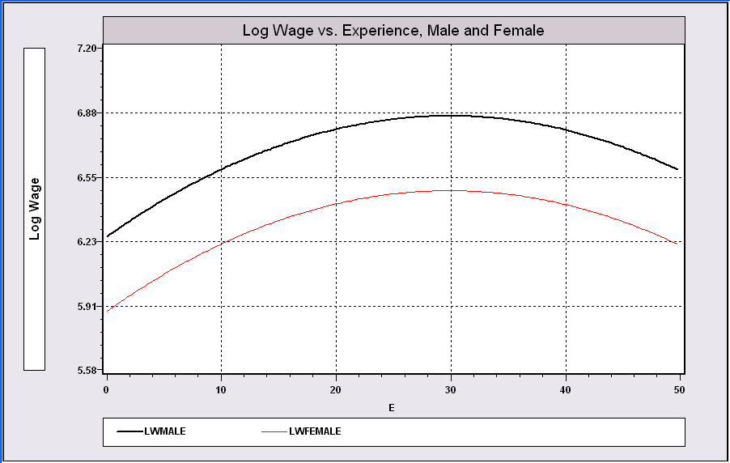
Model Building in Econometrics
Parameterizing the model
  Nonparametric analysis
  Semiparametric analysis
  Parametric analysis
Sharpness of inferences follows from the strength of the assumptions
A Model Relating (Log)Wage
to Gender and Experience

Slide 3
Cornwell and Rupert Panel Data
Cornwell and Rupert Returns to Schooling Data, 595 Individuals, 7 Years
Variables in the file are
EXP = work experience
WKS = weeks worked
OCC = occupation, 1 if blue collar,
IND = 1 if manufacturing industry
SOUTH = 1 if resides in south
SMSA = 1 if resides in a city (SMSA)
MS = 1 if married
FEM = 1 if female
UNION = 1 if wage set by union contract
ED = years of education
LWAGE = log of wage = dependent variable in regressions
These data were analyzed in Cornwell, C. and Rupert, P., "Efficient Estimation with Panel Data: An Empirical Comparison of Instrumental Variable Estimators," Journal of Applied Econometrics, 3, 1988, pp. 149-155.
Notes:
3

Slide 4


Slide 5
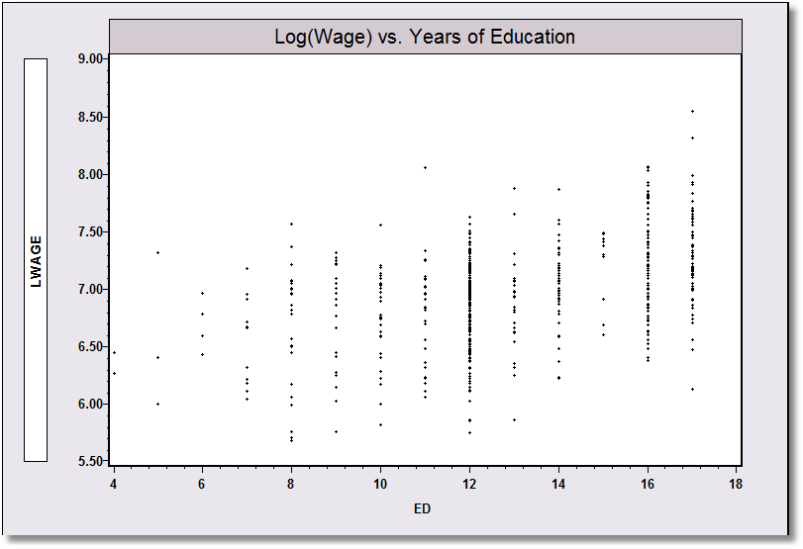
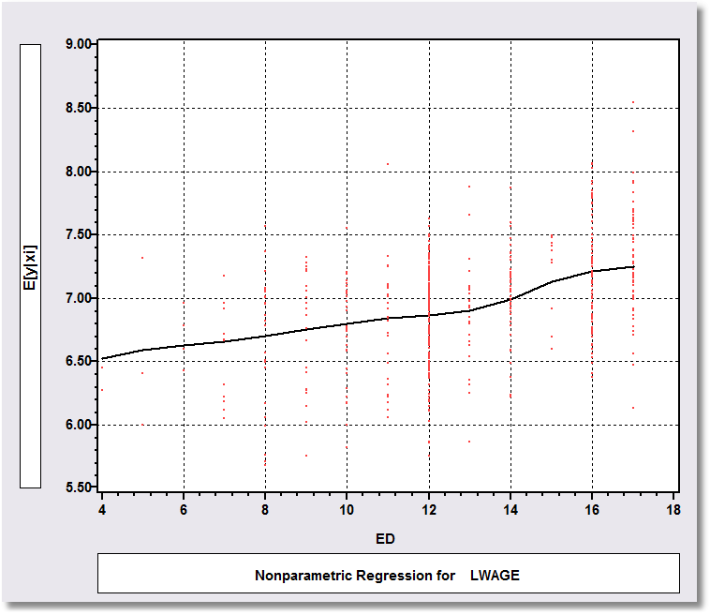
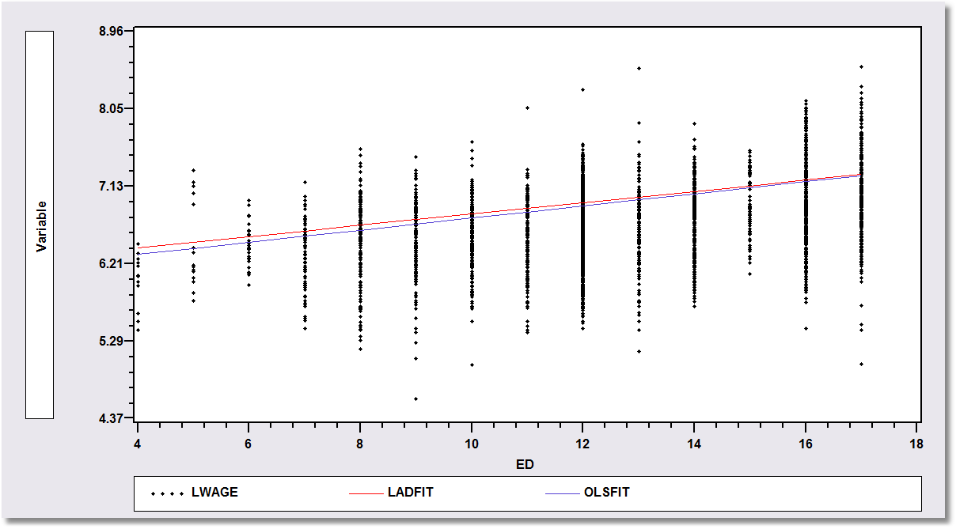
Application: Is there a relationship between Log(wage) and Education?
Nonparametric Regression
Kernel regression of y on x
Semiparametric Regression: Least absolute deviations regression of y on x
Parametric Regression: Least squares – maximum likelihood – regression of y on x

Slide 6
A First Look at the Data
Descriptive Statistics
Basic Measures of Location and Dispersion
Graphical Devices
  Box Plots
  Histogram
  Kernel Density Estimator

Slide 7
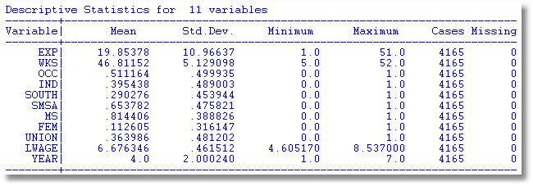
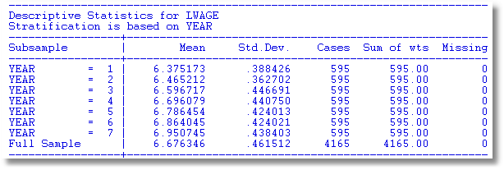

Slide 8
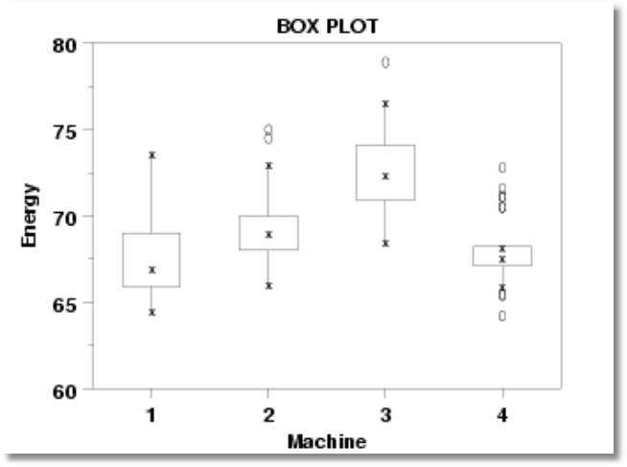
Box Plots

Slide 9
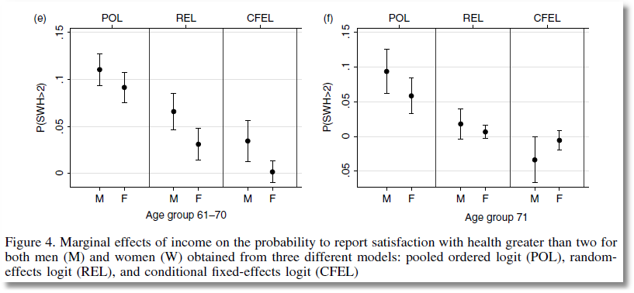
From Jones and Schurer (2011)

Slide 10
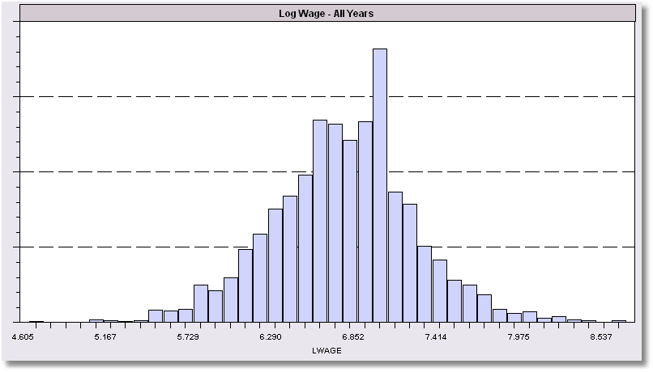
Histogram for LWAGE

Slide 11
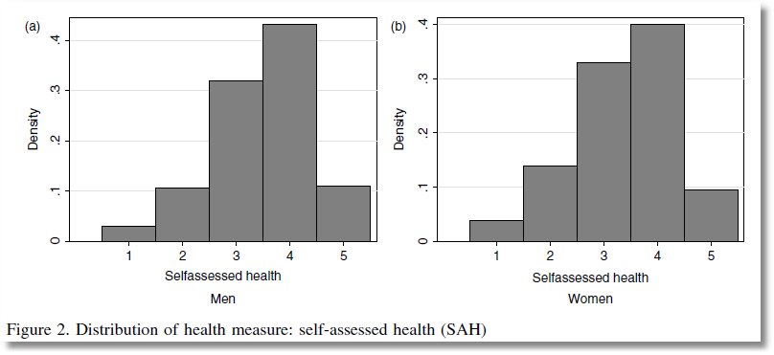

Slide 12
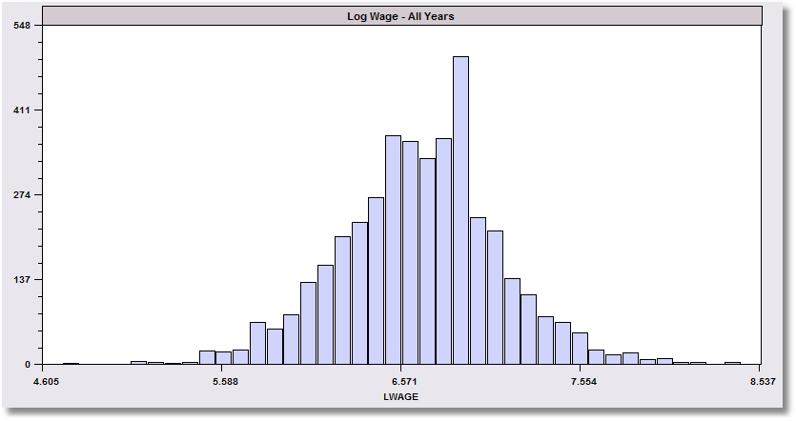
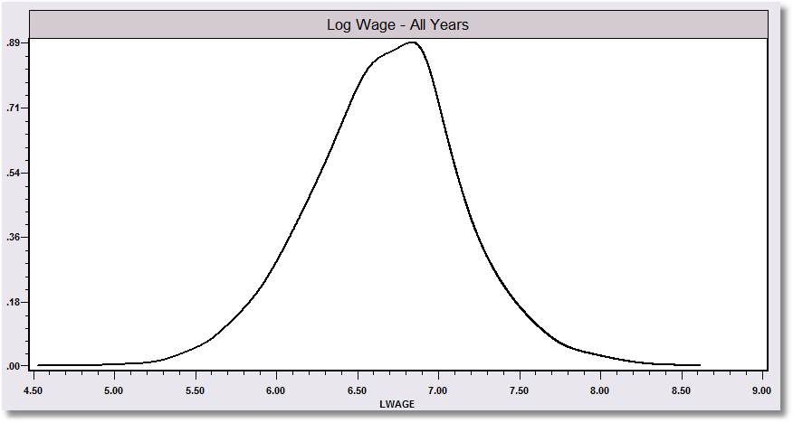
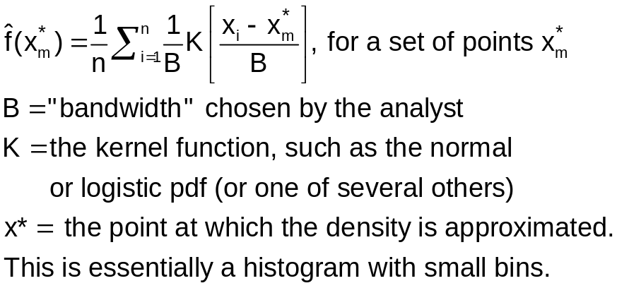
The kernel density estimator is a histogram (of sorts).

Slide 13
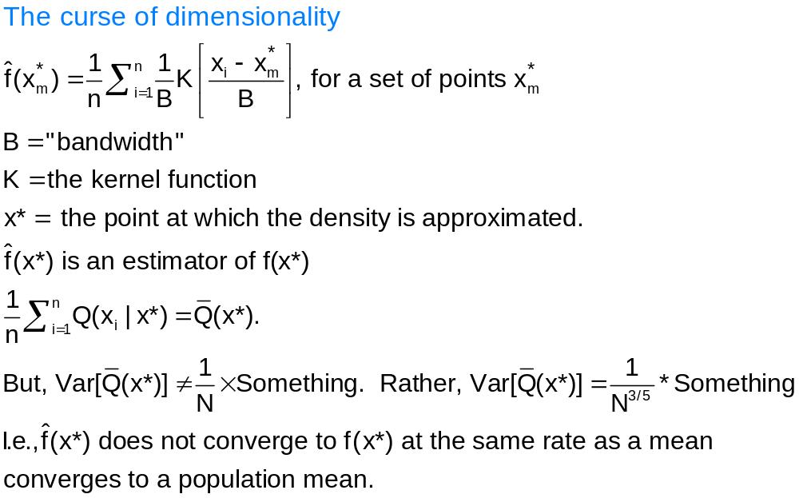
Kernel Density Estimator

Slide 14
Kernel Estimator for LWAGE

Slide 15
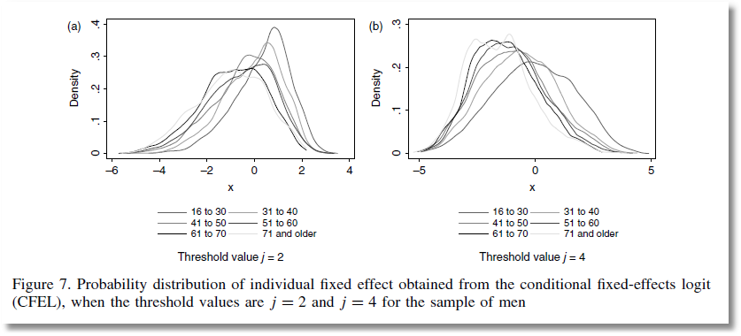
From Jones and Schurer (2011)

Slide 16
Objective: Impact of Education on (log) Wage
Specification: What is the right model to use to analyze this association?
Estimation
Inference
Analysis

Slide 17
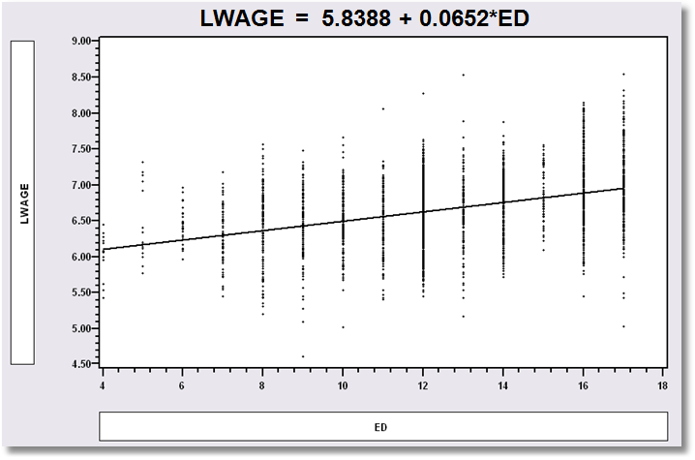
Simple Linear Regression
LWAGE = 5.8388 + 0.0652*ED

Slide 18
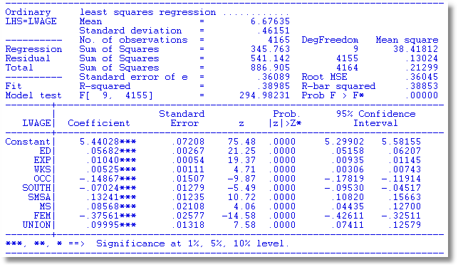
Multiple Regression

Slide 19

Specification: Quadratic Effect of Experience

Slide 20
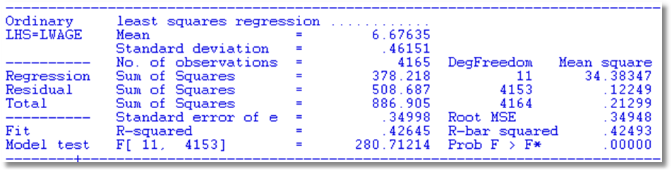
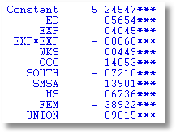
Partial Effects
Education: .05654
Experience .04045 - 2*.00068*Exp
FEM -.38922

Slide 21
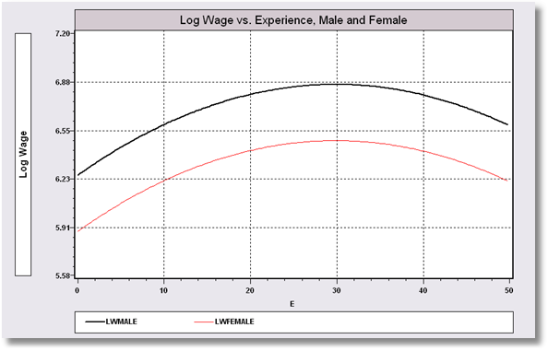
Model Implication: Effect of Experience and Male vs. Female

Slide 22
Hypothesis Test About Coefficients
Hypothesis
  Null: Restriction on β: Rβ – q = 0
  Alternative: Not the null
Approaches
  Fitting Criterion: R² decrease under the null?
  Wald: Rb – q close to 0 under the alternative?

Slide 23
Hypotheses
All Coefficients = 0?
R = [ 0 | I ] q = [0]
ED Coefficient = 0?
R = 0,1,0,0,0,0,0,0,0,0,0
q = 0
No Experience effect?
R = 0,0,1,0,0,0,0,0,0,0,0
0,0,0,1,0,0,0,0,0,0,0
q = 0
0

Slide 24
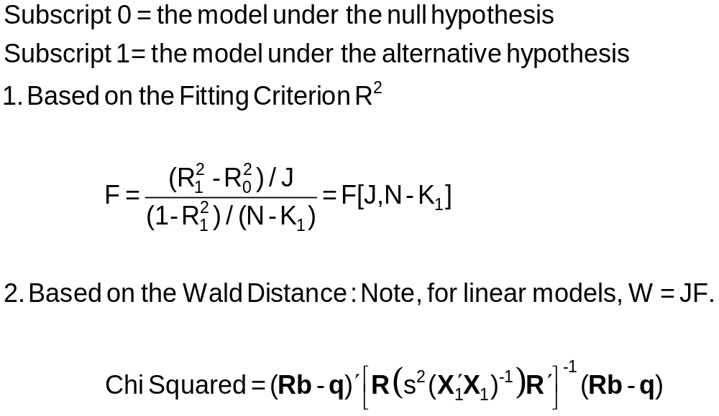
Hypothesis Test Statistics

Slide 25
Hypothesis: All Coefficients Equal Zero
All Coefficients = 0?
R = [0 | I] q = [0]
R₁² = .41826
R₀² = .00000
F = 298.7 with [10,4154]
Wald = b₂₋₁₁[V₂₋₁₁]⁻¹b₂₋₁₁
= 2988.3355
Note that Wald = JF
= 10(298.7)
(some rounding error)

Slide 26
Hypothesis: Education Effect = 0
ED Coefficient = 0?
R = 0,1,0,0,0,0,0,0,0,0,0,0
q = 0
R₁² = .41826
R₀² = .35265 (not shown)
F = 468.29
Wald = (.05654-0)²/(.00261)²
= 468.29
Note F = t² and Wald = F
For a single hypothesis about 1 coefficient.

Slide 27
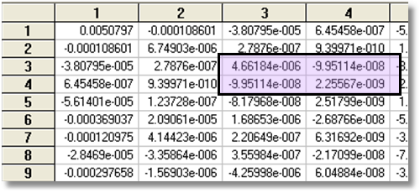
Hypothesis: Experience Effect = 0
No Experience effect?
R = 0,0,1,0,0,0,0,0,0,0,0
0,0,0,1,0,0,0,0,0,0,0
q = 0
0
R₀² = .33475, R₁² = .41826
F = 298.15
Wald = 596.3 (W* = 5.99)

Slide 28
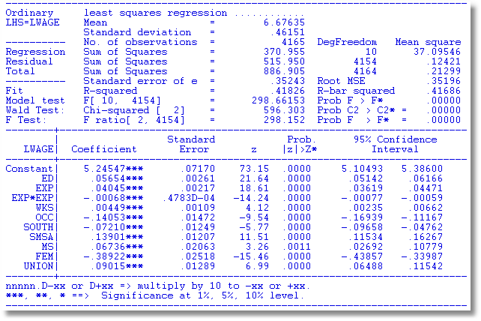
Built In Test

Slide 29
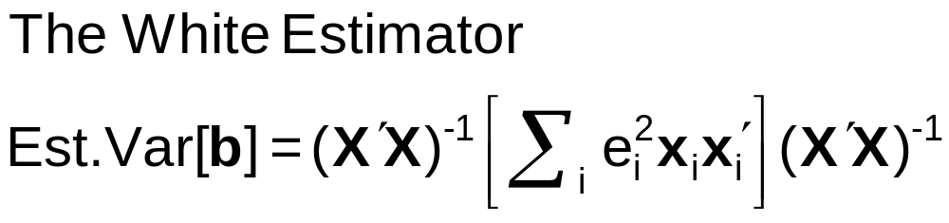
Robust Covariance Matrix
What does robustness mean?
Robust to: Heteroscedasticty
Not robust to:
  Autocorrelation
  Individual heterogeneity
  The wrong model specification
‘Robust inference’

Slide 30
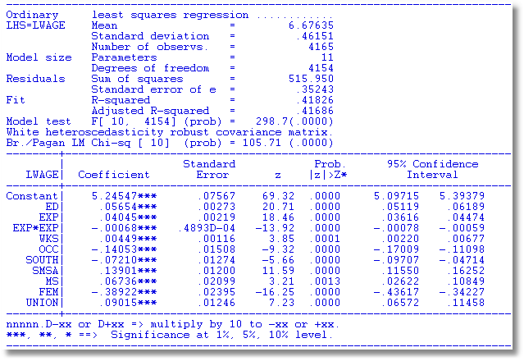
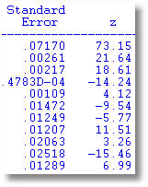
Robust Covariance Matrix
Uncorrected

Slide 31
Bootstrapping and Quantile Regresion

Slide 32
Estimating the Asymptotic
Variance of an Estimator
Known form of asymptotic variance: Compute from known results
Unknown form, known generalities about properties: Use bootstrapping
  Root N consistency
  Sampling conditions amenable to central limit theorems
  Compute by resampling mechanism within the sample.

Slide 33
Bootstrapping
Method:
1. Estimate parameters using full sample: → b
2. Repeat R times:
Draw n observations from the n, with replacement
Estimate β with b(r).
3. Estimate variance with
V = (1/R)Σ_{r} [b(r) - b][b(r) - b]’
(Some use mean of replications instead of b. Advocated (without motivation) by original designers of the method.)

Slide 34
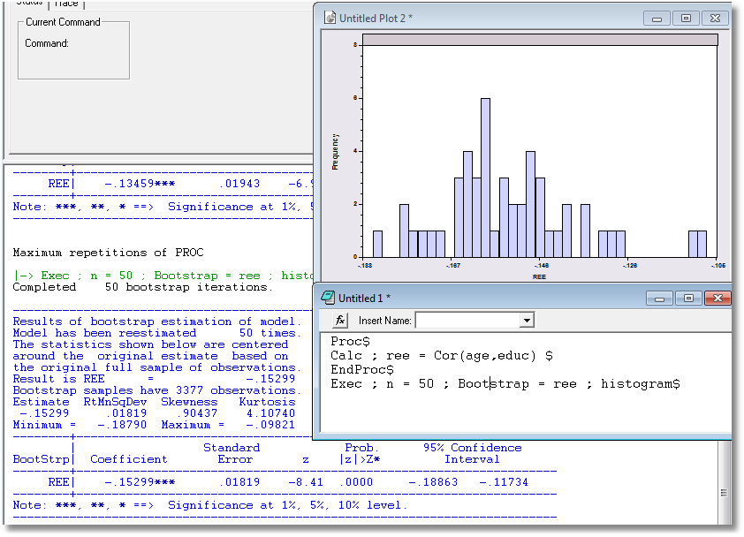
Application: Correlation between Age and Education

Slide 35
Bootstrap Regression - Replications
namelist;x=one,y,pg$ Define X
regress;lhs=g;rhs=x$ Compute and display b
proc Define procedure
regress;quietly;lhs=g;rhs=x$ … Regression (silent)
endproc Ends procedure
execute;n=20;bootstrap=b$ 20 bootstrap reps
matrix;list;bootstrp $ Display replications

Slide 36
Results of Bootstrap Procedure
--------+-------------------------------------------------------------
Variable| Coefficient Standard Error t-ratio P[|T|>t] Mean of X
--------+-------------------------------------------------------------
Constant| -79.7535*** 8.67255 -9.196 .0000
Y| .03692*** .00132 28.022 .0000 9232.86
PG| -15.1224*** 1.88034 -8.042 .0000 2.31661
--------+-------------------------------------------------------------
Completed 20 bootstrap iterations.
----------------------------------------------------------------------
Results of bootstrap estimation of model.
Model has been reestimated 20 times.
Means shown below are the means of the
bootstrap estimates. Coefficients shown
below are the original estimates based
on the full sample.
bootstrap samples have 36 observations.
--------+-------------------------------------------------------------
Variable| Coefficient Standard Error b/St.Er. P[|Z|>z] Mean of X
--------+-------------------------------------------------------------
B001| -79.7535*** 8.35512 -9.545 .0000 -79.5329
B002| .03692*** .00133 27.773 .0000 .03682
B003| -15.1224*** 2.03503 -7.431 .0000 -14.7654
--------+-------------------------------------------------------------

Slide 37
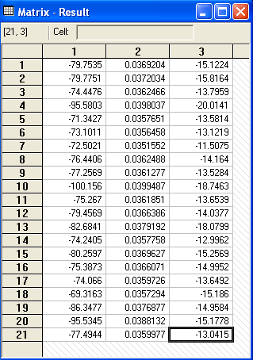
Bootstrap Replications
Full sample result
Bootstrapped sample results

Slide 38
Quantile Regression
Q(y|x,α) = β′x, α = quantile
Estimated by linear programming
Q(y|x,.50) = β′x, .50 ➔ median regression
Median regression estimated by LAD (estimates same parameters as mean regression if symmetric conditional distribution)
Why use quantile (median) regression?
  Semiparametric
  Robust to some extensions (heteroscedasticity?)
  Complete characterization of conditional distribution

Slide 39
Estimated Variance for
Quantile Regression
Asymptotic Theory
Bootstrap – an ideal application

Slide 40
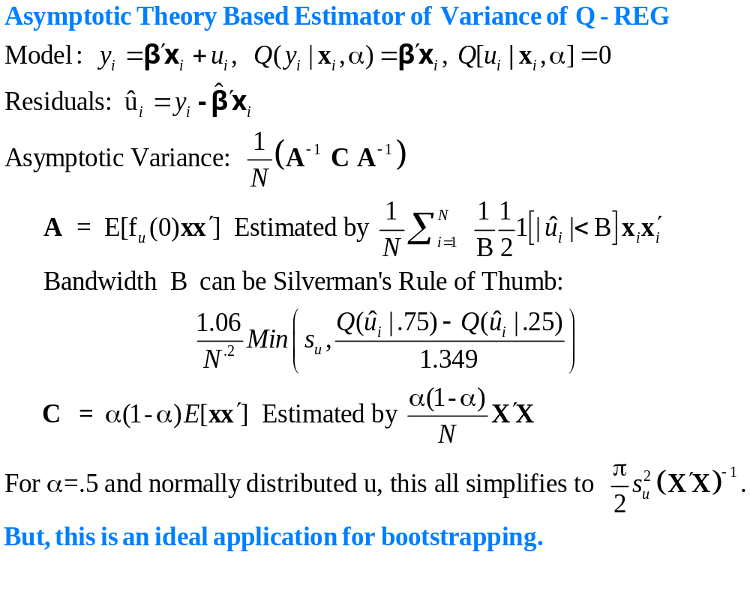

Slide 41
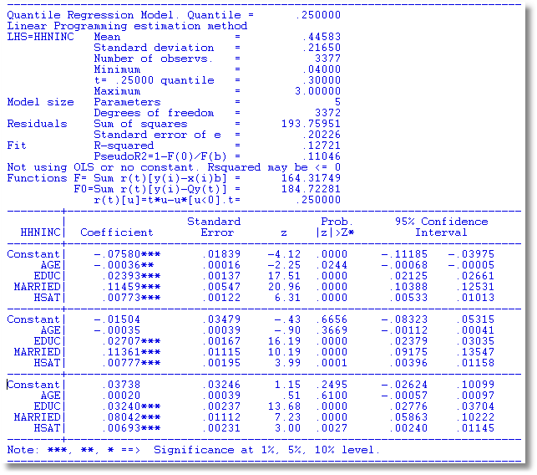
α = .25
α = .50
α = .75

Slide 42
OLS vs. Least Absolute Deviations
----------------------------------------------------------------------
Least absolute deviations estimator...............
Residuals Sum of squares = 1537.58603
Standard error of e = 6.82594
Fit R-squared = .98284
Adjusted R-squared = .98180
Sum of absolute deviations = 189.3973484
--------+-------------------------------------------------------------
Variable| Coefficient Standard Error b/St.Er. P[|Z|>z] Mean of X
--------+-------------------------------------------------------------
|Covariance matrix based on 50 replications.
Constant| -84.0258*** 16.08614 -5.223 .0000
Y| .03784*** .00271 13.952 .0000 9232.86
PG| -17.0990*** 4.37160 -3.911 .0001 2.31661
--------+-------------------------------------------------------------
Ordinary least squares regression ............
Residuals Sum of squares = 1472.79834
Standard error of e = 6.68059 Standard errors are based on
Fit R-squared = .98356 50 bootstrap replications
Adjusted R-squared = .98256
--------+-------------------------------------------------------------
Variable| Coefficient Standard Error t-ratio P[|T|>t] Mean of X
--------+-------------------------------------------------------------
Constant| -79.7535*** 8.67255 -9.196 .0000
Y| .03692*** .00132 28.022 .0000 9232.86
PG| -15.1224*** 1.88034 -8.042 .0000 2.31661
--------+-------------------------------------------------------------

Slide 43
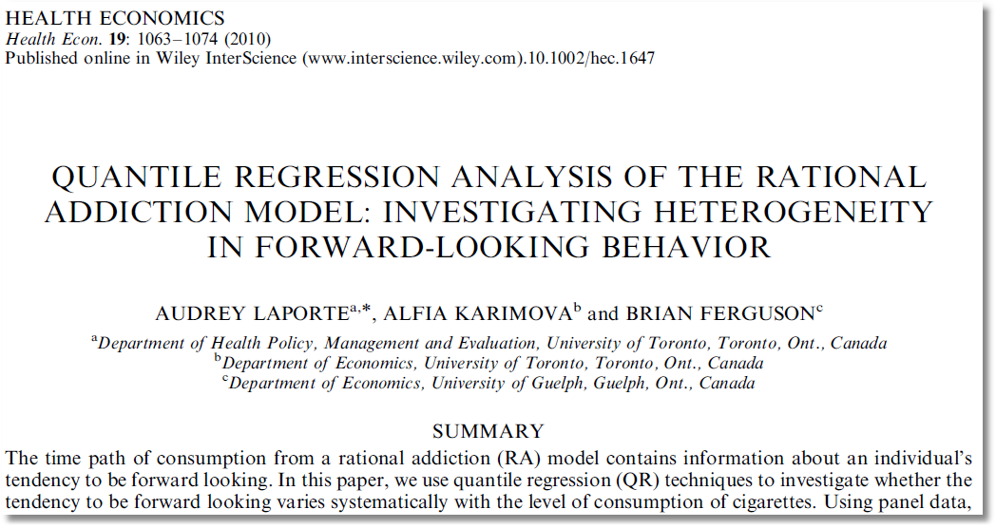

Slide 44
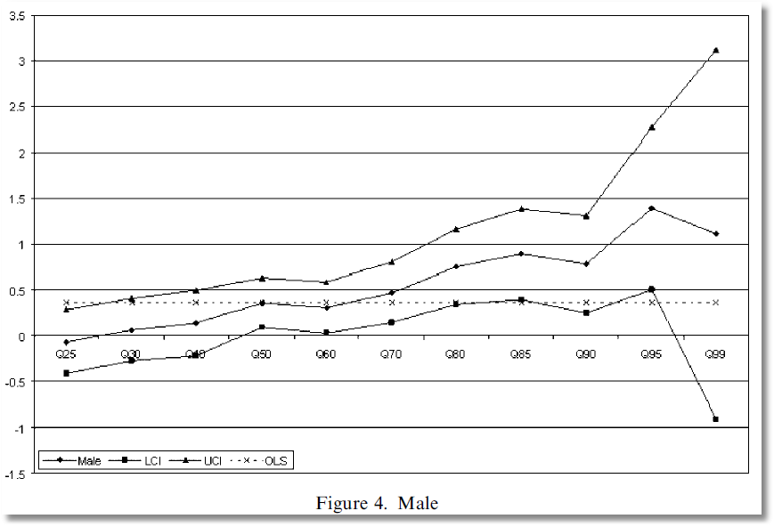

Slide 45
Nonlinear Models

Slide 46
Nonlinear Models
Specifying the model
  Multinomial Choice
How do the covariates relate to the outcome of interest
What are the implications of the estimated model?

Slide 47
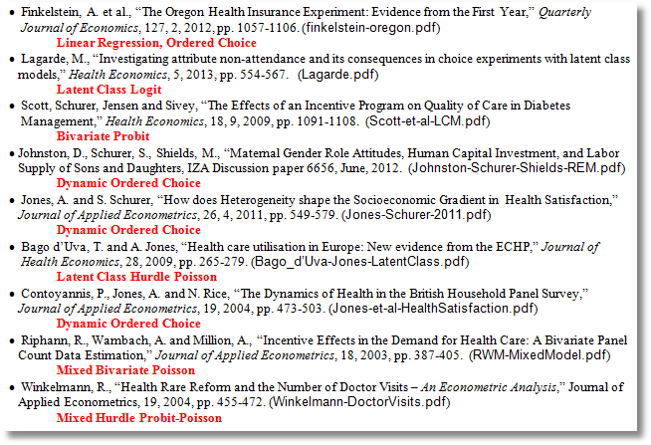

Slide 48
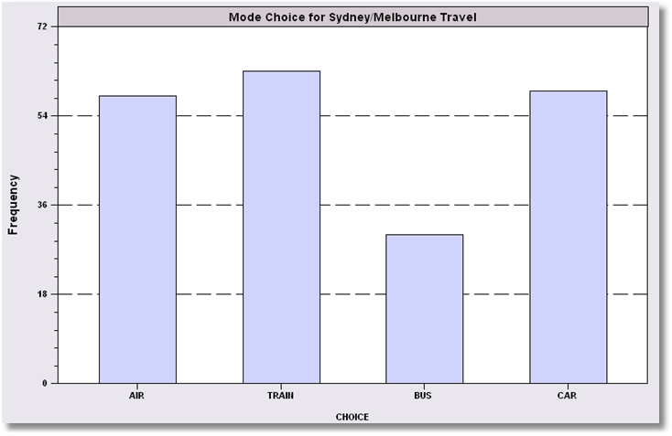
Unordered Choices of 210 Travelers

Slide 49
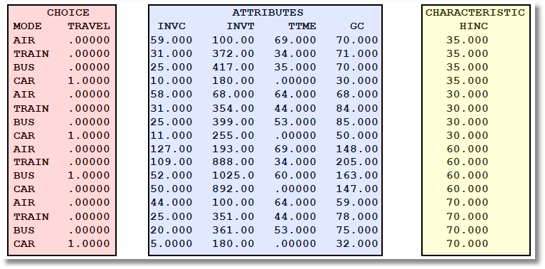
Data on Discrete Choices

Slide 50
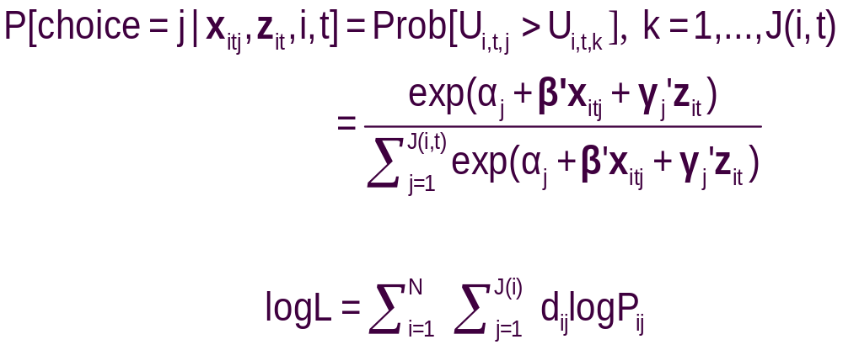
Specifying the Probabilities
• Choice specific attributes (X) vary by choices, multiply by generic
coefficients. E.g., TTME=terminal time, GC=generalized cost of travel mode
Generic characteristics (Income, constants) must be interacted with
choice specific constants.
• Estimation by maximum likelihood; d_{ij} = 1 if person i chooses j

Slide 51
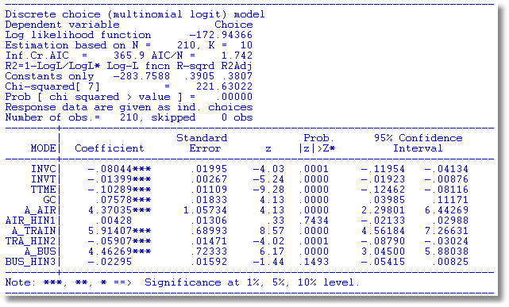
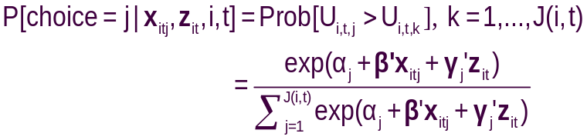
Estimated MNL Model

Slide 52
Endogeneity

Slide 53
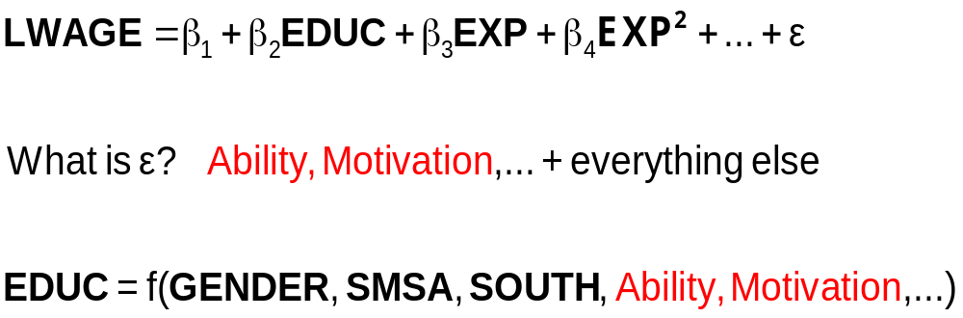
The Effect of Education on LWAGE

Slide 54
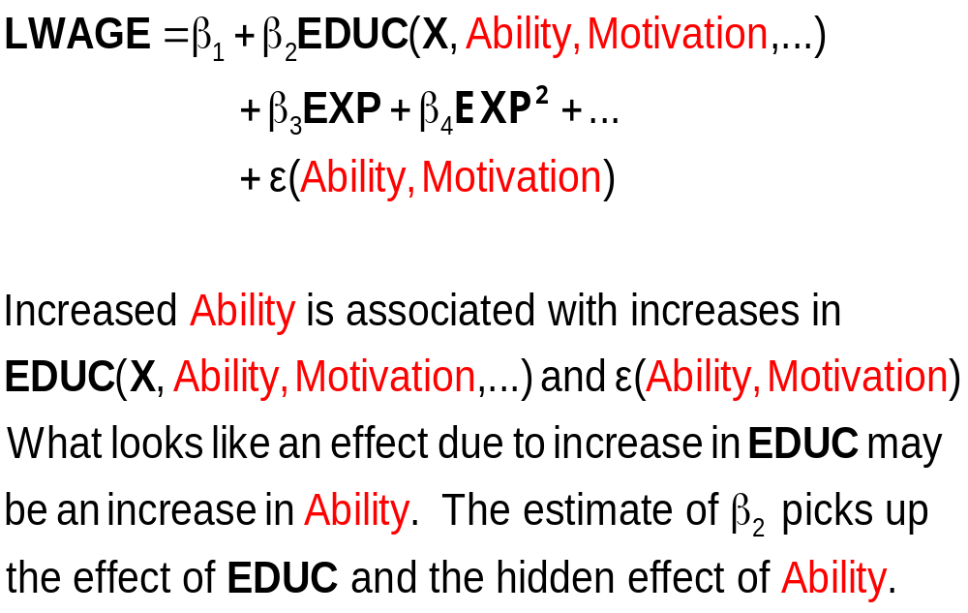
What Influences LWAGE?

Slide 55
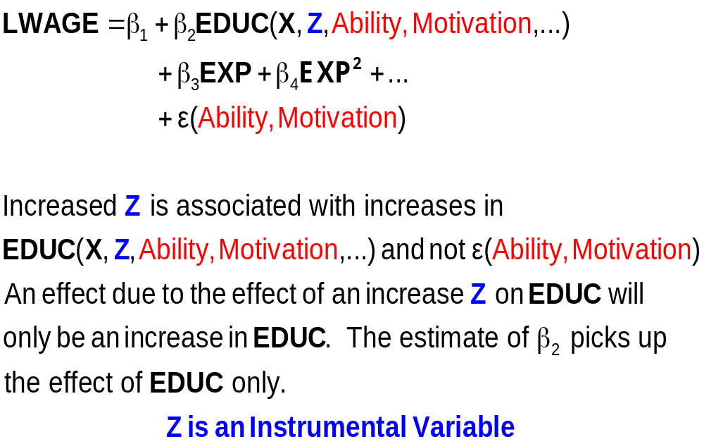
An Exogenous Influence

Slide 56
Instrumental Variables
Structure
  LWAGE (ED,EXP,EXPSQ,WKS,OCC,
  SOUTH,SMSA,UNION)
  ED (MS, FEM)
  Reduced Form:
  LWAGE[ ED (MS, FEM),
  EXP,EXPSQ,WKS,OCC,
  SOUTH,SMSA,UNION ]

Slide 57
Two Stage Least Squares Strategy
  Reduced Form:
  LWAGE[ ED (MS, FEM,X),
  EXP,EXPSQ,WKS,OCC,
  SOUTH,SMSA,UNION ]
Strategy
  (1) Purge ED of the influence of everything but MS, FEM (and the other variables). Predict ED using all exogenous information in the sample (X and Z).
  (2) Regress LWAGE on this prediction of ED and everything else.
  Standard errors must be adjusted for the predicted ED

Slide 58
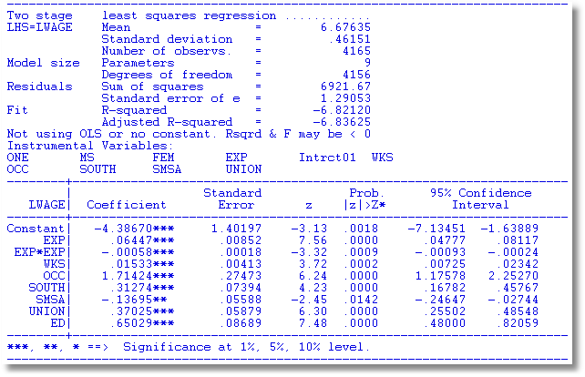
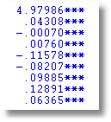
The weird results for the coefficient on ED happened because the instruments, MS and FEM are dummy variables. There is not enough variation in these variables.

Slide 59
Source of Endogeneity
  LWAGE = f(ED,
  EXP,EXPSQ,WKS,OCC,
  SOUTH,SMSA,UNION) + ε
  ED = f(MS,FEM,
  EXP,EXPSQ,WKS,OCC,
  SOUTH,SMSA,UNION) + u

Slide 60
Remove the Endogeneity
  LWAGE = f(ED,
  EXP,EXPSQ,WKS,OCC,
  SOUTH,SMSA,UNION) + u + ε
  Strategy
    Estimate u
    Add u to the equation. ED is uncorrelated with ε when u is in the equation.

Slide 61
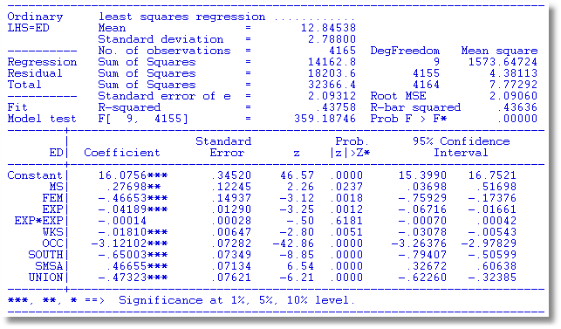
Auxiliary Regression for ED to Obtain Residuals

Slide 62
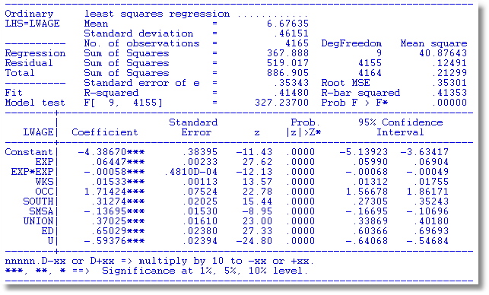
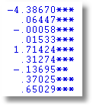
OLS with Residual (Control Function) Added
2SLS

Slide 63
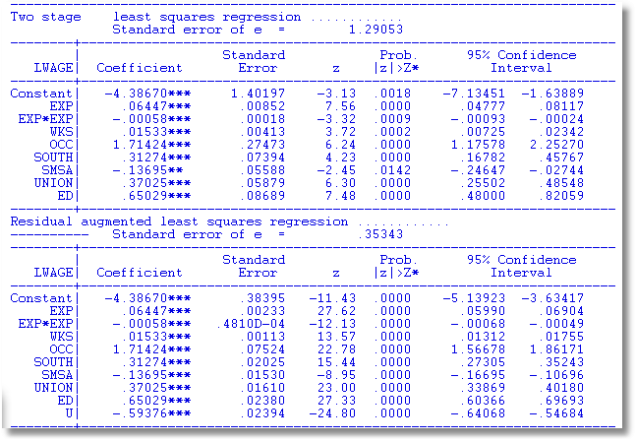
A Warning About Control Function

Slide 64
Endogenous Dummy Variable
Y = xβ + δT + ε (unobservable factors)
T = a dummy variable (treatment)
T = 0/1 depending on:
  x and z
  The same unobservable factors
T is endogenous – same as ED

Slide 65
Application: Health Care Panel Data
German Health Care Usage Data,
Variables in the file are
Data downloaded from Journal of Applied Econometrics Archive. This is an unbalanced panel with 7,293 individuals. They can be used for regression, count models, binary choice, ordered choice, and bivariate binary choice. This is a large data set. There are altogether 27,326 observations. The number of observations ranges from 1 to 7. (Frequencies are: 1=1525, 2=2158, 3=825, 4=926, 5=1051, 6=1000, 7=987).
DOCTOR = 1(Number of doctor visits > 0)
HOSPITAL = 1(Number of hospital visits > 0)
HSAT = health satisfaction, coded 0 (low) - 10 (high)
DOCVIS = number of doctor visits in last three months
HOSPVIS = number of hospital visits in last calendar year
PUBLIC = insured in public health insurance = 1; otherwise = 0
ADDON = insured by add-on insurance = 1; otherswise = 0
HHNINC = household nominal monthly net income in German marks / 10000.
(4 observations with income=0 were dropped)
HHKIDS = children under age 16 in the household = 1; otherwise = 0
EDUC = years of schooling
AGE = age in years
MARRIED = marital status
EDUC = years of education
Notes:
65

Slide 66
A study of moral hazard
Riphahn, Wambach, Million: “Incentive Effects in the Demand for Healthcare”
Journal of Applied Econometrics, 2003
Did the presence of the ADDON insurance influence the demand for health care – doctor visits and hospital visits?
For a simple example, we examine the PUBLIC insurance (89%) instead of ADDON insurance (2%).

Slide 67
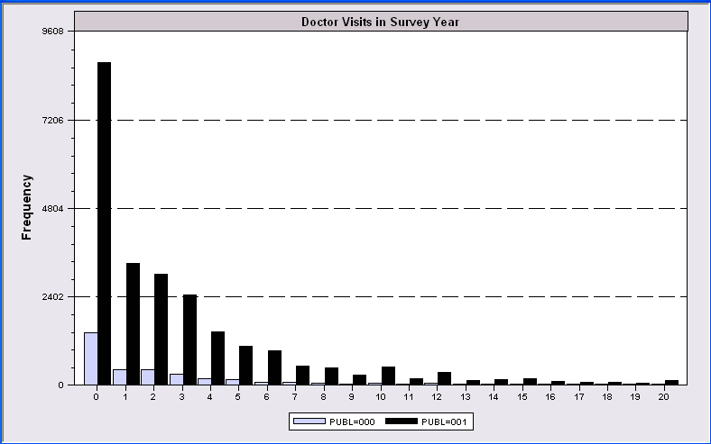
Evidence of Moral Hazard?

Slide 68
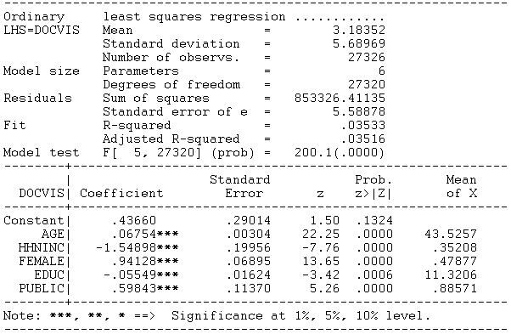
Regression Study

Slide 69
Endogenous Dummy Variable
Doctor Visits = f(Age, Educ, Health,
Presence of Insurance,
Other unobservables)
Insurance = f(Expected Doctor Visits,
Other unobservables)

Slide 70
Approaches
(Parametric) Control Function: Build a structural model for the two variables (Heckman)
(Semiparametric) Instrumental Variable: Create an instrumental variable for the dummy variable (Barnow/Cain/ Goldberger, Angrist, current generation of researchers)
(?) Propensity Score Matching (Heckman et al., Becker/Ichino, Many recent researchers)

Slide 71
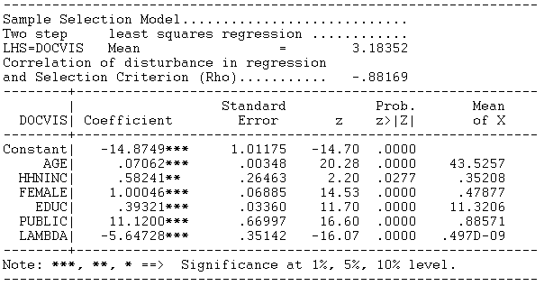
Heckman’s Control Function Approach
Y = xβ + δT + E[ε|T] + {ε - E[ε|T]}
λ = E[ε|T] , computed from a model for whether T = 0 or 1
Magnitude = 11.1200 is nonsensical in this context.

Slide 72

Instrumental Variable Approach
Construct a prediction for T using only the exogenous information
Use 2SLS using this instrumental variable.
Magnitude = 23.9012 is also nonsensical in this context.

Slide 73

Propensity Score Matching
Create a model for T that produces probabilities for T=1: “Propensity Scores”
Find people with the same propensity score – some with T=1, some with T=0
Compare number of doctor visits of those with T=1 to those with T=0.

Slide 74
Panel Data

Slide 75
Benefits of Panel Data
Time and individual variation in behavior unobservable in cross sections or aggregate time series
Observable and unobservable individual heterogeneity
Rich hierarchical structures
More complicated models
Features that cannot be modeled with only cross section or aggregate time series data alone
Dynamics in economic behavior

Slide 76


Slide 77


Slide 78


Slide 79


Slide 80


Slide 81


Slide 82


Slide 83


Slide 84


Slide 85


Slide 86
Application: Health Care Usage
German Health Care Usage Data This is an unbalanced panel with 7,293 individuals.
There are altogether 27,326 observations. The number of observations ranges from 1 to 7.
Frequencies are: 1=1525, 2=2158, 3=825, 4=926, 5=1051, 6=1000, 7=987.
Downloaded from the JAE Archive.
Variables in the file include
DOCTOR = 1(Number of doctor visits > 0)
HOSPITAL = 1(Number of hospital visits > 0)
HSAT = health satisfaction, coded 0 (low) - 10 (high)
DOCVIS = number of doctor visits in last three months
HOSPVIS = number of hospital visits in last calendar year
PUBLIC = insured in public health insurance = 1; otherwise = 0
ADDON = insured by add-on insurance = 1; otherswise = 0
INCOME = household nominal monthly net income in German marks / 10000.
(4 observations with income=0 will sometimes be dropped)
HHKIDS = children under age 16 in the household = 1; otherwise = 0
EDUC = years of schooling
AGE = age in years
MARRIED = marital status
Notes:
86

Slide 87

Balanced and Unbalanced Panels
Distinction: Balanced vs. Unbalanced Panels
A notation to help with mechanics
  z_{i,t}, i = 1,…,N; t = 1,…,T_{i}
The role of the assumption
  Mathematical and notational convenience:
    Balanced, n=NT
    Unbalanced:
  Is the fixed T_{i} assumption ever necessary? Almost never.
Is unbalancedness due to nonrandom attrition from an otherwise balanced panel? This would require special considerations.

Slide 88

An Unbalanced Panel: RWM’s GSOEP Data on Health Care

